Slide 1
Effects of an early matter dominated era on gravitational waves induced by scalar perturbations
Keisuke Inomata
Institute for Cosmic Ray Research (ICRR),
The University of Tokyo
Collaborators: K.Kohri(KEK), T.Nakama(HKUST), T.Terada(KEK)
arXiv: 1904.12878, 1904.12879

Slide 2
Overview
sudden reheating
Previous works
This work
gradual reheating
We revisit the effect of an early matter dominated era on the gravitational waves induced by scalar perturbations.
As a result, we find that the induced GWs strongly depend on how quickly the reheating occurs.

Slide 3
Outline
Introduction
eMD effects in gradual reheating scenario
eMD effects in sudden reheating scenario
Summary

Slide 4
GWs induced by curvature perturbations
At linear order, scalar perturbations do not induce GWs.
However,
at second order, scalar perturbations can induce GWs.
(Ananda et al 2006, Baumann et al. 2007)
Metric perturbations:
Scalar perturbations (related to curvature perturbations)
E.o.M for GWs:
Tensor perturbations (GWs)
Source term from second order scalar perturbations

Slide 5
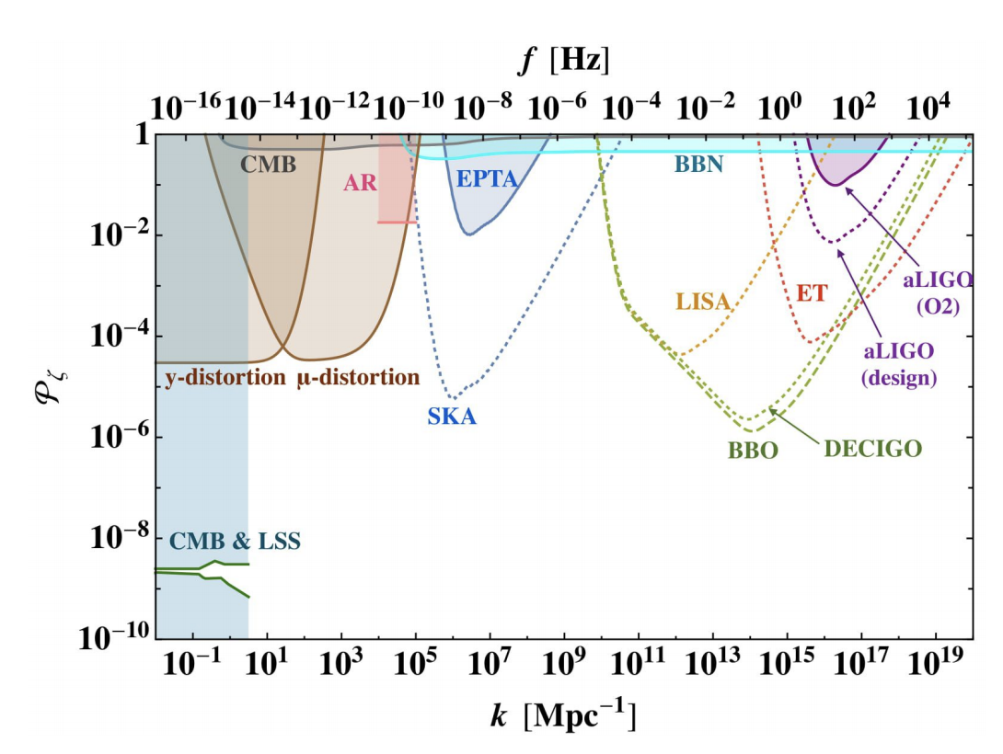
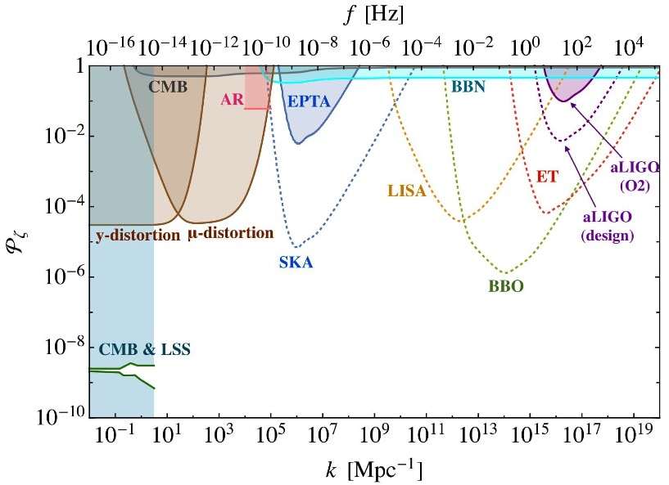
Motivations for the induced GWs
The frequencies of the induced GWs correspond to the scales of the scalar perturbations inducing GWs.
Since the wide range of GW frequencies could be observed in the future, we could investigate small-scale (scalar) perturbations using the induced GWs!
(Observations of CMB and LSS cannot investigate small-scale perturbations due to the Silk damping and the non-linear growth of perturbations)
The future and current GW projects can investigate the power spectrum of curvature perturbations.
(Inomata, Nakama, 2018)
Small-scale perturbations enter the horizon early, the induced GW could be a good probe of the early Universe.
(The left figure is just an advertisement of our previous work, arXiv: 1812.00674.)
Large scale
Small scale
These constraints are important when we consider the PBHs production.
Main question of this work
In left figure, the effects of eMD era have not taken into account.
What effects does the early matter dominated era make on the induced GWs?
GWs induced by the scalar perturbations can be a good probe to investigate the early Universe.
PBHs need large perturbations.
Large GWs are induced, which could be observed by

Slide 6
The history of the Universe
Inflation era
We focus on this!
(Early matter dominated (eMD) era)
Reheating
Radiation dominated (RD) era
(Late) matter dominated era (from z~3400)
Dark energy dominated era (from z~0.5)

Slide 7
What causes eMD era ?
One scenario: oscillation of inflaton
Chaotic inflation
Radiation
Inflation occurs the vacuum energy of the inflaton.
During the oscillation of an inflaton, the Universe behaves as MD era.
The oscillation amplitude decays due to the expansion and the decay to radiation.
During the oscillation
Time average
MD era !
RD era starts.
(Other scenario: oscillation of curvaton)

Slide 8
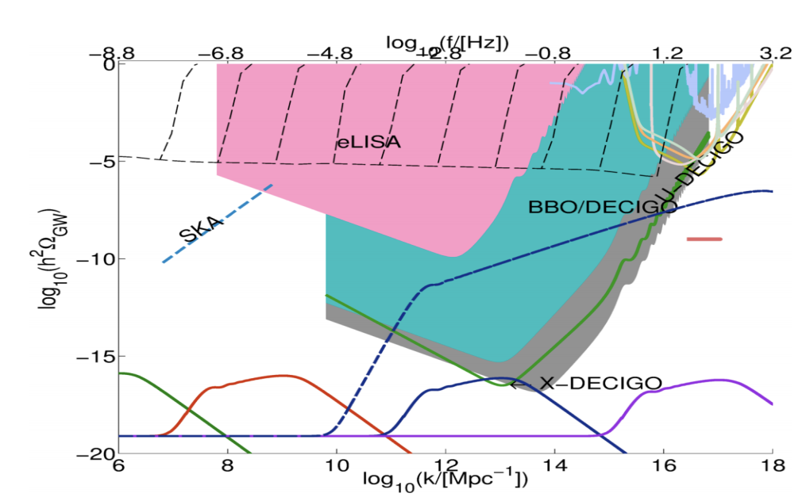
Results in previous works
There are works discussing the effects of an eMD era on the induced GWs.
(Assadullahi, Wands, 2009, Alabidi, Kohri, Sasaki, Sendaouda, 2013, Kohri, Terada, 2018)
During an eMD era, the transfer function of the gravitational potential (Φ), the source of GWs, does not decay even on subhorizon because of the growing matter perturbations.
(Alabidi et al., 2013)
(Alabidi, Kohri, Sasaki, Sendouda, 2013)
During eMD era
During RD era
Horizon entry
Induced GWs are enhanced?
If we know the power spectrum of curvature perturbations, we can easily calculate the GW energy density thanks to Kohri & Terada’s work.
What we calculate with above formula

Slide 9
Implicit assumptions in previous works
In previous works, the authors put the following (implicit) assumptions.
(Assadullahi, Wands, 2009, Alabidi, Kohri, Sasaki, Sendaouda, 2013, Kohri, Terada, 2018)
1. The transfer function of the gravitational potential (Φ), the source of the induced GWs, is unity (Φ=1) until the beginning of the RD era.
2. The perturbations that enter the horizon during an eMD era does not induce GWs during the RD era.
What we do in this work
We remove the above assumptions and revisit the effects of an eMD era on the induced GWs.
We consider two cases:
Gradual reheating, whose time scale is comparable to the Hubble time scale at that time.
Sudden reheating, whose time scale is much shorter than the Hubble time scale at that time.
If we know the power spectrum of curvature perturbations, we can easily calculate the GW energy density thanks to Kohri & Terada’s work.
What we calculate with above formula

Slide 10
Outline
Introduction
eMD effects in gradual reheating scenario
eMD effects in sudden reheating scenario
Summary

Slide 11
Gradual reheating
What we do
Calculation of the GWs induced throughout the gradual transition from eMD era to RD era
We consider the case where the field dominating the Universe during an eMD era (inflaton or curvaton) decays to radiation with a constant decay rate Γ.
We need to know how the perturbations evolve during the gradual transition.
In this gradual reheating scenario, the situation is similar to the decaying dark matter scenario.
E.o.M in decaying DM scenario (Poulin, Serpico, Lesgourgues, 2018)
Energy density of matter
Energy density of radiation
Energy density perturbation
Velocity divergence
If we know the power spectrum of curvature perturbations, we can easily calculate the GW energy density thanks to Kohri & Terada’s work.
What we calculate with above formula

Slide 12
Perturbations in gradual reheating
On subhorizon scale,
During eMD era, δ_{m} (∝ a) grows on subhorizon unlike δ_{r} .
Φ is mainly determined by
ρ_{m}δ_{m} for a while even after η_{eq.}
Fitting formula
We naively expect
If we take η_{R} = 0.83η_{eq}, the fitting formula fits the numerical result during the exponential decay very well!
If we know the power spectrum of curvature perturbations, we can easily calculate the GW energy density thanks to Kohri & Terada’s work.
What we calculate with above formula

Slide 13
Results
GWs induced by curvature perturbations with
Previous works
This work
(gradual reheating)
The induced GWs are suppressed compared to the previous results.
Main reason
A damping of tensor perturbation occurs during the gradual transition.
If we know the power spectrum of curvature perturbations, we can easily calculate the GW energy density thanks to Kohri & Terada’s work.
What we calculate with above formula

Slide 14
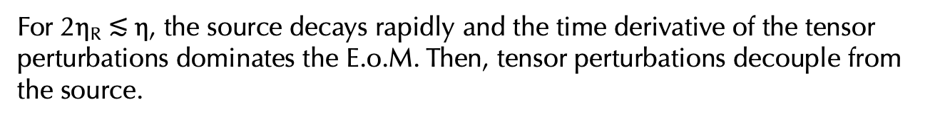
Why does the damping occur?
E.o.M for tensor perturbations:
For η $≪$ η_{R} , the source is almost constant and the tensor perturbations on subhorizon scale become
For η_{R} $≲$η $≲$ 2η_{R}, the source decays gradually and the tensor perturbations follows the decay for a while. During this phase, the damping occurs.
(The source and h are damping. )
For 2η_{R} $≲$η, the source decays rapidly and the time derivative of the tensor perturbations dominates the E.o.M. Then, tensor perturbations decouple from the source.
(Freely propagating GWs)
Describing the GWs induced during eMD era
Amplitude at the decoupling
Describing the GWs induced during RD era
What we calculate with above formula

Slide 15
Outline
Introduction
eMD effects in gradual reheating scenario
eMD effects in sudden reheating scenario
Summary

Slide 16


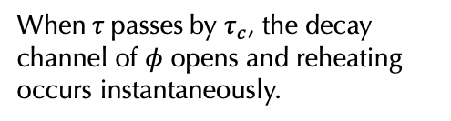


Toy model for sudden reheating
Here, we consider the sudden reheating scenario, where the transition time scale is much shorter than the Hubble time scale at that time.
So far, we have considered a gradual reheating, whose transition time scale is comparable to the Hubble time scale at that time.
Toy model:
We have seen that Φ decays exponentially during the gradual transition from eMD era to RD era and induced GWs are suppressed compared to the previous works.
Dominant field (such as inflaton or curvaton)
Trigger field (“triggeron”)
Field denoting the daughter particles of $φ$
(Decay rate of $φ→2χ$)
We take M$≫$m and initial condition of $τ$ as $τ_{0}≫$M.
Triggeron evolution during eMD era
When $τ$ passes by $τ_{c}$, the decay channel of $φ$ opens and reheating occurs instantaneously.
At first, decay of $φ$ is kinematically blocked.
$τ$ starts to roll at m~H.
If we know the power spectrum of curvature perturbations, we can easily calculate the GW energy density thanks to Kohri & Terada’s work.
What we calculate with above formula

Slide 17
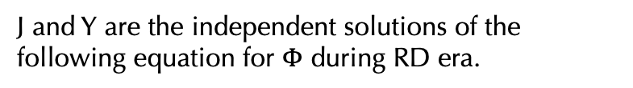
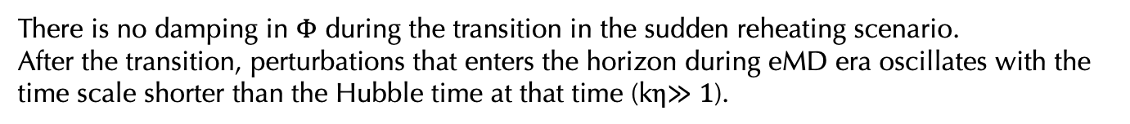
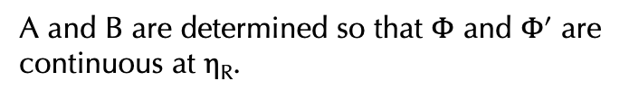
Evolutions in sudden reheating
J and Y are the independent solutions of the following equation for $Φ$ during RD era.
A and B are determined so that $Φ$ and $Φ$’ are continuous at η_{R}.
There is no damping in Φ during the transition in the sudden reheating scenario.
After the transition, perturbations that enters the horizon during eMD era oscillates with the time scale shorter than the Hubble time at that time (kη$≫1$).
Enhance GWs !
Source term
Dominant
If we know the power spectrum of curvature perturbations, we can easily calculate the GW energy density thanks to Kohri & Terada’s work.
What we calculate with above formula

Slide 18
Induced GWs
We consider the following power spectrum of curvature perturbations.
(We introduce k_{max} to avoid the non-linearity.)
If an eMD era lasts long, the induced GWs can be observed by future observations.
The amplitude at the start of the oscillation does not depend on the scale but the time scale of oscillation does.
We could possibly constrain the reheating temperature from the future observations in this sudden reheating scenario.
η_{R} is related to the reheating temperature.
If we know the power spectrum of curvature perturbations, we can easily calculate the GW energy density thanks to Kohri & Terada’s work.
What we calculate with above formula

Slide 19
Future constraints on reheating temperature
(We have neglected foregrounds)
Signal to noise ratio:
(Allen & Romano, 1997)
Induced GWs
(Corresponds to the length of eMD era)
The amplitude at the start of the oscillation does not depend on the scale but the time scale of oscillation does.
Observation time
Effective noise spectrum of each project
Power spectrum:
ρ=1 is taken in the figure.
The future observations could constrain the wide range of reheating temperature in the sudden reheating scenario.
If we know the power spectrum of curvature perturbations, we can easily calculate the GW energy density thanks to Kohri & Terada’s work.
What we calculate with above formula

Slide 20
Outline
Introduction
eMD effects in gradual reheating scenario
eMD effects in sudden reheating scenario
Summary

Slide 21
Summary of this talk
sudden reheating
Previous works
This work
gradual reheating
We have revisited the effect of the early matter dominated era on the gravitational waves induced by curvature perturbations, taking into account the perturbations throughout the transition.
As a result, we have found that the induced GWs strongly depend on how quickly the reheating occurs.

Slide 22
Backup

Slide 23
Foregrounds
In future, stochastic GWs of astrophysical origin or cosmological origins that are different from the induced GWs, such as those from phase transition, may be detected.
In that case, the constraints would become weak.
Foreground example:
Around PTA target frequency
GWs from supermassive-black-hole binaries
Around LISA target frequency
GWs from galactic white-dwarf binaries
Around BBO target frequency
GWs from neutron star binaries
We may use non-Gaussianity of the induced GWs to discriminate them from other sources.
(Bartolo et al., 2018)

Slide 24
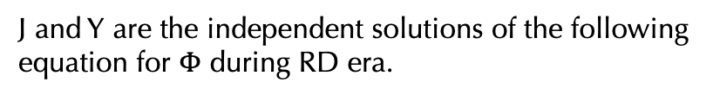
Evolutions in sudden reheating
So far, we have considered a gradual reheating, whose transition time scale is comparable to the Hubble time scale at that time.
J and Y are the independent solutions of the following equation for $Φ$ during RD era.
We have seen that Φ decays exponentially during the gradual transition from eMD era to RD era and induced GWs are suppressed compared to the previous works.
A and B are determined so that $Φ$ and $Φ$’ are continuous at η_{R}.
If we know the power spectrum of curvature perturbations, we can easily calculate the GW energy density thanks to Kohri & Terada’s work.
What we calculate with above formula

Slide 25
Why does the damping occur?
Describing the GWs induced during eMD era
Describing the GWs induced during RD era
E.o.M for tensor perturbations:
From this result, we can see the main reason of the cancellation between the components comes from the behaviors of Φ around the transition.
If we know the power spectrum of curvature perturbations, we can easily calculate the GW energy density thanks to Kohri & Terada’s work.
What we calculate with above formula

Slide 26



Stochastic gravitational waves
LIGO and Virgo have detected gravitational waves (GWs) induced by the mergers of BHs and NSs.
The direct detection of GWs has opened the door to a new era of astronomy and cosmology!
In this work, we discuss the early Universe in terms of GWs.
Image of GWs from mergers
In particular, we focus on stochastic GWs.
Stochastic GWs:
GWs created by superposition of a large number of independent sources.
Astrophysical source
Cosmological source
Mergers of compact objects, such as BHs, NSs, and WDs
Vacuum fluctuation during inflation
Cosmic strings
Second order scalar perturbations
Image of Stochastic GWs
We focus on this !

Slide 27
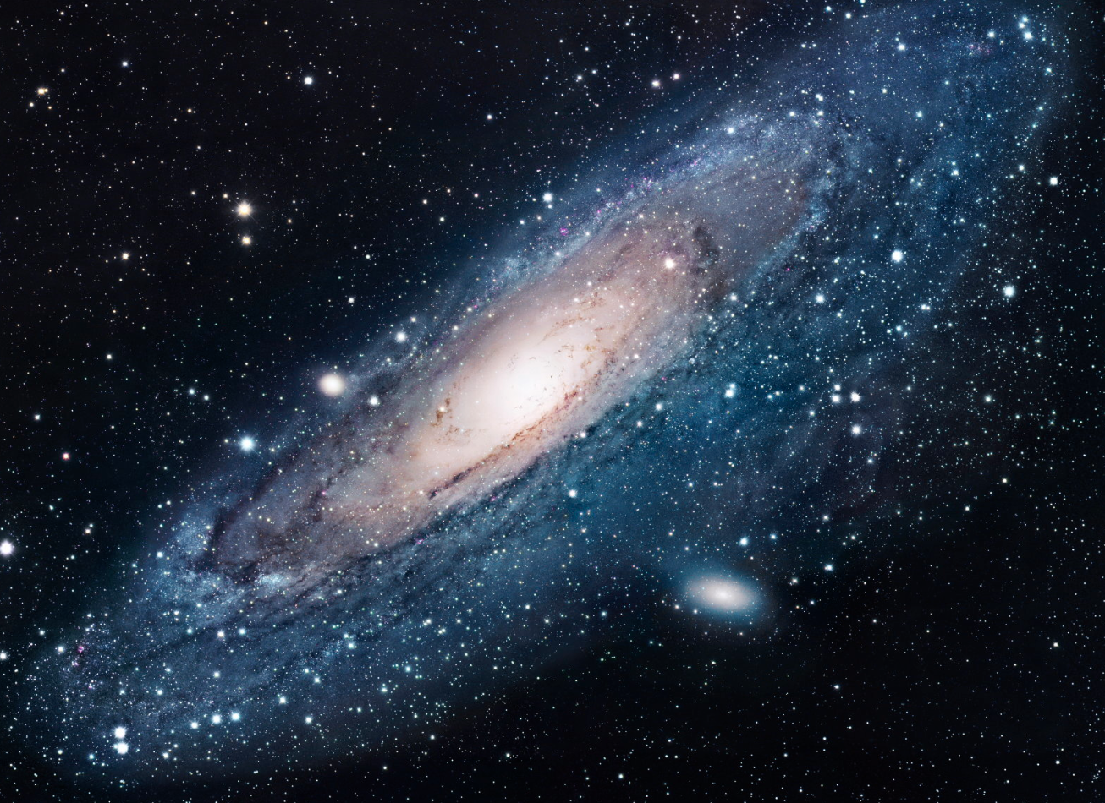
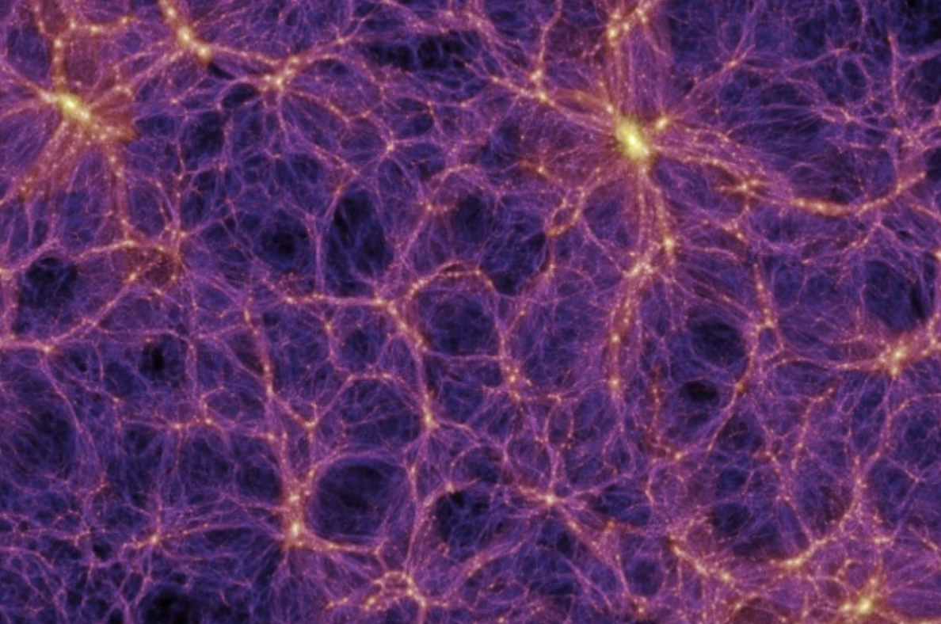
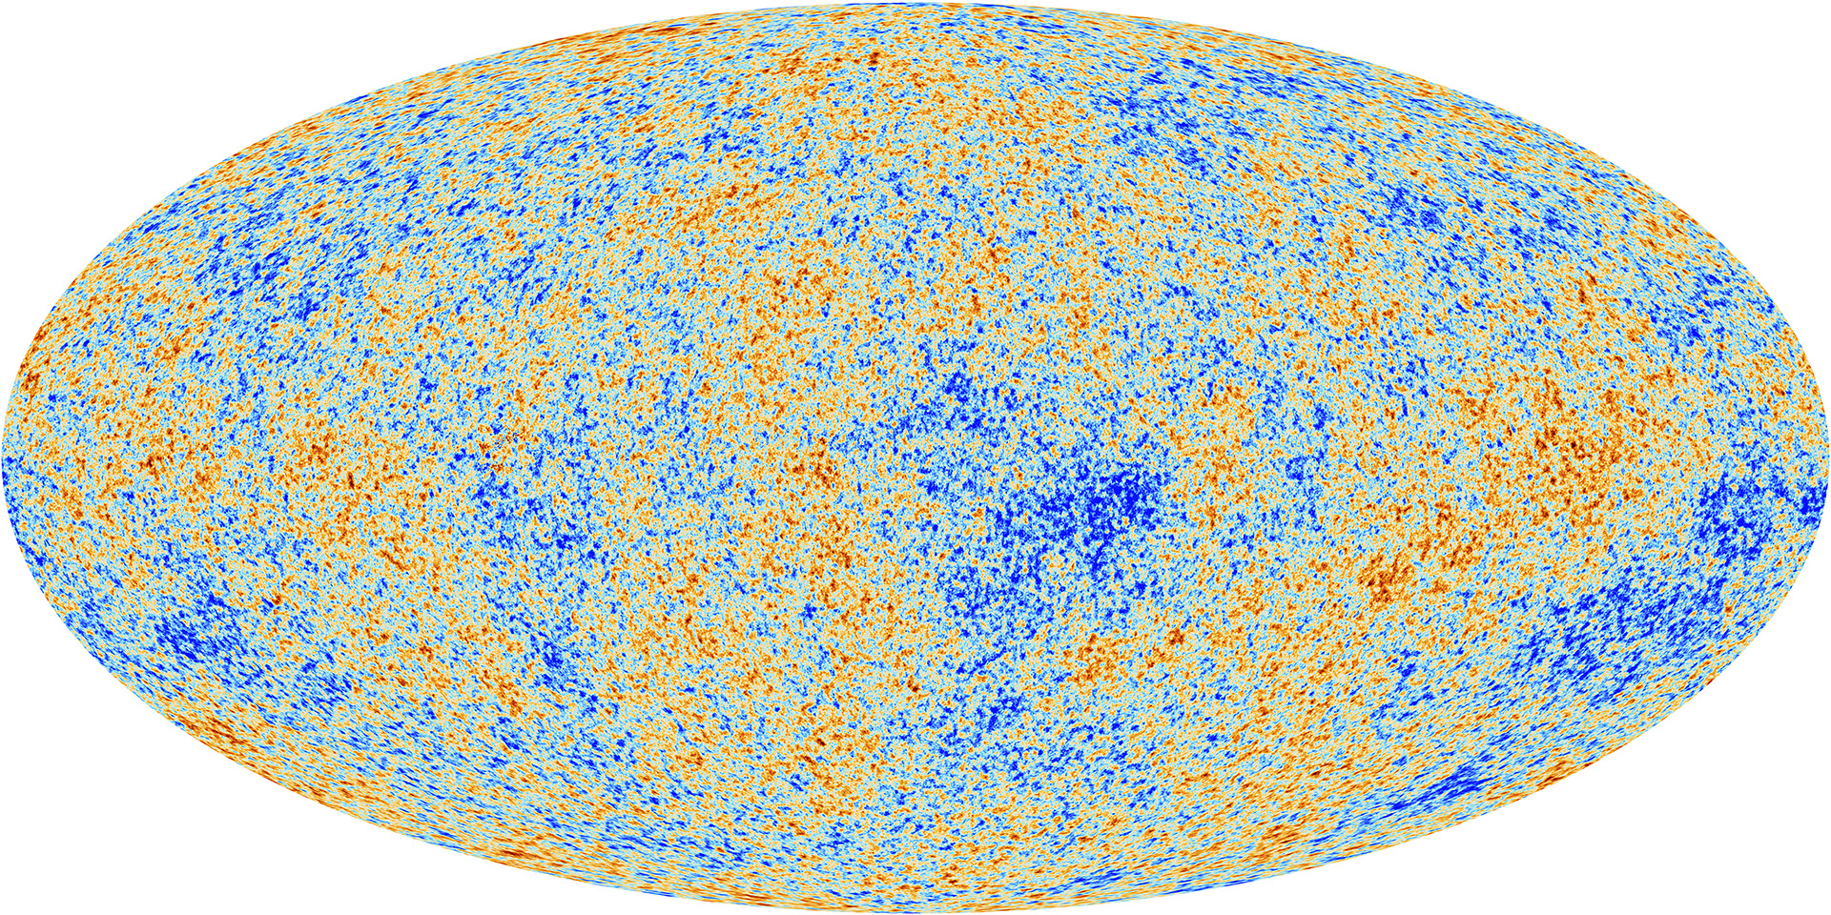
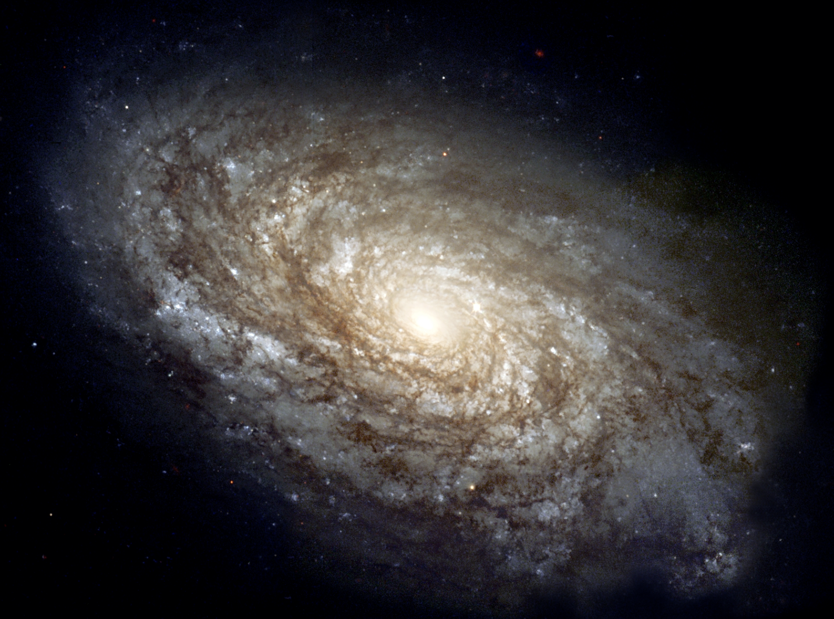
Scalar perturbation in Cosmology
Scalar perturbations induce the perturbations of energy density ($δρ/ρ$).
Scalar perturbations are origins of many things!
Examples
(Credit: Millennium Simulation Project)
(Credit: ESA and the Planck Collaboration)
(Credit: NASA and ESA)
Large Scale Structure
CMB perturbations
Galaxies
From the observations, we already know the amplitude of the scalar perturbations.
(Planck 2018)
curvature perturbation
scalar perturbation
Scalar perturbations originate from vacuum fluctuations of an inflaton during the inflation era.

Slide 28
Motivations for the induced GWs
The frequencies of the induced GWs correspond to the scales of the scalar perturbations inducing GWs.
We can investigate small-scale (scalar) perturbations using the induced GWs!
(Observations of CMB and LSS cannot investigate small-scale perturbations due to the Silk damping and the non-linear growth of perturbations)
The future and current GW projects can investigate the power spectrum of curvature perturbations.
These constraints are important when we consider the PBHs production.
(The left figure is just an advertisement of our previous work, arXiv: 1812.00674.)
(Inomata, Nakama, 2018)
In left figure, the effects of eMD era have not taken into account.
Large scale
Small scale
Main question of this work
Since small-scale perturbations enter the horizon early, the induced GW could be a good probe of the early Universe.
What kind of effects does the early matter dominated era make on the induced GWs?
GWs induced by the scalar perturbations can be a good probe to investigate the early Universe.
PBHs need large perturbations.
Large GWs are induced, which could be observed by

Slide 29
GWs induced by scalar perturbations
Metric perturbations:
Scalar perturbations (related to curvature perturbations)
(Newtonian gauge,
neglecting anisotropic stress)
Vector perturbations
(neglect in the following)
Tensor perturbations (GWs)
Substituting this metric into the Einstein tensor, we derive the following expression up to second order,
Einstein eq.
Energy momentum tensor is written as
Terms irrelevant to tensor perturbations
(from linear perturbation theory)
From Einstein eq., we derive the following equation for tensor perturbations
Projection operator onto the transverse and traceless tensor

Slide 30
Equations for tensor perturbations
E.o.M for tensor perturbation in real space:
We perform the Fourier transform.
Then we derive the following equation:
Source term from second order scalar perturbations
Point
At linear order, scalar perturbations do not induce GWs.
However,
at second order, scalar perturbations can induce GWs.
However,
at second order, scalar perturbations can induce GWs.

Slide 31
Evolutions of perturbations
Physical length
Reheating
Horizon scale
Superhorizon
perturbation scale
Power spectrum of scalar perturbation is determined
GWs start to be induced by scalar perturbations
Subhorizon
Time
Inflation era
Early matter era
Radiation era
However,
at second order, scalar perturbations can induce GWs.

Slide 32
Outline
General Introduction
Introduction of this work
eMD effects in gradual reheating scenario
eMD effects in sudden reheating scenario
Summary

Slide 33
Background in gradual reheating
The evolutions of background quantities.
(We have imposed that a and a’ are continuous at η_{R}.)
The fitting formula for a:
The fitting formula for w:
To get the approximation formula of the scale factor, we assume the scale factor instantaneously changes from the expression in eMD to that in RD era at η_{R} .
In the above figure, we take η_{R} = 0.83η_{eq} .
In the above figure, we take η_{R} = 0.83η_{eq} . (We will explain the reason later.)
If we know the power spectrum of curvature perturbations, we can easily calculate the GW energy density thanks to Kohri & Terada’s work.
What we calculate with above formula

Slide 34
Limits of applications of the formulas
If we consider the scale entering the horizon around the transition (k<30/η_{eq}), the fitting formula does not fit the numerical result very well.
To avoid high computational costs, we neglect the contribution from the perturbations (k<30/η_{eq}) in the following. (The analysis for 1/η_{eq}<k< k<30/η_{eq} is future work.)
In addition, the perturbations entering much before the transition can be non-linear during eMD, to which our analysis cannot be applied.
Nonlinear scale:
As a concrete example, we consider
To make the differences from the previous works look clear, we consider
If we know the power spectrum of curvature perturbations, we can easily calculate the GW energy density thanks to Kohri & Terada’s work.
What we calculate with above formula

Slide 35
Formulas we use to calculate induced GWs
Summary of the formulas we use:
(Kohri, Terada, 2018)
Energy density of the induced GWs
Power spectrum of the induced GWs
Here, we assume that the scale factor is given as, (because this fits the numerical result well)
Then we can express I as
Induced during eMD
Induced during RD
If we know the power spectrum of curvature perturbations, we can easily calculate the GW energy density thanks to Kohri & Terada’s work.
What we calculate with above formula

Slide 36
Summary for gradual reheating
We have revisited the effects of eMD era on the induced GWs in a gradual reheating scenario, taking into account the evolution of Φ, the source of induced GWs, during the transition.
As a result, we have found that the induced GWs are suppressed, compared to the previous results.
If we know the power spectrum of curvature perturbations, we can easily calculate the GW energy density thanks to Kohri & Terada’s work.
What we calculate with above formula

Slide 37
Formulas we use
Summary of the formulas we use:
(Kohri, Terada, 2018)
Energy density of the induced GWs
Power spectrum of the induced GWs
Substitute
If we know the power spectrum of curvature perturbations, we can easily calculate the GW energy density thanks to Kohri & Terada’s work.
What we calculate with above formula

Slide 38
Why does the cancellation occur?
Describing the GWs induced during eMD era
Describing the GWs induced during RD era
If we know the power spectrum of curvature perturbations, we can easily calculate the GW energy density thanks to Kohri & Terada’s work.
What we calculate with above formula

Slide 39
Results of Induced GWs
GWs induced during RD era
GWs induced during eMD era
(Black)
(Blue)
(Red)
The GWs are mainly induced by the perturbations around the smallest scales during the RD era.
The amplitude at the start of the oscillation does not depend on the scale but the time scale of oscillation does.
Source function:
Dominant
After the transition, the gravitational potential that enters the horizon during eMD era oscillates faster than the Hubble scale.
The smaller the scale is, the faster the oscillation frequency is.
The contribution from the smallest scale is dominant.
If we know the power spectrum of curvature perturbations, we can easily calculate the GW energy density thanks to Kohri & Terada’s work.
What we calculate with above formula

Slide 40
Results
GWs induced by curvature perturbations with
The induced GWs are suppressed compared to the previous results.
There are two reasons:
Each component of the induced GWs is suppressed because Φ is smaller than unity around the transition.
There is a damping of energy density after η_{R}. (Note that Ω_{GW,eMD} corresponds to the energy density at η_{R} up to some factor.)
If we know the power spectrum of curvature perturbations, we can easily calculate the GW energy density thanks to Kohri & Terada’s work.
What we calculate with above formula

Slide 41
Summary for sudden reheating
We have considered the sudden scenario, in which the transition time scale from eMD era to RD era is much shorter than the Hubble time scale at that time.
As a result, we have found that the induced GWs could be enhanced due to the fast oscillation of the perturbation after the transition.
Enhance GWs
The amplitude at the start of the oscillation does not depend on the scale but the time scale of oscillation does.
Fast oscillation
In this scenario, the reheating temperature could be constrained by the future GW observations.
If we know the power spectrum of curvature perturbations, we can easily calculate the GW energy density thanks to Kohri & Terada’s work.
What we calculate with above formula

Slide 42
How to calculate GWs in gradual reheating
We substitute the fitting formulas of Φ and w into f, given as
Note that we can neglect the contribution from the oscillation of Φ due to its small amplitude.
(Φ with k=30/η_{eq} starts to oscillate with Φ~O(10⁻⁶).)
Then we calculate the induced GWs with the following formulas.
Specifically, I² can be expressed as
For later convenience, we split the induced GWs into three parts as
These components are related to I²_{eMD}, I²_{RD}, and 2I_{eMD} I_{RD}, respectively.
If we know the power spectrum of curvature perturbations, we can easily calculate the GW energy density thanks to Kohri & Terada’s work.
What we calculate with above formula

Slide 43
What we do in this work
We revisit the effects of an eMD era on induced GWs.
As we will see, the results are sensitive to the time scale of the reheating. Then, we consider two cases:
Gradual reheating, whose time scale is comparable to the Hubble time scale at that time.
Sudden reheating, whose time scale is much faster than the Hubble time scale at that time.
In the following, to spotlight the effects of an eMD era on induced GWs, we focus on the GWs induced by the perturbations entering the eMD era.
(The effects mainly come from the behaviors of the perturbations on subhorizon during eMD era, which are different from those during RD era.)
If we know the power spectrum of curvature perturbations, we can easily calculate the GW energy density thanks to Kohri & Terada’s work.
What we calculate with above formula

Slide 44
Gradual reheating
We consider the case where the field dominating the Universe during an eMD era (inflaton or curvaton) decays to radiation with a constant decay rate Γ.
To consider GWs induced during RD era by the perturbations entering the horizon during eMD era, we need to take into account the evolution of the gravitational potential around the transition correctly.
In this gradual reheating scenario, we can apply the formulas for the decaying dark matter scenario to follow the evolutions of background or perturbation quantities.
E.o.M in decaying DM scenario (Poulin, Serpico, Lesgourgues, 2018)
Energy density of matter
Energy density of radiation
Energy density perturbation
Velocity divergence
If we know the power spectrum of curvature perturbations, we can easily calculate the GW energy density thanks to Kohri & Terada’s work.
What we calculate with above formula

Slide 45
What we do in this work
We revisit the effects of an eMD era on induced GWs.
As we will see, the results are sensitive to the time scale of the reheating. Then, we consider two cases:
Gradual reheating, whose time scale is comparable to the Hubble time scale at that time.
Sudden reheating, whose time scale is much shorter than the Hubble time scale at that time.
In the following, to spotlight the effects of an eMD era on induced GWs, we focus on the GWs induced by the perturbations entering the horizon during an eMD era.
When GWs are induced
We take into account this!
eMD
RD
When the source perturbations enter the horizon
(The effects mainly come from the behaviors of the perturbations on subhorizon during eMD era, which are different from those during RD era.)
eMD
Discussed so far
Never discussed
RD
No eMD effect
If we know the power spectrum of curvature perturbations, we can easily calculate the GW energy density thanks to Kohri & Terada’s work.
What we calculate with above formula

Slide 46
Evolutions of perturbations
Physical length
Reheating
Horizon scale
Superhorizon
Perturbation entering horizon during RD era
Perturbation entering horizon during eMD era
We focus on this!
Subhorizon
Time
Inflation era
eMD era
RD era
However,
at second order, scalar perturbations can induce GWs.

Slide 47
Future constraints on reheating temperature
Power spectrum:
(We have neglected foregrounds)
Signal to noise ratio:
(Allen & Romano, 1997)
Induced GWs
The amplitude at the start of the oscillation does not depend on the scale but the time scale of oscillation does.
Observation time
Effective noise spectrum of each project
ρ=1 is taken in the figure.
The future observations could constrain the wide range of reheating temperature in the sudden reheating scenario.
If we know the power spectrum of curvature perturbations, we can easily calculate the GW energy density thanks to Kohri & Terada’s work.
What we calculate with above formula

Slide 48
Why does the cancellation occur?
Describing the GWs induced during eMD era
Describing the GWs induced during RD era
x |I(x,x_{R})| decays around η=η_{R} due to the decay of the gravitational potential Φ, which means,
From this result, we can see the main reason of the cancellation between the components comes from the behaviors of Φ around the transition.
If we know the power spectrum of curvature perturbations, we can easily calculate the GW energy density thanks to Kohri & Terada’s work.
What we calculate with above formula

Slide 49
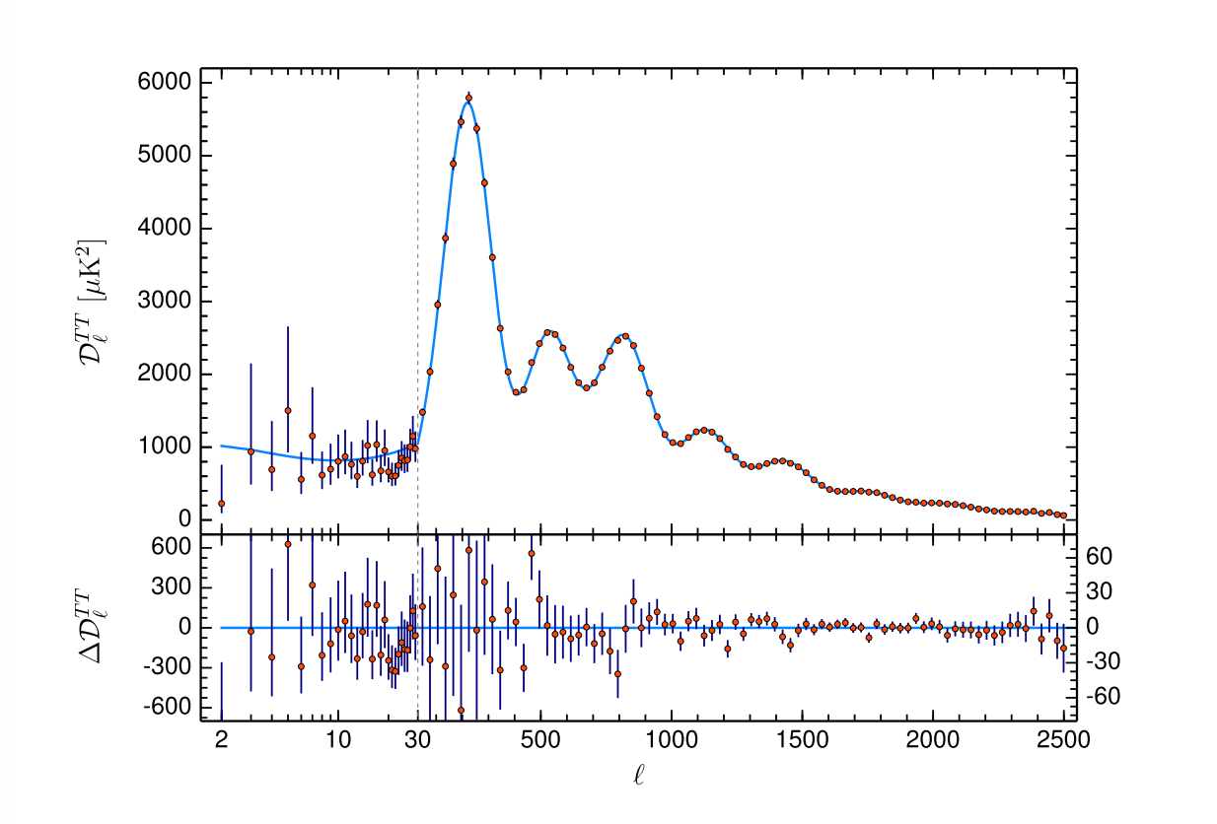
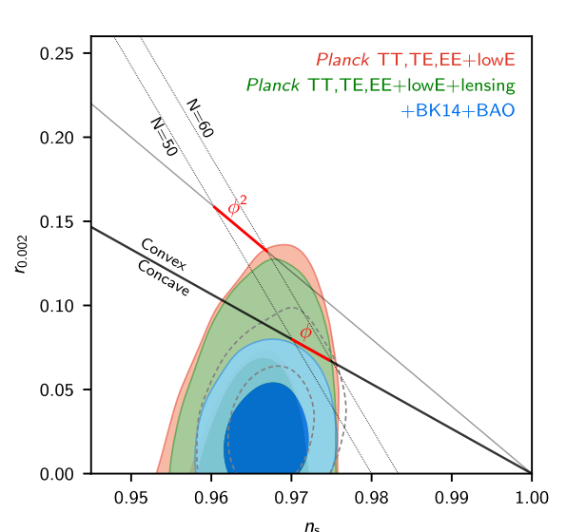
Perturbations and Cosmology
The inflation theory predicts power spectra of perturbations, including scalar (curvature), tensor (GWs) perturbations.
Therefore
To understand the nature of the inflation theory, it is important to investigate the perturbations.
Planck 2018
On large scale (>1Mpc), curvature perturbations are observed very well.

Slide 50
Current constraints on the small scale
BBN
PBH
Power spectrum of curvature perturbation
μ-distortion
y-distortion
Shaded regions are excluded by observations.
CMB and LSS
Note: the constraint from PBH has some uncertainties.
Large scale
Small scale
It is difficult to observe small scale perturbations due to Silk damping or non-linear growth of large scale structure(LSS).
Small scale perturbations have not constrained very well so far.

Slide 51
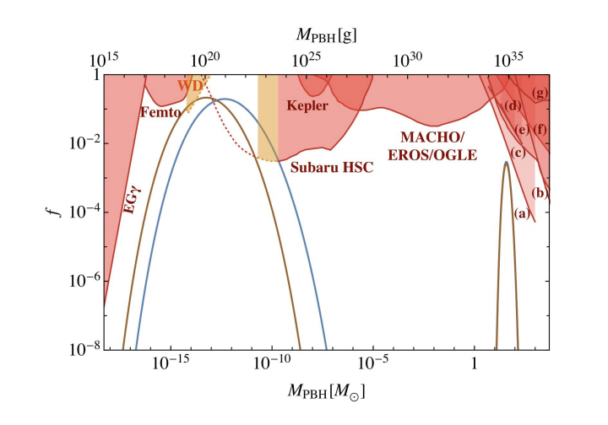
Small scale perturbation and PBH
Small scale pertb
Large scale pertb
<1Mpc
>1Mpc
Amplitude of curvature pertb
Space
Some inflation models predict large perturbations on small scale and sizable amount of PBHs.
PBH is one of the candidate of DM and the heavy BHs detected by LIGO.
PBH DM
PBH for LIGO
Therefore
It is important to discuss small scale perturbations.
Inomata et al. 2017

Slide 52
What we do in this work
GWs can be induced by scalar (curvature) perturbations at second order. (Terada-san’s talk)
If there is a large perturbation on small scale, the induced GWs can be constrained by observations.
We can constrain the small scale perturbations using the induced GWs!
Related at second order
Scalar perturbations
GWs
Constraints on small scale perturbation from induced GWs
Constraints on GWs from observations
We do this!
Related work: Assadullahi & Wands, 2009

Slide 53
Brief review of the induced GWs
GWs can be induced by scalar (curvature) perturbations at second order. (Terada-san’s talk)
Energy density of the induced GWs
Power spectrum of the induced GWs
What we calculate with above formula
If we know the power spectrum of curvature perturbations, we can easily calculate the GW energy density thanks to Kohri & Terada’s work.

Slide 54
Constraints on the induced GWs
When multiple detectors or pulsars are available, it is beneficial to use a cross-correlation between them to look for the correlated signal due to stochastic GWs.
Signal to noise ratio is defined as
(Allen & Romano, 1997)
Induced GWs
Observation time
Effective sensitivity
The effective sensitivity is given by
Overlap reduction function, coming from cross correlation
Noise power spectrum

Slide 55
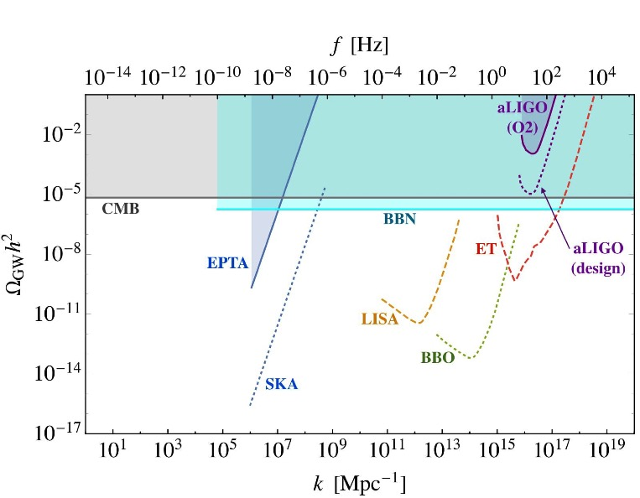
Summary of GW constraints
Shaded regions are excluded by current observations.
Note: We assume a perfect instrumental noise subtraction for LISA and ET and plot the single detector sensitivities of them for simplicity.

Slide 56
Outline
Introduction
Gravitational waves induced by scalar perturbations
Constraints on the power spectrum on small scale
Summary

Slide 57
How to derive the constraints
To be specific, we assume the peak-like profile for the power spectrum
Fix σ.
Fix T (observation time) for each project.
Fix k_{p} and calculate A that yields signal-to-noise ratio unity (ρ=1) for each project.
Change k_{p} and calculate A repeatedly and get the constraint curves on A.
EPTA:18 years, SKA: 20 years, aLIGO (O2): 4 months,
Others: 1 year.
Note: Since CMB and BBN constraints are those on the total amount of energy density of GWs, we do not use this procedure for them.

Slide 58
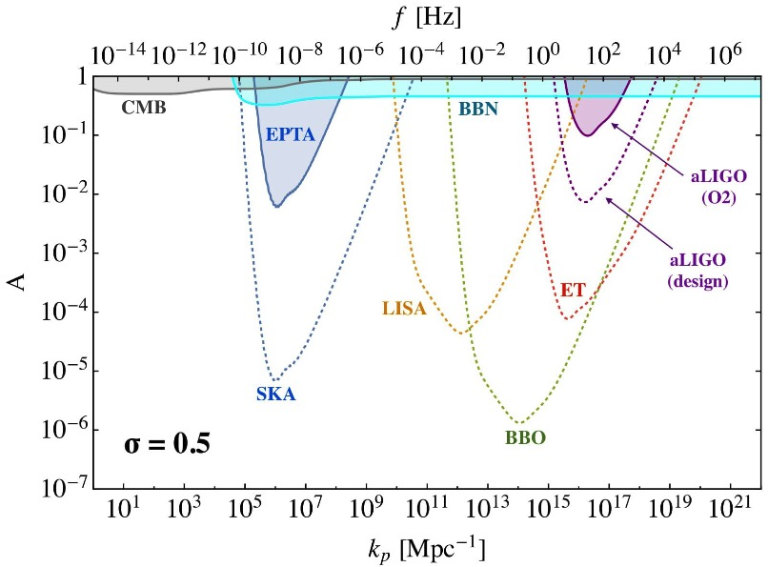
Constraints on small scale perturbations
The constraints on the smaller-scale are stronger compared to the effective sensitivities to GWs.
This is because of the frequency integration in the definition of signal-to-noise ratio.

Slide 59
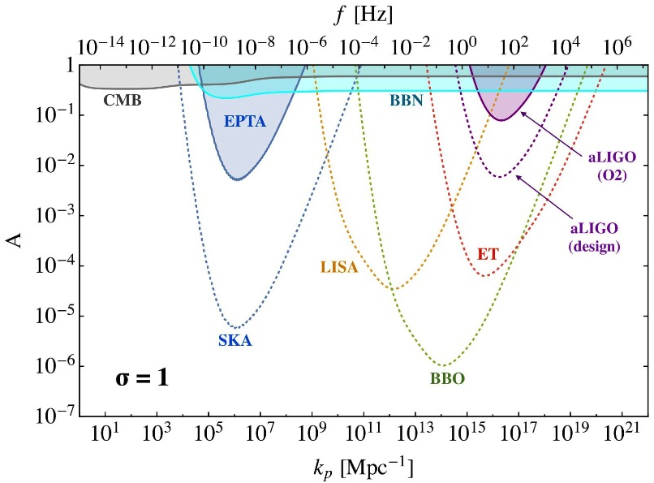
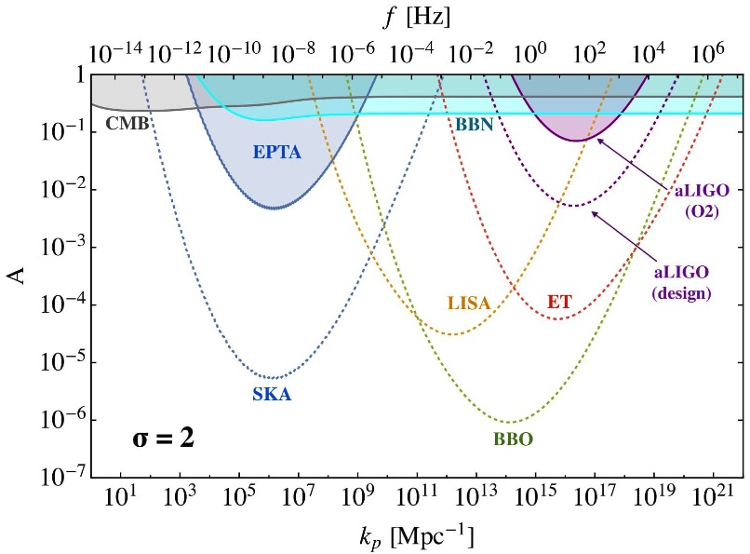
Profile dependence

Slide 60
Outline
Introduction
Gravitational waves induced by scalar perturbations
Constraints on the power spectrum on small scale
Summary

Slide 61
What we have done
Power spectrum of curvature perturbation
Large scale
Small scale
We have derived the constraints on small scale perturbations using GWs induced by scalar perturbations at 2nd order.

Slide 62
Foregrounds
In future, stochastic GWs of astrophysical origin or cosmological origins that are different from the induced GWs, such as those from phase transition, may be detected.
In that case, the constraints would become weak.
Foreground example:
Around PTA target frequency
GWs from supermassive-black-hole binaries
Around LISA target frequency
GWs from galactic white-dwarf binaries
Around BBO target frequency
GWs from neutron star binaries
We may use non-Gaussianity of the induced GWs to discriminate them from other sources.
(Bartolo et al., 2018)

Slide 63
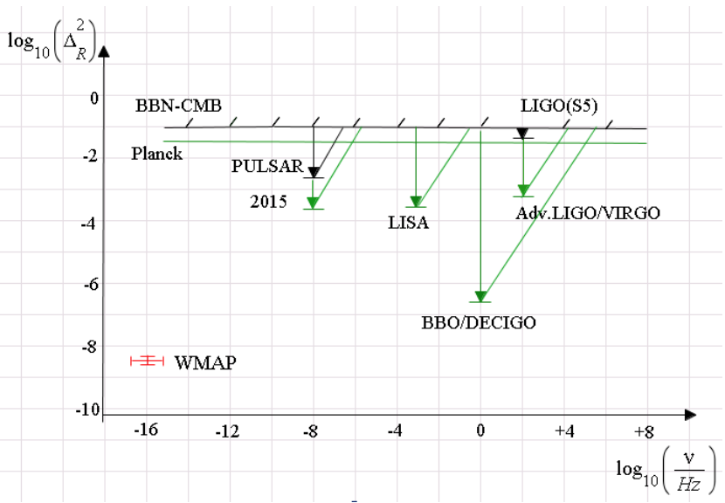
Difference between our work and previous work
Assadullahi & Wands, 2009
Our work
In previous work, they use the old formula for the induced GWs.
For scale invariant spectrum: (P_{ζ}＝A)
In addition, they do not take into account frequency dependence of the sensitivity curves.

Slide 64
Evolution of the induced GWs
Comoving scale
After the horizon entry, GWs are not induced so much because of the perturbation decay.
Scalar perturbations
(gravitational potential)
Ω_{GW} are suppressed similarly to Ω_{r}.
Horizon
Early
Horizon in
Matter-radiation equality
Present
GWs are dominantly induced at horizon entry.
What we calculate with the formula

Slide 65
What we do
Power spectrum of curvature perturbation
Large scale
Small scale
We derive constraints on small scale curvature perturbations using GWs induced by scalar perturbations.

