Slide 1
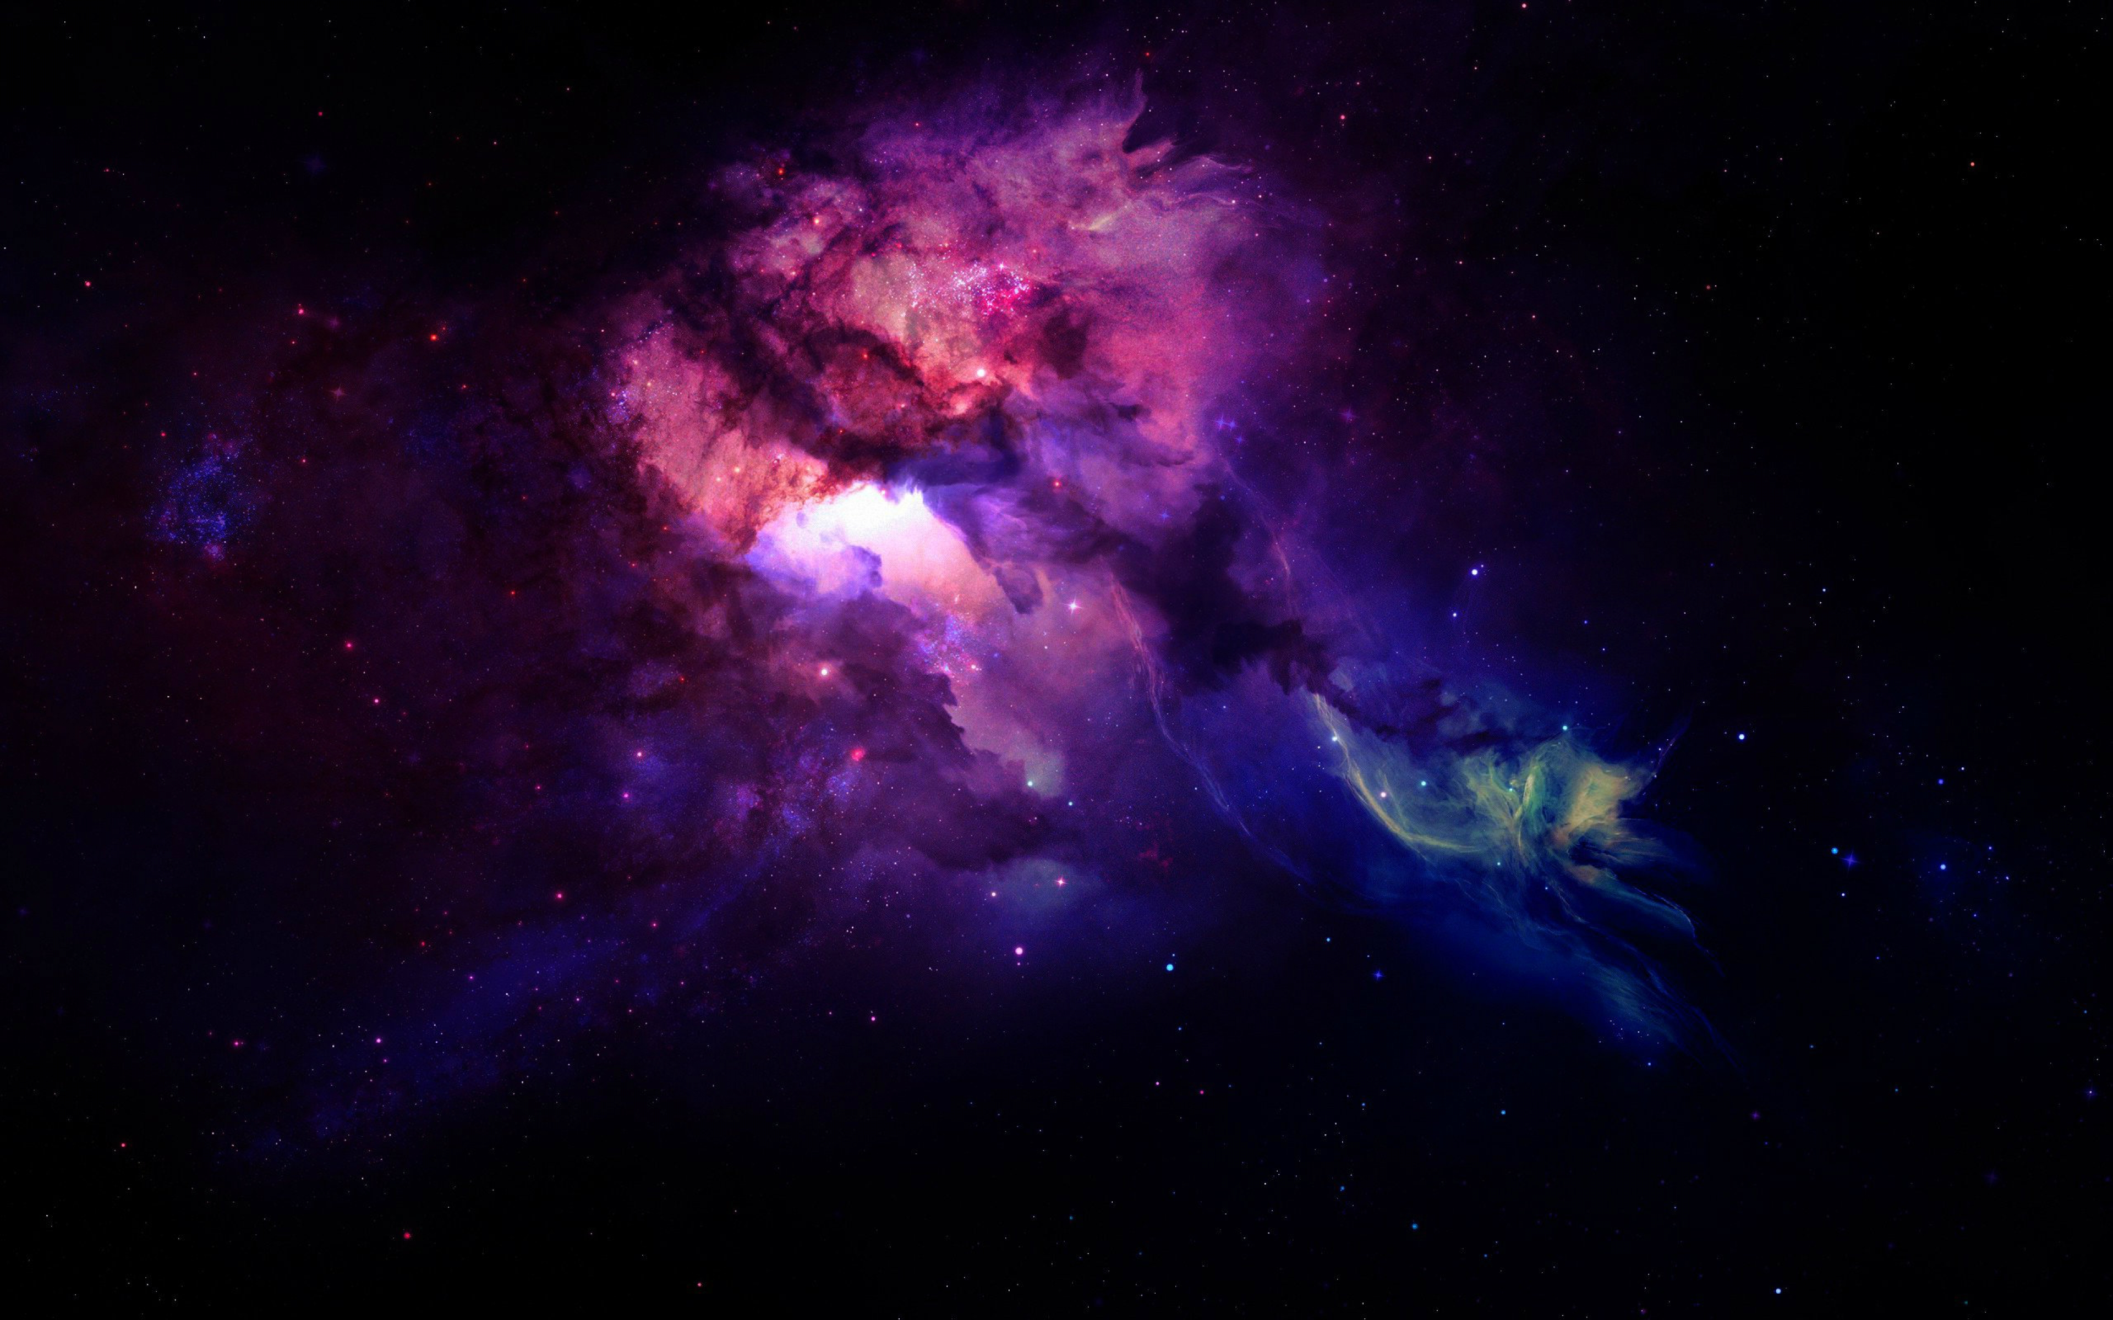


From QCD Axion Stars to Boson Stars:
Cosmology and Astrophysics
(arXiv: 1710.04729; 1804.07255; 1805.00430; 1906.02094)
Enrico D. Schiappacasse
Shanghai Jiao Tong University
43rd Johns Hopkins Workshop
KAVLI IPMU 2019
Shanghai Jiao Tong University
(with the collaboration of Mark Hertzberg , Gongjun Choi, and Hong-Jian He)

Slide 2
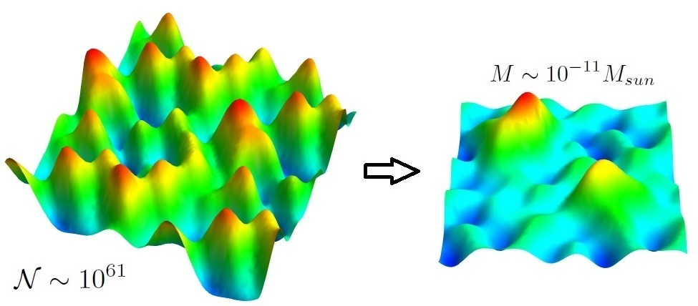
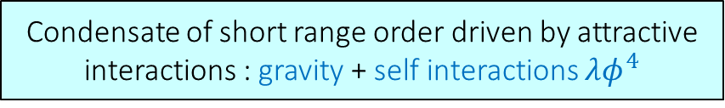
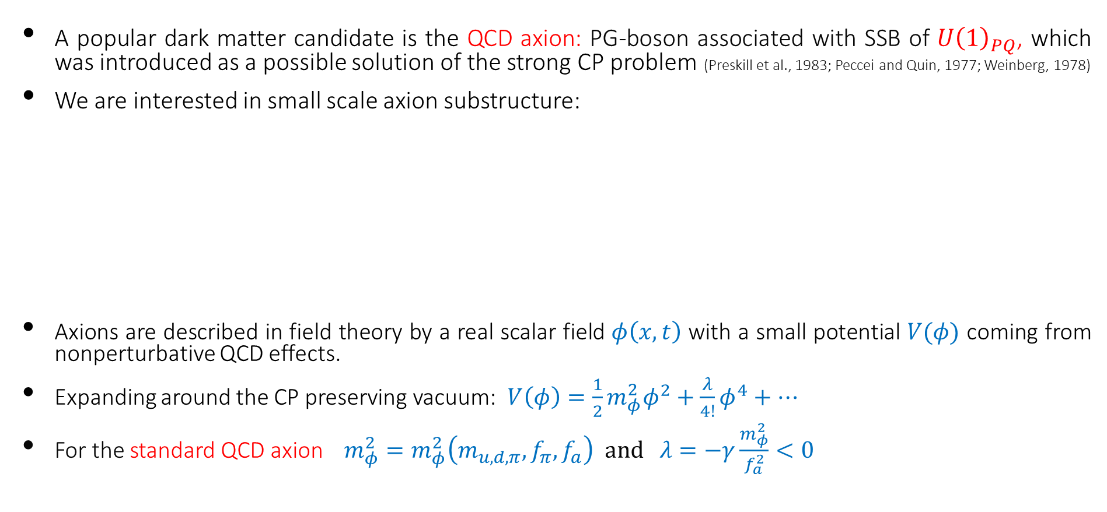
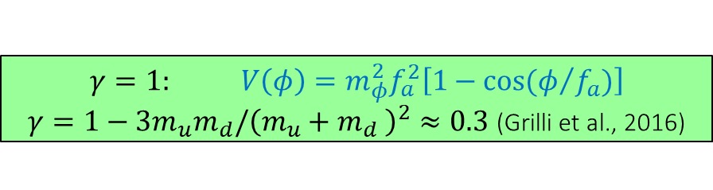
DARK MATTER AXION CLUMPS
2
A popular dark matter candidate is the QCD axion: PG-boson associated with SSB of ${U\left(1\right)}_{PQ}$, which was introduced as a possible solution of the strong CP problem (Preskill et al., 1983; Peccei and Quin, 1977; Weinberg, 1978)
We are interested in small scale axion substructure:
Axions are described in field theory by a real scalar field $φ\left(x,t\right)$ with a small potential $V(φ)$ coming from nonperturbative QCD effects.
Expanding around the CP preserving vacuum: $V\left(φ\right)=\frac{1}{2}m_{φ}^{2}φ^{2}+\frac{λ}{4!}φ^{4}+⋯$
For the standard QCD axion $m_{φ}^{2}=m_{φ}^{2}\left(m_{u,d,π},f_{π},f_{a}\right) and λ=−γ\frac{m_{φ}^{2}}{f_{a}^{2}}<0$
(Sikivie and Yang, 2009)
On small scales axions can gravitationally thermalize leading to a type of BEC
(Guth, Hertzberg, and Prescod-Weinstein, 2015)
Condensate of short range order driven by attractive interactions : gravity + self interactions $λφ^{4}$
$$γ=1: V\left(φ\right)=m_{φ}^{2}f_{a}^{2}\left[1−cos⁡(φ/{f_{a}})\right]$$
$γ=1−3m_{u}m_{d}/{\left(m_{u}+m_{d} \right)}^{2}≈0.3$ (Grilli et al., 2016)
ENRICO D. SCHIAPPACASSE – 43rd Johns Hopkins Workshop 2019 KAVLI IPMU – FROM QCD AXION STARS TO BOSON STARS

Slide 3
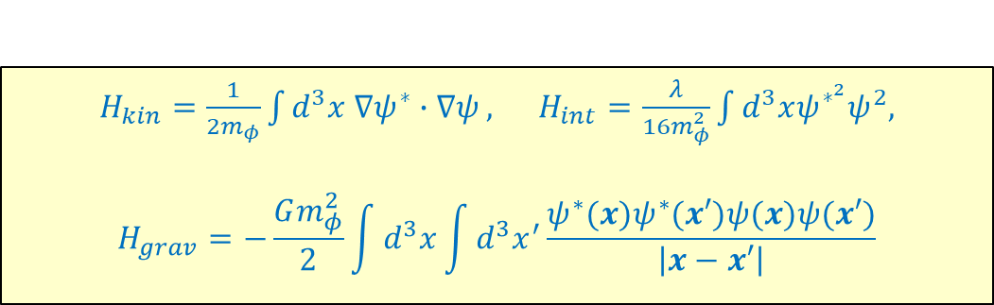
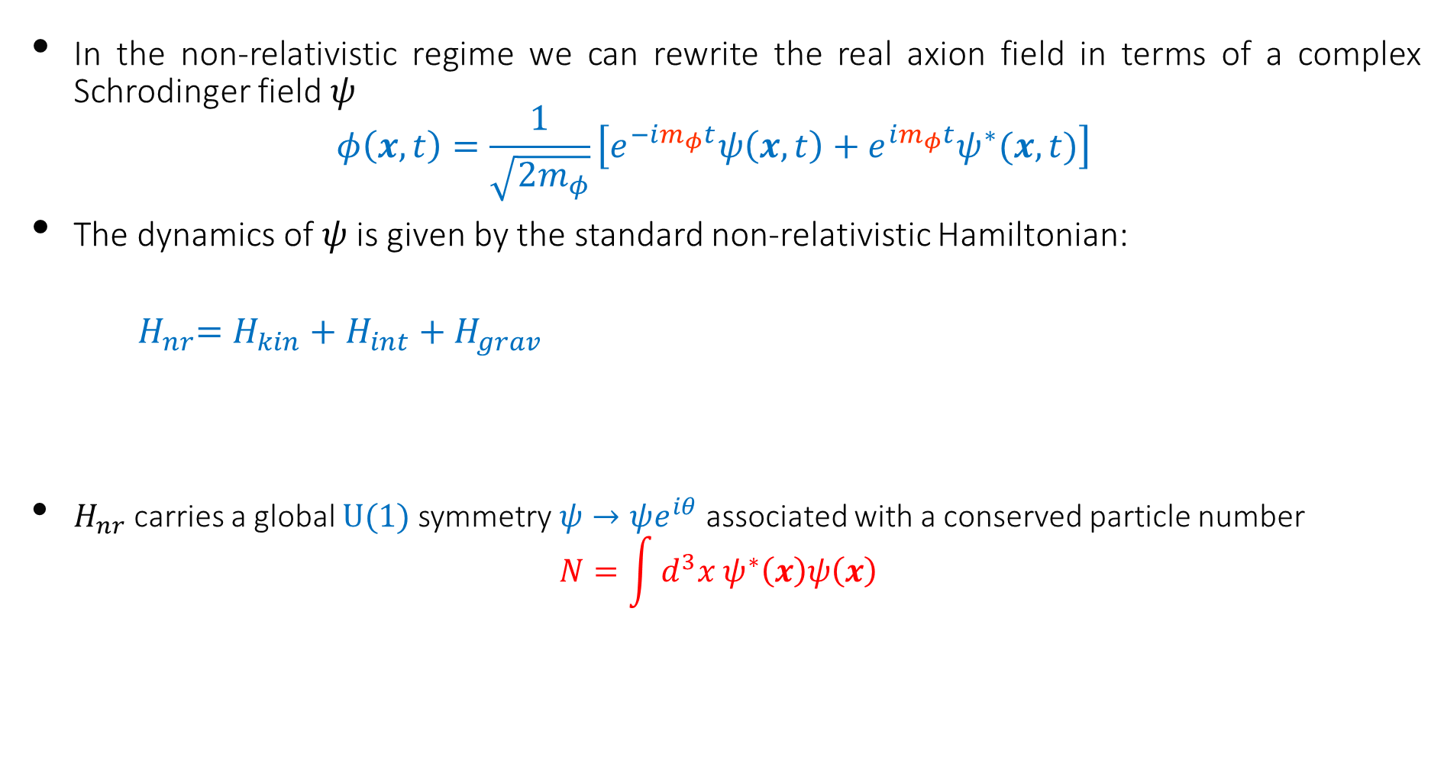
3
In the non-relativistic regime we can rewrite the real axion field in terms of a complex Schrodinger field $ψ$ :
$$φ\left(x,t\right)=\frac{1}{\sqrt{{2m}_{φ}}}\left[e^{−im_{φ}t}ψ\left(x,t\right)+e^{im_{φ}t}ψ^{∗}(x,t)\right]$$
The dynamics of $ψ$ is given by the standard non-relativistic Hamiltonian:
$${ H}_{nr}=H_{kin}+H_{int}+H_{grav}$$
$H_{nr}$carries a global $U(1)$ symmetry $ψ→ψe^{iθ}$ associated with a conserved particle number
$$N=\int{d^{3}x{ ψ}^{∗}\left(x\right)ψ\left(x\right) }$$
$H_{kin}=\frac{1}{2m_{φ}}\int{d^{3}x {∇ψ}^{∗}∙∇ψ},$ $H_{int}=\frac{λ}{16m_{φ}^{2}}\int{d^{3}xψ^{∗^{2}}ψ^{2},}$
$$H_{grav}=−\frac{Gm_{φ}^{2}}{2}\int{d^{3}x\int{d^{3}x^{′}\frac{ψ^{∗}(x)ψ^{∗}(x′)ψ(x)ψ(x′)}{\left|x−x′\right|}}}$$
(Guth, Hertzberg, and Prescod-Weinstein, 2015;
Schiappacasse and Hertzberg, 2017)
True BEC : State of minimum energy at fixed N (spherically symmetry)
Other type of BEC: State of minimum energy at fixed N and angular momentum L (non-spherical configuration)
ENRICO D. SCHIAPPACASSE – 43rd Johns Hopkins Workshop 2019 KAVLI IPMU – FROM QCD AXION STARS TO BOSON STARS

Slide 4


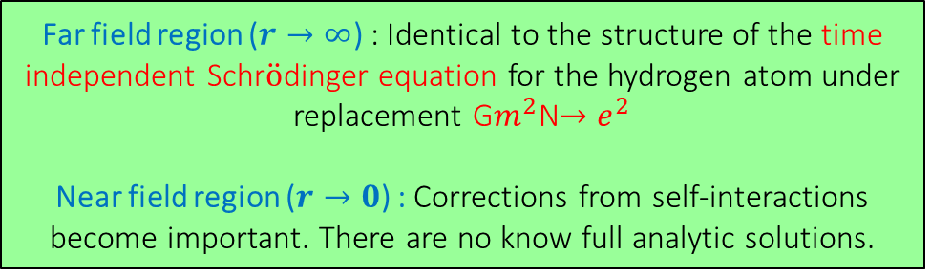
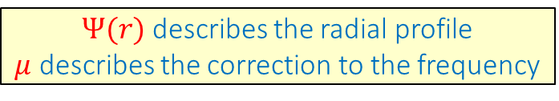
SPHERICALLY SYMMETRIC CLUMP CONDENSATES
4
$Ψ(r)$ describes the radial profile
$μ$ describes the correction to the frequency
Gravity will inevitably cause a homogeneous condensate to fragment into an inhomogeneous field configuration: locally this leads to the formation of BEC clumps.
The true BEC ground state is guaranteed to be spherically symmetric: $ψ\left(r,t\right)=Ψ(r)e^{−iμt}$
The time independent field equation for a spherically symmetric eigenstate is
$$μΨ=−\frac{1}{2m}\left(Ψ^{′′}+\frac{2}{r}Ψ^{′}\right)−4πGm^{2}Ψ\int_{0}^{∞}{dr^{′}{r′}^{2} \frac{{Ψ(r′)}^{2}}{r_{>}}+\frac{1}{2}\frac{∂V_{nr}}{∂Ψ}}$$
$$V_{nr}=−\frac{Ψ^{4}}{16{f_{a}}^{2}}$$
(Schiappacasse and Hertzberg, 1710.04729 )
Exponential-Ansatz
Sech-Ansatz
Numerical
Far field region ($r→∞$) : Identical to the structure of the time independent Schr$\ddot{o}$dinger equation for the hydrogen atom under replacement G$m^{2}$N$→e^{2}$
Near field region ($r→0$) : Corrections from self-interactions become important. There are no know full analytic solutions.
ENRICO D. SCHIAPPACASSE – 43rd Johns Hopkins Workshop 2019 KAVLI IPMU – FROM QCD AXION STARS TO BOSON STARS

Slide 5
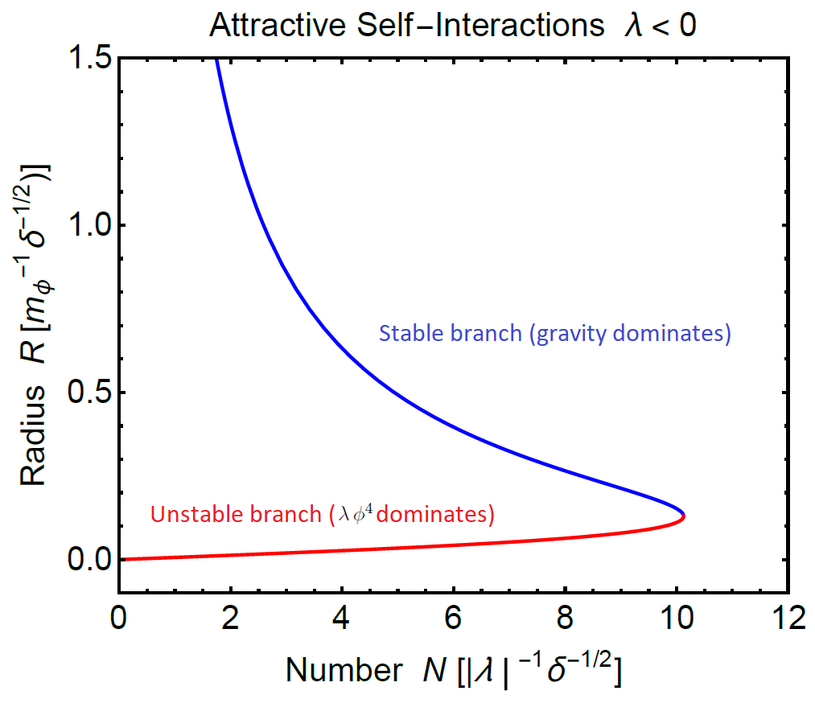
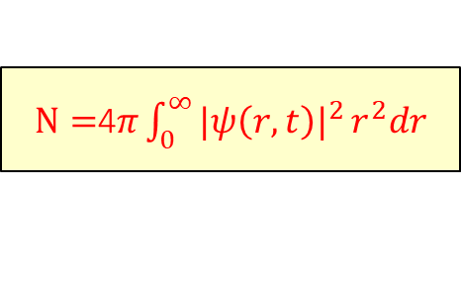
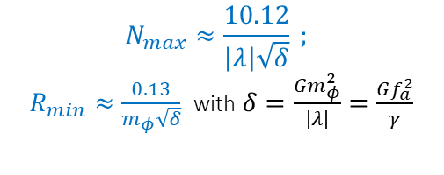
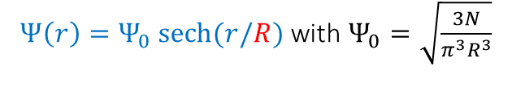


SPHERICALLY SYMMETRIC CLUMP CONDENSATES
5
SECH ANSATZ
axion-gravity-self-interactingggg system
$Ψ\left(r\right)=Ψ_{0} sech⁡(r/R)$ with $Ψ_{0}=\sqrt{\frac{3N}{π^{3}R^{3}}}$
$$N_{max}≈\frac{10.12}{\left|λ\right|\sqrt{δ}} ;$$
$R_{min}≈\frac{0.13}{m_{φ}\sqrt{δ}}$ with $δ=\frac{Gm_{φ}^{2}}{\left|λ\right|}=\frac{Gf_{a}^{2}}{γ}$
Radial perturbation of a ground state belonging to the stable branch.
$Any localized anstaz of a$ $single parameter R$
$$H\left(R\right)=a\frac{N}{m_{φ}R^{2}}−b\frac{Gm_{φ}^{2}N^{2}}{R}+c\frac{λN^{2}}{m_{φ}^{2}R^{3}} ⟸$$
R is the effective radius of the solution (variational parameter)
$N=$4$π{\int_{0}^{∞}{{|ψ\left(r,t\right)|}^{2}}r}^{2}dr$
(Schiappacasse and Hertzberg, 1710.04729 )
ENRICO D. SCHIAPPACASSE – 43rd Johns Hopkins Workshop 2019 KAVLI IPMU – FROM QCD AXION STARS TO BOSON STARS

Slide 6
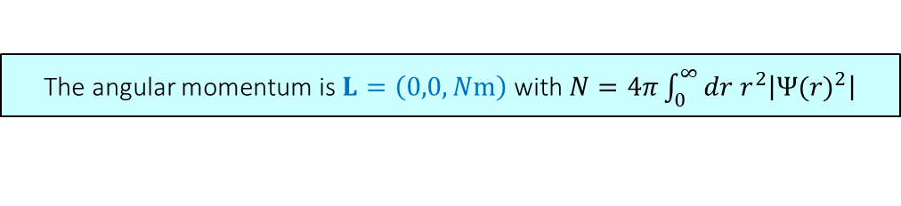

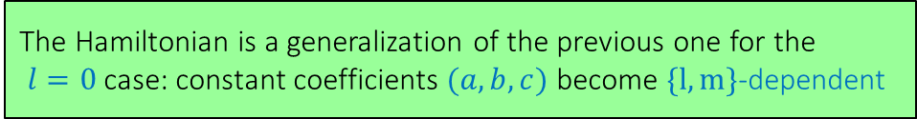
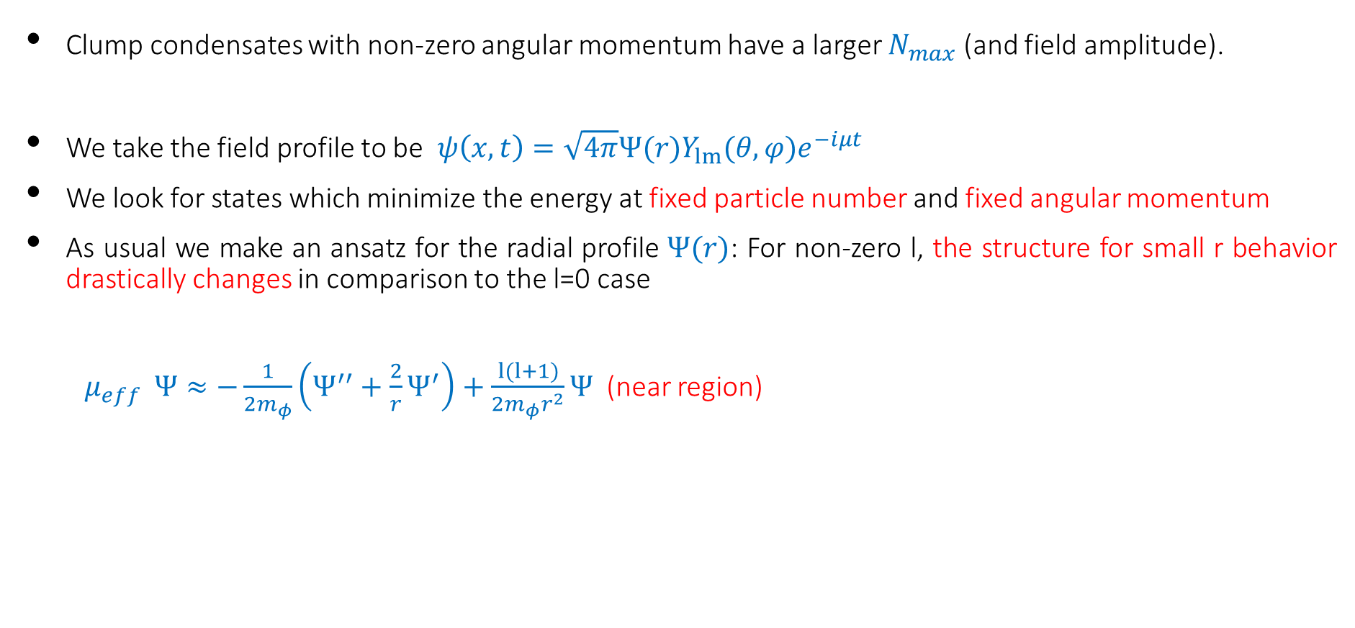
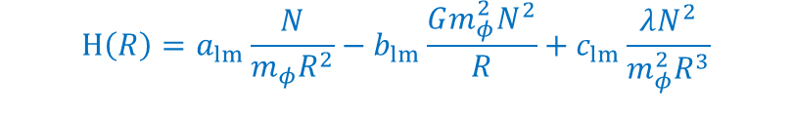
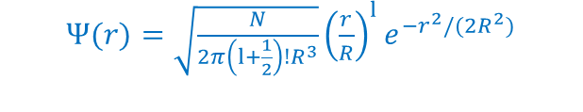

CLUMP CONDENSATES WITH ANGULAR MOMENTUM
6
Clump condensates with non-zero angular momentum have a larger $N_{max}$ (and field amplitude).
We take the field profile to be $ψ\left(x,t\right)=\sqrt{4π}Ψ(r)Y_{lm}(θ,φ)e^{−iμt}$
We look for states which minimize the energy at fixed particle number and fixed angular momentum
As usual we make an ansatz for the radial profile $Ψ(r)$: For non-zero l, the structure for small r behavior drastically changes in comparison to the l=0 case
${ μ}_{eff} Ψ≈−\frac{1}{2m_{φ}}\left(Ψ^{′′}+\frac{2}{r}Ψ^{′}\right)+\frac{l(l+1)}{2m_{φ}r^{2}}Ψ$ (near region)
The angular momentum is $L=\left(0,0,Nm\right)$ with $N=4π\int_{0}^{∞}{dr r^{2}\left|{Ψ(r)}^{2}\right|}$
We need $Ψ\left(r\right)=Ψ_{α}r^{l}−\frac{1}{2}Ψ_{β}r^{l+2}+…(near region)$
MODIFIED GAUSSIAN ANSATZ
These terms blow up when $r⟶0$
$Ψ(r)=\sqrt{\frac{N}{2π\left(l+\frac{1}{2}\right)!R^{3}}}{\left(\frac{r}{R}\right)}^{l}e^{{−r}^{2}/(2R^{2})}$
It includes the gravitational term
The Hamiltonian is a generalization of the previous one for the
$l=0$ case: constant coefficients $(a,b,c)$ become $\{l,m\}$-dependent
$$H\left(R\right)=a_{lm}\frac{N}{m_{φ}R^{2}}−b_{lm}\frac{Gm_{φ}^{2}N^{2}}{R}+c_{lm}\frac{λN^{2}}{m_{φ}^{2}R^{3}}$$
ENRICO D. SCHIAPPACASSE – 43rd Johns Hopkins Workshop 2019 KAVLI IPMU – FROM QCD AXION STARS TO BOSON STARS

Slide 7
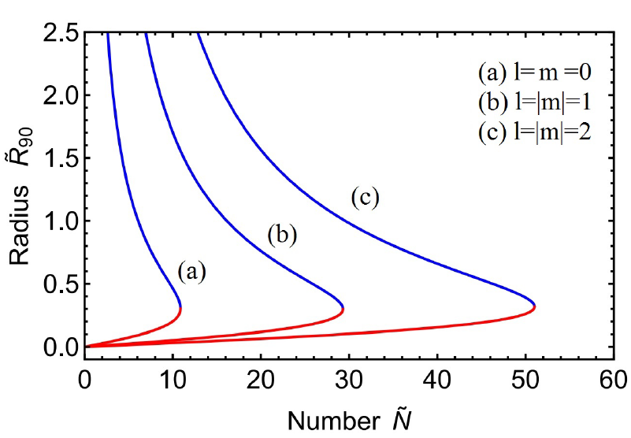
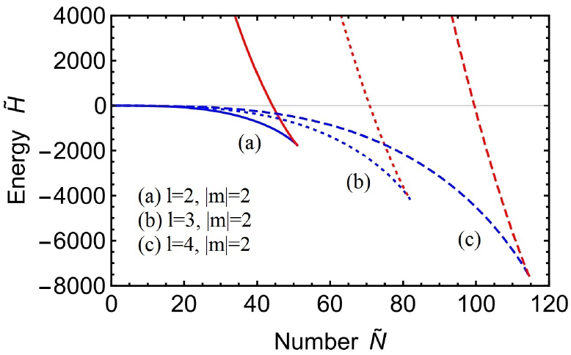
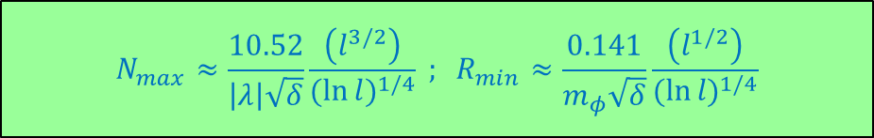
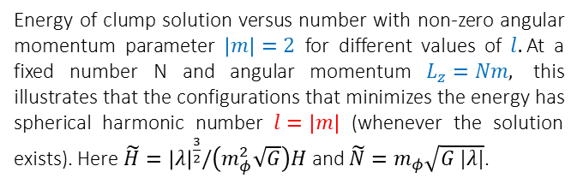
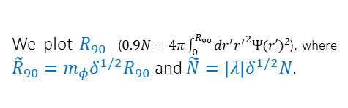
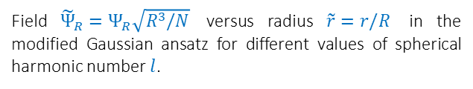

CLUMP CONDENSATES WITH ANGULAR MOMENTUM
Field ${\tilde{Ψ}}_{R}=Ψ_{R}\sqrt{R^{3}/N}$ versus radius $\tilde{r}=r/R$ in the modified Gaussian ansatz for different values of spherical harmonic number $l$.
7
We plot $R_{90}$ ($0.9N=4π\int_{0}^{R_{90}}{dr^{′}{r^{′}}^{2}{Ψ(r′)}^{2}}$), where ${\tilde{R}}_{90}=m_{φ}δ^{1/2}R_{90}$and $\tilde{N}=\left|λ\right|δ^{1/2}N$.
(Hertzberg and Schiappacasse, 1804.07255 )
Energy of clump solution versus number with non-zero angular momentum parameter $\left|m\right|=2$ for different values of $l.$At a fixed number N and angular momentum $L_{z}=Nm,$ this illustrates that the configurations that minimizes the energy has spherical harmonic number $l=\left|m\right|$ (whenever the solution exists). Here $\tilde{H}={\left|λ\right|}^{\frac{3}{2}}/\left(m_{φ}^{2}\sqrt{G}\right)H$ and $\tilde{N}=m_{φ}\sqrt{G |λ|}$.
At high $l=\left|m\right| ,$
$$N_{max}≈\frac{10.52}{\left|λ\right|\sqrt{δ}}\frac{\left(l^{3/2}\right)}{{(\ln{l})}^{1/4}} ; R_{min}≈\frac{0.141}{m_{φ}\sqrt{δ}}\frac{\left(l^{1/2}\right)}{{(\ln{l})}^{1/4}}$$
ENRICO D. SCHIAPPACASSE – 43rd Johns Hopkins Workshop 2019 KAVLI IPMU – FROM QCD AXION STARS TO BOSON STARS

Slide 8
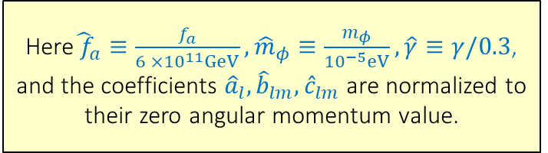
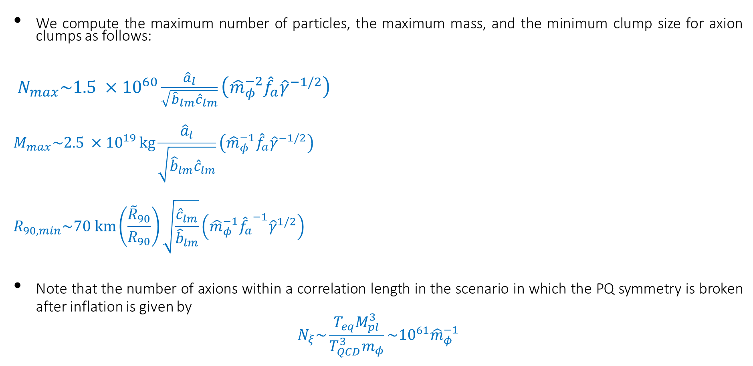
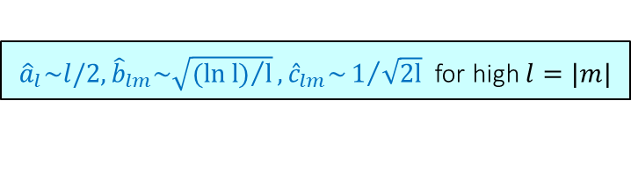
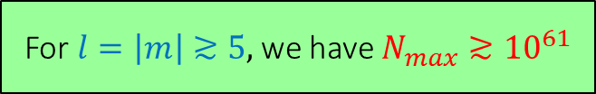
PHYSICAL PARAMETERS FOR AXION STARS
8
We compute the maximum number of particles, the maximum mass, and the minimum clump size for axion clumps as follows:
$N_{max}\sim 1.5 ×{10}^{60}\frac{{\hat{a}}_{l}}{\sqrt{{\hat{b}}_{lm}{\hat{c}}_{lm}}}\left({\hat{m}}_{φ}^{−2}{\hat{f}}_{a}{\hat{γ}}^{−1/2}\right)$
$$M_{max}\sim 2.5 ×{10}^{19 }kg\frac{{\hat{a}}_{l}}{\sqrt{{\hat{b}}_{lm}{\hat{c}}_{lm}}}\left({\hat{m}}_{φ}^{−1}{\hat{f}}_{a}{\hat{γ}}^{−1/2}\right)$$
$$R_{90,min}\sim 70 km\left(\frac{{\tilde{R}}_{90}}{R_{90}}\right)\sqrt{\frac{{\hat{c}}_{lm}}{{\hat{b}}_{lm}}}\left({\hat{m}}_{φ}^{−1}{{\hat{f}}_{a}}^{−1}{\hat{γ}}^{1/2}\right)$$
Note that the number of axions within a correlation length in the scenario in which the PQ symmetry is broken after inflation is given by system
$$N_{ξ}\sim \frac{T_{eq}M_{pl}^{3}}{T_{QCD}^{3}m_{φ}}\sim {10}^{61}{\hat{m}}_{φ}^{−1}$$
${{\hat{a}}_{l}\sim l/2,\hat{b}}_{lm}\sim \sqrt{{(\ln{l})}/l},{\hat{c}}_{lm}\sim 1/{\sqrt{2l}}$ for high $l=|m|$
Here${\hat{ f}}_{a}≡\frac{f_{a}}{6 ×{10}^{11}GeV}, {\hat{m}}_{φ}≡\frac{m_{φ}}{{10}^{−5}eV},\hat{γ}≡γ/0.3$,
and the coefficients ${{\hat{a}}_{l},\hat{b}}_{lm},{\hat{c}}_{lm}$ are normalized to
their zero angular momentum value.
(Guth, Hertzberg, and Prescod-Weinstein, 2015)
For $l=\left|m\right|≳5,$ we have $N_{max}≳{10}^{61}$
ENRICO D. SCHIAPPACASSE – 43rd Johns Hopkins Workshop 2019 KAVLI IPMU – FROM QCD AXION STARS TO BOSON STARS

Slide 9
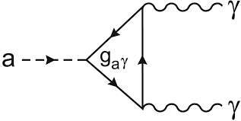
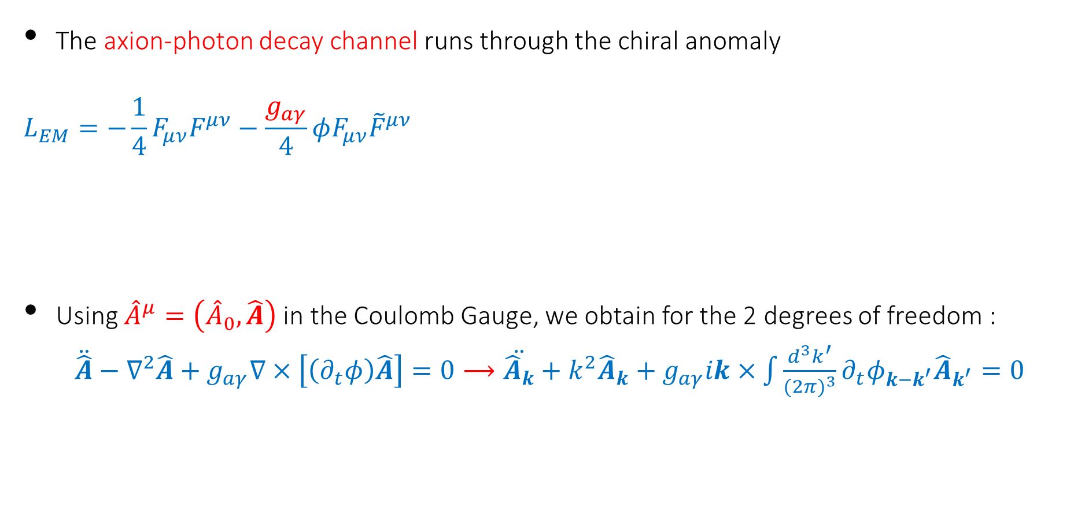
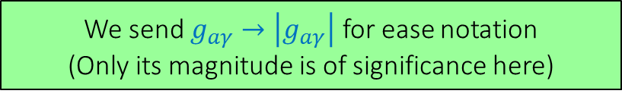
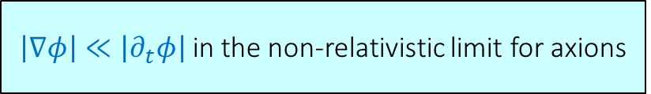
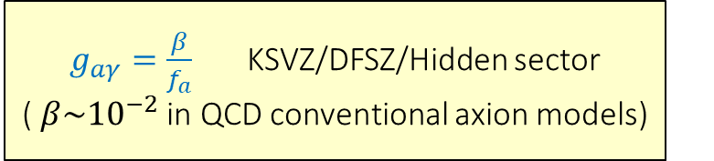
AXIONS AND PHOTONS
9
The axion-photon decay channel runs through the chiral anomaly
$$L_{EM}=−\frac{1}{4}F_{μν}F^{μν}−\frac{g_{aγ}}{4}φF_{μν}{\tilde{F}}^{μν}$$
Using ${\hat{A}}^{μ}=\left({\hat{A}}_{0},\hat{A}\right)$ in the Coulomb Gauge, we obtain for the 2 degrees of freedom :
$\ddot{\hat{A}}−∇^{2}\hat{A}+g_{aγ}∇×\left[\left(∂_{t}φ\right)\hat{A}\right]=0⟶\ddot{{\hat{A}}_{k}}+k^{2}{\hat{A}}_{k}+g_{aγ}ik×\int{\frac{d^{3}k^{′}}{{(2π)}^{3}}∂_{t}φ_{k−k^{′}}{\hat{A}}_{k^{′}}=0}$
$g_{aγ}=\frac{β}{f_{a}}$ KSVZ/DFSZ/Hidden sector ( $β\sim {10}^{−2}$ in QCD conventional axion models)
We send $g_{aγ}→\left|g_{aγ}\right|$ for ease notation
(Only its magnitude is of significance here)
Kim (1979); Zhitnitsky (1980)
$\left|∇φ\right|≪\left|∂_{t}φ\right|$ in the non-relativistic limit for axions
ENRICO D. SCHIAPPACASSE – 43rd Johns Hopkins Workshop 2019 KAVLI IPMU – FROM QCD AXION STARS TO BOSON STARS

Slide 10
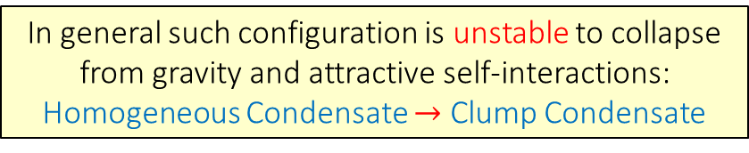
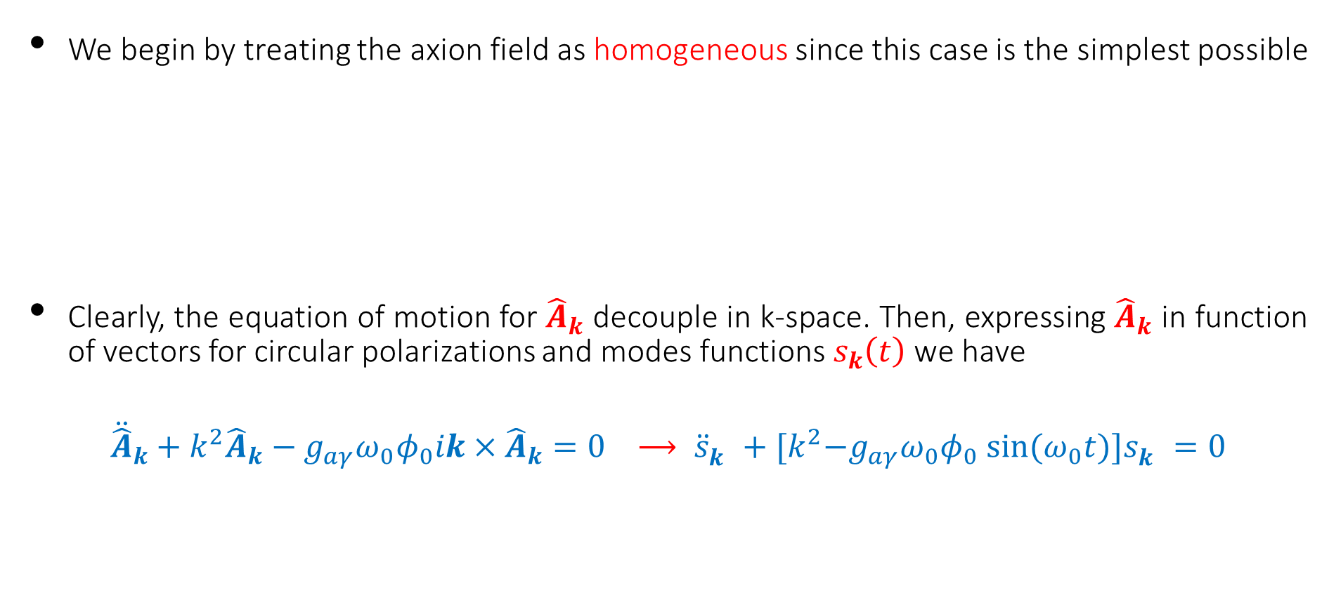
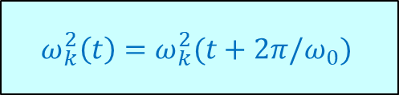
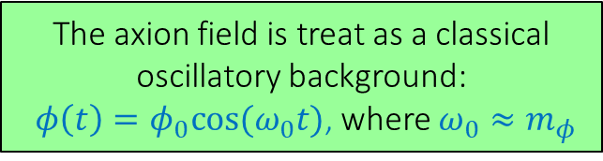
HOMOGENEOUS CONDENSATES
10
We begin by treating the axion field as homogeneous since this case is the simplest possible
Clearly, the equation of motion for ${\hat{A}}_{k}$ decouple in k-space. Then, expressing ${\hat{A}}_{k}$ in function of vectors for circular polarizations and modes functions $s_{k}\left(t\right)$ we have
$${\ddot{\hat{A}}}_{k}+k^{2}{\hat{A}}_{k}−g_{aγ}ω_{0}φ_{0}ik×{\hat{A}}_{k}=0 ⟶ {\ddot{s}}_{k}^{}+{[k}^{2}−g_{aγ}ω_{0}φ_{0} sin⁡(ω_{0}t)]s_{k}^{}=0$$
In general such configuration is unstable to collapse from gravity and attractive self-interactions:
Homogeneous Condensate $→$ Clump Condensate
The axion field is treat as a classical oscillatory background:
$φ\left(t\right)=φ_{0}cos⁡(ω_{0}t)$, where $ω_{0}≈m_{φ}$
(Guth, Hertzberg, and Prescod-Weinstein, 2015)
$$ω_{k}^{2}\left(t\right)=ω_{k}^{2}(t+2π/ω_{0})$$
ENRICO D. SCHIAPPACASSE – 43rd Johns Hopkins Workshop 2019 KAVLI IPMU – FROM QCD AXION STARS TO BOSON STARS

Slide 11


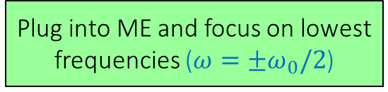
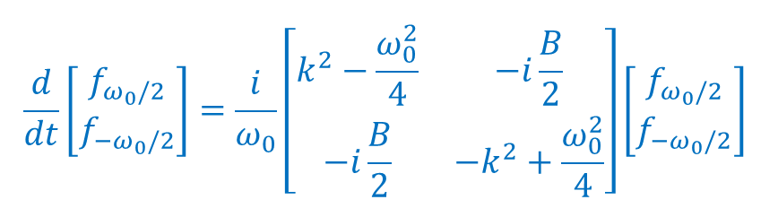
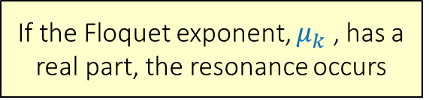
HOMOGENEOUS CONDENSATES
Small Amplitude Analysis
11
In the parameter space of Mathieu equation (ME) there is a band structure of unstable (resonant) and stable regions:
$$s_{k}^{}(t)=P_{k}\left(t\right)e^{μ_{k}t}+ P_{k}(−t)e^{−μ_{k}t}$$
At small amplitude of weak coupling limit of $(k/ω_{0})≫(g_{aγ}φ_{0}/2)$, we have a spectrum of narrow bands equally spaced at ${(k/ω_{0})}^{2}≈{(n/2)}^{2}$ for $n$ a positive integer.
Expand the solution for each circularized polarization as:
$$s_{k}^{}(t)=\sum_{ω}{e^{iωt} f_{ω}(t)}$$
(McLachlan, 1947)
If the Floquet exponent, $μ_{k}$ , has a real part, the resonance occurs
GENERAL SOLUTION
The band width and Floquet exponent magnitude decreases as $n$ increases
Plug into ME and focus on lowest frequencies ($ω=±ω_{0}/2$)
$$\frac{d}{dt}\left[\begin{matrix}f_{ω_{0}/2} \\ f_{{−ω}_{0}/2}\end{matrix}\right]=\frac{i}{ω_{0}}\left[\begin{matrix}k^{2}−\frac{ω_{0}^{2}}{4} & −i\frac{B}{2} \\ −i\frac{B}{2} & −k^{2}+\frac{ω_{0}^{2}}{4}\end{matrix}\right]\left[\begin{matrix}f_{ω_{0}/2} \\ f_{{−ω}_{0}/2}\end{matrix}\right]$$
Slowing varying
ENRICO D. SCHIAPPACASSE – 43rd Johns Hopkins Workshop 2019 KAVLI IPMU – FROM QCD AXION STARS TO BOSON STARS

Slide 12
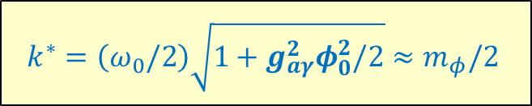


HOMOGENEOUS CONDENSATES
Small Amplitude Analysis
12
Numerical Analysis
(Standard Floquet Method)
Positive eigenvalues previous matrix
The growth rate is:${ μ}_{k}=\sqrt{\frac{g_{aγ}^{2}k^{2}φ_{0}^{2}}{4}−\frac{{\left(k^{2}−\frac{ω_{0}^{2}}{4}\right)}^{2}}{ω_{0}^{2}}}$
For ${ℜ(μ}_{k}) >0 :$Exponentially growing solutions
(First instability band)
For ${ℜ(μ}_{k})=0$: Instability band edges
$${ k}_{{l/r}_{edge}}=\sqrt{\frac{ω_{0}^{4}}{4}+\frac{g_{aγ}^{2}ω_{0}^{2}φ_{0}^{2}}{16}}∓\frac{g_{aγ}ω_{0}φ_{0}}{4}$$
$$k^{∗}=\left(ω_{0}/2\right)\sqrt{1+g_{aγ}^{2}φ_{0}^{2}/2}≈m_{φ}/2$$
Center of the band
$$μ_{H}^{∗}≈\frac{g_{aγ}m_{φ}φ_{0}}{4}$$
Maximum Floquet Exponent
(Hertzberg and Schiappacasse, 1805.00430 )
ENRICO D. SCHIAPPACASSE – 43rd Johns Hopkins Workshop 2019 KAVLI IPMU – FROM QCD AXION STARS TO BOSON STARS

Slide 13
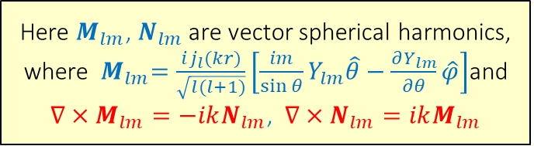
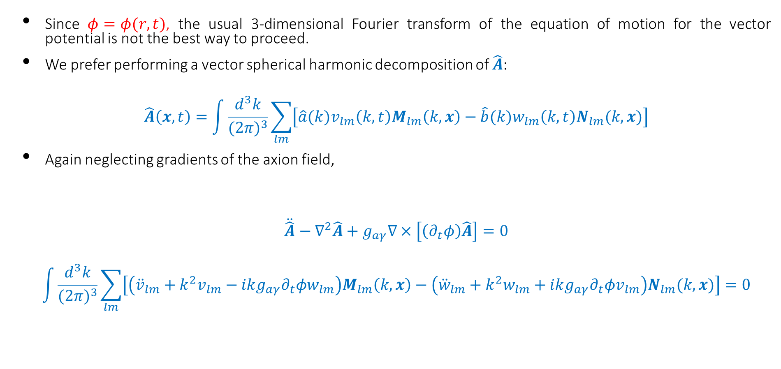
SPHERICALLY SYMMETRIC CLUMP CONDENSATES
Vector Spherical Decomposition
13
Since $φ=φ(r,t)$, the usual 3-dimensional Fourier transform of the equation of motion for the vector potential is not the best way to proceed.
We prefer performing a vector spherical harmonic decomposition of $\hat{A}$:
$$\hat{A}\left(x,t\right)=\int{\frac{d^{3}k}{{(2π)}^{3}}\sum_{lm}{\left[\hat{a}(k)v_{lm}\left(k,t\right)M_{lm}\left(k,x\right)−\hat{b}(k)w_{lm}\left(k,t\right)N_{lm}(k,x)\right]}}$$
Again neglecting gradients of the axion field,
$$\ddot{\hat{A}}−∇^{2}\hat{A}+g_{aγ}∇×\left[\left(∂_{t}φ\right)\hat{A}\right]=0$$
$$\int{\frac{d^{3}k}{{(2π)}^{3}}\sum_{lm}{\left[\left({\ddot{v}}_{lm}+k^{2}v_{lm}−ikg_{aγ}∂_{t}φw_{lm}\right)M_{lm}\left(k,x\right)−\left({\ddot{w}}_{lm}+k^{2}w_{lm}+ikg_{aγ}∂_{t}φv_{lm}\right)N_{lm}(k,x)\right]}=0}$$
lf-interacting system
Here $M_{lm}$, $N_{lm}$ are vector spherical harmonics, where ${ M}_{lm}=\frac{ij_{l}(kr)}{\sqrt{l(l+1)}}\left[\frac{im}{\sin{θ}}Y_{lm}\hat{θ}−\frac{∂Y_{lm}}{∂θ}\hat{φ}\right]$and $∇×M_{lm}=−ikN_{lm}$, $∇×N_{lm}=ikM_{lm}$
It can be solved numerically, but for any arbitrary sum over {l,m} is quite complicated
ENRICO D. SCHIAPPACASSE – 43rd Johns Hopkins Workshop 2019 KAVLI IPMU – FROM QCD AXION STARS TO BOSON STARS

Slide 14
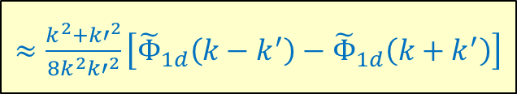





SPHERICALLY SYMMETRIC CLUMP CONDENSATES
Vector Spherical Decomposition
14
We focus on the $\left\{l=1,m=0\right\}$ channel for simplicity and leave a complete analysis for future work.
We write out the individual vector components $\left(\hat{r},\hat{θ},\hat{φ}\right)$ . Since the Coulomb Gauge reduces the system to only two independents equations $\left(∇∙\hat{A}=0\right),$we focus only on $\left(\hat{r}, \hat{φ}\right)$ components.
For the radial component, use $φ=Φ\left(r\right)cos⁡(ω_{0}t)$ and orthogonality properties of Spherical Bessel functions to obtain
$${\ddot{w}}_{10}\left(k^{′},t\right)+{k^{′}}^{2}w_{10}\left(k^{′},t\right)−\frac{2i}{π}g_{aγ}ω_{0}k^{′}sin⁡(ω_{0}t)\int{dk}k^{2}v_{10}(k,t)\int{dr r^{2}Φ\left(r\right)j_{1}\left(kr\right)j_{1}\left(k^{′}r\right)=0}$$
The spherically symmetry of the axion field means that we can represent $Φ\left(r\right)$by a 1-d (real) Fourier transform ${\tilde{Φ}}_{1d}(k)$
$$Φ\left(r\right)=\int{\frac{d\tilde{k}}{2π}cos⁡(\tilde{k}r){\tilde{Φ}}_{1d}(\tilde{k})}$$
$≈\frac{k^{2}+{k′}^{2}}{8k^{2}{k′}^{2}}\left[{\tilde{Φ}}_{1d}\left(k−k^{′}\right)−{\tilde{Φ}}_{1d}\left(k+k^{′}\right)\right]$
The 1d Fourier transform is dominated by $\tilde{k}≈0$. For example for sech ansatz${\tilde{ Φ}}_{1d}\left(\tilde{k}\right)=\sqrt{\frac{3N}{πR}}sech⁡\left(\frac{π\tilde{k}R}{2}\right)$, we have $\tilde{k}\sim 1/R≪m_{φ}$
The resonance occurs when $k≈k^{′}≈\frac{m_{φ}}{2}$ $→$ the second term is exponential suppressed for $R≫1/m_{φ}$
ENRICO D. SCHIAPPACASSE – 43rd Johns Hopkins Workshop 2019 KAVLI IPMU – FROM QCD AXION STARS TO BOSON STARS

Slide 15



SPHERICALLY SYMMETRIC CLUMP CONDENSATES
Vector Spherical Decomposition
15
A similar procedure can be applied for the other angular component equation, to obtain
$${\ddot{w}}_{10}\left(k,t\right)+k^{2}w_{10}\left(k,t\right)−ig_{aγ}ω_{0}k sin⁡(ω_{0}t) \int{\frac{dk′}{2π}v_{10}(k′,t){\tilde{Φ}}_{1d}\left(k−k^{′}\right)\text{=0}}$$
$${\ddot{v}}_{10}\left(k,t\right)+k^{2}v_{10}\left(k,t\right)+ig_{aγ}ω_{0}k sin⁡(ω_{0}t) \int{\frac{dk′}{2π}w_{10}(k′,t){\tilde{Φ}}_{1d}\left(k−k^{′}\right)\text{=0}}$$
A self-consistent resonant solution is just given by $w_{10}\left(k,t\right)=±iv_{10}(k,t)$ , which reduces the system to a single scalar differential equation
We compute the resonance structure numerically using Floquet theory :
interacting system
We determine the maximum Floquet exponent $μ^{∗}$
We use various choices of $g_{aγ}$ and parameters of axion clump ($R$ and $N$)
We operate in the sech approximation on the stable branch:
$φ\left(r,t\right)=Φ\left(r\right)\cos\left(ω_{0}t\right)=\sqrt{\frac{2}{m_{φ}}}Ψ\left(r\right)cos⁡(ω_{0}t)$ with $ω_{0}=m_{φ}+μ≈m_{φ}$
In the homogeneous case, there always exists a non-zero maximum Floquet exponent $μ_{H}^{∗}≈g_{aγ}m_{φ}φ_{0}/4$
ENRICO D. SCHIAPPACASSE – 43rd Johns Hopkins Workshop 2019 KAVLI IPMU – FROM QCD AXION STARS TO BOSON STARS

Slide 16






SPHERICALLY SYMMETRIC CLUMP CONDENSATES
Numerical Results
16
(Hertzberg and Schiappacasse, 1805.00430 )
The real part of $μ^{∗}$ becomes zero
below a critical $g_{aγ}$ or critical $N$.
system
For the QCD axions, when $N=N_{max}$
and $γ=0.3$, parametric resonance happens for $g_{aγ}>g_{aγ,min}≈\frac{β_{c}}{f_{a}}$ with $β_{c}≈0.3$
In conventional QCD axion models,
$g_{aγ}=\frac{O({10}^{−2})}{f_{a}}$. So, the resonance
could be possible in unconventional
axions models or for couplings to hidden sector photons
(Daido, Takahashi and N. Yokozaki 2018)
The maximum real part of Floquet exponent $μ^{∗}$, describing parametric resonance of photons from a spherically symmetric clump condensate, as a function of axion-photon coupling $g_{aγ}$. (Left) We plot $μ^{∗}$ in units of $m_{φ}\sqrt{δ}$ , $g_{aγ}$ in units of $\frac{\sqrt{γ}}{f_{a}}$, and $\tilde{N}=N/(|λ|\sqrt{δ})$. (Right) We plot $μ^{∗}$ in units of $m_{φ}\sqrt{δ}$ and $N$ in units of ${\left|λ\right|}^{−1}δ^{−1/2}$. Here ${\tilde{g}}_{aγ}=g_{aγ}f_{a}/\sqrt{γ}$.
Resonance Condition : $μ_{H}^{∗}≈\frac{g_{aγ}m_{φ}φ_{0}}{4}>μ_{esc}≈\frac{1}{2R}$
Furthermore, excellent approximation to the growth rate from a localized clump: $μ^{∗}≈\left\{\begin{aligned}μ_{H}^{∗}−μ_{esc}, μ_{H}^{∗}>μ_{esc} \\ 0, μ_{H}^{∗}<μ_{esc}\end{aligned}\right.$
Hertberg (2010); Kawasaki and Yamada (2014)
ENRICO D. SCHIAPPACASSE – 43rd Johns Hopkins Workshop 2019 KAVLI IPMU – FROM QCD AXION STARS TO BOSON STARS

Slide 17







CLUMP CONDENSATES WITH ANGULAR MOMENTUM
Approximate Treatment of Clump Resonance
17
For an approximate treatment of clump resonance, we use the condition for resonance $μ_{H}^{∗}>μ_{esc}$lllll , ,which was established for spherically symmetric clumps.
(for high $\left|m\right|=l$ and $N=N_{max}$ and ${\tilde{g}}_{aγ}$=$g_{aγ}f_{a}/\sqrt{γ}$)
Since${ μ}_{H}^{∗}≈g_{aγ}m_{φ}φ_{0}/4$, we need to determine the maximum field amplitude:
$$φ_{0}=\sqrt{\frac{2}{m_{φ}}}{ Ψ}_{0} \sqrt{4π}{\left|Y_{lm}\right|}_{0}$$
The radial profile is now peaked around $R_{p}=\sqrt{l}R$, but the full width in the radial direction is still $ω_{r}\sim 2R:$
$Ψ(r)≈\sqrt{\frac{N}{{(2π)}^{3/2}lR^{3}}}e^{−{\left(r−R_{p}\right)}^{2}/R^{2}}$ for high l
The angular dependence is non-trivial. For $l=\left|m\right|,$the real field $φ$ is
$φ\left(r,θ,φ,t\right)=\sqrt{\frac{2}{m_{φ}}}$ $\sqrt{4π}{\left|Y_{lm}\right|}_{0}Ψ(r){\left(−\sin{θ}\right)}^{l}cos⁡(ω_{0}t±lφ)$,
and the full width in the polar direction is $ω_{θ}\sim ∆θR_{p}/π\sim 2R$ where $∆θ=2\cos^{−1}(e^{−\frac{1}{l}\ln{2}})$. Then, we take as $μ_{esc}\sim 1/2R$
$\sqrt{4π}{\left|Y_{lm}\right|}_{0}≈\frac{\sqrt{2}l^{1/4}}{π^{1/4}}$ for high $\left|m\right|=l$
$Ψ_{0}=\sqrt{\frac{N_{max}}{{R_{min}}^{3}} }f_{l}$ with $f_{l}≈\frac{1}{{(2π)}^{3/4}\sqrt{l}}$ for high $\left|m\right|=l$
$$μ_{H}^{∗}≈5.8\sqrt{l}{(\ln{l})}^{1/4}{\tilde{g}}_{aγ}m_{φ}\sqrt{δ}$$
$μ_{esc}≈3.5{\left(\ln{l}\right)}^{\frac{1}{4}}m_{φ}\sqrt{δ}$
ENRICO D. SCHIAPPACASSE – 43rd Johns Hopkins Workshop 2019 KAVLI IPMU – FROM QCD AXION STARS TO BOSON STARS

Slide 18







CLUMP CONDENSATES WITH ANGULAR MOMENTUM
Numerical Results
2
18
$$μ^{∗}≈Max(μ_{H}^{∗}−μ_{esc},0)$$
The minimum axion-photon coupling $g_{aγ}$that is necessary in order to have resonance from a clump condensate as a function of its angular momentum $\left|m\right|=l$. We plot in units of $\frac{\sqrt{γ}}{f_{a}}.$ We take $N=N_{max}.$
(Hertzberg and Schiappacasse, 1805.00430 )
By taking $γ=0.3$ and $N=N_{max}$, for high angular momentum the minimum axion-photon coupling is just $g_{aγ}>g_{aγ,min}≈\frac{β_{c} }{f_{a}\sqrt{l}}$ with $β_{c}=0.3$
The maximum real part of Floquet exponent $μ^{∗}$, describing parametric resonance of photons from a clump condensate as a function of its angular momentum $\left|m\right|=l$. We plot $μ^{∗}$ in units of $m_{φ}\sqrt{δ}$. This is for attractive self-interactions with $N=N_{max}.$ Here ${\tilde{g}}_{aγ}=\frac{g_{aγ}f_{a}}{\sqrt{γ}}.$
For the QCD axion $g_{aγ}=O({10}^{−2})/f_{a}$, we need rather large angular momentum of $\left|m\right|=l≳O({10}^{3})$
ENRICO D. SCHIAPPACASSE – 43rd Johns Hopkins Workshop 2019 KAVLI IPMU – FROM QCD AXION STARS TO BOSON STARS

Slide 19


GENERAL RELATIVISTIC BOSON STARS
19
Here we analyze ground state configuration of boson stars with generic self-interaction with a full general relativistic treatment.
Stability properties of boson stars have been studied extensively in the literature.
(Lee and Pang, 1989; Seidel and Suen, 1990 ; Schunk and Torres, 2000; Lai, 2004; Croon, Fan, and Sun, 2018)
We are mainly interesting in two potentials with generic self-interactions ($Φ(r,t)=φ(r)e^{iωt}$):
$U_{Liouville}=f^{2}{m_{Φ}}^{2}\left(e^{{{\left|Φ\right|}^{2}}/{f^{2}}}−1\right) →U_{Liouville}=$ ${m_{Φ}}^{2}φ^{2}+\frac{{m_{Φ}}^{2}φ^{4}}{2f^{2}}+\frac{{m_{Φ}}^{2}φ^{6}}{6f^{4}}$+ $\frac{{m_{Φ}}^{2}φ^{8}}{2{4f}^{6}}+…$
$U_{Log}=f^{2}{m_{Φ}}^{2}log\left({{\left|Φ\right|}^{2}}/{f^{2}}+1\right) →U_{Log}=$ ${m_{Φ}}^{2}φ^{2}−\frac{{m_{Φ}}^{2}φ^{4}}{2f^{2}}+\frac{{m_{Φ}}^{2}φ^{6}}{3f^{4}}−$ $\frac{{m_{Φ}}^{2}φ^{8}}{{4f}^{6}}+…$
Mini-Boson Stars: $M_{max}=0.633 {m_{P}}^{2}/m_{Φ}$, $C_{max}≅0.08$
Quartic Self-interaction: $M_{max}=0.22 Λ^{1/2}{m_{P}}^{2}/m_{Φ}$, $C_{max}(Λ→∞)≅0.16$
ENRICO D. SCHIAPPACASSE – 43rd Johns Hopkins Workshop 2019 KAVLI IPMU – FROM QCD AXION STARS TO BOSON STARS

Slide 20


20
(Choi, He and Schiappacasse, 1906.02094 )
Possible Dectection: Chime is a novel transit radio telescope operating across the 400-800-MHz band. Wide bandwidth, high sensitivity, and a powerful correlator makes CHIME an excellent instrument for the detection of Fast Radio Bursts (FRBs). [CHIME/FRB Collaboration (1803.11235)]
ENRICO D. SCHIAPPACASSE – 43rd Johns Hopkins Workshop 2019 KAVLI IPMU – FROM QCD AXION STARS TO BOSON STARS

Slide 21


21
Projected parameter space of the boson star models which can be probed by detecting the lensed fast radio burst (FRBs). Here $ξ_{DM}$is the dark matter fraction coming from boson stars. We assume $ξ_{DM}$=0.01. In each plot, the upper part of the red horizontal lines can be probed by the FRBs with the corresponding time delays $\overline{Δt}$. For each given coupling strength parameter $Λ$, the blue and magenta line show the relation between the scalar particle mass and the maximum mass of the boson star.
Effective maximum compactness $C_{max}=\frac{0.99 M G_{N}}{R_{99}}$ as a function of $1/{f^{2}}$ (in units of ${{1/M}_{P}}^{2}$) for Liouville and Logarithmic potential. We have also added the usual case for a repulsive quartic self-interaction (green dashed curve). The black dashed curve corresponds to the asymptotic value of the maximum compactness when the coupling strength goes to infinity for the $U_{Quartic}.$
Scalar particle mass range derived from the mass constraint on the MACHO and the cold dark matter isocurvature modes constraint from the CMB.
${{Ο(10}^{−10}) eV \text{<} m}_{Φ}<{Ο(10}^{−3}) eV$ for $ξ_{DM}$=0.01.
(Choi, He and Schiappacasse, 1906.02094 )
ENRICO D. SCHIAPPACASSE – 43rd Johns Hopkins Workshop 2019 KAVLI IPMU – FROM QCD AXION STARS TO BOSON STARS

Slide 22

OUTLOOK
22
In this work we have explored a possible novel consequence of the axion model, in which gravitationally axion bound clumps can form and undergo parametric resonance into electromagnetic radiation.
For conventional values of axion-photon coupling, BEC (ground state) of axion dark matter can not undergo parametric resonance.
For BEC axion dark matter with sufficiently large angular momentum, atypically large axion-photon coupling $g_{aγ}≳1/{f_{a}},$ and for couplings to hidden sector, parametric resonance can occur.
It would be interesting to further explore possible theoretical realizations of these more general possibilities as well as to explore possible hints of the idea of a clump mass pile-up.
We have also explored generic scalar dark matter. In particular, we studied general relativistic boson stars with generic self-interactions: Liouville and Logarithmic scalar potential.
Boson stars with both non-trivial scalar potentials are able to have stable ground state configurations.
Since the Liouville potential can be seen as an infinite series of repulsive self-interacting terms after its Taylor expansion, boson stars under this scalar potential show a greater compactness in comparison to that of boson stars with either a Logarithmic potential or a repulsive quartic self-interacting term.
Lensing of FRBs can be a plausible method of detection of these boson stars constraining their parameter space.
ENRICO D. SCHIAPPACASSE – 43rd Johns Hopkins Workshop 2019 KAVLI IPMU – FROM QCD AXION STARS TO BOSON STARS

Slide 23
SOME REFERENCES
23
E. D. Schiappacasse and M. P. Hertzberg, “Analysis of Dark Matter Axion Clumps with Spherical Symmetry,” JCAP 1801, 037 (2018).
M. P. Hertzberg and E. D. Schiappacasse, “Scalar Dark Matter Clumps with Angular Momentum,” arXiv:1804.07255 [hep-ph] (2018).
M. P. Hertzberg and E. D. Schiappacasse, “Dark Matter Axion Clump Resonance of Photons,” arXiv:1805.00430 [hep-ph] (2018).
G. Choi, H. He and E. D. Schiappacasse, , “Probing Dynamics of Boson Stars by Fast Radio bursts and Gravitational Wave Detection,” arXiv:1906.02094[atro-ph.C0] (2019).
J. Preskill, M. B. Wise and F. Wilczek, “Cosmology of the Invisible Axion,” Phys. Lett. B 120, 127 (1983).
R. D. Peccei and H. R. Quinn, “CP Conservation in the Presence of Instantons,” Phys. Rev. Lett. 40, 279 (1978).
S. Weinberg, “A New Light Boson?,” Phys. Rev. Lett. 40, 223 (1978).
J. E. Kim, ‘’Weak Interaction Singlet and Strong CP Invariance,’’ Phys. Rev. Lett. 43, 103 (1979).
A. R. Zhitnitsky, “On Possible Suppression of the Axion Hadron Interactions. (In Russian),” Sov. J. Nucl. Phys. 31, 260 (1980).
A. H. Guth, M. P. Hertzberg and C. Prescod-Weinstein, “Do Dark Matter Axions Form a Condensate with Long-Range Correlation?,” Phys. Rev. D 92, 103513 (2015).
G. Grilli di Cortana, E. Hardy, J. Pardo Vega and G. Villadoro, “The QCD axion, precisely,” JHEP 1601, 034 (2016).
N. W. McLachlan, Theory and Application of Mathieu Functions (Oxford University Press, London, 1947), Chap. 6.
R. Daido, F. Takahashi and N. Yokozaki, “Enhanced axionphoton coupling in GUT with hidden photon,” Phys. Lett. B 780, 538 (2018).
M. P. Hertzberg, “Quantum Radiation of Oscillons,” Phys. Rev. D 82, 045022 (2010).
M. Kawasaki and M. Yamada, “Decay rates of Gaussian-type I-balls and Bose-enhancement effects in 3+1 dimensions,” JCAP 1402, 001 (2014).
ENRICO D. SCHIAPPACASSE – 43rd Johns Hopkins Workshop 2019 KAVLI IPMU – FROM QCD AXION STARS TO BOSON STARS

Slide 24

FURTHER DISCUSSIONS ABOUT AXION STARS
Effective Photon Mass
24
In the not-quite-empty space of the interstellar medium, photons acquire an effective mass equal to the plasma frequency as
$ω_{p}^{2}=\frac{4παn_{e}}{m_{e}}=\frac{n_{e}}{0.03{cm}^{−3}}{(6.4×{10}^{−12}eV)}^{2}$
Considering the spatial distribution of $n_{e}$ and the fact that axion clump condensates are moving in the galactic halo: $ω_{p}(t)≈ω_{p}f(t)$, where $f(t)$ is a non-periodic time dependent function of orden 1.
The modified equation for the mode function of the vector potential for the homogeneous case is
$${\ddot{s}}_{k}^{}+{[k}^{2}+ω_{p}^{2}(t)−g_{aγ}ω_{0}kφ_{0} sin⁡(ω_{0}t)]s_{k}^{}=0$$
Taking ${k≈(m}_{φ}/2)$ and using as reference the amplitude $φ_{0}$ evaluated for the case of a sech ansatz, we have
$\frac{ω_{p}^{2}}{{(g}_{aγ}ω_{0}kφ_{0})}\sim \frac{{10}^{−23}}{\left(\frac{β}{{10}^{−2}}\right){10}^{−19}}\sim {10}^{−4}$
So, we expect that the effect of the effective photon mass in the resonance should be negligible
ENRICO D. SCHIAPPACASSE – 43rd Johns Hopkins Workshop 2019 KAVLI IPMU – FROM QCD AXION STARS TO BOSON STARS

Slide 25


Astrophysical Consequences
25
Suppose $g_{aγ}>g_{aγ,min}$. The photon occupancy number will increase from $0$ to a large value, then the final output is a essentially classical electromagnetic waves.
After clumps formation, clumps with sufficiently large mass will undergo parametric resonance into photons.
If $N> N_{c},$ the clump will radiate into photons, losing mass until $M→M_{c}=N_{c}m_{φ}$: PILE-UP AT A UNIQUE VALUE OF CLUMPS.
Clump radius R as a function of clump number $N$ for spherically symmetric clumps with attractive self-interactions. We have taken the axion-photon coupling to be ${\tilde{g}}_{aγ}=\frac{g_{aγ}f_{a}}{\sqrt{γ}}=2$ here. For any clumps on the stable branch with number $N>N_{c}$they will resonantly produce photons, lose mass, and pile-up at the critical value $N_{c}≈3.7/(\left|λ\right|\sqrt{δ})$.
(Hertzberg and Schiappacasse, 1805.00430 )
ENRICO D. SCHIAPPACASSE – 43rd Johns Hopkins Workshop 2019 KAVLI IPMU – FROM QCD AXION STARS TO BOSON STARS

Slide 26


Electromagnetic Emission in the Sky
26
We can imagine a scenario in which the process of resonance is still occurring. Consider a pair of clump condensates, each with number $N_{1}$ and $N_{2}$ ($N_{1}<N_{c}$ and $N_{2}<N_{c}$).
Suppose that these clumps merge together in the late universe. If $N_{Total}=N_{1}+N_{2}>N_{c}$, then the resonance will suddenly begin to occur, driving the total towards $N_{Total}→N_{c}.$
So, we expect a sudden emission of electromagnetic radiation in the galaxy:
$$λ_{EM}≈{2π}/{k^{∗}}≈{4π}/{m_{φ}}$$
The typical mass of a clump is the order of ${\sim 10}^{−11}M_{⊙}$, which is comparable to the moon’s mass. If the merger took place, an amount of energy comparable to $Mc^{2}$ equivalent to Moon’s mass would be emitted to the galaxy.
$$λ_{EM}\sim {10}^{−1}m$$
ENRICO D. SCHIAPPACASSE – 43rd Johns Hopkins Workshop 2019 KAVLI IPMU – FROM QCD AXION STARS TO BOSON STARS

Slide 27


Estimate Growth time-scale
27
Suppose $g_{aγ}>g_{aγ,min}$. This will lead to an exponential growth in the electromagnetic field.
The photon occupancy number will increase from $0$ to a very large value, then the final output is essentially classical electromagnetic waves.
We can estimate a lower bound on the time-scale for this growth by taking $μ^{∗}\sim μ_{H}^{∗}.$ Let us consider the true BEC ground states. Since the condition for resonance is given by $g_{aγ}f_{a}>0.3$, we have
$${ μ}^{∗}\sim 15g_{aγ}f_{a}m_{φ}\sqrt{δ}≳5m_{φ}\sqrt{δ}$$
For typical values of QCD axion, we have $τ=1/μ^{∗}≲O({10}^{−4}sec)$
ENRICO D. SCHIAPPACASSE – 43rd Johns Hopkins Workshop 2019 KAVLI IPMU – FROM QCD AXION STARS TO BOSON STARS

Slide 28


Repulsive Self-Interactions (Non-relativistic Regime)
28
For repulsive interactions we have only $λ>0$ there is only 1 branch of solution. This branch is stable and there is no a maximum number of particles.
(Hertzberg and Schiappacasse, 1805.00430 )
The maximum real part of Floquet exponent $μ^{∗}$, describing parametric resonance of photons from a spherically symmetric clump condensate, as a function of axion-photon coupling $g_{aγ}$. (Left) We plot $μ^{∗}$ in units of $m_{φ}\sqrt{δ}$ , $g_{aγ}$ in units of $\frac{\sqrt{γ}}{f_{a}}$, and $\tilde{N}=N/(|λ|\sqrt{δ})$. (Right) We plot $μ^{∗}$ in units of $m_{φ}\sqrt{δ}$ and $N$ in units of ${\left|λ\right|}^{−1}δ^{−1/2}$. Here ${\tilde{g}}_{aγ}=g_{aγ}f_{a}/\sqrt{γ}$.
ENRICO D. SCHIAPPACASSE – 43rd Johns Hopkins Workshop 2019 KAVLI IPMU – FROM QCD AXION STARS TO BOSON STARS

