Slide 1
Ramond-Ramond Couplings of D-branes
Sotaro Sugishita (Kyoto Univ.)
Collaborators: Koji Hashimoto (Osaka Univ.)
Seiji Terashima (YITP Kyoto)
JHEP1503(2015)077 [arXiv: 1501.00995]
2nd String Theory in Greater Tokyo @ RIKEN
June 9, 2015

Slide 2

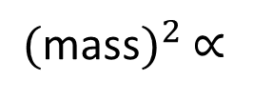
Introduction
Superstring theory
there are massless modes:
graviton, Ramond-Ramond fields, …
photon (gluon), gaugino
there are also massive modes.
$\text{(}$mass${\text{)}}^{2}$ $∝$
there are also tachyonic modes.
open string which stretches from D-brane to anti-D-brane contains a tachyonic mode
D-brane
anti-D-brane

Slide 3
superstring theory = massless fields
+ an infinite number of massive fields
+ (tachyon)
with specific non-local int
To find the true vacuum of theory, we should understand
how these modes interact with each others in off-shell regions.
Here, consider RR couplings.

Slide 4
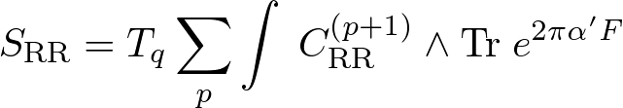
Ramond-Ramond couplings of D-branes
D-branes have RR charges.
[Polchinski (1995)]
open string modes on D-brane interact with RR fields in the bulk.
RR fields
massless gauge field
How do other modes of open string couple to RR-fields?

Slide 5

The generalization including tachyon modes on non-BPS D-branes or D-branes-antiD-branes was done in the context of BSFT.
[Kraus & Larsen (2000), Takayanagi, Terashima & Uesugi (2000)]
BSFT (Boundary String Field Theory)
BSFT is a formulation of open string field theory.
[Witten (1992)]
For superstring, BSFT action is just given by the disk partition function of NLSM for on-shell closed string bkgd with off-shell bdry int.
disk partition function
[Kutasov, Marino & Moore (2000), Marino (2001), Niarchos & Prezas (2001)]

Slide 6
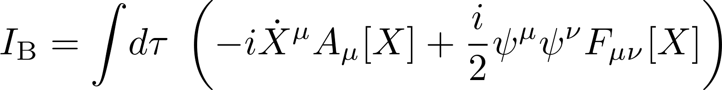
Ramond-Ramond sector
disk partition function for RR sector
with bdry int of photon
actually gives RR coupling:
there is no derivative correction.
Our work：
We derive the general RR coupling formula including massive modes of open strings on D9-branes using SUSY localization technique.

Slide 7

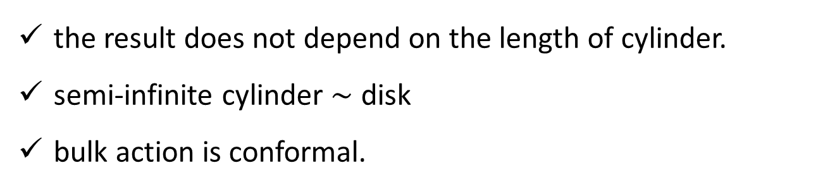
SUSY localization
closed string background: flat + constant RR field
We consider that the worldsheet is not disk but cylinder.
the result does not depend on the length of cylinder.
semi-infinite cylinder $\sim$ disk
bulk action is conformal.
periodic = RR sector

Slide 8
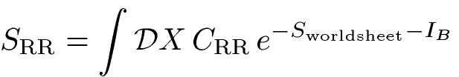
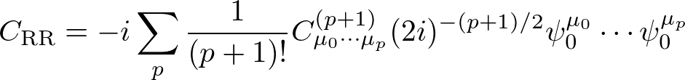
What we compute is the following path integral:
constant RR field
fermion zero modes
Boundary conditions
consider only D9-branes (and anti-D9 branes)
Neumann b.c.

Slide 9
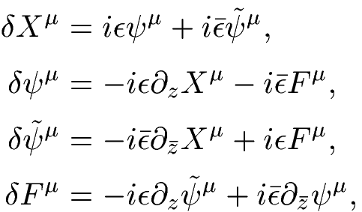


(1,1) SUSY transformation (off-shell)
Due to the bdry cond, only half of the SUSY is preserved
We apply the localization technique
using this worldsheet-SUSY.

Slide 10
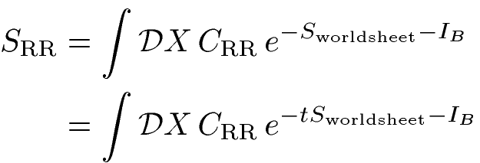
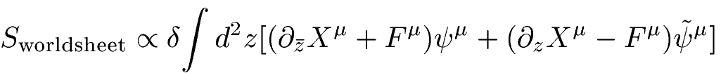


SUSY localization technique
SUSY exact term
SUSY inv.
is SUSY inv.
consider only SUSY inv boundary interactions

Slide 11
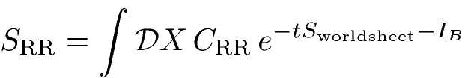
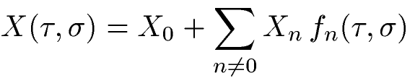


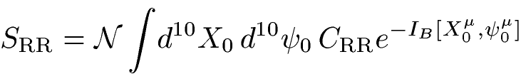

evaluation in the limit $t→∞$
nonzero modes:
can neglect the contributions to
can carry out path-int
zero modes:
not appear in
path int
int of zero modes

Slide 12


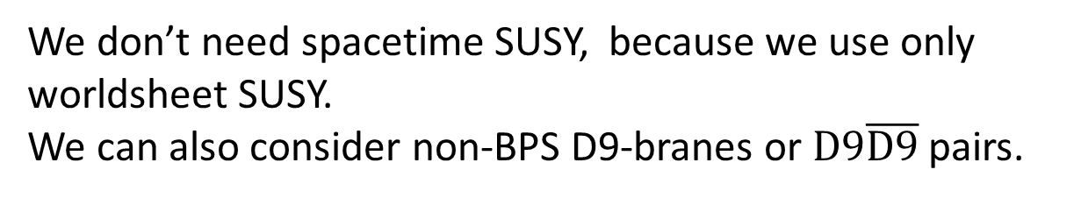
a comment
We don’t need spacetime SUSY, because we use only worldsheet SUSY.
We can also consider non-BPS D9-branes or $\text{D}9\overline{\text{D}9}$ pairs.
Next, I write down the general supersymmetric boundary interaction, and evaluate it on the localization locus.

Slide 13


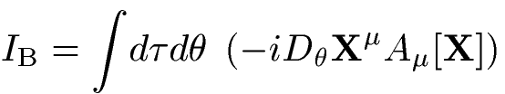
General RR couplings
Let’s write down general susy bdry int.
convenient to use superfield
e.g. the boundary interactions for photon

Slide 14
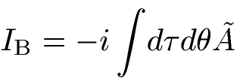
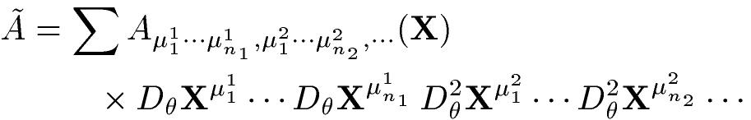
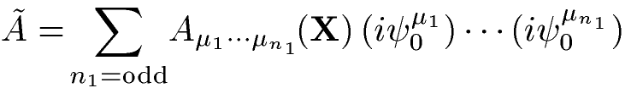
single BPS D9-brane
general susy bdry int is given by the sum of possible terms:
should be fermionic.
Localization computation says we can replace
totally antisymmetric
only antisymmetric modes can contribute to RR couplings

Slide 15
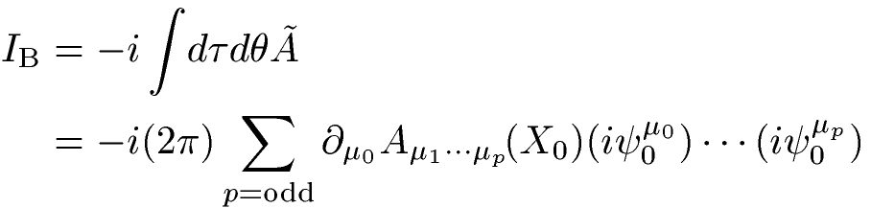
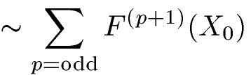
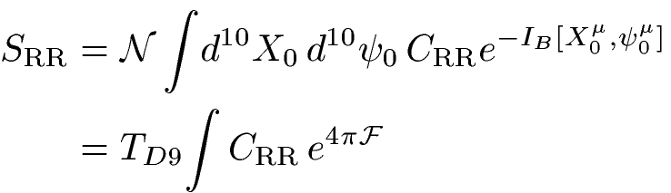
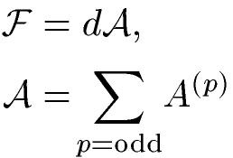

(p+1)-form
D9-brane charge formula

Slide 16
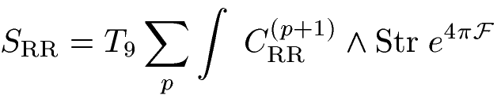

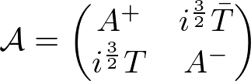
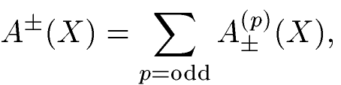
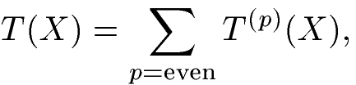
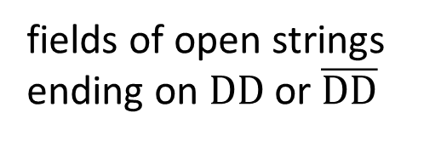


$N$ $\text{D}\text{9}$-$\overline{\text{D}\text{9}}$ pairs
field strength
Quillen’s superconnection
[cf. Kawamoto & Watabiki]
fields of open strings ending on $\text{DD}$ or $\overline{\text{DD}}$
fields of open strings ending on $\text{D}\overline{\text{D}}$

Slide 17
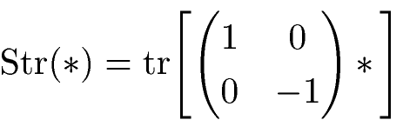
$N$ $\text{D}\text{9}$-$\overline{\text{D}\text{9}}$ pairs
massless
massive
tachyon
massive
If we consider only massless and tachyonic modes,
the result agrees with old result.
[Kraus & Larsen (2000), Takayanagi, Terashima & Uesugi (2000)]
Our result is complete generalization to include arbitrary bosonic modes of open superstring.

Slide 18




Discussion
gauge symmetry
is invariant under the transformation
are sums of higher forms.
This trsfm comes from the redundancy to add the total derivative term to the bdry int.
has extended gauge symmetry whose trsfm prmt is sum of higher forms

Slide 19
Summary
We compute BSFT action for RR sector by SUSY localization technique.
The computation can be done even for the boundary interactions including massive modes.
Although there is an infinite number of massive modes of open string, a finite number of antisymmetric modes can appear in D9-brane charge formula.
The coupling formula can be written in terms of superconnection.

Slide 21
Future work
curved background
Dp-branes
NSNS sector
comparison with other SFT (field redefintion)
stringy physics of massive modes
math of higher forms

Slide 23

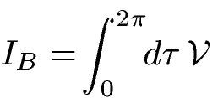

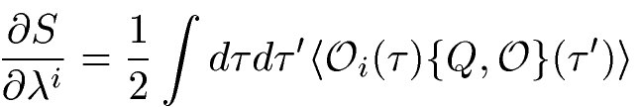
BSFT
non-linear sigma model with boundary interactions on disk
on-shell closed string background
general boundary interaction
(not conformal)
ghost number =1
$λ^{i}$ : coupling constants corresponding to open string excitations
BSFT action

Slide 24

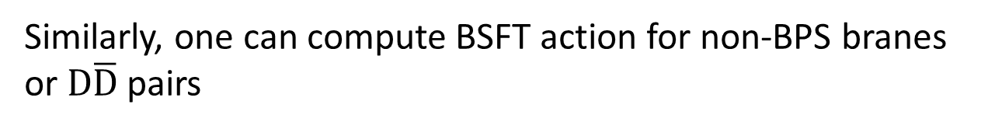
Example
boundary int for photon
By computing the disk partition function with this bdry int for NS-NS sector, the BSFT action is actually given by DBI action with higher derivative corrections.
DBI action + (higher deriv corrections)
Similarly, one can compute BSFT action for non-BPS branes or $\text{D}\overline{\text{D}}$ pairs
A lot of works about tachyon were done in this context.

Slide 25
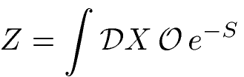



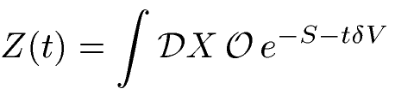
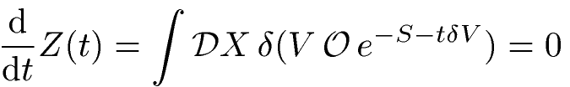
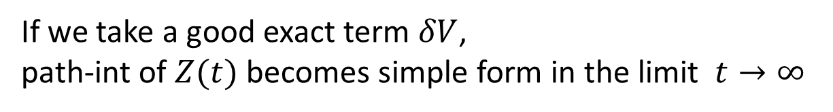
Localization technique
symmetry s.t.
exact term s.t.
If we take a good exact term $δV$,
path-int of $Z(t)$ becomes simple form in the limit $t→∞$

Slide 26

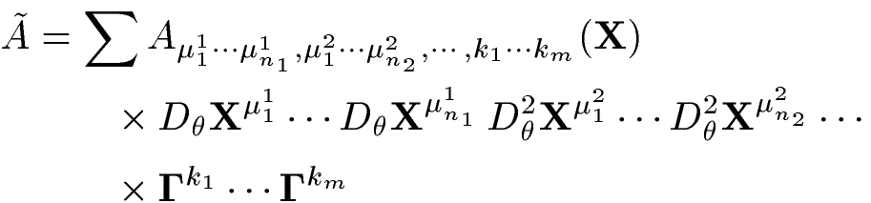
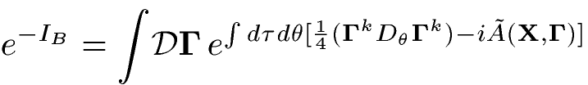



$N$ $\text{D}\text{9}$-$\overline{\text{D}\text{9}}$ pairs
The boundary int can be written into the following form by introducing boundary fermions in the case $N=2^{n−1}$:
[Kraus & Larsen (2000), Takayanagi, Terashima & Uesugi (2000)]
boundary fermion
（sum is taken so that $\tilde{A}$ is fermionic）

Slide 27
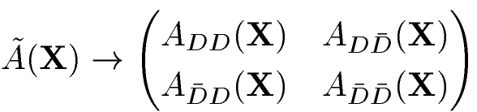

boundary fermion = Chan-Paton factor
,
By the SUSY localization argument,
only antisymmetric modes remain as the case of the single BPS D9brane
diagonal block = odd forms
non-diagonal block = even forms

Slide 28

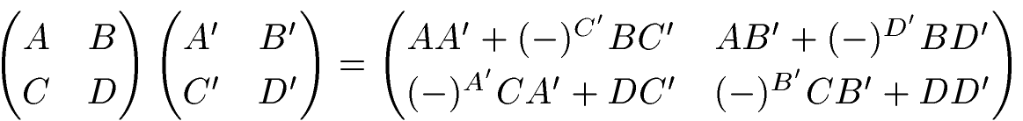
formula
[Kraus & Larsen (2000)]
where

Slide 29

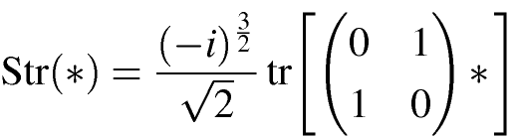


non-BPS D9-brane
charge quantization
Chern character of superconnection:
D-brane charges are quantized

Slide 30




D-brane creation via massive mode condensation ?
tachyon condensation
D9-brane can be annihilated by tachyon condensation.
massive mode condensation
Can multiple D9-branes be created from single D9-brane by massive mode condensation ?
cf. bosonic BSFT
[Hashimoto & Murata (2012)]

Slide 31

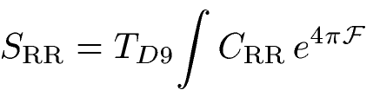
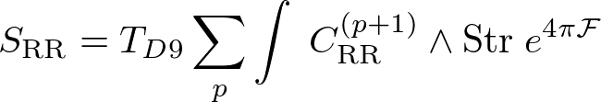
massive modes condensation
D9-charge can be read off from the coefficients of
Since total degree of forms should be 10 and is 10-form,
only 0-form (tachyon) can contribute to the coeff.
D9-brane charge can’t be created
via massive mode condensation.

