Slide 1

Observational Constraints on the Primordial Curvature Power Spectrum
Razieh Emami Meibody
(IAS)
Hong Kong University of Science and Technology
Based on :
arXiv:1705.09924, R. Emami, George F. Smoot

Slide 2
Outline:
A quick introduction to Primordial Black Hole as the Dark matter,
Observational Constraints on the primordial power-spectrum from the PBH,
An introduction to Ultra Compact Mini-Halos as the Dark matter
Observational Constraints on the primordial power-spectrum from the UCMH,
Conclusion

Slide 3
“An Introduction to PBH”

Slide 4
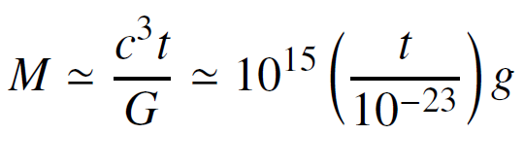
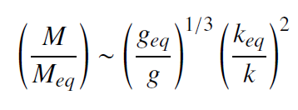
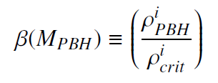
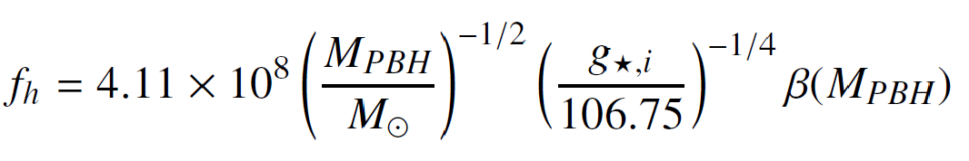
If the density perturbations at the stage of the horizon re-entry exceeds a threshold value, of
order one, the gravity on that region will overcome the repulsive pressure and that area
would be subjected to collapse and will form PBH.
Assuming that at every epoch, the mass of the PBH is a fixed fraction, $f_{M}$, of the horizon mass, we have,
Initial abundance of PBHs is given by:
(Current) fraction of the mass of Milky Way halo in PBHs:

Slide 5
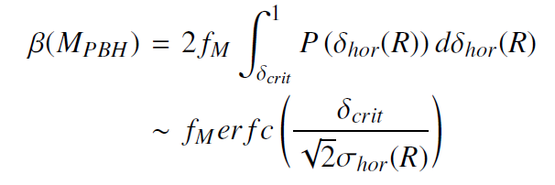
Observational Constraints on the primordial power-spectrum form the PBH
For this purpose, we should first figure out the observational constraints on the initial
abundance of PBH. Then using the following formula, we could calculate the
constraints on the primordial power-spectrum:

Slide 6
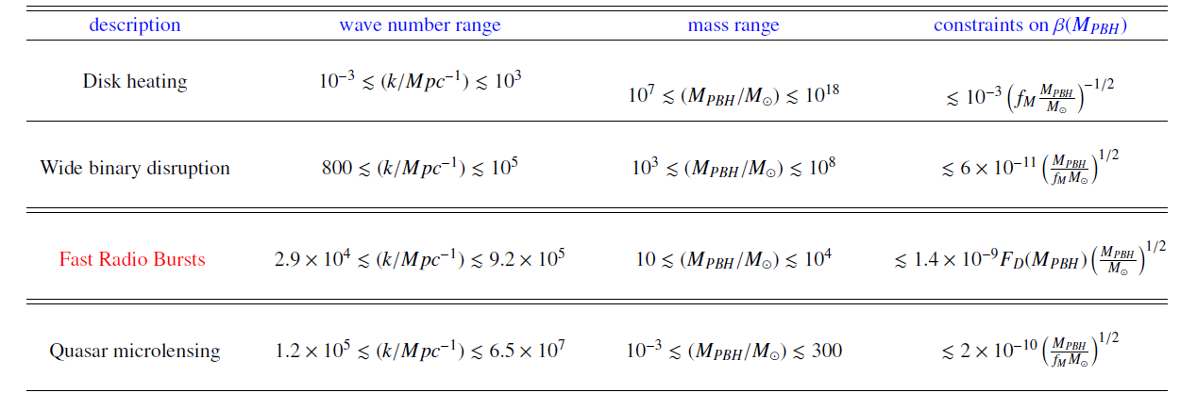
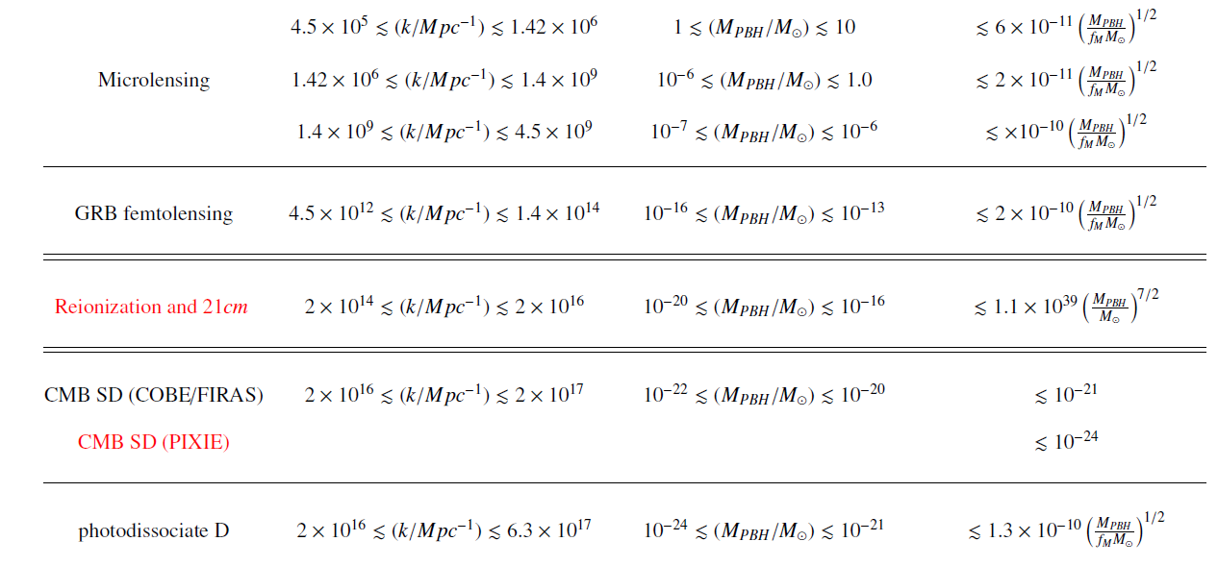
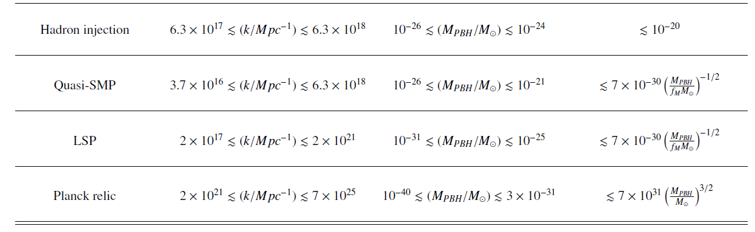

constraints on the initial PBHs abundance, $β_{PBH}$ :

Slide 7
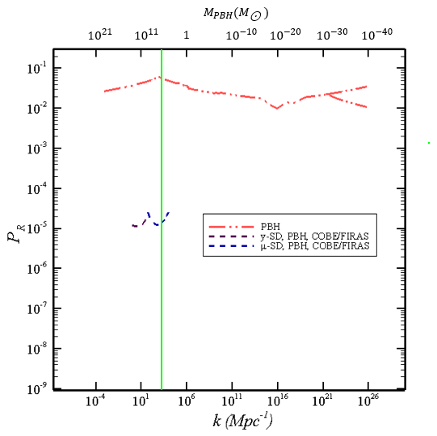
The “Current” constraints on the primordial power-spectrum:

Slide 8
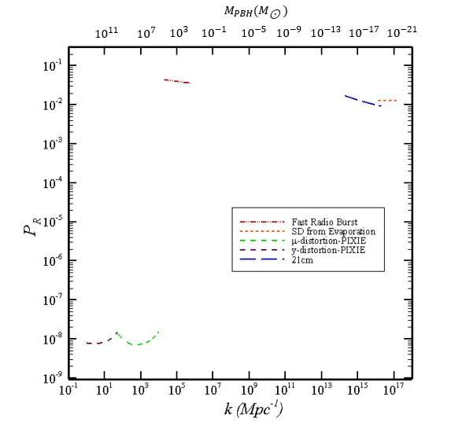
The “Futuristic” constraints on the primordial power-spectrum:

Slide 9
“An Introduction to UCMHs”

Slide 10
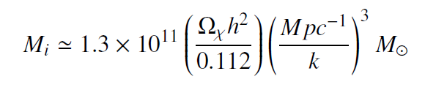
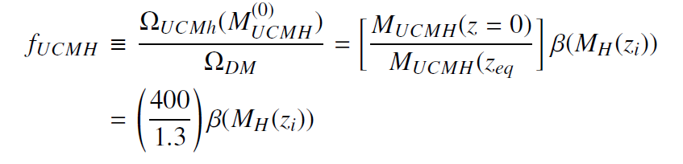

UCMHs are dense dark matter structures, which can be formed from the larger density
perturbations right after the matter-radiation equality.
Density perturbations of the order ${10}^{−3},$though its exact number is scale
dependent as we will point it out in what follows, can collapse prior or right after the matter-radiation
equality and therefore seed the formation of UCMHs.
The Mass fraction of UCMHs is given by:

Slide 11
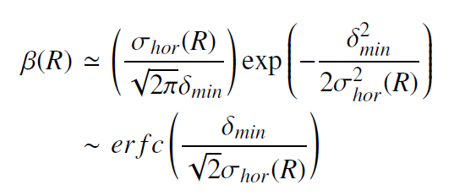
Observational Constraints on the primordial power-spectrum form the UCMHs
Like what we had for the PBHs, we should first figure out the observational constraints
on the initial abundance of UCMHs. Then, using the following formula, we could calculate the
constraints on the primordial power-spectrum:
Unlike to the case of the PBHs, though, the minimal threshold for the over-density shall be scale-dependent.

Slide 12
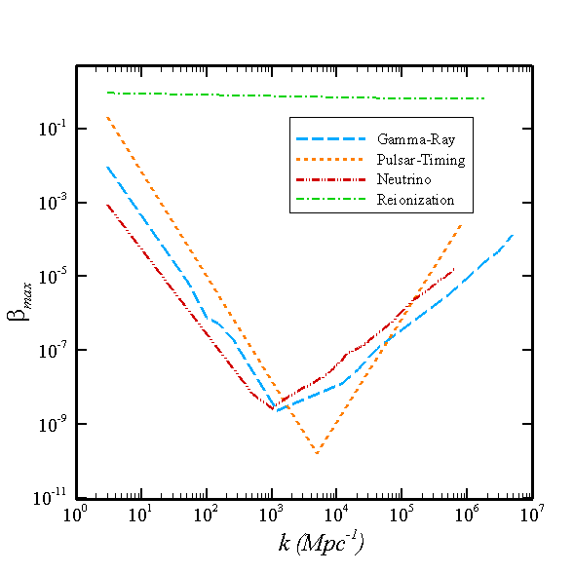

constraints on the initial UCMHs abundance, $β_{UCMH}$ :

Slide 13
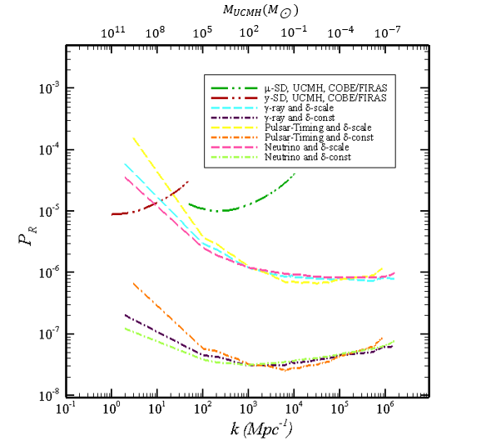
The observational constraints on the primordial power-spectrum:

Slide 14
“Combined Constraints on the Primordial Power Spectrum from PBH as well as the UCMHs”

Slide 15
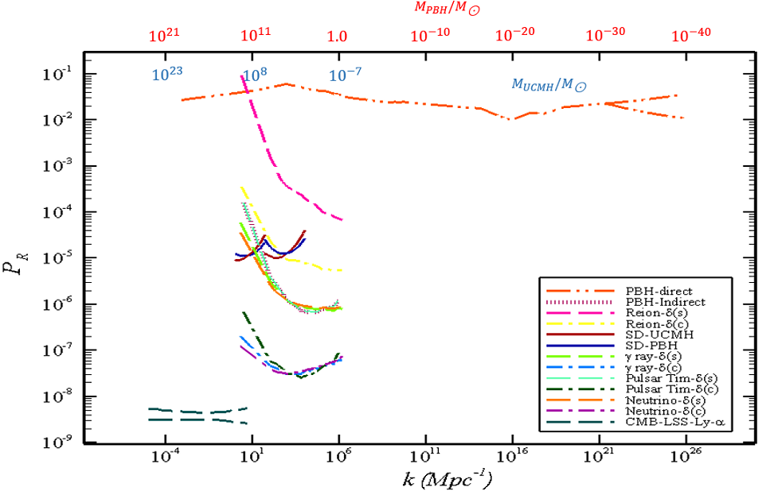

Slide 16
Conclusion:
We introduced PBH and UCMHs as two examples of the compact objects,
We Presented the observational constraints on the primordial power-spectrum from both of PBHs and UCMHs,
Finally, combining the constraints we discussed the possible issues on the PBH abundance from the constraints coming from the UCMHs.
Thanks so much for your attention!

