Slide 1
POLARBEAR-2 Cryogenic Half-Wave Plate
Charlie Hill (Grad Student, UC Berkeley)
w/ Akito Kusaka, Adrian Lee, and Paul Barton (LBNL)
B-modes in Space
2017-12-05

Slide 2
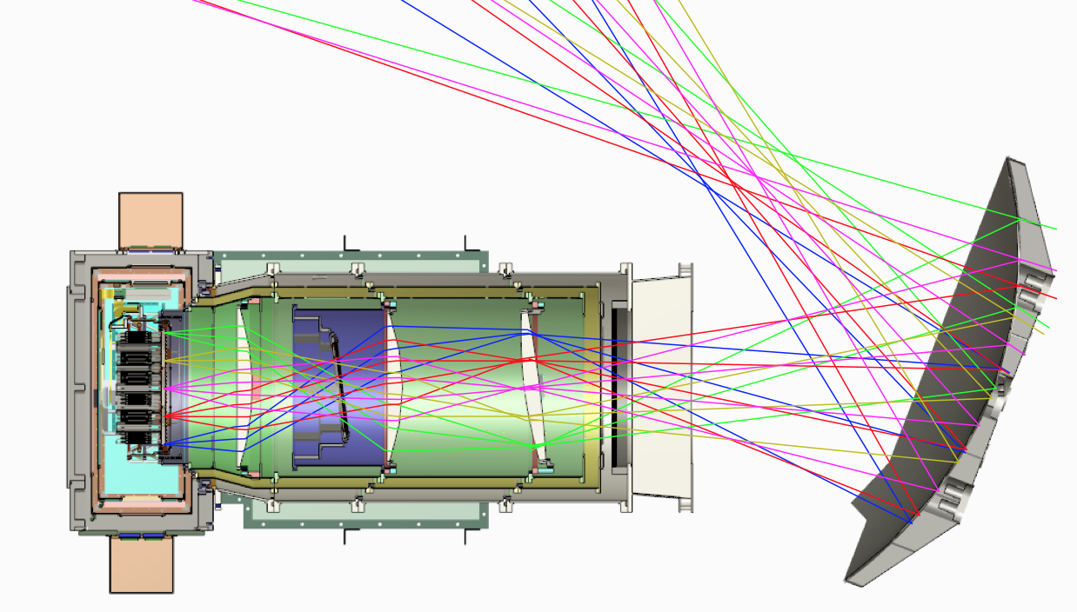
POLARBEAR-2 optical system
CMB Photon
PB2 camera
190 cm
Secondary
Off-axis Gregorian telescope
95/150 GHz dichroic detectors
Three alumina reimaging lenses
365-mm-diameter focal plane
4 deg field of view
5 m

Slide 3
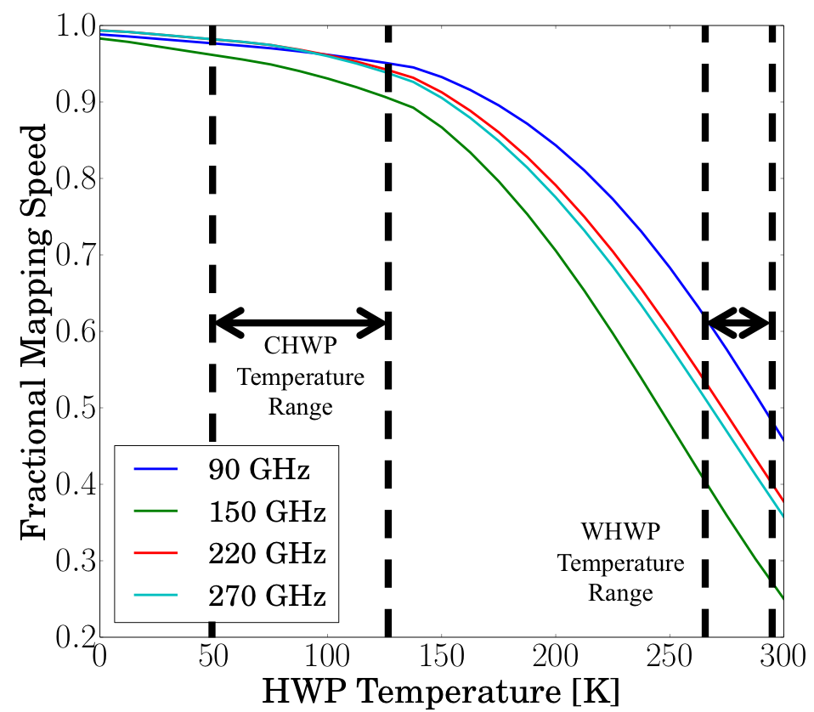
Motivation for a cryogenic half-wave plate
Warm HWP for PB2a
Impact of HWP temp on MS
500 mm
An ambient-temperature half-wave plate (HWP) has been constructed for PB2a
A cryogenic HWP (CHWP) improves PB2 mapping speed by ~2x compared to a warm HWP

Slide 4
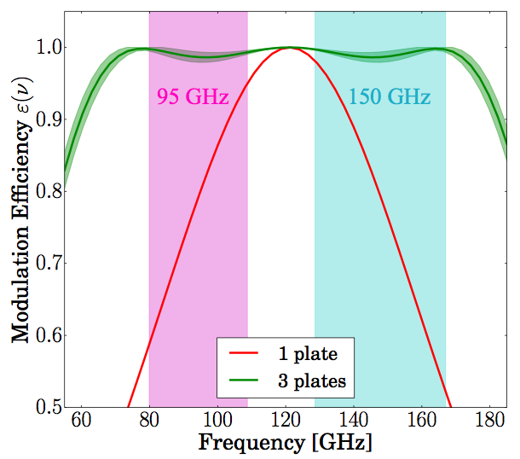
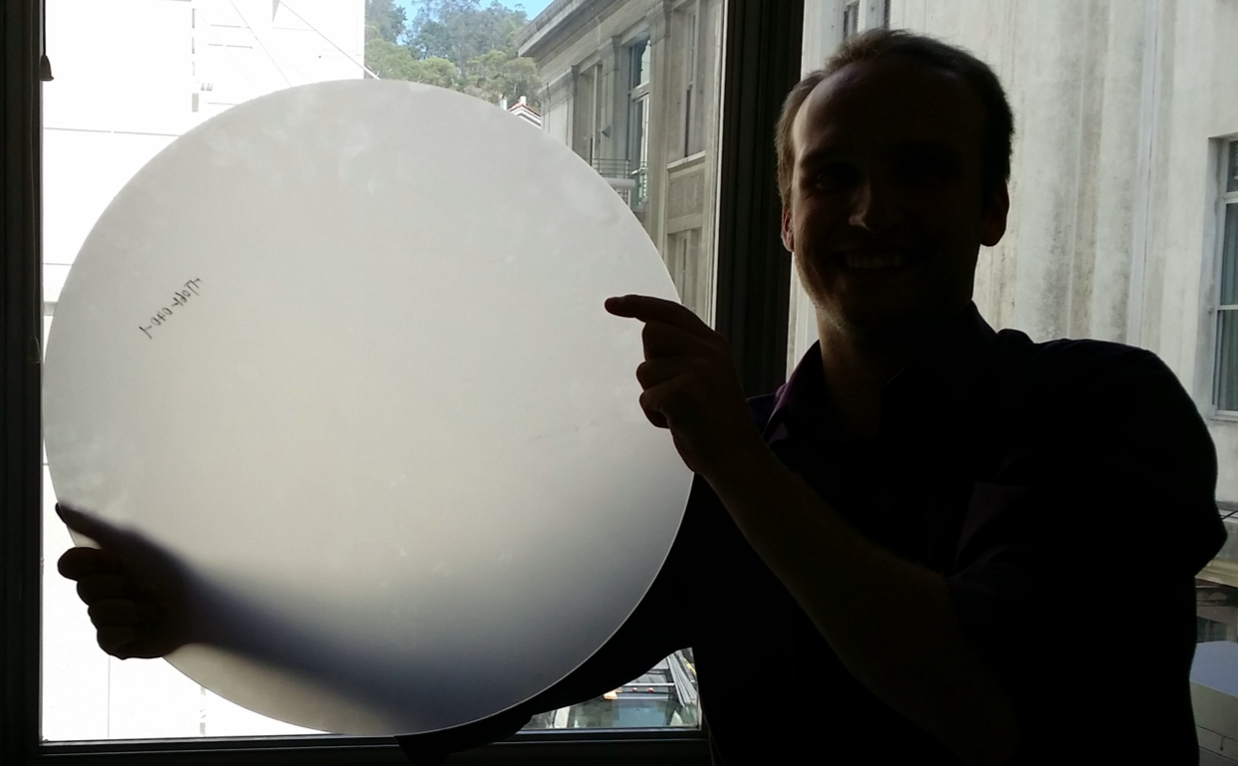
PB2 CHWP optical stack
D = 510 mm sapphire
Achromatic 3-stack HWP
2-layer thermal spray AR
95 GHz
150 GHz
Parameter | Value
A-plane | ± 1 deg
Parallelism | < 0.050 mm
Bow | < 0.010 mm
Band | Mod Eff
95 GHz | 98.9 %
150 GHz | 99.1 %
Band | Refl | Abs
95 GHz | 0.5 % | < 1.4 %
150 GHz | 0.6 % | < 0.8 %
Stack Element | Thickness [mm] | Index of Refraction | Loss Tangent [10⁻⁴]
Top AR Layer: SiO₂ TS | 0.435 ± 0.025 | 1.39 | < 10
Bottom AR Layer: Al₂O₃ TS | 0.265 ± 0.025 | 2.30 | < 10
Sapphire Ordinary Axis | 3.90 ± 0.2 | 3.37 | < 0.5
Sapphire Extraordinary Axis |  | 3.05

Slide 5
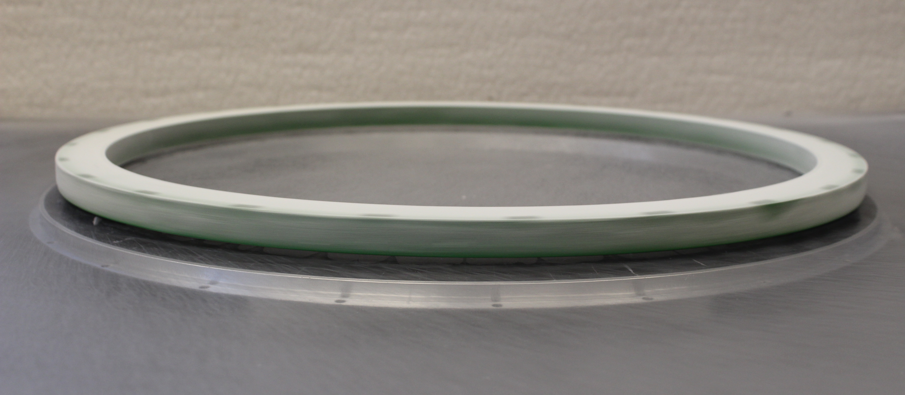
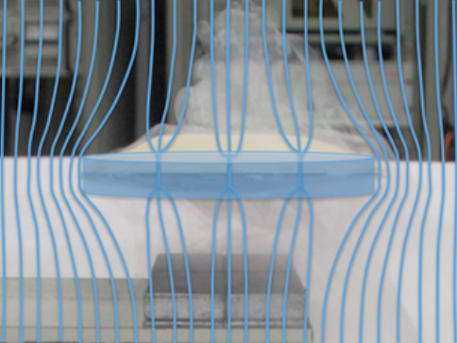
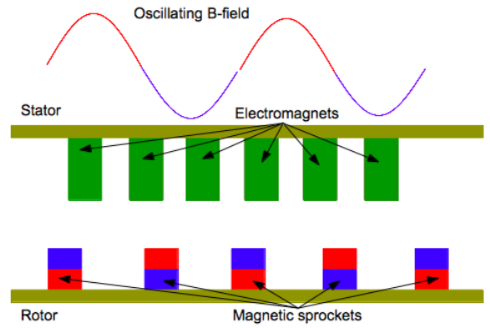
PB2 CHWP rotation mechanism
Magnetic levitation bearing
Magnetic motor
Solenoids
470 mm
NdFeB Rotor
600 mm
YBCO Stator
Flux pinning concept
Motor operation concept
~100 N/mm spring constant at 5 mm separation and 77 K
< 10 mW dissipation at 2 Hz and 77 K
Three-phase operation
< 100 mW motor power dissipation during 2 Hz continuous rotation

Slide 6
PB2 CHWP encoding and driving
Motor (and angle) encoding done using photodiode-LED pairs and a slotted plate
IR LED emitters (SPIDER)
Silicon photodiodes (SPIDER)
Quadrature readout
1 reference pulse per cycle (for absolute angle)
0.3 deg angular resolution (540 slits in slotted plate)
< 1 us timestamp jitter (leading to 10 uRad angle jitter using interpolation)
PD amplified warm and signal fed to dual Half-H drivers to excite coils

Slide 7
Table-top motor test

Slide 8
Motor performance
Table-top testing results
1/f knee at < 1 mHz → very stable rotation
Measured frictional dissipation < 50 mW
No pathologies in power spectrum indicates functional DAQ

Slide 9
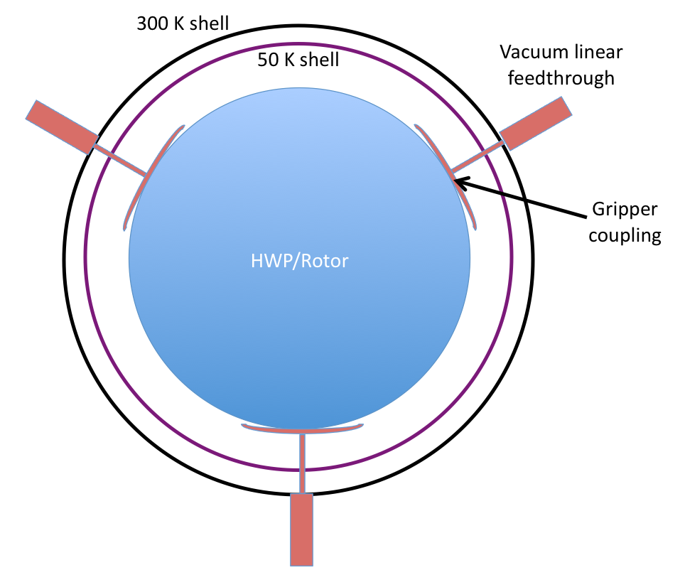
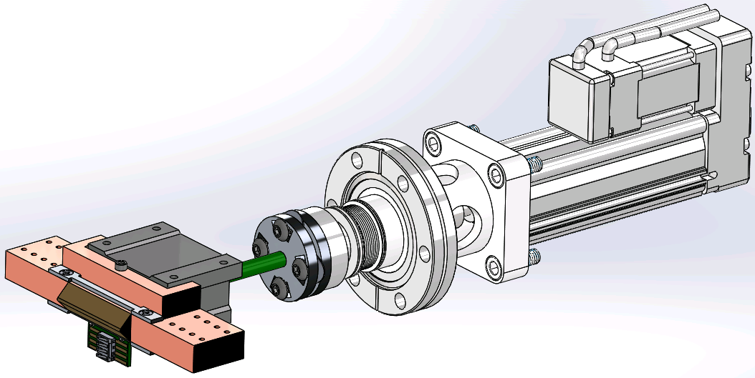
PB2 CHWP gripper
Conceptual cartoon
Gripper module
Bearing
Feedthrough actuator
Therm iso
Red = 300 K
Blue = 50 K
CF flange
Slipring contact
Coupling finger
Gravity
Vacuum feedthrough actuator
G10 isolation
50 K Frelon bearing
Copper contact finger with slip-ring contact for stationary thermometry
“Grip” to align the HWP
“Ungrip” to spin the HWP
Three gripper modules to constrain HWP position

Slide 10
PB2 CHWP implementation

Slide 11
PB2 CHWP implementation
CHWP system currently under evaluation at LBNL

Slide 12
PB2 vs LiteBIRD CHWP
PB2 | LiteBIRD
Gripper: Linear Actuator
300 K (ATM ambient) | 4 K (L2 ambient)
1e3 Torr (ATM ambient) | 1e-10 Torr (L2 ambient)
~3 mm throw (bearing sag at 100 K) | ~2 mm throw (bearing sag at 4 K)
50 lb holding force (HWP weight) | > 250 lbs (15g launch RMS, 4~5σ peak force)
Gripper: Compactness
~12” gripper footprint in radius | ~< 6” gripper footprint in radius
Gripper: Robustness
~10 gripper motions during operation | Many gripper motions possibly needed for periodic cooling
HWP Cooling
Strapped alumina filter on both sides of the HWP for good radiative cooling | Exposed to environment beyond entry aperture, no controlled radiative coupling
Bandwidth
2:1 (2 bands, 75 – 165 GHz) | 8:1 (12 bands, 35 – 270 GHz)

Slide 13
Backup Slides

Slide 14
Integrated rotor/stator assembly

Slide 15
PB2a WHWP

Slide 16
Slip-ring thermometer
Prototype system
Full-scale system
Slip-ring contact
Slip-ring traces
Slip-ring contact
Slip-ring traces
Prototype
Measured the temperature of stationary rotor
Acted as a switch for the “gripped” mode
Designed to lightly touch while rotating
Full-scale
Only designed to measure stationary
Will rely on remote thermometry for floating measurement

