Slide 1
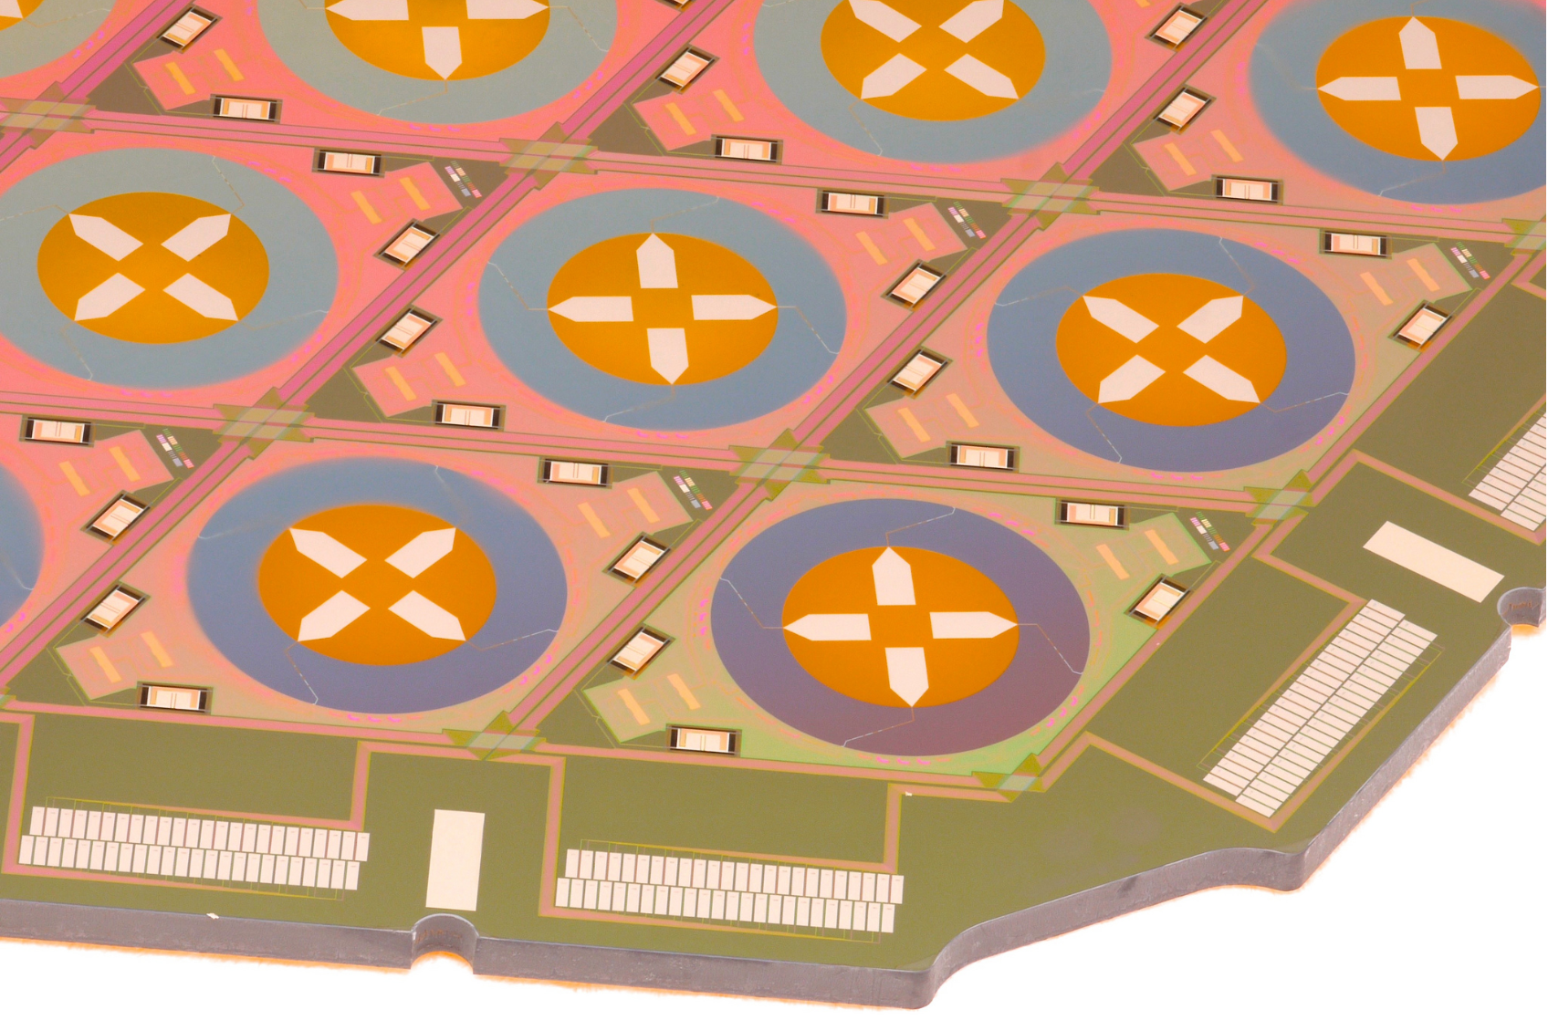
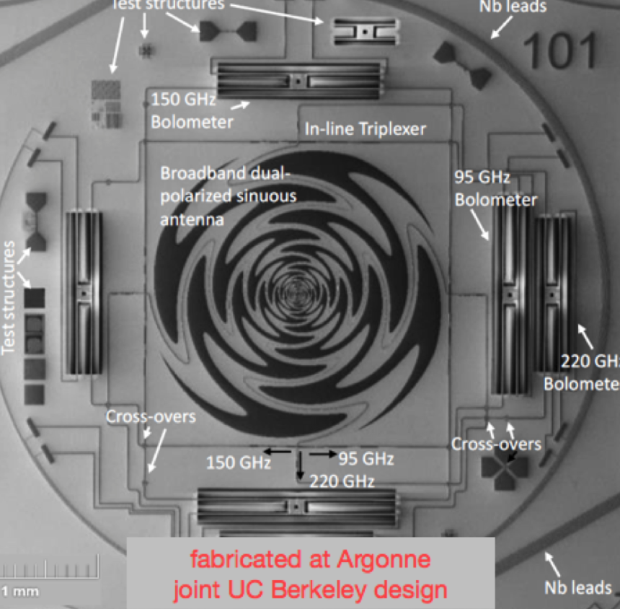
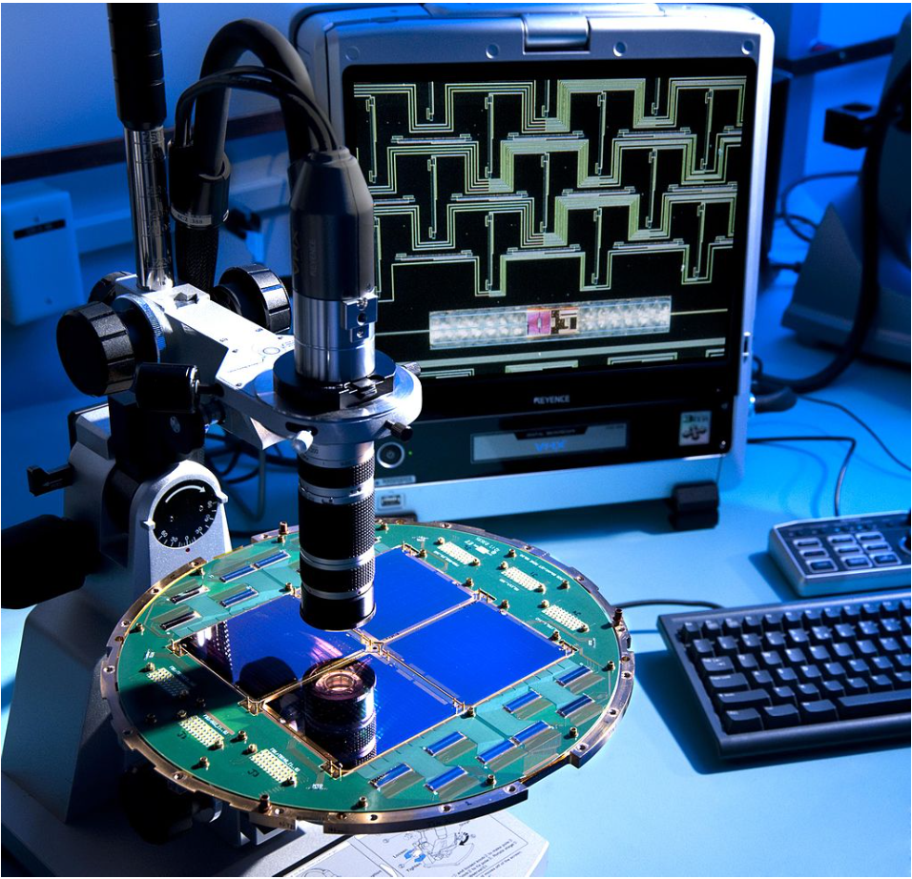
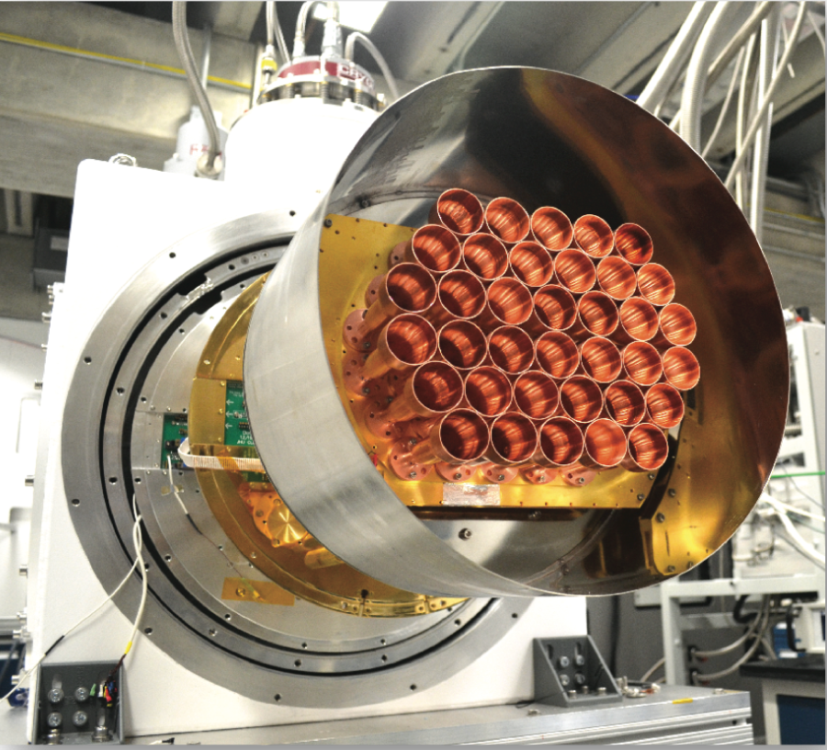
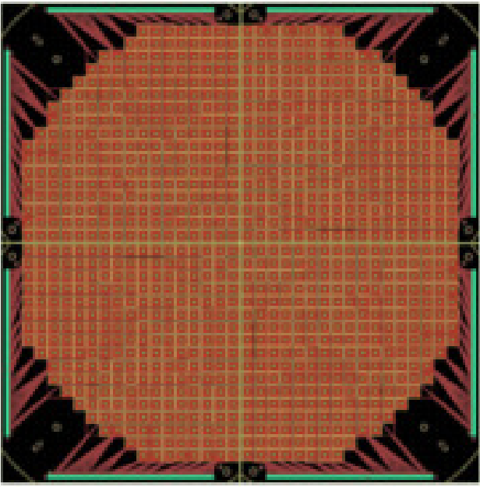
Single-Moded TES Detector Technologies for CMB Polarimetry
Jason Austermann – NIST-Boulder
(on behalf of the community)
B-Modes From Space II
4--6 Dec 2017

Slide 2
Single-Moded TES Detector Technologies for CMB Polarimetry
“single-moded” – EM propagation mode, NOT related to B-”modes”

Slide 3
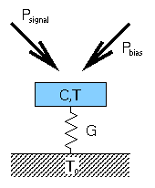
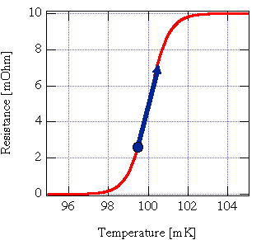
Single-Moded TES Detector Technologies for CMB Polarimetry
“single-moded” – EM propagation mode, NOT related to B-”modes”
TES – Transition Edge Sensor (bolometer)

Slide 4
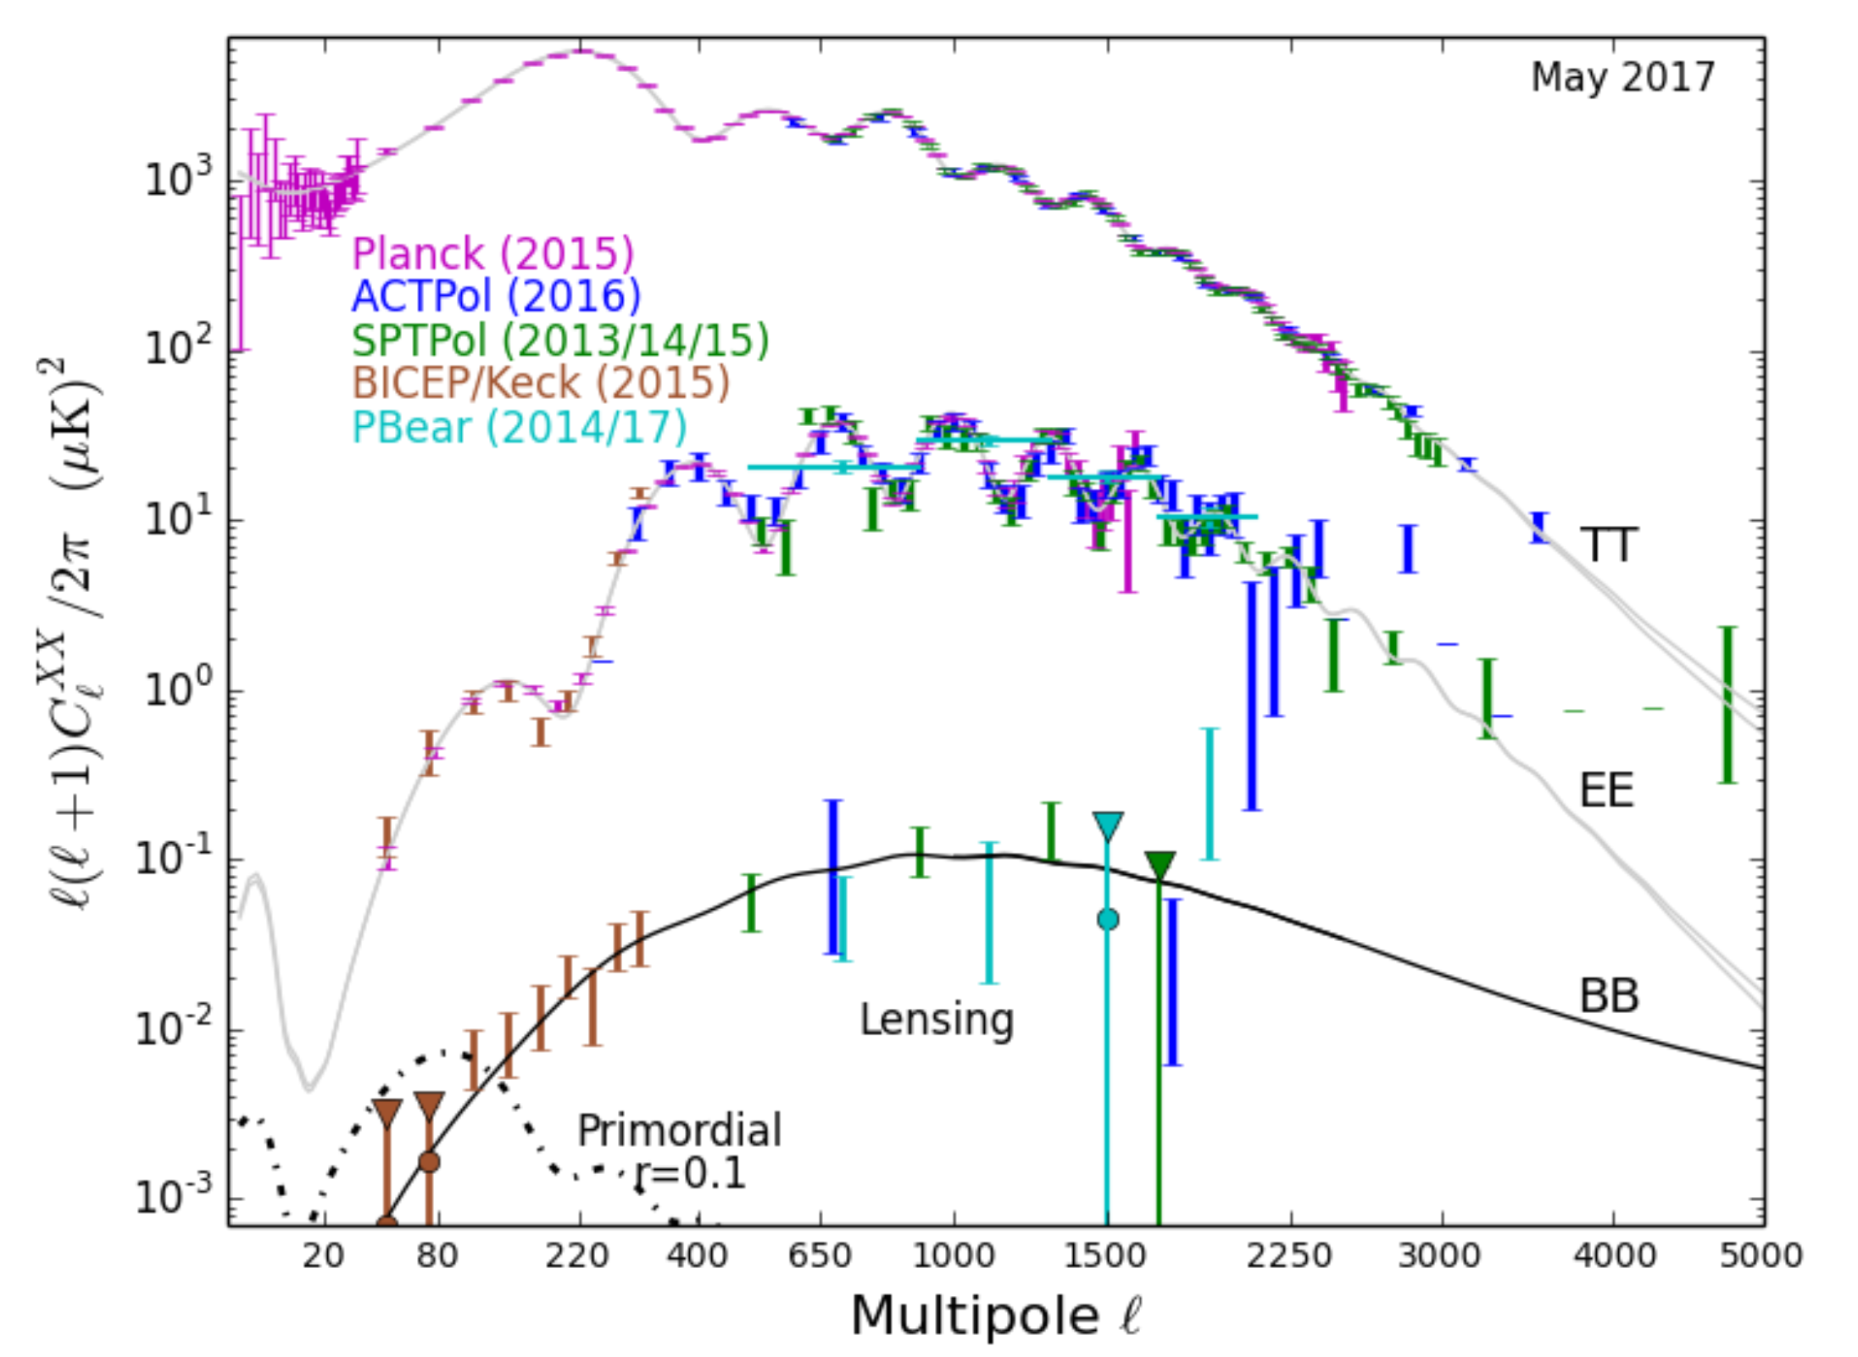
CMB Measurements are Difficult
Figure Credit: Lyman Page

Slide 5
CMB Measurements are Difficult
Fundamental Challenges
Low S/N Target
Figure Credit: Lyman Page

Slide 6
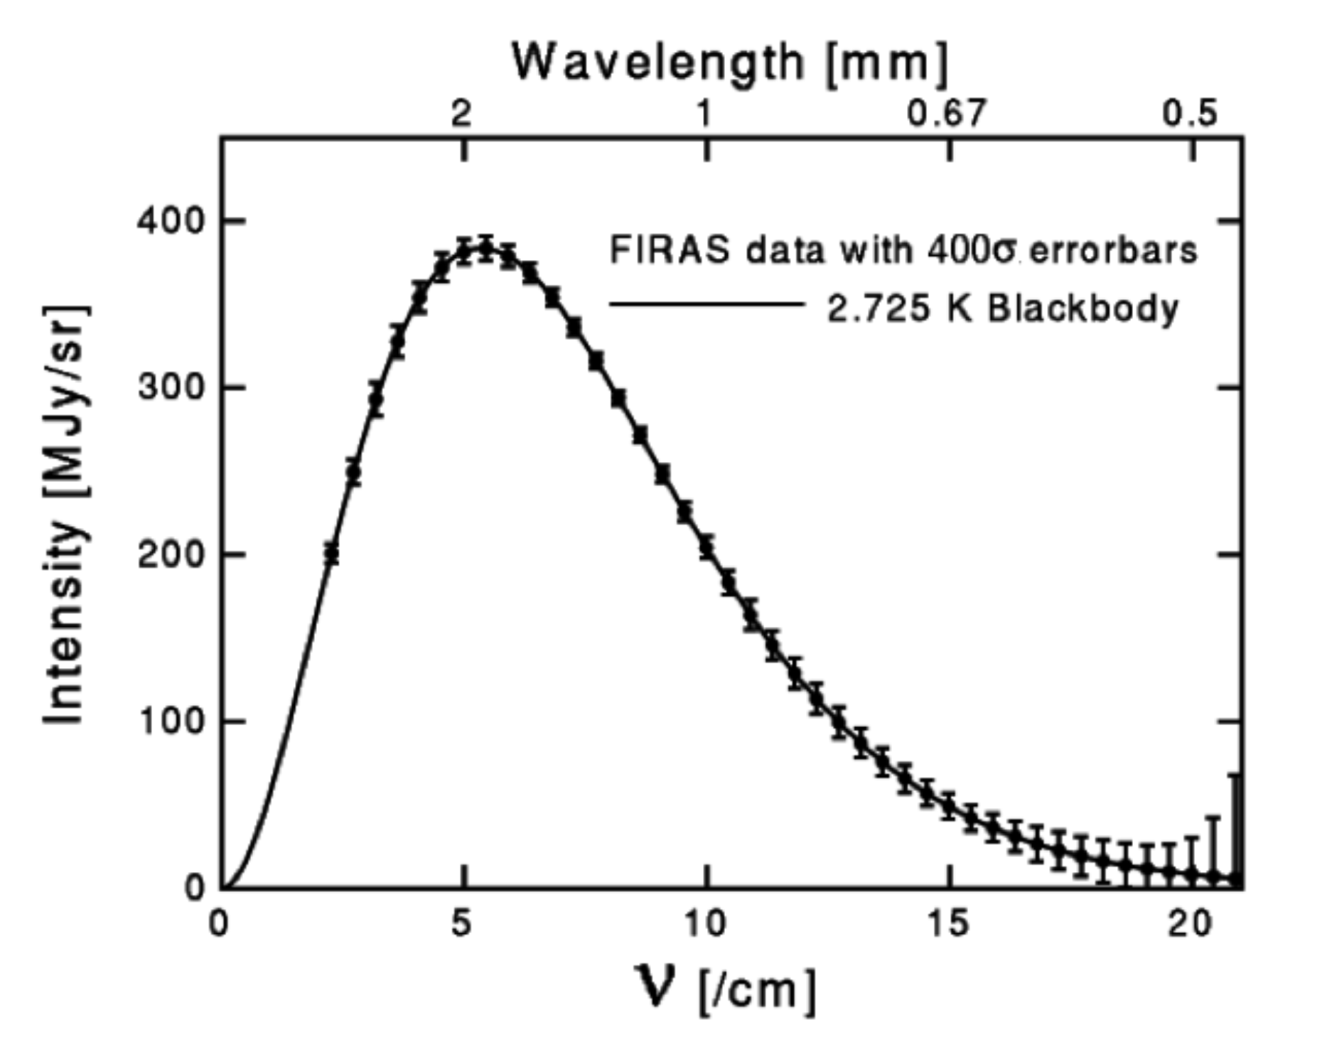
CMB Measurements are Difficult
Fundamental Challenges
Low S/N Target
Millimeter Wave
COBE CMB Spectrum

Slide 7
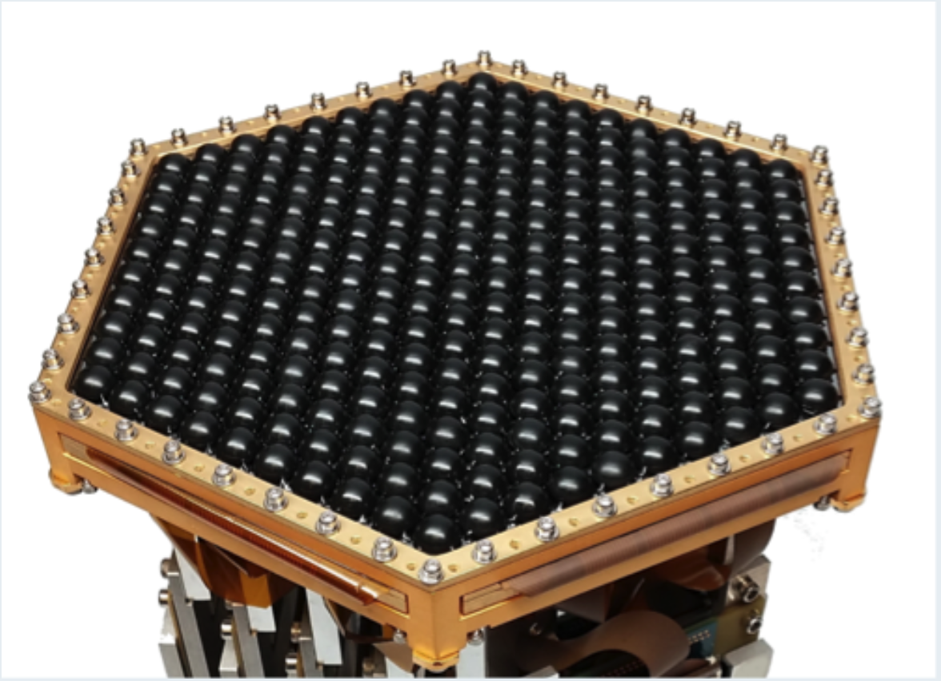
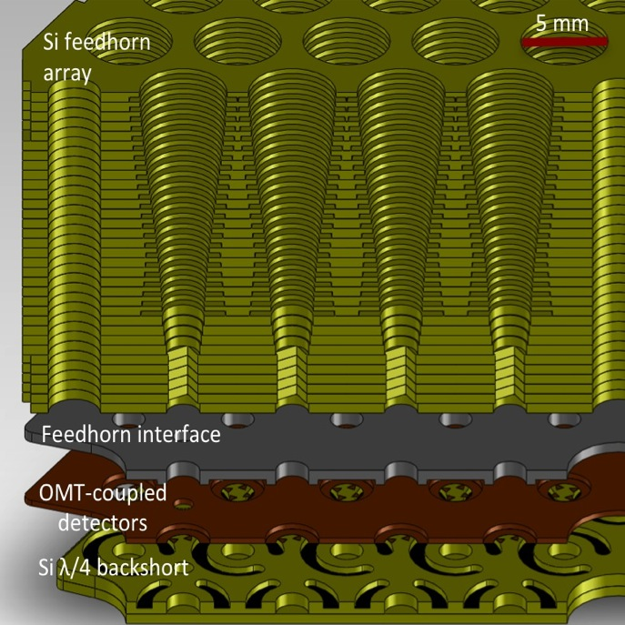
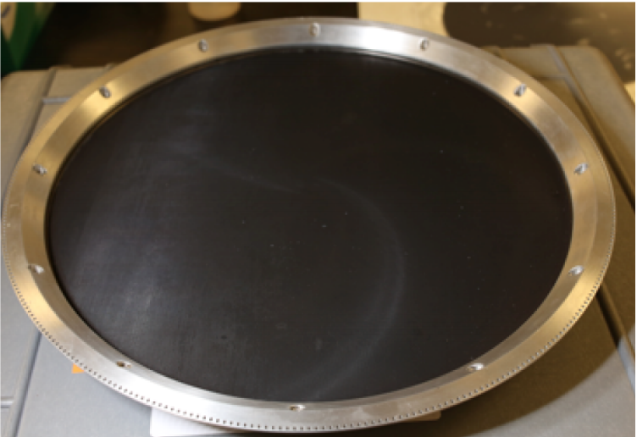
CMB Measurements are Difficult
Low-loss Optical Coupling
Fundamental Challenges
Low S/N Target
Millimeter Wave – new tech
Low-loss Filtering
150 GHz
230 GHz
Electronics & Readout

Slide 8
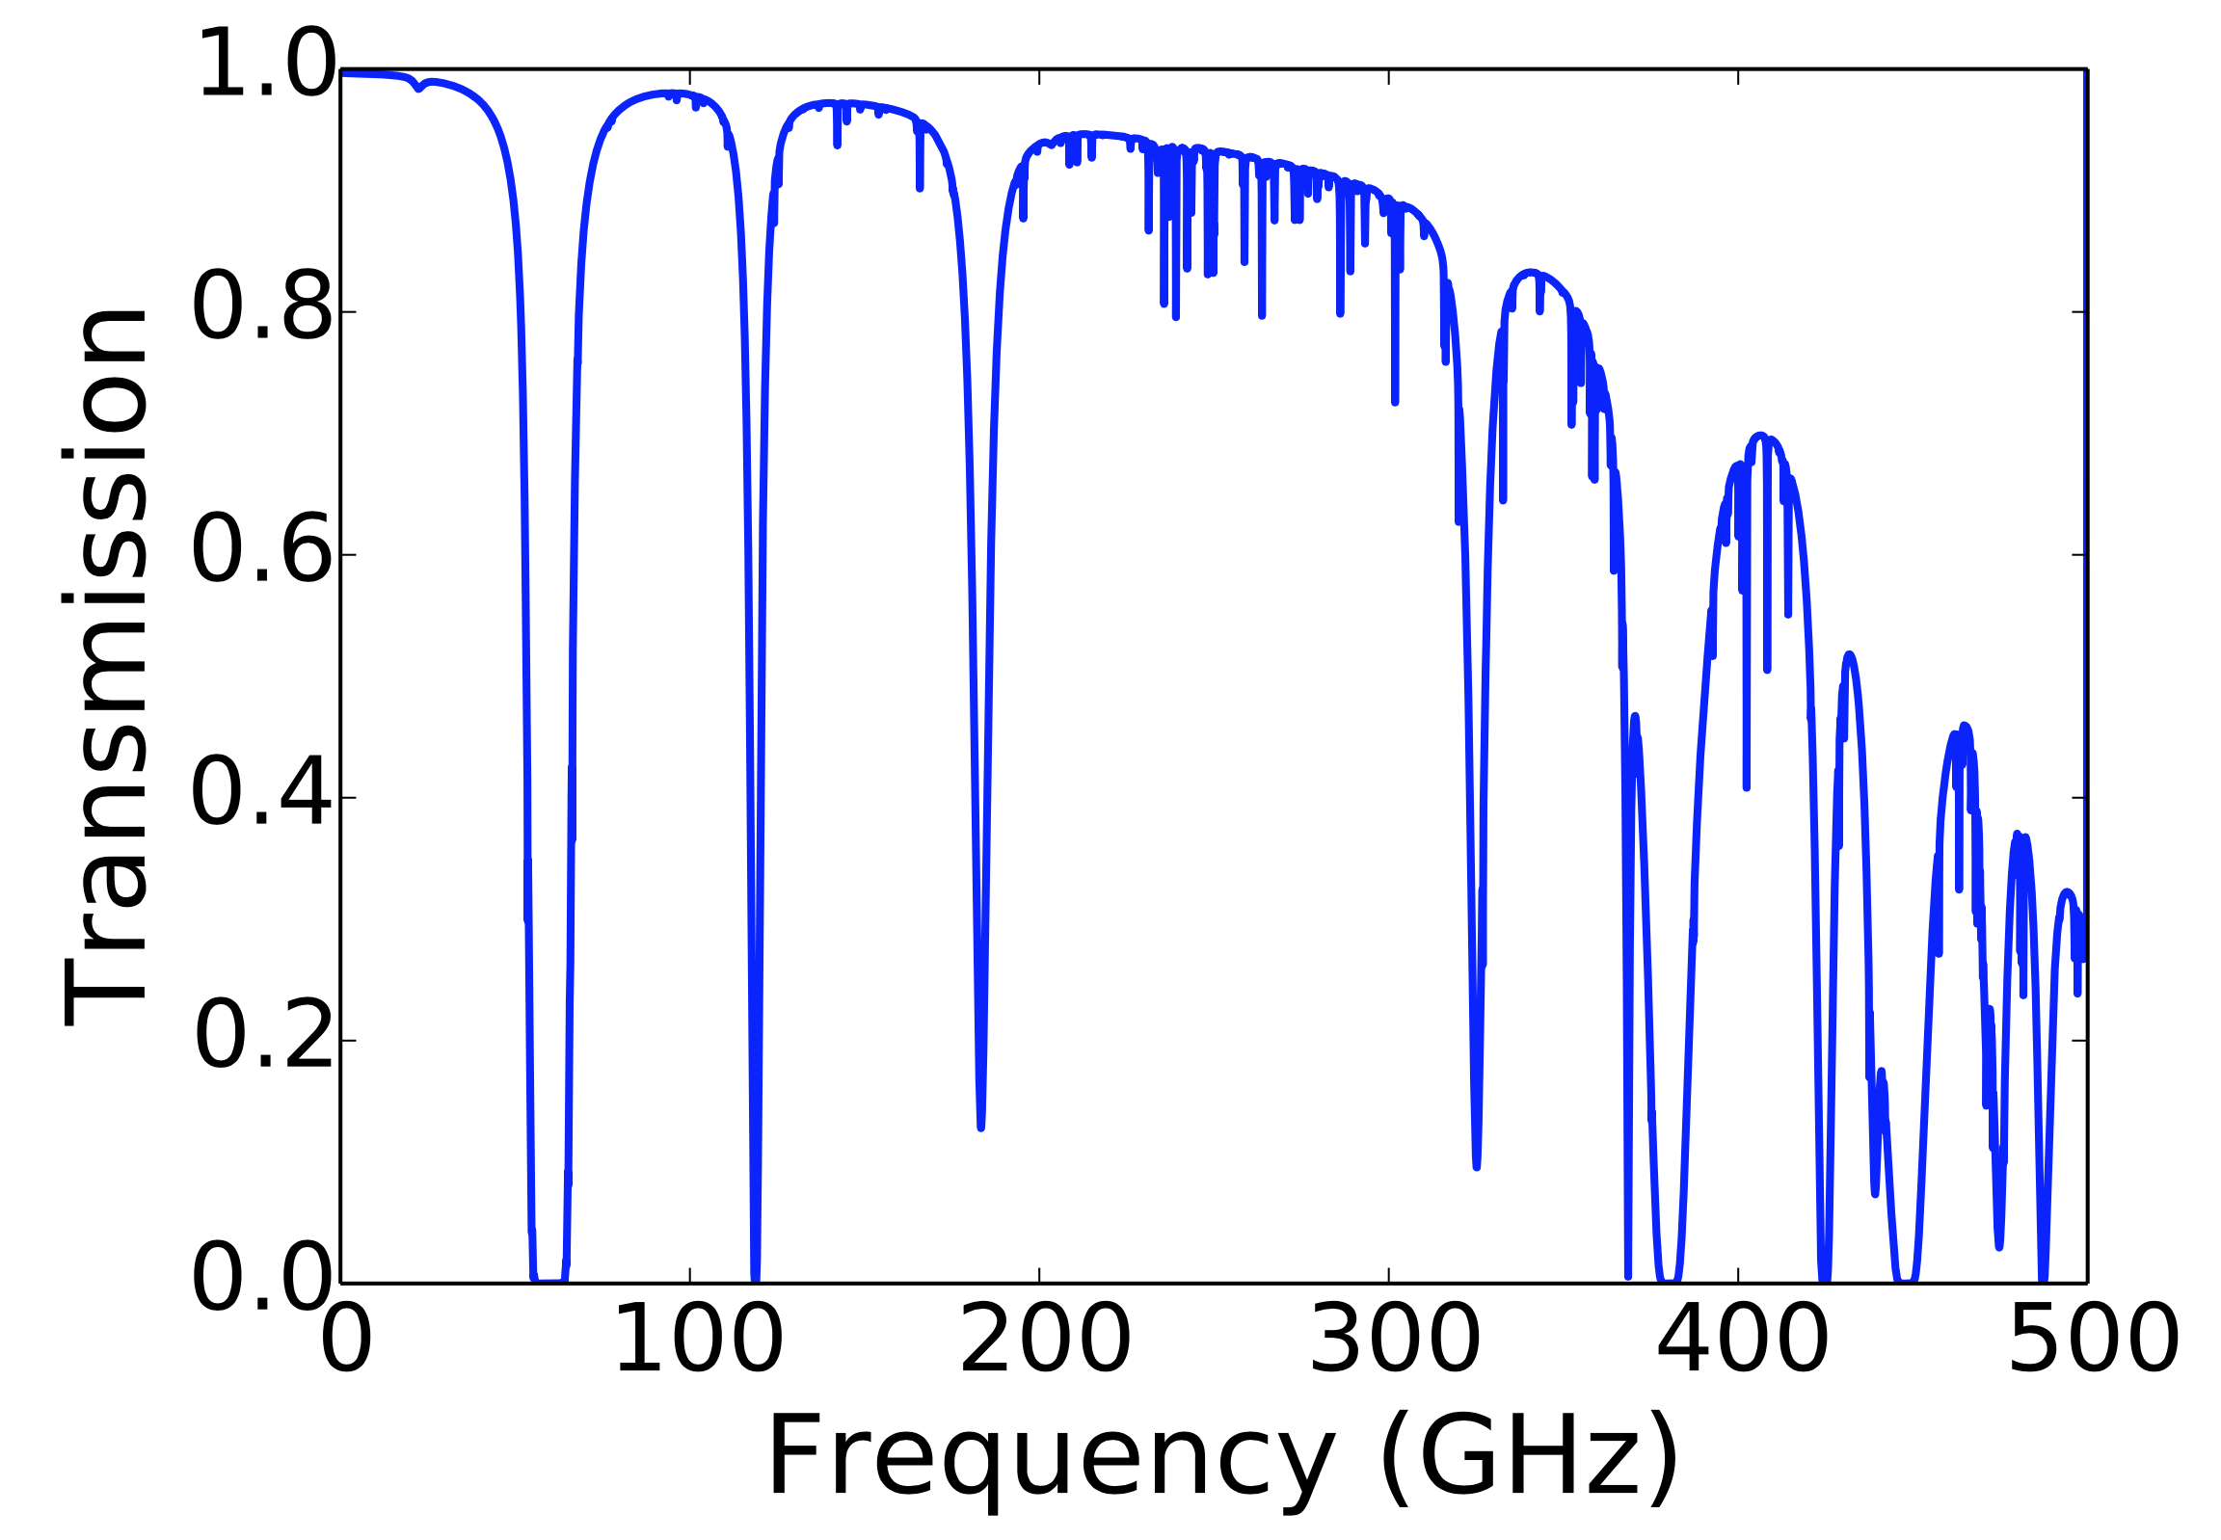
CMB Measurements are Difficult
Fundamental Challenges
Low S/N Target
Millimeter Wave
Other Sources of Emission
Good observing weather at typical Ground-Based CMB site

Slide 9
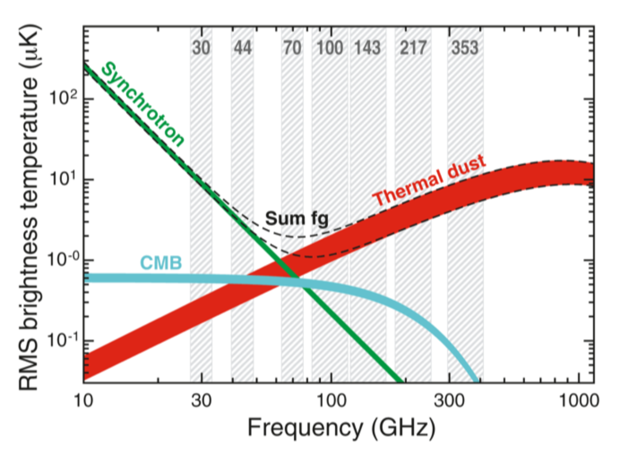
CMB Measurements are Difficult
Fundamental Challenges
Low S/N Target
Millimeter Wave
Other Sources of Emission
Planck X (2015)

Slide 10
CMB Measurements are Difficult
Fundamental Challenges
Low S/N Target
Millimeter Wave
Other Sources of Emission
Dynamic Range - Systematics
Figure Credit: Lyman Page

Slide 11
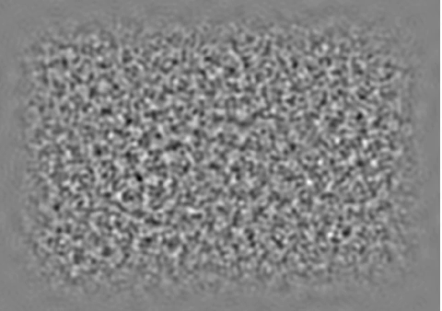
CMB Measurements are Difficult
(Animation in slide show)
Fundamental Challenges
Low S/N Target
Millimeter Wave
Other Sources of Emission
Dynamic Range - Systematics
ACTPol E-Mode w/ vs w/o 1-degree polarization rotation
Map credit: Blake Sherwin

Slide 12
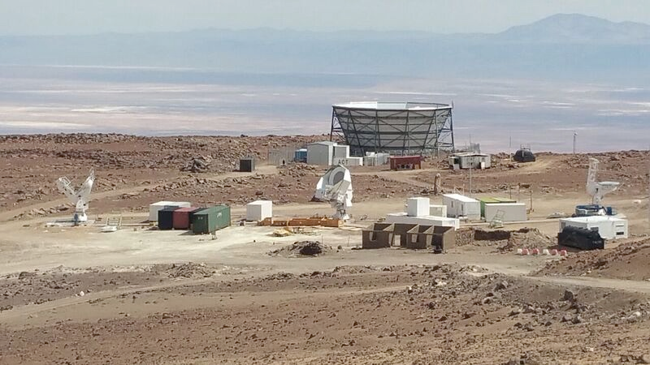
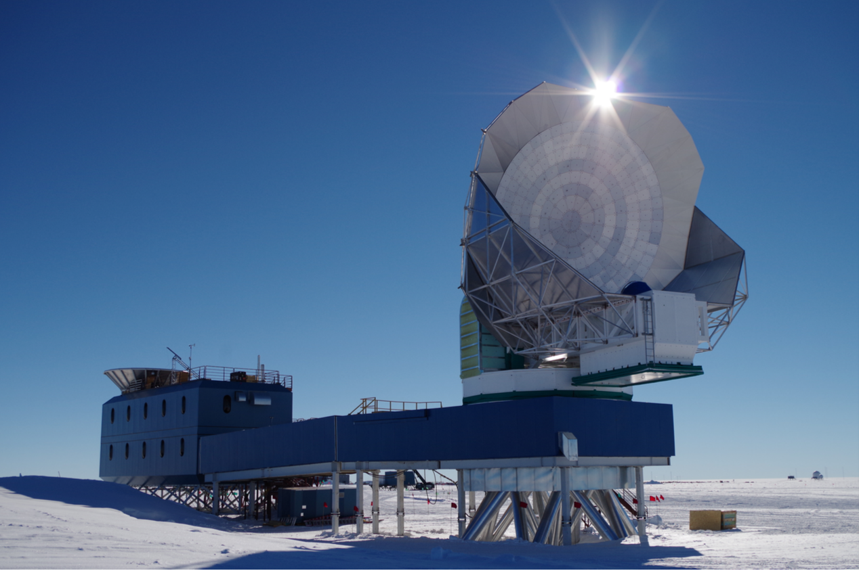
CMB Measurements are Difficult
Fundamental Challenges
Low S/N Target
Millimeter Wave
Other Sources of Emission
Dynamic Range -- Systematics
Competition…
Simons Array (fore); ACT (back)
SPT (fore); BICEP/KECK (back)

Slide 13
CMB Measurements are Difficult
Fundamental Challenges
Low S/N Target
Other Sources of Emission
Millimeter Wave
Dynamic Range -- Systematics
Competition!

Slide 14
Observation Time
How long will it take to detect primordial B-Modes?
t_{obs} = $\frac{fsky Asky}{ηobs}$ ($\frac{NETcmb}{map depth})2$
Assume r ~ 0.07 (current upper limit)
Map ~ 1% of the sky to a depth of 7 $μ$K-arcmin

Slide 15
Observation Time
Single Noiseless Detector
^{Single Mode Coupling} $NETcmb$ ~ 10 $μ$K$√s$ $ηobs$ = 1 t_{obs} ~ 1 month
How long will it take to detect primordial B-Modes?
t_{obs} = $\frac{fsky Asky}{ηobs}$ ($\frac{NETcmb}{map depth})2$
Assume r ~ 0.07 (current upper limit)
Map ~ 1% of the sky to a depth of 7 $μ$K-arcmin

Slide 16
Observation Time
Single Noiseless Detector
^{Single Mode Coupling} $NETcmb$ ~ 10 $μ$K$√s$ $ηobs$ = 1 t_{obs} ~ 1 month
How long will it take to detect primordial B-Modes?
t_{obs} = $\frac{fsky Asky}{ηobs}$ ($\frac{NETcmb}{map depth})2$
Assume r ~ 0.07 (current upper limit)
Map ~ 1% of the sky to a depth of 7 $μ$K-arcmin
…but realistic factors
Imperfect Receiver (~50% photons) Only partially coupled to sky (e.g. cold stop) Emission from optical elements Atmosphere atten./emission (ground-based) Scan strategy (e.g. telescope turnarounds lost) Cryogenic cycling Data Quality cuts Much, much more….

Slide 17
Observation Time
Single Noiseless Noisy Detector
^{Single Mode Coupling} $NETcmb$ ~ 10 $μ$K$√s$ → 300 $μ$K$√s$ $ηobs$= 1 → ~ 0.2 t_{obs} ~ 1 month → ~ 400 years!
How long will it take to detect primordial B-Modes?
t_{obs} = $\frac{fsky Asky}{ηobs}$ ($\frac{NETcmb}{map depth})2$
Assume r ~ 0.07 (current upper limit)
Map ~ 1% of the sky to a depth of 7 $μ$K-arcmin
…but realistic factors
Imperfect Receiver (~50% photons) Only partially coupled to sky (e.g. cold stop) Emission etc. from optical elements Atmosphere atten./emission (ground-based) Scan strategy (e.g. telescope turnarounds lost) Cryogenic cycling Data Quality cuts Readout noise, losses, etc Much, much more….

Slide 18
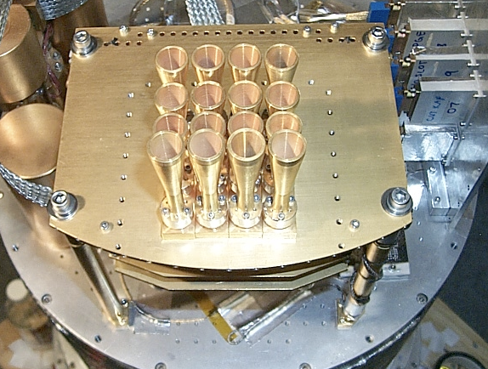
(Example) History of TES-based Array Complexity
Gen 0: Pre-TES
O(10) detectors
e.g. ACBAR, Planck

Slide 19
A (Biased) History of TES-based Array Complexity
Gen 0: Pre-TES
O(10) detectors
e.g. ACBAR, Planck
ACBAR
PLANCK

Slide 20
A (Biased) History of TES-based Array Complexity
Gen 0: Pre-TES
O(10) detectors
e.g. ACBAR, Planck
Detectors ~ background limited (from ground), so increase sensitivity by:
ACBAR
PLANCK

Slide 21
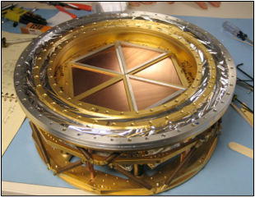
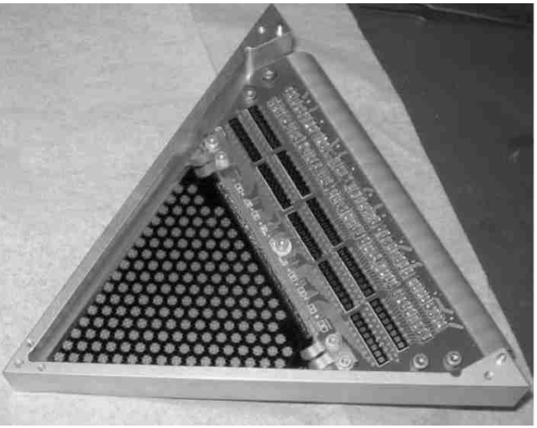
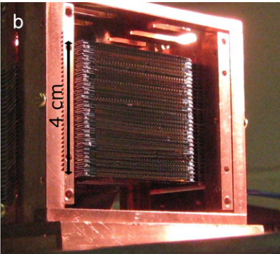
A (Biased) History of TES-based Array Complexity
Gen 0: Pre-TES
O(10) detectors
Gen 1: TES Arrays
10² – 10³ detectors
e.g. SPT-SZ, MBAC
e.g. ACBAR, Planck
Multiplexed Readout → Large Arrays
Detectors ~ background limited (from ground), so increase sensitivity by:
More Detectors
SPT-SZ
ACT-MBAC

Slide 22
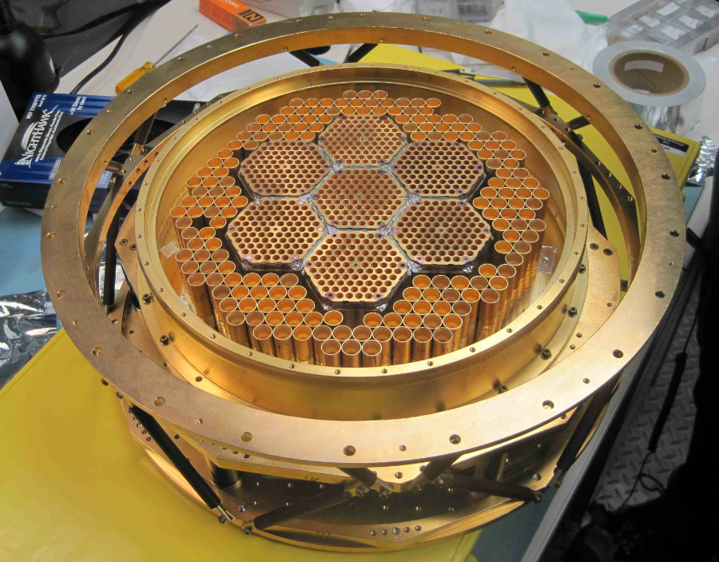
A (Biased) History of TES-based Array Complexity
Gen 0: Pre-TES
O(10) detectors
Gen 1: TES Arrays
10² – 10³ detectors
Gen 2: Polarization
O(10³) + polarization
e.g. SPT-SZ, MBAC
e.g. SPTpol, ACTPol, Polarbear, BICEP/KECK
e.g. ACBAR, Planck
Detectors ~ background limited (from ground), so increase sensitivity by:
More Detectors
Added Capabilities e.g. (polarization, systematic control)
ACTPol

Slide 23
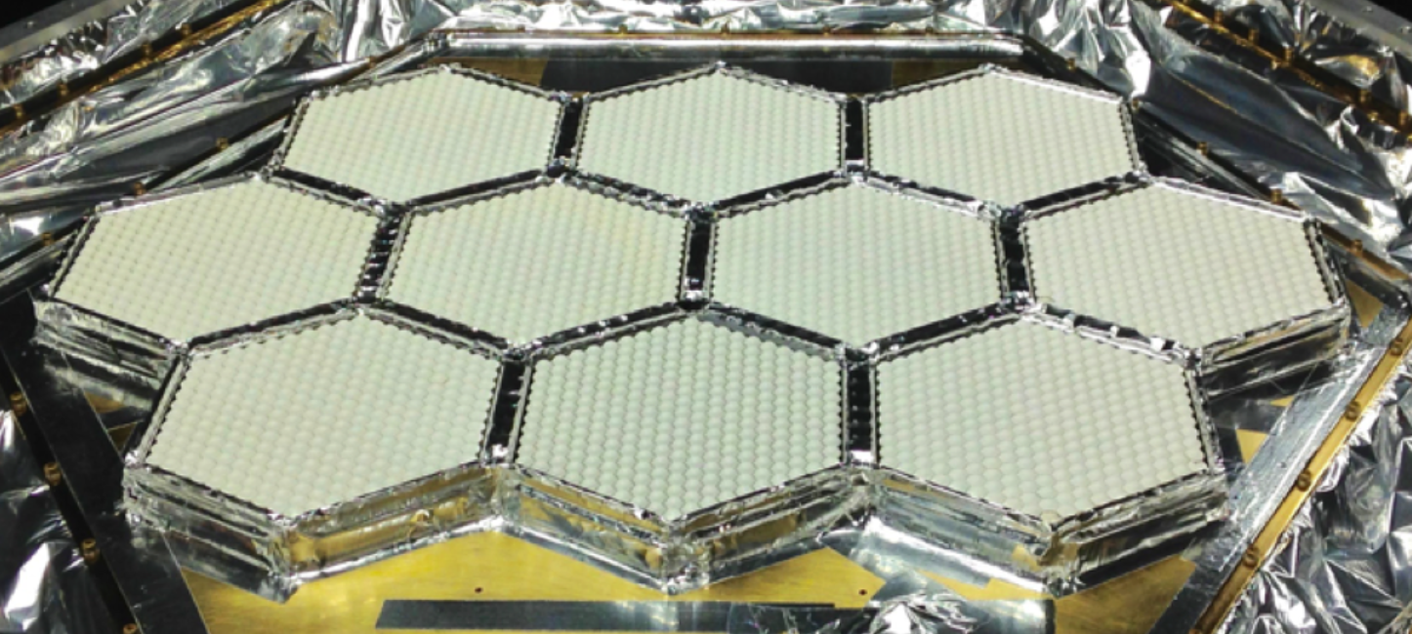
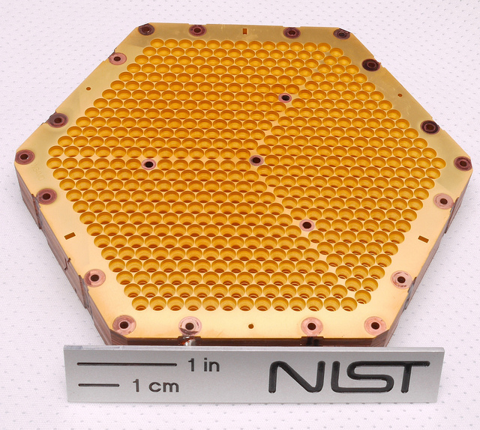
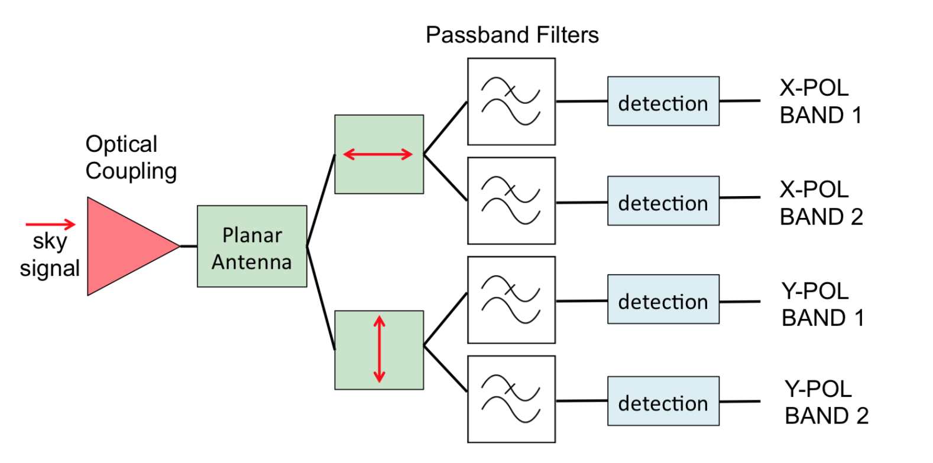
A (Biased) History of TES-based Array Complexity
Gen 0: Pre-TES
O(10) detectors
Gen 1: TES Arrays
10² – 10³ detectors
Gen 2: Polarization
O(10³) + polarization
Gen 3: multi-chroic
O(10⁴) + multi-chroic
e.g. SPT-SZ, MBAC
e.g. SPTpol, ACTPol, Polarbear, BICEP/KECK
e.g. SPT-3G, Advanced ACTPol, Simons Array
e.g. ACBAR, Planck
Detectors ~ background limited (from ground), so increase sensitivity by:
More Detectors
Added Capabilities e.g. (polarization, systematic control)
More Bandwidth / Multi-chroic

Slide 24
Optical Coupling Scheme drives Pixel Design
Feedhorn Coupled Waveguide
Phased Arrays
Hemispherical Lenslets
Metamaterial Lenslets
Advantages and Disadvantages to each

Slide 25
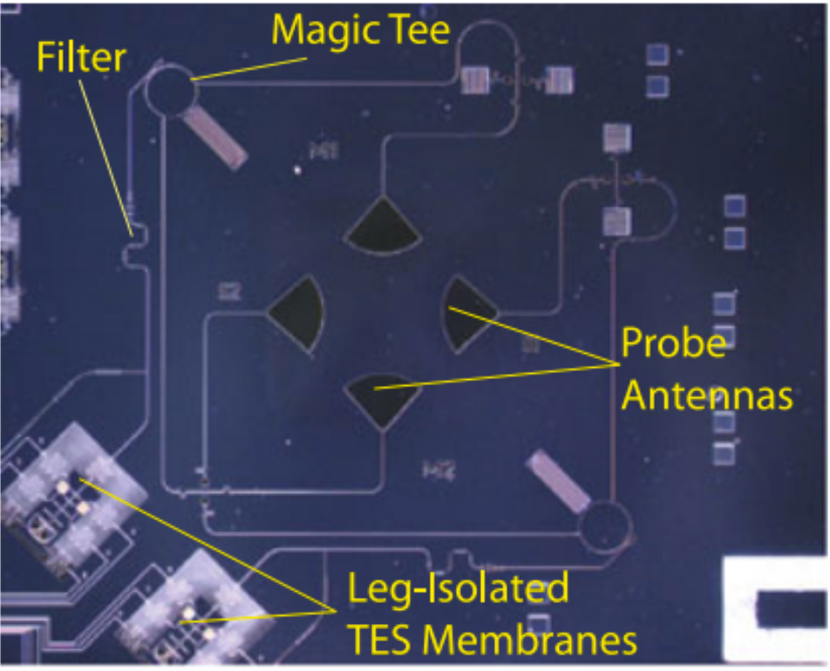
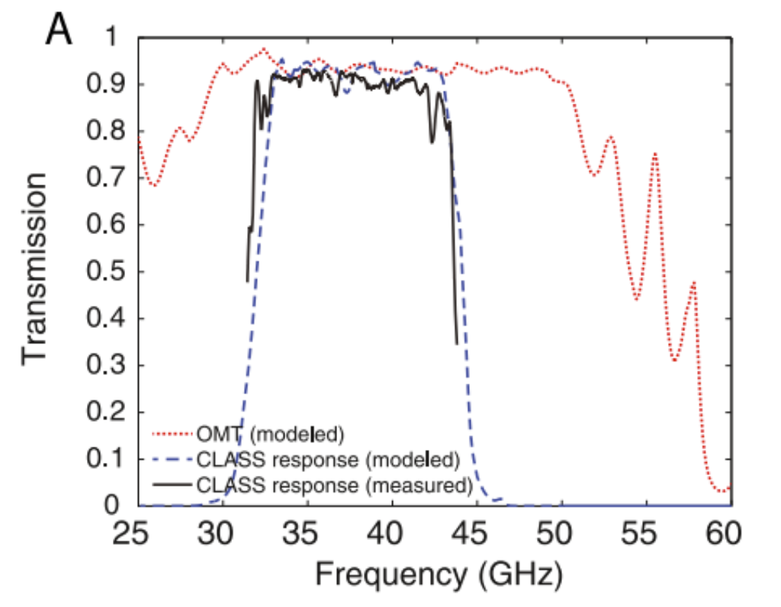
Optical Coupling Scheme drives Pixel Design
Feedhorn Coupled Waveguide
Phased Arrays
Hemispherical Lenslets
Metamaterial Lenslets
CLASS 40 GHz Array
NASA, Goddard feed-coupled detector
Chuss et al. JLTP (2012) 167:923-928

Slide 26
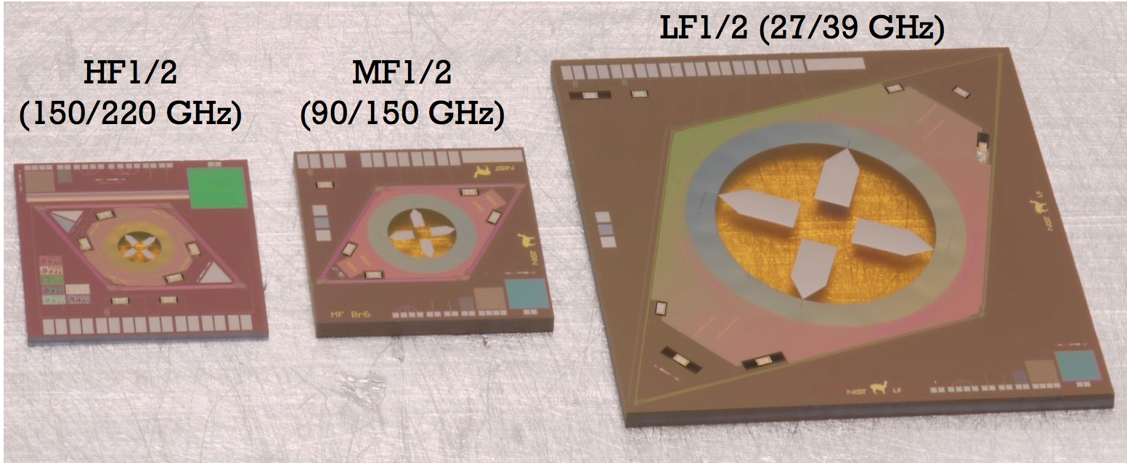
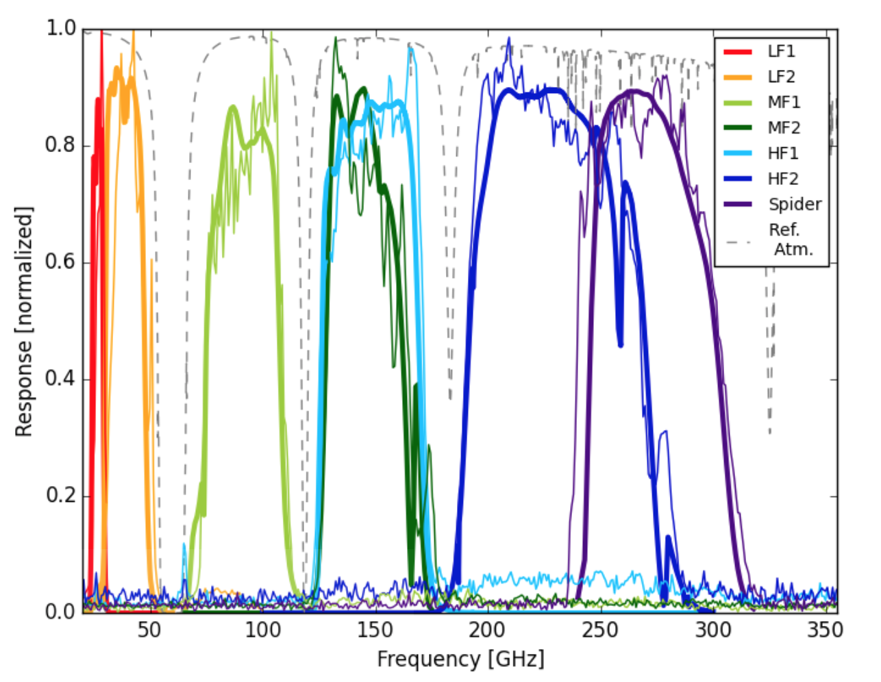
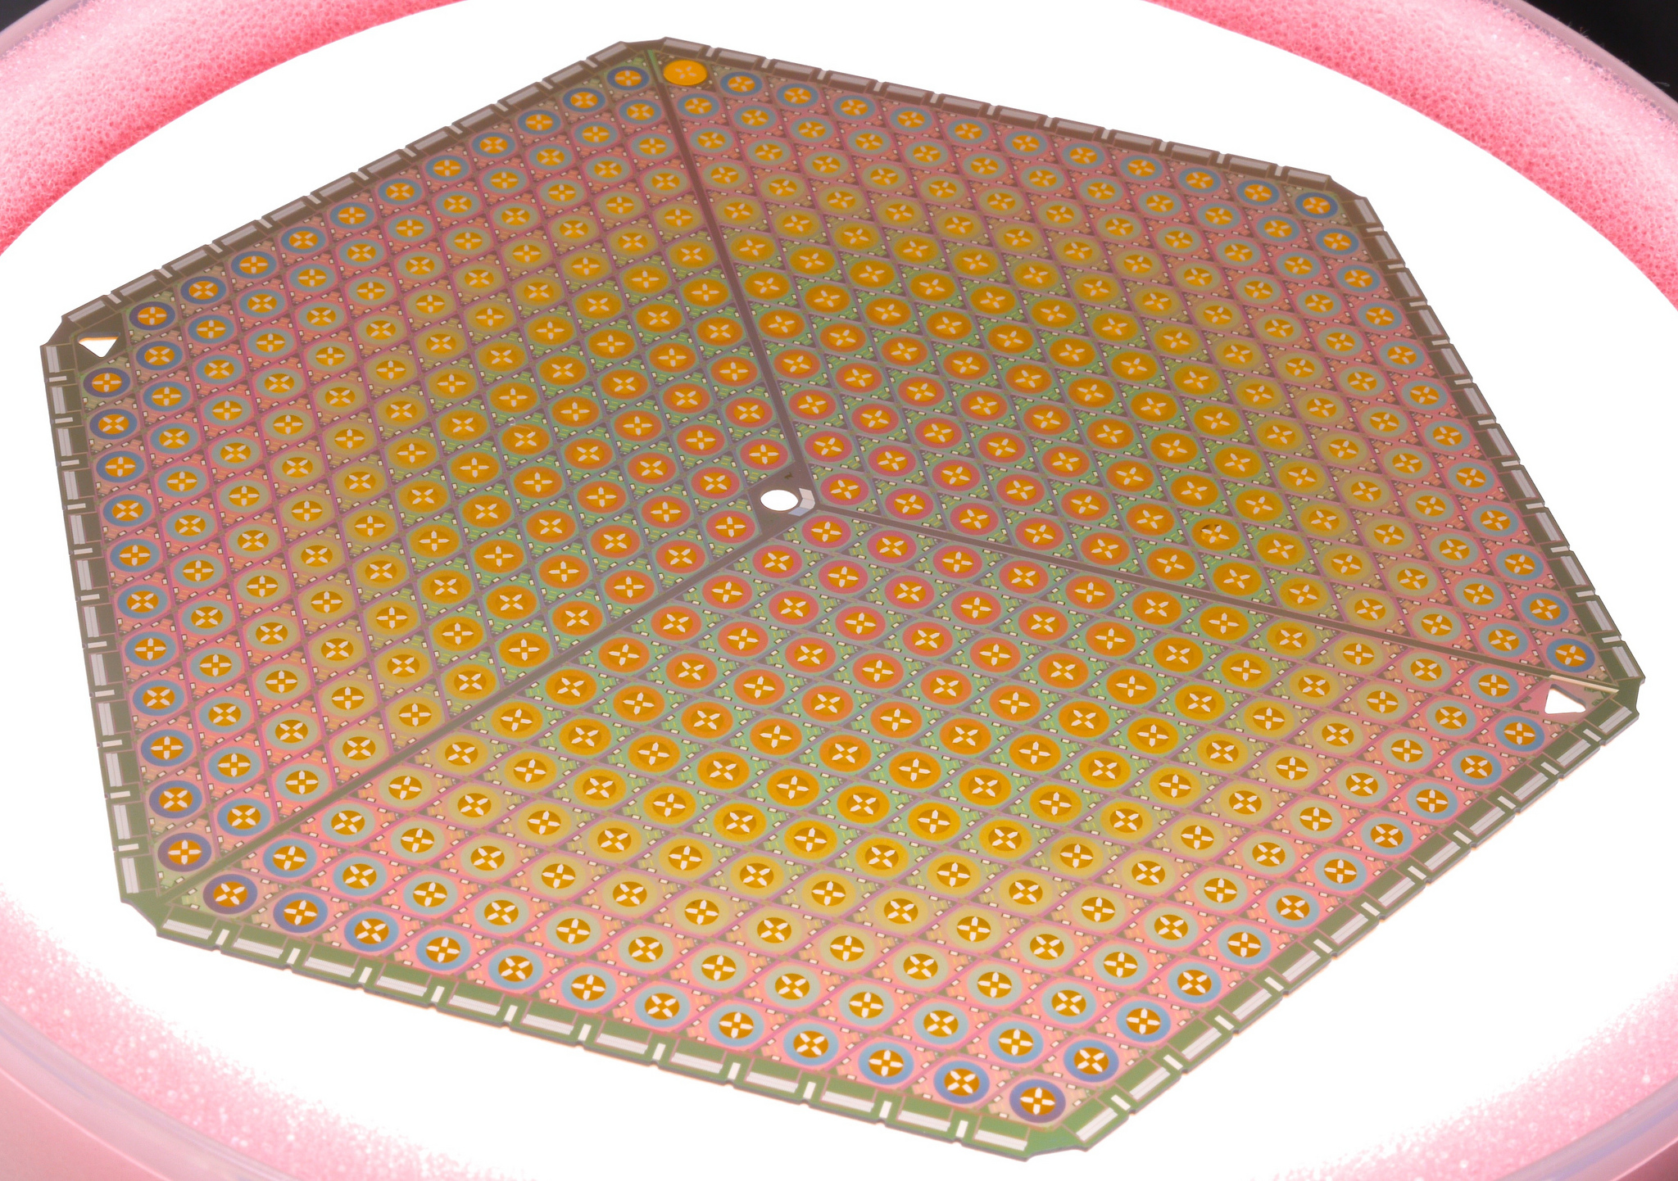
Optical Coupling Scheme drives Pixel Design
Feedhorn Coupled Waveguide
Phased Arrays
Hemispherical Lenslets
Metamaterial Lenslets
NIST-Boulder
MF
HF
Spider
LF
150 mm Wafer

Slide 27
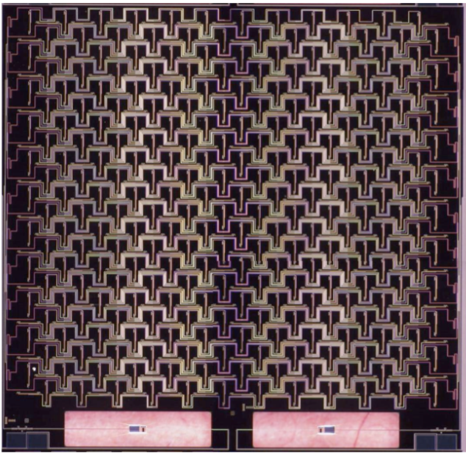
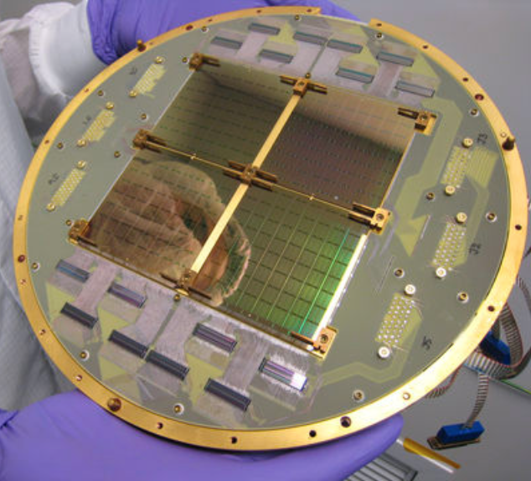
Optical Coupling Scheme drives Pixel Design
Feedhorn Coupled Waveguide
Phased Arrays
Hemispherical Lenslets
Metamaterial Lenslets
Caltech/JPL
TES

Slide 28
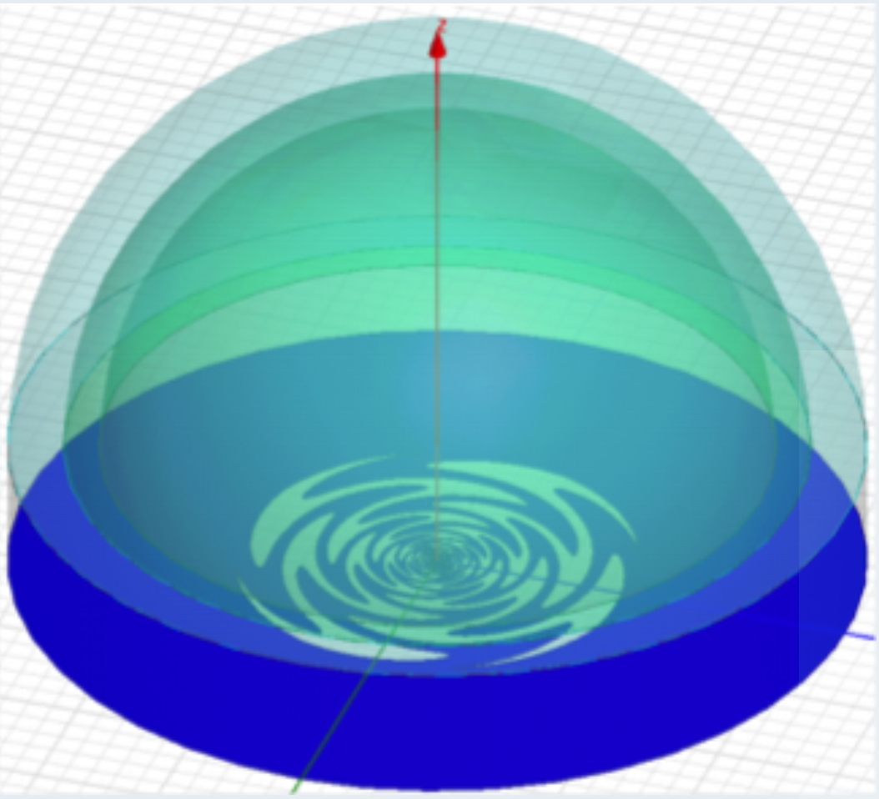
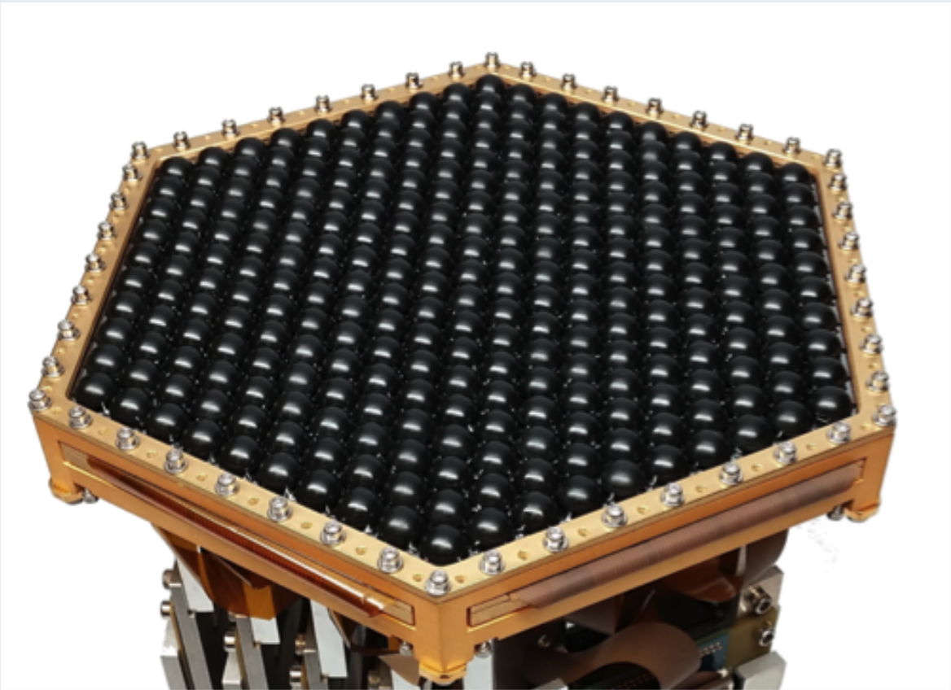
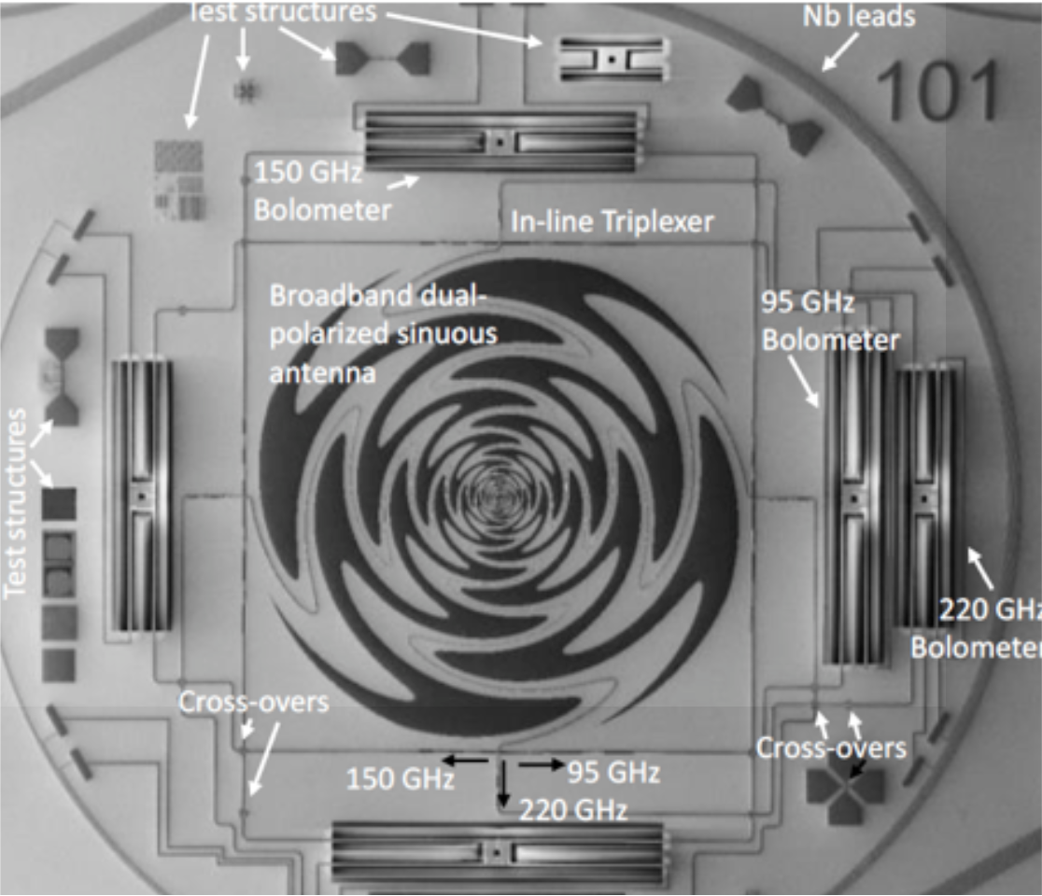
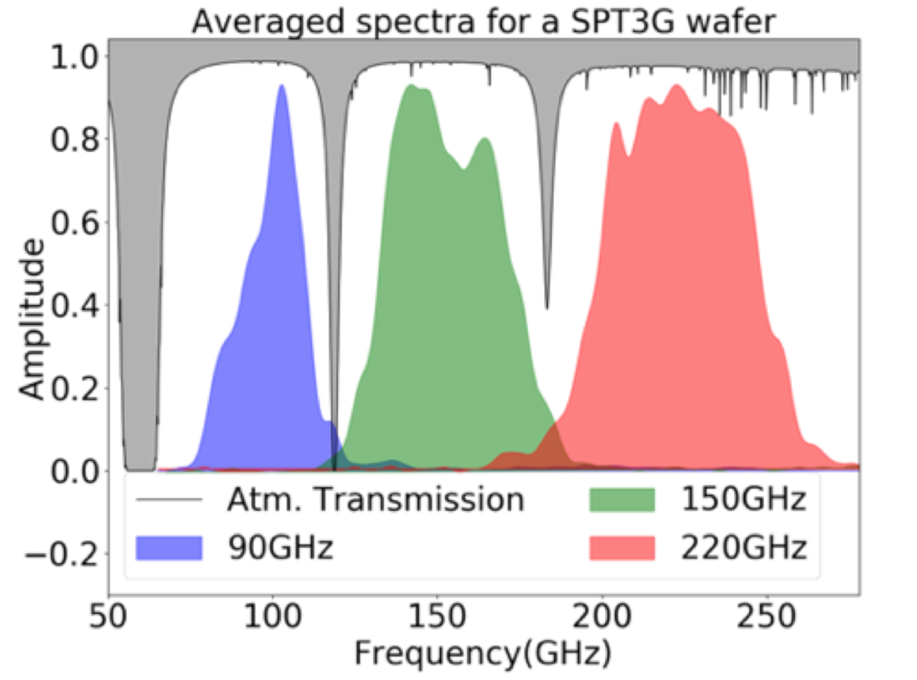
Optical Coupling Scheme drives Pixel Design
Feedhorn Coupled Waveguide
Phased Arrays
Hemispherical Lenslets
Metamaterial Lenslets
UC-Berkeley, Chicago, ANL

Slide 29
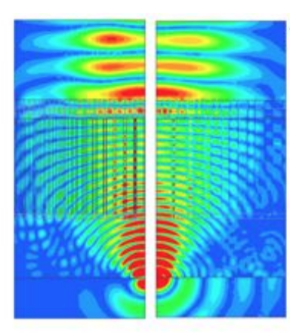
Optical Coupling Scheme drives Pixel Design
Gradient Index Lenslet (GRIN)
Metal Mesh Metamaterial Lenslet
Feedhorn Coupled Waveguide
Phased Arrays
Hemispherical Lenslets
Metamaterial Lenslets (planar lenslet)
Nils Halverson and collaborators

Slide 30
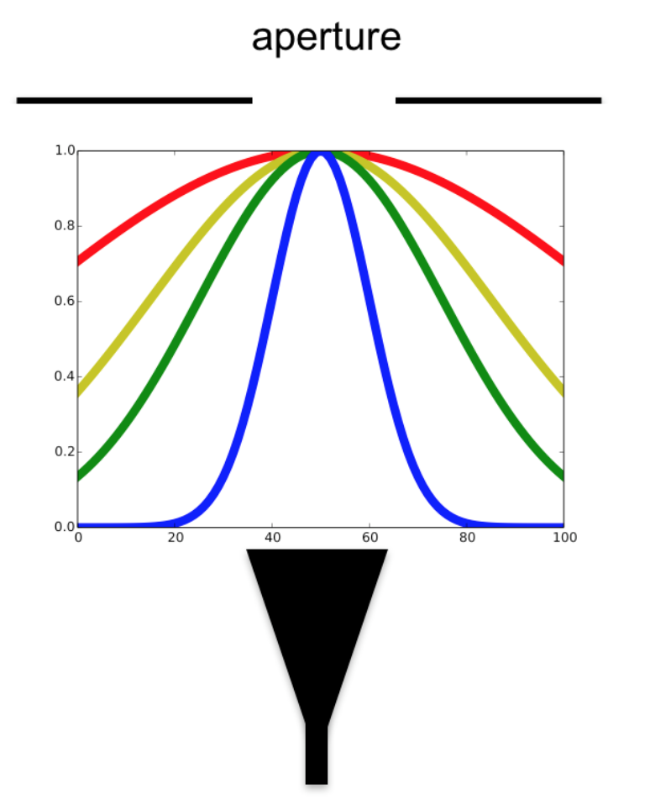
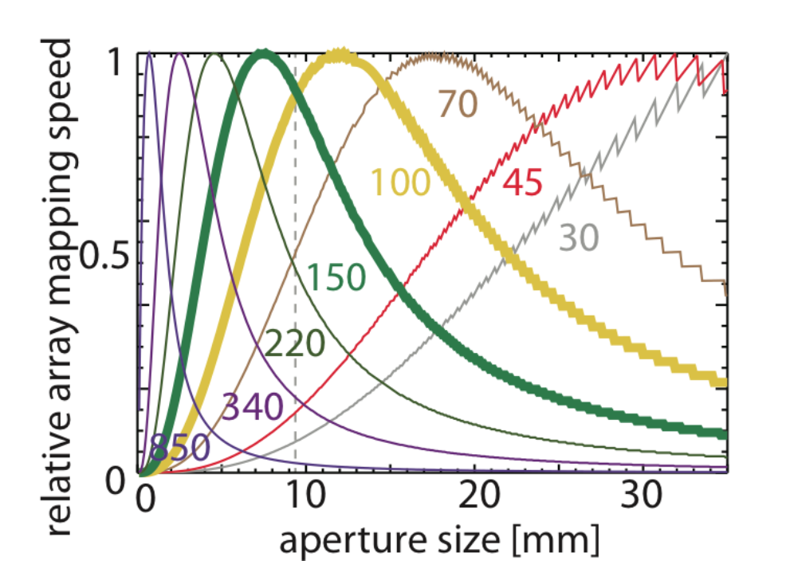
Multi-chroic Diminishing Returns
Mapping speed vs pixel size for
fixed focal plane size
Datta et al 2014

Slide 31
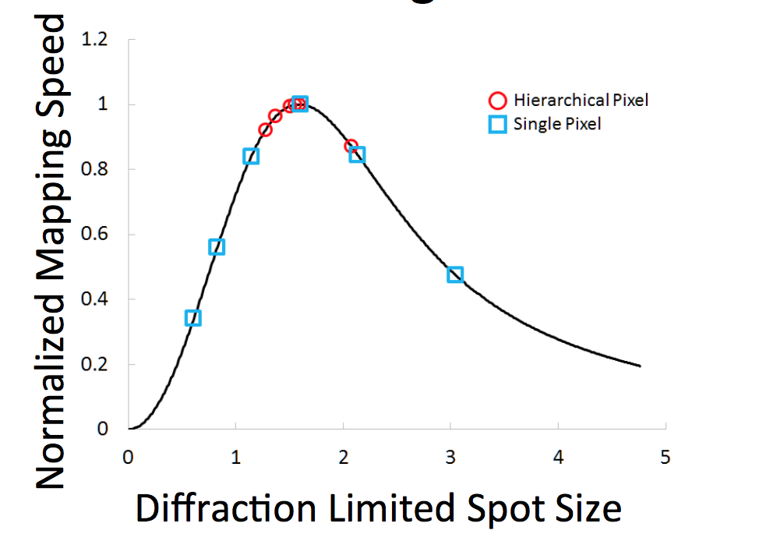
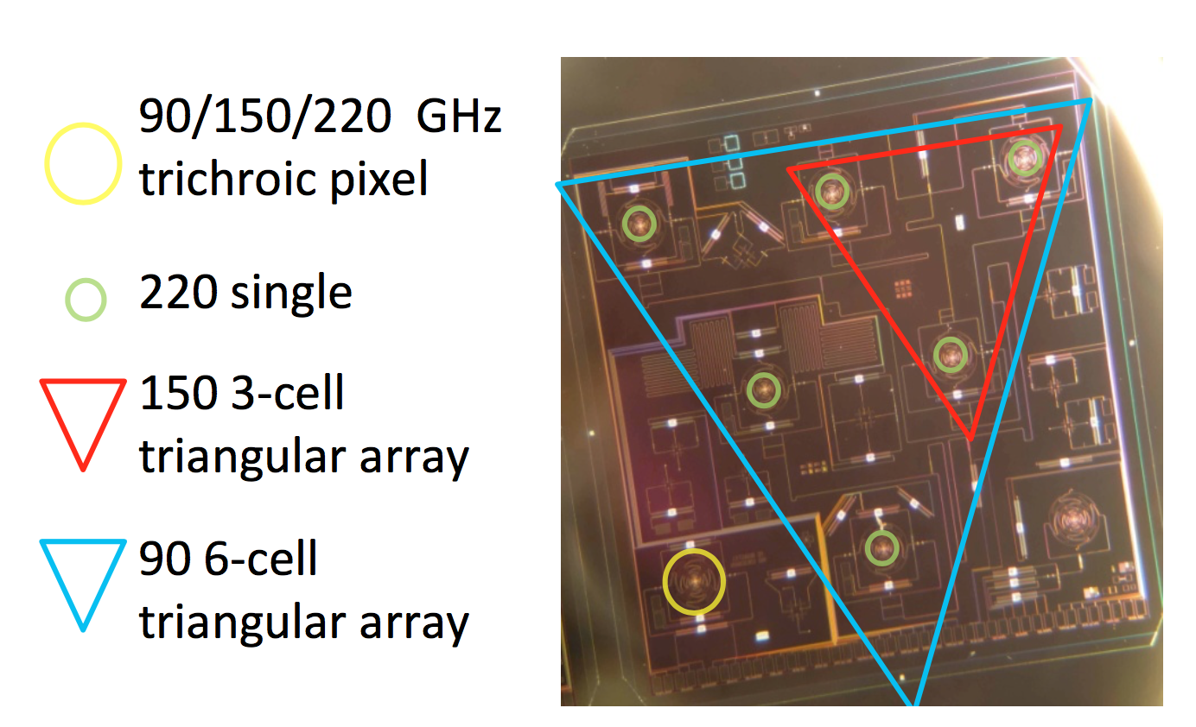
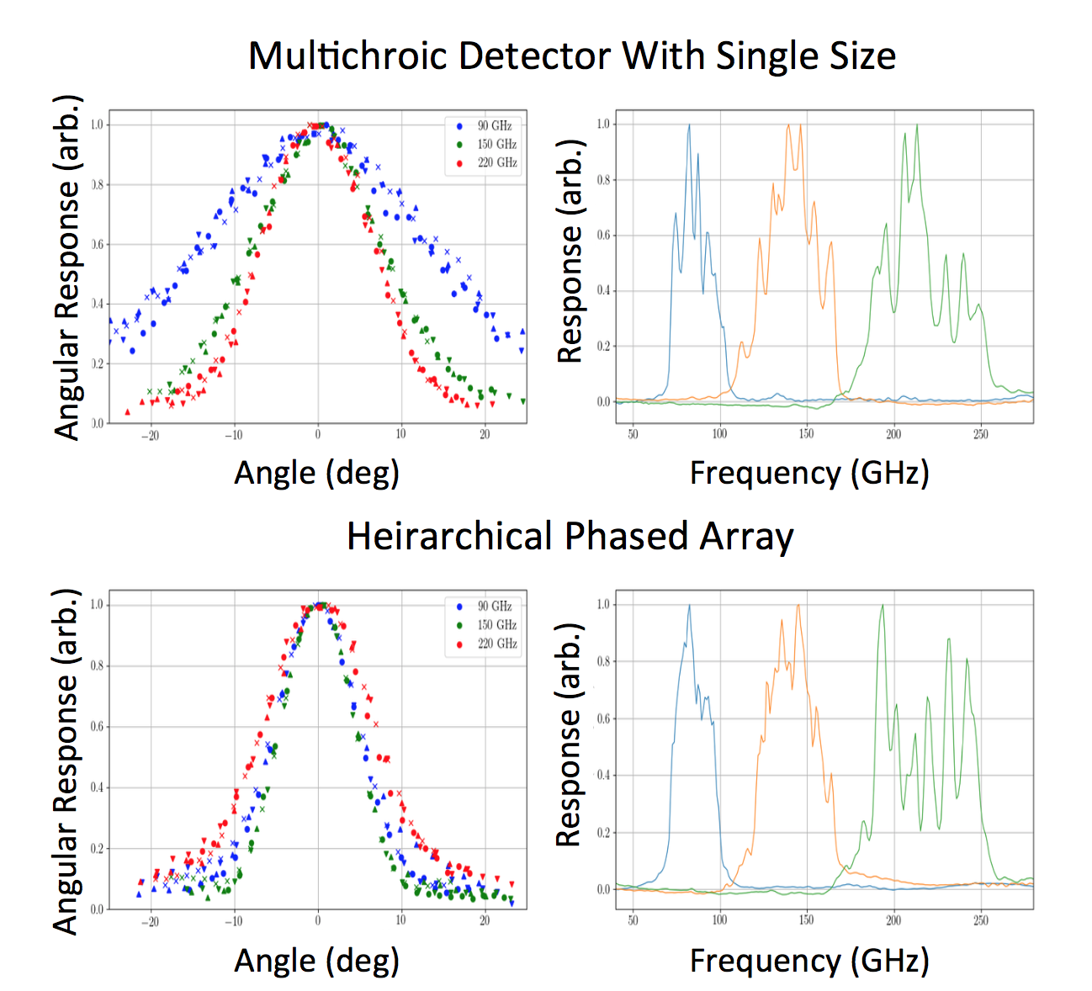
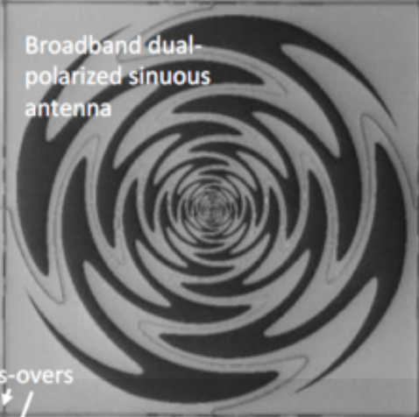
A Better Multi-chroic? Hierarchical phased array
Near Optimal Mapping Speed for all Bands
Antennae are coupled using Spherical Lenslets
Cukierman et al. 2017
UCB / LBNL

Slide 32
Detector Fabrication Developments
150 mm diameter wafers
150 mm Wafer

Slide 33
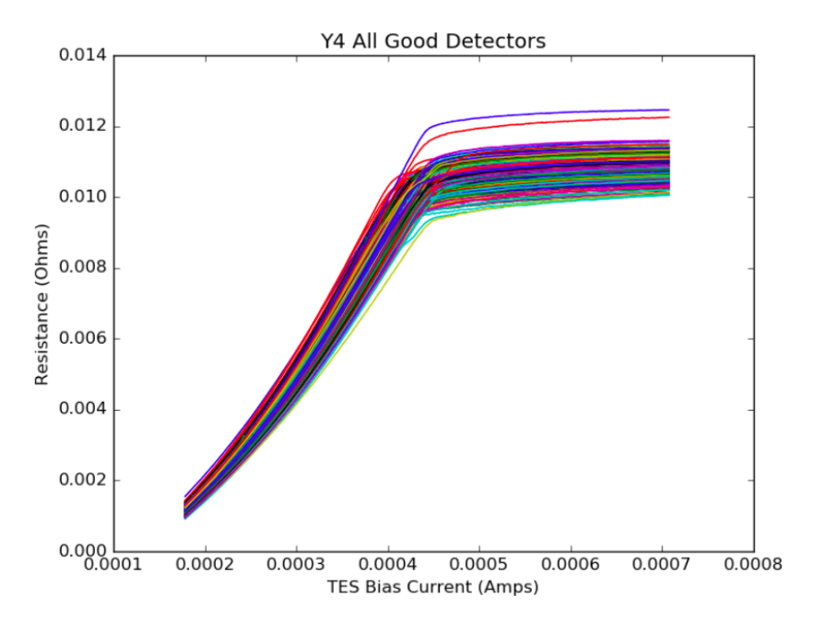
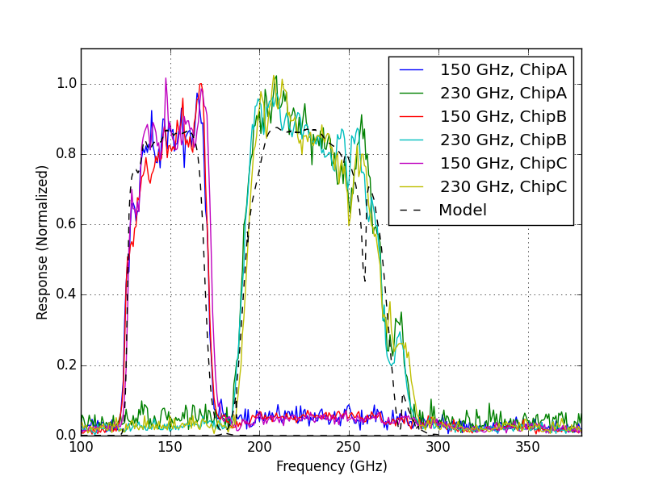
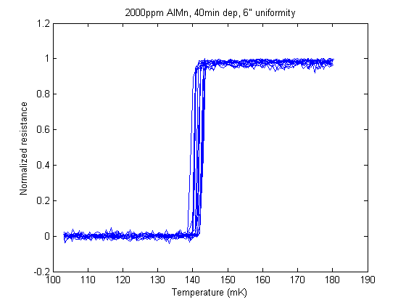
Detector Fabrication Developments
150 mm diameter wafers
Uniformity
Bandpass Uniformity
(varying wafers)
Array wide Electro-thermal uniformity
Tc Uniformity Across Array
140 mK
Resistance (Ohms)
2mK
Normalized Resistance
TES BIAS CURRENT
Temperature (mK)

Slide 34
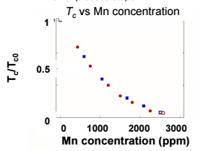
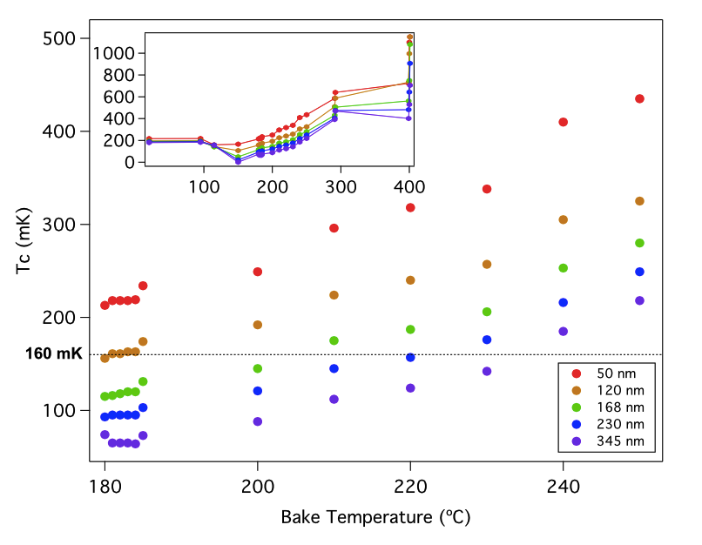
Detector Fabrication Developments
150 mm diameter wafers
Uniformity
Material Development
e.g. Tunable TES materials
Dielectric Improvements – Low Loss
 | Stoichiometry | Compressive stress [MPa] | Loss tangent
ACTPol SiO_{x} | Si-rich | 150 | 2.0e-3
Advanced ACTPol SiN_{x} | stoichiometric | 4 | 7.8e-4

Slide 35
Detector Fabrication Developments
150 mm diameter wafers
Uniformity
Material Development
Simplicity

Slide 36
Detector Fabrication Developments
150 mm diameter wafers
Uniformity
Material Development
Simplicity
Yield
- No longer need to make (N >> 1) wafers to yield 1 good one

Slide 37
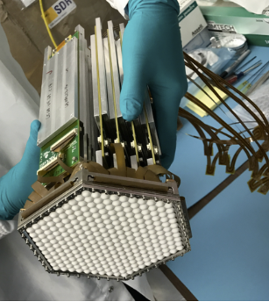
Assembly is increasingly difficult
Co-planar
3D
Advanced ACTPol
TDM
SPT-3G/Polarbear2
MHz FDM
Not an option for tiled focal plane
Exists/proven
Complicated
lots of connections

Slide 38
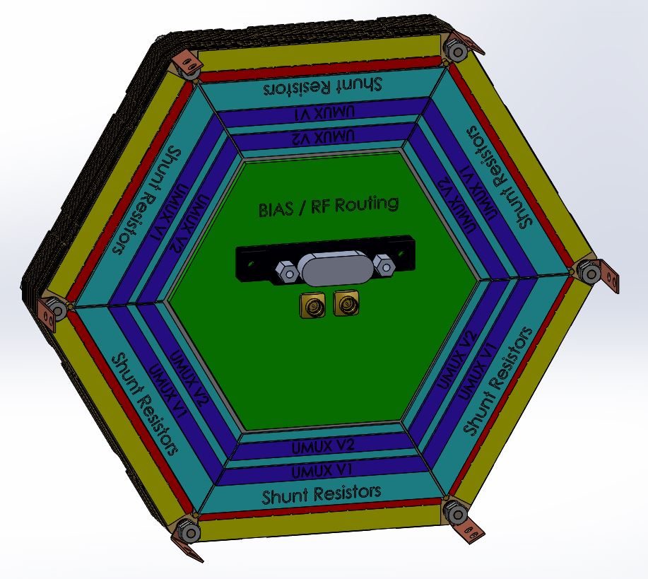
Assembly / Readout
Integrated fab
Co-planar
3D
2D backside
Integrated TES
MKID/LEKID
Advanced ACTPol
TDM
SPT-3G/Polarbear2
MHz FDM
Notional mSQUID
Also, e.g. BICEP3
TES: Prototypes only
MKIDs: ?
Obviously a no-go for tiled arrays
Exists/proven
Complicated
lots of connections
Requires smaller readout components (mSQUID) or low detector density
Space constraints and/or unproven

Slide 39
Conclusion
Mature
Wide-bandwidth, single-moded TES solutions very mature for ground/balloon missions
Collaborations pushing to space readiness, e.g. Litebird
Still active and improving
development continues in all areas (optical coupling, sensitivity, readout, fabrication, assembly)

Slide 40
end

