Slide 1
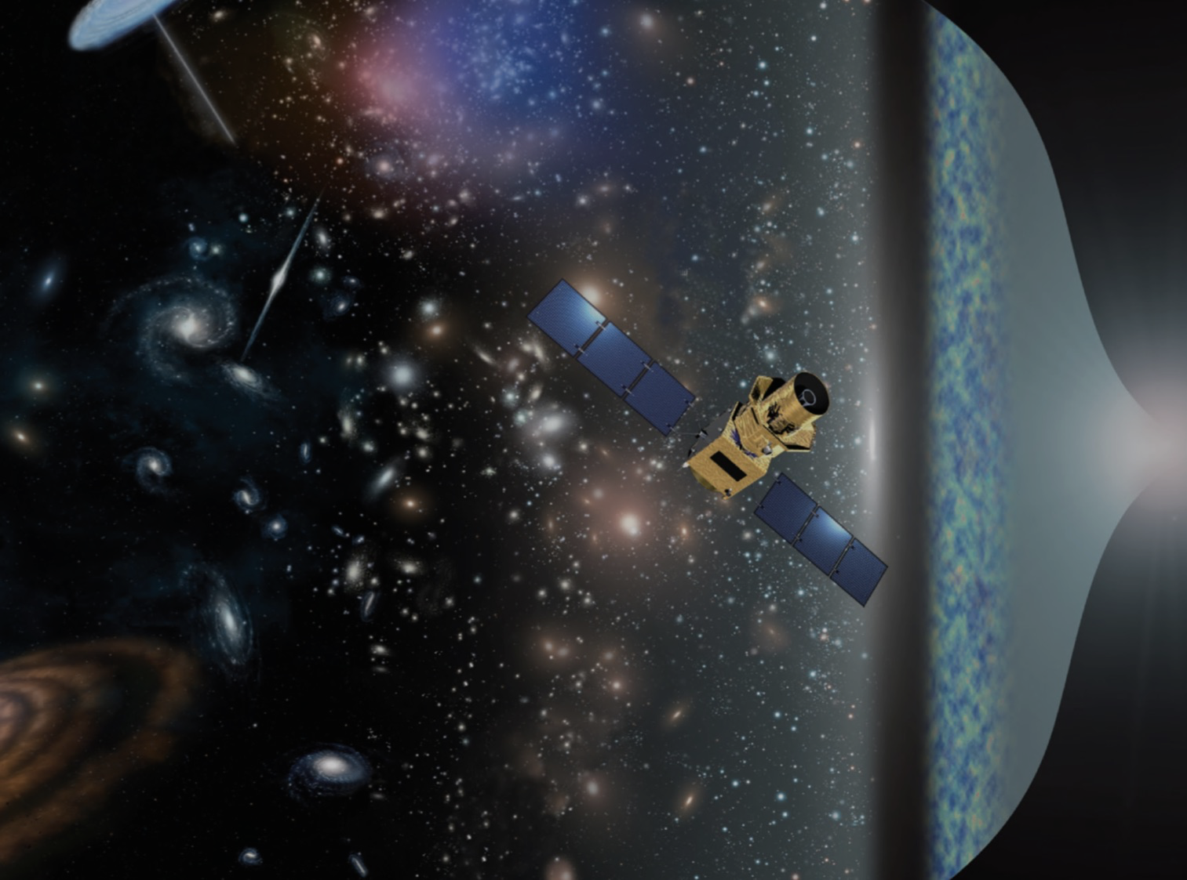
LiteBIRD
Masashi Hazumi
1) Institute of Particle and Nuclear Studies (IPNS), High Energy Accelerator Research Organization (KEK)
2) Kavli Institute for Mathematics and Physics of the Universe (Kavli IPMU), The University of Tokyo
3) Graduate School for Advanced Studies (SOKENDAI)
4) Institute of Space and Astronautical Science (ISAS), Japan Aerospace Exploration Agency (JAXA)
Notes:
Thank you. I am honored to be here to say a few words on LiteBIRD,
which is a satellite candidate of Institute of Space and Astronautical Science ,
Japan Aerospace Exploration Agency (JAXA)
aiming a launch in mid. 2020s.

Slide 2
LiteBIRD presentations at this workshop
Mathieu Remazeilles: Foreground separation
Josquin Errard: Foreground separation
Jay Austermann: Single-moded TES
Kam Arnold: TES readout
Hiroaki Imada: Optics
Yuki Sakurai: Polarization modulator
Ryota Takaku: Polarization modulator (poster)
Hiroaki Kanai: Polarization modulator (poster)
Kunimoto Komatsu: Polarization modulator (poster)
Hirokazu Ishino: Systematics
Many good slides !

Slide 3
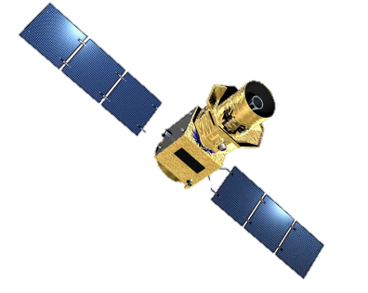
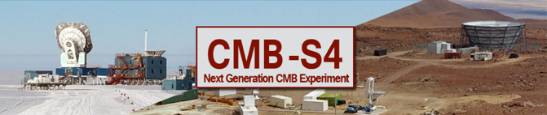
Basic Japanese Vision for 2020’s
Essentially the same vision I had in 2008, when Europe was focusing on Planck.
Powerful Duo
X
JAXA-led focused mission
σ(r)<0.001
  2 ≤ l ≤ 200
  focused but still with many byproducts
US-led telescopes on ground
  30 ≤ l ≤ 3000~10000
  e.g. Simons Observatory and CMB-S4
This powerful duo is the best cost-effective way.
Great synergy with two projects
  Foreground data from LiteBIRD, Delensing with CMB-S4 data
Notes:
If you want to launch a telescope with a dish diameter larger than 1 m, it is going to be very expensive.
Our strategy is to have a relatively small satellite for ultimate measurements of r, while
deploy telescope arrays on ground for sub-degree angular scale studies.
Examples are Simons Array, which is the extension of POLARBEAR that I am involved in, and
the future stage-4 array that is being discussed in US.
So the question is how we share finite resources available.

Slide 4
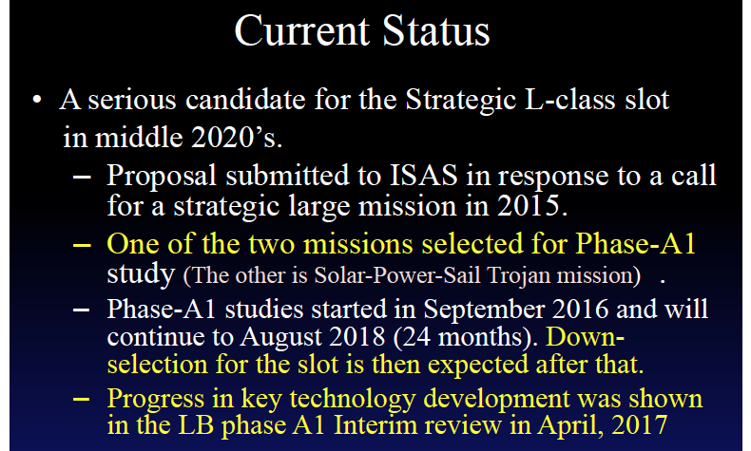
“Current Status of LiteBIRD in JAXA” by Toru Yamada
(Former ISAS Director of International Strategy and Coordination)

Slide 5
“Current Status of LiteBIRD in JAXA” by Toru Yamada
(Former ISAS Director of International Strategy and Coordination)

Slide 6
Full success of LiteBIRD
σ(r) < 1 × 10⁻³ (for r=0)
All sky survey (for 2 ≤ ≤ 200)*
Remarks
σ(r) is the total uncertainty on the r measurement that includes the following uncertainties**
  statistical uncertainties
  instrumental systematic uncertainties
  uncertainties due to residual foregrounds and bias
  uncertainties due to lensing B-mode
  cosmic variance (for r > 0)
  observer bias
The above should be achieved without delensing.
* More precise (i.e. long) definition ensures >5sigma r detection from each bump for r > 0.01.
** We also use an expression δr = σ(r=0), which has no cosmic variance.

Slide 7
Five uncertainty components
Statistics
Foreground
Goal
δr < 0.001
Systematics
Lensing
Observer bias
Notes:
To reach r=0.01, there are four obstacles that need to be addressed.
statistical errors, systematic errors, foreground and lensing B-mode.

Slide 8
Error budget assignment toward full success
Statistical error after foreground separation, including
lensing B-mode contribution (σ_{stat})
Systematic error (σ_{sys})
Margin (σ_{mgn})
Requirement: σ_{stat}² + σ_{sys}² + σ_{mgn}² < 0.001²
We assign σ_{stat} = σ_{sys} = σ_{mgn}
Therefore we require
    σ_{stat} < 0.57x10⁻³
    σ_{sys} < 0.57x10⁻³
      At the moment an effect of each sys. error item is required
      to be less than 1% of lensing BB power.
      Error budget management in the next step will allow less stringent requirements on outstanding items (e.g. Sidelobe, absolute angle error)

Slide 9
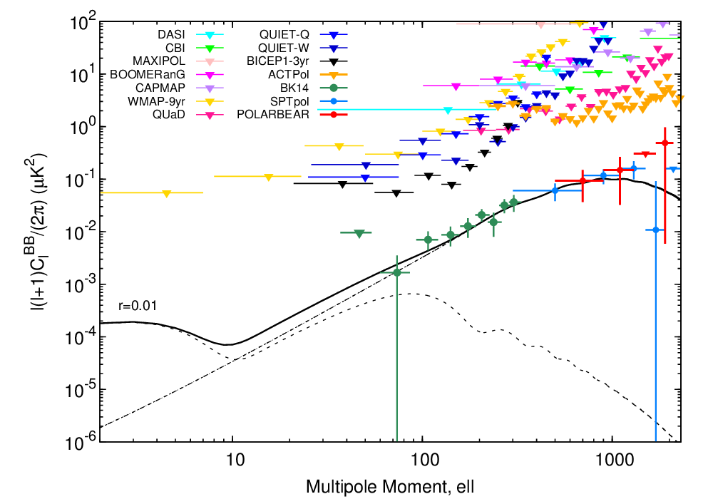
B-mode power spectrum (2016)
Secondary effect
(Gravitational lensing)
Inflation
r < 0.07 (95% C.L.)

Slide 10
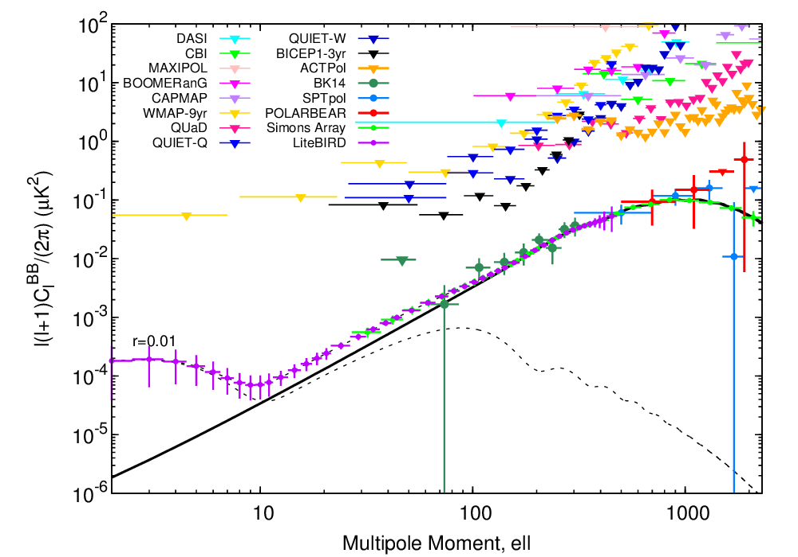
LiteBIRD expectation
Yuji Chinone
Secondary effect
(Gravitational lensing)
Inflation
Full Success：
σ(r) < 1 x 10⁻³ (for r=0)
2 ≤ ≤ 200
LiteBIRD

Slide 11
Extra success
Improve σ(r) with external observations
Topic | Example Method | Example Data
Delensing | Large CMB telescope array | CMB-S4 data Namikawa and Nagata, JCAP 1409 (2014) 009
 | Cosmic infrared background | Herschel data Sherwin and Schmittfull, Phys. Rev. D 92, 043005 (2015)
 | Radio continuum survey | SKA data Namikawa, Yamauchi, Sherwin, Nagata, Phys. Rev. D 93, 043527 (2016)
Foreground removal | Lower frequency survey | C-BASS upgrade
Delensing improvement to σ(r) can be factor ~2 or more.
  e.g. ~6sigma observation in case of Starobinsky model
  Need to make sure systematic uncertainties are under control.

Slide 12
Outcome of LiteBIRD
Success Criteria
System Requirements
Outcome
σ(r)< 0.001 (for r=0)
2 ≤ ell ≤ 200
Full & Extra Success
Lots of other science results
(τ, neutrino mass, pol. non-Gaussianity/bispectra, foreground science, etc.)
System requirements are determined from the focused mission of LiteBIRD.
LiteBIRD will produce lots of science results (collectively called “outcome”) thanks to its great precision.
These science results however should have no influence on system requirements.
In this way, LiteBIRD will keep system requirements simple, and make great outcome at the same time.

Slide 13
ISAS/JAXA Phase-A1
T. Dotani
Purpose : Risk mitigation through front-loading
TRL of mission instruments should be raised to 4 or 5.
  TRL4 : Breadboard model validation (in laboratory environment)
  TRL5 : Engineering model validation (in relevant environment)
Main Study Items in phase A1
Revision of the requirements to the mission instruments
Polarization Modulator (broad band coverage, thermal feasibility, launch lock, etc.)
Thermal and mechanical feasibility of the mission instruments
Compatibility of the heat load to the mechanical coolers with their performance.
Requirements to the service module and conceptual design of the satellite
Test and calibration plan
Task share and interfaces between the international partners.

Slide 14
International collaboration for LiteBIRD
Provisional task sharing
Japan: LFT, HWP, precoolers, spacecraft, launch, operation
US: Focal-plane units for LFT and HFT, cold readout
Canada: warm readout (DfMUX)
Europe: HFT, Sub-K cooler
All: Data analysis and scientific exploitation
Teams and supports from space agencies
US team (led by A. Lee) is supported by NASA for technology development.
Canadian Space Agency (CSA) supported warm readout technology development by McGill group. CSA issued (July 17, 2017) a Request for Proposals (RFP) to conduct a (Canadian) contribution study for the LiteBIRD mission.
European LiteBIRD consortium is being organized. Some of members are already registered as LiteBIRD external collaborators.
Joint Study Group has been formed between LiteBIRD Phase A team and external collaborators. Studies on foreground, systematics, calibration and HFT ongoing.
European LiteBIRD consortium
meeting in Aug. 2-3 in Cardiff.

Slide 15
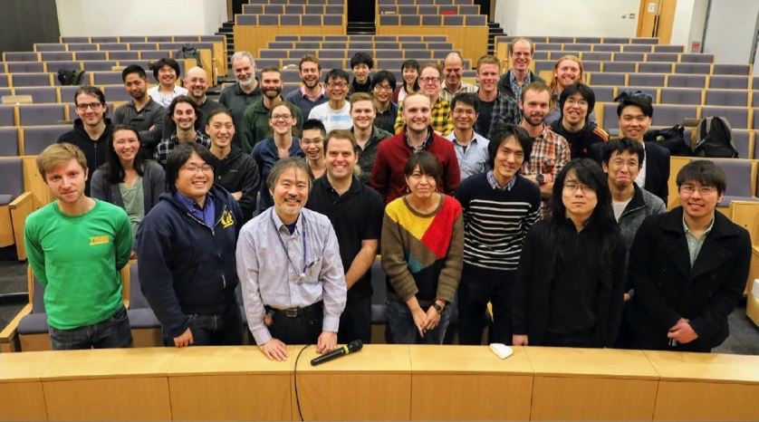
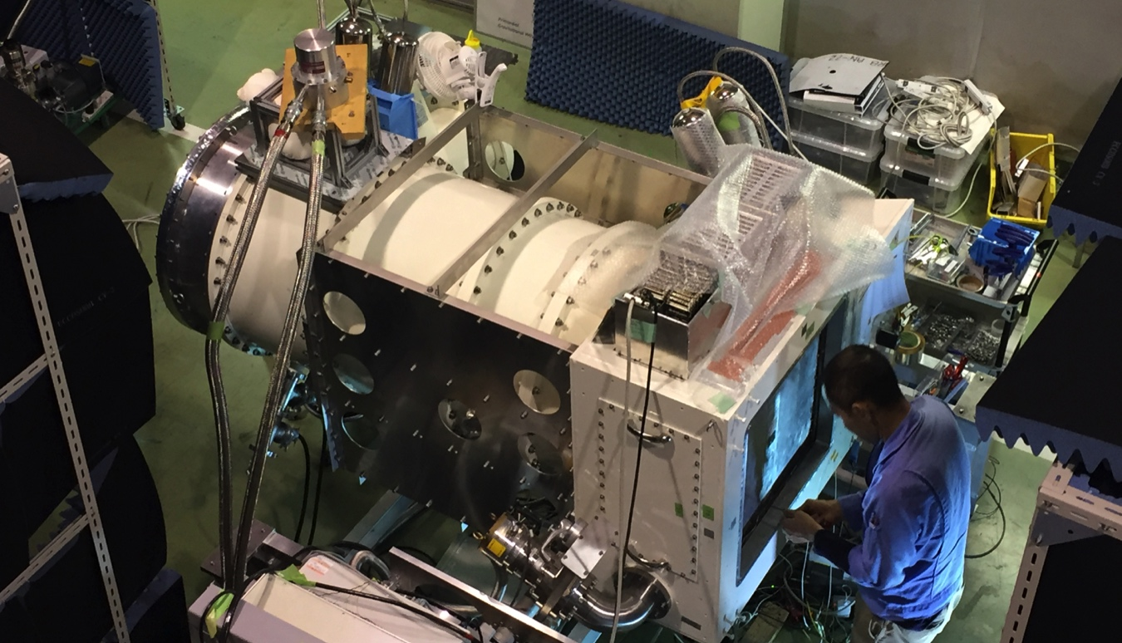
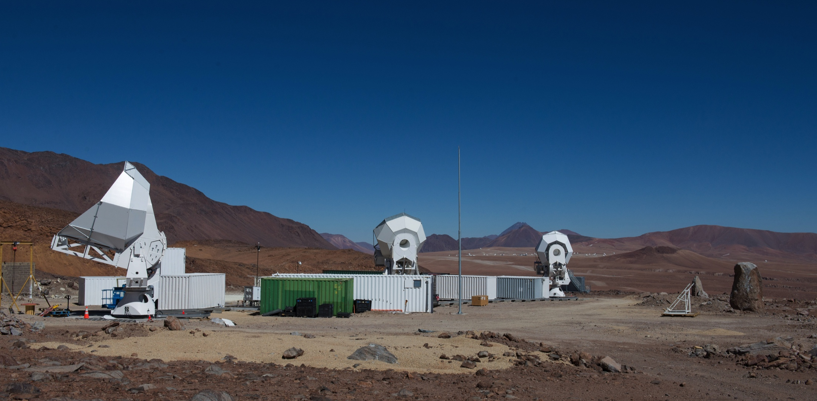
Simons Array Ongoing
Collaboration meeting at KEK (Mar 2017)
First receiver system
“POLARBEAR-2”
in preparation at KEK !
Ground-based project carried out by CMB experimenters on LiteBIRD. 10 years of collaboration b/w Japan, US, Canada, Europe. Stepping-stone for LiteBIRD.
Notes:
The current ongoing project on ground is Simons Array, three telescopes that enable 18 times the number of detectors as were in
POLARBEAR. Four frequency bands are chosen to remove foregrounds.
これからの地上計画はサイモンズアレイ計画です。3台の望遠鏡を使って、POLARBEARの１８倍の検出器で観測します。
前景放射を除去するために、４つの周波数での観測を予定しています。

Slide 16
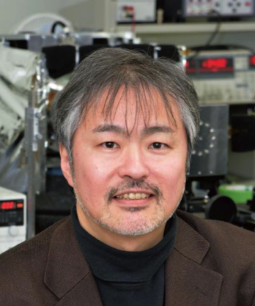
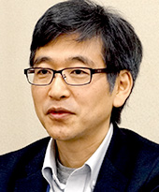
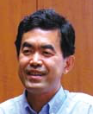
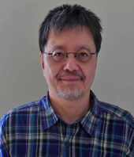
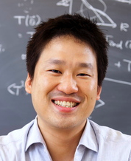
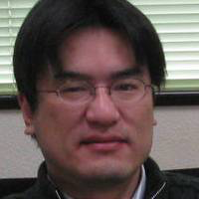
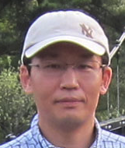
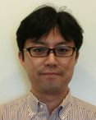

ISAS/JAXA
Phase-A1 Team
ver. 2017.11.02
Experience: X-ray satellites, CMB exp., Large-scale projects (HEP, ALMA)
PI M. Hazumi（KEK/IPMU）
Sub-PI N. Katayama(IPMU）
Advisors
K. Mitsuda(ISAS)
Y. Nakamura(ISAS)
Team leader (TL) T. Dotani (ISAS)
Ass. TL H. Tomida (ISAS) PE(TBD JAXA)
PS
E. Komatsu(MPA)
Archive/Data processing
H. Ishino
（Okayama U.）
International collaboration
(PI,TL)
Operation/GS
H. Ishino
(Okayama U.)
Mission system coordinator
Yutaro Sekimoto (ISAS)
Bus system coordinator
(= TL)
Other subsystems
attitude, propulsion
telemetry
power system
data processing
S&MA
TBD(JAXA)
Control TBD
(JAXA)
Foreground
N. Katayama
(IPMU)
Test/verification
H. Sugai
(IPMU)
Cold mission system coordinator
T. Matsumura (IPMU)
Thermal TBD
(JAXA)
Systematics
H. Ishino
(Okayama U.)
Thermal/Structural advisor
S. Utsunomiya (IPMU)
Structure TBD
(JAXA)
Room. Temp. electronics
H. Ishino (Okayama)
M. Tsujimoto (ISAS)
Cryocooler
K. Shinozaki (JAXA)
Detector
T. Matsumura
(IPMU)
Telescope¹⁾
Y. Sekimoto (ISAS)
Modulator
T. Matsumura (IPMU)
International Joint Study G
Systematics: H. Ishino
Foreground: N. Katayama
HFT: Y. Sekimoto
Calibration: T. Matsumura, H. Sugai
Canada readout team
CC-CTP
US sub-k
Cooler team
US
Detector team
Europe
HFT team
LL External Collaborators
(Planck etc)
“Telescope” = LFT+HFT

Slide 17
ISAS/JAXA Phase-A1 Plan
T. Dotani
phase A1a
phase A1b
phase A1c
FY2016
FY2017
FY2018
Q3
Q4
Q1
Q2
Q3
Q4
Q1
Q2
now
Development of the half wave plate
Design BBM PM
Produce a real-size BBM PM (polarization modulator), perform mechanical and thermal performance tests
PM trade-off
Freq. assignment LFT & HFT
Thermal and mechanical studies of mission instr.
Conceptual design of the mission instr.
“FY” = Japanese
Fiscal Year
(April – March)
Mirror & optical bench material
Define the requirements to the bus system
Draft ICD
Cooling system
Room-temp electronics
Scan strategy
Conceptual design of the bus system
Test plan of the mission instruments
Design test facilities

Slide 18
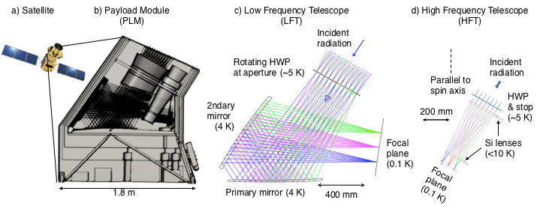
Payload Module: Phase-A1 2016 Baseline

Slide 19
LiteBIRD: 15 Frequency Bands
(Phase-A1 2016 baseline)

Slide 20
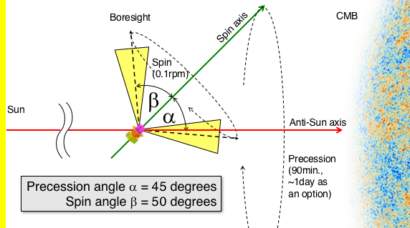
Scan Strategy
Orbit: L2 Lissajous
◯: good
△: marginal
Items | Alpha=65º/Beta=30º | Alpha=45º/Beta=50º | Comments
Thermal design | △ | ◯ | Moon shine
Cross links | ◯ | ◯ | Large-α is slightly better than smaller-α
Hit uniformity | Larger hole, smaller RMS | Smaller hole, Larger RMS | Hits concentration more around center hole w/ small-alpha option
Revisit time uniformity | △ (larger gaps in Δt dist.) | ◯ | Hole size also affects revisit time
Gain calib. w/ CMB dipole | △ | ◯ | ~10% better with small-alpha option
Beam calibration w/ Planets | △ | ◯ | Planet visible time ~x2 longer with small alpha-option

Slide 21
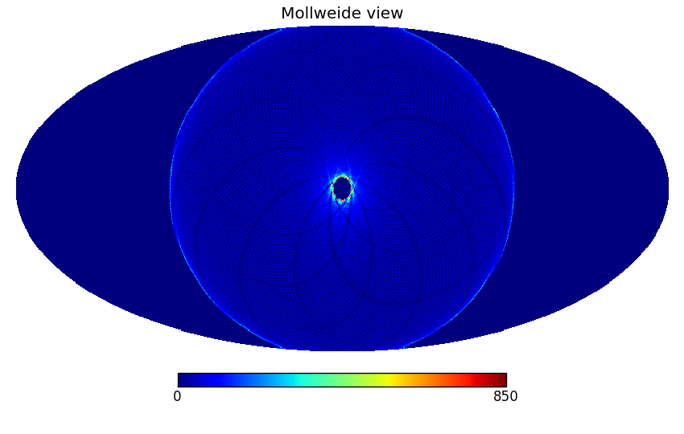
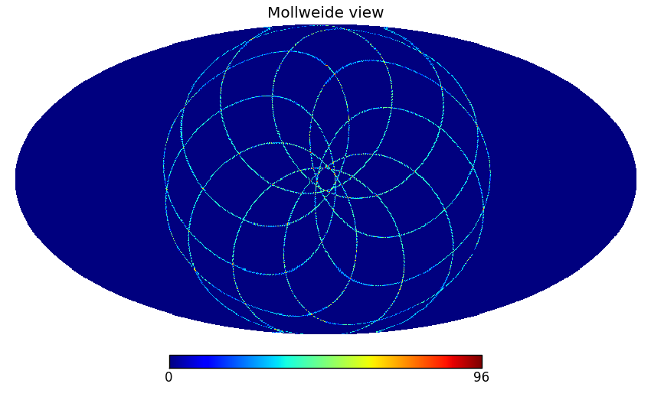
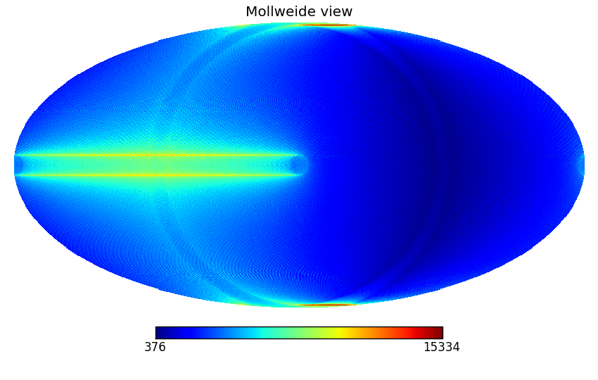
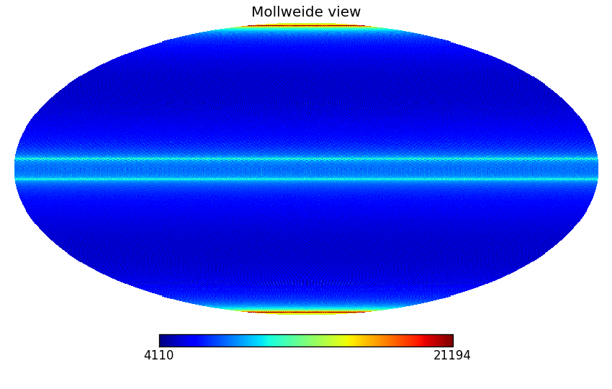
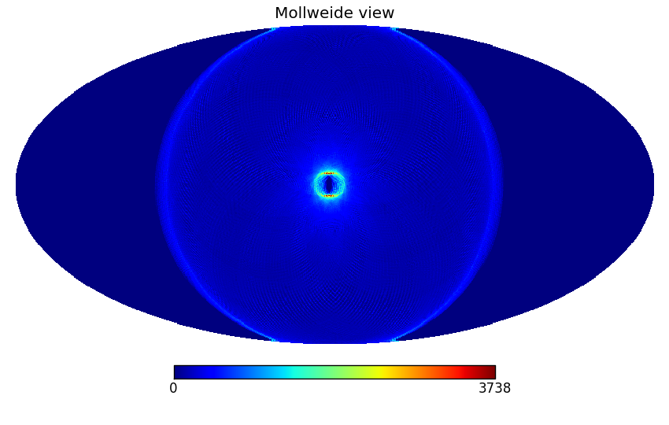
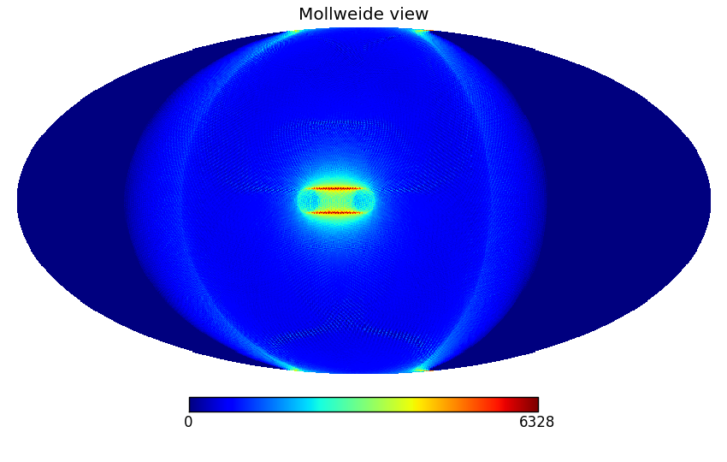
# of observations for each sky pixel
w/ a single detector
1 year
1 day
1 week
91 minutes
6 months
1 month

Slide 22
Main Specifications

Slide 23
2016 baseline is extendable
New launch vehicle: H-II → H3
New ground station: GREAT
New mirror design

Slide 24


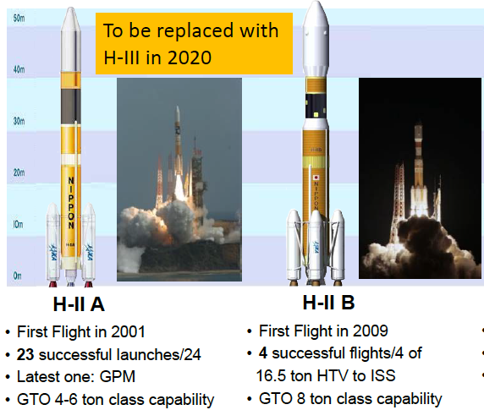
Launch Vehicle: H3
H3
First test launch in 2020
½ cost w/ same capability
(comparison w/ H-II B)
Larger envelope

Slide 25
Ground Station for Deep Space Exploration and Telecommunication (GREAT)
GREAT
Larger datalink capability

Slide 26
New Mirror Design for LFT
S. Kashima
Paper in preparation
SCS: Simple off-axis conic surface
ACS: Anamorphic conic surfaces
without higher-order terms
AAS: Anamorphic aspherical surfaces
with terms up to the 10th order
Strehl Ratio > 0.95 over 32 x 18 degrees²

Slide 27
Enhanced design example
Example focal plane in use
for foreground studies
(Slide shown by
M. Remazeilles)

Slide 28
Thermal design for enhanced focal planes
normal operation | mW
LF HWP | 2.0
HF HWP | 1.5
main truss | 8.4
radiation | 2.5
sensor/HK harness | 1.2
He lines | 1.7
Hybrid/ADR | 2.6
sum | 19.9
< 30 mW (requirement)
Outer shell (not shown) at 200 K
100K shield
30K shield
0.1K ADR
Aperture

Slide 29
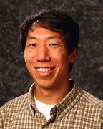
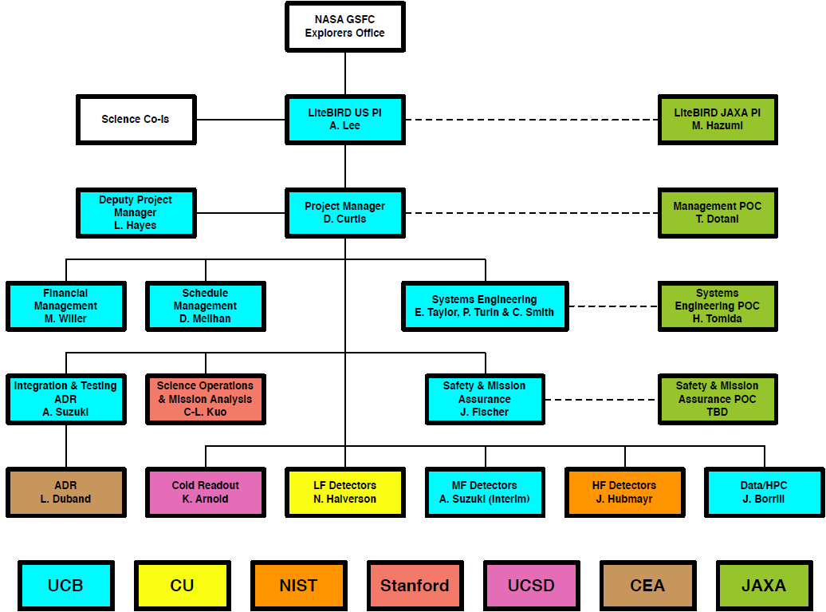
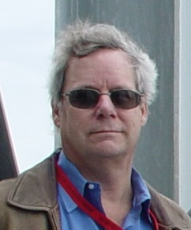
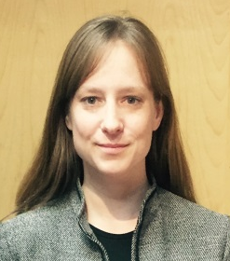
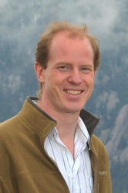
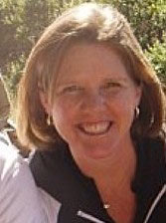
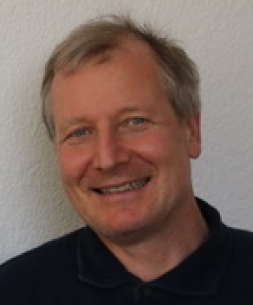
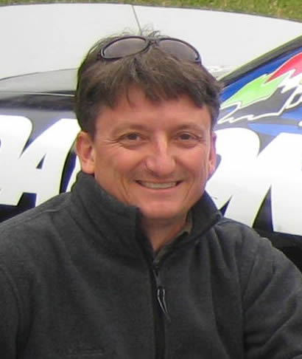
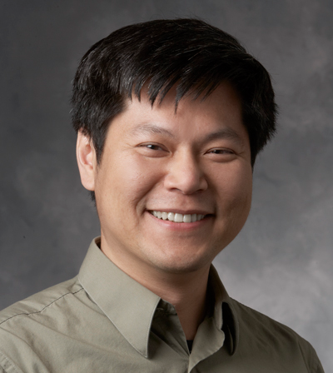
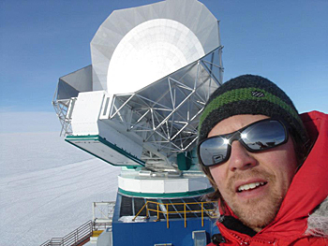
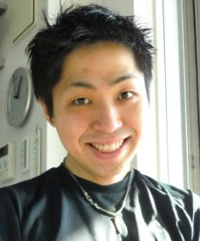

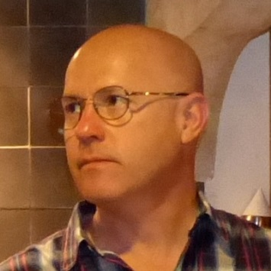

NASA MO Team leads
A. Lee

Slide 30
A. Lee
Technology Development for LiteBIRD and other CMB Missions
PCOS Program Technology Development
Kickoff
Adrian T. Lee
University of California, Berkeley
Physics Department and Space Sciences Laboratory
11/30/17

Slide 31
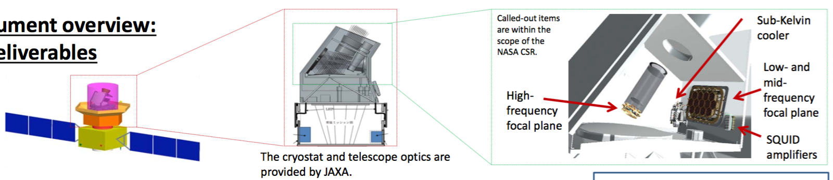
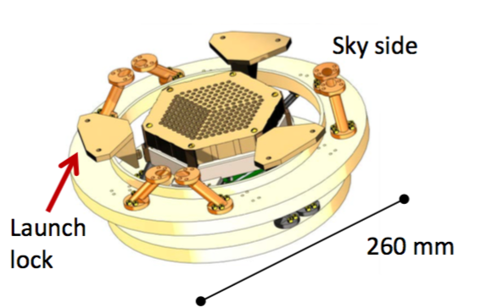
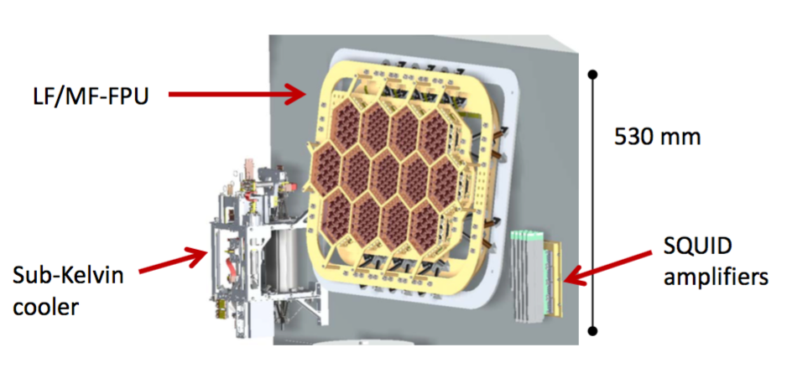
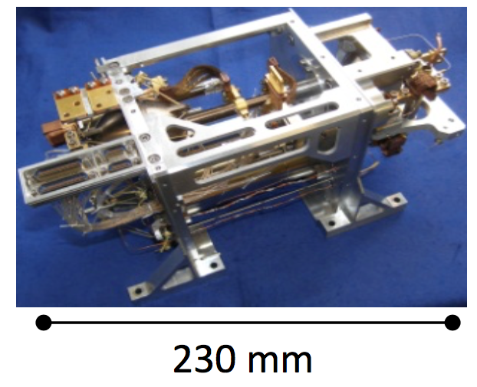
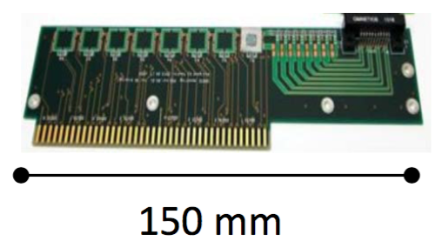
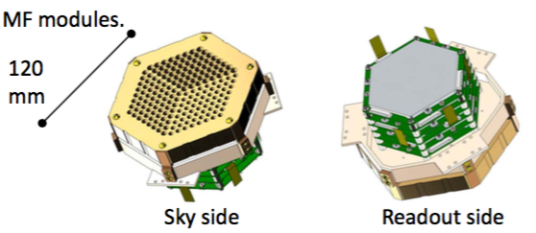
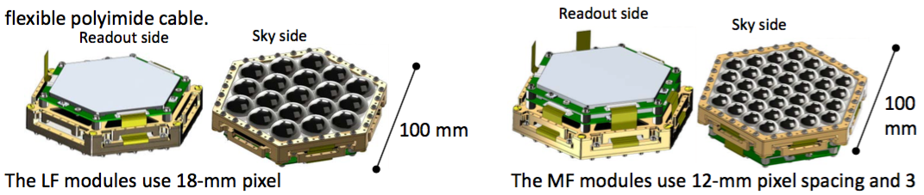
LiteBIRD U.S. Deliverables
A. Lee
HF = High Frequency, MF = Mid Frequency, LF = Low Frequency
to Europe
Sub-Kelvin Cooler
HF-FPU
SQUID Amplifiers
HF Module
LF Module
MF Module

Slide 32
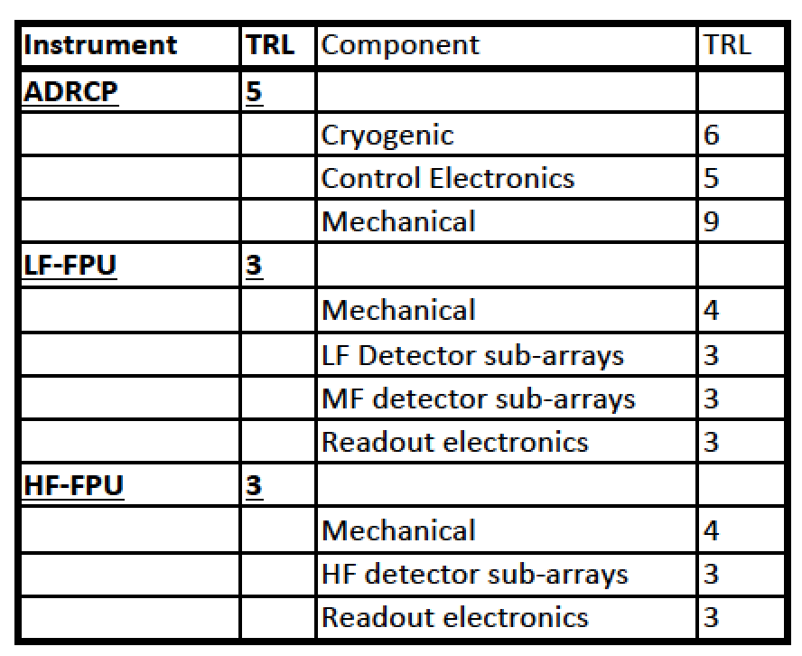
Objectives and Goals
A. Lee
Goal: Advance TRL of focal-plane and cryogenic readout
  2018 Mission of Opportunity preproposal
  2020 Concept Study Report (CSR)
  2021 Phase B Start
Sub-Kelvin
Cooler
to Europe
Low-frequency focal-plane unit
COMPONENT TRL GOAL: 5-6
(Preliminary)
High-frequency focal-plane unit

Slide 33
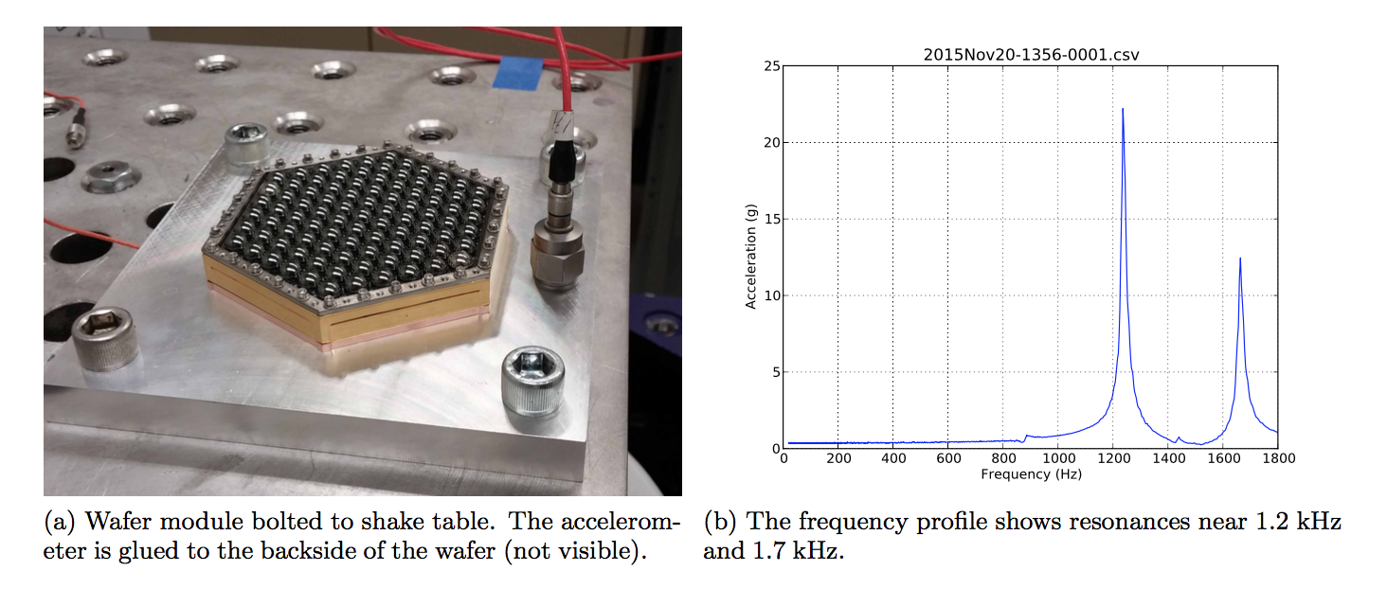
Technical Target #1 detector module launch vibration survival
A. Lee
Key performance specs or technical targets
  Detector Modules survive launch specification vibration
What are the success criteria?
  Successful verification of detector operation after shake test
Key challenges
  Brittleness of silicon wafers
Major milestones
  Measure resonance frequencies
  First full shake
  Redesign if needed
  Iterate cycle
Technology Readiness Level
assessment – current and target
  Currently at TRL 3
  Goal is 5-6

Slide 34
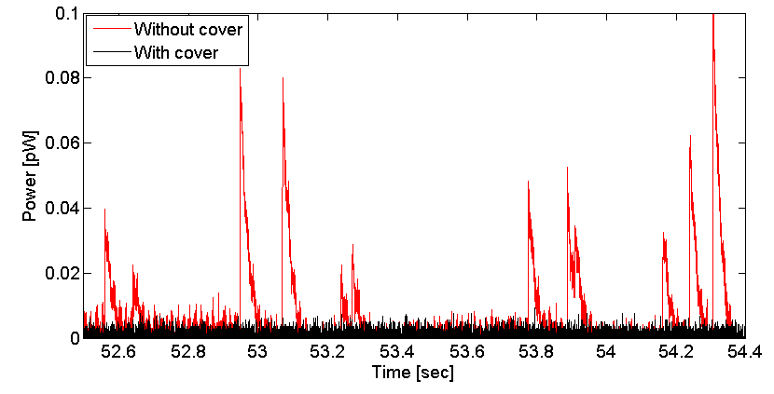
Technical Target #2 Cosmic Ray dead time mitigation
A. Lee
Key performance specs or technical targets
  Deadtime <~ 5% due to cosmic ray flux on detectors
What are the success criteria?
  Successful verification of deadtime using radioactive sources and accelerator sources
Key challenges
  Requires understanding of energy propagation mechanisms
  Building in mitigations without compromising detector function
Major milestones
  Measure susceptibility of ground-based designs
  Test mitigations one at a time
  Measure susceptibility
  Combine
Technology Readiness Level assessment
– current and target
  Currently at TRL 3
  Goal is 5-6

Slide 35
Canadian group formation
M. Dobbs
Proposal for development of Canadian Science Team also submitted recently

Slide 36
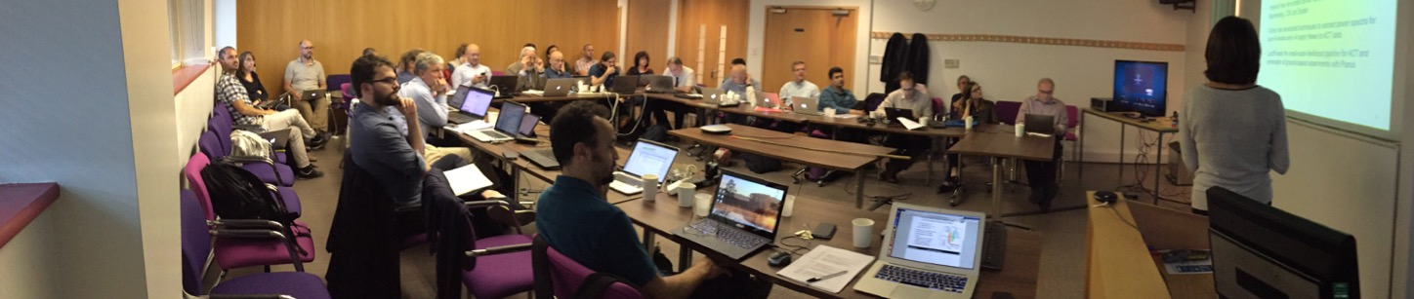
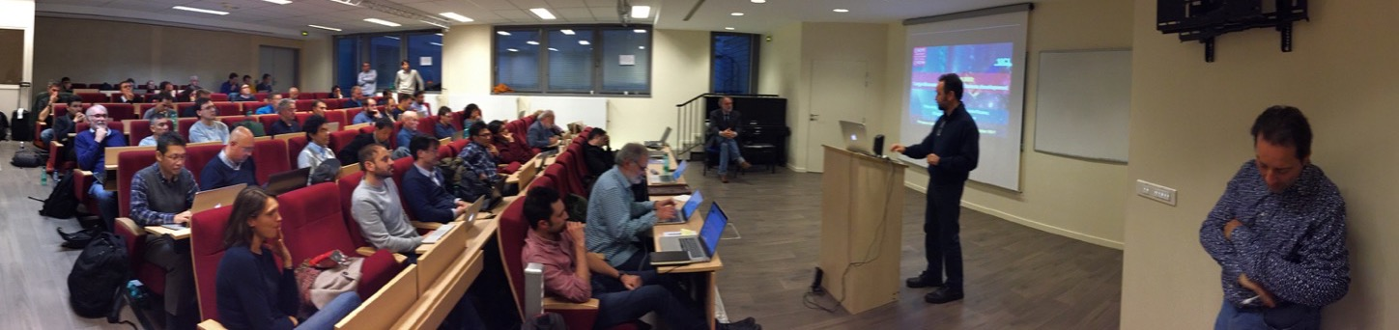

European LiteBIRD Consortium
1st Meeting in Cardiff (Aug 2-3, 2017)
2nd Meeting in Paris (Oct 23-24, 2017)
Expected major deliverables:
High-Frequency Telescope (HFT)
Sub-K cooling system
And strong role in data analysis
Discussions b/w
space agencies ongoing
JAXA ←→ASI, CNES, ESA
3rd Meeting in Turin
(Feb 8-9, 2018)

Slide 37

from LTD17 presentation by A. Suzuki

Slide 38
Keys to the success of Phase-A1
Successful R&D on critical payload components
  Polarization modulation
  Thermal design
Sufficient systematics and foreground mitigations
Sufficient calibration strategy and AIV plan
Reliable cost estimation
Clear international interfaces

Slide 39

LiteBIRD Summary
JAXA’s strategic L-class mission candidate, currently in Phase-A1
CMB polarization all-sky surveys for testing cosmic inflation
  One of top-priority science goals in JAXA roadmap
Launch in mid 2020’s w/ JAXA’s H3 for 3-year observations at L2
Focused mission & great outcomes
  δr < 0.001 (2 ≤ ≤ 200)
International project
  Japan: Heritages from JAXA’s cryogenic
  satellites, experiences from ground-based CMB
  projects, large HEP/astronomy projects
  US: Detector technology and experiences
  from ground-based CMB projects and Planck
  Canada: Warm readout electronics
  Europe: Planck legacies/lessons learned
Notes:
Here is the current situation. First of all,
the LiteBIRD proposal has passed the initial down-selection by ISAS of JAXA in June this year.
It is now in transition to phase-A studies.
A proposal by the US LiteBIRD team led by Adrian Lee at UC Berkeley was submitted to NASA last December.
It also passed the initial down-selection last month.
They are now also starting phase-A sutdies.
So LiteBIRD is now gaining some momentum.
PIXIE was porposed as a NASA’s small PI-led mission in 2011. It was not selected, but
the team plans to re-propose to the next MIDEX AO, which is likely to be in 2017.
There will be an ESA M5 call; the due date is not yet clear but will be next year.
The planned launch date will be around 2030.

Slide 40
Backup slides

Slide 41
Endorsements for LiteBIRD in Japan
MEXT roadmap 2017 (August 2017)
  proposed by Japanese Radio Astronomy community
  endorsed by Japanese HEP community
  LiteBIRD is selected as one of 7 new large-scale projects
JAXA roadmap
  Probing inflation from B-mode listed as one of top scientific objectives
JAXA prefers focused missions for strategic large mission program. LiteBIRD is exactly a focused mission.
LiteBIRD is very well endorsed !

Slide 42

Jan. 4, 2017
NASA Selects Mission to Study Jupiter’s Trojan Asteroids
NASA’s Lucy mission, which will launch in 2021 for the first reconnaissance of the Trojans, a population of primitive asteroids orbiting in tandem with Jupiter.
https://www.nasa.gov/feature/goddard/2017/nasa-selects-mission-to-study-jupiter-s-trojan-asteroids

Slide 43
http://jpn.nec.com/solution/space/technology/satellite004.html#astro-h
NEC

Slide 44
MELCO
http://www.mitsubishielectric.co.jp/society/space/satellite/heritage/index.html

Slide 45







Testing and integrations
LiteBIRD has members with the CMB instrument integration expertise, satellite integration expertise, HEP radiation expertise together with the fully equipped facilities.
JAXA 13-m diameter space chamber
Astro-H test is done here.
POLARBEAR2 integration is ongoing at KEK with sub-K cryogenic system and UC Berkeley TES bolometers.
JAXA Antenna test facility
JAXA 1-m diameter space chamber
Proton irradiation tests at HIMAC
JAXA 6-m diameter space chamber
Notes:
他の今後の課題：大面積化（6-inch wafer），1/f noise suppression，宇宙線耐性，space qualifiedな読み出し

