Slide 1
The Early and the Late Universe:
Inflationary Features and Implications on Cosmological Parameters
Cora Dvorkin
Harvard University
“B-mode from space” workshop,
December 2017, Berkeley

Slide 2
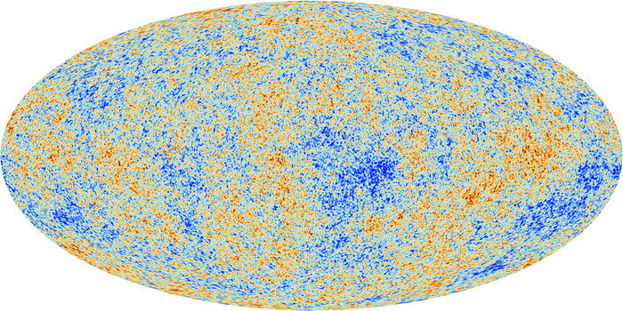
Cosmic Microwave Background
Planck collaboration

Slide 3
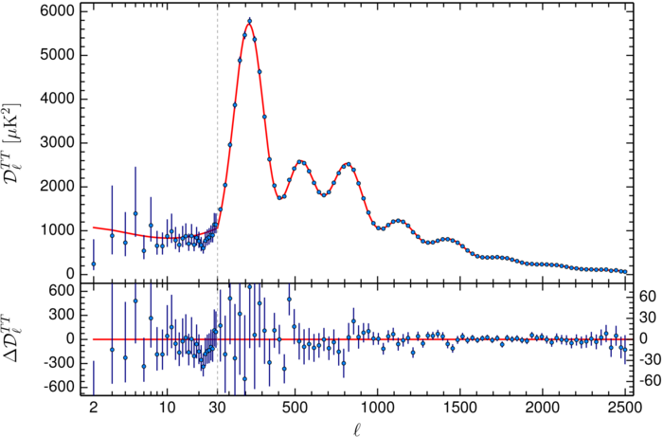
CMB Power Spectrum
Power spectrum: predicted and measured with great precision.
Planck collaboration

Slide 4
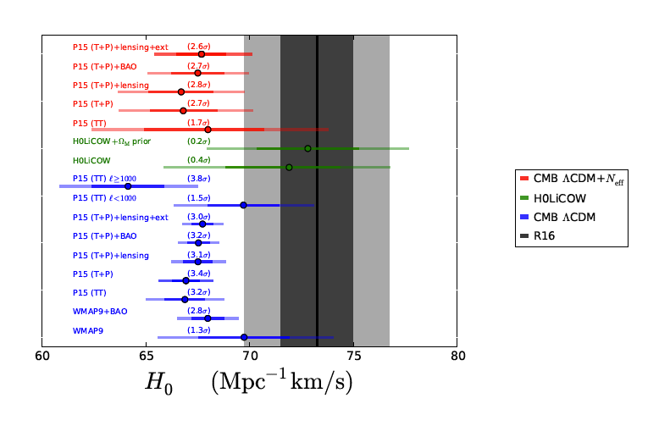
H₀ tension
Bernal et al., JCAP (2016)

Slide 5
Local cosmological inferences depend on the assumptions in the CDM model, in particular the form of the inflationary power spectrum.

Slide 6
Going Beyond Slow Roll
Slow roll is a commonly used approximation for inflationary models
where the scalar field potential is sufficiently flat and slowly varying.
It leads to curvature power spectra that are featureless and nearly scale
invariant.
Generalized Slow-Roll approximation: allows for features in the inflationary
potential. Here, the curvature power spectrum depends on a single source
function (responsible for the observable features):
C.Dvorkin, W.Hu, PRD (2009)
Simple to relate to the inflaton potential:

Slide 7
CMB TEMPERATURE
POWER SPECTRUM
INFLATIONARY
POTENTIAL
INITIAL CURVATURE
POWER SPECTRUM
CMB POLARIZATION
POWER SPECTRUM
wavenumber k [Mpc⁻¹]

Slide 8
CMB TEMPERATURE
POWER SPECTRUM
INFLATIONARY
POTENTIAL
INITIAL CURVATURE
POWER SPECTRUM
l
OBSERVABLES
CMB POLARIZATION
POWER SPECTRUM
wavenumber k [Mpc⁻¹]

Slide 9
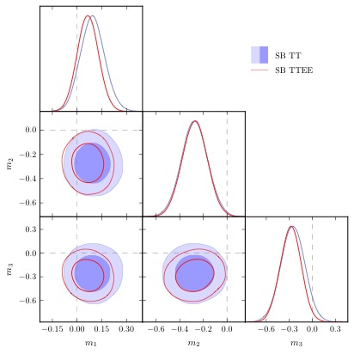
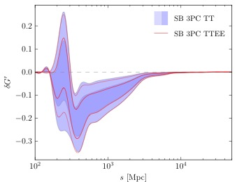
Functional reconstruction of Generalized tilt
• 2 PCs (out of 20) deviate from zero the 99% CL.
• These deviations prefer a sharp suppression in power at k=0.004 Mpc⁻¹.
Planck (2015) data
G. Obied, C. Dvorkin, C. Heinrich, W. Hu, and V. Miranda, PRD (2017)

Slide 10
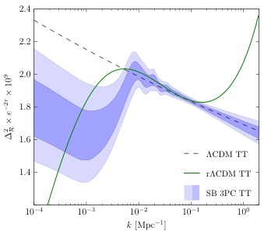
Initial Curvature Power Spectrum Reconstruction with Planck data
Planck (2015) data
G. Obied, C. Dvorkin, C. Heinrich, W. Hu, and V. Miranda, PRD (2017)

Slide 11
Features from Inflation
and our inference of the Hubble constant
• Local cosmological inferences depend on the assumptions in the CDM model,
in particular the form of the inflationary power spectrum.
Planck (2015) data
G. Obied, C. Dvorkin, C. Heinrich, W. Hu, and V. Miranda, PRD (2017)

Slide 12
Residuals in the TT data
G. Obied, C. Dvorkin, C. Heinrich, W. Hu, and V. Miranda, PRD (2017)

Slide 13
H₀ and inflationary parameters
G. Obied, C. Dvorkin, C. Heinrich, W. Hu, and V. Miranda, PRD (2017)

Slide 14
Response functions

Slide 15
Residuals in the TE data
G. Obied, C. Dvorkin, C. Heinrich, W. Hu, and V. Miranda, PRD (2017)

Slide 16
H₀ and polarization data
G. Obied, C. Dvorkin, C. Heinrich, W. Hu, and V. Miranda, PRD (2017)

Slide 17
Amplitude of structure
G. Obied, C. Dvorkin, C. Heinrich, W. Hu, and V. Miranda, PRD (2017)

Slide 18
Constraints on inflationary parameters
• n_{run,run} shows a 1.9 preference for violation of slow-roll in the r CDM model.

Slide 19
Conclusions
• Explored the relationship between features from inflation, and shifts in the cosmological
parameters.
• Preference for high H₀ and low values in from the TT data at <1000 is
driven by low <40 residuals in the data.
• However, TT, <1000 does not match the residuals particularly well.
Fitting for inflationary features, the low H₀ values favored by the full TT data are compatible
with TT, <1000 data.
• The SB parameters show 2 PCs that deviate from zero at 99% CL.
These deviations prefer a sharp suppression in power at k=0.004 Mpc⁻¹.
• Planck TE data prefers low H₀ values (due to an outlier at the l=165 bin,
region particularly sensitive to changes in ).
• Future polarization data should provide insight into low- TT residuals.
Features from reionization will have to be disentangled from features from inflation
(work in progress; see Vinicius Miranda’s talk).

Slide 20
Extra Slides

Slide 21
Low-l TT residuals
G. Obied, C. Dvorkin, C. Heinrich, W. Hu, and V. Miranda, arXiv:1706.09412 (2017)

