Slide 1
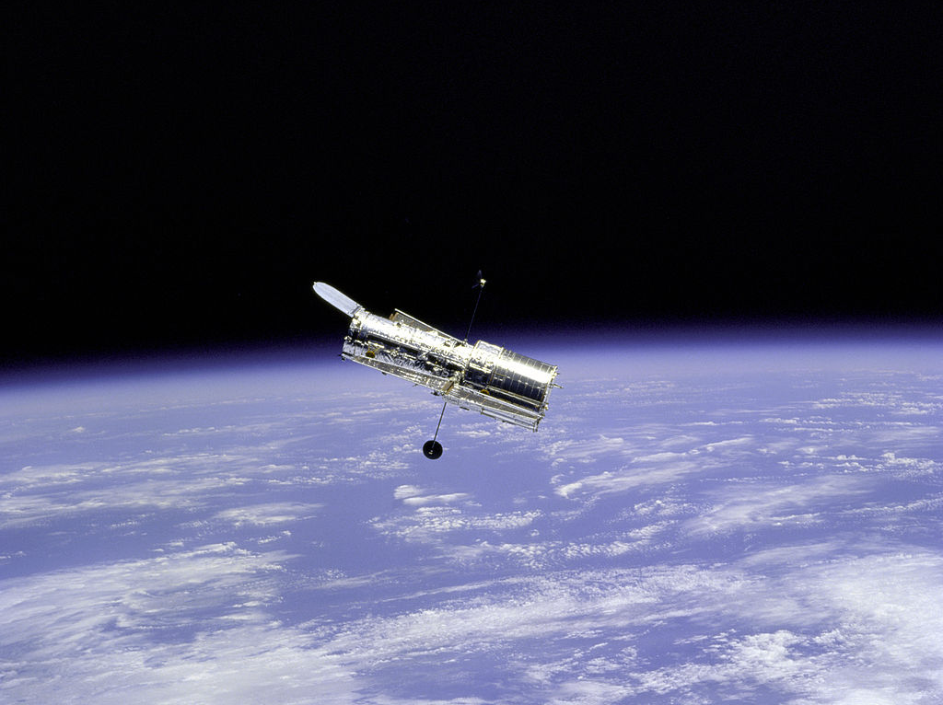
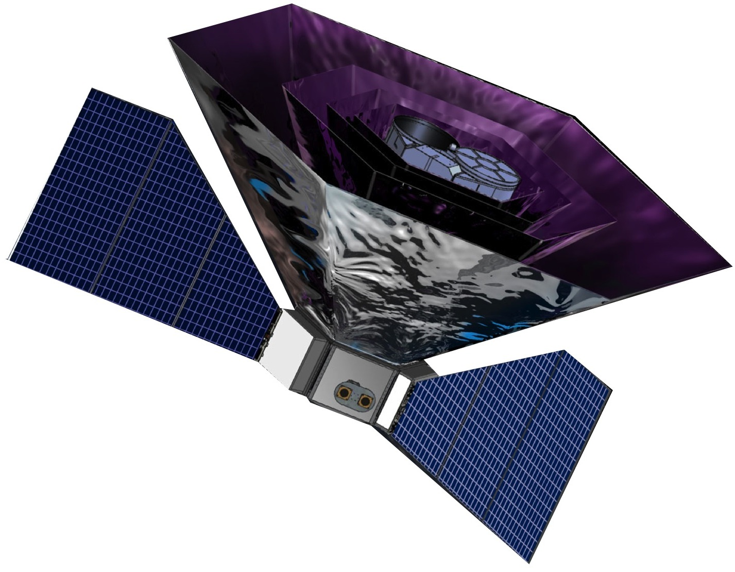
Galactic Dust
D Fixsen
University of Maryland / Goddard Space Flight Center

Slide 2
1) How good do we need to model the dust?
2) How do we model the dust?
3) How do we know it is good enough?
In order to measure r~.001 B modes!

Slide 3
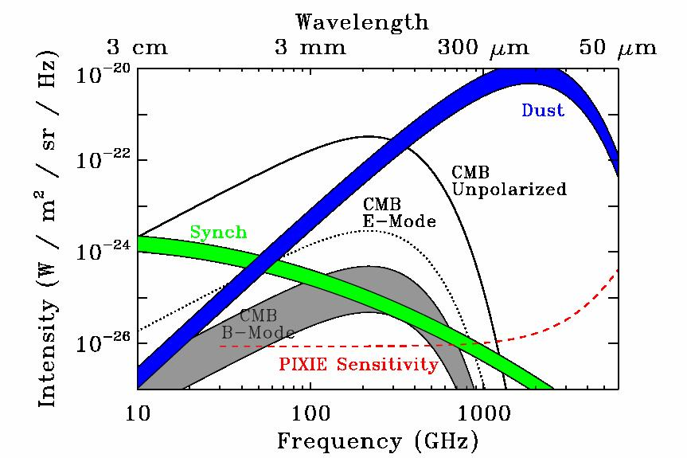
Interstellar Dust
Pixel-by-pixel dust characterization need to get to few*.001 of dust

Slide 4
How do we model the dust?
A)Build a model based on the physics of dust
Problem: Physics is complicated
B)Build a parametric mathematical spectral model
Problems: Different parameterizations lead to different results.
Need many frequencies (more than parameters)
C)Build a parametric mathematical spatial model
Problems: Low l’s are hard
Variation in distance
Real physical scales
What are the spatial variations in B modes
D)Combination of A, B & C
Problem: The model is complex

Slide 5
Dust is small (<1 um? )
Dust is cold (<30 K? )
Dust is thin (~10⁻⁵ ? )
Spherical dust r<<λ
Model aν²B_{ν}(T)

Slide 6
Temperature Distribution
Radiation Field – temperature proportional to radiation^(1/6)
Particle Size – bigger particles cooler
Chemistry – dependence on optical/UV vs IR emissivity
Stochastic Variation – dependence on time since UV photon
Dust must have a temperature distribution

Slide 7
Dash = ν²B_{ν}(T) uniform distribution
T = [0,20 K]
Dot = ν^{β}B_{ν}(T) modified black body
β=1.69 T = 18.03 K

Slide 8
FIRAS frequencies and weights ->
T = 18.03 K, β=1.69
Match is within 0.2% over the range .07-1.8 THz
4% at 3 THz
where FIRAS uncertainties are large
With PLANCK frequencies and weights ->
T=16.35 K, β=1.85, error of 20% at 30 GHz

Slide 9
Principle Component Analysis
allows data to show the way
Eigen Values > Eigen spectrum
Eigen Vectors > What is important

Slide 10
Eigen Value Spectrum

Slide 11
Take out known signals
Uniform Black Body spectrum (1 DOF)
CMB dipole (3 DOF)
Zodiacal emission (2 DOF)
C+ & N+ emission (12126 DOF)
CIB ???
CMB anisotropy?
CIB anisotropy?

Slide 12
Average of dimmest 10% of sky
Dash = uniform ν²B_{ν}(T) T=2.8-17.4 K
Dot = ν^{β}B_{ν}(T) β=.65 T=24.75
Dash-Dot CIB (Fixsen etal 1998)

Slide 13
Prime Eigen Vector
Dot = ν²B_{ν}(T) T=19.84 K

Slide 14
Second Eigen Vector
Dot = ν²dB_{ν}(T)/dT T=19.84 K
Dash = ν²dB_{ν}(T)/dT T=17.48 K

Slide 15
Third Eigen Vector
Dot = ν²d²B_{ν}(T)/dT² T=19.84 K

Slide 18
Residual Prime Eigen Vector (60% sky)
Dot = ν²B_{ν}(T) T=23.36 K

Slide 19
FIRAS data has too much noise
Include PLANCK data
Subtract CIB (which also removes offsets)
Subtract dipole (already done)
Subtract Zodi
Exclude brightest 40% of sky
Convolve with FIRAS Beam

Slide 20
Tilted by ν⁻²
Dot =CO lines
Dash =Sum
Warm Dust
ν²B_{ν}(20 K)
Synchrotron
ν^{-.7}
Cold Dust
ν²B_{ν}(5 K)

Slide 21
Summary
Dust is complicated, even along line of sight
Complications matter at level r<0.01
Available data show complications,
but can't unravel them
To KNOW we got it, extra frequencies, extra pixels
and extra S/N are needed.
Extra frequencies to analyze dust available .5-3 THz

