Slide 1
Equivalence principle violation after reheating
Daisuke Nitta (Nagoya University)
With Yuki mori, Koichiro Horiguchi (Nagoya),
Shohei Saga (Kyoto)
why does the universe accelerate@Tohoku univ.

Slide 2
・Table of contents
・motivation
・Horndeski vector-tensor theory
・perturbation in the thermal bath
・gravitational wave
・summary

Slide 3
・Motivation
Quantum gravity ?
Modified gravity
Extra field
Other
mechanisms
Dark Energy

Slide 4
・Motivation
Quantum gravity ?
Modified gravity
Extra field
Other
mechanisms
Dark Energy

Slide 5
・Motivation
Horndeski theory
(Horndeski 1973)
Gravity coupled with
Extrafield
(Ordinary) particle
Dark energy ?
Einstein’s equivalence principle(EEP) violation

Slide 6
・Motivation
Horndeski theory
(Horndeski 1973)
Gravity coupled with
Extrafield
(Ordinary) particle
Dark energy ?
Einstein’s equivalence principle(EEP) violation

Slide 7
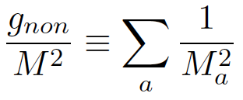
・Horndeski vector-tensor theory
We consider up to the first order of R
We will take into account all gauge field
Our model has
one free parameter
g_{non}: degree of freedom of gauge field

Slide 8
・Horndeski vector-tensor theory
Current solar system experiment gives
a lower limit
(Prasanna et.al. 2003)
M> 10⁻¹⁴ eV

Slide 9
・Horndeski vector-tensor theory
Why is it better after reheating?
The observation values depend on
the curvature to parameter M ratio, R/M
・In the expanding universe, this ratio is H/M.
・In the early universe,
ordinary particles was in a termal bath.
gravitational waves have been influenced
although M is relatively large.
(compared with M~10⁻¹⁴ eV)

Slide 10
・Horndeski vector-tensor theory
Einstein equation
Stress-energy tensor
Equation of motion for the gauge field

Slide 11
・Horndeski vector-tensor theory
x_{p}
y
curvature
x=x_{p}+y
Eikonal apploximation
gauge
Polarization vector

Slide 12
・Horndeski vector-tensor theory
Projecting into the polarization space
Dispersion relations
(Drummond&Hathrell 1980)

Slide 13
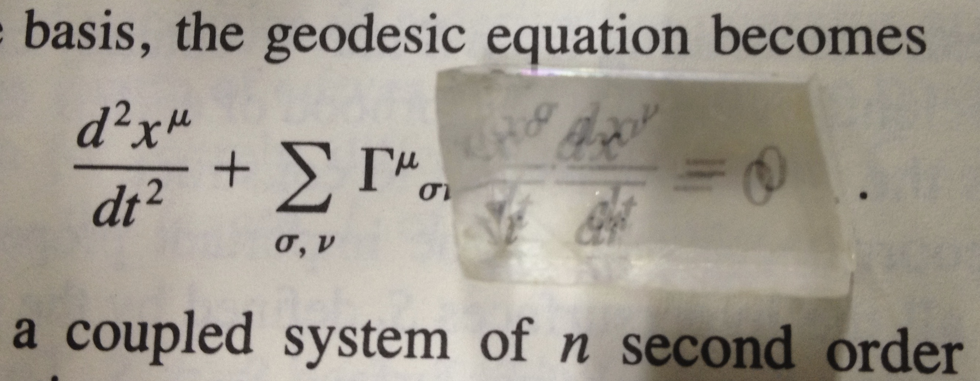
・Horndeski vector-tensor theory
Birefringence
(Drummond&Hathrell 1980)

Slide 14
・Perturbation in the thermal bath
・metric
・Einstein equation
Z: partition function

Slide 15
・Perturbation in the thermal bath
Why does the birefringence or dispersion relation
affect the gravitational wave ?
In a local coordinate system
I = +,-
from tensor mode

Slide 16
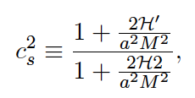
・Perturbation in the thermal bath
There is an upper limit of H^2/M^2
Laplacian instability
(B. Jimenez et al 2013)
The phase velocity
>0
q=1 : radiation
q=1/2: matter
Speed of the particle are given b

Slide 17
・Perturbation in the thermal bath
0th order equations
~ Radiation dominated universe
Upper limit

Slide 18
・Gravitational wave
To derive the gravitational wave, we approximate as
・radiation dominated universe
・up to the first order of H^2/M^2 <1
Equation
Energy density

Slide 19
・Gravitational wave
In the standerd theory
g*=106.75, g_{non}=24
When the reheating temperature T* ~ 10^7 GeV,
then f*~0.1Hz
DECIGO can detect the following parameter range
M^2 ~ 0.1MeV

Slide 20
・Summary
・non-minimal coupling causes the equivalence principle
Violation.
・In the Horndeski vector-tensor theory,
We calculate gravitational wave in the thermal bath.
Gravitational waves are slightly enhanced by anisotropic
stress.
・DECIGO can detect when M is larger than 0.1MeV

