Slide 1
On Observational Effects of Spherical Inhomogeneity
公募研究
「加速宇宙観測における等方な非一様性による系統誤差と宇宙原理の観測的検証」
について
Chulmoon Yoo(Nagoya Univ.)

Slide 2
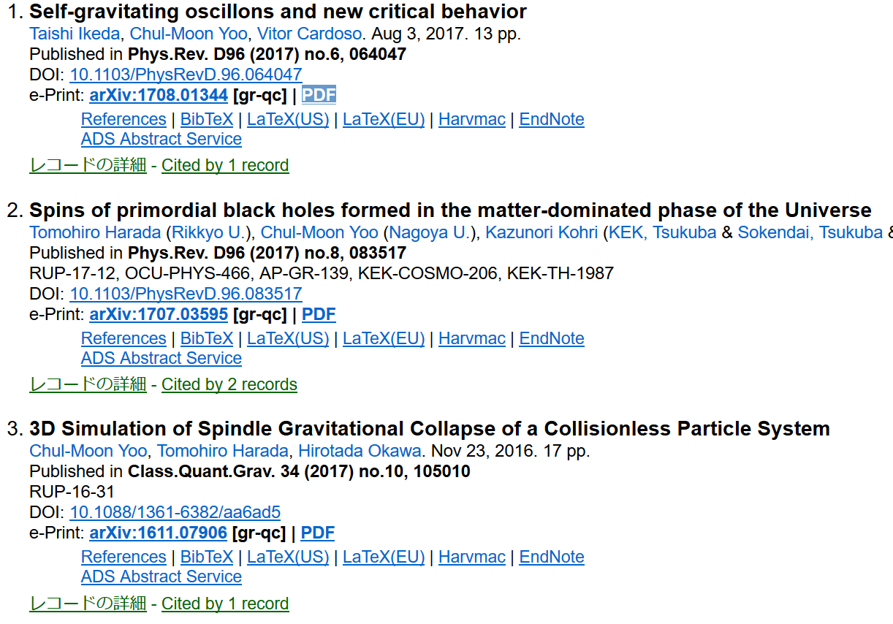
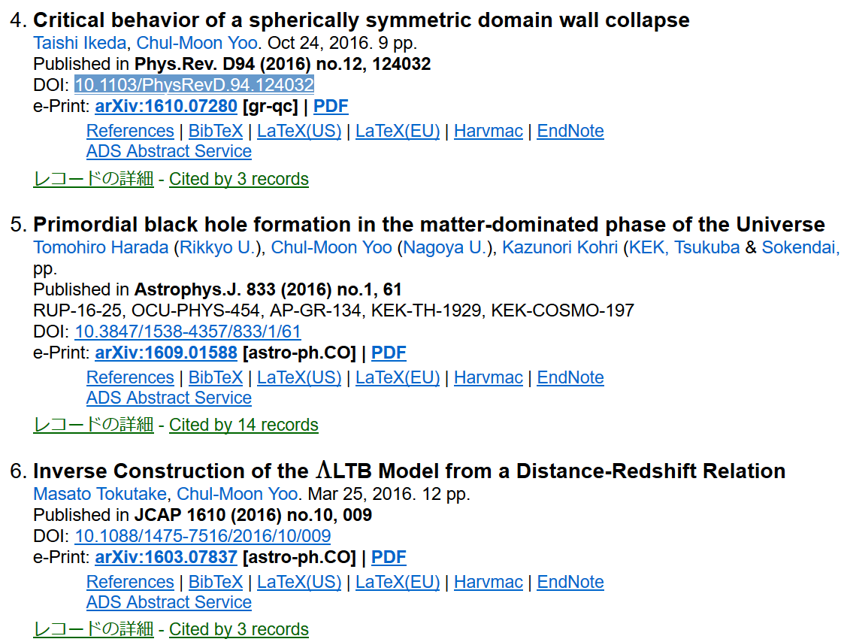
Published papers
Supported by A03 “Koubo-kenkyuu”
Collaboration with Kohri-san(A02)
Selected in the CQG highlight2017
On spherical inhomogeneity

Slide 3
On Observational Effects of Spherical Inhomogeneity
公募研究
「加速宇宙観測における等方な非一様性による系統誤差と宇宙原理の観測的検証」
について
Chulmoon Yoo(Nagoya Univ.)

Slide 4
Test of Cosmological Principle
◎Isotropy around us can be directly observed
◎Direct observation of the homogeneity is impossible
・ Communication w/ an observer separated by cosmological distance
◎Standard way
◎Non-standard way
・ Accept the Copernican principle
・ We are in the center
of an isotropic universe
・ Isotropy + Copernican principle
→ Homogeneity
(Cosmological principle)
・ How can we
observationally rule out it?
◎Indirect observational tests of cosmological principle

Slide 5
Effects of Spherical Inhom.
◎Distance-redshift relation for $Λ>0$ FLRW can be realized
by the spherical void model(LTB) without $Λ$
[iguchi, Nakamura, Nakao,astro-ph/0112419]
[CY,Kai,Nakao,arXiv:0807.0932]
◎Spherical inhomogeneity may cause a systematic error
in estimation of $Λ$
◎Existence of the void can make the value of local Hubble
higher than the asymptotic value measured by CMB.
The H₀ tension could be resolved.
◎Local void⇒small $σ_{8}$ and fewer cluster
[Marra et.al, arXiv:1303.3121]
[Keenan et.al, arXiv:1304.2884]
[Lee, arXiv:1308.3869]
[Ichiki, CY, Oguri arXiv:1509.04342]

Slide 6
(Λ)ＬＴＢ model
◎Spherically symmetric dust solution of Einstein Eqs.
◎Two independent physical functional d.o.f of radial coord. $r$
$k\left(r\right)$ ： 「curvature function」 ~ growing mode
$t_{B}\left(r\right)$ ： 「Bang time function」 ~ decaying mode
◎Here, we assume $t_{B}=const.$
・ Existence of the decaying mode spoils almost everything
→little prediction
◎ $k\left(r\right)$ should be fixed somehow

Slide 7
Setting
◎Fix $k\left(r\right)$ s.t. the observed distance is given by that of FLRW
$$D\left(z\right)=D_{FLRW}(z;Ω_{m0}^{dis},Ω_{Λ0}^{dis},H_{0})$$
◎The real value of $Λ≠3H_{0}Ω_{Λ0}^{dis}$⇒inhomogeneity
◎$ΛLTB$ is specified by 3 params.:($Ω_{Λ0}^{dis}$, $Ω_{m0}^{dis}$, $R_{Λ}≔Ω_{Λ0}/Ω_{Λ0}^{dis}$)
◎ $k\left(r\right)$ is modified so that it may asymptotically become flat FLRW
◎Constraints from CMB power spectrum and H₀

Slide 8
CMB in LTB
◎LTB with growing mode inhomogeneity
$$T_{0}=2.725$$
FLRW with radiation
・Parametrize the LTB function $k(r)$
・Solving geodesic, we obtain
the redshift~temperature
~radiation density
past light cone
・Matter density is also known
・Others are free
・Temperature fluctuation
for the corresponding FLRW model
ＬＳＳ
◎Correction associated with difference of distance($θ=\frac{diameter}{distance}$)
$C_{ℓ}=\sum_{ℓ^{′}}{\frac{2ℓ^{′}+1}{2}C_{ℓ^{′}}^{′}\int_{0}^{π}{P_{ℓ^{′}}\left(cos\left(θD_{A}/D_{A}^{′}\right)\right)P_{ℓ}\left(cosθ\right)sinθdθ}}$
$C_{ℓ}=\left(D_{A}^{′}/D_{A}\right)C_{D_{A}^{′}ℓ/D_{A}}^{′}$
flat sky approx.（$ℓ≫1）$

Slide 9
Setting for Power Spectrum
◎Data: Planck data ($ℓ>20$: flat sky approx)
◎Model parameters
・ 3 LTB parameters ($Ω_{Λ0}^{dis}$, $Ω_{m0}^{dis}$, $R_{Λ}$)⇒gradually connected to flat $ΛCDM$
・ Optical depth $τ$ is fixed as $τ=0.1$
・ Other parameters ($H_{0}$, $n_{s}$, $A$, $α≔baryon/matter$)
・ CosmoMC with 7 parameters
・ Prior: $H_{0}=72.5±2.5[km s^{−1} Mpc^{−1}]$ ⇒ Constraint on void depth
With Tokutake-kun and Ichiki-san

Slide 10
Contour map
◎Void depth
$Δ_{0}$:= ([central density] - [asym. density])/[asym. density]
・smaller $R_{Λ}$: deep void
・void depth is constrained
・$Ω_{Λ}=0$ is ruled out
・Significant inhomogeneity
is still possible

Slide 11
Previous Work
◎ Valkenburg, Marra and Clarkson[1209.4078]
-Form of curvature function is given by hand(3 parameters)
-WMAP, H0, BAO, SN, age data, linear kSZ and Compton-y from COBE
- $−0.29<δ_{0}<0.14(2σ)$ : “strongest constraint from kSZ”

Slide 12
Contour map
◎Void depth
$Δ_{0}$:= ([central density] - [asym. density])/[asym. density]
・smaller $R_{Λ}$: deep void
・void depth is constrained
・$Ω_{Λ}=0 is ruled out$
・Significant inhomogeneity
is still possible

Slide 13
Cluster kSZ Constraint
◎kSZ would be more effective to give a constraint
・ Planck: $ΔT/T≲8.8×10^{−4}$ for $z<1$
cluster
$$ΔT=T_{0}−T_{1}$$
T₀
T₁

Slide 14
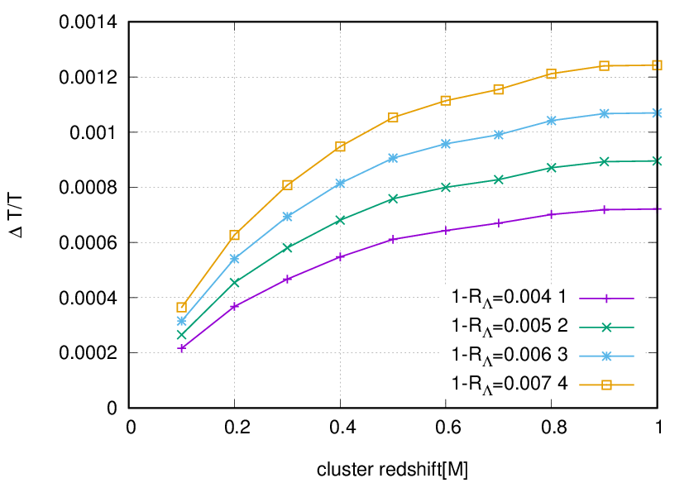
kSZ
($Ω_{Λ0}^{dis}$=0.7, $Ω_{m0}^{dis}$=0.3)
preliminary

Slide 15
Summary
◎CMB + H₀
・ Λ=0 is ruled out but still significant void depth is possible
◎kSZ would be more effective to give a constraint
・ Planck: $ΔT/T≲8.8×10^{−4}$ for $z<1$
・ $1−R_{Λ}≲0.004⇒$ ~0.4% systematic error
in cosmological parameters would be expected
⇒ at least a few % void depth can be constrained

Slide 16
Thank you

Slide 17
H₀ tension and inhomo.
◎No correlation between $Δ_{0}$ and H₀ ?（We have to check def. of $Δ_{0}$)
◎Correlation with fixed $Ω_{K0}^{dis}$ ⇒Resolution of H₀ tension without $Δ_{0}$?

Slide 18
Summary
◎CMB + H₀
・ Λ=0 is ruled out but still significant void depth is possible
◎kSZ would be more effective to give a constraint
・ Planck: $ΔT/T≲8.8×10^{−4}$ for $z<1$
・ $1−R_{Λ}≲0.004⇒$ ~0.4% systematic error
in cosmological parameters would be expected
◎Resolution of H₀ tension with non-void spherical inhom.?

