Slide 1
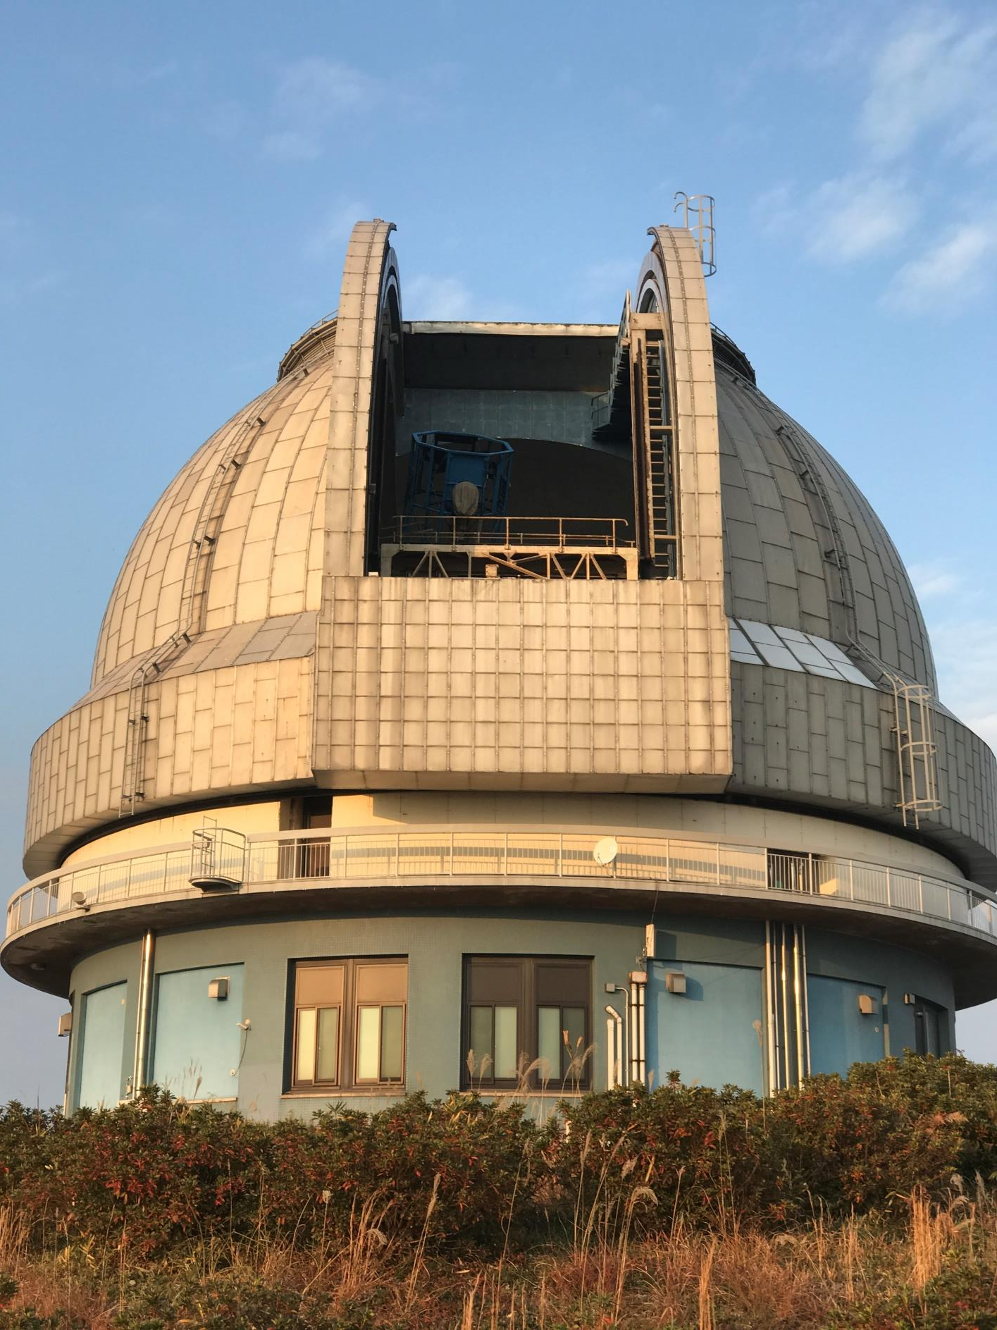





Astro-comb developed by AIST and the test observation at OAO
12 Feb. 2017, Why does the Universe accelerate? @Tohoku univ.
Sho OKUBO^{1,5}
K. Nakamura,^{1,5} M. Schramm,^{1,3,5} H. Yamamoto,^{2,5} J. Ishikawa,¹
K. Hosaka,^{1,5} F.-L. Hong,^{1,2,5} A. Onae,^{1,5} K. Minoshima,^{4,5} H. Tsutsui,^{3,5}
E. Kambe,^{3,5} H. Izumiura,^{3,5} and H. Inaba^{1,5}
1. National Institute of Advanced Industrial Science and Technology
2. Yokohama National University, 3. National Astronomical Observatory of Japan,
4. The university of Electro-Communications,
5. JST ERATO “Minoshima Intelligent Optical Synthesizer Project
Notes:
Thank you for introduction. I am Sho Okubo from AIST. Today, I’d like to talk about “Astro-comb developed by AIST and the test observation at OAO”

Slide 2
Outline
Motivation
  Optical frequency comb as a standard for spectrometers
Overview of our astro-comb
  I₂-stabilized laser
  Optical frequency comb
  Visible comb generation
  Mode-filtering cavity
Current status
  Astro-comb spectrum
  Test observation
Future plans
Notes:
First, I will talk about the motivation to develop astro-comb. Next, I will explain the overview of our astro-comb. Then, I will talk about the current situation. Finally, I will briefly touch on future plans.

Slide 3

Radial velocity measurement
Application 1：Exoplanets exploration
Application 2：Study of Universe acceleration
Star
Shift to high
frequency
Planet
Shift to low
frequency
Observer
Frequency
(radial velocity)
Novel prize HP
http://www.nobelprize.org/nobel_prizes/physics/laureates/2011/popular.html
Time
?
Frequency
(radial velocity)
Time
Notes:
Recent astrophysics requires precise measurements of Doppler shift of atomic absorption lines. The precision of “Horizontal axis” of astronomical spectrograph has become important.
For example, exoplanets exploration has become possible, and it is expected that it will be possible to directly observe the universe acceleration. For these applications, a resolution of several cm/s is required for the radial velocity observation.
最近の天体物理学では、原子吸光線のドップラーシフトの正確な測定が必要です。 天文学的な分光写真の「水平軸」の精度が重要になってきました。
例えば、外惑星探査が可能になり、宇宙の加速を直接観察することが可能になることが期待されます。 これらの用途では、視線速度観測に数cm / sの分解能が必要です。

Slide 4
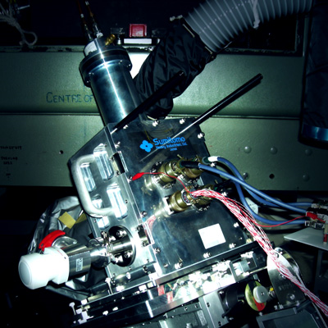
Radial velocity measurement
High dispersion spectrograph “HIDES-F (HIgh Dispersion Echelle Spectrograph)
Resolution
(λ/Δλ) ≈ 50,000 (Practically)-120,000 (Max)
Δν ≈ 12 GHz @ 500 nm
Wavelength
400-700 nm
Notes:
Basically, the radial velocities of astronomical objects are measured by observing spectra of celestial light with a spectrograph.
The Okayama Astrophysical Observatory has a high dispersion spectrograph, HIDES-F. We focus on it as the first equipment appropriate for installing a prototype "astro-comb".
基本的に、天体の視線速度は、天体光のスペクトルを分光器で観測することによって測定されます。
国立天文台、岡山天体物理観測所は高分散分光器HIDES-Fを保有しています。我々は、天文コム試作機を最初に設置するにふさわしい分光器としてこれに注目し、協力しています。

Slide 5
Why is it necessary?
Radial velocity measurement
Standard
Red
Blue
Spectrometer
Observed spectrum
Notes:
The horizontal axis of the spectrometer is not stable due to environmental factors. We can not distinguish whether the change is induced by stars or by spectrograph.
Therefore, we use wavelength stable light source or atom/molecule absorption lines as wavelength standards;
We compare the standards with observed stellar spectrum via the spectrograph.
環境要因によって分光器の水平軸は安定しません。 この変化が星によって引き起こされるのか分光器によって引き起こされるのかを区別することはできません。
したがって、我々は、波長安定性の光源または原子/分子吸収線を波長標準として使用します。
分光器を介して、観測された恒星スペクトルと標準を比較します。

Slide 6
Wavelength standards
Requirements
Red
Blue
High preciseness
Appropriate spectral density
Wide wavelength coverage
High and uniform intensity
Practicality
Notes:
There are several requirements to wavelength standards. First, the wavelength should be precise. 3 cm/s of radial velocity corresponds to 60 kHz of optical frequency @500 nm. Second, an appropriate spectral density is required. If it is too sparse, a high precision is not obtained. If it is too dense, the spectrograph can not resolve them. Third, for sufficient statistical processing, observation of many spectral lines is required, and a broad wavelength coverage is also required for the wavelength standards too. Fourth, it is desirable that the intensities of the wavelength standards are sufficiently high and uniform over the entire wavelength coverage. Finally, practicality such as robustness, alignment free and compactness is desired.
まず、波長は正確でなければならない。 3cm/sの視線速度は60kHz@500nmに相当する。
第二に、適切なスペクトル密度が必要である。 それがあまりにも疎である場合、精度は得られない。
第3に、十分な統計処理のために、多くのスペクトル線の観測が必要であり、波長標準にも広い波長範囲が必要である。
第4に、波長標準の強度は、十分に高く、全波長範囲にわたって均一であることが望ましい。
最後に、堅牢性、アライメントフリー、コンパクトさなどの実用性が望まれる。

Slide 7
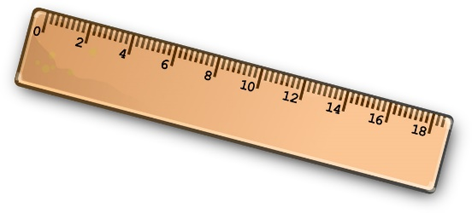
Comb as an wavelength standard
Time
Fourier transform
f_{rep}
Laser comb
0
f_{ceo}
frequency, ν
ν_{n} = f_{ceo} + n・f_{rep}
Optical frequency
Microwave frequency
Notes:
The optical frequency comb looks to be ideal as such a wavelength standard. The frequency comb is an optical pulse train with an equal time interval on the time domain, and has comb-like spectrum with an equal frequency interval over a broad wavelength coverage. Frequency comb can be regarded as a frequency ruler, i.e. wavelength standards.
光周波数コムは、そのような波長標準として理想的であるように見える。
周波数コムは、時間領域上で等しい時間間隔を有する光パルス列であり、広い波長範囲にわたって等しい周波数間隔を有するくし形スペクトルを有する。
周波数コムは、周波数のものさし、すなわち波長標準と見なすことができる。

Slide 8
Comb as an wavelength standard
Difficulty
50 GHz spacing!?
Enough power in the entire
wavelength region!?
Robust, compact,
and alignment free!?
Both broad spectral coverage and wide spacing frequency
high and uniform mode powers
Robustness, alignment free, and compactness
Notes:
However, In fact, it is not easy to apply the laser combs to the calibration for spectrographs. There are three main difficulties shown here; it is particularly difficult to achieve both a broad spectral coverage and a wide spacing frequency.
しかし実際には、分光器の校正にレーザーコームを適用することは容易ではありません。
ここには3つの大きな困難があり、広いスペクトル範囲と広い間隔周波数の両立は特に困難です。

Slide 9
Various approaches to astro-comb
Source comb
Mode filtering
Mode-locked laser
(f_{rep} = 100 MHz – 1 GHz)
f_{rep}
Er fiber
Yb fiber
Ti:Sapphire
Filtering cavity
n × f_{rep}
Wavelength conversion,
Spectral broadening
CW laser + Modulator
(f_{rep} = 10-20 GHz)
Nonlinear Crystal
PCF
HNLF
CW laser
EOM
Notes:
Several strategies are being adopted to realize such combs. For example, to obtain wide mode spacing comb, some groups use the combination of a mode-locked laser and mode-filtering cavities, and some groups use a modulation-based comb. Wavelength conversion and/or spectral broadening are used to obtain a broadband astro-comb in the desired wavelength region.

Slide 10
Our approach to astro-comb
Source comb
Mode filtering
Mode-locked laser
(f_{rep} = 100 MHz – 1 GHz)
f_{rep}
Er fiber
Yb fiber
Ti:Sapphire
Filtering cavity
n × f_{rep}
Wavelength conversion,
Spectral broadening
CW laser + Modulator
(f_{rep} = 10-20 GHz)
Nonlinear Crystal
PCF
HNLF
CW laser
EOM
Notes:
We have employed a new strategy for it. I would like to talk about the details from now.

Slide 11
Overview of our astro-comb
Notes:
Now I’ll explain about our astro-comb system.

Slide 12
System overview
Reference for
comb & cavities
② Comb
f_{ceo} = 0 Hz
① I₂-stabilized
CW laser
f_{rep} = 100 MHz, 1560 nm
Phase lock
1063 nm
③ Visible comb
generation
SHG
f_{rep} = 100 MHz, 380-540 nm
531.5 nm
④ Mode-filtering
using triple cavity
Reference for cavities
f’_{rep} = 42 GHz (f_{rep} x 420), 380-540 nm
To HIDES-F
Notes:
Our astro-comb consists of four parts. The comb generator outputs a 100-MHz spacing comb in the 1.5-micron region. This comb is converted to a visible wavelength and its spacing frequency is increased to 42 GHz with mode-filtering cavities. Iodine-stabilized laser is used as a frequency reference for the comb generator and mode-filtering cavities.

Slide 13
System overview
Frequency-stabilized laser
Reference for
comb & cavities
② Comb
f_{ceo} = 0 Hz
① I₂-stabilized
CW laser
① I₂-stabilized
CW laser
f_{rep} = 100 MHz, 1560 nm
Phase lock
1063 nm
③ Visible comb
generation
SHG
f_{rep} = 100 MHz, 380-540 nm
532 nm
④ Mode filtering
using triple cavity
Reference for cavities
f’_{rep} = 40 GHz (f_{rep} x 400), 380-540 nm
To HIDES-F
Notes:
First, I’ll explain the Iodine-frequency-stabilized laser.

Slide 14
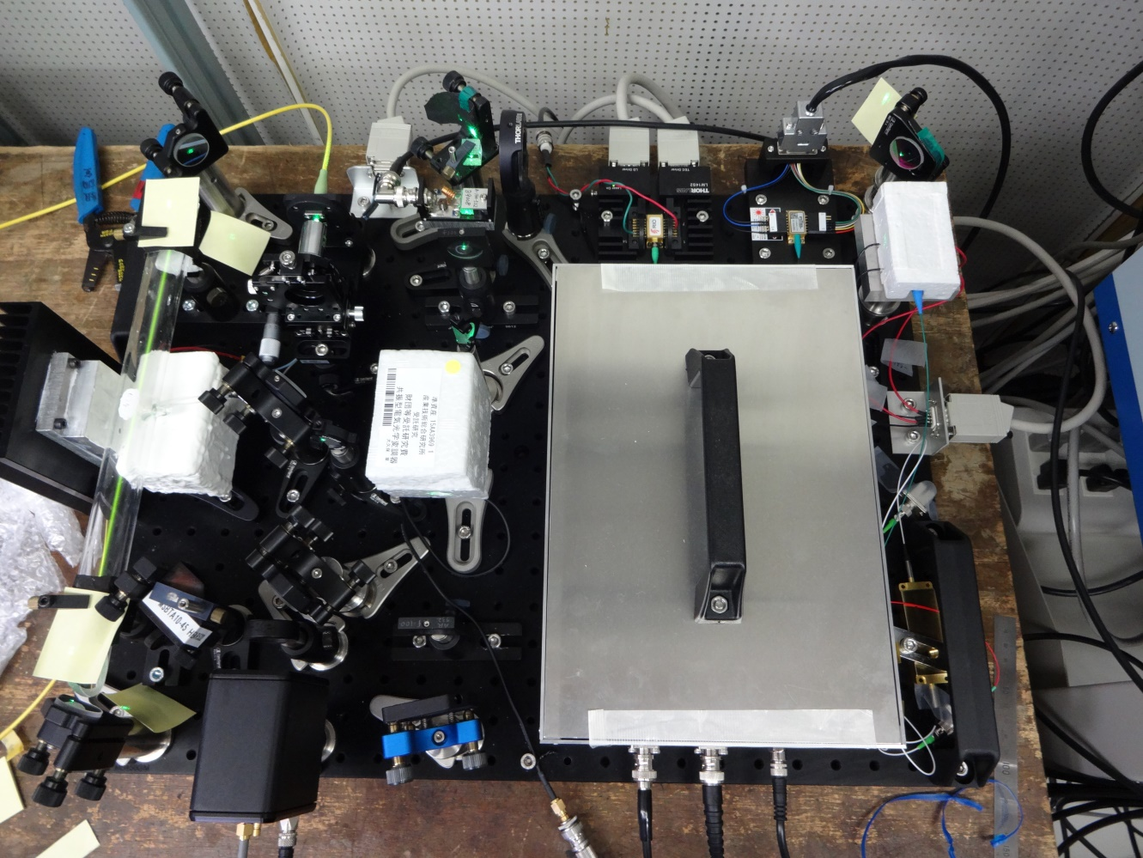
I₂-stabilized 1063 nm CW laser
To cavity system
531.5 nm
EOM
45 cm
60 cm
Notes:
This is the picture of the Iodine-stabilized laser. This is an nonlinear crystal, PPLN. It outputs a 531.5 nm light as the second harmonics of the source diode laser. This part is an spectrometer to observe the iodine signal.

Slide 15
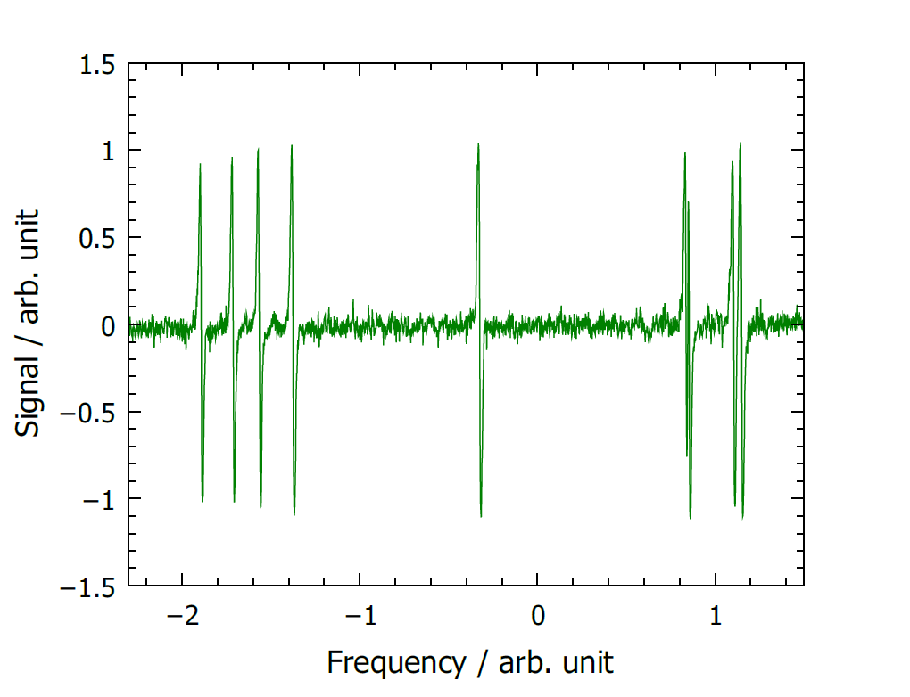
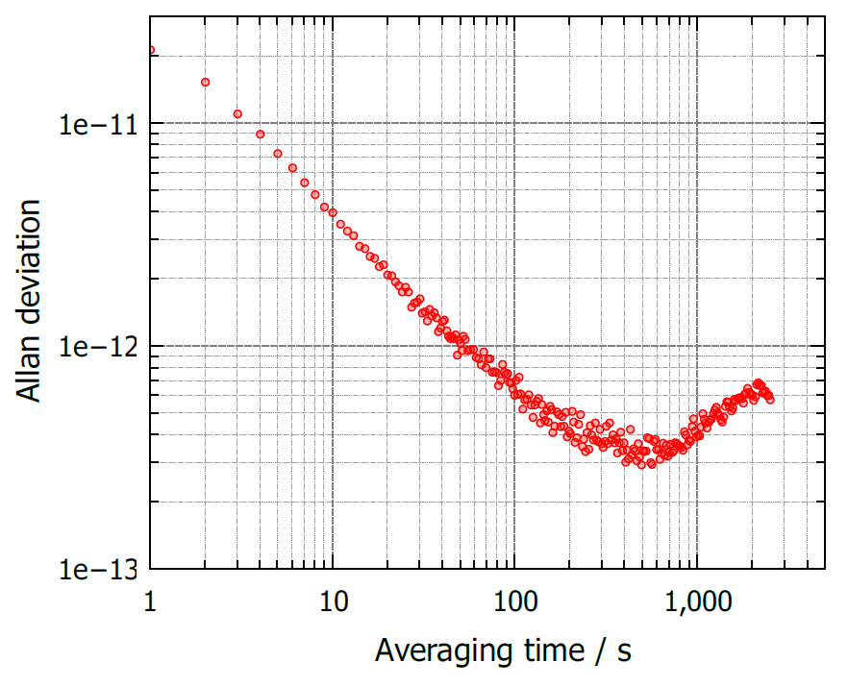
Signal and frequency stability
P(34)32-0 a₁₀ transition
Frequency stability
a₁₀
Frequency: 564 044 690 263 kHz
1 week continuous operation was confirmed.
Notes:
The laser frequency is stabilized to one of the iodine transitions.
The frequency stability of 2 parts 10^-11 at 1-second averaging is sufficient for wavelength standards for radial velocity measurements.

Slide 16
System overview
Optical frequency comb
Reference for
comb & cavities
② Source comb
② Comb
f_{ceo} = 0 Hz
① I₂-stabilized
CW laser
f_{rep} = 100 MHz, 1560 nm
Phase lock
1063 nm
③ Visible comb
generation
SHG
f_{rep} = 100 MHz, 380-540 nm
532 nm
④ Mode filtering
using triple cavity
Reference for cavities
f’_{rep} = 40 GHz (f_{rep} x 400), 380-540 nm
To HIDES-F
Notes:
Next I'll explain the optical frequency comb.

Slide 17
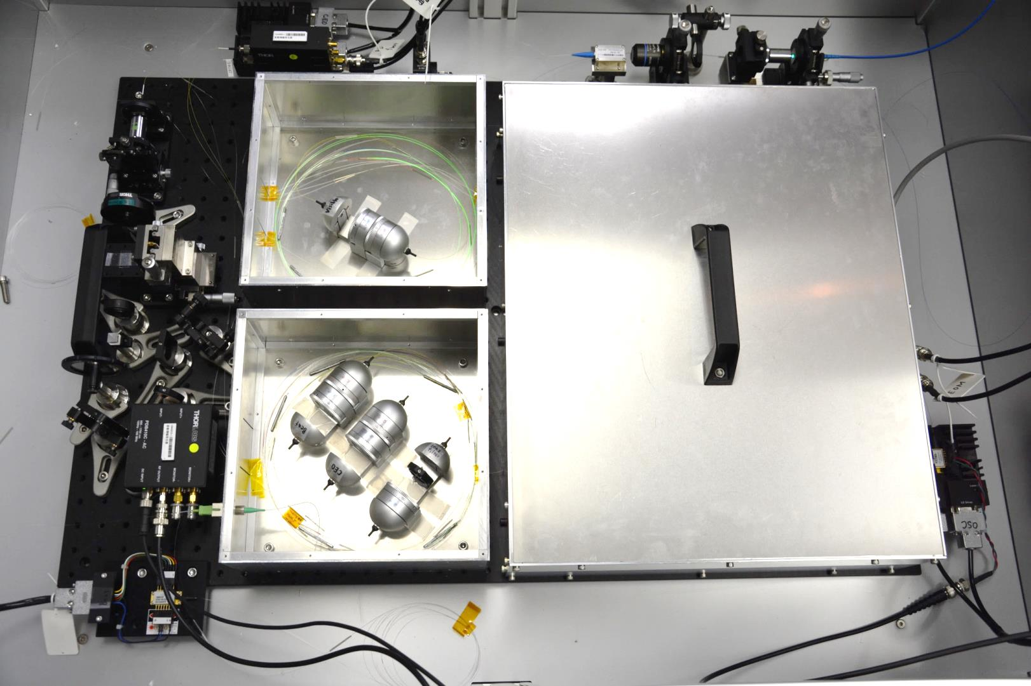
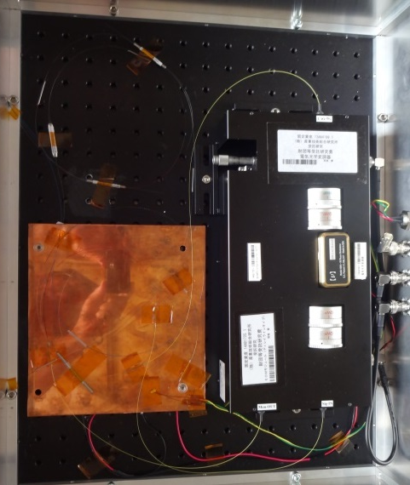
Optical frequency comb
EDFA
Laser oscillator
f-2f interferometer
EDFA
Notes:
This is the picture of the laser comb generator and the optical amplifiers. This is an interferometer for stabilizing the comb frequency.

Slide 18

Comb stabilization
EDF
TEC
f_{CEO} lock circuit
LD current
f_{rep} = 100 MHz
WDM
PBS
f_{beat} lock circuit
Q
H
EOM
H
Q
EOM
PZT
Temperature
PZT
Pump LD
Delay
f-2f
interferometer
EDFA
HNLF
f_{ceo}
Beat detection with
I₂-stabilized laser
EDFA
HNLF
f_{beat}
380-540 nm
visible comb generation
To mode-filtering cavity system
Notes:
The comb generator is an erbium-fiber-based mode-locked laser. The output of the comb generator is divided into three parts. Two of them is used for stabilization of all comb mode frequency. Another part is sent to the visible comb generation part, then sent to the mode-filtering part.

Slide 19
System overview
Optical cavity for mode-filtering
Reference for
comb & cavities
② Source comb
f_{ceo} = 0 Hz
① I₂-stabilized
CW laser
f_{rep} = 100 MHz, 1560 nm
Phase lock
1063 nm
③ Visible comb
generation
SHG
f_{rep} = 100 MHz, 380-540 nm
532 nm
④ Mode filtering
using triple cavity
④ Mode-filtering
using triple cavity
Reference for cavities
f’_{rep} = 40 GHz (f_{rep} x 400), 380-540 nm
To HIDES-F
Notes:
The final part is the mode-filtering cavities.

Slide 20
Mode filtering cavity
Original comb
Filtered comb
Cavity
Mode spacing
~100 MHz
Mode spacing
~10 GHz
Mode spacing
Original comb
...
...
frequency
FSR
Cavity
Mode spacing
Mode spacing of the extracted comb is an integer multiple of FSR
Filtered comb
...
...
Notes:
This is the concept of mode-filtering using optical cavities. The optical cavity extracts the comb modes if the mode frequency of the comb matches the mode frequency of the cavity. Therefore, the mode spacing of the extracted comb increases to an integer multiple of the cavity free spectral range.

Slide 21
Mode-filtering using three optical cavities
Iodine-stabilized
531.5 nm CW
λ/2
PDH
lock
Cavity lock
Visible comb
FSR = 10f_{rep} (1000 MHz)
Finesse: 100
100 MHz
PDH
lock
Cavity lock
42 GHz
FSR = (21/2)f_{rep} (1050 MHz)
Finesse: 100
PDH
lock
Cavity lock
To HIDES-F
FSR = 12f_{rep} (1200 MHz)
Finesse: 100
Notes:
This illustrates the mode-filtering cavity system. We use tree cavities with free spectral ranges of 1 GHz, 1.05 GHz, and 1.2 GHz. These filtering cavities extract the modes of the original comb every 10, 21, and 12 modes, respectively, and the mode spacing increases to 42 GHz. The lengths of these cavities are stabilized to the iodine-stabilized laser using Pound-Drever-Hall technique.

Slide 22
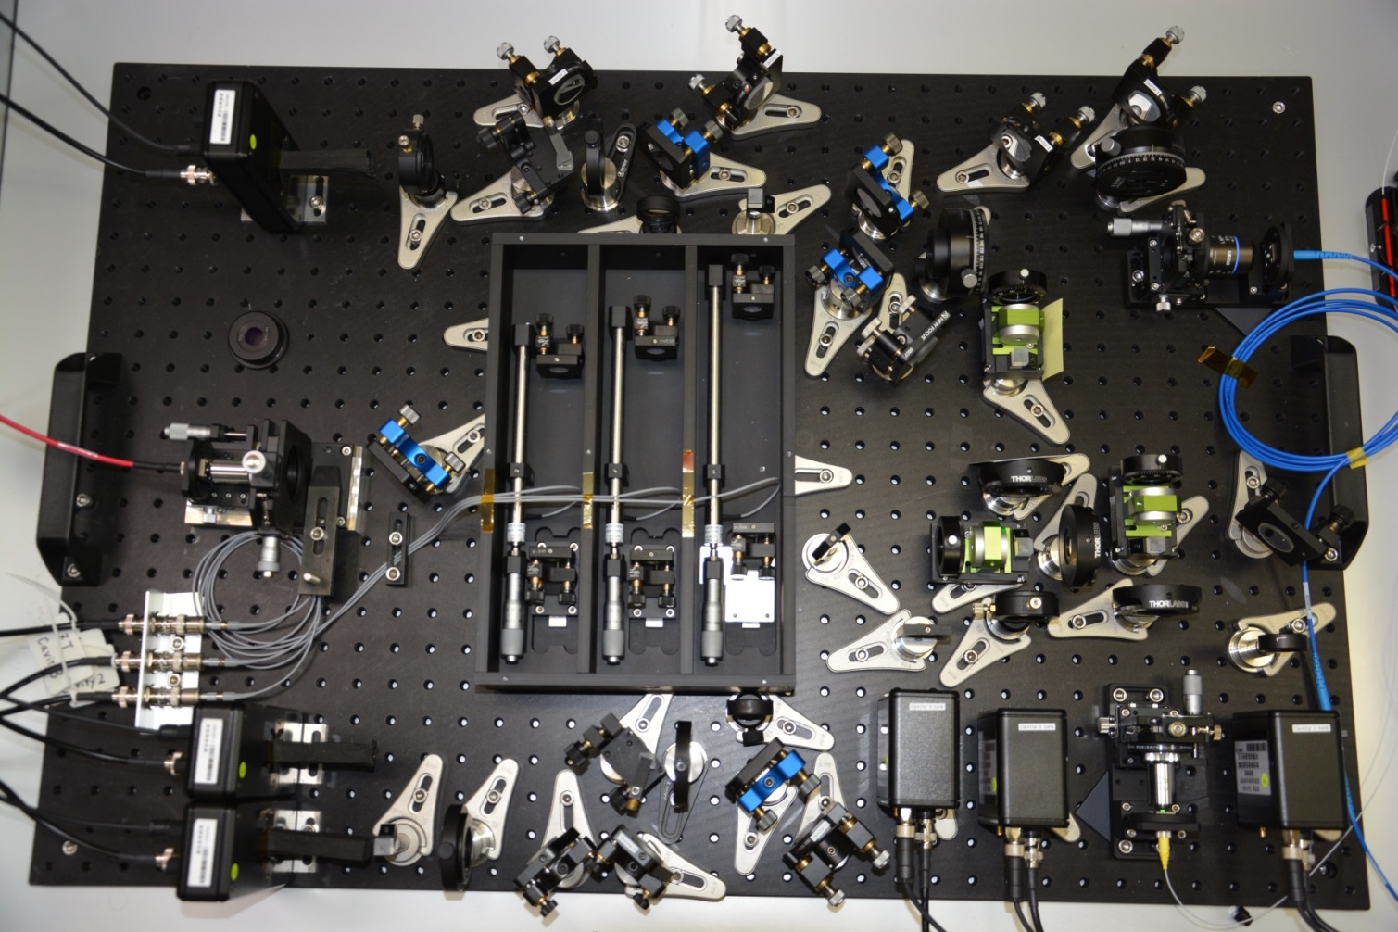
Cavity system overview
Comb
To HIDES-F
CW
531.5 nm CW laser for cavity locking
Comb
Notes:
This picture is the actual mode-filtering cavity system. This is beam path of the CW laser for stabilizing the mode-filtering cavities. This is the comb beam path.

Slide 23
Current status
Notes:
Next, I’ll explain the current situation.

Slide 24
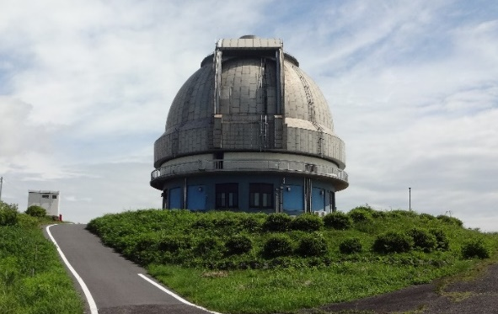
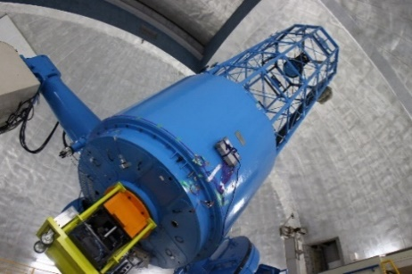
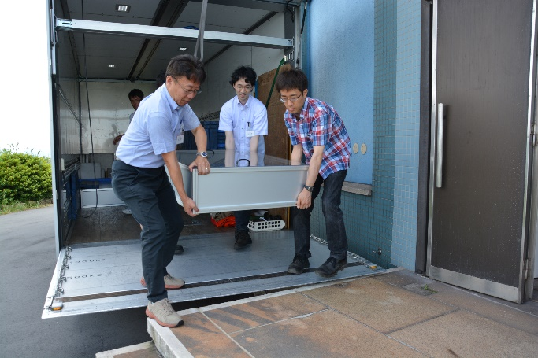
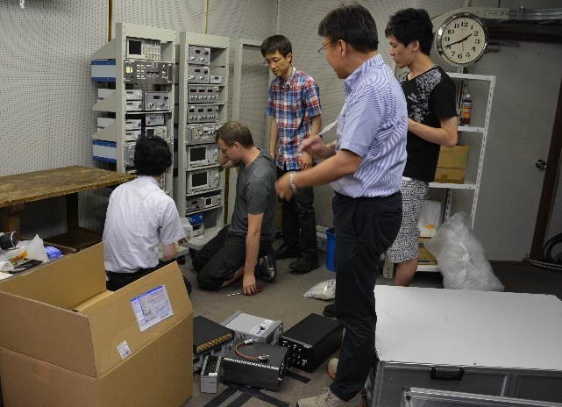
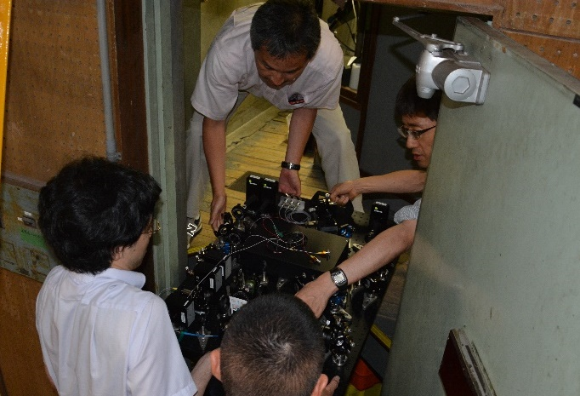
Current status
OAO, NAOJ
partly supported by
ERATO Minoshima
IOS project
188 cm telescope
2015FY~June 2016 Develop an astro-comb system at AIST (collaborating with OAO, YNU, and UEC)
July 4~8, 2016 The astro-comb was transported from AIST to OAO
Dec 4~6, 2017 Test observation
Notes:
In the summer of 2016, we transported the 1st astro-comb system to OAO and made adjustments for observing the spectrum with HIDES. Last December, the test observation was done.

Slide 25
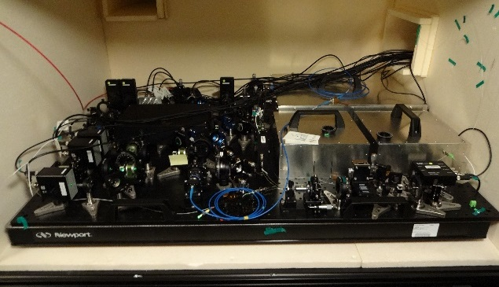
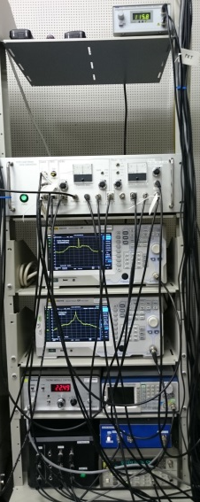
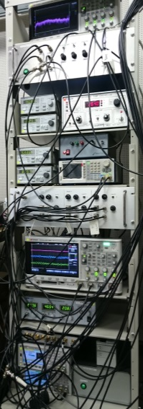
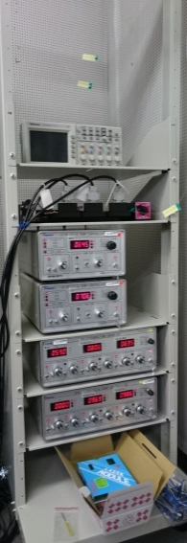

Astro-comb system in OAO
Coudé room (temperature controlled for HIDES-F
Control room
To HIDES
Cavity
Comb
Cable length
~10 m
Electronics
For stabilization
HIDES-F
is in this room
I₂-stabilized
1063 nm CW laser
Notes:
The optical frequency comb and mode-filtering cavities were installed in the Coude room. The iodine-stabilized laser and electronics were installed in the control room. Two rooms are connected by the electrical cables and optical fibers.

Slide 26
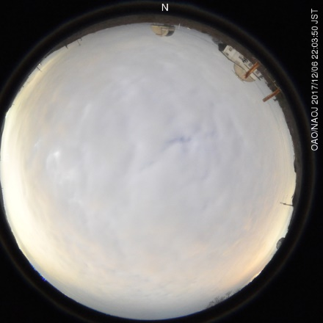
Test observation
Unfortunately, the sky was cloudy for three nights…
Dec 4-6, 2017
We alternately observed the astro-comb and Th-Ar lamp for spectral calibration.
Analysis results will be presented by Kambe-san
Notes:
In the test observation, we planed to observe the celestial light and astro-comb. But, unfortunately, the sky was cloudy every night. Instead, we alternately observed the astro-comb and Th-Ar lamp for spectral calibration. Next speaker Kambe-san will talk about the results.

Slide 27
Summary of the 1st astro-comb
Astro-comb spectrum with a 42-GHz spacing is observed between 500-520 nm.
Spectral coverage of the filtered comb is limited by the dispersion of the cavity mirrors.
Difficulty
◆ Narrow spacing of the original comb
and
◆ Broadband mode-filtering in the visible region
Combining them is challenging
Notes:
To summarize the 1st astro-comb, the comb spectrum with a 42-GHz spacing is observed between 500-520 nm. We think that the spectral coverage of the mode-filtered comb is limited by the group delay dispersion of the cavity mirrors. This is the comb spectrum before and after the mode-filtering cavities. We found that it is very challenging to combine the original comb with narrow spacing and the broadband mode-filtering in the visible region.

Slide 28
1st astro-comb approach
Source comb
Mode filtering
Mode-locked laser
(f_{rep} = 100 MHz)
f_{rep}
Er fiber
Yb fiber
Ti:Sapphire
Filtering cavity
n × f_{rep}
Wavelength conversion,
Spectral broadening
CW laser + Modulator
(f_{rep} = 10-20 GHz)
Nonlinear Crystal
PCF
HNLF
CW laser
EOM
Notes:
So we will change our strategy for the 2nd astro-comb.

Slide 29
2nd astro-comb approach (plan)
Source comb
Mode filtering
Mode-locked laser
(f_{rep} = 230 MHz)
f_{rep}
Er fiber
Yb fiber
Ti:Sapphire
Filtering cavity
n × f_{rep}
Wavelength conversion,
Spectral broadening
CW laser + Modulator
(f_{rep} = 10-20 GHz)
Nonlinear Crystal
PCF
HNLF
CW laser
EOM
Notes:
We plan to mode-filter before the spectral broadening and wavelength conversion. In this case, broadband mode-filtering is not required. We also plan to start from a larger mode-spacing comb.

Slide 30
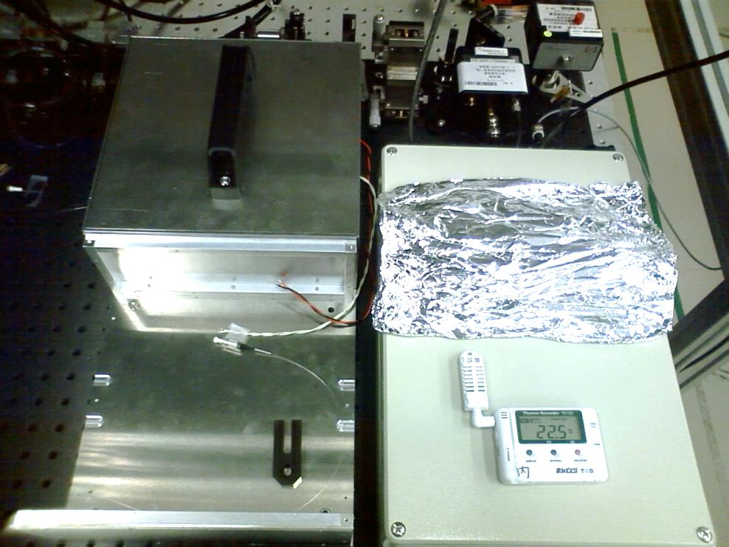
Now we are developing the 2nd astro-comb
Hardware improvement
Higher f_{rep} of the original comb
Wavelength conversion after mode-filtering
Higher astro-comb mode power.
Installation of the spectrum flattening system
Improvement for stationary operation
Automatic or remote control
Easy to operate
More robust system
Notes:
We are now developing the 2nd astro-comb. We plan to make these improvements based on the finding from the 1st astro-comb.
We also plan to make these improvements for stationary operation of the astro-comb.
This picture is the 2nd astro-comb under developing.

Slide 31
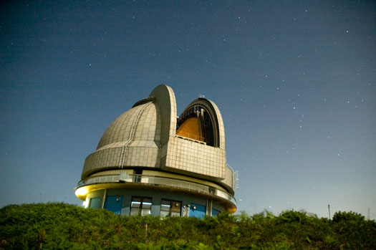
Thank you for your attention!!
Notes:
That’s all. Thank you for your attention.

