Slide 1
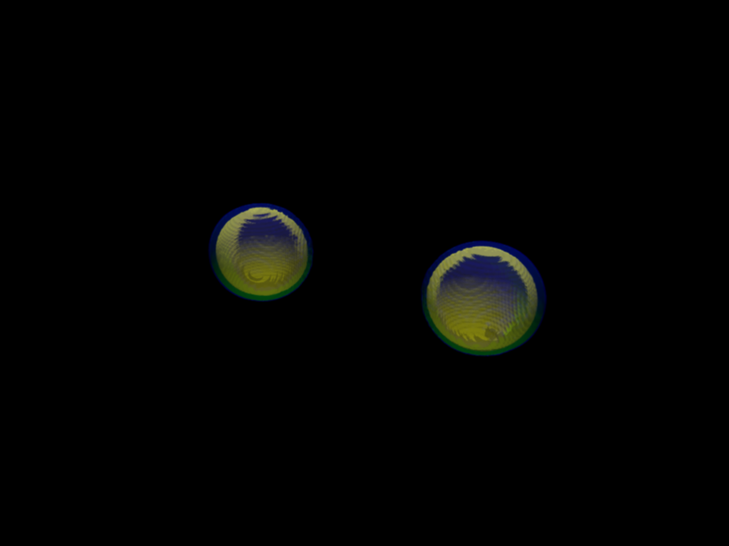


Gravitational waves and electromagnetic signals from a binary neutron star merger GW170817
Kenta Kiuchi (YITP)
Kenta Hotokezaka (Princeton), Koutarou Kyutoku (KEK), Kyohei Kawaguchi (AEI), Sho Fuibayashi (YITP), Yuichiro Sekiguchi (Toho Univ.), Masaru Shibata (YITP), Masaomi Tanaka (NAOJ), Shinya Wanajo (Sophia university)
Notes:
First of all, thank you for providing me an opportunity of seminar in AEI. My name is Kenta Kiuchi from Yukawa Institute for Theoretical Physics in Kyoto University and Today, I’m gonna talk about a recent progress of compact binary merger simulations in Kyoto group. In particular, I’m focusing on our understanding of the recent event of the binary neutron star merger. This work is in collaboration with Kenta Hotokezaka, Koutarou Kyutoku, Kyohei Kawaguchi, Yuichiro Sekiguchi, Masaru Shibata, Masaomi Tanaka and Shinya Wanajo.

Slide 2
GW170817 as a BNS merger event
Sky map by LIGO + VIRGO
LSC-Virgo collaboration PRL 2017
▶ Aug. 17th 2017, 74 sec. signals detected by LIGO-Hanford.
▶ S/N is 32.4 !
Notes:
As you all know, two thousand seventeen is a memorial year for gravitational wave physics.
On August 17th, a first direct detection of the gravitational waves from a binary neutron star coalescence was realized. This plots shows the spectrogram and in the first and middle panels, you can see signals which sweep up from the low frequency to high frequency. The advanced VIRGO was on line and did not observe this event, but it significantly contributed to the determination of the source position on the Sky map. The green circle was an error circle determined by the two advanced LIGO detectors and advanced VIRGO detector. This event was named as GW seventeen o eight seventeen. The signal to noise ratio was thirty two point two, which is much higher than the first direct detection from the binary black hole merger.

Slide 3
Real Multimessenger Astronomy Era
LSC-Virgo collaboration APJ 848, L12, 2017
▶ GW ⇒ γ-ray ⇒ UV, Optical, IR ⇒ X-ray⇒ Radio
▶ Host galaxy (NGC4993) was identified by the optical telescope (SSS17A)
Notes:
More surprisingly, simultaneous observations of the electro magnetic signals were done. This figure shows the time series of the observation. First, the gravitational wave detection was reported from LIGO-VIRGO collaboration. After one point seven second, the gamma-ray observatory reported the detection and its error circle overlapped the GW events. Subsequently, a bunch of the optical telescopes started a transient search within this error circle and identified the host galaxy. This plot shows the optical transient signal. Subsequently, the IR, X-ray, and radio signals were observed from this galaxy and identified as the electromangnetic counterpart of this GW event.

Slide 4
Source properties of GW170817
low NS spin prior
high NS spin
prior
LSC and Virgo collaboration PRL 119, 161101 (2017)
▶ Mass measurement of NSs.
m₁: 1.36-1.60 M☉, m₂ : 1.17-1.36 M☉ (low spin prior)
m₁: 1.36-2.26 M☉, m₂ : 0.86-1.36 M☉ (high spin prior)
▶ Luminosity distance is 40⁺⁸₋₁₄ Mpc
Notes:
This is a brief summary of the source properties of this GW event. This plot shows a probability of the estimated neutron star mass. For a low neutron star spin prior which is suggested by the binary neutron stars observed,
the estimated mass is between one point three six and one point six solar mass for the primarily and between one point one seven and one point three six solar mass for the secondary. For a high neutron star spin prior,
the estimated mass range becomes broad because the mass ratio of the binary has a degeneracy with the spin in the parameter estimation. Anyway, the neutron star masses are compatible with the binary pulsar observation.
Luminosity distance determined by the gravitational wave alone is about fourty megapersec.

Slide 5
Tidal deformability measurement of NSs
LSC and Virgo collaboration PRL 119, 161101 (2017)
R_{1.35M☉}= 14.4 km
R_{1.35M☉}= 13.6 km
R_{1.35M☉}= 11.1 km
▶ Tidal deformation Λ is related to a NS radius ⇒ Information of the NS equation of state.
▶ Soft EOS is favored (Λ≤ 800)
Notes:
Tidal deformability which is a neutron star radius related quantity is constrained for the first time. These plots shows the probability contour on the each tidal deformabilities and here is nine teen percent contour. Several representative equation of states are shown and for instance the EOS MS1 has a fourteen point four kilimoeter radius with one point three five solar mass, which is rejected from this gravitational wave observation. The H4 equation of state has thirteen point six kilometer radius and it is marginal. The APR4 equation of state has eleven point one kilometer radius. Therefore, this analysis suggests a relativity soft equation of state is favored.

Slide 6
Detection of GRB170817A
▶ T₉₀ = 2.0 ∓0.5 s, T₀ = 1.7s
▶ E_{iso} ～ 5×10⁴⁶ erg (too dim)
Notes:
At one point seven seconds after the binary neutron star mergers, the gamma ray signal was observed by Gamma-ray satellite Fermi GBM and Integral. The upper panels shows a light curve of the Fermi GBM and Integral and the bottom panel shows the spectgram of the GW event. Since T ninety is about seconds, this GRB is classified to a short duration gamma-ray burst. But. The isotropic equivalent energy is much smaller than the canonical short GRB even though this GRB is a closest event which happens at fourty Mega-parsec.

Slide 7
Detected UV-Optical-Infrared emission
Arcavi et al. Nature 24291, 2017
Drout et al. Science (aaq0049) 2017
▶ Rapid reddening from UV to IR
▶ Spectrum is quasi-black body
▶ Long-duration IR
component & short-duration
UV-Optical component
UV
Optical
IR
Notes:
This is a optical observation and here is a source position of this optical transient.
Because the event was close enough, a bunch of the telescopes performed a spectroscopy with short duration.
This plots a time evolution of the spectrum in UV, optical, and IR band. Within one point five day, the photon was emitted in UV and optical band. The spectrum was a quasi black body and it shifts toward the IR band within one week. This observation shows the emission has two component, short-duration UV-Optical (blue) component and long-duration IR (red) component.

Slide 8
About 100 days observation @ Radio, X-ray observation after the merger
Margutti et al. 18
Mooley et al. 17
Troja et al. 17
Hallnan et al. 17
▶ Dynamical ejecta? Structured Jet? Cocoon emission? (Margutti et al. 17, Gottleb et al. 17)
Notes:
Final point is a long-term observations of one hundred days after the merger at radio and X-ray band. This figure plots the Radio, Optical-Near Inflated, and X-rays spectrum at nine days, fifteen days, and one hundred ten days after the merger. Afterglow model based on the synchrotron radiation nicely fits the observation data. Theoretical models to explain these data are mildly relativistic dynamical ejecta, structured jet, or cocoon emission. I’m gonna touch this issue later on.

Slide 9
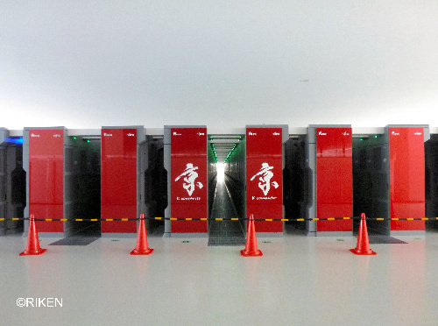
Role of simulation in GW physics
Figuring out a realistic picture of BH-BH, NS-NS, BH-NS mergers
Numerical relativity simulations on super-computer with a code implementing all the fundamental interactions
▶ Einstein eq.
▶ MHD
▶ Neutrino radiation transfer
▶ Nuclear EOS
▶The NR simulations of the BH-BH merger played an essential role for the first detection
Notes:
Under such a situation, main purpose of our research is figuring out a realistic picture of binary neutron star mergers and black hole neutron star mergers. We implement all the fundamental interactions into a code self-consistently and perform a simulation on the supercomputer. Concretely saying, we solve Einstein equation, magnetohydrodynamics equation, neutrino radiation transfer equation, and nuclear equation of state simultaneously. Point is that numerical relativity simulations of binary black hole mergers play a key role for the detection of gravitational waves.

Slide 10
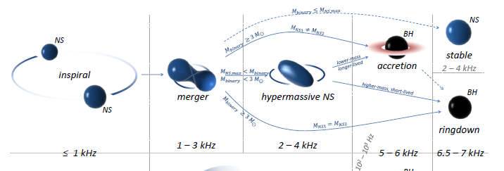
Exploring a realistic picture of NS-NS mergers
(Bartos et al. 13)
B-field and neutrino are irrelevant
Time axis
Evolution path depends on the total mass and maximum mass of NSs
Science target : Measuring a tidal deformability of NS
Notes:
This is a schematic picture of binary neutron star mergers and time axis is this direction. After merger, there are several possibilities in the evolution process, which is determined by the relation between the total mass of the binary and maximum mass of neutron star. During inspiral phase, the system is relatively clear in the sense that messy ingredients such as magnetic field and neutrino radiation transfer do not enter the game. After the merger, both effects play an important role. The first point is a late inspiral phase in which science target is to extract a tidal deformability of NSs.

Slide 11
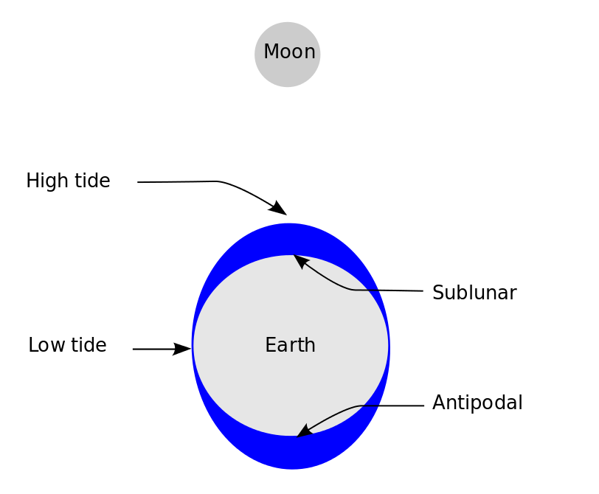
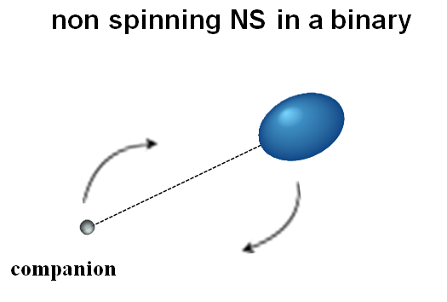
From inspiral to late inspiral phase
Earth tide
NS just before the merger could be deformed by a tidal force of its companion.
Notes:
You can understand tidal deformation of NSs as an analogy of the earth tide caused by the moon. This is a schematic picture of earth tide and the tidal force due to the moon deforms the earth, in particular, the surface of the ocean. The thing is same in compact binary mergers, a NS is deformed by a tidal field generated by its companion.
This effect becomes prominent just before the merger.

Slide 12

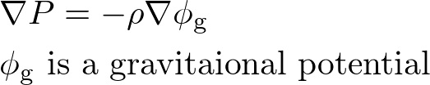


From inspiral to late inspiral phase
Tidal deformability depends on NS EOSs.
EOS ⇒ Pressure(P) as a function of the density(ρ)
Stiff EOS ⇒ Uniform ρ (large R)
Soft EOS ⇒ Centrally concentrated ρ (small R)
Notes:
To what extent the star is deformed is quantified by the tidal deformability and this quantity is characterized by the equation of state of neuron stars. Let me explain simply. Specifying an EOS means that you give pressure as a function of the density.
This is a schematic picture of an equation of state. If the pressure is a steep function of the density, we call it a stiff equation of state. If the gradient in terms of the density is small, we call it a soft equation of state. This stiffness reflects a density profile of NSs.
This is a hydrostatic equation and the pressure gradient balances with the gravity.
Therefore, given the gravity, the density gradient becomes shallow in case of the stiff equation of state. On the other hand, the density gradient becomes steep in case of the soft equation of state.
Qualitatively, you can say that a stiff equation of state gives uniform density profile with larger radius and a soft equation of state give centrally concentrated density profile with small radius.

Slide 13
From inspiral to late inspiral phase
Tidal deformation
Stiff EOS (large R) Soft EOS (small R)
NS
NS
NS
NS
Easily tidally deformed
Hard to be tidally deformed
Tidal deformability depends on NS EOSs
Notes:
This is a schematic picture of tidal deformation. For a stiff EOS, the NS is easily tidally deformed because its density profile is close to be uniform. On the other hand, for a soft EOS, the NS is hard to be tidally deformed because its density profile is centrally concentrated. This is an intuitive explanation how tidal deformability depends on equation of state.

Slide 14

Tidal deformability imprinted in GWs
Phase
Amplitude
Tidal force is attractive force ⇒
Tidal deformation accelerates the phase evolution
Theoretical template of GWs
Data + noise
Template
The phase error in a numerical simulation should be small enough
Notes:
Tidal deformability is imprinted in GWs as a phase shift. Let’ s decompose the GWs into amplitude and phase. Because the tidal force is attractive force, the tidal deformation accelerates the phase evolution. Our task is to derive an accurate evolution of the phase and amplitude. In actual observation, the data contains noise. This red noisy curves the observational data taken at Hanford. To extract gravitational waves from it, first you prepare a theoretical template of the waveforms and then you take a match between them. This is a standard matched filtering technique and generating theoretical template with high precision is an essential part to detect gravitational waves.

Slide 15





Toward a theoretical template bank
KK et al. 17
Error in previous works
B
HB
H
125H
15H
Phase error
▶ Phase error is significantly suppressed.
Notes:
We performed a bunch of the simulations of binary neutron star mergers by changing the equation of states, the neutron star mass, and grid resolution. This is one example of our latest result and it shows a phase shift between the two equations of state. Equation of state B is softest one and reproduces about eleven kilometers. Equation of state fifteen H is the stiffest one and it reproduces about fourteen kilometer. Let’s focus on the cyan curve which is a phase shift between the equation of state B and fifteen H and this vertical dashed line shows a peak time of the gravitational waves. You can see about three radian difference between the two. On the other hand, our estimated dephasing due to the numerical error is about point one radian. So, our waveforms have enough accuracy to distinguish the equation of states. Note that the phase error in the previous works is about three radian and it was hard to distinguish the equation of states. So, the quality of our simulation data is high enough to construct a template bank of gravitational waves.

Slide 16
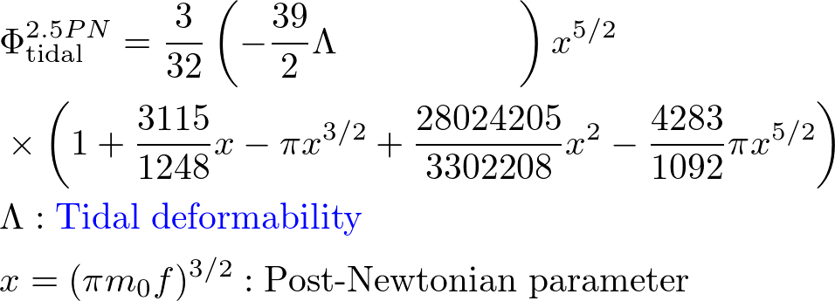

Kyoto template (Kawatuchi, KK et al 18)
GW phase
Modeling in binary black hole systems (Nagar et al. 16)
Tidal part (Damour et al 12)
Notes:
Very recently, our paper for the theoretical template has been accepted. So, let me introduce the Kyoto template.
In general, the gravitational wave phase modeling is composed of two parts. Point particle part and tidal deformation part.
For the former, the Post-Newtonian theory in conjunction with a numerical relativity simulation of binary black hole mergers derives the phase evolution. For the tidal part, the Post-Newtonian theory derives an analytic form of the phase evolution which is linearly proportional to the tidal deformability Lambda. X is the Post-Newtonian parameter with the total mass m_0 and the orbital frequency f.
This messy expression is irrelevant here and we come up with you need a non-linear term with respect to the Lambda to describe the phase evolution of the later inspiral phase. But, the coefficients a and p are unknown analytically. So, we add this non-linear term.

Slide 17
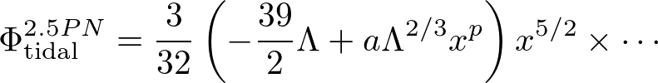

Kyoto template (Kawaguchi, KK et al 18)
Fitting by a NR simulation
1.25M☉-1.25M☉, 1.35M☉ -1.35M☉ with 5 EOSs
Notes:
We obtain these parameters a and p by fitting the phase evolution of the numerical relativity simulation of a particular model of binary neutron star merger. Then, we calibrate our model by comparing to other binary neutron star merger simulations.
This figure shows a phase difference between the Kyoto template and numerical relativity simulations of binary neutron star merger with 1.25-1.25 Solar mass and 1.35-1.35 solar mass. We assume fine equation of state and the phase difference is a function of the gravitational wave frequency. You can see that the phase difference is within point one radian up to one thousand Hertz and it is almost comparable with the phase error coming from the numerical simulation.

Slide 18
Kyoto template (Kawaguchi, KK et al 18)
1.21M☉-1.51M☉, 1.16M☉ -1.58M☉ with 5 EOSs
▶ Systematic error is less than 0.1 rad
⇒ Independent analysis of adv. LIGO data (Narikawa et al in prep)
Notes:
We also check Kyoto template with the unequal mass model with one point one and one point five one Solar mass and one point one six and one point five eight Solar mass. This figure also shows a phase difference between the two and you can see that the systematic error coming from the modeling is less than point one radian up to one thousand Hertz.
With this template, we are doing an independent analysis of advanced LIGO data for the tidal deformability of GW170817 and this is ongoing project.

Slide 19
Post merger evolution of BNSs
(Bartos et al. 13)
B-field and neutrino play an essential role
Time axis
Key ingredients
▶ Effective turbulent viscosity: MHD instability
▶ Electron fraction ≡ (# of electron)/(# of baryon) : Neutrino reaction
Notes:
Let’s switch the gear to a post merger evolution of remnant massive neutron star. In this phase, both magnetic field and neutrino radiation transport enter the game. Remnant massive neutron stars formed after the merger are sustained by nuclear pressure force as well as the centrifugal force because it rotates rapidly. The key ingredients in the post merger phase is effective turbulent viscosity produced by the MHD instability and neutrino reaction which determines the chemical property of the ejecta from the remnant.
Let me briefly explain these ingredients one by one.

Slide 20
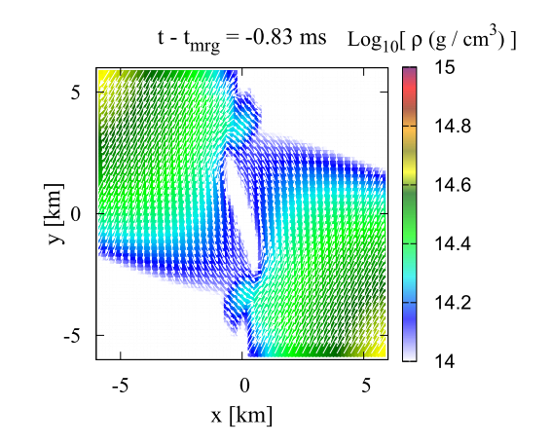
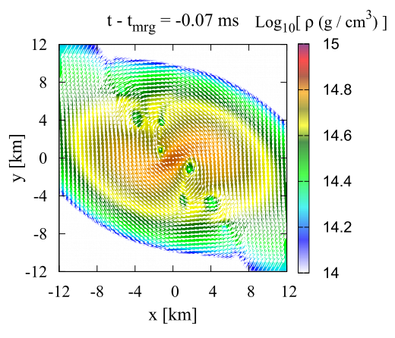
B-field amplification @ the merger
Kelvin Helmholtz instability (Rasio and Shapiro 99, Price & Rosswog 05)
v₂
g
ρ₂
ρ₁
v₁
Minimum wave number of the unstable mode ;
k_{min} ∝ g(ρ₁–ρ₂)/(v₁-v₂)²
⇒ If g = 0, all the mode are unstable. σ ∝ k
Notes:
The first point is the amplification at the merger. Rasio and Shapiro predicted the amplification due to the Kelvin-Helmholtz instability at the merger. This is a schematic picture of the instability and if you consider the two layers with the density rho one and rho two and velocity one and two. The linear perturbation analysis suggests that the minimum wave number of the unstable mode is proportional to the gravitational acceleration, density and velocity difference. In the absence of the gravity, all the mode are unstable and the growth rate is proportional to the wave number. In a binary neutron star merger situation, you can find a shear layer which develops when the two stars come into contact. These figures are density and velocity contour on the orbital plane just before and after the merger. Due to the Kelvin-Helmholtz instability, the vortices are developed and the magnetic field are curled by them. This is the basic magnetic field amplification mechanism at the merger.

Slide 21
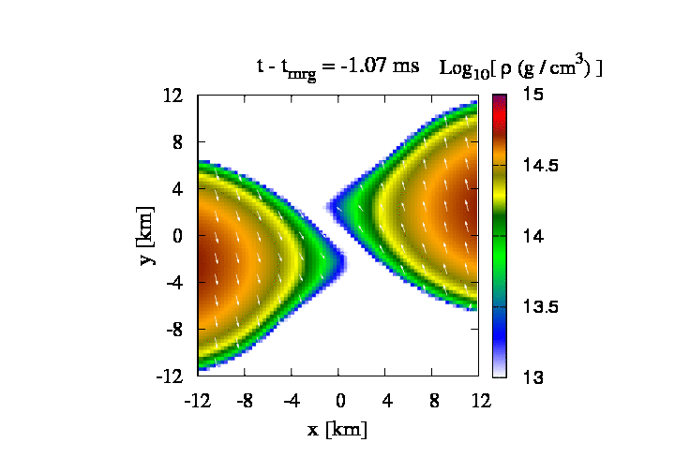
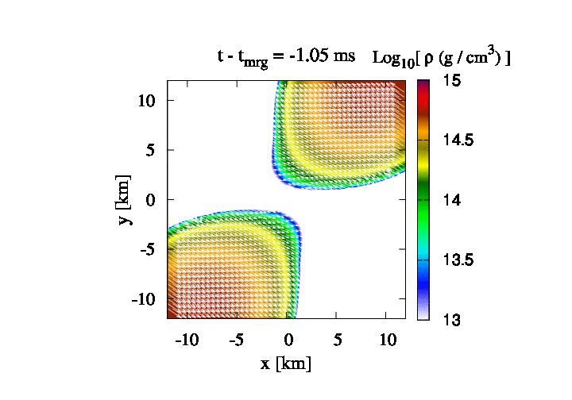
Magnetization of the remnant massive NS
Kelvin-Helmholtz instability (KK et al. 14, 15)
Low resolution
(Δx=150m)
Fine resolution
(Δx=17.5m)
▶Small scale vortices develop rapidly ⇒ Efficient amplification of the B-field
▶ Low res. run cannot reproduce vorticity formation
Notes:
Let me show the visualization of the density structure with velocity field on the orbital plane. In this simulation, I assigned a grid resolution which is ten times higher than those used in the previous simulations. You can see small scale vortices develop rapidly in the contact interface and interestingly even after the collision of two stars, two dense core collide several times and the shear layer reappears. This produces the Kelvin-Helmholtz vortices as well. On the other hand, with a resolution which was mostly used in the previous simulations, you can see that two large vortices may appear, but they are suddenly dissipated by the collision of two stars. Because the growth timescale of large scale vortices is longer than the dynamical timescale, there is no room for them to be developed. This is caused by the low resolution. In reality, small scale KH vortices develops within a short time scale and amplifies the magnetic field.

Slide 22
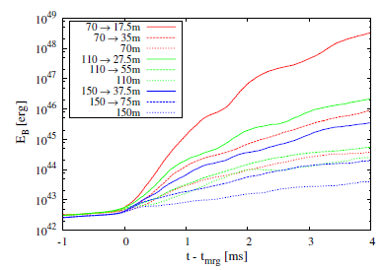

Magnetic field amplification
B-field energy evolution
B₀ = 10¹³G
Merger
▶ The growth rate shows the divergence. c.f. growth rate ∝ wave-number for Kelvin-Helmholtz instability.
Notes:
This figure shows the magnetic-field energy as a function of time, in which different color curve correspond to the different resolution. We found that in the highest resolution case, the energy is amplified by the factor of ten to six which means the averaged magnetic-field is amplified by the factor of ten to three. The growth rate should be proportional to the wavenumber and this feature is consistent with the Kelvin-Helmholtz instability. Because the growth rate of the magnetic-field energy is completely determined by the grid resolution, we speculate weak magnetic field suggested by the binary pulsar’s observation will be amplified within a short timescale after the merger in reality.

Slide 23
Magneto Rotational Instability (MRI)
▶ (Balbus & Hawley 91)
Differential rotation
Intuitive explanation of MRI
deceleration
acceleration
Center
×
Center
×
Magnetic field line
Center
×
Fluid element
MRI produces turbulence as well.
Notes:
After the formation of the merger remnant, it is subject to the so-called magneto rotational instability, MRI. The local stability analysis tells you that the instability criterion is a negative radial gradient of the angular velocity. With this instability, magnetic field amplifies exponentially within several rotational periods. This picture is an intuitive explanation of the MRI. Let me consider two fluid elements which rotate around the center. They are connected by the magnetic field lines and the inner element rotates faster than the outer element because of this condition. Once the inner element foregoes, it will be decelerated because the magnetic field line work as a spring. On the other hand, the outer element will be accelerated. In other word, the inner element loses the angular momentum and the outer gains the angular momentum. Because the centrifugal force balances with the gravity due to the central object, the inner element shifts to the inside orbit and the outer element shifts to the outside orbit. This is a negative feed back and this loop continues up to the saturation. The MRI produces turbulent state as well.

Slide 24
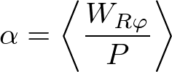
Effective turbulent viscosity in merger remnants
Space time diagram of merger remnant (KK et al. 17)
Envelope
MRI unstable
Dense core
MRI stable
W_{Rφ}: Reynolds + Maxwell stress
▶ α inside a core ≳ 5×10⁻³
▶ α inside an envelope ≈ 0.01-0.02
Notes:
We estimate the effective turbulent viscosity in the merger remnant. This shows a space-time diagram of the density and angular velocity on the orbital plane and here is the merger. We find that the merger remnant is composed of a dense core and envelope. The envelope as well as the core surface is subject to the MRI because of the negative gradient of the angular velocity. However, a region deep inside the core may not be subject to the MRI. Because the MHD simulation data provides you the Reynolds and Maxwell stress term, we estimate the Shakra-Suniyaev alpha parameter from our simulation. These plots a time evolution of the alpha parameter in the core region and the envelope region and the different colors show different resolution. Deep inside the core, the alpha parameter does not converge, but in the envelope the alpha is likely to be point o one or point o two.

Slide 25
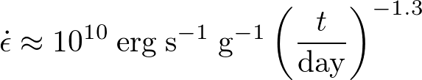

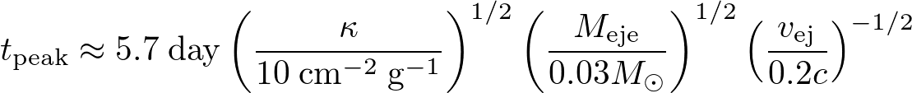
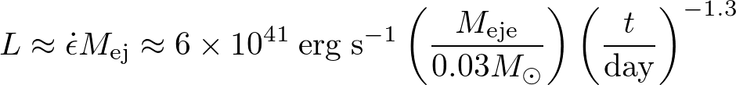
Optical-Infrared emission from BNS mergers (Metzger et al. 10)
Role of the r-process elements
▶ Heating source via radio-active decay
▶ Opacity source (Lanthanide elements) (Barnes & Kasen 13, Tanaka & Hotokezaka 13)
Properties of electromagnetic emission (Optical-IR)
▶ Peak time (diffusion time = dynamical time)
▶ Peak Luminosity
Notes:
Let’s move on to the neutrino topics. First, I will summarize a theoretical prediction of the observed optical and infrared emission in GW170817. During the merger, a significant amount of the neutron-rich matter could be ejected and the r-process nucleosynthesis may be realized in the ejecta. Once the r-process elements are synthesized, the unstable heavy elements are radioactively decayed. This decay could be heating source. In addition to that, the r-process elements becomes an opacity source. Theoretically, the opacity is estimated as about ten square centimeter per gram for the lanthanide elements. Based on this foundation, the optical and near infrared emission was proposed as macronova or kilonova. The ejecta is initially optically thick and expands with a relativistic speed. The peak time is roughly estimated by equating the diffusion time for the photon and expansion timescale as about one week with the typical ejecta mass and velocity. Peak luminosity is also estimated from the heating rate and ejecta mass. This is a theoretical prediction.

Slide 26
R-process nucleosynthesis and its opacity
Lanthanide
Optical
IR
Tanaka et al. 17
▶ Electron fraction Y_{e} is a key quantity
▶ Y_{e} ≳ 0.25 produces negligible / small amount of lanthanide ⇒ low opacity in optical
▶ Y_{e} ≾ 0.25 produces lanthanide ⇒ high opacity in IR
▶ Neutrino reaction determine Y_{e} of the ejecta
Notes:
So, the opacity is a key ingredient of the kilonova/macronova emission and let me explain the relation between the electron fraction and opacity. Electron fraction, Ye, is the fraction of the number of electron to the number of baryon. The left panel shows the r-process abundance fraction as a function of the atomic number assuming the electron fraction distribution of the ejecta from the merger. The right hand side panel shows the opacity dependence on the wavelength and this shows that if the electron fraction is greater than point two five negligible or small amount of the lanthanide is produced which results in a low opacity in optical wavelength. On the other hand, if Ye is lower than point two five, the significant amount of the lanthanide is produced which result in the high opacity in IR band. This is a relation between Ye and opacity and neutrino reaction determines the electron fraction of the ejecta.

Slide 27
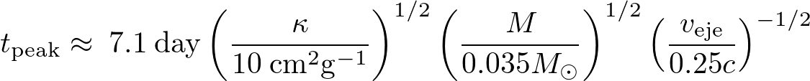
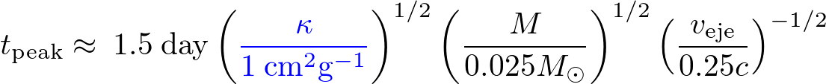
Detected UV-Optical-Infrared emission
▶ Long-duration IR component (Red)
▶ Short-duration UV-IR component (Blue)
Short-duration blue component suggests the low-opacity (Lanthanide-free elements) ejecta.
We build a model of GW170817 based on the NR simulations : neutrino radiation transfer & effective turbulent viscosity
Notes:
The long-duration red component observed in the optical counterpart of GW170817 agrees approximately with the macro nova or kilo nova theory. The light curve as well as the spectrum were fitted to estimate the mass and ejecta velocity. On the other hand, the short-duration blue component may be incompatible with the opacity predicted by the r-process nucleosynthesis and the observation data demands the low opacity component. We are building a modeling based on our numerical relativity simulations to explain this short-duration blue component later on.

Slide 28
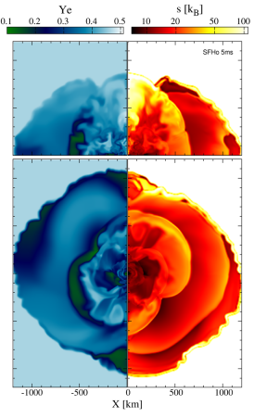

Numerical modeling of GW170817 (Shibata et al. 18, Fujibayashi, KK et al. 17)
High Y_{e}
Z [km]
Y [km]
Low Y_{e}
▶ Y_{e} ≾ 0.1 before the merger
▶ The positron capture (n+e⁺⇒p+ν_{e})and neutrino absorption (n+ν_{e}⇒p+e⁻) increases Y_{e}.
▶ Dynamical ejection is primarily driven by tidal torque (orbital direction)⇒ M_{eje}～O(10⁻³)M☉ ,Y_{e} ≈ 0.05-0.5, θ≳45°⇒ High opacity (red component)
Notes:
This is a schematic picture of the mass ejection in post merger phase. First mass ejection mechanism is a dynamical mass ejection which happens within a dynamical timescale. Note that the electron fraction before the merger is less than point one, which is determined by the beta equilibrium. We found that the dynamical mass ejection happens in two ways. The primarily mass ejection is driven by the tidal force which is mainly concentrated on the equatorial plane. This plot is a electron fraction contour on the orbital plane after the merger. The secondary mass ejection mechanism is a shock heating due to the colliding motion and violent oscillation of the remnant. Consequently, the positron capture and neutrino absorption increase the electron fraction. This component is ejected to the polar direction. This plots the electron fraction contour on a meridional plane. We find that the amount of the dynamical ejecta is about ten to the minus three solar mass, and the electron fraction has a broad range, and mainly it is concentrated in the orbital direction where the theta is a angle from the rotational axis. This implies that the dynamical ejecta may produce a lanthanide which results in the high opacity.

Slide 29
Numerical modeling of GW170817 (Shibata et al. 18, Fujibayashi, KK et al. 17)
▶ Magneto-turbulent viscosity drives a quick angular momentum transport ⇒ Revelation of the differential rotational energy ⇒ Sound wave generation
M_{eje}～10⁻²M☉(α/0.02), Y_{e} ≈ 0.2-0.5, θ≳ 30°, v～0.15-0.2c⇒ Low opacity (blue component)
Notes:
The subsequent evolution is determined by the viscous process in conjunction with the neutrino emission.
As I explained in the first part, magneto-turbulent state is likely to be realized immediately after the merger because of the several MHD instabilities. The resultant effective viscosity releases the differential rotation energy of the remnant. This figure shows the angular velocity profile and the central region is quickly relaxed into the uniform rotation. With this energy release, the sound wave is generated and it propagates outwards. This drives the second mass ejection and we call it early MHD or early viscous-driven ejecta. Our numerical experiment suggests the amount of the ejecta is about ten to the minus two solar mass with a hypothetical alpha parameter and the electron fraction is between the point two and five. This component is primarily ejected in the polar direction which results in the low opacity.

Slide 30
Numerical modeling of GW170817 (Shibata et al. 18, Fujibayashi, KK et al. 17)
▶ Viscous-driven ejecta with neutrino irradiation (from inner part of the torus)
t_{MNS}×10⁻³M☉/s, Y_{e} ≈ 0.35-0.5, θ≾ 30°⇒ Low opacity (blue component), t_{MNS} ≾～10s
▶ Late time viscous-driven ejecta (from the outskirt of the torus)⇒ ≳ 10⁻² M☉, Y_{e} ≈ 0.3-0.4, θ≳ 30°⇒ Low opacity (blue component)
Notes:
Subsequent component is the viscous-driven ejecta with neutrino irradiation which departs from the inner part of the torus.
Because the remnant core is a strong neutrino emitter, the neutrino irradiation changes the electron fraction of the component.
The estimated mass ejection rate is ten to the minus three solar mass per second and the electron fraction is between the point three five and point five. This component is primarily ejected to the polar direction and may synthesizes the lanthnide-free ejecta which results in the blue component. The torus gradually expands because of the angular momentum transport and at some point the neutrino cooling does not work. The viscous heating expands the torus more rapidly and the outskirt of the torus is consequently ejected. We call this ejecta the late-time visoucs-driven ejecta, and the estimated mass is greater than ten to the minus two solar mass, and the electron fraction is between point three and point four. The matter is ejected in the orbital direction. Because of the high electron fraction, it may produce a blue component.
Let me show a summary of the mass ejection from the merger remnant and this animation shows an electron fraction on a meridional plane.

Slide 31
Numerical modeling of GW170817 (Shibata et al. 18, Fujibayashi, KK et al. 17)
Schematic picture
Dynamical ejecta
NS
Torus
Early MHD/viscous-driven ejecta and Late-time viscous-driven ejecta
Viscous-driven ejecta with neutrino irradiation
▶ Ejecta has several components and red/blue depends on the viewing direction.
⇒GW and EM observations suggest the viewing angle is ≤ 28°
Notes:
Finally, we draw a schematic picture of the mass ejection from GW170817. Here is remnant neutron star and torus. The rotational axis is here. Dynamical ejecta contains the red component is concentrated on the orbital plane. The blue viscous-driven ejecta with neutrino irradiation is emitted to the polar direction. The late-time visocs-driven ejecta is blue and ejected to the orbital plane. So, the message of this figure is that a viewing angle is important to explain the early blue component of the electromagnetic emission associated with this GW event. Our model suggests that the viewing angle less than thirty degree is favored. Surprisingly, the gravitational wave and electromagnetic observations suggests that the viewing angle is less than twenty eight. Therefore, our picture matches with the observational data.

Slide 32
Optical-Infrared emission from GW170817 (Tanaka et al. 17)
▶ Light curve (HSC) fitting by a photon radiation trasfer simulation with Ye of ～0.25
⇒ Agree with our numerical modeling
Notes:
This plot shows an optical-infrared emission from GW170817 observed by HSC. The solid curves are theoretical light curve by a photon radiation transfer in which you assume the electron fraction of point two five. Yon can see the single component model can fit the observational data and the value of the electron fraction almost agrees with our numerical modeling.

Slide 33
Long-term radio, X-ray, optical observations
(Hotokezaka, KK et al. in prep)
Ioka & Nakamura 17
Mooley 17
▶ Jet-ISM / Jet-Cocoon / Dynamical ejecta-ISM interaction produces synchrotron radiation in X-ray and radio band ⇒ Long-term observation can rule out models
Notes:
The final topic is a long-term radio and X-ray observations. As I talked in Introduction, this GW event is likely to be associated with GRB events.
This is a schematic picture drawn by Ioka-san and Nakamura-san. Here is a merger remnant, and you have a jet which interacts with the inter stellar medium and produces the afterglow via synchrotron radiation. Jet may have a cocoon as well and the cocoon produces the afterglow.
The dynamical ejecta which is driven at the colliding interface of binary neutron stars could be mildly relativistic.
The interaction with ISM produces the afterglow. The long-term observation in radio and X-ray band could rule out some models.
The right panel shows the fitting result based on the theoretical models.

Slide 34
Long-term radio, X-ray, optical observations
(Hotokezaka, KK et al. in prep)
Mildly relativistic dynamical ejecta
kinetic energy above γβ
Lorentz factor × v/c
▶ Fast component coming from a contact interface
⇒ Mildly relativistic component β= v/c ～ 0.6
Notes:
We build a model based on numerical relativity to explain the radio and X-ray signals. First, we perform a high resolution numerical relativity simulation of binary neutron star and found that a fast dynamical component which was not found in the previous simulations.
This plot shows the kinetic energy as a function of the gamma beta where gamma is a Lorentz factor and beta is velocity divided by c.
Given gamma beta, the vertical axis shows the kinetic energy greater than the gamma beta. Different color shows a different polar angle since the dynamical ejecta has an asymmetry. For example, if you see the black dashed line which corresponds to the ejecta along the polar direction,
You can see a fast tail with the gamma beta greater than one.

Slide 35
Long-term radio, X-ray, optical observations
(Hotokezaka, KK et al. in prep)
▶ Our model can fit radio, X-ray, optical data
▶ Prediction : X-ray starts to decline around t ～ 100days
Notes:
With this hydrodynamical profile, we calculate the light curves at the radio and X-ray band. The circles, triangles, and squares show the radio, optical, and X-ray observation data points. The curves show the theoretical prediction based on the different binary model with the ISM density and microphysical parameter. Anyway, you can fit the observation data and we conclude that the mildly relativistic dynamical ejecta model is consistent with the observation. Interestingly, the other models such as a cocoon model or jet model predicts a different light curve in X-ray after one hundred days. So, future observations could rule out or confirm our scenario.

Slide 36
Summary
▶ Opening of the real multi messenger astronomy of compact binary merger (rich information!)
▶ Equation of state of neutron star matter (tidal deformability) is constrained for the first time.
⇒ We build a template band based on NR simulations and the data analysis is on going.
▶ R-process nucleosynthesis is very likely to occur in GW170817. ⇒ Blue and Red component
▶ Our numerical modeling explains the observational features of the optical-IR observations, but another possibility
Notes:
This is a summary. Gravitational waves and electromagnetic counter part from a binary neutron star merger have been observed simultaneously for the first time. This is a real opening of the multi messenger astronomy. It has been proved that the information is enormously rich!
The equation of state of neutron stat matter is constrained for the first time and a soft equation of state is favored.
We have built original template bank and will make it use for the real data analysis. R-process nucleosynthesis is very likely to occur. The blue and red components are compatible with the theoretical prediction. Our numerical modeling explains the observational features of the optical-IR observations.

Slide 37
Numerical modeling of GW170817 (Shibata et al. 18, Fujibayashi, KK et al. 17)
▶ If a merger remnant is a very/permanently long-lived NS, the rotational energy of 10⁵³ erg may be released by a magnetic dipole radiation.
⇒ Energy injection to ejecta
⇒ Optical counterpart of GW170817 did not show such an feature (E_{kin}≈10⁵⁰ erg)
⇒ Inferred merger remnant is a BH
▶ Binary mass of GW170817 ≈ 2.73-2.78M☉
▶ Mass (energy) radiated from a remnant via GW, neutrino, and ejecta ≈ 0.15∓0.03 M☉
⇒ Estimated remnant mass ≈ 2.60∓0.05 M☉
⇒ M_{max,sph} = M_{max,rigid} /1.2 = 2.15-2.25 M☉
Notes:
We also discuss a merger remnant. If the remnant is a very long-lived or permanently lived neutron star, the rotational energy of ten to the fifty three ergs could be radiated by a magnetic dipole radiation. This implies that energy injection may happen. On the other hand, the estimated kinetic energy of the ejecta of GW170817 is about ten to the fifty erg which is much smaller than it and no signal of the energy injection.
So, we infer that a merger remnant is a black hole. Since we know the mass of the binary neutron star, we can estimate an upper bound of the maximum mass of the neutron star. From our numerical experiments, we estimate the energy radiated from a remnant by gravitational waves, neutrino, and ejecta is about point o five solar mass. Then, we get a inferred remnant mass as two point six solar mass.
Because the massive neutron star transiently formed after the merger should collapse to a black hole, this mass should be smaller than the maximum mass of the uniformly rotating star. In addition, we know the relation between the maximum mass of the uniformly rotating neutron star is by twenty percent larger than that of the spherical neutron star irrespective of the equations of state. Finally, we can estimate the upper bound of the maximum mass of the spherical neutron star.

Slide 38
GW170817 as a central engine of off-axis SGRB?
Mooley 17
Ioka & Nakamura 17
Off-axis model
Cocoon model
▶ GRB170817A is associated with GW170817.
▶ It is too dim if we’ve observed a SGRB on axis.
⇒ May observe from off-axis
▶ Radio observation constraints a central engine?
Notes:
Final remark is the short gamma-ray burst. As you know, GRB seventeen o eight seventeen A is associated with this GW event.
But, it was too dim if we observe this GRB on axis. Instead, many people including Ioka san and Nakamura san built a model in which we observe this GRB from off-axis. These models can be tested by a radio observation. Last week, the radio observation for about three month after the GW event has reported. Black dots in a central and right panel are radio observational data for about one hundreds day.
On the other hand, the colored curves are theoretical light curve of the off-axis emission in the central panel and cocoon emission in the right panel. Since the light curve still keeps increasing, they concluded that the central engine is a cocoon emission with a choked jet.
Further observation will give use a solid constraint about the central engine model of this GRB. s

Slide 39
Another interpretation of GW170817 (Kasen et al. 17)
▶ M_{eje,blue} ≈ 0.025 M☉, v_{blue} ≈ 0.3c, M_{eje,red} ≈ 0.04 M☉, v_{red} ≈ 0.1c (note : uncertainty is larger!)
▶ Fast blue component comes from a dynamical ejecta emerging at the contact interface
▶ Slow red component comes from tidal ejecta and disk wind
Notes:
Of course, our interpretation of GW170817 is not unique. This is a schematic picture of the merger remnant drawn by Kasen and his collaborators. They estimated mass and velocity of the blue and red component by fitting observational data with radiation transfer simulation. Central panel is their interpretation of this event. Since blue component is very fast, they conclude this fast blue component comes from dynamical ejecta emerging at the contact interface. Furthermore, they conclude the red component comes from a mixture of the tidal component of the dynamical ejecta and disk wind which forms around a central black hole to account relatively large mass of the red component.
However, the caveat is that these numbers may not be firm since you have a larger uncertainty. Also, there is no numerical simulations which support massive blue dynamical ejecta which emerges from the contact interface of two stars.

