Slide 1
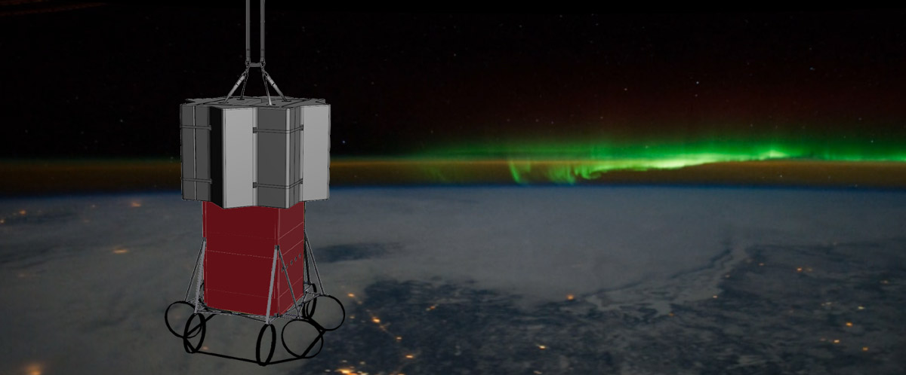
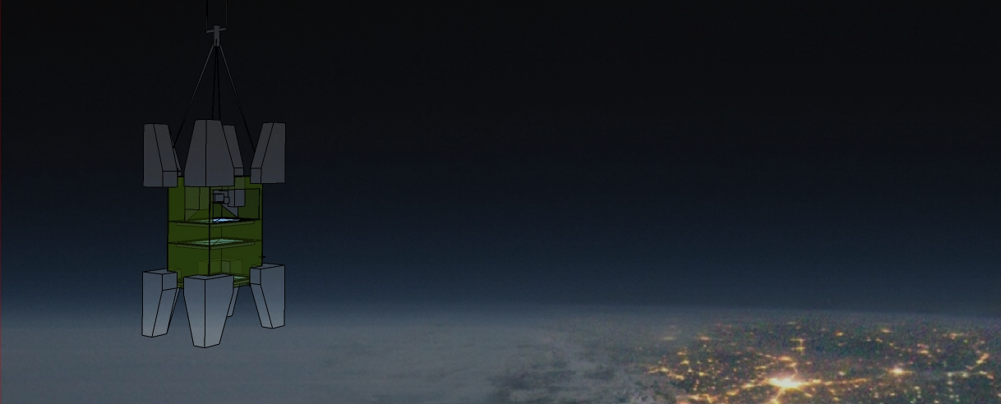
A detection unit designed for the study of the UHECRs from space
Guillaume Prévôt (APC, IN2P3 CNRS)
Sylvie Blin (OMEGA, IN2P3 CNRS)
Pierre Barrillon (LAL, IN2P3 CNRS)
  Context
  Previous pathfinders
  Realization of the first new generation prototype
5th International Workshop on New Photon-Detectors Tokyo 2018

Slide 2
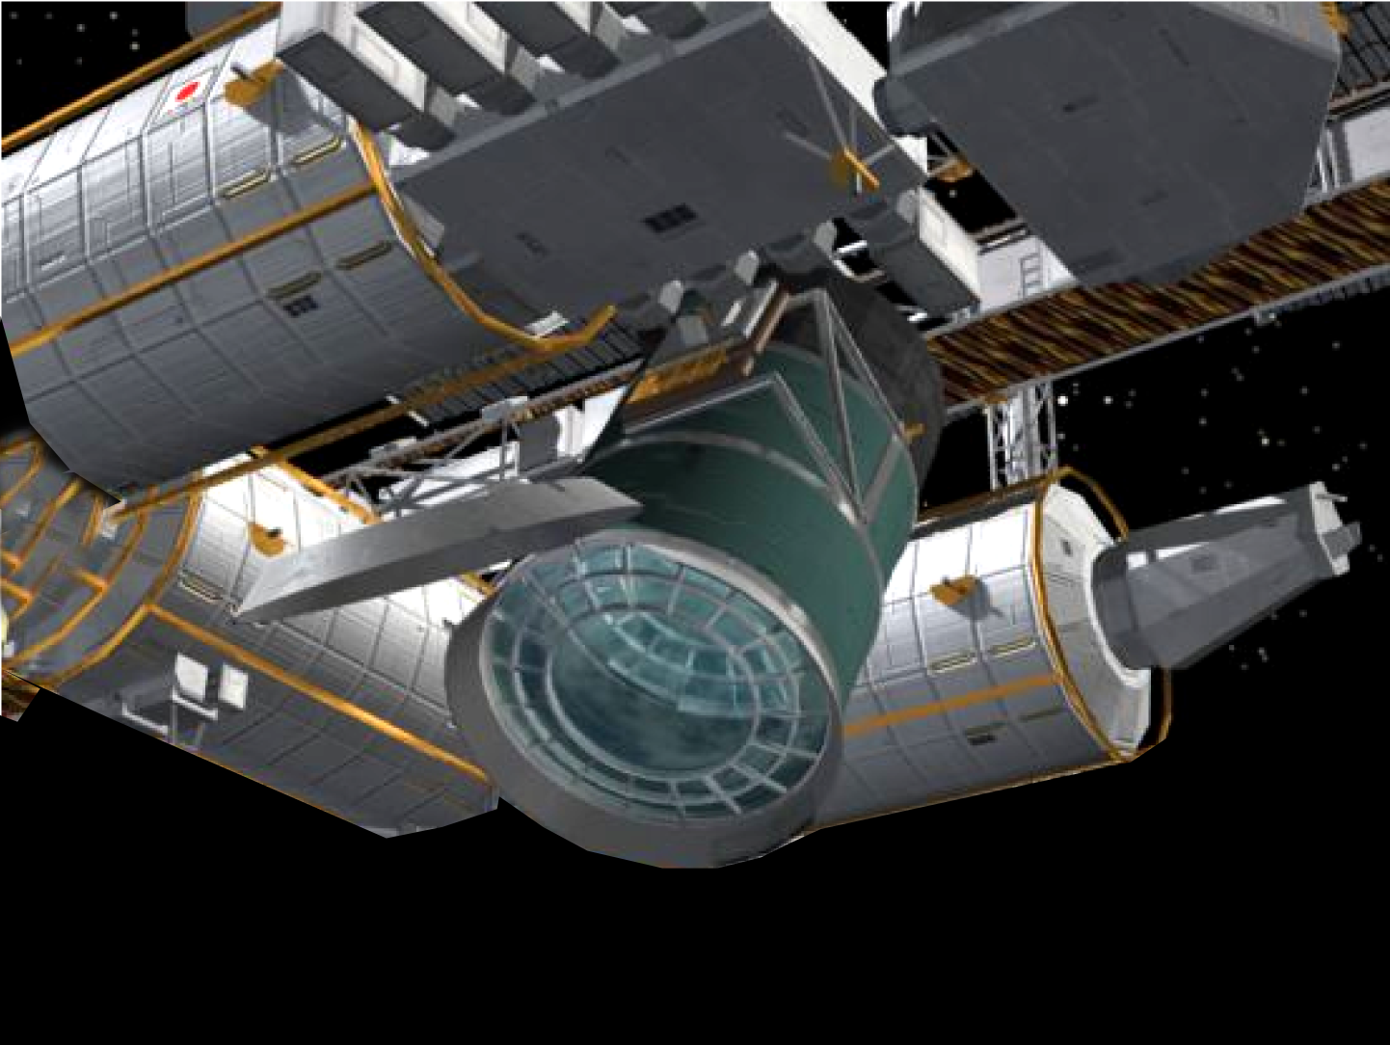
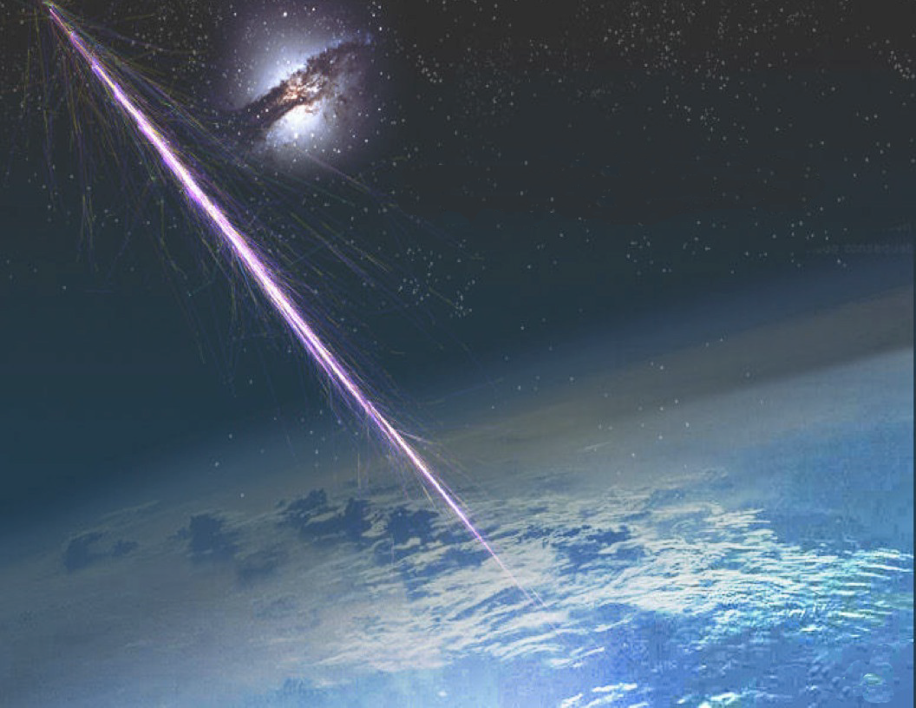
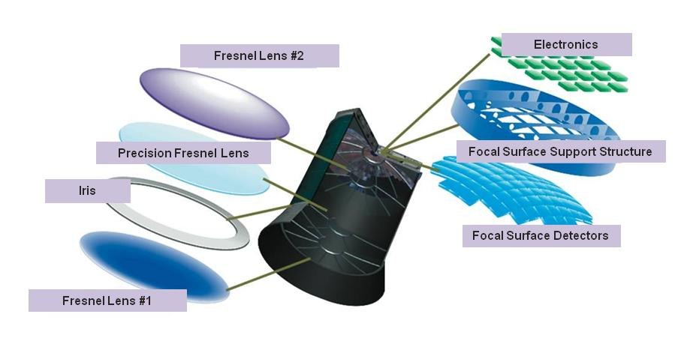

Slide 3
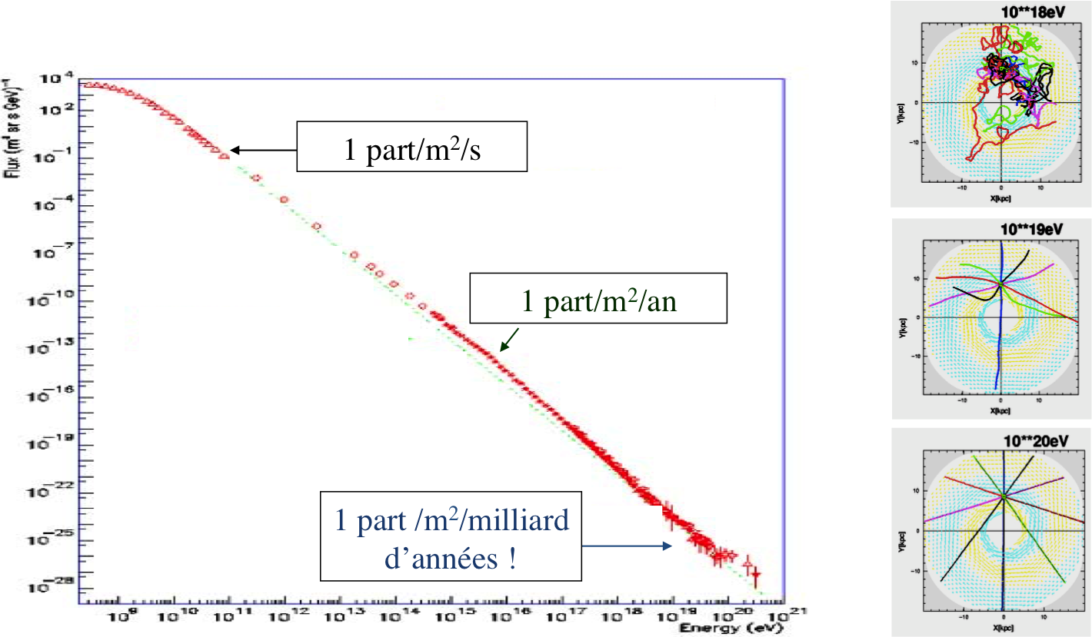
1 part/m²/s
1 part/m²/year
1 part/m²/billions years !

Slide 4
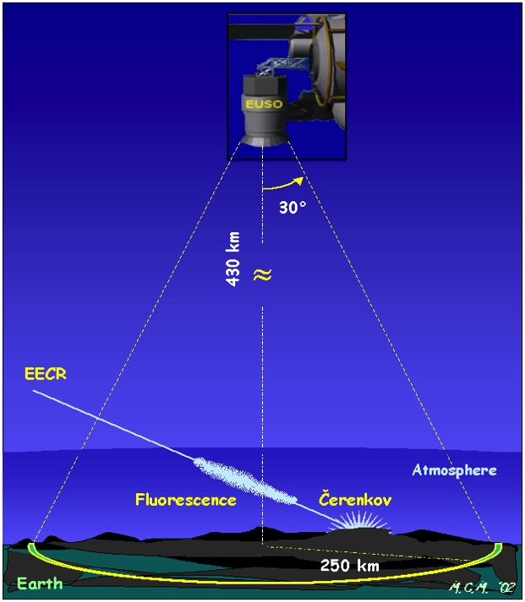
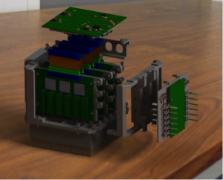
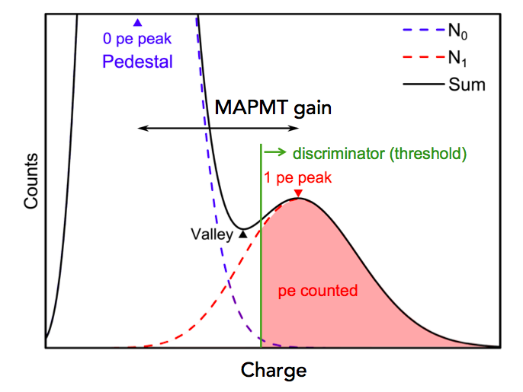
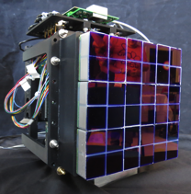
JEM-EUSO space mission detection principle
Ability to detect UHECR from above (fast signal: 50-150 μs), through the UV fluorescence light and the Cherenkov
Photoncouting
MAPMT + ASIC ( + FPGA)
Wide dynamic > 100 pe
Time resolution < 10 ns
GTU = 1 μs
(i.e. time for an event to cross one pixel on ground)
Detection area : 200 000 km²
Previous EUSO UV
camera prototype (2012-2017)
2304 pixels
(20 x 20 x 20 cm):
4
5th International Workshop on New Photon-Detectors Tokyo 2018

Slide 5
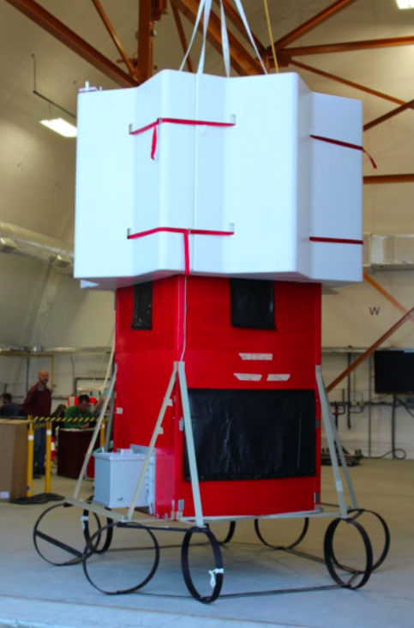
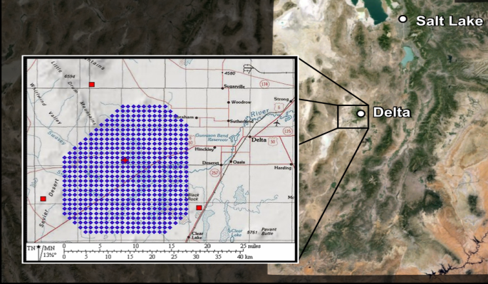
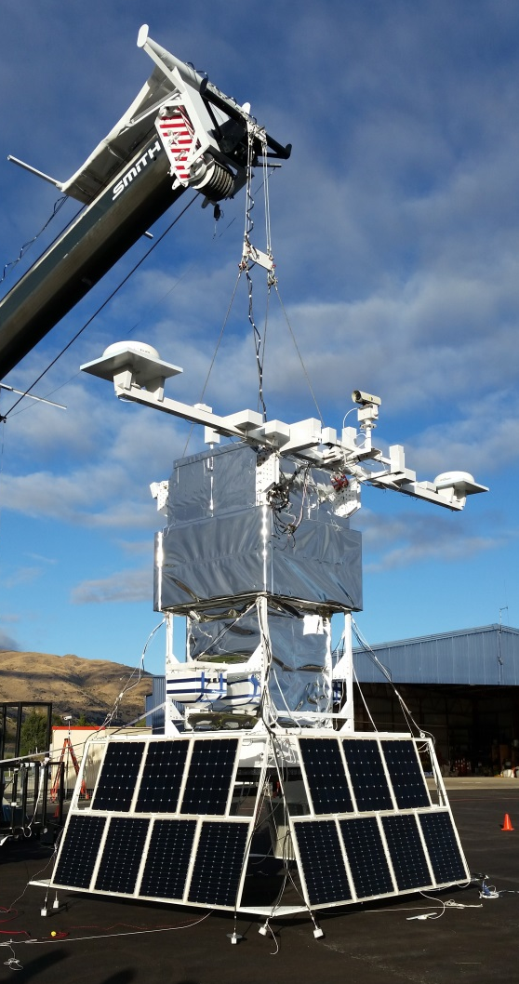
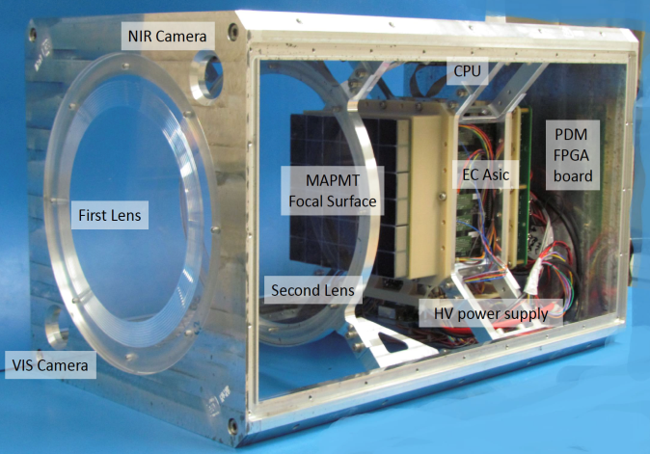
History: previous pathfinders
EUSO-Balloon (CNES)
A balloon-borne telescope (Canada 2012-2014)
EUSO-TA
On-ground pathfinder (Utah 2015-2017)
EUSO-SPB (NASA)
A balloon-borne telescope
(NZ 2015-2017)
Mini-EUSO (ASI+ROSCOMOS)
A pathfinder on-board the ISS 2019-2021
5th International Workshop on New Photon-Detectors Tokyo 2018

Slide 6

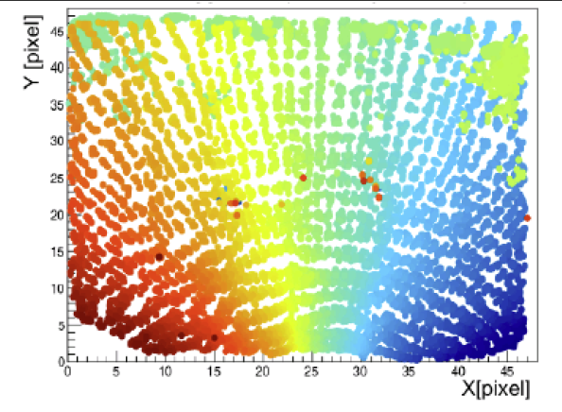
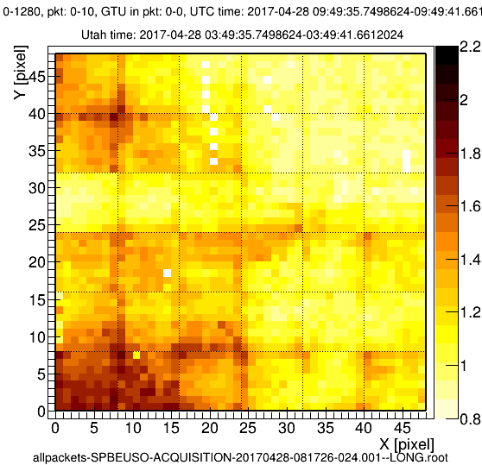
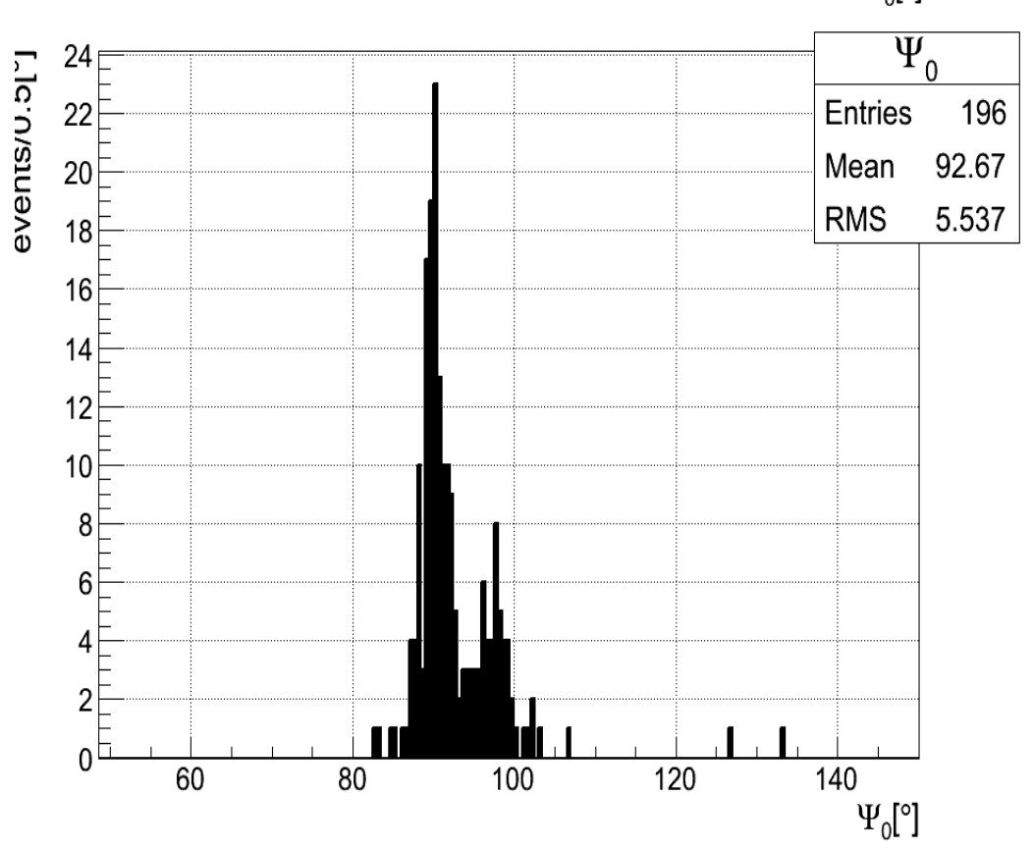
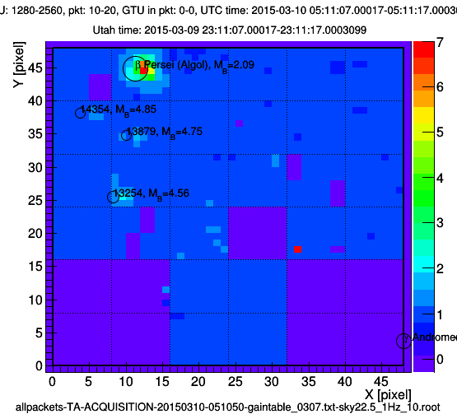
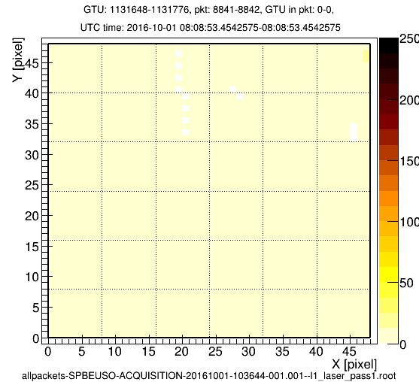
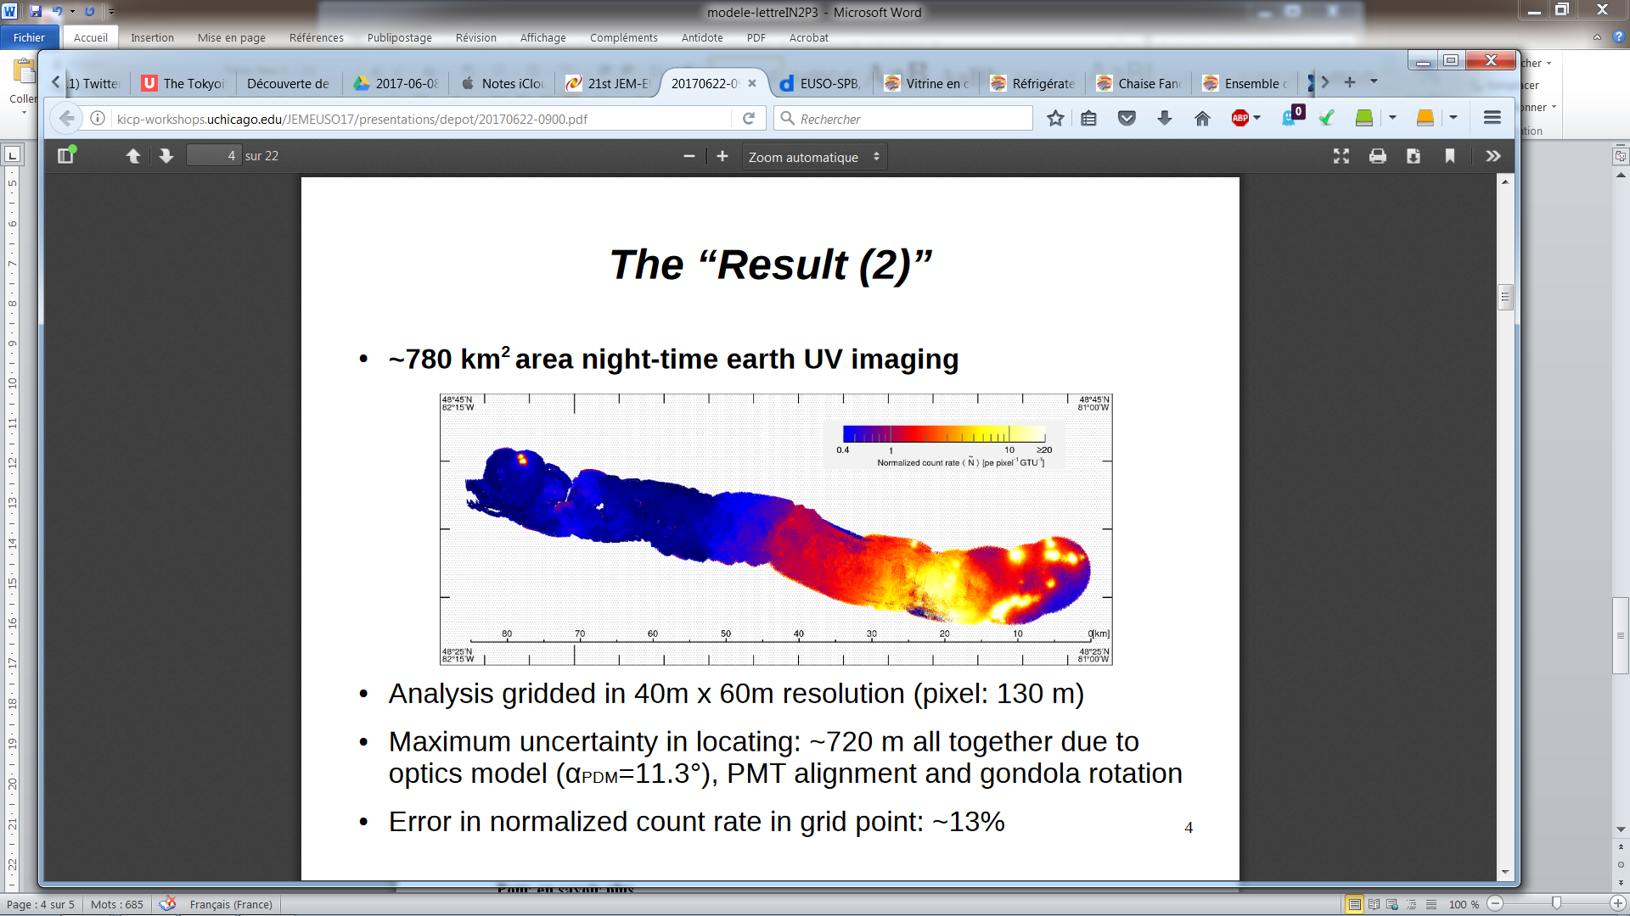
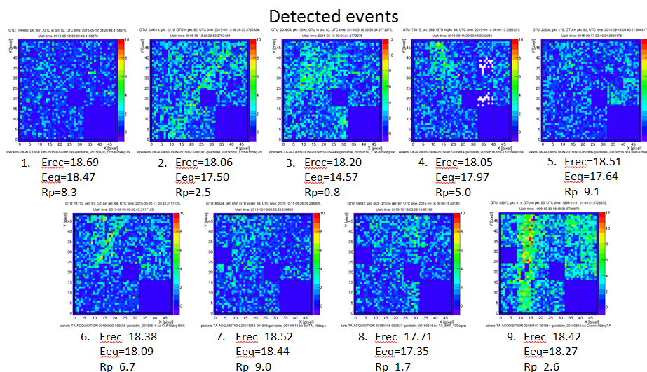
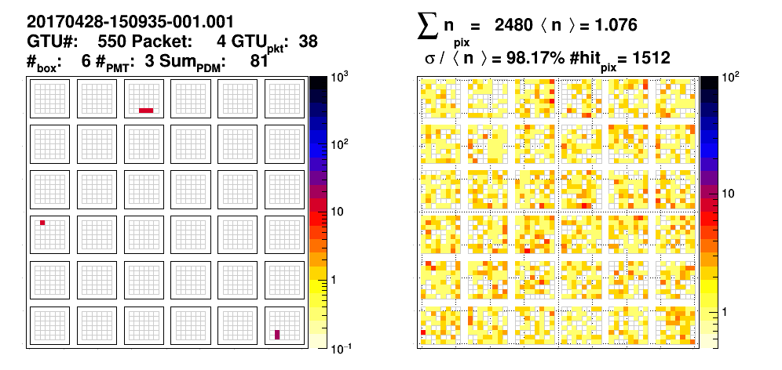
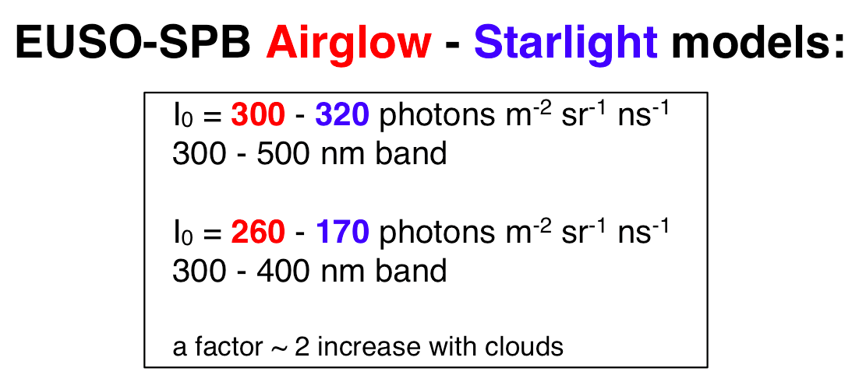
Previous pathfinders main results
EUSO-Balloon 2014
EUSO-TA 2015
EUSO-SPB 2017
6
5th International Workshop on New Photon-Detectors Tokyo 2018

Slide 7
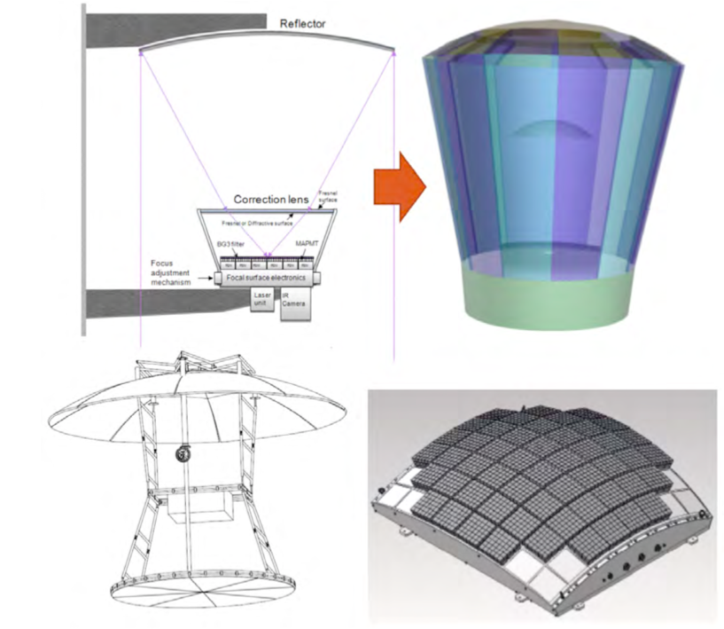
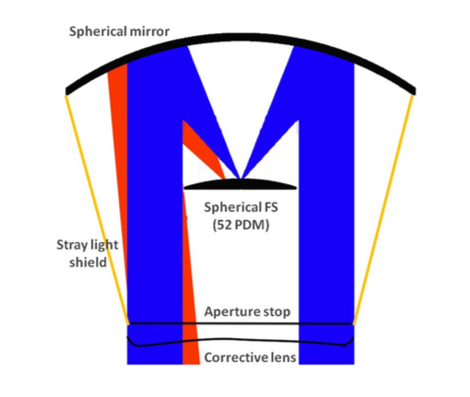

Slide 8
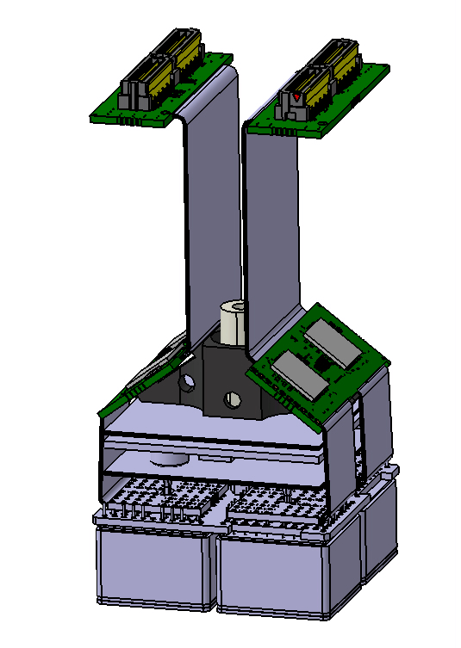
New design: need a more compact detection unit
To minimize the dead zones on the new focal surface, it is mandatory to integrate the ASIC boards inside the unit.
Previous height: 200mm -> new one: height = 55mm (flat camera)
55 mm
100 pins connector (to FPGA board)
kapton (output signals)
55 mm
ASIC board
kapton (anodes to ASIC board)
HVPS board
anode PCB
dynode PCB
64 pixels MAPMTs
to FPGA board
8
5th International Workshop on New Photon-Detectors Tokyo 2018

Slide 9
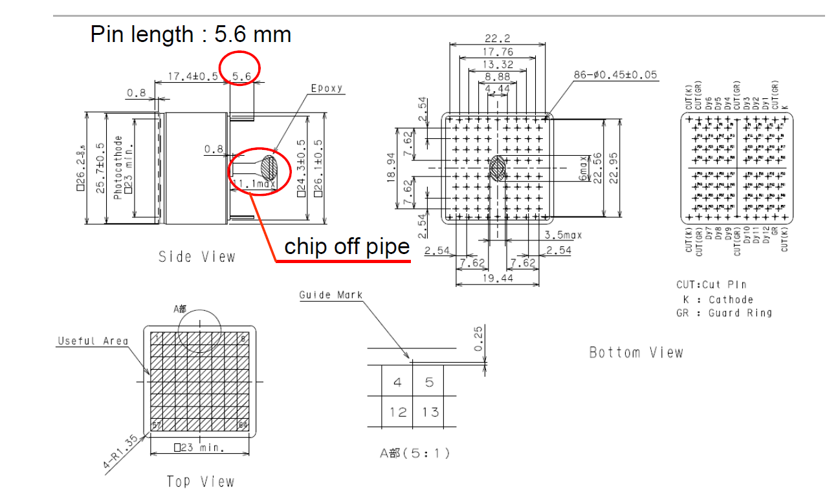
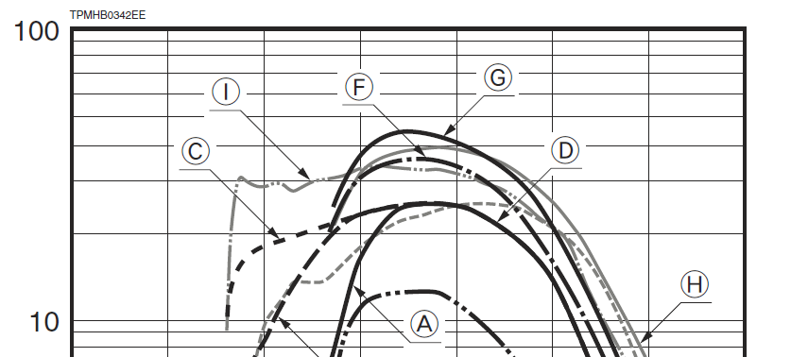
Hamamatsu 64 pixels MAPMT
R11265-103 (typical QE= 30% @ 400nm) (F)
R11265-203 (typical QE= 40% @ 400nm) (G)
9
5th International Workshop on New Photon-Detectors Tokyo 2018

Slide 10
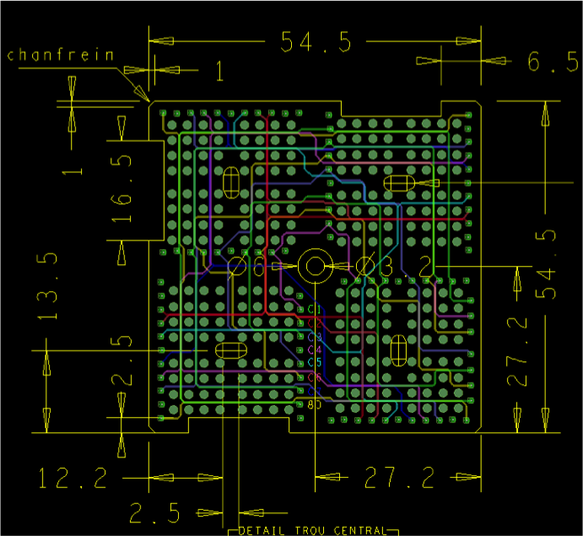
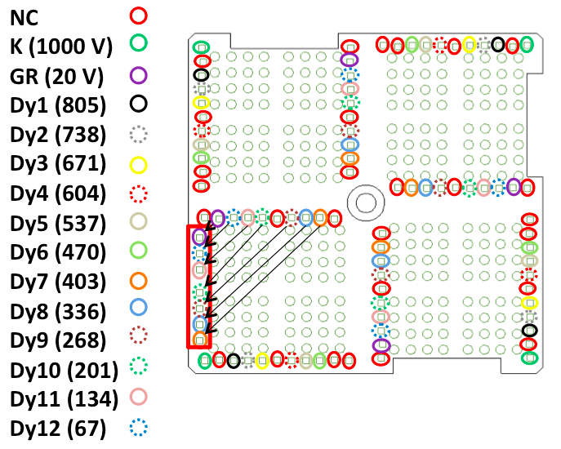
EC-dynode dimensions
54.5 x 54.5 mm x 1.2 mm thickness
8 layers PCB
3 areas 16.5 x 2.5 mm added to spread the potting
4 holes to accommodate the chip pipe tube
10
5th International Workshop on New Photon-Detectors Tokyo 2018

Slide 11
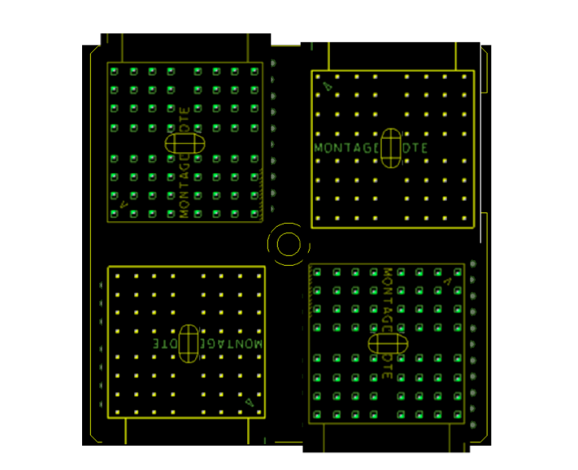
EC-dynode – EC-anode(s) assembly (bottom layer view)
kapton (anodes to ASIC board)
kapton (anodes to ASIC board)
kapton (anodes to ASIC board)
kapton (anodes to ASIC board)
11
5th International Workshop on New Photon-Detectors Tokyo 2018

Slide 12
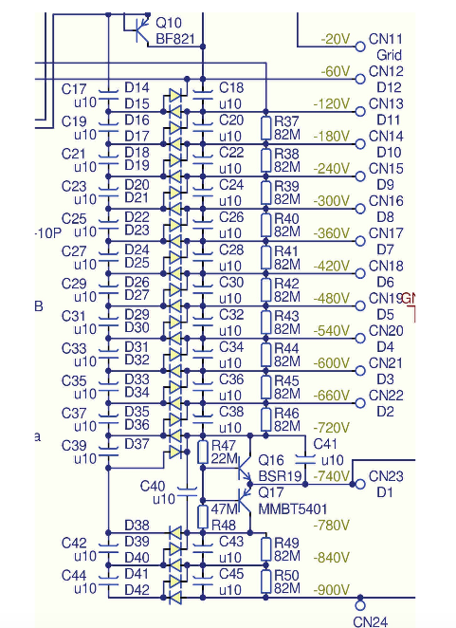
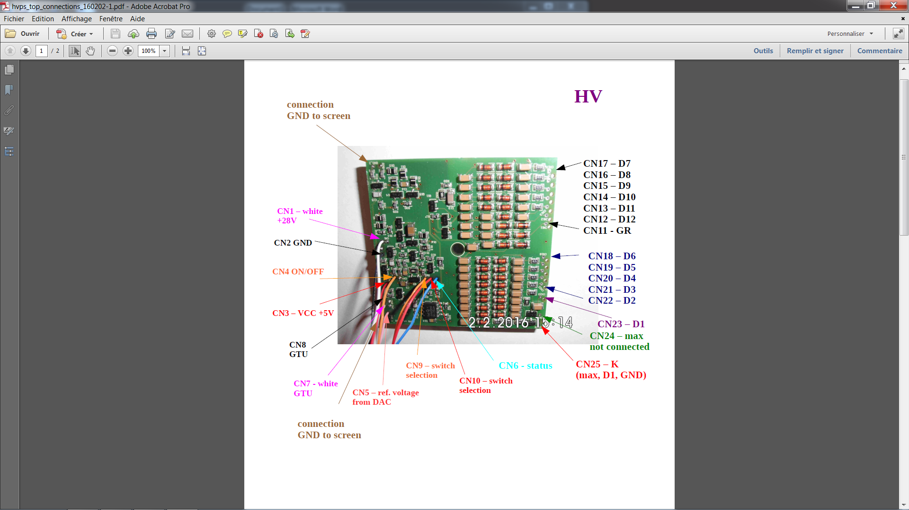
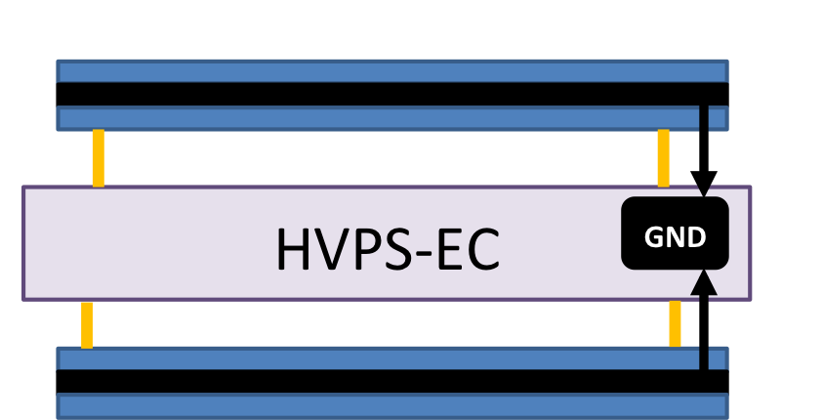
HVPS board (designed by NCBJ Poland)
Usual resistive dividers: consumption about 10W by EC_Unit.
Solution: Cockroft-Walton or "voltage multiplier" (the inter-dynode voltages are equal) -> 75 mW / EC.
The HVPS board also includes two types of protections:
  fast switches to protect the PMT (reduction of cathode potential to reduce/increase collection efficiency), reacting in less than 2μs
  a slow D12 current limit automatic OFF (photon counts > ~100 pe / a few pixels / GTU)
The board is surrounded by noise screens.
12
5th International Workshop on New Photon-Detectors Tokyo 2018

Slide 13
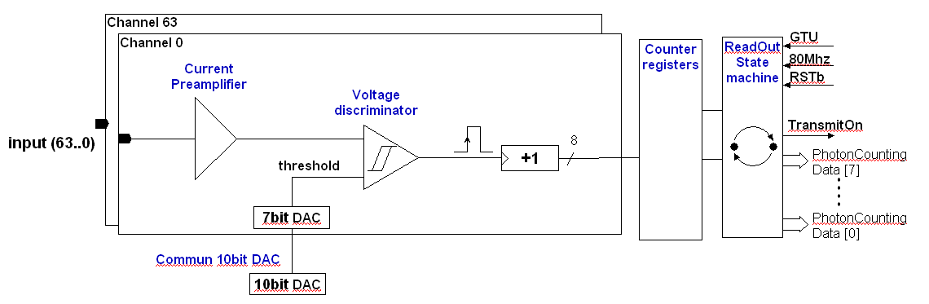
SPACIROC 3 ASIC chip
Developed by OMEGA IN2P3 for the experiment
64 channels photon counting
Single photon counting 100% trigger efficiency: 1/3 pe (~50 fC when MaPMT gain=106)
Internal 8 bits counter (in order to minimize the consumption)
Wide linear dynamic: 1 to 130 pe
MAPMT adjustment trigger by individual threshold for each pixel
Double pulse resolution : 5 ns / 200 MHz
Data acquisition & Readout to be done every 1 µs (GTU)
Readout Clock : 80 MHz
Output: 8 multiplexed data lines (to minimize interconnection with the FPGA)
Radiation Hardness By Design : TMR (Triple Module Redundancy)
Power budget : < 0.8 mW/pix
13
5th International Workshop on New Photon-Detectors Tokyo 2018

Slide 14
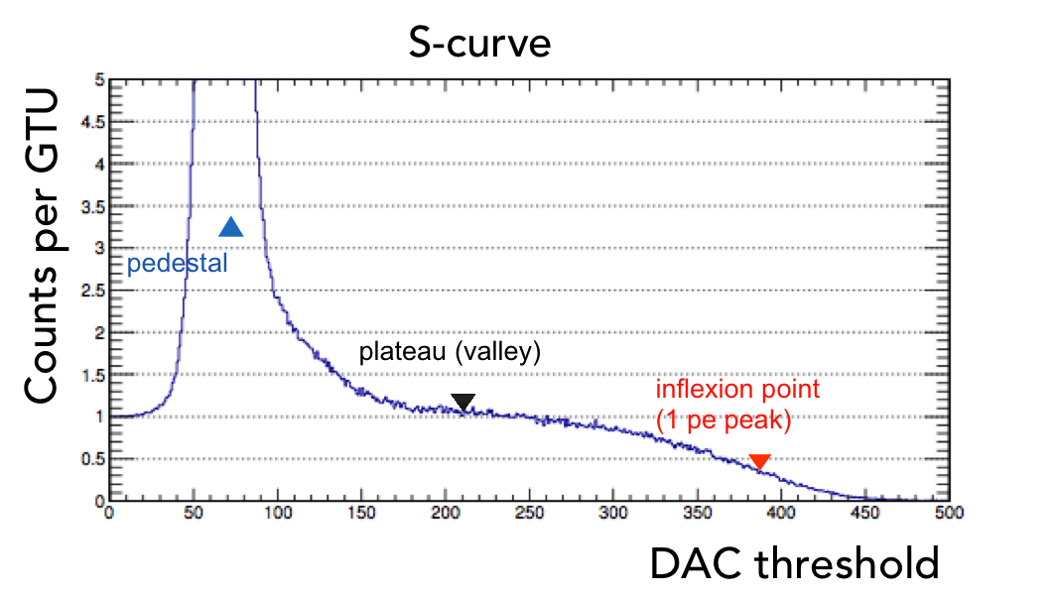
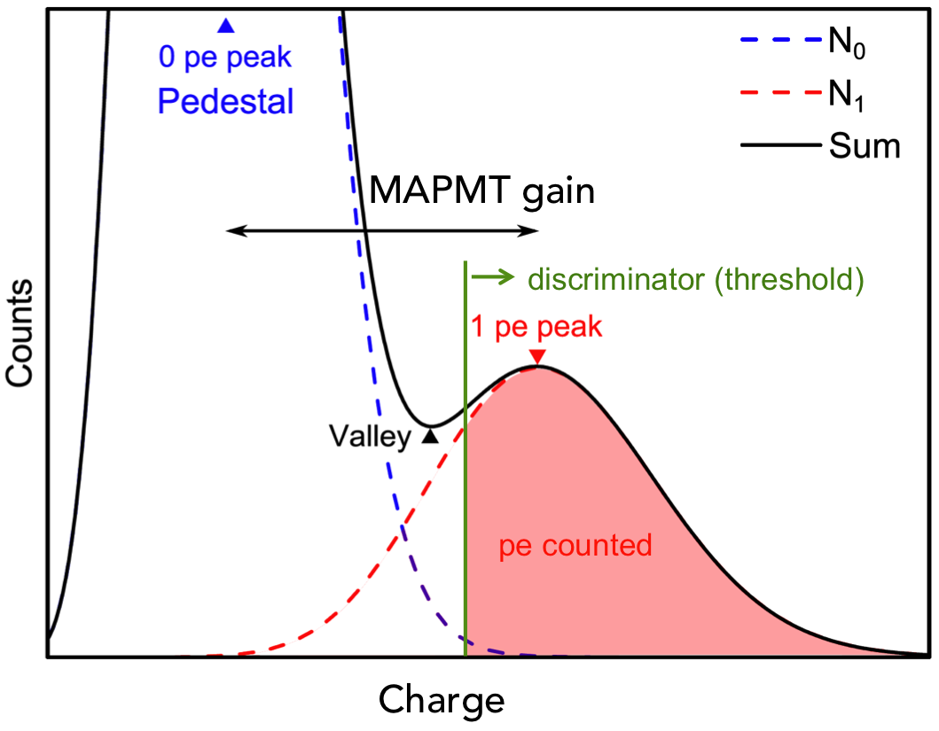
Photodetection
How photon counting is working?
MAPMT generates an output pulse when a photoelectron (pe) is produced.
The SPACIROC ASIC uses a discriminator to separate photoelectron pulses from baseline current and a counter incremented to measure the number of photoelectrons produced by MAPMT.
By changing the threshold, an integration of the spe spectrum can be done = S-Curve : basic tool for photodetection with EUSO-Balloon
The s-curve is used to characterize the detection performance of a pixel/channel (noise, gain, efficiency, determination of threshold)
14
5th International Workshop on New Photon-Detectors Tokyo 2018

Slide 15
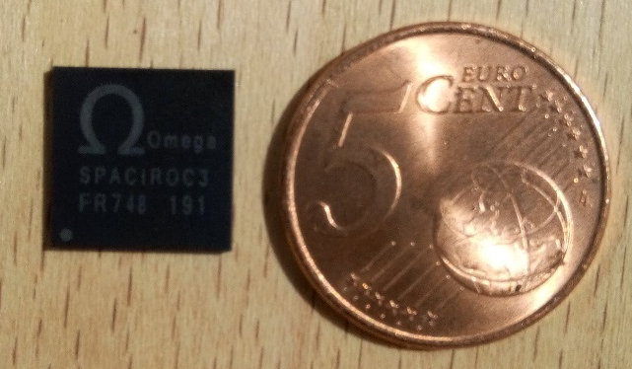
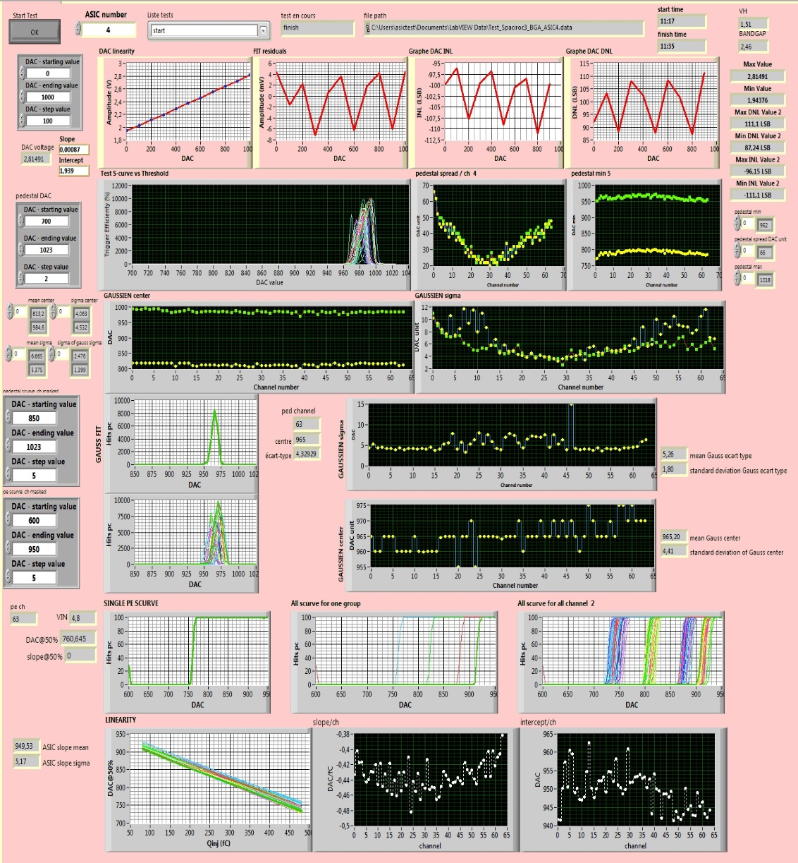
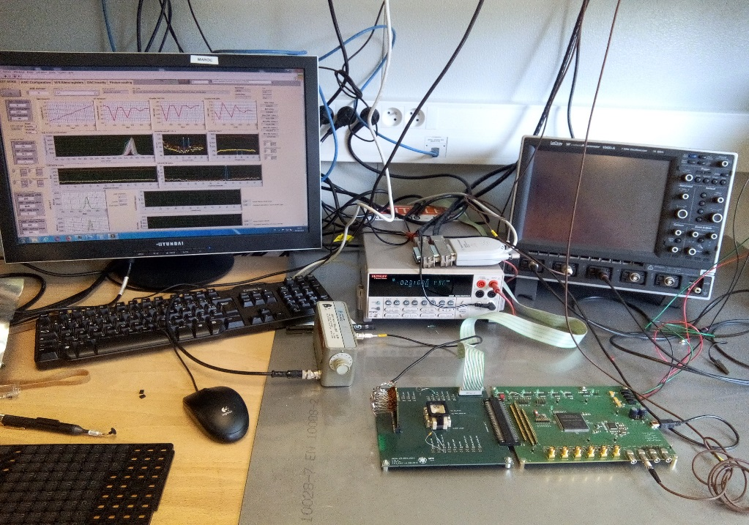
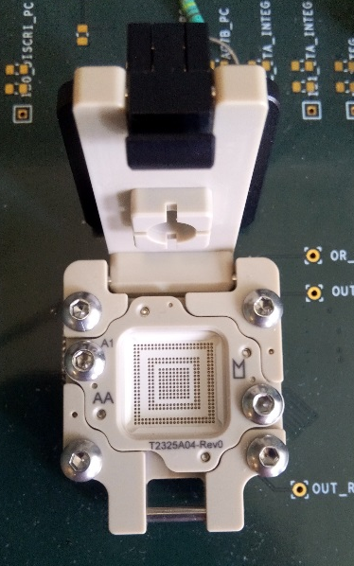
SPACIROC3 BGA serial test
SPACIROC3 BGA:
  Packaging: BGA 12 x 12 mm , 353 balls, pitch 0,5
  Socket Yamaichi Y-red BN0353 MI 0-H-S
SPACIROC3 ASIC automatic test:
  Dedicated test bench: power supply, labview, pulse generator, keithley
  130 SPACIROC3 BGA tested: functionality, linearity of DAC, charge injection -> S-Curve
  Good yield = 94%
previous
new
  BGA packaged Spaciroc 3 ASIC
15
5th International Workshop on New Photon-Detectors Tokyo 2018

Slide 16
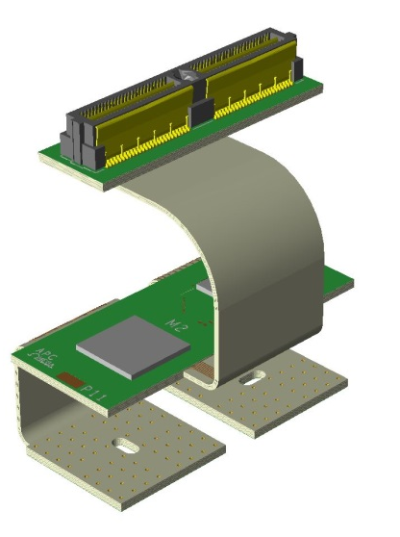
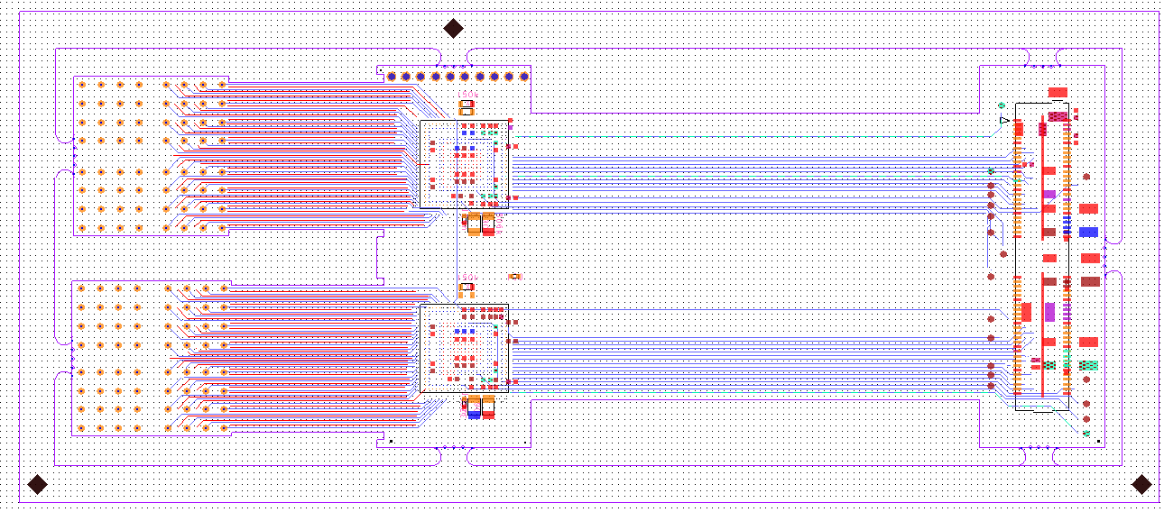
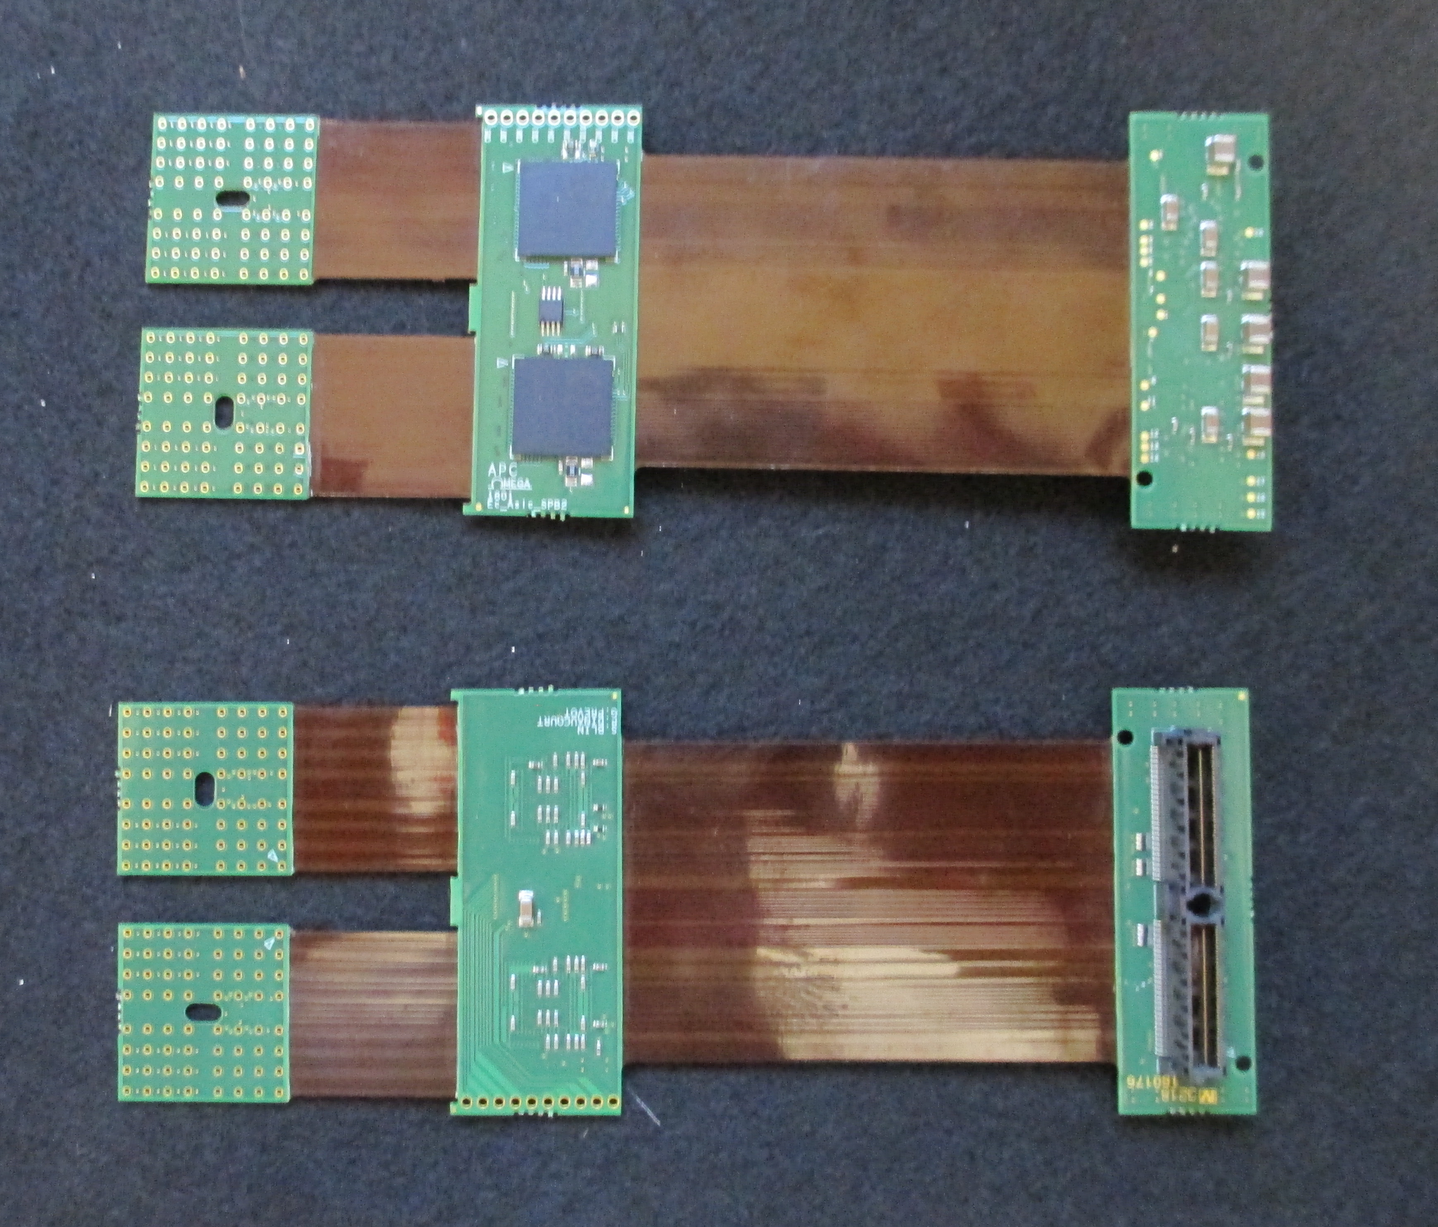
Routing and Dimensions of the new ASIC board
EC_anode boards
Kapton 1
BGA ASIC
Kapton 2
SAMTEC 100 pins
50 mm
155 mm
A complicated board:
A board challenging to route (inner micro-vias, density)
A board complicated to produce (PCB/kaptons, hard to find a manufacturer, bad yield)
A board uneasy to integrate inside the EC_Unit
16
5th International Workshop on New Photon-Detectors Tokyo 2018

Slide 17
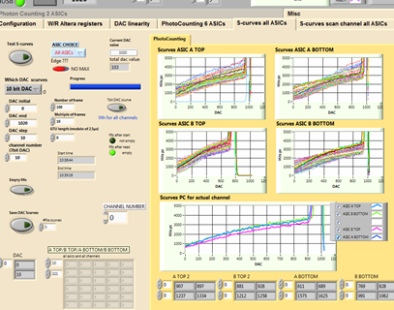
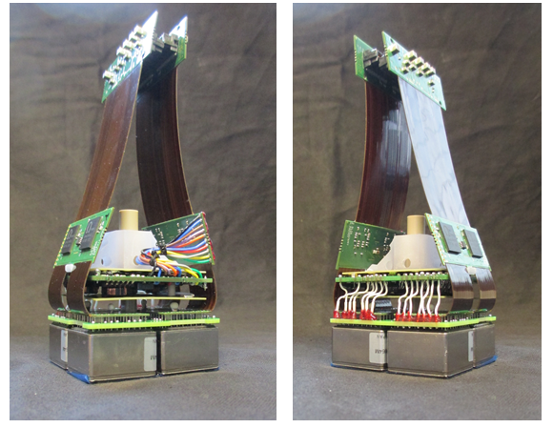
First prototype of our new EC_Unit
  A light (500g) compact (55mm x 55mm x 55mm) detection unit:
  256 pixels
  photocounting
  GTU = 1μs
  linear from 1/3 pe to 130 pe
  consumption = about 250mW
  including HVPS & safety switches
  potted (arathane resin)
  two 100 pins output connectors
17
5th International Workshop on New Photon-Detectors Tokyo 2018

Slide 18
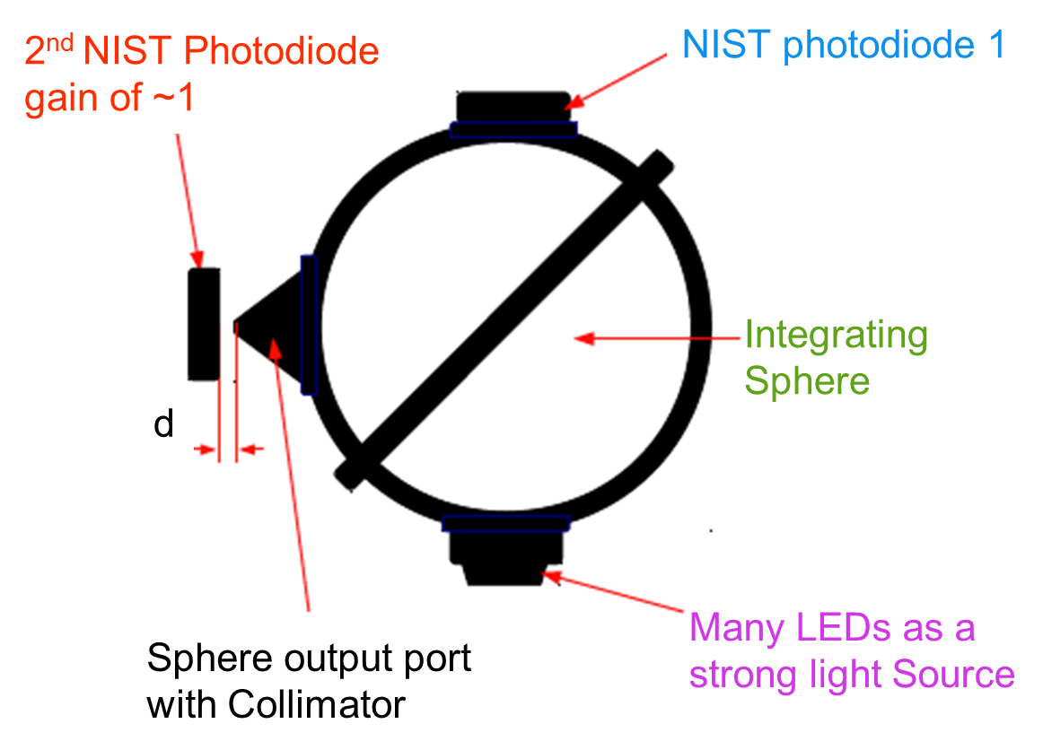
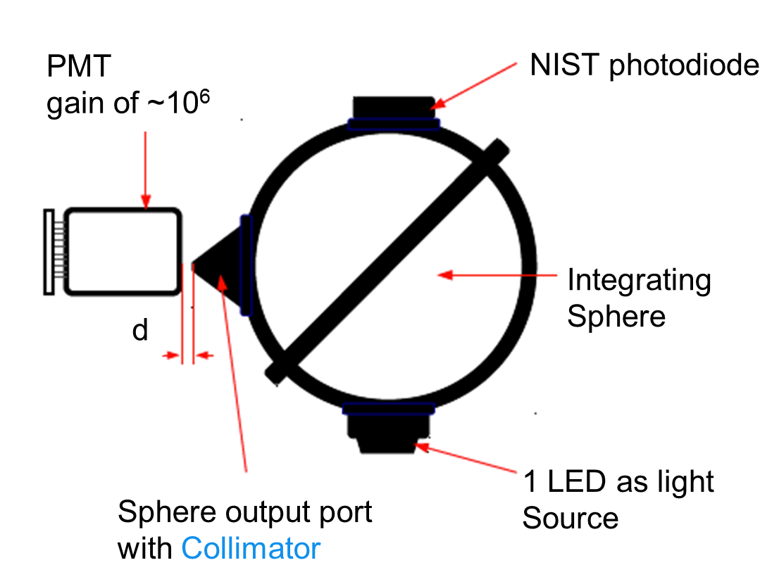
Absolute calibration
We use reference detectors: a NIST photodiode 1 called CONTROL NIST and a NIST photodiode 2 called TEST NIST, calibrated at 1.5%.
We measure the (geometrical) ratio of light between NIST 1 and NIST 2 for high light fluxes and then on the CONTROL NIST.
Only one pixel is illuminated => use of a collimator with output hole of 1.5 mm diameter placed at d < 1 mm from the MAPMT surface.
We developed an automatic set-up that allows us to scan all the pixels of a PMT.
Acquisition of N x 100 GTUs.
- 2 pe pile-up represents ~1% events
- Statistical uncertainty √N counts < 1%
- Systematic uncertainty: mainly NIST photodiode
- Uncertainty for reference pixels of ~5%
18
5th International Workshop on New Photon-Detectors Tokyo 2018

Slide 19
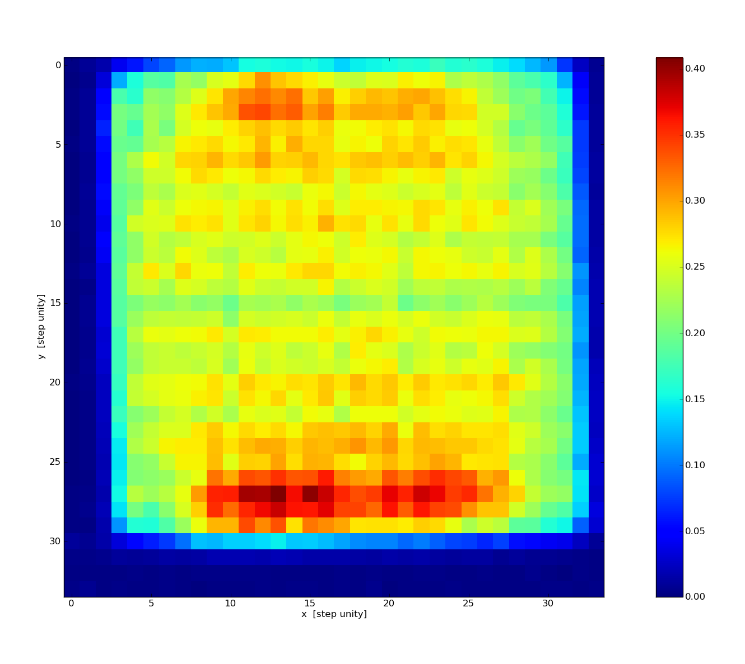
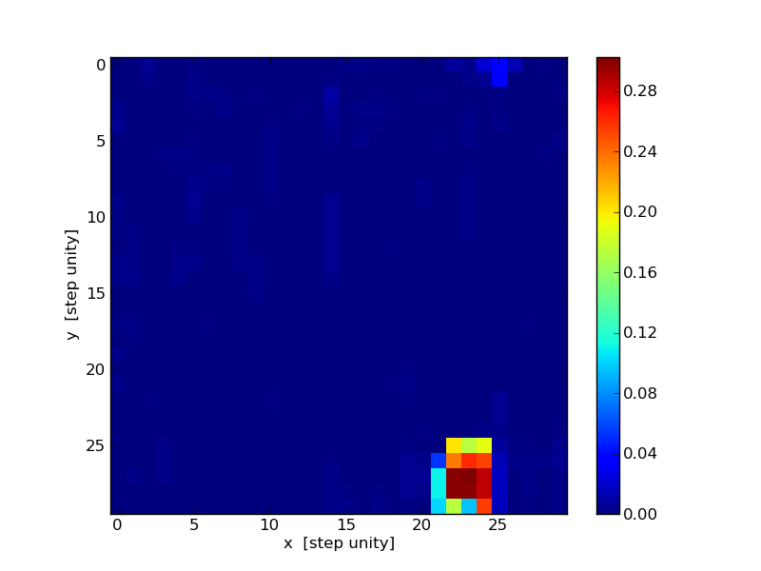

Automatic scans calibration: preliminary results
We use small steps (about 0.5mm) so we can evaluate the varying sensitivity inside a pixel)
Spot size = 1.5mm (pixel = 2.9 mm x 2.9 mm)
Automatic scan
for 1 PMT
Total efficiency
(SUM of the light seen
for every position)
Automatic scan
for 1 pixel
Total efficiency
(SUM of the light seen
for every position)
Automatic scan
for 1 pixel
Total efficiency
19
5th International Workshop on New Photon-Detectors Tokyo 2018

Slide 20
Conclusion
This third generation detection unit could catch UHECR from space:
  in the frame of K-EUSO (selected mission of ROSCOMOS, phase A)
  in the frame of POEMMA (selected for the NASA decadal survey) and its pathfinder EUSO-SPB 2 (2021)
Could have other applications?
Contact:
Guillaume Prévôt
prevot@apc.in2p3.fr
APC IN2P3 CNRS (Paris France)
20
5th International Workshop on New Photon-Detectors Tokyo 2018

