Slide 1
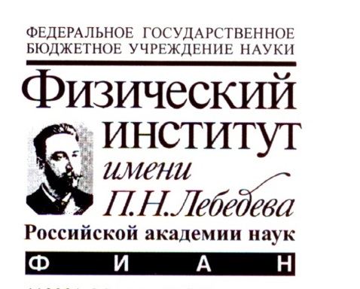
Fast Charged Particle Detector with High Dynamic Range at Horizon-10T Cosmic Rays Detector System
By: Ayan Batyrkhanov
For Horizon-T group

Slide 2
Horizon-T Group
R. U. Beisembaev, E. A. Beisembaeva, O. D. Dalkarov, V. A. Ryabov, S. B. Shaulov, M. I. Vildanova, V. V. Zhukov
P. N. Lebedev Physical Institute of the Russian Academy of Sciences, Moscow, Russia
K. A. Baigarin, A. Batyrkhanov, A. Iakovlev, T. Uakhitov, A. Yeltokov
Nazarbayev University, Astana, Kazakhstan
T. X. Sadykov
LLP “Institute of Physics and Technology”, Almaty, Kazakhstan
D. Beznosko
Bard College, New Orleans, LA, USA

Slide 3
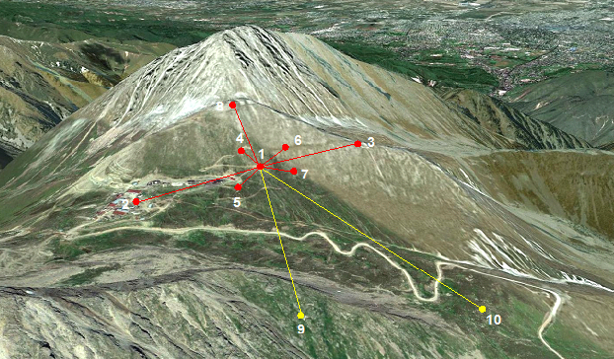
Horizon-10T (HT) Detector System [1,2,3]
An innovative detector system
pulse shape -> disk width information
2 ns resolution
EAS E> 10¹⁶ eV ; Zenith angles (0º - 85º).
At Tien Shan high-altitude Science Station ~3340 meters above the sea level
10 charged particle detection points [8]
separated by the distance up to 1.3 kilometer
Optical detector subsystem
to view the Vavilov-Cherenkov light from the EAS
Station name | Center | Yastrebov | Stone Flower | Left | Kurashkin | Right | Bottom | Upper | Cher | 600m | Bunker
Station # | 1 | 2 | 3 | 4 | 5 | 6 | 7 | 8 | VCD | 9 | 10

Slide 4
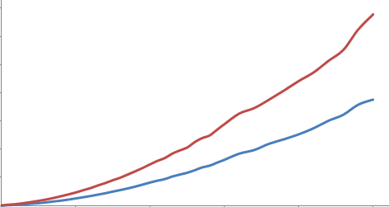
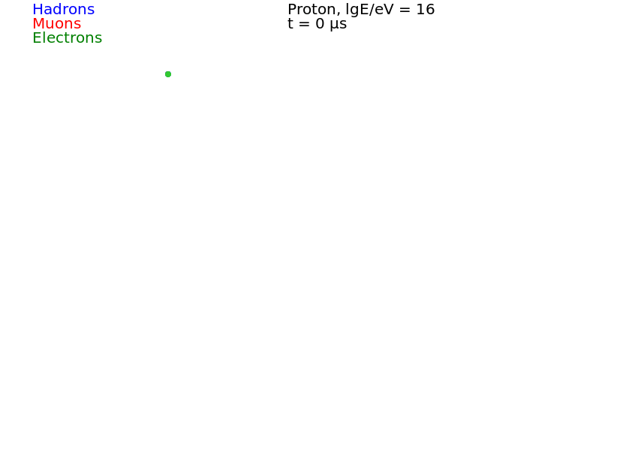
Temporal structure of eas
Time, ns
Can reconstruct using particle density distribution
Need to calibrate detection points to obtain equivalent MIP number
If know time and width, additional methods can be used (CORSIKA) [5]
Distance from core, m
Observation level with detectors

Slide 5
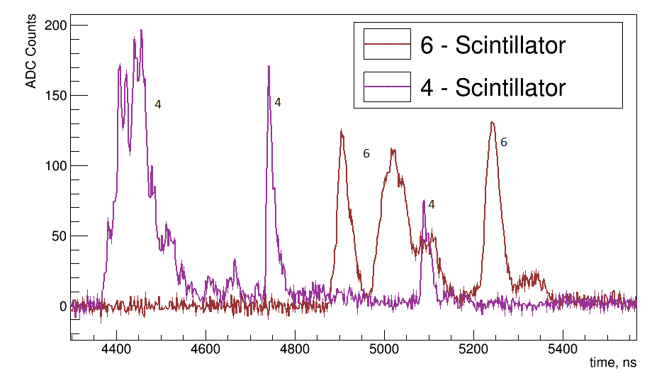
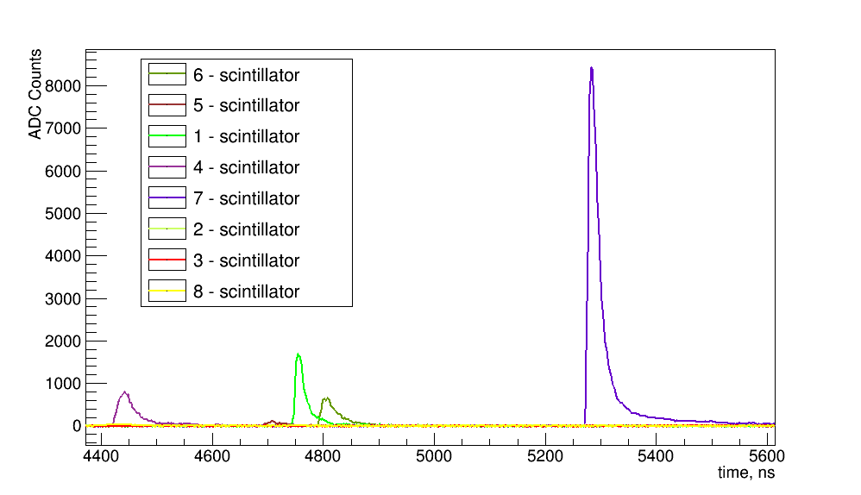
Data examples for Standard EAS
Standard EAS signal (bottom) and unusual event (right) from each HT detector
Corresponds to simulation
Estimated Energy:
~2·10¹⁶ eV (left) high zenith angle
5

Slide 6
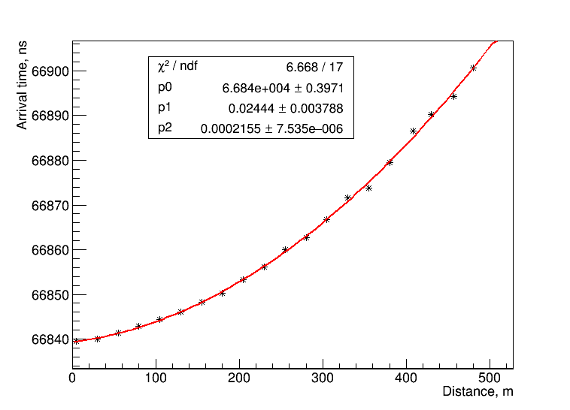
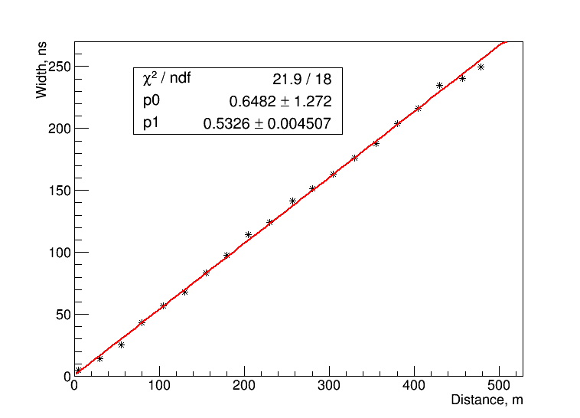
EAS characteristics from temporal structure
Disk arrival time ~r² (used for arrival direction determination)
Disk passage time (e.g. width) is growing with ~r
Can use particle density and pulse width additional information from each detection point
Need high time resolution

Slide 7
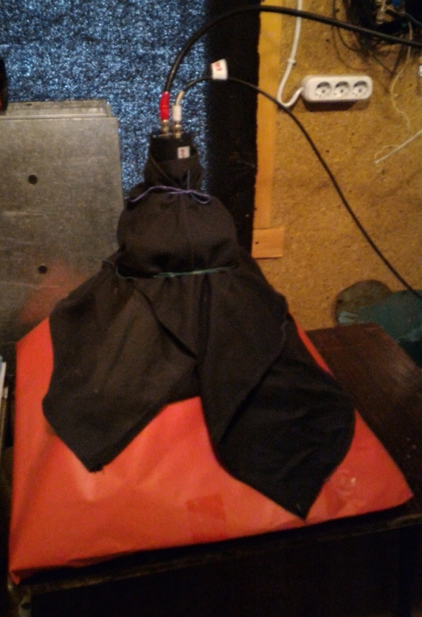
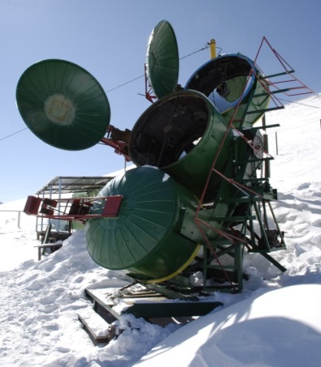
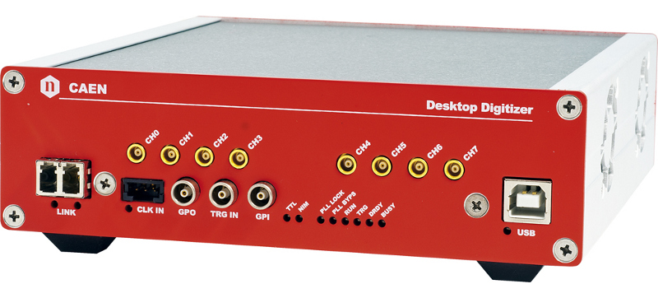
Horizon-T (HT) Detector System
1 m² polysterene-based scintillators & scintillating glass with PMT 1 m above
R7723 Hamamatsu [6] PMT (52 mm diameter)
2kV max voltage
1.7 ns pulse rise time
1.1 ns time spread
500 MHz digitization CAEN [9] DT5730 ADC
Cherenkov-Vavilov light detector
All channels MIP/cable/linear range calibrated
Two physics runs: 2016-2017 and 2017-2018

Slide 8
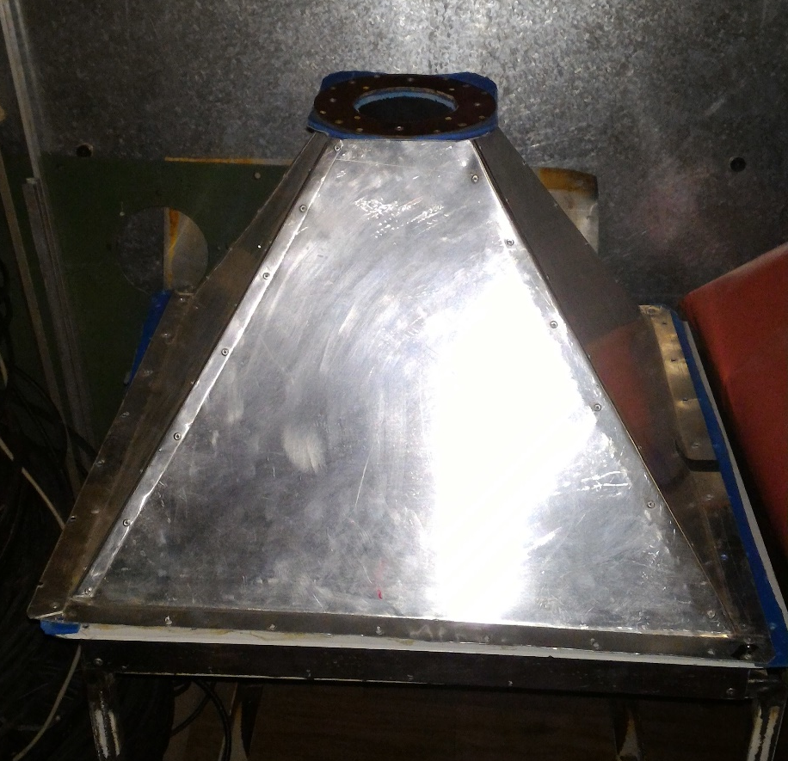
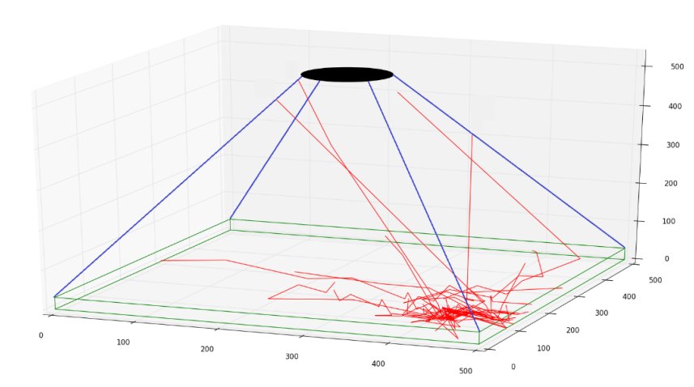
Detector design and simulation
Various designs were checked
Different PMT positions
Different scintillator shapes
PMT from the top gives better uniformity as well as circular scintillators
Calibration tests are for single MIP detection
Bottom of the scintillator is painted in order to increase reflectivity

Slide 9
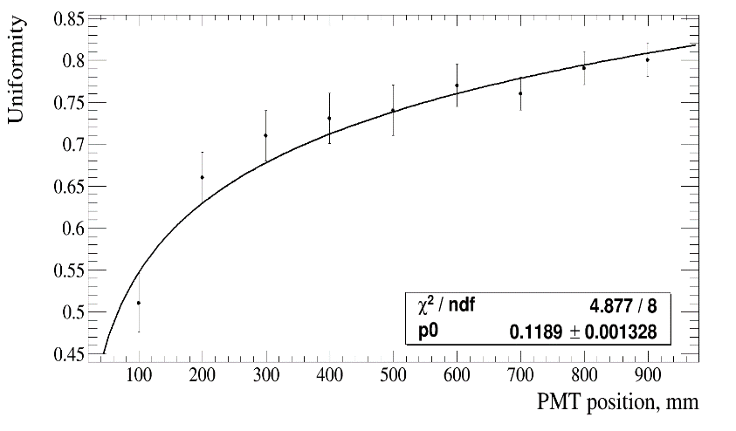
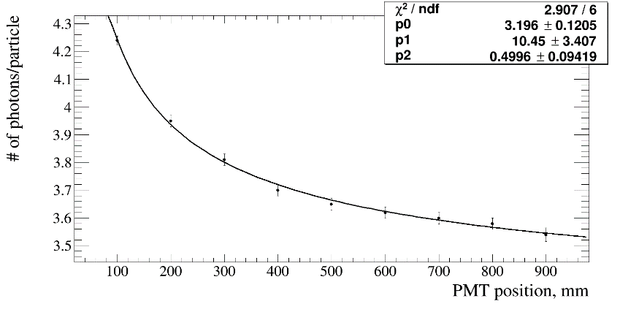
Detector design and simulation
PMT ‘above’ results in statistically significantly higher light yield:
3.65 ± 0.04 detected photon per MIP for ‘above’
3.19 ± 0.03 for ‘below’
Uniformity increases / saturates depending on position
Detected photon number decreases

Slide 10
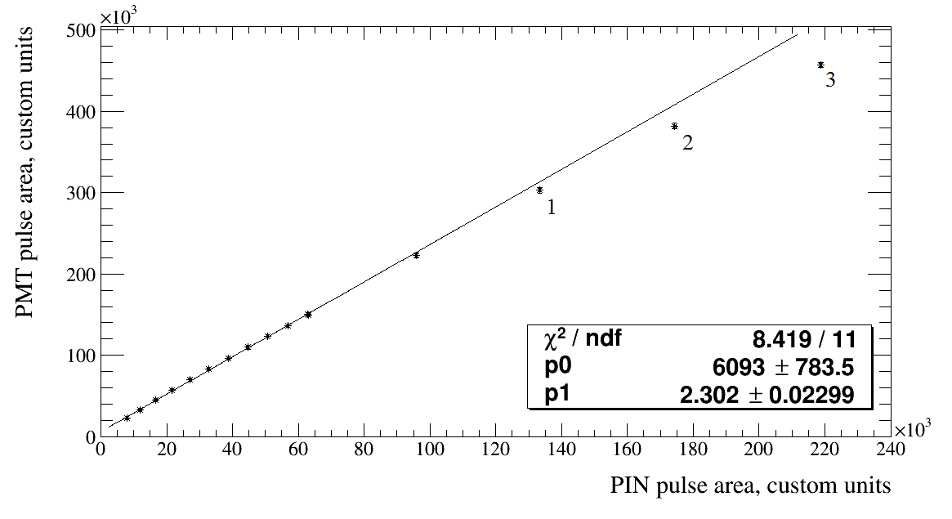
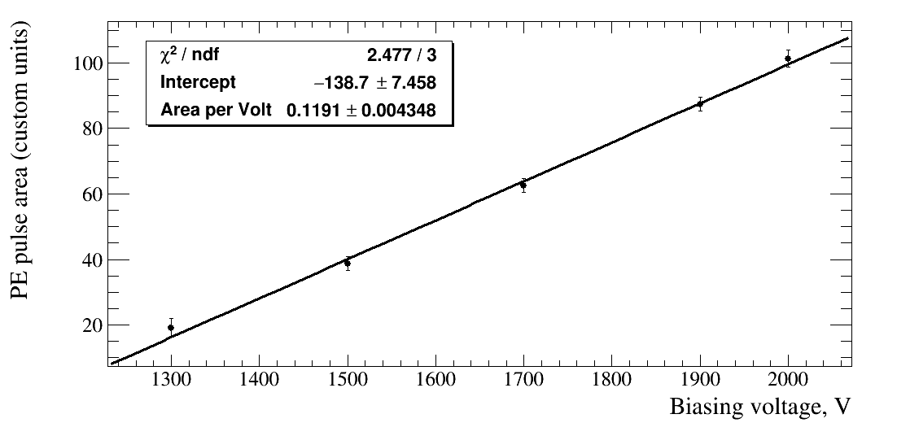
Signal Width measurements
Linearity of the width vs. number of photons detected
Linearity holds for 1 MIP and up to 3000
PMT response vs. voltage applied linearity

Slide 11
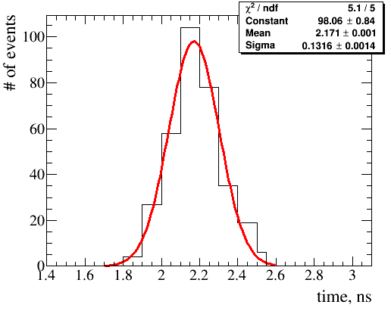
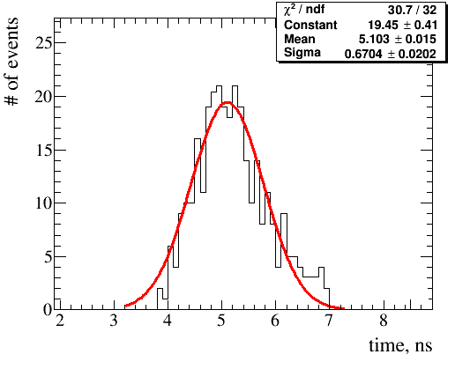
Time response measuremetns
~ 2.2 ns rise time response (10-50% of the pulse area) of the PMT+glass
~ 1.7 ns pulse width is limited by PMT, ADC characteristics and geometry
~ 5.1 ns total time response (10-90% of pulse area) of the PMT+glass

Slide 12
Conclusion and Future plans
In HT data, ‘unusual’ events have been identified
To study it better time resolution is required
Rise time of the PMT should match ADC rate
Fast time response
Far periphery detectors upgrade to larger areas is planned up to 12 m2

Slide 13
references
[1] RU Beisembaev, EA Beisembaeva, OD Dalkarov, VA Ryabov, AV Stepanov, NG Vildanov, MI Vildanova, VV Zhukov, KA Baigarin, D Beznosko, TX Sadykov, NS Suleymenov, "The 'Horizon-T' Experiment: Extensive Air Showers Detection," arXiv:1605.05179 [physics.ins-det], May 17 2016.
[2] Rashid Beisembaev, Dmitriy Beznosko, Kanat Baigarin, Elena Beisembaeva, Oleg Dalkarov, Vladimi Ryabov, Turlan Sadykov, Sergei Shaulov, Aleksei Stepanov, Marina Vildanova, Nikolay Vildanov, Valeriy Zhukov. "Horizon-T experiment status." EPJ Web Conf. 145 11004 (2017). DOI: 10.1051/epjconf/201614511004
[3] Rashid Beisembaev, Dmitriy Beznosko, Kanat Baigarin, Elena Beisembaeva, Oleg Dalkarov, Vladimir Ryabov, Turlan Sadykov, Sergei Shaulov, Aleksei Stepanov, Marina Vildanova, Nikolay Vildanov, Valeriy Zhukov. " Extensive Air Showers with unusual structure." EPJ Web Conf. 145 14001 (2017). DOI: 10.1051/epjconf/201614514001 ISVHECRI
[4] R U Beisembaev, D Beznosko, K A Baigarin, A Batyrkhanov, E A Beisembaeva, T. Beremkulov, O D Dalkarov, A Iakovlev, V A Ryabov, N S Suleimenov, T Kh Sadykov, Z Tagay, T Uakhitov, M I Vildanova and V V Zhukov. "Horizon-T experiment and detection of Extensive air showers with unusual structure", accepted to Journal of Physics: Conference series, 2018
[5]. D. Heck, J. Knapp, J.N. Capdevielle, G. Schatz, T. Thouw. CORSIKA: A Monte Carlo Code to Simulate Extensive Air Showers, Forschungszentrum Karlsruhe Report FZKA (6019).
[6]. HAMAMATSU PHOTONICS K.K., Electron Tube Division, 314-5, Shimokanzo, Iwata City, Shizuoka Pref., 438-0193, Japan, http://www.hamamatsu.com
[7] R.U. Beisembaev, D. Beznosko, E.A. Beisembaeva, A. Duspayev, A. Iakovlev, T.X. Sadykov, T. Uakhitov, M.I. Vildanova, M. Yessenov and V.V. Zhukov, "Fast and simple glass-based charged particles detector with large linear detection range," Journal of Instrumentation, vol. 12, no. T07008, 2017.
[8] D. Beznosko, T. Beremkulov, A. Iakovlev, S. Jakupov, D. Turganov, A. Tussipzhan, T. Uakhitov, M.I. Vildanova, A. Yeltokov, V.V. Zhukov."Horizon-T Experiment Upgrade and Calibration of New Detection Points", arXiv:1803.08309 [physics.ins-det], Mar 22, 2018.
[9].CAEN S.p.A. Via della Vetraia, 11, 55049 Viareggio Lucca, Italy. http://caen.it.

