Slide 1
First demonstration of portable Compton camera to visualize 223-Ra concentration for radionuclide therapy
Kazuya Fujieda (Waseda University)
J. Kataoka, S. Mochizuki, L. Tagawa, S. Sato, R. Tanaka (Waseda University),
K. Matsunaga, T. Kamiya, T. Watabe, E. Shimosegawa, J. Hatazawa(Osaka University),
S. Ohsuka (Hamamatsu Photonics K. K.)

Slide 2
Outline
1
Introduction
- Radionuclide therapy
Experimental Methods
- Compton camera
Compton Camera Images of 223-Ra
- A small bottle
- NEMA IEC body phantom
Conclusion

Slide 3
Introduction
2
Radiation therapies
External radiation therapies
Radionuclide therapy (RNT)
Irradiating beams from the outside of the body
Damage to
not only cancer cells
but also normal cells
Placing the radioactive implant in or near the tumor
Selectively damage cancer cells
Beta particles
- more than a few mm range
Alpha particles
- large linear energy transfer
- shorter range (~10 μm)
RNT with alpha-emitting nuclides can minimize damage to normal cells
Hard to determine whether the implant has been properly delivered

Slide 4
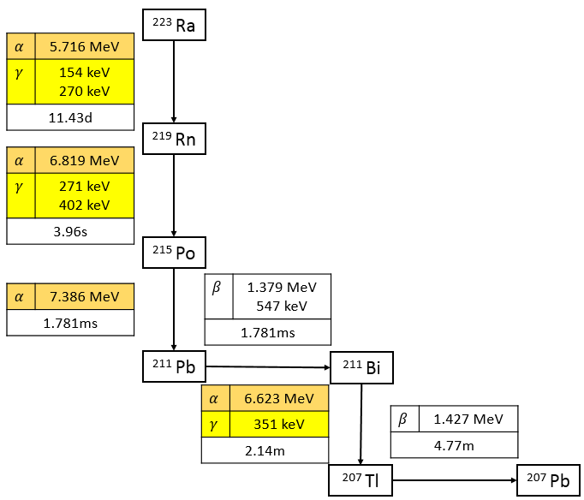
223-Ra
3
The characteristic of 223-Ra
An alpha-emitting nuclide
Used for treating bone metastasis cancer
Also emit gamma rays during its collapse process
Detect with a gamma-ray visualization module
Determine the position of 223-Ra
The main energy of gamma rays emitted from 223-Ra
- 154 keV, 271 keV, 270 keV,
351 keV, 402 keV
Determine the position of 223-Ra by gamma rays emitted

Slide 5
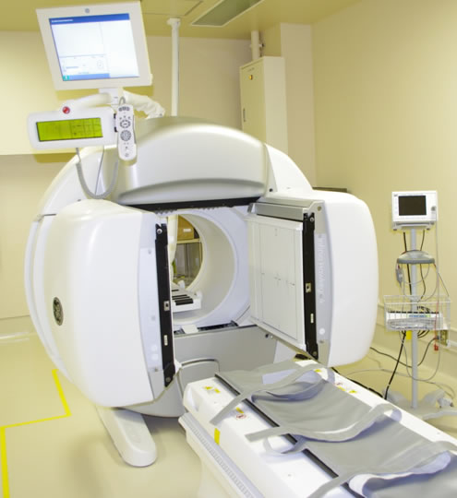
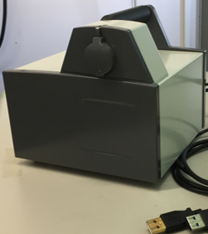
SPECT vs. A Compton camera
4
Gamma-ray visualization modules in RNT
Single photon emission tomography (SPECT)
A Compton camera
(A new method)
Identify the direction of arrival of gamma rays by passive collimators
Burdens to patients
- The relatively long
exposure
- Planar geometry
Identify the direction of arrival of gamma rays with Compton-scattering kinematics
Advantages to patients
- Wider field of view
- Less burdens
in imaging
- easiness of 3D imaging
Reduce burdens to patients by using a Compton camera

Slide 6
A Compton camera
5
The principle of a Compton camera
Visualize the arrival direction of gamma rays ($θ$) by utilizing Compton-scattering kinematics
$θ$ is calculated from …
- The reaction position: $\left(x_{sca},y_{sca},z_{sca}\right)$, $\left(x_{abs},y_{abs},z_{abs}\right)$
- The energy deposition: $E_{sca},E_{abs}$
- The formula of Compton scattering
$$θ=\cos^{−1}\left(1−\frac{mc^{2}}{E_{abs}}+\frac{mc^{2}}{E_{sca}\text{+}E_{abs}}\right)$$
Specify the position of source by overlapping a Compton cone
(whose vertical angle is $θ$)
$$θ$$
$$\left(\begin{aligned}x_{sca} \\ y_{sca} \\ z_{sca} \\ E_{sca}\end{aligned}\right)$$
$$\left(\begin{aligned}x_{abs} \\ y_{abs} \\ z_{abs} \\ E_{abs}\end{aligned}\right)$$
A Compton camera visualizes the arrival direction of gamma rays

Slide 7
A Compton camera (DOI-CC)
6
DOI-CC
A portable Compton camera (16 cm × 15 cm × 15 cm, 2.5 kg)
Developed for an environmental survey in Fukushima
A Compton camera that can obtain the depth of interaction (DOI-CC)
Resolutions of DOI-CC at 662keV
- The angular resolution: ~8$°$ (FWHM at the center of FOV)
- The energy resolution: 7.8 % (FWHM)
Kishimoto et al., IEEE Trans. Nucl. Sci, 59, (2013), 38-43.
Constitution of DOI-CC
- Scintillator: Ce:GAGG arrays (Ce-doped Gd₃Al₂Ga₃O₁₂)
- Photon detector: 8×8 MPPC arrays
(Multi-pixel photon counter)
- Two couples of Ce:GAGG and MPPC @ scatterer
- One Ce:GAGG sandwiched with two MPPC @ absorber
Configuration of DOI-CC
 | Scatterer | Absorber
Crystal size | 2.0 × 2.0 × 4.0 mm³ | 2.0 × 2.0 × 2.0 mm³
Array | 11 × 11 arrays 2 × 2 set | 11 × 11 arrays 2 × 2 set
Layer | 2 | 10
Imaging 223-Ra with a portable Compton camera (DOI-CC)

Slide 8
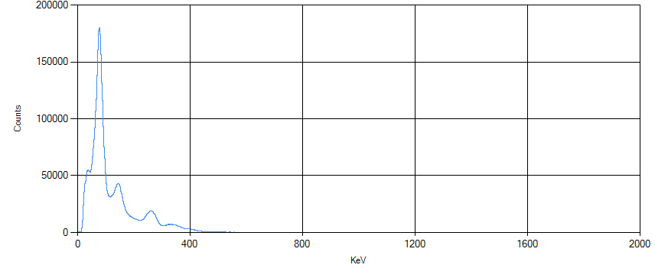
Imaging (a small bottle filled with 223-Ra)
7
Experimental setup
Energy spectrum (all events)
A small bottle filled with 223-Ra (0.56 MBq)
84 keV
DOI-CC
154 keV
$$45°$$
269 & 271 keV
10cm
or
15cm
324-351 keV
Set the bottle at 4 positions:
10 cm 0 deg. / 10 cm 45 deg. /
15 cm 0 deg. / 15 cm 45 deg.
The time for each measurement: 20 min
Set two energy bands for image reconstruction:
260-310 keV (target 269 & 271 keV)
288-388 keV (target 324-351 keV)
Confirm whether DOI-CC can reconstruct the true position of 223-Ra

Slide 9
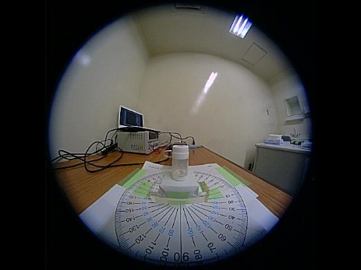
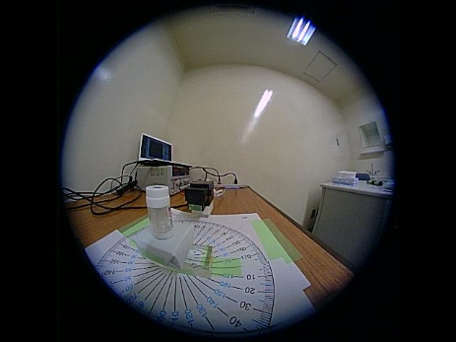
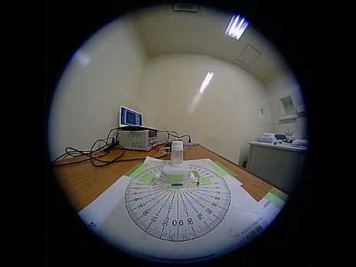
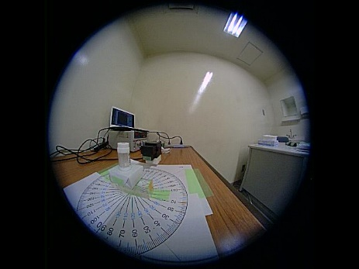
Imaging (a small bottle filled with 223-Ra)
8
Reconstructed images
- MLEM (maximum likelihood expectation maximization) reconstruction images
10 cm 0 deg.
10 cm 45 deg.
15 cm 0 deg.
15 cm 45 deg.
324-351
keV
269 & 271
keV
Reconstruct the true position of 223-Ra with DOI-CC successfully

Slide 10
Imaging (NEMA IEC body phantom)
9
Experiment setup
- NEMA IEC body phantom (consisted of six spheres)
- Three of them were filled with 223-Ra (9 kBq/ml)
- Rotate DOI-CC around the phantom for 3D imaging
(at 8 positions)
- The time for each measurement: 30 min
The diameters of the spheres | The radioactivity of 223-Ra | The distance from the center of the phantom
13 mm （a small sphere） | 10.8 kBq | 50 mm
22 mm （a middle sphere） | 50.4 kBq | 55 mm
37 mm （a large sphere） | 238.5 kBq | 60 mm
Reconstruct the 3D image of a complex phantom with DOI-CC

Slide 11
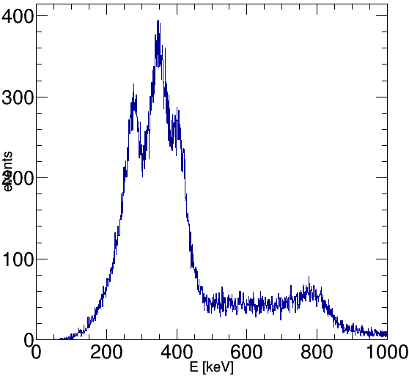
Imaging (NEMA IEC body phantom)
10
Energy spectrum (only coincidence events)
- Set the four energy bands:
269 & 271 keV
324-351 keV
401 & 404 keV
832 keV
The energy of gamma ray targeted | The energy bands set
269 & 271 keV | 248–308 keV
324-351 keV | 318-378 keV
401 & 404 keV | 380-429 keV
832 keV | 742-842 keV
Reconstruct the 3D image at each energy bands

Slide 12
Imaging (NEMA IEC body phantom)
11
3D reconstructed images (324-351 keV, 12590 events)
Normalized to enhance low-intensity spheres
Simple back projection (SBP)
MLEM (20 iterations)
MLEM (20 iterations, normalized)
The spheres are reconstructed at the correct position

Slide 13
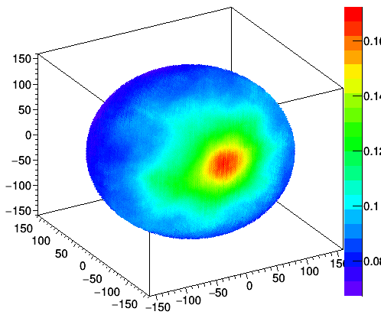
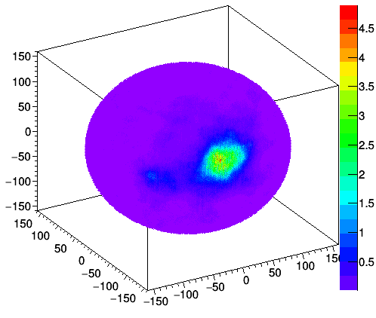
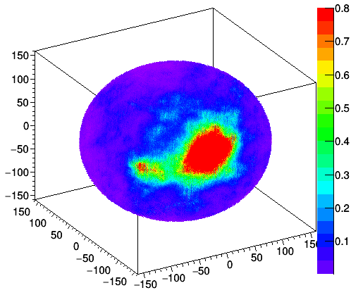
Imaging (NEMA IEC body phantom)
11
3D reconstructed images (324-351 keV, 12590 events)
Normalized to enhance low-intensity spheres
Z [mm]
Z [mm]
Z [mm]
Y [mm]
Y [mm]
Y [mm]
X [mm]
X [mm]
X [mm]
Simple back projection (SBP)
MLEM (20 iterations)
MLEM (20 iterations, normalized)
The spheres are reconstructed at the correct position

Slide 14
Imaging (NEMA IEC body phantom)
12
3D reconstructed images of the other energy bands (20 MLEM iterations)
269 & 271 keV
(12321 events)
401 & 404 keV
(5046 events)
832 keV
(525 events)
The best result is the image of 324-351 keV

Slide 15
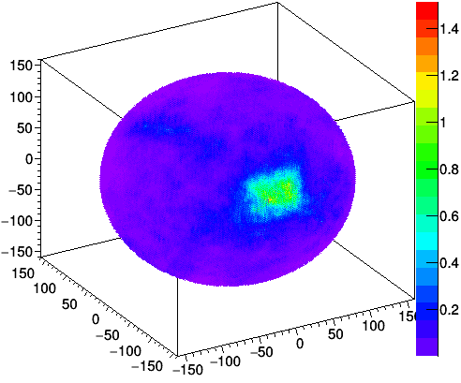
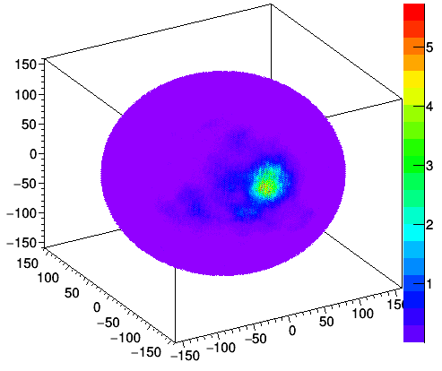
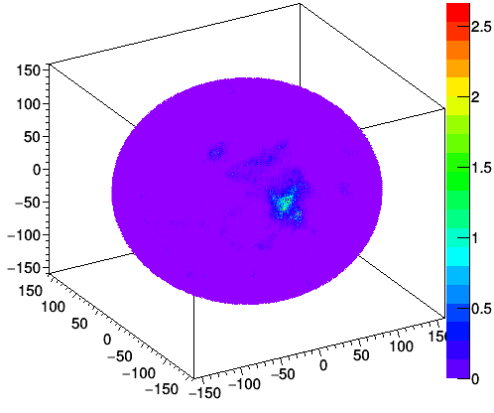
Imaging (NEMA IEC body phantom)
12
3D reconstructed images of the other energy bands (20 MLEM iterations)
Including fake events
(chance coincidence, etc.)
Less number of events than 324-351 keV
Less number of events than 324-351 keV
Z [mm]
Z [mm]
Z [mm]
Y [mm]
Y [mm]
Y [mm]
X [mm]
X [mm]
X [mm]
269 & 271 keV
(12321 events)
401 & 404 keV
(5046 events)
832 keV
(525 events)
The best result was the image of 324-351 keV

Slide 16
Analysis (NEMA IEC body phantom)
13
Analyze the SBP reconstructed image of 324-351 keV
- Obtain an azimuth profile of a thin slice
(every 15 mm in the radial direction of the phantom)
- If there are three spheres in the slice,
there are three peaks in the profile
- Fit with three Gaussian functions and a constant offset
- (The integral value of each Gaussian function)
= (The relative radioactivity of each sphere)
Z [mm]
Y [mm]
X [mm]
CC
Z
Y
X
$$r$$
223
Ra
$$θ$$
Confirm the relative intensity of the spheres

Slide 17
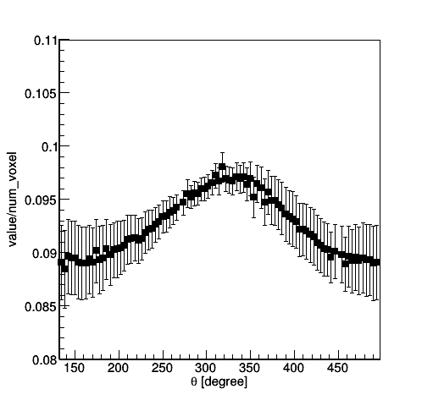
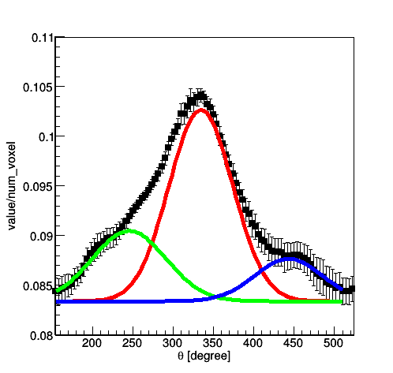
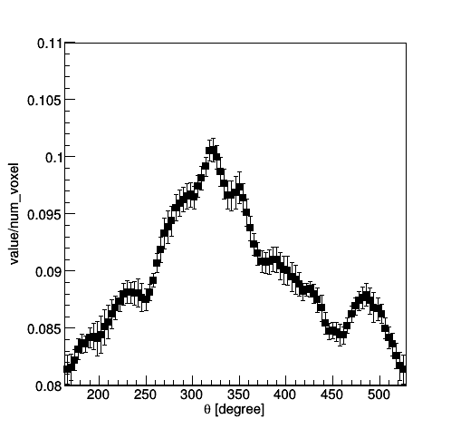
Analysis (NEMA IEC body phantom)
14
The azimuth profiles of the 324-351 keV SBP image
Three peaks: Large (red),
Middle (green), Small (blue)
More than three peaks
Only one peak
$r$=15-30 mm (no sphere)
$r$=45-60 mm (3 spheres)
$r$=120-135 mm (no sphere)
Fit with three Gaussian function and constant offset

Slide 18
Analysis (NEMA IEC body phantom)
15
The relative intensity of the spheres
- Compare with the integral value of the spheres where the spheres exist
The diameter of the spheres | The integral value | The normalized integral value (the value of the large sphere equal to the radioactivity of 223-Ra) | The radioactivity of 223-Ra
13 mm (small) | 101.2 +/- 24.5 | 13.0 +/- 3.1 | 10.8 kBq
22 mm (middle) | 381.3 +/- 65.0 | 48.9 +/- 8.3 | 50.4 kBq
37 mm (large) | 1858.4 +/- 142.4 | 238.5 +/- 18.3 | 238.5 kBq
Almost consistent with the actual 223-Ra intensity of each sphere
Reconstruct the relative intensity of 223-Ra successfully

Slide 19
Conclusion
16
A small bottle filled with 223-Ra
- Reconstruct the correct position of 223-Ra with DOI-CC successfully
A complex phantom of 223-Ra
- Obtain 3D reconstructed images
- Reconstruct the correct positon and relative intensity successfully
The imaging of 223-Ra with DOI-CC was succeeded

Slide 20
Future Work
17
Image the body of a patient
The experimental setup
The reconstructed image
[mm]
feet
side
head
side
Preliminary
DOI-CC
[mm]
10-min measurement
with DOI-CC
Compare with
the image of SPECT
(30-min measurement)
The accumulation consistent with SPECT
Shorter time for measurement
Wider FOV
Optimize the detector configuration to improve the angular resolution

Slide 22
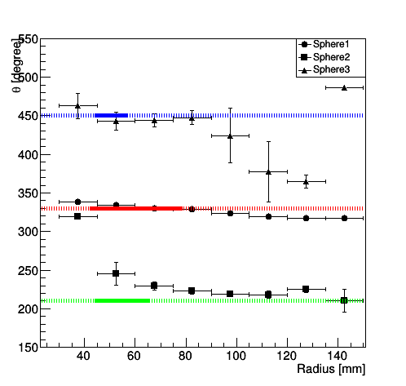
Appendix (Analyze NEMA IEC body phantom)
A1
The mean value of Gaussian functions
(= the angle of the center of the spheres)
The diameters of the spheres | The angle of the center of the spheres
13 mm （A small sphere） | 450$°$
22 mm （A middle sphere） | 210$°$
37 mm （A large sphere） | 330$°$
The area where three spheres exist is denoted by solid lines
Affected by the largest sphere
The mean value is similar to the true value

