Slide 1
Evaluation of a novel photon-counting CT system using 16-ch MPPC array for multicolor 3D imaging
Takuya Maruhashi (Waseda Univ.)
M. Arimoto (Kanazawa Univ.), J. Kataoka, H. Kiji (Waseda Univ.),
S. Terazawa, H. Nitta, S. Shiota (Hitachi Metal Ltd.), H. Ikeda (ISAS)
Maruhashi et al NIM-A, in press

Slide 2
Outline
Introduction
Approach
3D multicolor imaging
K-edge imaging of a contrast agent
Summary & Future work
- PC-CT system using MPPC (Multi pixel photon counter)
- Identification of a lighter materials using a X-ray spectral information
- Reconstruction of a Iodine and gadolinium contrast agents

Slide 3
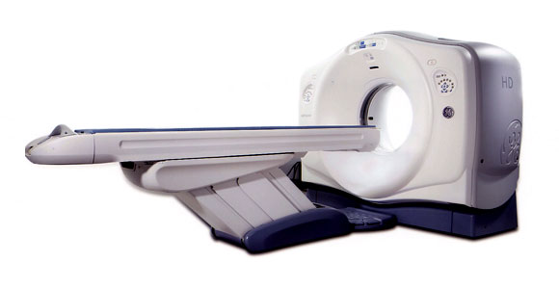
Introduction
1
X-ray CT imaging
X-ray generator
CT image
Phantom
X-ray
Image reconstruction
Detector
Problems of conventional CT
Conventional
CT detector
X-ray
High radiation dose (~10mSv/CT scan)
- All X-ray signal piles up
Beam hardening artifact
- Miss identification of material
GOS scintillator
photodiode (PD)

Slide 4
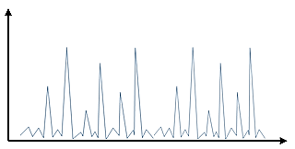
Photon counting CT (PC-CT)
2
Conventional CT system
X-ray generator
Integrate X-ray signals
with a certain time
⇒ Readout current (DC) signal
Readout DC signal
X-ray signals
Phantom
Charge
Conventional CT cannot acquire
the energy information
of individual X-ray pulses
X-ray
Time
Detector
Photon counting CT
Count each pulse signal
Multiple energy thresholds
⇒ Enable to detect
individual X-ray pulses
Eth3
Eth2
Cut dark noise
⇒ Achieve low dose
Eth1
Eth0

Slide 5
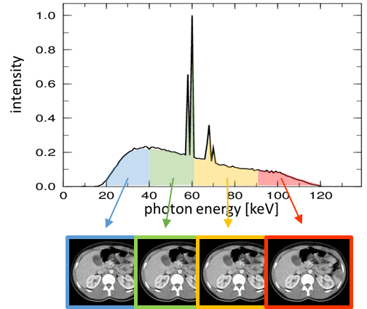
Energy resolved CT image
3
Multiple energy thresholds
- Energy discrimination of X-ray signals
Ex) 4 energy thresholds
Eth 1
Eth 2
Eth 3
Eth 4
PC-CT system can reconstruct CT images
in different energy bands with one CT scan
Energy resolved CT image
- Improve a contrast of soft tissue
- Reduce a beam hardening of X-ray
20 – 40 keV
90 – 120 keV
40 – 60 keV
60 – 90 keV
PC-CT enables more accurate
diagnosis than conventional CT
4 Energy resolved CT images
are reconstructed

Slide 6
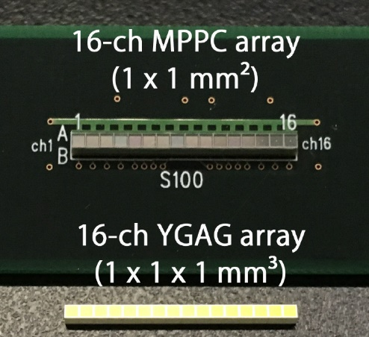
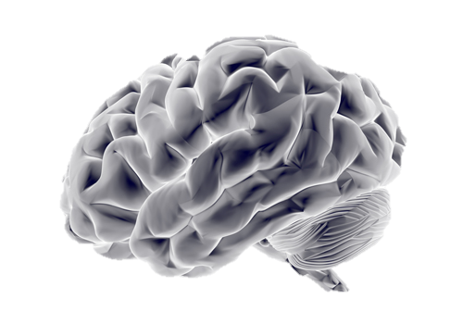

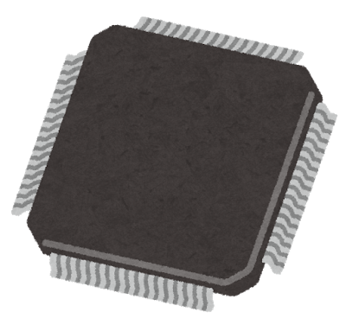
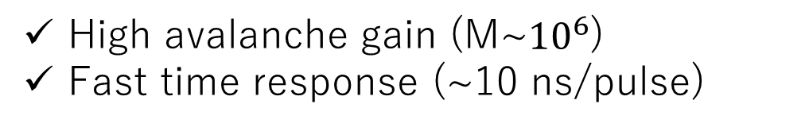
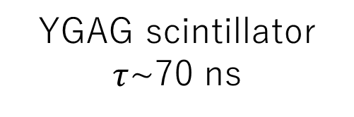
MPPC PC-CT system
4
We proposed a PC-CT system using MPPC (Multipixel photon counter)
X-ray
MPPC performance
High speed
scintillator
Scintillator
High avalanche gain (M~${10}^{6}$)
Fast time response (~10 ns/pulse)
Photodiode
MPPC
Conventional CT
Photon counting CT
Our PC-CT system using 16-channel MPPC array
YGAG scintillator
$τ$~70 ns
LSI
…
…
X-ray
generator
16-ch MPPC & YGAG array

Slide 7
Detailed setup of our PC-CT system
5
Ch 1
Ch 2
Ch 3
Phantom
Ch 4
LSI
~
~
~
~
Ch 15
Ch 16
Al filter (1mm)
Arimoto et al NIM-A,
in press
X-ray generator
Scintillator
MPPC
Cu Collimator
16-ch signals
The projection data in each direction is acquired
by repeating the linear and rotation move
Our PC-CT system reconstruct 16 slice CT image

Slide 8
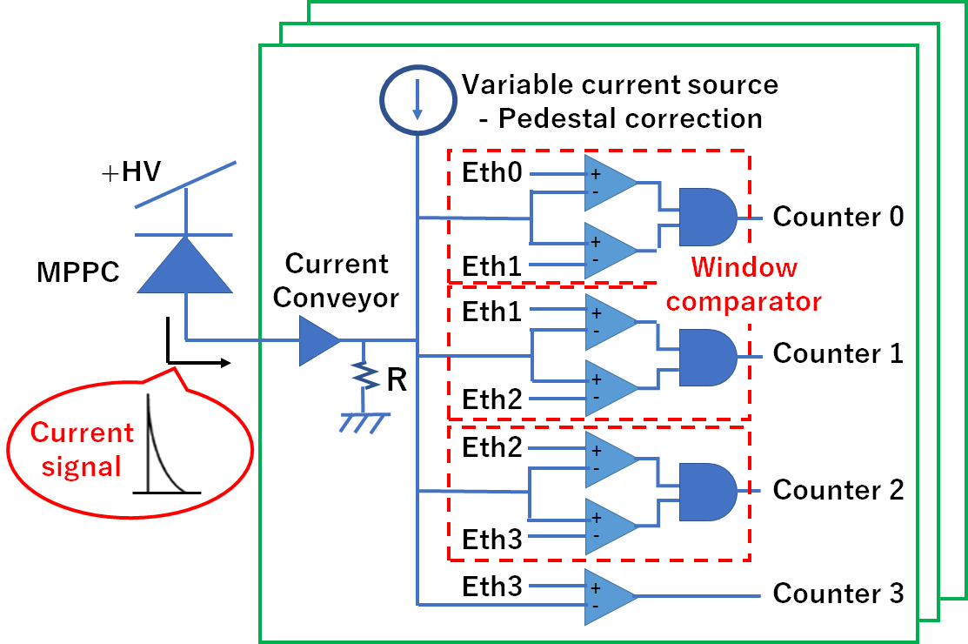

Schematic view of the signal processing in LSI
6
The signals of MPPC array
Schematic view of the signal processing
Ch 1
$×$ 16 ch
Ch 2
Ch 3
Ch 4
LSI
~
~
~
Ch 15
Ch 16
Energy discrimination in 16-ch
Ch 1
Ch 2
Eth3
Eth3
Eth2
Eth2
…
Eth1
Eth1
Eth0
Eth0
Newly developed LSI set 4 energy thresholds at each channel

Slide 9
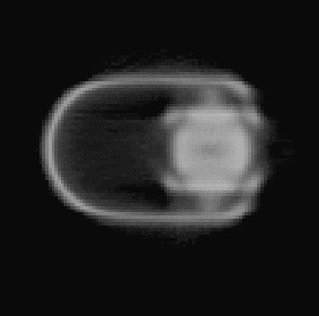
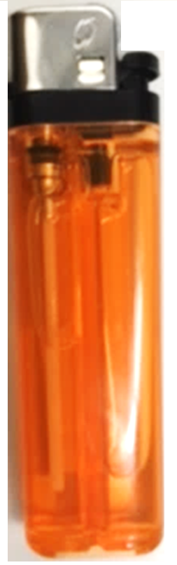

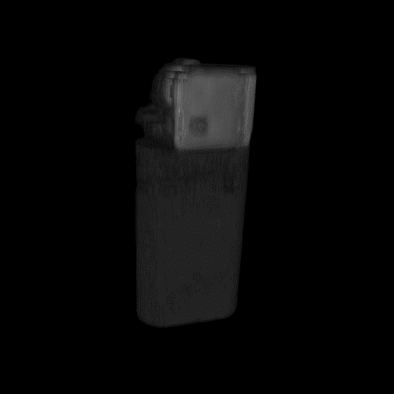

Color imaging of a lighter phantom
7
Conventional CT cannot acquire the X-ray spectrum information
Lighter phantom
Conventional energy integrated image
X-ray
Monochromatic
Conventional CT
Photon counting CT
Monochromatic image
No information about material
Multicolor image
Accurate identification of material
Notes:
16ch 撮影を3度繰り返し、スライス画像を取得の説明

Slide 10
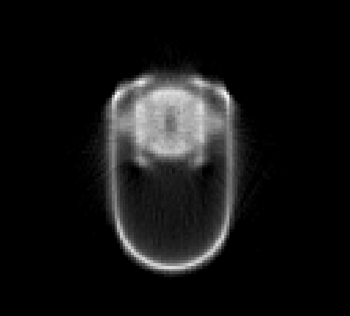
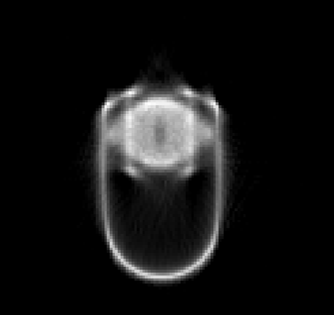
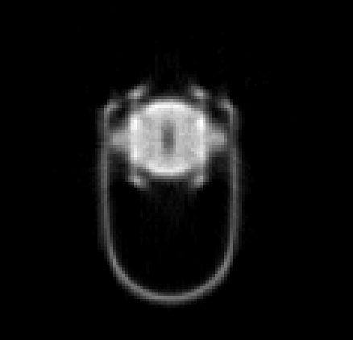
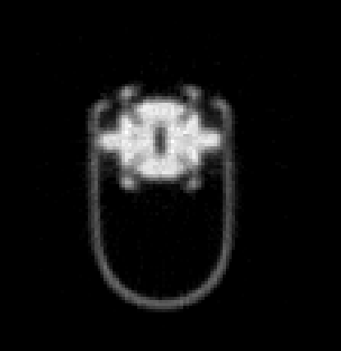
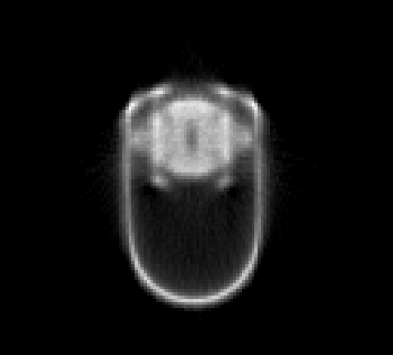

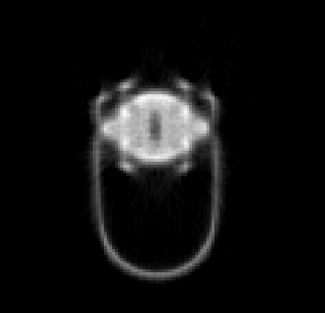




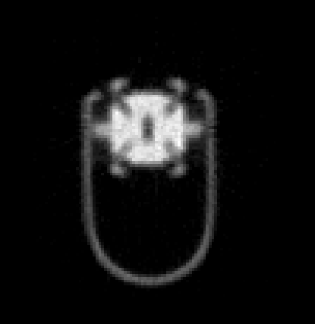


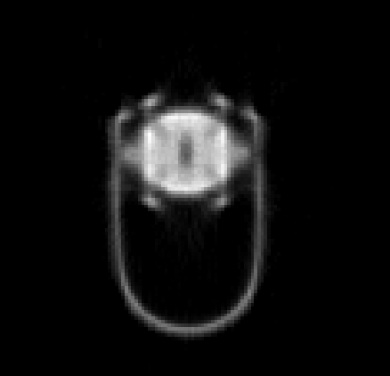
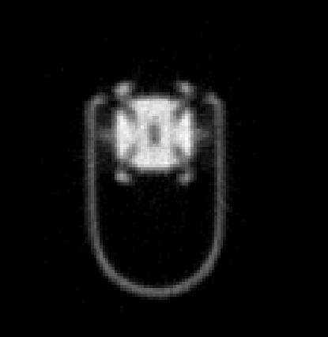
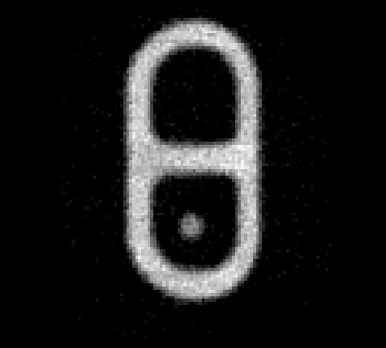
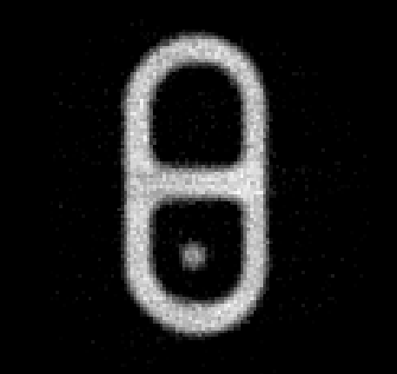
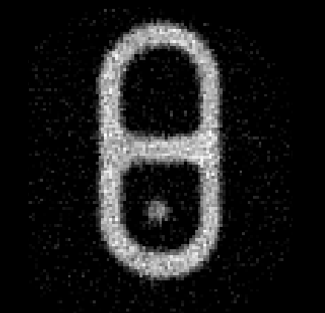
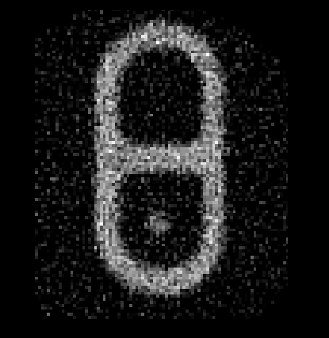


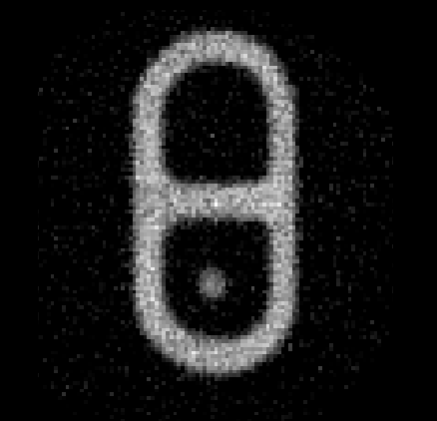
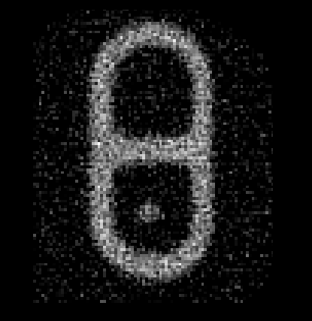
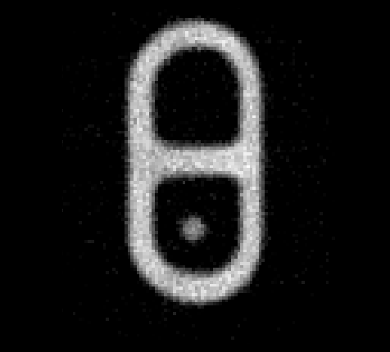
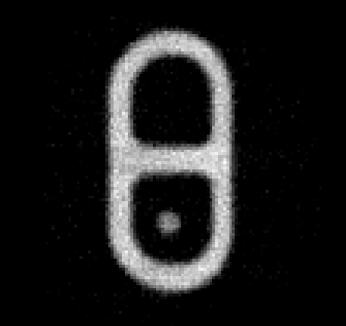
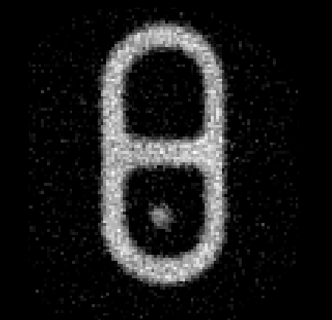
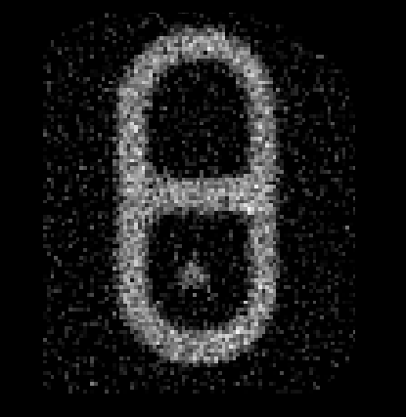


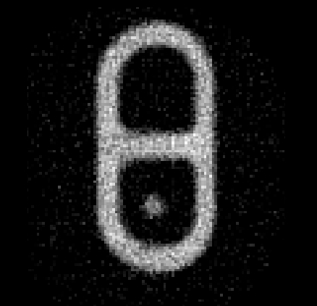
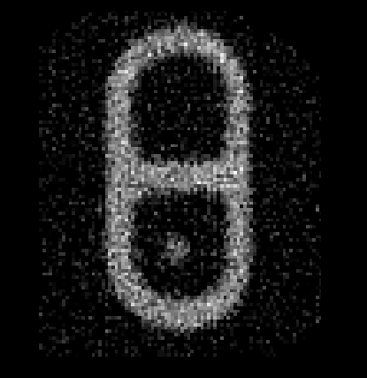
Energy resolved image of a lighter phantom
8
Eth 0,1,2,3 : 20, 30, 60, 90 keV
( Tube voltage : 150 kV , Tube current : 0.1 mA )
Slice energy resolved CT images
X-ray
20 - 30 keV
30 - 60 keV
60 - 90 keV
90 - 150 keV
…
…
…
…
Using 4 energies resolved image,
we try to emphasize each lighter material
Main parts of lighter
Plastic , Aluminum , Iron

Slide 11
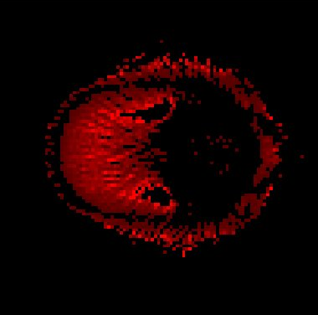


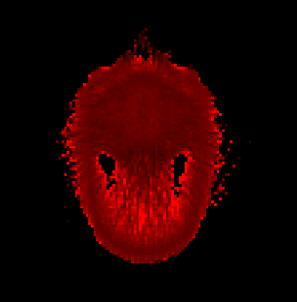
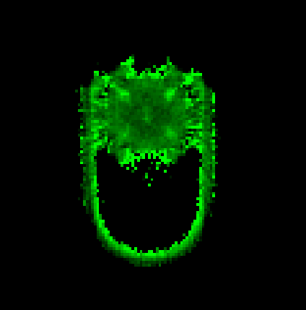

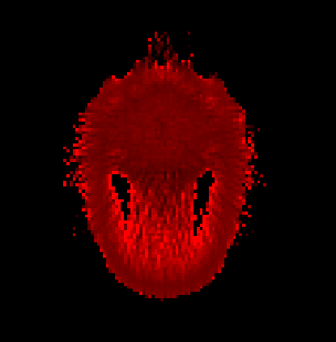
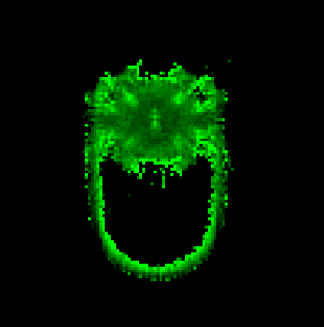

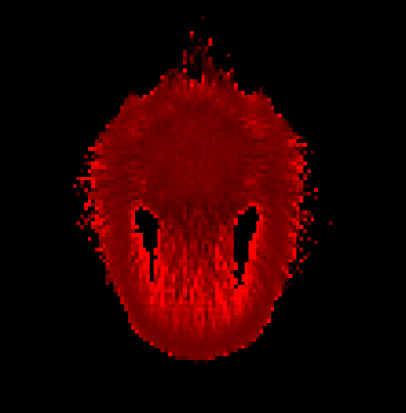
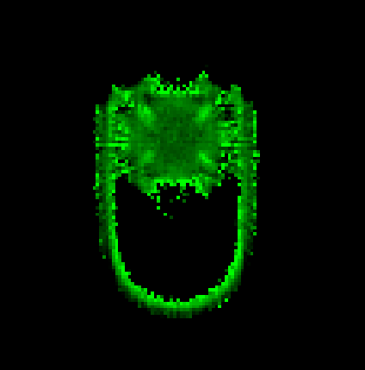

Reconstructing multicolor image
9
Slice energy resolved CT images
20-30 keV
30-60 keV
60-90 keV
90-150 keV
Energy subtraction
CT values change considerably
in 2 energy windows
…
…
…
…
Energy subtraction
Energy subtraction
Energy
resolved
Subtracting energy resolved image
between 2 energy windows,
we reconstructed specific material
Using different energy dependence
of CT values, our PC-CT system decomposed the lighter materials.
…
…
…
Low energy
plastic
Medium energy
aluminum
High energy
iron

Slide 12
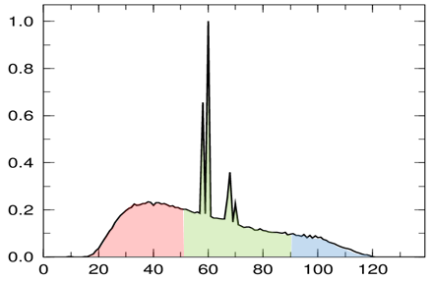
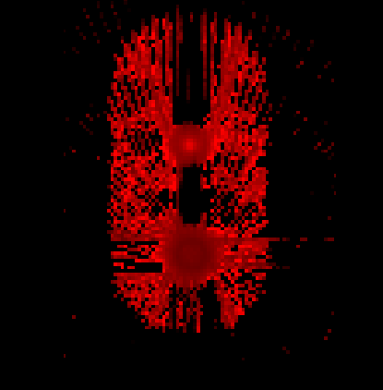
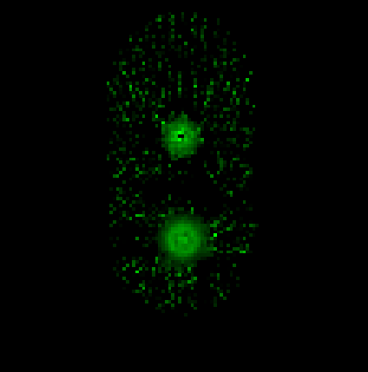
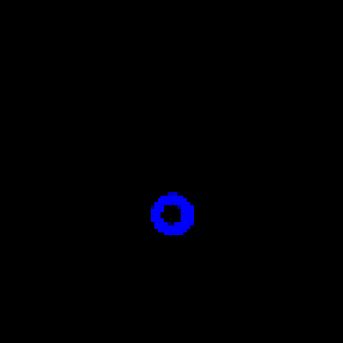

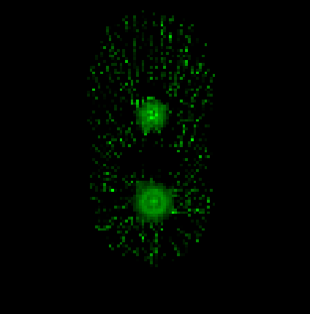


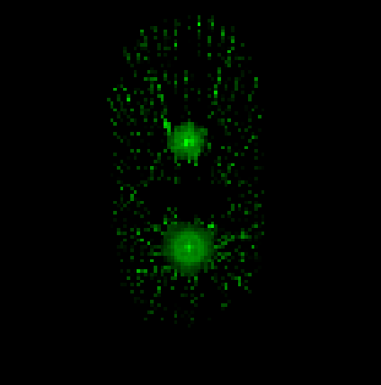
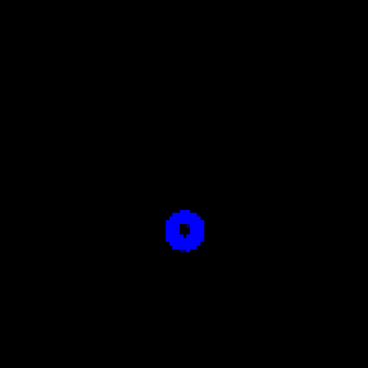

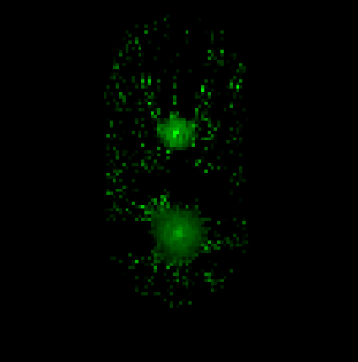

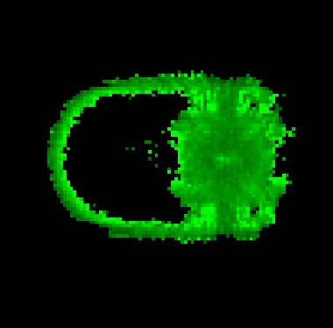
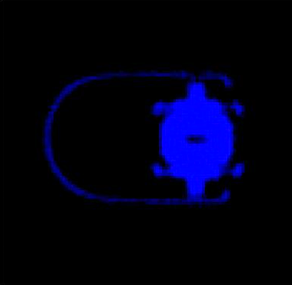



3D color lighter imaging
10
Plastic
Aluminum
Iron
Intensity
…
…
…
keV
Using multi slice images of lighter material,
our PC-CT system reconstructed
3D color image of
plastic, aluminum and iron parts
Plastic
Aluminum
Iron

Slide 13





Overlay 3D lighter imaging
11
RGB 3D image
Overlay slice
CT images
RGB image
Reconstruct
3D image
z
x
Plastic
y
Aluminum
Projection of 3D image
Iron
XY
YZ

Slide 14


K-edge imaging of contrast agent
12
K-edge imaging
Using the K-absorption edge of a contrast agents
Greatly improve the blood tissue contrast
Linear attenuation coefficient $[{cm}^{2}/g]$
PC-CT has great advantages in K-edge imaging
Absolute quantification of contrast agent
- Concentration (mg/ml) of contrast agent
Photon energy [keV]
Simultaneous imaging of multiple contrast agents
- Iodine, Gd, AuNP …
PC-CT system achieves more detailed tissue diagnosis
In this study, we evaluated our PC-CT system’s performance of K-edge imaging

Slide 15




K-edge imaging of iodine contrast agent
13
- Eth 0,1,2,3 : 35, 45, 55, 70 keV
- Tube voltage : 120 kV
- Tube current : 0.1 mA
K-absorption edge
Iodine : 33.2 keV
Linear attenuation coefficient $[{cm}^{2}/g]$
Iodine concentration
5, 10, 15, 20 mg/ml
keV
(c) = (a) – (b)
(a)
(b)
10 mg/ml
Iodine
5 mg/ml
15 mg/ml
35-45keV
45-55keV
Energy subtraction
Water
20 mg/ml
Using the K-absorption edge of iodine,
our PC-CT system improved the iodine contrast

Slide 16

























Reconstruction of 16-ch density image
14
Density image
Energy subtraction image
10 mg/ml
180$°$
…
…
5 mg/ml
15 mg/ml
θ
0$°$
20 mg/ml
Projection of the density image
least-squares method
$$J=\sum_{E=1}^{4}{{(μ_{{measured}_{ E}}^{} − ρ{ μ}_{m_{ E}}^{})}^{2}}$$
Density [mg/ml]
Estimate density ($ρ$ ) of material
Degree

Slide 17
Measured density vs Real density
15
To measure the density value and error,
we defined region of interest (ROI)
Plot : measured density
Iodine density image
Ideal line
Measured density [mg/ml]
10 mg/ml
…
5 mg/ml
15 mg/ml
20 mg/ml
ROI in each iodine phantom
Real density [mg/ml]
Our PC-CT accurately reconstructed iodine phantom (5, 10, 15, 20 mg/ml)

Slide 18





Simultaneous imaging of iodine & gadolinium
16
Multiple contrast agents with different pharmacokinetic
probe different diseases in one CT scan
Linear attenuation coefficient $[{cm}^{2}/g]$
Eth 0,1,2,3 : 35, 45, 55, 70keV
K-absorption edge : Iodine 33.2 keV , Gd 50.2 keV
water
Energy resolved CT images
keV
35-45keV
45-55keV
55-70keV
70-120keV
Iodine 10mg/ml
Gd
10mg/ml
Difference of K-absorption edge & Energy resolved CT image
We tried simultaneous imaging of multiple contrast agents

Slide 19









Result of simultaneous imaging
17
4 Energy resolved CT images
35-45keV
45-55keV
55-70keV
70-120keV
Energy subtraction
at K-absorption edge
of iodine and gadolinium
Energy subtraction + least-squares method
Iodine
Gd
12 ± 1 mg/ml
10 ± 1 mg/ml
…
Iodine
density image
Gadolinium
density image
Overlay density image
Our PC-CT system accurately identified the iodine and gadolinium phantom
Enable to probe different pharmacokinetic of contrast agents

Slide 20
Summary & Future work
18
Summary
Our PC-CT system reconstructed 3D multicolor CT image of the lighter phantom
- Using the X-ray spectral information, we accomplished accurate material
identification
Our PC-CT system enables K-edge imaging of contrast agent
- Our system accurately reconstructed the concentration of Iodine and
gadolinium phantom
Future work
To more practical CT imaging, the number of channel : 16-ch → 64-ch
CT scan using a medical phantom or living mouse

Slide 21
appendix

Slide 22






PD, APD vs MPPC
Comparison of CT images (PD, APD and MPPC)
Check improvement of S/N by internal amplification
PD,APD
MPPC
Size
1mm×1mm
Size
1mm×1mm
Gain : $\sim {10}^{6}$
Current readout
Current readout
(Scintillator : $GOS$)
Gain
PD : 1
APD : 50
S8664-11
S12571-050C
Pulse readout
Scintillator : $GOS$ ($1×1×1{mm}^{3}$)
Scintillator : $Ce:YAP$ ($1×1×1{mm}^{3}$)
Light yield (ph/MeV) | Decay time (ns)
50,000 | 3,000
Light yield (ph/MeV) | Decay time (ns)
10,000 | 25

Slide 23









Comparison the CT images
X-ray : 120kV
PD
APD
Phantom
Contrast-to-noise ratio
$$CNR= \frac{μ_{alcohol}−μ_{water}}{σ_{water}}$$
CNR = 1.42
CNR = 4.41
$σ_{water} ∝ \frac{1}{\sqrt{n}}$
MPPC
(Current readout)
MPPC
(Pulse readout)
Alcohol
($0.78g/{cm}^{3}$)
Water
($1.0g/{cm}^{3}$)
$n$ : photon statistic
~ radiation dose
CNR = 5.32
CNR = 17.9
Comparing the CNR, we estimated
MPPC device enable to reduce radiation dose ~ 1/100

Slide 24



X-ray computed tomography
Phantom
Ch 1
Ch 2
Ch 3
Ch 4
LSI
~
~
~
~
Ch 15
Ch 16
Al filter (1mm)
Scintillator
MPPC
X-ray generator
Cu Collimator
Ratio of incident X-ray
and transmitted X-ray
$$p=−\log_{e}{\frac{I}{I_{0}}}$$
Projection data

Slide 25





Material identification
Line attenuation
coefficient (LAC)
Mass line attenuation
coefficient (MLAC)
Density
$μ$[/cm]
=
$μ_{m}$[${cm}^{2}$/g]
$ρ$ [g/${cm}^{3}$]
×
iodine
Mass line attenuation coefficient (${cm}^{2}/g$)
Depending on the density of the materials,
Different materials will have the same CT value
water
Conventional CT,
CT value is the only parameter.
↓
It is difficult to discriminate materials
Photon energy (keV)
If the photon energy is constant,
MLAC becomes a substance-specific value

Slide 26






Count rate of our system
X-ray count rate (Tube voltage : 150kV)
Motivation
The radiation dose of CT is${10}^{8\sim 9}Hz/{mm}^{2}$
It is necessary to investigate X-ray tolerance
Measured output rate 5MHz/${mm}^{2}$
$$Output rate$$
Measurement data
Counted ~1/100 of conventional CT rate
We attempted CT imaging
under low dose rate (several MHz/${mm}^{2}$)
$$Input rate$$

Slide 27



Energy resolution of our PC-CT system
Motivation
${}_{}^{241}{Am}$spectrum ( 16ch )
Each energy window width
is determined by energy resolution
Measurement method
${}_{}^{241}{Am}$ $γ$-ray spectrum at 16ch
Photoelectric peak @ 60keV
Energy resolution
31%(FWHM)
Each energy window width is 20keV
Energy discrimination is possible

Slide 28




Beam hardening artifact
Radiation quality
① < ② < ③
CT image
X-ray spectrum
Al
X-ray
Incident
X-ray
Al
transmitted
X-ray

Slide 29


Beam hardening artifact
X-ray : 150kV
Phantom
All energy : 30-150keV

Slide 30

Line attenuation coefficient
water
alcohol
Line attenuation coefficient [/cm]
High
Low
Contrast ratio of water and alcohol

Slide 31
Measured CT value vs Theoretical CT value
We measured 4 CT values of each material
from 4 energy resolved images
Intensity
Plot : Measured CT value
Line : Theoretical CT value
keV
Plastic
Aluminum
Iron
CT value [HU]
CT value [HU]
CT value [HU]
Photon energy [keV]
Photon energy [keV]
Photon energy [keV]
Choosing a proper energy window, our PC-CT can identify lighter materials

Slide 32






Color imaging of lighter phantom
To emphasize plastic parts, we compared 4 energy resolved images
(A)
(B)
20-30 keV
30-60 keV
(E) = (B)/(A)
(C)
(D)
60-90 keV
90-150 keV
(F) = (D)/(B)

Slide 33






Color imaging of lighter phantom
To emphasize aluminum parts, we compared 4 energy resolved images
(A)
(B)
20-30 keV
30-60 keV
(E) = (B)/(A)
(C)
(D)
60-90 keV
90-150 keV
(F) = (D)/(B)
Notes:
この図見せられても、伝わらない気が。。。

Slide 34
Variation of iodine density value between 16ch
Histogram of density value between 16-ch
Iodine density image
10 mg/ml
…
5 mg/ml
15 mg/ml
20 mg/ml
ROI in each iodine phantom

Slide 35
Variation of iodine density value between 16ch
Iodine density image
10 mg/ml
…
5 mg/ml
15 mg/ml
20 mg/ml
ROI in each iodine phantom

Slide 36











Gadolinium K-edge imaging
16
16-ch Gd density image
Gd K-absorption edge : 50.2 keV
2
1
Eth 0,1,2,3 : 35, 45, 55, 70 keV
θ
Gd phantom
Water
15mg/ml
20mg/ml
3
4
Gd
Projection of the density image
10mg/ml
5mg/ml
20 mg/ml
Gd concentration
5, 10, 15, 20 mg/ml
15 mg/ml
10 mg/ml
5 mg/ml
Using the K-absorption edge,
our PC-CT enable Gd K-edge imaging
1
2
3
4

