Slide 1
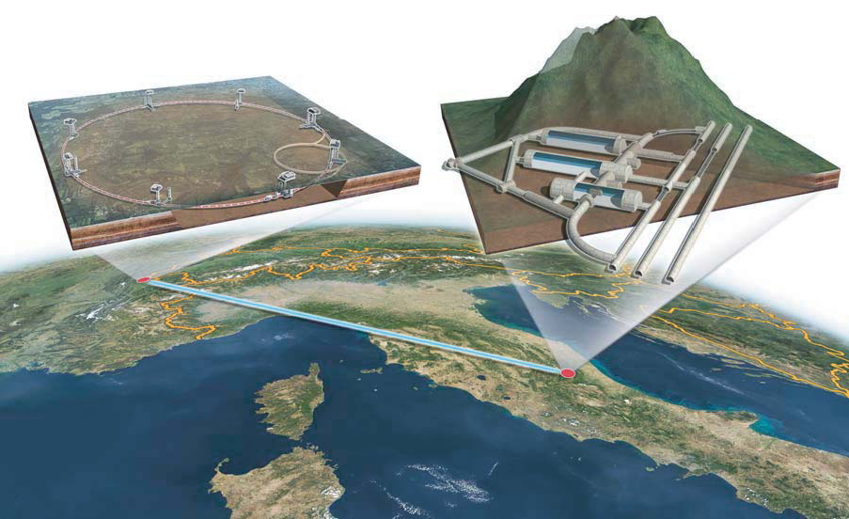
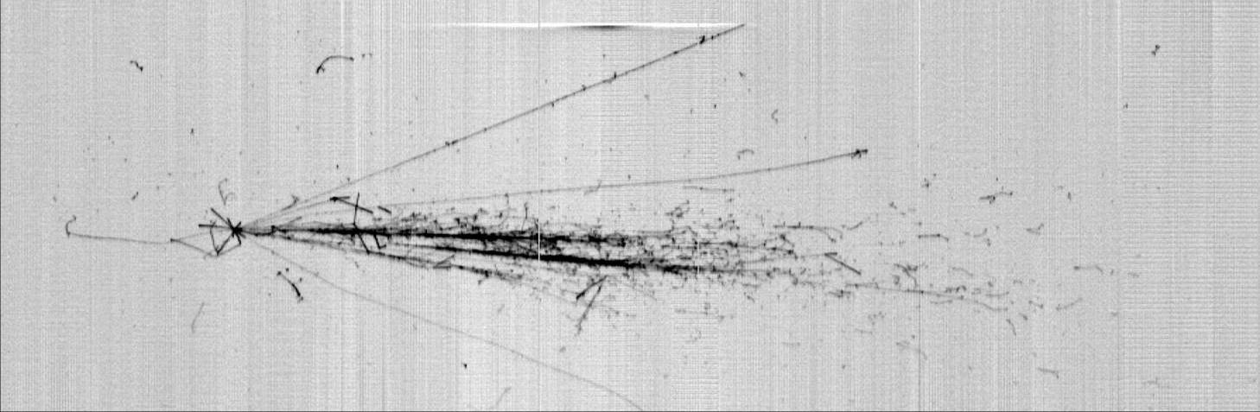
ICARUS Status and Plans
D. Gibin
Dipartimento di Fisica e Astronomia and INFN Padova
For the ICARUS Collaboration
NNN13 Kavli IPMU
11-13 November 2013

Slide 2
The ICARUS Collaboration
M. Antonelloª, B. Baibussinov^{b}, P. Benetti^{c}, F. Boffelli^{c}, A. Bubak^{k}, E. Calligarich^{c}, N. Canciª, S. Centro^{b}, A. Cesana^{f}, K. Cieslik^{g}, D. B. Cline^{h}, A.G. Cocco^{d}, A. Dabrowska^{g}, D. Dequal^{b}, A. Dermenev^{i}, R. Dolfini^{c}, A. Falcone^{c}, C. Farnese^{b}, A. Fava^{b}, A. Ferrari^{j}, G. Fiorillo^{d}, D. Gibin^{b}, S. Gninenko^{i}, A. Guglielmi^{b}, M. Haranczyk^{g}, J. Holeczek^{l}, M. Kirsanov^{i}, J. Kisiel^{l}, I. Kochanek^{l}, J. Lagoda^{m}, S. Mania^{l}, A. Menegolli^{c}, G. Meng^{b}, C. Montanari^{c}, S. Otwinowski^{h}, P. Picchi^{n}, F. Pietropaolo^{b}, P. Plonskiº, A. Rappoldi^{c}, G.L. Raselli^{c}, M. Rossella^{c}, C. Rubbia^{a,j,q}, P. Sala^{f}, A. Scaramelli^{f}, E. Segretoª, F. Sergiampietri^{p}, D. Stefanª, R. Sulej^{m,a}, M. Szarska^{g}, M. Terrani^{f}, M. Torti^{c}, F. Varanini^{b}, S. Ventura^{b}, C. Vignoliª, H. Wang^{h}, X. Yang^{h}, A. Zalewska^{g}, A. Zani^{c}, K. Zarembaº.
a Laboratori Nazionali del Gran Sasso dell'INFN, Assergi (AQ), Italy
b Dipartimento di Fisica e Astronomia e INFN, Università di Padova, Via Marzolo 8, I-35131 Padova, Italy
c Dipartimento di Fisica Nucleare e Teorica e INFN, Università di Pavia, Via Bassi 6, I-27100 Pavia, Italy
d Dipartimento di Scienze Fisiche, INFN e Università Federico II, Napoli, Italy
e Dipartimento di Fisica, Università di L'Aquila, via Vetoio Località Coppito, I-67100 L'Aquila, Italy
f INFN, Sezione di Milano e Politecnico, Via Celoria 16, I-20133 Milano, Italy
g Henryk Niewodniczanski Institute of Nuclear Physics, Polish Academy of Science, Krakow, Poland
h Department of Physics and Astronomy, University of California, Los Angeles, USA
i INR RAS, prospekt 60-letiya Oktyabrya 7a, Moscow 117312, Russia
j CERN, CH-1211 Geneve 23, Switzerland
k Institute of Theoretical Physics, Wroclaw University, Wroclaw, Poland
l Institute of Physics, University of Silesia, 4 Uniwersytecka st., 40-007 Katowice, Poland
m National Centre for Nuclear Research, A. Soltana 7, 05-400 Otwock/Swierk, Poland
n Laboratori Nazionali di Frascati (INFN), Via Fermi 40, I-00044 Frascati, Italy
o Institute of Radioelectronics, Warsaw University of Technology, Nowowiejska, 00665 Warsaw, Poland
p INFN, Sezione di Pisa. Largo B. Pontecorvo, 3, I-56127 Pisa, Italy
q GSSI, Gran Sasso Science Institute, L’Aquila, Italy

Slide 3
A multi-faceted programme
Our future physics oriented programme is characterized by:
  Continued analysis of ≈3000 ν events already collected with CNGS2. A main result has been the major clarification of sterile neutrino search, now concentrated on a small possible window in Δm²_{41,,}compatible also with cosmological predictions for dark matter. More results are also coming.
  T600 Overhaul +construction of smaller T150 detector “clone” under CERN approved experiment WA104 & recommendations of CTS
  This new dual detector configuration will definitively clarify the sterile neutrino questions and on the same time ensure the bulk of the preparatory phase of the LNBE Coll., accumulating > 10⁶ ν events in a short ν baseline for test and analysis purposes as a running premise to LBNE.
  Possible long term use of T600 as“near detector” of LBNE.

Slide 4
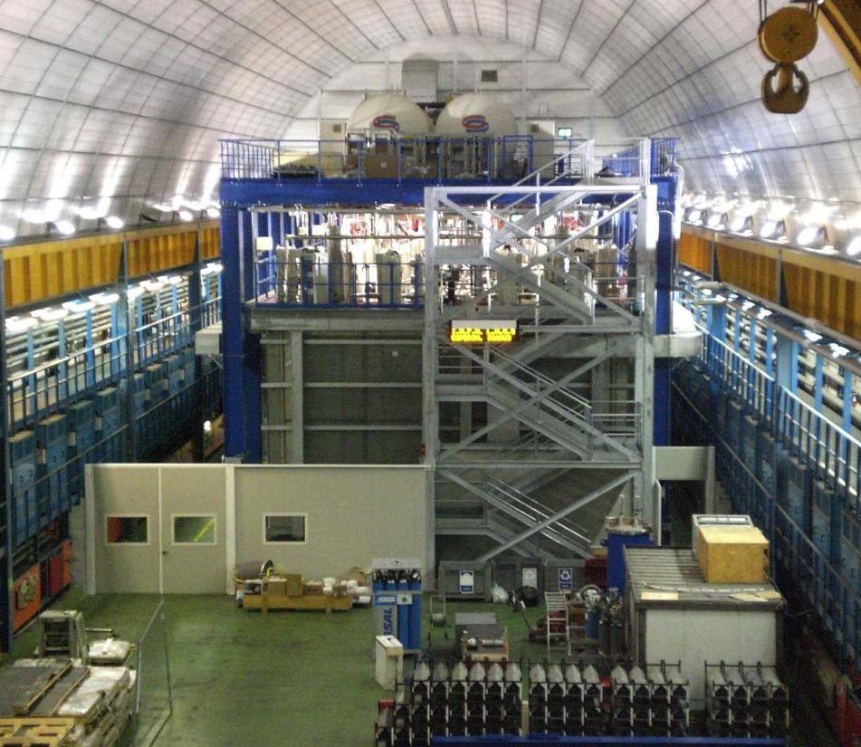
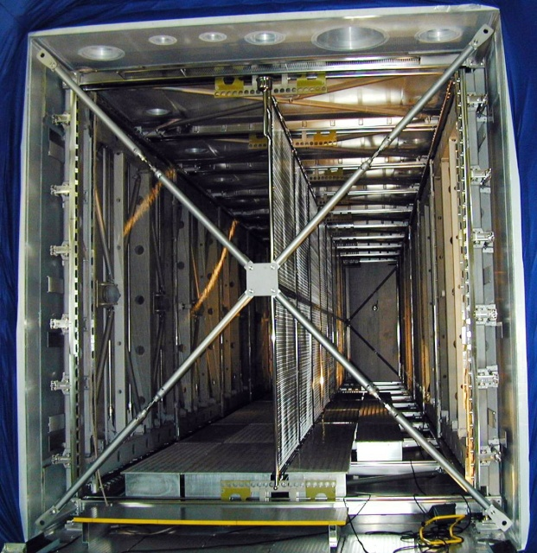
ICARUS @ LNGS: the first LARGE LAr-TPC
cathode
LN₂ vessels
1.5m
cryogenics
(behind)
readout electronics
T300
T300
E
E
readout wire arrays
Two identical modules
(2 chambers per module)
  Liquid Ar active mass: ≈ 476 t
    Drift length = 1.5 m (1 ms)
    E_{drift} = 0.5 kV/cm; v_{drift} = 1.55 mm/μs
3 readout wire planes/chamber, @ 0,±60°
  ∼54000 wires, 3m m pitch
20+54 PMTs , 8” Ø, for scintillation light:
  VUV light (128nm) with wave shifter (TPB)
In operation since may 2010
decommissioning started on June 27th, cryo empty on July 25th (740 tons of LAr recovered).
Slide: 4

Slide 5
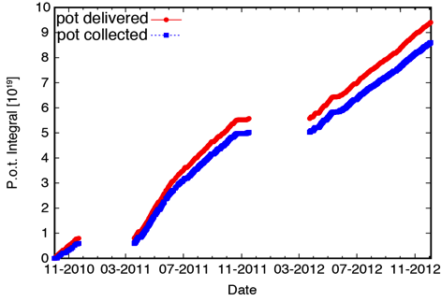
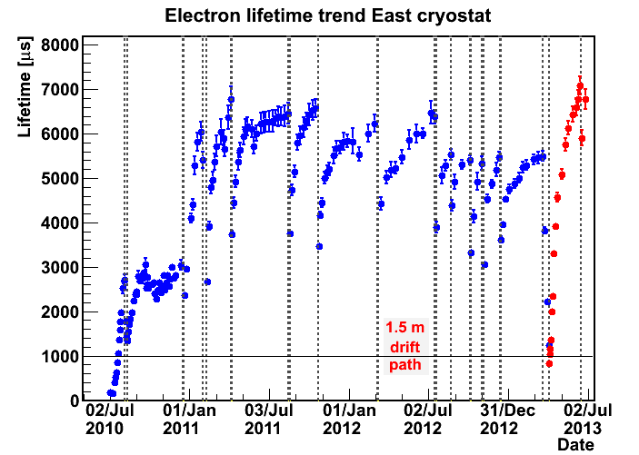
The ICARUS detector at LNGS Laboratory
Exposed to CNGS ν beam up to December 3rd 2012, taking data also with Cosmics to study detector capability for atm.-ν and proton decay search up to June 2013 reaching a total exposure of 0.73 kt year.
Total collected CNGS event statistics: 8.6 10¹⁹ pot with remarkable detector live-time > 93 %
2012
2011
2010
τ_{ele} > 5ms (~60 ppt [O2] eq): maximum charge attenuation of 17% at 1.5m
New pump
60 ppt [O₂]_{eq}
Different operating conditions successfully tested in the last months:
  Larger drift electric field (1 kV/cm)
  New pump for LAr purification allowing to exceed τ_{ele} > 7ms
max drift

Slide 6
T600 run at LNGS: first publications
“Underground operation of the ICARUS T600 LAr-TPC: first results”, JINST 6 (2011) P07011.
“A search for the analogue to Cherenkov radiation by high energy neutrinos at superluminal speeds in ICARUS”, PLB 711 (2012) 270.
“Measurement of neutrino velocity with the ICARUS detector at the CNGS beam”, PLB 713 (2012) 17.
“Precision measurement of the neutrino velocity with the ICARUS detector in the CNGS beam”, JHEP 11 (2012) 049.
“Precise 3D Reconstruction Algorithm for the ICARUS T600 Liquid Argon Time Projection Chamber Detector”, AHEP 2013 (2013) 260820.
“Experimental search for the LSND anomaly with the ICARUS detector in the CNGS neutrino beam”, EPJ C73 (2013) 2345.
“Search for anomalies in ν_{e} appearance from ν_{μ} beam”, EPJ C73 (2013) 2599.
Analysis of the large amount of physics data becoming progressively the main activity of the collaboration
Technical papers in preparation on cryogenic plant performance, trigger system, μ momentum reconstruction by Multiple Scattering

Slide 7
The situation of the short baseline neutrinos
The possibility of short-baseline neutrino oscillations due to the existence of one or more sterile neutrinos at the eV scale is a hot topic in current neutrino physics.
Sterile neutrino existence is not only very important “per se” but also for Astrophysics and Cosmology and its relation to Dark Mass.
Recent results, including ICARUS, have considerably increased the evidence on the so far preferred 3+1 alternative for νe and νμ appearance and disappearance in short-baseline experiments, given by the general formula
The ICARUS experiment has shown that the the MiniBooNE low-energy anomaly (for its 3 lowest energy bins) is incompatible with ν oscillations and probably due to other (instrumental) effects.

Slide 8
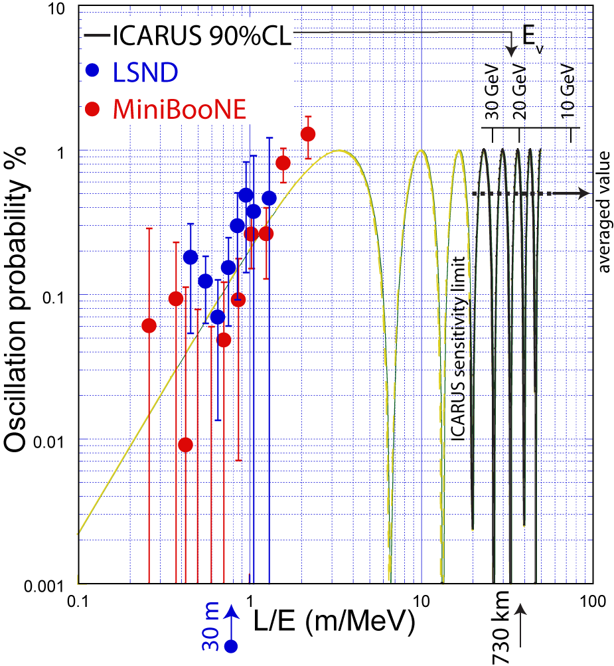
A search for LSND effects with ICARUS at CNGS
  The CNGS facility delivered an almost pure ν_{μ} beam in 10-30 GeV E_{ν} range (beam associated ν_{e} ~1%) at a distance L=732 km from target.
  There are differences w.r.t. LNSD exp.
  - L/E_{ν} ~1 m/MeV at LSND, but
  L/E_{ν} ≈36.5 m/MeV at CNGS
  - LSND -like short distance oscill. signal
  averages to sin²(1.27Δm²_{new} L /E) ~1/2
  and <P>_{νμ→νe} ~ 1/2 sin²(2θ_{new})
  When compared to other long baseline results (MINOS and T2K) ICARUS operates in a L/E_{ν} region in which contributions from ν oscillations are not yet too relevant.
  Unique detection properties of LAr-TPC technique allow to identify unambiguously individual e-events with high efficiency.

Slide 9
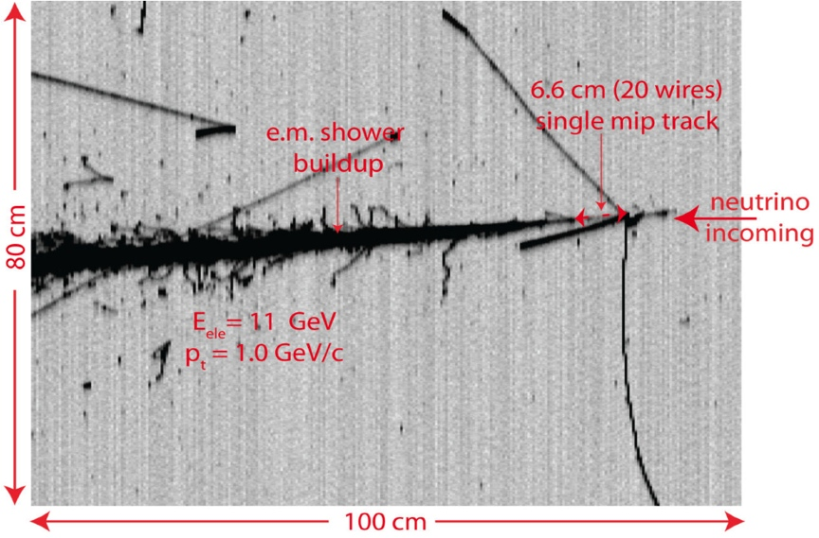
Search for νe events in CNGS beam
Selection of ν_{e} events
ν_{e} CC event candidates are visually selected with vertex inside fiducial volume (for shower id.) : > 5 cm from TPC walls and 50 cm downstream
Energy selection: <30 GeV
  50% reduction on intrinsic beam ν_{e}
  only 15% signal events rejected
ν_{μ} CC events identified by L > 250 cm primary track without had. int.
ν_{e} MC event
The “Electron signature” requires:
  A charged track from primary vertex, m.i.p. on 8 wires, subsequently building up into a shower; very dense sampling: every 0.02 X₀
  Isolation (150 mrad) from other ionizing tracks near the vertex in at least one of the TPC views.
Electron efficiency studied with events from a MC (FLUKA) reproducing in every detail the signals from wire planes: η = 0.74 ± 0.05 (η’ = 0.65 ± 0.06 for intrinsic ν_{e} beam due to its harder spectrum).

Slide 10
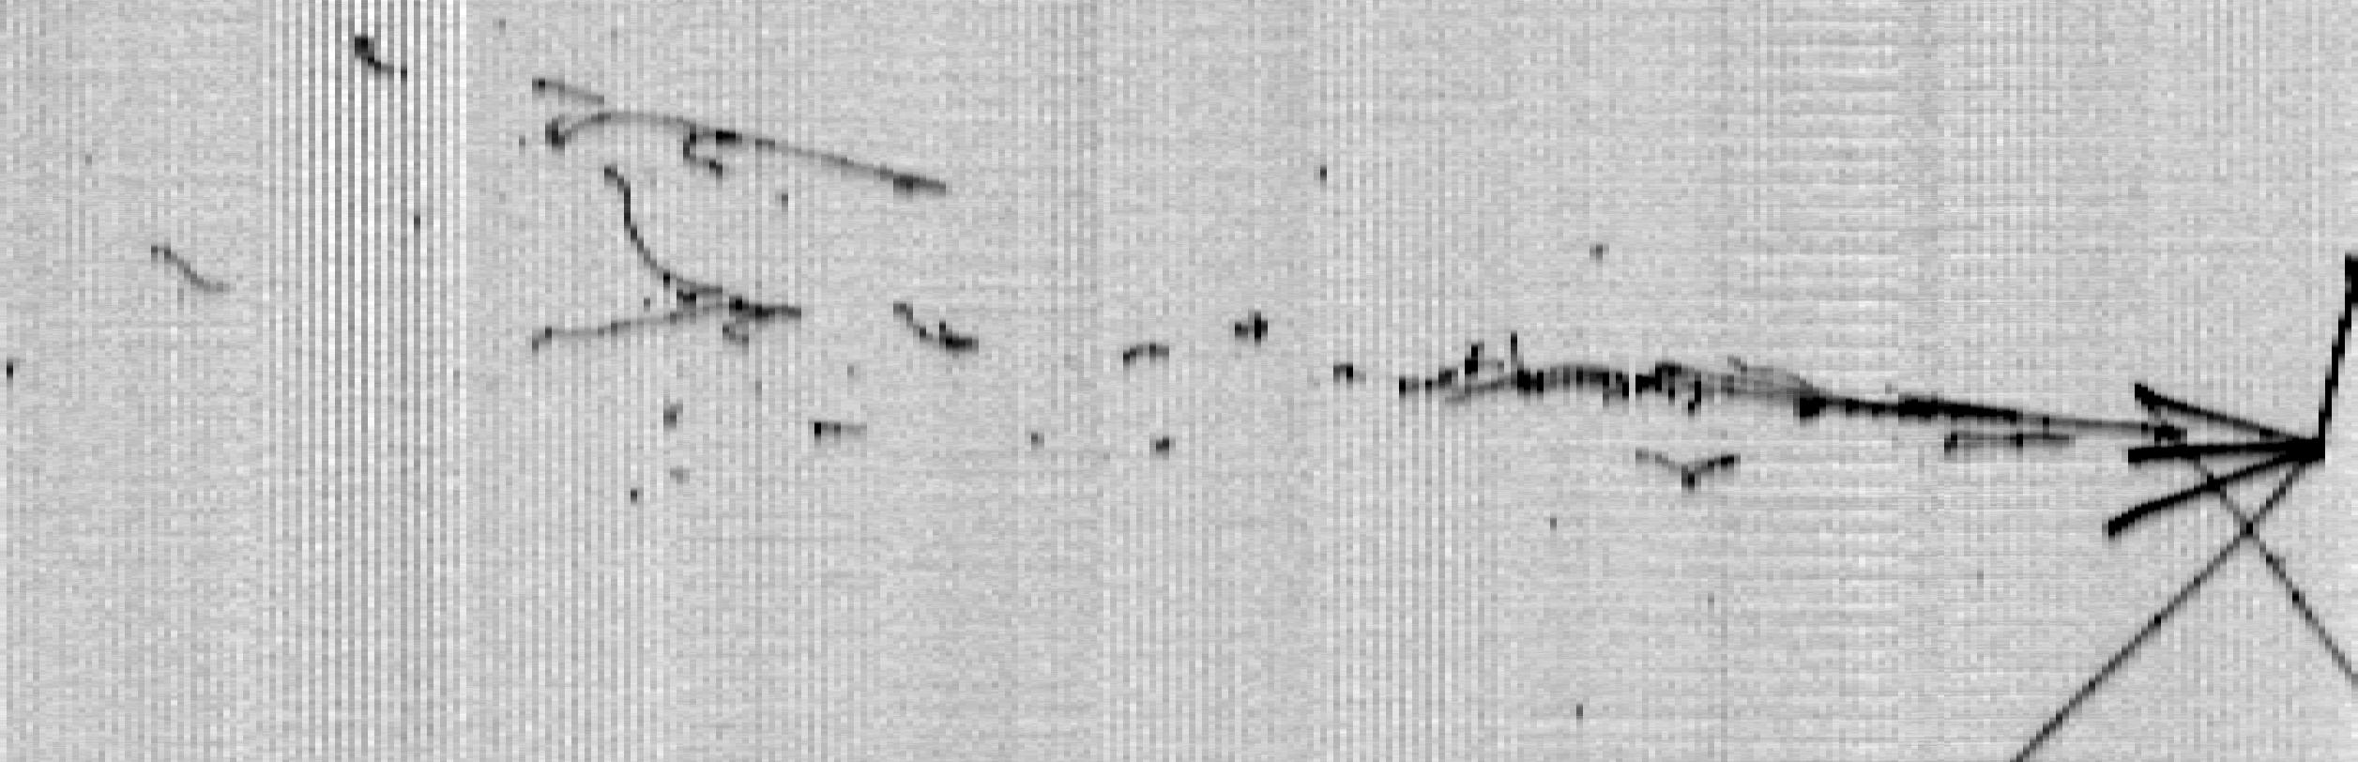
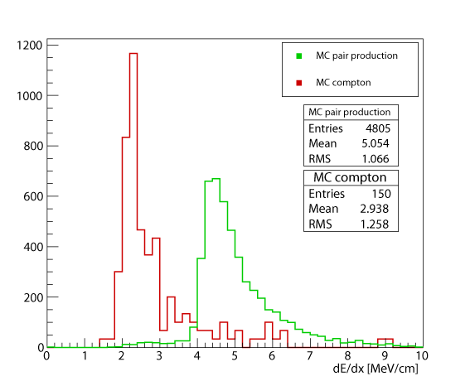
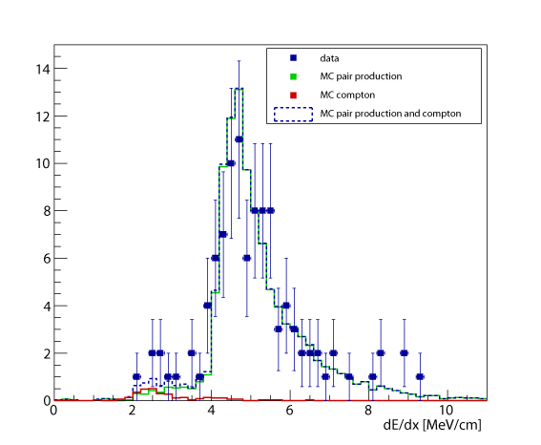
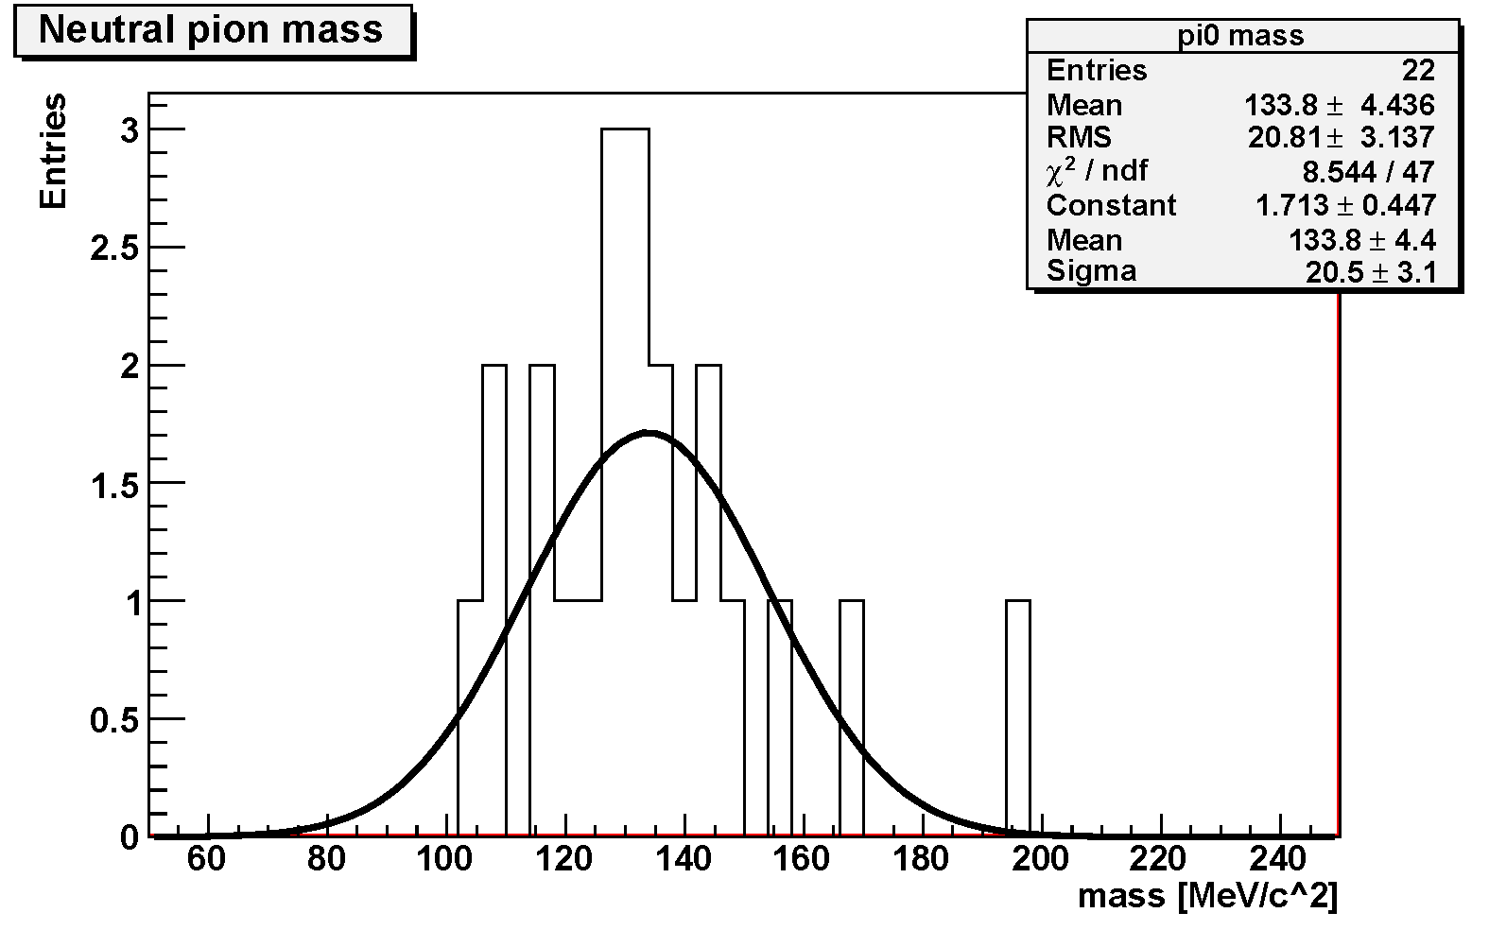
e/γ separation and π⁰ reconstruction in ICARUS
π⁰ reconstruction:
E_{k} = 102 ± 10 MeV
p_{πo} = 912 ± 26 MeV/c
m_{πo} = 127 ± 19 MeV/c²
θ
θ = 28.0 ± 2.5º
E_{k} = 685 ± 25 MeV
MC: single electrons (Compton)
MC: e⁺ e– pairs (γ conversions)
data: EM cascades (from π⁰ decays)
Sub-GeV E range
Collection
Mγγ=133.8±4.4(stat)±4(syst)MeV/c²
1 m.i.p.
2 m.i.p.
2 m.i.p.
1 m.i.p.
MC
Unique feature of LAr to distinguish e from γ and reconstruct π⁰
➔ Estimated bkg. from π⁰ in NC and ν_{μ} CC : negligible (from MC and scanning)
Slide# : 10

Slide 11
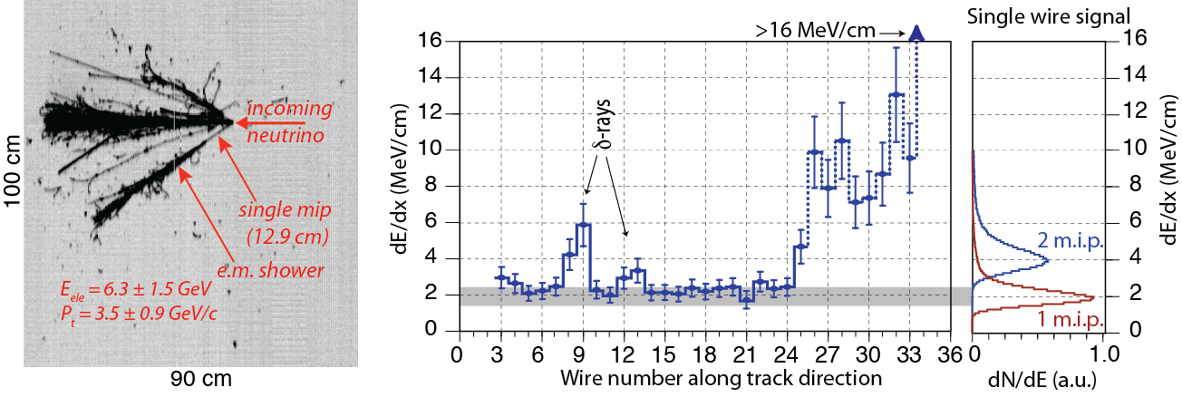
The new ICARUS results
Enlarged statistics wrt first publication: 1995 ν interactions (6.0 10¹⁹ pot over the full recorded sample of 8.6 10¹⁹ pot), EPJ C73:2599
Re-evaluation of the selection efficiency for beam ν_{e}
Four events found with a clear electron signature
In all events the single electron shower is opposite to hadronic component in the transverse plane.
The evolution of the actual dE/dx from a single track to an e.m. shower for the electron shower is shown along the individual wires.
The expected number of e- events from intrinsic ν_{e} beam, θ₁₃~9⁰ and ν_{μ}−ν_{τ} oscillations is then 6.4±0.9 (syst. only).

Slide 12
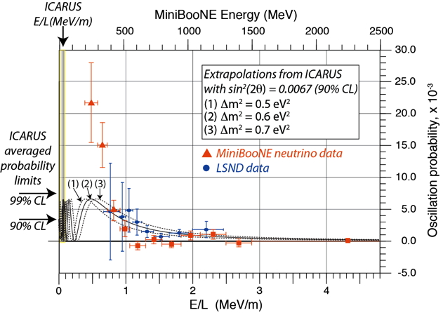
Exclusion of the low energy Mini BooNE experiment
The ICARUS results exclude the existence of the (otherwise questionable) low energy sterile neutrino peak presented by MiniBooNE both in the neutrino and antineutrino channels. This is also confirmed by OPERA.

Slide 13
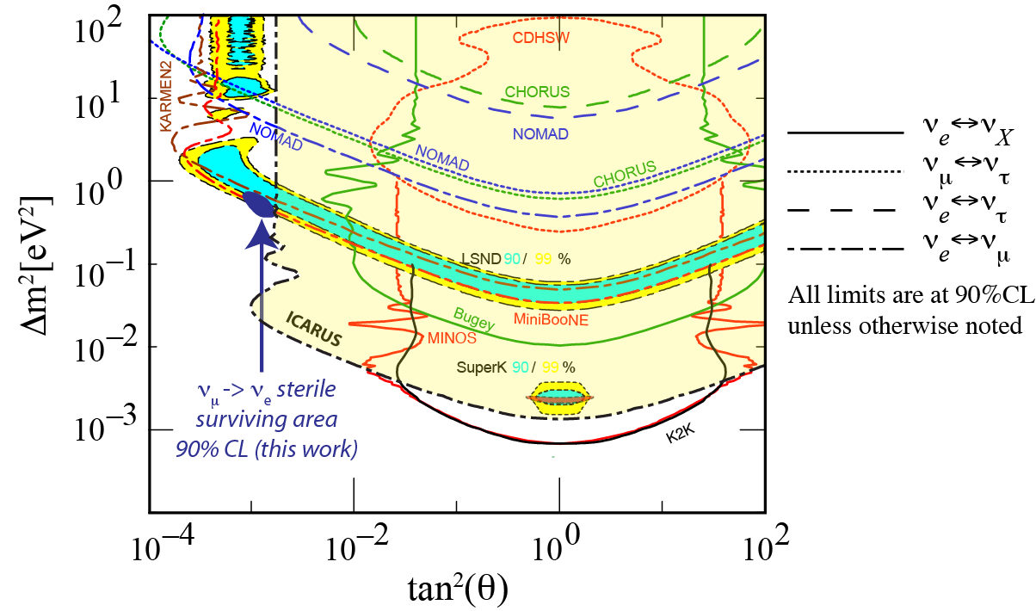
LSND-like exclusion from the ICARUS experiment
allowed MiniBooNE
First results:
Eur. Phys. J. C 73 (2013)
allowed LSND 90%
allowed LSND 99%
limit of KARMEN
present ICARUS exclusion area
ICARUS result strongly limits the window of parameters for a possible LSND anomaly to a very narrow region (Δm² ≈ 0.5 eV² and sin²2θ ≈ 0.005) where there is an overall agreement (90% CL) of
the present ICARUS limit
the limits of KARMEN
the positive signals of LSND and MiniBooNE

Slide 14
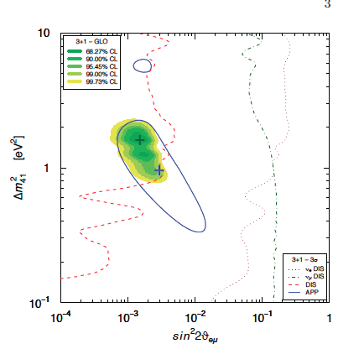
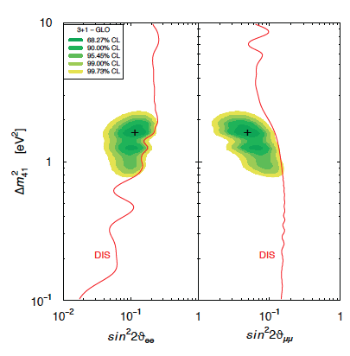
A new coherence of the global 3+1 fits
Giunti, Laveder et al., arXiv:1308.5288
Global fits of sin²θ_{μe} (appearance) and of sin²θ_{ee} & sin²θ_{μμ} (disappearance) with the corresponding common range values for Δm²₄₁. ICARUS result is relevant in excluding most of the area: a well defined common region, 0.82<Δm²₄₁<2.19 eV² within expectations of cosmological results.
Δm²₄₁ ≈ 6 eV² region not allowed mainly because of old BNL-E776 data and cosmological exclusion. The crucial indication in favor of short-baseline is still given by the old LSND result: MiniBooNE experiment was inconclusive.
ICARUS-NESSIE P347, now WA104 will be able to give a definitive answer to the sterile neutrino hypothesis.

Slide 15
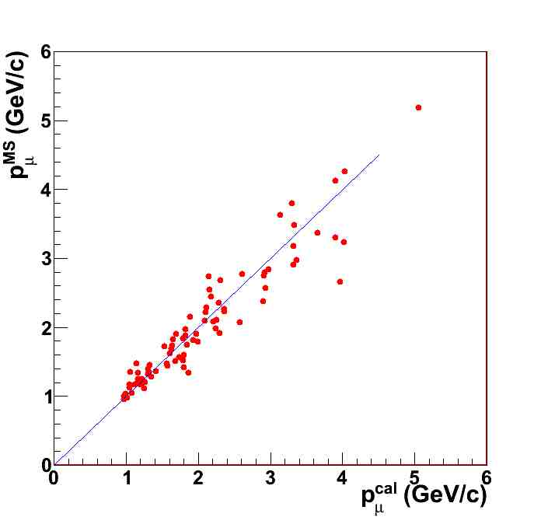
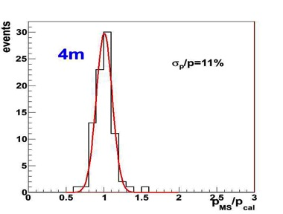
Muon momentum by multiple scattering
Excellent benchmark: horizontal μ from CNGS stopping in the T600
  Calorimetric measurement is possible
  The energy range (0.5-4.0 GeV) is perfectly matched to future short and long baseline experiments
  Momentum measurement using the first 4 meters of μ track (130 stopping μs from νμCC in the upstream rock)
Good resolution over the full muon momentum range
Higher statistics and extension to full CNGS sample ongoing
MS p_{MS} vs calorimetry p_{cal}
Event by event ratio p_{MS} /p_{cal}

Slide 16
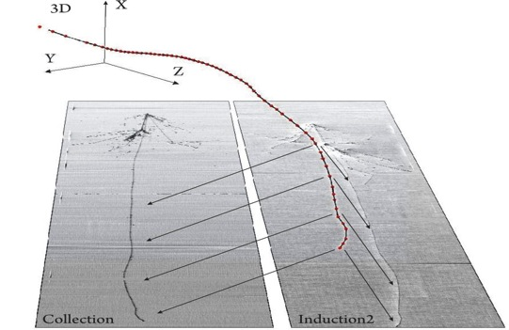
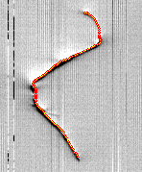
3D reconstruction (example of stopping µ)
NEW: Simultaneous 3D polygonal fit →2D hit-to-hit associations no longer needed
Adv.High Energy Phys.
2013 (2013)260820
Collection view
T300 real event
Induction 2 view
Induction 1 view

Slide 17
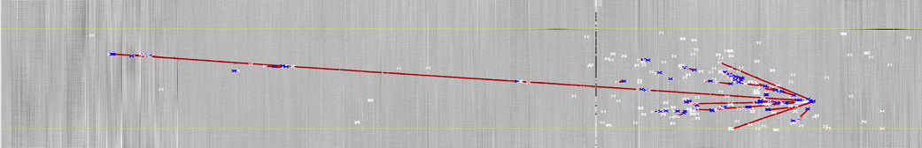
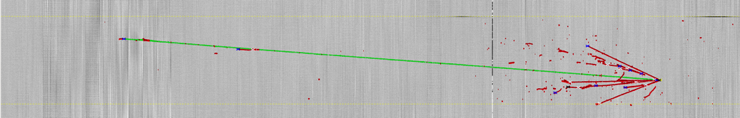
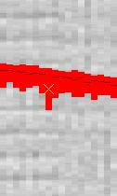
Automation of reconstruction
CNGS ν event primary vertex: automatic reconstruction
  Validation with visually identified CNGS vertices
  algorithm efficiency ~ 97%
automatic event segmentation algorithm
  Track identification
  Shower identification
  Ready in 2D, to be extended in 3D
FIRST STAGE, output from segmentation: clusters and vertices
Candidates for shower: high density of vertices
Just single hits-> neutron, noise
SECOND STAGE, Track clusters, after merging clusters from the segmentation stage:
Selected example in green
Deltas are excluded during the clusters merging .

Slide 18
Clarifying the anomalies.
A new experiment, capable to clarify all the ν anomalies at the appropriate > 5 sigma level is therefore highly desirable.
Such an experiment is based on two main, innovative concepts and a low energy ν and anti-ν beam.
  The first new concept is the comparison for spectral differences of two (or more) identical detectors located at two different distances. In the case of absence of “anomalies”, the two distributions will be a precise copy of each other, without any Monte Carlo comparison.
  The second new concept is the novel, now fully operational large mass Liquid LAr-TPC detectors developed by the ICARUS collaboration. The detector is a “bubble chamber like” sampling, homogeneous calorimeter with excellent accuracies and the total energy reconstruction of the event from charge integration.

Slide 19
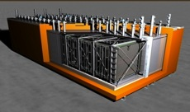
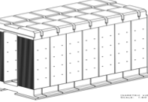
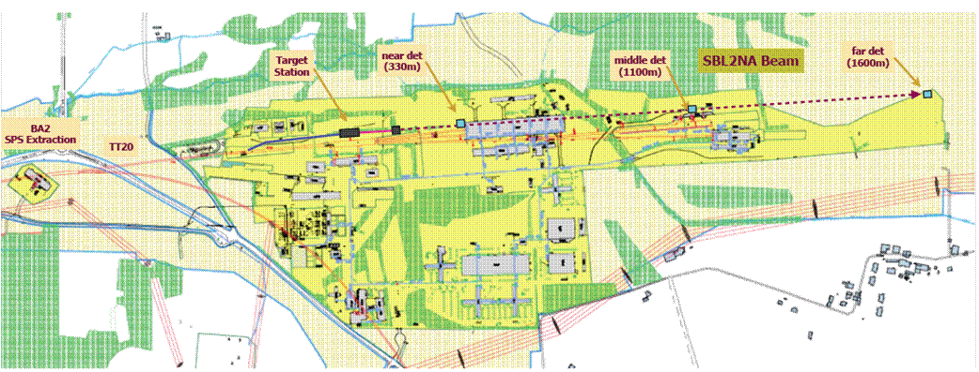
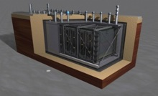
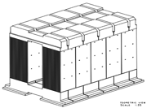
Alternative 1: ICARUS at CERN
New CERN SPS 2 GeV neutrino facility in North Area
Far position: 1600 m
ICARUS-T600 detector + magnetic spectrometer
Near position: 410 m
150t LAr-TPC detector to be build
+ magnetic spectrometer

Slide 20
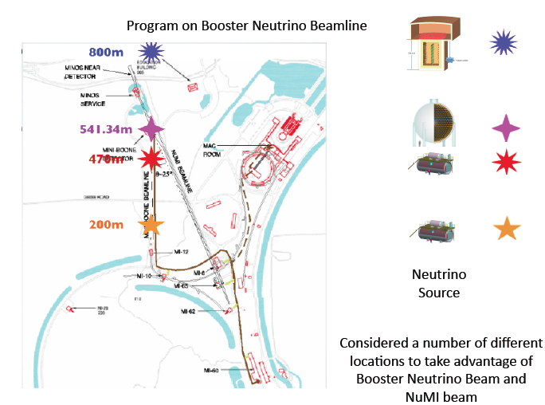
Alternative 2. LAr-TPC alternative at Fermilab
LAr1:1 kton fiducial
volume Liquid Argon TPC
is Far detector
LAr -TPC
LAr -TPC
MicroBooNE (60 t)
is the Near detector
LAr -TPC

Slide 21
Basic features
Our proposed experiment, collecting a large amount of data both with neutrino and antineutrino focussing and muon momentum determination may be able to give a likely definitive answer to the 4 following queries:
  the LSND/+MiniBooNe both antineutrino and neutrino νμ → νe oscillation anomalies;
  The Gallex + Reactor oscillatory disappearance of the initial ν−e signal, both for neutrino and antineutrinos
  an oscillatory disappearance maybe present in the ν−μ signal, so far unknown.
  Accurate comparison between neutrino and antineutrino related oscillatory anomalies, maybe due to CPT violation.
In absence of these “anomalies”, the signals of the detectors should be a precise copy of each other for all experimental signatures and without any need of Monte Carlo comparisons.

Slide 22
Conclusions
ICARUS has now successfully completed the CNGS-2 experiment
ICARUS-NESSIE is now an approved experiment WA104.
Both T600 and T150 will become operational with the vigorous CERN support.
Our vigorously INFN driven programme will be continued, but in a closer International collaboration and as members of the LBNE team.
We are receiving the consensus and an approval of the CTS.
ICARUS is the only operational, physics production scale LAr detector and it shall be so for several years to come. We intend to:
  contribute to the definitive clarification of the “sterile neutrino” story, either at CERN or at FermiLab.
  collaborate with LBNE during the preparation phase and with a large amount of neutrino events at the appropriate energy
  our detector as a convenient “near detector” in the LBNE experimental phase.
The useful lifetime of the ICARUS detector could then be extended to the two next decades to come !

Slide 23
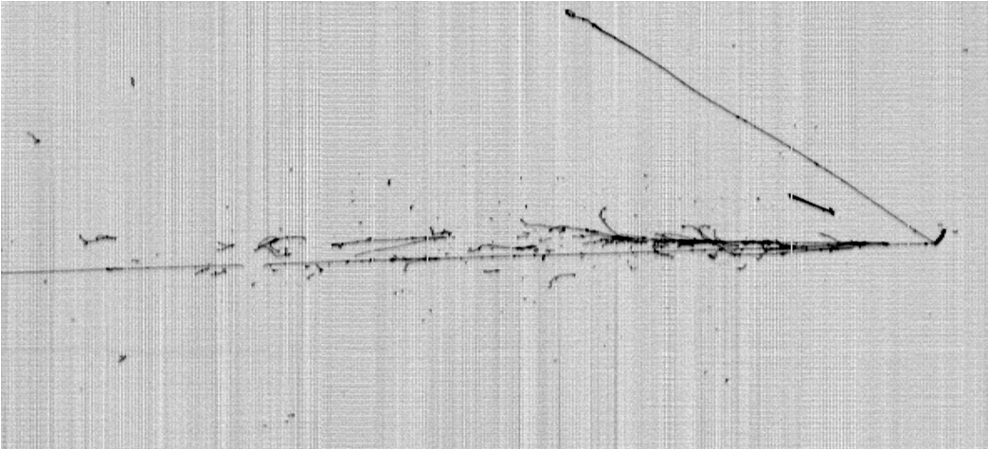
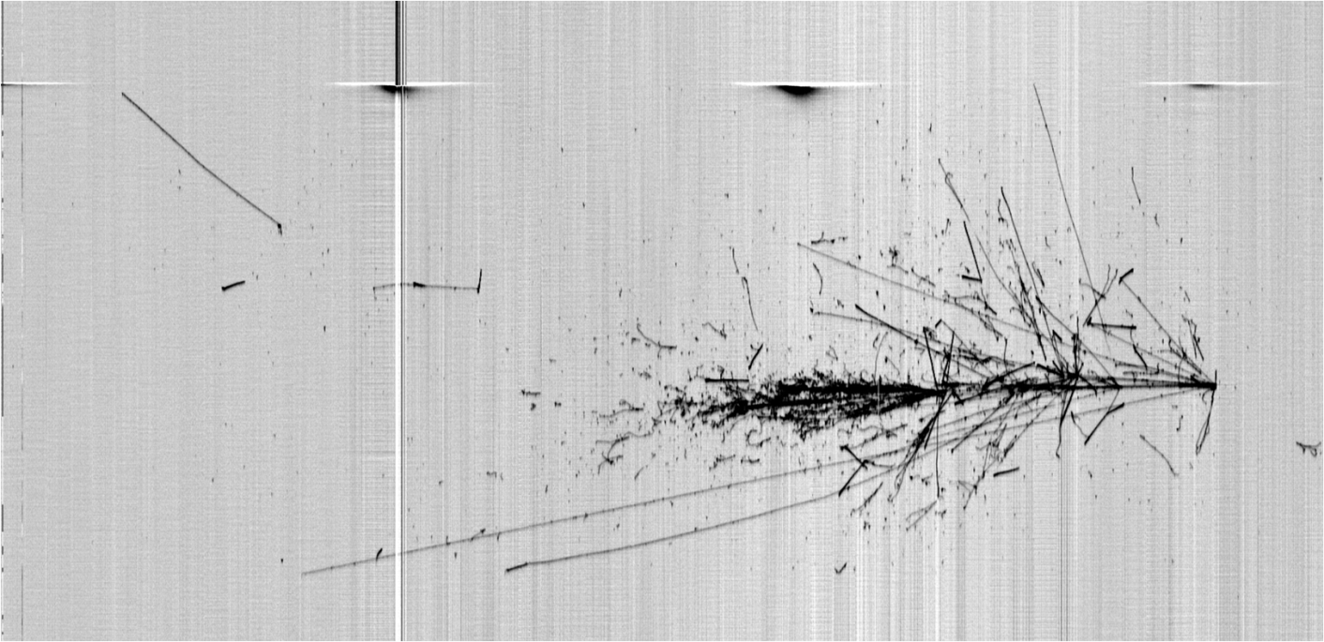
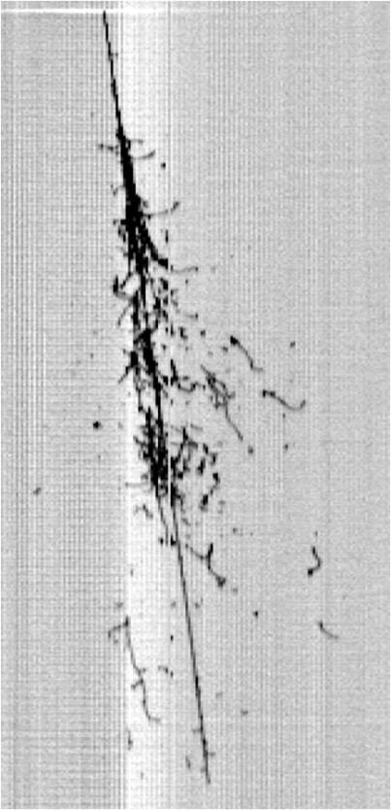
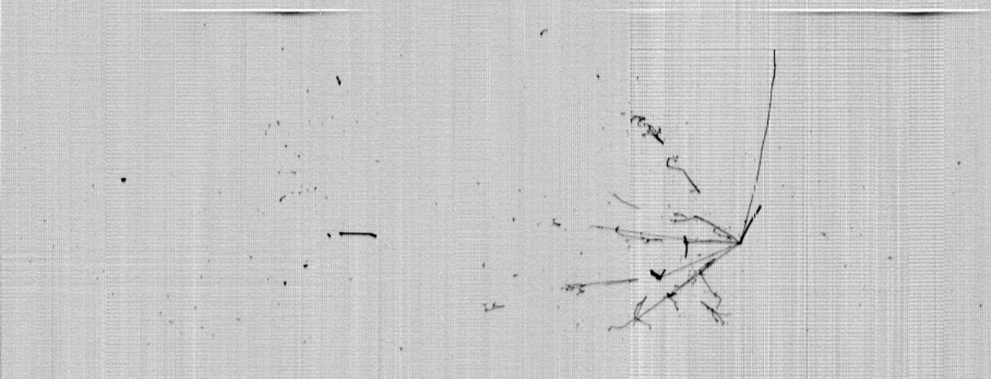
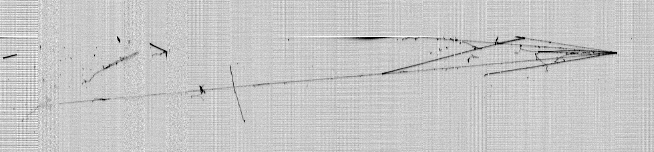
Thank you !
LNGS_May2011
Slide 23

