Slide 2
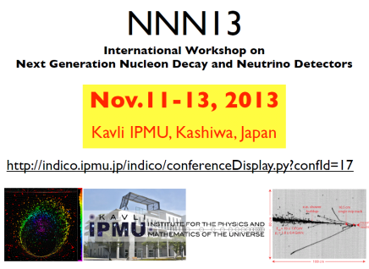
Neutrino activities at CERN
International Workshop of Next Generation Nucleon Decay and Neutrino Detectors (NNN13)
M. Calviani (CERN)
With contributions from M. Nessi, R. Steerenberg, I. Efthymiopoulos, A. Ferrari, P. Sala, V. Venturi, A. Perillo-Marcone, C. Strabel, H. Vincke, J. Osborne, M. Battistin, S. Girod, K. Kershaw, L. Faisandel, M. Archambault

Slide 3
Outline of the talk
Recent neutrino beams at CERN
  CNGS experience
CERN Neutrino Project and perspectives
  Detectors R&D and design for a neutrino beam
EU-funded studies
  LAGUNA-LBNO and HP-PS

Slide 4
Recent neutrino beams at CERN

Slide 5
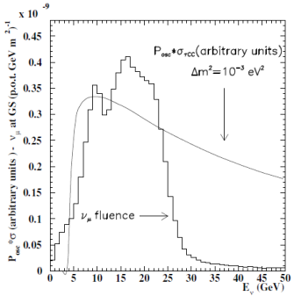
CERN Neutrinos to Gran Sasso (CNGS) experience
2006 -2012
Long-baseline (730 km) ν beam designed for oscillation studies with ν_{τ} appearance
  2 optimised detectors at LNGS:
    OPERA (1.2 kt)
    ICARUS (0.6 kt)
3.5 GeV (threshold for τ production)
Energy spectrum of ν_{μ} well matched to R~σ_{τCC}/E_{ν}² at ~17 GeV to maximize signal rate

Slide 6
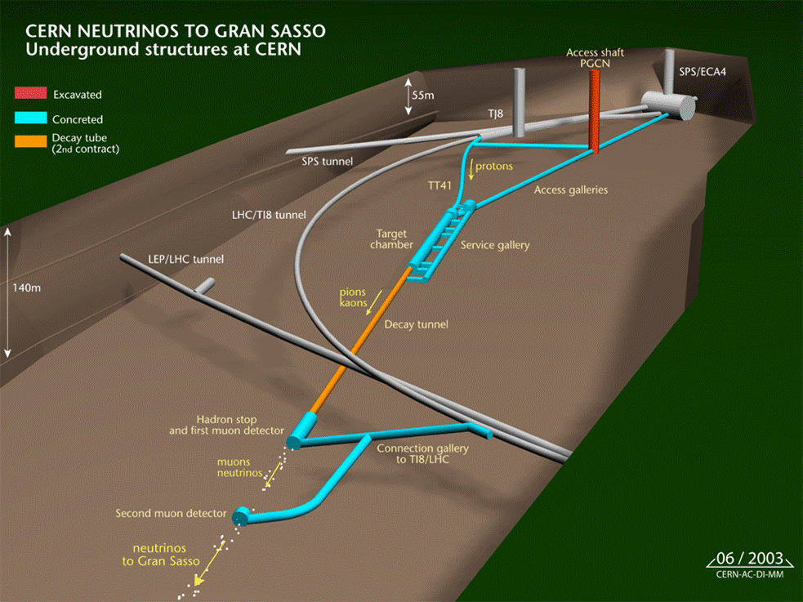
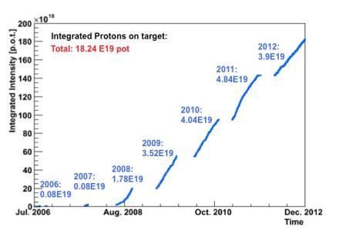
400 GeV primary beam
~510 kW (100% df)
Intensity per extraction = 2.4*10¹³ p
~4.5*10¹⁹ POT/y (max)

Slide 7
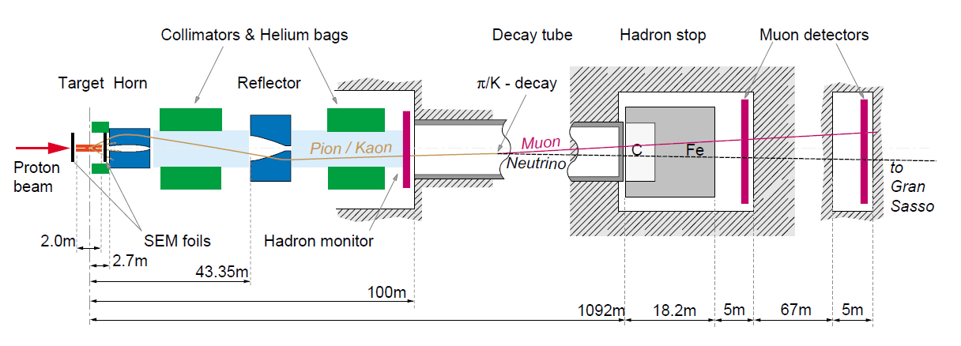

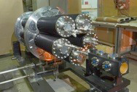
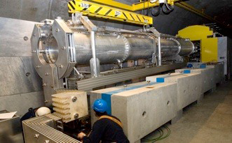
CNGS target
Magnetic horns

Slide 8
CNGS status
CNGS program has completed at the end of 2012, cumulating 1.85*10²⁰ POT
  Lots of operational experience in running a high power target facility
OPERA successfully detected 3 ν_{τ}, with further analysis ongoing
  http://arxiv.org/pdf/1308.2553v1.pdf
ICARUS 600 ton LAr fully operational and exploited for physics
  http://arxiv.org/abs/1209.0122, etc.
Area up to target presently going to be reused for a proof-of-principle experiment (AWAKE)
See N. Naganawa presentation, this workshop
See D. Gibin presentation, this workshop

Slide 9
CERN Neutrino Project

Slide 10
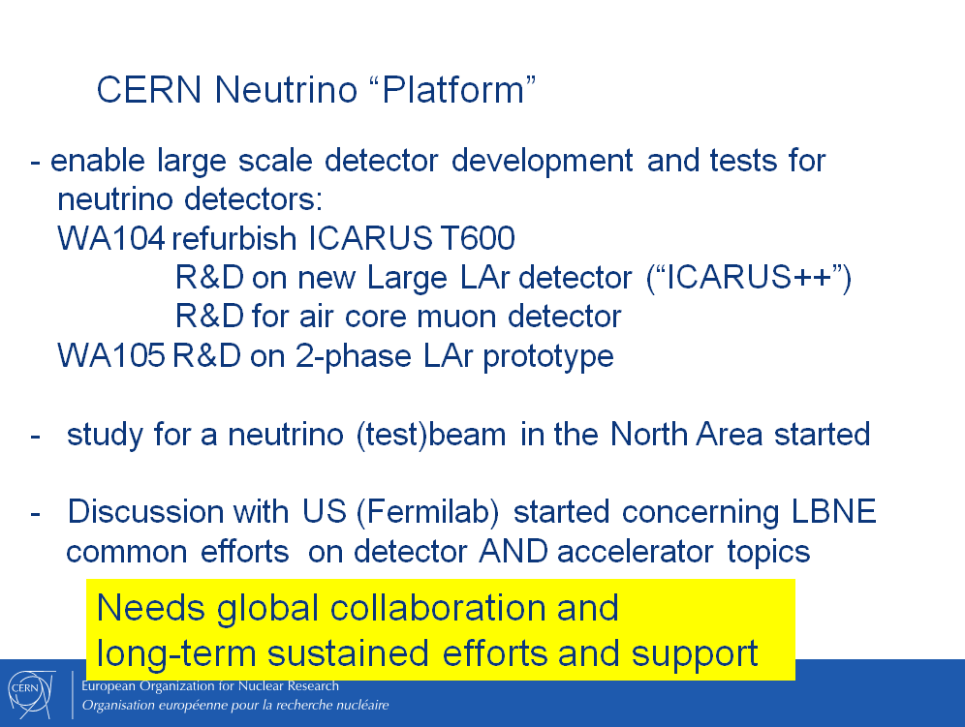
CERN Neutrino Project
R. Heuer (CERN DG), P5 meeting, 2nd November 2013 (link)

Slide 11
Feedbacks from committees
From ESG (link):
  CERN should develop a neutrino program to pave the way for a substantial European role in future long-baseline experiments
  Europe should explore the possibility of major participation in leading long-baseline neutrino projects in the US and Japan
From SPSC108:
  […] it is important to strenghten the neutrino activities at CERN
  […] The SPSC considers that a new short baseline neutrino beam at the SPS could be an adequate facility to foster this focus in the near future […]

Slide 12
Approved
Neutrino detectors R&D
Logistics & test beam infrastructure
Approved
PHYSICS
PL: M. Nessi (CERN)
Design (and implement) a neutrino beam at CERN
CERN Neutrino Platform
EU participation in a High Intensity Facility (detectors, beam, infrastructure)
Investigate new programs
(μ storage ring, beta beams)

Slide 13
Neutrino detectors R&D
WA104 (SPSC-P-347)
  rebuild ICARUS T600 at CERN
  R&D on new large LAr TPC (i.e. event reconstruction)
  R&D on an AIR core muon detector (NESSiE) or eventually integrated a solenoid in the main TPC
  Sterile neutrino physics w/ neutrino beam, cross-section measurement, large event samples, etc.
WA105 (SPSC-EOI-007)
  R&D on a 2 phases large LAr TPC prototype
  LAGUNA-PROTO construction
  Events reconstruction
MIND: R&D on muon tracking detectors
2014 -2018

Slide 14
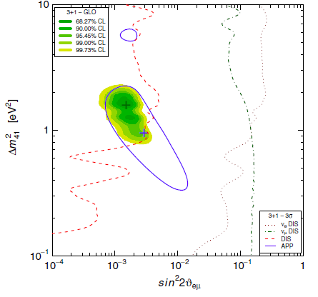
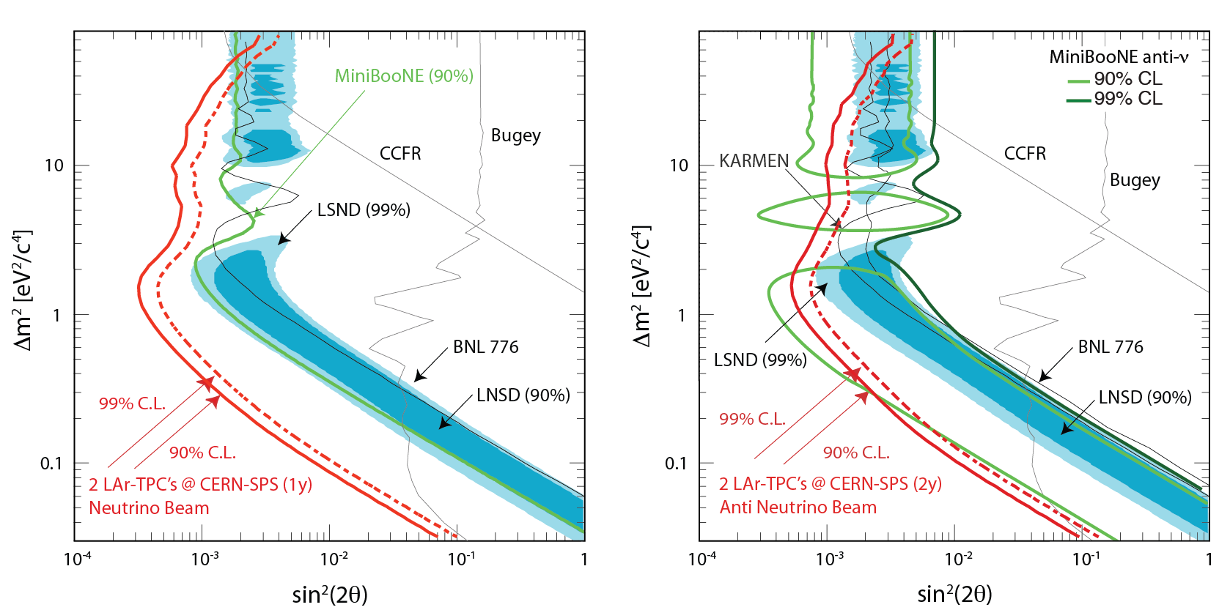
ν_{μ}→ν_{e} “anomalous” oscillations
Exploring the existance of one or more sterile neutrinos (SPSC-P-347)
1 year ν_{μ} beam
2 years anti-ν_{μ} beam
ν_{μ}→ν_{e}
‾ν_{μ}→‾ν_{e}
Allowed region in a global 3+1 neutrino fit
Giunti et al. 2013
LSND allowed region is fully explored in both cases
See D. Gibin presentation, this workshop

Slide 15
Logistics & test beam infrastructure
2014 -2016
Extension of the existing North Area experimental facility
  Make use of existing test beam infrastructure
  Charged particle beams, from few GeVs to 20 GeV, and neutrino (if approved)
    ν beam at ~6.5 meters below the floor of EHN1
  Cryogenic services
  460 meters from target(s) – no background muons
ICARUS T150, LAGUNA-PROTO, NESSiE, MIND + possible new detectors

Slide 16
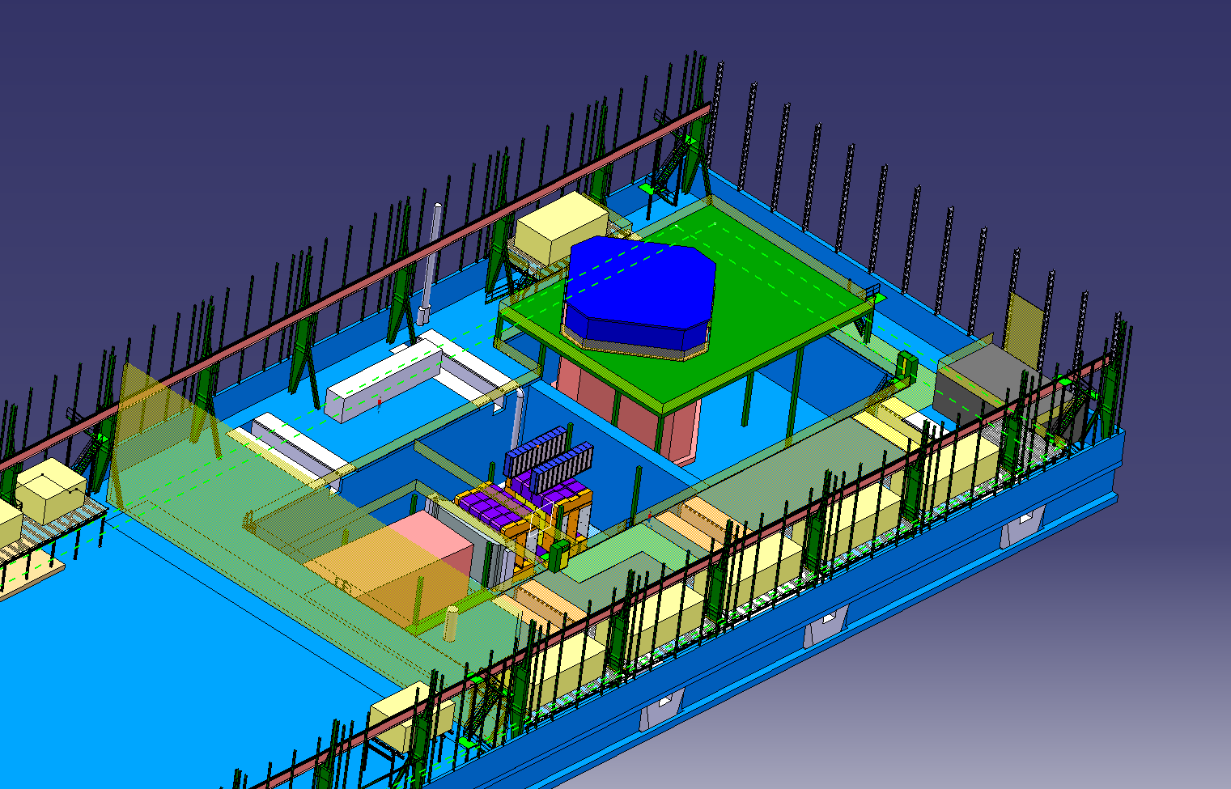
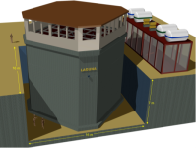
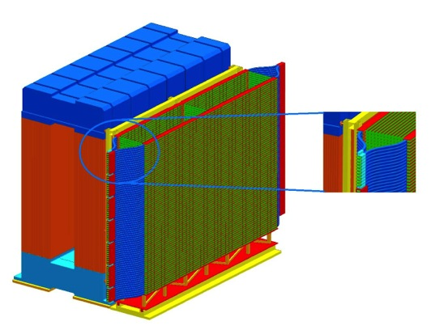
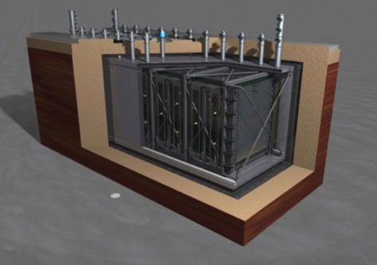
ν + charged beams for all experiments
MIND
LAGUNA-PROTO
~64 meters
New detectors?
NESSiE
ICARUS T150

Slide 17
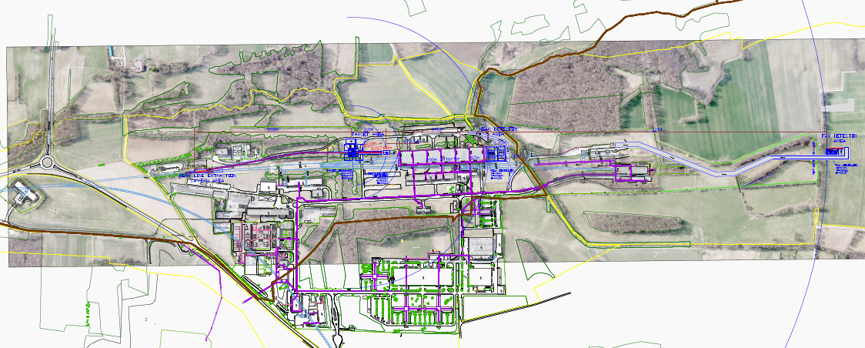
CERN Neutrino Facility design study
Near detector facility
~460 m from target
Far detector facility
~1600 m from target
Primary beam extraction from TT20
Target area

Slide 18
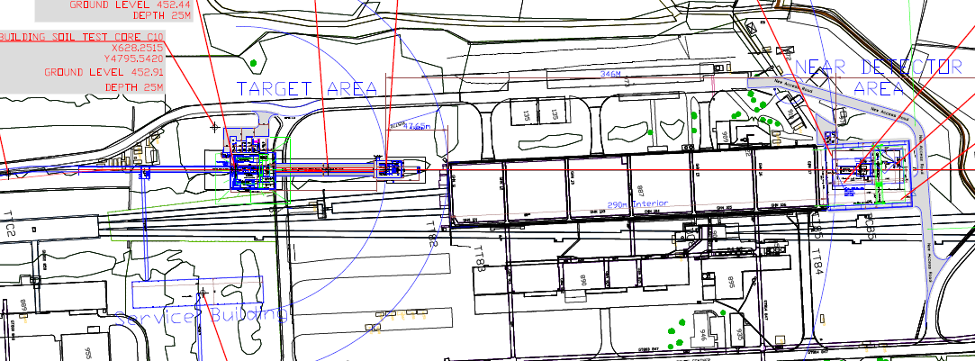
460 meters
Existing EHN1 buiding
Neutrino target area
EHN1 extension

Slide 19
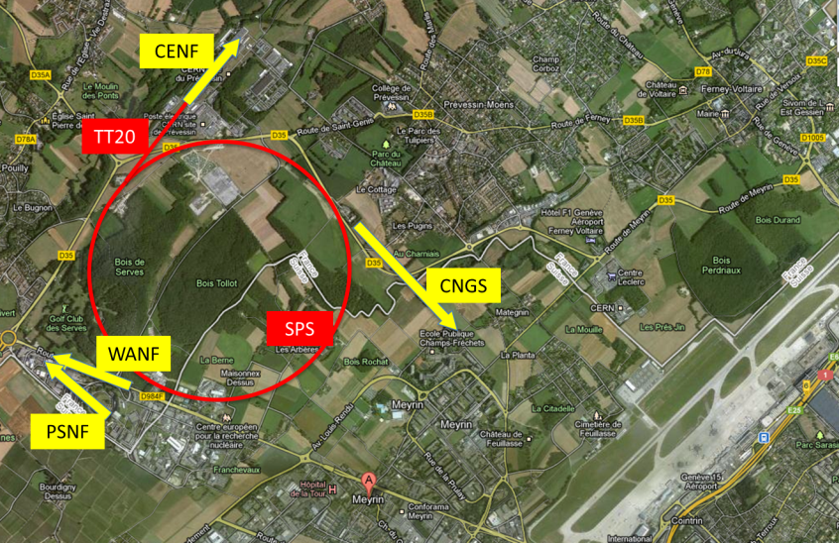
proposed
CERN’s PS/SPS complex
2006-2012
80-90s
proposed

Slide 20
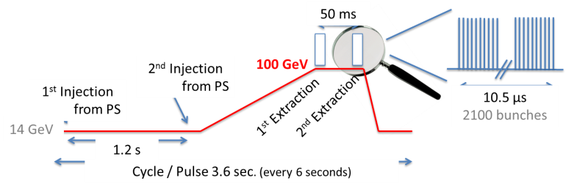
Primary proton beam characteristics
Primary beam momentum 100 GeV/c (new extraction line)
Fast extraction: beam excitation via injection kicker in LSS1 and extraction in LSS2
  Novel solution successfully tested for low intensities beams (2012)
~720 kJ/pulse → ~200 kW on target (max)
Beam time structure similar to CNGS
→ Up to 4.5x10¹⁹ POT/y

Slide 21
Secondary beam production
Due to the shallow depth of the beam line (~14 meters), a target area approach based on long tunnels (i.e. CNGS, WANF, etc.) is not applicable
A multi-compartment solution similar to T2K/NuMI has been therefore developed, taking into account the specificities of CERN

Slide 22
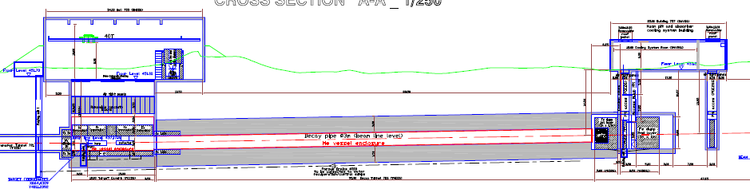
Target cavern and hall
Hadron absorber and μ pits
Decay pipe
Beam line under He, to avoid NO_{x} formation and to reduce air activation
Angle, distance and depth optimised to keep dose rate in EHN1 <1 μSv/h
Target shielding such that dose rate in target building area <15 μSv/h
Air treatment and water recuperation
Civil engineering drillings/soil tests already performed, yielding promising results

Slide 23
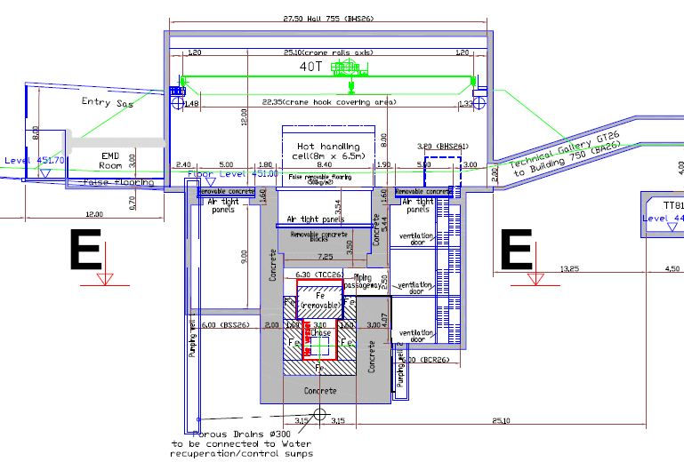
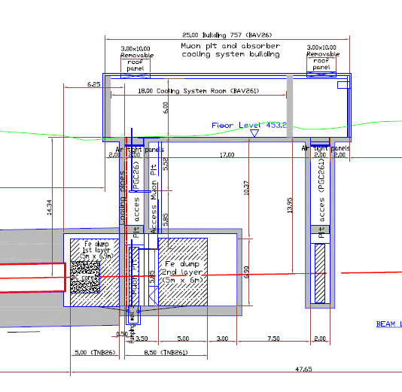
Secondary beam production
Target area trasveral cross-cut
Hadron absorber / muon pits longitudinal cut

Slide 24
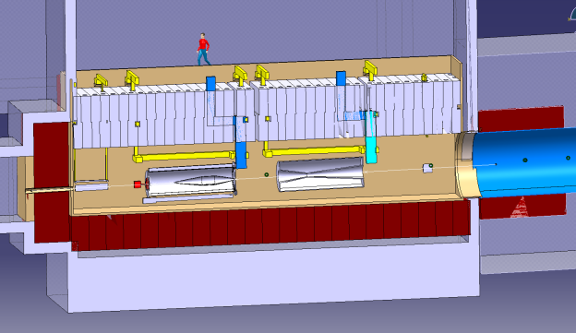
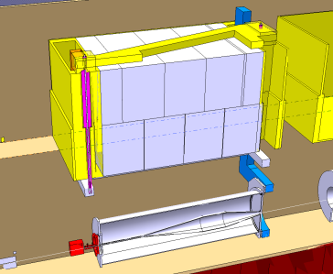
Secondary beam production
Integration of target trench, 3x3 m², matching DP diameters
2.4 m
18 m
Preliminary design of the support module, pure vertical movements

Slide 25
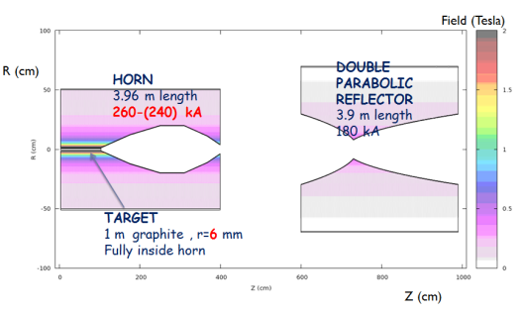
Neutrino beam optimisation
5 GeV pion focusing – central ν_{μ} energy ~1.8 GeV
Target inside horn, followed by reflector
Perfect focus within 1 rad
Best configuration
Initial configuration
Far detector:
  ~1M ν_{μ} /y
  ~20k ν_{e} /y

Slide 26
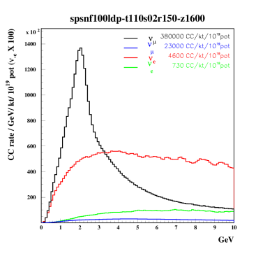
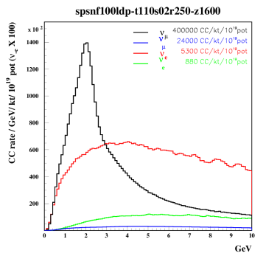
Neutrino beam optimisation
ν_{μ}
DP radius
150 cm
ν_{μ}
DP radius
250 cm
ν_{e} x100
ν_{e} x100
Baseline DP radius of 150 cm
Effect of radius increase (e.g. to 250 cm):
  Increase in ν_{μ} rate at low energy (20% at 1 GeV)
  Small increase in total (5-10% integrated)
  Slightly larger increase of intrinsic ν_{e} (15%)

Slide 27
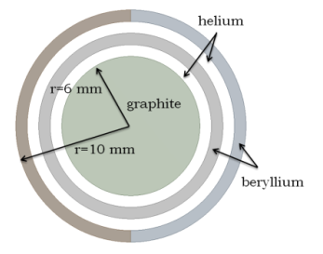
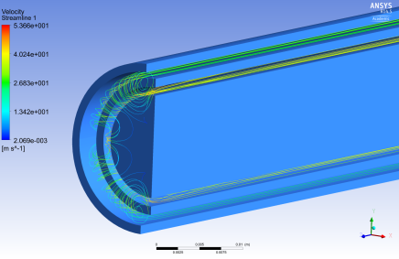
CENF target R&D
100 cm long, 12 mm Ø → challenging design
  ~2 kW dep. power, He-cooled graphite PT2020
Graphite to be maintained around 600-700 K to minimize mechanical properties change due to radiation effects
Baseline fully inserted inside horn
helium is blown into the Be-Be channel and comes back from the C-Be internal channel

Slide 28
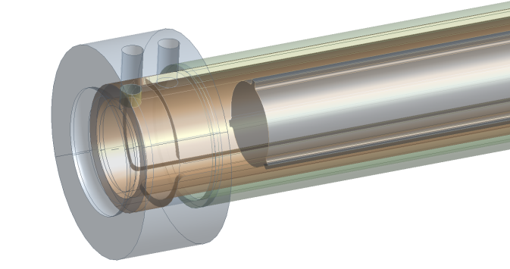
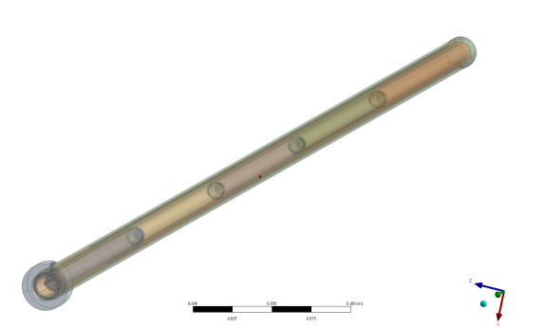
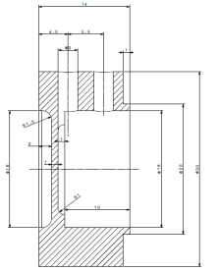
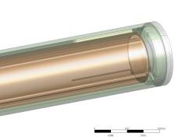
He inlet/outlet at plenum
Prototype foreseen during 2014
Downstream window
outlet
inlet
5 graphite fit bars, 20 cm each to compensate for high fragility

Slide 29
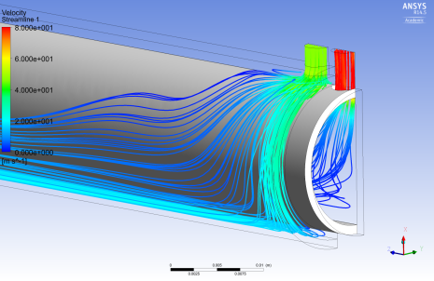
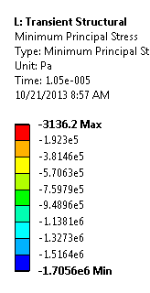

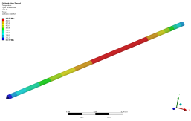

Target CFD results
VALUE | CFX-Thermal
Temp graphite [K] | 740 – 590
Max temp Be [K] | 545
P inlet [bar]- V outlet [m/s] | 15 80
DP [kPa] | 1.4
DT He [k] | 230
Max He Velocity [m/s] | 100
He flow | 0.4 g/ s
Thermal compressive stress: <2 MPa
Max graph. radial expansion: ~120 μm
Stresses due to pressure on Be structure (@20bar): 25 MPa (max)

Slide 30
Radioprotection
Radioprotection pivotal aspect for the design of the installation
Additional complication due to the proximity to CERN fence (~70 meters)
Analysis performed:
  Air activation → max annual releases <10 TBq/y
  High energy hadrons and cumulated dose
  Waste zoning
  Prompt dose and soil activation
  Residual dose rates

Slide 31
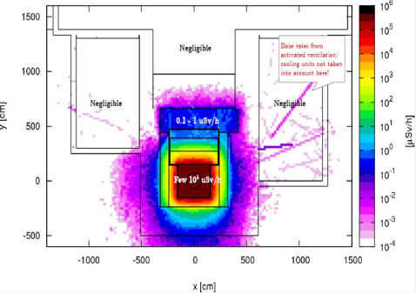
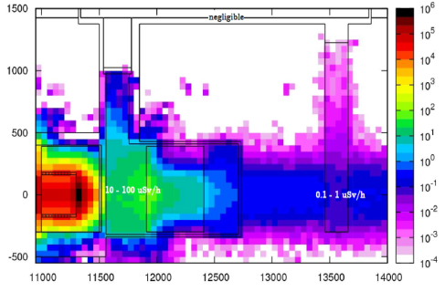
Prompt dose in accessible areas during operation <15 μSv/h
Residual dose rate in service pit (above He-vessel), 0.1 – 1 μSv/h
High energy hadron fluence in the target hall is <10⁶ HEH/cm²/y → ok for electronics

Slide 32
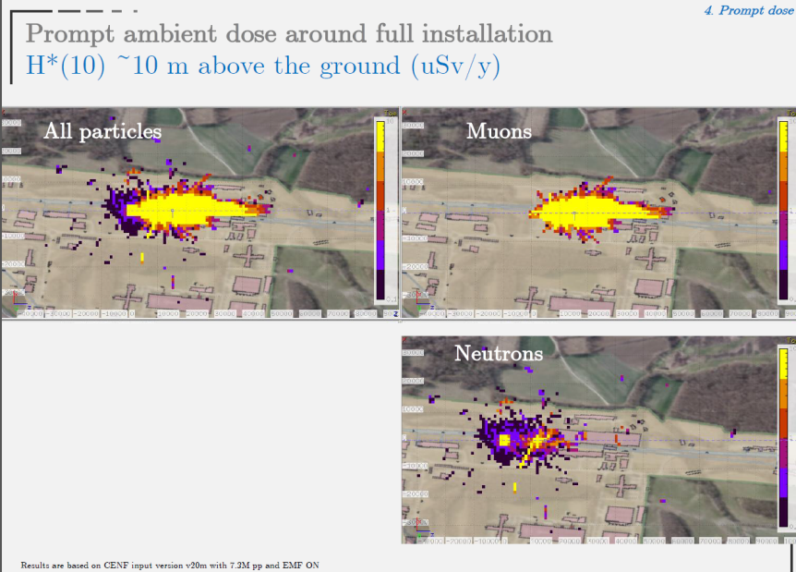
Yearly ambient dose rate at CERN fence is ≤5 μSv/y

Slide 33
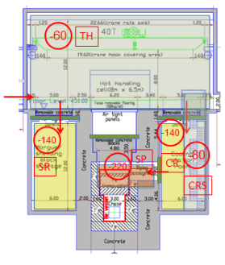
Cooling and ventilation configuration
CENF ventilation design respects ISO17873:2004*
Pressure cascade of multicompartments (from -60 to -220 Pa)
  Flow rate: between 1 and 5 volumes/h
  HEPA filters
  Low humidity control in the service pit
(*) adapted for nuclear instalallation other than nuclear reactors

Slide 34
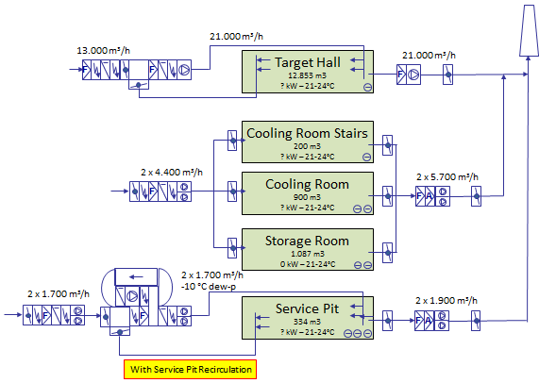
Cooling and ventilation configuration

Slide 35
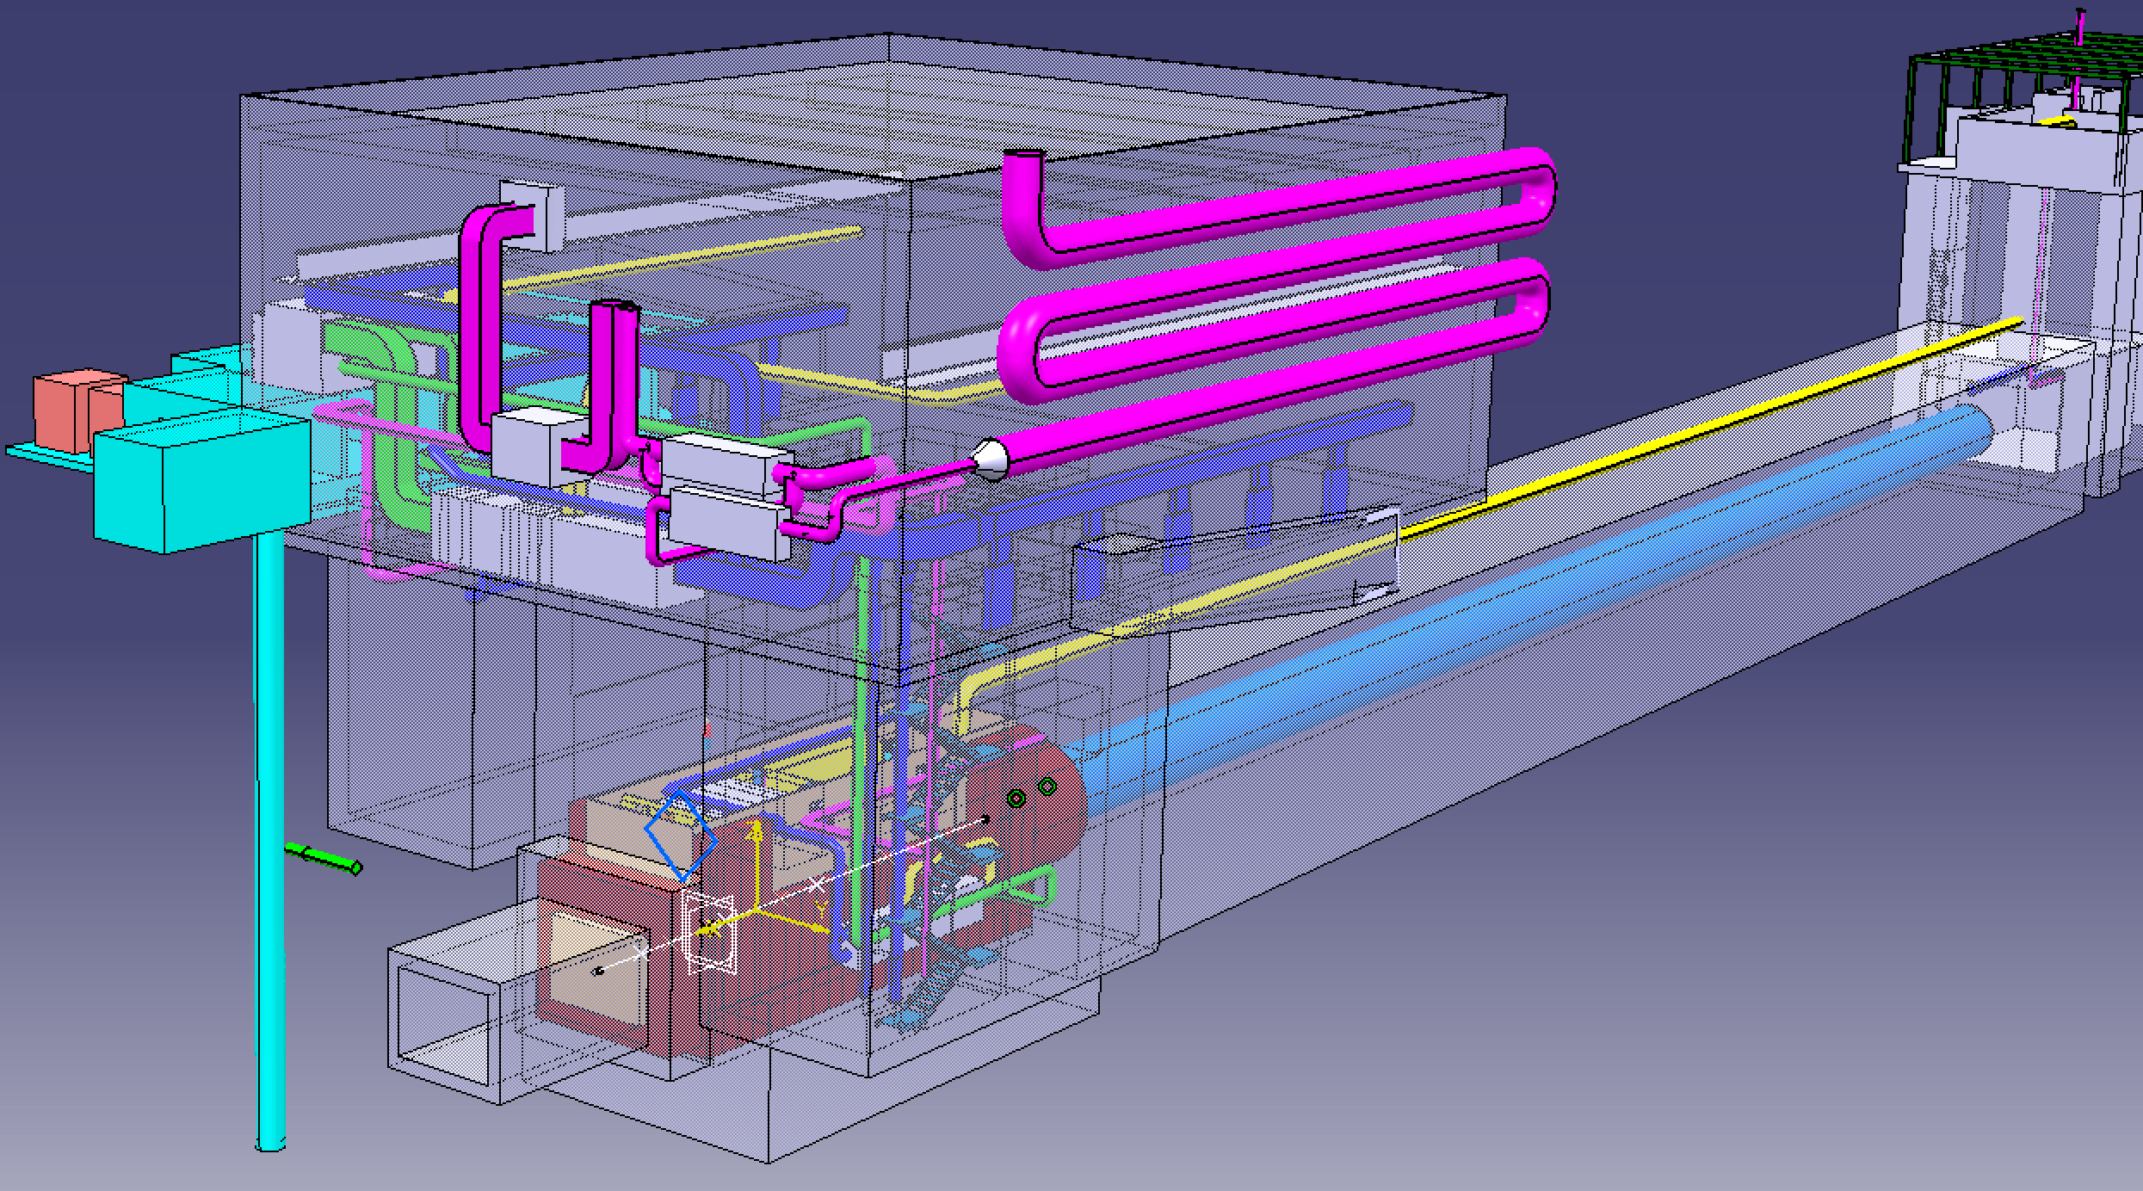
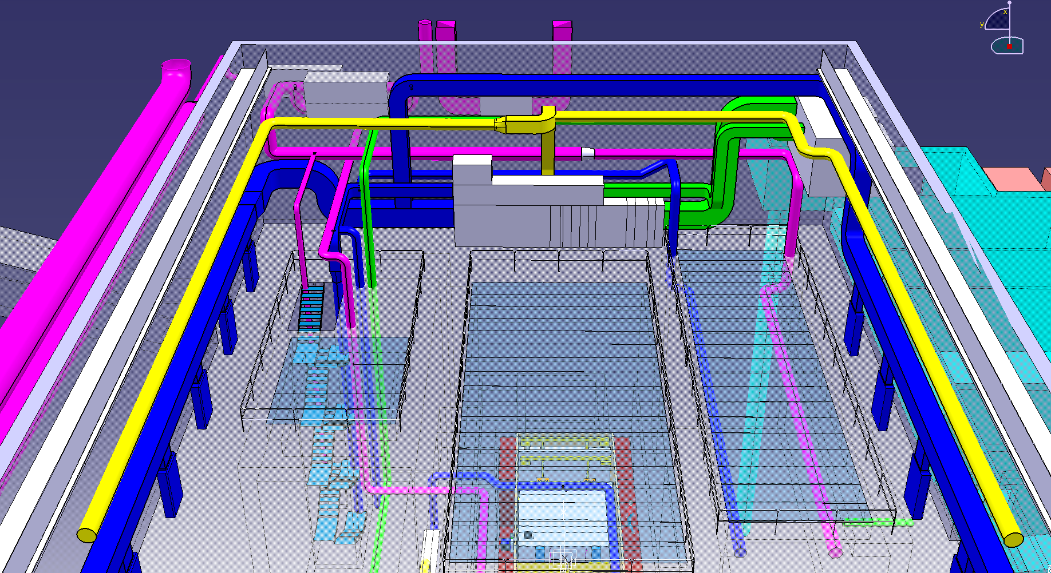
CV integration inside the target and HS buildings

Slide 36
Summary
A sound technical design for a new CERN neutrino beamline is being developed
  A special thank to T2K colleagues
Facility designed for a beam power of 200 kW, but the design is scalable for higher power
A design study report will be released during the course of 2014

Slide 37
EU-funded studies

Slide 38
LAGUNA-LBNO design study
2011 -2014
Design study for the realization of an European LBL experiment with beams from CERN to Pyhäsalmi in the framework of FP7
  Initial beam from SPS(+) 400 GeV/750 kW
  Longer term: LP-SPL to HP-PS 50 GeV/2 MW
Study of primary beam possibilities
Secondary beam, decay volume, dump, etc.

Slide 39
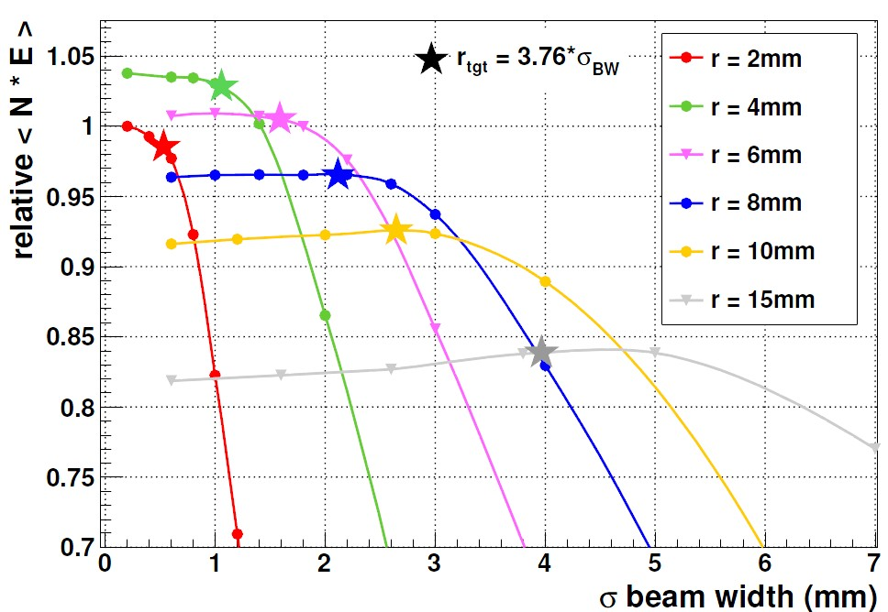
Secondary Beam optimisation
Objective is to maximize the ν CC rate in the FD location at 2300 km from CERN
  Taking into account both beam operation
Conceptual design of the line based on a CNGS+ configuration

Slide 40
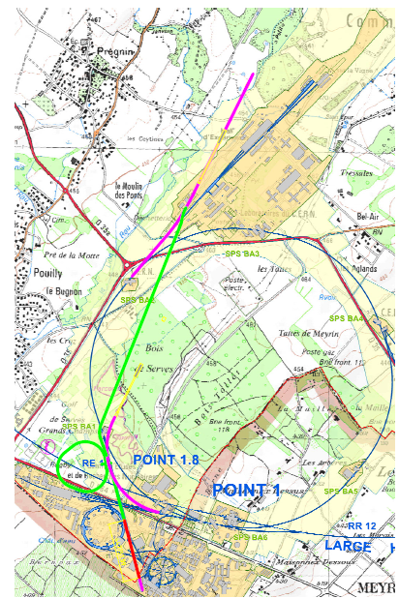
Civil engineering aspects
Challenges for the design:
  18% slope (CNGS was 5.4%)
  100 m long Fe absorber (μ in ND)
  ND (800 m from target) at -180 m depth

Slide 41
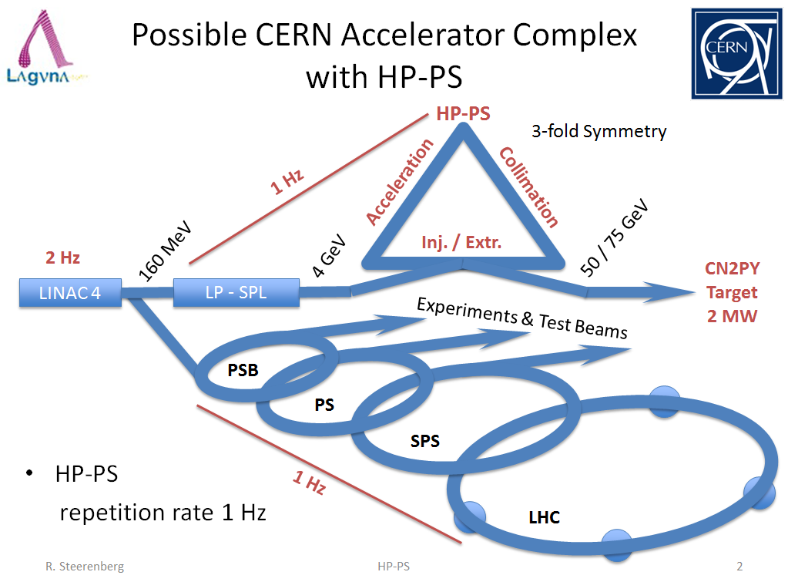

Slide 42
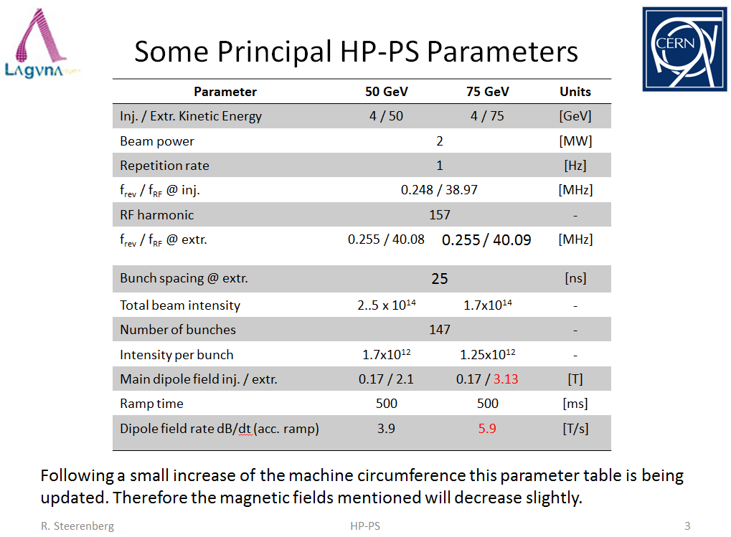
superferric

Slide 43
Conclusions

Slide 44
Conclusions
CNGS successfully ended operation at the end of 2012
CERN activities on neutrinos continue with the creation of the CERN Neutrino Project
  For the moment focus on collaborative efforts for neutrino detector R&D and detector tests with charged particle beams
  Completion of the design of a multipurpose neutrino beam line (200 kW)
    Neutrino test beam for detector R&D
    Possible use for physics (final assessment of sterile neutrino issue) & cross-section measurements

