Slide 1
Future neutrino beam(s) at Fermilab
A. Marchionni, Fermilab
NNN13
International Workshop on Next generation Nucleon Decay and Neutrino Detectors
Kashiwa, November 2013
Recent upgrades to the accelerator complex and to the NuMI neutrino beamline
Present status and future plans for the accelerator complex
Motivations for a new long-baseline neutrino beamline
  Design choices of the LBNE neutrino beamline
Additional neutrino programs

Slide 2
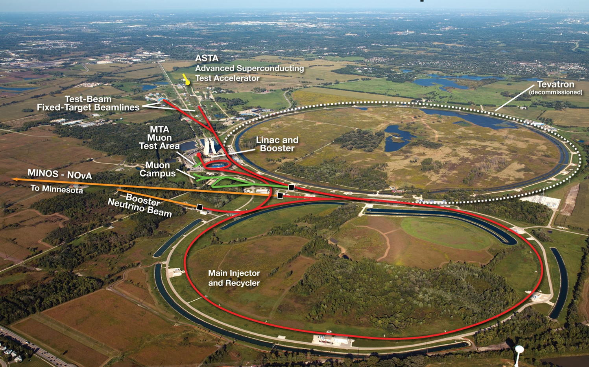
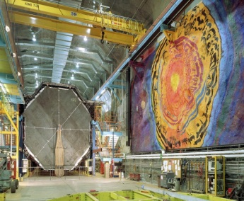
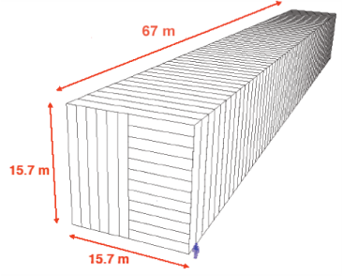
Present FNAL accelerator complex
Long Baseline experiments
MINOS 732 km
NOvA 810 km
14 mrad off-axis

Slide 3
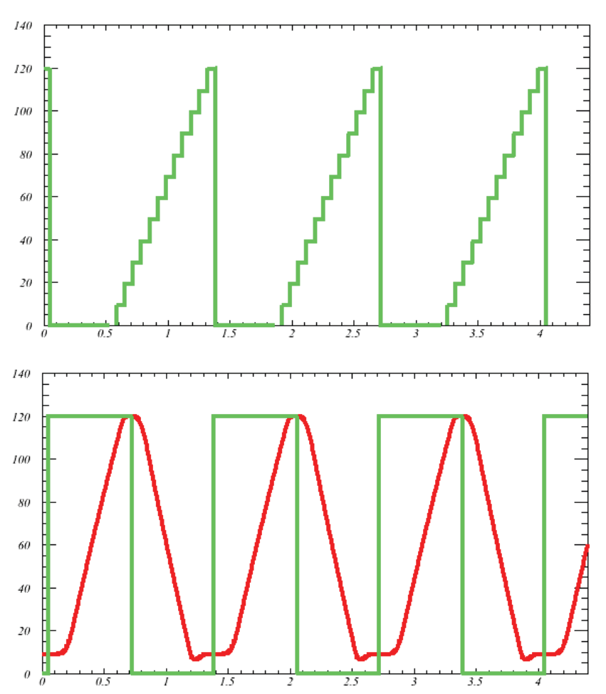
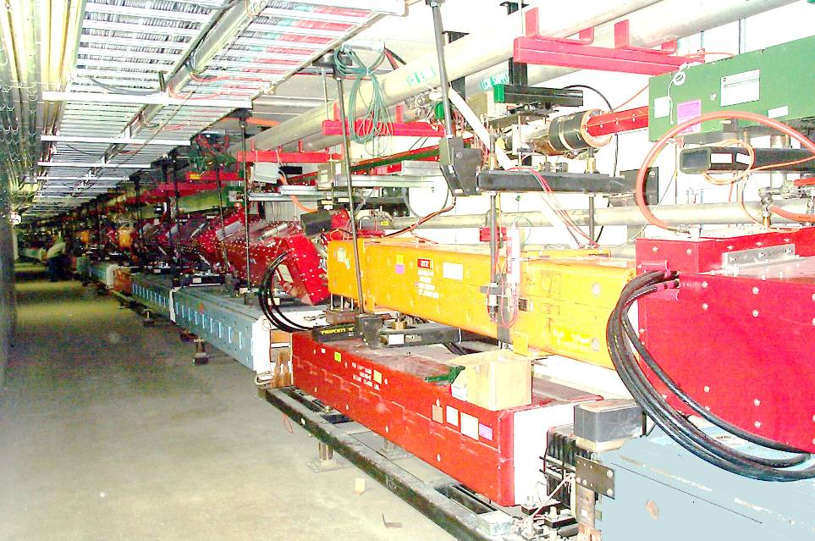
Accelerator Complex reconfiguration
Recycler
Recycler
NuMI line
Main Injector
Main Injector
MI tunnel
With the conclusion of the Collider program, we can use the Recycler as a proton pre-injector to Main Injector, thus saving injection time
A shutdown, from May 2012 to August 2013, to reconfigure the accelerator complex and to upgrade the NuMI beamline just completed
The upgrades will allow 700 kW on the NuMI target

Slide 4
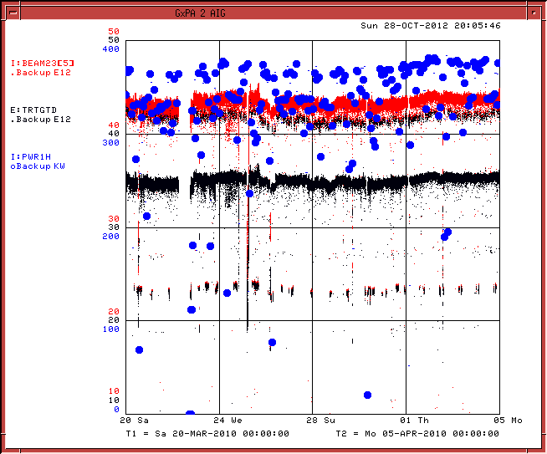

Past and projected performance
March/April 2010 (MI beam to $\overline{p}$ source & NuMI)
11 Booster batches, 9 to NuMI
NuMI Multi-batch slip- stacking in Recycler
Booster intensity (protons/batch) | 4.3x10¹²
# Booster batches | 12
MI cycle time (s) | 1.333
Booster (protons/hr) | 1.4x10¹⁷
MI intensity (ppp) | 4.9x10¹³
NuMI beam power (kW) | 700
PoT/year to NuMI | 6x10²⁰
375 kW
15 days
Total beam in MI (x10¹² ppp), 2.2 s cycle time
Beam to NuMI (x10¹² ppp)
1 hour average Beam Power in MI (kW)

Slide 5
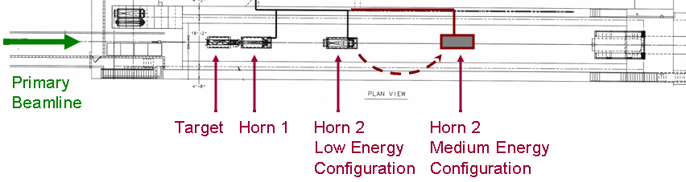
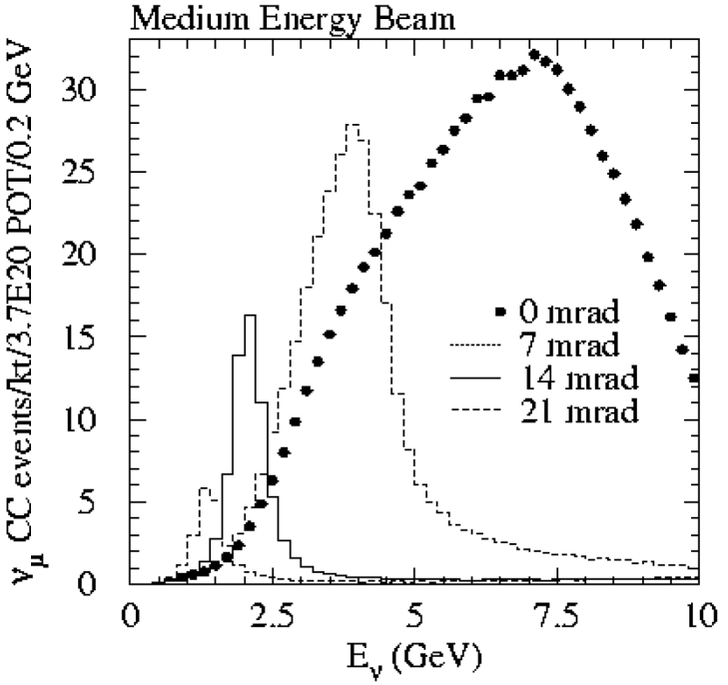
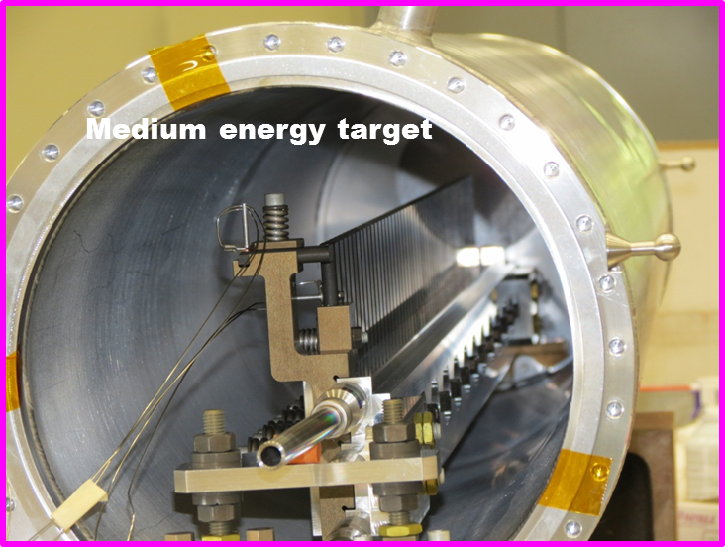
NuMI neutrino line upgrades
NuMI was designed for 4E13 ppp every 1.87 s (400 kW beam power)
  Cycle rate from 0.5 to 0.75 Hz X1.5
  Per pulse intensity from 4.0E13 to 4.9E13 X1.2
  Beam power from 400 to 700 kW x1.75
NOνA requires Medium Energy Neutrino Configuration

Slide 6
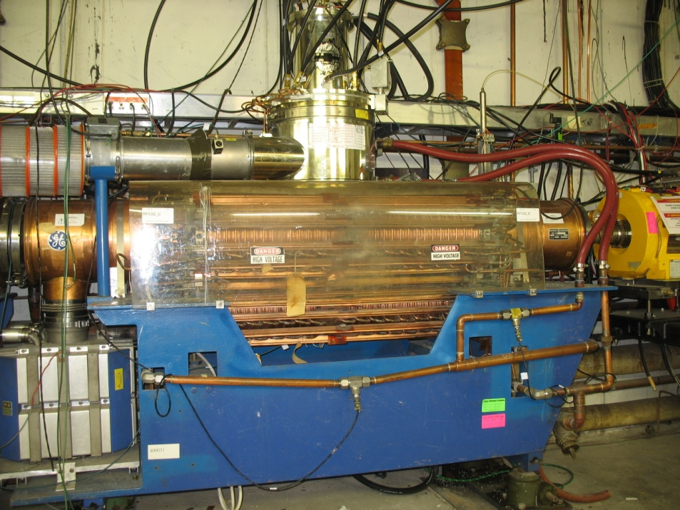
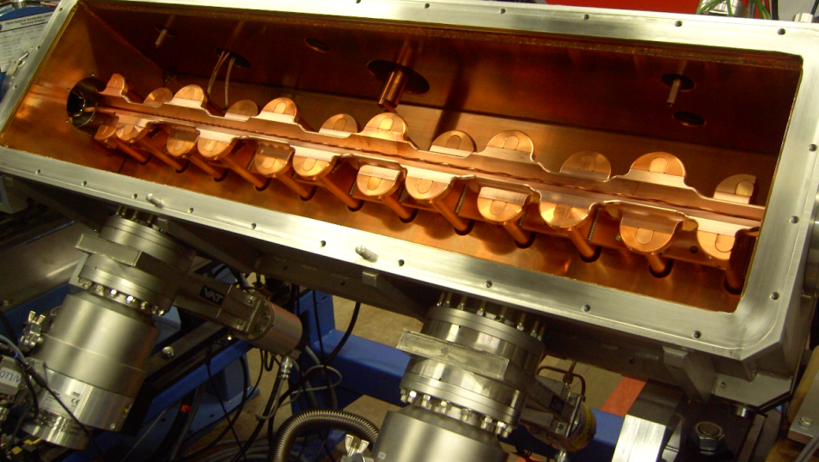
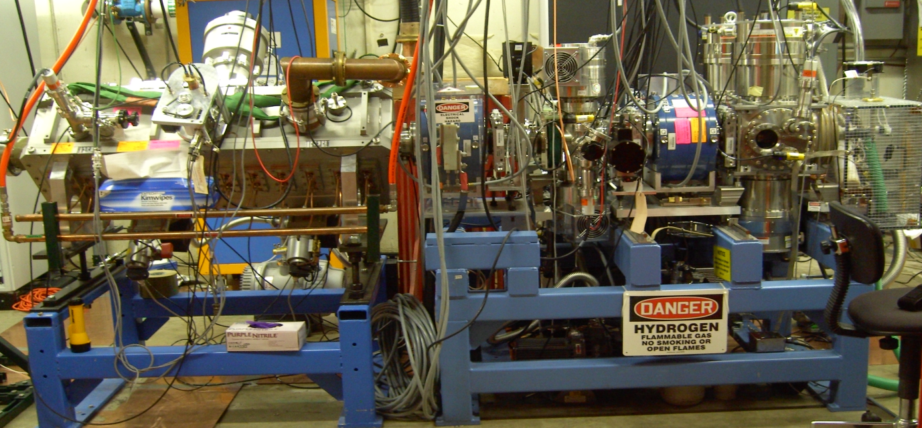
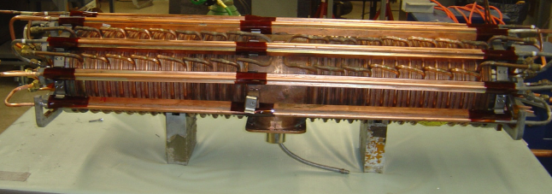
Proton Improvement Plan (PIP)
Replace obsolete components and improve reliability
  40 year old Proton Source
Refurbish Booster RF cavities
to run at 15 Hz
Refurbished Solid State Cavity
Opened RFQ
Tuner rebuild
8 of 19 cavities have been refurbished to run at 15 Hz
Ion source and RFQ

Slide 7
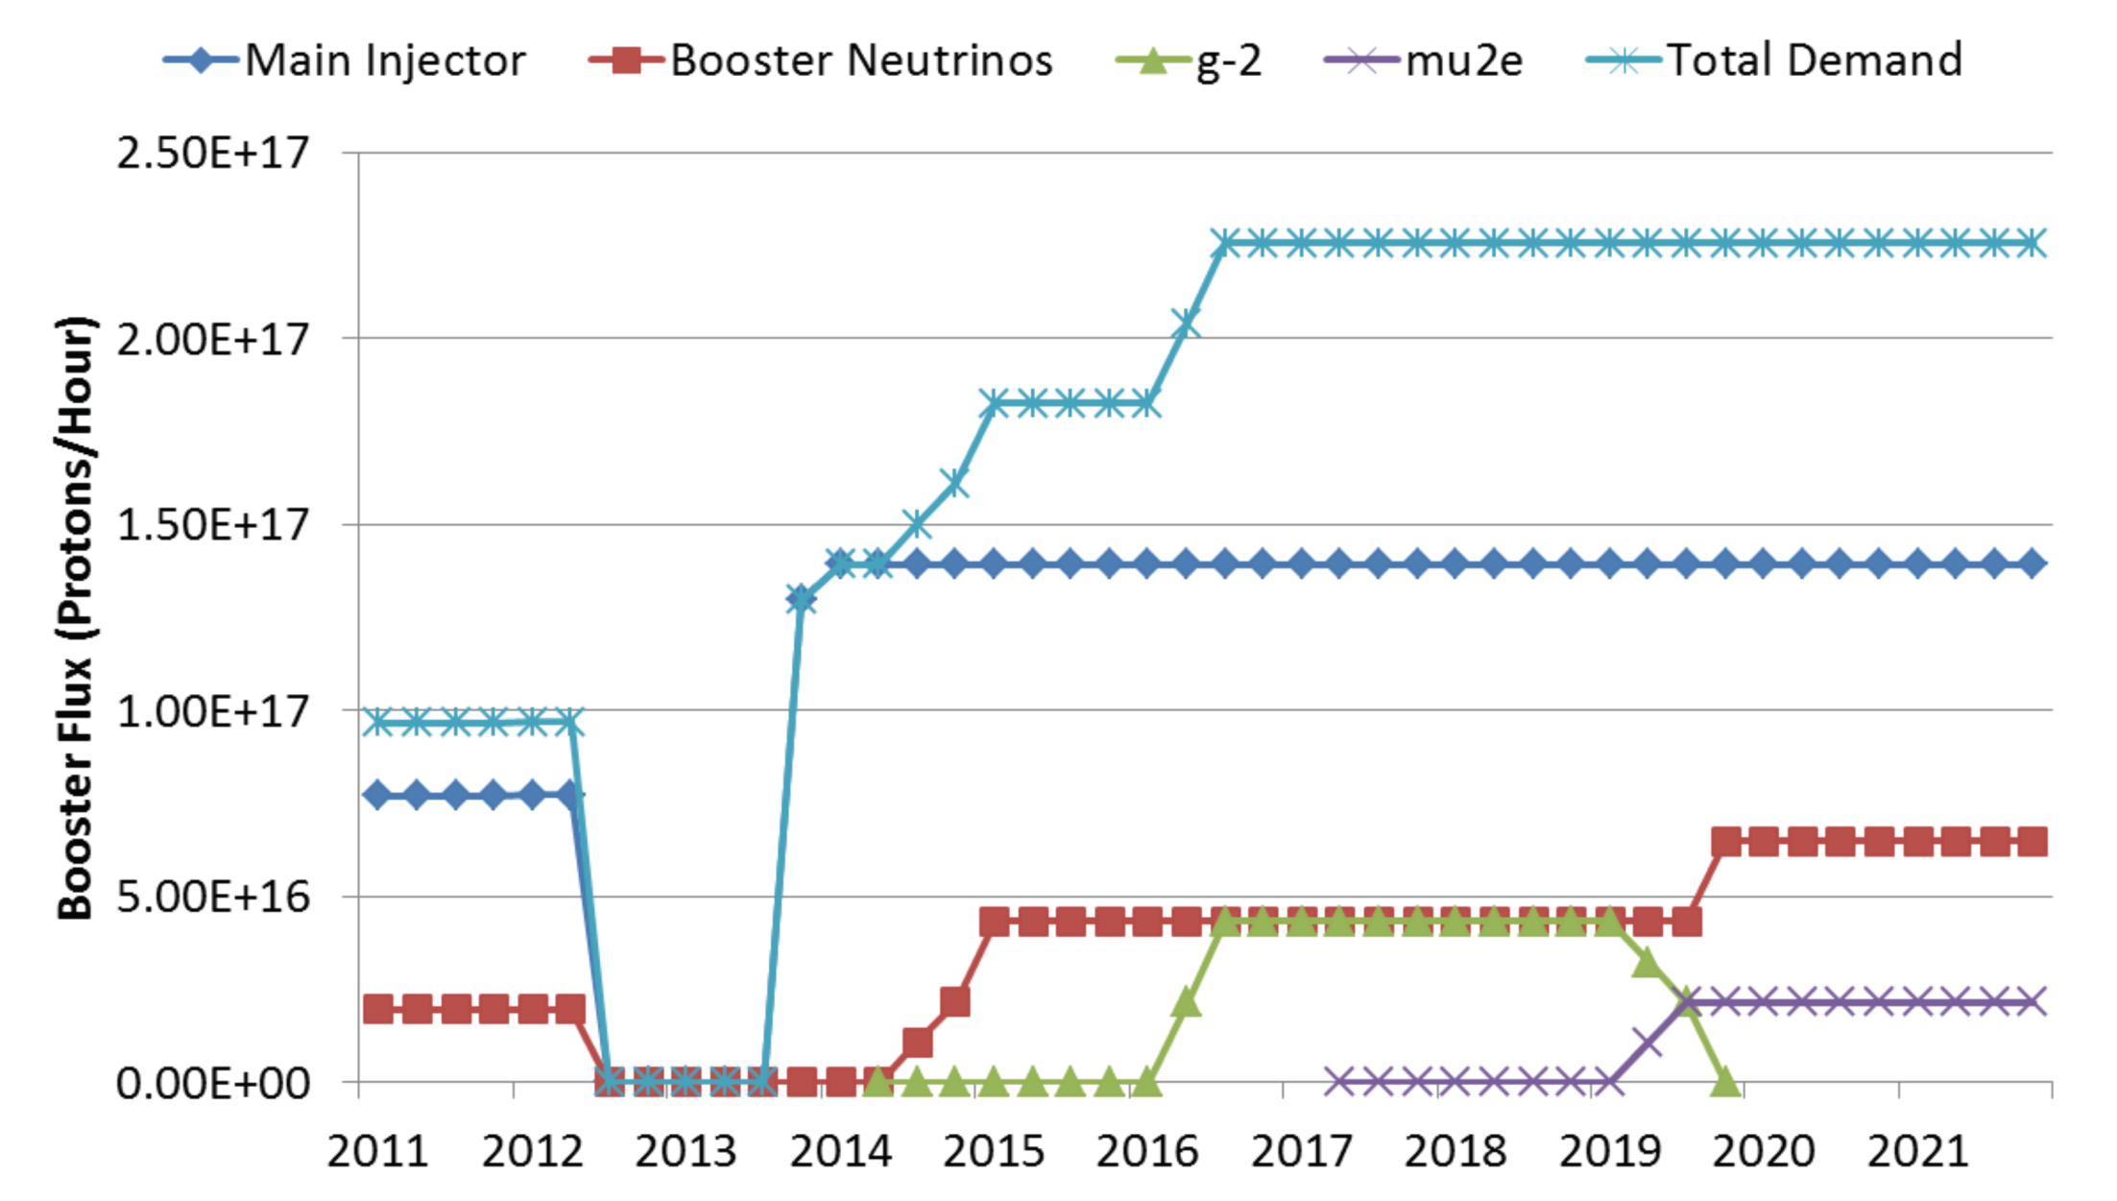
Proton Source demands
NOvA
shutdown
9 Hz
120 GeV ν
6.5 Hz
8 GeV ν
g-2
Mu2e

Slide 8
Accelerator complex status and plans
Presently running with Main Injector only, 6 Booster batches
  2.5E13, 1.67 s cycle time, 280 kW peak power
Commissioning of Recycler ring (~ 4 months)
  peak power ≥ 500 kW in 2014
  at ~ 700 kW in 2015
Project X (http://arxiv.org/abs/1306.5022) is a complete design concept for
  3 GeV CW superconducting H- linac with 1 mA average beam current
  3-8 GeV pulsed linac with 43 mA average beam current
  Recycler and Main Injector upgrades to provide ≥ 2 MW to the long baseline neutrino target at 60-120 GeV
Fermilab plans to reorient the Project X program to have a goal of delivering > 1 MW from Main Injector to the neutrino program by 2025
  800 MeV srf linac injecting into existing Booster
    6.6E12 protons per batch @ at 12 batches/1.2 sec
    12 batch slip-stacking in Recycler, providing 1.2 MW
  or 400 MeV srf linac appended to existing 400 MeV linac (“afterburner”)

Slide 9
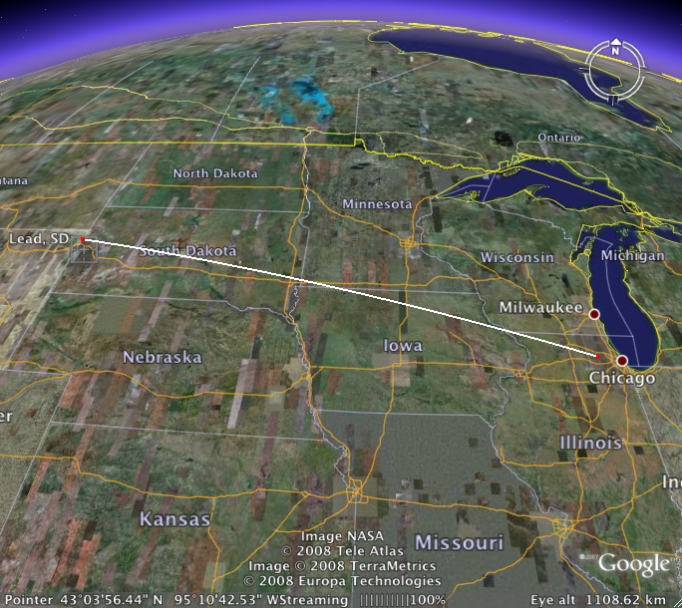

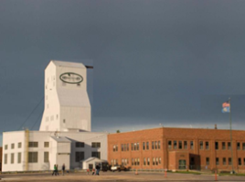
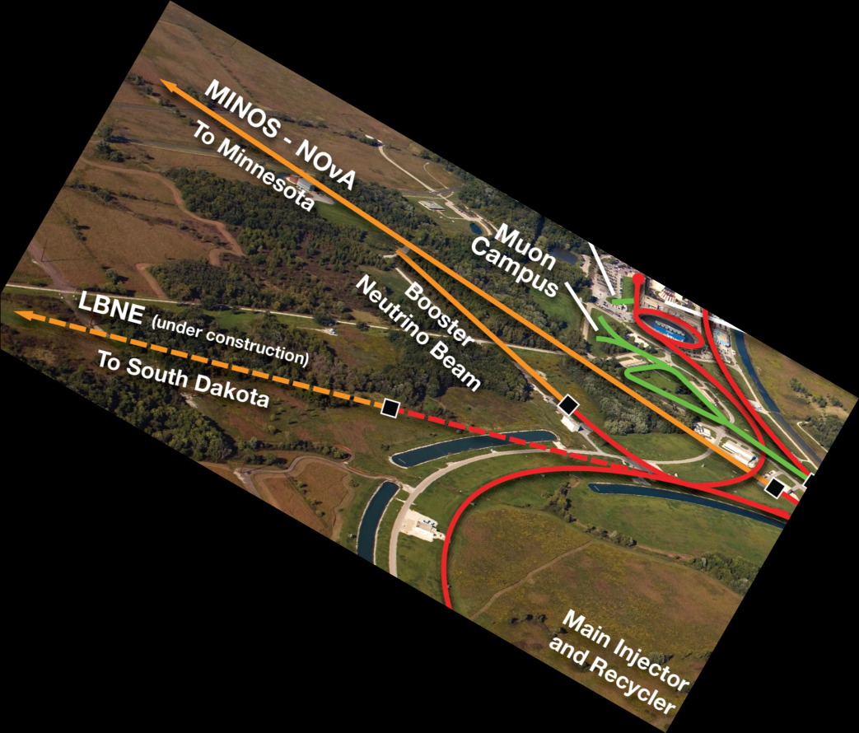

LBNE: Long Baseline Neutrino Experiment
ν
ν
1300 km
ν
ν
ν
ν
ν
A new neutrino beamline over 1300 km
Proton beam power assumption
  700 kW → 1.2 MW → 2.3 MW
A highly-capable near detector system
A ≥10 kt fiducial mass LAr TPC far detector underground at SURF
A cavern for a full 34 kt detector system

Slide 10
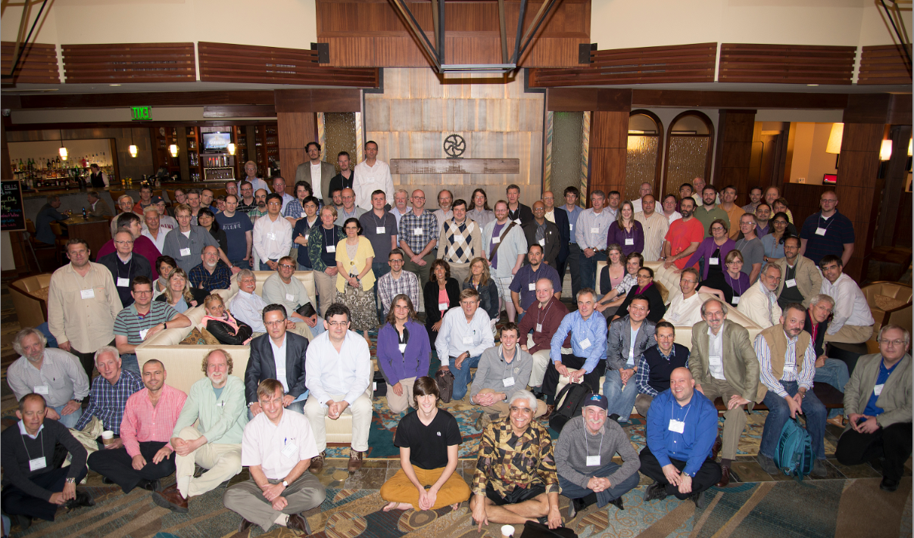
LBNE Science Collaboration
452 members, 78 institutions, 6 countries (Sept. 2013)
357 US + 95 non-US
Alabama
Argonne
Boston
Brookhaven
Cambridge
Catania
Columbia
Chicago
Colorado
Colorado State
Columbia
Dakota State
Davis
Drexel
Duke
Duluth
Fermilab
Hawaii
Indian Group
Indiana
Iowa State
Irvine
Kansas State
Kavli/IPMU-Tokyo
Lawrence Berkeley NL
Livermore NL
London UCL
Los Alamos NL
Louisiana State
Maryland
Michigan State
Minnesota
MIT
NGA
New Mexico
Northwestern
Notre Dame
Oxford
Pennsylvania
Pittsburgh
Princeton
Rensselaer
Rochester
Sanford Lab
Sheffield
SLAC
South Carolina
South Dakota
South Dakota State
SDSMT
Southern Methodist
Sussex
Syracuse
Tennessee
Texas, Arllington
Texas, Austin
Tufts
UCLA
Virginia Tech
Washington
William and Mary
Wisconsin
Yale
Fort Collins, September 2013

Slide 11
Primary Scientific Objectives
  CP Violation in neutrino sector?
    Violation of a fundamental symmetry; viability of leptogenesis models
  Neutrino Mass Hierarchy determination
    GUTs, Dirac vs. Majorana nature and feasibility of measuring 0νββ decay
  Testing Three Neutrino-Flavor Paradigm
    Precision measurements of known fundamental mixing parameters
    non-standard interactions, sterile neutrinos
  Neutrino interaction measurements
  Supernova ν burst flux measurement
  Nucleon Decay measurement
    Baryon number violation search, GUTs

Slide 12
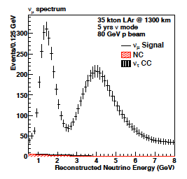
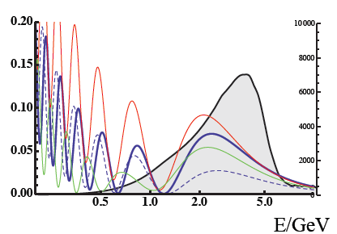
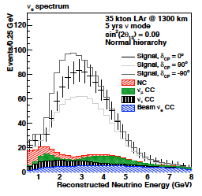
Experimental Technique
Probability
δ_{CP}=+90°, 0, -90°
dashed=inverted MH
700 kW beam
ν_{μ}
ν_{μ}
Unoscillated
spectrum
disappearance
CC events/GeV/
100kt/MW-yr
7,000 evts
Probability ν_{μ}->ν_{e}
appearance
ν_{e}
Produce a pure wide band ν_{μ} muon-neutrino beam with energy spectrum matched to the 1st and 2nd oscillation maximum
Measure spectrum of ν_{μ} and ν_{e} at a distant detector
750 evts
(330 IH)
C. Adams et al. arXiv:1307.7335

Slide 13
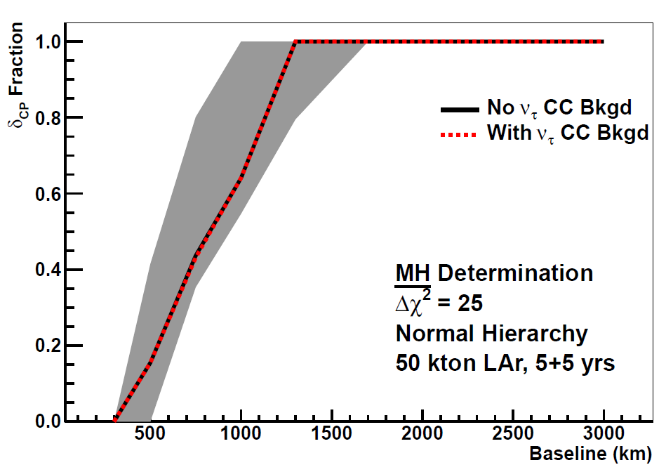
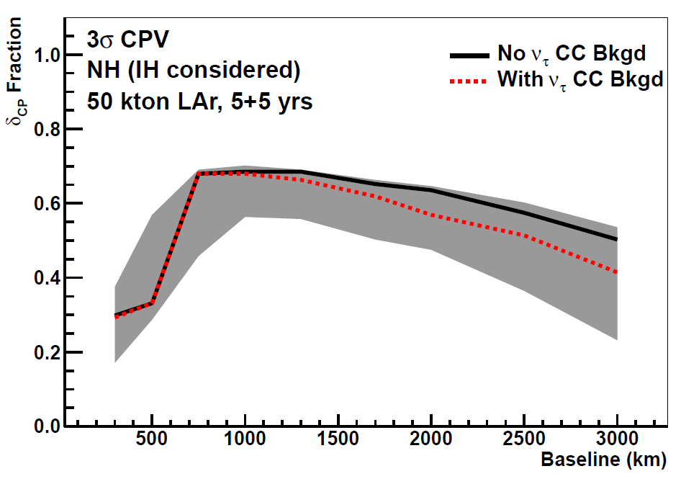
Optimal baseline for FNAL MI neutrinos
M. Bass et al. arXiv:1311.0212
Shaded bands show range due to uncertainty in oscillation parameters and considers both octant solutions for ϑ₂₃
mass hierarchy considered unknown for CPV plot
LBNE is a near optimal choice of beam and distance for sensitivity to CP violation and neutrino mass hierarchy

Slide 14
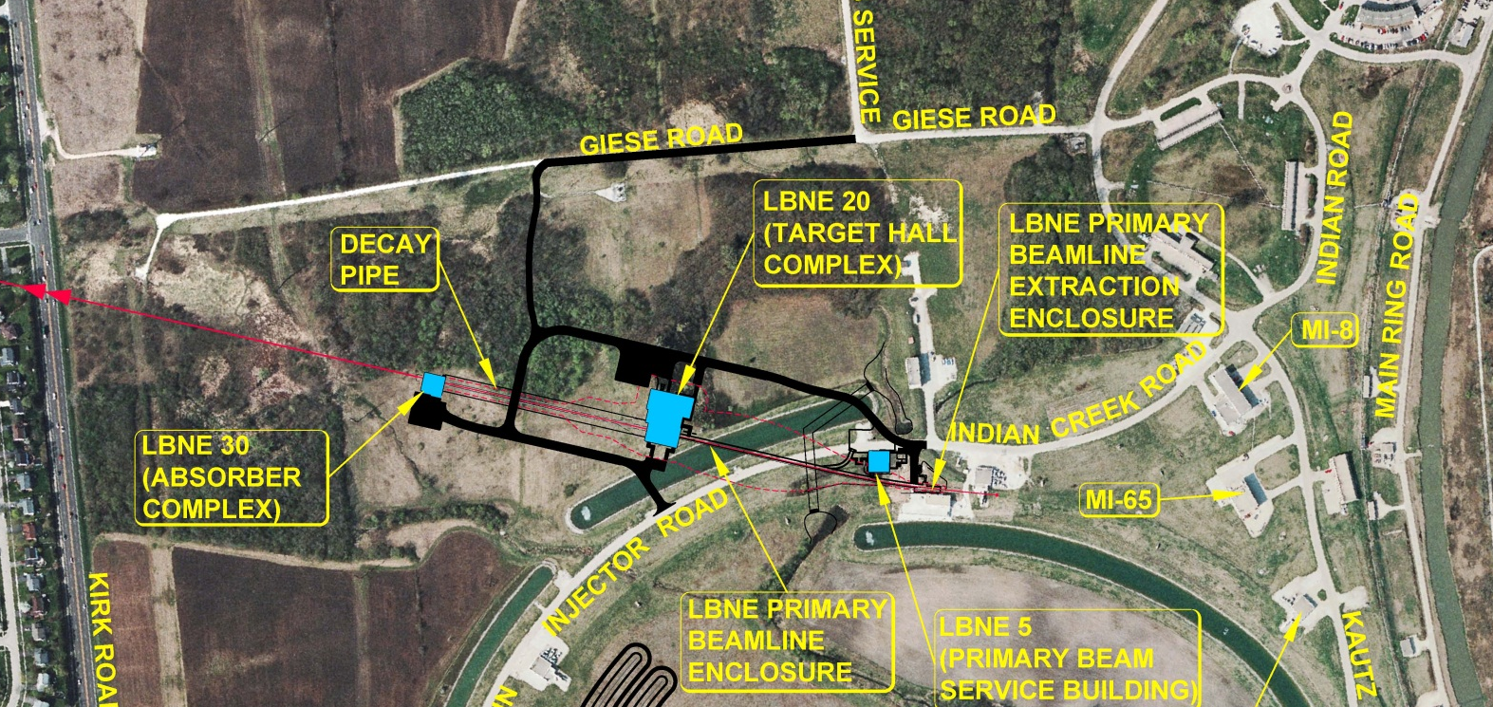
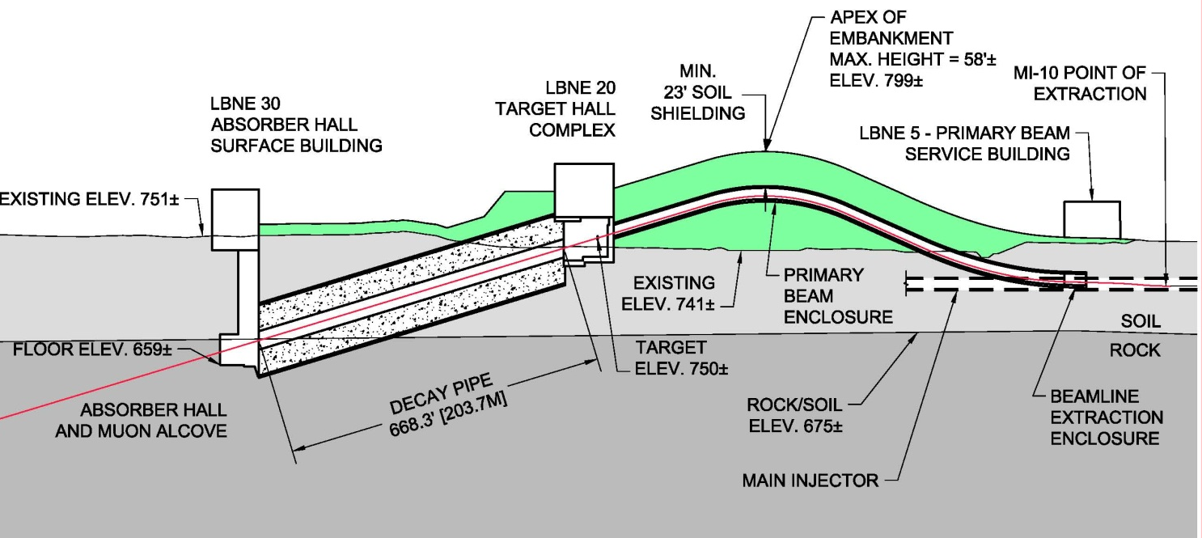
LBNE Beamline
NEAR DETECTOR
Kirk Rd
Main Injector
Main Injector
60 ≤ E_{beam} ≤ 120 GeV
700 kW initially, upgradeable 2.3 MW
designed for 30 years lifetime

Slide 15
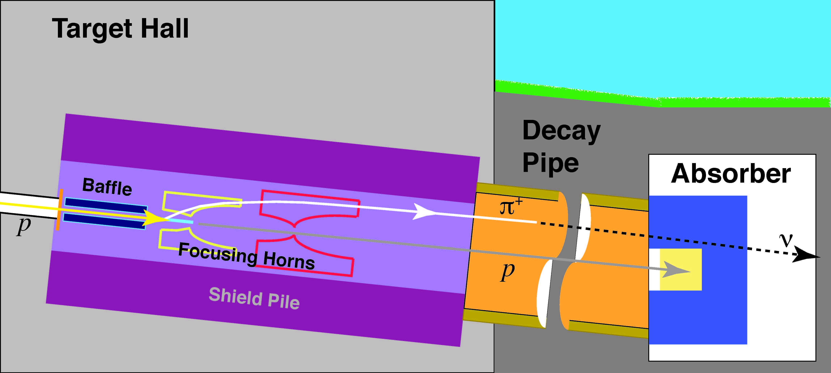
Components of the Neutrino Beamline
The neutrino spectrum is determined by the geometry of the target, the focusing horns and the decay pipe geometry
Target
Air & water-cooled
Air-cooled
Water-cooled
Primary Beam Window
NuMI design Horns and NuMI-like low energy target for 700 kW operation
Conceptual design complete for 700 kW beam power

Slide 16
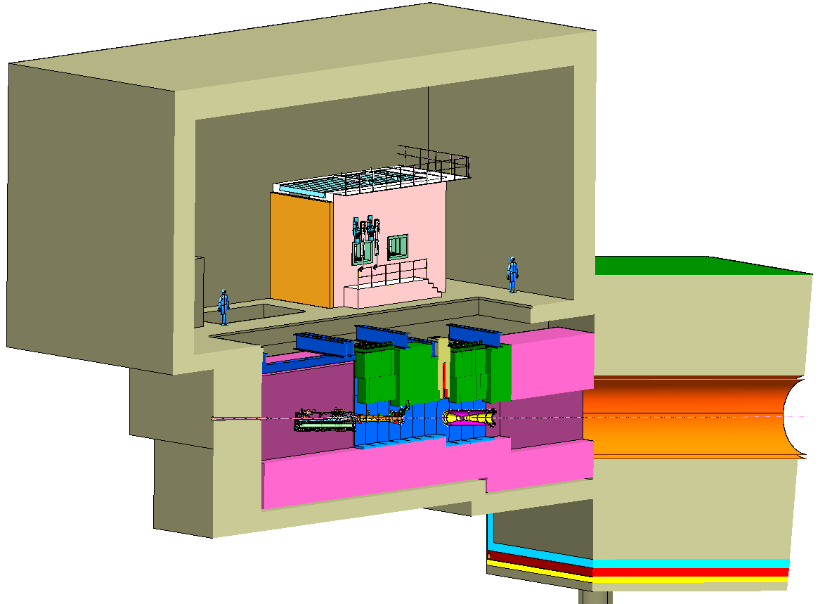
Target Hall/Decay Pipe Layout
Decay Pipe concrete
shielding (5.5 m)
Work Cell
Considering a 250 m long, helium-filled Decay Pipe
air-filled
4 m
204 m
steel
Geomembrane barrier system to keep groundwater out of decay region, target chase and absorber hall
Baffle/Target Carrier
Target Chase: 1.6 m/1.4 m wide, 24.3 m long

Slide 17
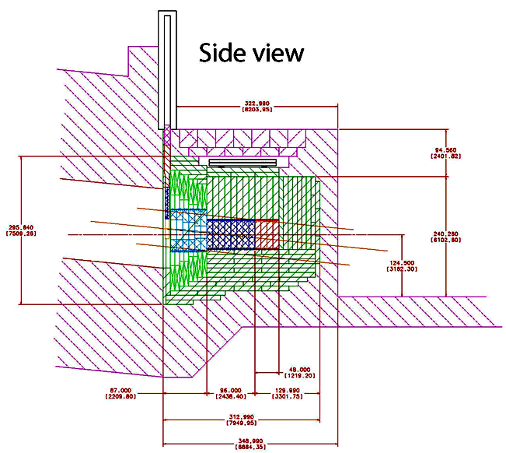
Beam Absorber
Designed for 2.3 MW
Al core blocks (60”x60”x12”)
Iron core blocks (60’x60”x12”)
Al pre-mask
Iron shielding blocks
Concrete
Core blocks are water-cooled
Absorber-core blocks will be instrumented with at least eight thermocouples, distributed
radially every 45 at a radius of approximately 400 mm

Slide 18
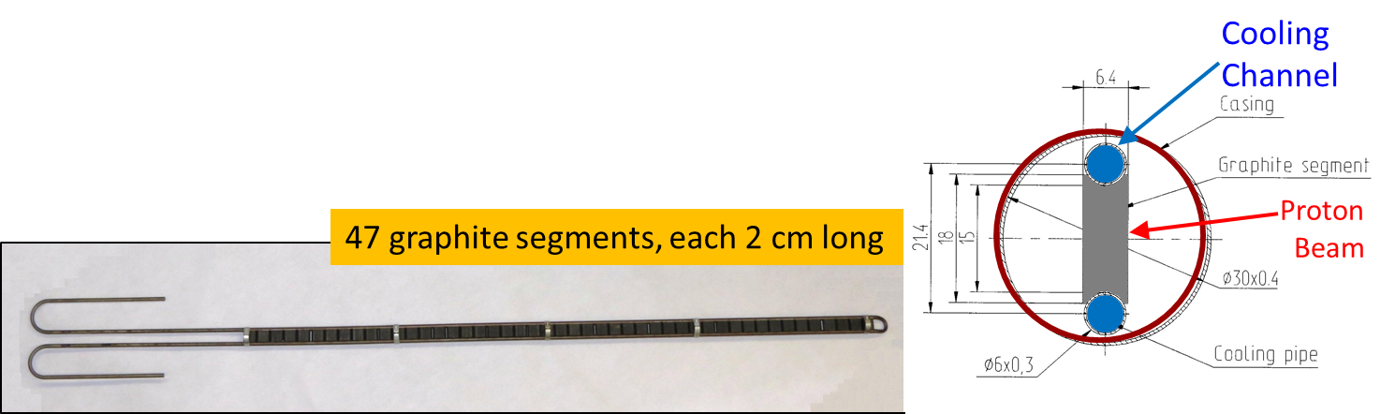
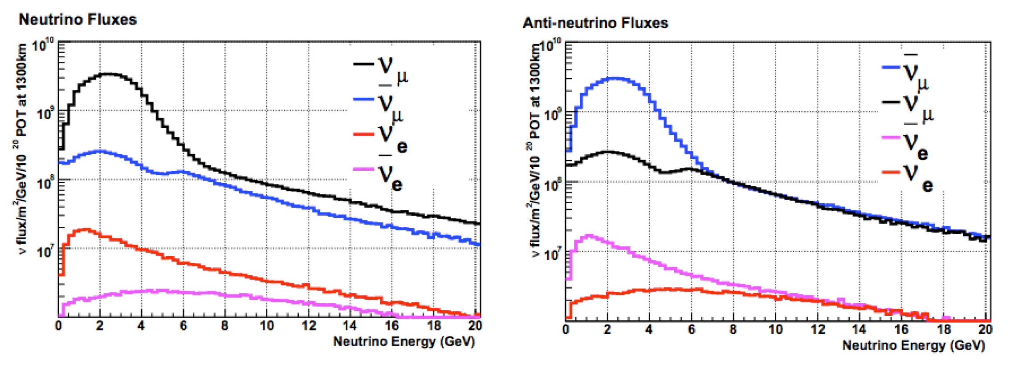
The Neutrino spectra
NuMI-like low energy target
  Cooling lines made from continuous titanium tubing instead of stainless steel with welded junctions
  Outer containment can be made out
  of beryllium alloy instead of aluminum
NuMI design horns, 204 m long decay pipe 4 m Ø

Slide 19
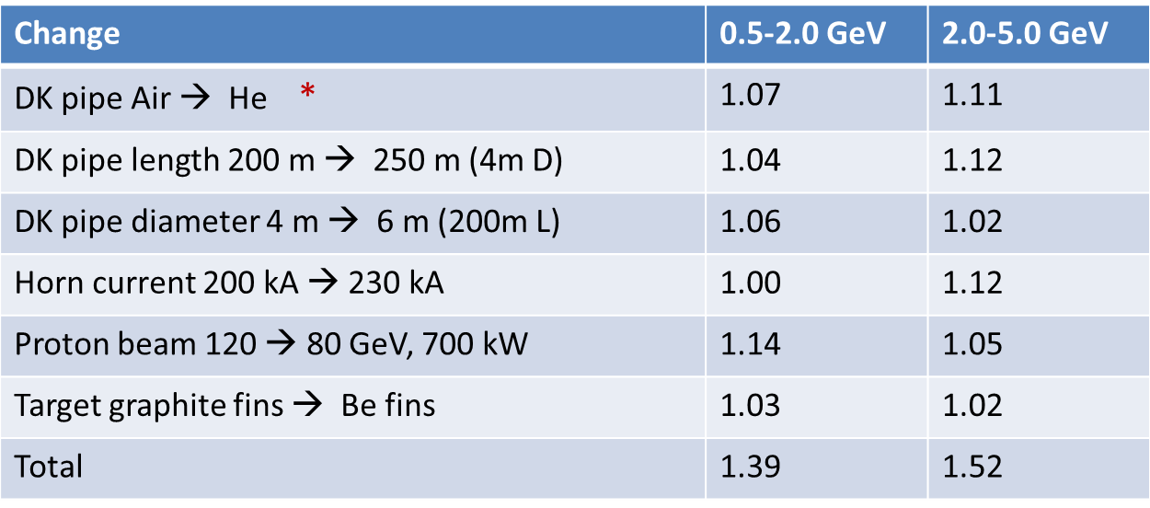
Design changes under consideration to improve the physics capabilities
“80 GeV beam”
Ratio of ν_{μ}→ν_{e} CC appearance rates at the far detector
* Simplifies the handling of systematics as well

Slide 20
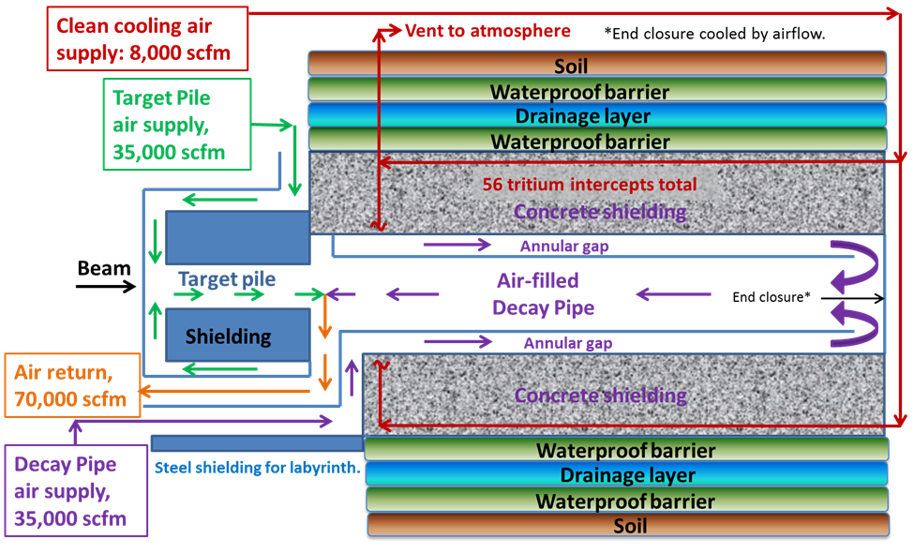
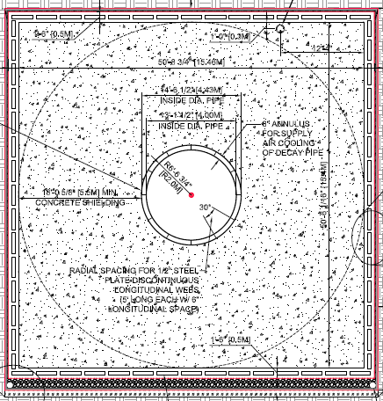
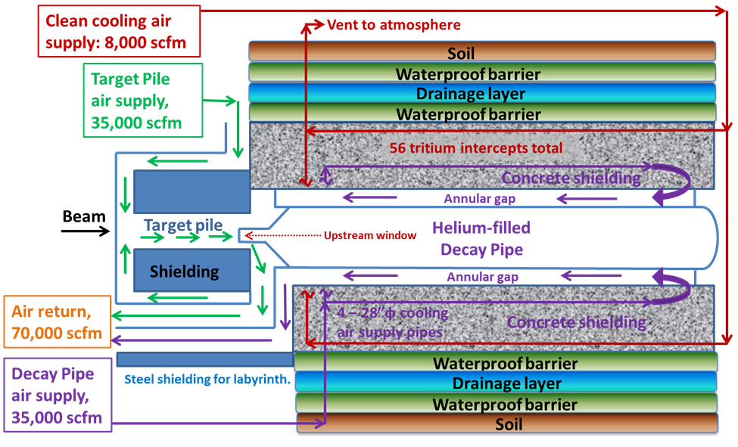
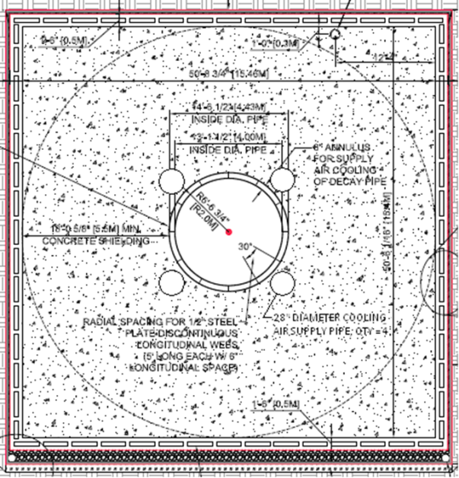
Decay pipe design options
Air filled/air cooled
He filled/air cooled

Slide 21
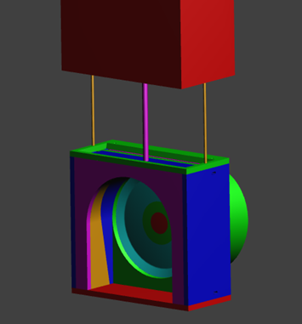
Upstream decay pipe window for helium-filled decay pipe
The design allows removal and replacement of the window given the harsh operating environment
Beryllium central disk electron beam welded to an aluminum transition region to fabricate a 1m-diameter window

Slide 22
Design strategy vs beam power
Designed for 2.3 MW at startup:
  the radiological shielding of enclosures
  beam absorber
  decay pipe cooling
  remote handling
  radioactive water system piping
What would have to be re-evaluated or replaced as beam power increases beyond 700 kW:
  Beam Profile Monitors in the Primary Beam
  Primary Beam Window, Baffle, Target, Horns and Target & Horn Instrumentation (Target and Horn alignment monitors and Hadron monitor) in Neutrino Beam
  Upstream Decay Pipe window if helium in Decay Pipe
R&D is needed beyond 700 kW for
  Primary beam window, target, horns, Hadron Monitor

Slide 23




High power target and windows R&D
RaDIATE
Collaboration
to generate new and useful materials data for application within the accelerator and fission/fusion communities
a first stage exploratory study is complete for Be, Tungsten and graphite
High Intensity Beam Single Pulse Test at CERN’s HiRadMat Facility
Planning to do single pulse beam tests on Be (and possibly other materials) for application to targets and beam windows

Slide 24
Additional neutrino programs
MINERvA
  NuMI near hall
  ν cross section measurements
MicroBooNE, 60 ton fiducial LAr TPC
  start data taking in spring 2014, located on the Booster Neutrino Beam
  will test some of the important design aspects of large LAr TPCs
  will address the MiniBooNE excess as electrons or photons seen in neutrino mode
LAr-1, proposal, arXiv:1309.7987
  addresses sterile neutrinos, located on the Booster Neutrino Beam
  a set of three detectors: LAr1-ND (40 ton fiducial) at 100 m, MicroBooNE at 470 m, LAr1-FD (1 kton fiducial) at 700 m
nuSTORM, proposal, Neutrinos from STORed Muons, arXiv:1308.6822
  electron and muon neutrinos from the decay of a stored muon beam
  will provide measurements of ν_{e} and ν_{μ} cross sections with percent-level precision
  allows searches for sterile neutrinos
  constitutes the first step in the development of muon accelerators

Slide 25
Summary
Upgrades to the accelerator complex and the NuMI beamline recently completed
  presently at ~280 kW, commissioning the Recycler ring, increasing beam power, 700 kW operation expected in 2015
Fermilab plans to reorient the Project X program to have a goal of delivering > 1 MW by 2025
A new long-baseline neutrino beamline is needed for the next generation neutrino oscillation experiment (LBNE) for unambiguous determination of the Mass Hierarchy and to possibly discover CP violation over a large range of CP violation δ
The LBNE Beamline conceptual design is complete for 700 kW beam power
  Additional design and R&D work is needed beyond 700 kW (beam windows, target, horns…)
Plenty of opportunities for international collaboration

Slide 26
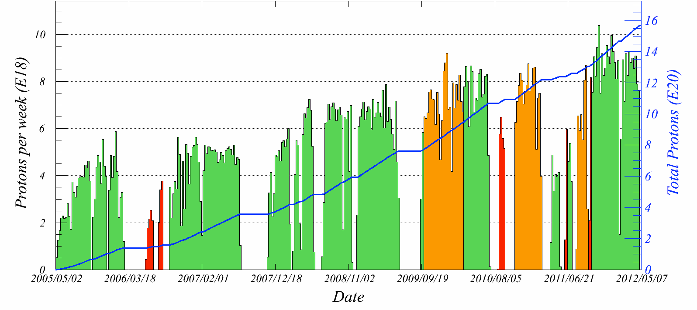
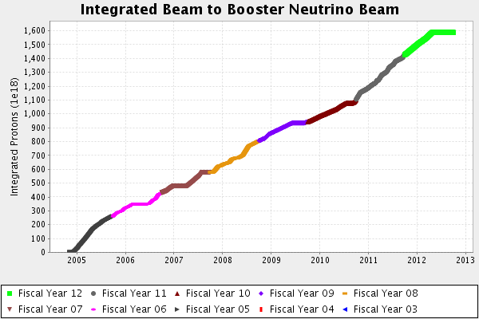
NuMI 2005-2012
1.56 × 10²¹ protons on target [POT]
Low energy neutrino mode
Special running conditions
Low energy antineutrino mode
BNB 2004-2012

Slide 27
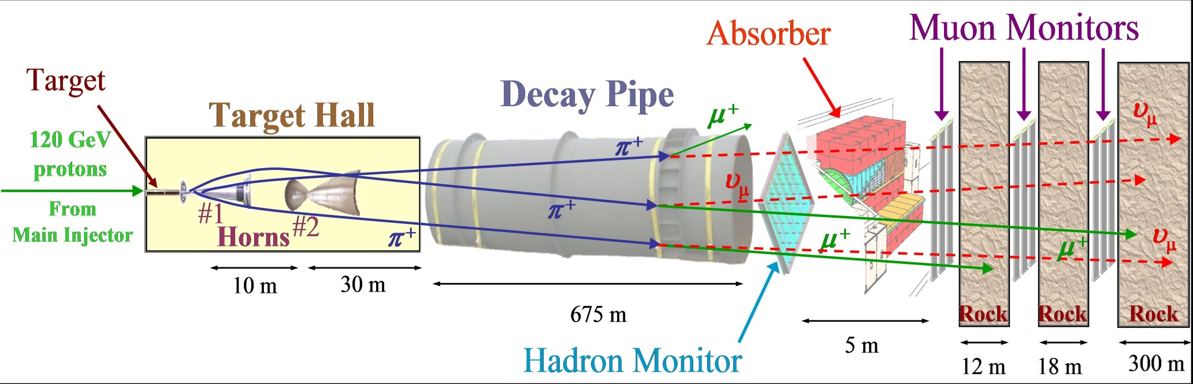
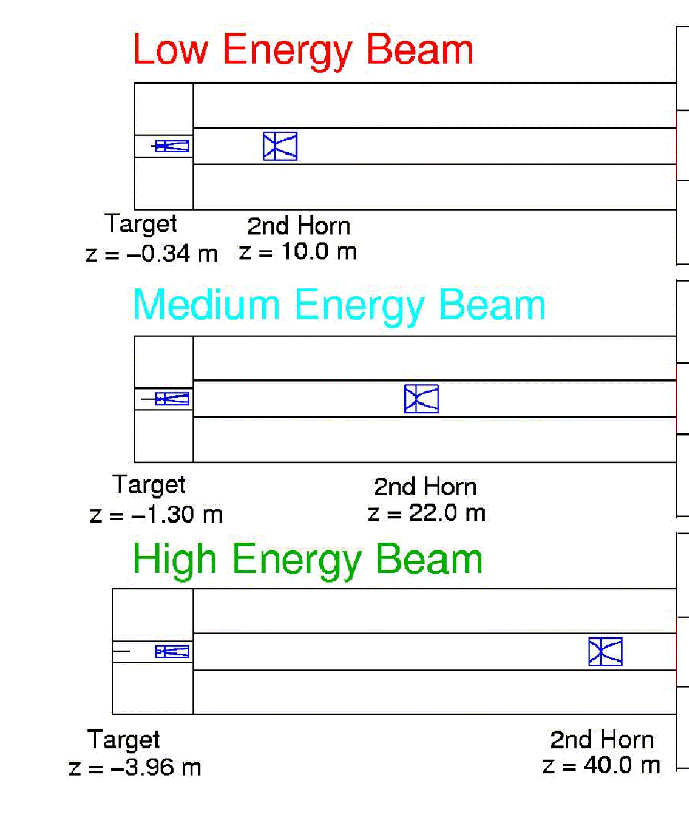
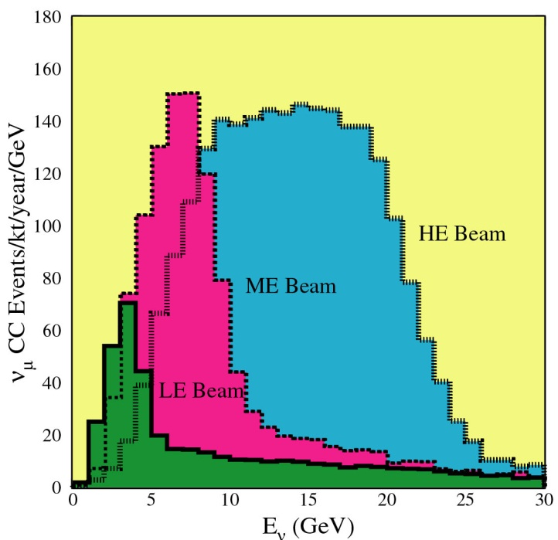
NuMI beamline

Slide 28
Accelerator upgrade plan
Main Injector (MI) is a rapid cycling accelerator at 120 GeV
  Booster batches injected into MI at 15 Hz
  MI is 7 times the circumference of the Booster
Using the Recycler to accumulate protons from the Booster while MI is accelerating, saves 0.4 s for each 6 Booster batches injected
Recycler momentum aperture large enough to allow slip-stacking operation in Recycler, for up to 12 Booster batches injected
  6 batches are slipped with respect to the other 6 and, at the time they line up, they are extracted to MI in a single turn and there re-captured and accelerated
  MI will run at its design acceleration rate of 240 GeV/s (1.333 s cycle time)
  4.3×10¹² p/batch, 95% slip-stacking efficiency
  4.9×10¹³ ppp at 120 GeV every 1.333 s ⇒ 700 kW
New Recycler injection line, new transfer lines MI-Recycler, new 53 MHz RF system & instrumentation in Recycler, 2 additional RF stations in MI
Proton Source improvements

Slide 29
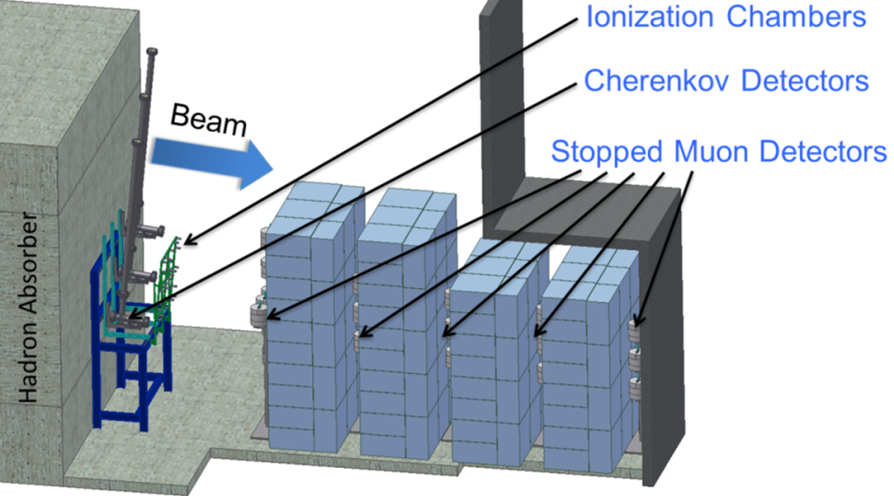
Muon Monitor System

Slide 30
Baseline Optimization
Mary Bishai
Matter
effect
only
CP
asymmetry
in vacuum
Large sensitivity to MH at the 1st oscillation maximum
Large CP violation effects at the 2nd oscillation maximum
2nd oscillation maximum must be in an accessible energy range
Optimum is achieved when the asymmetry due to the matter effect is larger than the largest CP effect, but does not saturate the total asymmetry

Slide 31
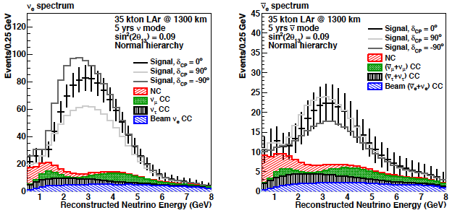
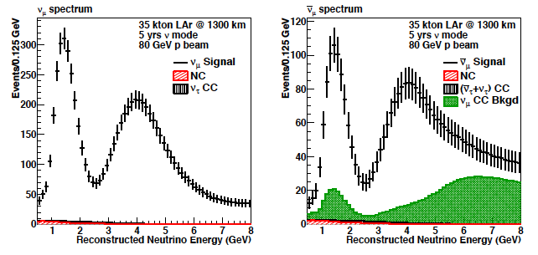
LBNE 35 kt Far Detector Spectra
Appearance
180 evts
(272 IH)
750evts
(330 IH)
ν (5 yrs)
ν (5 yrs)
Disappearance
w/o osc: 20,000
w/ osc:
7,000
w/o osc: 6,700
w/ osc: 2,200

Slide 32
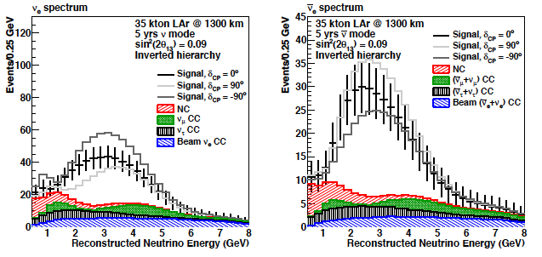
LBNE Spectra-Mass Hierarchy
Normal
180 evts
750 evts
Difference due to mass ordering
Inverted
272 evts
330 evts
Notes:
Spectra from 2010/11 PWG report w/ sin2theta13=0.1, later slides show sensitivities from improved 80 GeV beam and latest osc.params.

Slide 33
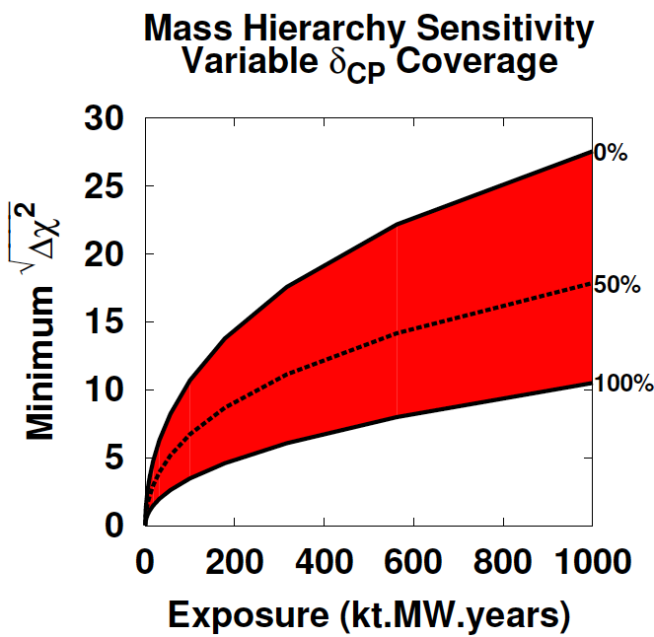
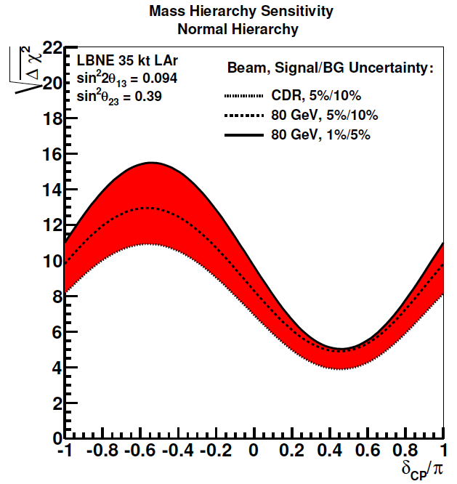
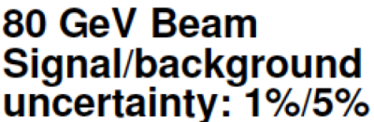
Sensitivity to Mass Hierarchy
Exposure 245 kt.MW.yr
(700 kW x (5ν+5ν) yr
or 1.2 MW x (3ν+3ν) yr
Normal Hierarchy
Band is range of beam and
systematics assumptions
100%

Slide 34
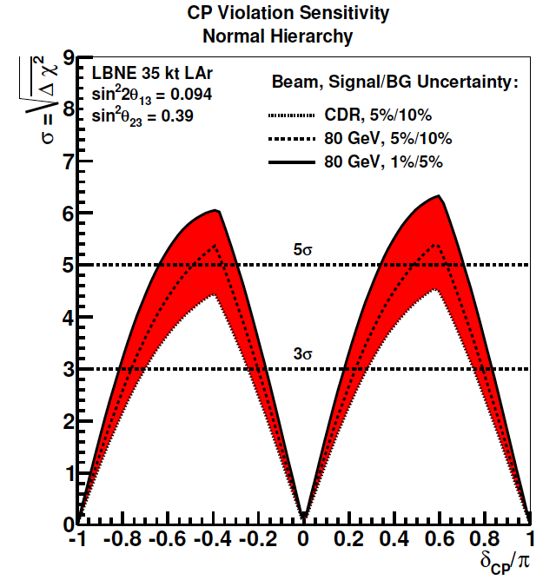
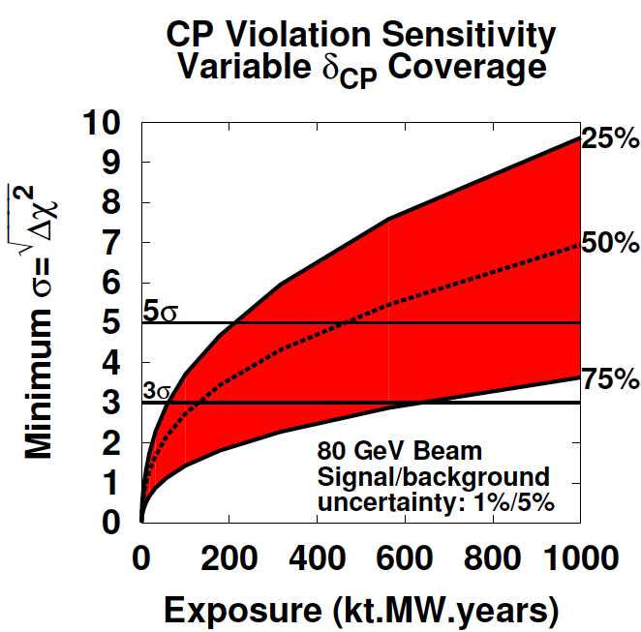
Sensitivity to CP violation
Exposure 245 kt.MW.yr
CP Violation Sensitivity
Normal Hierarchy
64%

