Slide 1
Future Neutrino Beam in J-PARC
Tetsuro Sekiguchi
IPNS, KEK

Slide 2
Contents
Introduction
Upgrade Plan of J-PARC accelerator
Upgrade Plan of Neutrino Facility
Summary

Slide 3
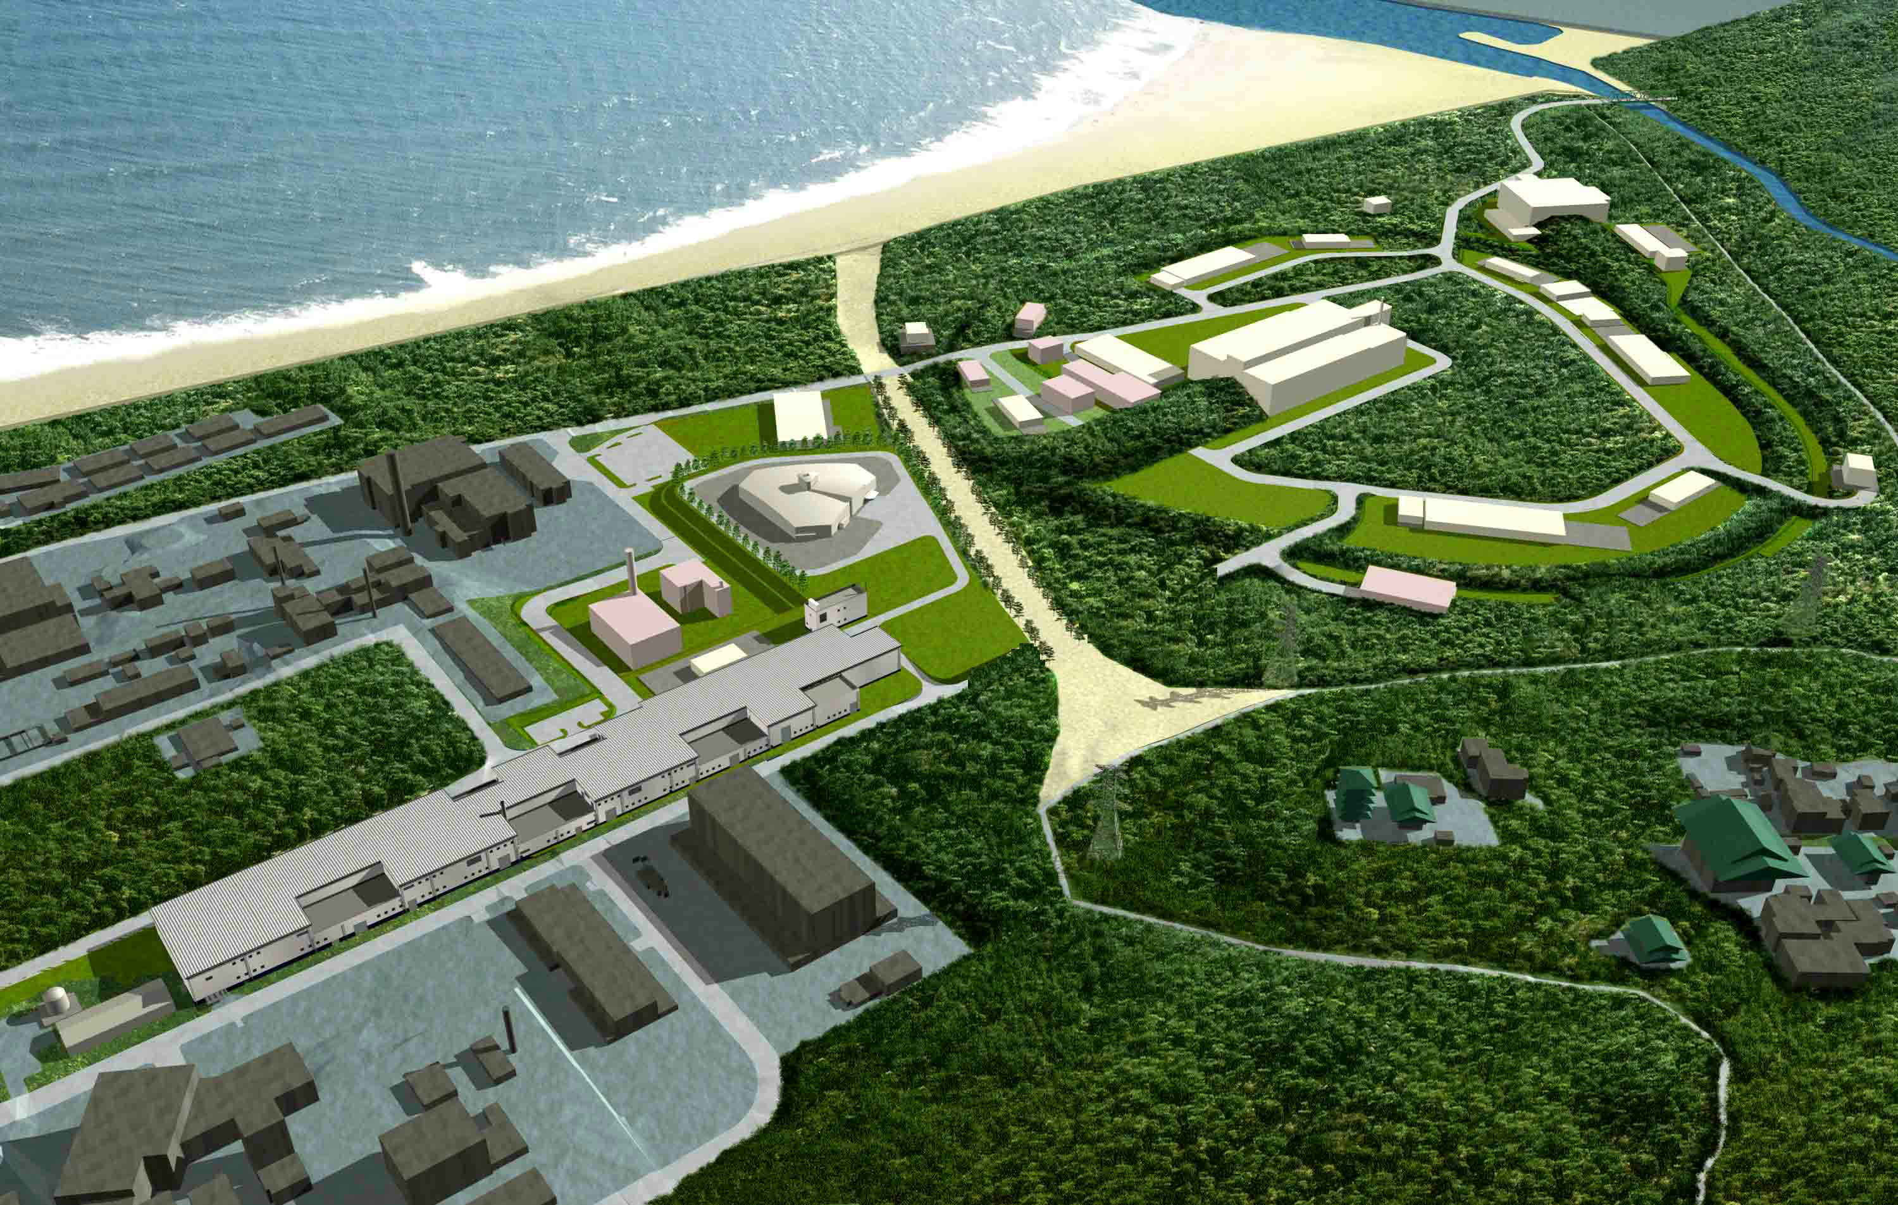
J-PARC
Materials and Life Science
Experimental Facility (MLF)
Hadron Experimental Facility
500 m
Neutrino Experimental
Facility
Rapid Cycle Synchrotron (RCS)
(3 GeV synchrotron)
(25 Hz, 1MW)
Main Ring (MR)
(30 GeV synchrotron)
(0.75MW)
Linac
(330m)

Slide 4
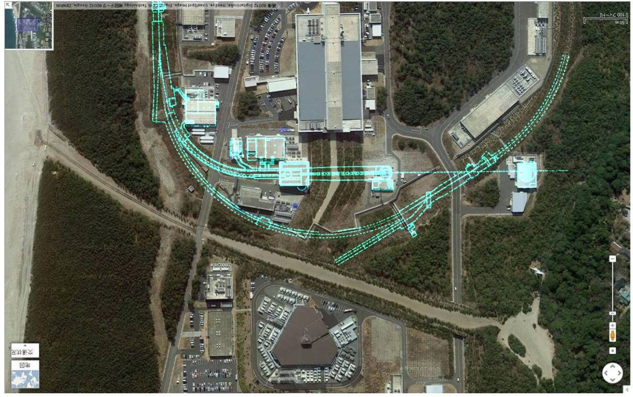
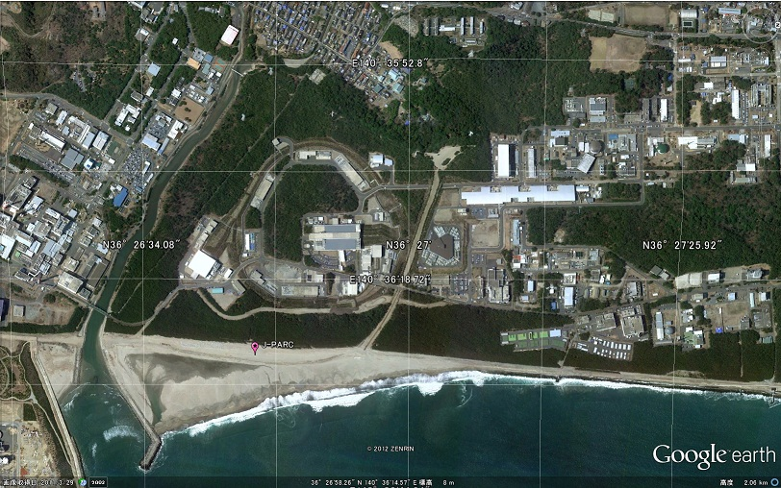
Neutrino Facility
Beam
Dump
Near Neutrino
Detectors
Decay
Volume
Muon
Monitors
Target
Horns
ν
μ
π
Main
P
295km
To Kamioka
Ring
Primary
Beam-line
110m
280m
Extraction
Point

Slide 5
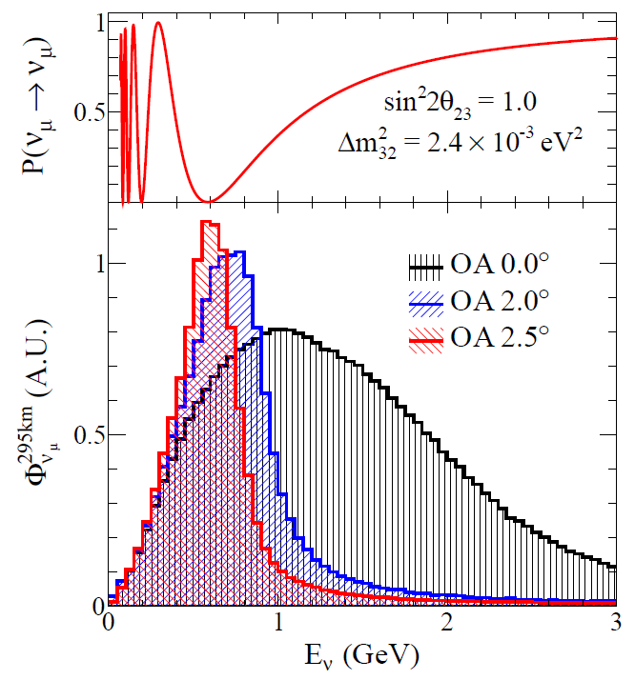
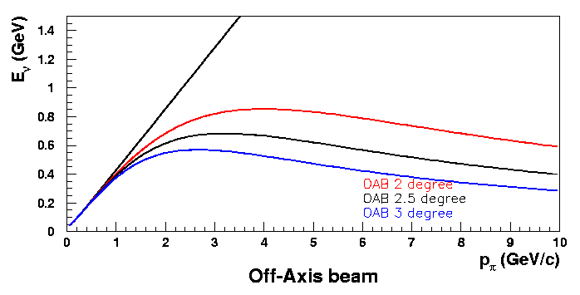
Neutrino Beamline
Conventional neutrino beam
  p + C → π⁺ → μ⁺ + ν_{μ}
Designed for T2K experiment
  High intensity beam
    750kW proton beam (30 GeV, 3.3x10¹⁴ protons/pulse)
  Off-axis beam (2~2.5º)
    Narrow band beam ~ 0.6 GeV
      1st oscillation maximum
SK
Horns
Decay Pipe
θ
Target
Oscillation
Maximum
π⁺ -> μ⁺ + ν_{μ} decay

Slide 6
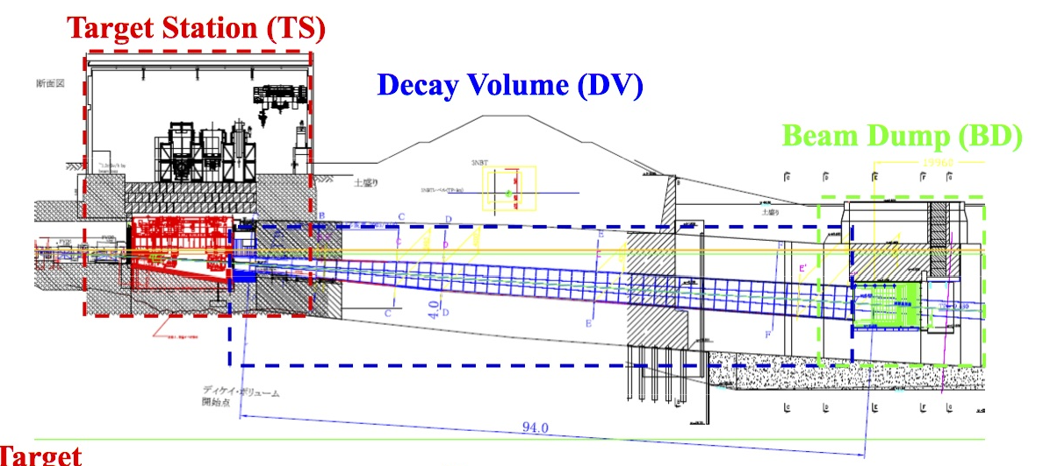
Secondary Beamline
a
Target Station (target and horns inside He vessel)
Decay volume
Beam dump

Slide 7
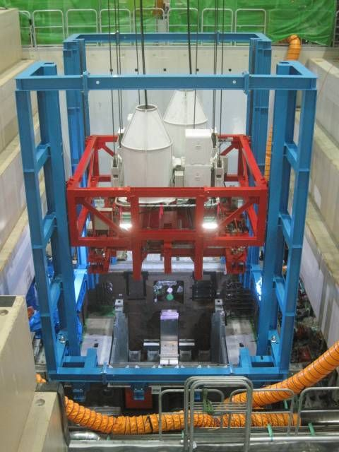
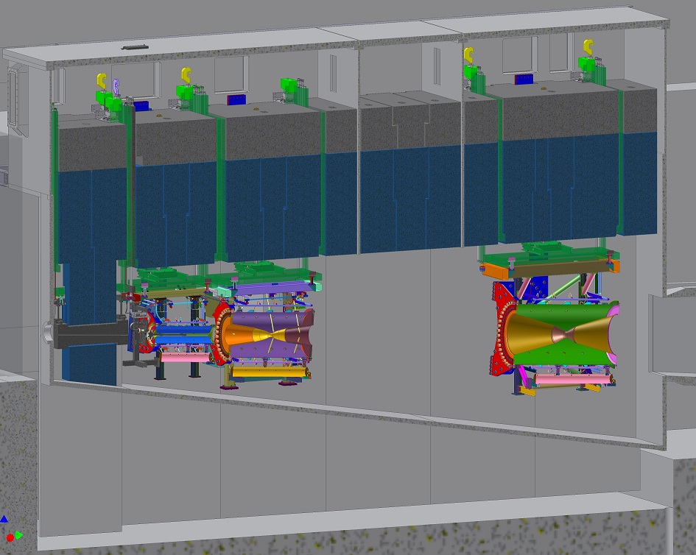

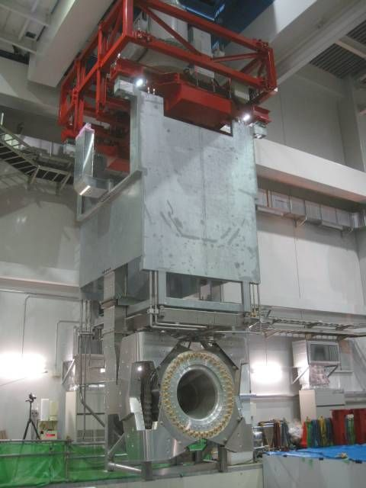
Target Station
Large flange, sealed with
Al plates, t= 120mm
Service Pit
Beam window
Ti-alloy
Horn-3
Horn-1
Horn-2
10.6m
Beam
Baffle
Graphite
Collimator
OTR
Target
DV
collimator
15.0m
3 horns / a baffle are placed inside He vessel
Apparatus on the beam-line highly irradiated after beam.
Handled by remote-controlled crane.

Slide 8
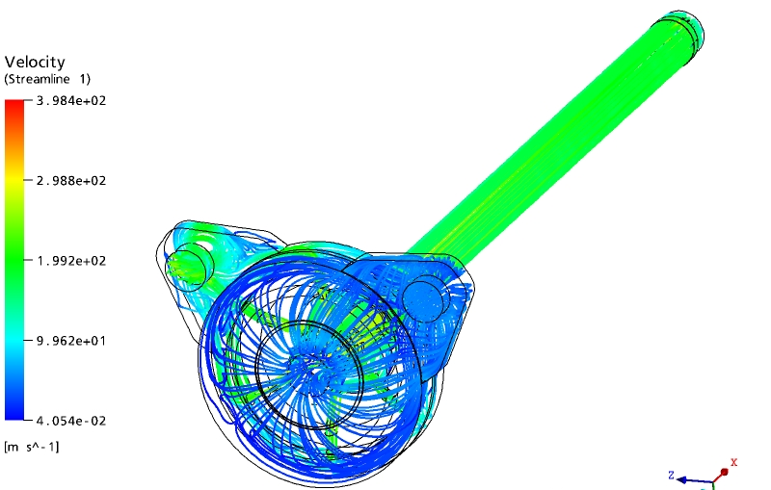
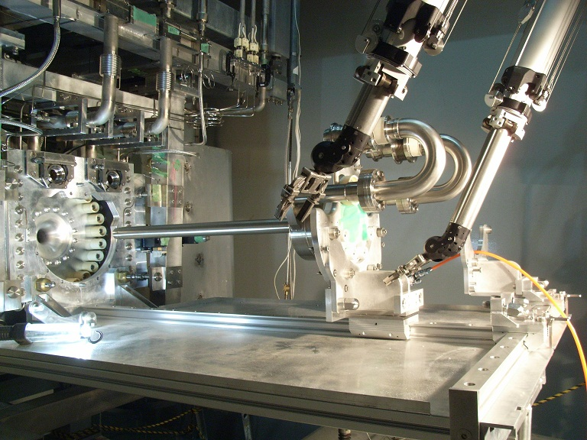
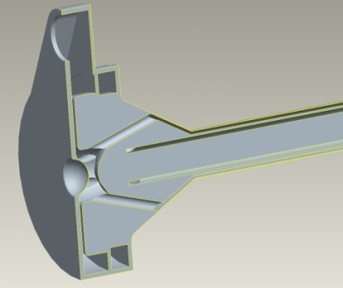
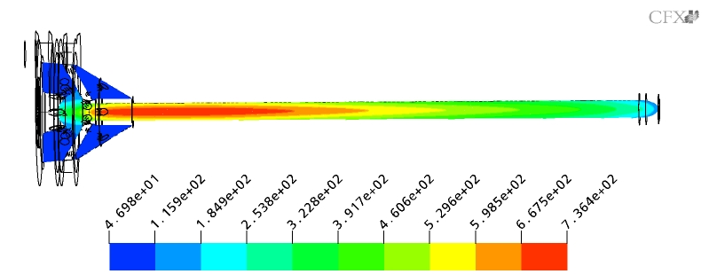
Target
26mmφ x 910mm
CFX analyses
Graphite
IG-430U
9Nm³/min
(v=200m/s)
Ti-6Al-4V
(0.3mmT)
He-gas cooling
30GeV-750kW (~20kW heat load)
Conductivity 140→20W/mK(rad. damage)
736ºC
Remote maintenance
ΔT~200K ~7MPa (Tensile strength 37MPa)

Slide 9
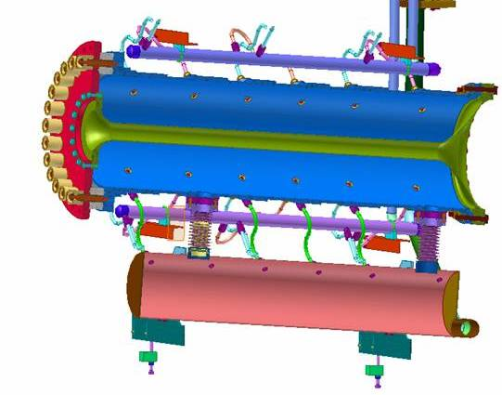
Magnetic Horns
Aluminum alloy conductor (A6061-T6)
  Double cylinder (inner: t3mm, outer: t10mm)
  Tensile strength: 310MPa → 95MPa after 5x10⁸ cycle
  25MPa allowable stress (taking into account corrosion)
  Safety factor ~ 2
320kA pulsed current (rated)
  2.1 T (max.) toroidal field
  2~3ms pulse width
  0.4Hz rep. rate → 1 Hz for 750kW
Water cooled
  Total heat load: 25kJ @ 750kW
    15kJ (beam) + 10kJ (Joule)
  Spraying water to inner conductor

Slide 10
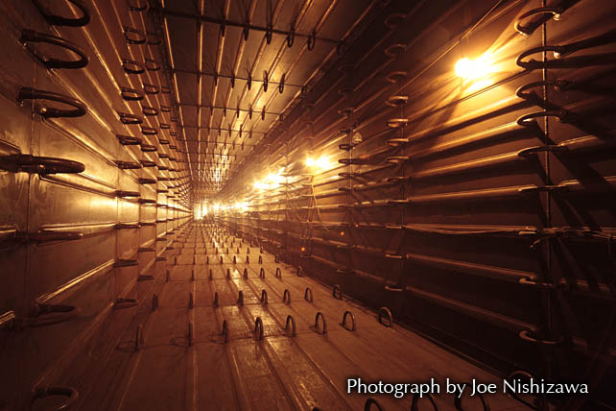
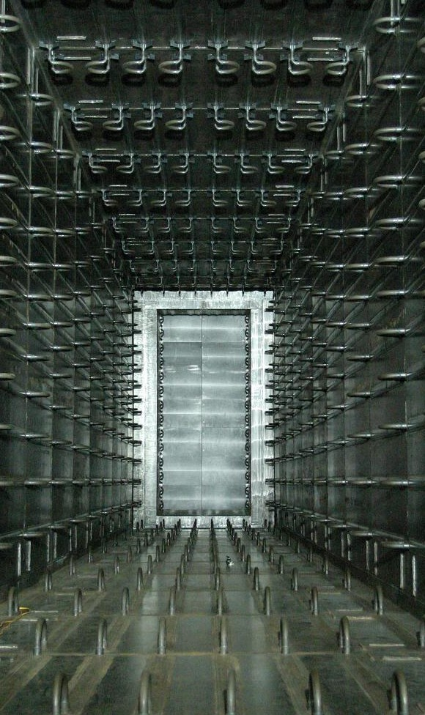
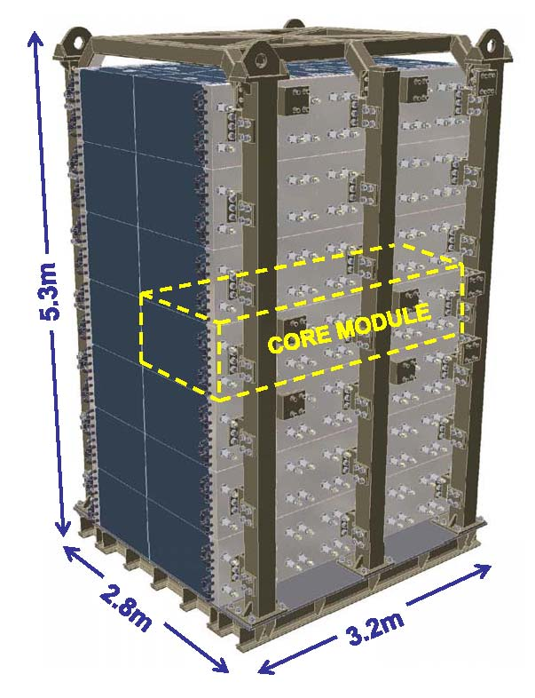
Decay Volume & Beam Dump
Decay Volume
  100m-long
  Water cooled iron walls ➔ 4MW
  2~2.5º OA angle for SK and HK
Beam Dump
  Graphite core
  Water cooled ➔ 3MW
Designed for multi-MW beam since no access is possible after beam operation due to irradiation

Slide 11
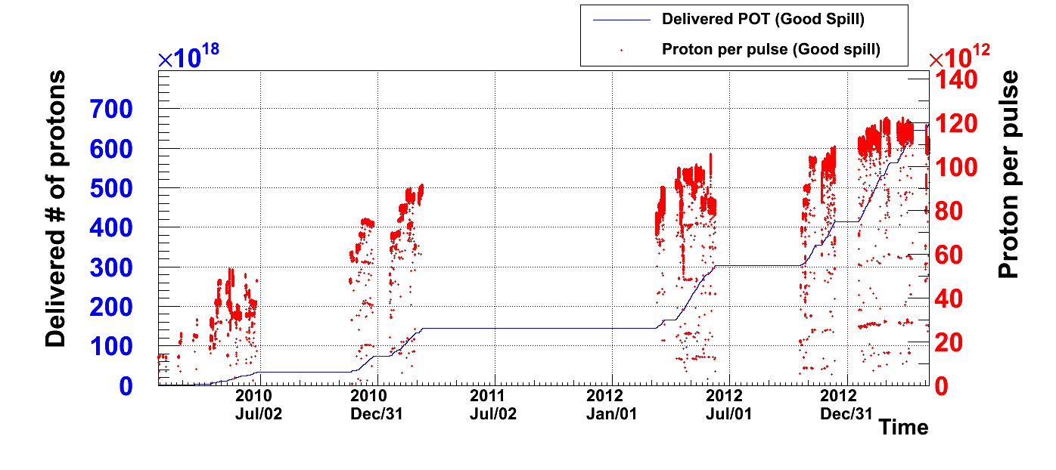
Operation History
Rep=3.52s
→50kW
[6 bunches]
3.2s→3.04s
→145kW
2.56s
→190kW
2.48s
→235kW
x10¹⁹
6.63x10²⁰pot
^{until} May.8,’13
x10¹²
70
120
3.01x10²⁰pot
Jun.9,’12
60
1.43x10²⁰pot
^{until} Mar.11,’11
100
50
Protons Per Pulse
80
40
Delivered # of Protons
Mar.8, 2012
60
30
20
40
10
20
Run-1
Run-2
Run-3
Run-4
0
0
Total # of pulses
2.2x10⁶
4.7x10⁶
7.7x10⁶
1.2x10⁷
1.2x10¹⁴ ppp: world record of extracted protons/pulse for synchrotron
No replacement of target and horns up to 1.2x10⁷ pulses

Slide 12
Contents
Introduction
Upgrade Plan of J-PARC accelerator
Upgrade Plan of Neutrino Facility
Summary

Slide 13
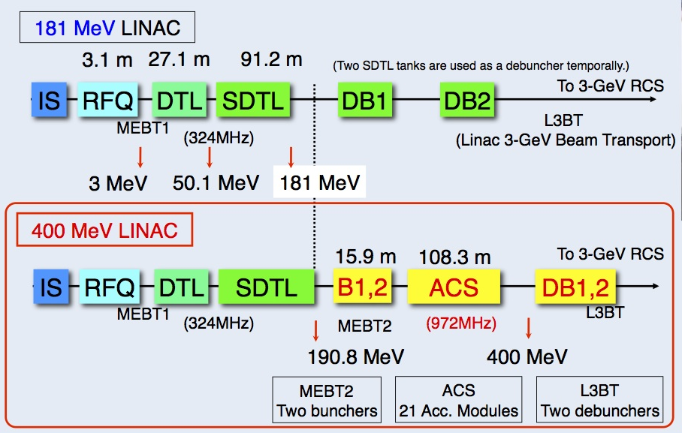
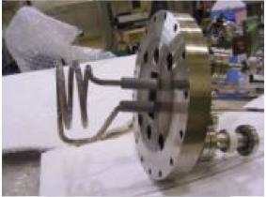
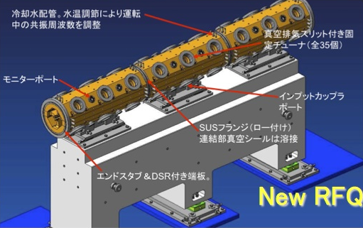
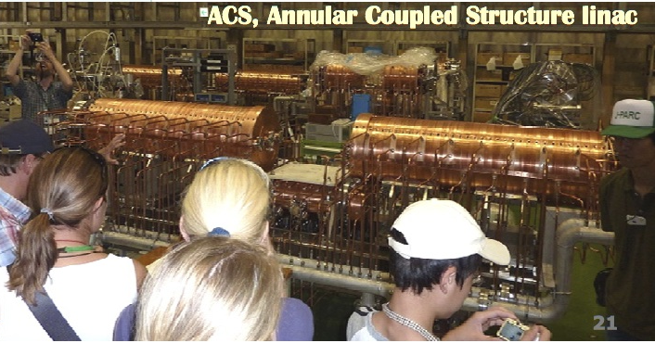
Linac Upgrade
New accelerating structure, ACS, will be installed to increase the extracted beam energy from 181MeV to 400MeV (JFY2013)
Front-end part (IS+RFQ) will be replaced to increase peak current from 30mA to 50mA (JFY2014)
RF antenna
Collab. w/ SNS

Slide 14
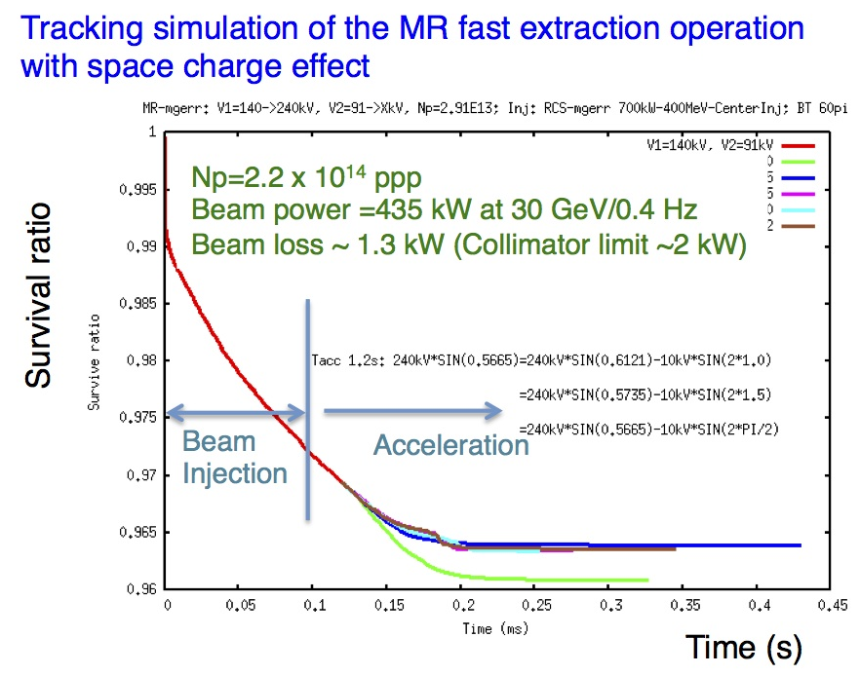
MR Upgrade
Number of protons/pulse is limited by beam loss due to space charge effect
  ~450kW is estimated upper limit with current apparatus.
To achieve 750kW
  Higher beam energy than 30GeV
    Too high power consumption P_{50GeV}=4xP_{30GeV}
  Higher rep. rate than 0.4Hz
    1.3sec cycle with 2.0x10¹⁴ protons/pulse
We choose higher rep. rate scenario for 750kW

Slide 15
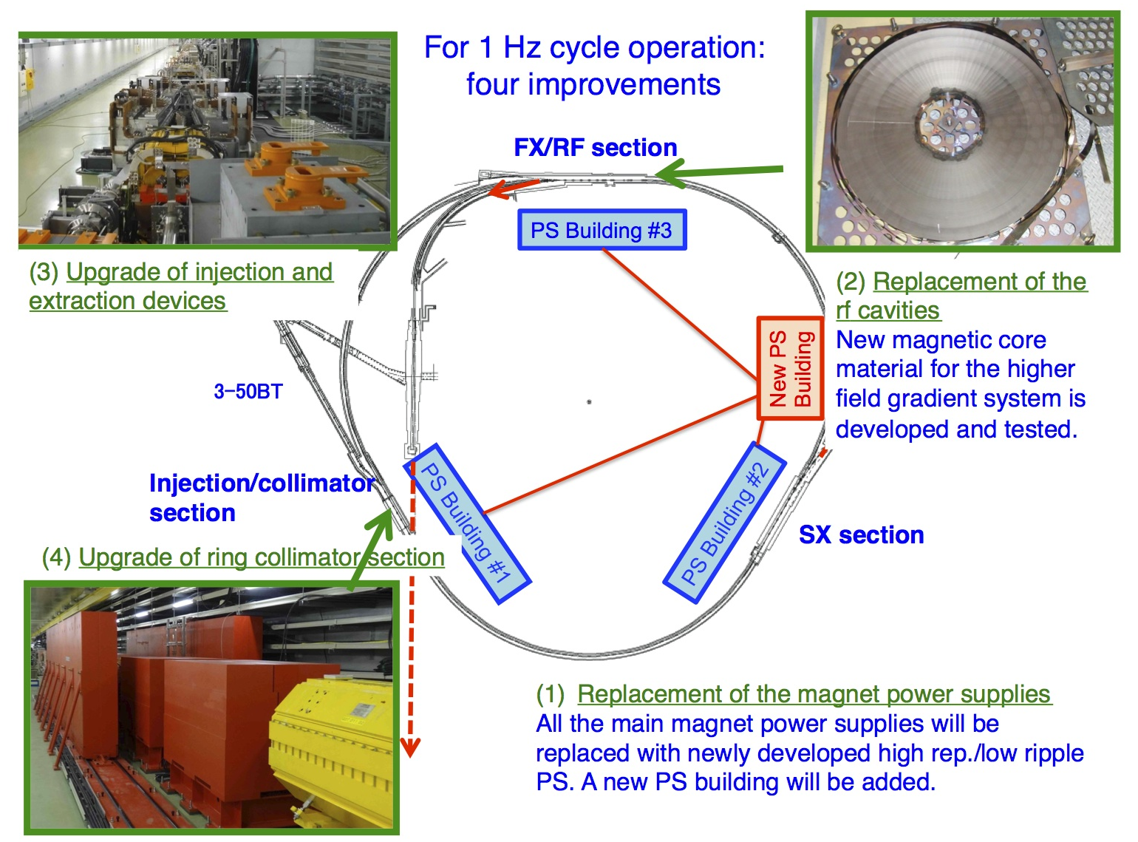
MR Upgrade
2kW → 3.5kW

Slide 16
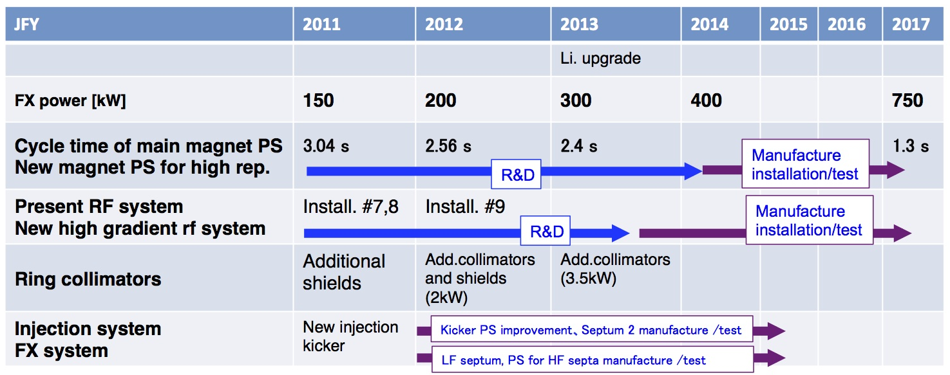
MR Upgrade Timeline
750kW
400kW
300kW
200kW
150kW

Slide 17
Contents
Introduction
Upgrade Plan of J-PARC accelerator
Upgrade Plan of Neutrino Facility
Summary

Slide 18
Acceptable Beam Power
Acceptance of each component for high power beam
  Target
    Mechanical: 0.75MW
    Cooling: 0.75MW
  Horn
    Cooling for conductors: 1.85MW
    Cooling for striplines: 0.4MW
    Hydrogen production: 0.3MW
    Power supply: 0.4Hz, 250kA
  He vessel, Decay Volume & Beam Dump
    Cooling: 4MW(HV&DV), 3MW(BD)
  Facility
    Water disposal: 0.5MW
    Radio-active air: 0.5MW

Slide 19
Hydrogen Production in Horn
H₂ production by water radiolysis (2H₂O→2H₂+O₂)
  H₂ production rate: 40L/day (0.7%/day) @750kW
  H₂ must be removed. → H₂ recombination (2H₂+O₂→2H₂O)
Service Pit
Machine Room
He gas line
He
He vessel
H₂O
Pump
Suction pump
Buffer tank
Beam
H₂
Height
~8m

Slide 20
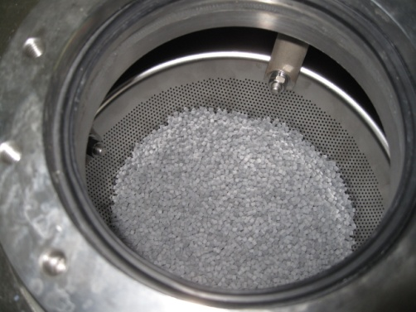
Hydrogen Production in Horn
H₂ recombination + forced circulation outside He vessel
  H₂ density after 1 week 220kW beam
    1.6% near horn, 1.0% in tank
      ~1.5% expected w/o recomb.→ H₂ inside horn not removed.
    Forced circulation inside horn is really necessary.
Service Pit
Machine Room
He gas line
Catalyst canister
(Catalyst = Alumina pellet with 0.5%Pd )
H₂: 1.6%
O₂: 0.7%
He
H₂: 1.0%
O₂: 0.03%
diffusion
H₂O
He vessel
Pump
Suction pump
Buffer tank
Beam
H₂
Height
~8m
Acceptable beam power
~300kW

Slide 21
Hydrogen Production in Horn
Forced circulation inside horns
  New horns have forced circulation lines
    H₂ density will be below 1% even with higher power beam
    New horn will be installed in FY2013
Service Pit
Machine Room
He gas line
He
He vessel
H₂O
Forced circulation
Pump
Suction pump
Buffer tank
Beam
H₂
Height
~8m
Acceptable beam power should be checked with beam

Slide 22
Horn Power Supply
@ 250 kA, 0.4Hz
@ 320 kA, 1Hz
PS(New)
PS (K2K)
PS (New)
PS(New)
PS (New)
4.1 kV
5.5 kV
5.8 kV
5.5 kV
4.3 kV
New power supply production for 1Hz operation,
  Designed for 320kA operation
  Energy recovery (~50% of stored energy recycled)
  Low input load
    One horn is operated with a power supply
    Low impedance striplines are also developed
Production is on going → Operation from fall in 2014.

Slide 23
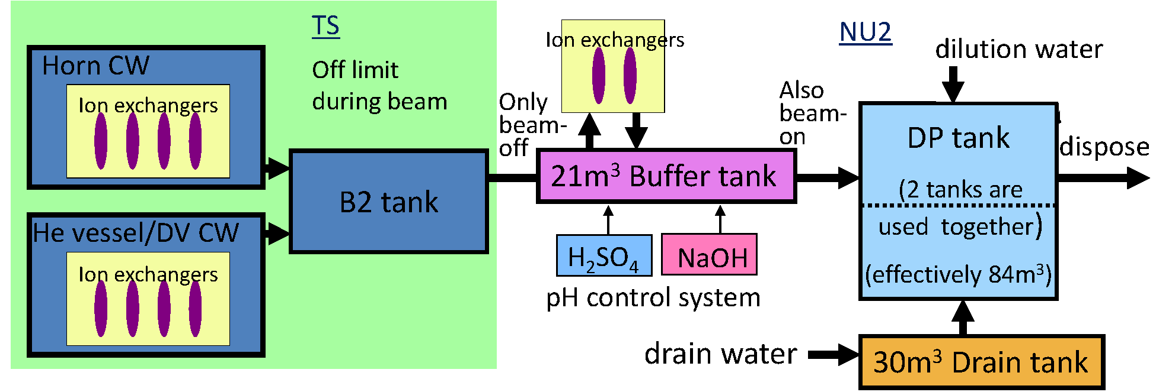
Disposal of Radio-active Water
Remove
99.9 % of ⁷Be
Regulation
Be7 < 30Bq/cc
H3 < 42Bq/cc
80times
/year
No access during beam
Accessible during beam
Maintenance scenario
  Be7: 53GBq/10²⁰pot → removed by ion-exchanger (99.9%)
  Tritium: 24GBq/10²⁰pot → dilution & disposal
Present capacity
  80 dilution cycles/year (3 working days/cycle)
  Acceptable beam power is ~500kW

Slide 24
Disposal of Radio-active Water
Remove
99.9 % of ⁷Be
Regulation
Be7 < 30Bq/cc
H3 < 42Bq/cc
80times
/year
No access during beam
Accessible during beam
New facility building
New DP tank 240m³
Upgrade of water disposal system
  New building for water disposal system is planned.
  240m³ DP tank (320m³ in total) → 2MW acceptable

Slide 25
Radio-active Air
Chimney stack
Short-lifetime radio-activity like Ar41(τ~2h) produced in underground area
Exhaust system
Ground floor
Radiation monitor
for exhaust air
Concrete shields
Building
Service pit
Helium compressor
Helium compressor
Target
Cooling water system
Horns
Storage area
Cooling water system
Helium vessel
Machine room

Slide 26
Radio-active Air
Chimney stack
Go out through exhaust line
Leakage of radioactive air
from underground area
through gaps
Exhaust system
Ground floor
Regulation by law:
< 0.5 mBq/cc
Radiation monitor
for exhaust air
Concrete shields
Building
Service pit
Helium compressor
Helium compressor
Target
Cooling water system
Horns
Storage area
Cooling water system
Helium vessel
Machine room

Slide 27
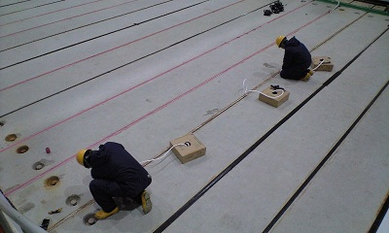
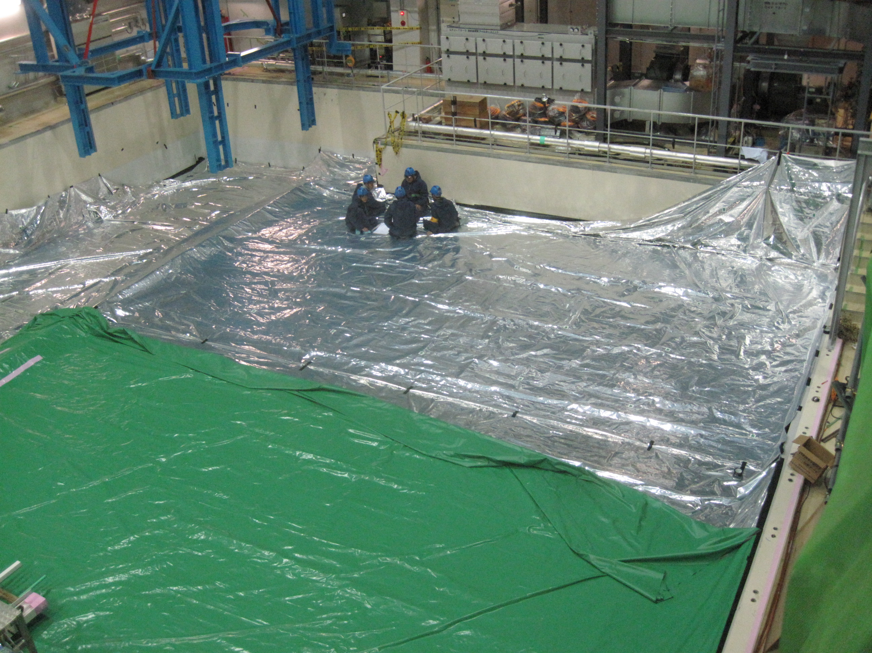
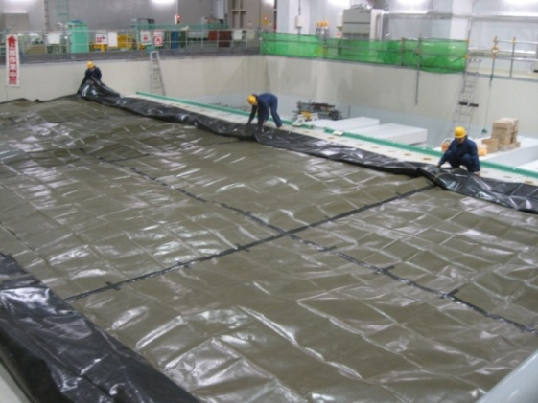
Air Tightness Improvement
Caulking between concrete shields
Lay the air-tight sheet
Air-tight sheet
(made of the same material for balloon)
Protection sheet
(over air-tight sheet)
Lay the protection sheet under air-tight sheet

Slide 28
Radio-active Air
Chimney stack
Go out through exhaust line
Leak rate reduced, but leakage happens
through the edge of sheet.
Exhaust system
Ground floor
Caulking + Air-tight sheet
Regulation by law:
< 0.5 mBq/cc
Radiation monitor
for exhaust air
Concrete shields
Building
Service pit
Now :
~0.2 mBq/cc
@ 230kW
Helium compressor
Helium compressor
Target
Acceptable beam power
~500kW
Storage area
Cooling water system
Horns
Cooling water system
Helium vessel
Machine room

Slide 29
Radio-active Air
Chimney stack
Go out through exhaust line
Add air-tight lamination (made of steel and air-tight material) under concrete shields
Exhaust system
Ground floor
Caulking + Air-tight sheet
Regulation by law:
< 0.5 mBq/cc
Radiation monitor
for exhaust air
Concrete shields
Building
Service pit
Helium compressor
Acceptable beam power > 1MW
(should be confirmed with actual setup)
Helium compressor
Target
Cooling water system
Horns
Storage area
Cooling water system
Helium vessel
Machine room

Slide 30
Acceptable Beam Power
Acceptance of each component for high power beam
  Target
    Mechanical: 0.75MW
    Cooling: 0.75MW
  Horn
    Cooling for conductors: 1.85MW
    Cooling for striplines: 0.4MW → 0.75MW (2014~)
    Hydrogen production: 0.3MW → > 1MW (2014~)
    Power supply: 0.4Hz, 250kA → 1Hz, 320kA (2014~)
  He vessel, Decay Volume & Beam Dump
    Cooling: 4MW(HV&DV), 3MW(BD)
  Facility
    Water disposal: 0.5MW → 2MW (2016 or 2017~)
    Radio-active air: 0.5MW → > 1MW (2014~)
Graphite material is supposed to withstand up to ~1.5MW, when optimization of design including beam size, horn shape, cooling, etc is done.

Slide 31
Summary
J-PARC neutrino beamline is designed for 750kW beam
J-PARC accelerator aims to achieve 750kW beam with 1Hz operation.
There are some devices which limit acceptable beam power.
Several upgrades are planed to accept 750kW beam.

