Slide 1
OPERA RESULTS
N. Naganawa (Nagoya University)
on behalf of the OPERA Collaboration

Slide 2




The OPERA Collaboration
OPERA collaboration
Belgium
ULB Brussels
Italy
Bari
Bologna
LNF Frascati
L’Aquila
LNGS
Naples
Padova
Rome
Salerno
Korea
Jinju
Croatia
IRB Zagreb
Russia
INR RAS Moscow
LPI RAS Moscow
ITEP Moscow
SINP MSU Moscow
JINR Dubna
France
LAPP Annecy
IPHC Strasbourg
Switzerland
Bern
Japan
Aichi edu.
Kobe
Nagoya
Toho
Nihon
Germany
Hamburg
Israel
Technion Haifa
Turkey
METU Ankara
（11 countries、28Institutes、~140 researchers）

Slide 3
Aim
Provide a clear evidence to neutrino oscillation
through detection of appeared ν_{τ} from ν_{μ} → ν_{τ}
oscillation.

Slide 4
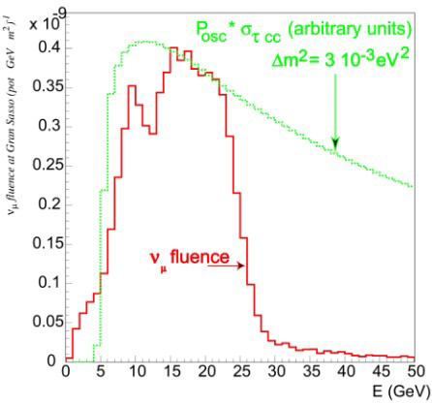
Detect ν_{τ} appearance in long baseline
ν_{μ} beam
ν_{μ}
CERN SPS
The beam optimized for ν _{τ} appearance in the atmospheric oscillation region
Δm₂₃² = (2.43±0.13)×10⁻³ eV²
sin²2θ₂₃ = 1.0
17 GeV
ν_{τ}
730km
Appearance
Gran Sasso Underground Laboratory
ν_{μ} ( m⁻² / pot) 7.45x10⁻⁹
ν_{μ} CC / pot / kton 5.44x10⁻¹⁷
< E >_{ν} ( GeV ) 17
(ν_{e +} ν_{e}) / ν_{μ} 0.87 %
ν_{μ} / ν_{μ} 2.1 %
ν_{t} prompt negligible
Notes:
4

Slide 5
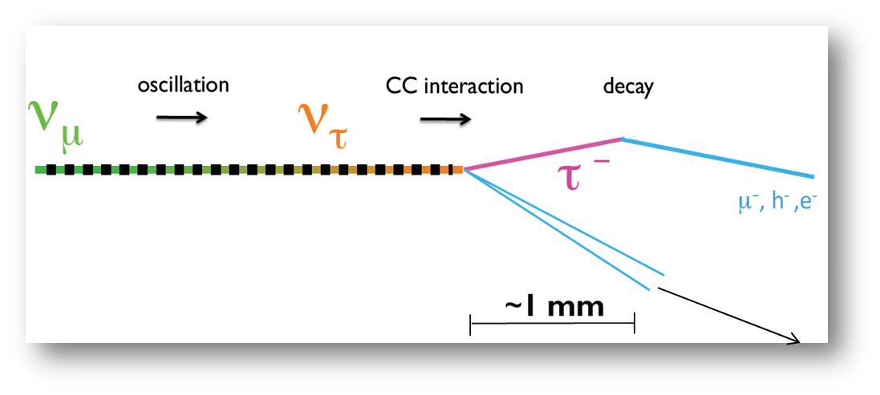
Principle
Detecting ν_{τ} charge current interaction, event-by event
by using decay topology of τ.
τ decay channel | B.R (%)
τ → μ | 17.7
τ → e | 17.8
τ → h | 49.5
τ → 3h | 15.0
cτ =87μm
no other lepton at the primary vertex
Micrometric resolution is needed.

Slide 6

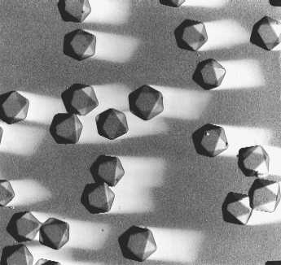
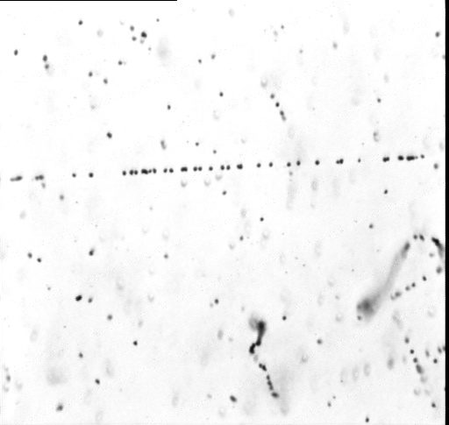
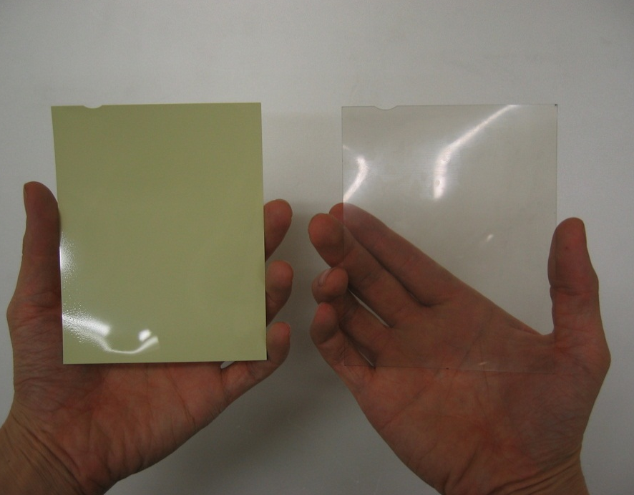
Nuclear emulsion for OPERA
AgBr Crystals
44μm emulsion layer
210μm plastic base
200nm
44μm emulsion layer
The first automatically poured nuclear emulsion (collaboration with FUJIFILM)
(10⁷ films)
~30 developed silver grains / 100 μm M.I.P. track
M.I.P.
10GeV π⁻
20μm
A compton track

Slide 7
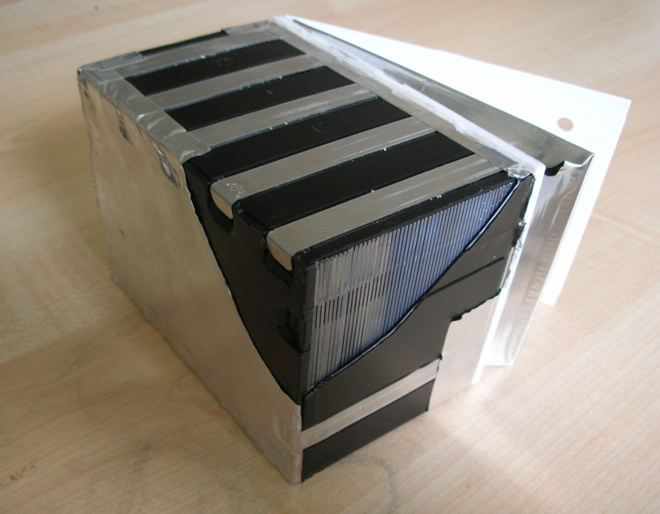
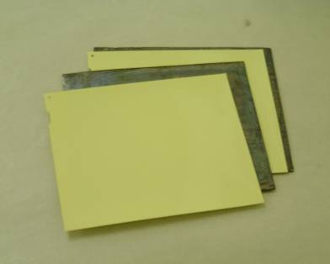
Emulsion Cloud Chamber (ECC)
ν_{τ} detection by ECC
(proven in DONUT (1998))
ECC
7.5cm
A stack of
57 emulsion films,
56 lead plates (1mm -thick each)
12.5cm
10cm
8.3kg
10X₀
Neutrino Beam
(vertical for films)
OPERA emulsion film
Lead plate : 1mm
- Increase ν interaction as target
- Momentum measurement
(Multiple Coulomb Scattering)
- Shower analysis
10cm
12.5cm

Slide 8
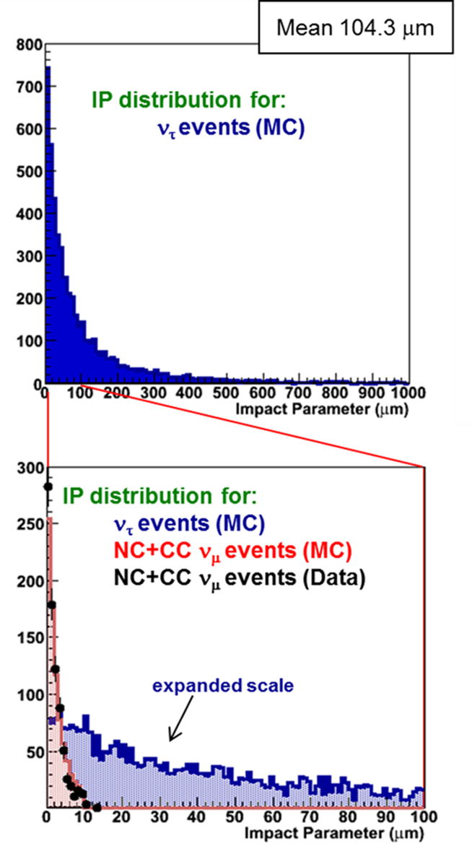
ν_{τ} CC Detection
Long flight decay
1mm
lead
emulsion
emulsion
plastic
Decay point
ν_{τ}
IP
τ
Primary
vertex
1mm Pb
100
500
μm
Short flight decay
ν_{τ}
Decay point
IP
τ
10 μm ｖｓ cτ = 87μm
Decay search : IP 10μm~500μm
Primary
vertex
1mm Pb
10

Slide 9
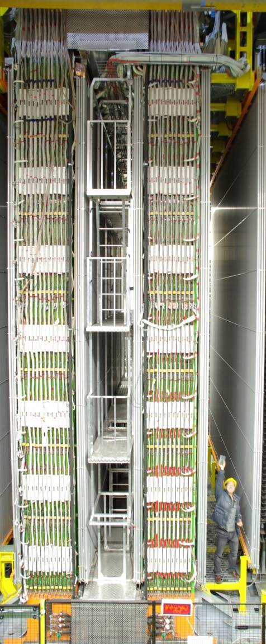
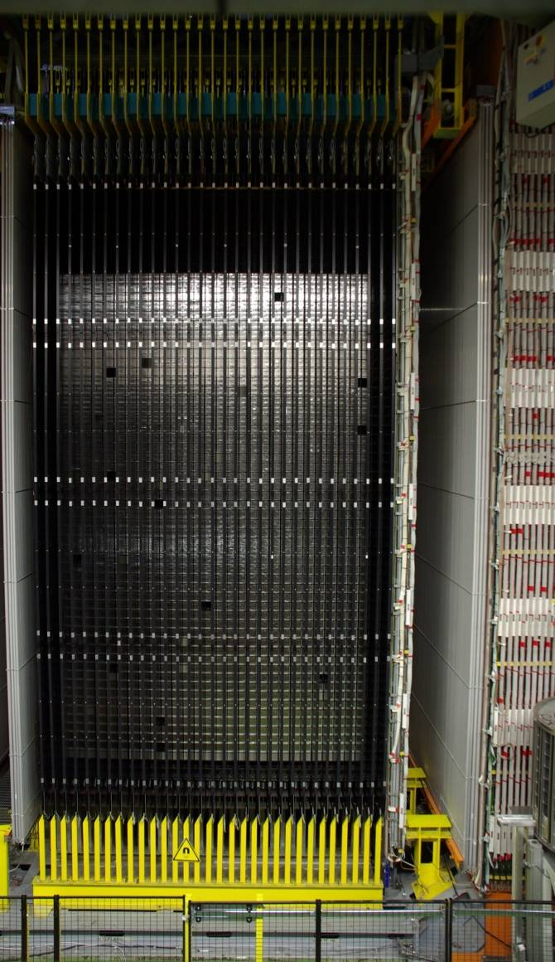
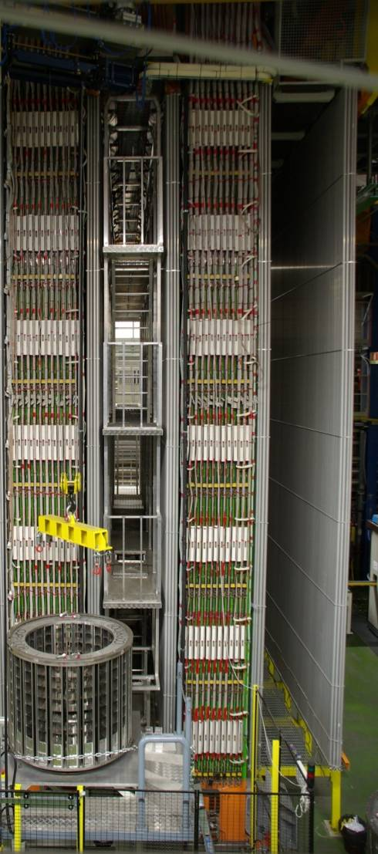
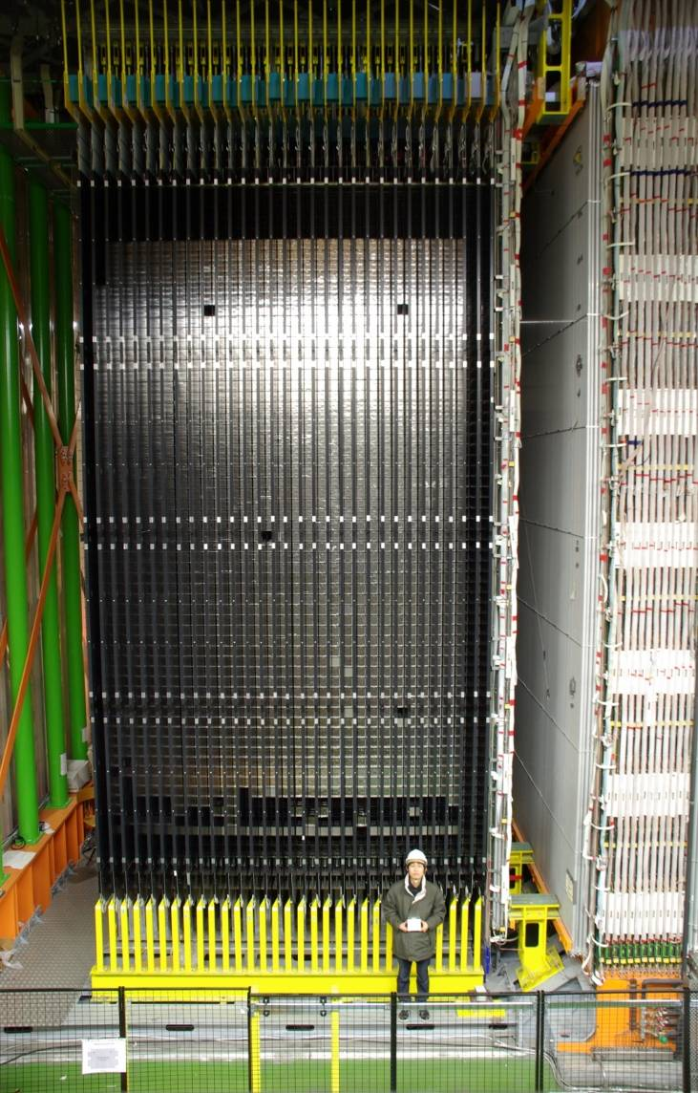
The OPERA detector (1400m underground of Gran Sasso)
1.25 kton detector with micrometric resolution.
Hybrid of ECCx150,000 & Electronic detectors.
ν
A person with ECC

Slide 10
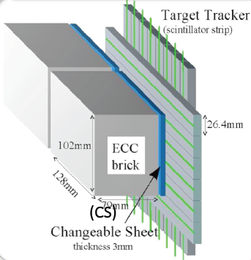
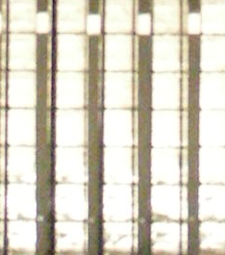
Target Tracker
(plastic scintillators）
ECC
ν

Slide 11
Target Tracker
(plastic scintillators）
ECC
ν

Slide 12
Emulsion - Electronic Hybrid Technique
Muon spectrometer
ECC +
Target tracker
RPC + drift tubes
ν
particle id,
μ charge, momentum

Slide 13
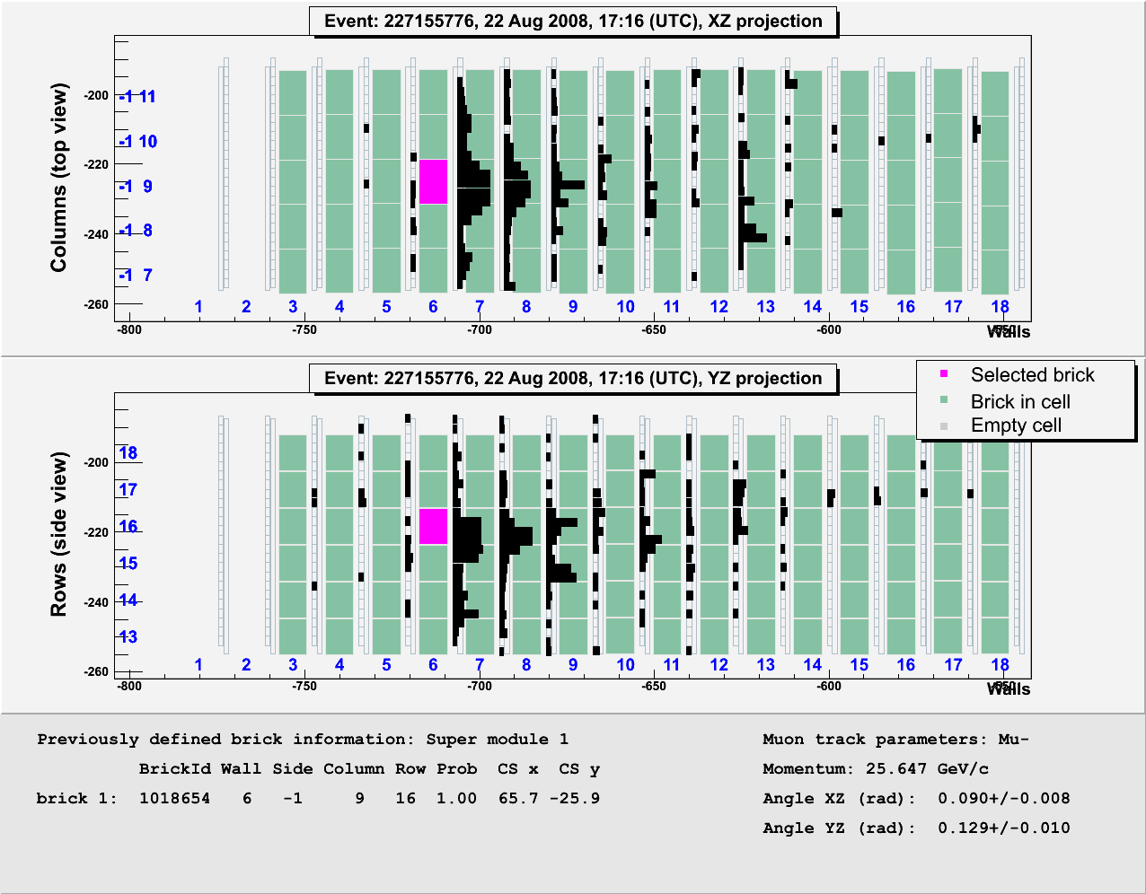
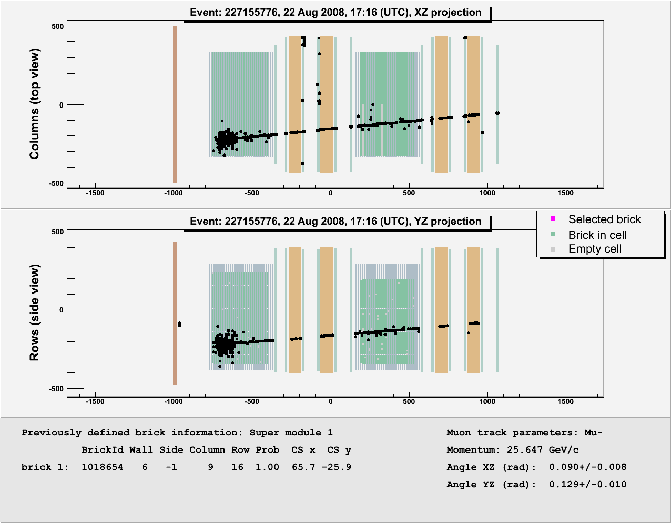
Flow of analysis

Slide 14

ECC and CS
Changeable
Sheet (CS)
A pair of films
Neutrino Beam
Develop only CS
films

Slide 15
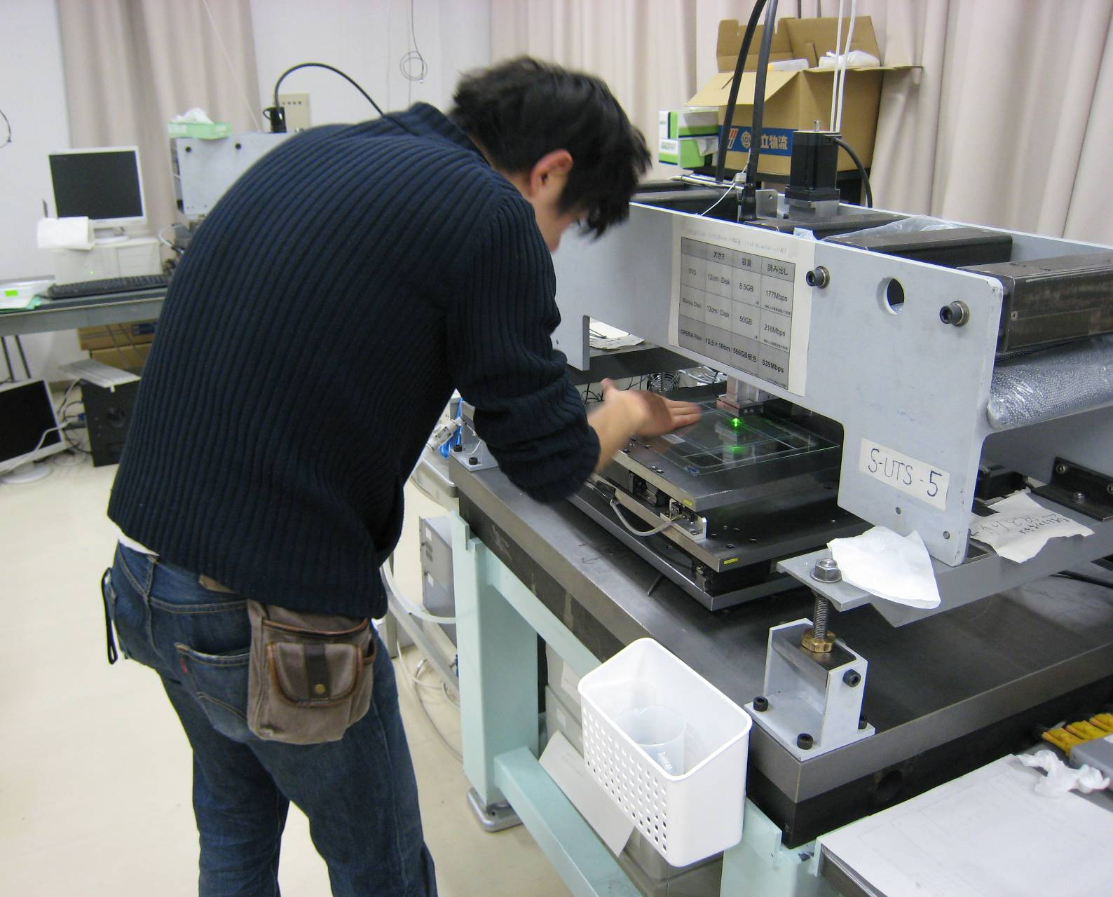
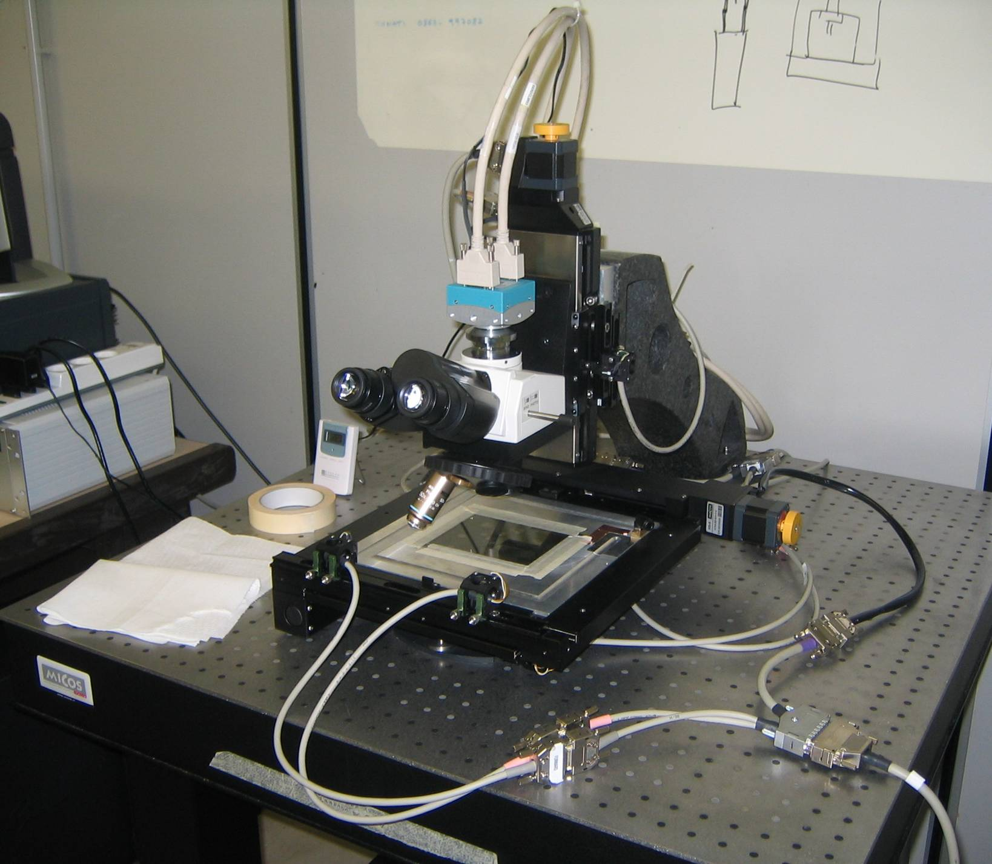
Scanning: half in Japan, half in Europe
Japanese Scanning System (SUTS)
European Scanning System（ESS)
Scanning speed:
75cm2/h
High speed CCD
camera (3 kHz)
Piezo-controlled
objective lens
FPGA Hard-coded algorithms
Scanning speed:
20cm2/h
Customized commercial
optics and mechanics
asynchronous DAQ software

Slide 16
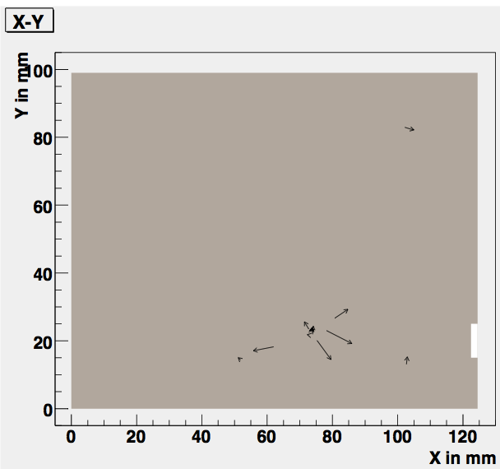

Slide 17
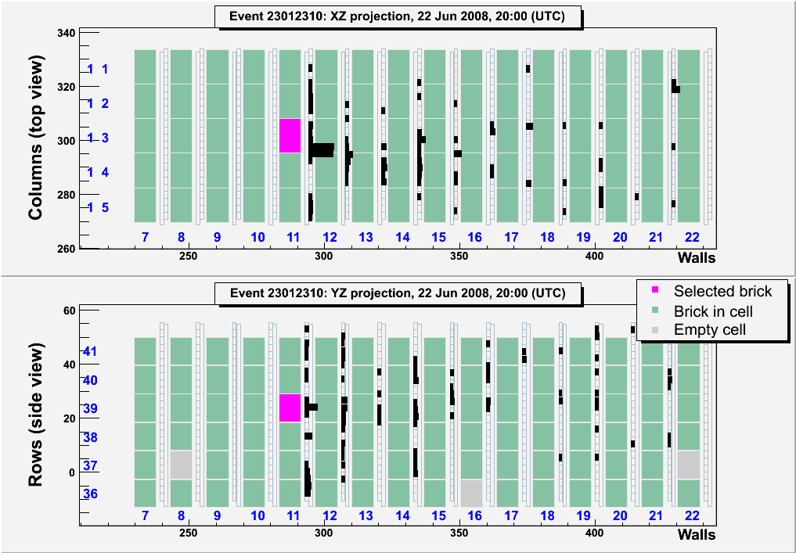
When no good tracks in CS, →2nd brick’s CS
1st
extraction
?
2nd

Slide 18
CS → ECC → ν interaction point
(SCAN BACK)
ECC
CS
5 mm
No track.

Slide 19
CS → ECC → ν interaction point
(SCAN BACK)
ECC
CS
5 mm
Scan and readout all the tracks.

Slide 20
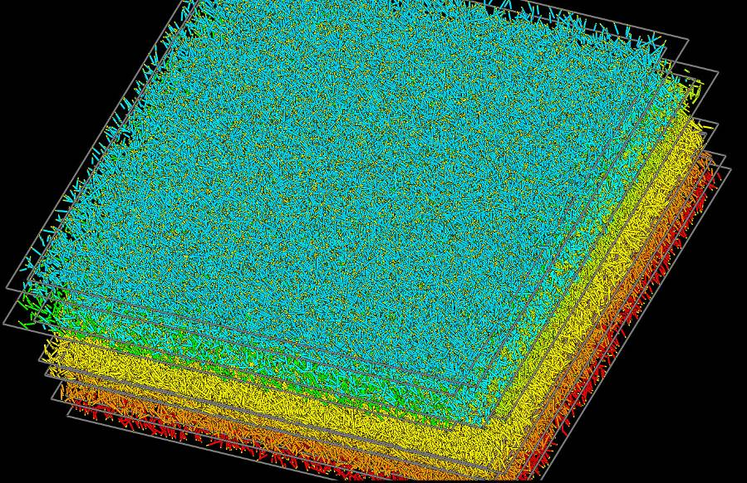
Around the stopping plate 1cm² ×10plate (~10⁵ Tracks) volume scan
3D Reconstruction of interaction

Slide 21
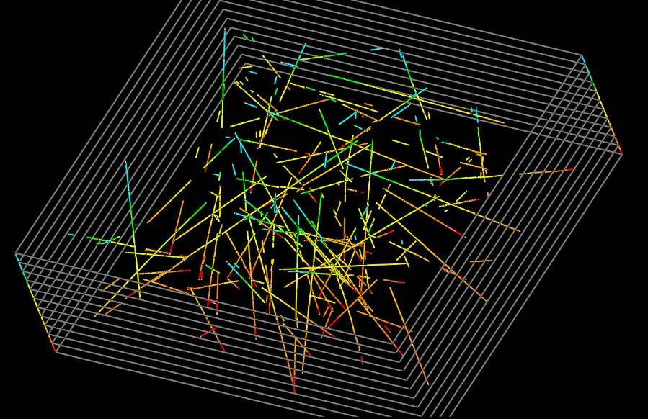
Tracks remaining after taking 4 layers’ coincidence.

Slide 22
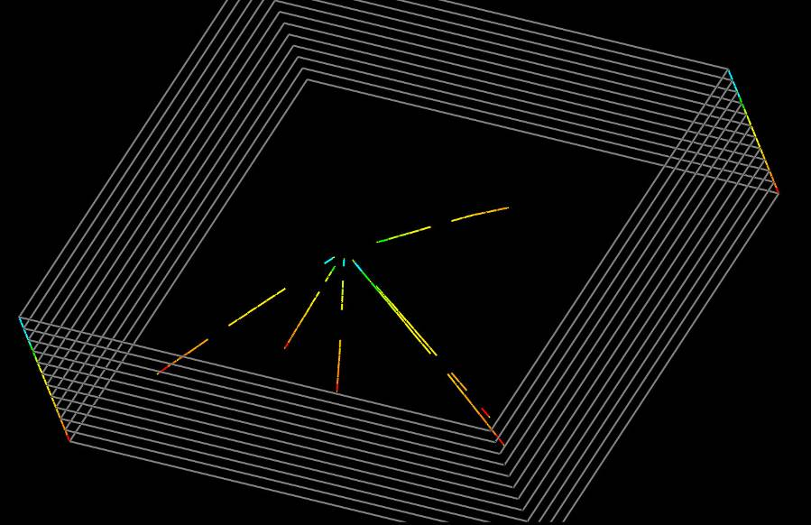
After rejection of tracks penetrating the volume…
→ ν interaction point
If there is a track with large IP → decay candidate.

Slide 23
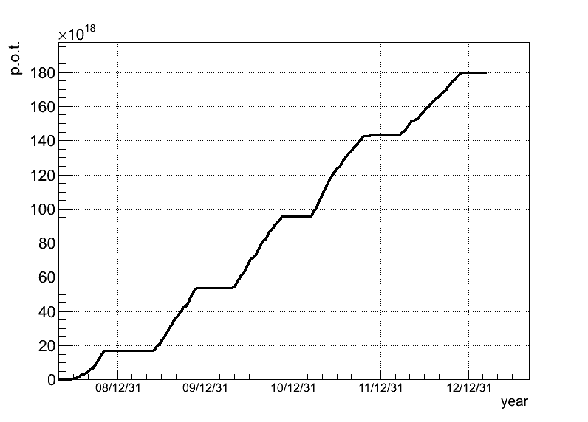
Final performances of the CNGS beam after five
years’ (2008-2012) exposure
P. O. T. (10¹⁸)
200
Year | Beam days | P.O.T. (10¹⁹)
2008 | 123 | 1.74
2009 | 155 | 3.53
2010 | 187 | 4.09
2011 | 243 | 4.75
2012 | 257 | 3.86
Total | 965 | 17.97
2012
2011
100
2010
2009
2008
date
In total, 17.97x10¹⁹ P.O.T. (80% of the proposal) was provided
during 5 years’ run.

Slide 24
Analyzed events and result
Decay searched events | Expected ν_{τ} | Observed ν_{τ} | Expected BG
5272 | 1.7 | 3 | 0.184+-0.025
(Δm²₂₃=2.32x10⁻³ eV², sin²2θ₂₃=1)
3rd ν_{τ} event with τ → μ decay
Submitted to PRL in Nov. 2013.

Slide 25

3rd tau neutrino candidate (τ -> μ)

Slide 26
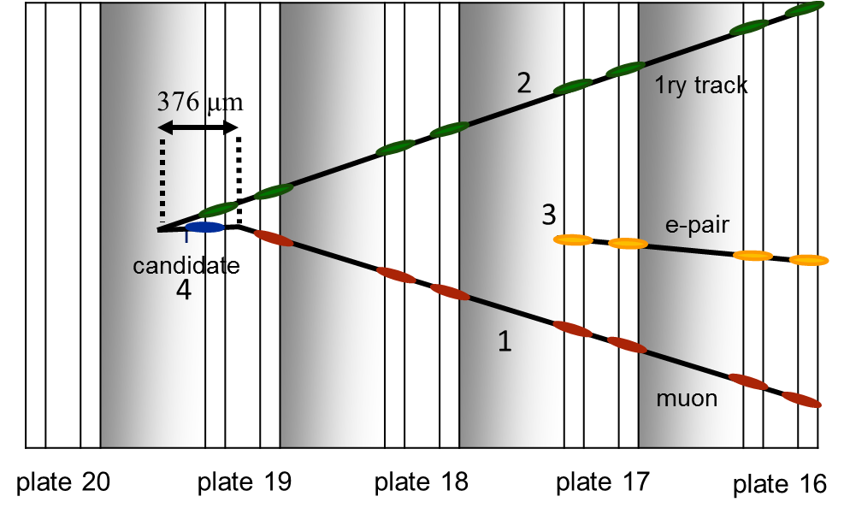
Event analysis
ν beam transverse plane
p_{τ}
pri. h
p_{h total}
φ=155°
e-pair
Kink Angle (mrad) | 245±5
Decay Length (μm) | 376±10
μ momentum (Gev/c) | 2.8±0.2
Decay Pt (Mev/c) | 690±50
Phi Angle (degrees) | 155±15
μ IP:93.7+-1.1μm
Decay in plastic base
with large Pt.

Slide 27
Main background source
ν_{τ}
τ
μ⁻
ν_{μ}
μ
μ⁻
ν_{μ}
c
μ⁺
Pb
film
film
film
μ⁻
Pb
Pb
Signal: τ → μ
BG ① μ large angle
scattering
BG② charm decay

Slide 28
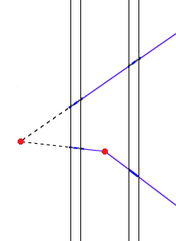
Kink topology found in base.
225μm
V0
P_{t}=690MeV/c
If large angle μ scattering,
Probability : 10⁻⁷-10⁻⁸
V1
τ
376μm
plastic
base
Pb plate
Pb plate
Emulsion layer
Emulsion layer

Slide 29
Main background source
ν_{τ}
τ
μ⁻
ν_{μ}
μ
μ⁻
ν_{μ}
c
μ⁺
Pb
film
film
film
μ⁻
Pb
Pb
Signal: τ → μ
BG ① μ large angle
scattering
BG② charm decay

Slide 30
Primary particle
TThit
the primary particle is a hadron
The primary particle had momentum of (0.90 -0.13 + 0.18) GeV/c
If it had been μ, it would have penetrated 14 bricks.
It penetrates only one downstream brick (TT hits),
→it cannot be identified as a muon.

Slide 31
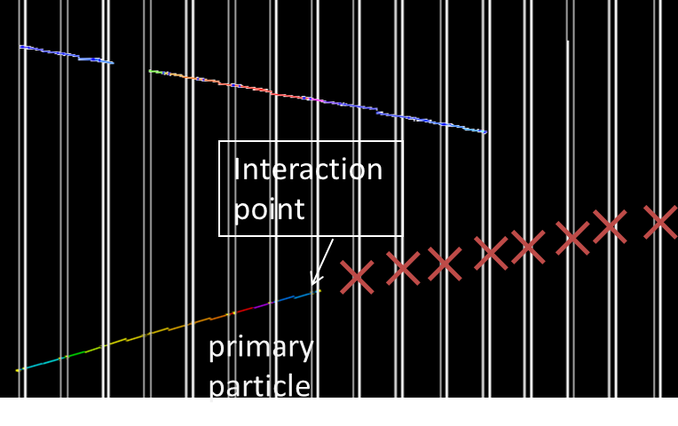
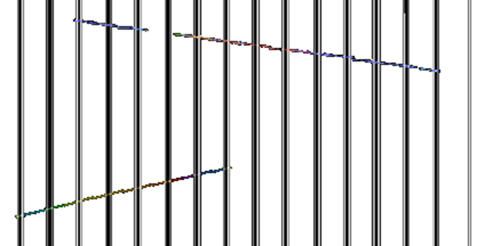

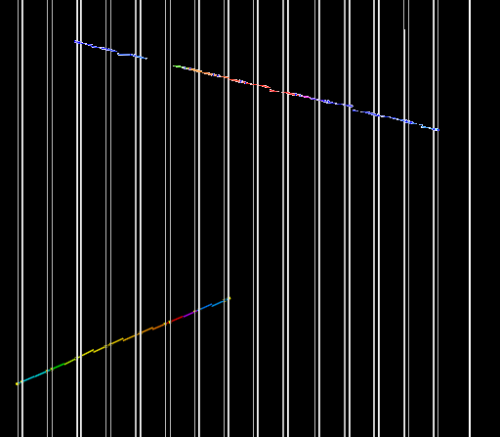
The track entered the brick from 27th film, 60micron from the edge.
And, interacted after crossing 18 emulsion films without visible charged particles
another timing CR
~7cm
no track in 8 downstream films
Stopping point
primary hadron
In this brick
cross checked by 4 downstream CSs
possibility of Inefficiency by emulsion
(2.7*10^-8 ) * 1.25*10^-3
~10^-11

Slide 32
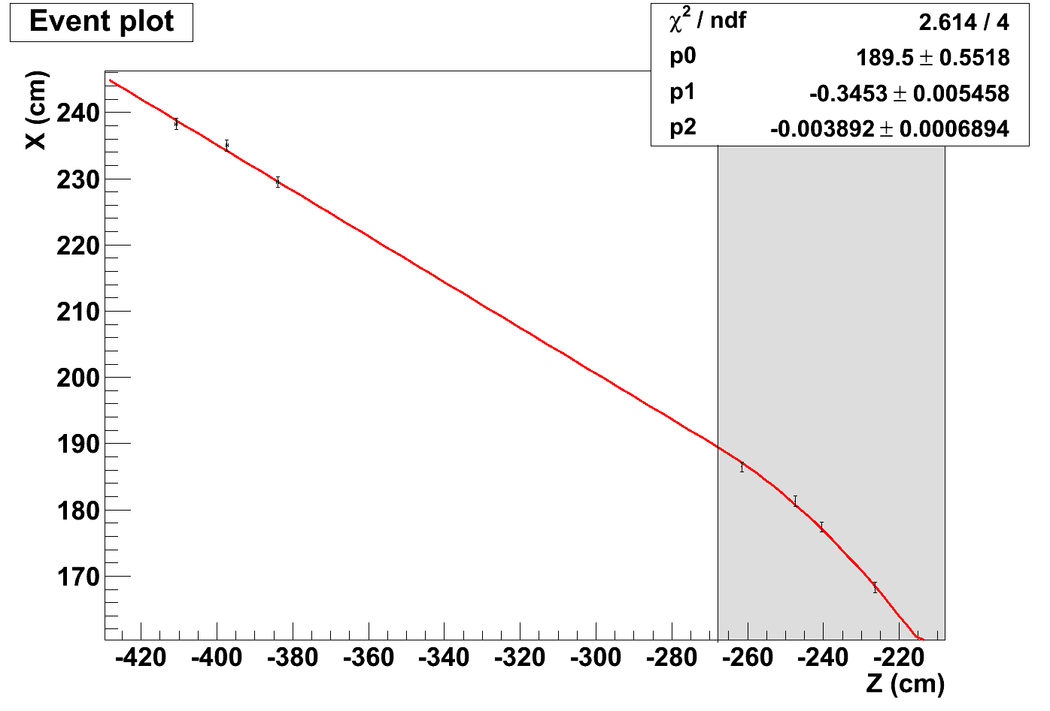
Negative muon charge (hybrid detector Pid)
from track curvature in the spectrometer (RPC hits)
-
μ
Target Tracker hits
X
B
Spectrometer 4hits
curvature radius
~ 85cm
muon charge is
Negative in 5.6 σ
RPC hits
μ⁻ → not a charm BG,
appeared ν_{τ} was not an anti particle.

Slide 33
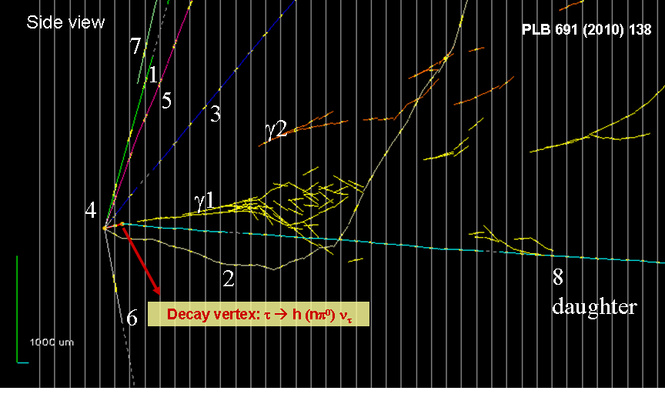
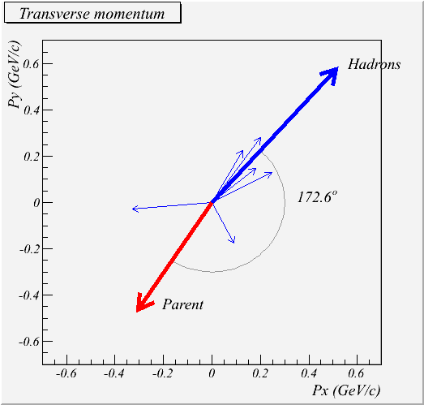
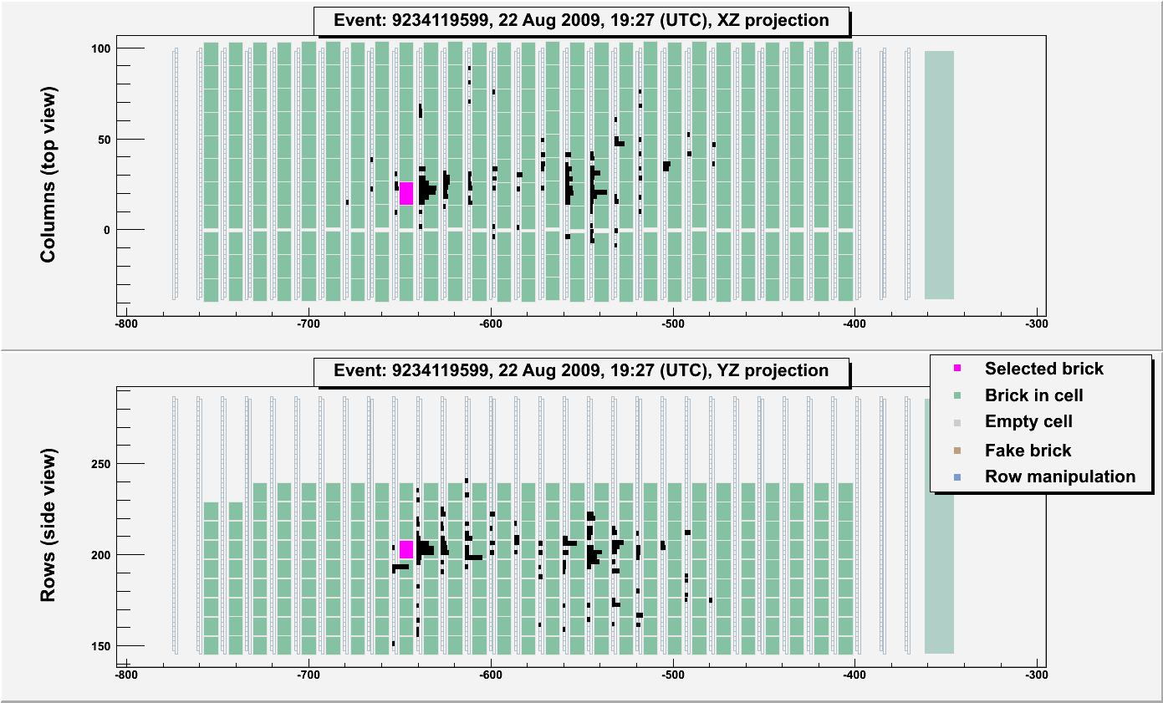
ν_{μ} → ν_{τ} oscillation search
First ν_{τ} candidate
Decay vertex: τ⁻ → h π⁰ ν_{τ}
The viewer of scintillation Target Tracker
VARIABLE | AVERAGE | Selection criteria
kink (mrad) | 41 ± 2 | >20
decay length (μm) | 1335 ± 35 | within 2 lead plates
P daughter (GeV/c) | 12 ⁺⁶₋₃ | >2
Pt (MeV/c) | 470 ⁺²³⁰₋₁₂₀ | >300 (γ attached)
missing Pt (MeV/c) | 570 ⁺³²⁰₋₁₇₀ | <1000
φ (deg) | 173 ± 2 | >90
top view
ν beam
interaction ECC -> pink color
side view

Slide 34
mass of ρ reconstructed
In 25% of tau decay, ρ will be produced. ： τ ◊ ρ (π⁻ π⁰) ν_{τ}
γ + γ | π⁻ + γ + γ
120 ± 20 (stat.)± 35 (syst.) MeV | 640 ⁺¹²⁵₋₈₀ (stat.)⁺¹⁰⁰₋₉₀ (syst.) MeV
πº mass = 135 MeV | ρ(770) mass = 775 MeV

Slide 35
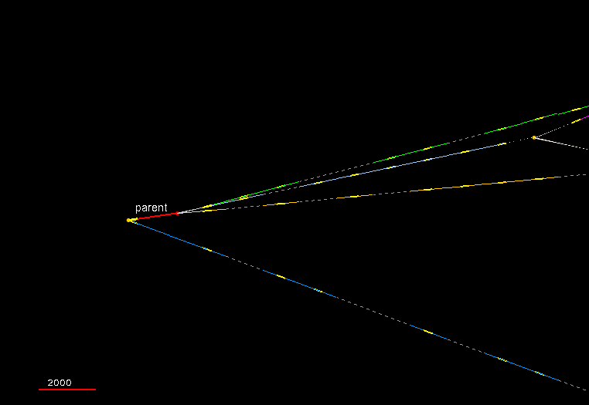
ν_{μ} → ν_{τ} oscillation search
2nd ν_{τ} candidate
2000 μm
2-prong ν interaction with one track showing a secondary vertex compatible with the hypothesis of
τ⁻ → h⁺ h⁻ h⁻ ν_{τ}

Slide 36
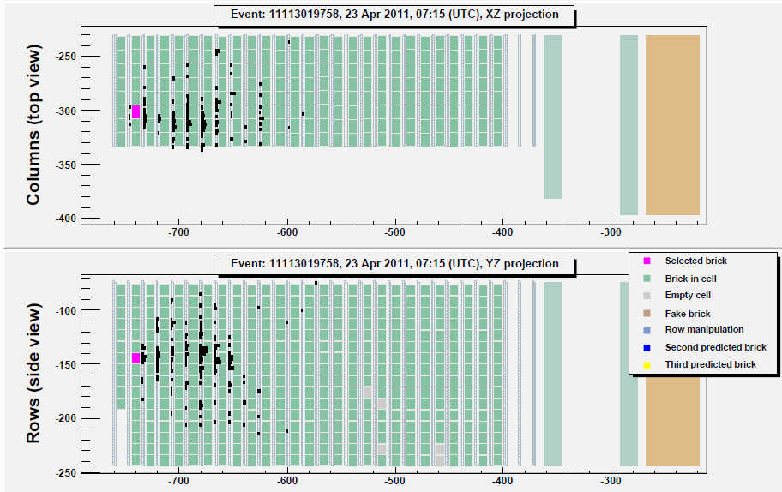
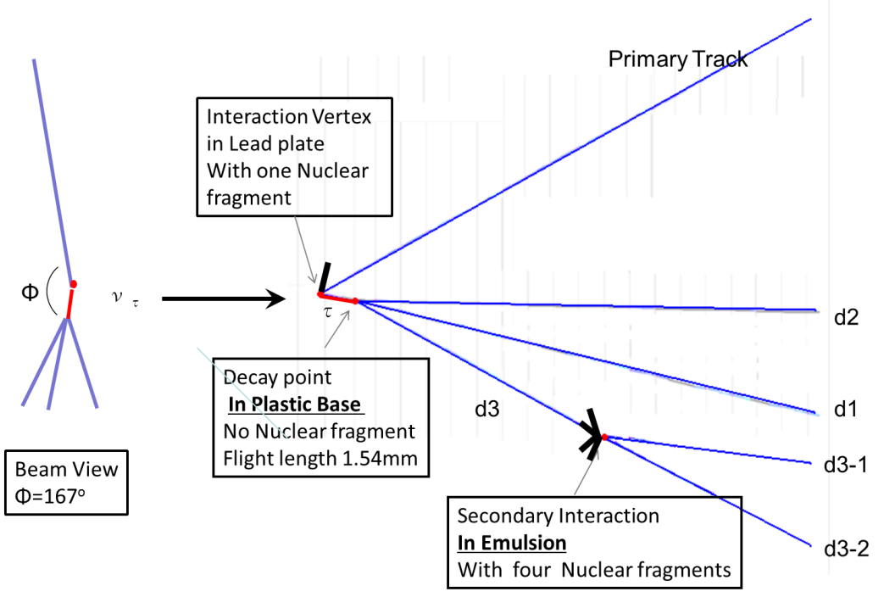
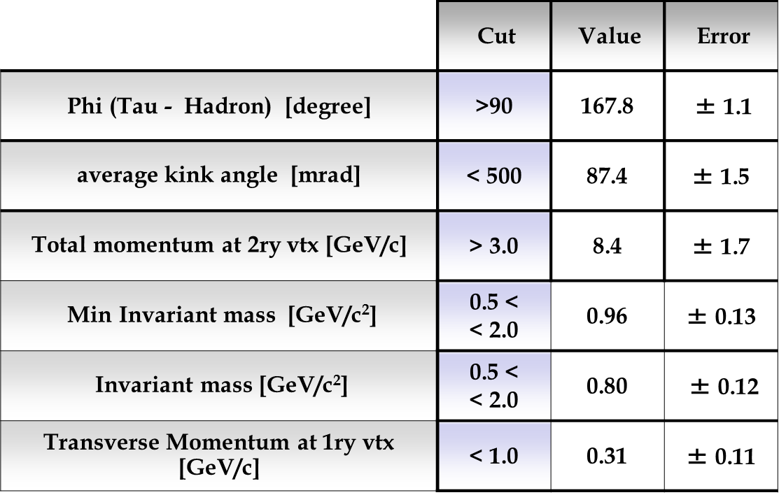
ν_{μ} → ν_{τ} oscillation search
Event kinematics
2nd ν_{τ} candidate
All track were identified as hadron .
2 tracks : hadron interaction was located
2 tracks : range momentum inconsistent for μ

Slide 37
expectation of signal and background, and significance
 | Signal | Background | Charm | μ scattering | had int
τ→ h | 0.31+-0.06 | 0.027+-0.005 | 0.011+-0.002 | - | 0.016+-0.005
τ → 3h | 0.43+-0.09 | 0.12+-0.02 | 0.11+-0.02 | - | 0.0021+-0.0006
τ → μ | 0.54+-0.11 | 0.021+-0.010 | 0.0044+-0.0008 | 0.017+-0.010 | -
τ → e | 0.46+-0.09 | 0.020+-0.004 | 0.020+-0.004 | - | -
total | 1.7 | 0.184+-0.025 | 0.15 | 0.017 | 0.018
With 3 ν_{τ} candidtes, significance is 3.4 σ
by counting method. (p value = 2.9 x 10⁻⁴ )

Slide 38
Summary
Through 5 years’ operation of CNGS, 17.97x10¹⁹ P.O.T. of neutrinos were provided to OPERA. (80% of proposal)
Decays have been searched for 5272 events.
In them, 3 ν_{τ} events (τ→h, τ→3h, τ→μ) have been found till now.
1.7 signals and 0.184+-0.025 B.G. events are expected.
Significance is 3.4 σ by counting method.
These results are submitted to Physical Review Letters.
Main part of analysis shifted to 2nd bricks’.

Slide 39

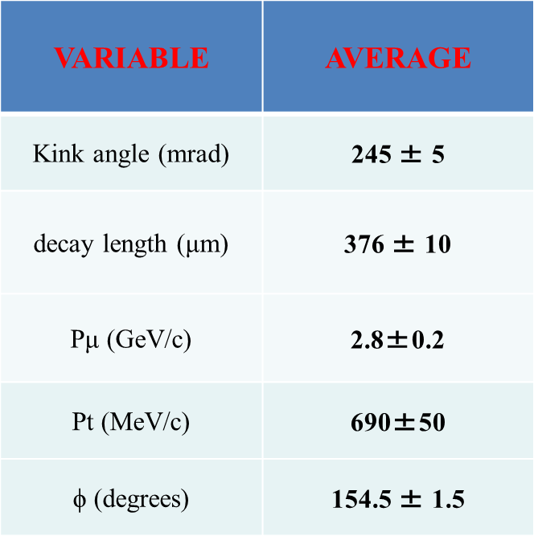
p_{τ}
primary
track
pri. h
376μm
p_{h total}
φ=154.5°
e-pair
τ
e-pair
muon
film 38
film 39
film 40
film 41
film 42
γ is attached to the primary vertex.

Slide 40
This result is consistent to the one by another method.
(E = 2.61 GeV however the error is not evaluated )
Pb1mm
gamma
Track of electron (positron)
Radiation energy loss correction
=
=
=
=

Slide 41
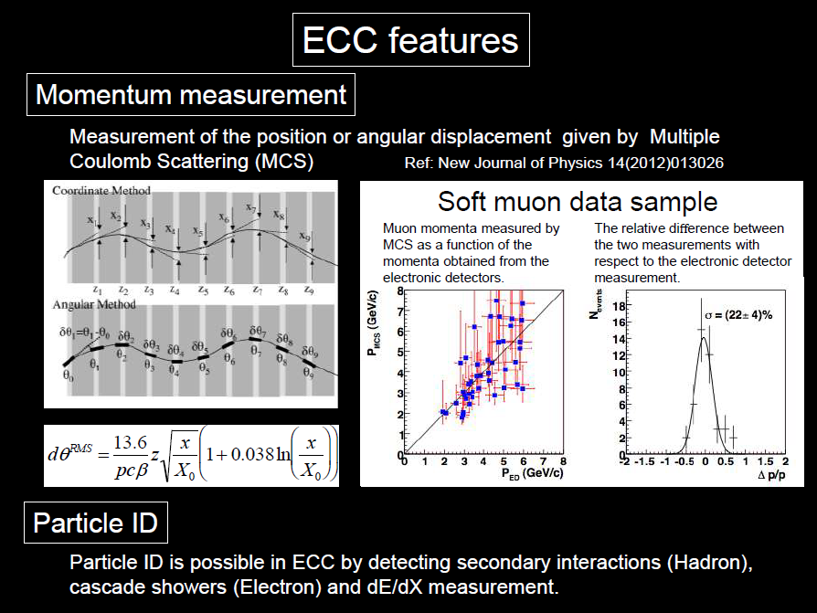

Slide 42
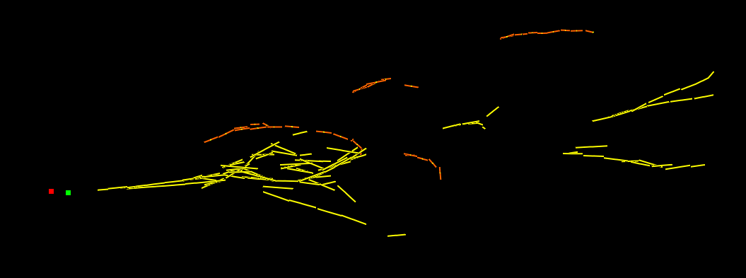
Pointing accuracy of gamma
γ2
primary vertex
kink point
γ1
Pointing accuracy depends of distance and multiple Coulmb scattering.
 | Distance to kink point (mm) | 1ry vertex とのIP (μm) <accuracy> | kink point とのIP (μm) <精度> | Probability emitted from 1ry vertex | Probability Emitted from kink point
γ1 | 2.2 | 45.0 <11> | 7.5 <7> | <10⁻³ | 0.32
γ2 | 12.6 | 85.6 <56> | 22 <50> | 0.10 | 0.82
from kink point
From kink point
Notes:
42

Slide 43
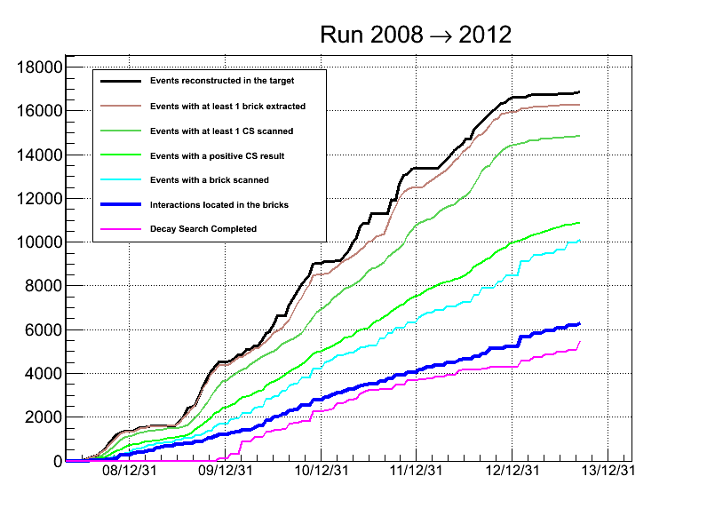
event
extracted
CS scanned
CS track found
ECC scanned
νint. found
Decay searched
Completed: 2008, 2009
2010-12 on going with optimised strategy
Located: 6299, Decay search: 5497

Slide 44
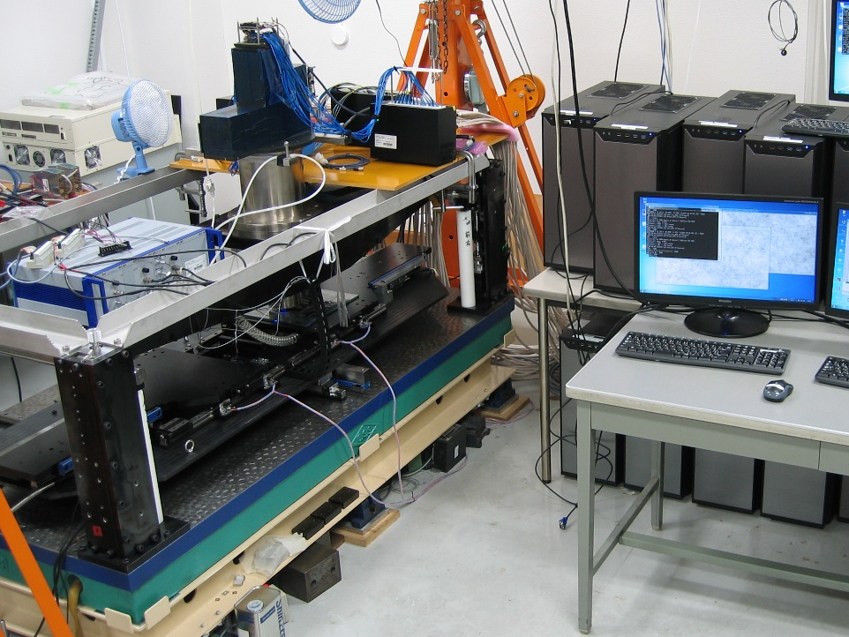
HTS
36 PCs with
72 GPU boards
(For the detection of tracks)
Optics with wide field of view
Z
X
Y
~2000m²/year
Speed in cm²/ hour
9000
10000
1000
~20m²/year
72
100
x 100
10
1
Accurate, high-speed stage.
1
0.082
0.1
0.01
0.003
0.001
TS
NTS
UTS
S-UTS
HTS
Notes:
これが現在開発中のHTSのです。
S-UTSの１００倍を目指して開発を行っています。
HTSは「」「」「」からなります。
まず、高速に読み取るために、高速精密ステージを設計しました。これは１秒間に１０視野読み取る性能があります。
さらに、１視野あたりの視野面積を大きくするために、巨大対物レンズを用意しました。こちらに上の部分が見えています。
さらに、この先にはビームスプリッターで分割された６つの結像面に、６つのカメラユニットを取り付けます。
１つのカメラユニットにはそれぞれ１２個のセンサがついており、全部で７２センサで広い視野面積を達成します。
ここから取得した画像情報は、３６台のコンピュータと７２個のGPUボードにより解析し、最終的に飛跡情報が出力されます。
まず、広視野光学系について詳しくみていきます。

Slide 45
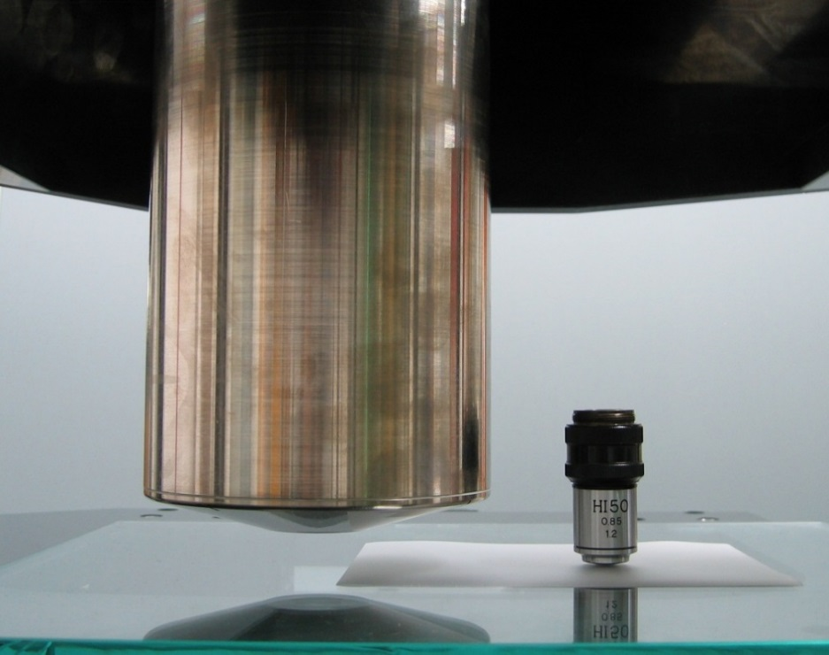
HTS
36 PCs with
72 GPU boards
(For the detection of tracks)
Optics with wide field of view
Z
X
Y
Accurate, high-speed stage.
Field of view (0.2mm)2 → (5mm)2
x~600
Notes:
これが現在開発中のHTSのです。
S-UTSの１００倍を目指して開発を行っています。
HTSは「」「」「」からなります。
まず、高速に読み取るために、高速精密ステージを設計しました。これは１秒間に１０視野読み取る性能があります。
さらに、１視野あたりの視野面積を大きくするために、巨大対物レンズを用意しました。こちらに上の部分が見えています。
さらに、この先にはビームスプリッターで分割された６つの結像面に、６つのカメラユニットを取り付けます。
１つのカメラユニットにはそれぞれ１２個のセンサがついており、全部で７２センサで広い視野面積を達成します。
ここから取得した画像情報は、３６台のコンピュータと７２個のGPUボードにより解析し、最終的に飛跡情報が出力されます。
まず、広視野光学系について詳しくみていきます。

Slide 46
HTS
36 PCs with
72 GPU boards
(For the detection of tracks)
Optics with wide field of view
Z
X
Y
 | SUTS (OPERA) | HTS Guaranteed | HTS Hardware | HTS target
Speed | 72cm²/h | 300cm²/h | 2250cm²/h | 9000cm²/h
・高速精密ステージ
Accurate, high-speed stage.
CS test scan OK
22 September 2013
日本物理学会2013年秋季大会 22aSP-4
Notes:
これが現在開発中のHTSのです。
S-UTSの１００倍を目指して開発を行っています。
HTSは「」「」「」からなります。
まず、高速に読み取るために、高速精密ステージを設計しました。これは１秒間に１０視野読み取る性能があります。
さらに、１視野あたりの視野面積を大きくするために、巨大対物レンズを用意しました。こちらに上の部分が見えています。
さらに、この先にはビームスプリッターで分割された６つの結像面に、６つのカメラユニットを取り付けます。
１つのカメラユニットにはそれぞれ１２個のセンサがついており、全部で７２センサで広い視野面積を達成します。
ここから取得した画像情報は、３６台のコンピュータと７２個のGPUボードにより解析し、最終的に飛跡情報が出力されます。
まず、広視野光学系について詳しくみていきます。

Slide 47
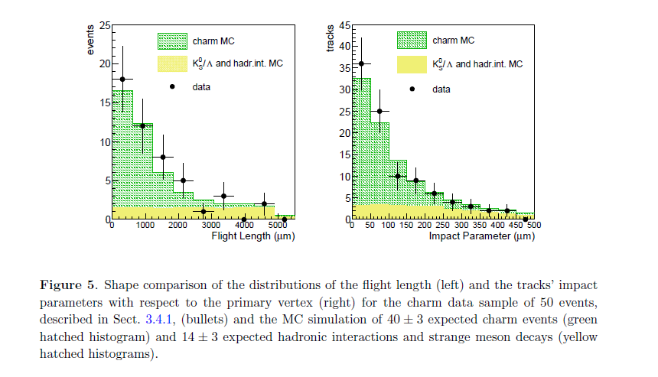
Charm events from ν_{μ} CC interaction

Slide 48
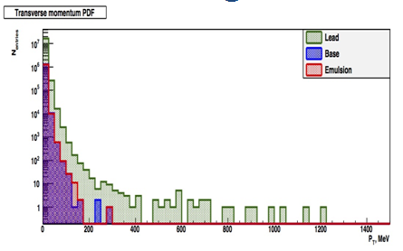
BG2 : Muon Large Angle Scattering
Prob
quark
kink point
muon
Pb Film
Kink Angle (mrad) | 245±5
Decay Pt (Mev/c) | 690±50
Tranverse momentum PDF
10⁷
Scattering probability is
proportional to the amount of
material. Pb : 10⁻⁶
film (emulsion + plastic base) :
10⁻⁸ - 10⁻⁷
10⁴
690MeV/c
at base
Upper limit : Proposal Value 10⁻⁵
(S.A. Akimenko et at al, NIM A423 1986 518)
0
500
1000
P_{T} (MeV/c)

Slide 49
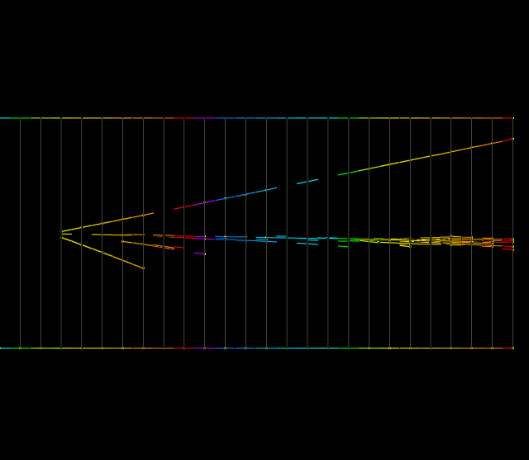
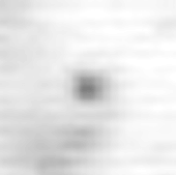

ν_{e} detection in ECC
hadron
ν_{e}
electron
Microscopic image from
the view of the beam axis
γ−>e+e-
hadron
Electromagnetic shower
electron
γ ◊e⁺ e⁻
4.1X₀
1μm
Primary electron track observed as an isolated track,
not as a pair tracks
fine position resolution of nuclear emulsion and fine segmentation (track reconstruction
each 1mm lead plate (0.18X₀)) in ECC
−> separate electron from γ−>e+e-
Electromagnetic shower developed in ECC
−> separate electron from pion
Notes:
実際のイベントの絵を見せる、
BGについても話す

Slide 50
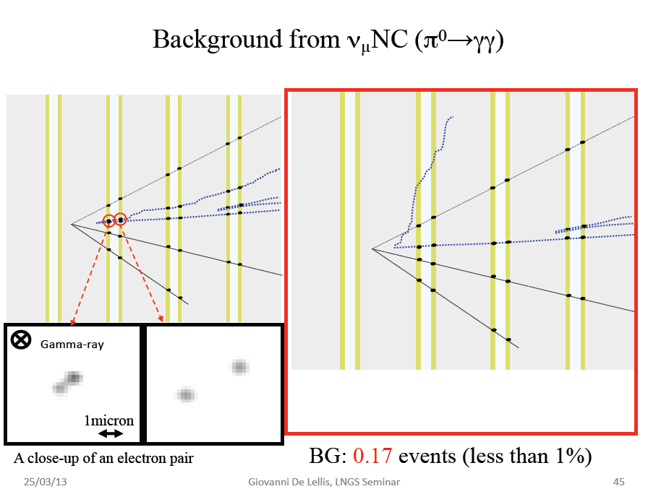

Slide 51
Analysis of 2008-2009 data sample
19 ν_{e} events observed out of 505 0μ events
Systematic Uncertainty
1：Beam flux 10%
2：Detection efficiency
10%(Eν>=10GeV)
20%(Eν<10GeV)
Expected number of background ν_{e} events :19.8±2.8(sys)
−> Observation agrees with background expectation
（prompt ν_{e}, NC with π⁰, τ−>e）
Published: JHEP07(2013)004

Slide 52
OPERA ν_{μ}−>ν_{e} oscillation results
(in 2008+2009 data set)
3 flavor mixing model for standard
oscillation
Upper limit (90%C.L.) @Δm²₁₃=2.32 x 10⁻³（eV²）
sin²(2θ₁₃) = 0.44
N_{expBG} = 4.6±0.7(sys), N_{obs} = 4 (E_{ν}__{rec}<20GeV)
Observation is compatible with non-oscillation hypothesis
Notes:
52
52
Dm2_13=Dm2_23 変数として解析
Dm2_12は定数

Slide 53
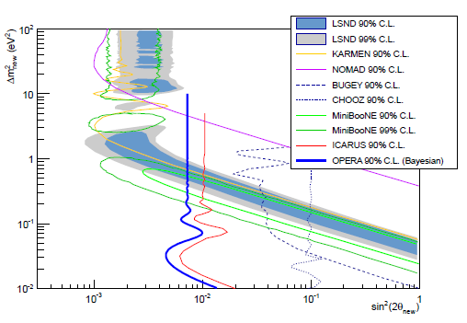
OPERA ν_{μ}−>ν_{e} oscillation results
(in 2008+2009 data set)
2 flavor mixing model for non-standard oscillation with a dominant mass scale
N_{expBG} = 9.4±1.3(sys)
N_{obs} = 6
(E_{ν}__{rec}<30GeV)
Upper limit (90%C.L.) @largeΔm²
sin²(2θ) = 7.2 x 10⁻³
Notes:
53
53
ICARUS について

Slide 54
Main background source
ν_{τ}
τ
h
ν_{μ}
c
h
ν_{μ}
h
h
Pb
film
film
μ⁻
film
Pb
Pb
Signal: τ → h
BG ① charm decay
BG ② hadron interaction

Slide 55
Main background source
ν_{τ}
τ
h
ν_{μ}
c
h
ν_{μ}
h
h
Pb
film
film
μ⁻
film
Pb
Pb
Signal: τ → h
BG ① charm decay
BG ② hadron interaction

Slide 56
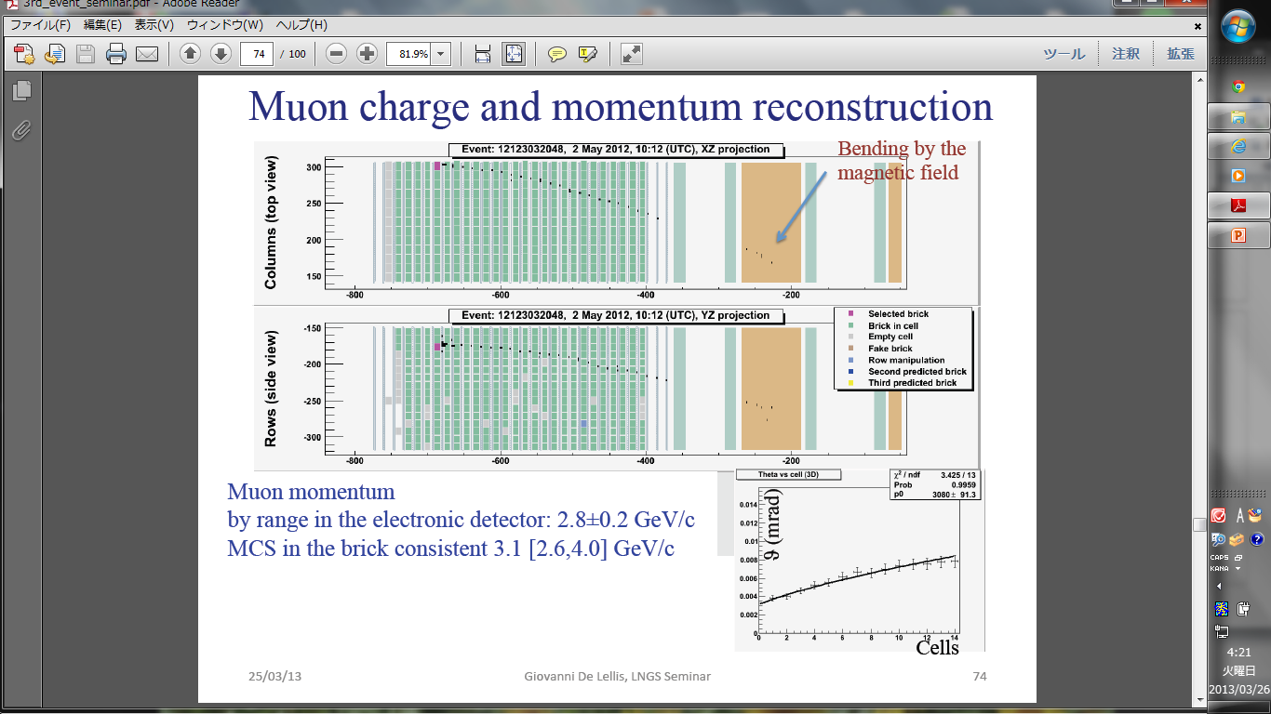
daughter particle
muon identified by TT hits
lead

