Slide 1
ΝΝΝ 2014

Slide 2
Most of you think that the NNN locations are chosen at random.
You are wrong.
There is a mystic symbolism in the places chosen
Let me prove it to you

Slide 3
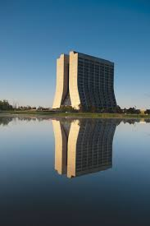
In 2012, we buried hints of CPT violation at Fermilab
ν
Perfect mirror
symmetry
ν
Wilson had the presentiment that Fermilab will become important for neutrino physics, when he designed the High Rise

Slide 4
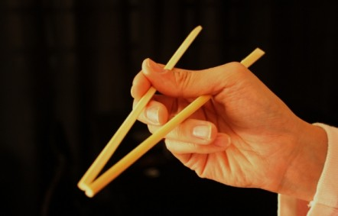
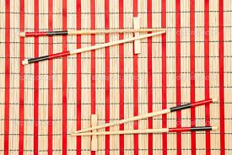
It is only natural that we continued in Japan in 2013, where the neutrino is part of the daily experience
Remember the Zen
principle of Haim Harari:
“Neutrino physics
is the art of
learning a lot
of things by
observing
nothing”
ν
In fact the flavour composition (mixing angles) of neutrinos was known here till time immemorial, encoded in the sushi sticks

Slide 5
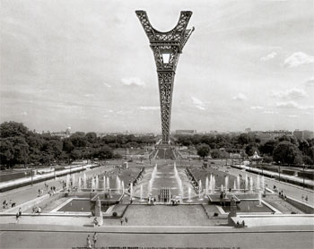
We invite you in 2014 to Paris, where we hope to explore further the hints of inverted mass hierarchy
ν
NNN2014 Paris, 4-6 November 2014
Astroparticle Physics and Cosmology laboratory

Slide 6
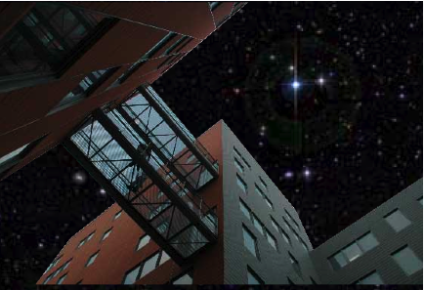
Astroparticle Physics and Cosmology Laboratory
(interdisciplinary laboratory inaugurated in 2005)
250 researchers and engineers working on 3 themes:
Neutrino
High Energy Universe
Cosmology and gravitation
Transversal activities
Theory
R&D
Algorithmics/ Computing Center

Slide 7
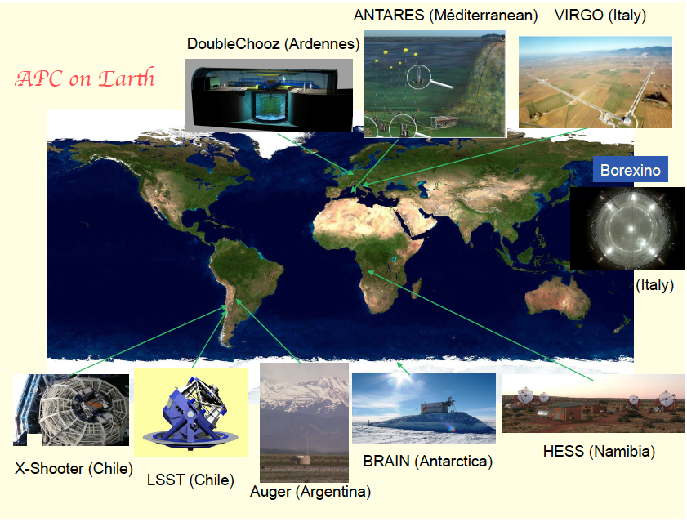

Slide 8
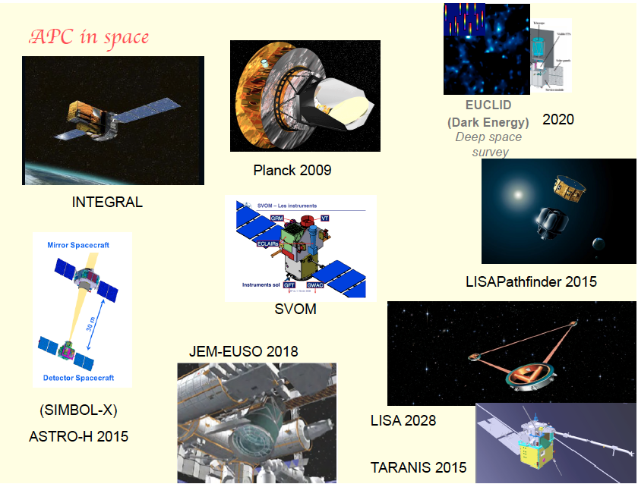

Slide 9
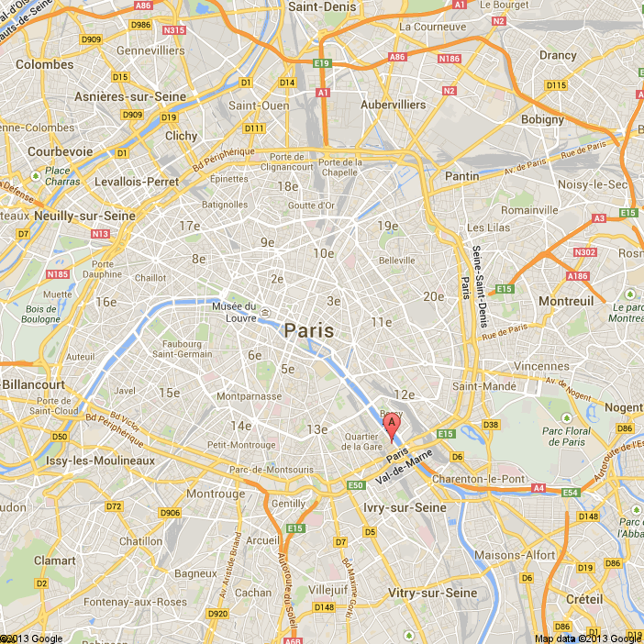
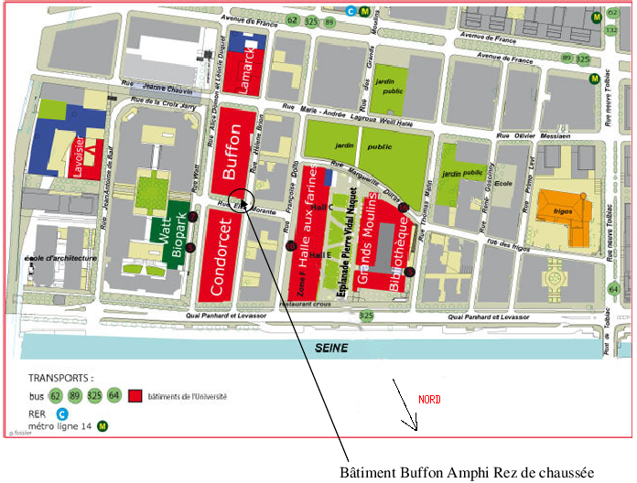
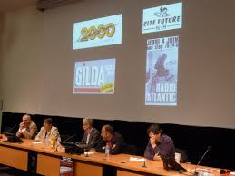
Venue in central Paris
Amphitheatre Buffon
Mo Bibliothèque
We will experiment a new scheme for NNN in accordance with the NNN committee
3 full days
Less reviews of current neutrino experiments and more discussion of common topics of the future NNN detectors (e.g. methods of analysis, R&D, liquid argon, photodetectors, acquisition etc) and theory …

