Slide 1
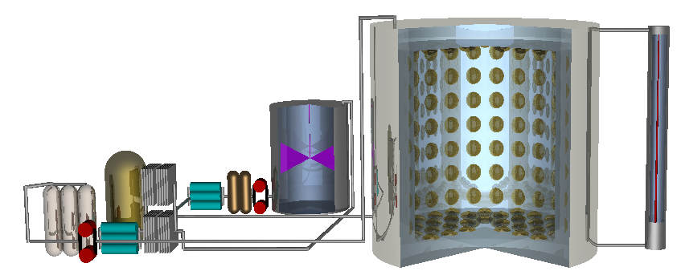


Gadolinium Doped Water Cherenkov Detectors
Andrew Renshaw for the
Super-Kamiokande Collaboration
NNN 2013: Tuesday Nov. 12th, 2013

Slide 2
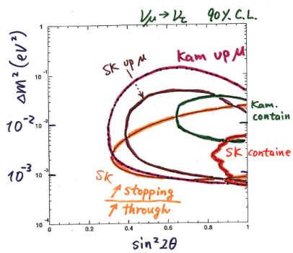
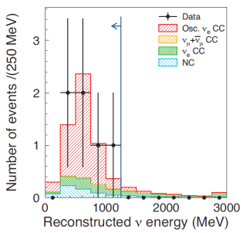
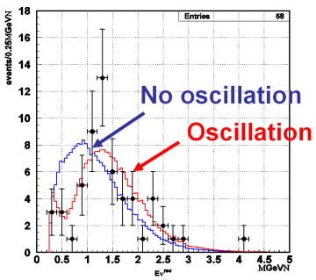
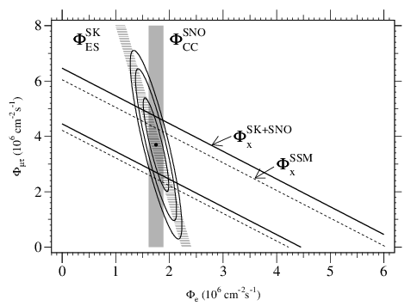
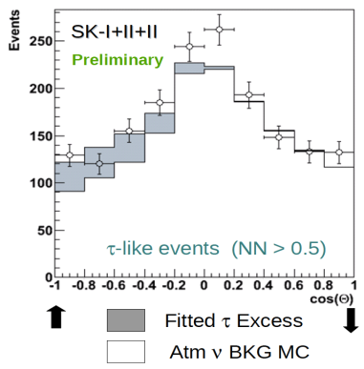


Physics Achievements with
Super-Kamiokande
Atmospheric ν oscillations
θ13 by T2K
(indication)
θ13 by T2K
(observation)
K2K confirmed atmospheric osc.
by long baseline ν
Super-K is approaching 20 years old!!!!!
96 | 97 | 98 | 99 | 00 | 01 | 02 | 03 | 04 | 05 | 06 | 07 | 08 | 09 | 10 | 11 | 12 | 13
Solar ν oscillations
Tau-ν appearance in atmospheric ν
Solar day/night asymmetry
day
night
A_{DN}=-3.2±1.1±0.5 %

Slide 3
GADZOOKS!
Currently n captures on H
n+H→2.2 MeV γ
ΔT = ~200 μsec
[Beacom and Vagins, Phys. Rev. Lett., 93:171101, 2004]
0.1% Gd gives
~90% efficiency
for n capture
In Super-K this means
~100 tons of water soluble
Gd₂(SO₄)₃
n
Captures on Gd
ν_{e}
γ
100%
p
p
80%
60%
Gd
e⁺
γ
40%
20%
With 0.1% Gd Loading
0%
~90% or more of the time
0.0001%
0.001%
0.01%
0.1%
1%
n+Gd→~8MeV γ
ΔT = ~30 μsec
Gd in Water

Slide 4
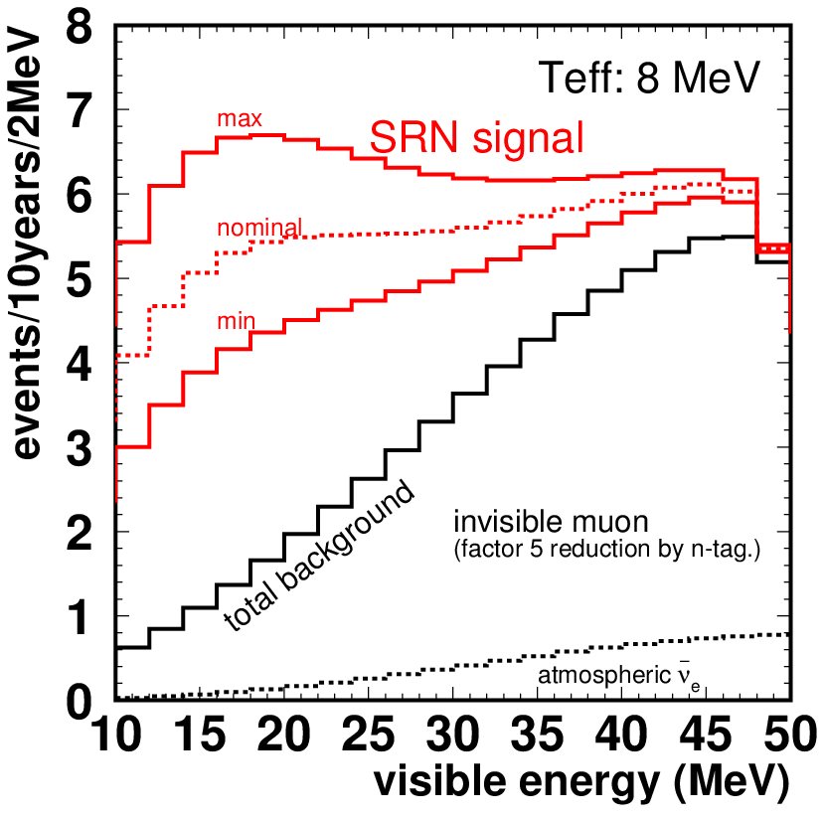
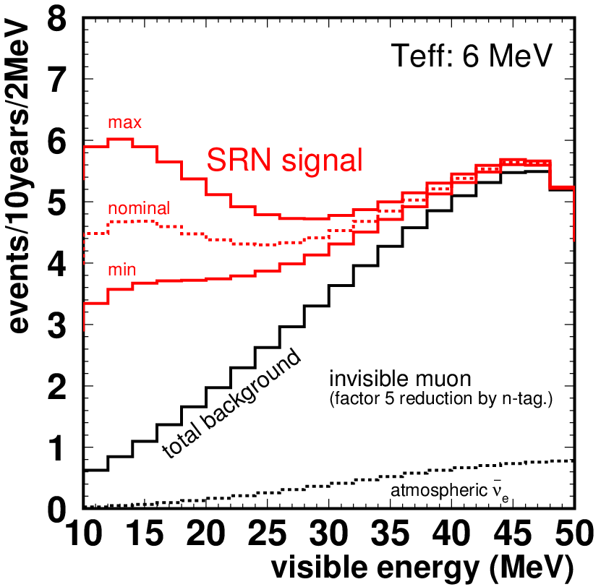
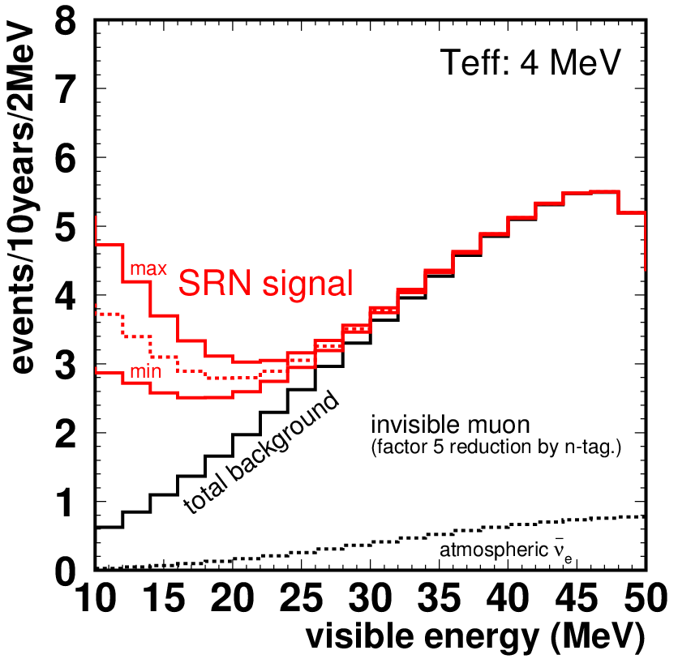
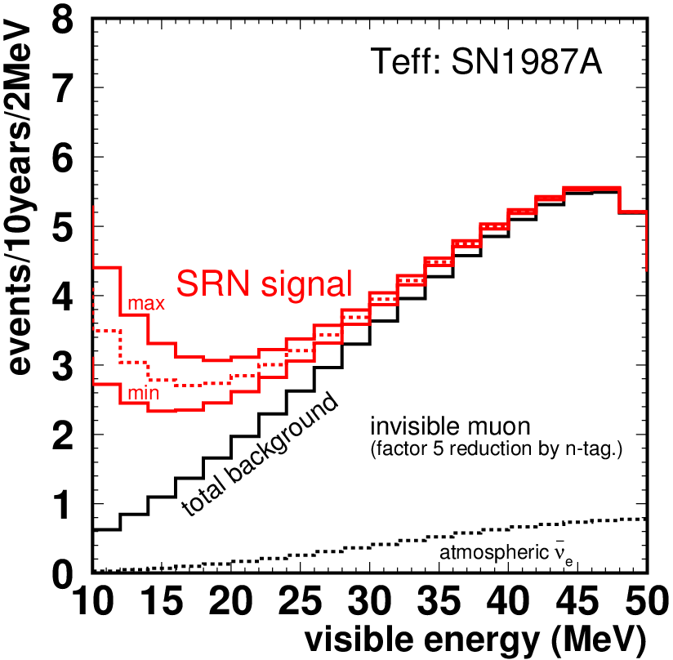
SRN Signal In GADZOOKS!
33~45 ev.
Expect number of events in 10 years in
E_{total} =10-30 MeV
26~34 ev.
Assuming
Capture efficiency of 90% and Gd gamma detection efficiency of 74%.
Invisible muon B.G. is 35% of the SK-IV invisible muon BG.
13~16 ev.
12~16 ev.
Min/nominal/Max are due to uncertainties in astronomy.
Background: ~18 ev.
[SRN flux from Horiuchi et al. PRD, 79, 083013 (2009)]
[M. Nakahata]

Slide 6
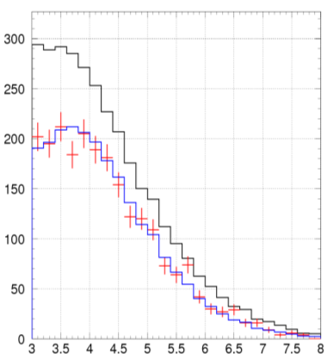
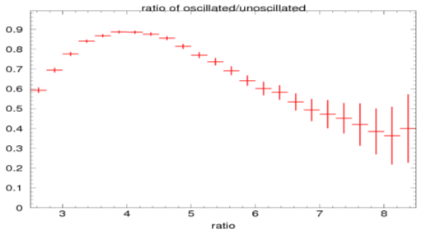
Reactor Antineutrinos in GADZOOKS!
~1000 or more reactor neutrinos per year
unoscillated spectrum
from Monte Carlo
One year MC study assuming ∆m² = 8E-5 and sin^²(2θ) = .86 [K. Bays]
Positron spectrum from one year of Monte Carlo oscillated

Slide 7
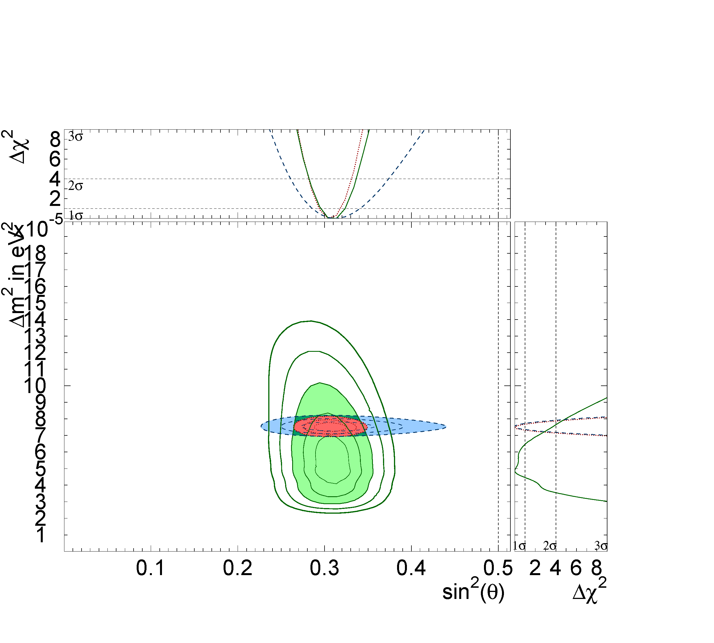
Reactor Antineutrinos in GADZOOKS!
Regardless of what Japan’s nuclear future holds, we will surely look for (and measure) a reactor signal in GADZOOKS!
After all, it defines the lower end of the DSNB energy window.
~5 years of GADZOOKS!
(by itself)
95% C.L. by K. Bays
The signal from (South?) Korea alone will provide an event rate in SK similar to KamLAND’s when all Japanese reactors were on.
[M. Vagins]

Slide 8
Other Added Benfits
Solar neutrino background reduction and spallation cut improvement, reduce deadtime
Better study of hadronic final states in atmospheric/accelerator neutrino events, help identify (anti)neutrino and interactions
Neutrino-neutron elastic scattering will be a significant new NC channel in accelerator studies➔accelerator neutrino flux
Atmospheric neutrino background reduction for proton decay analysis (no n in final state), and aid in bound-nucleon decay w/ ejected neutron
Preliminary MC studies show little to no impact on current physics analyses

Slide 9
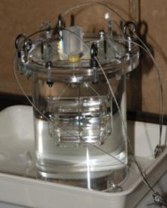
Gd Inside SK
2.4L vessel
2007: 0.2 % GdCl₃
α+ ⁹Be→¹²C*+n
¹²C*→¹²C+ γ(4.4 MeV)
n+p →…… →n +Gd→Gd+ γ
[SK Collab, Astropart. Phys. 31,
320-328 (2009)]
(Am/Be Source)
BGO signal (prompt signal
(large and long time pulse))
BGO
Look for Cherenkov signal (delayed signal)
2010: 0.2% Gd₂(SO₄)₃
Solution

Slide 10
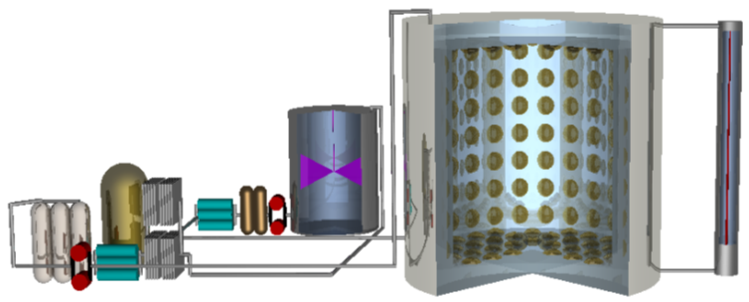
Pushing The Gd Front
Many studies have been ongoing in both the US and Japan over the last 10 years
EGADS (Evaluating Gadolinium’s Action on Detector Systems)
  New dedicated, multi-million dollar test facility
  Kamioka mine (near SK)
  Will address all issues of the GADZOOKS! principle.
Water transparency measurement device
240 50 cm PMTs
Pre-treatment system
Gd Removal System
Selective water+Gd filtration system
[Graphic by A. Kibayashi]
200 ton water tank
(SUS304)

Slide 11
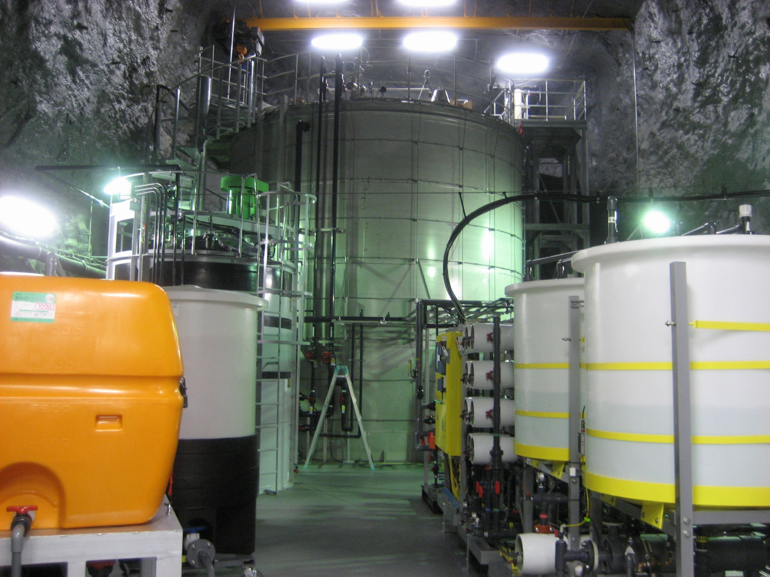
The EGADS Lab
Water transparency measurement device
200 ton tank
15 m³ tank and pre-treat system
Gd resin removal system
Selective filtration system

Slide 12
Challenges Faced
Compound to be used
Effects on detector components
Introduction and removal
Introduction of new backgrounds for new and existing analysis
Keep Gd inside the SK tank
Maintaining ultrapure doped water
Effect on water transparency

Slide 13
Which Compound To Use
Three choices investigated thus far:
  Gd(NO₃)₃
    Easily dissolved
    Nitrate opaque in the UV (very bad for Cherenkov light)
  GdCl₃
    Easily dissolved
    Chloride highly corrosive (not good for components)
  Gd₂(SO₄)₃
    Octahydrate form dissolves easily
    Good water transparency
Gadolinium sulfate is the compound being tested at EGADS

Slide 14
Materials Effects
31 materials present in the SK tank have been long-term soak tested in Gd₂(SO₄)₃ solution to check for corrosion.
Only affected material is a rubber used for the FRP/acrylic cases.
Further studies with this rubber show the effect is comparable to pure water if temperature is kept below 15 ̊C.
Final soak study of SK materials will be done with components installed inside EGADS detector

Slide 15
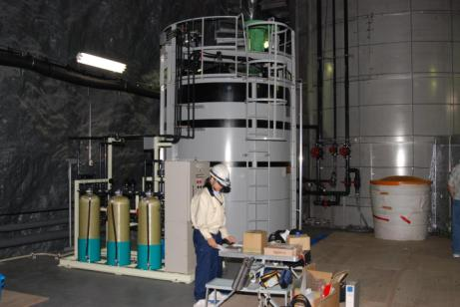
Gd Pre-Treatment System
  Gd₂(SO₄)₃ is soluble up to 2% by mass
15 m³ tank to dissolve Gd
Make concentrated solution and then add to detector in steps
Simple water system with uranium removing resin tanks

Slide 16
Selective Water Filtration
UF#1 Reject Line
Ultrafilter #1
Ultrafilter #1
Chiller
200 ton EGADS
Detector
UV
#1
To Drain
AJ
0.2 μm
2nd Stage Filter
5 μm
1st Stage
Filter
Gd is diverted here and bypasses Deionization (DI)
Membrane
Degas
UF#2
Reject
Nanofilter #1
Nanofilter #1
Concentrated Gd NF Reject Lines
0.5 ton Collection Buffer Tank
Nanofilter #1
Nanofilter #1
Conveying
Pump
(~0.35 MPa,
>4 ton/hr)
Ultrafilter #2
99.99% Gd recovered each pass, <0.006% lost
Ultrafilter #2
Recycles RO Reject Lines
UV
#2
0.5 ton Buffer Tank
RO Permeate Lines
Nanofilter #2
Nanofilter #2
Nanofilter #2
TOC
Repressur-
ization
Pump
(>0.9 MPa,
>2 ton/hr)
DI
#2
DI
#1
Repressurization
Pump
(>0.9 MPa, >1.5 ton/hr)
RO #2
5 μm
Filter
5 μm
Filter
RO #1

Slide 17
Water Transparency Monitoring
Precision measurements of attenuation lengths >100 m
Log(Ch.B/Ch.A)
~0.1% Gd₂(SO₄)₃ solution
Monitor relevant Cherenkov region using multiple
lasers
Devices fully automated, running is rather simple and quick
Water column depth

Slide 18
EGADS Tests
Pure water in 200 ton tank (no PMTs)
Gd water in 15 m³ tank
Gd water in 200 ton tank (no PMTs)
Pure water in 200 ton detector (with PMTs)
  Ongoing now
Gd water in 200 ton detector (with PMTs)
✓
✓
✓

Slide 19
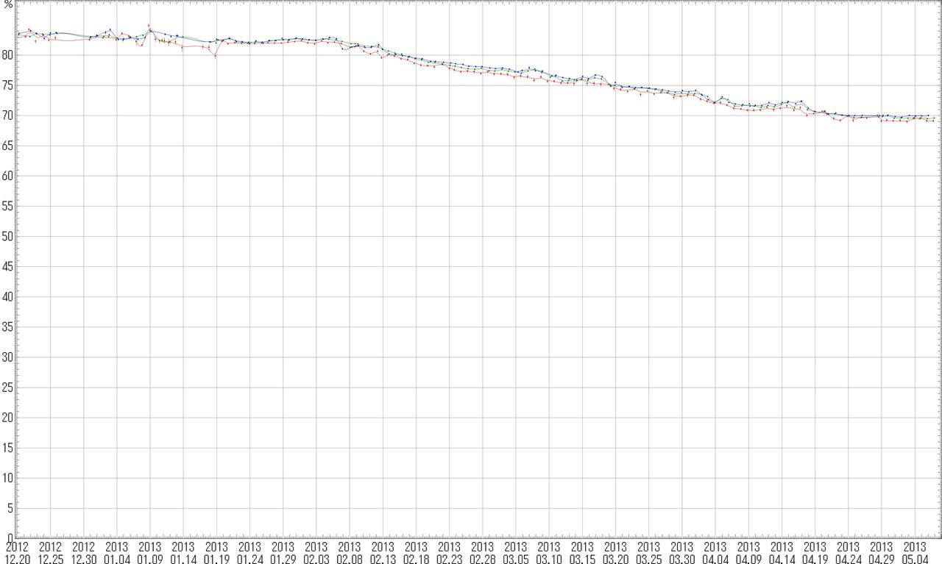
EGADS 200 Ton Tank Gd-Water Transparency
SK-III and SK-IV Ultrapure Water = 74.7% - 82.1% @ 15 m
400 kg (0.2%) → 88% on Gd
149.4 (0.075%) → 73% on Gd
274 kg (0.138%) → 83% on Gd
89.4 kg (0.045%) → 62% on Gd
The light left at 15 m in the 200m³ tank stainless steel) was ~69% for 0.2% Gd₂(SO₄)₃, which corresponds to ~84% of pure water.
60 kg (0.03%) → 52% n capture on Gd
30 kg of Gd₂(SO₄)₃*8H₂O (0.015%) → 35% n capture on Gd

Slide 20
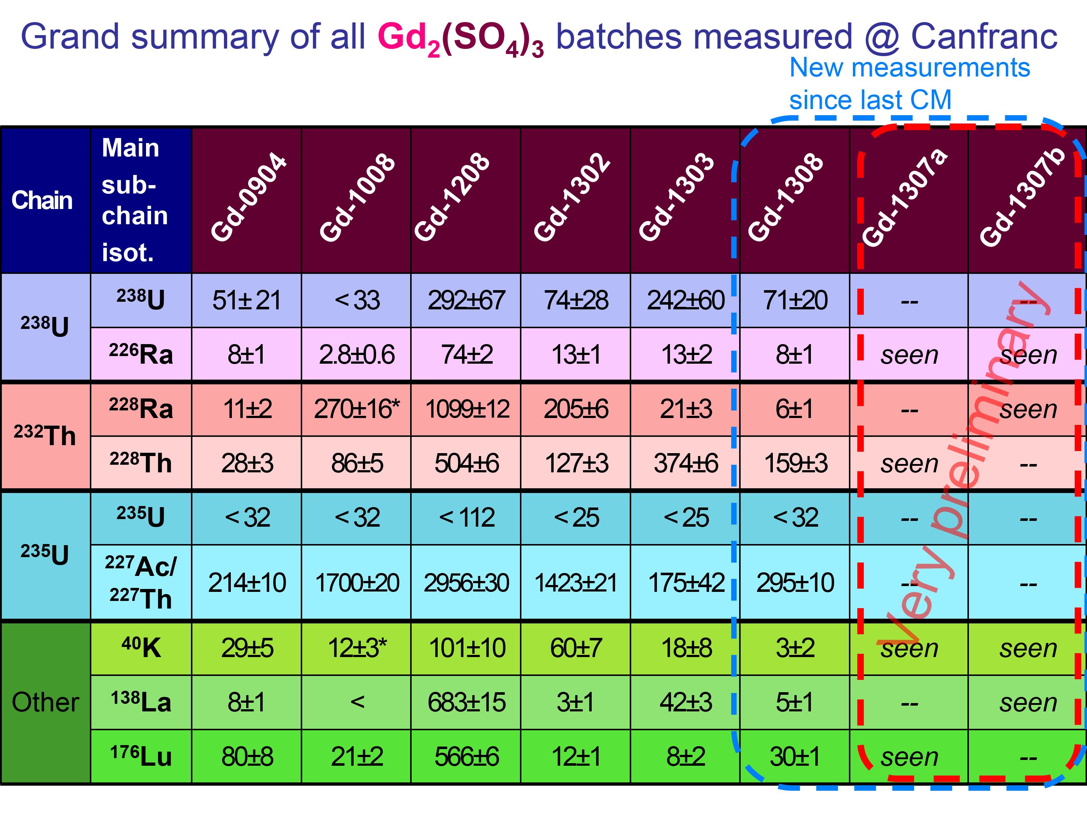
Radioactive Backgrounds

Slide 21
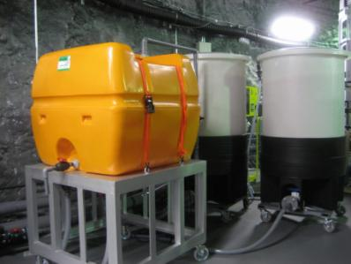
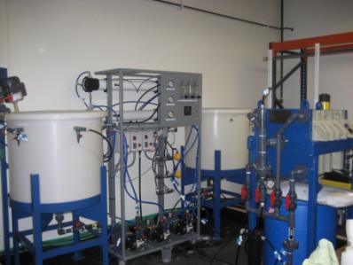
Gd Removal
First method used at EGADS
Method 2: Removal system and filtering
Method 1: Ion exchange resin
pH up->Gd out of solution
Filter with a mechanical filter
Settling tanks may be more useful than filter press
Test shows Gd levels ~1000 ppm to less than 0.5 ppb
Resin will saturate, ok for small scale

Slide 22
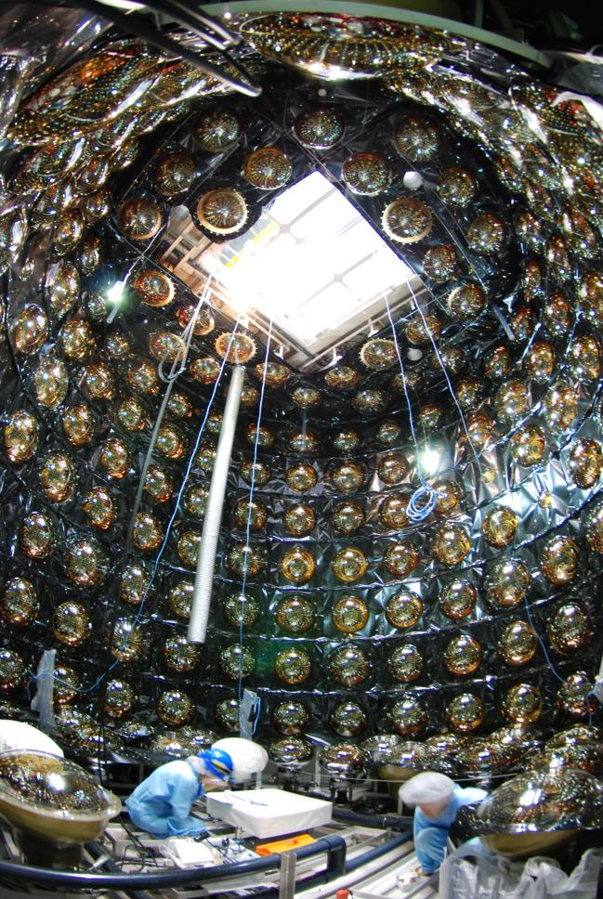
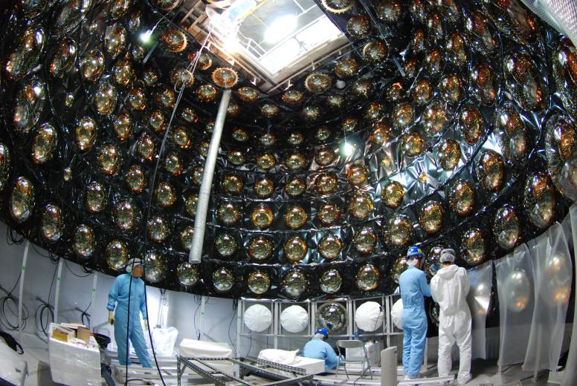
240 PMTs Installed this Summer
Pure water circulation was started.
Gd-loaded test will start soon

Slide 23
EGADS Roadmap
2009 2010 2011 2012 2013 2014 2015 2016 2017
R&D Project
Approved
Hall E Excavation
Build 200-ton Tank
Install Water Systems
15-/200-t Pure Water Runs
EGADS will run for the indefinite future as an instant Galactic supernova detector!!!
15-ton Tank Gd Runs
200-ton Tank Pure Water Run w/o PMTs
200-ton Tank Gd Run w/o PMTs
200-ton Tank PMT Installation
200-ton Tank Pure Water Data-taking Run
200-ton Tank Gd Data-taking Run
ATM → QBEE Electronics Upgrade
Full Galaxy Supernova Sensitivity
Fully Automated Instant Supernova Alert Capability
[M. Vagins]

Slide 24
The Road to GADZOOKS!
Water in 200 ton detector currently 17.4 MΩ-cm, will soon remove extra DI unit from system
Add Gd to EGADS detector in January 2014
Run EGADS Gd detector as final proof of principle test
Full SK MC studies with additional information of scattering and absorption of Gd
May 2014->SK to decide on GADZOOKS!
So far, so good!!!!!!

Slide 25
WATCHMAN
US based remote reactor monitoring demonstration, adopting many EGADS techniques
1 kt FV, 50 M$ Total Project Cost
Preferred site identified (IMB/Morton Salt, Ohio) and approvals obtained from mine operators
MC studies and prototype detector deployment ongoing
FY14 decision point for full detector
FY16 start of construction

