Slide 1
Performance evaluation and pre-calibrations of prototype photo-detectors
Seiko Hirota (Kyoto)
2013. 6. 22
@ 3rd HK open meeting

Slide 2
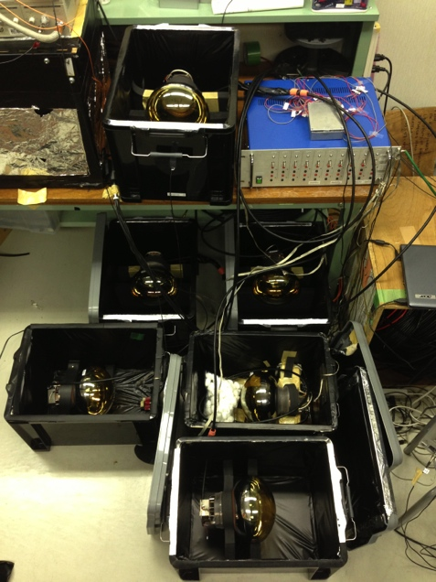
Photo-detector preparation for the proof test
Production of photo-detectors for the proof test
  10 of 8 inch HPDs
  8 of 20 inch high-QE PMTs
8inch HPDs
This talk
Pre-selection and calibration
  To reject photo detectors showing too bad performance
  Check basic performance after calibration.
Feasibility Check
  Operation check of all HPDs in Gd water.
  Additional calibration.
In this Summer!
Install 8 of 8” HPDs and 5 of 20” high-QE PMTs into the tank
Notes:
As Nishimura-san said, we are preparing for the proof test.
New photo-detectors have been arrived
We must select photo sensors to get same performance as other normal QE PMTs in EGADS tank
At first to reject
流れを言う。
10本、8本が来た→不良品を除く(性能面で) →最終的には不良品以外のものから選んでいれる。
今回は「ダメなものをはじくために測定した」という事を強調？

Slide 3
Criteria for Pre-selection
High-QE 20” PMTs and 8” HPDs were selected with…
    Dark Rate < 35kHz
      To avoid many fake triggers.
    P/V ratio (1 p.e.) > 1.2
      To require good 1 p.e. sensitivity.
Normal-QE 20” PMTs have already been selected by this criteria for installation.
Photo detectors to be installed into the EGADS tank must satisfy these criteria at least.

Slide 4
Sequence of pre-calibration and pre-selection
1 p.e. charge distribution
Single p.e. gain at tentative HV
Performance Evaluation
P/V
Gain
Adjustment
Gain-HV Curve
HV scan using constant light source
Dark Rate
For pre-selection
Pre-calibration
Setup In Kamioka mine @ 25℃
4
Dark box
Discri
Counter
For Dark Rate
Laser
Diode
  Integration width 200ns
  (407nm 70ps pulse)
Photo-sensor
ADC
For Gain Curve, 1 p.e.

Slide 5
High-QE PMT result

Slide 6
High-QE PMT Gain Adjustment
Gain of PMTs are set to 1.4×10⁷ same as normal QE PMTs
HV distribution
high-QE PMTs
normal QE PMTs
(×0.08 normalize)
Num. of PDs
1.4×10⁷
After gain
adjustment
1500 1750 2000 2250 2500 [V]
1p.e. Gain distribution
Fit Function
Gain∝V^{α}
high-QE PMTs
normal QE PMTs
(×0.026 normalize)
Applied voltage [V]
Num. of PDs
We tuned all PMTs’ gain within 2% precision from target.
1 2 3 4
Gain [pC/1p.e.]
Notes:
青の図の説明
スケール、ビンを荒くしてログ、字は大きく
低そうに見える件は別にバックアップに。
（聞かれたら、でいい）

Slide 7
High-QE PMT 1p.e. resolution
Charge
distribution
P/V distribution
pedestal
high-QE PMTs
normal QE PMTs
(×0.08 normalize)
1p.e. peak
P/V = 1.88
valley
P/V
Clear 1p.e. peak is recognized.
P/V is the ratio of 1 p.e. peak to valley height.
Comparable to normal-QE PMTs.
  Completely same structure except for photo cathode as SK PMT.
Notes:
グラフの横軸を変える。
・1p.e.がはっきり見える
・PVの定義
・P/VはノーマルQEのものと同じ。
--（光電面以外は同じ)

Slide 8
High QE PMT Dark Rate
!! Measured for pre-selection !!
HV ON
35kHz
Stabilization of Dark Rate
1.0
0.9
0.8
Measured
for pre-selection
high-QE PMTs
normal QE PMTs
(×0.08 normalize)
Dark Rate [kHz]
Dark Rate @ 0.8p.e. Distribution
Time after HV ON
All high-QE PMTs show lower dark rate than 35kHz.
Dark rate after stabilization to evaluate performance during operation will be measured in the tank.
Notes:
安定性の図6時間のものに変える。
ダークレートが高いとダメな事を再度確認。
見せている結果は遮光後のもので、入れておいておくと下がる事を説明
6時間ぐらいで下がる、さらにタンク内で数ヶ月かけて下がる事も期待される→はかる予定

Slide 9
Summary of high QE PMT measurement
<35kHz
>1.2
PMT Serial | Adjuted gain (/1p.e.) difference |  | HV | Dark Rate @0.8p.e. | P/V | Q.E. @370nm
ZP0007 | 2.30 | +0.49% | 1759V | 10.43 kHz | 1.38 | 31.5
ZP0012 | 2.24 | -0.65% | 1775V | 22.72 kHz | 2.11 | 29.2
ZP0014 | 2.30 | +0.76% | 2170V | 19.44 kHz | 1.70 | 34.8
ZP0015 | 2.30 | +0.54% | 1858V | 27.64 kHz | 1.82 | 32.6
ZP0021 | 2.29 | +0.23% | 1723V | 20.61 kHz | 1.40 | 31.5
ZP0022 | 2.26 | -0.93% | 1790V | 20.38 kHz | 1.70 | 30.8
ZP0024 | 2.26 | -0.91% | 1580V | 33.23 kHz | 1.62 | 32.5
ZP0025 | 2.32 | +1.37% | 1664V | 13.32 kHz | 1.37 | 29.4
All 8 high-QE PMTs were measured
and passed the pre-selection !
Notes:
＋ーつける
下２桁までにする

Slide 10
HPD result

Slide 11
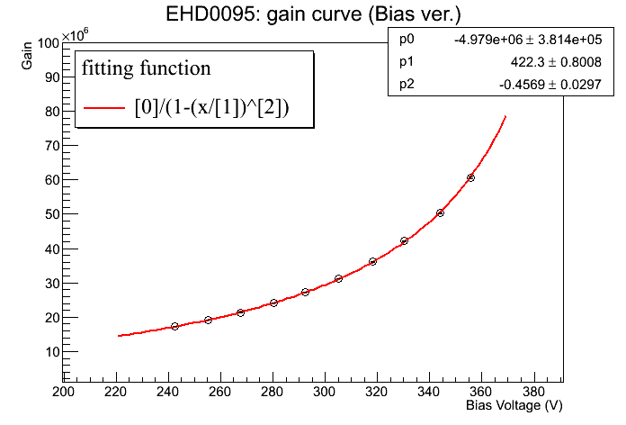
How to Adjust HPD Gain
Avalanche Diode (AD)
~8kV
e
Amplifier
e
AD
“Bombardment” gain
~300 @8kV
Amplifier gain
~700
Total
Gain
AD gain
~200@300V
HV dependence
AD bias dependence
Total Gain
Total Gain
Fix to 8kV
Tuned by AD bias V

Slide 12
How to decide target AD gain
Performance by AD bias gain
1p.e. Resolution
EHD 0057
P/V
Pedestal width
Total gain by various AD bias V at 8kV
Single p.e. resolution is related to AD gain.
Target gain for HPDs is set so that best performance is obtained.

Slide 13
HPD Gain Adjustment
HPD
5×10⁷
Target Gain
Precision of gain tuning [%]
Gain – HV Curve.
Gain distribution of all HPDs after calibration.
Gains are adjusted within 3% difference from the target.
Notes:
分布図
横軸 AD Bias
１
ADゲインで合わせる。
再度原理を説明。
ゲインの説明。
2.
何に合わせるか(分解能の良いところで合わせる)
横軸ゲインでつくる

Slide 14
HPD 1p.e. resolution
Charge Distribution of 1p.e.
P/V Distribution of 1p.e.
normal PMTs for EGADS
(×0.08 normalize)
Pedestal
1.2
HPD
Valley
1p.e. peak
P/V
Ave. ~1.4
Ave. ~4
All HPDs show excellent P/V in comparison with PMTs
Notes:
1p.e.は「とても」よい事を言う。
図に1.2？のラインを入れておく
JPSの図
青も緑と同じように

Slide 15
HPD Dark Rate
!! Measured for pre-selection !!
Dark Rate Scan
Distribution of Dark Rate
35kHz
35kHz
Green : HPD
Blue: normal PMTs
for EGADS
(Scaled ×0.08
1p.e.
plateau
Dark Rate [kHz]
HPDs show clear shoulder of 1 p.e.
  Threshold will be set in plateau region
All HPDs show lower dark rate than 35kHz.
These results are gotten just after light shielding.
  Dark rate after long-time stabilization in the EGADS tank will be measured.
Notes:
文の位置
ダークレートの測定に関しては、pre-selection 用の測定だという事を明記。
ダークレートの図をラインにする。（ノーマルのものと比較してみる）
1p.e.の場所がわかるようにする。
下の2項目が先。どっちがどっちの図に対応するかわかるように。
最後に、最終的な値はEGADSではかる
赤のグラフの1p.e.を確認のこと
色を青、緑に重ねる。

Slide 16
Summary of HPD measurement
<35kHz
>1.2
HPD Serial | Adjusted gain (/1p.e.) difference |  | Bias Voltage | Dark Rate | P/V
0073 | 8.0pC | -2.12% | 371V | 10kHz | 4.54
0074 | 8.1pC | -1.82% | 350V | 14kHz | 5.41
0078 | 8.3pC | +1.21% | 267V | 3kHz | 3.59
0080 | 8.2pC | +0.40% | 327V | 6kHz | 3.01
0083 | 8.0pC | -2.85% | 296V | 1kHz | 5.58
0084 | 8.0pC | -2.01% | 341V | 3kHz | 5.32
0091 | 8.1pC | -1.05% | 324V | 15kHz | 4.80
0092 | 8.0pC | -2.40% | 297V | 25kHz | 5.11
0094 | 8.1pC | -1.27% | 354V | 6kHz | 4.32
0095 | 8.3pC | +1.18% | 333V | 8kHz | 5.25
All 10 HPDs pass the pre-selection and show excellent P/V!

Slide 17
Summary
All 10 HPDs and 8 high-QE PMTs were prepared
for the proof-test in the EGADS tank.
We measured P/V and dark rate of these photo-detectors after a gain adjustment
  High-QE PMT: comparable to normal-QE PMTs
  HPD: Excellent P/V and lower dark rate
Notes:
小項目は、各サマリーテーブルに移動。
Following thingsはいらない。
（最後は言うとすれば、温度依存性とQEの効果を考慮したいと考えている)

Slide 18
Back Up

Slide 19
Timing resolution of HPD
Timing distribution of 1p.e. signal
σ =1.1ns
1p.e. signal
2p.e.
3p.e.
±3σ
Pulse Height distribution

Slide 20
Plan of final calibration for installation
In case of HPD
  Not only gain dependence of 1 p.e. resolution but also temperature dependence of gain will be took into consideration in decision of HPD operation gain in EGADS.
  After setting water-proof housing, we will do calibration of gain.
In case of high QE PMT
  We will do energy calibration before installation.
HPD防水の様子

Slide 21
Contents
Overview of HPD and high QE PMT calibration
HPD selection criteria for installation to EGADS
Set up for calibration and performance evaluation
High QE PMT selection criteria for installation to EGADS
Sequence of measurement
High QE PMT calibration result
  Gain curve
  1 p.e. resolution
  Dark Rate
HPD calibration Result
  Gain curve
  1 p.e. resolution
  Dark Rate
Changing points in HPD electronics after calibration
Plan of final check before the installation
Summary

Slide 22
HPD Measurements
Flasher Rate < 1Hz in total HPDs
  In the past, there were some PMTs make flasher in the SK tank.
  Also we confirmed that some HPD makes flash with some rate .
  We checked abnormal HPD signal rate because in most case, flashes accompany with some inverted or very big HPD signals.
Dark rate < 80kHz
  Same as PMT selection by EGADS
Better 1p.e. resolution
  All HPDs have better resolution than PMTs. So we will remove worse 2 HPDs

Slide 23
High QE PMT measurements
Gain adjustment
  Gains were set to 10⁷ in single p.e. detection.
    Gain will be difference if we inject large number of photons due to quantum efficiency.
Gain Curve
  Light source yield were set to where PMT can always detect ~50 p.e.s.
1 p.e. resolution
  Light source were set to where PMT can detect 1p.e. in every 10 injections.
Dark Rate
  High QE PMTs are expected to have higher dark rate than normal QE PMTs corresponding to QE.
  Dark Rate must be under 30kHz at 0.25 p.e. level to installation into the EGADS tank.
Dark Rate とQEの関係図

Slide 24
8” HPD measurements
Gain adjustment
  Gains were set to 5×10⁷ in 1p.e. detection
    Required dynamic range of 8” HPDs is narrower than 20” PMTs due to its aperture size.
    We want to operate HPDs with best performance.
Gain Curve
  Light source yield were set to where PMT can always detect ~50 p.e.s.
1 p.e. resolution
  Light source were set to where PMT can detect 1p.e. in every 10 injections.
Dark Rate
  Dark rates at 0.6 p.e. level must be under 30kHz to installation into the EGADS tank.
    Threshold for HPD signals will be around 0.6 p.e.
    Because of better resolution than PMTs, we don’t need to set threshold of HPDs to low p.e. level like that of PMTs (0.25 p.e. in SK)

Slide 25
HPD abnormal signal rate
Abnormal signals which is partly or totally inverted are accompanied with flashes but not all abnormal signals have them.
正極パルスの例
正極パルスレートの分布
および、発光レート
セレクション基準

Slide 26
HPD Gain Curve
ゲインの決め方(別ページ)
  PMTと同じでない理由も含めて（分かりにくならなければ）EGADSでのエレキの話しがいる？
Gain curve 重ね描きの図
ターゲットゲインを明記(図中に)
HPD毎のHV設定値を表で示す
合わせたあとの1p.e.のピークの重ねがき

Slide 27
Improvement after HPD calibration
保護回路実装の経緯(簡単に)
保護回路実装による波形の変化
1p.e. 、ダークレート、TTSの変化、許容範囲かどうか

Slide 28
Convolution of C.E. and Q.E.
同じ光量で取ったと思しきデータを解析した結果？見積もりをだしてみる？
ある大きな光量でキャリブレーションしたときの設定値?

Slide 29
Convolution of C.E. and Q.E.
同じ光量で取ったと思しきデータを解析した結果？見積もりをだしてみる？
ある大きな光量でキャリブレーションしたときの設定値?

Slide 30
Over view of
Photo-detectors pre-calibration
We prepared following things for the proof test.
  10 of 8 inch HPDs
  8 of 20 inch high QE PMTs
We will install these things into EGADS tank
  8 of 8 inch HPDs
  5 of 20 inch PMTs
We measured gain curve and other basic performance for adjustment of gain and selection
  1p.e. resolution (All HPDs and PMTs)
  Dark Rate (All HPDs and PMTs)
  TTS (Single HPD)
8inch HPDs

Slide 31
Sequence of measurement
1p.e. measurement.
  To know absolute gain at some HVs of photo-detectors.
  Light source were set to where PMT can detect 1p.e. in every 10 injections.
Gain Curve measurement
  To know relative gain curve as HVs change.
  Light source yield were set to where PMT can always detect ~50 p.e. s.
Adjustment of gain.
  Scale relative gain curve based on the result of 1p.e. measurement.
  Iteration of tuning gain.
1p.e. resolution, dark rate measurement with adjusted gain.
  Dark rate @ Thr. must be under 35kHz (Same selection criteria as EGADS ).
 | 20” High QE PMT | 8” HPD
Target Gain | 1.4×10⁷ (for 1p.e. detection) | 5×10⁷ (for 1p.e. detection)
 | Same gain as 20” normal PMTs in EGADS. We adjust these gains in 1p.e. measurement. Target gain will be difference in energy calibration due to high QE. | Required dynamic range of 8” HPDs is narrower than 20” PMTs due to its aperture size. We want to operate HPDs with best performance.
Notes:
ダークレートとP/Vがpreselection の基準になる理由
EGADSのPMTも同じように不良品チェックされている。
手順

Slide 32
Set Up for measurements
----- For Dark Rate Threshold Scan
----- For Gain Curve, 1 p.e. resolution
measurement
Location: Lab-B, Kamioka mine
Temperature: 25℃
TKO
Dark box
ATM Discri
Laser
Diode
DAQ PC
Counter
Photo-sensor
ADC
VME
HV Power Supply LV Power Supply
(~2kV for PMTs ) (~10V for HPDs)
OR
Laser Diode
NIM
Notes:
セットアップの図は写真の方が良い。→前ページに一緒に入れる(入れられれば)
(レーザーの波長、パルス幅、積分の時間）

Slide 33
For Dark Rate Threshold Scan
Discri
Counter
ADC
For Gain Curve, 1 p.e. resolution measurement

Slide 34
High QE PMT Gain Curve
HV distribution after adjustment
1.4×10⁷
Red : high QE PMTs
Blue: normal PMTs
for EGADS
(Scaled ×0.08)
Fit Function
Gain∝V^{α}
Gain distribution after adjustment
Applied voltage [V]
We adjusted gain of PMTs to 1.4×10⁷ same as normal PMTs in the EGADS tank.
We can tune all PMTs’ gain in 2%.
Applied voltages are difference from that of normal one. It is because of the difference of production lot.
Red : high QE PMTs
Blue: normal PMTs
for EGADS
(Scaled ×0.08)
Gain [pC/1p.e.]
Notes:
スケール、ビンを荒くしてログ、字は大きく
低そうに見える件は別にバックアップに。
（聞かれたら、でいい）

Slide 35
Set Up for measurements
In Kamioka mine @ 25℃
Dark box
Discri
Counter
For Dark Rate
Laser
Diode
  (407nm 70ps pulse)
Photo-sensor
ADC
For Gain Curve, 1 p.e.
  Integration width 200ns
Location
  Lab-B, Kamioka mine
Temperature
  25℃
Light source
  Laser diode (407nm 70ps pulse)
Integration width of ADC
  200ns
Notes:
セットアップの図は写真の方が良い。→前ページに一緒に入れる(入れられれば)
(レーザーの波長、パルス幅、積分の時間）

