Slide 1
Status of HK water system and water quality 3rd Open Meeting for Hyper-K June 21 2013
Hiroyuki Sekiya
ICRR, University of Tokyo
for the Hyper-K Working Group 2
1

Slide 2
Targets of WG2
Source water in the mountains
Tochibora and Mozumi
Ultra pure water for supplying
Water system design
Water in the tank
Water flow design
Gd water option
Mark’s talk

Slide 3
Source Water for Hyper-K
Tochibora is already reported.
Our demand (>300m³/h) is filled.
Mozumi is not investigated officially yet.

Slide 4
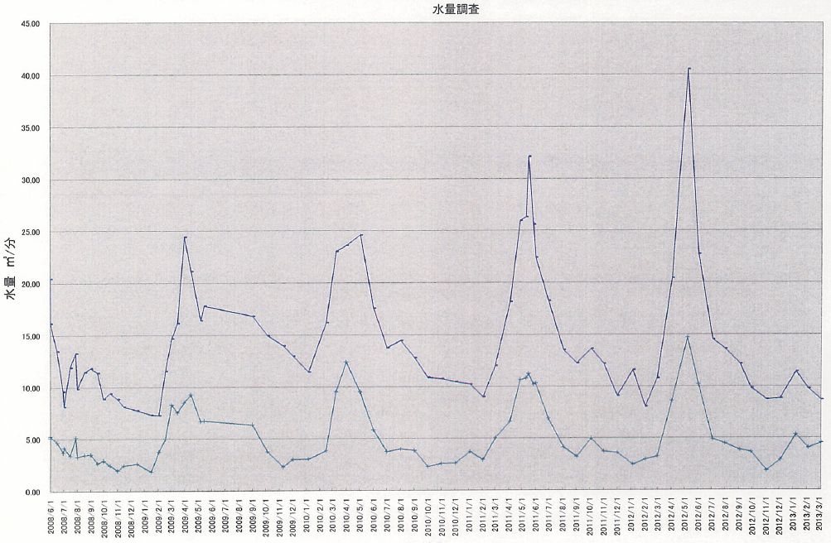
Atotsu water stream
45
m³/min.
40
35
30
25
20
15
10
5
0

Slide 5
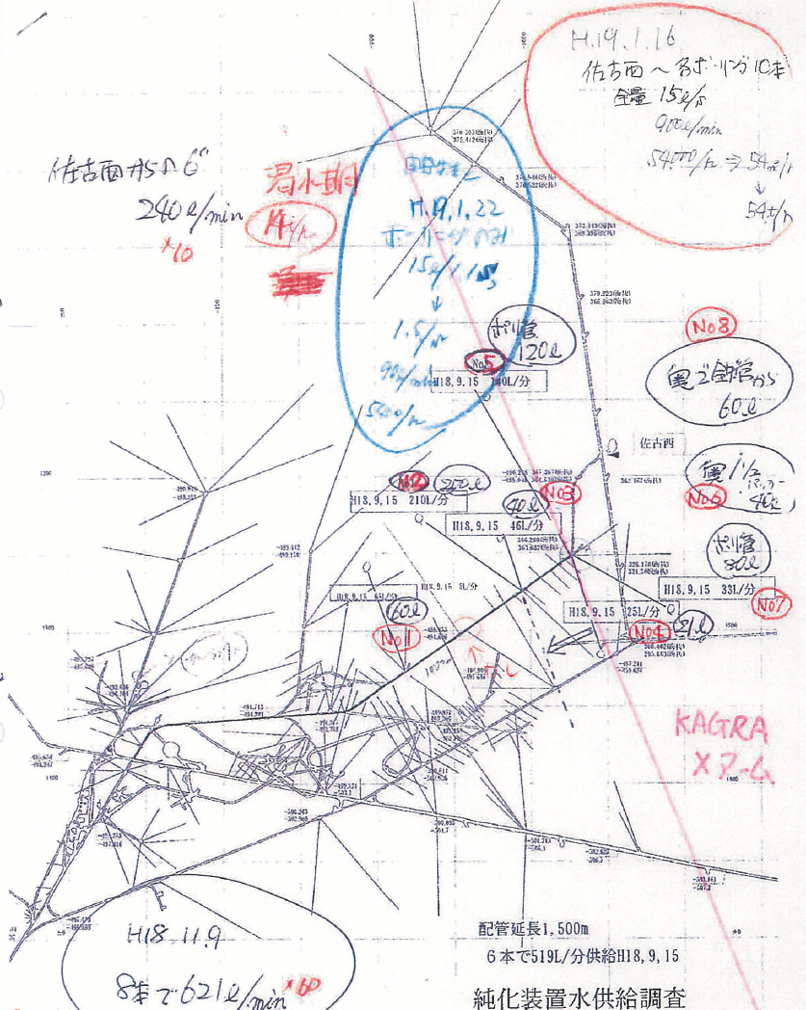
In addition
More than 300m³/h spring in KAGRA tunnel

Slide 6
Hyper-K water system Cost estimation of the Revised design

Slide 7
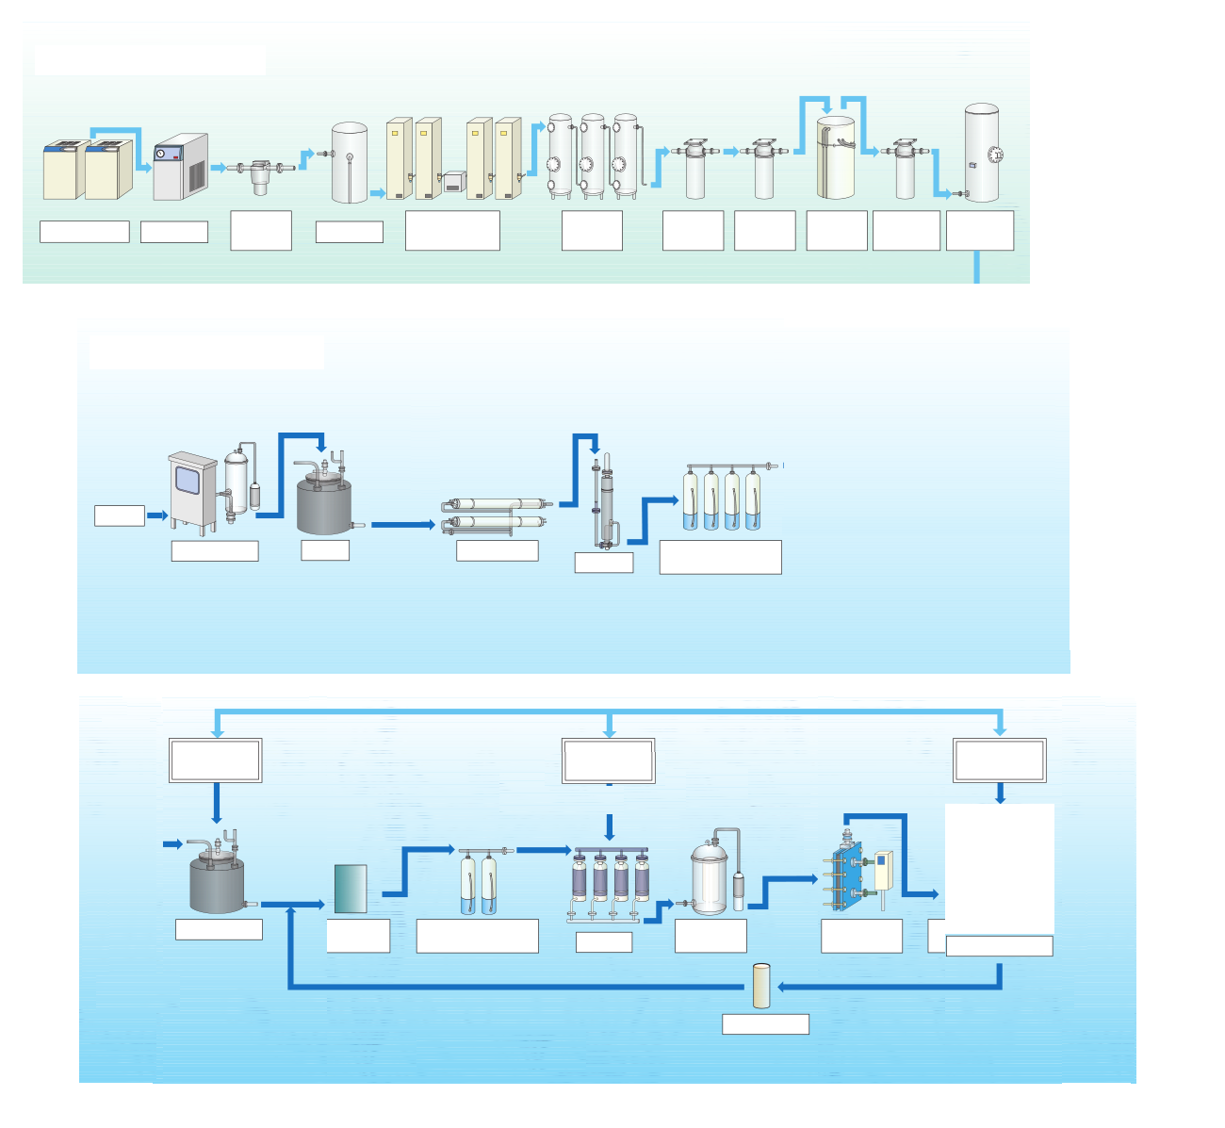
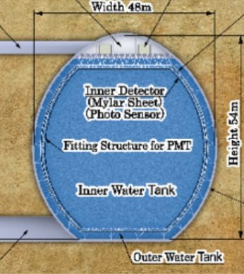
Rn Free Air generator (400Nm³/h)
Compressor
Dryer
0.3μm
filter
Buffer
H2O,CO2
remover
20ºC
Charcoal
0.1μm
filter
0.01μm
filter
-40ºC
Charcoal
0.01μm
filter
Buffer
Water Purification System
Tochibora plan
Mine water
10μm filter
Buffer
RO
CO2 remover
DI(MB)
NO RO
0.24kt/h for initial supply
purge
purge
purge
Buffer
UV
DI(CP)
MD
UF
T controller
1.2kt/h for recirculation
1μm filter
HK Tank

Slide 8
Rn Free Air generator (400Nm³/h)
Compressor
Dryer
0.3μm
filter
Buffer
H2O,CO2
remover
20ºC
Charcoal
0.1μm
filter
0.01μm
filter
-40ºC
Charcoal
0.01μm
filter
Buffer
Water Purification System
Mozumi plan
Mine water
DI(MB)
RO
DI(MB)
10μm filter
Buffer
RO
CO2 remover
CO2 remover
NO RO
0.3kt/h for initial supply
purge
purge
purge
purge
purge
Buffer
UV
DI(CP)
MD
UF
T controller
1.2kt/h for recirculation
1μm filter
HK Tank

Slide 9
Super-K water system
reject
compensation pump
FI-2
PI-8
PI-9
FI-6
drain
strainer
PI-11
FI-204
FP-4
FP-5
filter
RO-2
pump
FI-7
RO-2
Primary pump
FI-1
reject (drain)
RO-1-1
CIA-6
strainer
RO-1 pump
FI-3
PI-1
PI-A
PI-B
filter
mine water
PI-2
PI-3
PI-5
FI-5
CIA-1
Rn-free-air
dissolving tank
CIA-2
reject (drain)
RO-3 pump
RT-1
RT-3
RO-3
550
CV-2
post RO
pump
RO water tank
HE1
reject
UV
sterilizer
RT-2
RT-4
filter
FI-202
CIA-3
Ion exchanger 1/2
reject
RO-1-2
HE3
reject
UF reject pump
vacuum degasifier
reject
700
FI-10
PI-20
HE4
TIA-2
CIA-4
UF reject tank
A
v94
CIA
FI-101
ultra filter
membrane degasifier
PI-C
CV-1
B
PI-18
TI-101
FI-ID
purified water supply pump A/B
SK
tank
ID
bottom
return
pump

Slide 10
With or without RO?
For prolong the lifetime of UFs
At the beginning of the recirculation, UFs may be clogged frequently.
Initial cost vs. running cost
MF
UF
NF
RO
DI

Slide 11
Design with RO

Slide 12
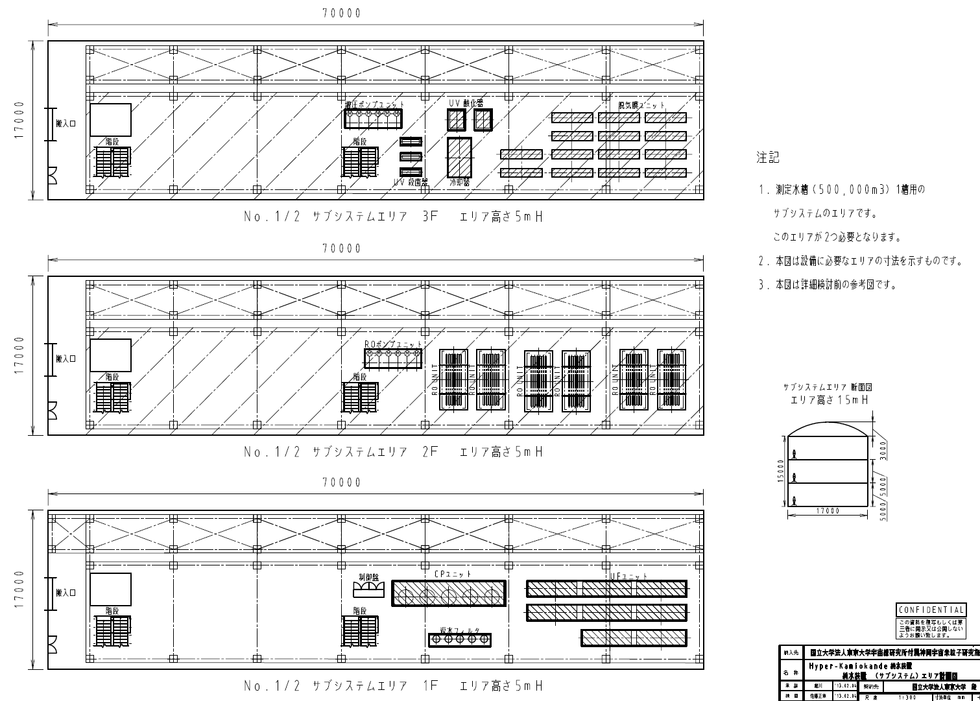
Layout
3 stages
Room for
Gd option

Slide 13
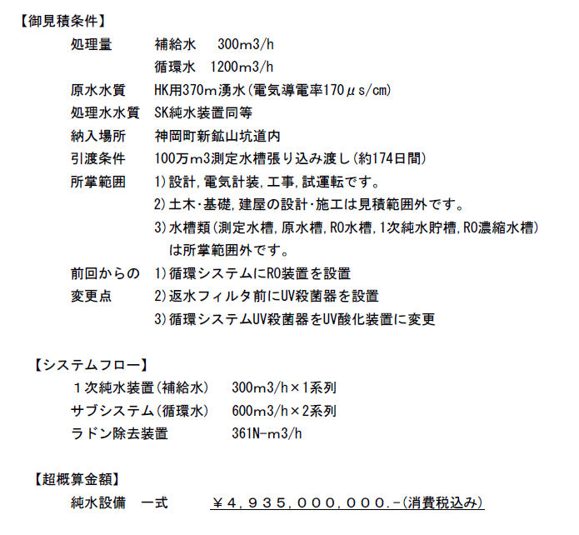
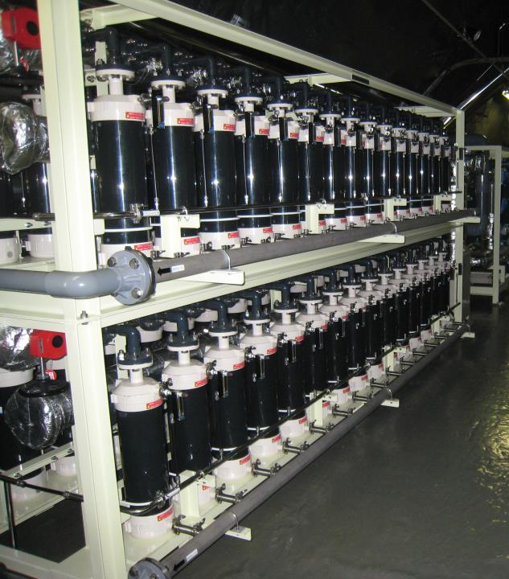
Cost estimation
Difference from previous estimation
RO
Increased UV sterilizer
SK-type MD
49.35 Oku-Yen

Slide 14
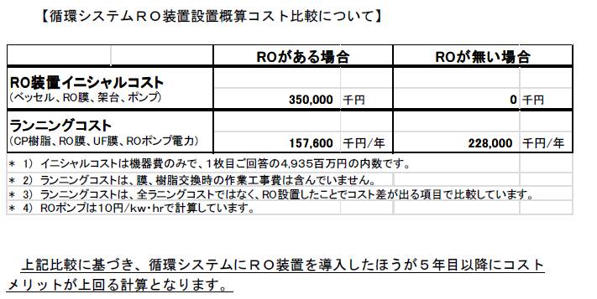
Consideration of running cost
w/RO
w/o RO
Initial
cost
3.5M$
0$
Running cost
About RO
1.6M$
2.3M$
After 5 years of running, w/RO system will gain cost merit.

Slide 15
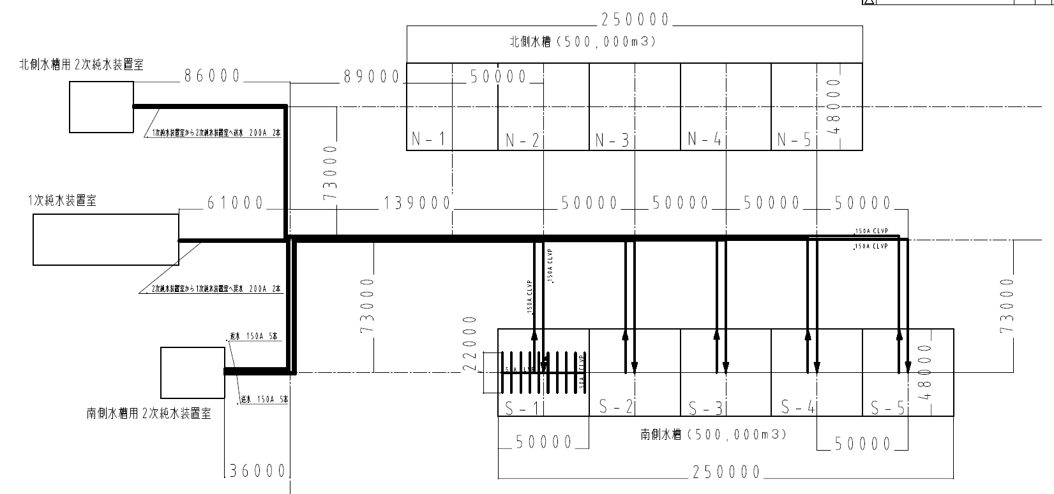
Plumbing from water system to tanks

Slide 16
Cost estimation
1.05 Oku-Yen

Slide 17
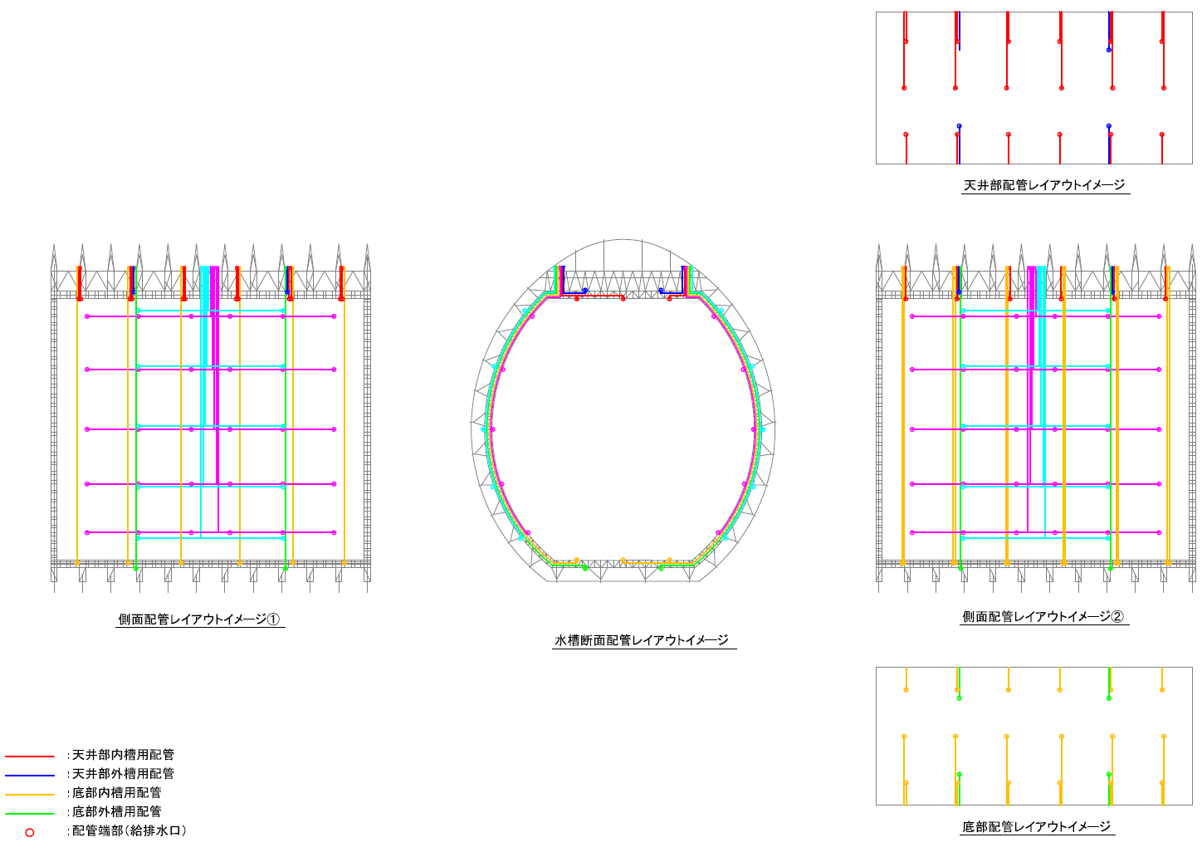
Plumbing in the tanks
Additional inlets/oultels at 5 levels of side wall for:
future activities to prevent stagnation
recirculation during initial filling to prevent bacteria from growing (180days!)
Cost is already included in the TANK

Slide 18
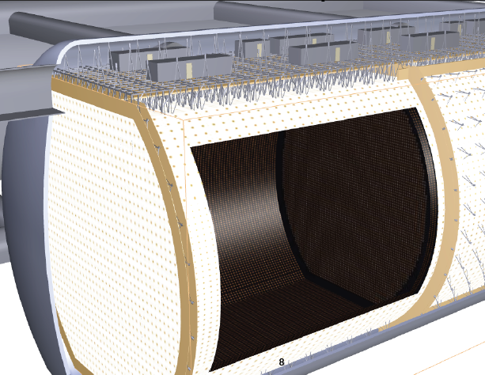
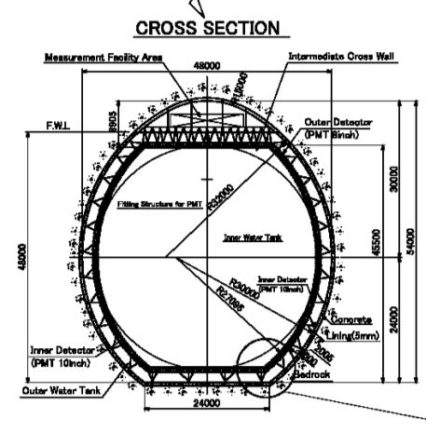
Water Flow simulation updates
One compartment for the first step
Software:
ANSYS GAMBIT2.4.1+Fluent13.0

Slide 19
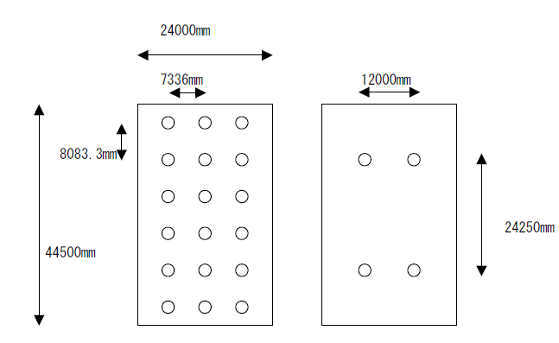
Water inlets & outlets conditions
Top and bottom pipes only
Equally distributed per top/bottom cross section

Slide 20
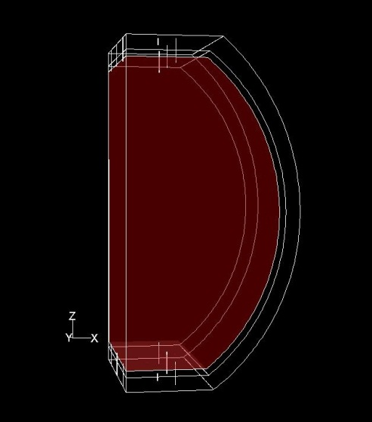
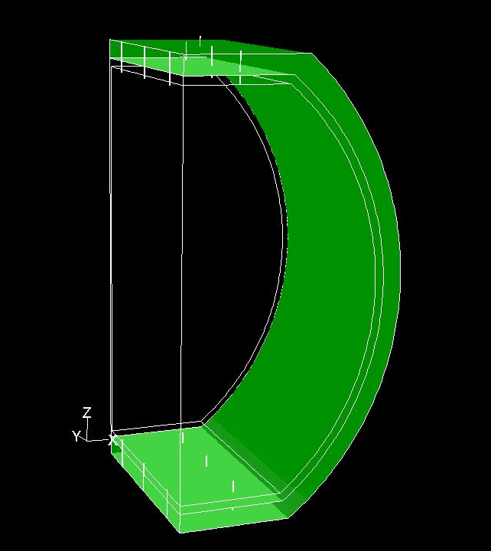
ID & OD Conditions
ID & OD are dealt as completely separated containers.
Because of its symmetrical shape, only 1/4 volume is considered for the simulation.
1,400,000 mesh
(xy, and yz symmetry)
 | Inner detector | Outer detector
Volume | 370,000m³ | 89,000m³
Flow rate | 96.7t/h | 23.3t/h
Number of inlets (outlets) | 18 | 4
Flow rate / inlet (outlet) | 5.37 | 5.82

Slide 21
Temperature condition
Cooling water 10.5ºC
Supplying water 13.0ºC
Top level rock 16.7ºC
Bottom level rock 17.7ºC

Slide 22
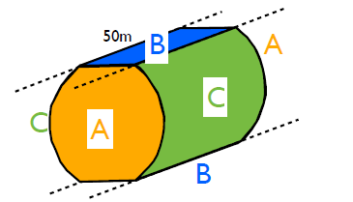
Other heat source conditions
Unlike SK, electronics(HV, QBee,..) are also in the tank.
The heat from compensation coil depends on the direction of the tank.
For one compartment
Area
47.4kW

Slide 23
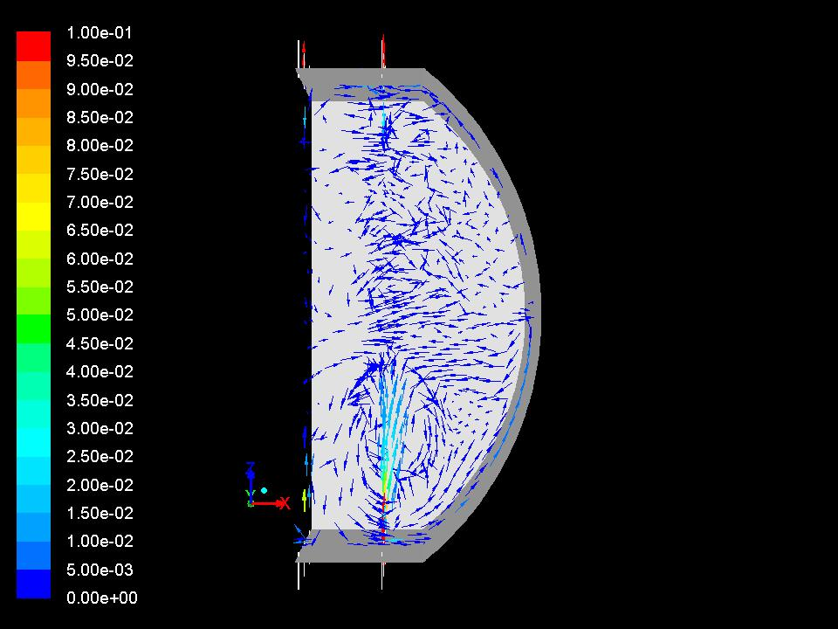
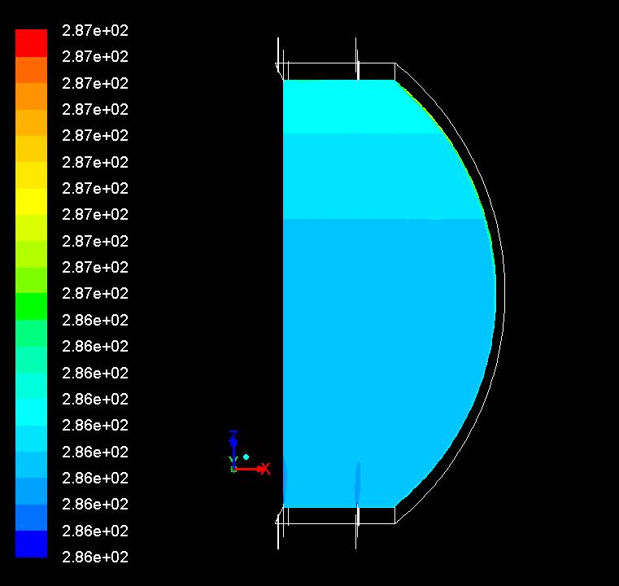
Full treatment simulation
supply: bottom, return: top
This is like SK… LowE oriented tuning.
Bottom convection and top stagnation.
ID ¼
Temperature

Slide 24
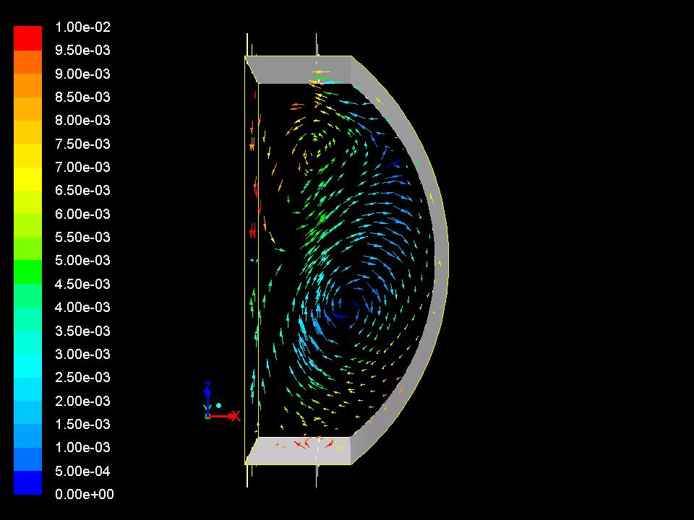
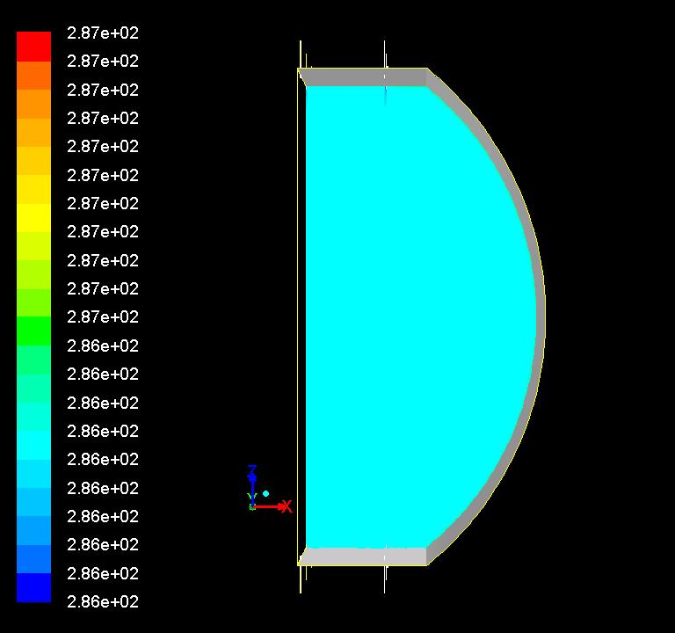
Inverse operation
Supply cold water to the top, return: bottom
This is atmpd/t2k oriented tuning.
Whole convection uniform detector
ID ¼
Temperature

Slide 25
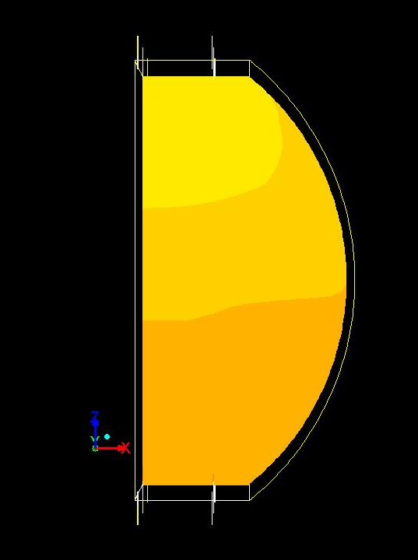
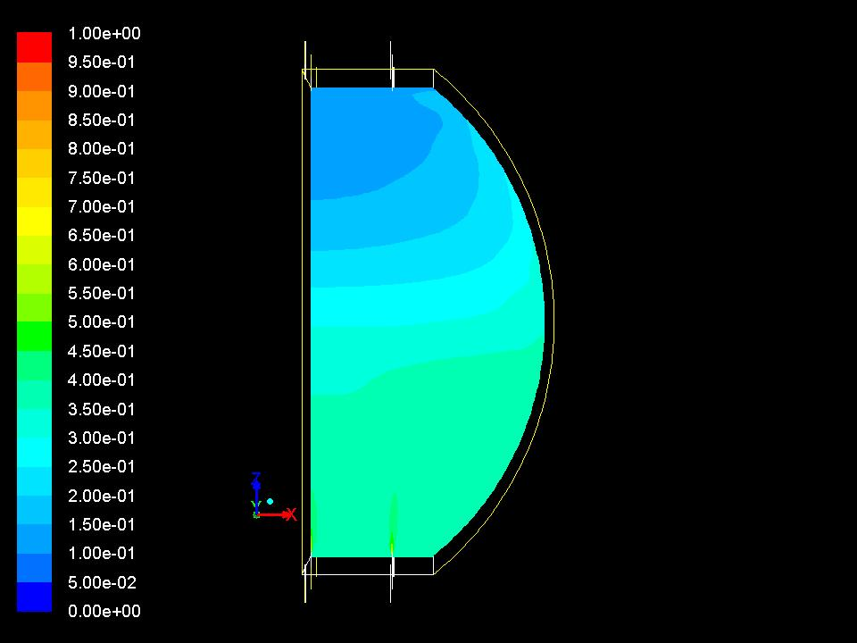
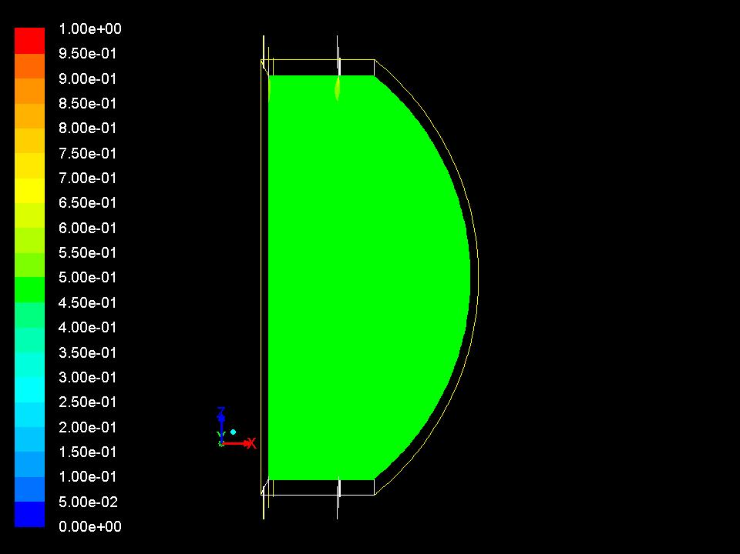
Time evolution
supply: bottom, return: top
10 days
20 days
30 days
40 days
Supply cold water to the top, return: bottom
Not yet

Slide 26
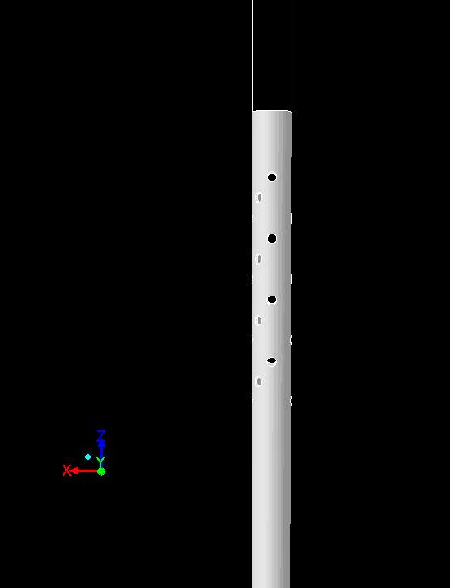
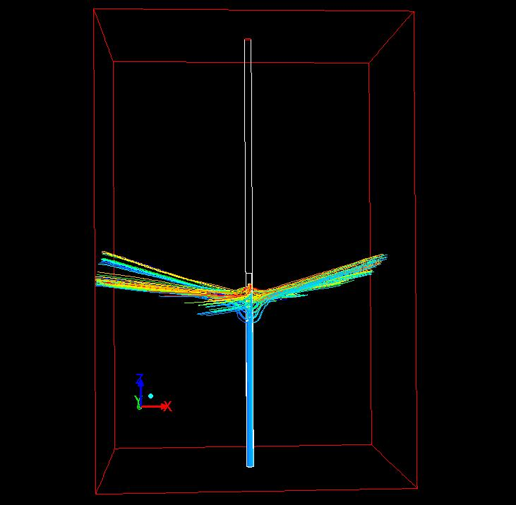
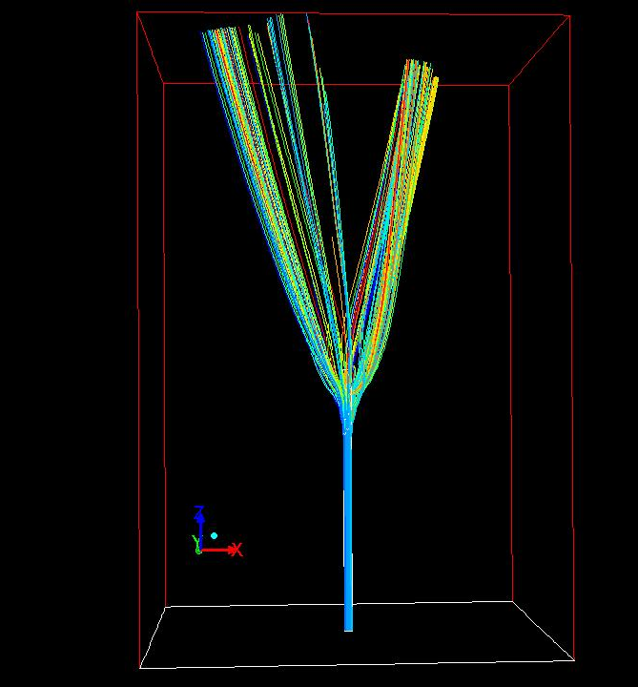
Inlet pipe shape simulation
SK inlet (thickness is unknown)
Very difficult…
4mm thick pipe case
Thin pipe case

Slide 27
Conclusion
Hyper-K water system was re-designed w/RO.
For both Mozumi and Tochibora options
Rough cost estimations are finished
Progress on the water flow simulation.
Super-K flow is reproduced in Hyper-K tank.
Started to estimate the effects of inlet pipe shapes.
Working on detail simulations.
SK flow in SK tank? For the validation of the simulation.
Using side wall inlets/outlets

Slide 28
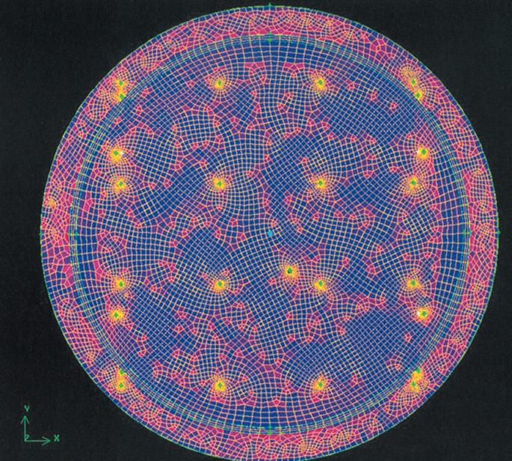
SK mesh for the flow simulation

