Slide 1
ICFA Neutrino panel Asia community meeting
ICFA neutrino panel Asian members
Jun Cao
Soo-Bong Kim
Takashi Kobayashi
Naba Mondal
Masato Shiozawa

Slide 2
ICFA?
N.Lockyer (Chair), R.Rubinstein (Sec), R.Heuer, M.Krammer, J. Mnich,
D.MacFarlane, I. Shipsey, S.Ivanov, A.Bondar, W.Yifang, G.Alves, V.Tsakanov, A.Roy
A.Suzuki, T.Mori, W.Trischuk, H.Aihara

Slide 3
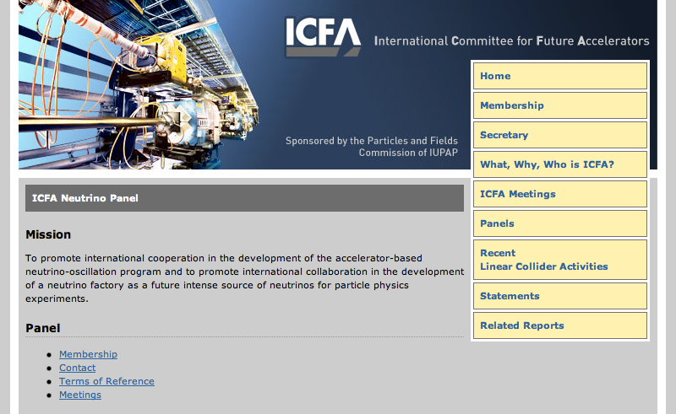
http://www.fnal.gov/directorate/icfa/neutrino_panel.html

Slide 4
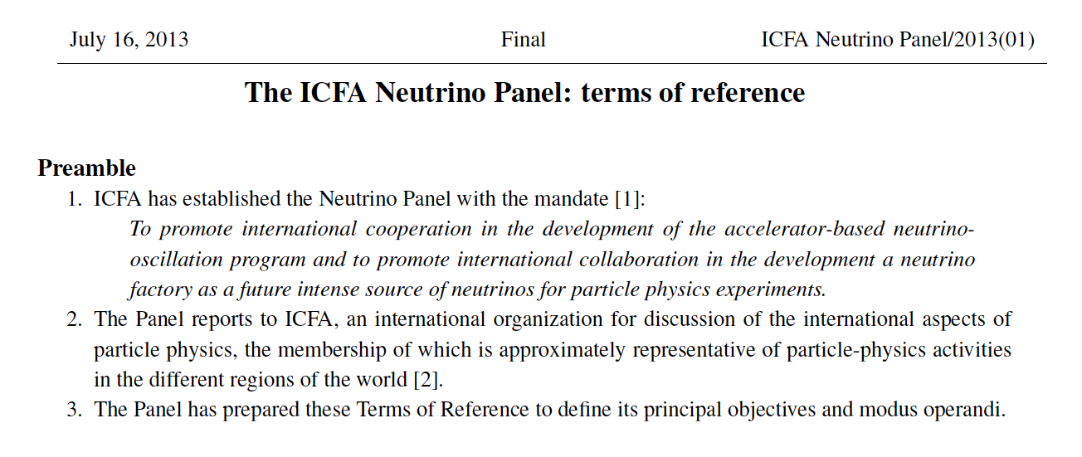
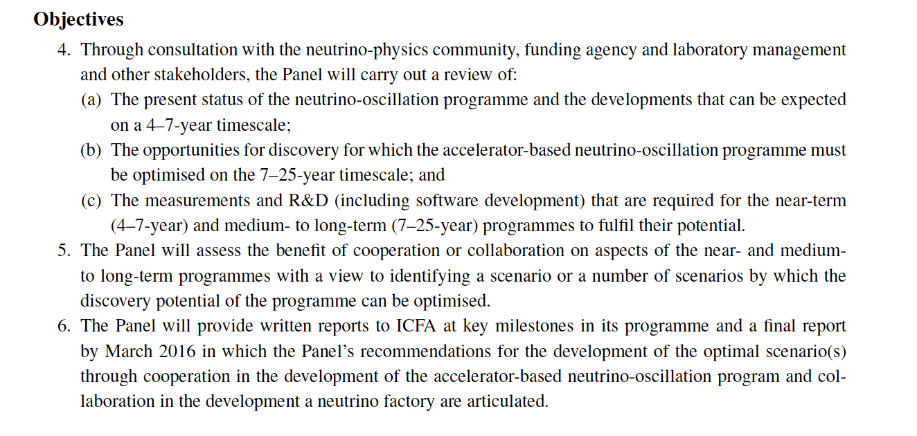
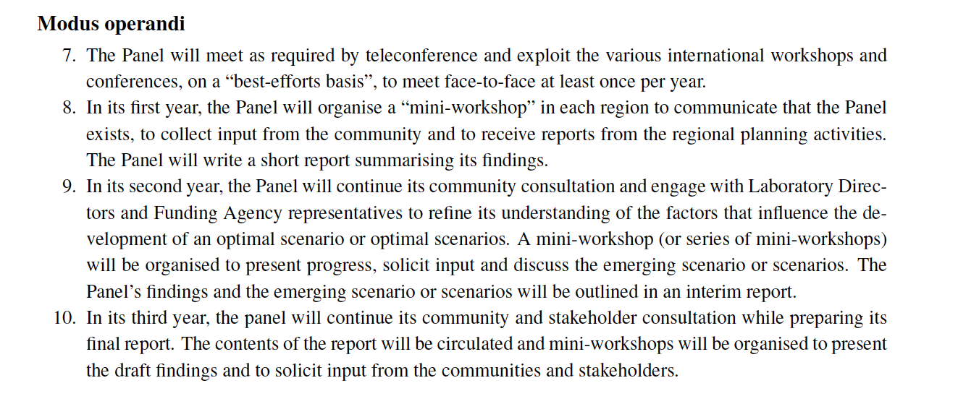

Slide 5
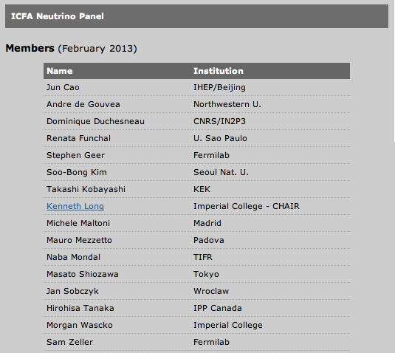

Slide 7
Let’s not just listen the talk but please make lively discussions and give us your opinions & thoughts for future accelerator-based neutrino programs

