Slide 1
Neutrino Program in China
Jingyu Tang
Institute of High Energy Physics, CAS
ICFA Neutrino Panel – Asian Community Meeting
Nov.13, 2013, Kashiwa City, Chiba, Japan

Slide 2
Outline
Introduction to neutrino experiments in China
Present: Daya Bay Neutrino Experiment
Near future: Jiangmen Neutrino Experiment (JUNO)
Long term: MOMENT – a muon-decay medium baseline neutrino beam
Summary

Slide 3
Introduction to Neutrino Experiments in China
China started the neutrino experiment program from 2003, with IHEP as the core and the driving engine
Became a very important part of high-energy physics in China
Three major steps:
Daya Bay experiment (in operation)
JUNO experiment (under construction)
MOMENT experiment (planning, long term)
Uniting domestic researchers (universities and institutes) and attracting international collaboration

Slide 4
Daya Bay Neutrino Experiment
First neutrino experiment facility
Based on Daya Bay reactor
Milestones:
2003: project proposed
2006: project approved
2007: ground breaking
2011: installation completed, data taking started
2012.3: announcing the discovery of new neutrino oscillation (θ13 measured to be non-zero)
2013.8: announced the first direct measurement of
and more precise measurement on θ13
Continue data taking for 4-5 years more

Slide 5
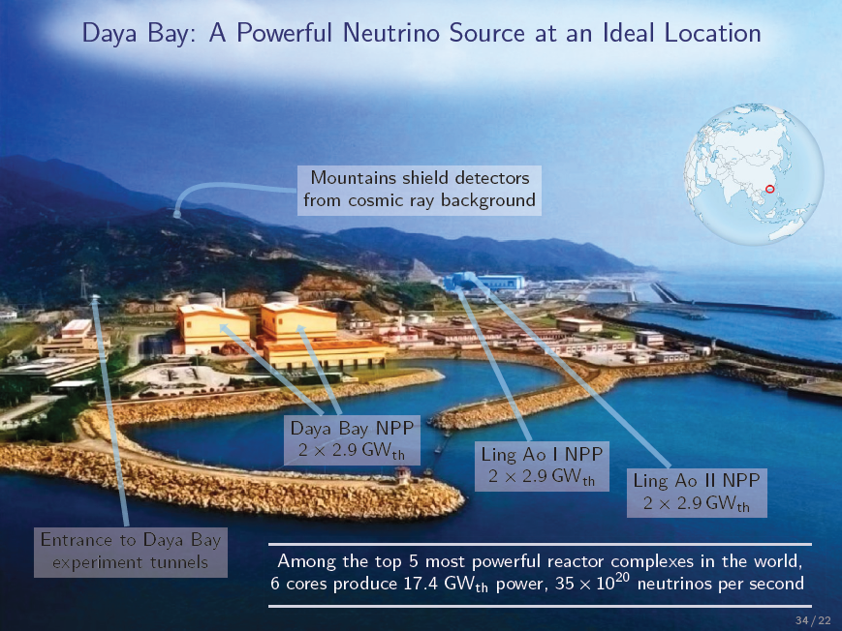
Summary
Preliminary study of the neutrino beam MOMENT looks competitive
Muon-decayed neutrinos (advantage in background)
High neutrino flux with neutrino energy: 100-400 MeV
Not a facility project yet, just concept study
Following studies will focus on
Suitable detector and baseline distance
Optimization of the target station (used protons, heat and radiation)
Higher field (14 T) for the capture solenoid
Optimization of transport/decay channels
Technical difficulties
Proton driver: to be solved by China-ADS and others
Target and very high field SC solenoids: collaboration and R&D
Detector: to be identified

Slide 6
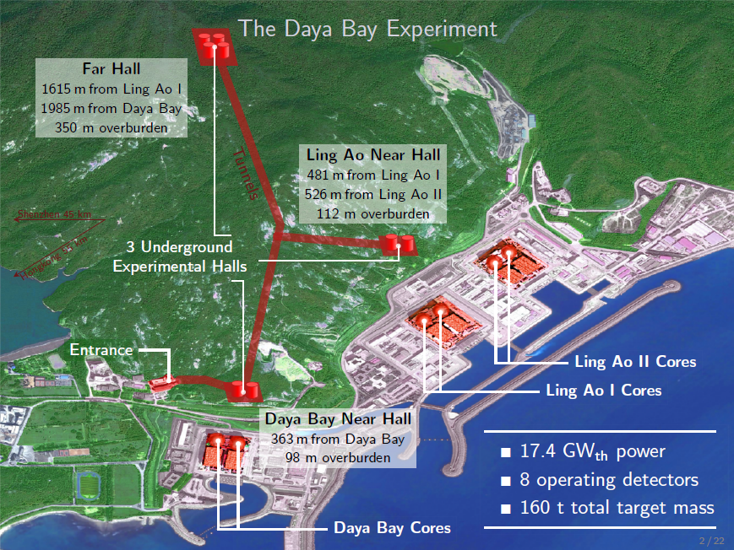
Thank you for attention!

Slide 7
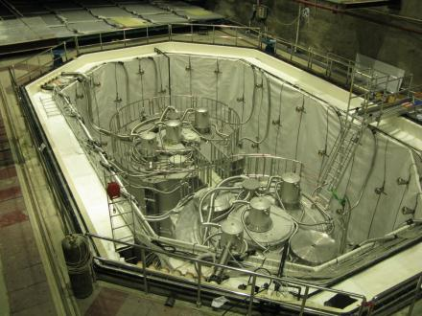
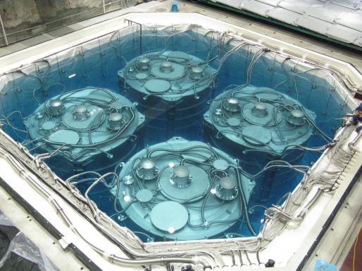
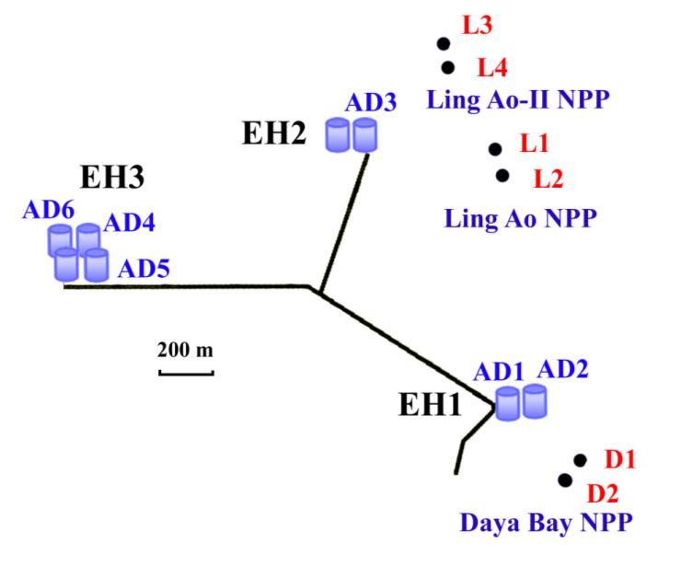
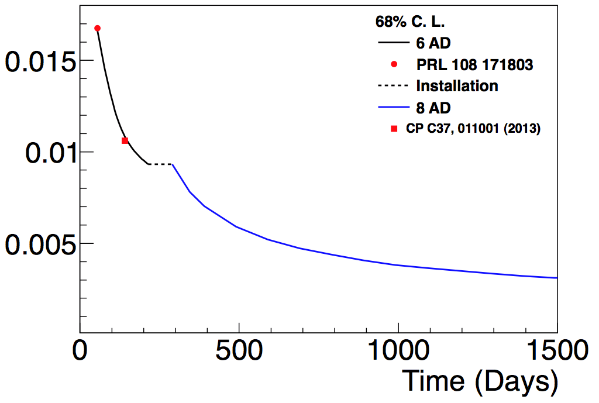
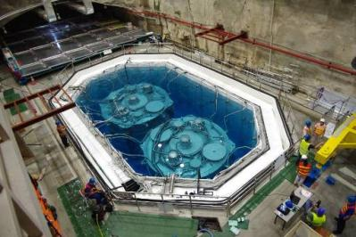
Daya Bay Experiment
Completed all installations in Sep. 2012.
AD8
AD7
8 AD run
We are here
Uncertainty of sin²2θ₁₃

Slide 8
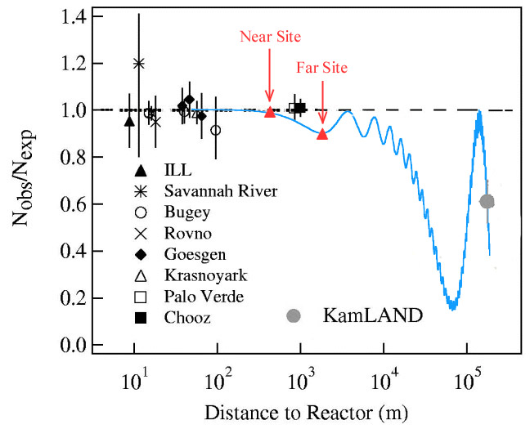
JUNO Experiment
JUNO (DYB-II) has been approved in China in Feb. 2013
Equivalent to CD1 of US DOE
Daya Bay
Daya Bay II
20 kton LS detector
3%/√E̅ resolution
Rich physics
Mass hierarchy
Precision measurement of 4 oscillation parameters to <1%
Supernovae neutrino
Geoneutrino
Sterile neutrino
Atmospheric neutrinos
Exotic searches
Talk by Y.F. Wang at ICFA seminar 2008...NuFact 2012; by J. Cao at Nutel 2009...NPB 2012 (ShenZhen);
Paper by L. Zhan, Y.F. Wang, J. Cao, L.J. Wen, PRD78:111103,2008; PRD79:073007,2009

Slide 9
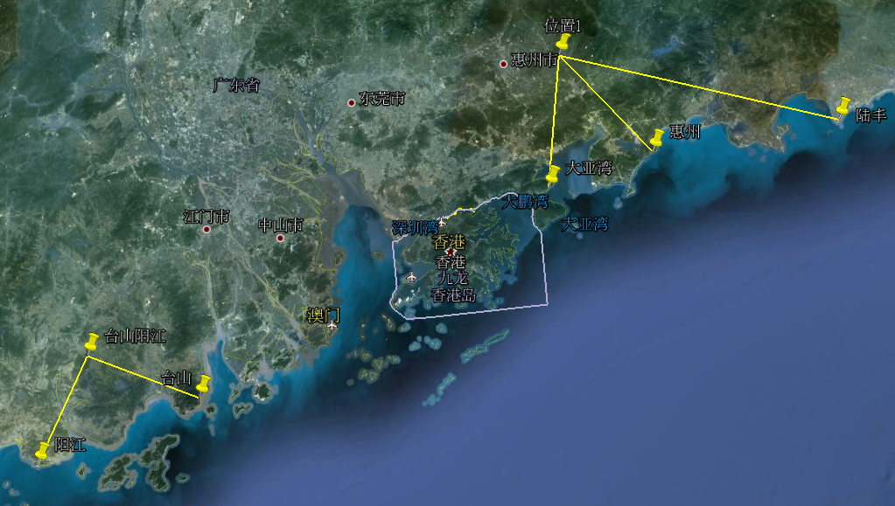
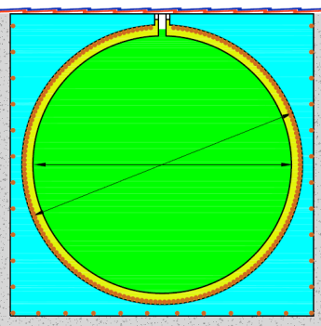
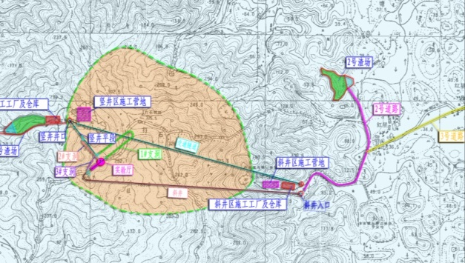
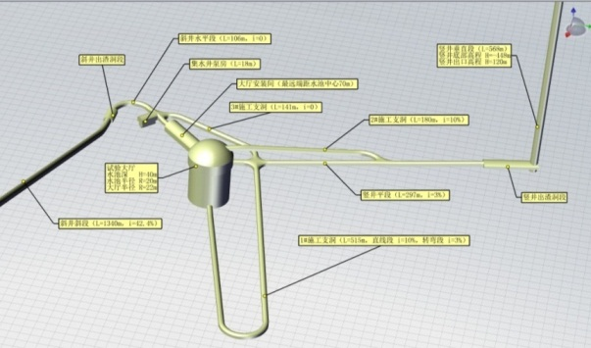
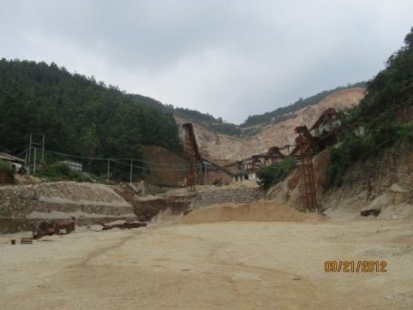
The reactors and site
 | Daya Bay | Huizhou | Lufeng | Yangjiang | Taishan
Status | Operational | Planned | Planned | Under construction | Under construction
Power | 17.4 GW | 17.4 GW | 17.4 GW | 17.4 GW | 18.4 GW
Kaipin, Jiangmeng, Guang Dong
Lufeng
Huizhou
34.5m
Daya Bay
Hong Kong
Scheduled data taking ~2020
Site survey and civil design:
Taishan
Yangjiang

Slide 10
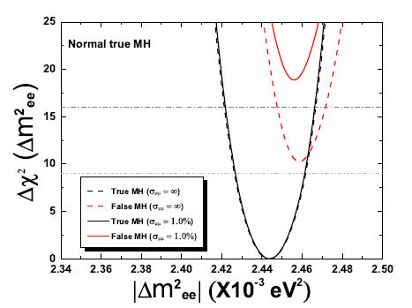
Projected Sensitivity
 | DYB | JUNO
Δm²₁₂ | 3% | 0.6%
Δm²₂₃ | 5% | 0.6%
sin²θ₁₂ | 6% | 0.7%
sin²θ₂₃ | 20% | N/A
sin²θ₁₃ | 14%➔ 4% | ~ 15%
Dashed lines: relative measurement determines the MH to 3σ in 6 years.
Solid lines: with 1% precision Δm²_{μμ} measurement from T2K and Nova, sensitivity increase to 4σ.
core distribution and energy non-linearity included.
Will be more precise than CKM matrix elements !
Probing the unitarity of UPMNS to ~1% level
arXiv:1303.6733

Slide 11
JUNO Project Planning
Complete tunnel
Start detector
Installation
Ready for LS
production
2017
Complete install.
Testing
Start data taking
2019
Complete CDR
Start civil bidding
2013
Build PMT production line
2015
2014
Start civil construction
PMT prototype
2016
Complete TDR
Start PMT mass
production
Equipment bidding
2018
Complete detector
installation
LS into tank

Slide 12
A dedicated facility for CP measurements?
JUNO and other experiments
Measurements in Mass Hierarchy and other mixed parameters
It looks that CP phase measurement will be the last undetermined key property of neutrino.
A good dedicated machine to measure CP phase

Slide 13
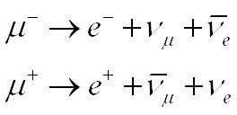
MOMENT: A muon-decay medium baseline neutrino beam facility
A new idea on neutrino beam
Using a CW proton linac as the proton driver
Simplified design from the China-ADS linac
1.5 GeV, 10 mA ➔ 15 MW in beam power
Mercury jet target in high-field SC solenoid
Collection of pions and muons
Muon transport and decay channel
Pure μ+ or μ- decay
High neutrino flux at a detector of >50 km

Slide 14
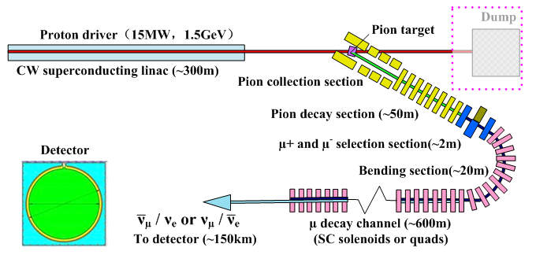
Schematic for MOMENT
Detector

Slide 15
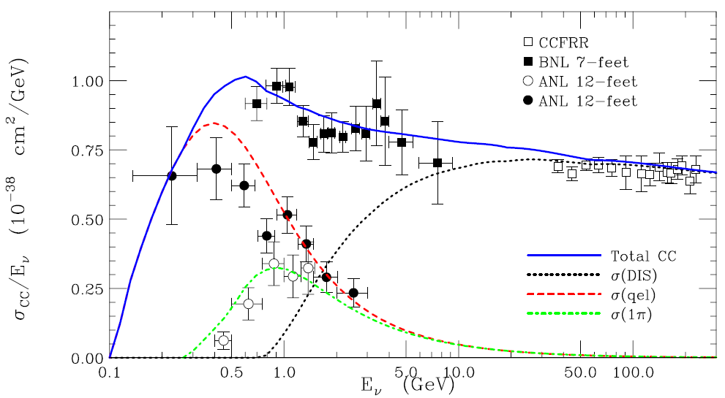
A π0-free neutrino beam line
Neutrino energy: ~ 300 MeV ➔ baseline = 150 km
Although we loose some statistics due to the lower cross section, but we gain by being background free from π⁰

Slide 16
Proton Driver
A CW proton SC linac can provide the highest beam power, and selected as the proton driver for MOMENT
China-ADS project was launched in beginning 2011, with a long-term goal to drive a subcritical reactor with 12-15 MW proton beam; MYRRHA is also developing a CW proton linac of lower power. And Project-X for CW RF but chopped beam.
One of the main goals in the China-ADS R&D phase is to develop the relevant technologies with the SC proton linac working in CW mode
If R&D successful in CW linac, in early 2020, the accumulated experience will allow us to build a proton driver based on the similar CW linac in GeV but with much lower requirement on reliability

Slide 17
Design scheme for the proton driver
Design goal:
Beam energy: 1.5 GeV
Beam current: 10 mA
Simplified design scheme from the China-ADS design
Much less redundancy wrt China-ADS
3.2-MeV RFQ (room-temperature)
Three sections SC spoke cavities (160 MeV)
Two sections SC elliptical cavities (1.5 GeV)
In total, 195 SC cavities in 52 cryostats, linac length: ~ 300 m

Slide 18
Lattice of the linac
a: Spoke021 section, b: Spoke040 section, c: Ellip063 section,
d: Ellip082 section (<1 GeV), e: Ellip082 section (> 1 GeV)

Slide 19
Higher proton energy?
Study shows that neutrino yield per proton is slightly more than proportional to beam energy
If beam power keeps unchanged, neutrino flux will increase slightly with increasing proton energy
More benefit in the pion beam core
Pion energy spectrum shifts towards higher
Anyway, alternative proton driver schemes with higher energy have also been studied.

Slide 20
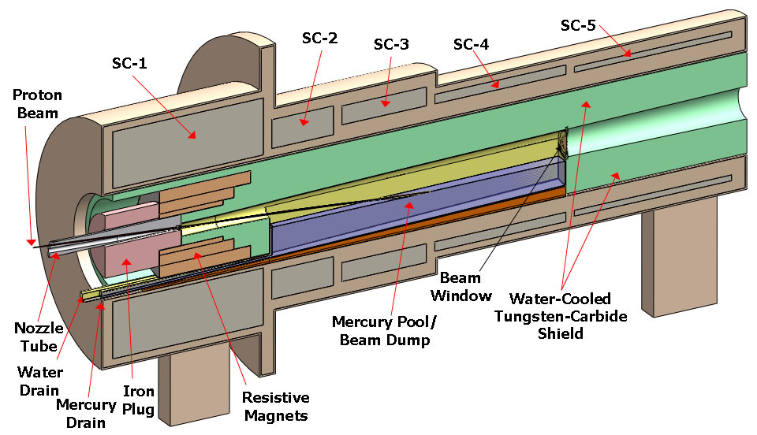
Target and pion/muon collection - Target
Mercury jet target (similar to NF design, MERIT experiment)
Higher beam power: heat load, radioactivity
On the other hand, easier to some extent due to CW proton beam (no shock-wave problem)
Other target solutions such as fluidized tungsten-powder target can also been considered

Slide 21
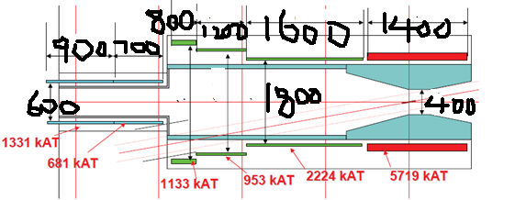
Magnetic field of main SC solenoid: 10 T
Target: radius - 4 mm, effective length – 30 cm
Pion production ratio: 0.15 π/p @1.5 GeV
Similar field configuration as at COMET
14 T capture field is under study

Slide 22
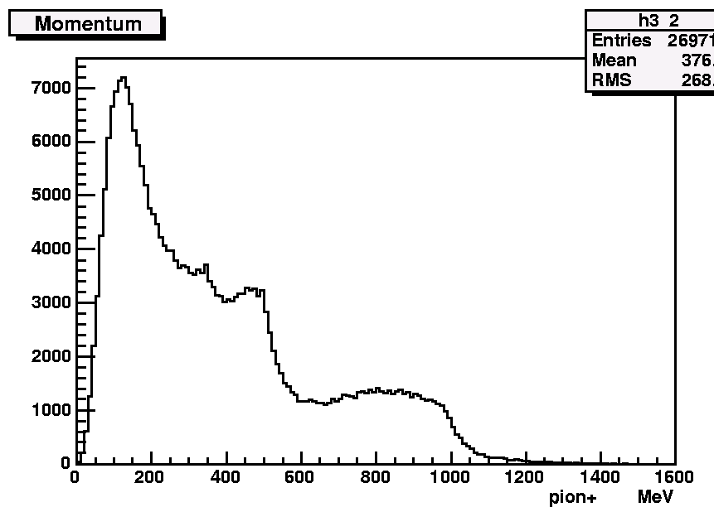
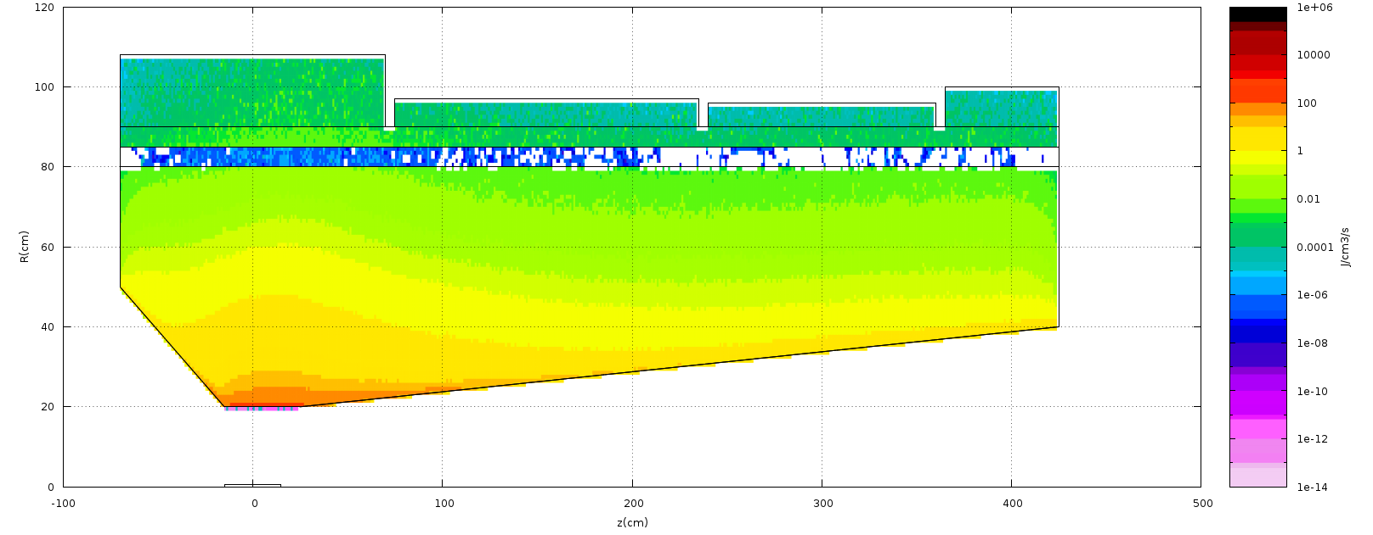
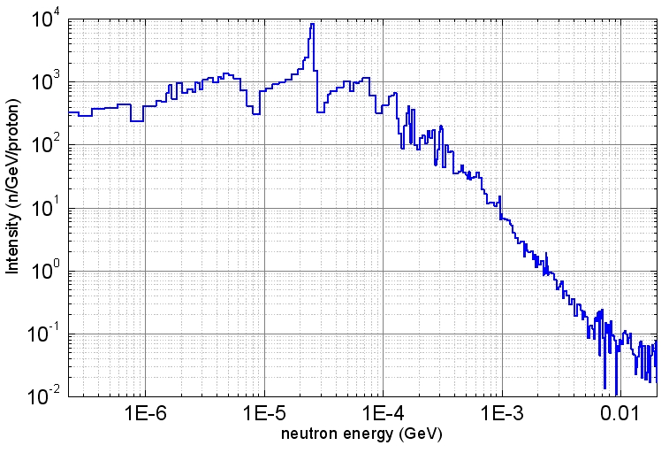
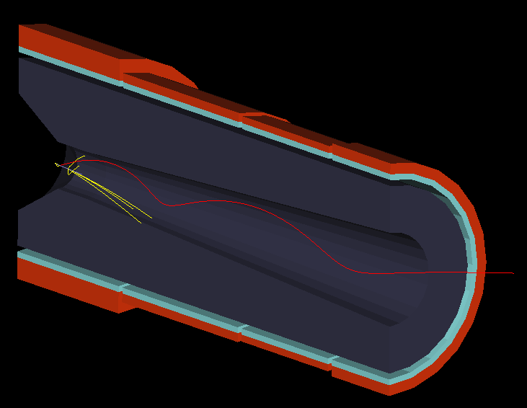
Large heat deposit and irradiation in SC solenoids
Pion energy spectrum at exit (4 m from target center)
0.8kW
0.15kW
0.06kW
0.05kW
In coils: 3.1 X 10¹⁵ n/m²/s

Slide 23
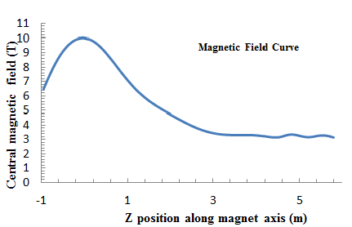
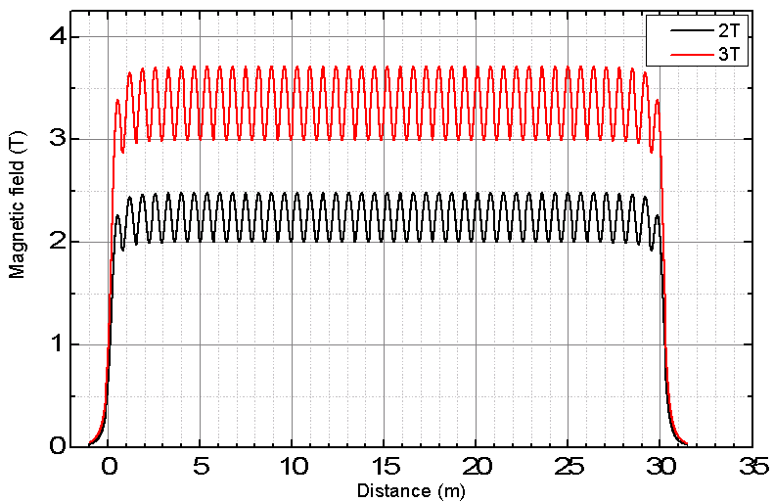
Pion/muon collection and transport
A straight section in SC solenoids of about 50 m to match the SC solenoids at the target, and for the pions to decay into muons
Adiabatic field transition from the high capture field to the lower focusing field to convert transverse momentum into longitudinal
Chicane in the beginning to collect scattered protons
Very large emittance and momentum spread
Pions with lower energy decay faster
Similar beam rigidity assures that pions and muons can be transported in the same focusing channel
Momentum and emittance of pions almost preserved in muons

Slide 24
Collection and transport efficiency
Modest acceptance for channels
About 0.0052 μ+/proton for about 50 πmm-rad at entrance of muon decay channel
Emittance limitation is acceptable
Try to transport large momentum range π/μ
Expected: >±50% centered at 300 MeV/c
7 T
 | muon/proton | Portion（%）
No limit on emittance | 9.48E-03 | 100
Emittance: 100 πmm-rad | 8.04E-03 | 85
Emittance: 80 πmm-rad | 7.31E-03 | 77
Emittance: 50 πmm-rad | 5.22E-03 | 55
Emittance limit in both (X-X’) and (Y-Y’)

Slide 25
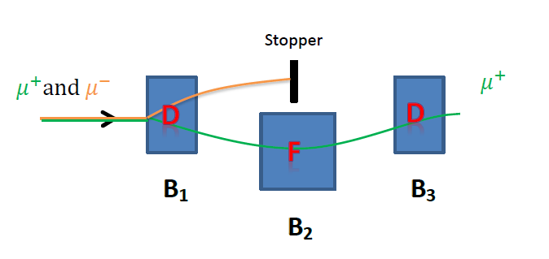
A selection section of about 2 m (length) to select π+/μ+ from π-/μ-, as either μ+ beam or μ- beam is used for producing the required neutrinos
For very large emittance, a group of three SC dipoles with strong gradient (similar as an DFD FFAG focusing) is used for bending (e.g., 40 ° /-80 ° /40 °) and focusing
Reverse the fields when changing from μ+ to μ-

Slide 26
Muon transport and decay - Muon bending section
A bending section is required before the muon decay channel, to suppress the background of pion-decayed neutrinos at the detector by limiting the momentum acceptance when needed
Bending angle is adaptable according to the general layout
More energetic pions continue to decay in the section
Many short SC solenoids aligned with increased angle displacement to bend and focus the beam simultaneously
Short solenoids helps reduce beam centroid excursion (aperture, beam loss)
Alternate reverse SC field also helps reduce the excursion, and emittance coupling
A small vertical field component is also helpful to reduce the excursion and for momentum selection

Slide 27
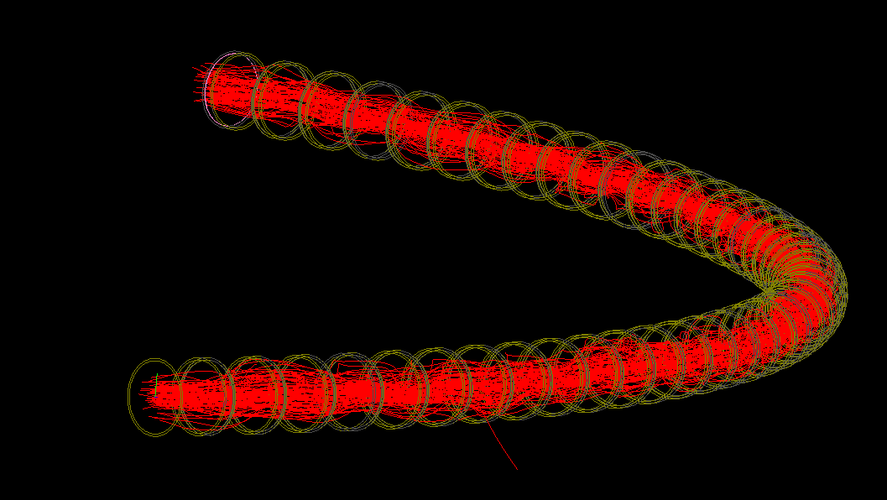
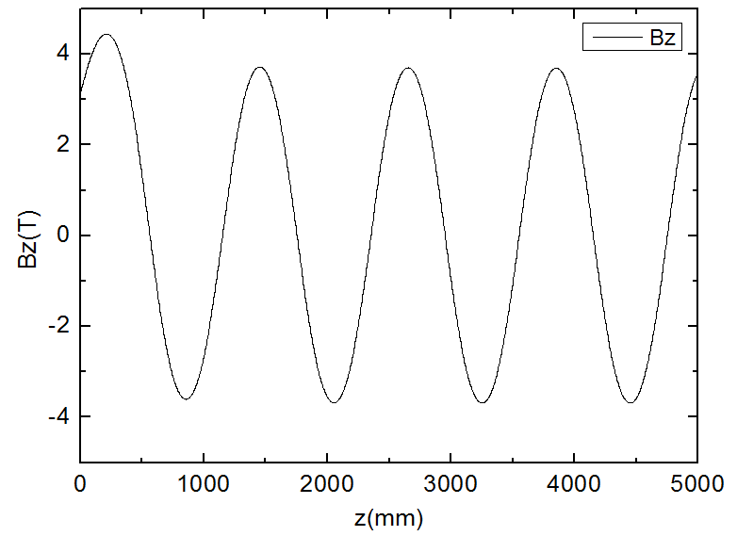
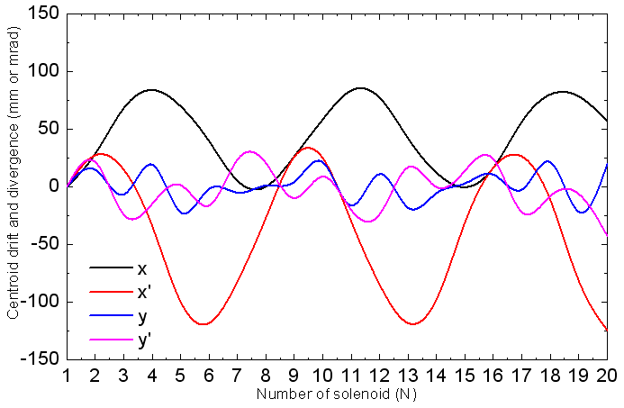
Beam tracking simulated by G4beamline
Bending section by slanted solenoids (39*2°=78°) has very good momentum acceptance, Δp/p>±50%
Small vertical component (~0.055 T) helps
Θ=2°
Field distribution (left) and beam centroid evolution (right)

Slide 28
Muon transport and decay - Muon decay channel
A long decay channel of about 600 m is designed for production of neutrinos
About 35% (centered momentum: ~300 MeV/c)
Important to have smaller divergent angle
Neutrino energy spectrum at detector related to the angle
Modest beam emittance and large aperture
Adiabatic matching from 3.7 T in the bending section to 1.0 T in the decay section
Aperture/Field | Acceptance (πmm-rad) X: in mm; X’: in mrad
φ600, 3.7 T | 100 (x: 280, x’: 357)
φ800, 1.0 T | 65 (x: 380, x’: 171)

Slide 29
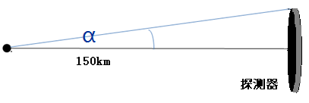
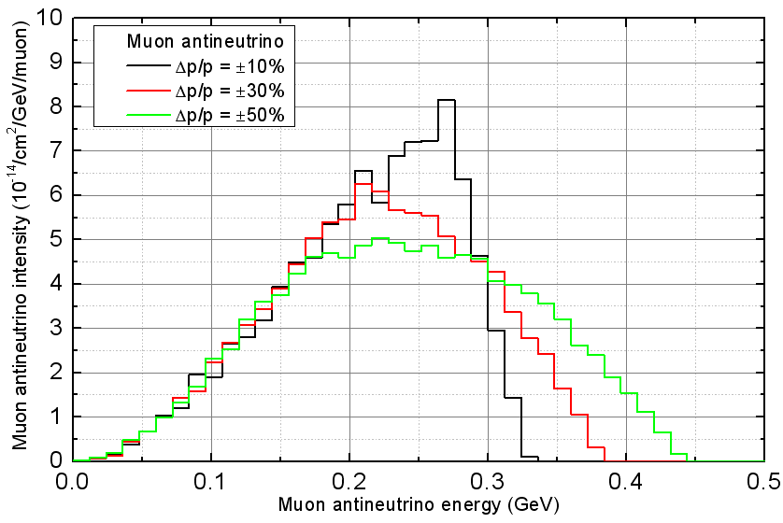
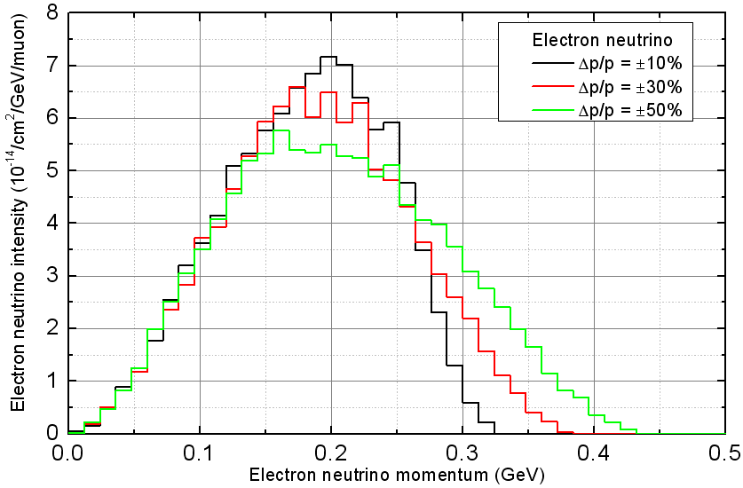
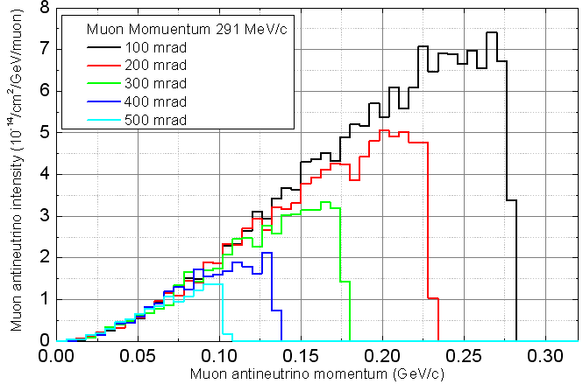
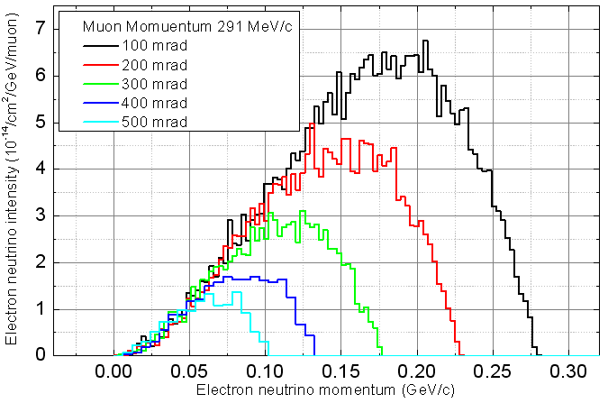
Neutrino energy spectra dependent on muon momentum and divergent angle

Slide 30
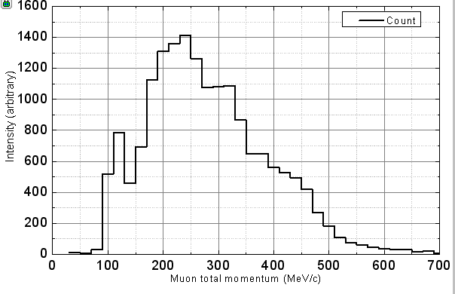
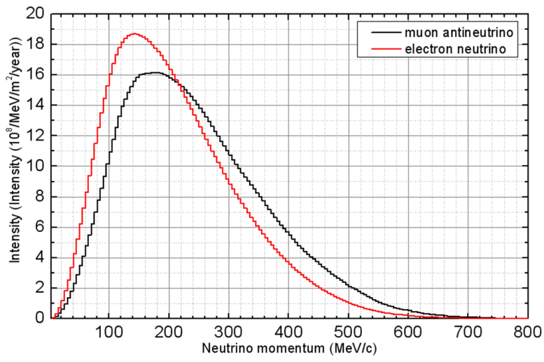
Neutrino flux and possible detector
Suitable detector for MOMENT is still under study
100-150 km from the target/source
Mass: 0.1-1 Mton
Simultaneous detection of all four neutrino types: ${\overline{ν}}_{μ},ν_{e}/ν_{μ}$, ${\overline{ν}}_{e}$
Flavor sensitive, charge sensitive and NC/CC sensitive
One example is Gd-doped water detector
Neutrino spectra at the detector centered at about 250 MeV
Energy spectra of decayed muons and neutrino at detector

Slide 31
Estimate of neutrino flux
Proton on target ( operation 5000 h): 1.125 × 10²⁴ proton/year
Muon yield: 1.62 × 10⁻² $$/proton
Muon decay probability: 0.35
Total neutrino yield: 4.4 × 10⁻³ ν/proton (in pair)
5.0 × 10²¹ ν/year (in pair)
(NF: 1.1 × 10²¹ ν/year )
Neutrino flux at detector: dependent on the distance
4.6 × 10¹¹ ν/m²/year (@150 km)

Slide 32
Summary
China has well established a neutrino program into the future
Daya Bay will continue to produce good experiment results
JUNO will participate in the world competition for the measurement on mass hierarchy
MOMENT is still a concept, and a far way to go; it looks competitive in the CP violation measurement
Collaboration and competition with leading labs coexist at the same time, and are helpful for the neutrino community

Slide 33
Thank you for attention!

