Slide 1
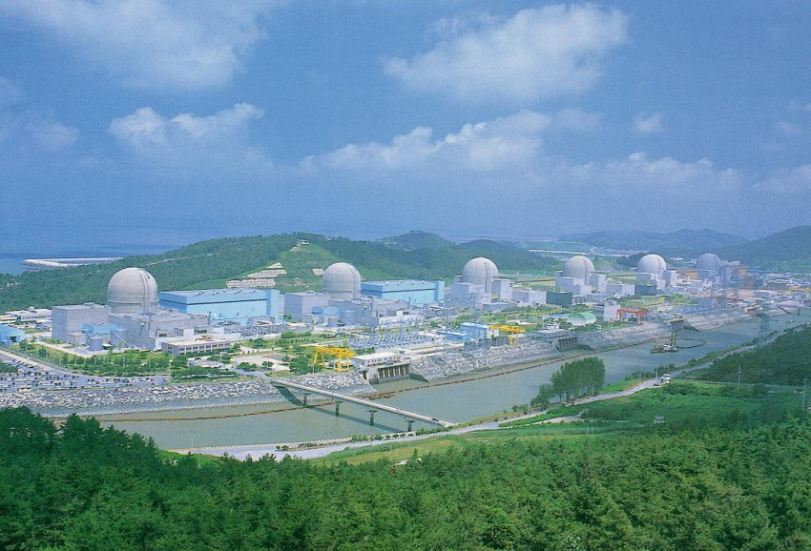
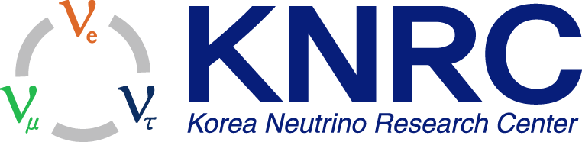
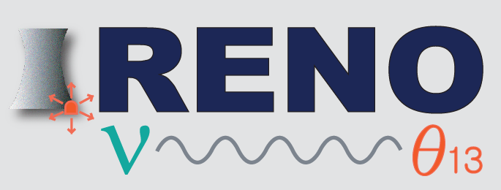
Neutrino Program in Korea
(RENO/RENO-50/AMoRE/SBL)
ICFA Neutrino Panel (Asian Neutrino Community Meeting)
K.K. Joo
Chonnam National University
November 13, 2013
2013-11-13 Kavli, IPMU, Japan

Slide 2
Fundamental Questions on Neutrino
Absolute neutrino masses? (Why so small?)
Neutrino mass ordering? (Normal or inverted?)
Dirac or Majorana? (Neutrinoless double beta decay?)
Leptonic CP violating phase?
3 ν paradigm enough? (Sterile neutrino?)
Why so large neutrino mixing angles?
※ High precision measurement of neutrino oscillations
→ Precise values of mixing angles and mass difference are necessary for solving those fundamental problems

Slide 3
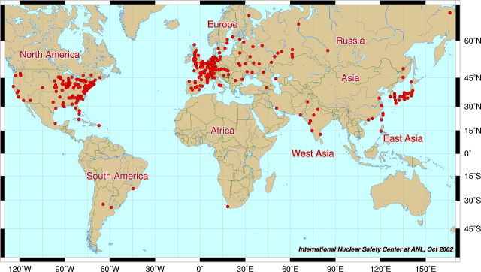
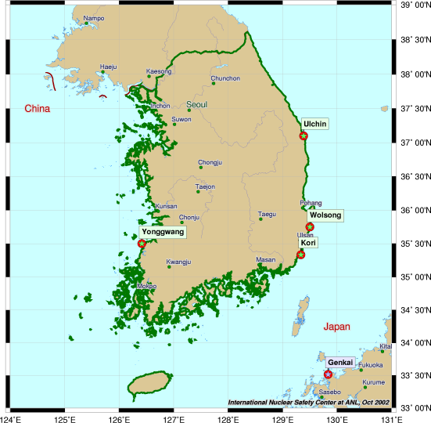
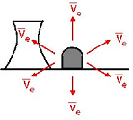
Reactor Neutrinos
Reactor Neutrinos
Nuclear Power Plants around the World
~5×10²¹ ν/sec
Cost-free, intense, low-energy & well-known neutrino source !
In Korea, 4 nuclear reactor sites
(Yonggwang, Uljin, Wolsung, Kori)

Slide 4
YongGwang Nuclear Power Plant
YongGwang(靈光):
= glorious[splendid] light
(~spirited)
New name: Hanbit
Located in the west coast of southern
part of Korea
~300 km from Seoul
6 reactors are lined up in roughly equal
distances and span ~1.3 km
Total average thermal output ~16.7GW_{th}
(one of powerful sources in the world)

Slide 5
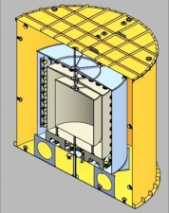
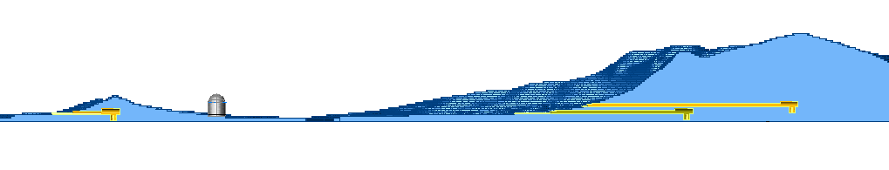
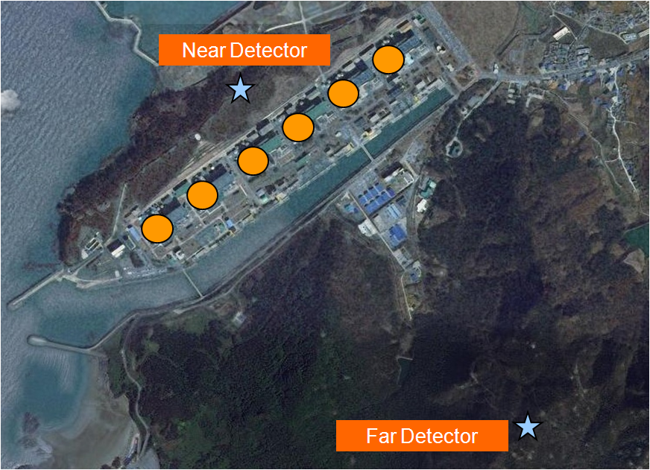
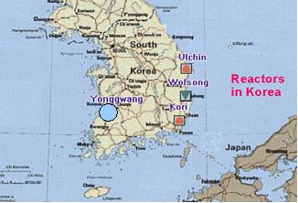
Google Satellite View of Experimental Site
200m high
Near Detector
70m high
Reactors
100m
300m
290m
1,380m
Far Detector
290m
YongGwang Nuclear Power Plant
1380m

Slide 6
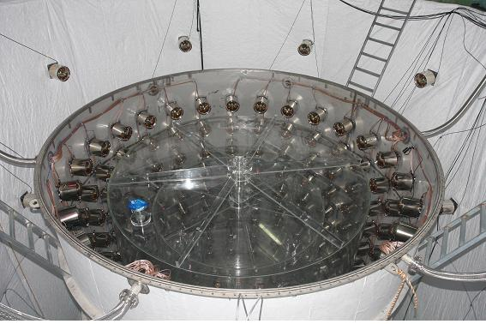
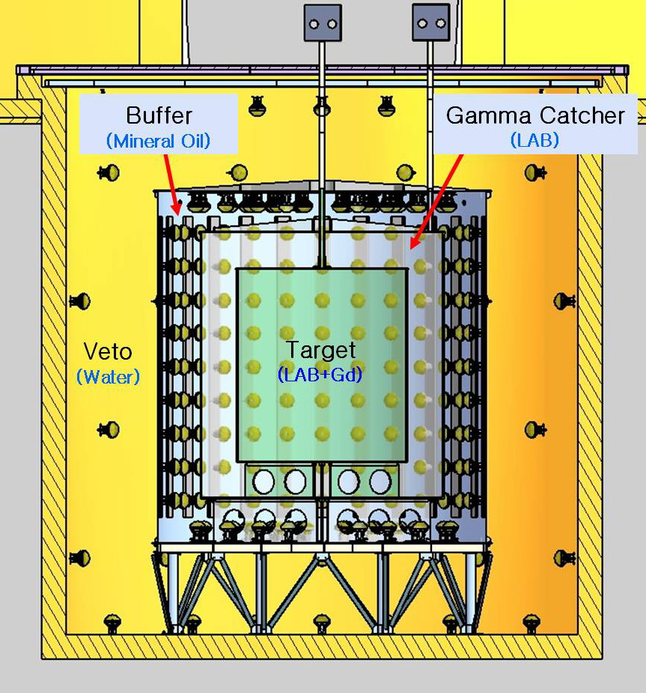
RENO Detector
 | Thick (cm) | vessel | Material | Mass (tons)
Target | 140 | Acrylic (10mm) | Gd(0.1%) +LS | 15.4
Gamma catcher | 60 | Acrylic (15mm) | LS | 27.5
Buffer | 70 | SUS(5mm) | Mineral oil | 59.2
Veto | 150 | Steel (15mm) | water | 354.7
Inner PMTs: 354 10” PMTs
  solid angle coverage = ~14%
Outer PMTs: ~ 67 10” PMTs
total ~460 tons

Slide 7
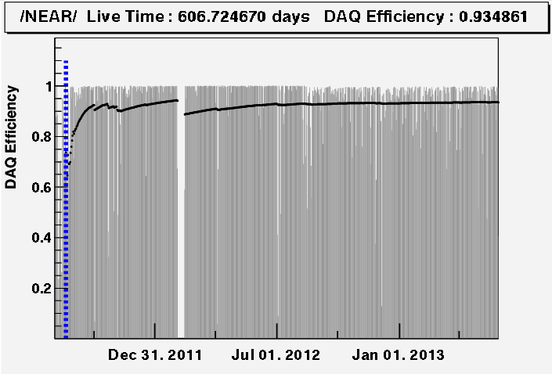
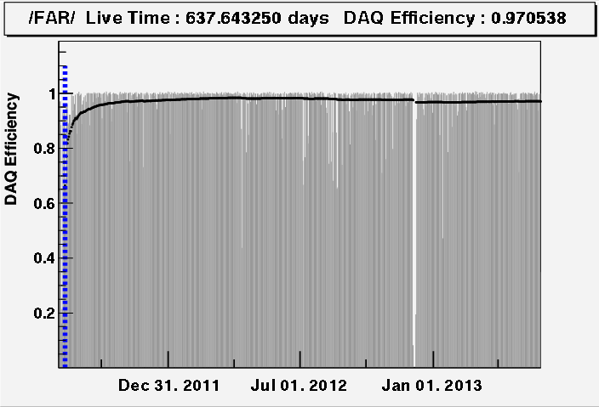
RENO Data Taking Status
Data taking began on Aug. 1, 2011 with both near and far detectors.
(DAQ efficiency : ~95%)
Near
A (220 days) : First θ₁₃ result
[11 Aug, 2011~26 Mar, 2012]
PRL 108, 191802 (2012)
A
B (403 days) : Improved θ₁₃ result
[11 Aug, 2011~13 Oct, 2012]
NuTel 2013
Far
C (~700 days) : Shape+rate analysis
(in progress)
[11 Aug, 2011~31 Jul, 2013]
B
Absolute reactor neutrino flux measurement in progress
[reactor anomaly & sterile neutrinos]
C

Slide 8
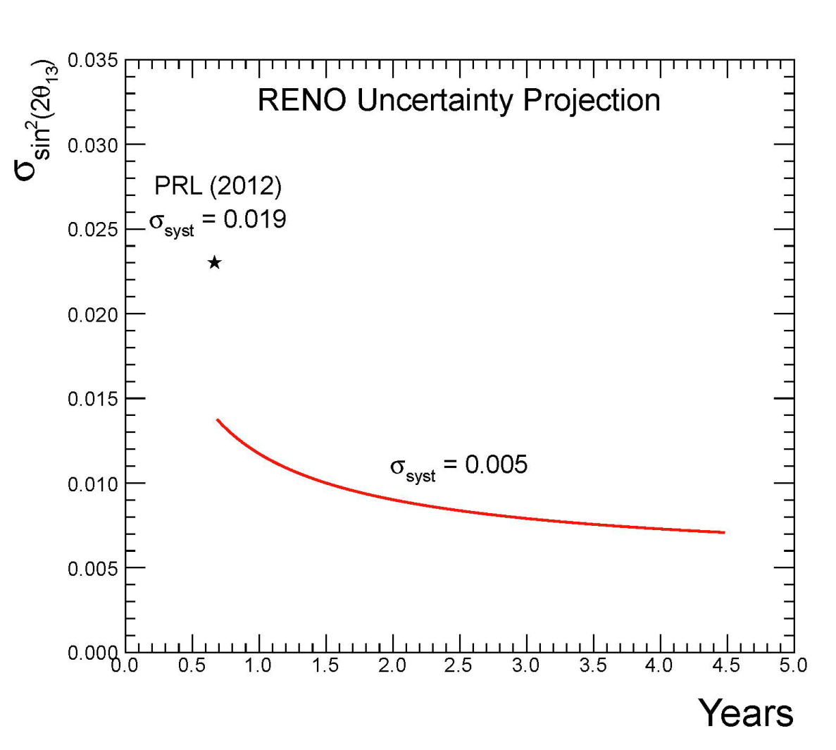
RENO’s Projected Sensitivity of θ₁₃
(402 days)
(6.4 σ)
(~ 13 σ)
(5 years)
(16 % precision)
(7 % precision)
2012. 4
5 years of data : ±0.007 (7% precision)
- statistical error : ±0.010 → ±0.005
- systematic error : ±0.012 → ±0.005
2013. 3
2013. 9
(7 % precision)

Slide 9
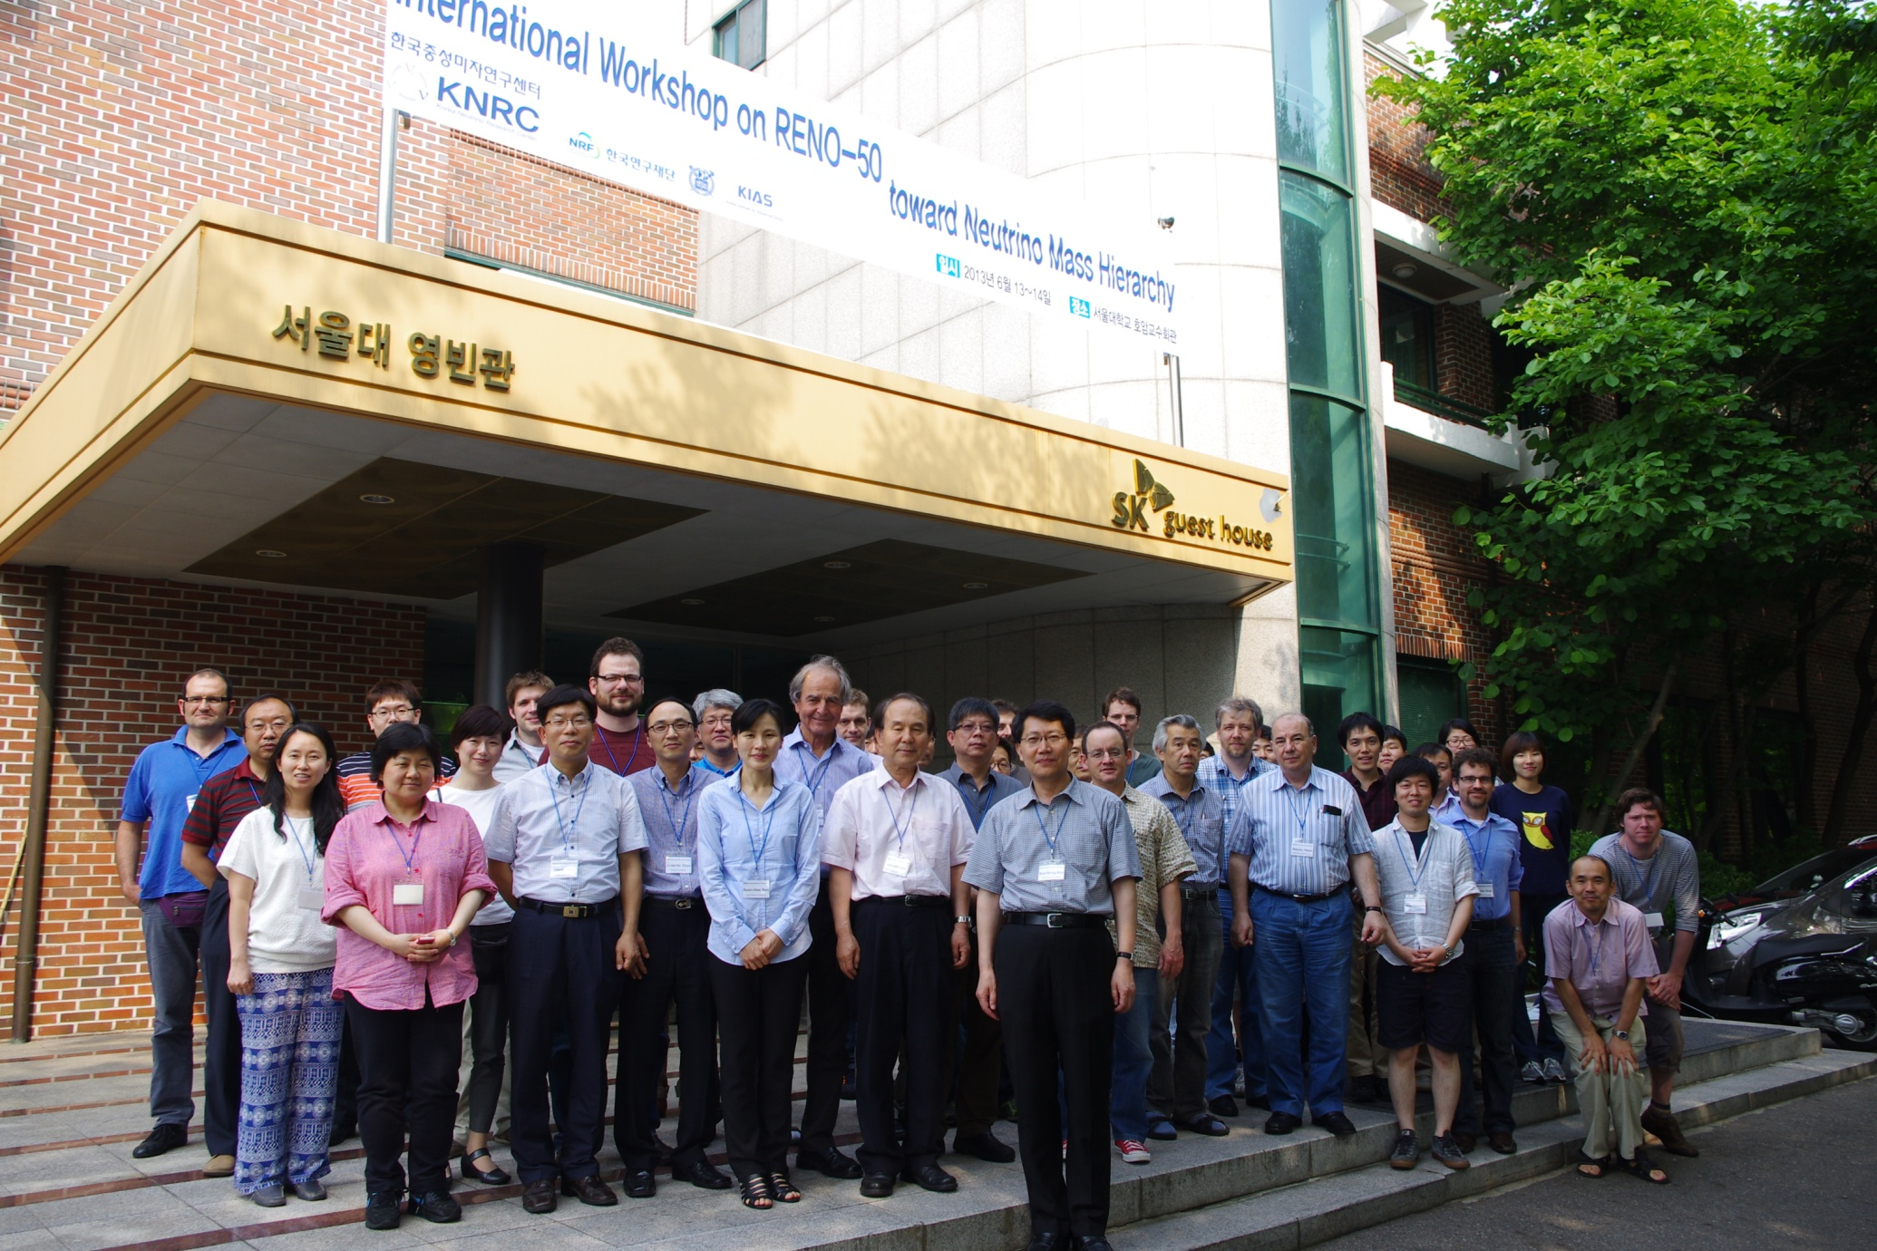
International Workshop on RENO-50
Seoul, June 13-14, 2013

Slide 10
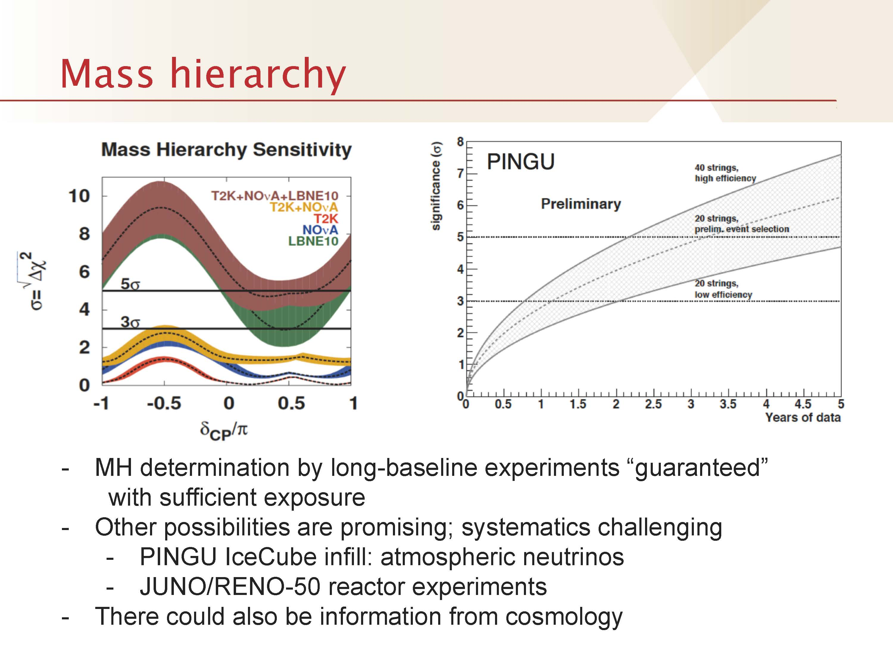
RENO-50 at Snowmass
Summary talk on Intensity Frontier by J. Hewett at Snowmass meeting (Aug. 2013)

Slide 11
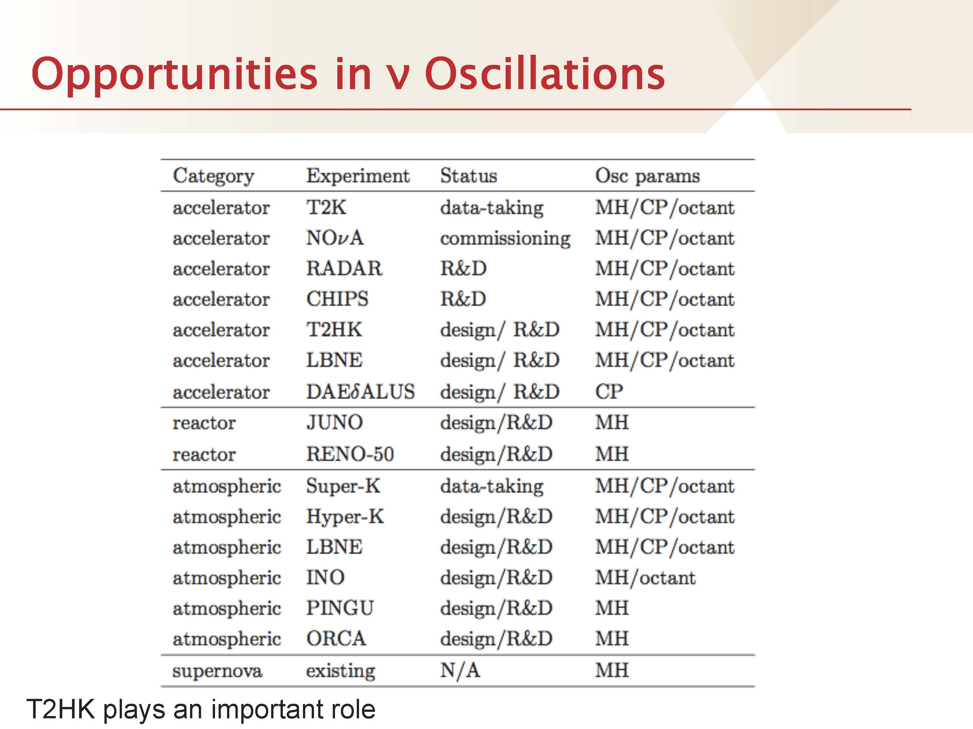
RENO-50 at Snowmass
Summary talk on Intensity Frontier by J. Hewett at Snowmass meeting (Aug. 2013)

Slide 12
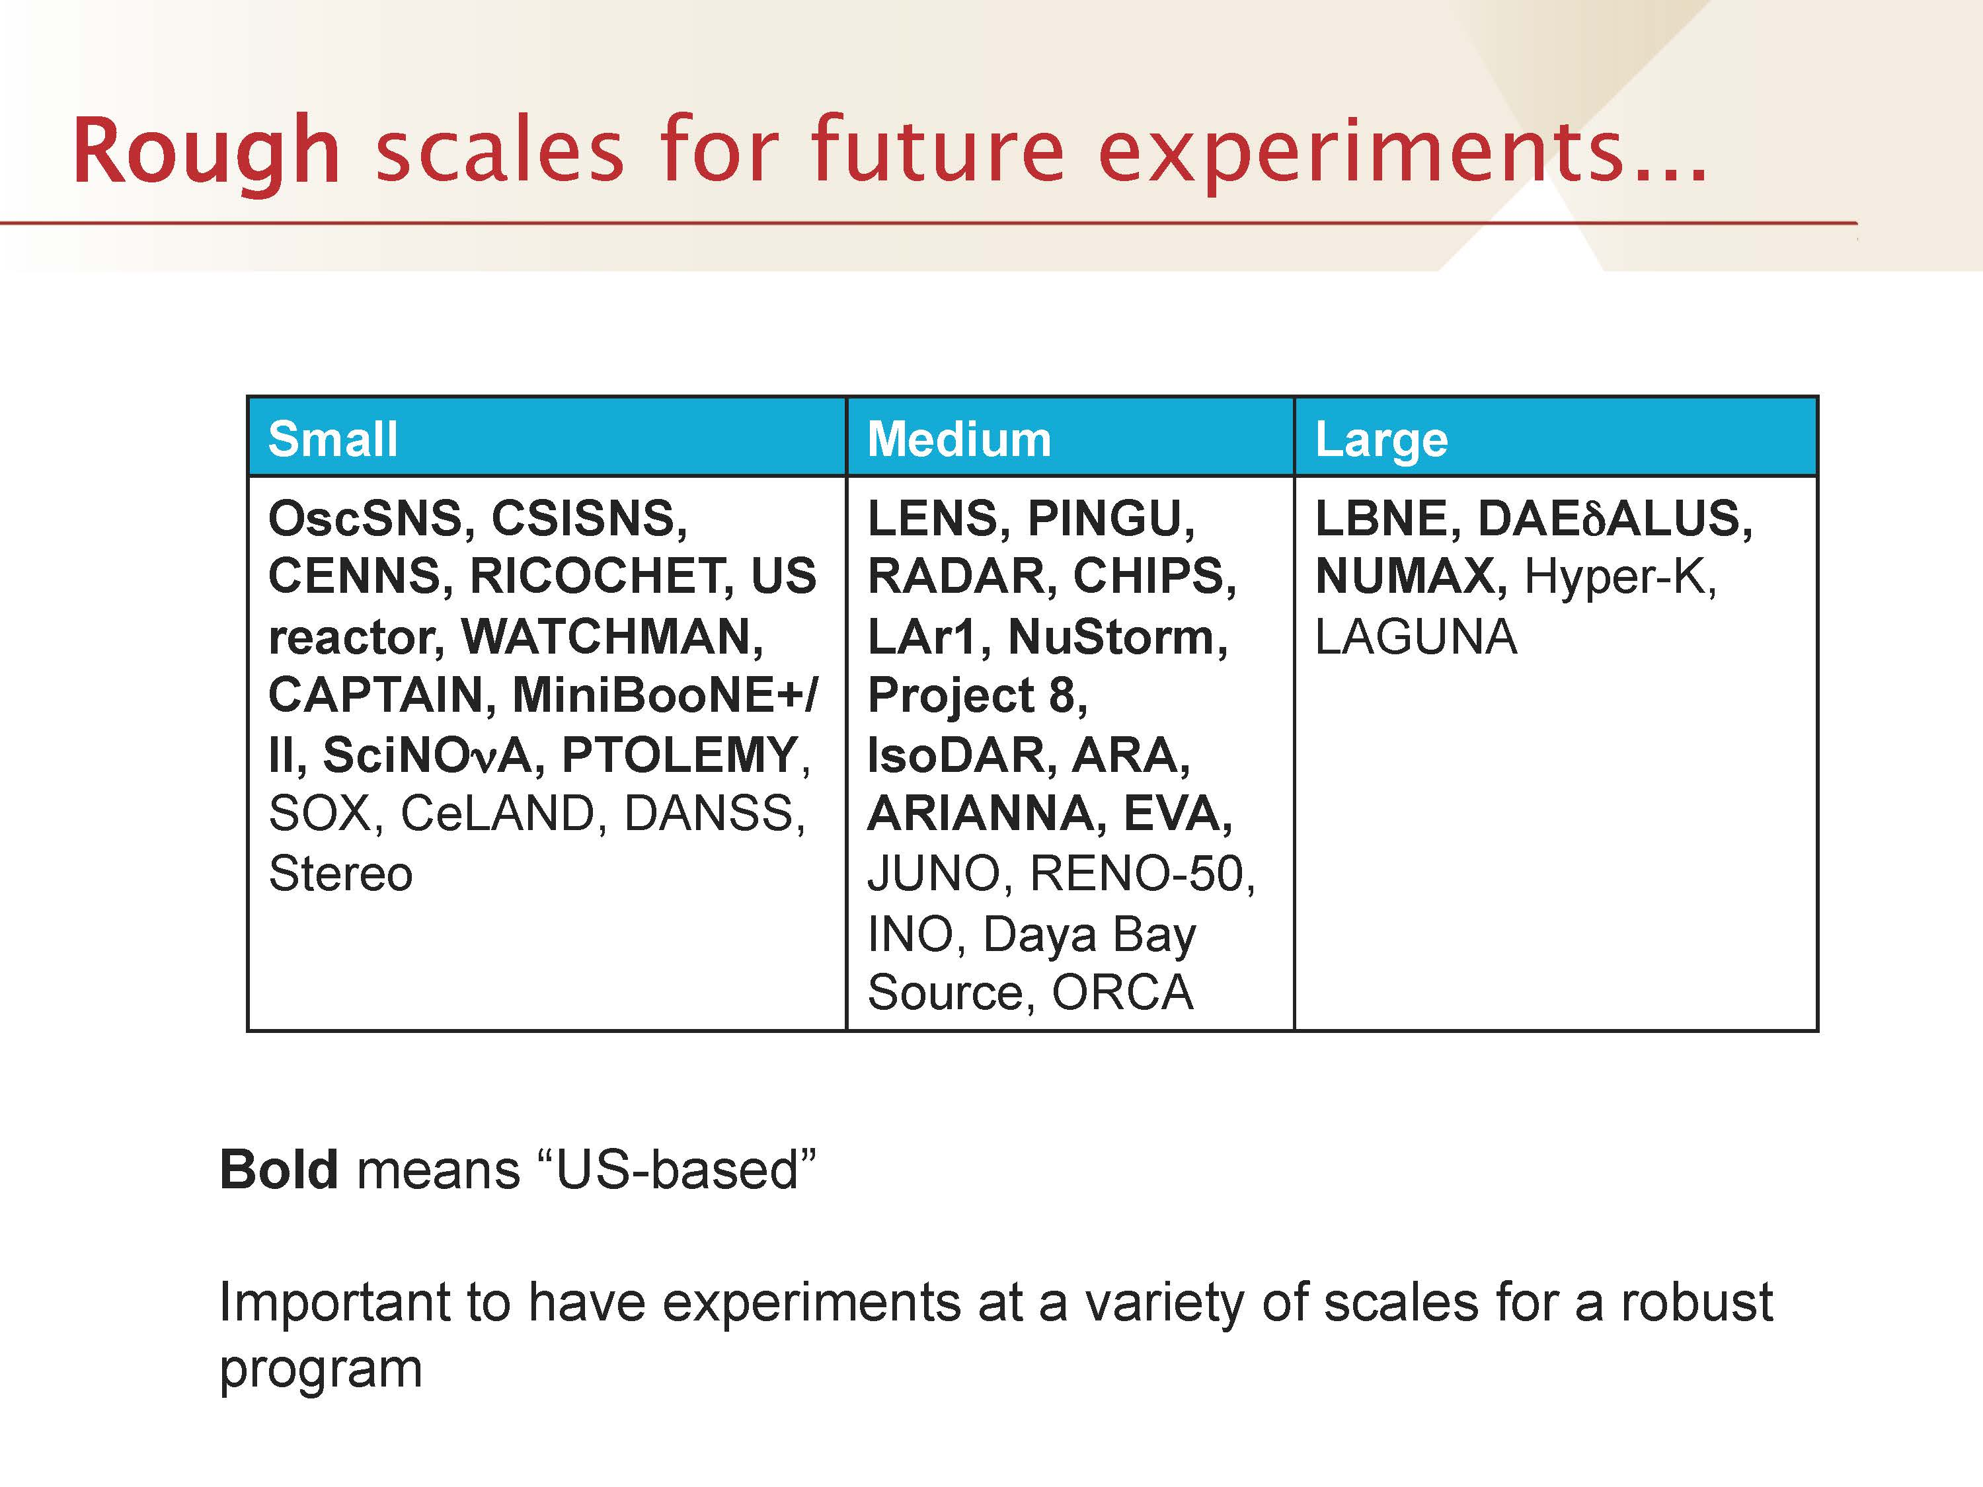
RENO-50 at Snowmass
Summary talk on Intensity Frontier by J. Hewett at Snowmass meeting (Aug. 2013)

Slide 13
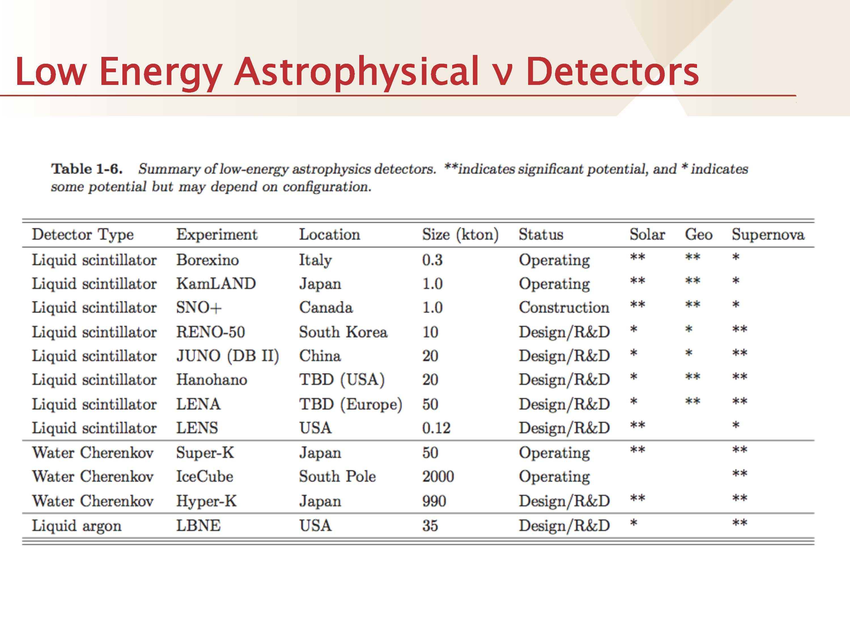
RENO-50 at Snowmass
18
Summary talk on Intensity Frontier by J. Hewett at Snowmass meeting (Aug. 2013)

Slide 14
Overview of RENO-50
RENO-50 : An underground detector consisting of 18 kton ultra- low-radioactivity liquid scintillator & 15,000 20” PMTs, at ~50 km away from the Hanbit(Yonggwang) nuclear power plant
Goals : - Determination of neutrino mass hierarchy - High-precision measurement of θ₁₂, Δm²₂₁ and Δm²₃₁ - Study neutrinos from reactors, the Sun, the Earth, Supernova, and any possible stellar objects
Budget : $ 100M for 6 year construction (Civil engineering: $ 15M, Detector: $ 85M)
Schedule : 2013 ~ 2018 : Facility and detector construction 2019 ~ : Operation and experiment

Slide 15
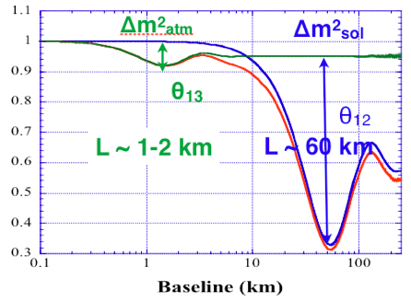
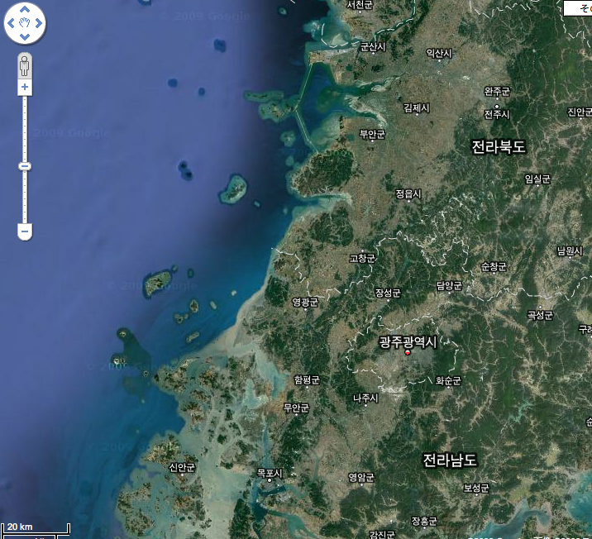
Reactor Neutrino Oscillations
L~50km experiment could be a natural extension of current RENO θ₁₃ experiment.
Large θ₁₂ neutrino oscillation effect at 50km + 18kton liquid scintillator detector

Slide 16
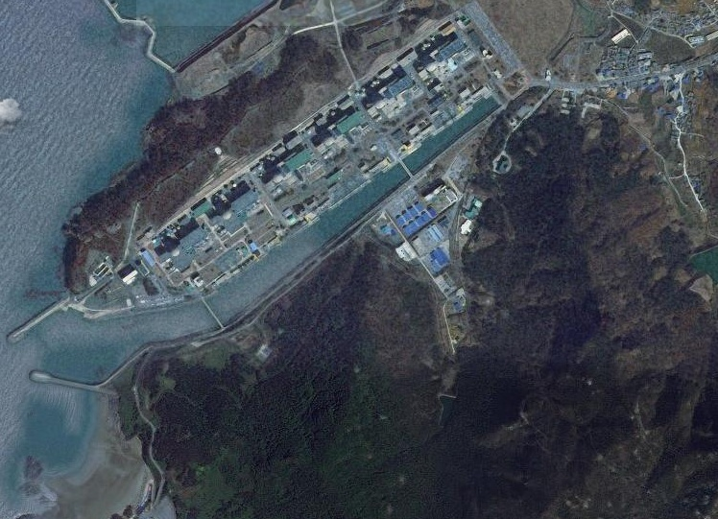
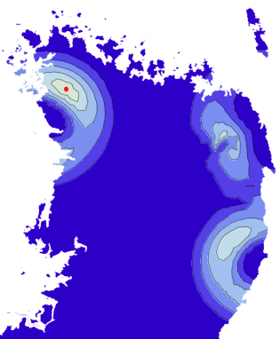
Near Detector
Far Detector
RENO-50
18 kton LS Detector ~47 km from YG reactors
Mt. Guemseong (450 m) ~900 m.w.e. overburden

Slide 17
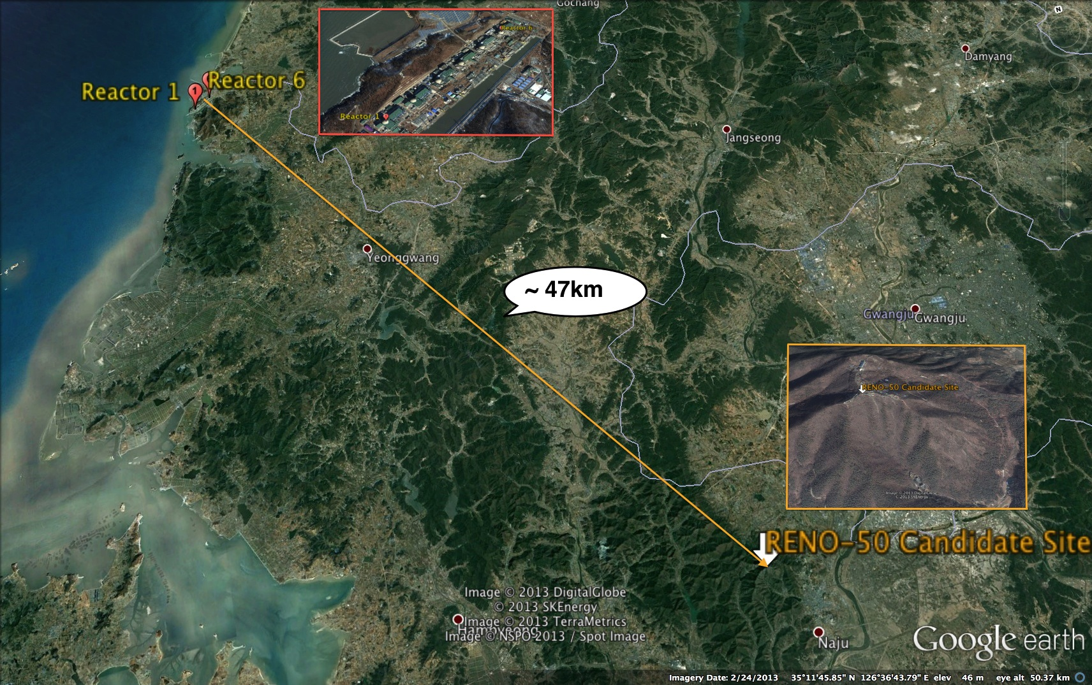
RENO-50 Candidate Site
Mt. GuemSeong
Altitude : 450 m

Slide 18
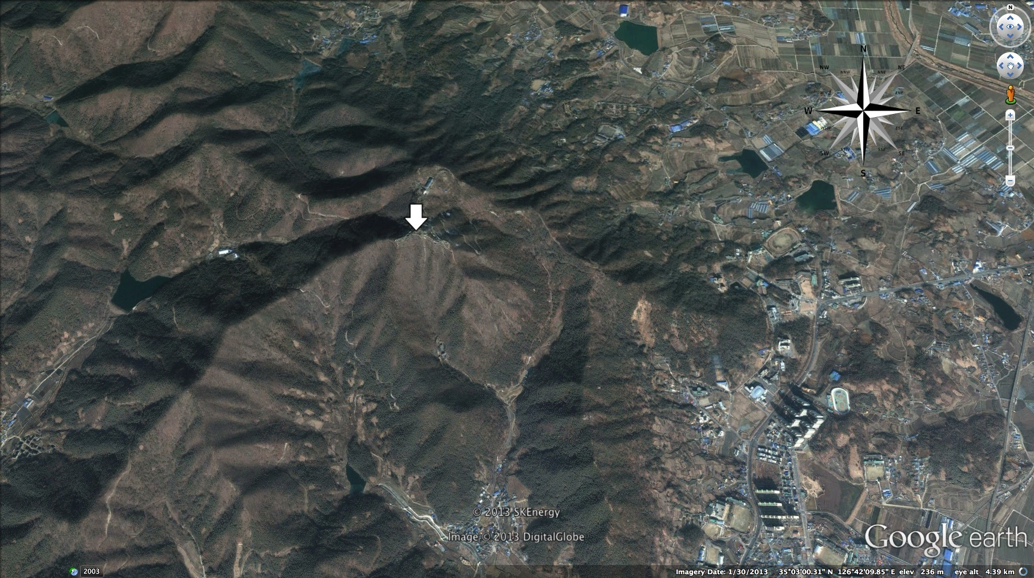
RENO-50 Candidate Site
Mt. GuemSeong
Altitude : 450 m
Dongshin University
RENO-50 Candidate Site

Slide 19
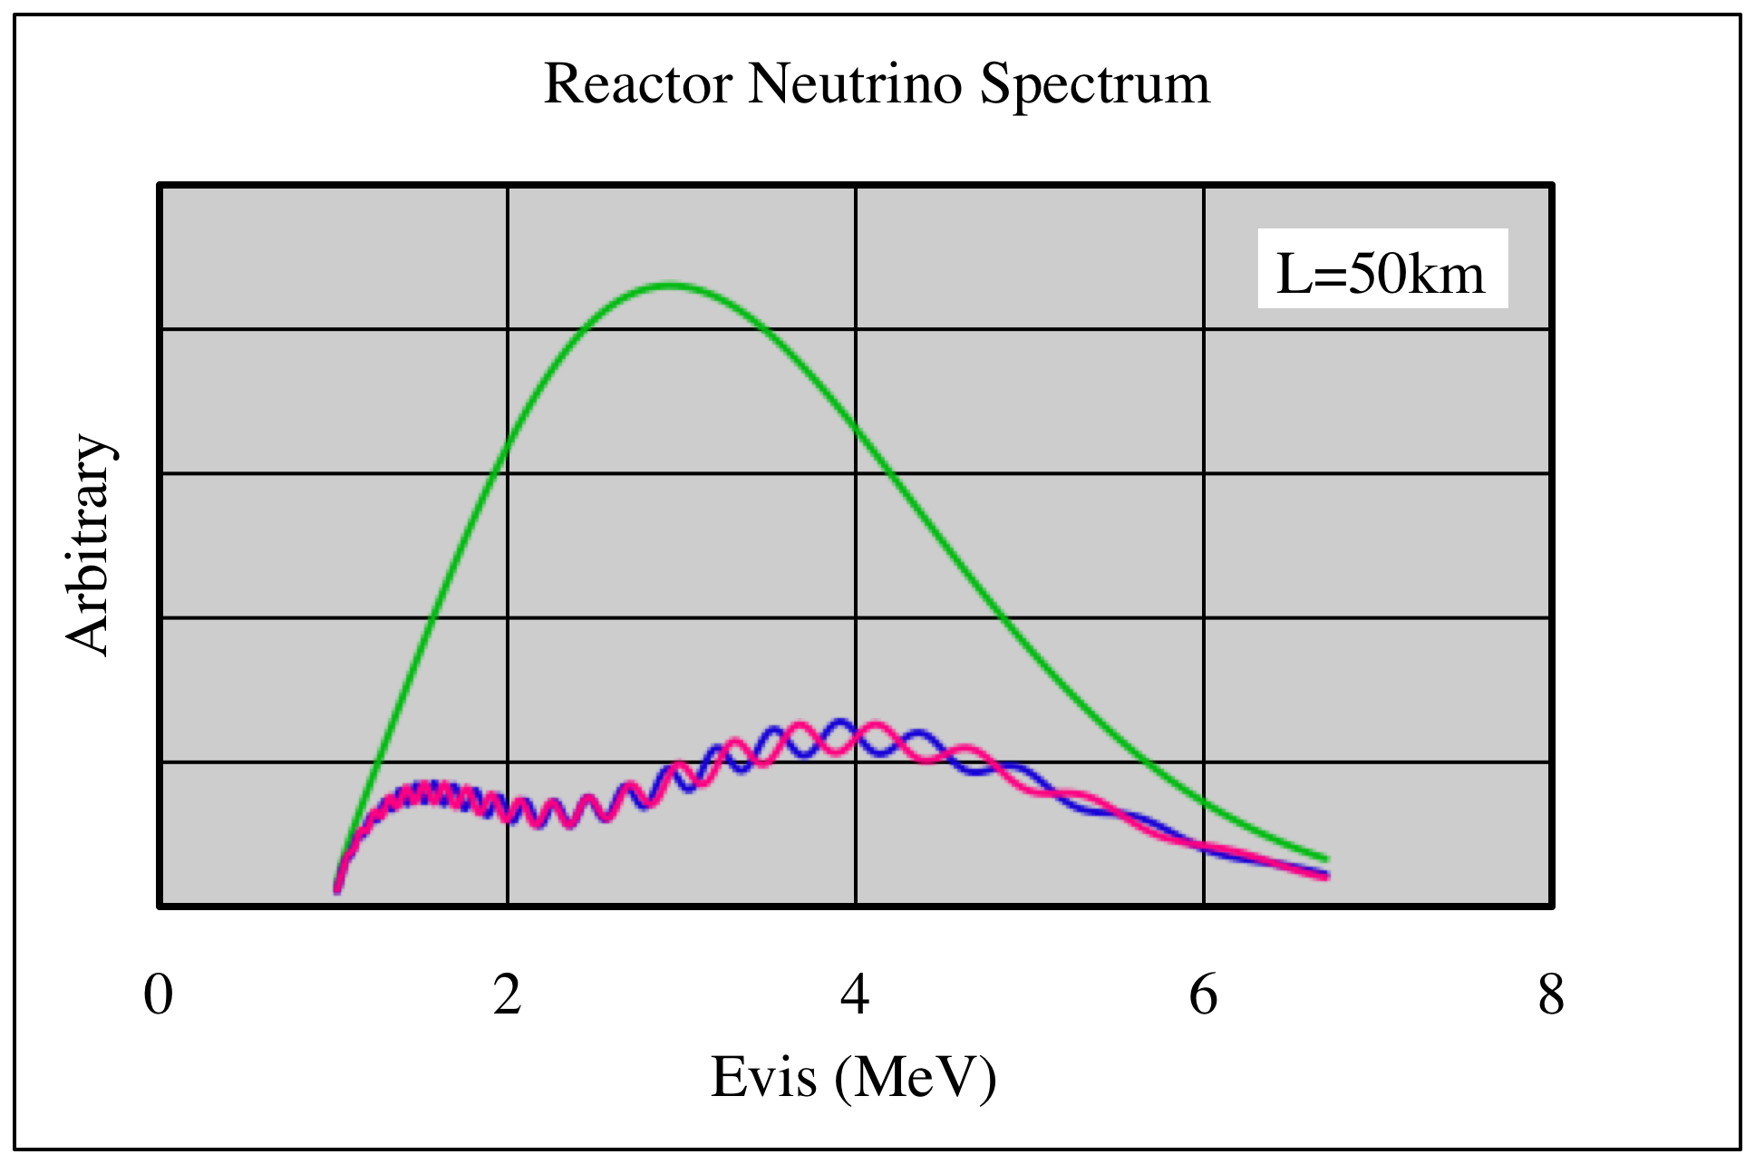
1st Δm²₂₁ Maximum (L~50km) ;
mass hierarchy + precise value of θ₁₂, Δm²₂₁ & Δm²₃₁
Reactor Neutrino Oscillation
RENO
Large Deficit
Precise θ₁₂
KamLAND
Ripple
RENO-50
Mass Hierarchy

Slide 20
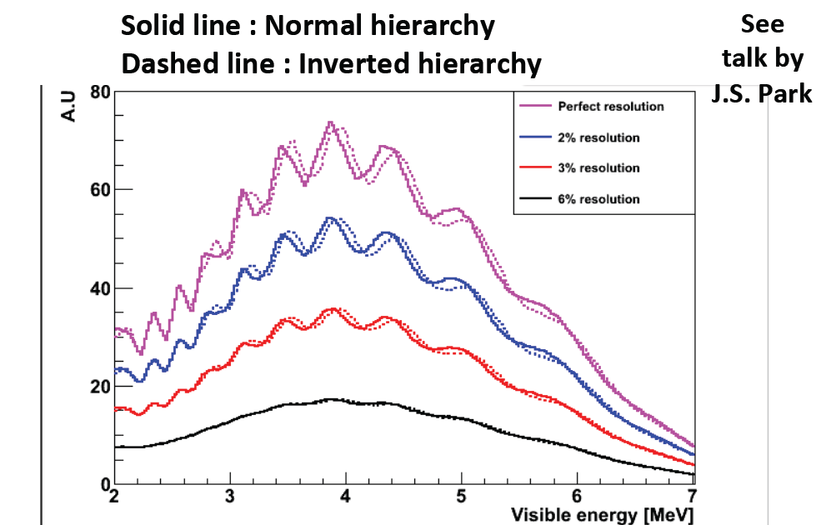
Energy Resolution for Mass Hierarchy
Better than 3% energy resolution is required
Determining the mass hierarchy is very challenging, but not impossible with very good energy resolution

Slide 21
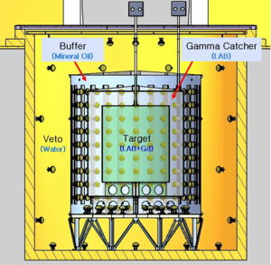
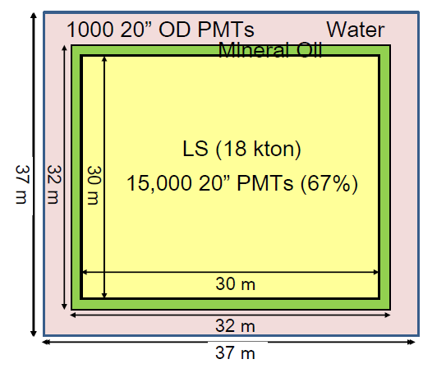
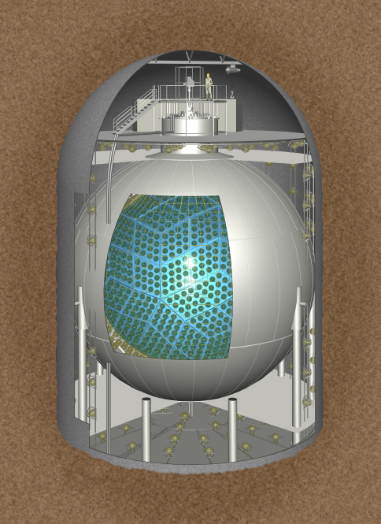
Conceptual Design of RENO-50
■ 18 ktons ultra-low-radioactivity Liquid Scintillation Detector
RENO
RENO-50
8.8 m
5.8 m
~1kt
5.4 m
8.4 m
KamLAND

Slide 22
Technical Challenges
 | KamLAND | RENO-50
LS mass | ~1 kt | 18 kt
Energy Resolution | 6.5%/√E | 3%/√E
Light yield | 500 p.e./MeV | >1000 p.e./MeV
Large detector (18 ktons) : D=30m, H=30m
3% energy resolution :
- High transparency LS : 15 m → 25 m (purification & better PPO)
- Large photocathode coverage : 34% → 67% (15,000 20” PMT)
- High QE PMT : 20% → 35% (Hamamatsu 20” HQE PMT)
- High light yield LS : ×1.5 (1.5 g/ℓ PPO → 5 g/ℓ PPO)

Slide 23
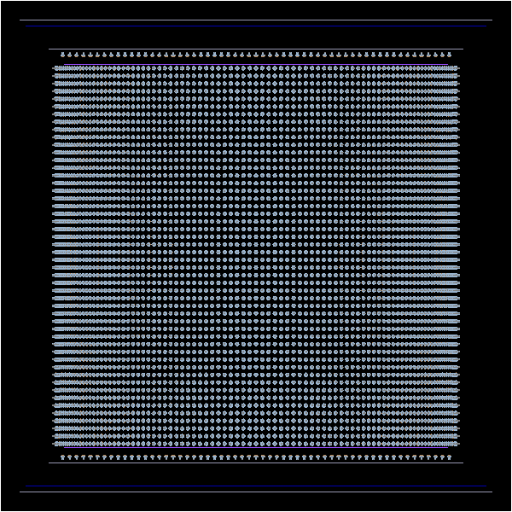
MC Simulation of RENO-50
Target : Acrylic, 30m*30m
Buffer : Stainless-Steel, 32m*32m
Veto : Concrete, 37m*37m
PMT arrangement scheme.
Barrel :
50 raw * 200 column
(9*26 for RENO)
Top & Bottom
2500 PMTs for each region. (60 for RENO)

Slide 24
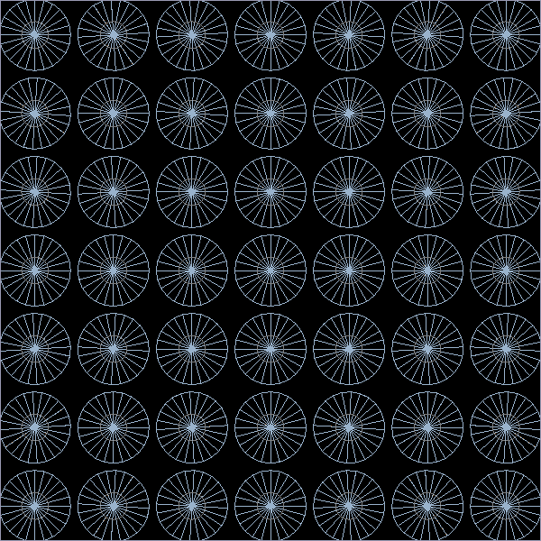
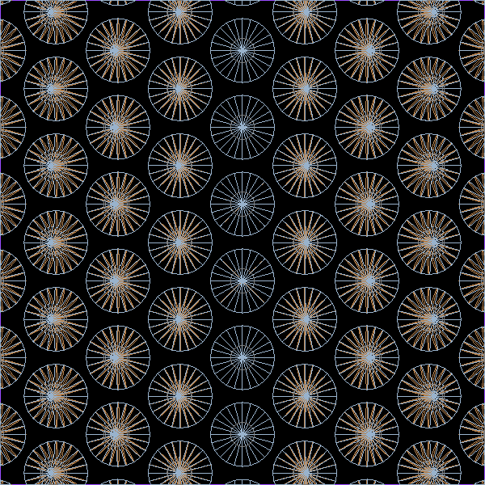
RENO-50 PMT Arrangement
Top & Bottom
Barrel
60 cm
55 cm
57 cm
55 cm

Slide 25
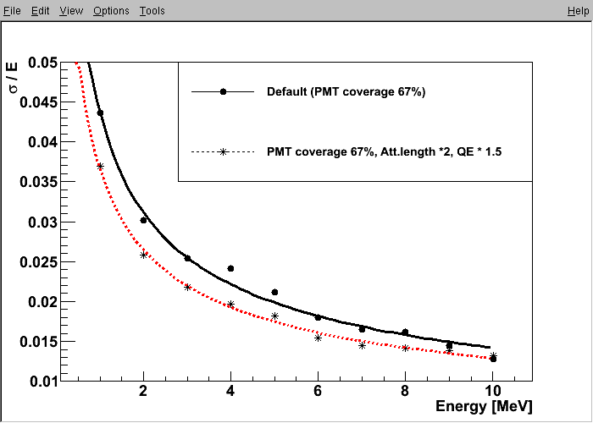
Expected Energy Resolution
PMT coverage : 67% (15,000 20” PMTs)
PMT coverage : 67% (15,000 20” PMTs)
+ Attenuation length : 25 m
+ QE : 35%

Slide 26
RENO-50 vs. KamLAND
 | Oscillation Reduction | Reactor Neutrino Flux | Detector Size | Syst. Error on ν Flux | Error on sin²θ₁₂
RENO-50 (50 km) | 80% | 13×6×φ₀ [6 reactors] | 18 kton | ~ 0.3% | < 1%
KamLAND (180 km) | 40% | 55×φ₀ [55 reactors] | 1 kton | 3% | 5.4%
Figure of Merit | ×2 | ×1.5 | ×18 | ×10
(50 km / 180 km)² ≈ 13
Observed Reactor Neutrino Rate
RENO-50 : ~ 15 events/day
KamLAND : ~ 1 event /day

Slide 27
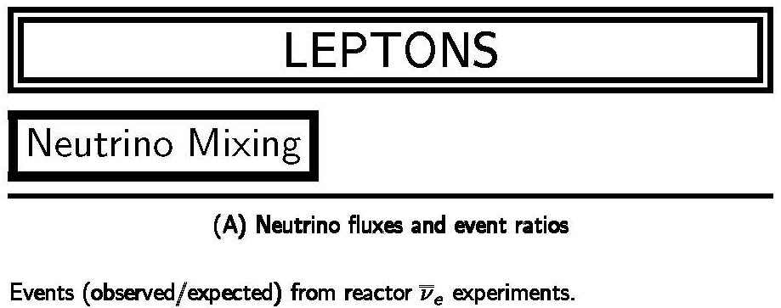
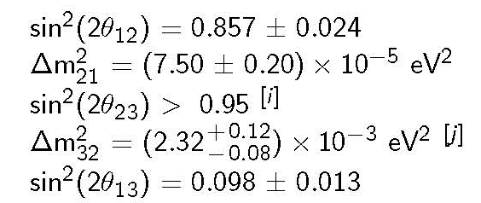
2012 Particle Data Book
(±2.8%)
sin²θ₁₂ = 0.312±0.017 (±5.4%)
(±2.7%)
(±3.1%)
sin²θ₂₃ = 0.42+0.08−0.03 (+19.0 -7.1%)
(+5.2-3.4%)
∆m₂₁² / |∆m₃₁₍₃₂₎²| ≈ 0.03
(±13.3%)
sin²θ₁₃ = 0.0251±0.0034 (±13.5%)
Precise measurement of θ₁₂, Δm²₂₁ and Δm²₃₂
(← 5.4%)
(← 2.6%)
(← 5.2%)

Slide 28
Additional Physics with RENO-50
Neutrino burst from a Supernova in our Galaxy
- ~5,600 events (@8 kpc)
- A long-term neutrino telescope
Geo-neutrinos : ~ 1,000 geo-neutrinos for 5 years
- Study the heat generation mechanism inside the Earth
Solar neutrinos : with ultra low radioacitivity
- MSW effect on neutrino oscillation
- Probe the center of the Sun and test the solar models
Detection of J-PARC beam : ~100 events/year
Neutrinoless double beta decay search : possible modification like KamLAND-Zen

Slide 29
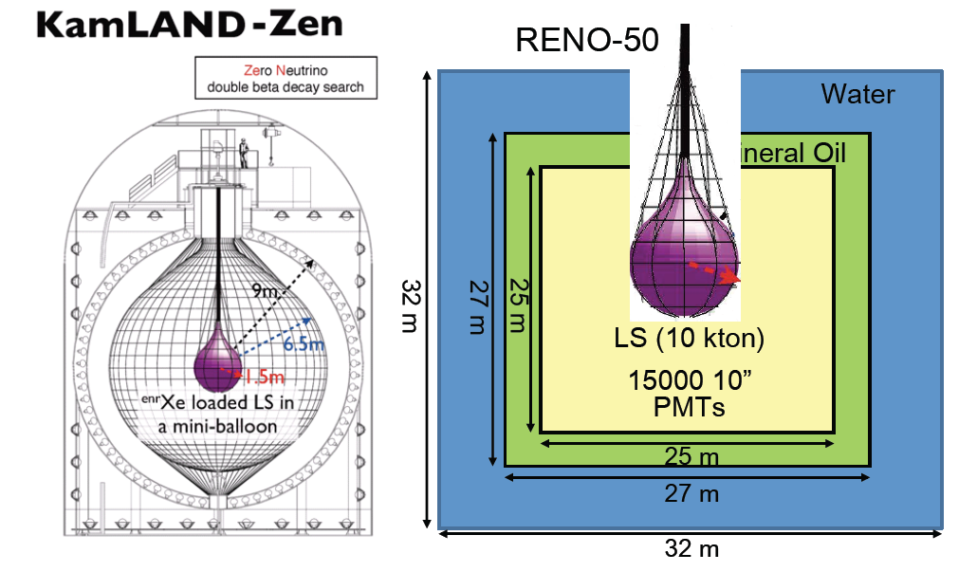


Physics with RENO-50
Search for neutrinoless double beta decay
18
20”

Slide 30
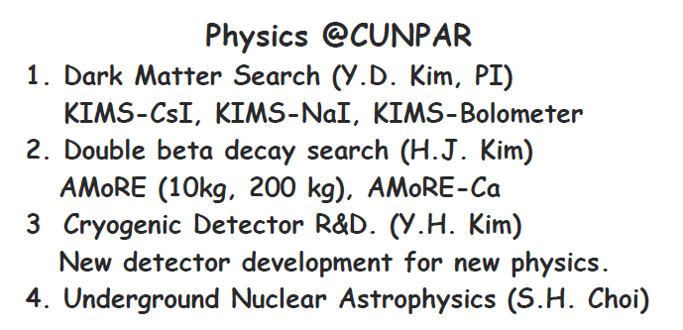
Institute of Basic Science (IBS)
CUNPA
+
CUNPA (Center for Underground Nuclear & Particle Astrophysics)
~$10M/year for next 10 years. Total ~$100M
Fully funded for 10yrs

Slide 31
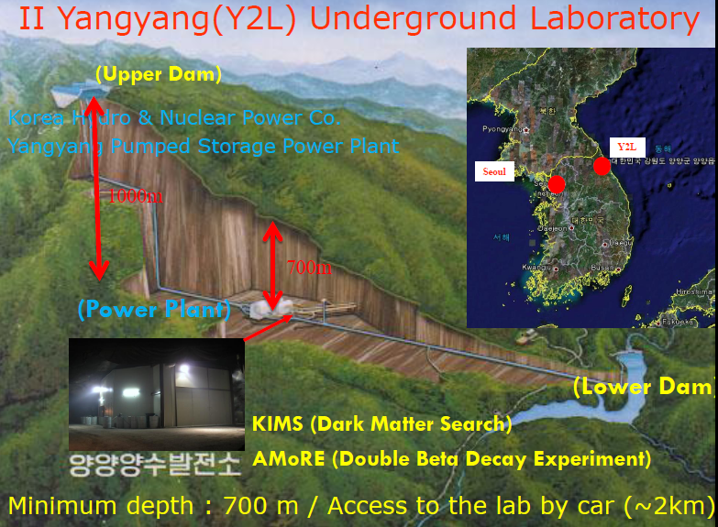
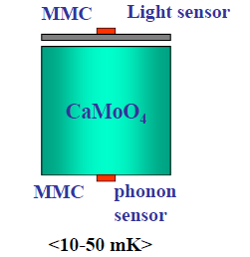
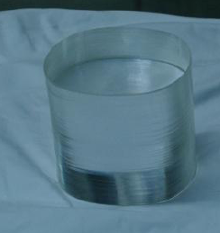
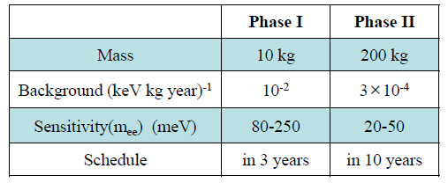

AMoRE (Advanced Mo-based Rare process Experiment)
- Searching for neutrino-less double beta decay of ¹⁰⁰Mo
using cryogenic ⁴⁰Ca¹⁰⁰MoO₄ detectors
5 countries (Korea, Russia,
Ukraine, China, Germany)
- 13 institutes, ~84 collaborators
Location: Y2L or new lab
Weight ~300g
AMoRE detector

Slide 32
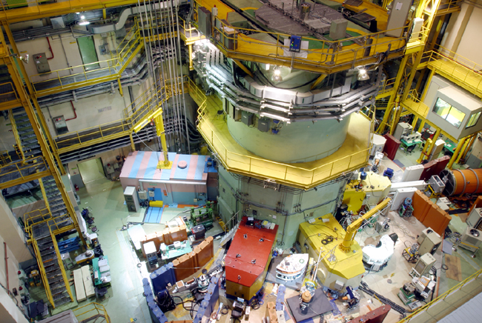
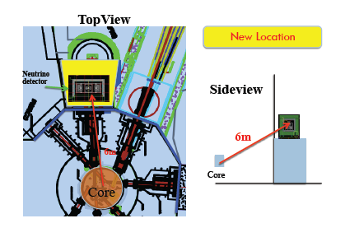
Hanaro Short Baseline (SBL) Neutrino Experiment in Korea
Baseline ~6m
~100 neutrinos/day
Funded (~2M$) for 3 yrs
30MW Hanaro research reactor in KAERI, Daejeon, Korea is used to investigate a reactor neutrino anomaly
Small core size: 20x40x60 cm³
50L prototype detector and then 500L LS (GdLS, ⁶LiLS) main detector

Slide 33
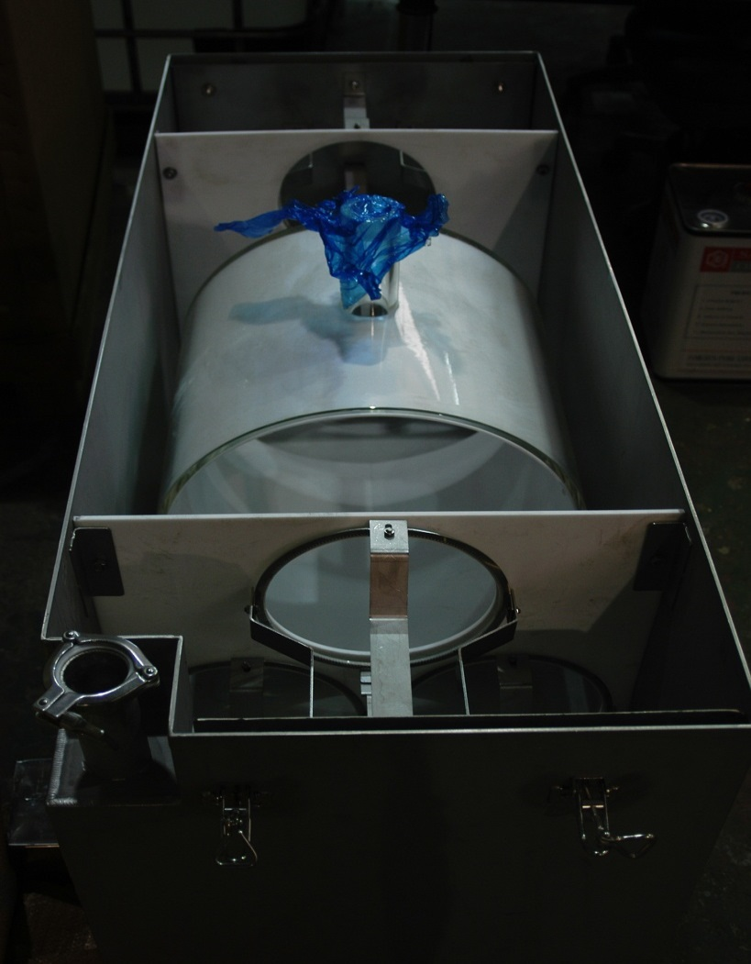
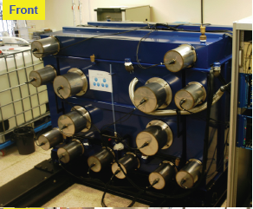
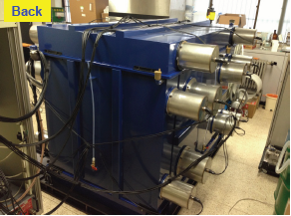
Hanaro SBL Prototype Detector
Target
(50L)
Target (50L) of GdLS/⁶LiLS
PMT: 6 x 8” R5912 Hammatsu PMTs
Passive shield (10 cm thickness Lead)
4π muon veto
Background is studied at over ground LAB
Deployment plan: Hanaro @6m, March 2014

Slide 34
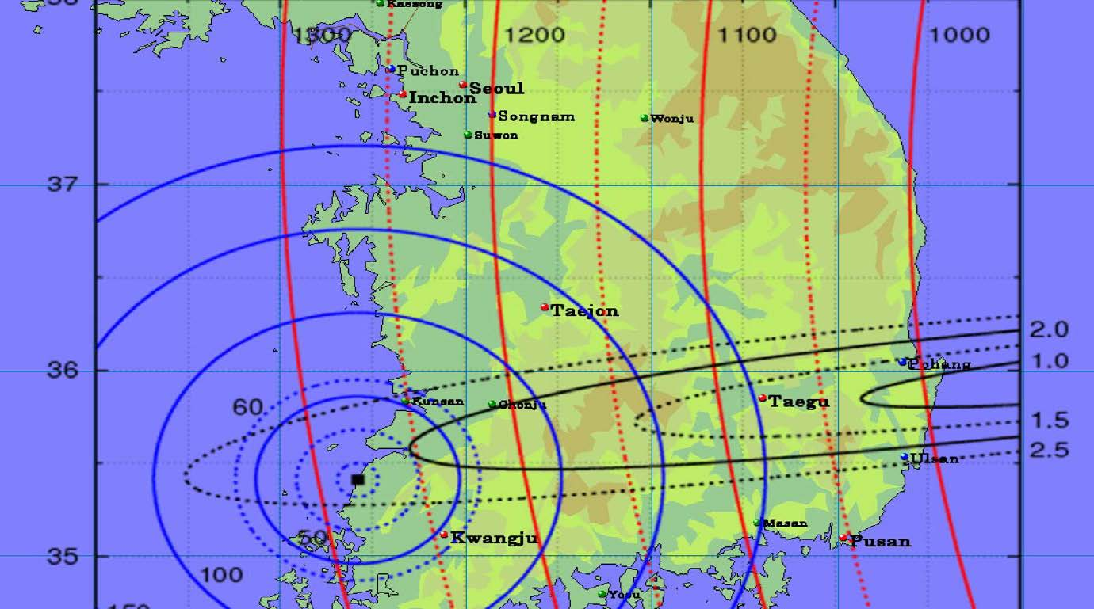
J-PARC neutrino beam
Dr. Okamura & Prof. Hagiwara

Slide 35
RENO-50 Schedule
2013 : Group organization
Detector simulation & design
Geological survey
2014 ~ 2015 : Civil engineering for tunnel excavation
Underground facility ready
Structure design
PMT evaluation and order,
Preparation for electronics, HV, DAQ & software tools,
R&D for liquid scintillator and purification
2016 ~ 2018 : Detector construction
2019 ~ : Data taking & analysis

Slide 36
Closing Remarks
A clear disappearance of reactor antineutrinos is observed. The smallest mixing angle of θ₁₃ is firmly (to ~10% precision) measured by the reactor experiments.
The mixing angle of θ₁₃ expects to be measured to ~5% precision within 3 years. This will provide the first glimpse of δ_{CP.} if accelerator results are combined.
Longer baseline (~50 km) reactor experiments is under pursuit to perform high-precision measurements of θ₁₂, Δm²₂₁, & Δm²₃₁ , and to determine the mass hierarchy.
Korean reactors can be used as an intense neutrino source to study the neutrino properties. RENO-50, a multi-purpose neutrino detector. AMoRE experiment will be carrying out for 10 yrs from now on. Construction for SBL is under way.

Slide 38
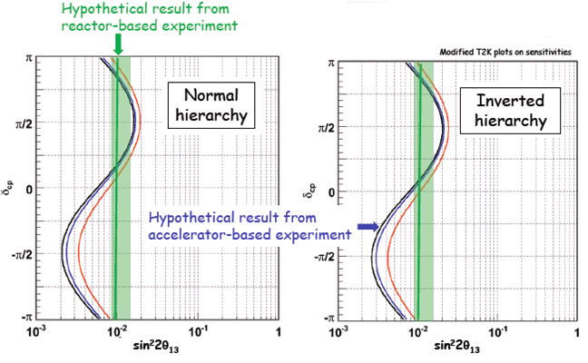
θ₁₃ from Reactor and Accelerator Experiments
* Reactor
- Clean measurement of θ₁₃ with no matter effects
* Accelerator
- mass hierarchy + CP violation + matter effects
Precise measurement of θ₁₃
Complementary :
Combining results from accelerator and reactor based experiments could offer the first glimpse of δ_{CP.}

Slide 39

⁹Li/⁸He β-n Backgrounds
⁹Li/⁸He are unstable isotopes emitting (β,n) followers and produced when a muon interacts with carbon in the LS.

Slide 40


Summary of Final Data Sample
(Prompt energy < 10 MeV)
279787
30211
20.48± 2.13
4.89± 0.60
737.69± 2.58
70.13± 0.75
369.03
402.69
62.0± 0.014
71.4± 0.014
3.61± 0.05
0.60± 0.03
13.73± 2.13
3.61± 0.60
3.14± 0.09
0.68± 0.04

Slide 41


Reactor Neutrino Anomaly
전체 원자로 측정실험 의 측정거리에 따른 정리
CHOOZ Data
2009년 이전
2009년 원자로 중성미자 스펙트럼을 수정→ 이전실험들의 데이터가 약 6% 정도 작음.
실험
Double Chooz(FRANCE)
Daya Bay(China)
RENO(KOREA)
KAMLAND Data

Slide 42






Slide 43


Slide 44


Slide 45


Slide 46


Slide 47


Slide 48


RENO-50 vs. KamLAND
RENO-50
RENO-50 is dedicated to the YG power plant. (negligible contribution from the other nuclear power plants)
RENO can be used as near detectors.
Precise reactor neutrino fluxes :
systematic error from ~3% to ~0.1%
KamLAND uses the entire Japanese nuclear power plants as a source.

