Slide 1
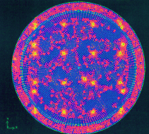
Status of HK Water 4th Open Meeting for Hyper-K January 28 2014
Hiroyuki Sekiya
ICRR, University of Tokyo
for the Hyper-K Working Group 2
1

Slide 2
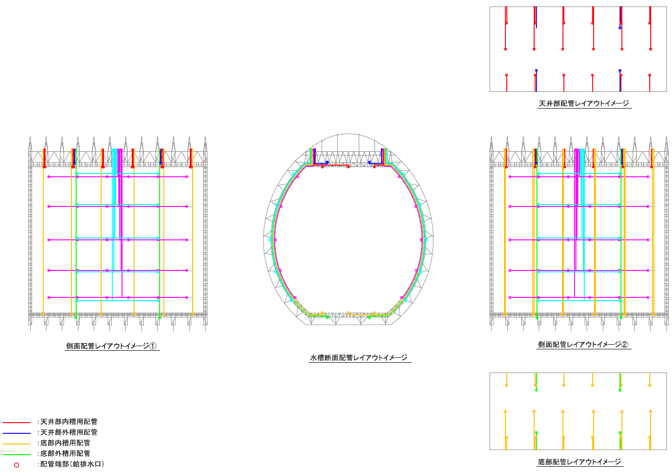
Plumbing in the tanks
Additional inlets/outlets at 5 levels of side wall for:
*future activities to prevent stagnation
*recirculation during initial filling to prevent bacteria from growing
Slide from the last open HK meeting

Slide 3
Topic of this talk
Make the most of the side wall inlets and outlets to go beyond SK water quality
Current activity to prevent stagnation
is water flow simulations
Recirculation during initial filling
requires additional bottom pumps

Slide 4
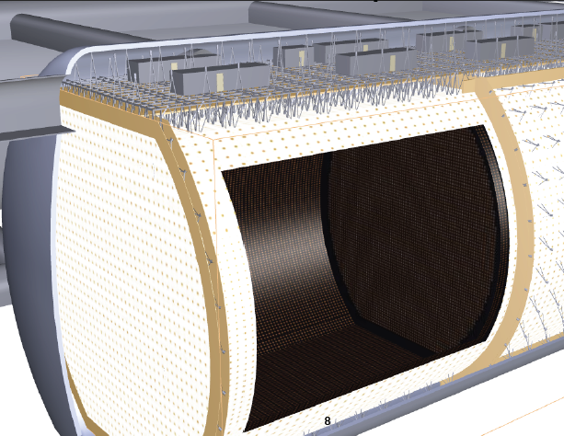
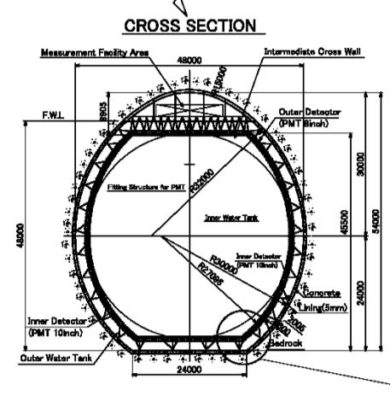
Water Flow simulation
One compartment
Software updates:
ANSYS GAMBIT2.4.6+Fluent14.5

Slide 5
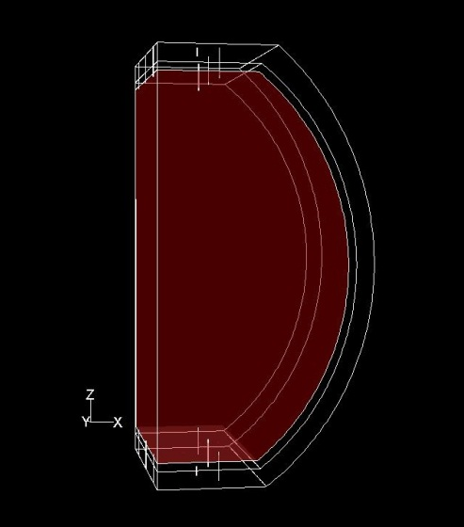
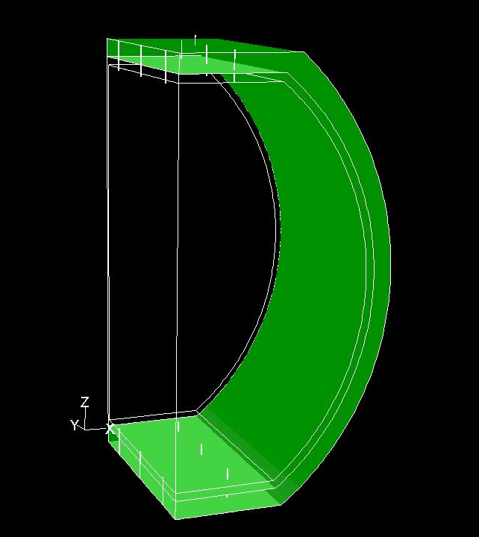
ID & OD Conditions
Reminder
ID & OD are dealt as completely separated containers.
Because of its symmetrical shape, only 1/4 volume is considered for the simulation.
1,400,000 mesh
(xy, and yz symmetry)
 | Inner detector | Outer detector
Volume | 370,000m³ | 89,000m³
Flow rate | 96.7t/h | 23.3t/h
Number of inlets (outlets) | 18 | 4
Flow rate / inlet (outlet) | 5.37t/h | 5.82t/h

Slide 6
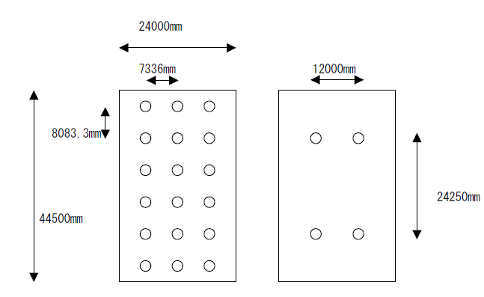
Water inlets & outlets conditions
Reminder
Top and bottom
Equally distributed per top/bottom cross section
ID
OD

Slide 7
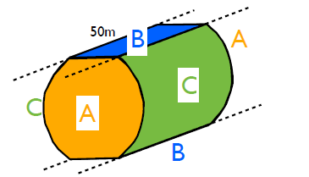
Heat source conditions
Reminder
Base on measured Tochibora temperature
Cooling water 10.5ºC
Supplying water 13.0ºC
Top level rock 16.7ºC
Bottom level rock 17.7ºC
For one compartment
Area
47.4kW

Slide 8
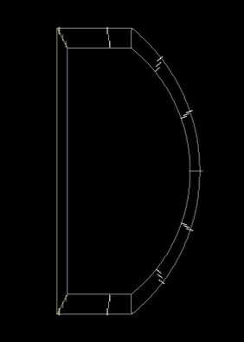
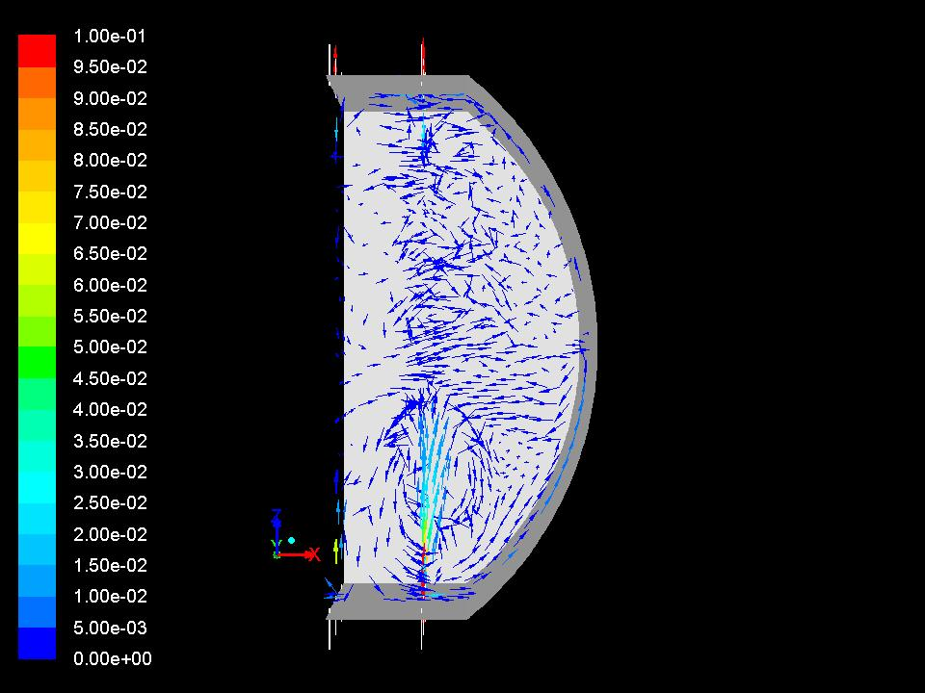
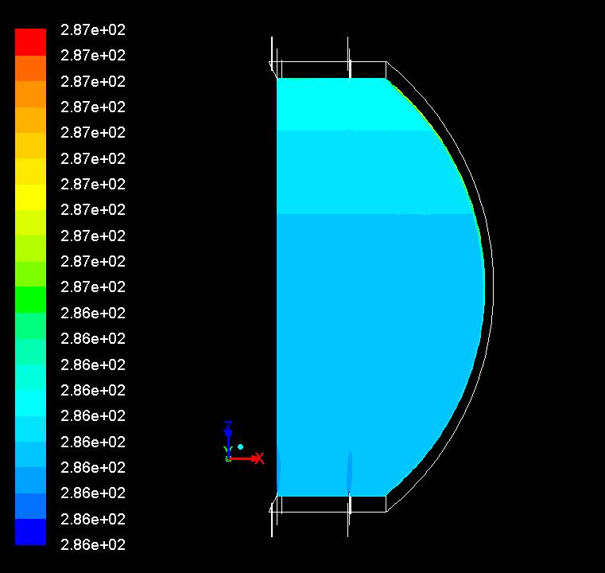
SK-like operation
Reminder static solutions
supply: bottom, return: top
Reproduces SK
bottom convection & top stagnation
ID ¼
Temperature
→LowE oriented tuning.

Slide 9
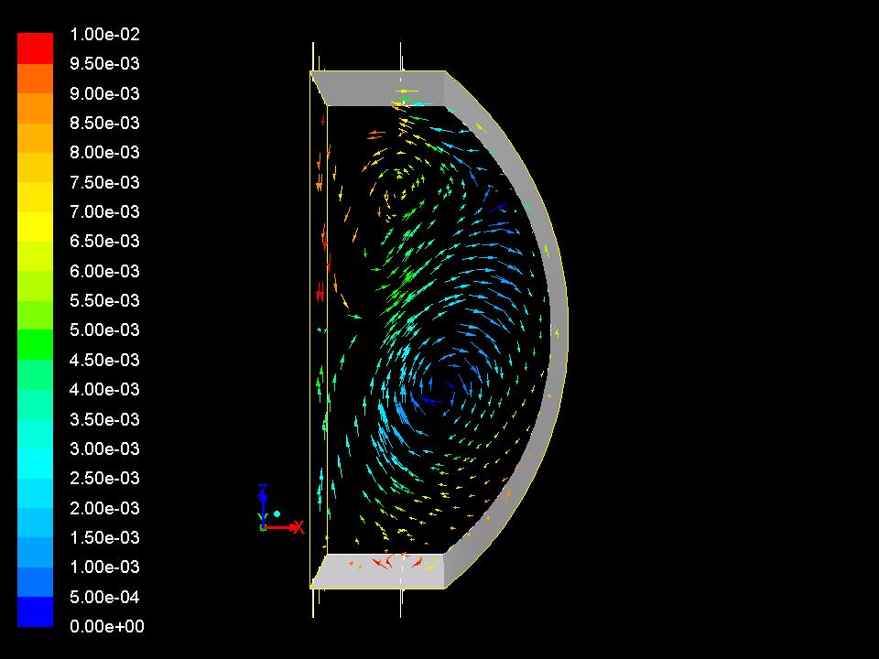
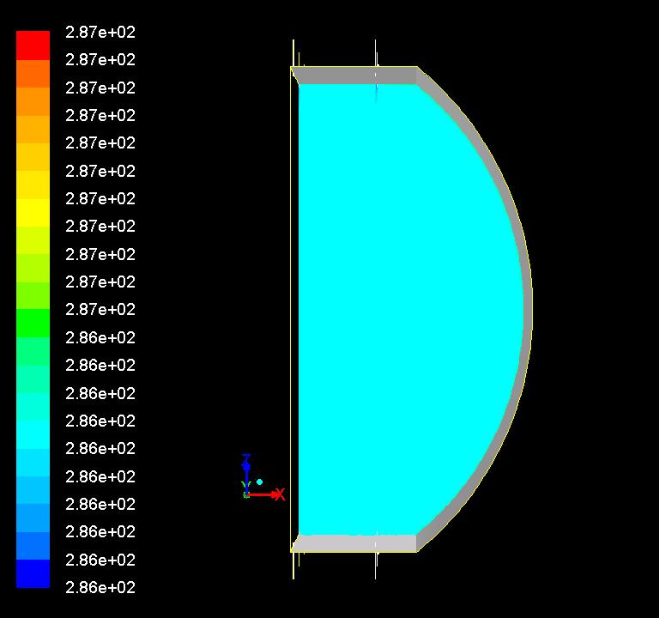
Inverse operation
Reminder static solutions
Supply cold water to the top, return: bottom
Whole convection
uniform detector
ID ¼
Temperature
→T2HK oriented tuning.

Slide 10
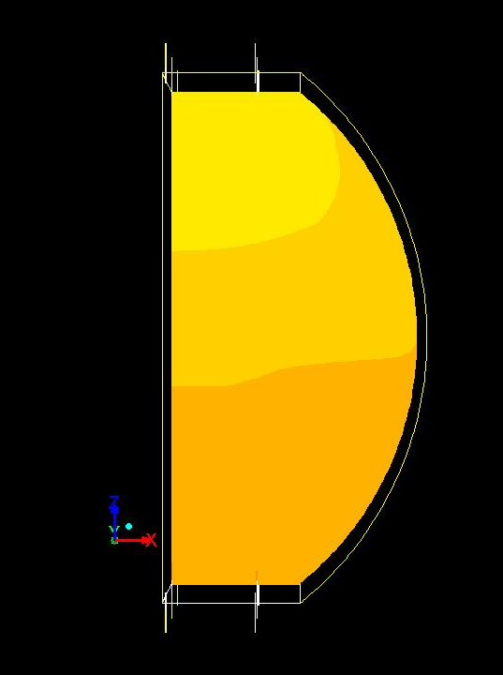
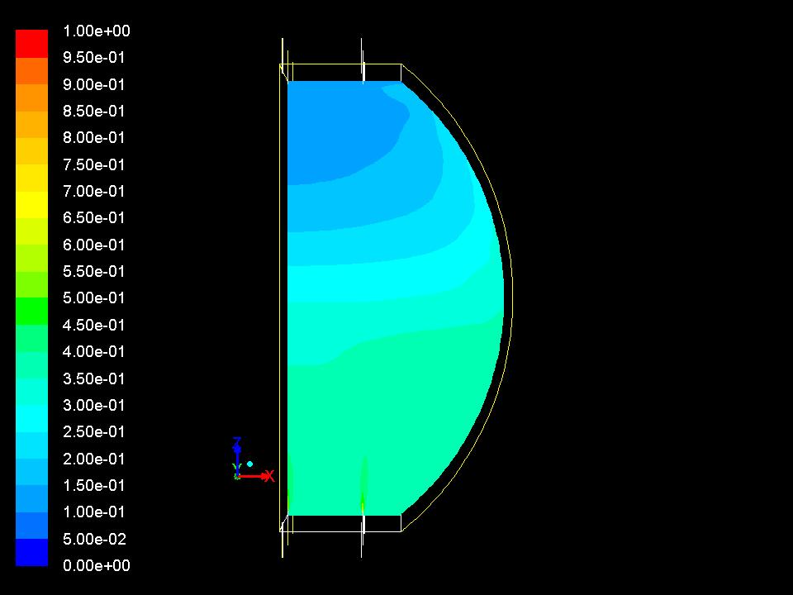
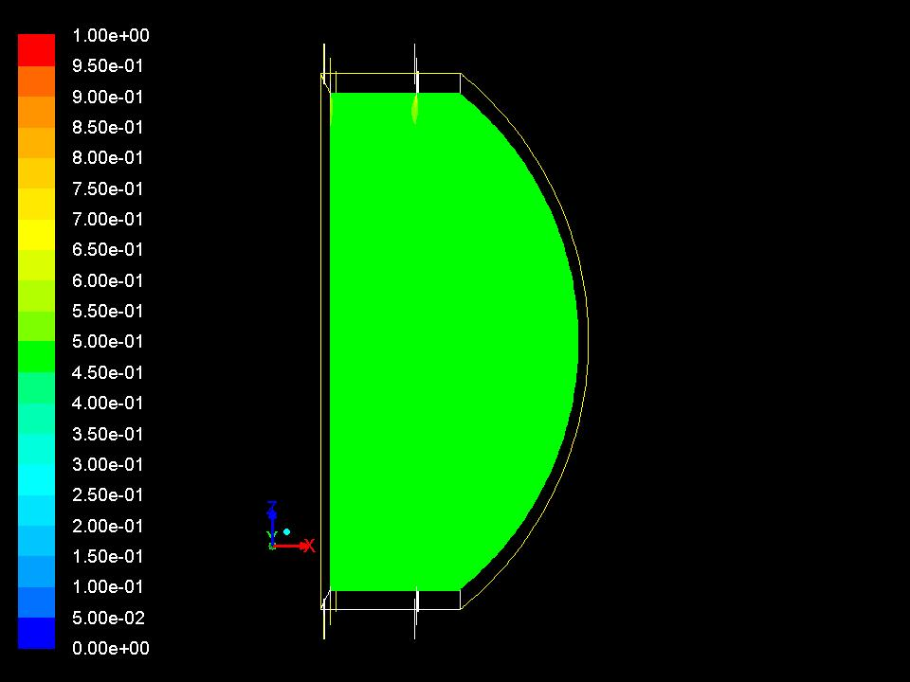
Water replacement efficiency
supply: bottom, return: top
w/ Time evolution
15%
45%
55%
75%
40%
60%
75%
85%
10 days
20 days
30 days
40 days
supply cold water to the top, return: bottom
30%
50%
Not yet
65%
75%

Slide 11
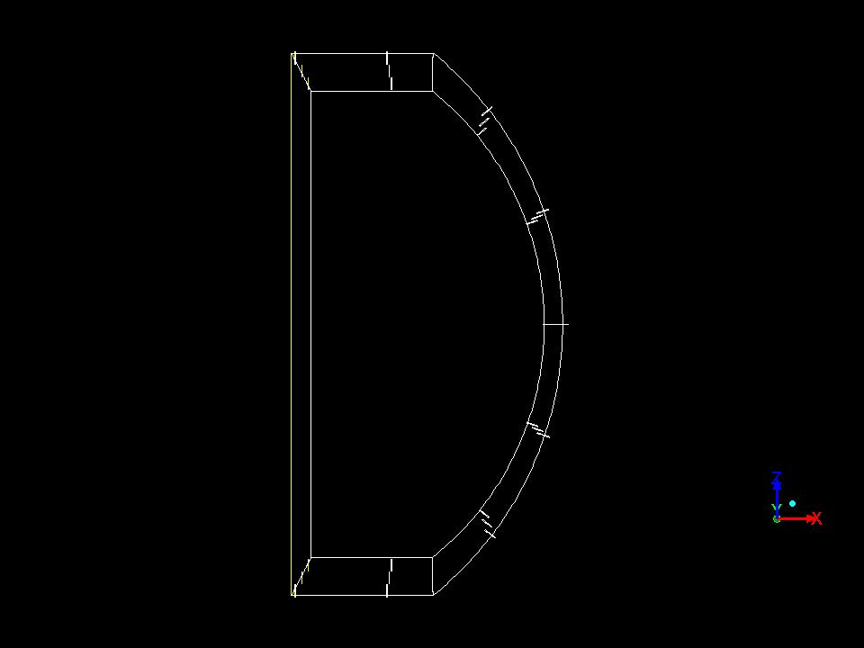
Try to maximize the efficiency using the side wall pipes
Two more cases

Slide 12
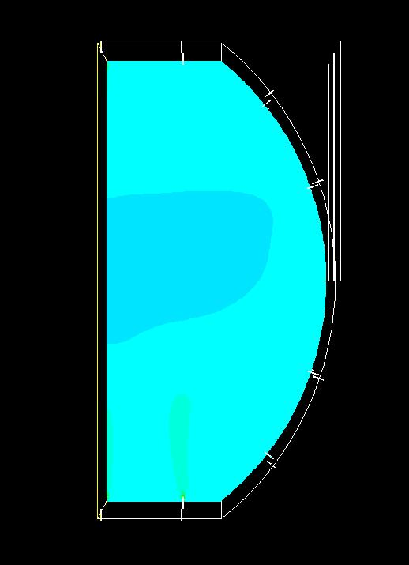
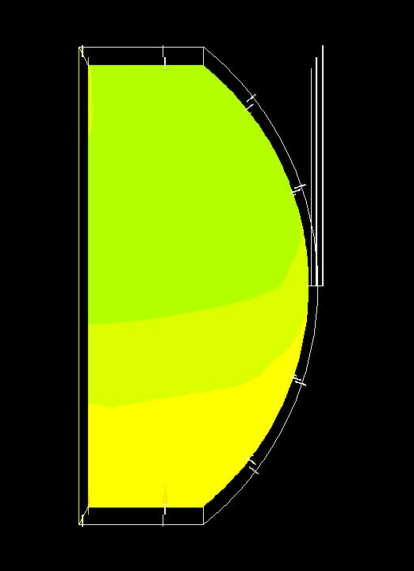
Comparison with “SK operation”
15%
45%
55%
75%
40%
60%
75%
85%
10 days
20 days
30 days
40 days
30%
45%
60%
75%
25%
30%
55%
70%
80%

Slide 13
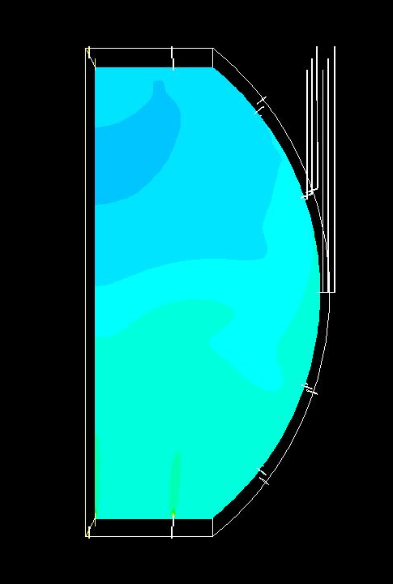
Comparison with “SK operation”
15%
45%
55%
75%
40%
60%
75%
85%
10 days
20 days
30 days
40 days
20%
40%
60%
70%
35%
55%
70%
80%

Slide 14
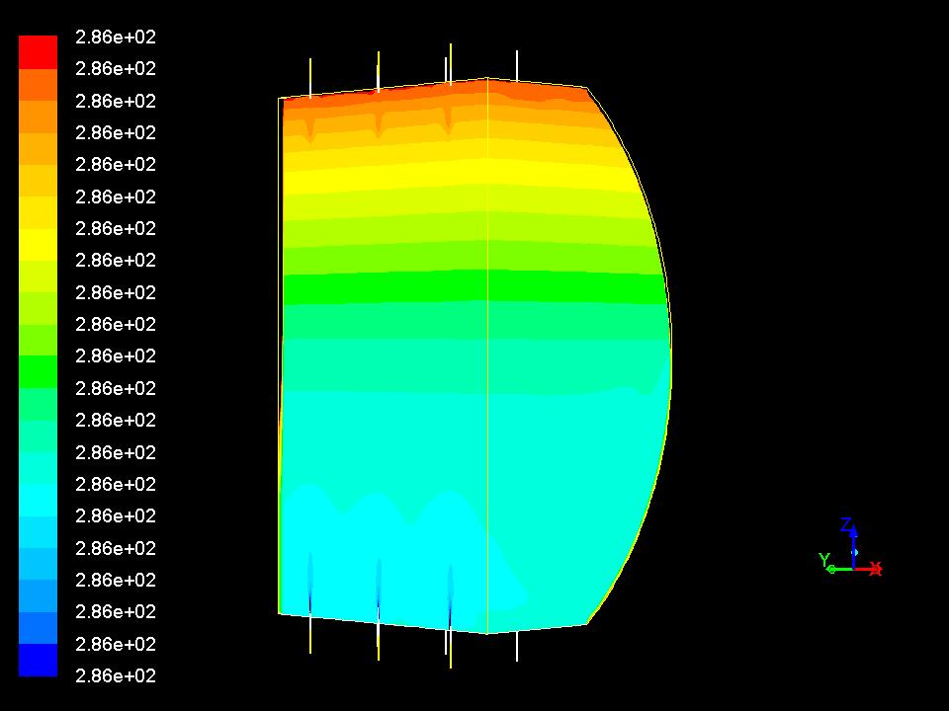
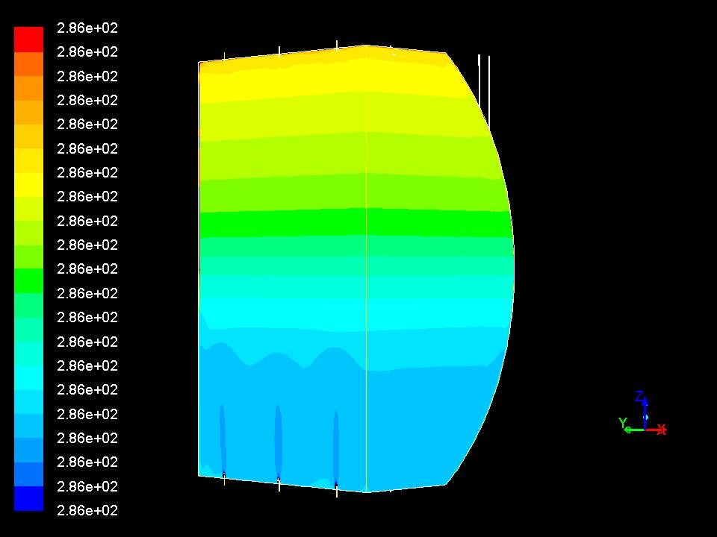
Milder temperature gradient
Suppresses the bottom convection region and enlarges lowest energy FV
286.3K
286.2K
286.1K

Slide 15
90 days to fill a tank

Slide 16
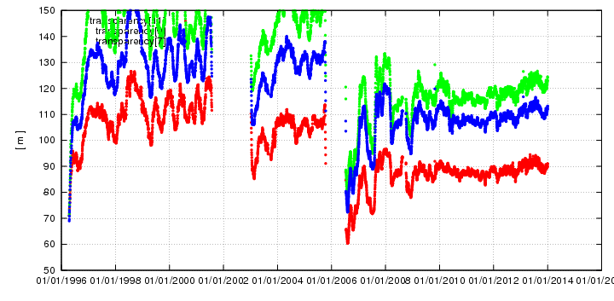
60 days filling without recirculation caused
2 months dead + 2 months bad (for lowE)
Water transparency [ m ]
SK-I
SK-III

Slide 17
HK has 2 recirculation systems
One is used for the filling, the other can be used for the purification of the filled water!

Slide 18
New bottom pump
From 2nd stage
Main return pump
To 2nd stage
Side wall outlets for this level
Pump for circulation during the filling period
Water level
HK Tank
Additional pumps should be installed at the bottom

Slide 19
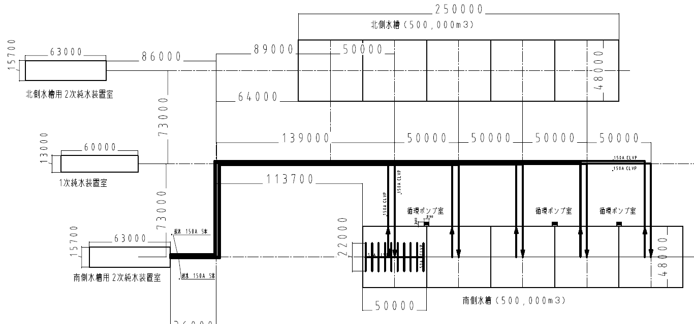
Now pump rooms
L3.4m x W3.7m x 6 must be allocated somewhere near the tanks.

Slide 20
Conclusion
Progress on the water flow simulation.
Using side wall inlets/outlets
Started designing the recirculation mode during the initial filling
Additional pump rooms should be caverned

Slide 21
おまけ

Slide 22
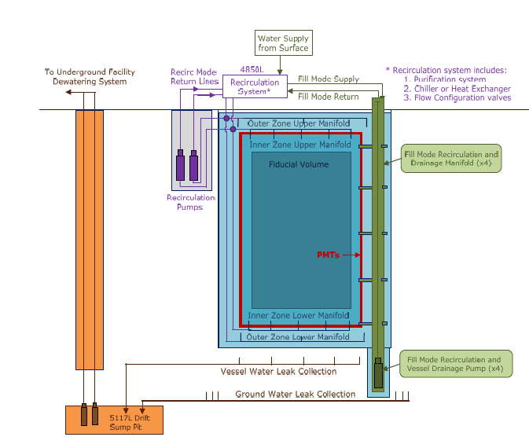
But there is no pump that can suck 48m of water
Pumps should be installed at the bottom
Like LBNE CDR
arXiv: 1204.2295

