Slide 1

DAQ (i.e electronics) R&D status in Canada
F.Retiere, T.Lindner, C. Rethmeier (undergrad. Student), P-A. Amaudruz, D. Bishop and 4 UBC eng. students

Slide 2
Outline
Explore flash ADC solution
  Requirement
  Strategy
  Test setup
  Test results
Front end electronics communication protocol
  Investigate using rapidIO protocol

Slide 3
Electronics requirement recap
Timing resolution σ≤0.5ns for 1 photo-electron
Noise ≤0.1PE
Dynamic range
  1,000 PE over 1ms
    What is it over 50ns, 250?
  Maintain PMT linearity, i.e. use low gain?
Power dissipation ~1W/channel
Readout scheme
  Dark noise dominated ~5kHz/PMT
    Only send time (~TDC) and charge (~QDC) for single PE
    Could send more data for >1PE pulses
  Trigger less front end. Send information to backend for all pulses
    Data suppression occur in backend
  Daisy-chained in-water front end boards
    Need fail-safe communication system
Desirable features:
  Deadtime-less
  Ability to identify and time stamp every photo-electrons

Slide 4
Our digitization strategy
Analog shaper
Flash ADC
FPGA
PMT
Adjust the pulse shape to match FADC digitization frequency
Produce waveforms
Determine if pulses fit single PE template
If yes, extract time and charge
If not, save waveform fragment

Slide 5
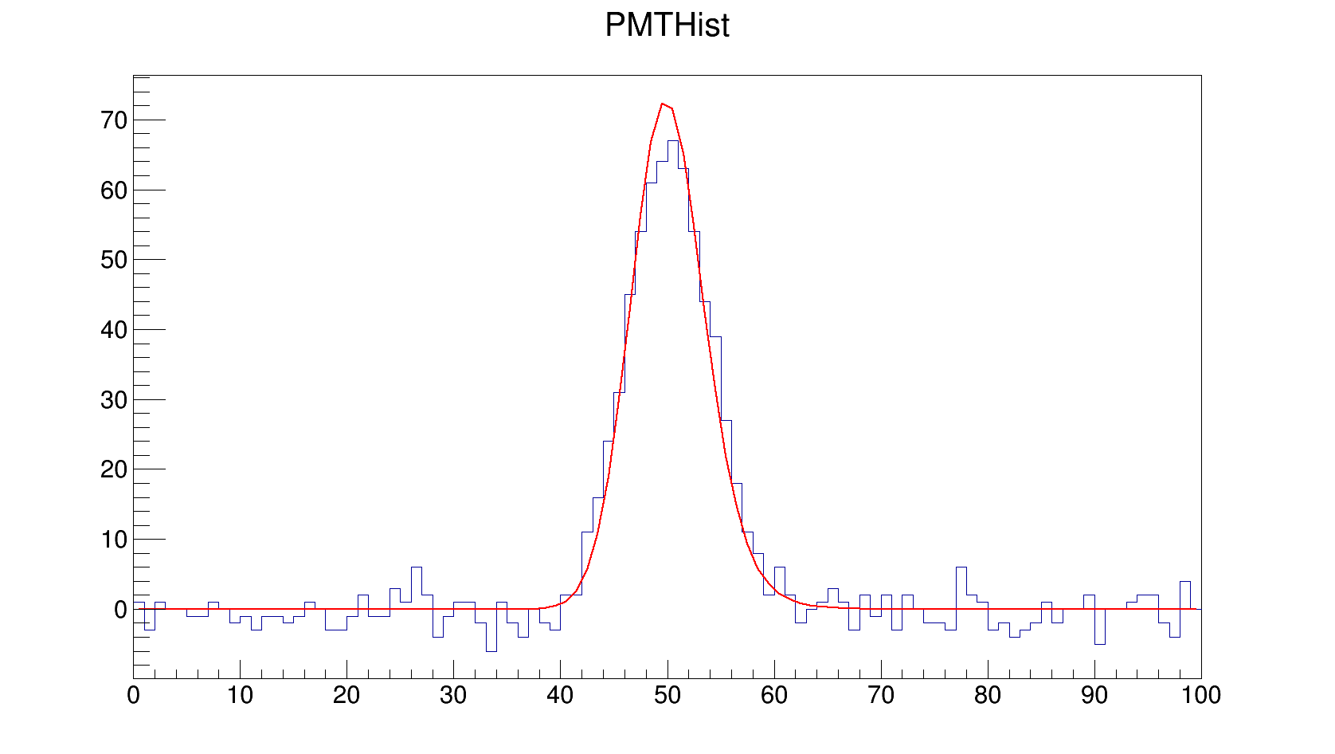
Measuring time
FPGA based (eventually)
  Digital CFD
  Template matching
  Some smart interpolation
Analysis offline for now
  Use fit function
Performance expectation
  Resolution scales by rise time over signal to noise
  Crank the PMT gain yield better time but worse dynamic range / linearity
Amplitude (~0.1mV/bin)
Time (2ns/bin)

Slide 6
Test setup
Signal
  PMT + shaper
    R5912 PMT (8”) but Transit Time Spread ~ 3ns and R9875P with TTS<0.5ns but very fast pulse
    Shaping using DEAP signal conditioning board. Not optimized for timing resolution
  Arbitrary waveform generator
    Allow changing pulse shape, and amplitude
Digitizers
  500MHZ, 14bits, CAEN V1730
  250MHz, 12bits, CAEN V1720
  100MHz, TRIUMF custom FADC for GRIFFIN experiment
Pulse analysis offline analysis for now
  Test CAEN digital CFD later this year

Slide 7
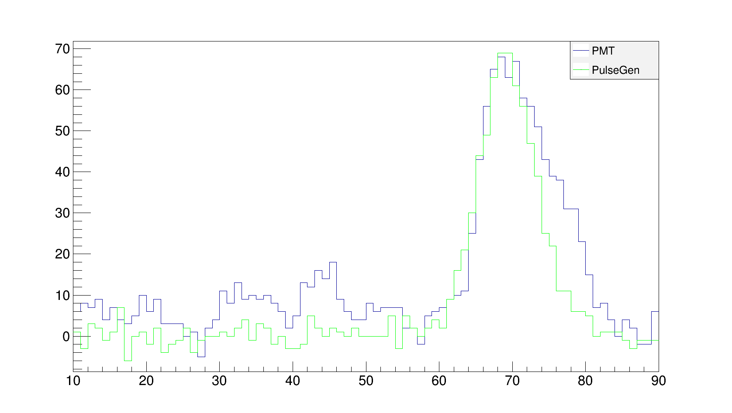
PMT+SCB vs Arbirtrary waveform generator
Amplitude (~0.1mV/bin)
Time (2ns/bin)

Slide 8
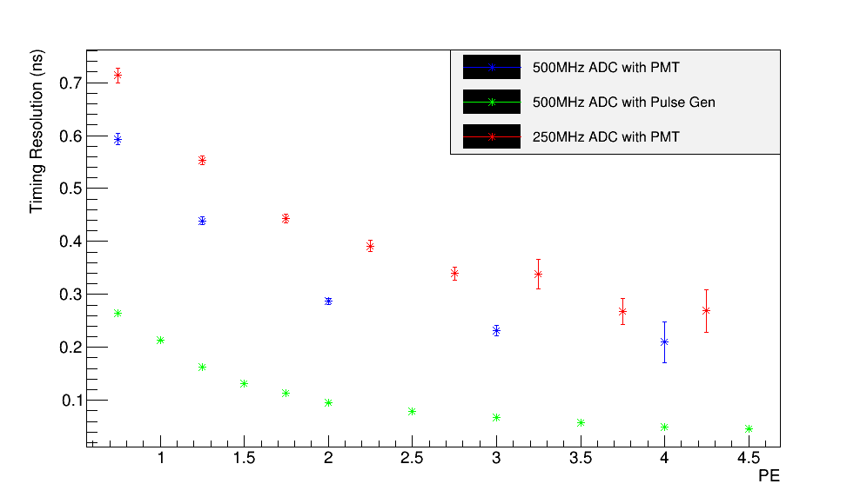
Timing resolution vs PE
PE is not a well defined quantity however…

Slide 9
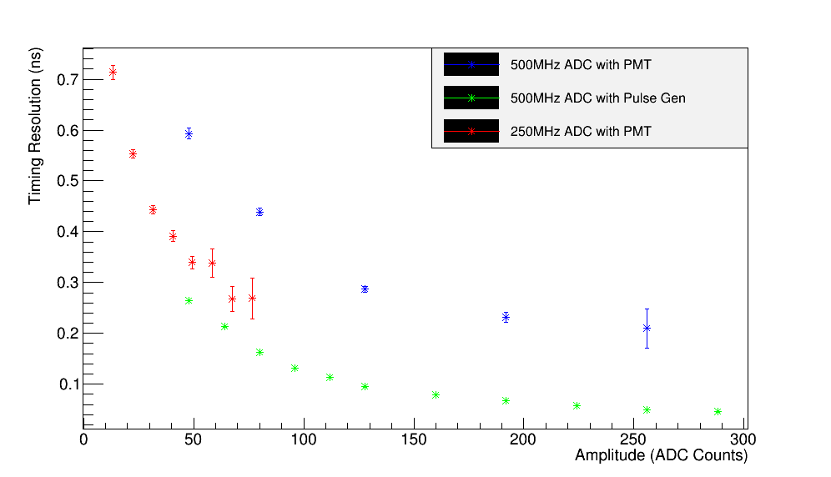
Timing resolution vs amplitude
Cranking up the PMT gain helps but compromise dynamic range.
Single PE amplitudes should be ~20ADC for 12 bits ADC and 80ADC for 14 bits ADC
So inferred SPE resolution is 0.55ns for 12bits/250MHz ADC, 0.42ns for 14bits/500MHz ADC

Slide 10
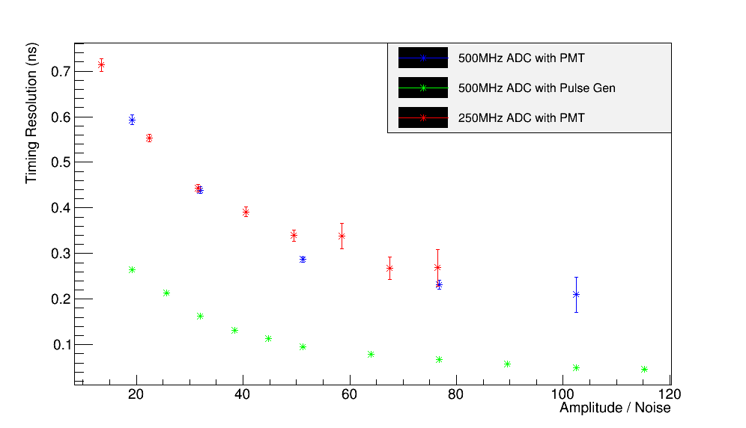
Timing resolution vs S/N
Good news: speed does not matter much... If rise time is the same
Main difference likely due to fitting scheme:
Full waveform for AWG, only rise time for PMT+SCB

Slide 11
Future test plans
Using AWG in next 2 months
  Compare 500MHz, 250MHz and 100MHz FADC
  Investigate scaling with signal to noise and rise time
  Write a paper
Build shapers optimized for 500MHz, 250MHz and 100MHz and 12-14-16 bits
  Investigate performances
    Especially noise
  Identify a compelling solution for HK prototype
    500MHz is not a valid solution because it is too expensive and power hungry
Work in collaboration with Warsaw

Slide 12
Implementation in HK prototype
Build on a mezzanine
  Interface with carrier board
    Interface specifications to be written by T2K collaboration
    Carrier board hardware should be fleshed out
Start design work in March 2015
  Mezzanine hardware
  Firmware
    Step 1 shipping raw waveforms
    Step 2 with online suppression
  Also investigating the option of having CAEN provide the mezzanine
    Repackaging existing mezzanine used in VME modules

Slide 13
Rapid-IO for communication
Set up a project with UBC engineering students
  Entertaining summary here http://m.youtube.com/watch?v=SLuMxaAzK0s
Goal was to develop a fail-safe mesh network exploring various options
  Student focused on rapidIO (as suggested)
  Did not investigate other options thoroughly
Development on Altera evaluation boards

Slide 14
RapidIO communication
What we learned:
  Multi-layer systems with a lot of build-in fonctionality
  Very good monitoring and error checking capabilities
  Students achieved 900Mbps so ~90% efficiency with fix routine
  Students developed on the fly routing capabilities but efficiency only 50%
    And on the fly re-routing is probably not desirable
Overall promising solutions

Slide 15
Summary
Promising results with flash ADC
  Will start specific implementation for HK in 2014
    Start with shaper and use commercial FADC
    In collaboration with Warsaw group
  Design and build mezzanine prototype in 2015
Will also investigate added value of flash ADC regarding physics
Promising results with rapidIO protocol
  Flexible routing scheme and error checking
  Development to continue in house
    Mostly driven by other projects

