Slide 1
Dynamical friction
from scalar dark matter in the relativistic regime
Dina Traykova, Katy Clough, Thomas Helfer, Pedro G. Ferreira, Emanuele Berti, Lam Hui
Thomashelfer@live.de
j.c.aurrekoetxea@gmail.com
eugene.a.lim@gmail.com

Slide 2
GRChombo
Numerical GR code with Adaptive Mesh Refinement
Open Source www.grchombo.org
Focus on flexibility

Slide 3
Cosmic Strings
Inflation
Higher Dim
Black Holes
Dynamic Friction of scalar fields
Special thanks to Markus Kunesch, Saran Tunyasuvunakool, Pau Figuras, Katy Clough, Dina Traykova for providing movies

Slide 4
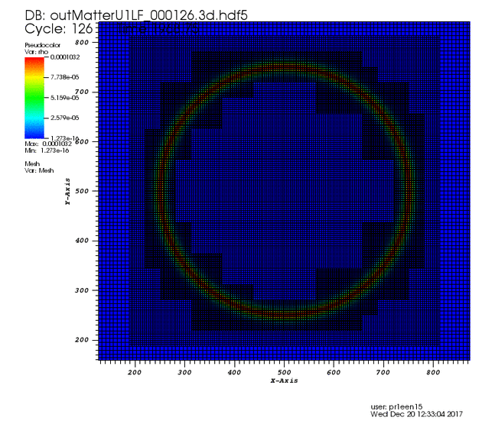
Adaptive mesh

Slide 5
www.grchombo.org

Slide 6
Dynamical friction

Slide 7
Dynamical friction

Slide 8
Dynamical friction
$$F$$

Slide 9
Dynamical friction (with scalar fields)
$$F_{d}$$
Lam Hui et al 1610.08297

Slide 10
c
Bondi accretion
Relevant (small r)
${F=F_{d}+F}_{Bondi}$
$$κ→1$$
$$κ→0$$
$$F_{d,nonrel}$$
$${F_{d,nonrel} \sim F}_{Chandra }$$
velocity
0
more wave-like
$$α_{S}=μM$$
more particle-like

Slide 11
c
Bondi accretion
Relevant (small r)
${F=F_{d}+F}_{Bondi}$
$$κ→1$$
$$κ→0$$
$$F_{d,nonrel}$$
$${F_{d,nonrel} \sim F}_{Chandra }$$
velocity
0
more wave-like
$$α_{S}=μM$$
more particle-like

Slide 12
c
Bondi accretion
Relevant (small r)
${F=F_{d}+F}_{Bondi}$
$$κ→1$$
$$κ→0$$
$$F_{d,nonrel}$$
$${F_{d,nonrel} \sim F}_{Chandra }$$
velocity
0
more wave-like
$$α_{S}=μM$$
more particle-like

Slide 13
c
Bondi accretion
Relevant (small r)
${F=F_{d}+F}_{Bondi}$
$$κ→1$$
$$κ→0$$
$$F_{d,nonrel}$$
$${F_{d,nonrel} \sim F}_{Chandra }$$
velocity
0
more wave-like
$$α_{S}=μM$$
more particle-like

Slide 14
c
Bondi accretion
Relevant (small r)
${F=F_{d}+F}_{Bondi}$
$$κ→1$$
$$κ→0$$
$$F_{d,nonrel}$$
$${F_{d,nonrel} \sim F}_{Chandra }$$
velocity
0
more wave-like
$$α_{S}=μM$$
more particle-like

Slide 15
c
Bondi accretion
Relevant (small r)
${F=F_{d}+F}_{Bondi}$
$$κ→1$$
$$κ→0$$
$$F_{d,nonrel}$$
$${F_{d,nonrel} \sim F}_{Chandra }$$
velocity
0
more wave-like
$$α_{S}=μM$$
more particle-like

Slide 16
Dynamic friction

Slide 17
Force modification

Slide 18
Force modification
Relativistic correction

Slide 19
Force modification
Relativistic correction
Pressure correction

Slide 20
c
Bondi accretion
Relevant (small r)
${F=F_{d}+F}_{Bondi}$
$$κ→1$$
$$κ→0$$
$$F_{d,nonrel}$$
$${F_{d,nonrel} \sim F}_{Chandra }$$
velocity
0
more wave-like
$$α_{S}=μM$$
more particle-like

Slide 21
c
Relativistic and pressure correction
$F_{d}=F_{d,nonrel}{ γ\left(1+v^{2}\right)}^{2} \left(1+\frac{v^{2}}{1+v^{2}}\right)$
$$F_{d,nonrel}$$
velocity
0
more wave-like
$$α_{S}=μM$$
more particle-like

Slide 22
c
Relativistic and pressure correction
$F_{d}=F_{d,nonrel}{ γ\left(1+v^{2}\right)}^{2} \left(1+\frac{v^{2}}{1+v^{2}}\right)$
SIMULATIONS
$$F_{d,nonrel}$$
velocity
0
more wave-like
$$α_{S}=μM$$
more particle-like

Slide 23
Energydensity $ρ$
$α_{S}=Mμ=0.05$
v$=0.5$
$μ$ … scalar field mass
$M$ … mass black hole

Slide 24
Results
F
v

Slide 25
Bondi accretion
${F=F}_{d}$ + $F_{B}$

Slide 26
c
Relativistic and pressure correction
$F_{d}=F_{d,nonrel}{ γ\left(1+v^{2}\right)}^{2} \left(1+\frac{v^{2}}{1+v^{2}}\right)$
SIMULATIONS
$$F_{d,nonrel}$$
velocity
0
more wave-like
$$α_{S}=μM$$
more particle-like

Slide 27
c
Relativistic and pressure correction
$F_{d}=F_{d,nonrel}{ γ\left(1+v^{2}\right)}^{2} \left(1+\frac{v^{2}}{1+v^{2}}\right)$
Bondi accretion
Relevant (small r)
${F=F_{d}+F}_{Bondi}$
SIMULATIONS
$$F_{d,nonrel}$$
velocity
0
more wave-like
$$α_{S}=μM$$
more particle-like

Slide 28
Energydensity $ρ$
$α_{S}=Mμ=1$
v$=0.5$
$μ$ … scalar field mass
$M$ … mass black hole

Slide 29
Bondi Accretion

Slide 30
Conclusion
Simulated scalar field dynamic friction for the first time
Introduced new corrections that can account for different regimes

Slide 31
Visualisation – Not Science ! :)

Slide 32
Conclusion
Simulated scalar field dynamic friction for the first time
Introduced new corrections that can account for different regimes

Slide 33
Force over time

