Slide 1
(Topological) Twist and Scale vs Conformal invariance
Yu Nakayama (Rikkyo)
A part of this talk is based on discussions
with Slava Rychkov

Slide 2
Books from Ooguri-san
Ooguri-san is not only a pioneer and a role model but also a host father for many generations of physicists who strives to study in US from other countries

Slide 3
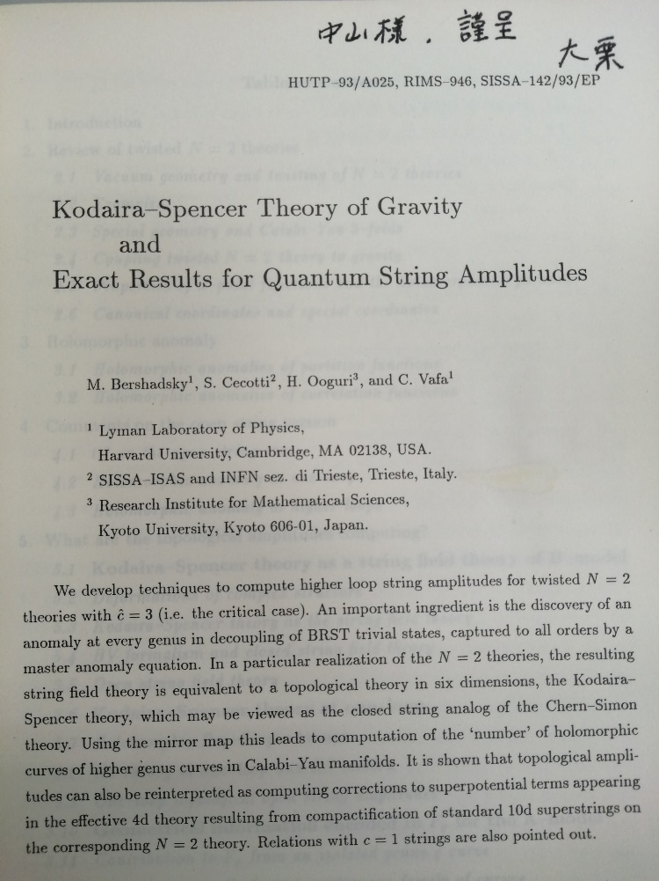
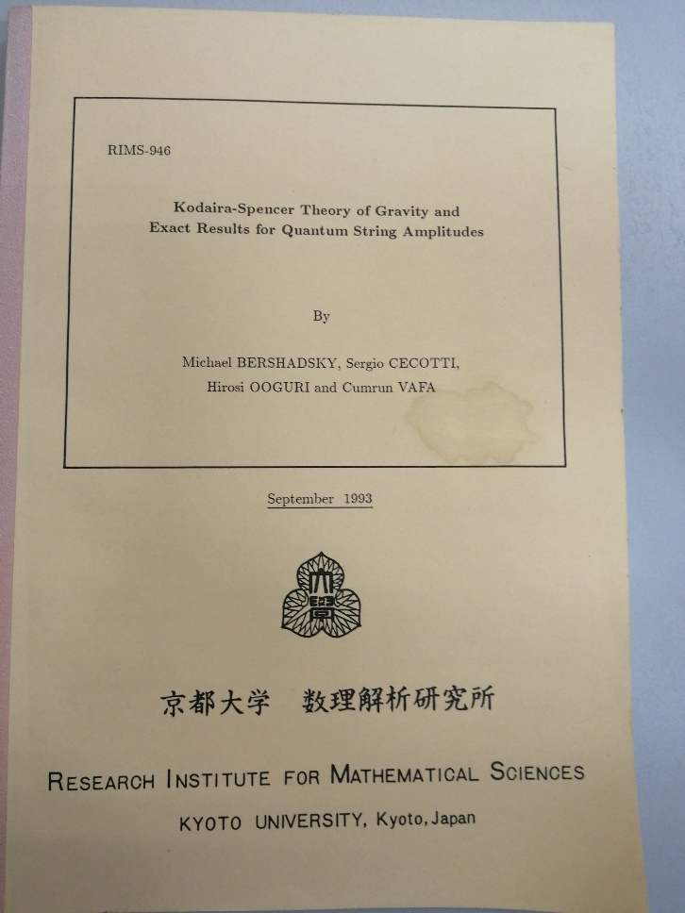
BCOV’s real preprint
“Your brain functions sharpest at your age, and these days never come back.”

Slide 4
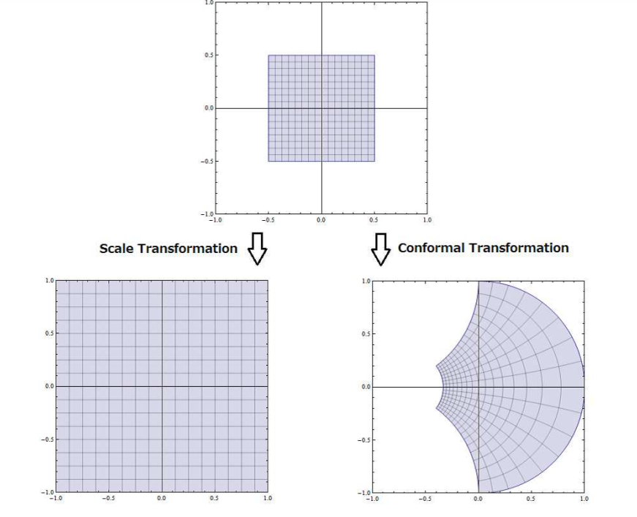
Scale vs Conformal
Conformal invariance is very powerful (e.g. conformal bootstrap) in critical phenomena
Critical phenomena → Scale invariance
Gap between
scale invariance and
conformal invariance?

Slide 5
Scale vs Conformal
Consider a local relativistic (Euclidean) QFT with (symmetric) energy-momentum tensor
Scale invariance (w/o conformal)
→
Conformal
:virial current

Slide 6
A simple counter-example (El-Shawk Nakayama Rychkov)
Consider free U(1) gauge theory in d-dimension
Massless → obviously scale invariant
But it is not conformal
Can be generalized to free p-form gauge theories

Slide 7
Argument for scale → conformal?
Unitarity argument
This is the proof by Zamoldochkov and Polchinski in d=2 (or d=4 by Schwimmer, Komargodski, Luty, Rattazzi, Polchinski etc)
If scale without conformal, c (or a) decreases forever → in unitary theory, is essentially (on-shell) zero
Genericity argument
Requires dimension d-1 vector operator
Generically most operators get renormalization (anomalous dimensions)
Looks very fine-tuned and unlikely

Slide 8
(Topological) twist
Consider d-dim CFT with O(d) internal symmetry
Define twisted Euclidean rotation by O(d) in the product of O(d) x O(d)
Lorentz spin and internal spin mixed
E.g. becomes tensor + scalar
Unitarity (reflection positivity) is lost…
Spinor-supersymmetry → scalar-supersymmetry

Slide 9
Twist and conformal symmetry
In curved background we add extra connection
→ Energy-momentum tensor is modified
Special conformal symmetry appears to be lost (Witten)
Note, however, we did not do anything in flat space (→ “special conformal symmetry” is hidden)
If we take BRST cohomology, it becomes topological

Slide 10
Adding twisted deformations
We have new “twisted scalar deformations”!
→ twisted RG flow (not studied very much)
Novel fixed points → would be scale without conformal
Perturbatively it must be so because small RG effects cannot get rid of virial current
With the deformation, one cannot undone the twist!
Quite general. Argument against genericity?

Slide 11
QFT construction 1
Consider O(d) model
Twist → free vector in Feynman gauge
Add a scalar deformation
Can we find non-trivial fixed point?
Yes, but just Wilson-Fisher fixed point (with twist that can be undone)
Now with twisted scalar deformation
Any scale w/o conformal fixed point?

Slide 12
QFT construction 2
Now with twisted scalar deformation
Any scale w/o conformal fixed point? (only at particular , it is conformal)
Do perturbative epsilon expansion
Aharony-Fisher (1973) did the analysis and found the fixed point with (“Landau gauge” fixed point)
： free scale without conformal
: interacting scale without conformal!
Although interacting, Virial current is not renormalized (YN-Rychkov)

Slide 13
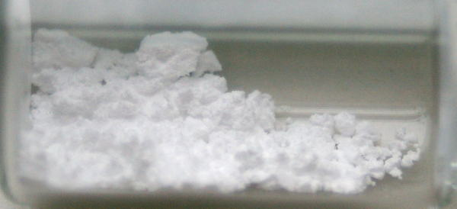
Physical realization
Is topological twist just a mathematical tool?
Consider Heisenberg magnet: O(3) inv Landau-Ginzburg theory
Index I was is originally space-time vector!
Separation of spin and orbit is a (topological) twist!
Dipolar-Dipolar interaction breaks the spin-orbit separation
So in the actual magnet, we may have to introduce “topologically twisted” scalar deformations
Experimental evidence (say in EuO) suggests Aharony-Fisher fixed point (rather than Heisenberg) can be realized in nature (Mezei)

Slide 14
Holography 1: effective description
We work on AdS4/CFT3
Einstein + SO(3) Yang-Mills (in Euclidean signature)
Twisted deformation with novel fixed points → would be scale w/o conformal
ansatz
Scale (w/o conformal) solution
Geometry is AdS but matter breaks isometry
Cannot expect in Lorentzian signature, but possible in Euclidean signature because field strength is self-dual!

Slide 15
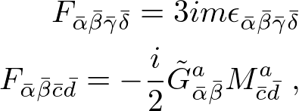
Holography 2: M-theory uplift
We work on AdS4/CFT3
Consider (Euclidean) M-theory compactification on AdS4 x S7
Pope argued Einstein + cc + SO(3) YM is consistent truncation in Lorentzian signature
Consistent truncation works in Euclidean signature as well (Consistency of the truncation is “miraculous”)

Slide 16
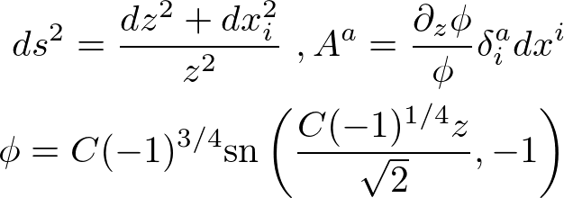
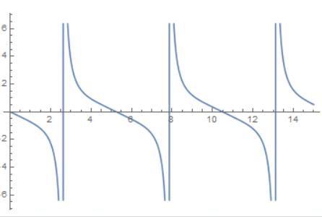
Holography 3:Cyclic RG solutions
One can construct more general RG-flow solutions
It shows a cyclic RG behavior, or discrete scale invariance
Chern-Simons “like” deformation at UV

Slide 17
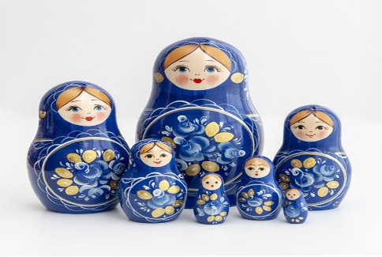
Summary
“Kanreki” means “returning to your birth”
Is it consistent with c-theorem or a-theorem?
My suggestion: topological twist and self-dual field strength are the key!
Ooguri-san is a world expert on them
I wish you fruitful, prosperous and wonderful years ahead!

Slide 18
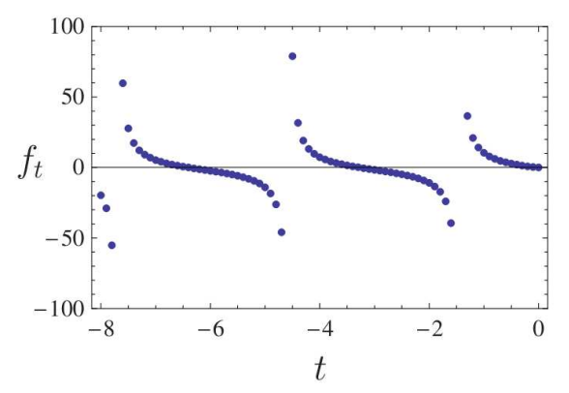
Cyclic RG in Efimov effect
Discrete scale invariance is known to appear in Efimov effect (three-body interacting non-relativistic bosons) by solving Schrodinger eq.
RG analysis gives cyclic flow (with familiar poles!)

Slide 19
Holography 0: Scale w/o Conformal?
If one wants to realize d-dim Poincare + scale in d+1 dimensional geometry, it must be AdS (YN)
If we have no Virial current, it must be conformal
Coset space analysis (Schafer-Nameki-Yamazaki-Yoshida)
Matter (as well as KK mode in extra dimension) can break AdS isometry (while preserving the AdS metric)
This is suspicious in Lorentz signature (NEC), but maybe possible in Euclidean signature

