Slide 1
Features & Fantasies of Moduli Dependence in CFT
Eric Perlmutter, IPhT Saclay
HirosiFest @ Kavli IPMU
October 21, 2022

Slide 2
HirosiFest will be a weekly event!
Every Thursday/Friday year-round – no exceptions
Alternating between Caltech & IPMU
Annual meeting at Aspen Center for Physics
Registration required, Frequent Flyer status recommended
More details at www.hirosi.gov

Slide 3
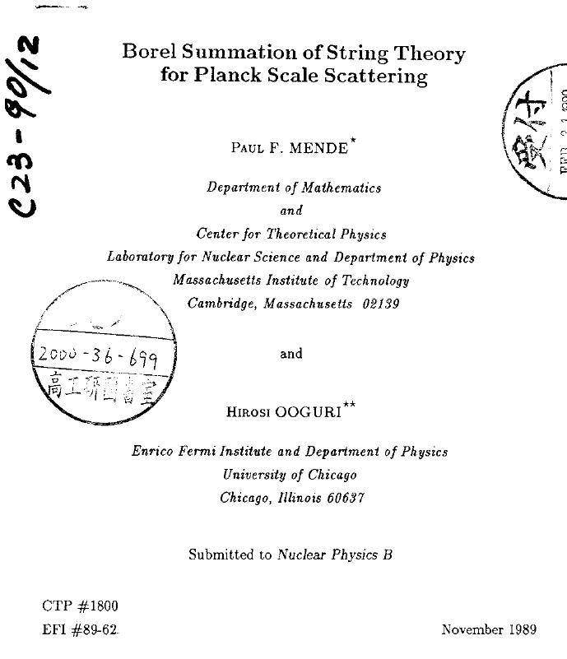

Slide 7
HIROSI RULES
1. Be precise
2. Be efficient
3. Be prepared

Slide 8
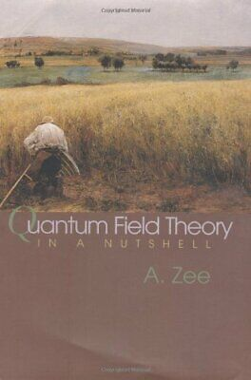
Huge range of topics, using a huge range of techniques, often with strong mathematical connection (OSV, EOT, Calabi-Yau/EG bootstrap, …)
If most string theorists are localized somewhere on a spectrum between “mathematical” and “physical”, Hirosi freely oscillates between both ends.
H I R O S I
Fun fact: Hirosi’s h-index is the sum of dimensions of the three smallest irreducible representations of the Mathieu group M₂₄.
Notes:
Eguchi
Mende
Maldacena
MAGOO
Kraus Shenker
Vafa swamp
Schwarz Green (swamp)
Keller CY
Kravchuk mod boot
Narnia
c-1/16
U(1) twist gap
RCFT
WGC etc
Harlow
+ topological string, moonshine (EOT),

Slide 9
Huge range of topics, using a huge range of techniques, often with strong mathematical connection (OSV, EOT, Calabi-Yau/EG bootstrap, …)
If most string theorists are localized somewhere on a spectrum between “mathematical” and “physical”, Hirosi freely oscillates between both ends.
Admirable balance between The Big Picture and The Small Details.
Often we reflect as a field on the question “What is String Theory?”
Hirosi has done a great deal to expand the answer to that question.
H I R O S I
Fun fact: Hirosi’s h-index is the sum of dimensions of the three smallest irreducible representations of the Mathieu group M₂₄.
Notes:
Eguchi
Mende
Maldacena
MAGOO
Kraus Shenker
Vafa swamp
Schwarz Green (swamp)
Keller CY
Kravchuk mod boot
Narnia
c-1/16
U(1) twist gap
RCFT
WGC etc
Harlow
+ topological string, moonshine (EOT),

Slide 10
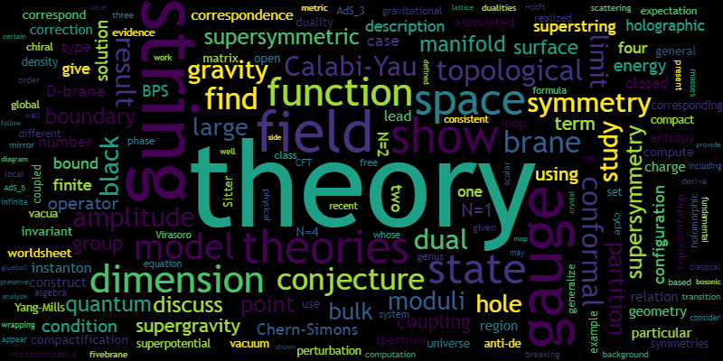
Huge range of topics, using a huge range of techniques, often with strong mathematical connection (OSV, EOT, Calabi-Yau/EG bootstrap, …)
If most string theorists are localized somewhere on a spectrum between “mathematical” and “physical”, Hirosi freely oscillates between both ends.
Admirable balance between The Big Picture and The Small Details.
Often we reflect as a field on the question “What is String Theory?”
Hirosi has done a great deal to expand the answer to that question.
H I R O S I
Fun fact: Hirosi’s h-index is the sum of dimensions of the three smallest irreducible representations of the Mathieu group M₂₄.
Notes:
Eguchi
Mende
Maldacena
MAGOO
Kraus Shenker
Vafa swamp
Schwarz Green (swamp)
Keller CY
Kravchuk mod boot
Narnia
c-1/16
U(1) twist gap
RCFT
WGC etc
Harlow
+ topological string, moonshine (EOT),

Slide 11
We also owe Hirosi our gratitude for his leadership and administrative roles in shaping our field.
Surely this takes enormous energy!
The science is the better for his vision.
H I R O S I
Notes:
Eguchi
Mende
Maldacena
MAGOO
Kraus Shenker
Vafa swamp
Schwarz Green (swamp)
Keller CY
Kravchuk mod boot
Narnia
c-1/16
U(1) twist gap
RCFT
WGC etc
Harlow
+ topological string, moonshine (EOT),

Slide 12
Today: a collection of results about moduli-dependence in conformal field theories and holographic implications, as well as – most importantly – some fantasies and conjectures.
1) Weak coupling
Bootstrap bounds on rational points in moduli space (d=2)
CFT Distance Conjecture (d>2)
2) Strong coupling
A CFT sharpening of the AdS scale separation problem
3) Final fantasies
These are curated to, and inspired by, Hirosi’s interests.

Slide 13
Today: a collection of results about moduli-dependence in conformal field theories and holographic implications, as well as – most importantly – some fantasies and conjectures.
1) Weak coupling
Bootstrap bounds on rational points in moduli space (d=2)
CFT Distance Conjecture (d>2)
2) Strong coupling
A CFT sharpening of the AdS scale separation problem
3) Final fantasies
These are curated to, and inspired by, Hirosi’s interests.
2
2

Slide 14
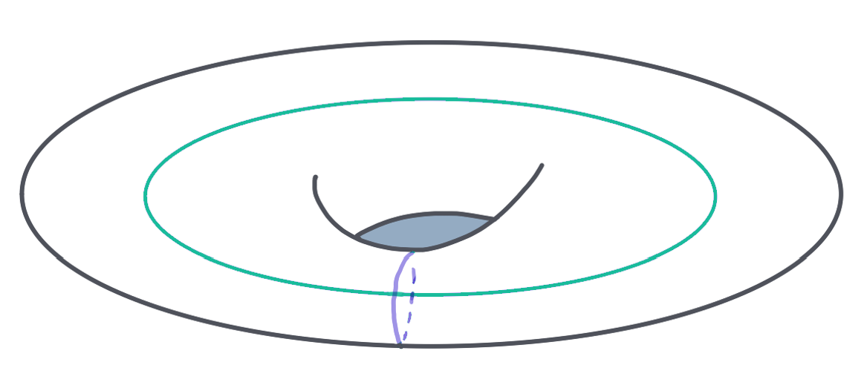
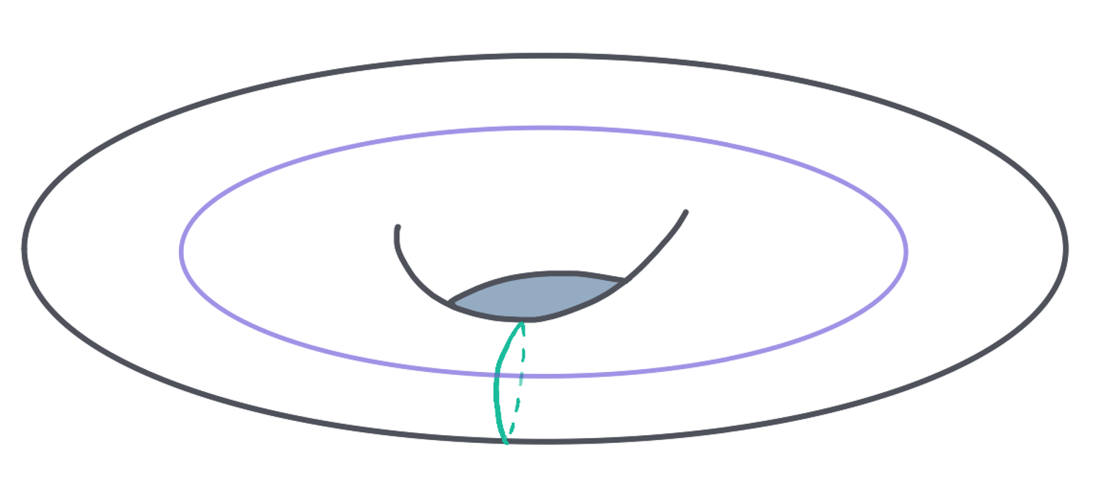
The Man from the 2 Dimensions
Hirosi has written many papers on 2d CFT.
Some are about structural properties that follow from symmetry, often in unobvious ways.
There is a certain type of approach that I want to focus on here, in which 2d CFTs are constrained by imposing number-theoretic properties of CFT data.
e.g. Hirosi et al’s studies of twist gap in U(1) CFT and RCFT involve subtle implications of rationality.
Strong constraints of RCFT have a history, of course…
… I’d like to consider the converse: “Only when one has taken into account the rationality of the physics do the symmetries become understood.”
e.g. [Eguchi-Ooguri, Harlow-Ooguri, Benjamin-Ooguri-Shao-Wang, Benjamin-Keller-Ooguri-Zadeh,…]
[Moore-Seiberg]

Slide 15
These results indicate certain shortcomings in the conformal/modular bootstrap programs in 2d CFT.
Known constraints:
Modularity Positivity Discreteness Integrality

Slide 16
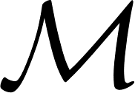
These results indicate certain shortcomings in the conformal/modular bootstrap programs in 2d CFT.
Known constraints:
Modularity Positivity Discreteness Integrality
What is the space of 2d CFTs?
We imagine that, for (super-)Virasoro CFTs without extended chiral algebra, RCFTs form a small corner.
One abstract construction of irrational CFTs is to activate moduli of an RCFT
Move along conformal manifold via exactly marginal couplings to operators $𝒪$ of $Δ=2$.
I feel it is very well-motivated to study RCFTs/conformal manifolds of this type.
(cf. Hirosi’s 2020 works on density of RCFTs in moduli space and relation to twist gaps/enhanced symmetries.)

Slide 17
Rational points in moduli space
In 2020, Justin Kaidi and I proved a rigorous bootstrap bound for rational points in moduli space.
Assuming that <$𝒪$> $≠$ 0 on$T^{2}$, one can derive the following spectral bound on the RCFT:
There exists a non-holomorphic operator $φ$ with and dimension $Δ_{φ}≤Δ_{∗}$:
This is exact in central charge c.
(If <$𝒪$> is diagonal, the $d_{𝒪}$ term disappears.)
RCFT
$d_{𝒪}$ = rank of 1-loop dilatation matrix

Slide 18
Rational points in moduli space
RCFT
Where does this come from?
It follows from imposing modularity, discreteness and integrality – without positivity.
Logic of proof:
Consider one-point functions <$𝒪$>. Non-positive in the q expansion…
Rationality → <$𝒪$> is a gluing of $d_{𝒪}$-dimensional vector-valued modular forms (vvmf) on L and R.
When <$𝒪$> is exactly marginal, the vvmf components have integer q-expansion.
We proved that such a vvmf must have a polar term in q-expansion using a mathematical result known as the “Unbounded Denominator Conjecture”, which inputs integrality in a crucial way.
Gluing L and R consistently leads to above result.

Slide 19
Integrality in RCFT
In RCFTs, which have a finite number of modules w.r.t. an extended chiral algebra $𝒜$, torus observables are constructed by gluing vvmfs on left and right.
The vvmf components are characters/blocks of the extended chiral algebra. e.g.
Near the cusp, take
The following conjecture [Atkin, Swinnerton-Dyer; Mason] is a theorem as of 2021 [Calegari, Dimitrov, Tang]:
We now prove something about $m_{0}^{(i)}$.

Slide 20
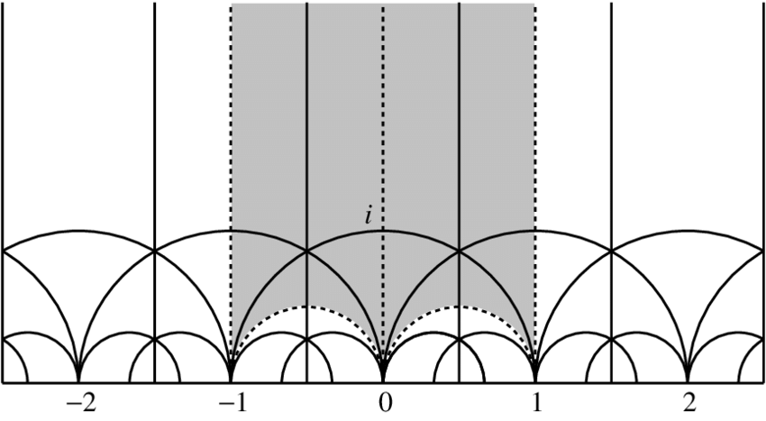
ex. $N=2$

Slide 21
$v_{i}(q)$ has zero here…
ex. $N=2$

Slide 22
$v_{i}(q)$ has zero here…
ex. $N=2$
… so${ v}_{i}(q)$ has pole here or here…

Slide 23
$v_{i}(q)$ has zero here…
… so $v_{j≠i}(q)$ has pole here!
ex. $N=2$
… so${ v}_{i}(q)$ has pole here or here…

Slide 24
$v_{i}(q)$ has zero here…
… so $v_{j≠i}(q)$ has pole here!
ex. $N=2$
… so${ v}_{i}(q)$ has pole here or here…

Slide 25
Integrality in RCFT
We can now return to our one-point function.
Key point: When $h_{𝒪}=1$, Virasoro blocks are simply characters of the relevant module. (Pf: $𝒪=$ current.)
This is very special. In particular, at $h_{𝒪}=1$the q-expansion is integral!
Ensuring a left-right gluing consistent with $SL(2,ℤ)$ valence formula leads to
N.B. , so $φ$has first-order anomalous dimension in CPT:

Slide 26
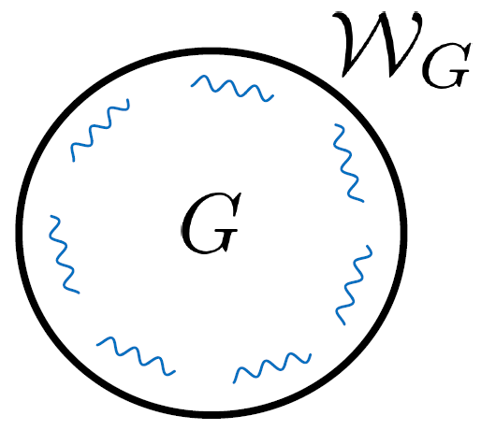
Integrality in RCFT: Comments
The c/12 is evocative.
It is the sought-after threshold for Virasoro primary dimensions in the ordinary modular bootstrap.
Instead, we are in RCFT. In large c limit, chiral algebra $𝒜$grows.
→ BH threshold in “Pure $𝒜$-gravity” with $N_{currents}(𝒜)→ ∞$
(At large c, $φ$ must be single-trace: large c factorization implies < [$𝒪^{n}$]$𝒪$[$𝒪^{n}$]> = 0.)
Does this bound extend on $ℳ$ a finite distance away from rational point?
Thinking about this could be helpful for the generic bootstrap problem.

Slide 27
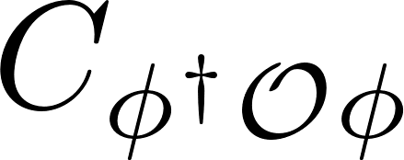
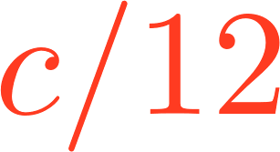
Determinacy in RCFT
2nd result: all OPE coefficients for operators with $Δ_{φ}$ >$Δ_{∗}$ are determined by those with $Δ_{φ}≤Δ_{∗}$.
This is a determinacy of the OPE: “light fixes heavy”.
$∃$ spectral counterpart. Define the twist
It is a basic fact that, in holomorphic CFT, the spectrum $t>c/12$ is determined by its complement.
In RCFT, this is still true. It, too, follows from the property of vvmfs proven earlier, now applied to Z-Z’.
Could twist determinacy hold in 2d CFTs (unitary + compact)? What about $∆$-determinacy?
L fixes H
(Z = meromorphic modular function for SL(2,Z))
. . .
(Polar/Light)
(Non-polar/Heavy)
[Benjamin, Collier, Fitzpatrick, Maloney, EP]

Slide 28
1) Weak coupling
Bootstrap bounds on rational points in moduli space (d=2)
CFT Distance Conjecture (d>2)
2) Strong coupling
A CFT sharpening of the AdS scale separation problem
3) Final fantasies

Slide 29
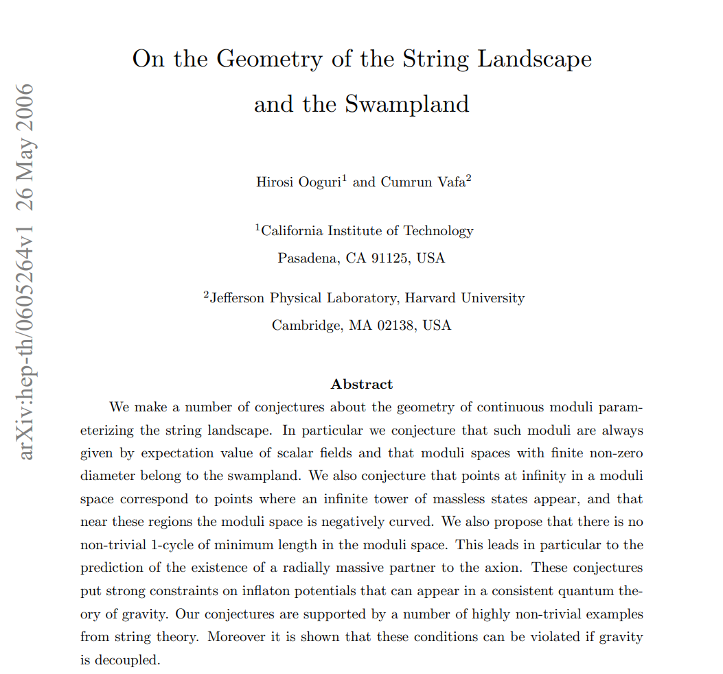
Let’s turn to the space of d>2 CFTs.
String theory suggests organizing principles for field theory.
One apparent feature of string theory is encoded in the Swampland Distance Conjecture:
Infinite distance limits in moduli space are necessarily accompanied by a tower of fields becoming massless exponentially fast.
Universality at boundaries of moduli space.
Can we formulate a precise analog of this in CFT?

Slide 30
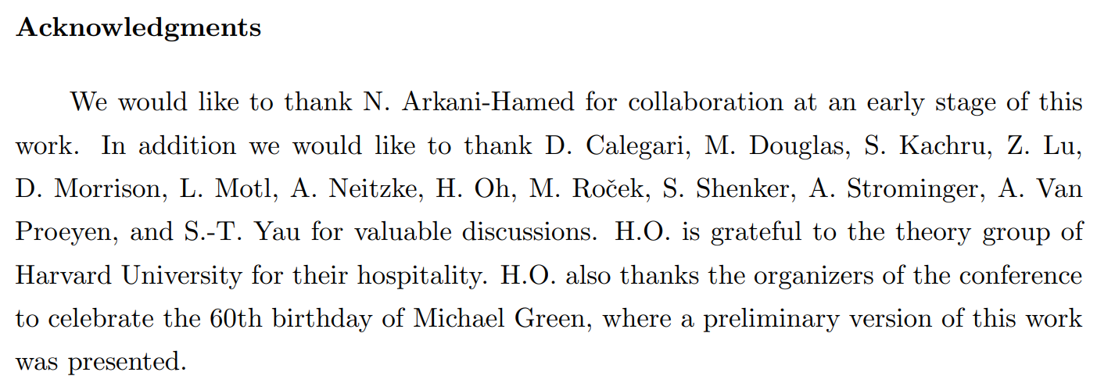
Let’s turn to the space of d>2 CFTs.
String theory suggests organizing principles for field theory.
One apparent feature of string theory is encoded in the Swampland Distance Conjecture:
Infinite distance limits in moduli space are necessarily accompanied by a tower of fields becoming massless exponentially fast.
Universality at boundaries of moduli space.
Can we formulate a precise analog of this in CFT?

Slide 31
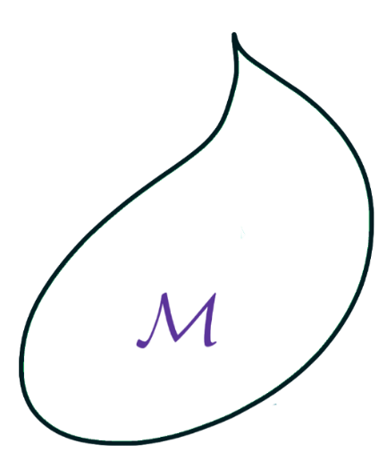
CFT Distance Conjecture
Let’s gain intuition for what an analog might be:
QG/Swampland Distance Conjecture
CFT
Scalar moduli
Moduli space
Moduli space metric
Coupling to gravity
Masslessness
Exponential decay with distance
Exactly marginal couplings
Conformal manifold
Zamolodchikov metric
Local CFT, i.e. contains stress tensor
Saturation of unitarity bound (think AdS)
Exponential decay with distance (why, metrically?)
Known examples: free CFTs are at infinite distance.
Abstractly, Free CFT = Higher-spin CFT (“HS point”)
[Maldacena-Zhiboedov]

Slide 32
CFT Distance Conjecture
[EP, Rastelli, Vafa, Valenzuela]
For unitary, local CFTs in d>2 dimensions, we thus formulated a set of conjectures:
1) All CFTs at infinite distance are HS points, i.e. free CFTs.
Equivalent:

Slide 33
CFT Distance Conjecture
[EP, Rastelli, Vafa, Valenzuela]
For unitary, local CFTs in d>2 dimensions, we thus formulated a set of conjectures:
1) All CFTs at infinite distance are HS points, i.e. free CFTs.
Equivalent:
2) HS currents approach unitarity bound exponentially in geodesic Z-distance.
Equivalent: Asymptotic hyperbolicity of Z-metric near cusp.
Equivalent:

Slide 34
CFT Distance Conjecture
[EP, Rastelli, Vafa, Valenzuela]
For unitary, local CFTs in d>2 dimensions, we thus formulated a set of conjectures:
1) All CFTs at infinite distance are HS points, i.e. free CFTs.
Equivalent:
2) HS currents approach unitarity bound exponentially in geodesic Z-distance.
Equivalent: Asymptotic hyperbolicity of Z-metric near cusp.
Equivalent:
2a) Convexity/monotonicity of diameters in spin-J submanifolds.

Slide 35
CFT Distance Conjecture
Comments:
Holds at arbitrary central charge c
At large c, we are far from Einstein regime. No a priori relation to WGC, EFT, etc.
Why not d=2? All d=2 CFTs are HS CFTs.
Instead, [Kontsevich-Soibelman] conjecture that scalar gap closes.
(Prove using modular invariance?)
RCFTs also muddy a possible extension to d=2.
(Analog for rational points on $ℳ$? No clear relation to Z-distance.)
In any case, all distance conjectures in d $≥$ 2 CFTs can be phrased uniformly:
At infinite distance, the twist gap vanishes.

Slide 36
CFT Distance Conjecture: Speculations
A few (more) speculative remarks.
Here is a plausible conjecture, suggested by hyperbolicity of Z-metric near cusps (if true):
In d>2,
What other properties does the volume obey? Does another CFT quantity set an upper bound?
What about degeneracy of HS currents in CFT Distance Conjecture: must it be Hagedorn?
One tower = vector model behavior. But familiar vector models do not have moduli.
(In CS-matter theories, higher-spin ABJ, etc, marginal directions are large N artifacts.)
Previously conjectured in d=2 CFT by Douglas (+ twist gap condition), for string moduli space by Vafa
But see [Stout; Basile-Campoleoni-Pekar-Skvortsov]

Slide 37
1) Weak coupling
Bootstrap bounds on rational points in moduli space (d=2)
CFT Distance Conjecture (d>2)
2) Strong coupling
A CFT sharpening of the AdS scale separation problem
3) Final fantasies

Slide 38
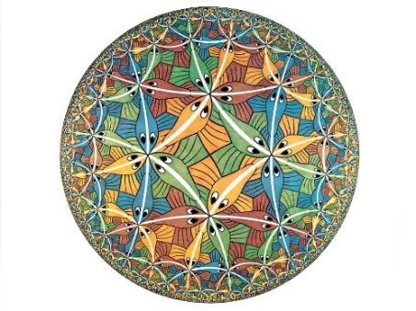
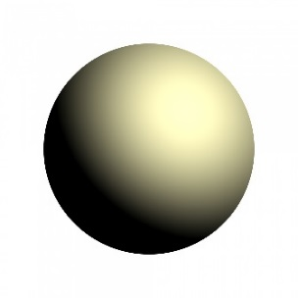
Sharpening the AdS Scale Separation problem
Are large extra dimensions required in AdS/CFT in the Einstein gravity regime?
We are taught that local R-symmetry is geometrized. Is this always true?
This is a genuinely “stringy” problem.
This is hard, even with maximal supersymmetry.
[See “Snowmass White Paper: Bootstrapping String Theory”, Gopakumar, EP, Pufu, Yin, for further perspective]

Slide 39
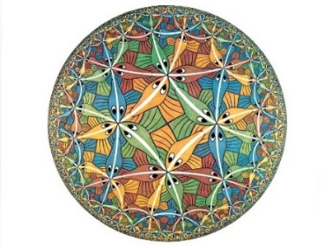
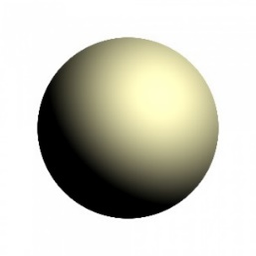
Sharpening the AdS Scale Separation problem
There is a growing appetite for the large N CFT/bootstrap side to rigorously solve this problem.
I won’t solve it today. But I will sharpen and strengthen the question in CFT.

Slide 40
Sharpening the AdS Scale Separation problem
We consider sequences of local CFTs with an asymptotic limit of large N, large HS gap (single-trace).
This is the regime of bulk derivative expansion around Einstein (super)gravity.
The following statements are plausibly true:
Every large N, large gap CFT must have a (parametrically) infinite tower of symmetric, traceless spin-2 single-trace operators with $Δ_{2}\sim O(1)$.
If a theory contains one non-conserved (“massive”) spin-2 operator with $Δ_{2}\sim O\left(1\right),$it must contain an infinite tower of them with the same parametric mass.
There are no consistent AdS truncations to a finite number of massive spin-2's.
[Heemskerk-Penedones-Polchinski-Sully, …]
[Lust-Palti-Vafa]
[Gauntlett-Varela; Liu-Pope]

Slide 41
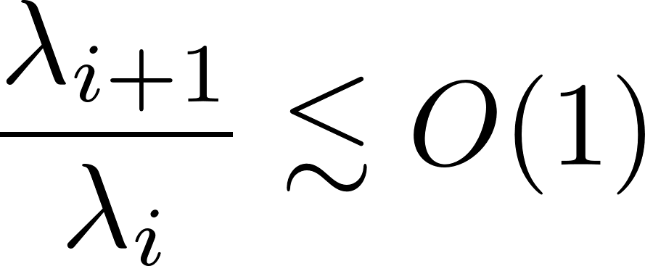
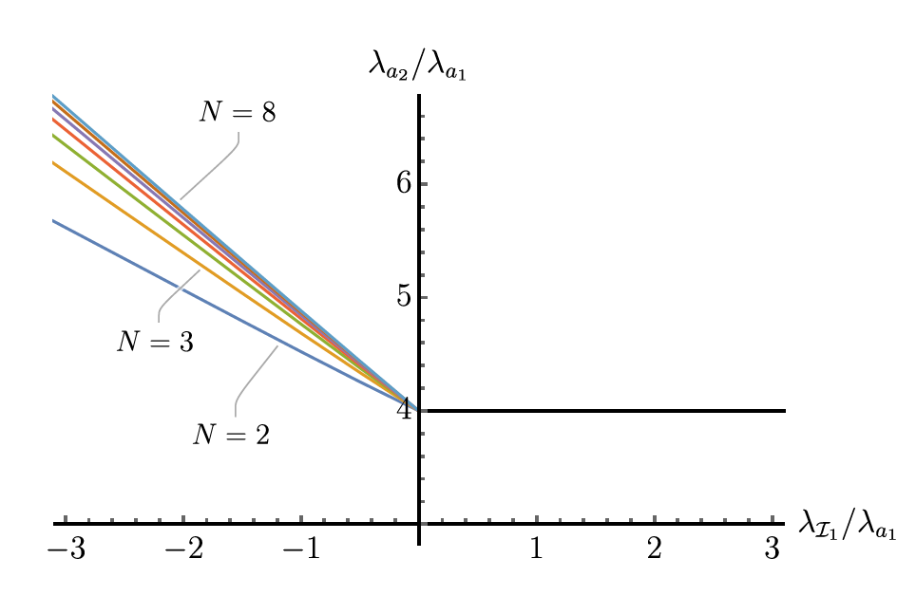
Sharpening the AdS Scale Separation problem
First point: Spin-2 operators are the “smoking gun” for large extra dimensions.
Since there is a SUGRA approximation in D dims, the spin-2’s must descend from D-dim graviton.
Unlike scalars (moduli) or vectors (flavor symmetries).
Intuition for CFT from AdS:
Define $N_{2}$ := number of light spin-2’s.
If $D=d+1$, then $N_{2}=1$, i.e. just the graviton.
If $N_{2}>1$, then $D>d+1$. From SUGRA point of view, expected to imply $N_{2}=∞$.
We want to understand this purely from CFT: what values of $N_{2}$ are possible?
cf. [Collins, Jafferis, Vafa, Xu, Yau]: spin-2 spectrum should start at O(1) (diameter bounds)
cf. [Bonifacio-Hinterbichler]: for positively curved, closed Einstein manifolds with $∂ℳ$=0,

Slide 42
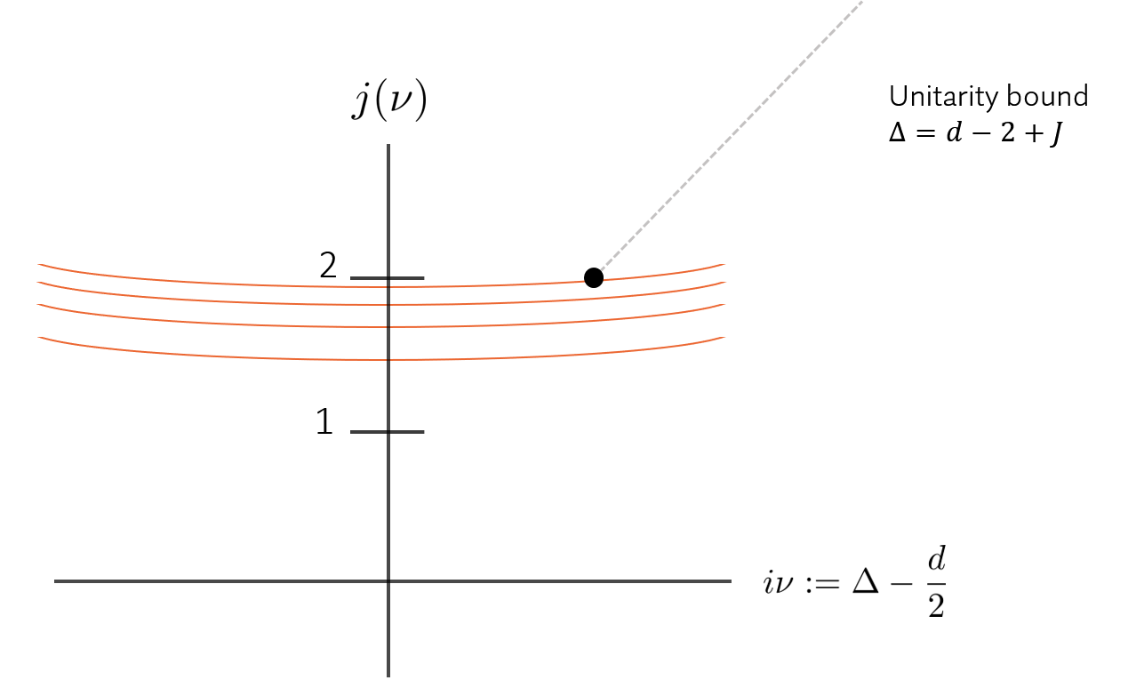
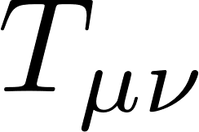
Sharpening the AdS Scale Separation problem
Second point: this is a Regge problem.
(Most) CFT local operators lie on analytic “Regge trajectories”
Analyticity implies (with standard assumptions) that
in planar CFT, all operators of spin J > 1 lie on trajectories.
So the CFT dual of the AdS scale separation question is:
How sparse can the single-trace “spin-2 trajectories” be?
Scalars + vectors need not lie on Regge trajectories.
[Costa-Hansen-Penedones; Caron-Huot; Penedones-Silva-Zhiboedov; Kravchuk-Simmons-Duffin]

Slide 43
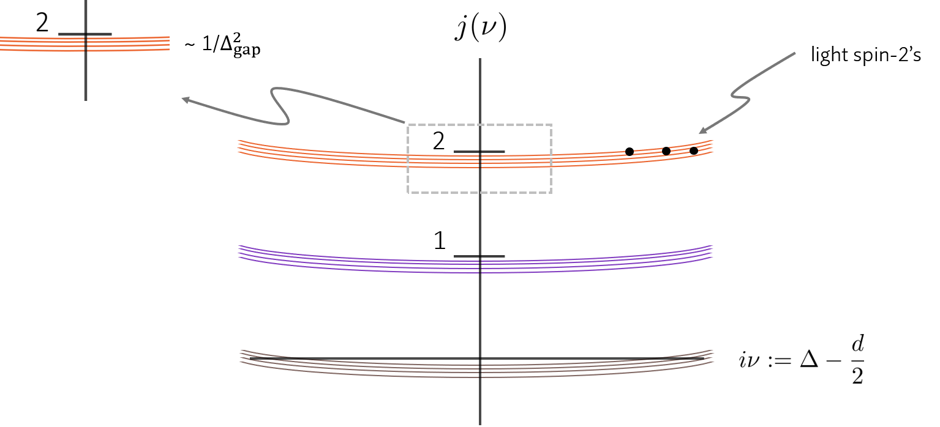
Sharpening the AdS Scale Separation problem
Third point: this is a Regge intercept problem.
What is the smallest allowed number of trajectories with intercept equal to two?

Slide 44
Sharpening the AdS Scale Separation problem
To summarize, we can now:
Use rigid structure of large N Regge trajectories
Focus solely on the intercepts
Comments:
Not grading by global symmetry. In other words, we want to argue using conformal symmetry. (Generically there will be spin-2 singlets, e.g. AdS₅ x T^{1,1})
Applies in d=2 also (with due care to subtract Virasoro descendants)
This is a classical phrasing. Contrast with 1-loop diagnostic of [Alday-EP]
Recent bootstrap work by [Alday-Chester] on existence of “pure AdS” solutions with maximal supersymmetry: suggestive but inconclusive

Slide 45
Sharpening the AdS Scale Separation problem
To summarize, we can now:
Use rigid structure of large N Regge trajectories
Focus solely on the intercepts
Comments:
Not grading by global symmetry. In other words, we want to argue using conformal symmetry. (Generically there will be spin-2 singlets, e.g. AdS₅ x T^{1,1})
Applies in d=2 also (with due care to subtract Virasoro descendants)
This is a classical phrasing. Contrast with 1-loop diagnostic of [Alday-EP]
Recent bootstrap work by [Alday-Chester] on existence of “pure AdS” solutions with maximal supersymmetry: suggestive but inconclusive
Conjecture: finite $N_{2}≠1$ is not allowed.

Slide 46
Let me close with some Final Fantasies.

Slide 47
The bootstrap needs to understand/incorporate number-theoretic constraints on 2d CFT data.
What classes of numbers are allowed to characterize (S)CFT data?
What are the abstract consequences of integrality in irrational CFT?
In 2d (S)CFT, the central charge c must be algebraic, maybe even rational.
Evidence?
In (0,2) SCFTs with U(1)_{R}, c-extremization
Would give a novel explanation of part of the c-theorem,
If true, this would be monumental.
[Benini,Bobev]
Notes:
(Transcendentality properties of perturbative field & string theory amplitudes, modular graph forms, etc.)
(Geometric (tori admitting complex multiplication) – a predecessor of Hirosi’s work)
(Recent bootstrap works on automorphic spectra of hyperbolic surfaces: arithmetic surfaces lead to features in bounds)

Slide 48
All compact, unitary (super-)Virasoro CFTs are either RCFTs or exactly marginal deformations thereof.
Hypothetical space of compact, unitary (super-)Virasoro CFTs:
Moving along $ℳ$, c_{currents} drops to 1 while c stays constant
RCFTs for extended chiral algebras
(excise these points)
M(p,p+1) Virasoro minimal models
If c must in fact be rational, this becomes a viable possibility.
Notes:
It seems wise to study the possible consistency of pure gravity + massless scalar. (Note: still scale separated.)

Slide 49
All compact, unitary (super-)Virasoro CFTs are either RCFTs or exactly marginal deformations thereof.
Hypothetical space of compact, unitary (super-)Virasoro CFTs:
Moving along $ℳ$, c_{currents} drops to 1 while c stays constant
RCFTs for extended chiral algebras
(excise these points)
M(p,p+1) Virasoro minimal models
If c must in fact be rational, this becomes a viable possibility.
Is this really so crazy?
Notes:
It seems wise to study the possible consistency of pure gravity + massless scalar. (Note: still scale separated.)

Slide 50
Happy 60th Birthday Hirosi!
Thank you for your many deep insights, camaraderie, and your stewardship of our field.

