Slide 1
Search for vector dark matter in microwave cavities with Rydberg atoms
J. Gué, A. Hees, J. Lodewyck, R. Le Targat, P. Wolf
SYRTE
SYstèmes Références Temps-Espace, CNRS, Observatoire de Paris, Université PSL, Sorbonne Université, LNE
Very Light Dark Matter Workshop
March 28th 2023
1

Slide 2
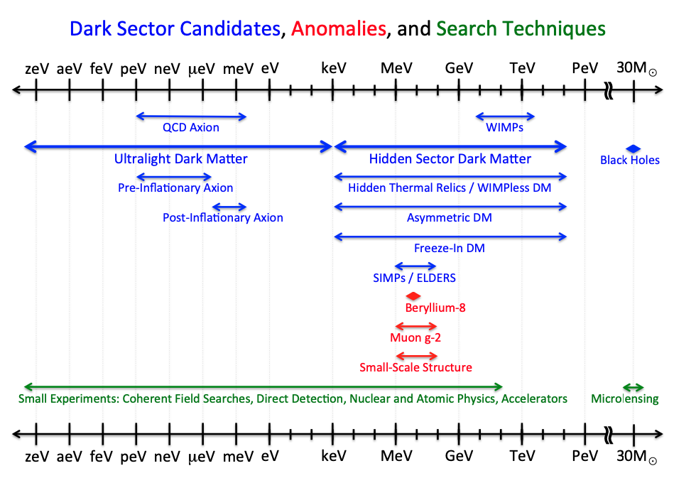
Classes of Dark Matter
ULDM mass interval
Fig. 1 from US cosmic vision : new idea for Dark Matter 2017, Arxiv:1707:04951
2

Slide 3
Ultralight Dark Matter (ULDM) models
$$\sim 0.3 GeV/{cm}^{3}$$
$$\frac{n}{n_{k}}\sim \frac{6π^{2}ℏ^{3}}{c^{2}}\frac{ρ_{DM}}{m^{4}v_{max}^{3}}$$
Occupation number
in phase space
$$\sim {10}^{−3}c$$
$$<10 eV$$
Inspired from Tourrenc et al, Arxiv:quantum-ph/0407187, 2004
3
Notes:
ULDM models : Here, occupation number in phase space as function of mass, density, velocity
With DM parameters and considering mass < 10 eV → occupation number > 1 meaning that the particle has to be bosonic
Additionnally of m << eV (which is our case in the microeV range), occupation number >> 1, meaning that the field can be treated classically (interactions etc…)
What are the different ULDM models : scalar fields, pseudo scalar fields, and vector fields, such as DP

Slide 4
Ultralight Dark Matter (ULDM) models
$$\sim 0.3 GeV/{cm}^{3}$$
$$\frac{n}{n_{k}}\sim \frac{6π^{2}ℏ^{3}}{c^{2}}\frac{ρ_{DM}}{m^{4}v_{max}^{3}}>1$$
ULDM (with $m<10 eV$) has to be bosonic (Pauli exclusion principle)
When $m≪eV → \frac{n}{n_{k}}≫1→$ the field can be treated classically.
We classify the different ULDM models from their nature
Occupation number
in phase space
$$\sim {10}^{−3}c$$
$$<10 eV$$
Inspired from Tourrenc et al, Arxiv:quantum-ph/0407187, 2004
Scalar field (Dilatons,...)
Pseudo-scalar field (Axions,…)
Vector field (Dark photons (DP),...)
3
Notes:
ULDM models : Here, occupation number in phase space as function of mass, density, velocity
With DM parameters and considering mass < 10 eV → occupation number > 1 meaning that the particle has to be bosonic
Additionnally of m << eV (which is our case in the microeV range), occupation number >> 1, meaning that the field can be treated classically (interactions etc…)
What are the different ULDM models : scalar fields, pseudo scalar fields, and vector fields, such as DP

Slide 5
Phenomenology of the Dark Photon (DP)
$$ω=m (k=0)$$
Cosmologically, DP field oscillates at its Compton frequency $\vec{φ}={\vec{φ}}_{0}\cos{ωt}$
$$ℒ=−\frac{1}{4}F^{μν}F_{μν}+j^{μ}A_{μ}−\frac{1}{4}φ^{μν}φ_{μν}−\frac{1}{2}m^{2}φ_{μ}φ^{μ}−\frac{χ}{2}F^{μν}φ_{μν}$$
This mixing generates a standard electric field filling the whole space
$${\vec{E}}_{DP}≈−iχω{\vec{φ}}_{0}e^{−iωt}$$
which we would like to detect ! Or, constrain $χ$ on a given range of DP masses.
Additionally, if DP field accounts for the whole DM, ${|\vec{E}}_{DP}|=χ\sqrt{2ρ_{DM}}$
Kinetic mixing coupling
EM field
EM strength tensor
DP strength tensor
DP field
Horns et al. JCAP, 2013
DP field itself
4

Slide 6
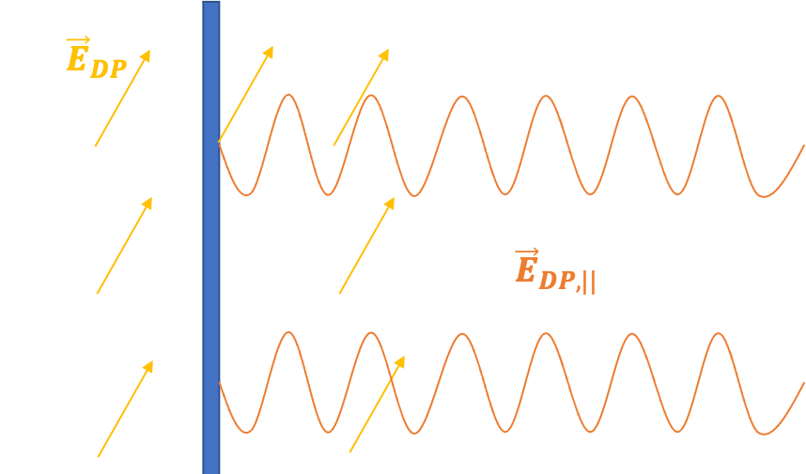
Resonant cavity and why using it in this context ?
Consider a perfect metallic plate anywhere in space in this context
In 1D microwave cavities, we consider two (non ideal) mirrors
→ Ideal instrument to enhance this weak DP electric field
loss of energy characterized by mirrors reflectivity r (related to quality factor Q of the cavity)
→ By boundary conditions (oscillations of $e^{−}$), propagation of “regular” electric field ${\vec{E}}_{DP,||}$ with amplitude corresponding to the component of${ \vec{E}}_{DP}$ parallel to the plate
$${\vec{E}}_{DP,||}+{\vec{E}}_{prop}=0$$
5
Notes:
In this context of standing DP electric field shown in yellow, consider a perfect metallic plate. By boundary conditions, component E field parallel to the plate is 0 implying mathematically that the plate emits prpagating regular EM wave with same frequency and with amplitude = to parallel component of E_DP in orange in the figure. By usual I mean EM wave with standard dispersion relation.
Now imagine 1D microwave cavity with two non ideal mirrors, two different EM waves propagate inside and if DP field has right frequency, resonance -> ideal instrument to enhance this weak DP field.
But, loss of energy characterized by r

Slide 7
The experiment : Setup using microwave signal
6
Notes:
So let’s look at the experiment specifically : what we can do if we consider the DP field is to try to detect this field directly. What we can do is apply an external field E_a and measure the square of the total electric field inside the cavity (DM and applied field contributing)
Scheme : blue, contribution from the applied field and orange from the DP electric field. This way, we still have trms oscillating too fast/amplitude too small but also cross terms, in particular one oscillating at difference of frequencies that can be detected.
The applied field which works as an amplificator for the DM field.

Slide 8
The experiment : Setup using microwave signal
We can either measure the DM electric field directly…
$${ \vec{E}}_{T} ∝{{\vec{X}}_{DM}e}^{−iω_{DM}t}$$
Amplitude too small $(𝒪(χ))$
Oscillates too fast $(𝒪(GHz))$
DM field contrib. (small)
6
Notes:
So let’s look at the experiment specifically : what we can do if we consider the DP field is to try to detect this field directly. What we can do is apply an external field E_a and measure the square of the total electric field inside the cavity (DM and applied field contributing)
Scheme : blue, contribution from the applied field and orange from the DP electric field. This way, we still have trms oscillating too fast/amplitude too small but also cross terms, in particular one oscillating at difference of frequencies that can be detected.
The applied field which works as an amplificator for the DM field.

Slide 9
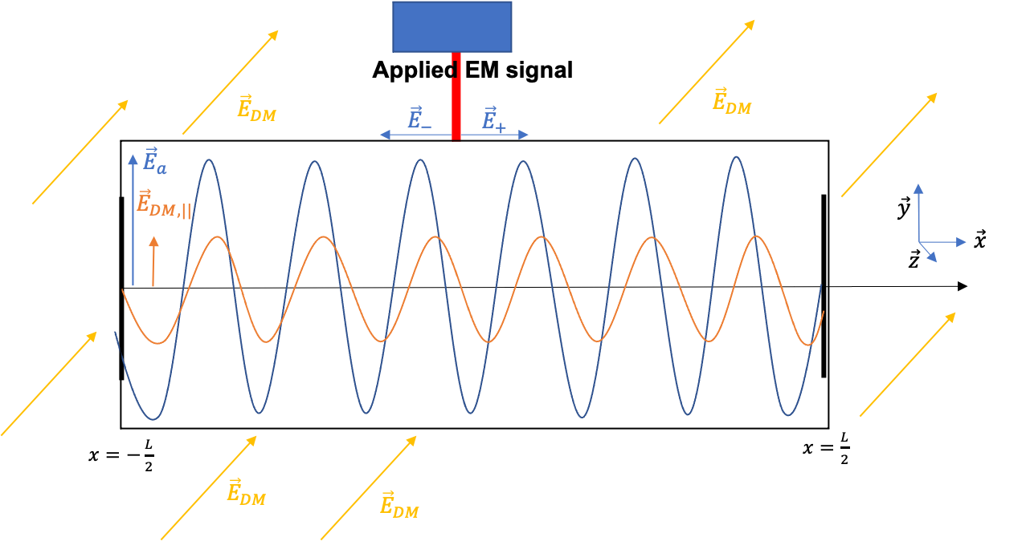
The experiment : Setup using microwave signal
We can either measure the DM electric field directly…
$${ \vec{E}}_{T} ∝{{\vec{X}}_{DM}e}^{−iω_{DM}t}$$
Amplitude too small $(𝒪(χ))$
Oscillates too fast $(𝒪(GHz))$
DM field contrib. (small)
…or apply an external field ${\vec{E}}_{a}∝{\vec{X}}_{a}e^{−iω_{a}t}$ and measure the square of the total electric field
$$ω_{a}+ω_{DM}$$
$$ω_{a}−ω_{DM}$$
✓
$${|\vec{E}}_{T}|^{2}∝ X_{a}X_{DM}\left[\cos\left(∆ωt+φ_{a}\right)+\cos\left(Σωt+φ_{a}\right)\right]+ \\ X_{DM}^{2}\cos{(2ω_{DM}t)}+X_{a}^{2}\cos{(2ω_{a}t+φ_{a})}$$
Oscillating too fast/Amplitude too small
6
Notes:
So let’s look at the experiment specifically : what we can do if we consider the DP field is to try to detect this field directly. What we can do is apply an external field E_a and measure the square of the total electric field inside the cavity (DM and applied field contributing)
Scheme : blue, contribution from the applied field and orange from the DP electric field. This way, we still have trms oscillating too fast/amplitude too small but also cross terms, in particular one oscillating at difference of frequencies that can be detected.
The applied field which works as an amplificator for the DM field.

Slide 10
The experiment : Setup using microwave signal
We can either measure the DM electric field directly…
$${ \vec{E}}_{T} ∝{{\vec{X}}_{DM}e}^{−iω_{DM}t}$$
Amplitude too small $(𝒪(χ))$
Oscillates too fast $(𝒪(GHz))$
DM field contrib. (small)
…or apply an external field ${\vec{E}}_{a}∝{\vec{X}}_{a}e^{−iω_{a}t}$ and measure the square of the total electric field
$$ω_{a}+ω_{DM}$$
$$ω_{a}−ω_{DM}$$
✓
$${|\vec{E}}_{T}|^{2}∝ X_{a}X_{DM}\left[\cos\left(∆ωt+φ_{a}\right)+\cos\left(Σωt+φ_{a}\right)\right]+ \\ X_{DM}^{2}\cos{(2ω_{DM}t)}+X_{a}^{2}\cos{(2ω_{a}t+φ_{a})}$$
Oscillating too fast/Amplitude too small
We aim at detecting a time oscillating signal → $ω_{DM}$is such that $∆ω<{πf}_{s}$
use of the applied field to amplify the weak DM field (through ${\vec{X}}_{a}$)
6
Notes:
So let’s look at the experiment specifically : what we can do if we consider the DP field is to try to detect this field directly. What we can do is apply an external field E_a and measure the square of the total electric field inside the cavity (DM and applied field contributing)
Scheme : blue, contribution from the applied field and orange from the DP electric field. This way, we still have trms oscillating too fast/amplitude too small but also cross terms, in particular one oscillating at difference of frequencies that can be detected.
The applied field which works as an amplificator for the DM field.

Slide 11
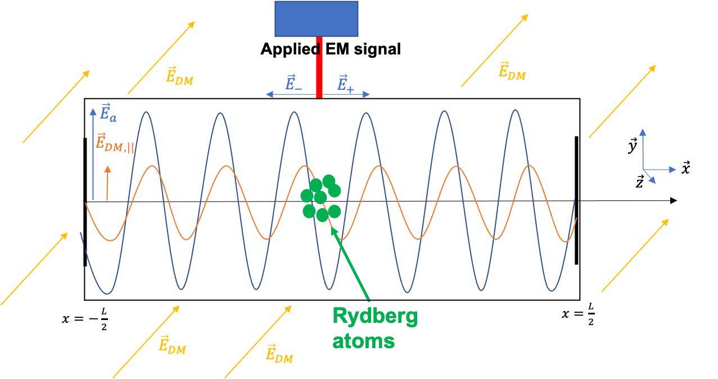
The experiment : Detection using Rydberg atoms
Best way of measuring the square of the electric field strength is through quadratic Stark effect
$$Δν=\frac{1}{2h}∆α{\left\langle E\right\rangle }^{2}$$
Measurement of transition frequency of atoms and look for $ν\left(t\right)=ν_{0}+Δν\cos{(Δωt+φ_{a})}$
With Rydberg atoms (atoms with high $n$):
High accuracy on $Δν$ from ${\left\langle E\right\rangle }^{2}$
Large polarizability $∆α$ ($∝n^{7}$)
→ Better sensitivity on ${\left\langle E\right\rangle }^{2}$
Short lifetime ($\sim μ$s)
Non-destructive measurement
→ High sampling frequency possible
7
Notes:
observable to try to detect the DM electric field but how to measure it ? Stark Effect which characterizes the frequency shift of an atom from the application of electric field (le dire clairement)
(Use of stark effect because this effect is sensitive to E^2.)
To do so, w could use regular atomic clocks which have a very good resolution but not high sensitivity on E^2. Another possibility is to use of rydberg atoms for this purpose which are atoms with high principal quantum number n, implying that electrons are usually not as much bounded to the nucleus as regular atoms. One of the consequences of that is an exaggerated response to electric field.
They have lot of advantages
The experimental method is simple :
This way, large window of mass scanable

Slide 12
Rough estimation of the experiment sensitivity
1st source of noise : Statistical noise
Measurement uncertainty on the frequency shift of atoms…
$$σ_{∆ν}^{2}=\frac{S_{∆ν}f_{s}}{2}$$
…induces a measurement uncertainty on the electric field squared
$$S_{∆ν}={\left(\frac{∆α}{2h}\right)}^{2}S_{E^{2}}$$
With $n>60$ Rydberg atoms, we can reach $σ_{∆ν}={10}^{3} Hz$ and $\frac{∆α}{2h}\sim {10}^{5} \text{Hz}\text{/}{(V/m)}^{2}$
Frequency shift noise PSD
Frequency shift variance
Electric field squared noise PSD
Bridge et al. Opt. Express, 2016
Millen et al. Journal of Physics, 2011
8
Notes:
Now, what is the experiments sensitivity ? different sources of noise and how do they impact the sensitivity of the experiment.
First source of noise is statistical noise For Rydberg Sr atoms, this noise is equivalent to a minimal detectable field power of 1 (V/m)^2
plots : exclusion plots of current dark photons searches through chi coupling with photons. Different experiments : indirect ones (cosmo in blue and astro in green) and direct ones (lab experiments in red).
Now if we zoom in this part, we have different experiments and we see the constraint on chi from this experiment Small remark : two different constraints related to 1st and 3rd cavity resonance.
I will now show only the constraints from lab experiments and I discard the CMB constraint on purpose. We see that at this point, experiment allows to scan new regions of the plot compared to other lab experiments.

Slide 13
Rough estimation of the experiment sensitivity
2nd source of noise : Systematic noise
Amplitude fluctuation of the applied field, characterized by the Relative Intensity Noise (RIN) of the signal generator
$$X_{a}→X_{a}\left(1+\int{dω_{0}\frac{ΔX_{a}{(ω}_{0})}{X_{a}}\cos{{(ω}_{0}t+φ_{0})}}\right)$$
Assuming a flicker noise, $S_{RIN}\left(ω\right)=\frac{{10}^{−13}}{ω}$,
the main amplitude fluctuation (mimicking a signal at $Δω$) is at frequency $ω_{0}=Δω$. Then
$$X_{a}→X_{a}+{ΔX}_{a}(Δω)\cos{(Δωt+φ_{0})}$$
Related to the RIN PSD $S_{RIN}$
(Rubiola, 2005)
9
Notes:
Stochastic expression for Xa + explain all terms in integral
The ratio Delta Xa/Xa is directly related to RIN noise, which we consider to be flicker
Main noise contribution mimicking a signal oscillating at Delta omega is when omega0 = Delta omega. This simplifies the above equation to …

Slide 14
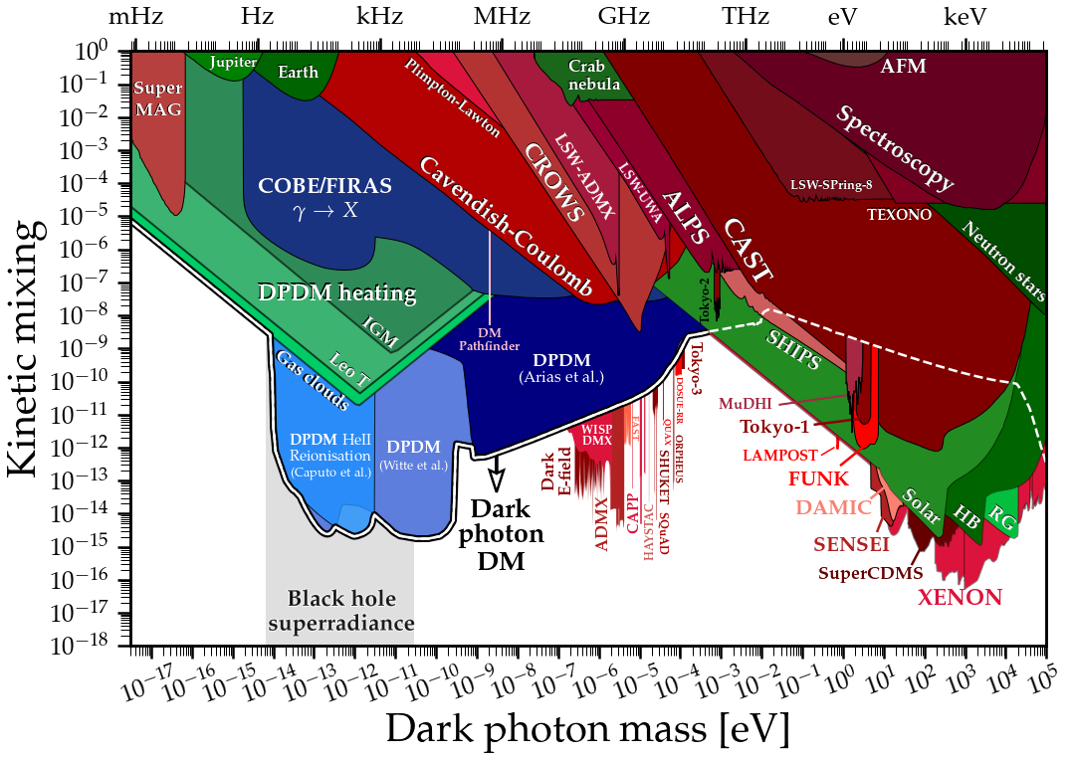
Rough estimation of the experiment sensitivity
(O’Hare, AxionLimits https://github.com/cajohare)
11

Slide 15
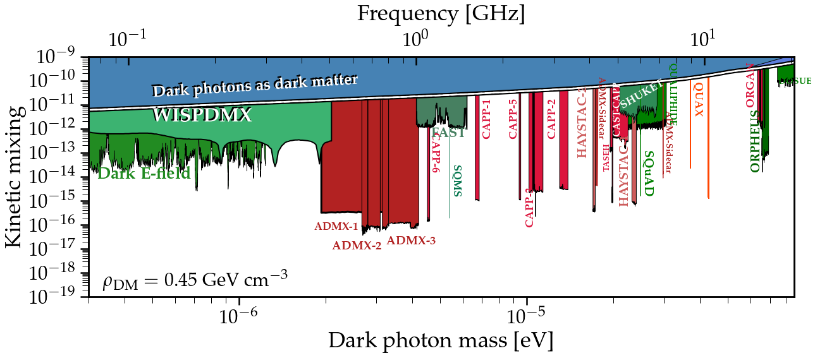
Rough estimation of the experiment sensitivity
12

Slide 16
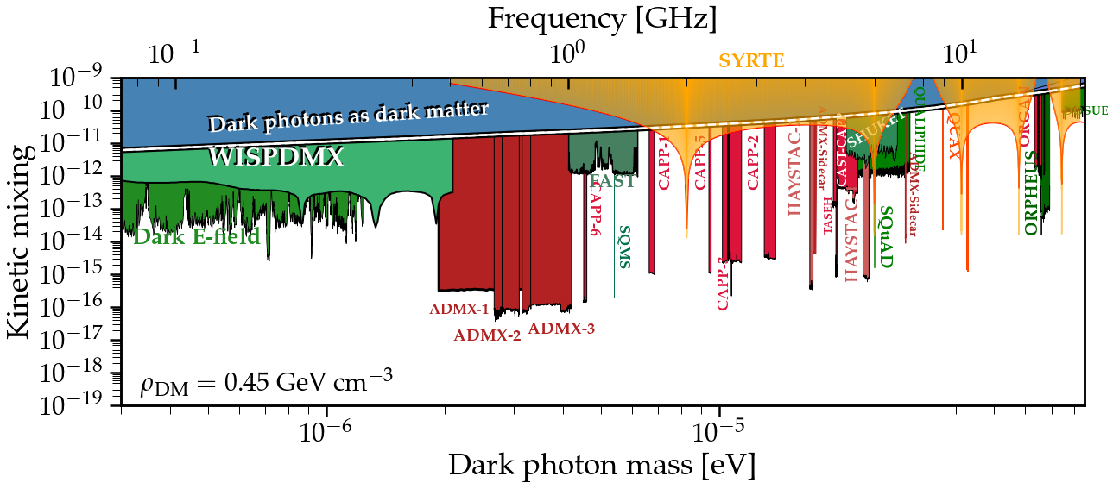
Rough estimation of the experiment sensitivity
Considering realistic experimental parameters, the experiment sensitivity is
With these parameters, $\sim 5$ days of data-taking could constrain the light blue region
12

Slide 17
Conclusion
DP is a serious DM candidate → numerous lab experiments trying to detect it.
Proposal of a new kind of experiment looking for DP using atoms inside a microwave cavity. As a resonant device, it acts as a narrowband DM detector.
With the current technology in atomic physics, competitive sensitivity on the coupling constant $χ$compared to other already existing experiments.
Experiment could be feasible in the near future in labs (e.g using Sr or Hg clocks)
13

Slide 18
Thank you for your attention !
This work was supported by the Programme National GRAM of CNRS/INSU
with INP and IN2P3 co-funded by CNES.

Slide 19
Back-up : Experimental methodology
Apply electric field with frequency $ω_{a}$ for $T_{obs}$ → scan DM signals with $\frac{2π}{T_{obs}}<|Δω|<\frac{{πf}_{s}}{2}$
2) Shift applied frequency by $πf_{s}$for $T_{obs}$
→ scan new DM signals with $\frac{2π}{T_{obs}}<|Δω|<\frac{{πf}_{s}}{2}$
Allowed interval for $ω_{DM}$
New allowed interval for $ω_{DM}$
Shift of $ω_{a}$
$$ω (Hz)$$
$$ω (Hz)$$
$$Δω=πf_{s}/2$$
$$Δω=πf_{s}/2$$
$$Δω=πf_{s}/2$$
$$Δω=πf_{s}/2$$
$$ω_{a}^{(1)}$$
$$ω_{a}^{(1)}$$
$$ω_{a}^{(2)}$$
N times
→ Large window of DM frequencies scanable $(=Nf_{s})$
8
Notes:
The experimental methodology we propose is quite simple. Strt by applying electric field with frequency w_a for duration Tobs. This way, you can scan DM signals such that the diff of frequencies is lower than sampling frquency/ 2 (Nyquist frequency)
Then, switch w_a by sampling frequency and scan new DM signals which fulfill same conditions.
Repeat as much as you want (or time allows), and this way you can scan large window of DM masses

Slide 20
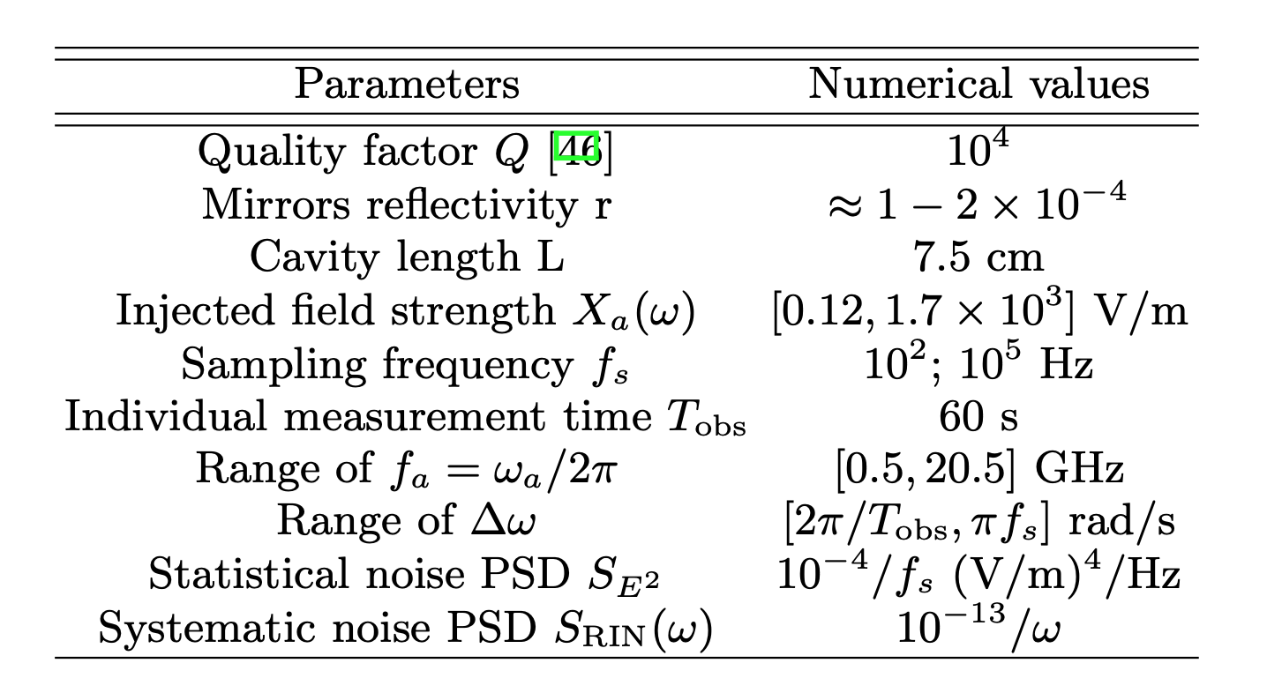
Back-up : Experimental parameters
Guena, 2012
Vallet et al. NJP, 2017
Millen et al. Journal of Physics, 2011
Rubiola, 2005

Slide 21
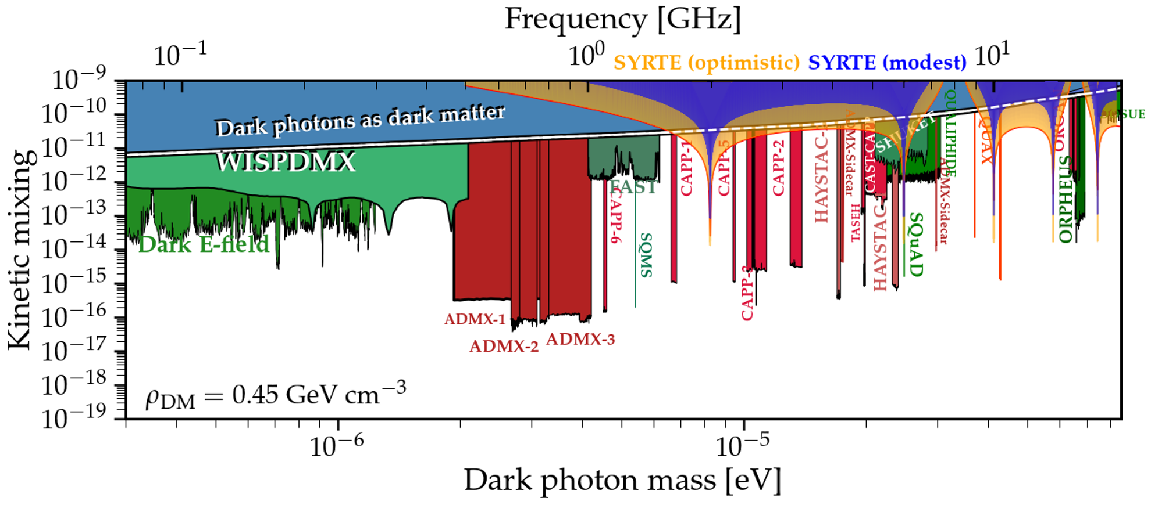
Back-up : Experiment sensitivity with different $f_{s}$
Considering two scenarii ($f_{s}={10}^{2}$ Hz (« modest ») and $f_{s}={10}^{5}$ Hz (« optimistic »)), the experiment sensitivity is
12

Slide 22
Back-up : Cosmological evolution of DP field
Free Klein-Gordon equation of each DP space component $φ^{i}$
$${\ddot{φ}}^{i}+3H{\dot{φ}}^{i}+ω^{2}φ^{i}≈0$$
whose solution is oscillatory when $ω≫H$
Treating DP field as a classical massive field, we have (in its rest frame)
$$\vec{φ}={\vec{φ}}_{0}\cos{(ωt)}$$
Now, considering the DP field makes the whole DM local density, it passes through lab with ${\vec{v}}_{DM}$
$\vec{k} \sim \frac{m{\vec{v}}_{DM}}{ℏ}→λ≫L$, size of experiment considered in the following → propagation neglected in the lab frame
$\left|{\vec{φ}}_{0}\right|=\frac{\sqrt{2μ_{0}ρ_{DM}}c}{ω}$
$$ω=\frac{mc^{2}}{ℏ}$$
$𝒪({10}^{−3}$c)
$𝒪({10}^{−6}$ eV)
$$𝒪(300 m)$$
7
Notes:
Cosmo evo : Each space component of the field follows KG equation. When f >> H, solution is oscillatory and has the form … with omega = m in the RF of DP. Just a standing classical field oscillating.
If DP = DM, galactic velocity is vDM hence we need to check the form of the field in the lab frame. k neglected hence same standing wave in our frame. Amplitude of oscillation related to rhoDM

Slide 23
Back-up : Cavity parameters
Resonance conditions : $λ=\frac{2L}{n} or kL=nπ$
Detection at the center from atoms → we require n odd (antinode at the center)
Reflectivity coeff of mirrors r is related to quality factor as
$$Q=\frac{2π}{λ(1−r^{2})}$$
This relation is valid only around resonances.
Finesse of a cavity defined as
$$ℱ=2πN_{e}→ℱ≈Q$$
Notes:
Ne = average number of round trips before the energy inside the cavity drops to 1/e of its initial value

Slide 24
Back-up : Atomic clock
From http://hyperphysics.phy-astr.gsu.edu
Atoms inside a cavity, excited by a laser.
The closer the frequency of the laser is to the energy difference between the 2 levels, the more excited atoms there will be
Assessment of the frequency of the laser to be closest possible to the energy difference.
→ Wave with appropriate frequency and need to count oscillations to give time

Slide 25
Back-up : why microwave regime and not optical ?
${\vec{E}}_{DP}≈−iχω\vec{ϕ}e^{−iωt}$valid if we neglect k. To do so, we require $L≪λ$ (L, size of experiment considered (< 10 cm)) → ok in microwave range → in optical range, $k \sim {10}^{6} m^{−1}≫\frac{2π}{λ}$
Optical frequency $≡$ eV mass → QFT required for DP field

Slide 26
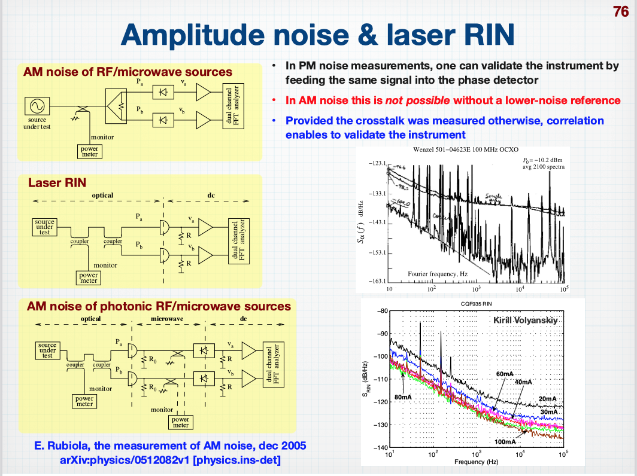
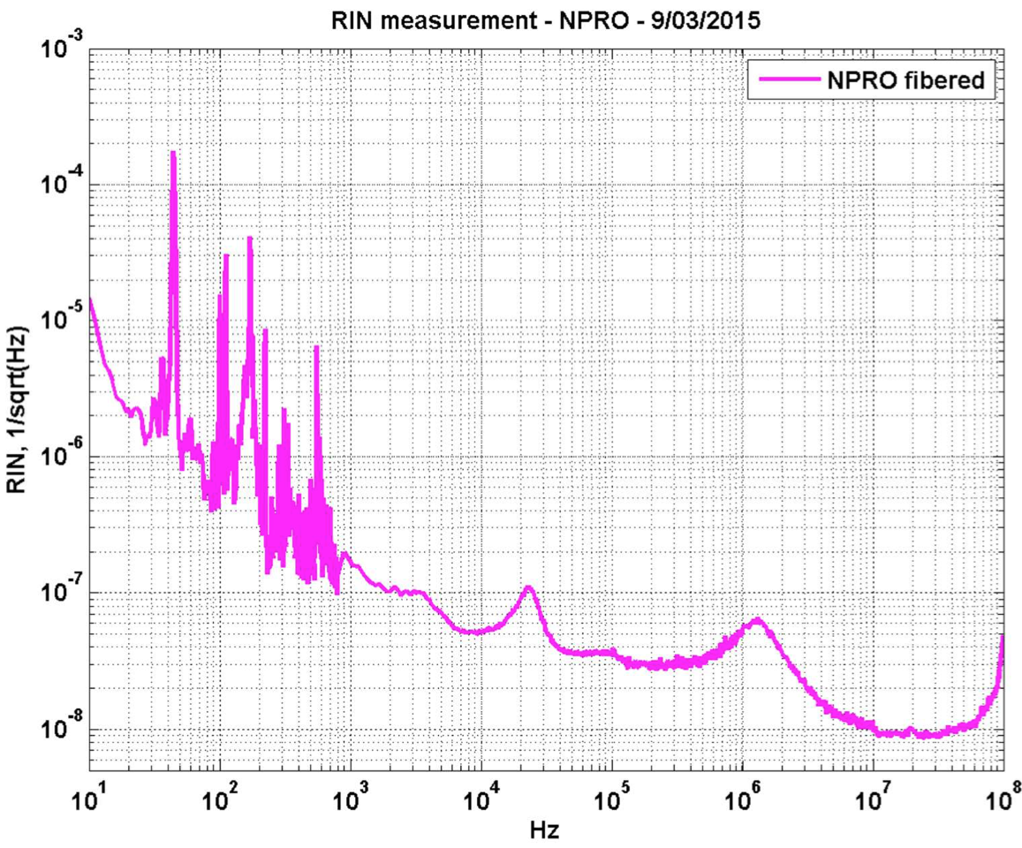
Back-up : Systematic noise and Data analysis
`
With RIN noise $∝f^{−1}$, the $S_{RIN}={10}^{−9}/\sqrt{Hz}$ works at frequencies $f \sim {10}^{4}−10^{5}$ Hz
$\sqrt{S_{RIN}}$of different sources (arXiv : Rubiola, 2005)
$\sqrt{S_{RIN}}$of a Nd laser, measurement
provided by Artemis lab.

