Slide 1
Multiphonon Processes in Spin-Dependent Dark-Matter Scattering
Bethany Suter, UC Berkeley
Berkeley Week
IN collaboration with P. Munbodh, S. Knapen, S. Gori, & T. Lin

Slide 2
Outline
The experimental outlook
Why phonons + DM
Derivation of Multiphonon scattering
Results!

Slide 3
Outline
The experimental outlook
Why phonons + DM
Derivation of Multiphonon scattering
Results!

Slide 4
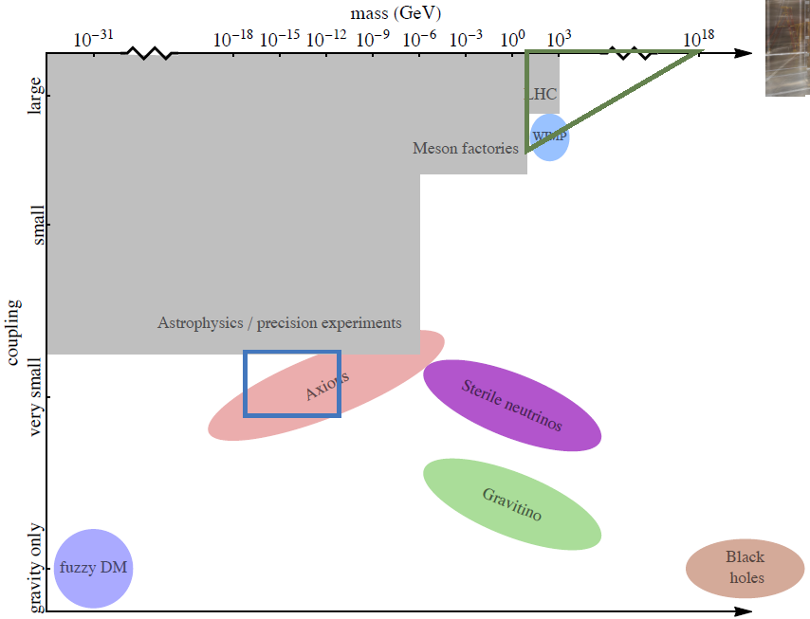
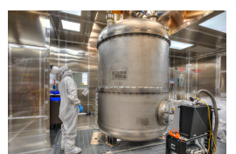
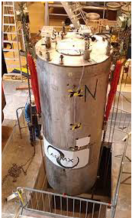
The Dark Matter Landscape
Nuclear recoils (LZ, XENON1T, …)
Resonant cavities (ADMX, MADMAX, DMradio…)
Figure by S. Knapen

Slide 5
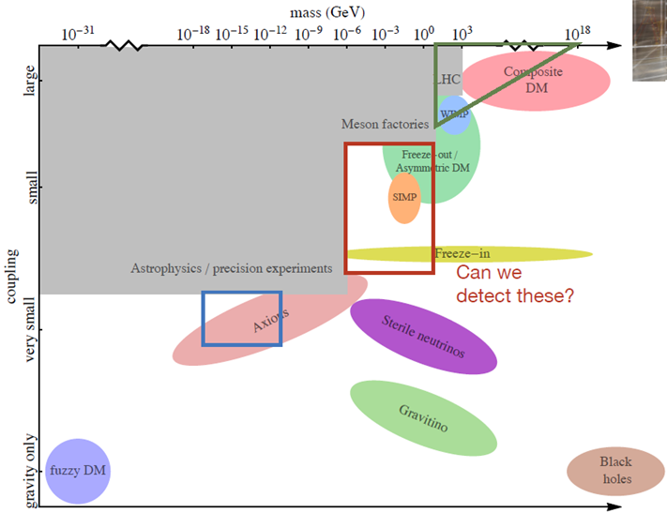
The Dark Matter Landscape
Nuclear recoils (LZ, XENON1T, …)
Resonant cavities (ADMX, MADMAX, DMradio…)
Figure by S. Knapen

Slide 6
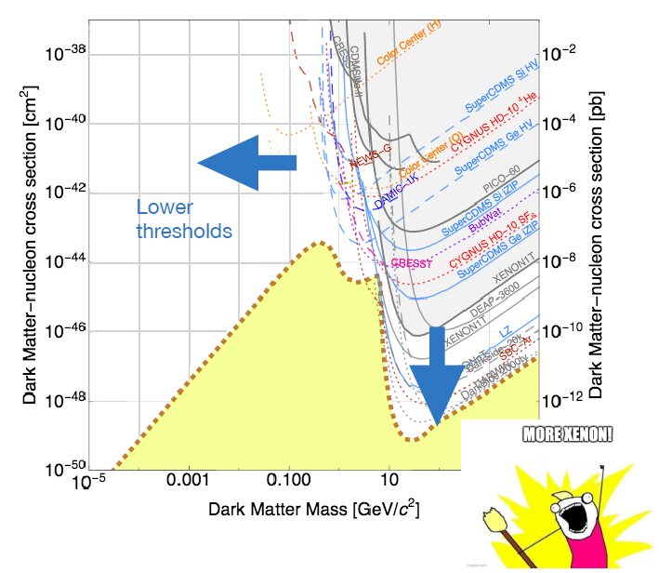
Light Dark Matter Direct Detection
What do we need?
M. Battaglieri: 1707.04591
Meme credit: S. Knapen

Slide 7
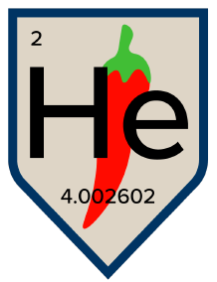
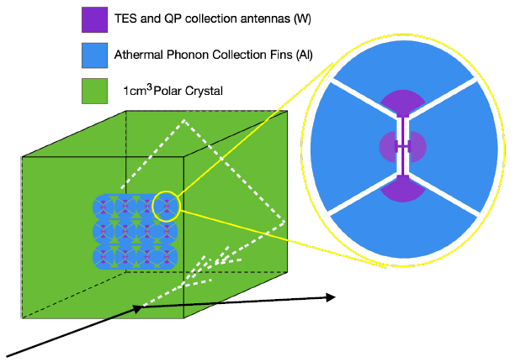
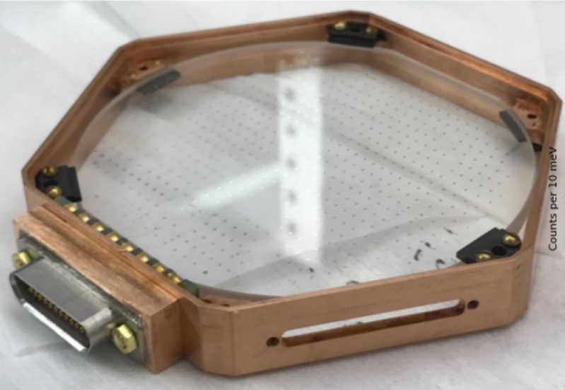
Phonon Detector: SPICE
Polar Materials: GaAs or Sapphire
Scintillation & phonons
Background discrimination!
Low energy TES
SPICE / HeRALD
TESSERACT
3’’ sapphire detector
$\sim 10$ meV threshhold
Figure from M. Pyle
Picture from TESSERACT Website

Slide 8
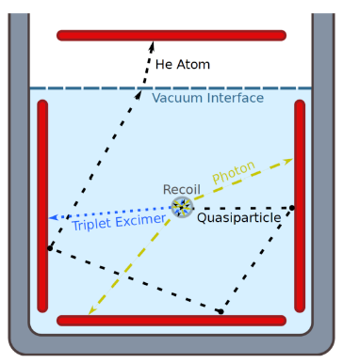
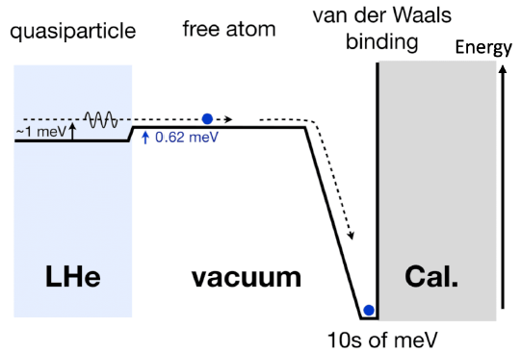
Phonon Detector: HeRALD
Calorimeters with TES readout
Quantum evaporation of He atoms
SPICE / HeRALD
TESSERACT
S. Hertel, A. Biekert, J.Lin, V.Velan, & D. McKinsey arXiv:1810.06283
Figures from J. Lin slides

Slide 9
Outline
The experimental outlook
Why phonons + DM
Derivation of Multiphonon scattering
Results!

Slide 10
Slide by S. Knapen

Slide 11
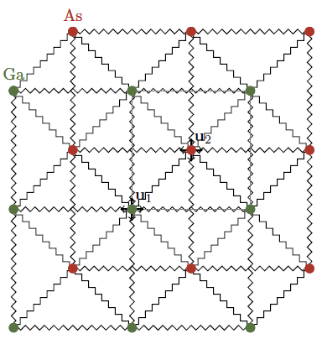
Phonons
Very complicated system of coupled harmonic oscillators
Acoustic Phonons
Coherent motion of the lattice atoms
Wavelength $→$ 0 corresponds to displacement of the crystal
Wavelength → 0 corresponds to displacement of the crystal
Optical Phonons
Out of phase motion of the lattice atoms
If material is polar, couples to EM field
Figure from S. Knapen

Slide 12
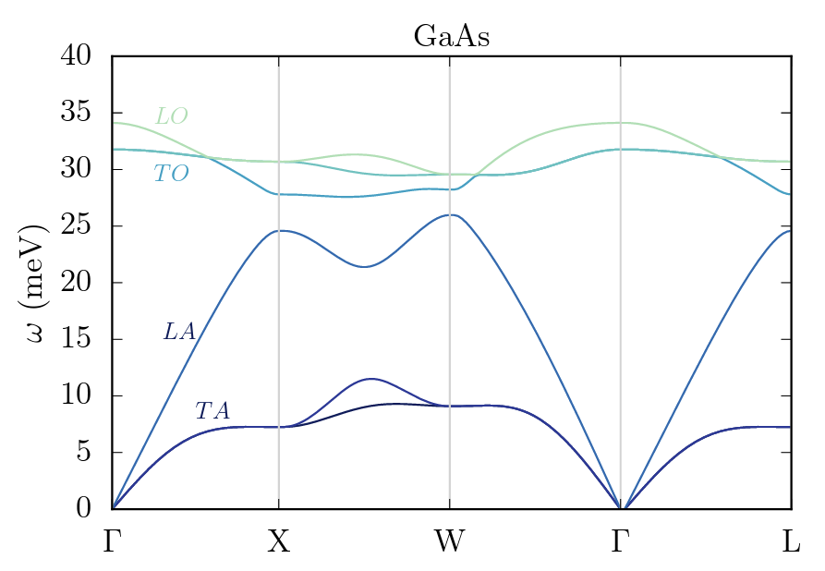
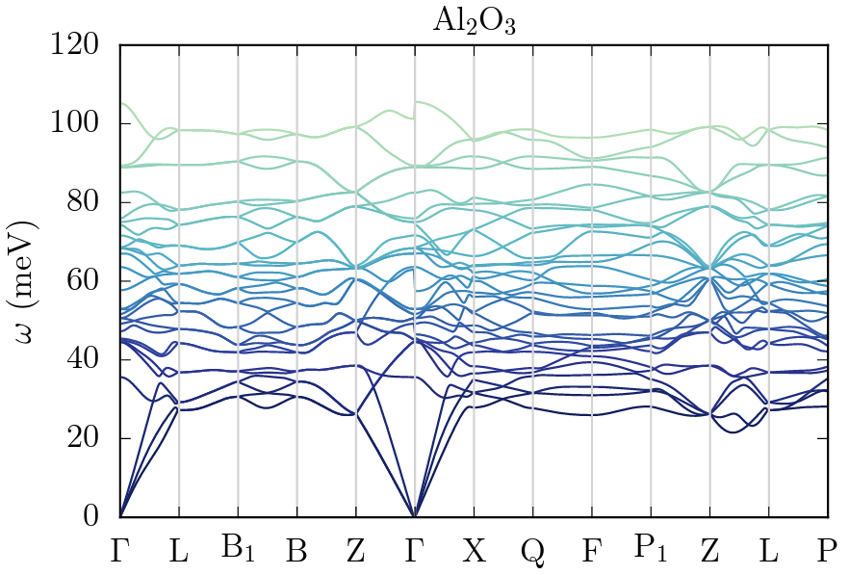
Acoustic vs Optical
Low momentum transfer = only excite acoustic phonon in 1st Brillouin zone
$$ω=c_{s}\left|q\right| ≈2c_{s}vm_{X}∼7 meV× \frac{m_{X}}{100keV}$$
Best threshold is in 10 – 100 meV range, so difficult or impossible to detect
Optical modes don’t have this scaling:
$$ω \sim 30 meV as \left|q\right|→0$$
Figures from arXiv:1807.10291

Slide 13
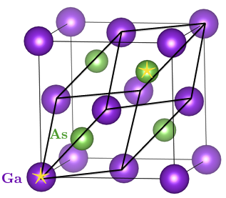
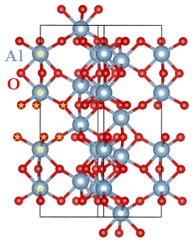
Polar Materials
$$GaAs$$
At least two different atoms with different effective charges
Each unit cell forms an electric dipole
E field or dark photon causes vibrations
$→$Optical phonons
GaAs
2 atoms in unit cell
3 acoustic phonons, 3 optical phonons
Sapphire
10 atoms in unit cell
3 acoustic phonons, 27 optical phonons
${Al}_{2}O_{3}$ (Sapphire)
Primary crystal axis
Figures from arXiv:1807.10291

Slide 14
Benefits of Polar Materials
Gapped dispersion of optical phonons
Single or multiphonon
Anisotropic crystal structures
Daily modulation in rate
Low screening
Required: few free electrons, high polarizability
Gap for electronic excitations $\sim O\left(1−10 eV\right)$
Kinetic mixing with dark photon couples to dipole moment
Easy to fabricate
S. Griffin, S. Knapen, T. Lin, M. Pyle, K. Zurek: 1807.10291

Slide 15
Outline
The experimental outlook
Why phonons + DM
Derivation of Multiphonon scattering
Results!

Slide 16
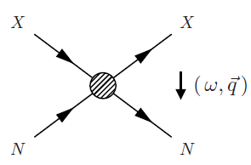
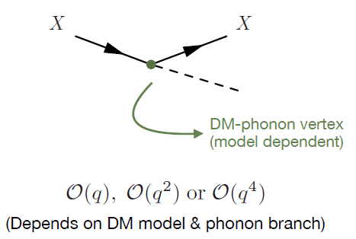
DM - Phonon EFT
Nuclear Recoil:
$ω=\frac{q^{2}}{2m_{N}}$
Phonon Regime:
$q ≪\sqrt{2m_{N}ω}$
Momentum is a good expansion parameter
S. Knapen, T. Lin, M. Pyle, K. Zurek: 1712.06598
S. Griffin, S. Knapen, T. Lin, M. Pyle, K. Zurek: 1807.10291
Figures from S. Knapen

Slide 17
DM-Multiphonon Expansion
B. Campbell-Deem, P. Cox, S. Knapen, T. Lin, T. Melia: 1911.0348
B. Campbell-Deem, S. Knapen, T. Lin, E. Villarama: 2205.02250
Figures from S. Knapen

Slide 18
Multiphonon Rate (SI)
Begin with Fermi’s golden rule:
$$\frac{dσ}{d^{3}qdω}\sim \sum_{i,f}{{\left|\sum_{ℓ}^{N}{\left\langle λ_{f}\left|e^{iq⋅r_{ℓ}}\right|λ_{i}\right\rangle }\right|}^{2}δ(E_{f}−ω)}$$
Replace delta function:
$$\frac{dσ}{d^{3}qdω}\sim \int_{−∞}^{∞}{dt}\sum_{i,f}{{\sum_{ℓ,ℓ^{′}}^{N}{\left\langle λ_{i}\left|e^{iq⋅r_{ℓ}}\right|λ_{f}\right\rangle \left\langle λ_{f}\left|e^{−iq⋅r_{ℓ^{′}}}\right|λ_{i}\right\rangle }}^{ }e^{i\left(E_{f}−ω\right)t}}$$
Use completeness of states:
$$\frac{dσ}{d^{3}qdω}\sim \int_{−∞}^{∞}{dt}\sum_{i}{\sum_{ℓ,ℓ^{′}}^{N}{\left\langle λ_{i}\left|{e^{iq⋅r_{ℓ}(0)}e}^{−iq⋅r_{ℓ^{′}}(t)}\right|λ_{i}\right\rangle }e^{iωt} }$$
Let’s do SI first (easier)
Initial and final crystal configurations: Spin & phonon excitations

Slide 19
Multiphonon Rate (SI)
How can we calculate this for an arbitrary crystal?
$$\frac{dσ}{d^{3}qdω}\sim \int_{−∞}^{∞}{dt}\sum_{i}{\sum_{ℓ,ℓ^{′}}^{N}{\left\langle λ_{i}\left|{e^{iq⋅r_{ℓ}(0)}e}^{−iq⋅r_{ℓ^{′}}(t)}\right|λ_{i}\right\rangle }e^{iωt} }$$
Incoherent Approximation:
Set ℓ = ℓ′ $→$ no interference between atoms
Good when $q ≫2π/a$
Harmonic Approximation:
Decompose into a sum of harmonic oscillators weighted by the phonon density of states
Good for crystals with few anharmonicities
?
$$\left\langle 0\right|e^{iq⋅r_{ℓ}(0)}e^{−iq⋅r_{ℓ}(t)}|0⟩ ∼ e^{\left\langle 0\left|q⋅r_{ℓ}\left(0\right)q⋅r_{ℓ}\left(t\right)\right|0\right\rangle } +⋯$$

Slide 20
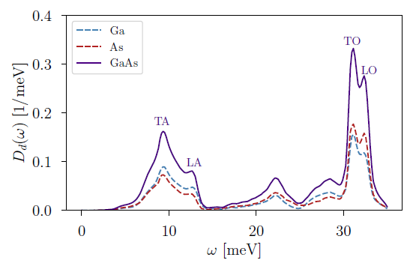
Multiphonon Rate (SI)
$$\frac{dσ}{d^{3}qdω} \sim \sum_{d}^{N}{f_{d}^{2}e^{−2W_{d}(q)}}∑{\left(\frac{q^{2}}{2m_{d}}\right)}^{n}\frac{1}{n!}\left(\prod_{i=1}^{n}{∫dω_{i}\frac{D_{d}\left(ω_{i}\right)}{ω_{i}}}\right)δ\left(\sum_{j}{ω_{j}−ω}\right)$$
$$\frac{dσ}{d^{3}qdω} \sim \sum_{d}^{N}{f_{d}^{2}}\sqrt{\frac{2π}{Δ_{d}^{2}}}\exp\left(−\frac{{\left(ω−\frac{q^{2}}{2m_{d}}\right)}^{2}}{2Δ_{d}^{2}}\right)$$
$$\frac{dσ}{d^{3}qdω} \sim \sum_{d}^{N}{f_{d}^{2}}×δ\left(ω−\frac{q^{2}}{2m_{d}}\right)$$
$$q ≫\sqrt{2ωm_{d}}$$
Impulse Approximation
Partial density of States
Free nuclear recoil limit!
B. Campbell-Deem, S. Knapen, T. Lin, E. Villarama: 2205.02250

Slide 21
Spin Dependent Derivation
Nuclear Spin Polarized
Similar to spin independent case, with a form factor correction
Nuclear Spin Unpolarized
Cross section doesn’t average away:
$ℓ=ℓ′$ (incoherent) terms contribute $\sim ⟨S_{N}^{2}⟩$
Previous calculation holds!
Cross section doesn’t average away:
ℓ=ℓ′ (incoherent) terms contribute ~ ⟨𝑆_𝑁^2⟩
Previous calculation holds!
(see T. Trickle et. al. 2009.13534)
Figures by S. Knapen

Slide 22
Spin Dependent Derivation
The crystal dynamics remain the same:
$$\frac{dσ}{d^{3}qdω}\sim q^{2}⟨S_{χ}^{2}⟩\sum_{ℓ,d }^{N}{\left(\overline{\frac{f_{d}^{2}\left\langle S_{d}^{2}\right\rangle }{m_{d}^{2}}}\right)\int_{−∞}^{∞}{dt}\left\langle λ_{0}\left|{e^{iq⋅r_{ℓ}(0)}e}^{−iq⋅r_{ℓ^{′}}(t)}\right|λ_{0}\right\rangle }e^{iωt}$$
The bar denotes an average over isotope abundances
$\left\langle S_{d}^{2}\right\rangle$ is the averaged squared spin of the nucleus
Approximations:
Incoherent
Harmonic
Isotropic crystal
Spherically symmetric spins
Exactly the same as SI case

Slide 23
Outline
The experimental outlook
Why phonons + DM
Derivation of Multiphonon scattering
Results!

Slide 24
Model Dependence: EFT operators
Pseudoscalar mediator & fermion DM
($O_{4}^{f}$) : $ℒ_{ }⊃g_{χ}a\overline{χ}γ^{5}χ+g_{p}a \overline{N}γ^{5}N$
$$ℒ_{NR} \sim \left(q⋅S_{N}\right)\left(q⋅S_{χ}\right)$$
($O_{3}^{f}$) : $ℒ_{ }⊃g_{χ}a\overline{χ}χ+g_{p}a \overline{N}γ^{5}N$
$$ℒ_{NR} \sim (S_{N}⋅S_{χ})$$
A. Fitzpatrick, W. Haxton, E. Katz, N. Lubbers, Y. Xu arXiv:1203.3542

Slide 25
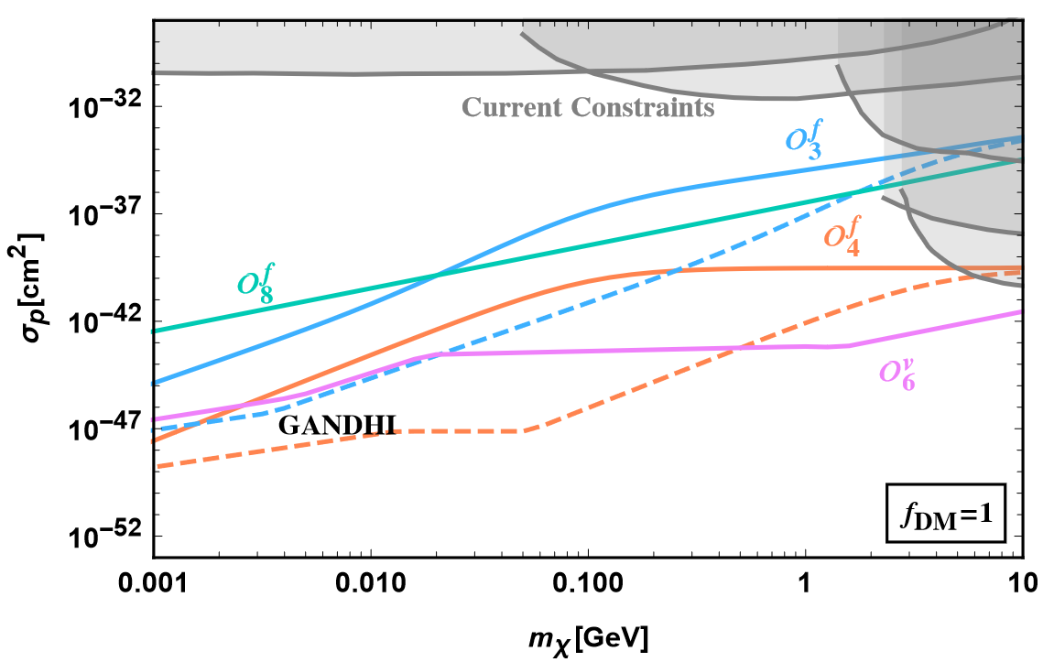
Spin Dependent Constraints
$m_{a}$ is not fixed
H. Ramani, G. Woolley arXiv:1905.04319

Slide 26
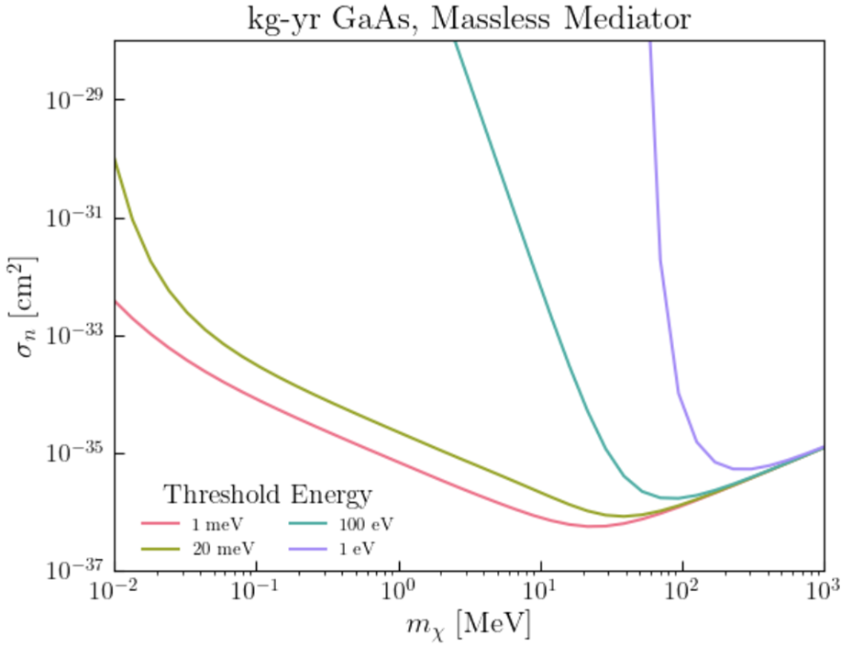
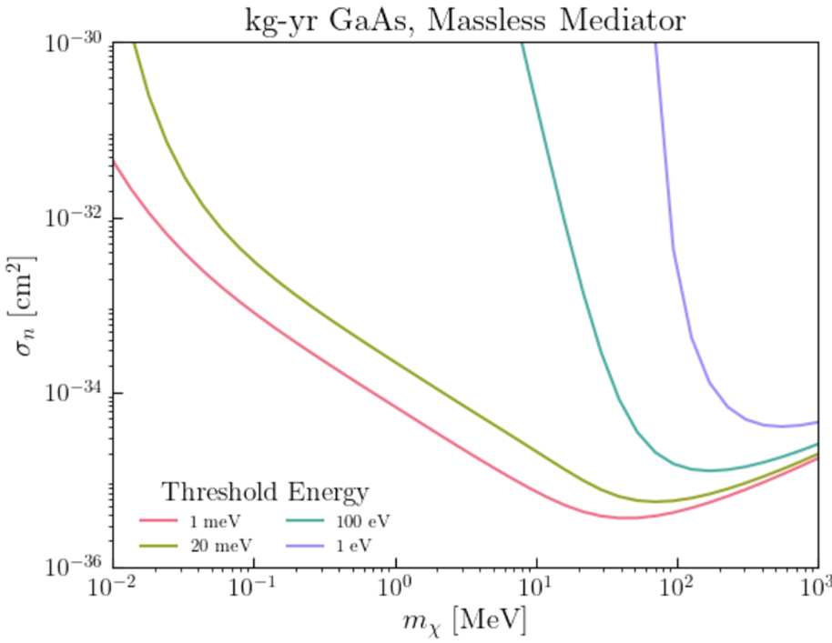
Results
PRELIMINARY
PRELIMINARY
$$\overline{σ_{p}}$$
$$\overline{σ_{p}}$$
Pseudoscalar DM, massless mediator
Scalar DM, massless mediator
Cross sections needed for 3 events/kg-year rate for GaAs using several threshold energies

Slide 27
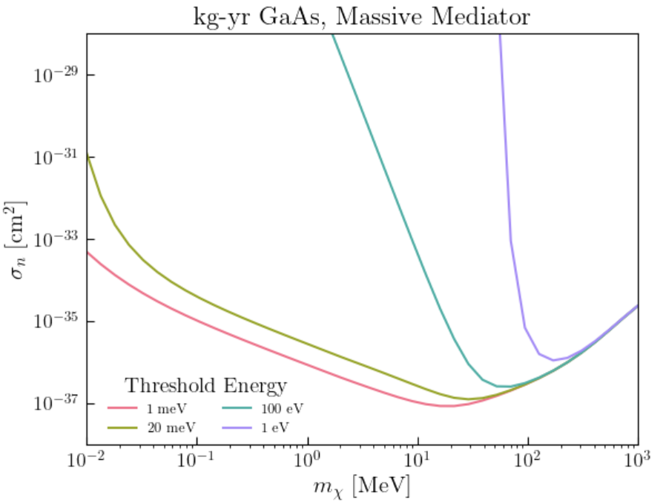
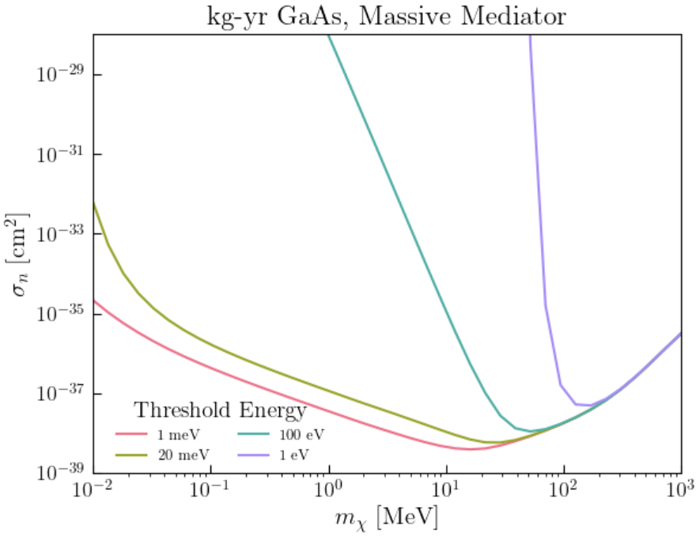
Results
PRELIMINARY
PRELIMINARY
$$\overline{σ_{p}}$$
$$\overline{σ_{p}}$$
Pseudoscalar DM, massive mediator
Scalar DM, massive mediator
Cross sections needed for 3 events/kg-year rate for GaAs using several threshold energies

Slide 28
Summary
Lots of new proposed experiments are looking for dark matter-phonon interactions
Multiphonon – DM interactions cover intermediate DM mass ranges between nuclear recoil and single phonon detection
Spin dependent multiphonon scattering utilizes similar methods as spin independent when crystal spins are randomly distributed
The cross sections for spin dependent cases are within the range of future experiments – spin dependent multiphonon experiments should be created to probe intermediate DM masses

Slide 29
Questions?

Slide 30
Backup Slides

Slide 31
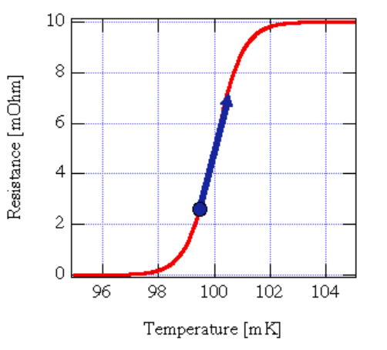
Transition Edge Sensors (TES)
Superconducting film acting at the phase “transition edge”
Large change in resistance with tiny shifts in temperature
Smaller band widths $→$ lower threshold energies

Slide 32
Approximations
Spin Independent
Spin Dependent
n-ph expansion
(no approximation)
$$ω=\frac{q^{2}}{2m_{d}}$$
Impulse approximation
DM phase space
$$→$$
B. Campbell-Deem, S. Knapen, T. Lin, E. Villarama: 2205.02250

Slide 33
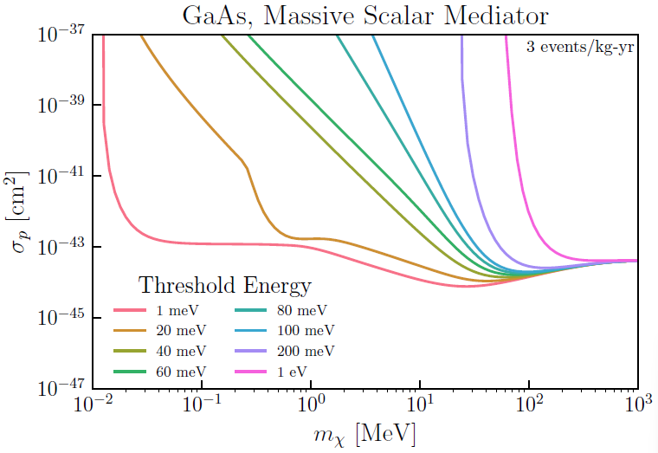
Spin Independent Results
Assumes a coupling $\sim A_{d}$
Isotropic approximation
Anharmonic corrections around $m_{χ} \sim 1−10 MeV$: 2309.10839
B. Campbell-Deem, S. Knapen, T. Lin, E. Villarama: 2205.02250

