Slide 1
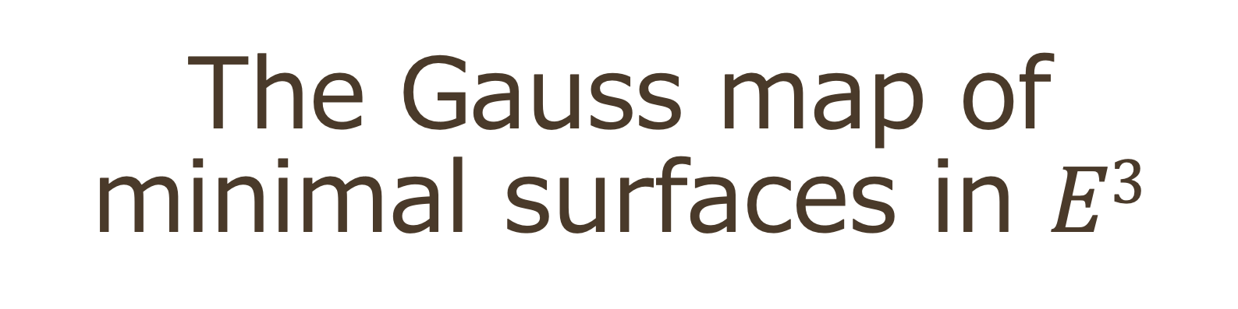
The Gauss map of minimal surfaces in $E3$
Workshop on the Physics and the Mathematics of the Universe
Kavli IPMU
14-18 July 2025
Reiko Miyaoka
（Tohoku University）

Slide 2
To My Mum

Slide 3
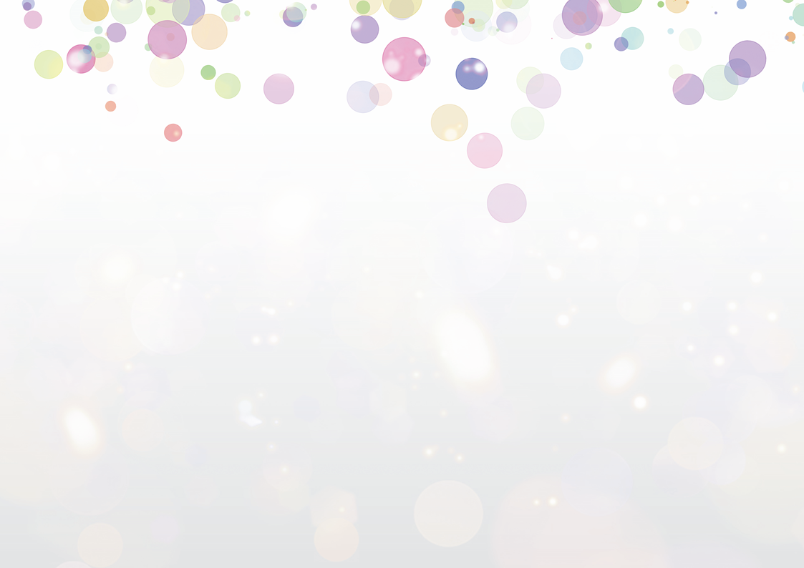

Self introduction
PhD. Tokyo Institute of Technology 1983
Professor at Sophia University 1999-2002
Professor at Kyushu University 2003-2006
Professor at Tohoku University 2007-2021
Majoring in Differential Geometry
The text book of my master's course was
Survey of Minimal Surfaces (R. Osserman )
* I have 3 kids and 2 grandkids.

Slide 4
【Talk plan】
Introduction to minimal surface theory
Riemann surfaces and one-variable complex analysis
Weierstrass-Enneper representation
Method to construct various examples
A clue to the problem of exceptional values
Quiz and Problem: Construct your own minimal surfaces

Slide 5
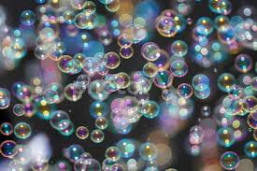
Soap films and soap bubbles:
What’s the difference？

Slide 6
Trap the air or not
Soap bubbles trap the air．
Soap films do not trap the air．
Both surfaces minimize the area.
Soap bubbles keep the volume of the air trapped.
Soap films just minimize the area bounded by a given frame.

Slide 7
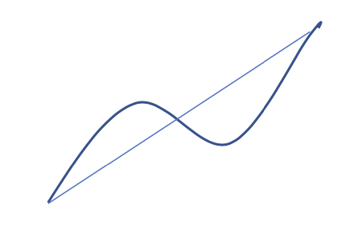
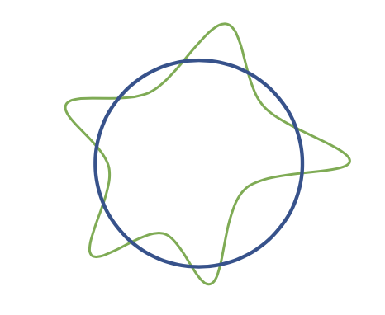
E.g. in the curves case
The shortest path joining two points is
a line segment．
The shortest path surrounding a certain
area is a circle．
The results vary under different conditions.

Slide 8
Minimal surfaces
A Minimal surface, like a soap film, is
a surface that spans a given frame
with the possible smallest area.
A surface without boundary is called minimal
if every sufficiently small portion is minimal
in the above sense.

Slide 9
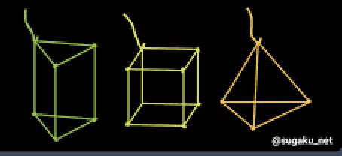
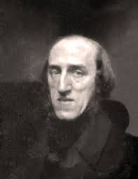
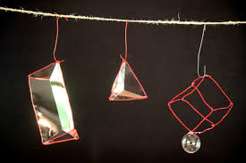
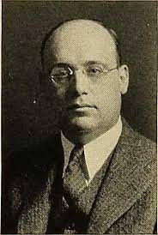
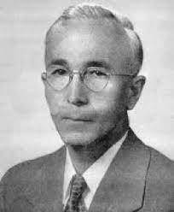
Plateau Problem
J.Plateau (1801-1883) Belgium physicist
Research on capillarity，retinal phenomenon
Lost eyesight（1843, observed the Sun too much？）
Plateau problem Plateau
Is there a minimal surface spanning any frame？
When the frame is homeomorphic to a circle,
Yes: J.Douglas, T.Rado answered independently (1930).
Douglas: got the first Fields prize (1936)
Douglas
Rado

Slide 10
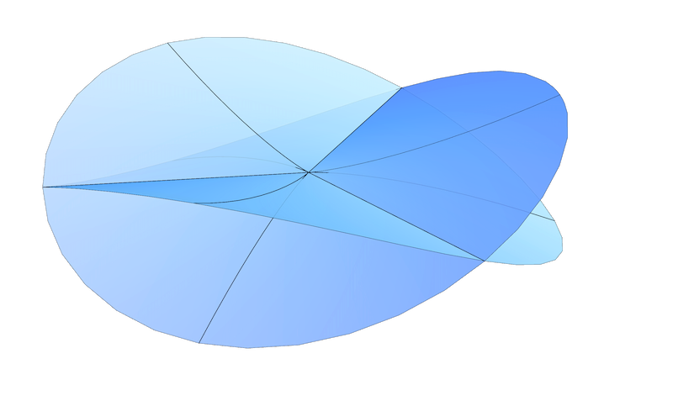
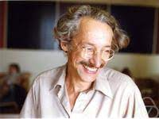
However, the surface might have singularities
R. Osserman shows (1970)
If the surface has the minimum area,
No true singularities.
R. Gulliver (1973)
No false singularities.
Thus the Plateau problem was settled．

Slide 11
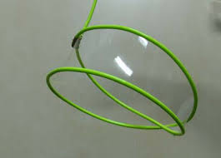
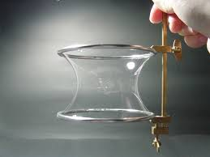
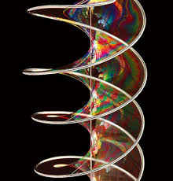
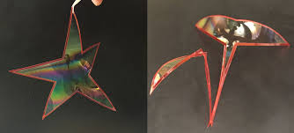
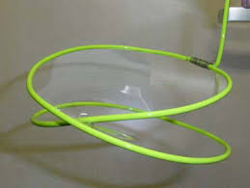
Experiment
Pull up a frame from the soap liquid gently.
Then we obtain a minimal surface．
Catenoid
Helicoid
Any frames
Different minimal surfaces with the same frame．
Upper: Mobius strip．

Slide 12
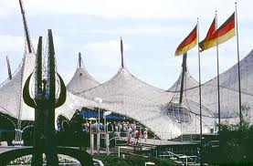
Why are minimal surfaces important？
Frei Otto uses them in architecture,
as they are beautiful, save the material, and strong.
The roof of the
Munich Olympic Stadium
1972

Slide 13
Minimal surfaces with 3D symmetry
Triply periodic minimal surfaces appear in physics,
chemistry, crystallography, as interfaces
Schwarz Primitive surface (1880s) Diamond surface
Gyroid (A. Schoen,1970)

Slide 14
Other aspects
Relation to investigate the blackholes：
Event horizon cut by a time-level is a minimal surface in the
Flamm paraboloid in the Schwarzschild space-time.
Used to solve the Poincaré conjecture:
The existence of an essential surface (uncompressed minimal
surface) guarantees the decomposition of a 3-manifold into
a hyperbolic part and a graph part.
In general, the minimality of some quantity is used to
represent important objects in geometry.
e.g., geodesics for 1-cycle, minimal surfaces for 2-cycle,…

Slide 15
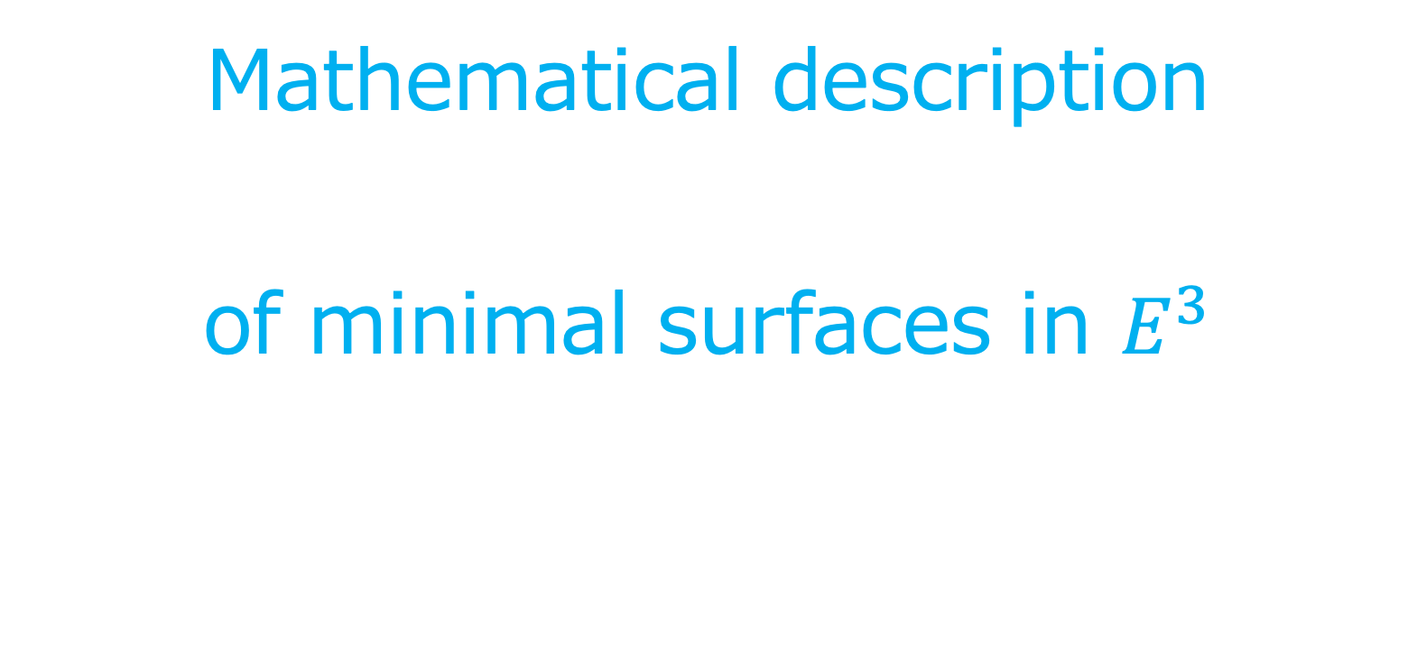
Mathematical description
of minimal surfaces in $E^{3}$

Slide 16
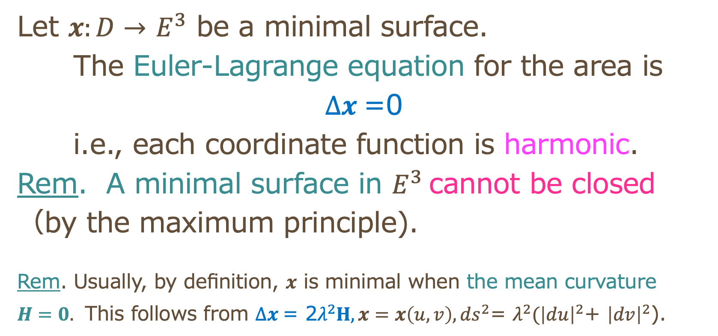
Equation of minimal surfaces
Let $x:D→$ $E^{3}$ be a minimal surface.
The Euler-Lagrange equation for the area is
$Δx$=0
i.e., each coordinate function is harmonic.
Rem. A minimal surface in $E^{3}$cannot be closed
（by the maximum principle).
Rem. Usually, by definition, $x$ is minimal when the mean curvature
$H=0.$ This follows from $Δx \text{= 2}λ^{2}H, {x=x\left(u,v\right), ds}^{2}$= $λ^{2}{(\left|du\right|}^{2}$+ ${\left|dv\right|}^{2}$).

Slide 17
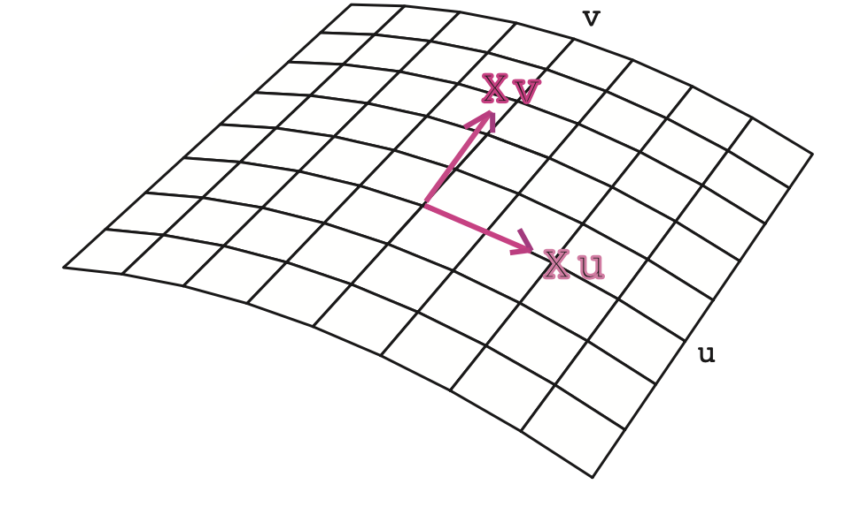
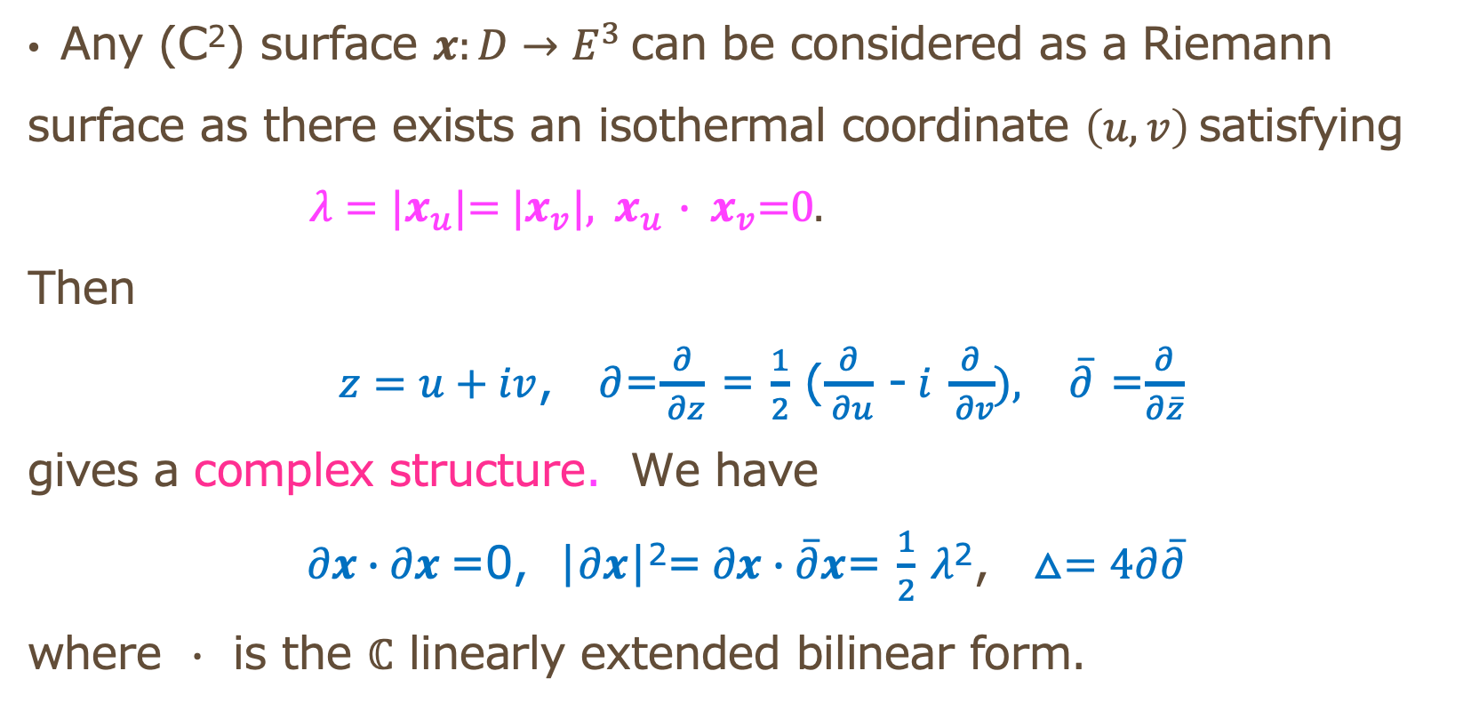
Expression in a complex variable
Any (C²) surface $x:D→E^{3}$can be considered as a Riemann
surface as there exists an isothermal coordinate $\left(u,v\right)$satisfying
$λ=|x_{u}$|= |$x_{v}$|, ${ x}_{u}$ $∙ x_{v}$=0.
Then
$z=u+iv$, $∂$=$\frac{∂}{ ∂z}$ = $\frac{1}{2}$ ($\frac{∂}{ ∂u}$ -$i$ $\frac{∂}{ ∂v}), \overline{∂}$ =$\frac{∂}{∂\overline{z}}$
gives a complex structure．We have
$∂x∙∂x$=0, |$∂x$|²=$∂x∙\overline{∂}x$= $\frac{1}{2}$ $λ$²， $△=4∂\overline{∂}$
where $∙$ is the $ℂ$ linearly extended bilinear form．

Slide 18
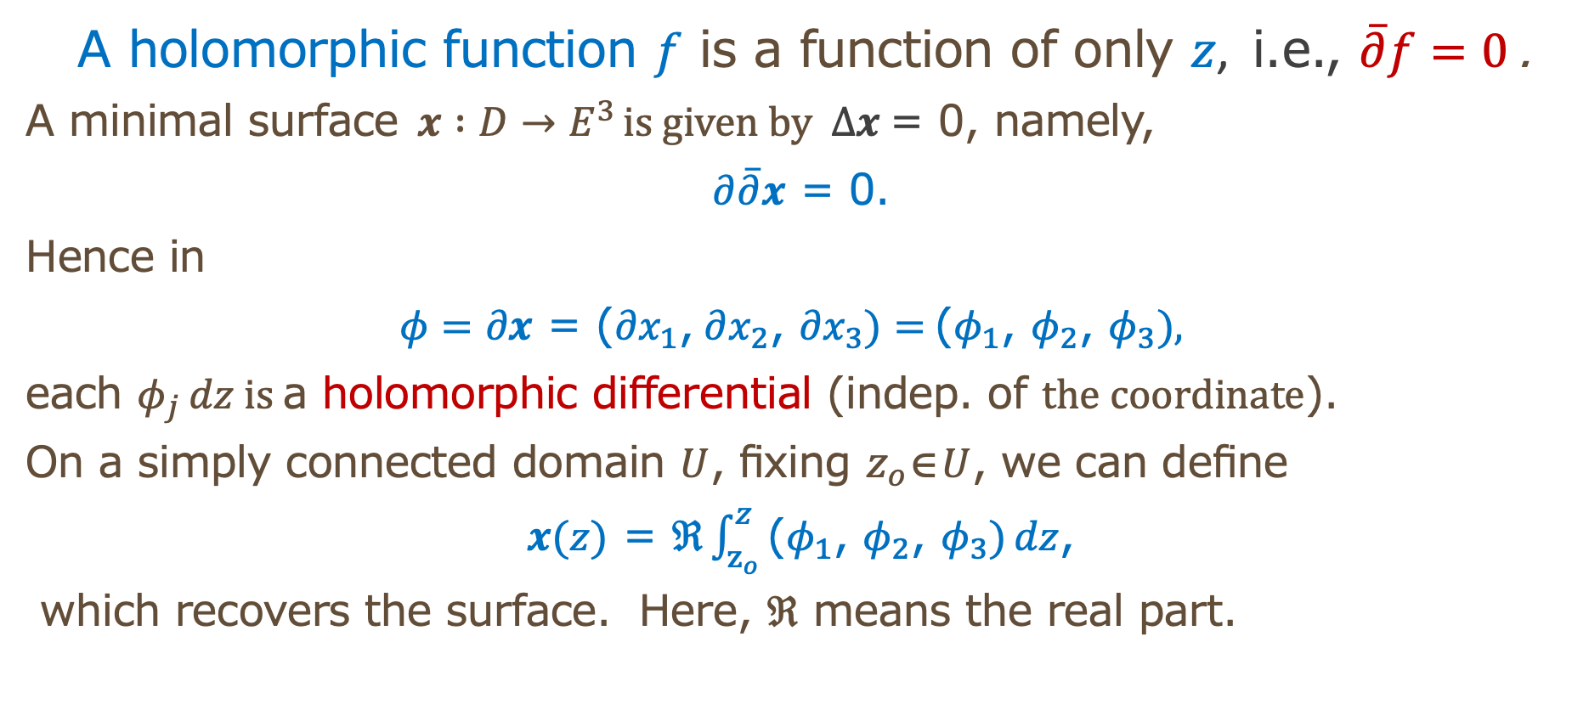
Method by complex analysis
A holomorphic function $f$ is a function of $\text{only} z$, i.e., $\overline{∂}f=0$ .
A minimal surface$x :D→E^{3 }is given by Δx \text{=}$0, namely,
$∂\overline{∂}x$ = 0.
Hence in
$φ=∂x$ = $\text{(}{∂x}_{1}\text{,} ∂x_{2}\text{,} {∂x}_{3})=$($φ_{1}$, $φ_{2}$, $φ_{3}),$
each $φ_{j }dz is$a holomorphic differential (indep. of $the coordinate$).
On a simply connected domain $U$, fixing $z_{o}$∈$U$, we can define
$x(z)$ = $ℜ\int_{z_{o}}^{z}{\text{(}φ_{1}\text{, }φ_{2}\text{, }φ_{3})}dz$,
which recovers the surface．Here, $ℜ$ means the real part．

Slide 19
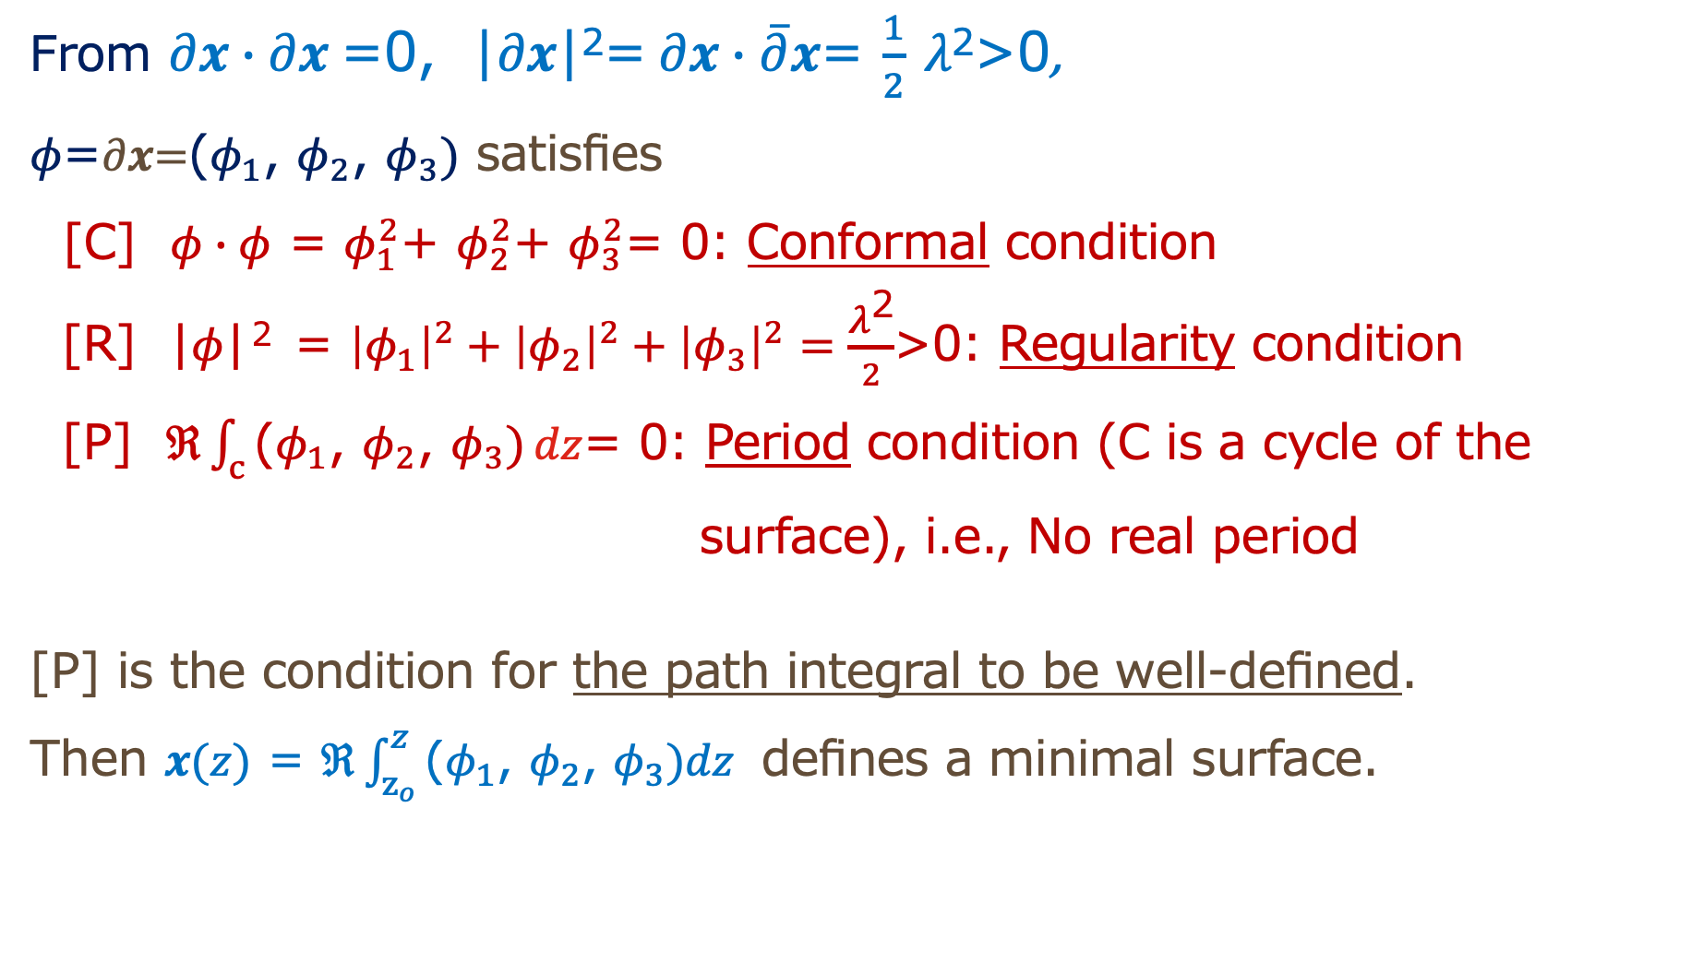
Properties of the holomorphic differentials
From $∂x∙∂x$=0, |$∂x$|²=$∂x∙\overline{∂}x$= $\frac{1}{2}$ $λ\text{2}\text{>0}$,
$φ\text{=}∂x\text{=}\text{(}φ_{1}\text{, }φ_{2}\text{, }φ_{3})$ satisfies
[C] $φ∙φ$ = $φ_{1}^{2}$+ $φ_{2}^{2}$+ $φ_{3}^{2}$= 0: Conformal condition
[R] |$φ$|^{２} = ${\left|φ_{1}\right|}^{2}+{\left|φ_{2}\right|}^{2}+{\left|φ_{3}\right|}^{2}=\frac{λ\text{2}}{2}$>0: Regularity condition
[P] $ℜ\int_{c}{\text{(}φ_{1}\text{, }φ_{2}\text{, }φ_{3})}dz$= 0: Period condition (C is a cycle of the
surface), i.e., No real period
[P] is the condition for the path integral to be well-defined.
Then $x(z)$ = $ℜ\int_{z_{o}}^{z}{\text{(}φ_{1}\text{, }φ_{2}\text{, }φ_{3})dz}$ defines a minimal surface.

Slide 20
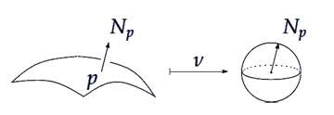
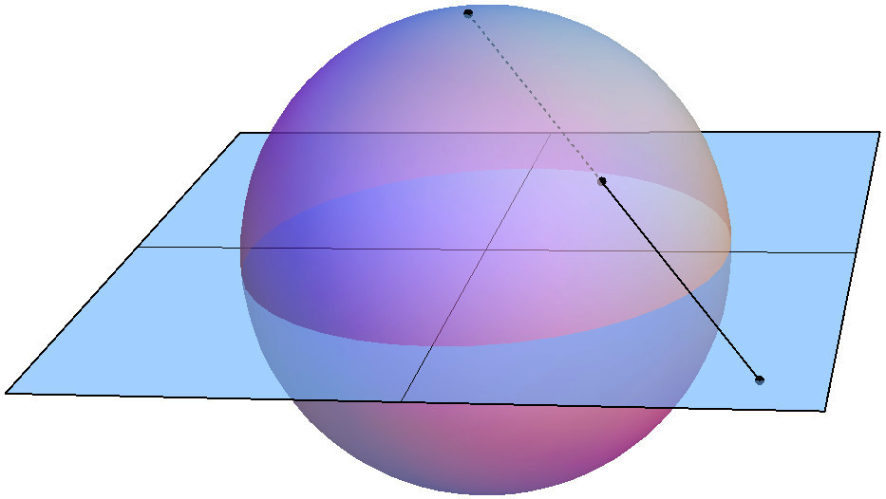
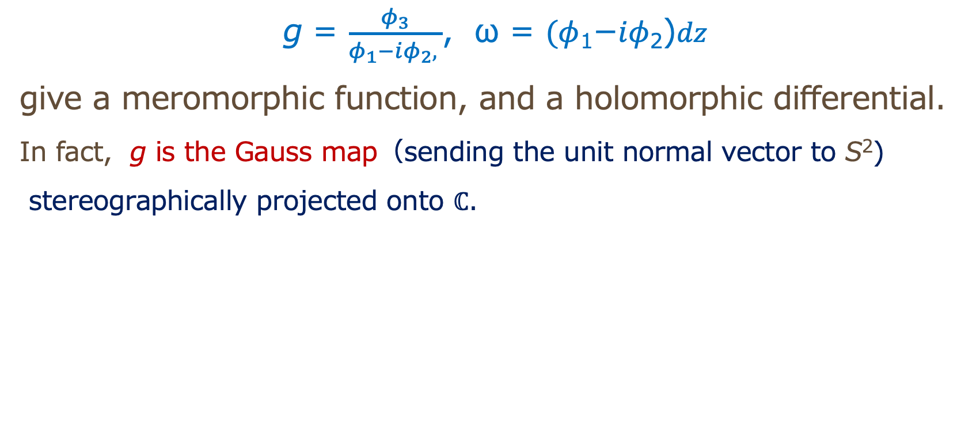
Geometric meaning
g = $\frac{φ_{3}}{φ_{1}−iφ_{2}, }$, ω = $(φ$₁−$iφ$₂)$dz$
give a meromorphic function, and a holomorphic differential.
In fact, g is the Gauss map（sending the unit normal vector to S²)
stereographically projected onto $ℂ$.
g

Slide 21
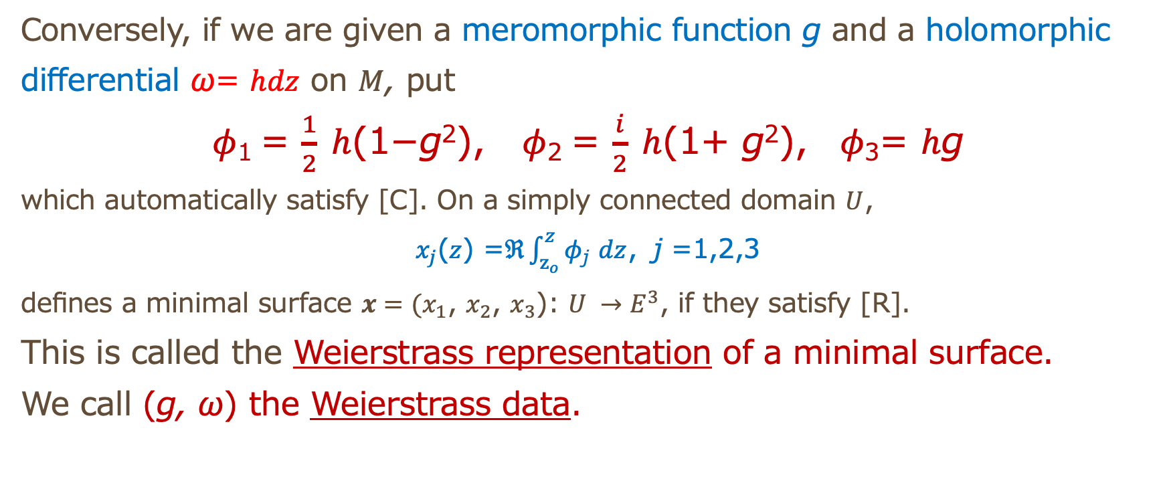
The Weierstrass representation and the Weierstrass data
Conversely, if we are given a meromorphic function g and a holomorphic
differential ω= $hdz$ on $M$, put
$φ$₁ = $\frac{1}{2} h$(1−g²), $φ$₂ = $\frac{i}{2} h$(1+ g²), $φ\text{3}$= $h$g
which automatically satisfy [C]. On a simply connected domain $U$,
$x_{j}$($z$) =$ℜ\int_{z_{o}}^{z}{φ\text{j} }dz$，j =1,2,3
defines a minimal surface $x=(x_{1}$, $x_{2}$, $x_{3}$): $U →E^{3}$, if they satisfy [R].
This is called the Weierstrass representation of a minimal surface.
We call (g, ω) the Weierstrass data.

Slide 22
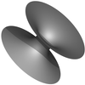
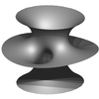
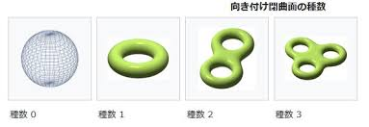
Shape of surfaces
Closed surface
Open surface
Obtained by taking-off points or domains from a closed surface
Classified by the genus G= the
number of holes．
G=0 G=1 G=2…
sphere torus float ring for 2, 3, …
We assume orientability.
Sphere minus 2 points
Torus minus 3 points
Catenoid Costa surface
If we take off points from a closed surface, we call it a punctured Riemann surface．

Slide 23
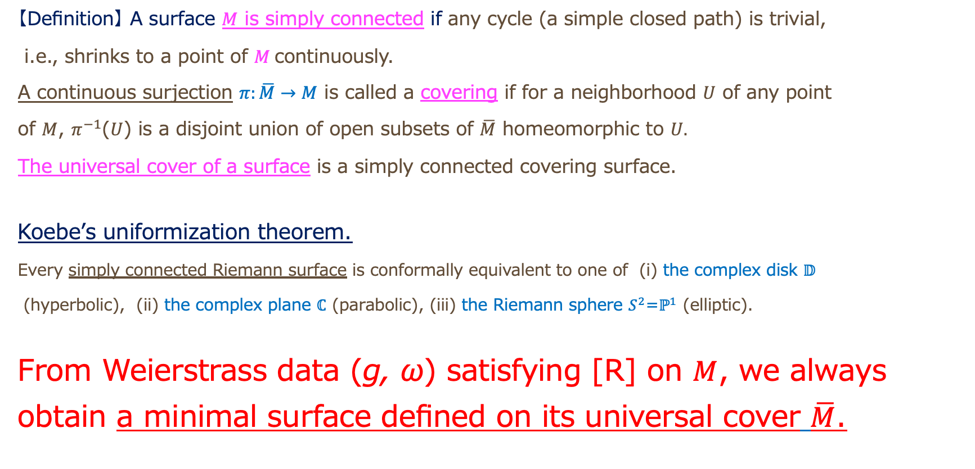
The universal cover
【Definition】 A surface $M$ is simply connected if any cycle (a simple closed path) is trivial,
i.e., shrinks to a point of $M$continuously.
A continuous surjection $π:\overline{M}→M$ is called a covering if for a neighborhood $U$ of any point
of $M$, $π^{−1}$($U$) is a disjoint union of open subsets of $\overline{M}$ homeomorphic to $U.$
The universal cover of a surface is a simply connected covering surface.
Koebe’s uniformization theorem.
Every simply connected Riemann surface is conformally equivalent to one of (i) the complex disk $𝔻$
(hyperbolic), (ii) the complex plane $ℂ$ (parabolic), (iii) the Riemann sphere $S^{2}$=$ℙ^{1}$ (elliptic).
From Weierstrass data (g, ω) satisfying [R] on $M$, we always
obtain a minimal surface defined on its universal cover $\overline{M}$.

Slide 24
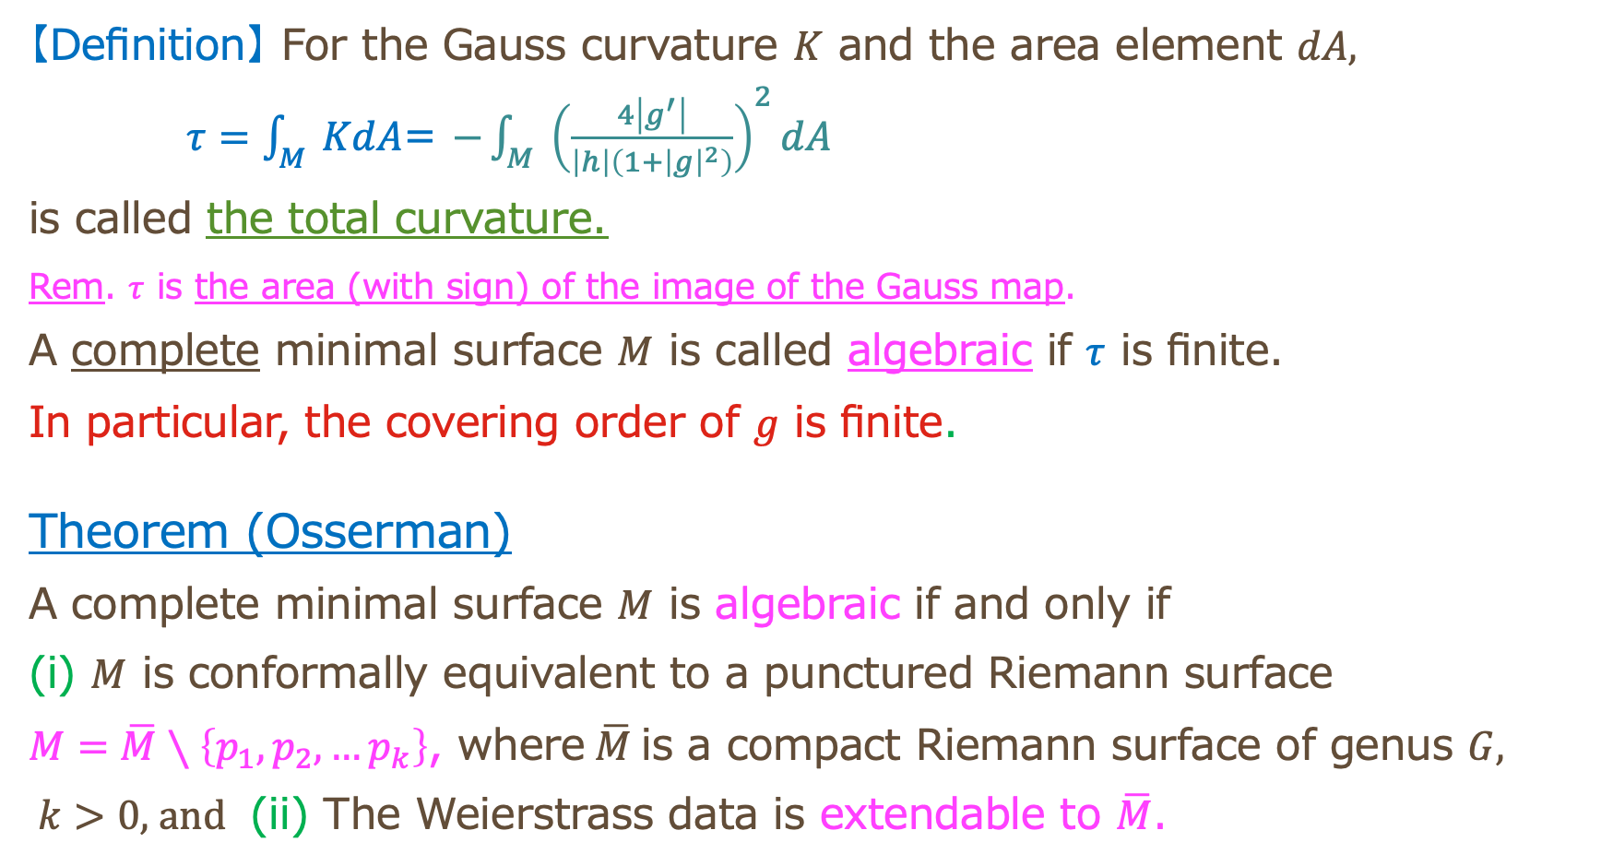
Algebraic minimal surfaces
【Definition】 For the Gauss curvature $K$ and the area element $dA,$
$τ=\int_{M}{KdA}$= $−\int_{M}{{\left(\frac{4\left|g^{′}\right|}{\left|h\right|\left(1+{\left|g\right|}^{2}\right)}\right)}^{2}dA}$
is called the total curvature.
Rem. $τ$ is the area (with sign) of the image of the Gauss map.
A complete minimal surface $M$ is called algebraic if $τ$ is finite.
In particular, the covering order of $g$ is finite.
Theorem (Osserman)
A complete minimal surface $M$ is algebraic if and only if
(i) $M$ is conformally equivalent to a punctured Riemann surface
$M=\overline{M}∖\left\{p_{1},p_{2},…p_{k}\right\}$, where $\overline{M}$is a compact Riemann surface of genus $G$,
$k>0,$and (ii) The Weierstrass data is extendable to $\overline{M}$.

Slide 25
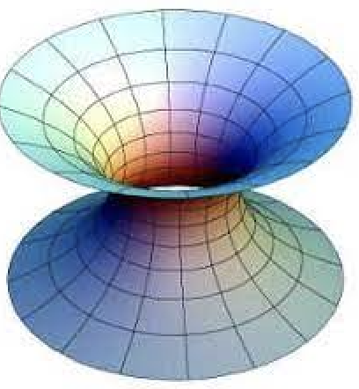
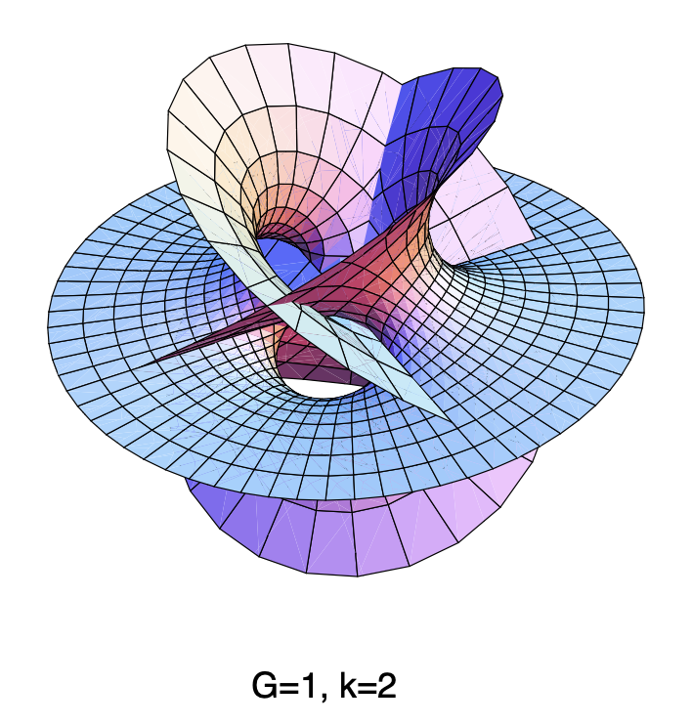
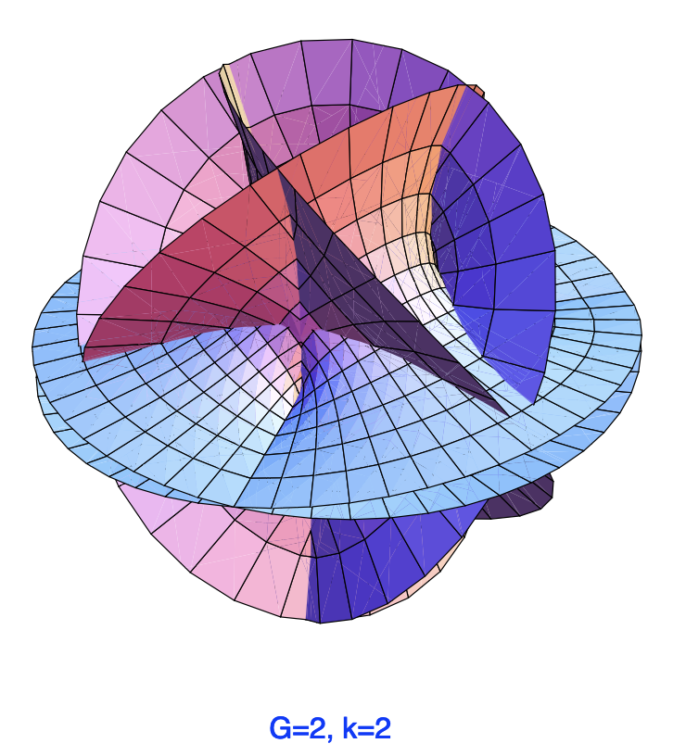
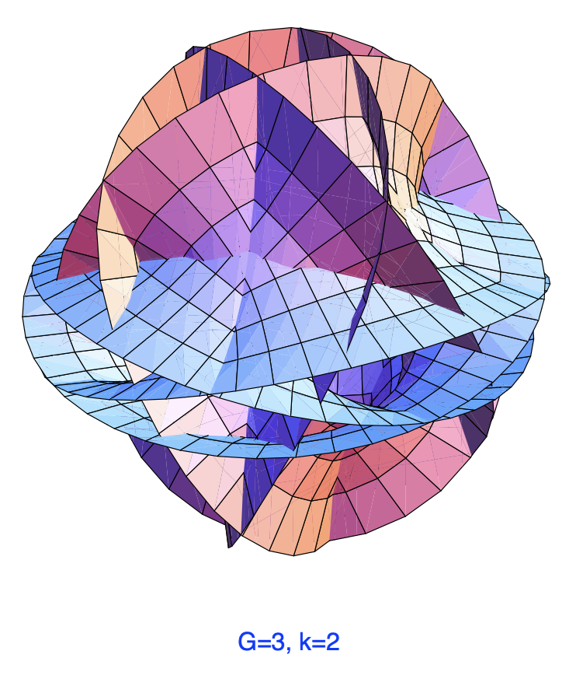
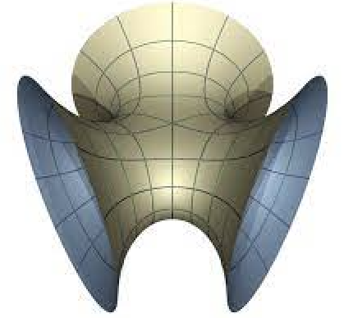
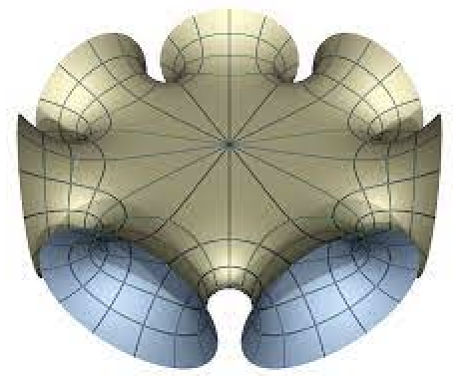
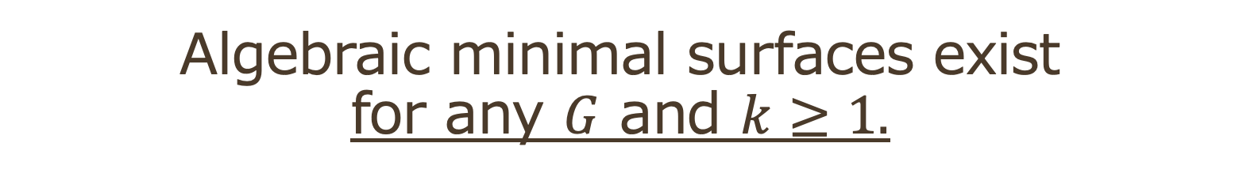

Algebraic minimal surfaces exist for any $G$ and $k≥1.$
By T. Shoda-S. Fujimori, graphics by S. Fujimori
Algebraic does not mean
a surface described by algebraic equations.
$G=$0

Slide 26
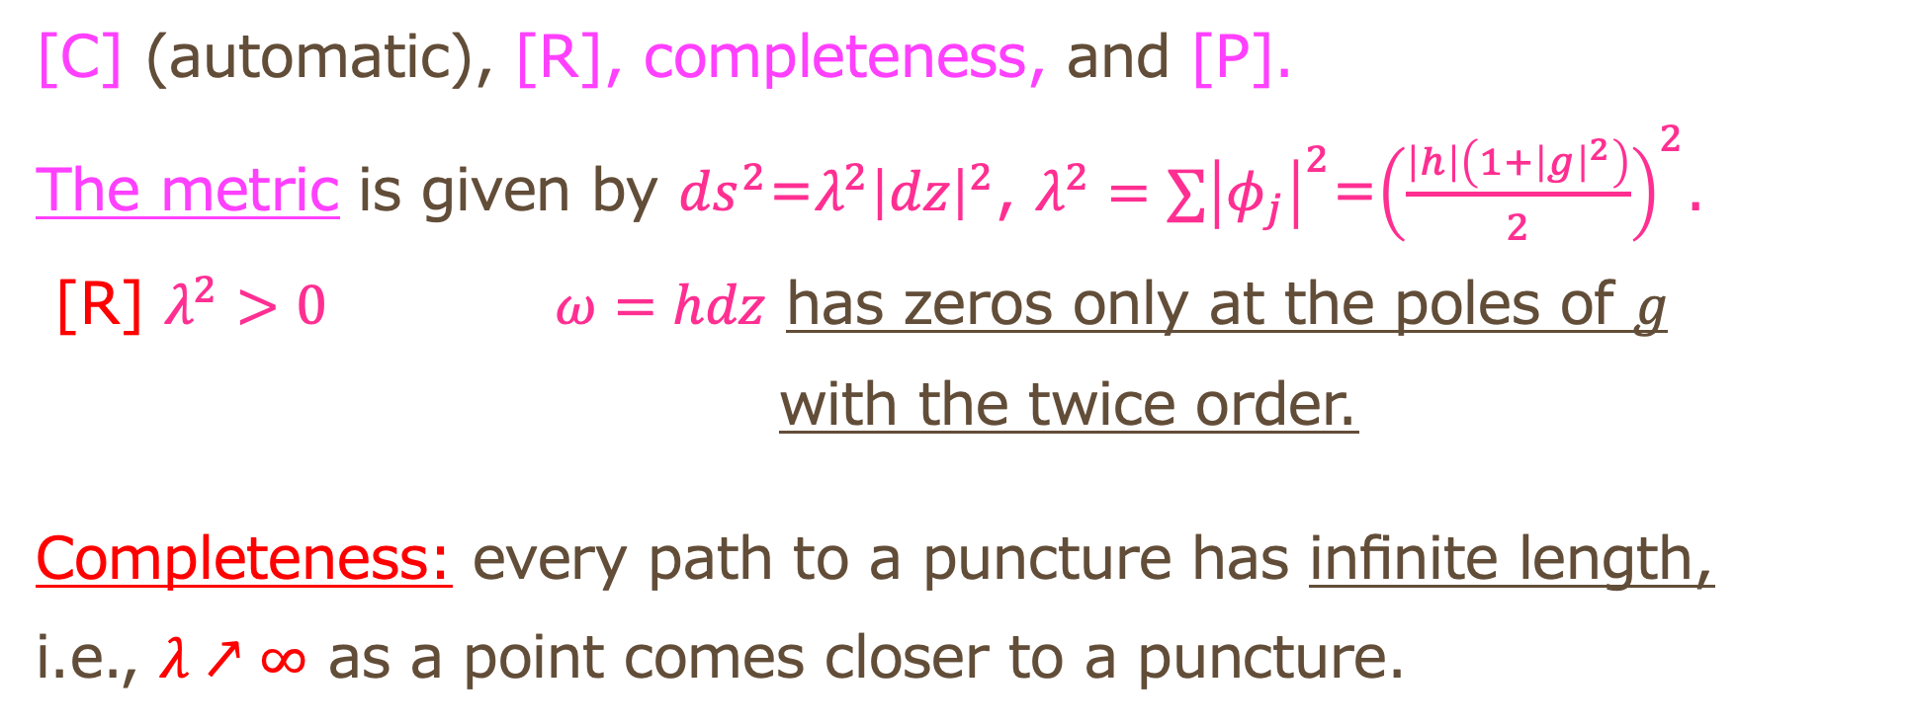
Check points for $\left(g, ω\right)$ in the algebraic case
[C] (automatic), [R], completeness, and [P].
The metric is given by ${ds}^{2}$=$λ^{2}{\left|dz\right|}^{2}$, $λ^{2}=∑{\left|φ_{j}\right|}^{2}$=${\left(\frac{\left|h\right|\left(1+{\left|g\right|}^{2}\right)}{2}\right)}^{2}$.
[R] $λ^{2}>0$ $ω=hdz$ has zeros only at the poles of $g$
with the twice order.
Completeness: every path to a puncture has infinite length,
i.e., $λ↗∞$ as a point comes closer to a puncture.

Slide 27
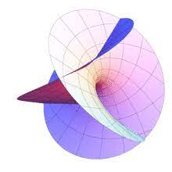
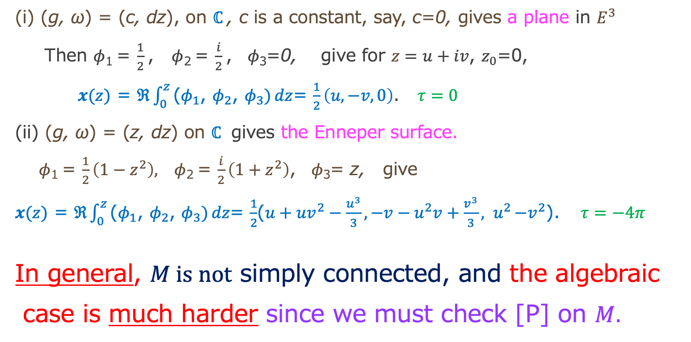
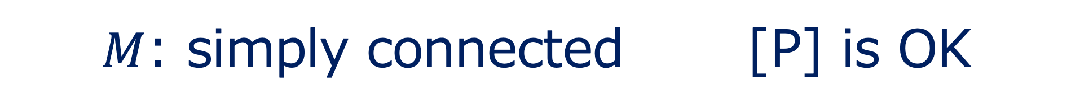
$M$: simply connected [P] is OK
(i) (g, ω) = (c, dz), on $ℂ$, c is a constant, say, c=0, gives a plane in $E^{3}$
Then $φ$₁ = $\frac{1}{2}$, $φ$₂ = $\frac{i}{2}$, $φ\text{3}$=0, give for $z=u+iv$, $z_{0}$=0,
$x(z)$ = $ℜ\int_{0}^{z}{\text{(}φ_{1}\text{, }φ_{2}\text{, }φ_{3})}dz$= $\frac{1}{2}\left(u,−v,0\right)$. $τ=0$
(ii) (g, ω) = (z, dz) on $ℂ$ gives the Enneper surface.
$φ$₁ = $\frac{1}{2}\left(1−z^{2}\right), φ$₂ = $\frac{i}{2}\left(1+z^{2}\right)$, $φ\text{3}$= z, give
$x(z)$ = $ℜ\int_{0}^{z}{\text{(}φ_{1}\text{, }φ_{2}\text{, }φ_{3})}dz$= $\frac{1}{2}$($u+uv^{2}−\frac{u^{3}}{3}, −v−u^{2}v+\frac{v^{3}}{3}{, u}^{2}{−v}^{2}$). $τ=−4π$
In general, $M is not$ simply connected, and the algebraic
case is much harder since we must check [P] on $M.$

Slide 28
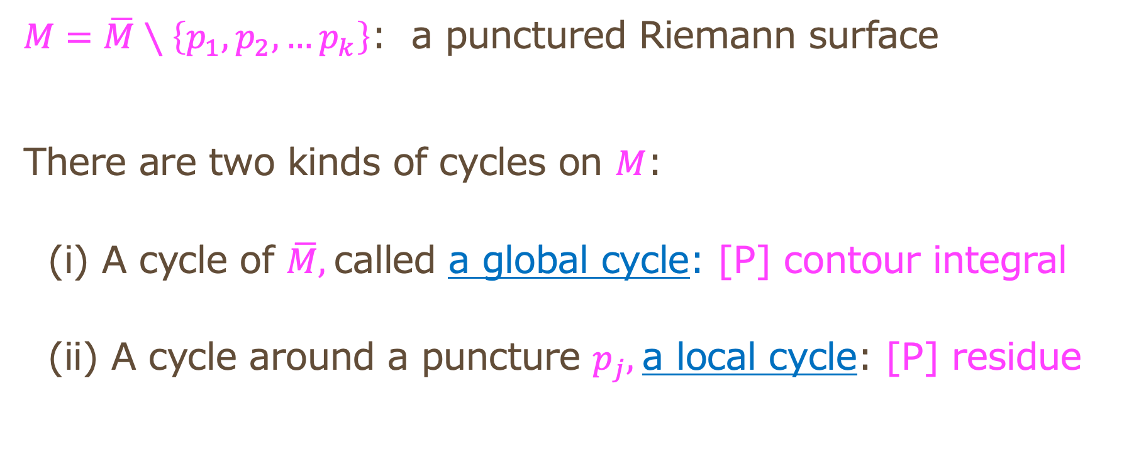
[P] along cycles
$M=\overline{M}∖\left\{p_{1},p_{2},…p_{k}\right\}$: a punctured Riemann surface
There are two kinds of cycles on $M$:
(i) A cycle of $\overline{M},$called a global cycle: [P] contour integral
(ii) A cycle around a puncture $p_{j},$a local cycle: [P] residue

Slide 29
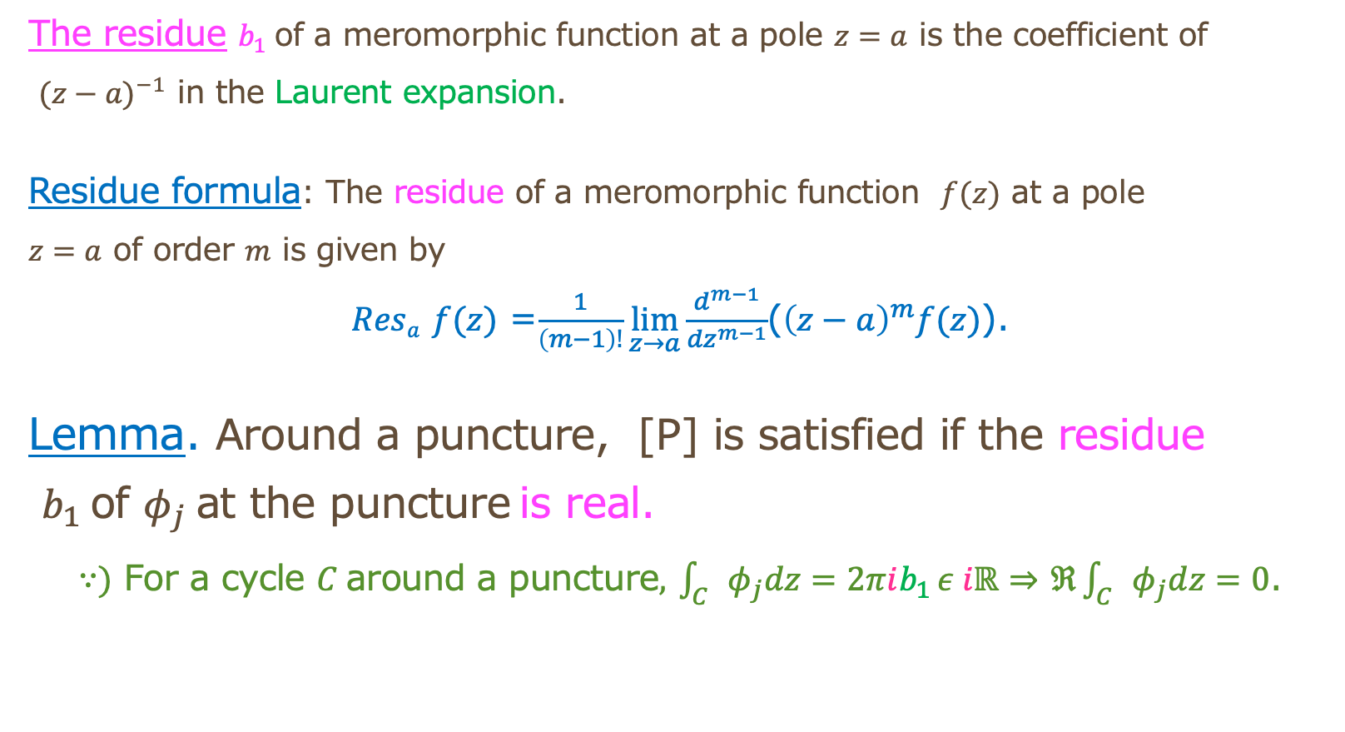
[P] at punctures depends on the residue
The residue $b_{1}$of a meromorphic function at a pole $z=a$ is the coefficient of
${(z−a)}^{−1}$ in the Laurent expansion.
Residue formula: The residue of a meromorphic function $f(z)$ at a pole
$z=a$ of order $m$ is given by
$Resa$ $f(z)$ =$\frac{1}{\left(m−1\right)!}\lim_{z→a}{\frac{d^{m−1}}{{dz}^{m−1}}}$(${\left(z−a\right)}^{m}f(z)$).
Lemma. Around a puncture, [P] is satisfied if the residue
$b_{1}$of $φ_{j}$at the puncture is real.
$∵)$ For a cycle $C$around a puncture$,$ $\int_{C}{φ_{j}dz=2πib_{1}}ε iℝ⇒$ $ℜ\int_{C}{φ_{j}dz=0}$.

Slide 30
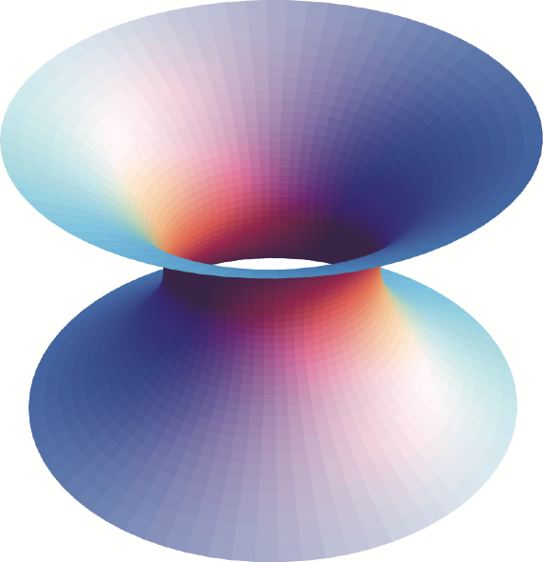
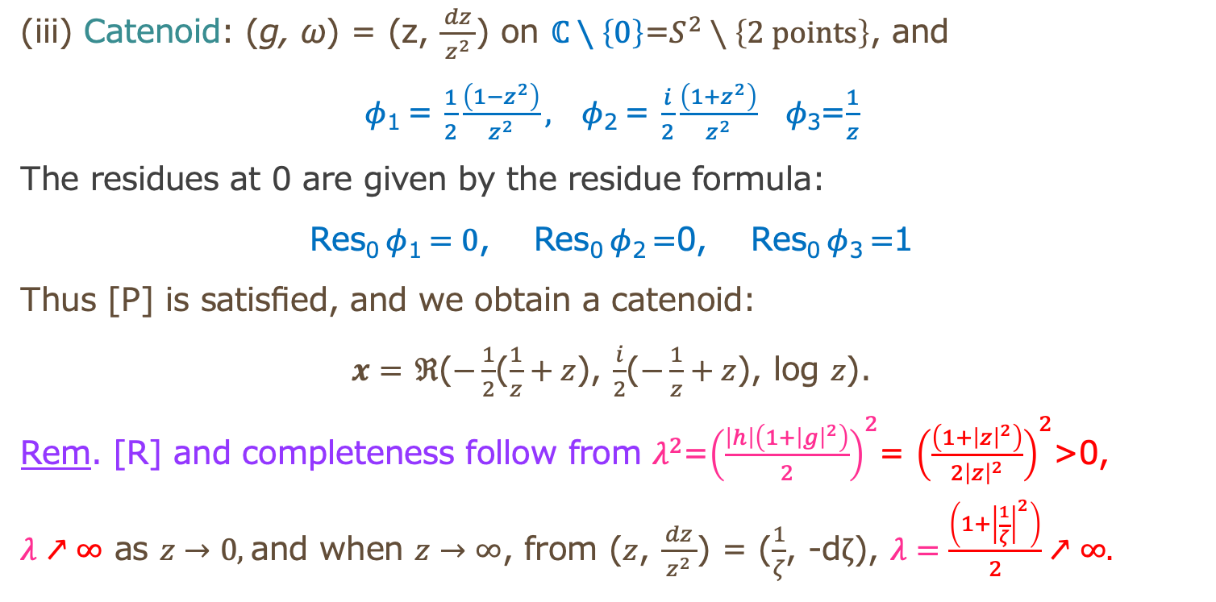

$G=0$: No global cycles
[P]: only residues at punctures
(iii) Catenoid: (g, ω) = (z, $\frac{dz}{{ z}^{2} }$) on $ℂ$ $∖\left\{0\right\}$=$S^{2}∖\left\{2 points\right\}$, and
$φ$₁ = $\frac{1}{2}\frac{\left(1−z^{2}\right)}{z^{2}}, φ$₂ = $\frac{i}{2}\frac{\left(1+z^{2}\right)}{z^{2}}$ $φ\text{3}$=$\frac{1}{z}$
The residues at 0 are given by the residue formula:
Res₀$φ$₁ $=0$, Res₀$φ$₂ $=$0, Res₀$φ$₃ $=$1
Thus [P] is satisfied, and we obtain a catenoid:
$x=$ $ℜ$($−\frac{1}{2}$($\frac{1}{z}+z$), $\frac{i}{2}$($−\frac{1}{z}+z$), log $z$).
Rem. [R] and completeness follow from $λ^{2}$=${\left(\frac{\left|h\right|\left(1+{\left|g\right|}^{2}\right)}{2}\right)}^{2}$= ${\left(\frac{\left(1+{\left|z\right|}^{2}\right)}{2{\left|z\right|}^{2}}\right)}^{2}$>0,
$λ↗∞$ as $z→0,$and when $z→∞$, from ($z$, $\frac{dz}{{ z}^{2} }$) = ($\frac{1}{ζ}$, -d$ζ$), $λ=\frac{\left(1+{\left|\frac{1}{ζ}\right|}^{2}\right)}{2}↗∞.$

Slide 31

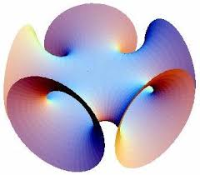
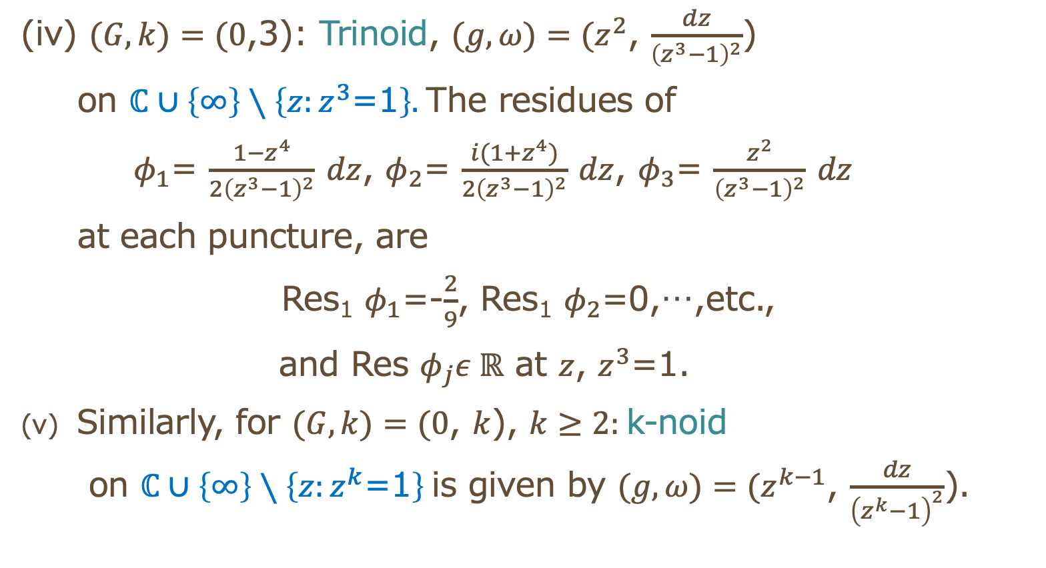
(iv) $(G,k)=(0$,3): Trinoid, $(g,ω)=(z^{2}$, $\frac{dz}{{\left(z^{3}−1\right)}^{2}}$)
on $ℂ∪\left\{∞\right\}∖\left\{z:z^{3}\text{=1}\right\}.$The residues of
$φ_{1}$= $\frac{1−z^{4}}{{2\left(z^{3}−1\right)}^{2}}$ $dz$, $φ_{2}$= $\frac{i(1+z^{4})}{{2\left(z^{3}−1\right)}^{2}}$ $dz$, $φ_{3}$= $\frac{z^{2}}{{\left(z^{3}−1\right)}^{2}}$ $dz$
at each puncture, are
Res₁ $φ_{1}$=-$\frac{2}{9}$, Res₁ $φ_{2}$=0,…,etc.,
and Res $φ_{j}ε ℝ$ at $z$, $z^{3}$=1.
Similarly, for $(G,k)=(0$, $k$), $k≥2:$k-noid
on $ℂ∪\left\{∞\right\}∖\left\{z:z^{k}\text{=1}\right\}$is given by $(g,ω)=(z^{k−1}$, $\frac{dz}{{\left(z^{k}−1\right)}^{2}}$).

Slide 32


Higher genus case
$\overline{M}$=$\left\{\left(z,w\right){: w}^{2}=z\left(z^{2}−a^{2}\right)\right\}$, $a ε ℝ, a>0,$ is a torus.
Actually, this is a double cover of $P^{1}$=$S^{2}$ branching at $−a,0,a,∞ ε P^{1}.$
$P$aste two spheres $P^{1}$along 2 slits $\left[−a,0\right]$, $\left[a,∞\right]$, we obtain a torus.
On $M=$ $\overline{M}∖\left\{\left(∞,∞\right)\right\}$,${ w(z)}^{2}=z\left(z^{2}−a^{2}\right)$, we define
$g\left(z\right)=\frac{Bw(z)}{z}$, $h\left(z\right)dz=\frac{zdz}{w(z)}$
where $B$ is chosen so that the data satisfies [P].
Denote by $0^{m}$, and $∞^{m}$ a zero of order $m,$ and a pole of order $m$ of $g$ and $h.$
$g$ has $0^{1}$ at $±a,$ and $∞^{1}$ at $0 and ∞. hdz$ has $0^{2}$ at $0,$ and $∞^{2}$ at $∞.$
Thus [R] is satisfied.
Also, the completeness condition at ($∞,∞)$ is satisfied as $λ^{2}={\left(\frac{\left|h\right|\left(1+{\left|g\right|}^{2}\right)}{2}\right)}^{2}↗∞$.

Slide 33



Check [P] along cycles
For a local cycle $β$ around $∞$, $φ_{3}$=$hgdz=Bdz$ has no real period if $B ε ℝ.$
We can see ${Res}_{∞}h=0$ and ${Res}_{∞}hg^{2}=0,$and so $φ_{\begin{aligned}1 \\ \end{aligned}}$ and $φ_{\begin{aligned}2 \\ \end{aligned}}$ have no periods.
For global cycles, let $γ_{1}$ be a contour around $\left[−a,0\right]$, and $γ_{2}$ around $\left[0,a\right].$ Put
$F=\int_{0}^{a}{\frac{xdx}{\sqrt{x\left(a^{2}−x^{2}\right)}}}$, $G=\int_{0}^{a}{\frac{\left(a^{2}−x^{2}\right)dx}{\sqrt{x\left(a^{2}−x^{2}\right)}}}εℝ_{+}$.
We can compute $\int_{γ_{1}}{h\left(z\right)dz=−2F}$, $\int_{γ_{1}}{hg^{2}\left(z\right)dz=−2B^{2}G,}$ and so,
$\int_{γ_{1}}{φ_{\begin{aligned}1 \\ \end{aligned}}dz=−F+}$ $B^{2}G$ and $\int_{γ_{1}}{φ_{\begin{aligned}2 \\ \end{aligned}}dz=−i(F+}$ $B^{2}G)$, and similarly,
$\int_{γ_{2}}{φ_{\begin{aligned}1 \\ \end{aligned}}dz=−i(F+}$ $B^{2}G)$ and $\int_{γ_{2}}{φ_{\begin{aligned}2 \\ \end{aligned}}dz=F−}$ $B^{2}G.$
Thus for $B=\sqrt{\frac{F}{G}}$, all the real period vanish, and we obtain Chen-Gackstatter surface.

Slide 34


Costa surface (details: later)
(viii) Costa surface: (g, ω)= ($\frac{B}{w}$, $\frac{zdz}{w}$), w² =z(z²−a²)
on $T^{2} ∖$ $\left\{3 points\right\}.$
It satisfies [P] for global and local cycles (not elementary).
So is algebraic.
https://home.hiroshima-u.ac.jp/fujimori/x3d-chm-2-j.html
By Shoichi Fujimori (Hiroshima)

Slide 35
Today’s topic
Exceptional values of the Gauss map of
an algebraic minimal surface

Slide 36



Picard’s and Fujimoto’s Theorems
Picard’s Theorem： An entire function (holomorphic function
on $ℂ$) omits at most two values．
e.g., $e^{z }$ omits 0 and ♾️．
Fujimoto’s Theorem (1988)：
The Gauss map g of a complete minimal surface
in $E^{3}$ omits at most four values (sharp).
e.g., The Scherk surface omits four values.
In this case, $τ=∞ and not algebraic$.
This is a geometric version of Picard’s Theorem.

Slide 37
In the algebraic case
Osserman’s Theorem (1964)
The Gauss map of an algebraic minimal
surface, not a plane, omits at most three values.
Open problem: Is three sharp?

Slide 38


When $M$ is algebraic, $τ=−4dπ,$ where $d$ is the order of g
(i) The plane: (g, ω) = (c, dz)
$τ=$0, g omits all the values except for c.
(ii) Enneper surface: (g, ω) = (z, dz)
$τ=−4π, \text{g}\text{=}\text{z} \text{omits} \text{♾️．}$
(iii) Catenoid: (g, ω) = (z, $\frac{dz}{{ z}^{2} }$)
$τ=−4π$, g=z omits 0 and ♾️．
(v) Costa surface: (g, ω)= ($\frac{B}{w}$, $\frac{zdz}{w}$), w² =z(z²−a²)
$τ=−12π$, g= $\frac{B}{w}$ omits one value.

Slide 39


Denote by $D_{g}$ the number of exceptional values of the Gauss map $g$
Before going to $D_{g}$=3,
to what extent examples with $D_{g}$=2 exist?
Theorem (M.-K.Sato, 1994)
There exist algebraic minimal surfaces with $D_{g}$=2 when
(i) $G$=0, $k≥2$
(ii) $G$=1, $k≥3$
(iii) $G ≥2$, $k≥4.$

Slide 40




Algebraic minimal surfaces with $D_{g}$=2
M.-Sato (1994) (1) For $(G,k)=(0$,$2$), and $M=ℂ∖\left\{0\right\}$,
$g\left(z\right)=\frac{z^{n}−a}{z^{n}−1},$
$hdz=\frac{{\left(z^{n}−1\right)}^{2}}{z^{m}}dz$, $n≥m−1$ if $a=−1$, $n>m−1≥1$ if $a≠−1$
gives an algebraic minimal surface whose Gauss map omits $1, a$.
(2) For $(G,k)=(0$, $3$), and $M=s^{2 }∖\left\{±i, ∞\right\}$, Graphics by K. Sato
$g\left(z\right)=σ\frac{z^{2}+1+a(t−1)}{z^{2}+t},$
$hdz=\frac{{\left(z^{2}+t\right)}^{2}}{{\left(z^{2}+1\right)}^{2}}dz, \left(a−1\right)\left(t−1\right)≠0,$
$σ^{2}=\frac{t+3}{a\left\{\left(t−1\right)a+4\right\}}<0$
gives an algebraic minimal surface whose Gauss map omits $σ$ and $σa.$
Note that the directions of the
exceptional values can change.

Slide 41




Higher genus examples for $D_{g}$=2
Theorem (M. 1994) (details, later)
There exit two types of algebraic minimal surfaces with ${(G,k)=(1,4), and D}_{g}$=2.
$M=T^{2}∖\left\{p_{1},p_{2},p_{3},p_{4}\right\}$, and $D_{g}$=2
Type A Type B
Graphics by K. Sato
Many other examples exist using the covering method, as shown below.

Slide 42


Most people believe that
The Gauss map $g$of an algebraic minimal surface satisfies $D_{g}≤2$.
How to attack?
(1) By contradiction: Suppose $D_{g}$=3, then, … a contradiction follows?
(2) Construct an example with $D_{g}$=3.
(3) Extend the Nevanlinna theory on the disk $𝔻$ (very difficult!).
The problem is still open.
The difficulty is caused by the period condition [P].

Slide 43
Pseudo-algebraic
When (g, ω) is extended to a compact Riemann
surface, but [P] does not hold, then the minimal
surface is defined only on the universal cover.
Such surfaces are called
pseudo-algebraic.

Slide 44



Examples of pseudo-algebraic surfaces
(vi) Helicoid: (g, ω) = (z, $\frac{idz}{{ z}^{2} }$) on $ℂ$ $∖\left\{0\right\}$.
Ex.1. Show that it does not satisfy [P].
Hence, the surface is defined only on the universal
cover $ℂ$ of $ℂ$ $∖\left\{0\right\}$. $τ=∞$
(vii) Scherk surface: (g, ω)= (z, $\frac{idz}{z^{4}−1}$) on $ℂ∪\left\{∞\right\}$ $∖\left\{4 points\right\}$
It does not satisfy [P]. Hence, the surface is defined
on the universal cover $𝔻,$the disk. $τ=∞$
Ex.2. Show this.

Slide 45

Voss‘ surface
$On M=ℂ∖\left\{a_{1},a_{2},a_{3}\right\}$, define $\left(g,ω\right)$=$\left(z, \frac{dz}{Π\left(z−a_{j}\right)}\right)$.
This gives the Scherk surface, $D_{g}$=4, namely, $g omits a_{1},a_{2},a_{3}$ and $∞$.
In the same way, o$n M=ℂ∖\left\{a_{1},a_{2}\right\}$, we obtain a pseudo-algebraic
minimal surface with $D_{g}$=3, namely, $g omits$ $a_{1},a_{2}$and $∞$.
Rem. The completeness restricts the number of points $a_{j}$’s to be less than four.
These surfaces are called the Voss surface.
Rem. There exist complete minimal surfaces with $D_{g}$=4 which are NOT pseudo-algebraic.

Slide 46

Totally ramified value number
【Definition】 We call $b∈P^{1}$a totally ramified value of $g$ when at any inverse
image of $b$, $g$ branches. We regard exceptional values also as totally ramified values.
Let $\left\{a_{1}, …,a_{r_{0}},b_{1}, …,b_{l_{0}}\right\}⊂P^{1}$ be the set of totally ramified values of $g$,
where $a_{j}$’s are exceptional values.
For each $a_{j}$, put $ν_{j}=∞,$ and for each $b_{j}$, define $ν_{j}$ to be the minimum of the multiplicity
of $g$ at points $g^{−1}\left(b_{j}\right).$Then we have $ν_{j}≥2$. We call
$ν_{g}=∑_{a_{j}\text{,}b_{j}}\left(1−\frac{1}{ν_{j}}\right)$=$r_{0}$+ $∑_{b_{j} }\left(1−\frac{1}{ν_{j}}\right)$
the totally ramified value number (TRVN) of $g$.
Obviously, $D_{g}≤ν_{g}.$

Slide 47

Amazing fact
Theorem (Y. Kawakami, 2006)
The Gauss map of the algebraic minimal surfaces given in (2) by M.-Sato has totally
ramified value number 2.5. In fact, it has two exceptional values, and another totally
ramified value at $z=0$where $g^{′}\left(0\right)= 0,$and $ν=2$ at $g\left(0\right).$
This is amazing because in Fujimoto’s theorem, both $D_{g}$ and $ν_{g}$ are bounded by
the same integer 4, although $ν_{g}$ is a rational number.
To explain the natural meaning of TRVN, we need the second main theorem in the
Nevanlinna theory, which we have no space to mention here.

Slide 48

New conjecture
This theorem is a breakthrough to propose:
【Conjecture】 For algebraic minimal surfaces,
there exists 2.5 < $κ$ < 3 which satisfies $ν_{g}≤$ $κ$.
In particular,
$$D_{g}≤2.$$

Slide 49

Extension of Osserman’s theorem
Theorem (R. Kobayashi-Kawakami-M. 2008)
Consider a non-flat pseudo-algebraic minimal surface with the basic domain $\overline{M}∖\left\{p_{1},…,p_{k}\right\}$.
Let $d$ be the degree of $g$ considered as a map on $\overline{M}$. Then we have
$\text{(}\text{a}\text{) }D_{g}≤2+\frac{2}{R }−\frac{l}{d}$, $\frac{1}{R}$ = $\frac{G−1−k/2}{d}$ $≤$ 1
where $l$ is the number of (not necessarily totally) ramified values other than the exceptional values of $g.$
On the other hand, the totally ramified value number of $g$ satisfies
(b) $ν_{g}≤2+\frac{2}{R}$
and $D_{g}≤$ $ν_{g}≤$4 follows. In algebraic case, the second inequality is the strict inequality.
$\text{(}\text{a}\text{)}$ and (b) are best possible in both algebraic and non-algebraic cases, and we
cannot show $D_{g}≤2$ in the algebraic case by this method.

Slide 50

Important tools for the proof
The Riemann-Roch theorem (R-R for short)
$S$: compact Riemann surface of genus $G$ deg$(K)=2G−2$, $K$: the canonical divisor,
i.e., for $ω$: a holomorphic differential on $S$,
$∑$(the order of the zeros of $ω)$- $∑$(the order of the poles of $ω)$ =$2G−2$
2. The Riemann-Hurwitz theorem (R-H for short)
$π: \overline{S}→S: \text{A} \text{branched}$covering of order $d,$ $\overline{S} and S:\text{compact} \text{Riemann} \text{surfaces}$.
$e_{p}=$ the branching order at $p ε S,$ $χ\left(S\right):$ The Euler number $χ\left(S\right)=2(1−G)$.
$χ(\overline{S}$)=d$χ(S)$- $∑_{pεS}\left(e_{p}−1\right)$

Slide 51

Theorem (Fang, Gackstatter,M.,...)
If $D_{g}$ =3, $G>0$ and $k≥3$.
($M$ is hyperbolic.)
An example with $D_{g}$=3 should have
$G>0$, if exists.

Slide 52


The case $G>0$
There are three ways to construct algebraic
minimal surfaces with $G>0$.
Covering method (Klotz-Sario)
Branched covering method (use elliptic or hyperelliptic curves, Chen-Gackstatter)
For $G=1$, use the Weierstrass $𝔭$function (Costa).

Slide 53

1. Covering method
Lemma. If $x: M_{0}→$ $E^{3}$ is a complete minimal surface, and $π:$ $M→$ $M_{0}$
is a covering map, then $x ∘π:$ $M→$ $E^{3}$ is a complete minimal surface with
possively a higher genus.
* However, this surface has the same image as $x: M_{0}→$ $E^{3}$, and
it is of no use to construct new examples.
* On the other hand, if we have one example with $D_{g}$ =3, the covering
method produces many such examples with more complicated topology.

Slide 54




Details of Lemma
Take $\left(n−2\right)$ sheets of $M_{0}$= $S^{2}∖\left\{3 points\right\}$, and make a slit $α$between $p_{1}$ and $p_{2}.$
Call the lower part $α_{1} and the upper part α_{2}$.
Paste $α_{1}$of the $j$-th sheet to $α_{2}$ of the $\left(j+1\right)\text{−}\text{th} \text{sheet}.$
Repeat this, and paste $α_{1}$of the $\left(n−2\right)$-th sheet to $α_{2}$ of the $1st sheet$.
Then we obtain a covering $π:$ $M_{n}=S^{2}∖\left\{n points\right\}$ $→$ $M_{0}$.
Take $two$ sheets of $M_{n}$, $n≥$5, and make a slit $α_{i}$between $p_{2i−1}$ and $p_{2i},$ $i=$1,…,$G+1, n >2G+2.$ Call the two parts of $α_{i}$by $α_{i_{1}}$ and $α_{i_{2}}$.
Paste $α_{i_{1}}$ of the first sheet to $α_{i_{2}}$ of the second sheet, and $α_{i_{2}}$ of the first sheet to $α_{i_{1}}$ of the second sheet.
Then we obtain a surface with $G$ handles, and the number of deleted
points is $k=2\left(n−2G−2\right)+2G$+2=2$\left(n−G−1\right)$.
If we paste $M_{n}$ and $M_{n+1}$ similarly, we obtain a surface of genus $G$ and the number of deleted points is 2$\left(n−G−1\right)$+1.

Slide 55

Examples by the covering method
By Lemma, starting from a complete minimal surface $x: M_{0}→$ $E^{3}$,
say, a trinoid, we obtain a complete minimal surface
$x:\overline{M}∖\left\{p_{1},…,p_{n}\right\}→$ $E^{3}$,
s.t. the genus of $\overline{M}$ is $G≥1,$and $k=2\left(n−G−1\right)$ or $k=2\left(n−G−1\right)$+1.
However, this surface has the same image as $x: M_{0}→$ $E^{3}$, say, a trinoid,
and is of no use to construct exmaples with $D_{g}$ =3.

Slide 56



2. Branched covering method
From $M=$ $\overline{M}∖\left\{\left(∞,∞\right)\right\}$, $\overline{M}\text{=}\left\{\left(z,w\right){ w}^{2}=z\left(z^{2}−a^{2}\right)\right\},$ we obtain
the Chen-Gackstatter surface.
More generally, using $\overline{M}$=$\left\{\left(z,w\right){ w}^{2}=z\left(z^{2}−a^{2}\right)\left(z^{2}−b^{2}\right)\right\}$, etc.,
we obtain the family of Chen-Gackstatter surfaces, $G=1,2,3…$.
However, the Gauss map takes all values,
$D_{g}$ =0.

Slide 57


3. Weierstrass $𝔭$ function
Let $L=\left\{m+ni, m,n ε ℤ\right\}$, and $π: ℂ→$ $ℂ/{L=\overline{M}}$, a torus.
【Definition】 The Weierstrass $𝔭$ function $𝔭\left(u\right):ℂ→$ $ℂ∪\left\{∞\right\}$ is a doubly periodic function
satisfying $𝔭\left(u+α\right)$= $𝔭\left(u\right)$,$α ε L,$ given by
$𝔭\left(u\right)$=$\frac{1}{u^{2}}+∑\left(\frac{1}{{\left(u−m−ni\right)}^{2}}\text{−}\frac{1}{{\left(m+ni\right)}^{2}}\right),$
where $∑$ means the sum of $\left(m,n\right) ε ℤ^{2}$, $\left(m,n\right)≠\left(0,0\right)$. It satisfies
${{(𝔭}^{′})}^{2}$=4$𝔭$($𝔭^{2}$ $\text{−} a^{2}$)
where $a=𝔭$($\frac{1}{2}$)=$𝔭\left(\frac{i}{2}\right),$and $\overline{M}$=$\left\{\left(𝔭,𝔭^{′}\right)\right\}$ is a torus $T^{2}$.
If we use $𝔭\left(u\right)$ to define a Weierstrass data on a
punctured torus, all the global periods vanish.

Slide 58


Details in the case $D_{g}$=2
Theorem (M. 1994) Let $L=\left\{m+ni, m,nεℤ\right\}$, and $π: ℂ→$ $ℂ/{L=\overline{M}}$, a torus.
Put $M=$ $\overline{M}∖\left\{p_{1},p_{2},p_{3},p_{4}\right\}$ where
$p_{1}$= $π\left(0\right)$, $p_{2}$= $π$($\frac{1}{2}$), $p_{3}$= $π\left(\frac{i}{2}\right)$, $p_{4}$= $π\left(\frac{1+i}{2}\right).$
Using the Weierstrass $𝔭$ function $𝔭\left(u\right)$ and writing $u=$ $π\left(u\right)$, define
A: ($g$,$hdu)=\left(\frac{c}{{𝔭^{j}\left(u\right)𝔭}^{′}\left(u\right)},𝔭\left(u\right)du\right)$, for $j=1,2,3,…$,
B: ($g$,$hdu)=\left(\frac{c}{{𝔭^{j}\left(u\right)𝔭}^{′}\left(u\right)},𝔭^{j+1}\left(u\right)du\right)$, for $j=2,4,6,….$
Then we obtain two types of algebraic minimal surfaces with ${G=1, and D}_{g}$=2.
Rem. The Costa surface is obtained by putting $M=$ $\overline{M}∖\left\{p_{2},p_{3},p_{4}\right\},$ $j=0$ in A and B.
In this case, $D_{g}$=1.

Slide 59

Quiz
Problem 1. Check [C], [R], [P], and the completeness
conditions for (g, ω) given in this lecture.
Problem 2. Try to construct your own algebraic minimal
surfaces.
Final Problem (Tough).
Try to construct those with $D_{g}$= 3 (!).
Prove non-existence, otherwise.

Slide 60

Start with Problem 1: Trinoid
Quiz 1. $(G,k)=(0$,3): Trinoid, $(g,ω)=(z^{2}$, $\frac{dz}{{\left(z^{3}−1\right)}^{2}}$) on $ℂ∪\left\{∞\right\}$ $∖\left\{z:z^{3}\text{=1}\right\}.$
Show [R], [P], and the completeness of this data,
i.e., [R]: $ω=hdz$ has zeros only at the poles of $g$ with the twice order.
[P]: Compute the residues of
$φ_{1}$= $\frac{1−z^{4}}{{2\left(z^{3}−1\right)}^{2}}$ $dz$, $φ_{2}$= $\frac{i(1+z^{4})}{{2\left(z^{3}−1\right)}^{2}}$ $dz$, $φ_{3}$= $\frac{z^{2}}{{\left(z^{3}−1\right)}^{2}}$ $dz$
at $z$ where $z^{3}$=1,
Res₁ $φ_{1}$=-$\frac{2}{9}$, Res₁ $φ_{2}$=0,…, Res $φ_{j}ε ℝ$.
Completeness: $λ=\frac{\left|h\right|\left(1+{\left|g\right|}^{2}\right)}{2}↗∞$ as a point comes closer to $z$ where $z^{3}$=1

Slide 61

M.S-surface 1
$(G,k)=(0$,$2$), on $M=ℂ∖\left\{0\right\}$, let $a≠0, ∞.$
All the algebraic minimal surfaces with $D_{g}$=2, $g$omitting $a$ and 1,
are given by $g\left(z\right)=\frac{z^{n}−a}{z^{n}−1},$ $hdz=\frac{{\left(z^{n}−1\right)}^{2}}{z^{m}}dz$,
where $n≥m−1$ if $a=−1$, $n>m−1≥1$ if $a≠−1.$
Quiz 2. Show [R], [P], and the completeness of this data,
i.e., [R]: $ω=hdz$ has zeros only at the poles of $g$ with the twice order.
[P]: compute the residue at $z=0,∞$.
Completeness: $λ=\frac{\left|h\right|\left(1+{\left|g\right|}^{2}\right)}{2}↗∞$ as a point comes closer to $z=0,∞$.

Slide 62

M-S surface 2
$(G,k)=(0$, $3$), and $M=ℂ∖\left\{±i\right\}$, put
$g\left(z\right)=σ\frac{z^{2}+1+a(t−1)}{z^{2}+t},$ $hdz=\frac{{\left(z^{2}+t\right)}^{2}}{{\left(z^{2}+1\right)}^{2}}dz, \left(a−1\right)\left(t−1\right)≠0,$ ${ σ}^{2}=\frac{t+3}{a\left\{\left(t−1\right)a+4\right\}}<0$
Since ${\begin{aligned}g\left(∞\right)=σ \\ g\left(±i\right)=σa\end{aligned},}_{ }$the Gauss map omits $σa$ and $σ$.
Quiz 3. Show [R], [P], and the completeness ([C] is automatic),
i.e., [R]: $ω=hdz$ has zeros only at the poles of $g$ with the twice order.
[P]: compute the residue at $z=±i,∞$.
Completeness: $λ=\frac{\left|h\right|\left(1+{\left|g\right|}^{2}\right)}{2}↗∞$ as a point comes closer to $z=±i,∞$.

Slide 63


$G=1,$ a global cycle appears
On $M=$ $\overline{M}∖\left\{\left(∞,∞\right)\right\}$, $\overline{M}$= $\left\{\left(z,w\right):w(z)=z\left(z^{2}−a^{2}\right)\right\},$define
$g\left(z\right)=\frac{Bw(z)}{z}$, $h\left(z\right)dz=\frac{zdz}{w(z)}$.
We see ${Res}_{∞}h=0$ and ${Res}_{∞}hg^{2}=0,$and so $φ_{\begin{aligned}1 \\ \end{aligned}}$ and $φ_{\begin{aligned}2 \\ \end{aligned}}$ have no periods, and ${Res}_{∞}φ_{3}ε ℝ \text{if} Bεℝ$.
As global cycles, let $γ_{1}$ be a contour around $\left[−a,0\right]$, and $γ_{2}$ around $\left[0,a\right].$
Put $F=\int_{0}^{a}{\frac{xdx}{\sqrt{x\left(a^{2}−x^{2}\right)}}}$, $G=\int_{0}^{a}{\frac{\left(a^{2}−x^{2}\right)dx}{\sqrt{x\left(a^{2}−x^{2}\right)}}}εℝ_{+}$.
Quiz 4. Compute $\int_{γ_{1}}{h\left(z\right)dz=−2F}$, $\int_{γ_{1}}{hg^{2}\left(z\right)dz=−2B^{2}G,}$ and so,
$\int_{γ_{1}}{φ_{\begin{aligned}1 \\ \end{aligned}}dz=−F+}$ $B^{2}G$ and $\int_{γ_{1}}{φ_{\begin{aligned}2 \\ \end{aligned}}dz=−i(F+}$ $B^{2}G)$, and similarly,
$\int_{γ_{2}}{φ_{\begin{aligned}1 \\ \end{aligned}}dz=−i(F+}$ $B^{2}G)$ and $\int_{γ_{2}}{φ_{\begin{aligned}2 \\ \end{aligned}}dz=F−}$ $B^{2}G.$
Then for $B=\sqrt{\frac{F}{G}}$, all the real period vanish, and we obtain Chen-Gackstatter surface

Slide 64

M-S surface 3 ($j>0)$and the Costa ($j=0)$
Using the Weierstrass $𝔭$ function$, on M=$ $\overline{M}∖\left\{p_{1},p_{2},p_{3},p_{4}\right\}$ where
$π: ℂ→$ $ℂ/{L=\overline{M}}$={($𝔭,𝔭^{′}):{{(𝔭}^{′})}^{2}\text{=4}𝔭\text{(}𝔭^{2}\text{ −} a^{2}\text{)}$}, $p_{1}$= $π\left(0\right)$, $p_{2}$= $π$($\frac{1}{2}$), $p_{3}$= $π\left(\frac{i}{2}\right)$, $p_{4}$= $π\left(\frac{1+i}{2}\right),$
writing $u=$ $π\left(u\right)$, we define
A: ($g$,$hdu)=\left(\frac{c}{{𝔭^{j}\left(u\right)𝔭}^{′}\left(u\right)},𝔭\left(u\right)du\right)$, for $j=1,2,3,…$,
B: ($g$,$hdu)=\left(\frac{c}{{𝔭^{j}\left(u\right)𝔭}^{′}\left(u\right)},𝔭^{j+1}\left(u\right)du\right)$, for $j=2,4,6,….$
Quiz 5. Show [R], [P], and the completeness,
i.e., [R]: $ω=hdu$ has zeros only at the poles of $g$ with the twice order.
[P]: compute the residue at $p_{1}$, $p_{2}$, $p_{3}$, $p_{4,.} and$contour integrals for global cycles.
Completeness: $λ=\frac{\left|h\right|\left(1+{\left|g\right|}^{2}\right)}{2}↗∞$ as a point comes closer to $p_{1}$, $p_{2}$, $p_{3}$, $p_{4}$.

Slide 65

Costa surface
$(G,k)=(1$,$3$), and $M= T^{2}∖\left\{3 points\right\}$where $T^{2}$={($z, w):w2 =z(z2−a2)$},
(g, ω)= ($\frac{B}{w}$, $\frac{zdz}{w}$), is the special case of the previous one if we put $j=0,$
where $z=𝔭 and w=𝔭^{′}.$
Thus the following can be shown as before.
Quiz 6. Show [R], [P], and the completeness,
i.e., [R]: $ω=hdz$ has zeros only at the poles of $g$ with the twice order.
[P]: Compute the residue at $p_{1}$, $p_{2}$, $p_{3}$. ([P] is OK for global cycles).
Completeness: $λ=\frac{\left|h\right|\left(1+{\left|g\right|}^{2}\right)}{2}↗∞$ as a point comes closer to $z=±i,∞$.

Slide 66
Graphics tool
3d-xplormath (free software)
https://3d-xplormath.org/
To attack Problem 2 and the Final problem (!),
much more detailed argument is required.
Be ambitious!

Slide 67
References
R. Osserman: A Survey of minimal surfaces, Van Nostrand Reinhold (1969)
Colding-Minicozzi: A course in Minimal Surfaces, GSM 121 AMS (2011)
R. Miyaoka-K. Sato: On a complete minimal surface whose Gauss map misses two points, Archiv der
Math, 63, (1994) 565576-576.
・ Y.Kawakami, R.Kobatashi and R. Miyaoka, The Gauss map of pseudo-algebraic minimal surfaces , Forum Math. 20 (2008), 1055–1069
In Japanese
宮岡礼子:極小曲面と変分問題，数理科学 (2010) 30-36
:複素数で表す極小曲面，数理科学 (2014-10) 14-20
:曲面論と可積分系, 数理科学 (2015) 7-13.
:曲がった空間の幾何学（ブルーバックス），講談社 (2017) おすすめ
:曲線と曲面の現代幾何学，岩波書店 (2019） text book for undergraduate
:極小曲面，共立出版 (2022） text book for gradient students
:研究室の窓「原点は極小曲面」, 数理科学, (2022) 70-76.
:数理科学特集 「曲線と曲面を考える」，数理科学, (2024-2) 5-6.

Slide 68

Thank you for your attention!

