Slide 1
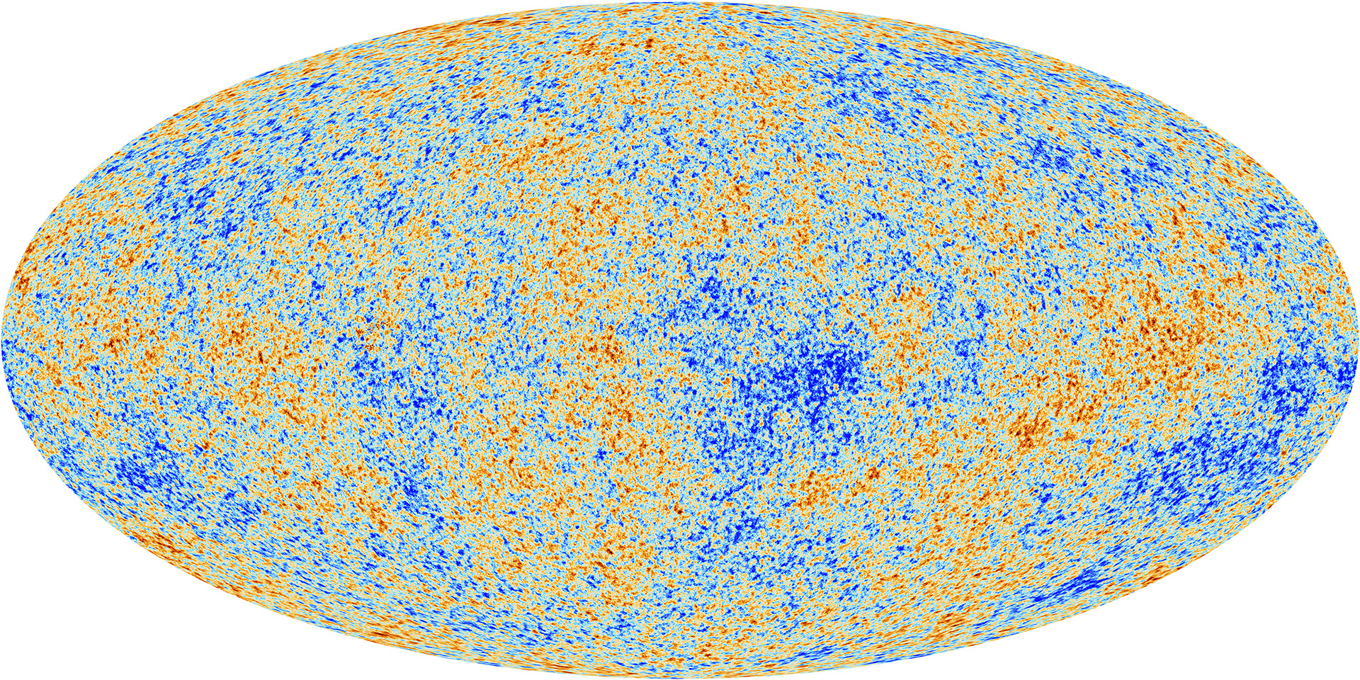
Exercise: Evolution of the primordial density peak
A useful illustration of BAO physics (Daniel Eisenstein)
Consider the primordial density peak for the perturbations, assuming the adiabatic initial condition
Assume that the primordial peak is given by a Gaussian, for illustration
Mass profile (3D)
Use the transfer function of each component to compute the time evolution of its mass profile
The “pattern” of temperature fluctuations is one realization of the initial conditions
Primordial density peaks are from the inflation-quantum fluctuations
Also Ichiki & MT 09
transfer function: use CAMB to compute it, for LCDM model

Slide 2
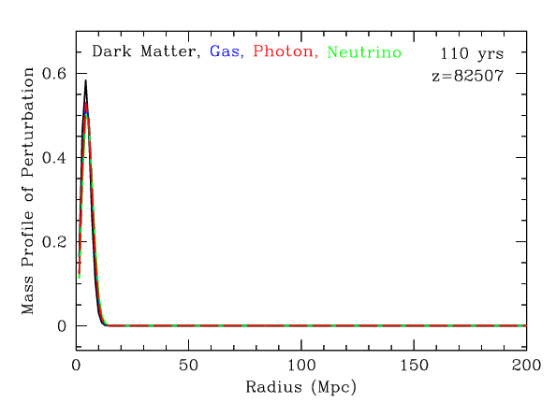
Credit: D. Eisenstein
aa
The initial condition
The perturbations are on super-horizon scales
All the components have the same profile of perturbations or the same Fourier phase (adiabatic initial condition)

Slide 3
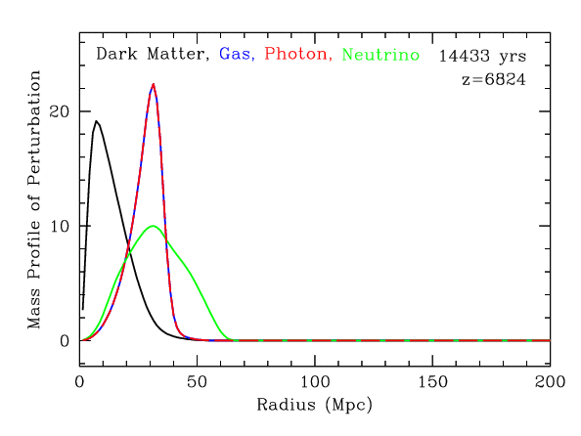
Credit: D. Eisenstein
The perturbations enter into the horizon
The photo-baryon plasma are free-streaming out of the potential, with the sound speed
Neutrino is more free-streaming
CDM continues to collapse, with a slow growth rate in radiation era

Slide 4
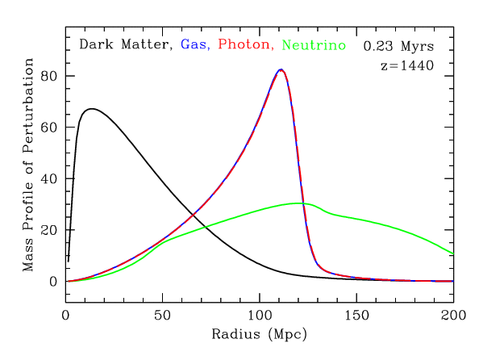
Credit: D. Eisenstein
Now matter dominated regime
CDM remains centrally concentrated
The gravity force attracts the other components towards the center

Slide 5
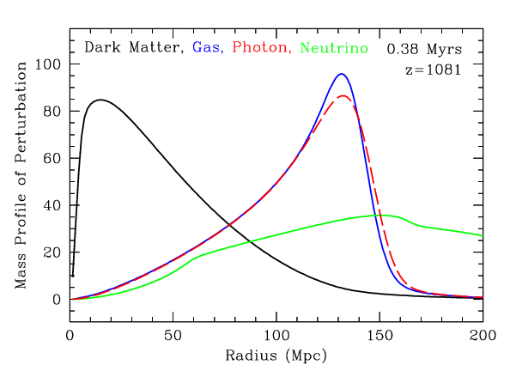
Credit: D. Eisenstein
Free electrons are captured in protons to form hydrogen
Decoupling between photons and baryon

Slide 6
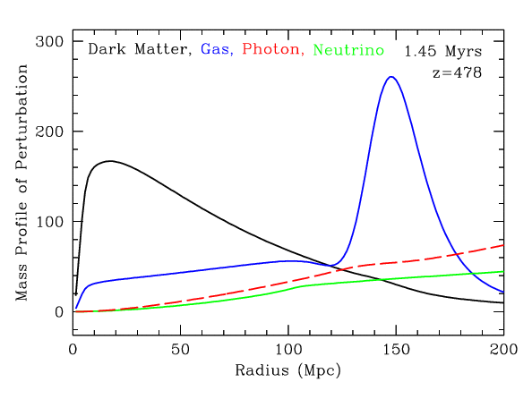
Credit: D. Eisenstein
Photon now free-streams out of the potential
The two cold components (CDM and baryon) attract each other

Slide 7
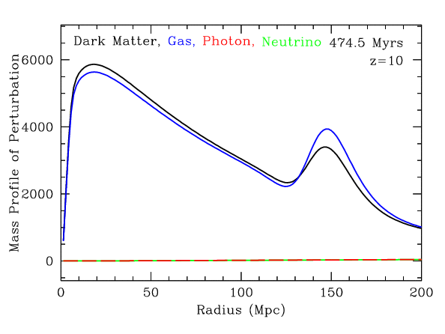
Credit: D. Eisenstein
CDM and baryon profiles are getting similar

Slide 8
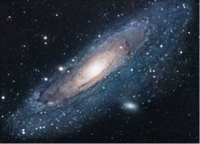
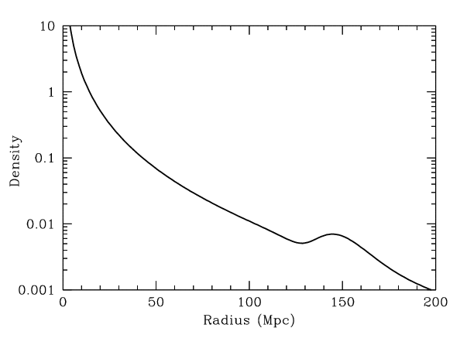
Credit: D. Eisenstein
Today (note: based on linear theory)
BAO peak of total matter (~147Mpc)
Galaxies tend to be formed at the overdensity regions of total matter

Slide 9


Slide 10
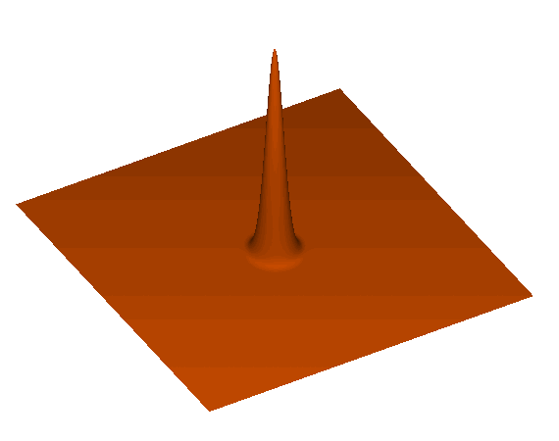
single peak

Slide 11
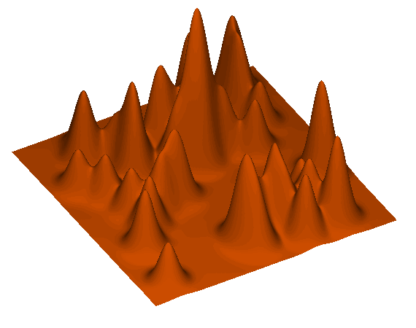
many peaks
Standing, acoustic peaks excited

Slide 12
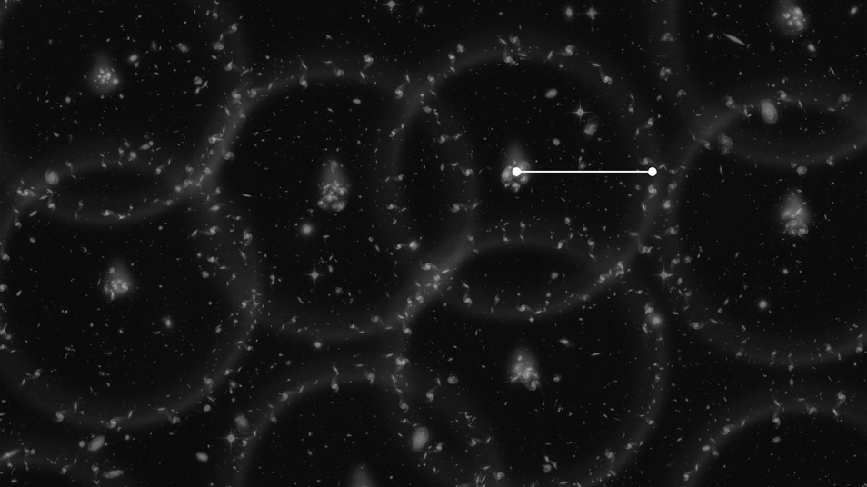
Illustration
Paired galaxies tend to have characteristic separation (rs)
A robust method to measure the separation is the two-point correlation function
The two-point correlation function gives a probability of finding paired of galaxies as a function of the separation

Slide 13
BAO geometrical test
The sound horizon r_s is determined by physics in the early universe, and is precisely constrained by CMB (~0.2%)
Paired galaxies have preferred separation (rs) – standard ruler, i.e. baryon acoustic oscillation (BAO)
We can realize the BAO scale by the angular separation and redshift difference between paired galaxies
Because we a priori know r_s, we can infer the angular diameter distance and the Hubble expansion rate from the measured separations
Redshift of center: z
BAO test is free of (or not affected by) astrophysical systematic errors, and give a robust, powerful geometrical test of both the radial and angular distances

Slide 14
Alam+17, BOSS DR12
Daniel Eisenstein made the first detection of BAO (~3σ) from real data, after some theoretical studies (Eisenstein+05)
Free of galaxy bias uncertainty
BAO test
Not use the amplitude affected by galaxy bias uncertainty
Alam+20, eBOSS DR16
Eisenstein+05
Notes:
include those from SDSS MGS (Ross et al. 2015; Howlett et al. 2015), BOSS galaxies (Alam et al. 2017), eBOSS LRGs (Bautista et al. 2020; Gil-Marin et al. 2020), eBOSS ELGs (Tamone et al. 2020; de Mattia et al. 2020), eBOSS quasars (Hou et al. 2020; Neveux et al. 2020), the BOSS+eBOSS Lyα auto-correlation, and the BOSS+eBOSS Lyα-quasar cross-correlation measurements (du Mas des Bourboux et al. 2020). Red points correspond to transverse BAO, while green points to radial BAO. The MGS DV measurement is plotted in orange with a translation to DM assuming a ΛCDM model for illustrative purposes. The red and green theory curves are not fit to the BAO data; they are the Planck bestfit predictions for a flat ΛCDM model.

Slide 15
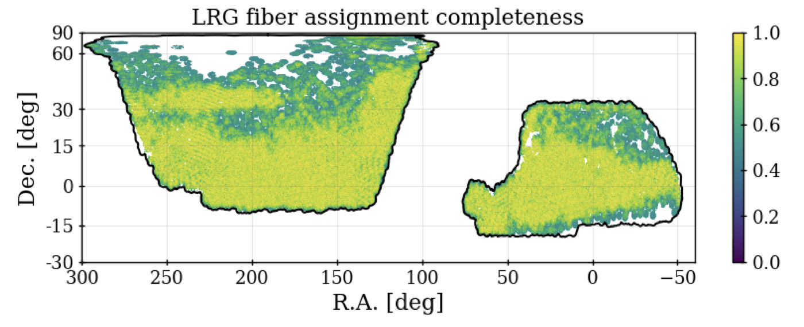
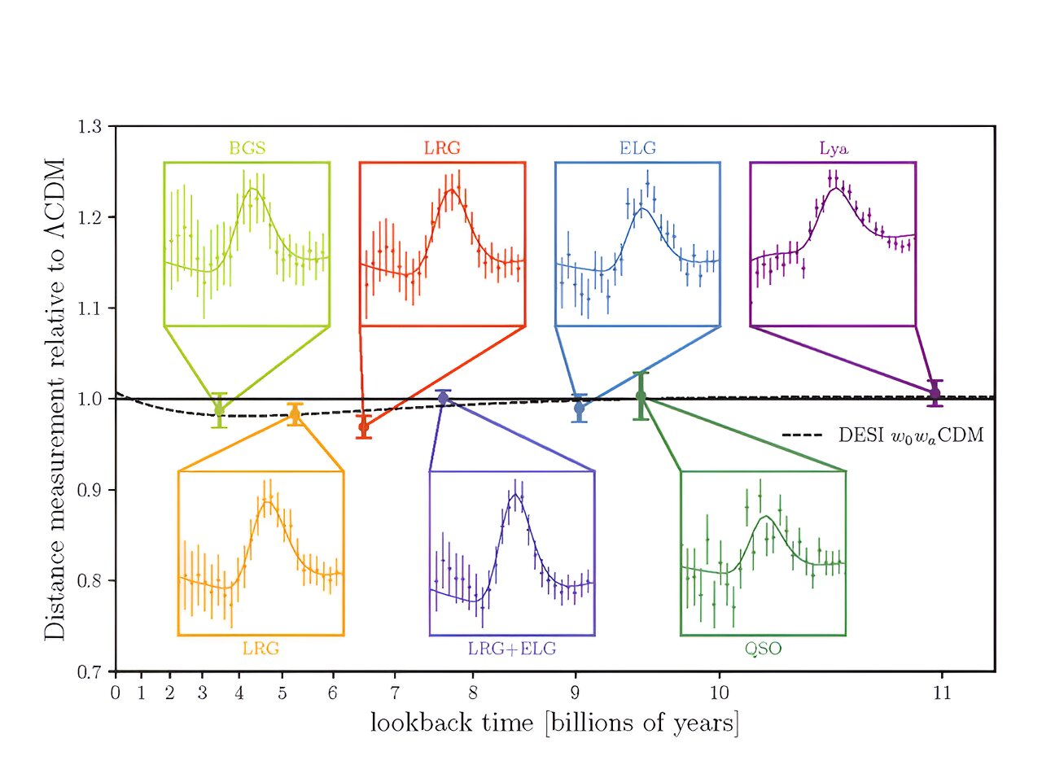
DESI DR2 BAO
arXiv:2503.14738

Slide 16
