Slide 1
Session 7: Electron Scattering -S.Dytman, O.Benhar and M.Sakuda
Experiments:
1) JLAB CLAS results on pion production from nuclear target
-H.Lee and S.Manley (Rocheter)
2) Comparison of the F2 Structure Function in Iron as Measured by Charged
Lepton and Neutrino Probes -N.Kalantarians (Hampton)
3)180deg electron scattering at the S-DALINAC
-P.Von Neumann-Cosel(Darmstadt)
Theory:
4) Unified description of inclusive electron-nucleus scattering within the
spectral function - N.Rocco (Rome,Sapienza)
5) Results of Green's function Monte Carlo calculations in the quasi-elastic
sector -A.Lovato (ANL)
6) Proposed experiment to measure the Argon spectral function through Ar(e,e'p)
-O.Benhar (Rome, Sapienza)

Slide 2
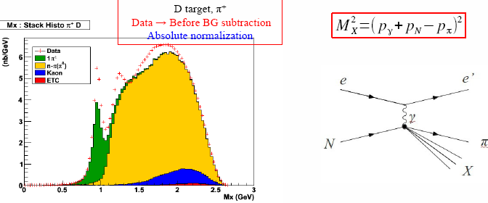
1) JLAB CLAS results on pion production from nuclear target -H.Lee and S.Manley (Rocheter)
High statistics inclusive 1π⁺⁻ production data to understand pion nuclear effects.
e+A→e+ 1π⁺⁻ + N + X
1π⁺⁻ + Δ ?

Slide 3
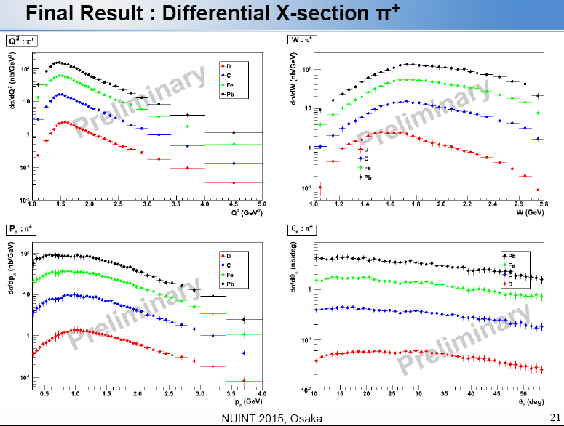
CLASS (dσ/dp,Q²,W,θ) on e+A→e+ 1π⁺⁻ + N + X (A=D,C,Fe,Pb) [Preliminary]

Slide 4
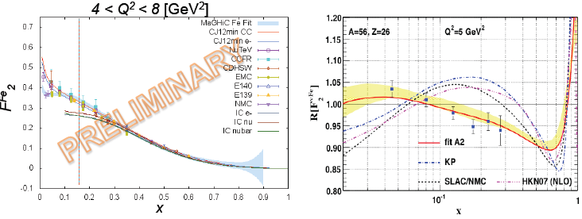
2) Comparison of the F2 Structure Function in Iron as Measured by Charged Lepton and Neutrino Probes -N.Kalantarians (Hampton)
A key to F_{2Fe}/F_{2D} problem with leptons and neutrinos
F2D (right) was constructed with nCTEQ, which is based largely based on charged lepton data.
F2Fe only (left), for neutrino and charged lepton scattering data. The difference is in the (anti) shadowing region,
We need more neutrino-deuteron scattering data.
We need more F2D data with neutrinos.
Notes:
The slide on the right: the nCTEQ prediction, showing/stating a difference in F2Fe/F2D between neutrino and charged lepton scattering, especially for (anti) shadowing.
The plot on the left: F2Fe only, for neutrino and charged lepton scattering data. The difference is in the (anti) shadowing region, which echoes what nCTEQ predicted.
The F2D has been part of the controversy because it was constructed with nCTEQ, which is/was based largely based on charged lepton data. This also helps give motivation for the need for (more) neutrino-deuteron scattering data

Slide 5
3) 180deg electron scattering at the S-DALINAC -P.Von Neumann-Cosel (Darmstadt)
180deg=
Only Transverse contributes
=σ−τ responce

Slide 6
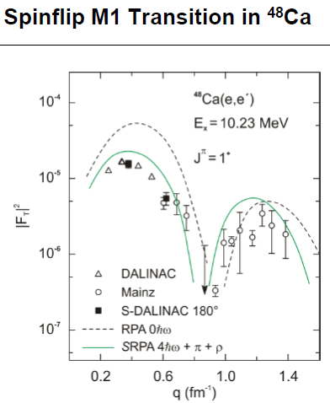
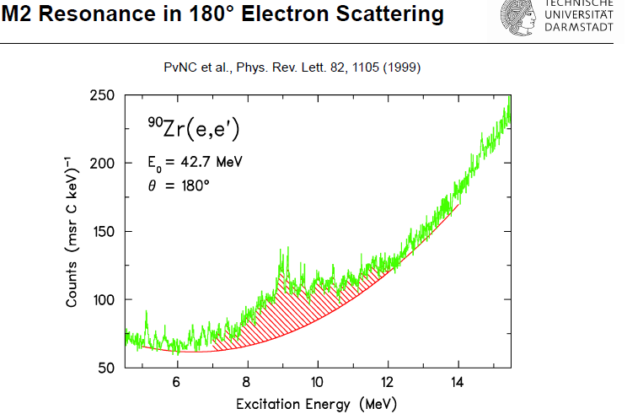
Cross section measurements (σ−τ multipoles) in supernova energy region (Ee~50-130MeV)
Good data for multipoles + QE at 50-100MeV region

Slide 7
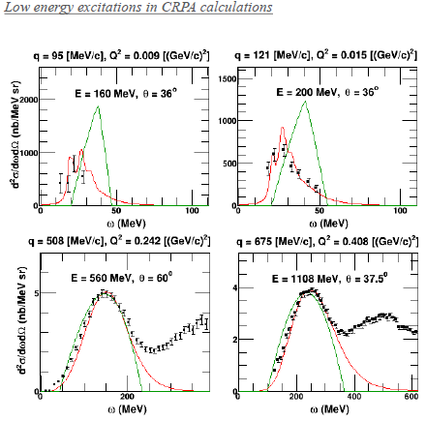
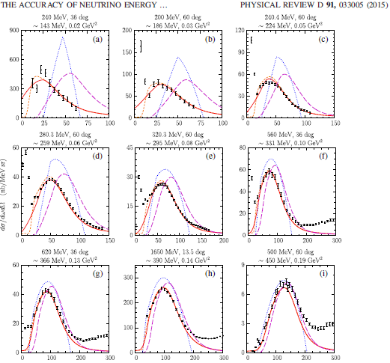
Wealth of data in C(e,e’) to test your models for Ee= 150MeV - 2000MeV
Low energy excitations in RPA calculations-N.Jachowicz (Gent)
QE is being tested for Ee>200MeV. Ankowski etal,PRC91,033005 (NuInt14).

Slide 8
Theory

Slide 12
Summary and Outlook
Harry T.-S. Lee (ANL):”Tons of π data to test your models” .
We have also many electron scattering data at various kinematic regions (E,q) to test your models. QE: Not only the vector part of the cross setion, but also the nuclear effects (Initial and Final State Interactions, transparency, Pauli, 1p1h, 2p2h, MEC) can be tested.
Possible new data at S-DALINAC in 50-130MeV.
CLASS pion data from non-resonant, resonant and DIS region.
A good analysis on F2Fe/F2D: A hint to solve difference seen in F2Fe/F2D. We need new data on F2D with neutrinos.
Theory: Already given.
Outlook: Electron Scattering data are/will be as valuable as neutrino scattering data to understand lepton-nucleus interactions and nuclear effects.

Slide 13
Backup

Slide 14
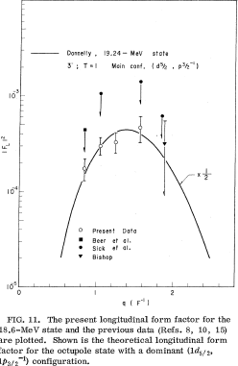
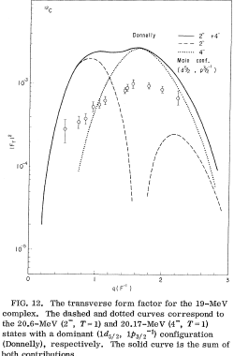
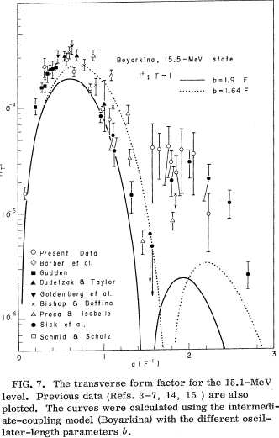
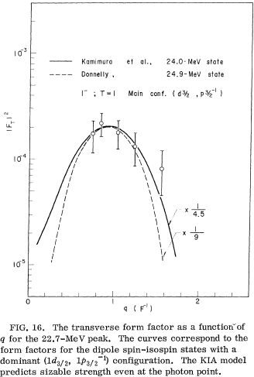
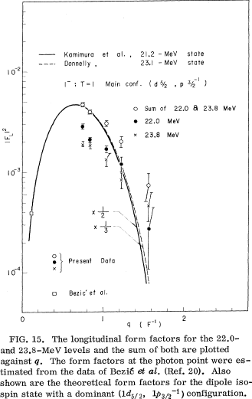
Form Factors (Cross Sections) for C-12 Giant Resonances (1⁺,1⁻,2⁻)

