Slide 1


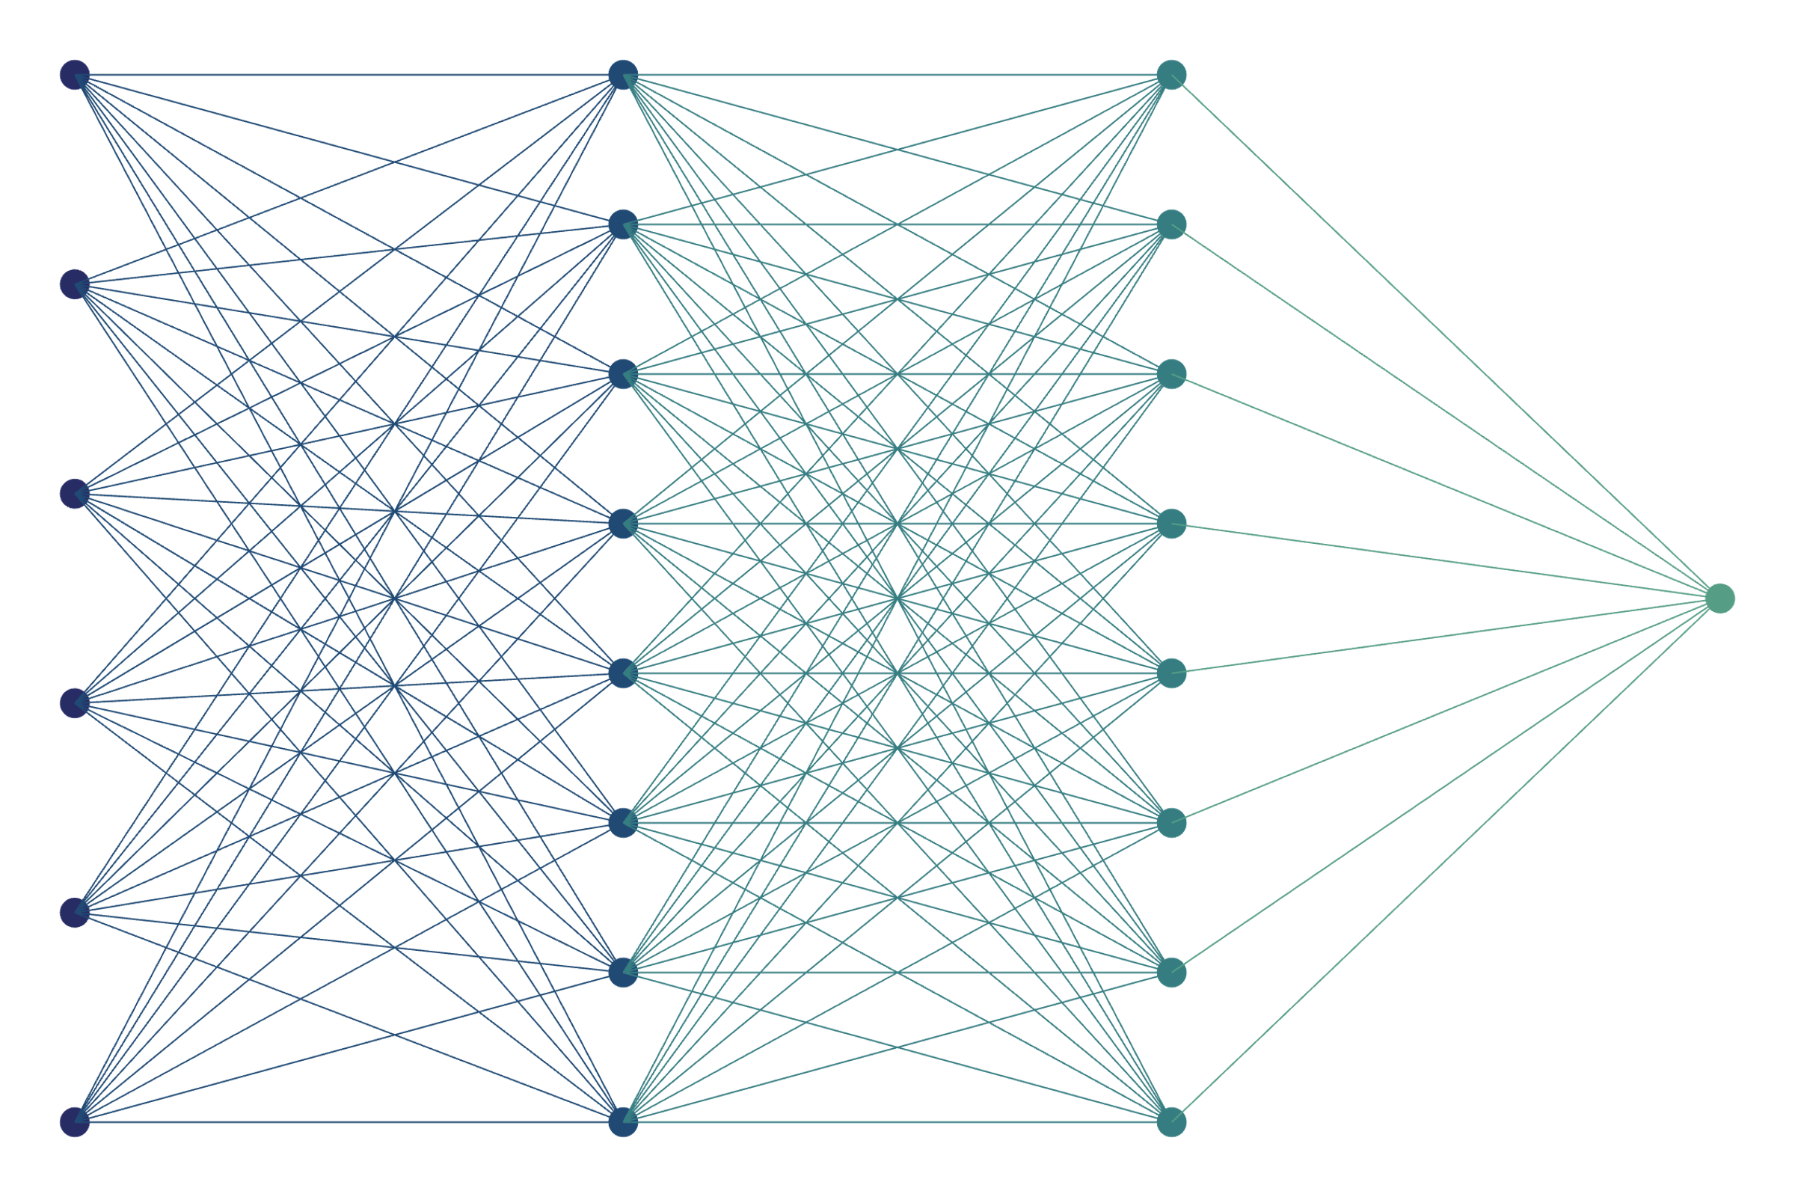
ML Methods for the keV sterile neutrino search with the TRISTAN-Phase of the KATRIN Experiment
Luca Fallböhmer –
NPML 2025

Slide 2
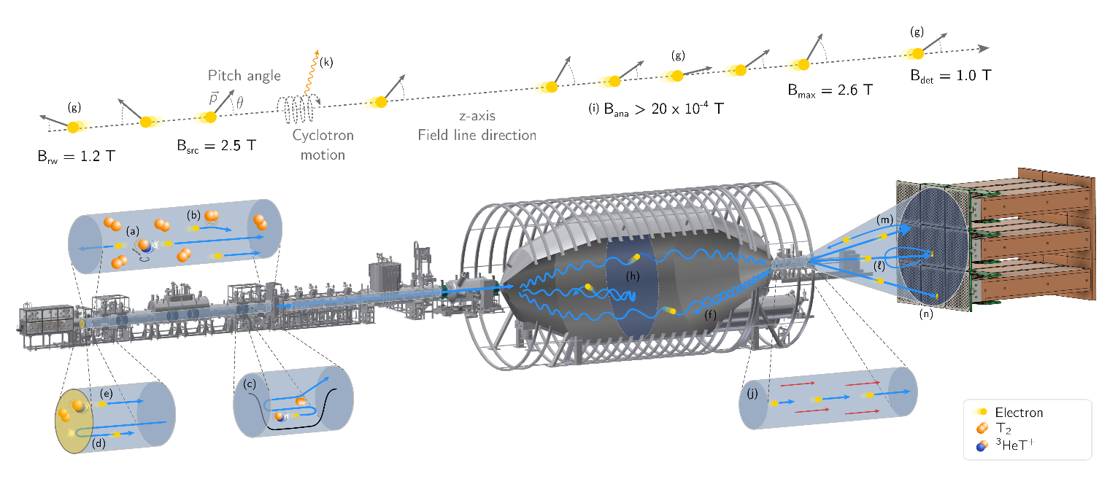


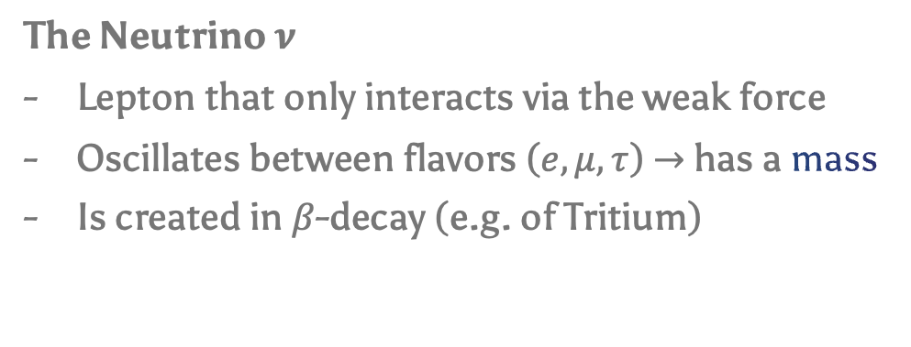

Neutrino Physics and the KATRIN Experiment
The Neutrino $ν$
Lepton that only interacts via the weak force
Oscillates between flavors ($e,μ,τ$) $→$ has a mass
Is created in $β$-decay (e.g. of Tritium)
BSM
$${\overline{ν}}_{e}$$
n
p
n
p
n
p
$$e$$
KATRIN Experiment
MAC-E Filter
Strong $T_{2}$ source

Slide 3

Neutrino Physics and the KATRIN Experiment
The Neutrino $ν$
Lepton that only interacts via the weak force
Oscillates between flavors ($e,μ,τ$) $→$ has a mass
Is created in $β$-decay (e.g. of Tritium)
BSM
$${\overline{ν}}_{e}$$
n
p
n
p
n
p
$$e$$
KATRIN Experiment
MAC-E Filter
Strong $T_{2}$ source

Slide 4

Neutrino Physics and the KATRIN Experiment
The Neutrino $ν$
Lepton that only interacts via the weak force
Oscillates between flavors ($e,μ,τ$) $→$ has a mass
Is created in $β$-decay (e.g. of Tritium)
BSM
$${\overline{ν}}_{e}$$
n
p
n
p
n
p
$$e$$
KATRIN measures:
The kinematic endpoint region
A low number of counts (<1 CPS)
In integral mode
KATRIN Experiment
MAC-E Filter
Strong $T_{2}$ source

Slide 5

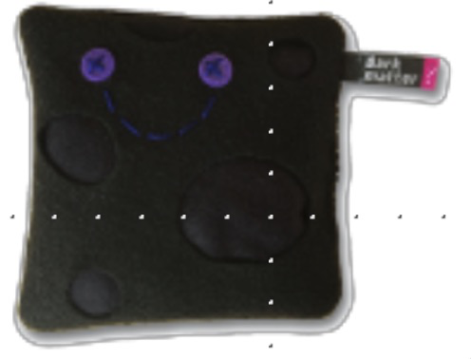
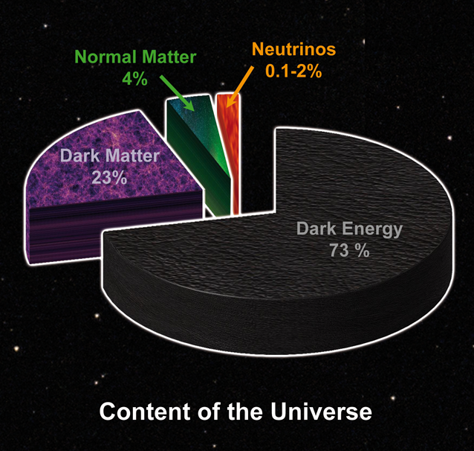

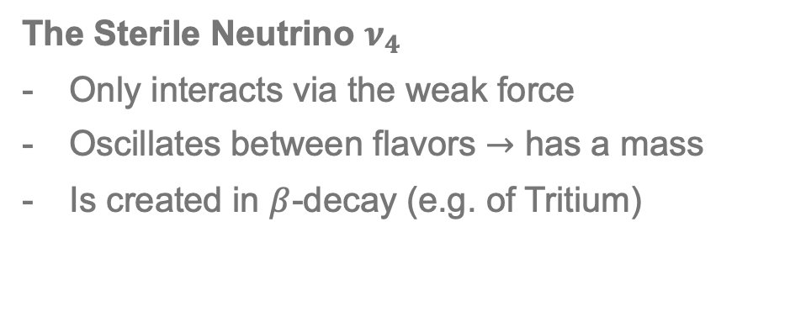

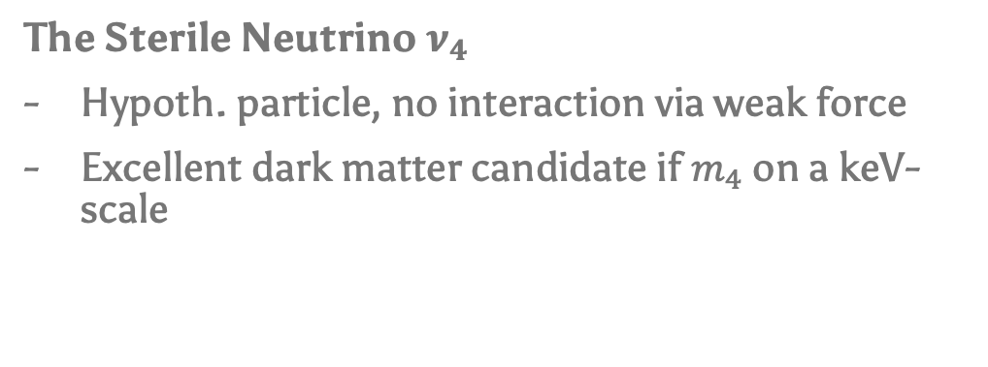


… but there’s more!
The Sterile Neutrino $ν_{4}$
Hypoth. particle, no interaction via weak force
Excellent dark matter candidate if $m_{4}$ on a keV-scale
$${\overline{ν}}_{e}$$
The Sterile Neutrino $ν_{4}$
Only interacts via the weak force
Oscillates between flavors $→$ has a mass
Is created in $β$-decay (e.g. of Tritium)
+
n
n
p
n
p
p
$$m_{1,2,3}$$
$$m_{4}$$
$$e$$

Slide 6

… but there’s more!
The Sterile Neutrino $ν_{4}$
Hypoth. particle, no interaction via weak force
Excellent dark matter candidate if $m_{4}$ on a keV-scale
The Sterile Neutrino $ν_{4}$
Only interacts via the weak force
Oscillates between flavors $→$ has a mass
Is created in $β$-decay (e.g. of Tritium)

Slide 7
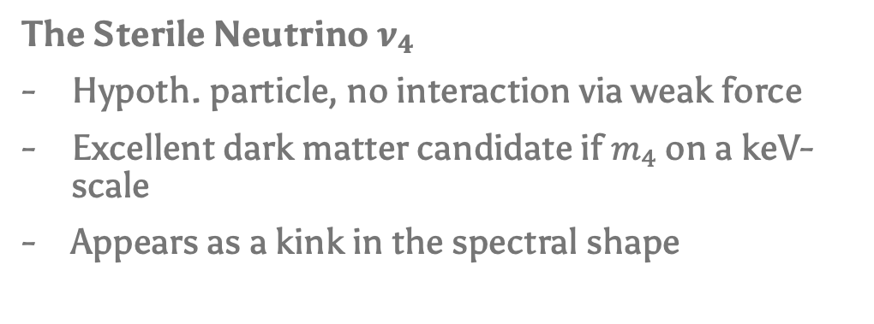
… but there’s more!
The Sterile Neutrino $ν_{4}$
Hypoth. particle, no interaction via weak force
Excellent dark matter candidate if $m_{4}$ on a keV-scale
Appears as a kink in the spectral shape
The Sterile Neutrino $ν_{4}$
Only interacts via the weak force
Oscillates between flavors $→$ has a mass
Is created in $β$-decay (e.g. of Tritium)

Slide 8
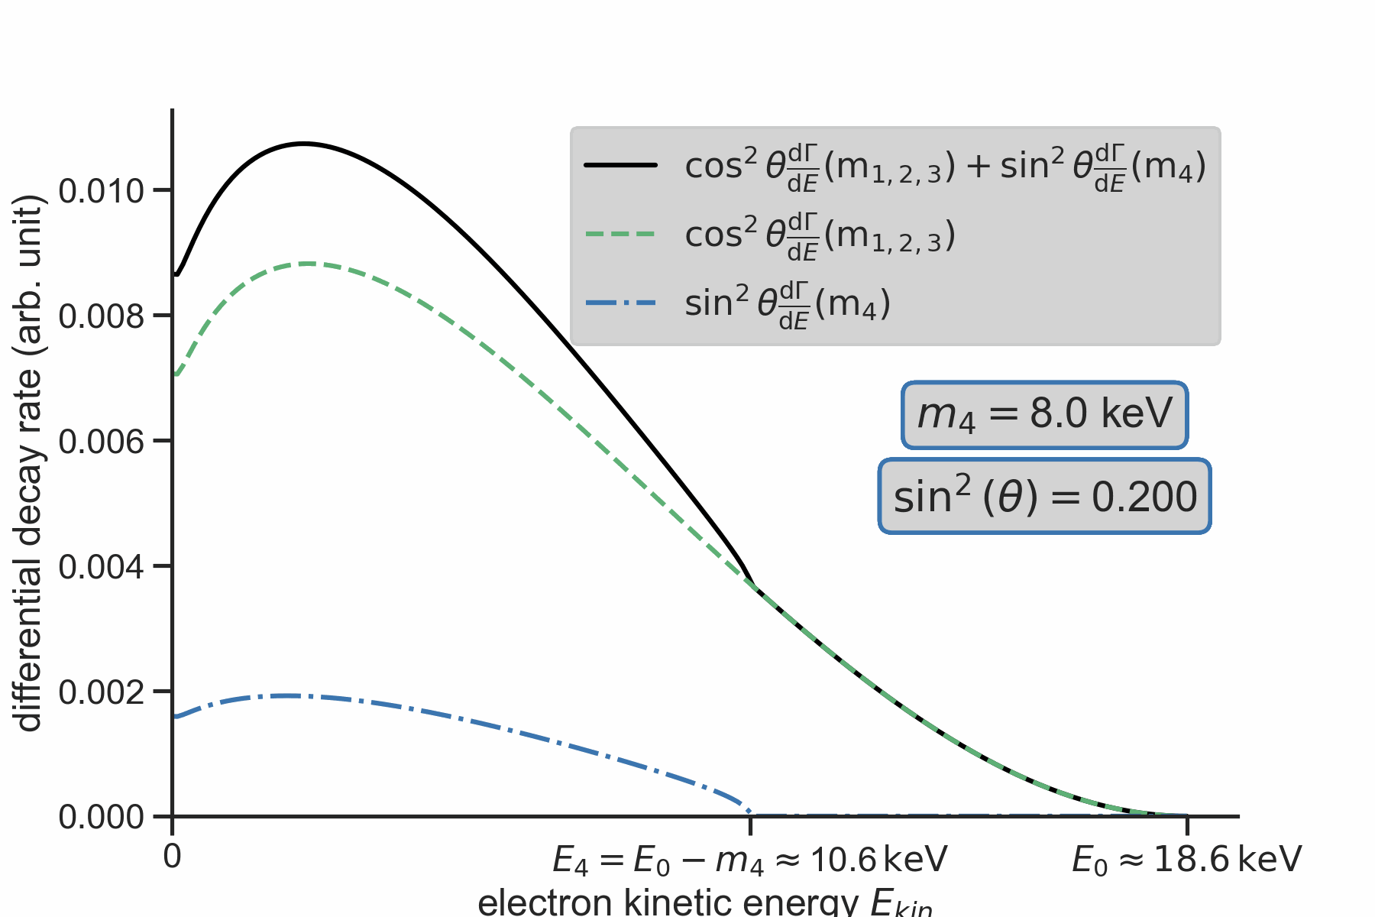
… but there’s more!
The Sterile Neutrino $ν_{4}$
Hypoth. particle, no interaction via weak force
Excellent dark matter candidate if $m_{4}$ on a keV-scale
Appears as a kink in the spectral shape
The Sterile Neutrino $ν_{4}$
Only interacts via the weak force
Oscillates between flavors $→$ has a mass
Is created in $β$-decay (e.g. of Tritium)

Slide 9
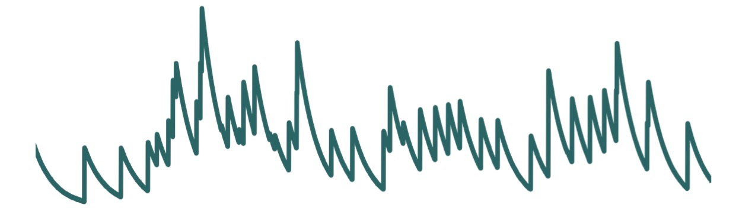
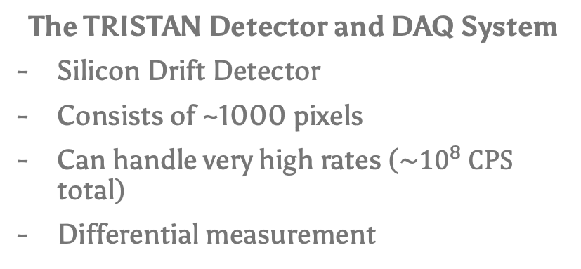
… but there’s more!
The Sterile Neutrino $ν_{4}$
Hypoth. particle, no interaction via weak force
Excellent dark matter candidate if $m_{4}$ on a keV-scale
Appears as a kink in the spectral shape
The Sterile Neutrino $ν_{4}$
Only interacts via the weak force
Oscillates between flavors $→$ has a mass
Is created in $β$-decay (e.g. of Tritium)
The TRISTAN Detector and DAQ System
Silicon Drift Detector
Consists of ~1000 pixels
Can handle very high rates (${\sim 10}^{8} CPS$ total)
Differential measurement

Slide 10
Challenge: Systematic Effects
The Sterile Neutrino $ν_{4}$
Only interacts via the weak force
Oscillates between flavors $→$ has a mass
Is created in $β$-decay (e.g. of Tritium)

Slide 11
Challenge: Systematic Effects
The Sterile Neutrino $ν_{4}$
Only interacts via the weak force
Oscillates between flavors $→$ has a mass
Is created in $β$-decay (e.g. of Tritium)

Slide 12
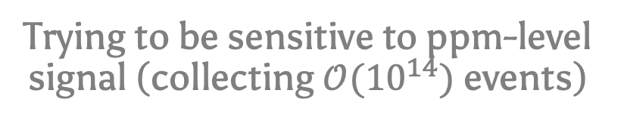
Challenge: Systematic Effects
Percent-level systematic effects
(e.g. Backscattering @ Detector)
While…
Trying to be sensitive to ppm-level signal (collecting $𝒪({10}^{14})$ events)

Slide 13
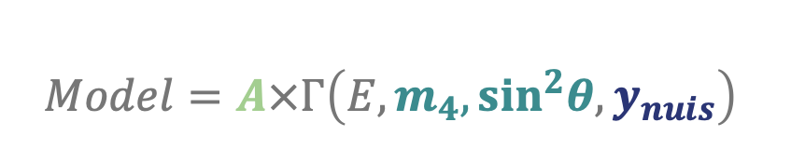
Challenge: Systematic Effects
Model systematic effects via Monte Carlo simulations
(need to be very precise)
Fit prediction to data
$$Model=A×Γ\left(E,m_{4},\sin^{2}θ,y_{nuis}\right)$$
free amplitude
Sterile parameters
Nuisance parameters

Slide 14
Challenge: Systematic Effects
Model systematic effects via Monte Carlo simulations
(need to be very precise)
Fit prediction to data
$$Model=A×Γ\left(E,m_{4},\sin^{2}θ,y_{nuis}\right)$$
But…
Limited accuracy of MC
Limited statistics of MC
free amplitude
Sterile parameters
Nuisance parameters

Slide 15
How to Deal with MC Limitations using ML?
First Ideas (work in progress)

Slide 16
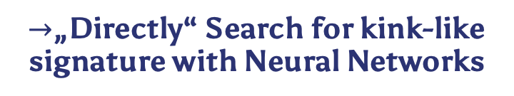


How to Deal with MC Limitations using ML?
First Ideas (work in progress)
Limited Accuracy of MC:
$→$„Directly“ Search for kink-like signature with Neural Networks
Binned $β$-spectrum
Neural Network
Sterile Y/N
$m_{4}$, ${\text{sin}}^{2}θ$
Catch Mismodelling

Slide 17


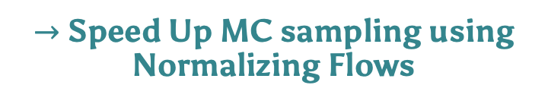
How to Deal with MC Limitations using ML?
First Ideas (work in progress)
Limited Accuracy of MC:
Limited Statistics of MC:
$→$„Directly“ Search for kink-like signature with Neural Networks
$→$ Speed Up MC sampling using Normalizing Flows
Binned $β$-spectrum
Neural Network
Input Params.
MC Simulation
Output Params.
Sterile Y/N
$m_{4}$, ${\text{sin}}^{2}θ$
1. train
2. substitute
Normalizing Flow
Catch Mismodelling

Slide 18
How to Deal with MC Limitations using ML?
First Ideas (work in progress)
Maybe today
TODAY
Limited Accuracy of MC:
Limited Statistics of MC:
$→$„Directly“ Search for kink-like signature with Neural Networks
$→$ Speed Up MC sampling using Normalizing Flows
Binned $β$-spectrum
Neural Network
Input Params.
MC Simulation
Output Params.
Sterile Y/N
$m_{4}$, ${\text{sin}}^{2}θ$
1. train
2. substitute
Normalizing Flow
Catch Mismodelling

Slide 19
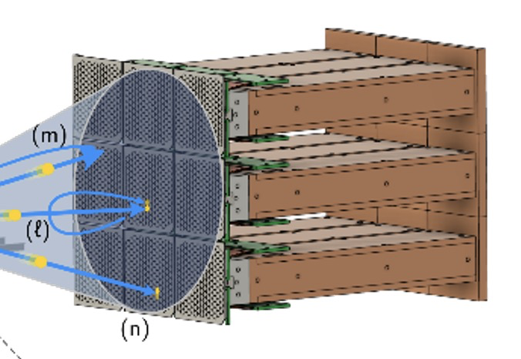
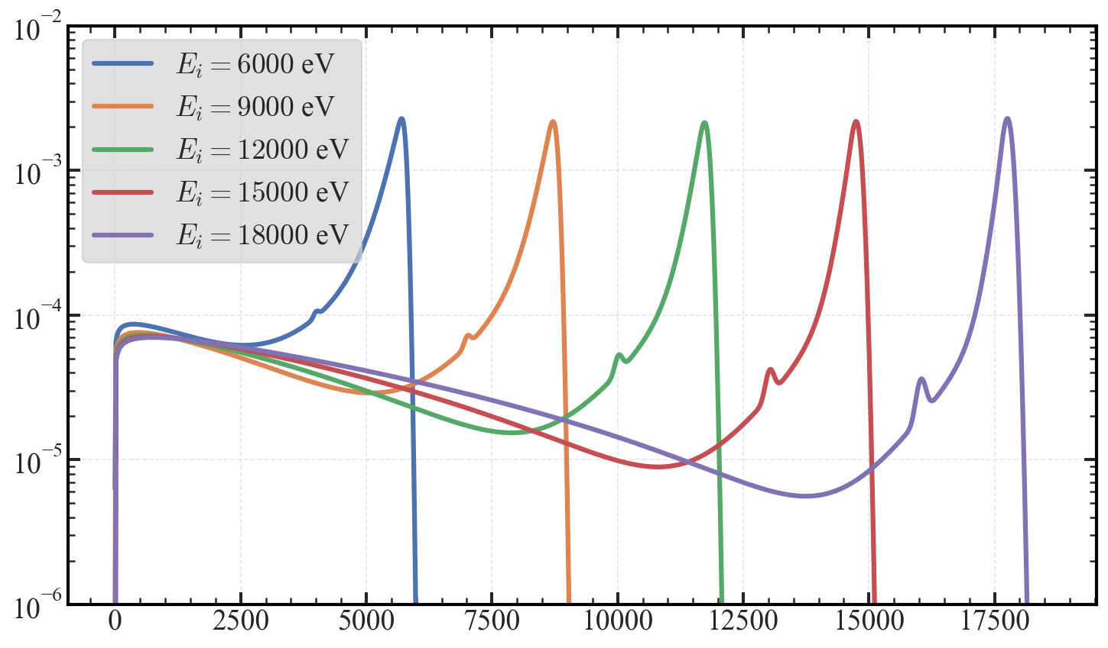
Flow Based Monte Carlo - Setting
Empirical Detector Response for different initial electron energies
Feasibility study on simple example:
Are the flows:
Accurate Enough?
Fast Enough?
Can we draw more samples than we train with?
$$p_{DR}\left(E_{out} | E_{i}\right)$$
$E_{out}$ in eV

Slide 20
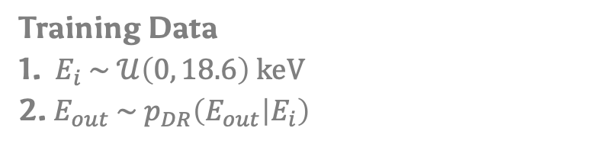
Flow Based Monte Carlo - Setting
Empirical Detector Response for different initial electron energies
Feasibility study on simple example:
Are the flows:
Accurate Enough?
Fast Enough?
Can we draw more samples than we train with?
$$p_{DR}\left(E_{out} | E_{i}\right)$$
Training Data
1. $E_{i} \sim 𝒰\left(0, 18.6\right) keV$
2. $E_{out} \sim p_{DR}\left(E_{out} | E_{i}\right)$
repeat N-times for N samples
$E_{out}$ in eV

Slide 21



Flow Based Monte Carlo - Setting
Empirical Detector Response for different initial electron energies
Feasibility study on simple example:
Are the flows:
Accurate Enough?
Fast Enough?
Can we draw more samples than we train with?
$$p_{DR}\left(E_{out} | E_{i}\right)$$
Training Data
1. $E_{i} \sim 𝒰\left(0, 18.6\right) keV$
2. $E_{out} \sim p_{DR}\left(E_{out} | E_{i}\right)$
repeat N-times for N samples
$E_{out}$ in eV
Models / Techniques
1. Discrete Normalizing Flow (RQ-Spline)
2. MLP trained in Flow-Matching scenario (OT CFM)
$$E_{i}$$
Analytical Response
$$E_{out}$$
NN

Slide 22
Flow Based Monte Carlo - Results
Analytical Truth
Preliminary, WIP

Slide 23
Flow Based Monte Carlo - Results
Analytical Truth
Samples from Analytical Truth used as training data („MC-truth“)
Preliminary, WIP

Slide 24
Flow Based Monte Carlo - Results
Analytical Truth
Samples from trained Flow
(@ same statistic of MC Truth)
Samples from Analytical Truth used as training data („MC-truth“)
Preliminary, WIP

Slide 25
Flow Based Monte Carlo - Results
@ same statistic of MC Truth: Inference speedup by 500x with virtually no quality loss
Analytical Truth
Samples from trained Flow
(@ same statistic of MC Truth)
Samples from Analytical Truth used as training data („MC-truth“)
Preliminary, WIP

Slide 26
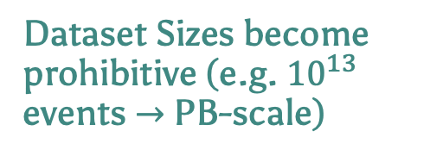
Flow Based Monte Carlo - Limitations
What happens at large statistics N?
Dataset Sizes become prohibitive (e.g. ${10}^{13}$ events $→$ PB-scale)
Training Times become prohibitive
Can we draw more samples than we train with ?

Slide 27
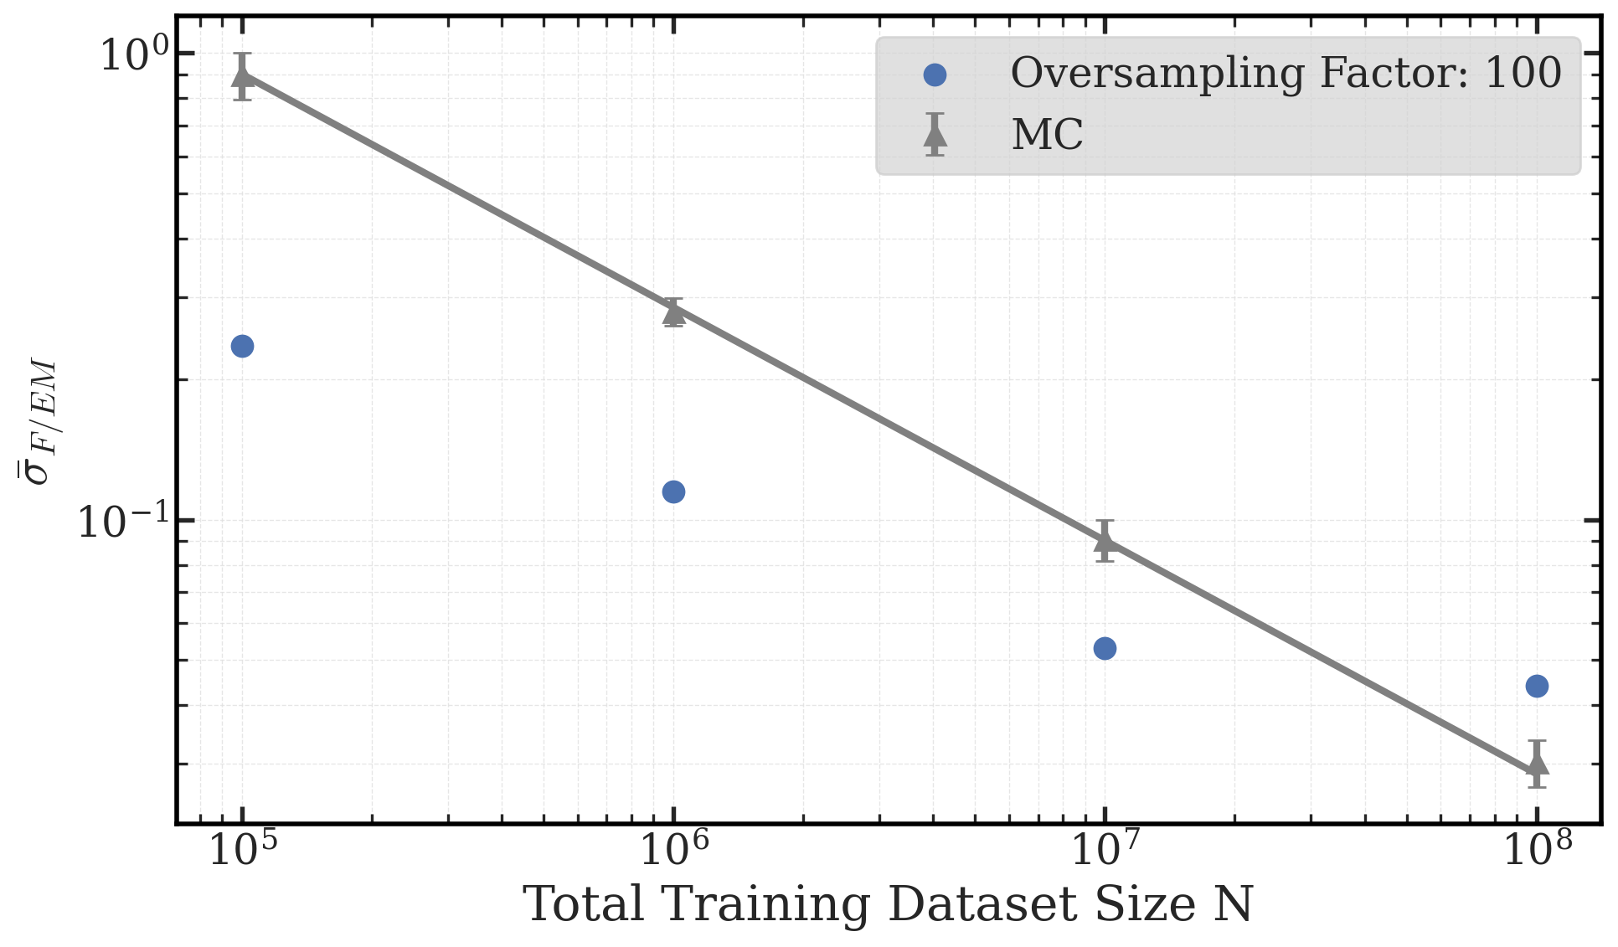

Flow Based Monte Carlo - Limitations
(FM) Sample quality for $n_{θ\text{−}updates}=\text{const}\text{.}$
What happens at large statistics N?
Quality metric based on residual truth - sample
Dataset Sizes become prohibitive (e.g. ${10}^{13}$ events $→$ PB-scale)
Training Times become prohibitive
Preliminary, WIP
Can we draw more samples than we train with ?

Slide 28
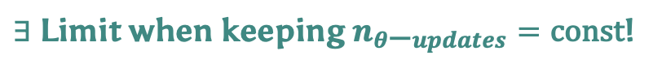

Flow Based Monte Carlo - Limitations
(FM) Sample quality for $n_{θ\text{−}updates}=\text{const}\text{.}$
What happens at large statistics N?
Quality metric based on residual truth - sample
Expected MC scaling
Dataset Sizes become prohibitive (e.g. ${10}^{13}$ events $→$ PB-scale)
Training Times become prohibitive
„Bias floor“
Preliminary, WIP
Can we draw more samples than we train with ?
$∃$ Limit when keeping $n_{θ\text{−}updates}=\text{const}$!
Diminishing returns for increased effort

Slide 29
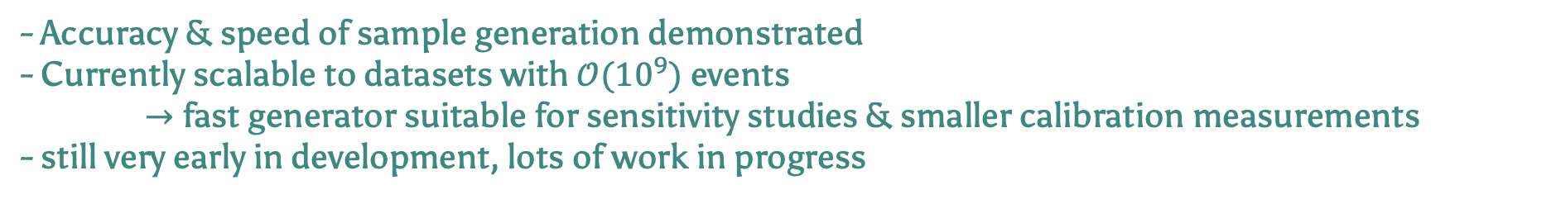
Flow Based Monte Carlo – Where would this be used?
Normalizing Flow
Full Beamline MC
Flow
Full Beamline MC
Geant 4
Geant 4
Geant 4
Highest speedup
not modular
Only speed up bottleneck MCs
Highly modular
Conclusion & Outlook
Accuracy & speed of sample generation demonstrated
Currently scalable to datasets with $𝒪({10}^{9})$ events
$→$ fast generator suitable for sensitivity studies & smaller calibration measurements
still very early in development, lots of work in progress

Slide 30
How to Deal with MC Limitations using ML?
First Ideas (work in progress)
Limited Accuracy of MC:
Limited Statistics of MC:
$→$„Directly“ Search for kink-like signature with Neural Networks
$→$ Speed Up MC sampling using Normalizing Flows
Binned $β$-spectrum
Neural Network
Input Params.
MC Simulation
Output Params.
Sterile Y/N
$m_{4}$, ${\text{sin}}^{2}θ$
1. train
2. substitute
Normalizing Flow
Catch Mismodelling

Slide 31
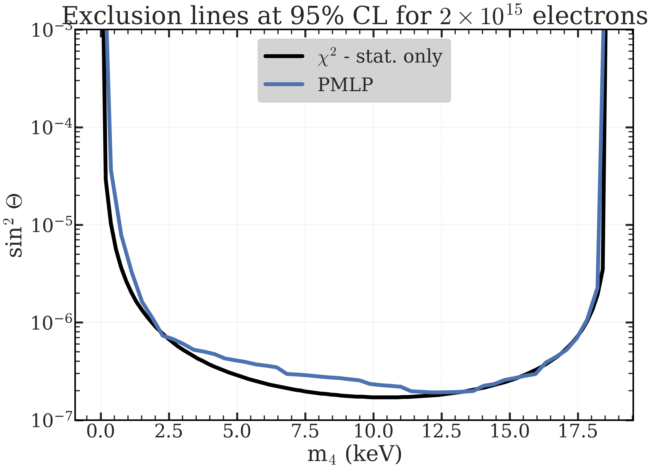
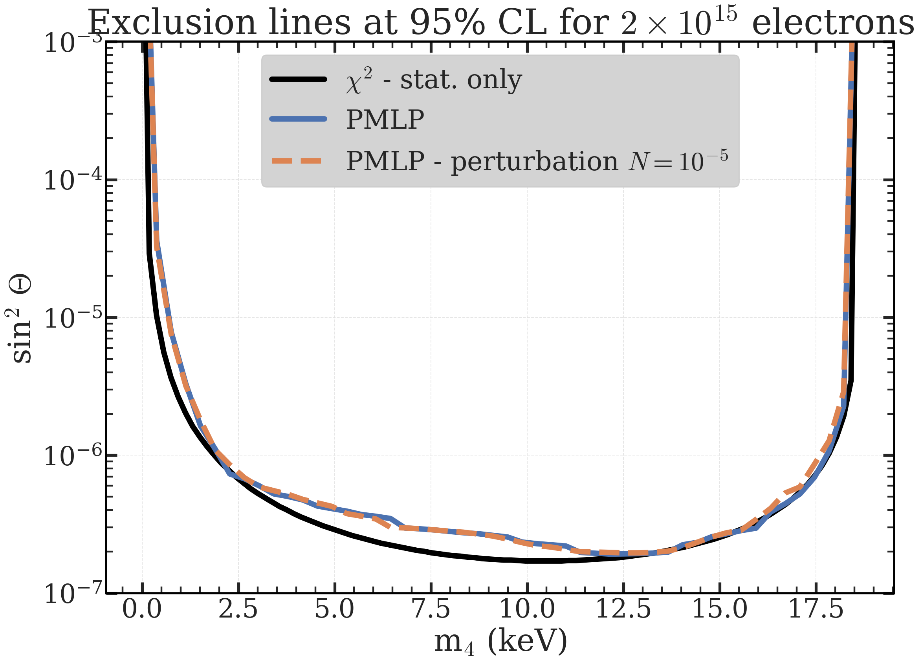
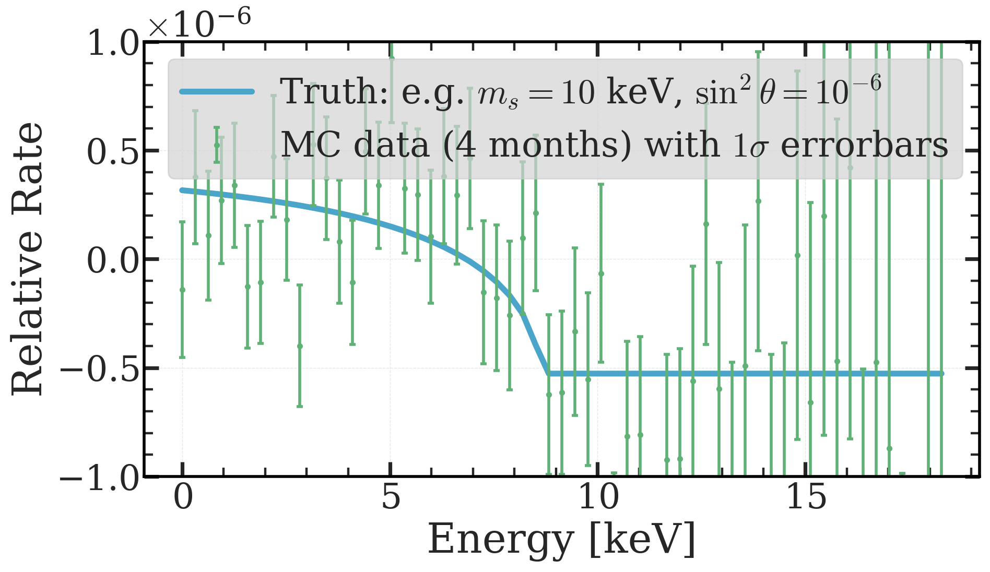
Search for Sterile Signature with NN
~1 yr.
Motivation:
NN could learn higher-order correlations to “semantically“ learn the kink-like signature
First Check:
Are Neural Networks even sensitive to the sterile neutrino signature?
Example MC Signature
LHR in stat. only case
Preliminary, WIP

Slide 32
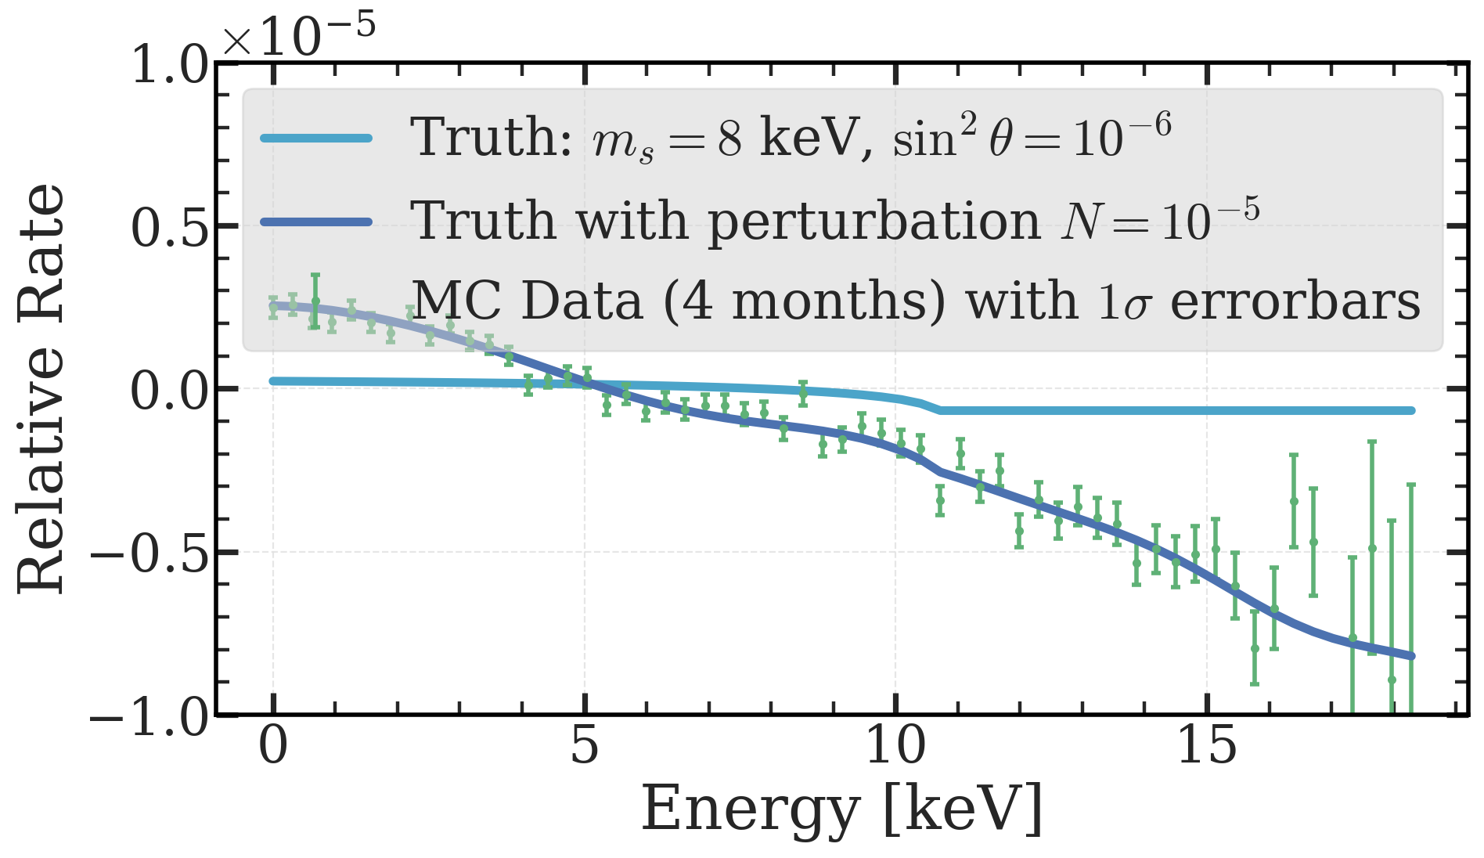
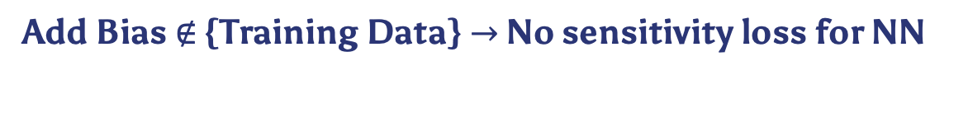
Search for Sterile Signature with NN
Motivation:
NN could learn higher-order correlations to “semantically“ learn the kink-like signature
Preliminary, WIP
First Check:
Are Neural Networks even sensitive to the sterile neutrino signature?
MC Sig. w/ smooth bias
Add Bias $∉$ {Training Data} $→$ No sensitivity loss for NN

Slide 33
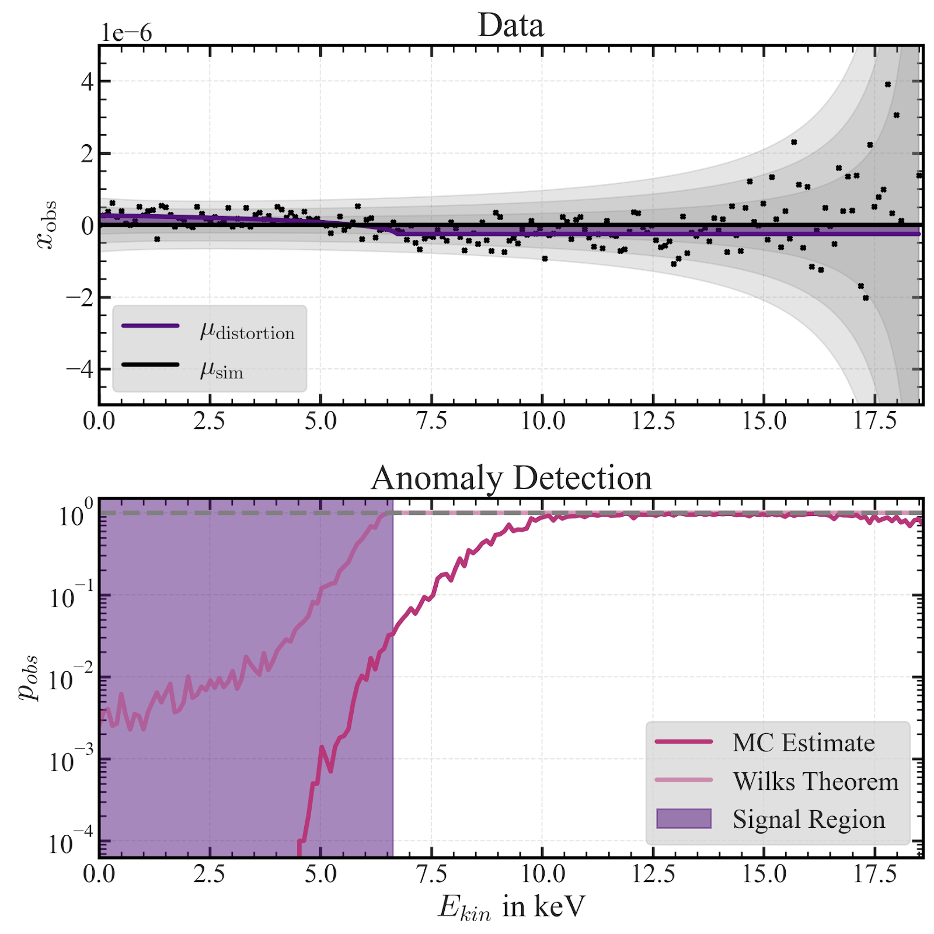
Search for Sterile Signature with NN
Bin-Wise stat. Significance of sterile signature
Another Example:
Can do bin-wise tests for the stat. significance of sterile signature or mismodelling, etc.
Idea:
Train bin-wise classifier, NN will learn LHR for each bin when minimizing BCE („LHR-trick“)
Preliminary, WIP
How to get p-values:
Use a MC estimate, for a global p-value: take care to include “look-elsewhere-effect“!

Slide 34
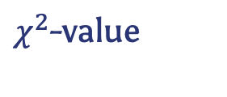

Search for Sterile Signature with NN - Outlook
Where would this be used?
Observed Spectrum
Robust under smooth mismodelling
Fit
NN
MC
train
$χ^{2}$-value
$$m_{4}, {\text{sin}}^{2}θ$$
Crosscheck & Catch mismodelling
Limitations
Still somewhat reliant on the MC (used as training data, cant be too far off)
Still to be tested for non-smooth / larger group of perturbations

Slide 35
Backup 1: Flow Based MC

Slide 36
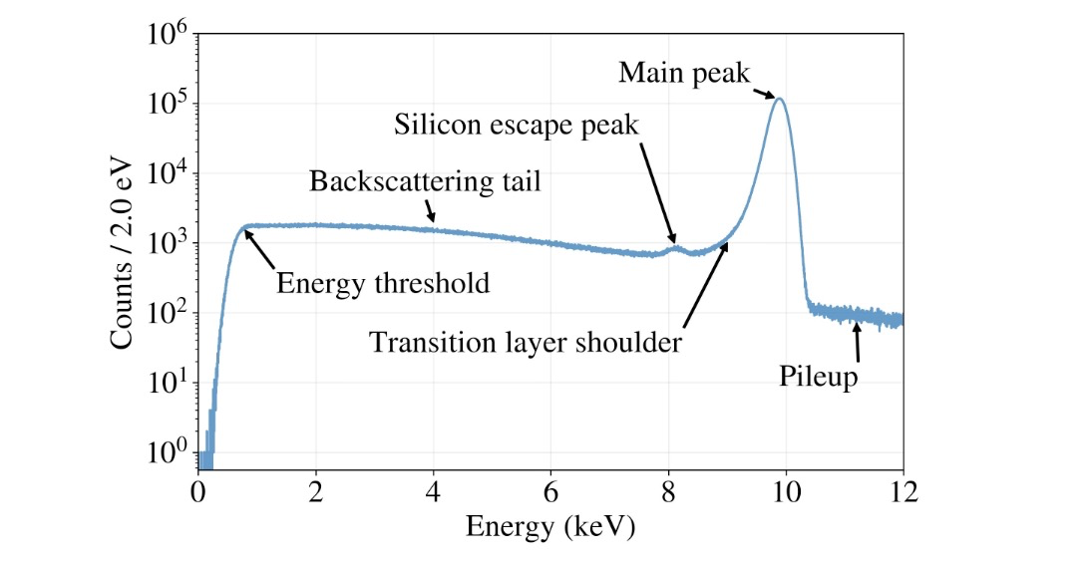
Real Response of TRISTAN Detector
To a monoenergetic electron beam

Slide 37
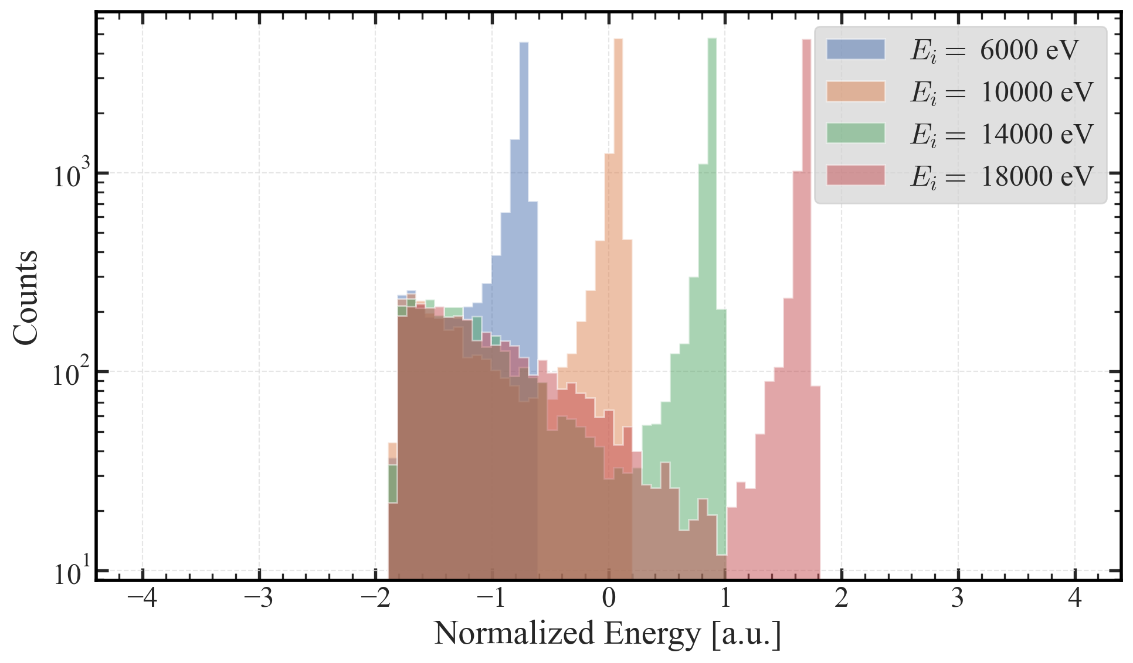
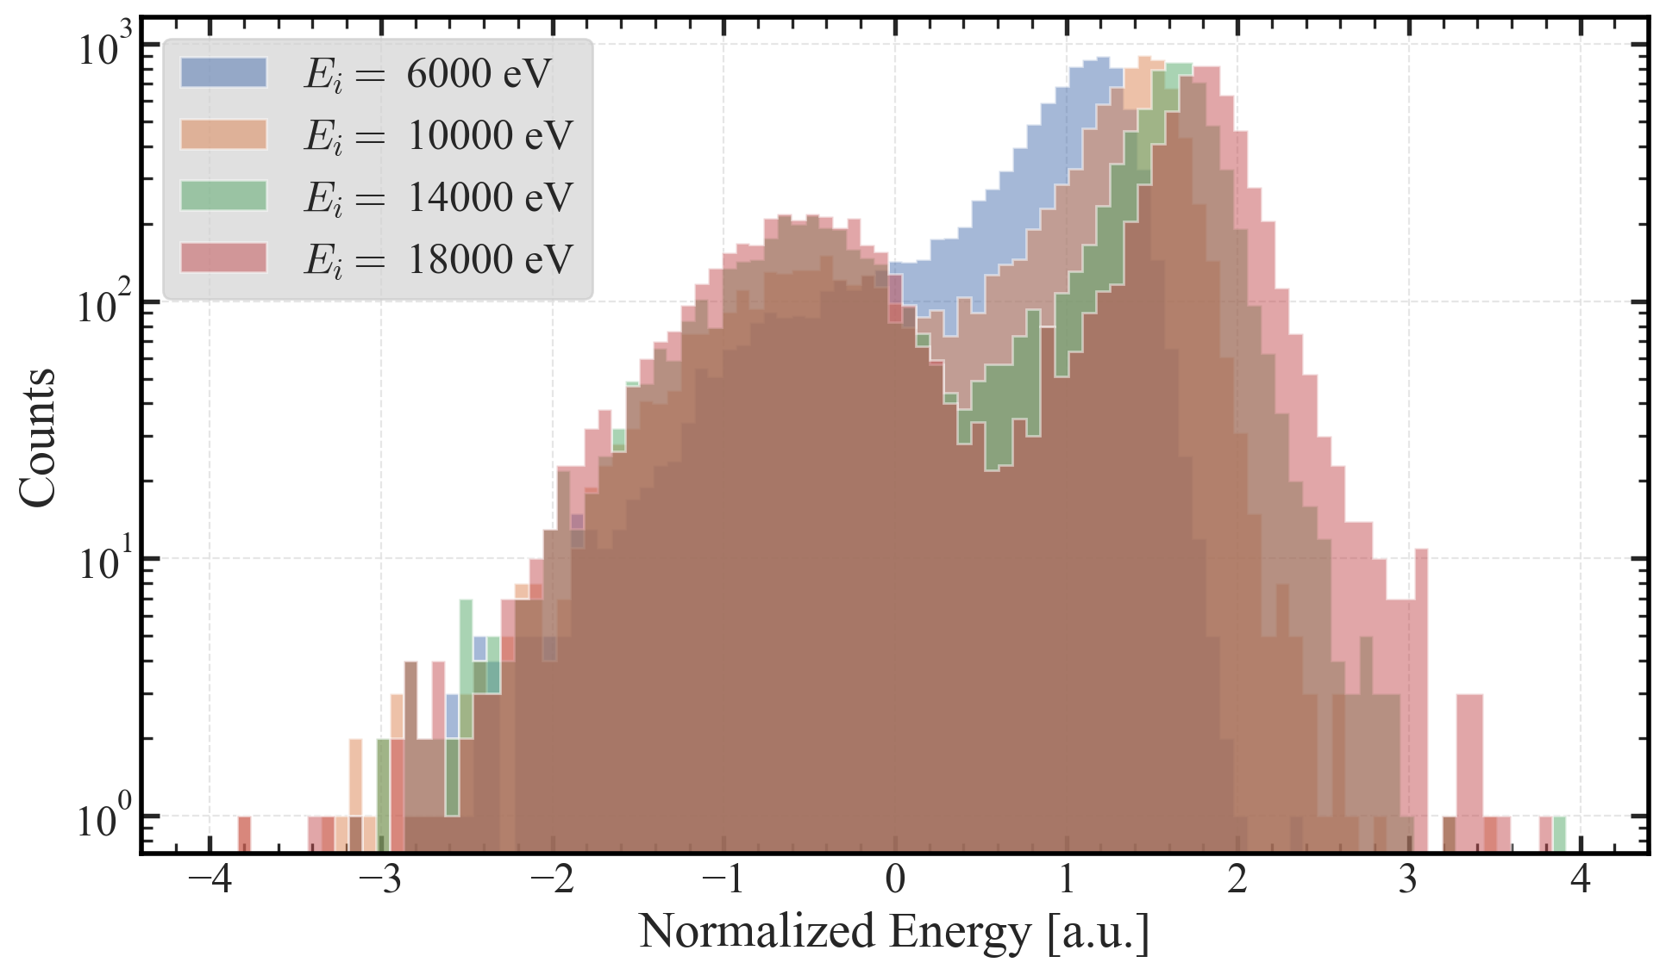
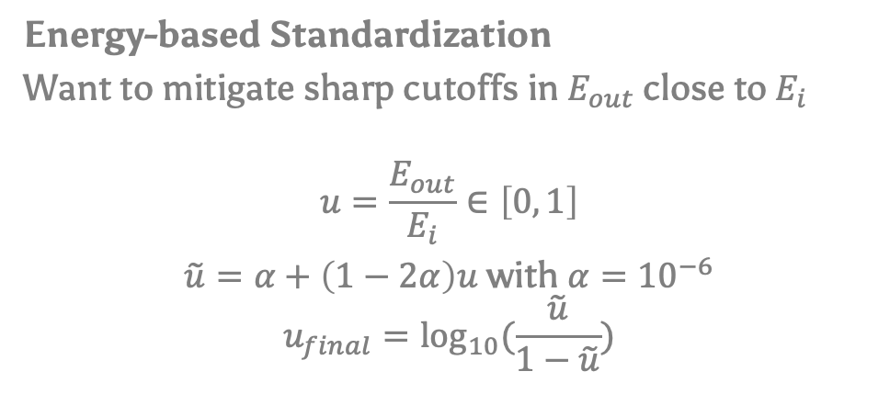
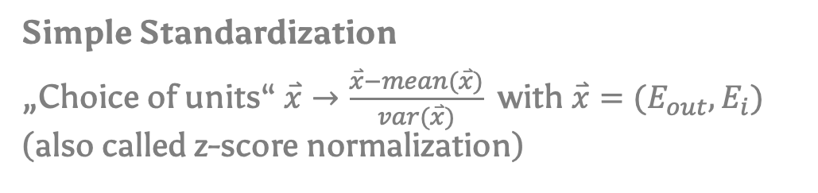
Flow Based Monte Carlo - Data
Preliminary, WIP
Simple Standardization
„Choice of units“ $\overset{⃑}{x}→\frac{\overset{⃑}{x}−mean(\overset{⃑}{x})}{var(\overset{⃑}{x})}$ with $\overset{⃑}{x}=(E_{out}, E_{i})$ (also called z-score normalization)
z-score norm
Energy-based Standardization
Want to mitigate sharp cutoffs in $E_{out}$ close to $E_{i}$
$$u=\frac{E_{out}}{E_{i}}∈\left[0, 1\right]$$
$\tilde{u}=α+\left(1−2α\right)u$ with $α={10}^{−6}$
$$u_{final}={\text{log}}_{10}(\frac{\tilde{u}}{1−\tilde{u}})$$
„energy“ norm
Preliminary, WIP

Slide 38
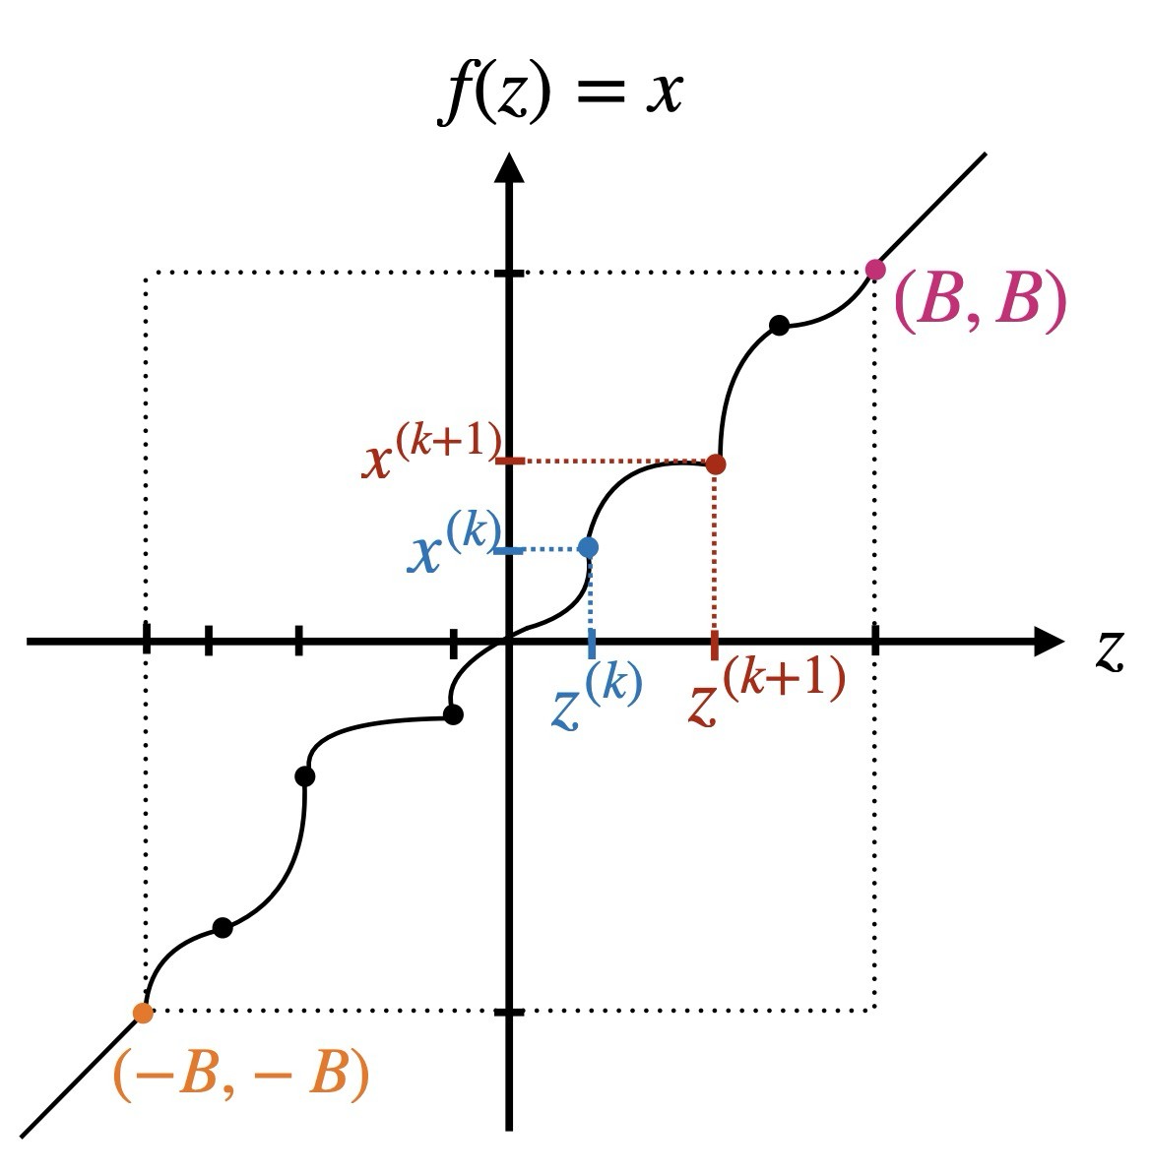
Flow Based Monte Carlo - Model
[1] https://udlbook.github.io/udlbook/
(Conditional) Discrete Normalizing Flows
How does a RQS transform look like?
Additional Conditional Info concatenated to NN input
NN
[1]
How do they work?
Minimize KL-Div. between model and target density by minimizing NLL of samples!
NNs learn series of invertible transforms while keeping Jacobians in check (Jacobian <-> „density info“)
Allows sampling & density estimation!
NN just learns the positions & derivatives @ these positions, constraining the RQ-spline

Slide 39
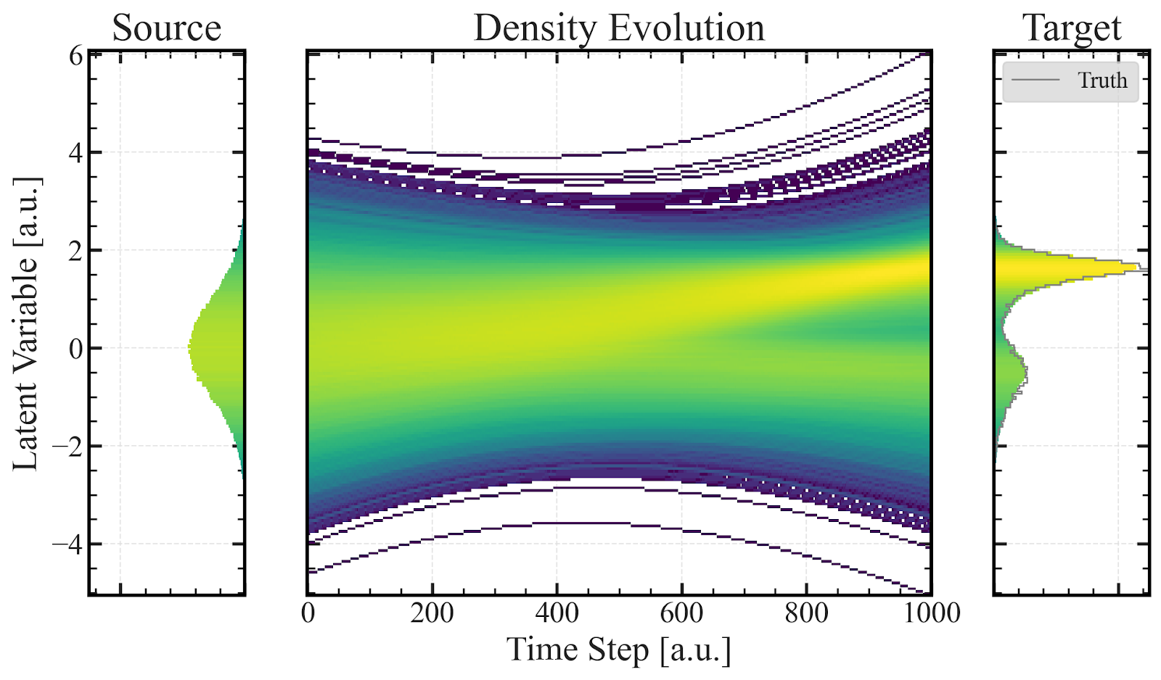
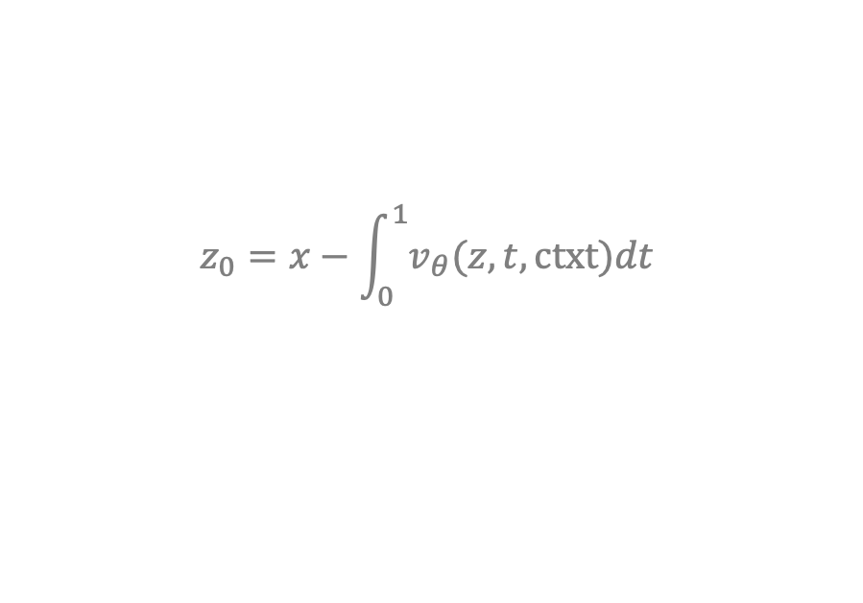
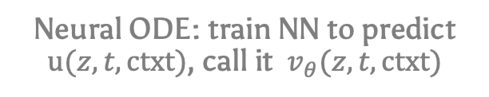
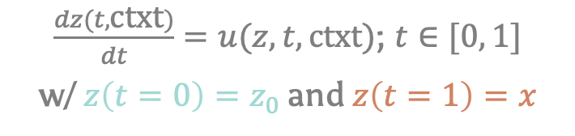

Flow Based Monte Carlo - Model
[1] https://udlbook.github.io/udlbook/
Going from discrete transformations to continuous field
[1]
Updates to latent variable z become infinitesimally small
$\frac{dz(t, \text{ctxt})}{dt}=u(z, t, \text{ctxt}\text{)}$; $t∈[0, 1]$
w/ $z\left(t=0\right)=z_{0}$ and $z\left(t=1\right)=x$
Continuous limit ($f_{n}$ w/ $n→∞$)
Neural ODE: train NN to predict $u(z, t, \text{ctxt}\text{)}$, call it $v_{θ}(z, t, \text{ctxt}\text{)}$
To do training / density est.:
Integration @ Training Time!
$$z_{0}=x−\int_{0}^{1}{v_{θ}(z, t, \text{ctxt})dt}$$
Preliminary, WIP

Slide 40
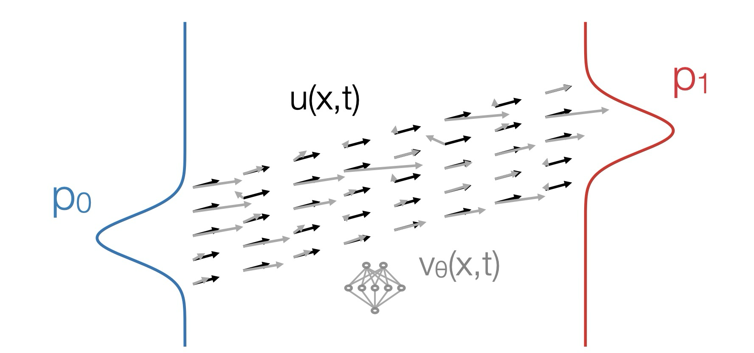
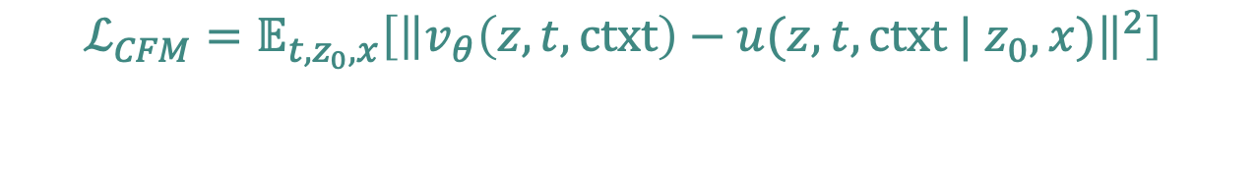
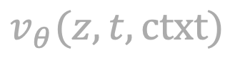
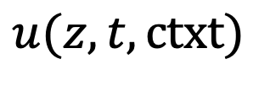
Flow Based Monte Carlo - Model
[2] Nicole Hartman, ODSL GenAI Days
Do regression on the ODE velocity field!
Integration @ training time:
Very time consuming
(doesn‘t scale nicely to higher D)
$$u(z, t, \text{ctxt})$$
(Conditional) Flow Matching to the Rescue!
(no integration required for training)
$$v_{θ}(z, t, \text{ctxt})$$
[2]
$$ℒ_{CFM}=𝔼_{t, z_{0},x}\left[{\left\|v_{θ}\left(z, t, \text{ctxt}\right)−u(z, t, \text{ctxt}\text{ | }z_{0}, x)\right\|}^{2}\right]$$

Slide 41

Flow Based Monte Carlo - Model
[2] Nicole Hartman, ODSL GenAI Days
Do regression on the ODE velocity field!
Integration @ training time:
Very time consuming
(doesn‘t scale nicely to higher D)
$$u(z, t, \text{ctxt})$$
(Conditional) Flow Matching to the Rescue!
(no integration required for training)
$$v_{θ}(z, t, \text{ctxt})$$
[2]
$$ℒ_{CFM}=𝔼_{t, z_{0},x}\left[{\left\|v_{θ}\left(z, t, \text{ctxt}\right)−x−z_{0}\right\|}^{2}\right]$$
& straight line approx.

Slide 42
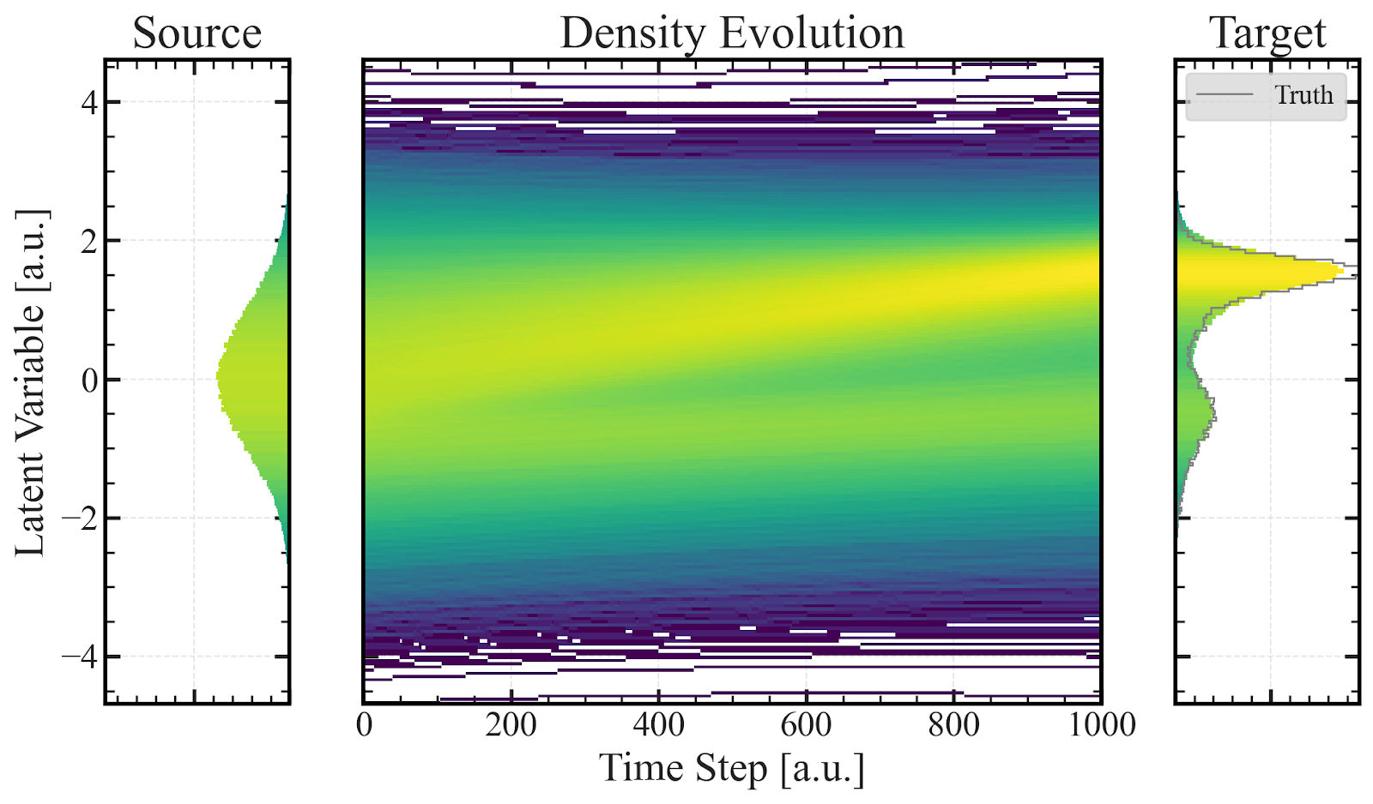


Flow Based Monte Carlo - Model
What we want:
Accurate sampling
Fast sampling
Conditional Flow Matching with:
Velocity Field Predictor: MLP with Unet-like Structure & self attn. at bottleneck
Optimal Transport Coupling between Source and Target
Lightweight model
Straight prob. paths
$x_{t}$, t, context
$$v_{t}$$
Input Layer
X
Hidden Layers
CFM
+
+
X
MHA
+
+
Output head
X
Concat.
+
+
+
Element-wise Add.
Architecture
CFM w/ (batch-wise) optimal transport coupling
Unet-like to retain info from different scales

Slide 43
Backup 2: “Kink search” with Neural Networks

Slide 44
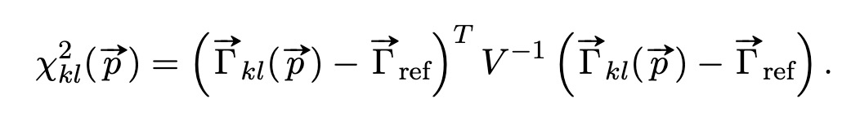


Exclusion Lines
Goal: Compare NN to “traditional” method -> draw an exclusion line
1 yr.
$χ^{2}$-based approach
Gridscan over $\left(m_{4},{\text{sin}}^{2}\left(θ\right)\right)$
$χ^{2}$computed at every gridpoint $kl$
Contour drawn at 95% CL
${χ_{crit}}^{2}$= 5.99 if Wilks‘ theorem holds
Nuisance parameters: global signal amplitude

Slide 45


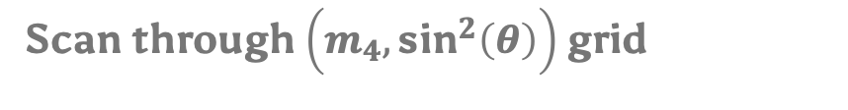

Exclusion Lines using Neural Networks
$${\text{sin}}^{2}θ=0$$
$${\text{sin}}^{2}θ=0$$
$${\text{sin}}^{2}θ=0$$
$${\text{sin}}^{2}θ=0$$
0.001
$${\text{sin}}^{2}θ=0$$
0.002
0.001
0.002
0.000
…
$${\text{sin}}^{2}θ,m_{4}=GP$$
$${\text{sin}}^{2}θ,m_{4}=GP$$
$${\text{sin}}^{2}θ,m_{4}=GP$$
$${\text{sin}}^{2}θ,m_{4}=GP$$
$${\text{sin}}^{2}θ,m_{4}=GP$$
0.901
0.902
0.899
0.903
0.901
…
Scan through $\left(m_{4},{\text{sin}}^{2}\left(θ\right)\right)$ grid

Slide 46
Binary Classification
Three Takeaways
1.
NNs are very sensitive to the sterile neutrino signature

Slide 47
Binary Classification
Three Takeaways
1.
NNs are very sensitive to the sterile neutrino signature
2.
Can handle detector related syst. effects and uncertainties

Slide 48
Binary Classification
Three Takeaways
1.
NNs are very sensitive to the sterile neutrino signature
2.
Can handle detector related syst. effects and uncertainties
3.
Can handle small smooth modelling inaccuracies

Slide 49
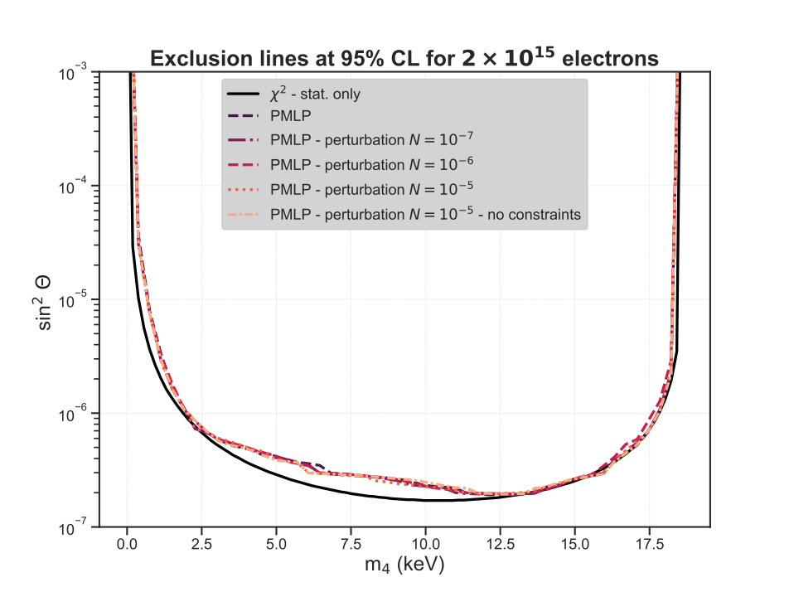
Binary Classification
Three Takeaways
1.
NNs are very sensitive to the sterile neutrino signature
2.
Can handle detector related syst. effects and uncertainties
3.
Can handle small smooth modelling inaccuracies

Slide 50
Binary Classification
Caveats
1.
Not completely model independent (training data has to come from somewhere)
2.
Not 100% transparent
(only likelihood-ratio estimator)

Slide 51
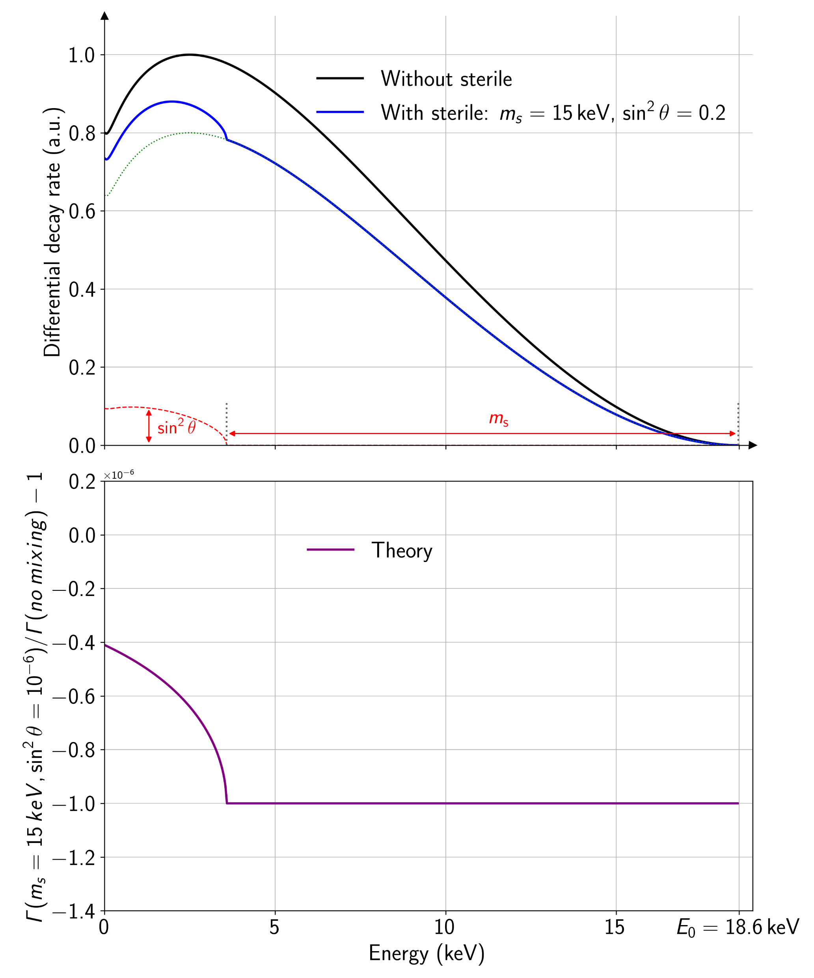



Training Data
$$m_{s}=5 keV$$
$\sin^{2}θ={10}^{−6}$
$$m_{s}=10 keV$$
$$\sin^{2}θ={10}^{−6}$$
Training Data should include:
Different sterile signatures
Statistical fluctuations

Slide 52


Training Data
$$m_{s}=5 keV$$
$\sin^{2}θ={10}^{−6}$
$$m_{s}=10 keV$$
$$\sin^{2}θ={10}^{−6}$$
Training Data should include:
Different sterile signatures
Statistical fluctuations

Slide 53





Training Data
Theoretical Prediction
Sample $m_{4},{\text{sin}}^{2}(θ)$
Statistically fluctuate sample
Repeat $N$ times
50% probability to set ${\text{sin}}^{2}\left(θ\right)=0$

Slide 54



Training Data
e.g.
Label 0 for${ \text{sin}}^{2}θ=0$
Training Dataset
Add labels for each sample
Optionally add syst. effects
Feature standardization
T
Label 1 for${ \text{sin}}^{2}θ>0$
Done via convolution with Response Matrices

Slide 55



Backup: Sterile Neutrino Parameter Space

Slide 56


Backup: Sensitivity Studies – Contour Uncertainty
Statistical fluctuations in spectra
Statistical fluctuations in histograms

