Slide 1


Study of the performance of the NEXT-100 Tracking Plane using a
Sparse Convolutional Neural Network
NPML 2025
University of Tokyo
María Cid on behalf of the NEXT collaboration

Slide 2
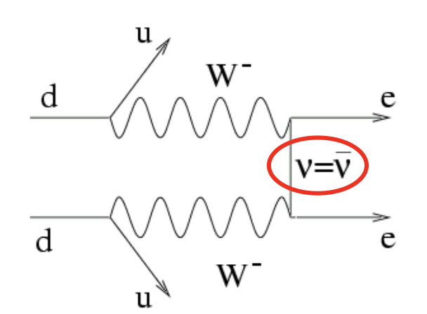

Neutrinoless double beta decay in Xe
(2vßß)
The observation of this decay would:
Demonstrate the Majorana nature of neutrinos
Violate lepton number conservation
Provide information on neutrino hierarchy and mass scale
¹³⁶Xe
¹³⁶Ba⁺⁺
2e⁻
+
Q_{ββ} = 2458 keV
Notes:
the NEXT experiment aims to find the neutrinoless double beta decay, which (as its been said in previous talks) is a hypothesized process that consists on two simultaneous double beta decays where the two anti-neutrinos emitted become a virtual neutrino (annihilate each other). The observation of such decay would demonstrate the Majorana nature of neutrinos, this is, that the neutrino is its own antiparticle, imply total lepton number violation and provide some insight into the neutrino hierarchy and mass scale.

Slide 3

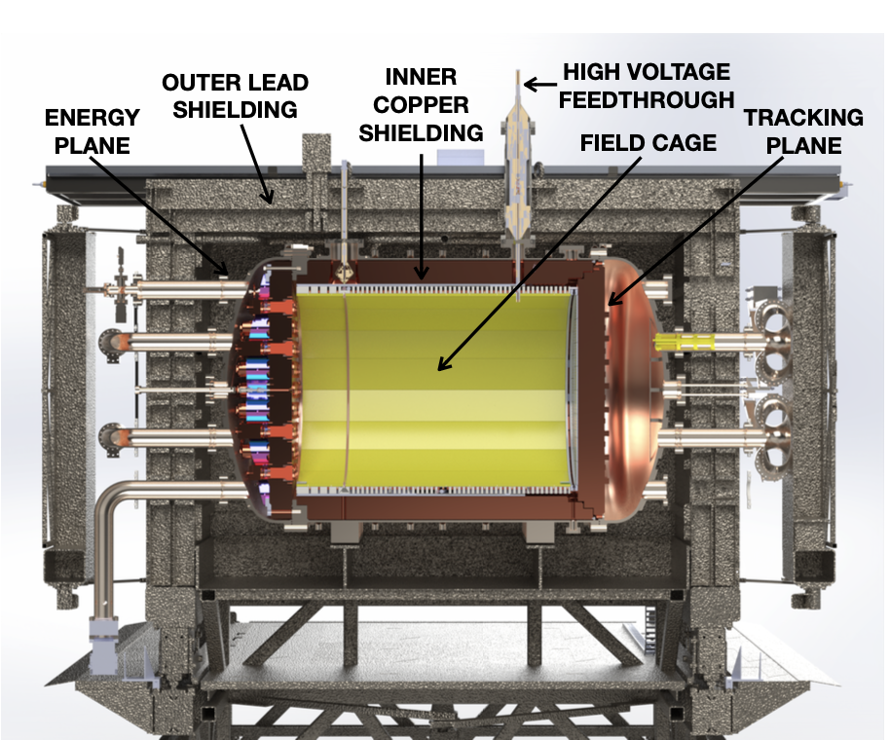
Neutrino Experiment with a Xenon TPC (NEXT) @
LSC
Canfranc
High Pressure Xenon TPC with electroluminescent amplification (HPXeTPC-EL)
Search for neutrinoless double beta decay (0vßß)
NEXT-100 detector can hold ~100kg of Xe gas at a maximum pressure of 15 bar.
Hosted at Laboratorio Subterráneo de Canfranc (LSC) in Spain.
Notes:
The NEXT experiment is searching for neutrinoless double beta decay in high-pressure Xenon gas at the Laboratorio Subterráneo de Canfranc, which is an underground facility located in the Pyrenees in Spain. As we can see here, the NEXT geometry consists of a high-pressure time projection chamber (HPXeTPC) using an electroluminescence (EL) region for signal amplification, and these are the main parts or components of the NEXT-100 detector in specific and we can see that it has two sensor planes, one with SiPMs for tracking, and the other with PMTs to account for the energy

Slide 4
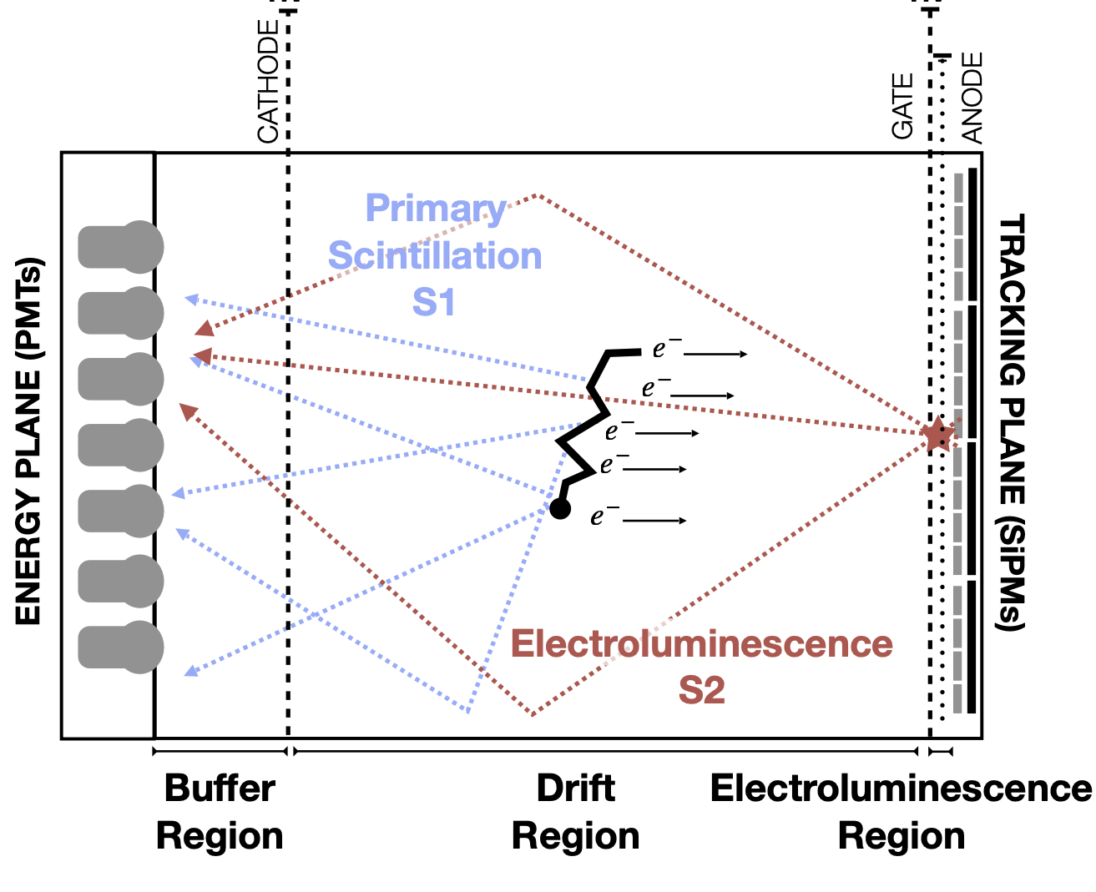
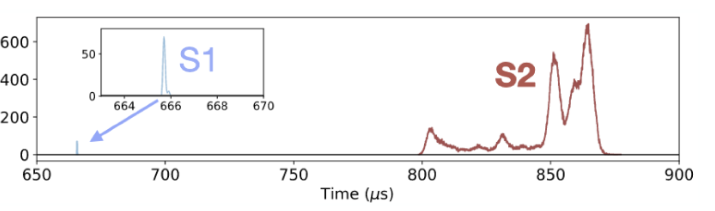
Neutrino Experiment with a Xenon TPC (NEXT)
Energy loss of a charged particle interacting in the high pressure Xe gas:
Excitation of Xe atoms
Ionization
Hit info: (x, y, z, E)
De-excitation of Xe:
Primary Scintillation, S1
Marks t₀
Drift time: DT_{i} = t_{i} - t₀
Acceleration of ionization electrons at the EL region:
Secondary Scintillation, S2
S2 measured in 1μs time intervals: S2 time, t_{i}
Notes:
The principle of operation of the NEXT TPC (HPXeTPC with EL amplification) relies on the fact that when a charged particle interacts in high pressure xenon gas, it loses energy by ionisation and by exciting the atoms in the gas.
S2 se mide en intervalos temporales de 1mus y para cada uno de estos intervalos el DT se corresponde con la diferencia entre este tiempo y t0

Slide 5
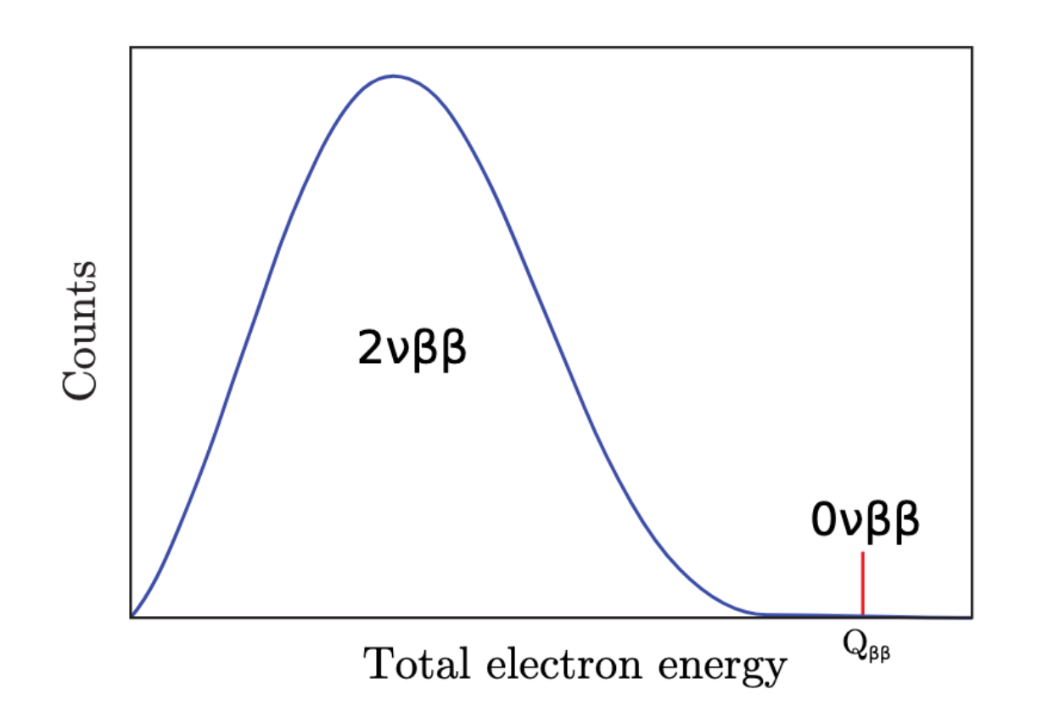
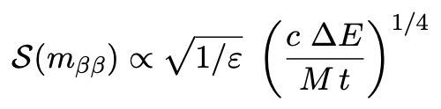
Neutrino Experiment with a Xenon TPC (NEXT)
This technology allows for:
Excellent energy resolution
Background counts
Energy resolution
Sensitivity to 0vßß
Exposure time
Detector efficiency
Isotope mass

Slide 6
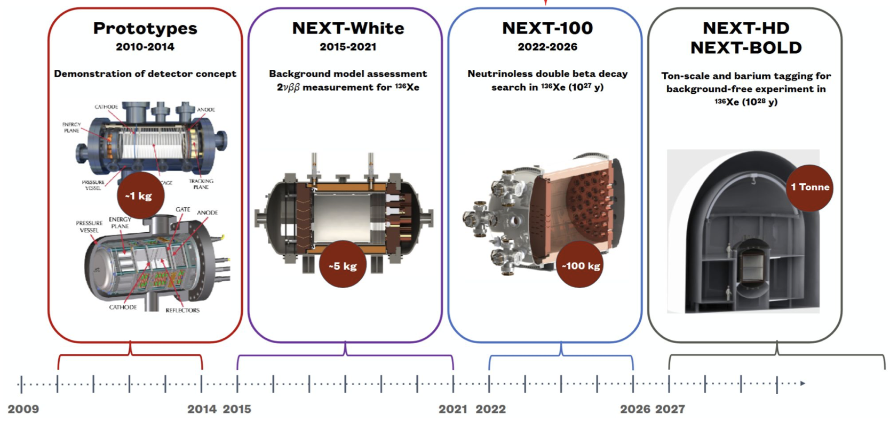
Neutrino Experiment with a Xenon TPC (NEXT)
This technology allows for:
Scalability
Energy resolution
Background counts
Sensitivity to 0vßß
Exposure time
Detector efficiency
Isotope mass

Slide 7
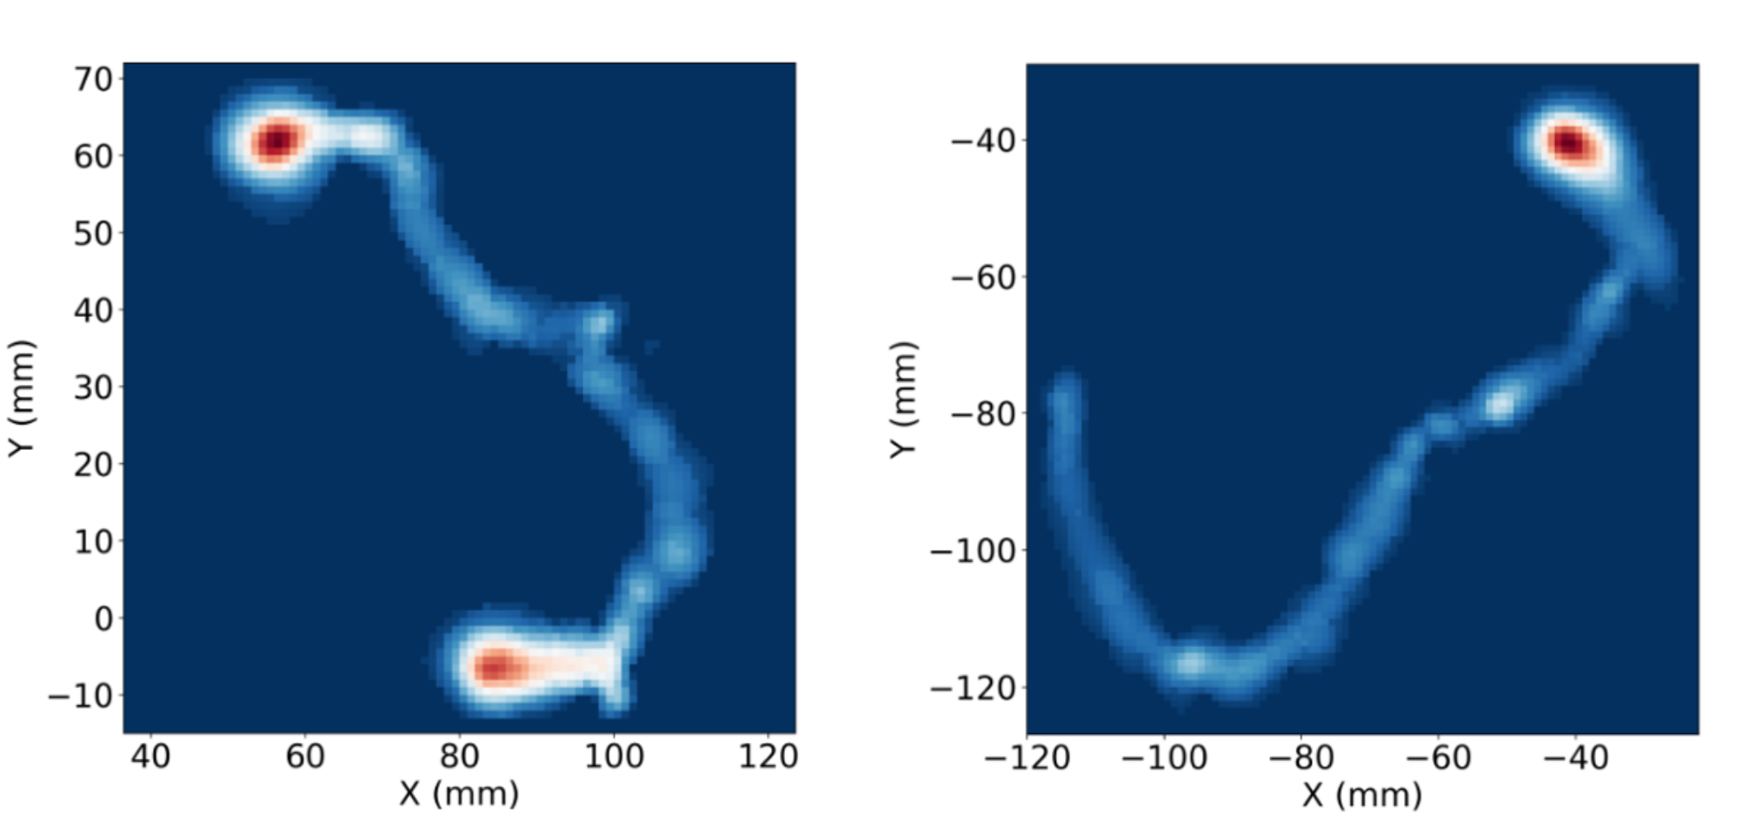
Neutrino Experiment with a Xenon TPC (NEXT)
This technology allows for:
Background discrimination
Energy resolution
Background counts
Sensitivity to 0vßß
Exposure time
Detector efficiency
Isotope mass

Slide 8
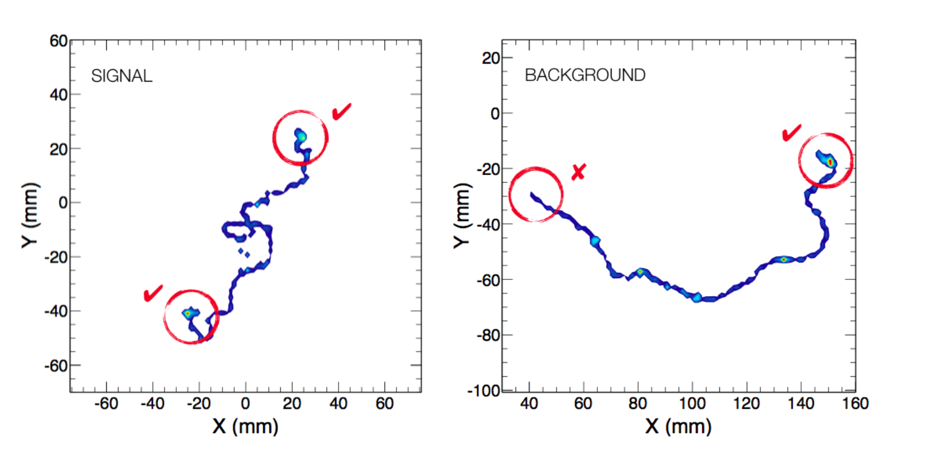
Neutrino Experiment with a Xenon TPC (NEXT)
Topological signature of a signal candidate: single track with two “blobs” (small regions, corresponding to the Bragg peaks, where a large amount of the energy of the particles is deposited)
signal vs background discrimination
The topological signature depends on:
Diffusion of the ionization electron trail on its way to the anode
Separation between SiPMs (SiPM pitch) for granularity
Operational pressure of the Xe gas
Notes:
Our signal consists always of two electrons emitted from the same vertex, so the topological signature looks like a single track with the two electron energy depositions at each end, whereas the background events consists of a single electron energy deposition with

Slide 9
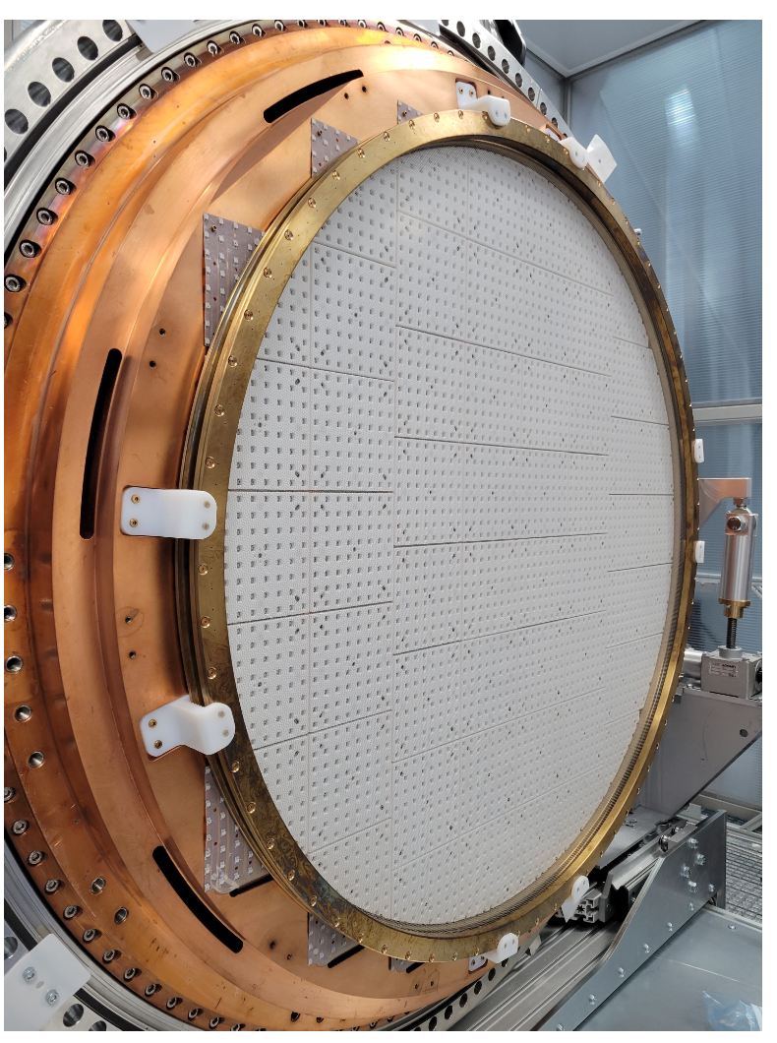
Study of the tracking plane performance
NEXT-100 currently operating with a 15 mm pitch (distance between SiPMs) in the tracking plane
How to improve topological reconstruction…?
  Study the diffusion with different gas mixtures:
    15% He + 85%Xe vs 100% Xe
  Change the operational pressure of the gas:
    5 bar vs 13.5 bar
  Move to a lower pitch?
    Study the performance with different pitches:
      5 mm
      10 mm
      15 mm
SiPM Tracking plane
EL region

Slide 10


Sparse Convolutional Neural Network (SparseConvNet)
Neural network with 3D “sparse” convolutions
  https://github.com/facebookresearch/SparseConvNet
Does not require 3D convolutions across every point in a dense grid: takes instead a list of only the voxels with non-zero energy
Also implements “submanifold” sparse convolutions, which preserve the number of non-zero voxels
Normal (sparse or dense) convolution
“Submanifold” sparse convolution

Slide 11
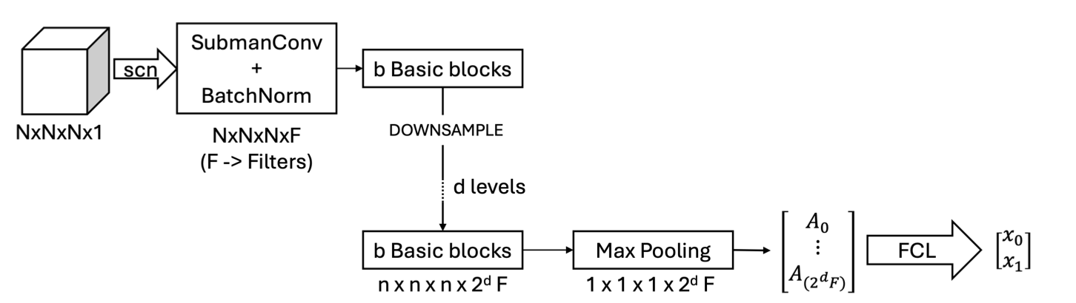
NEXT SparseConvNet
Latest code:
https://github.com/jerenner/NEXT_SPARSECONVNET
Network architecture

Slide 12
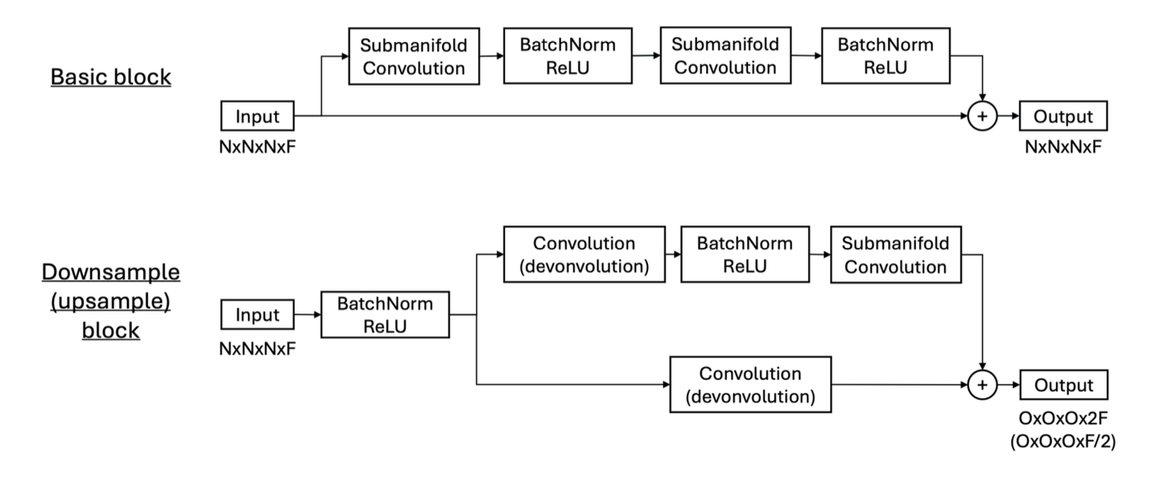
NEXT SparseConvNet
Network
architecture
For classification:
  Max pooling
  Convert to dense
  2 fully-connected layers (last one gives classification in 2 outputs)
Notes:
This is the architecture of the SparseConvNet
It consists of a series of “blocks” which downsamples the spatial dimensions of each event and then performs classification
We only use half of the net: the other half (reconstructs the spatial dimensions and) can be used for tasks like segmentation as done by Martin

Slide 13
Simulation
Simulation of single and double electron tracks using 2 different simulation paths:
Full reconstruction:
  “standard” waveform-based simulation
  simulates the reconstruction of sensor hits and correction of their energies
nexus (Geant4)
→
detector simulation
→
reconstruction chain
→
voxels
Sensim (sensor simulation):
  no waveform generation and reconstruction
  directly calculates the expected energy of a single “hit” in each SiPM
  partially truth-based but still includes critical physics effects like electron drift, diffusion and EL production
nexus (Geant4)
→
sensor simulation
→
voxels
Notes:
Falta decir que el background simulado es single electron y la señal es double electron

Slide 14
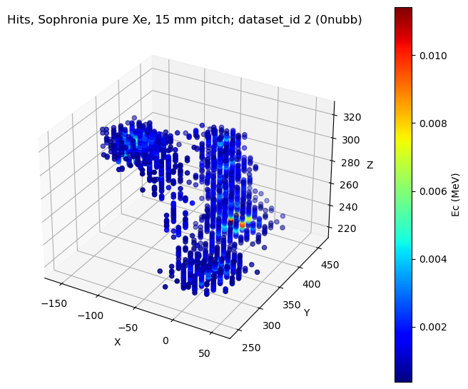
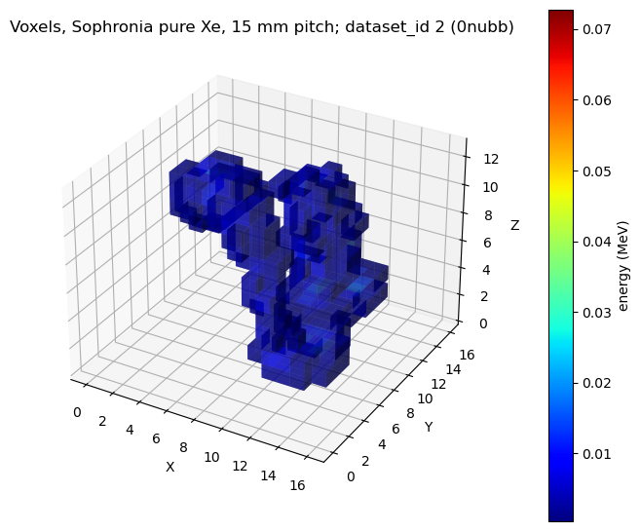
Simulation
Standard (15 mm) hits (full reconstruction), voxelized:

Slide 15
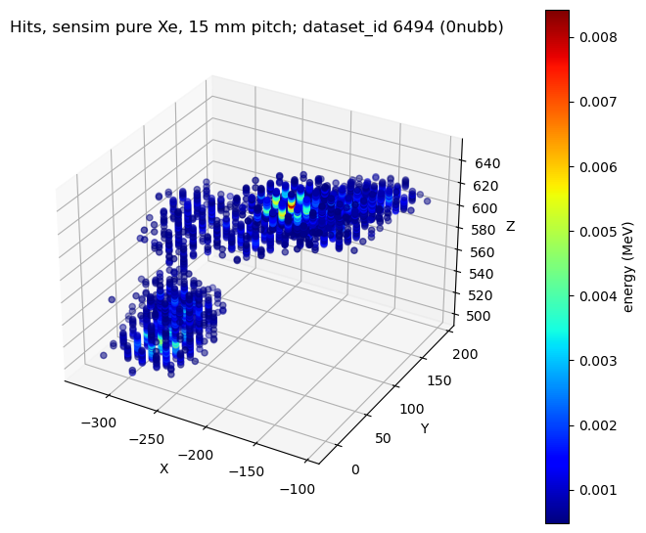
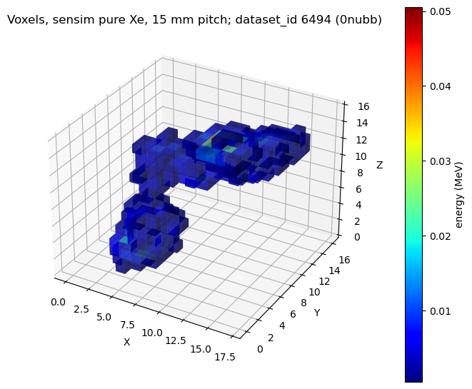
Simulation
Sensim (15 mm) hits, voxelized:

Slide 16
CNN results: dataset preparation
Cut on voxel energy sum = [2.4,2.55] MeV (around Q_{ββ} energy)
70% training / 20% validation / 10% test
2 x 3 x 2* x 2 combinations (*Xe/He only run with sensim)
5 bar
5 mm
Pure Xe
sensim
x
10 mm
x
x
13.5 bar
Xe/He 85/15
standard
15 mm
2 pressures
2 gas mixtures
2 simulation methods
3 pitches

Slide 17
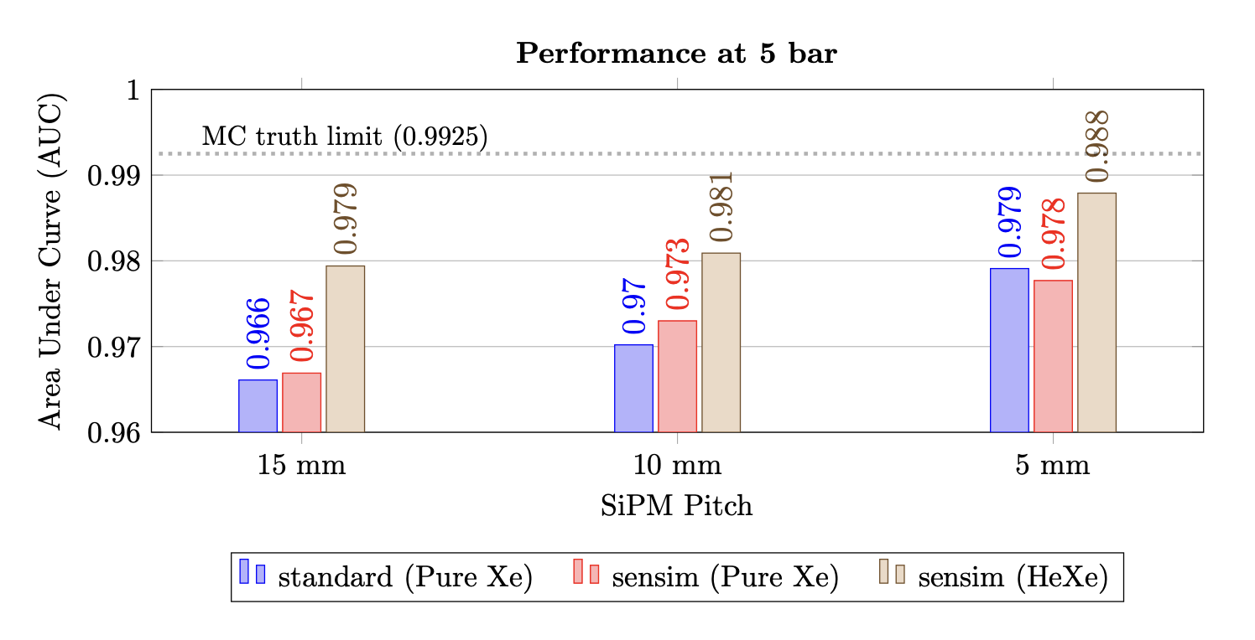
CNN results (5 bar)
*Area Under the Receiver Operating Characteristic (ROC) Curve
Notes:
We also show the Monte Carlo true information voxelized at 2x2x2 mm^3 as the “ideal case”

Slide 18
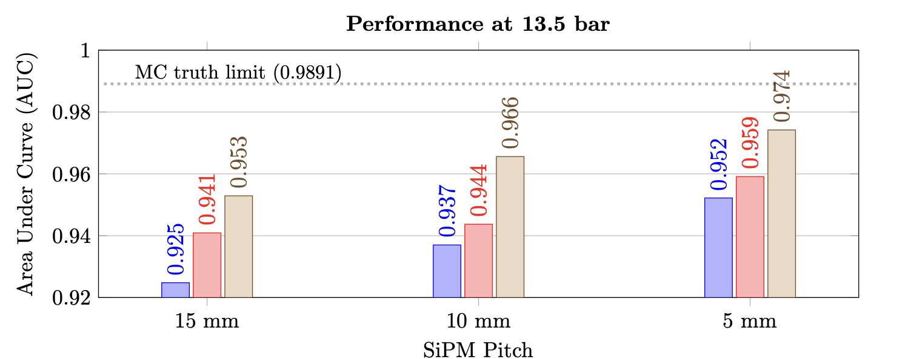
CNN results (13.5 bar)
*Area Under the Receiver Operating Characteristic (ROC) Curve

Slide 19
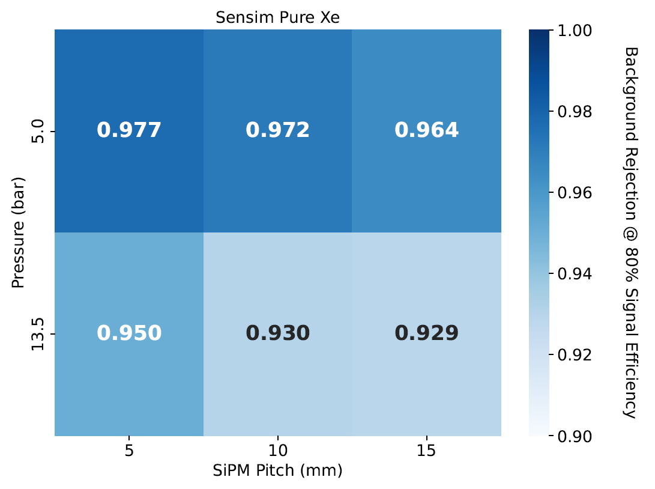
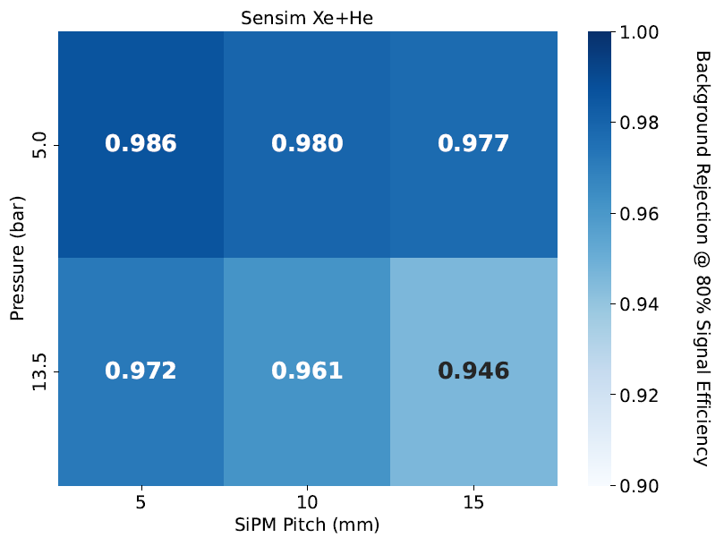
CNN results (Sensim)
Background rejection at 80% signal efficiency

Slide 20
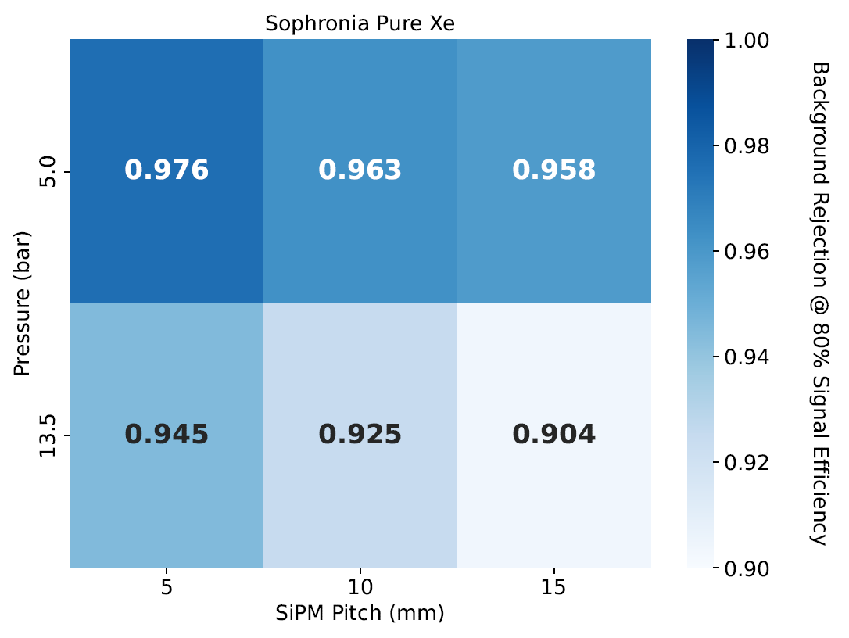
CNN results (Standard simulation pure Xe)
Background rejection at 80% signal efficiency

Slide 21
Conclusions
Best results (background rejection) at 5bar, 5mm pitch and mixture He+Xe.
Operational pressure of 5 bar yields better rejection power but also a lower signal factor than at 13.5 bar (factor of 2 less background but also factor of 3 less signal)
Better results with 5mm pitch than 10mm but it may not be worth the upgrade?
Optimal cost/performance configuration:
High pressure (13.5 bar) + 10 mm pitch + mixture HeXe
Notes:
Results seem good across the board:
better at 5 bar than at 13.5 bar
better results at lower pitches
better with Xe/He
factor of ~2-3 difference between best case (HeXe + 5 mm pitch) and “worst” case (pure Xe + 15 mm pitch)
Poner algo de por qué se elige el pitch de 10mm en vez del de 5mm (por relación ganancia/coste o lo que sea)

Slide 22
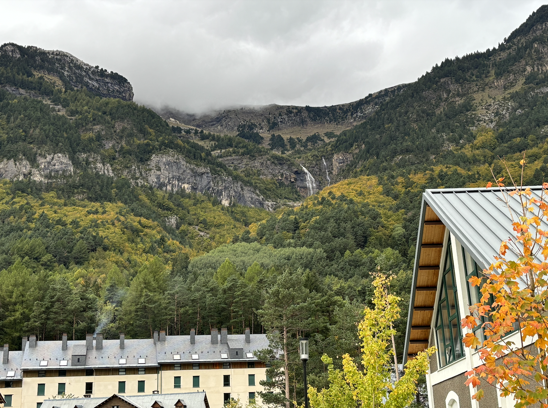
Thanks for your attention!!

Slide 23
Backup slides

Slide 24
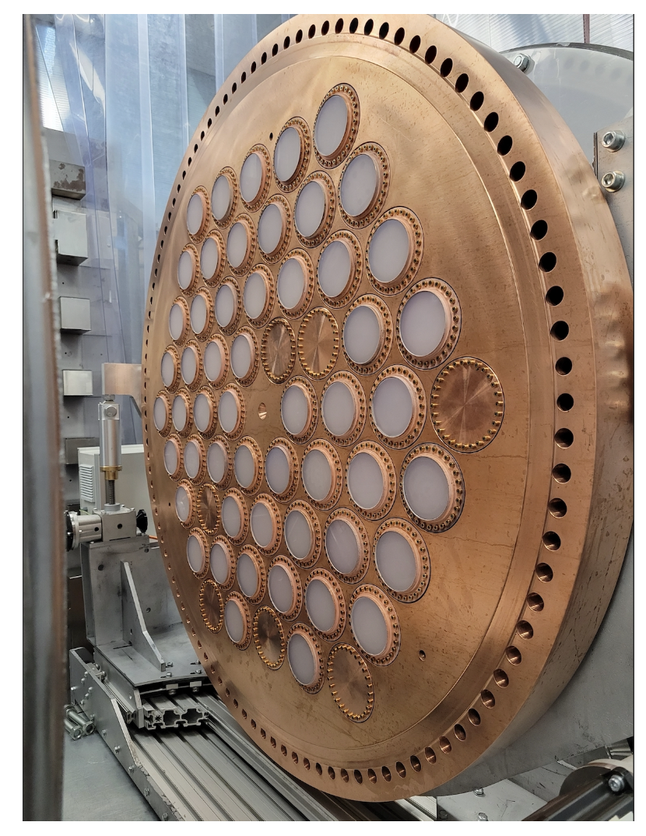
NEXT-100 detector
Two sensor planes:
SiPM Tracking plane
PMT Energy plane
EL region
Notes:
The NEXT-100 detector can hold ~100kg of xenon gas at 15bar and as I have probably already said, the energy and spatial pattern of ionizing particles in the detector are accurately reconstructed using the energy plane (PMTs) and the tracking plane (SiPMs) respectively that collect the signal from the amplification region . So here we can see both of them (tracking plane with EL region for signal amplification).
Tracking plane: Silicon PhotoMultipliers (SiPMs), collection of the signal from the amplification region, allows for the reconstruction in the XY plane of the coordinates of the event.
Energy plane: PhotoMultiplier Tubes (PMTs), records the start time of an event t₀, triggered by S1, measures the total energy of the chamber, proportional to S2

Slide 25
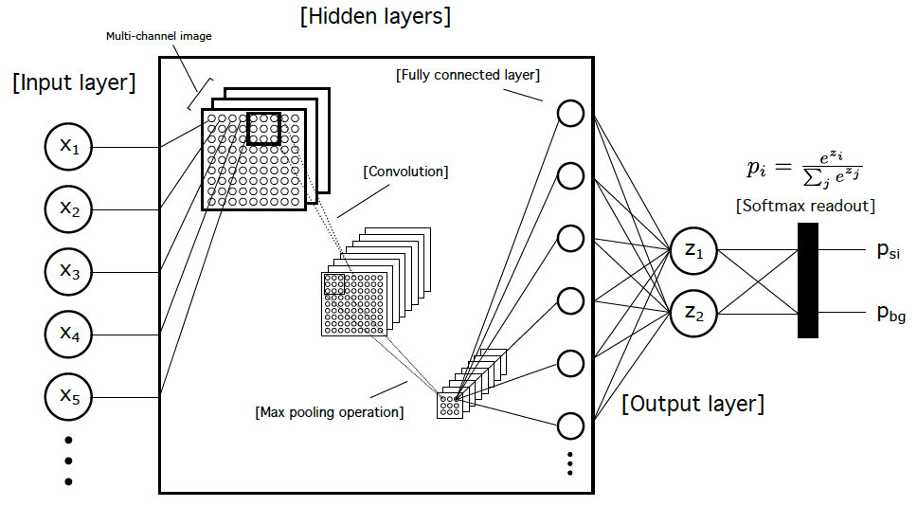
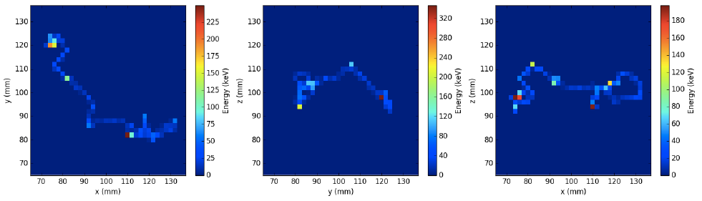
Neural Networks
Alternative to classical topology cut
Classification probability (“topology cut”)

Slide 26
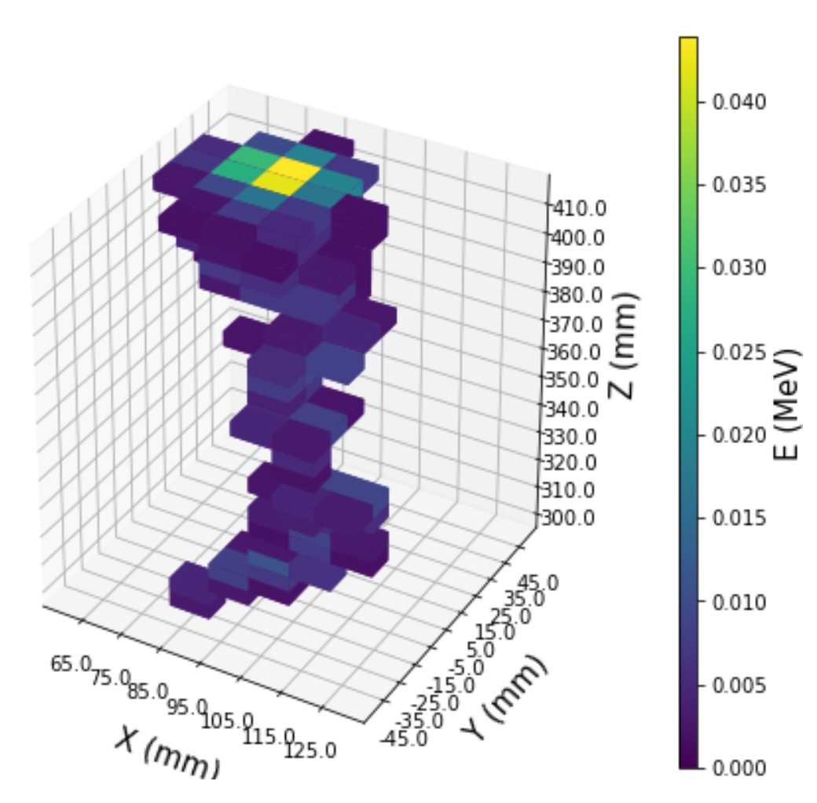
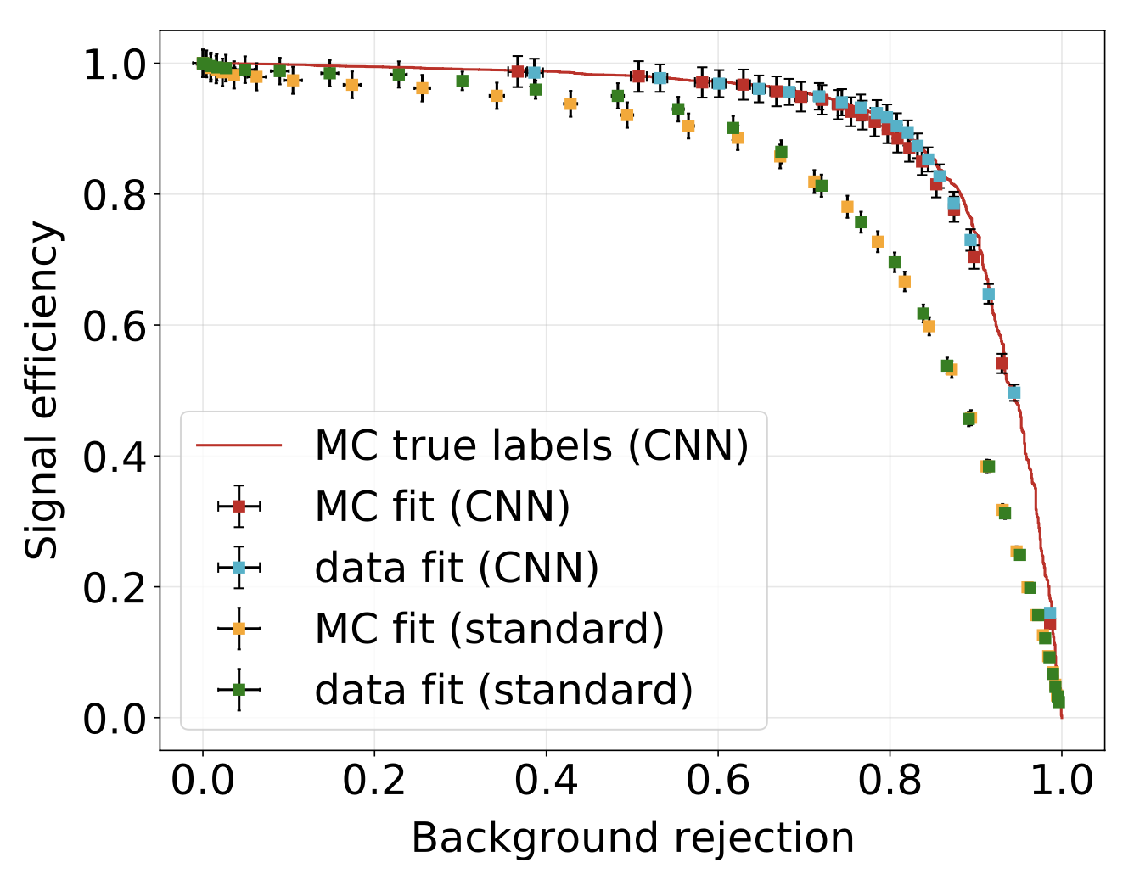
Sparse Convolutional Neural Nets (CNNs)
Results of signal/background classification in NEXT-White using SparseConvNet (arXiv:1505.02890)
Input is 3D “voxelized” reconstructed tracks; output is signal/background probability
JHEP 2021, 189 (2021)

Slide 27
NEXT-100 detector
Energy plane
PhotoMultiplier Tubes (PMTs)
Records the start time of an event t₀, triggered by S1
Measures the total energy of the chamber, proportional to S2

Slide 28
NEXT-100 detector
Tracking plane
Silicon PhotoMultipliers (SiPMs)
Collection of the signal from the amplification region
Allows for the reconstruction in the XY plane of the coordinates of the event
EL region
Notes:
Omitir estas dos que ya lo vas a explicar en el funcionamiento de next si vas muy justa de tiempo

Slide 29
Simulation
2 different simulation paths:
reconstruction: nexus → detsim → hypathia → sophronia [→ voxels]
sensim: nexus → sensim [→ voxels]
“reconstruction” simulates the reconstruction of hits and correction of their energies
  NEXT-100 geometry
  Light tables and Kr maps
“sensim” is a modified detsim by Martín; provides the “energy” detected by each SiPM directly using PSFs (functions that account for the expected charge distribution for a pointlike EL light source at a location z in the EL gap)
In each case, we convert “calibrated” hits or the “sensim” sensor responses to voxels: 15x15x(~10) for 15 mm pitch, 10x10x(~10) for 10 mm pitch and 5x5x5 for 5mm pitch

Slide 30
CNN results
Datasets were prepared:
  All events with voxel energy sum outside of range [2.4,2.55] MeV were discarded
  Divided into:
    70% training
    20% validation
    10% test
  Network was trained until loss seemed to converge and the weights for an epoch after convergence were chosen
  Test set evaluated with those weights
Simulations done in pure Xe and in a Xe(85%)-He(15%) mixture (HeXe) (sensim only) to observe the effects of lower diffusion

Slide 31
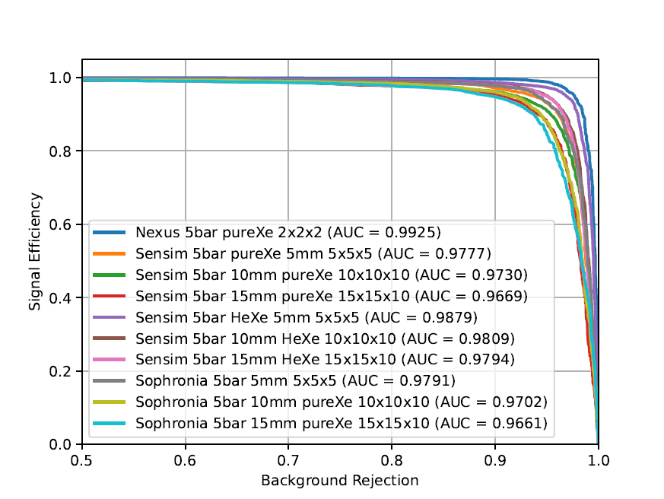
CNN results
(5 bar)
Signal efficiency vs. background rejection

Slide 32
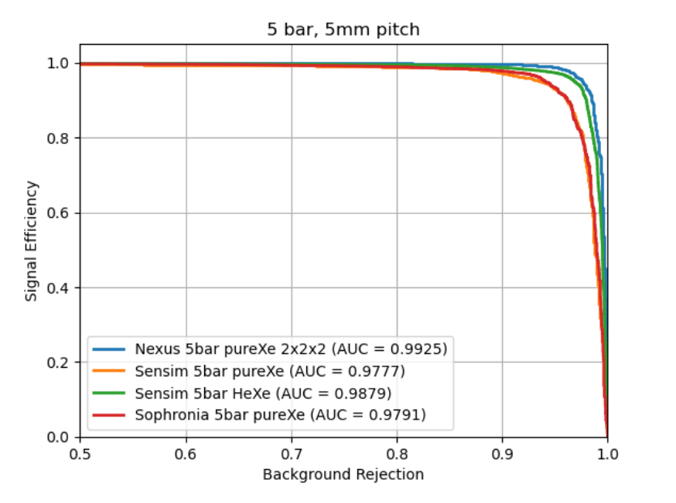
CNN results
(5 bar, 5mm)
Signal efficiency vs. background rejection

Slide 33
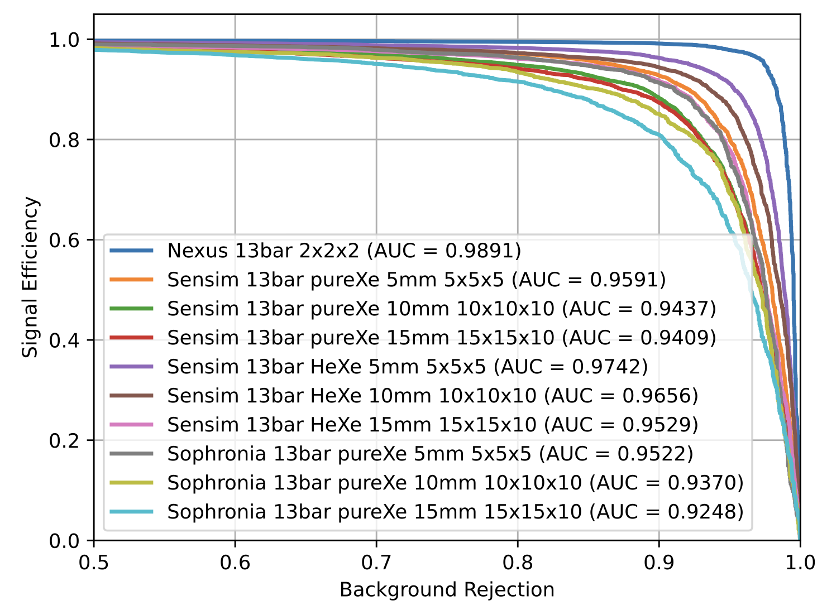
CNN results
(13.5 bar)
Signal efficiency vs. background rejection

Slide 34
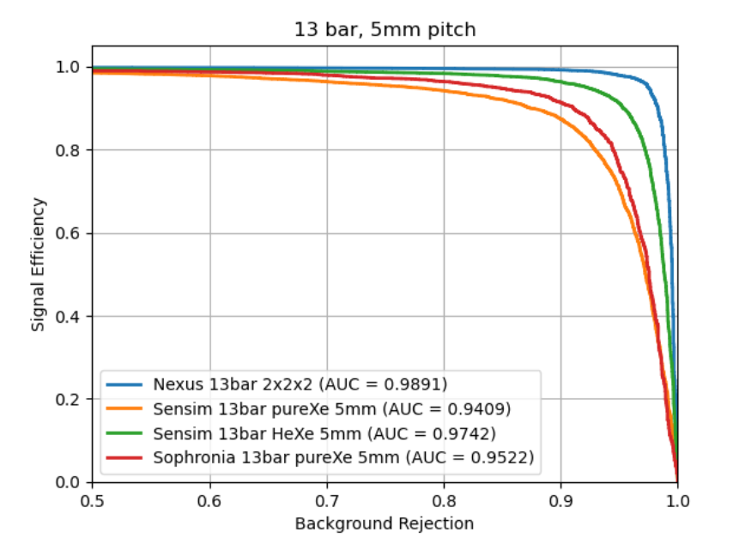
CNN results
(13.5 bar, 5mm)
Signal efficiency vs. background rejection

