Slide 1

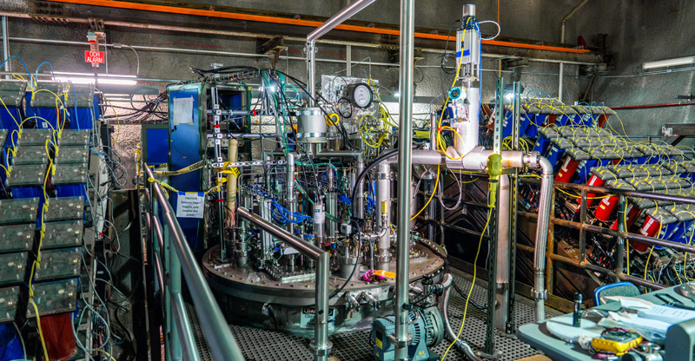




Track Matching Across Detectors:
Using GNNs to Match Particles across DUNE’s Near Detector Prototypes
Jessie Micallef (she/they)
on behalf of the DUNE Collaboration
jessie.micallef@tufts.edu

Slide 2
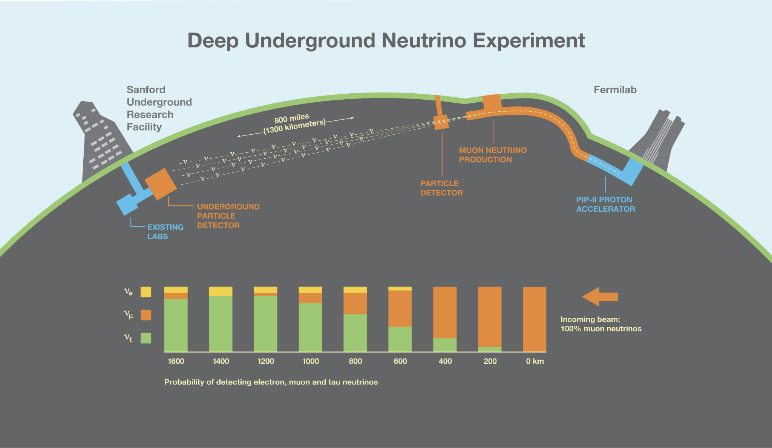

DUNE: Precise Neutrino Oscillation Measurements
𝝂_{e}
𝝂_{𝜇}
More bison
Some bison
𝝂_{𝜇} Beam
𝝂_{𝜏}
Near Detector
Accelerator
Far Detector
*not to scale

Slide 3
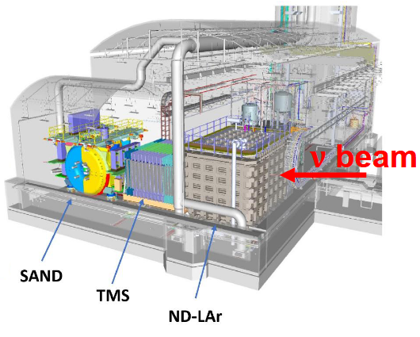
Near Detector (ND) Liquid Argon (LAr)
Important to constrain 𝝂
Flux (enter)
Cross section (interact)
Detector systematics (detect)
with ND that has same target
(LAr) as Far detector

Slide 4
Near Detector (ND) Liquid Argon (LAr)
Important to constrain 𝝂
Flux (enter)
Cross section (interact)
Detector systematics (detect)
with ND that has same target
(LAr) as Far detector
Near Detector (ND) Liquid Argon (LAr) Time Projection Chamber
The Muon Spectrometer

Slide 5
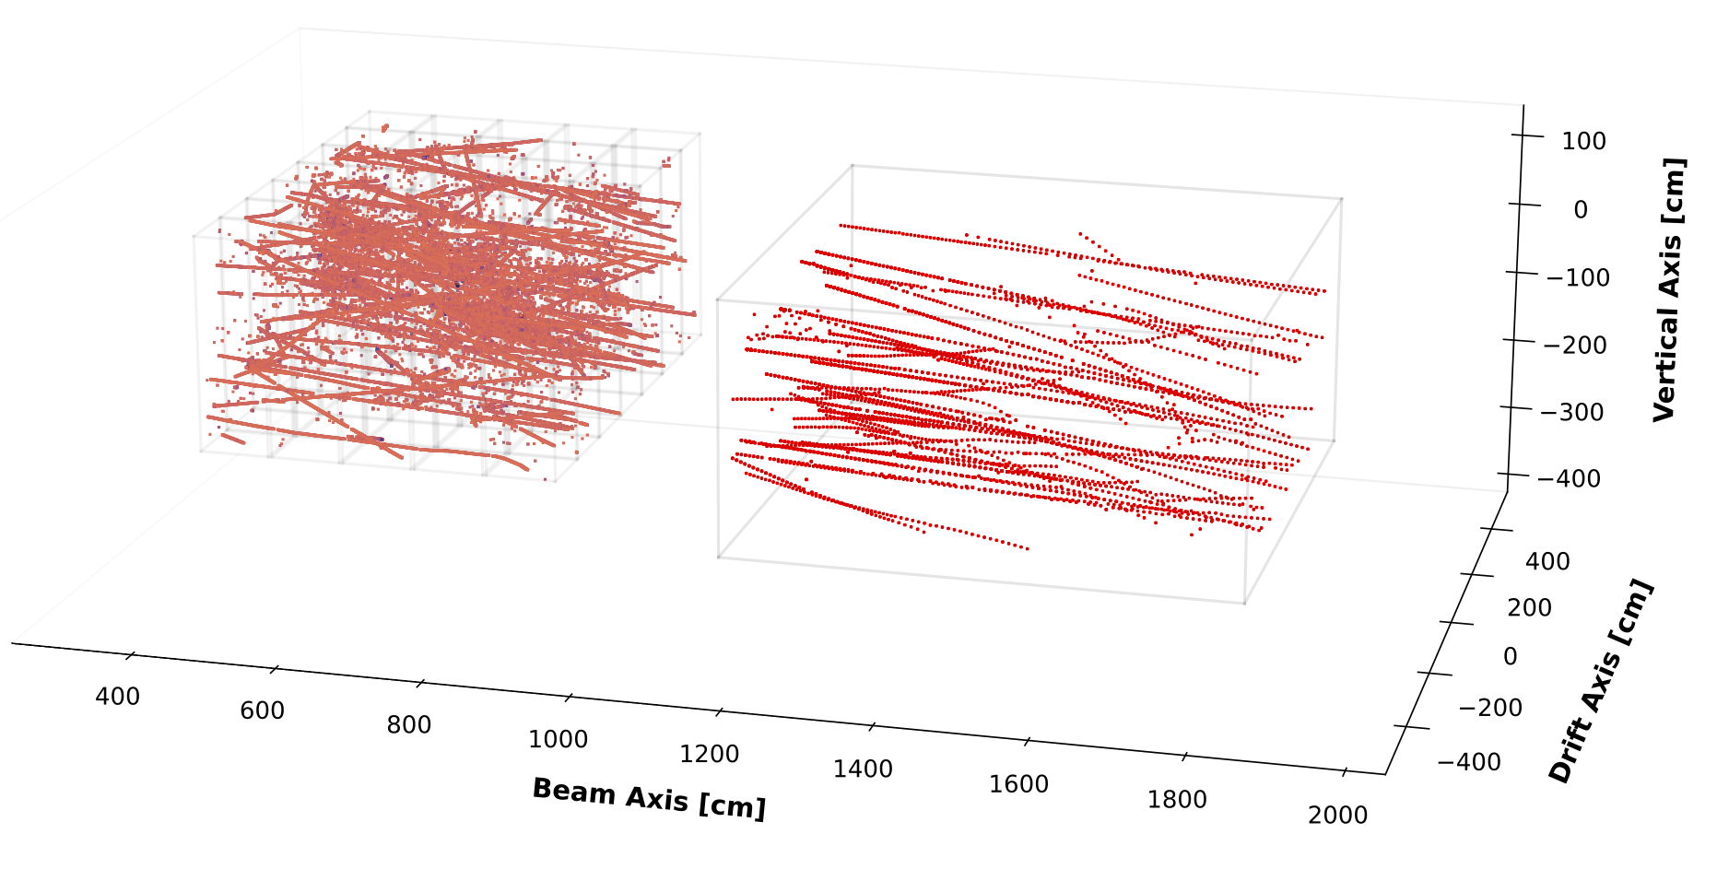
The Muon Spectrometer:
Valuable for PID and Removing Background Muons
𝝂 beam
ND LArTPC
DUNE Work-In-Progress
SIMULATION
Downstream
Muon Tagger

Slide 6
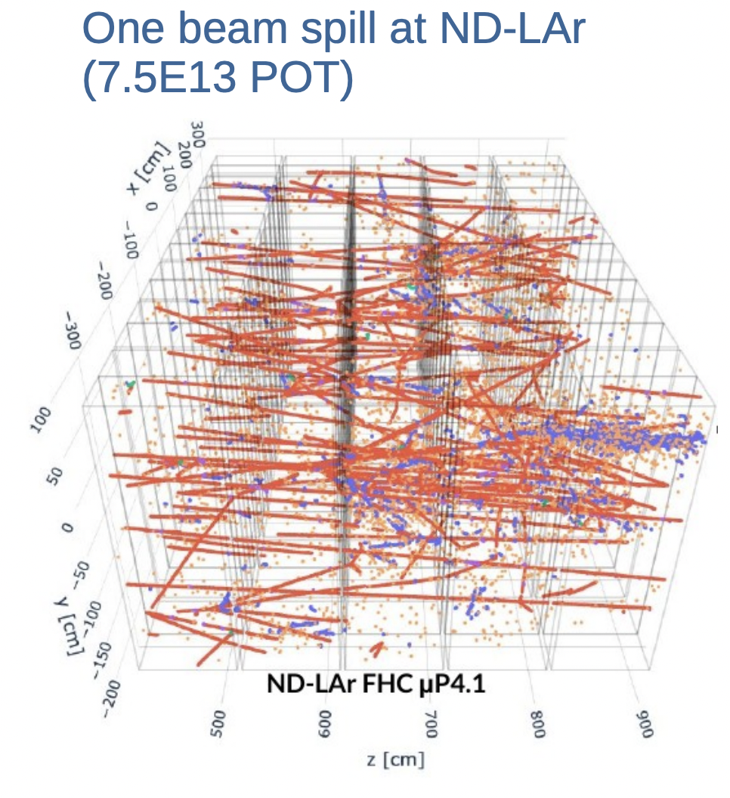
Handling Beam Intensity in Near Detector LAr
~100 beam-related
interactions!

Slide 7
Handling Beam Intensity in Near Detector LAr
~100 beam-related
interactions!
Advanced detector tech:
✅ LArTPC detectors

Slide 8
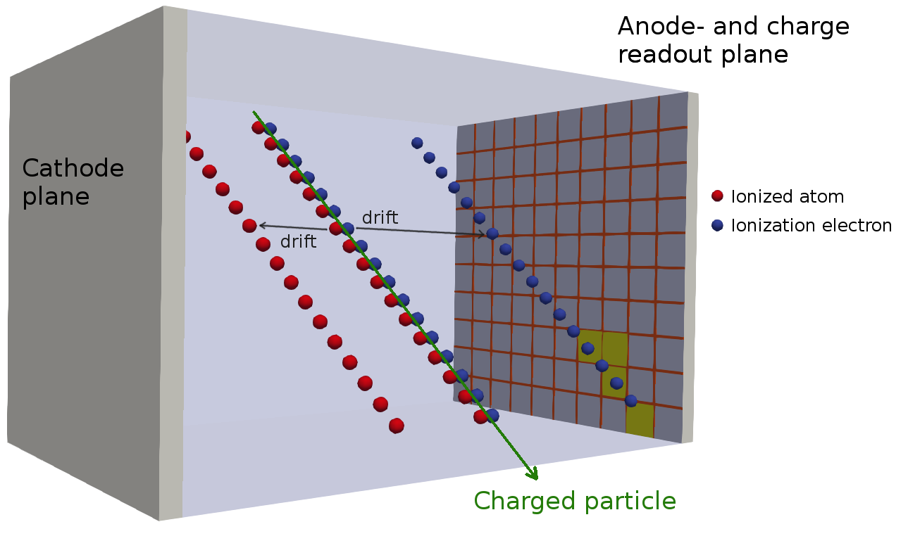
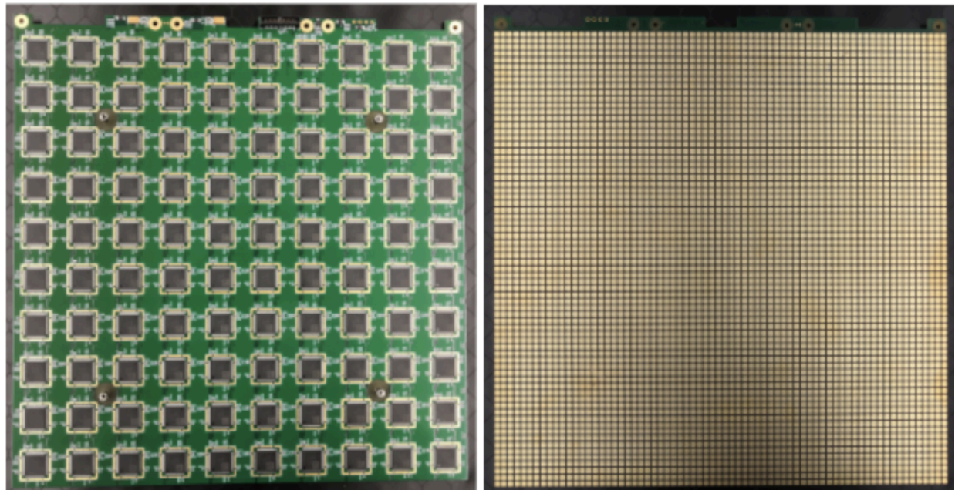
LArTPC with Pixel Readout
DUNE ND-LAr uses 2D pixel plane readout instead of wires → native 3D image!
Back of plane with LArPix ASICs (left) & TPC-facing side of pixel plane with pixel pitch ~4mm (right)
LArPix Paper

Slide 9
Handling Beam Intensity in Near Detector LAr
More details:
Single Module
Near Detector CDR
~100 beam-related
interactions!
Advanced detector tech:
✅ LArTPC detectors
✅ Native 3D detection

Slide 10
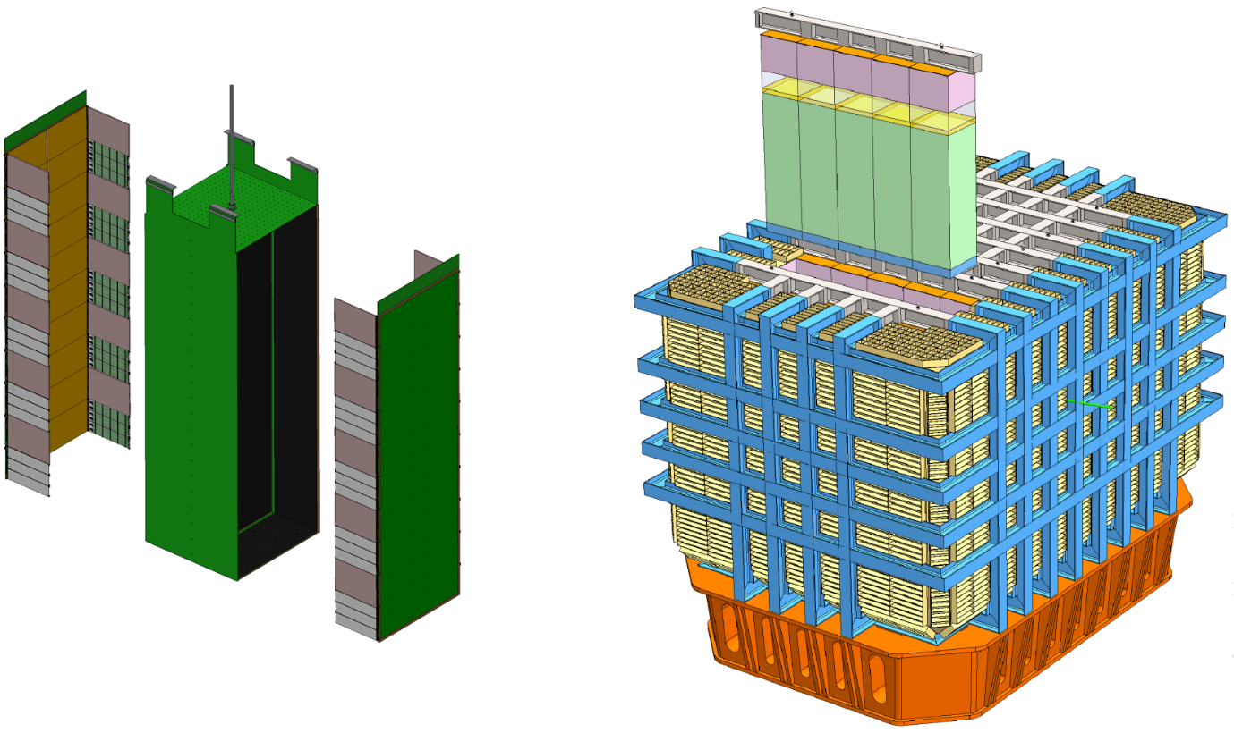

Handling Beam Intensity in Near Detector LAr
More details:
Single Module
Near Detector CDR
~100 beam-related
interactions!
Advanced detector tech:
✅ LArTPC detectors
✅ Native 3D detection
✅ Optically separated modules
Light detectors
drift
Anode readout
5x7 Modules
cathode
Anode readout

Slide 11
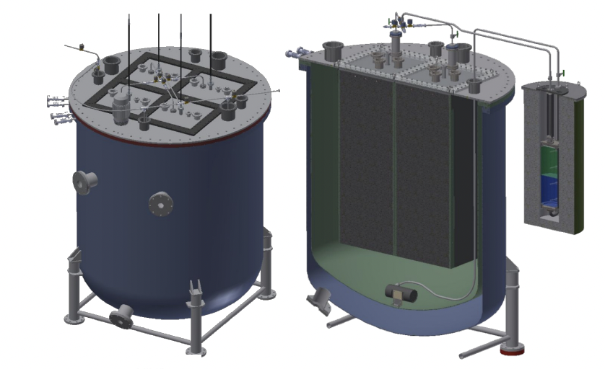
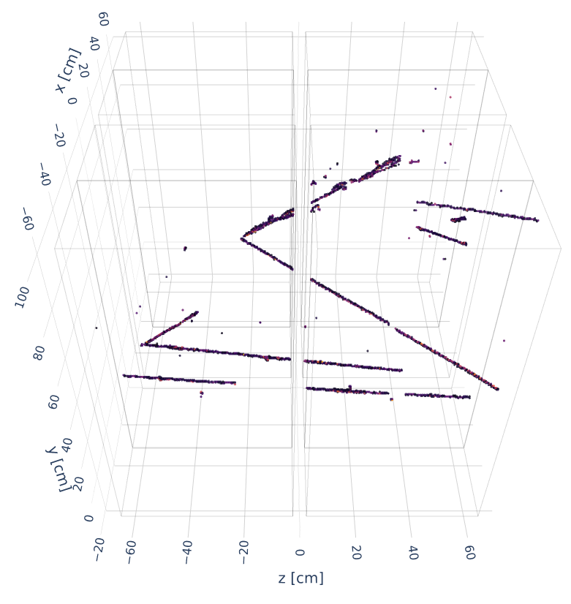
Novel Tech Needs Prototypes: 2x2 Demonstrator
Color: energy deposition heatmap
Light detectors
drift
2x2 Modules
SIMULATION
DUNE Work-In-Progress
More details:
Single Module
Near Detector CDR
Operation of 2x2
Anode readout
cathode
Anode readout

Slide 12
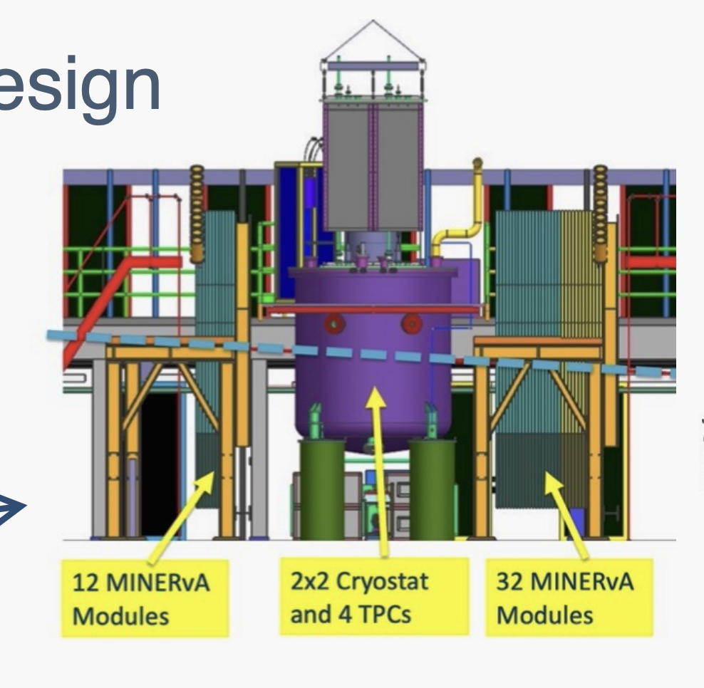
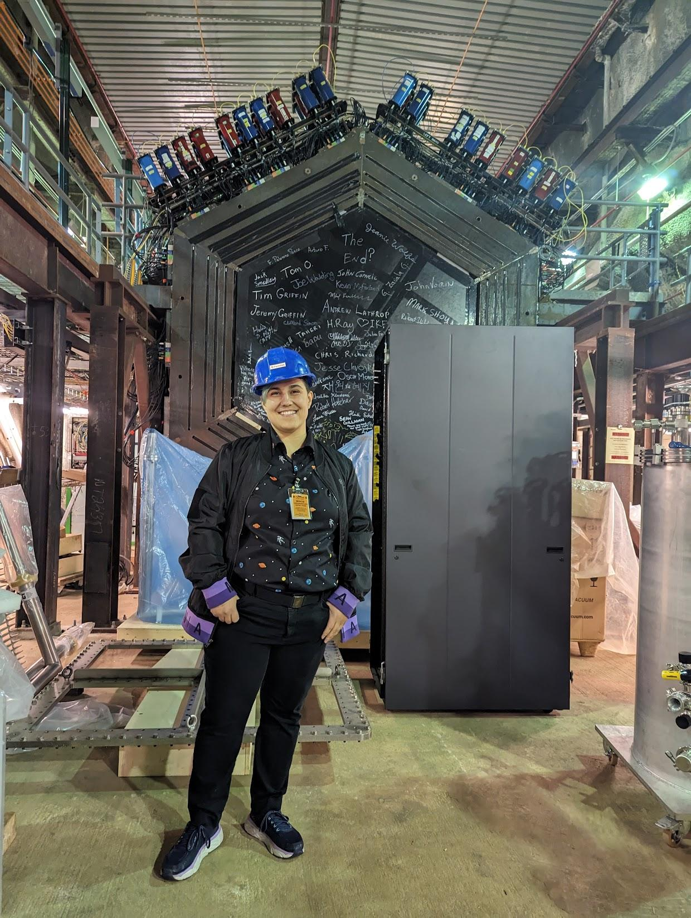
2x2 Prototype in Fermilab NuMI 𝝂 Beam
𝝂
Upstream
Muon Tagger
2x2 LArTPC
Downstream
Muon Tagger
More details: Operation of 2x2

Slide 13
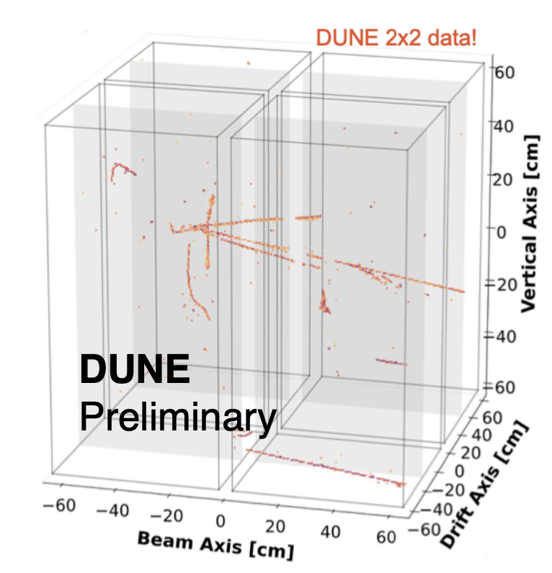
2x2 Prototype in Fermilab NuMI 𝝂 Beam
𝝂
Upstream
Muon Tagger
2x2 LArTPC
Downstream
Muon Tagger
More details: Operation of 2x2

Slide 14
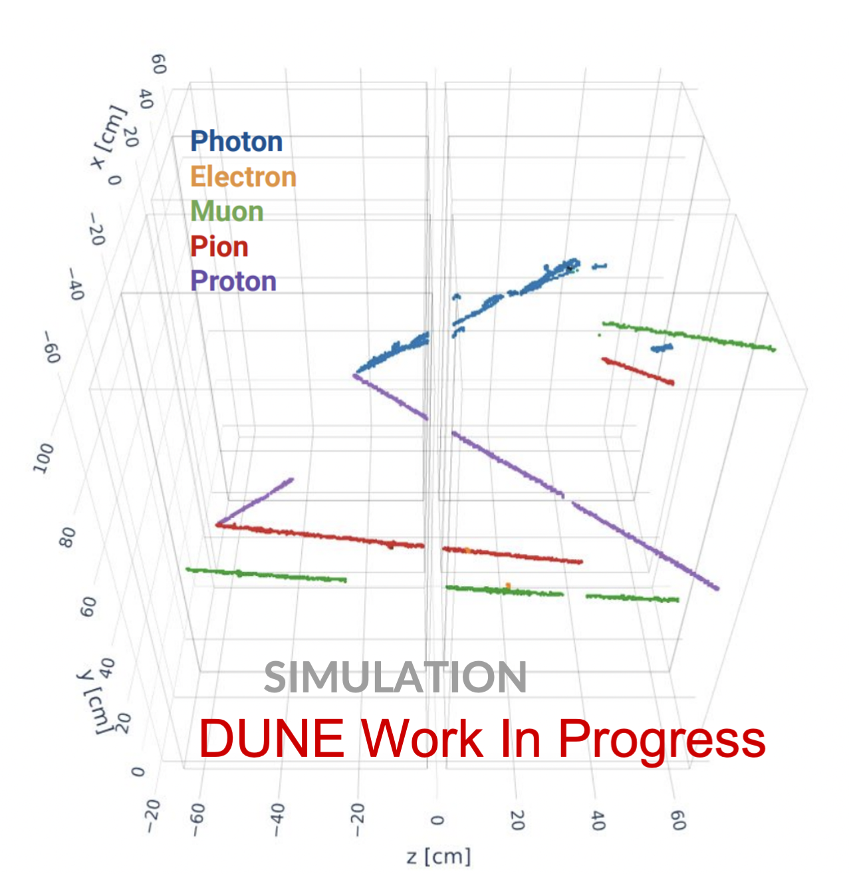
2x2 Prototype in Fermilab NuMI 𝝂 Beam
See earlier talk by Francois:
Deep Neural Network Cascade for the Deep Underground Neutrino Experiment
DNN prediction for 2x2!
𝝂
Upstream
Muon Tagger
2x2 LArTPC
Downstream
Muon Tagger

Slide 15
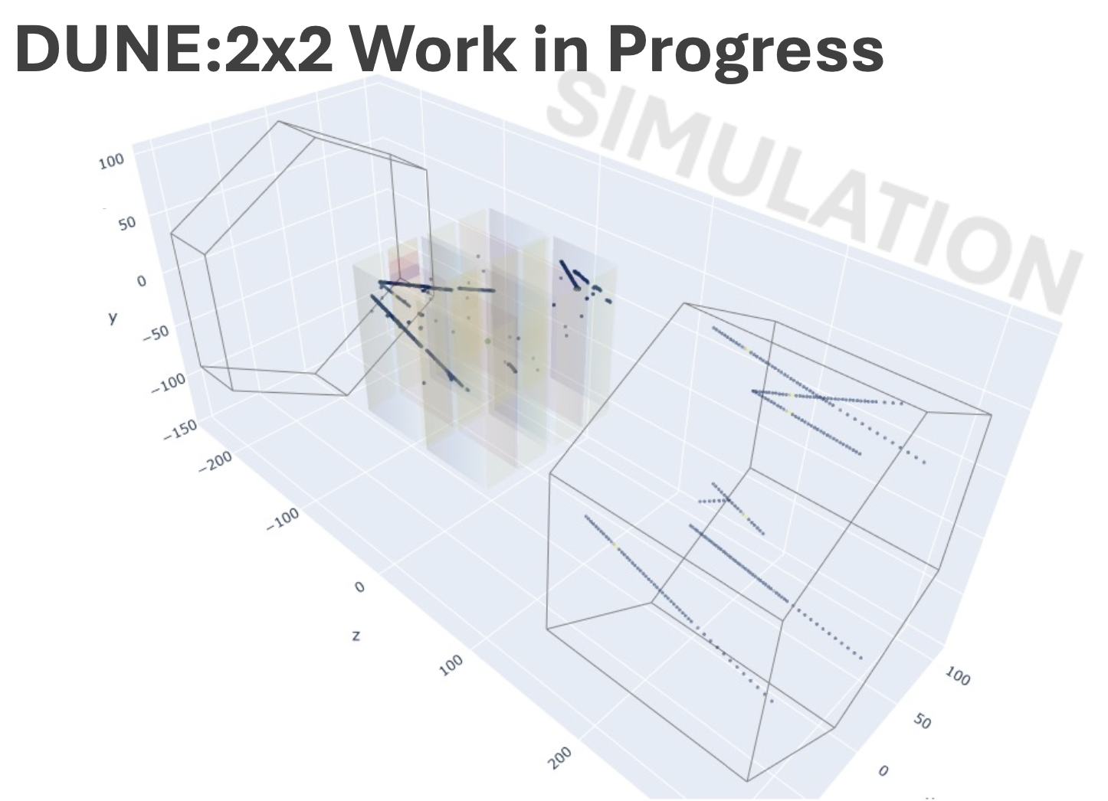
Muons Leave the 2x2 LArTPC Volume:
Can this information improve the PID?
Let’s add muon tagger detector information!
2x2 LArTPC
Downstream
Muon Tagger

Slide 16

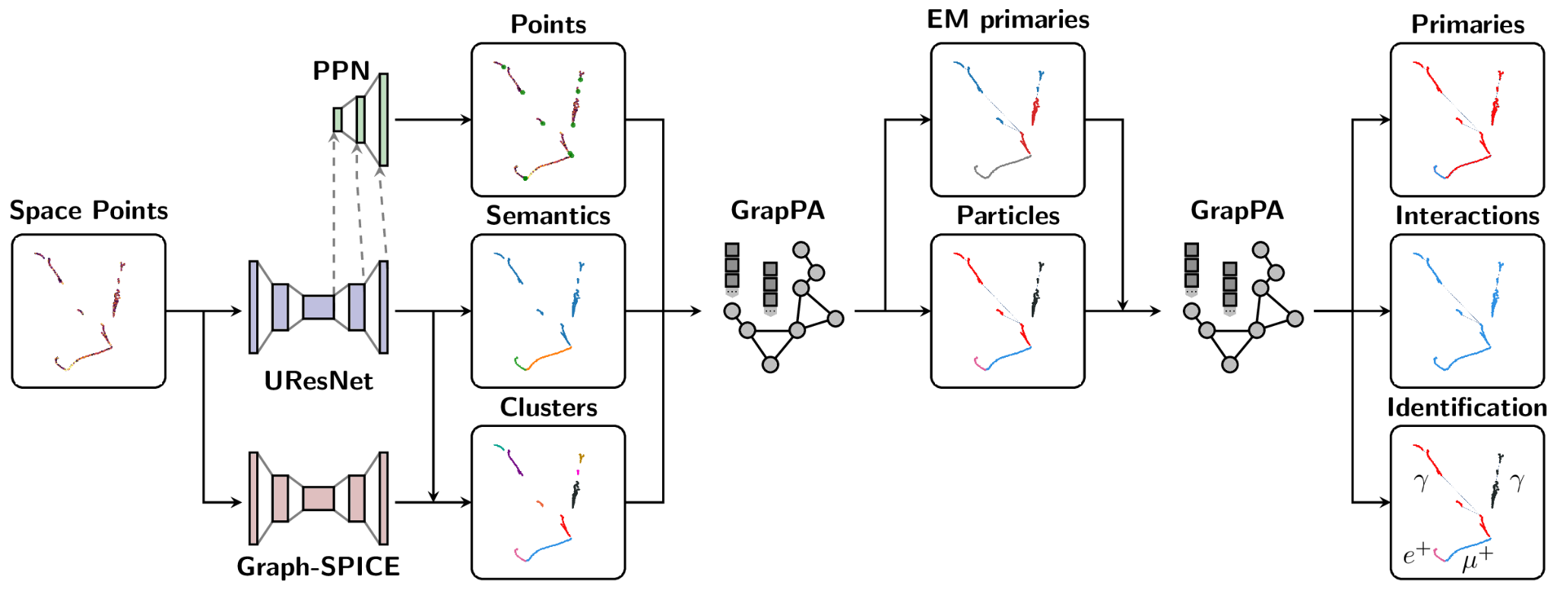
Machine Learning for LArTPCs:
Pixel
Fragment
Interactions
See earlier talk by Francois:
Deep Neural Network Cascade for the Deep Underground Neutrino Experiment

Slide 17

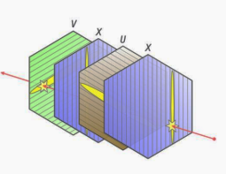
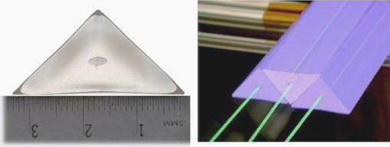
Muon Tagger uses Solid Scintillators
Muon Tagger:
Solid scintillation particle detector with 3 orientations
𝝂
Upstream
Muon Tagger
2x2 LArTPC
Downstream
Muon Tagger
MINERvA Operations

Slide 18
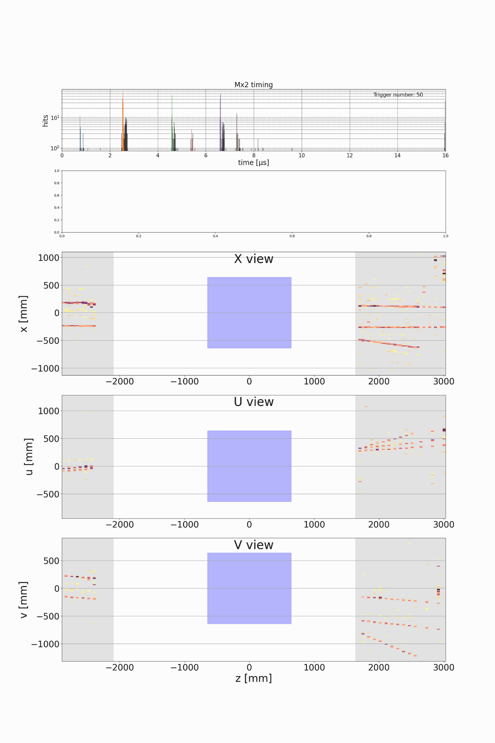
3D from 2x2 vs 2D MINERvA Muon Tagger
Muon Tagger: inherently a 2D output!
Inherently a 3D pixel readout
SIMULATION
Upstream
Muon Tagger
2x2 LArTPC
Downstream
Muon Tagger
DUNE Work-In-Progress
MINERvA Operations

Slide 19
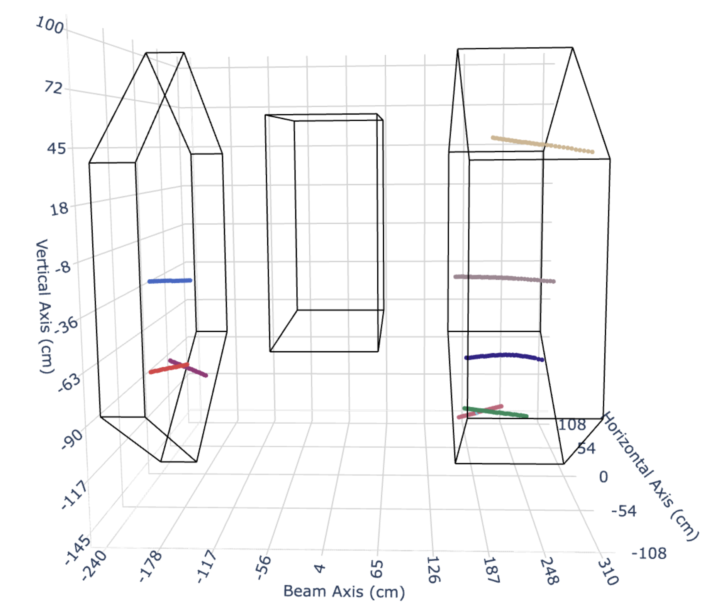

Muon Tagger Track Segments
Colors indicate track segment
Ignoring 2x2 for simple test
SIMULATION
Traditional Track Reconstruction
DUNE Work-In-Progress
SIMULATION
Note: left & right are not the same particles
DUNE Work-In-Progress
Upstream
Muon Tagger
2x2 LAr with
4 TPCs
Downstream
Muon Tagger
Upstream
Muon Tagger
2x2 LAr with
4 TPCs
Downstream
Muon Tagger

Slide 20

SPINE: Inserting 2D Muon Detector
Pixel
Fragment
Interactions
GrapPA: PhysRevD. 104. 072004

Slide 21
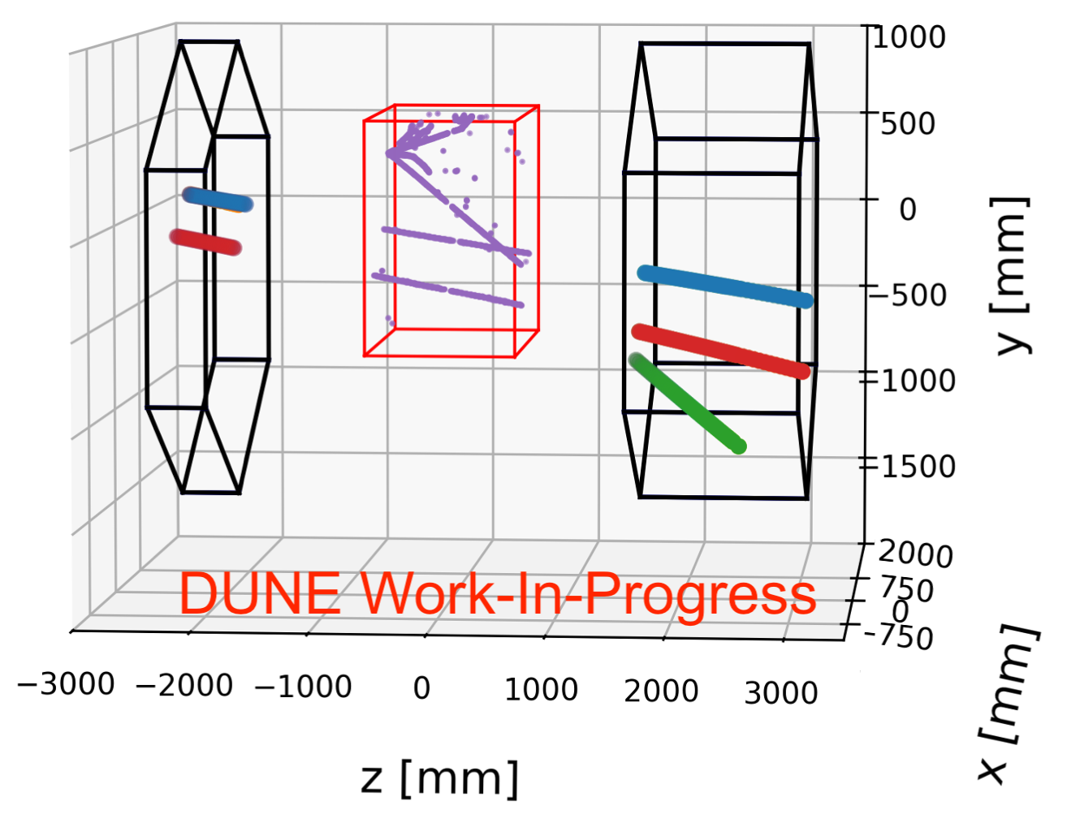
Inserting Muon Detector
SIMULATION
GrapPA: PhysRevD. 104. 072004

Slide 22
Inserting Muon Detector
SIMULATION
Traditional Track Reconstruction
SIMULATION
GrapPA: PhysRevD. 104. 072004

Slide 23
Add Muon Detector Input for LArTPC ML
Step 1: Match Across MINERvA
Color: idealized matched track segments
Upstream
Muon Tagger
Downstream
Muon Tagger
GrapPA: PhysRevD. 104. 072004
2x2 LArTPC

Slide 24
Establishing Language
8 Negatives (not connected)
True Positive
2 Positive Cases
True Negatives
True Positive
Ignoring 2x2 for simple test
Ignoring 2x2 for simple test
SIMULATION
SIMULATION
Upstream
Muon Tagger
2x2 LArTPC
Downstream
Muon Tagger
Upstream
Muon Tagger
2x2 LArTPC
Downstream
Muon Tagger

Slide 25
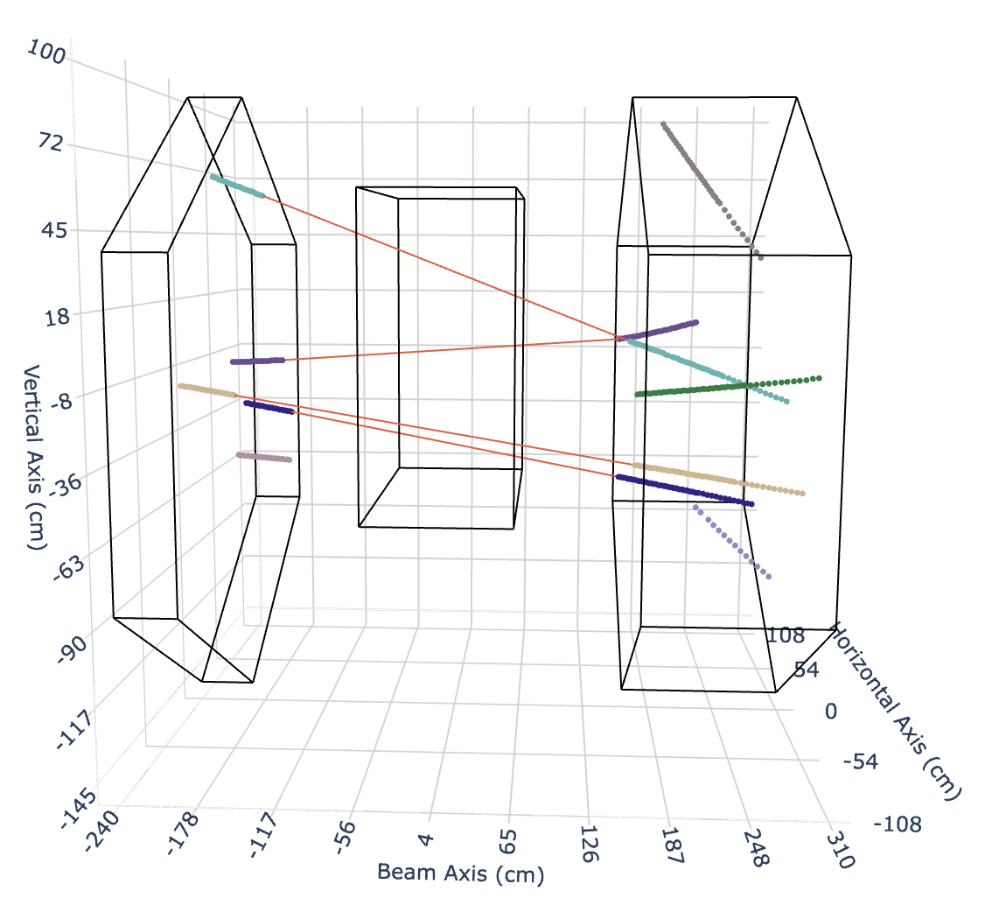
Success: Muon Tagger Track Matching
Colors show true match,
GNN prediction in red line
Overall 99.7% accuracy. Even with MUCH MORE negative cases in sample, the network isn’t over-predicting based on statistics
✅
4 tracks matched!
Ignoring 2x2 for simple test
99 (0.8%) | 81,920 (99.8%)
12,275 (99.2%) | 152 (0.2%)
Negative
GNN Predicted Label
SIMULATION
DUNE Work-In-Progress
Positive
SIMULATION
DUNE Work-In-Progress
Positive Negative
Upstream
Muon Tagger
Downstream
Muon Tagger
2x2 LArTPC
True Label

Slide 26
Add Muon Detector Input for LArTPC ML
Step 1: Match Across MINERvA
✅
Color: idealized matched track segments
SIMULATION

Slide 27
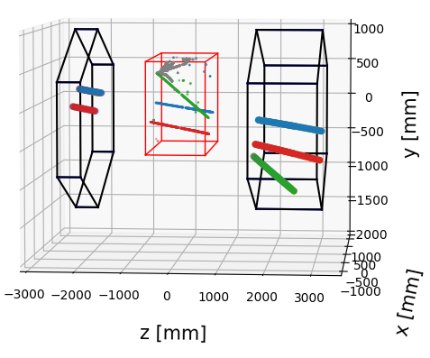
Add Muon Detector Input for LArTPC ML
Step 1: Match Across MINERvA
✅
Step 2: Match Across 2x2
Color: idealized matched track segments
Color: idealized matched track segments
SIMULATION
SIMULATION
Idealized output
DUNE Work-In-Progress

Slide 28
Inserting Muon Detector
SIMULATION
SIMULATION
Traditional Track Reconstruction
GrapPA: PhysRevD. 104. 072004

Slide 29
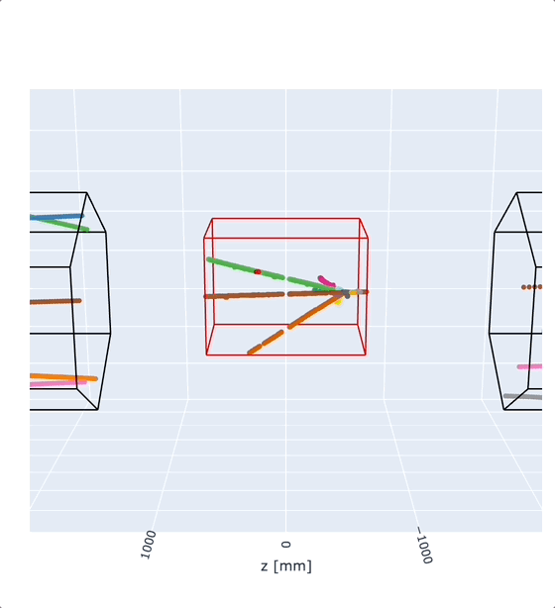
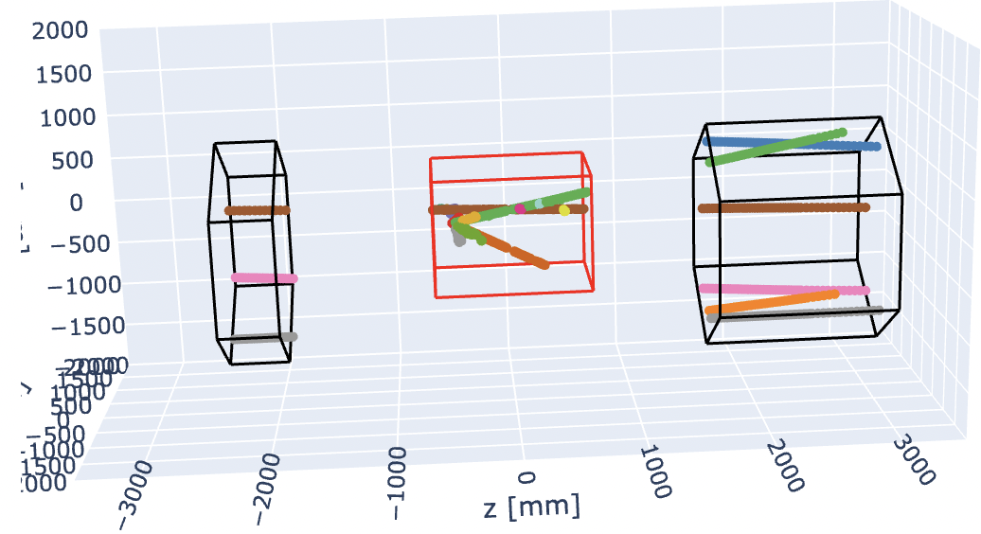
Setting up 2x2 + Muon Tagger with True Tracks
More “match” cases + more messy:
Upstream to Downstream (pink & gray here)
Upstream to 2x2 to Downstream (brown here)
Upstream to 2x2 (not shown here)
2x2 to Downstream (green here)
DUNE Work-In-Progress
SIMULATION
Vertical axis (mm)
SIMULATION
DUNE Work-In-Progress
Beam axis (mm)

Slide 30
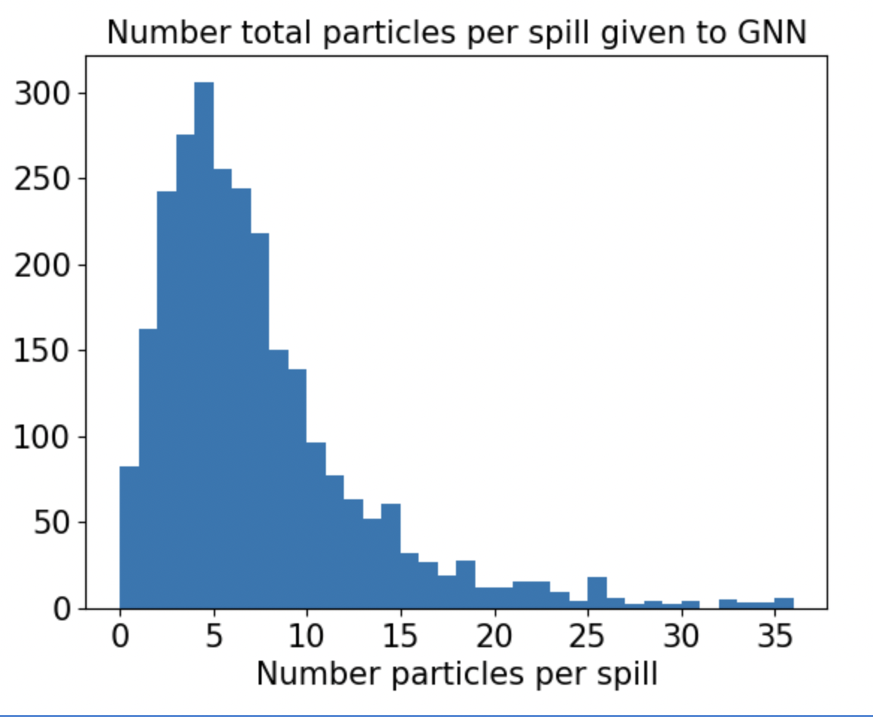
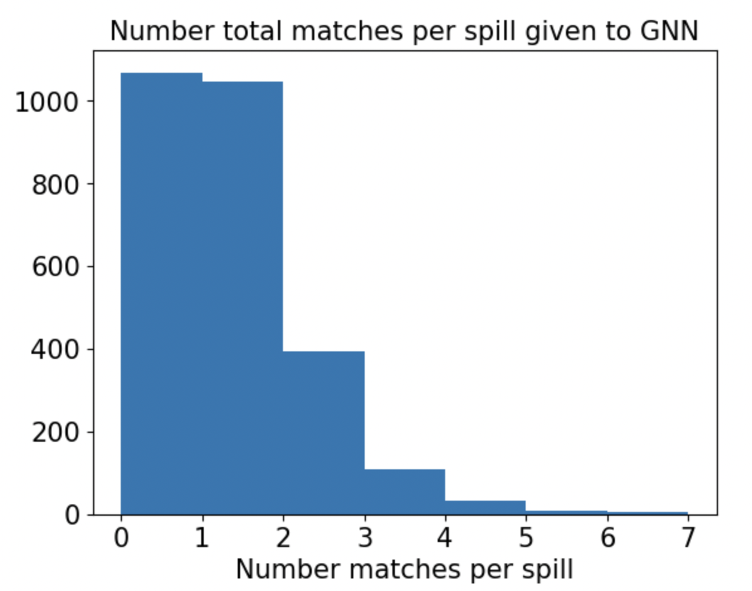
More Complex! Let’s train with 2x2 True Particles
More “match” cases + more messy:
Upstream to Downstream (pink & gray here)
Upstream to 2x2 to Downstream (brown here)
Upstream to 2x2 (not shown here)
2x2 to Downstream (green here)
(15 overflow, up to ~120 particles)
DUNE Work-In-Progress
SIMULATION
DUNE Work-In-Progress
Vertical axis (mm)
SIMULATION
SIMULATION
DUNE Work-In-Progress
Beam axis (mm)

Slide 31
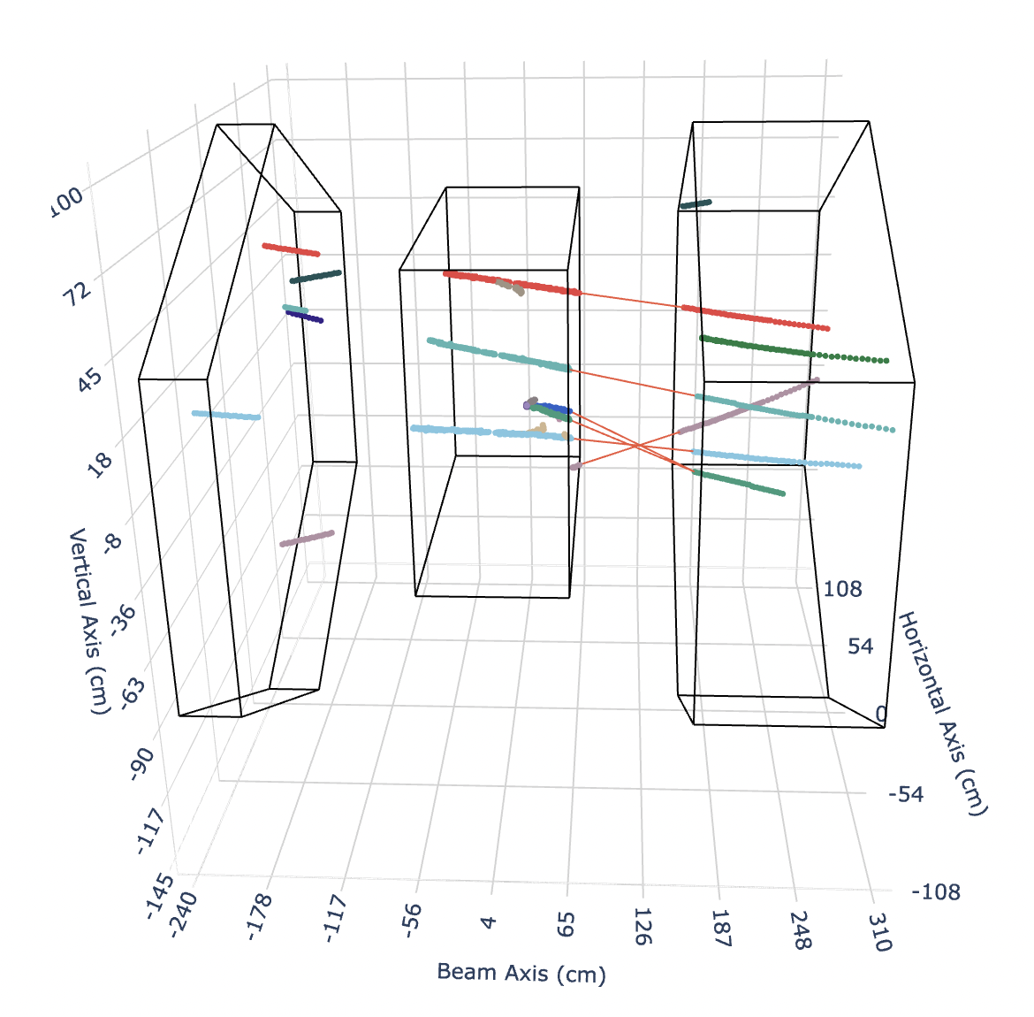
Results: More Complex! But GNN Handles it!
Colors show true match,
GNN prediction in red line
Network predicts ALL SIX track matches!
Adds one additional match
Attaches two 2x2 tracks to one segment in downstream
Can reinforce/require 1 match
SIMULATION
DUNE Work-In-Progress
Upstream
Muon Tagger
2x2 LArTPC
Downstream
Muon Tagger

Slide 32
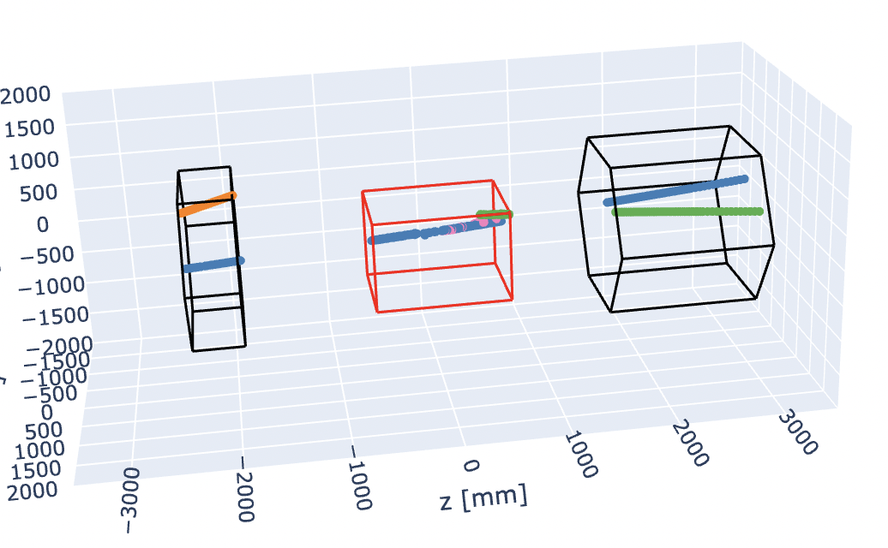
Track Matching on True Particles with 2x2
2 True Positive
12 True Negative
Even more negative cases now due to complexity. Network does well, but could benefit from weighting
True Negative
True Positive
Confusion: Track Matching Muon Tagger Tracks with True Particles in 2x2
True Positive
284 (8.2%) | 240,497 (99.8%)
4,324 (91.8%) | 411 (0.2%)
Negative
Vertical axis (mm)
GNN Predicted Label
SIMULATION
SIMULATION
DUNE Work-In-Progress
DUNE Work-In-Progress
Positive
Beam axis (mm)
Positive Negative
Upstream
Muon Tagger
2x2 LArTPC
Downstream
Muon Tagger
True Label

Slide 33
Track Matching on True Particles with 2x2
Even more negative cases now due to complexity. Network does well, but could benefit from weighting
Confusion: Track Matching Muon Tagger Tracks with True Particles in 2x2
Training sample: ~14,000 events
With ~2,700 testing events
Further tuning can be done
Weight positive cases (matching)
Create a threshold for track size to be considered for matching
Add semantics information from previous steps!
→ Very promising result so far! Accuracy of 99.7% for validation sample
284 (8.2%) | 240,497 (99.8%)
4,324 (91.8%) | 411 (0.2%)
Negative
GNN Predicted Label
SIMULATION
DUNE Work-In-Progress
Positive
Positive Negative
True Label

Slide 34
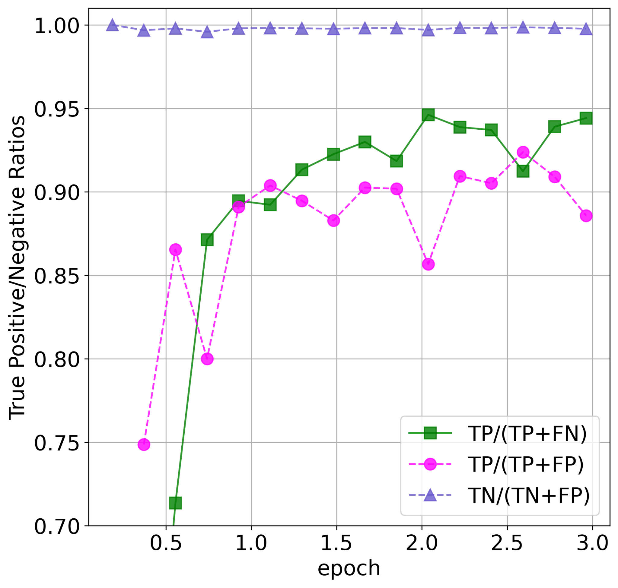
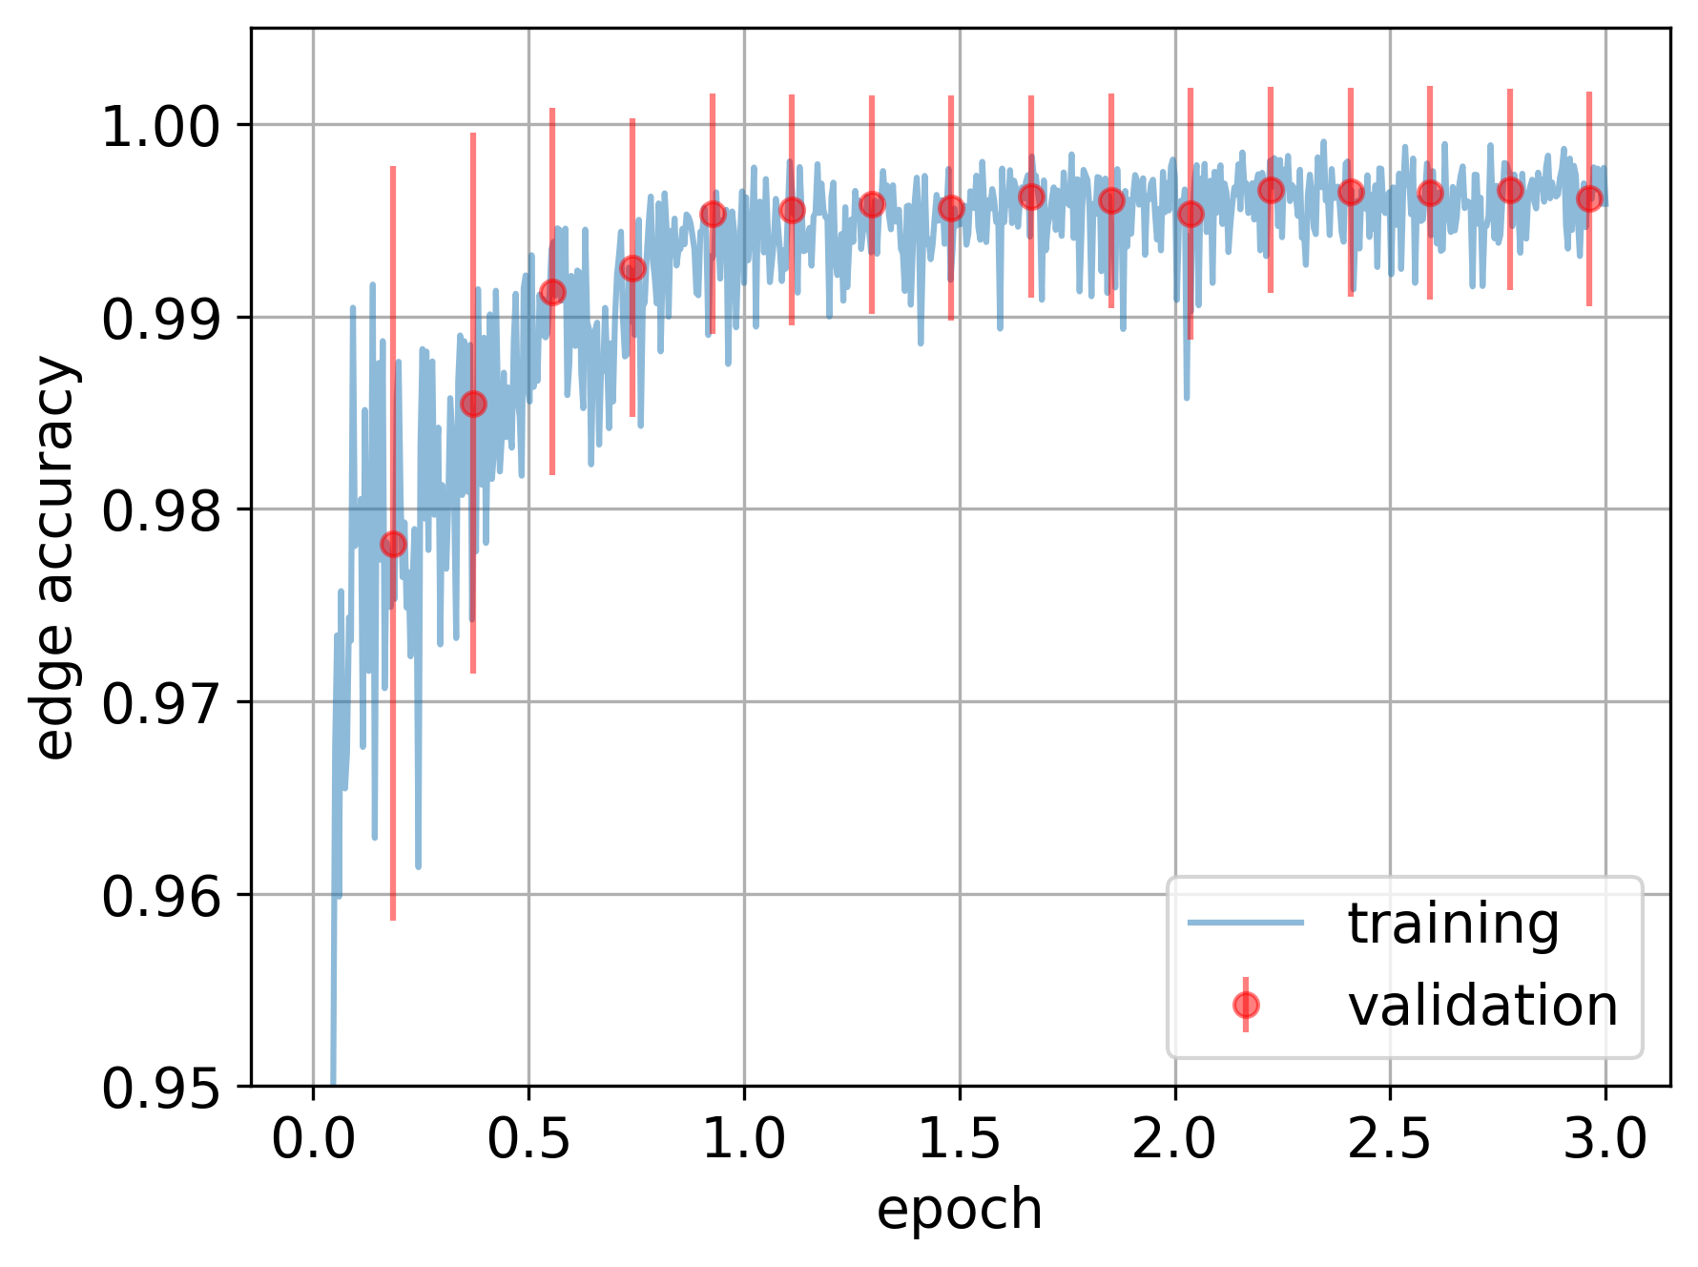
Track Matching on True Particles with 2x2
True Positives (TP): Track Matching Muon Tagger Tracks with True Particles in 2x2
Overall accuracy reaches 99.7%
True Neg. Rate
Accuracy: Track Matching Muon Tagger Tracks with True Particles in 2x2
True Pos. Rate
Precision of Pos.
DUNE Work-In-Progress
DUNE Work-In-Progress
DUNE Work-In-Progress
SIMULATION
SIMULATION

Slide 35
Future: Add Muon Tagger Input Mid-ML Series
Step 1: Match Across MINERvA
✅
Step 2: Match Across 2x2
👏
Color: idealized matched track segments
Color: idealized matched track segments
SIMULATION
SIMULATION
Idealized output
DUNE Work-In-Progress

Slide 36
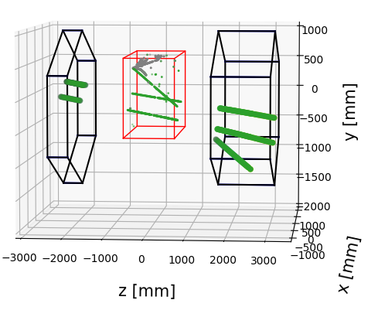
Future: Add Muon Tagger Input Mid-ML Series
Step 1: Match Across MINERvA
✅
Step 2: Match Across 2x2
👏
Step 3: Particle Identification
Color: idealized matched track segments
Color: idealized matched track segments
Muon
SIMULATION
SIMULATION
SIMULATION
Idealized output
Idealized output
DUNE Work-In-Progress
DUNE Work-In-Progress

Slide 37
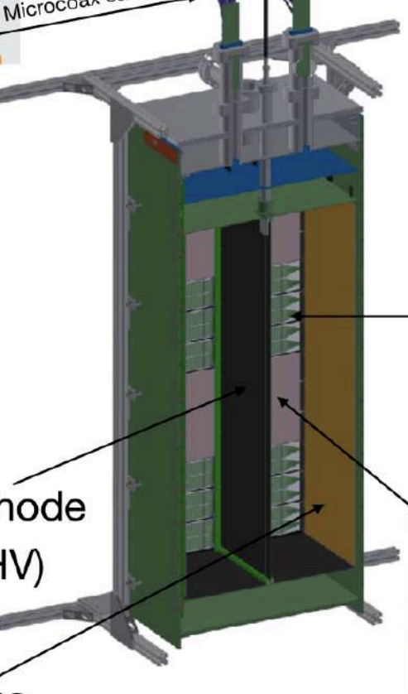
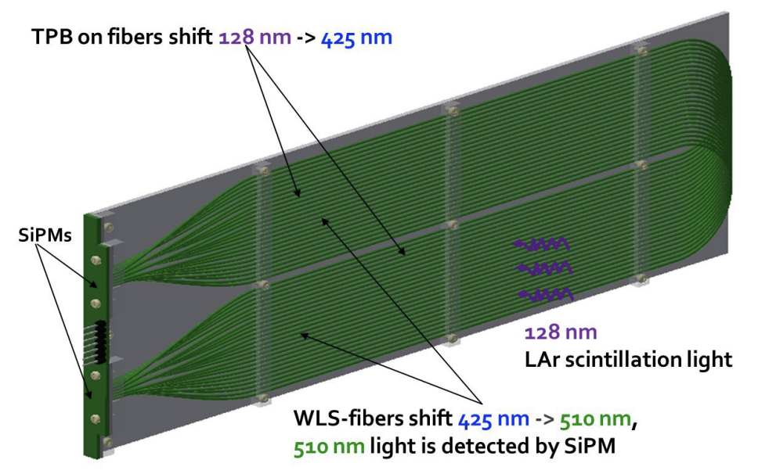
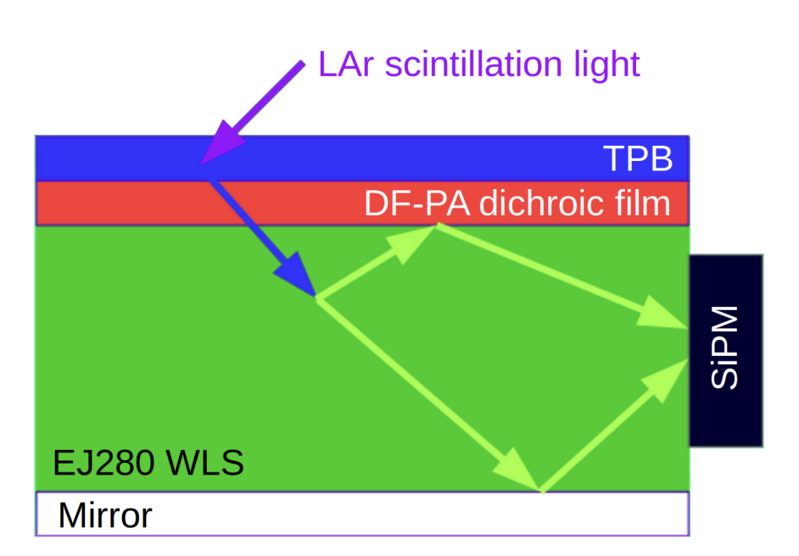
Future Applications
Integrating detection from multiple detectors into single network
Light & Charge
Single ND-LAr Module
Light Collection Module
ArCLight
Cathode
Charge readout

Slide 38
Future Applications
Integrating detection from multiple detectors into single network
Light & Charge
ND-LAr & TMS
Single ND-LAr Module
Light Collection Module
ArCLight
Cathode
Charge readout

Slide 39
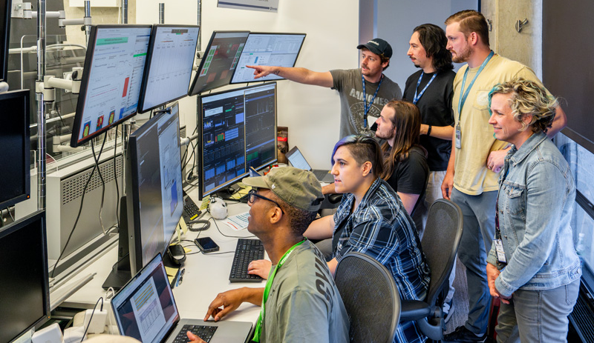
Future for DUNE’s 2x2 LArTPC Prototype
Expand ML reconstruction beyond LArTPC charge input
External muon tagger
Additional light-based input
Analyzing 4.5 days of 2x2 data from 2024!
Currently running without beam!
Planning for another NuMI beam run in 2026

Slide 40
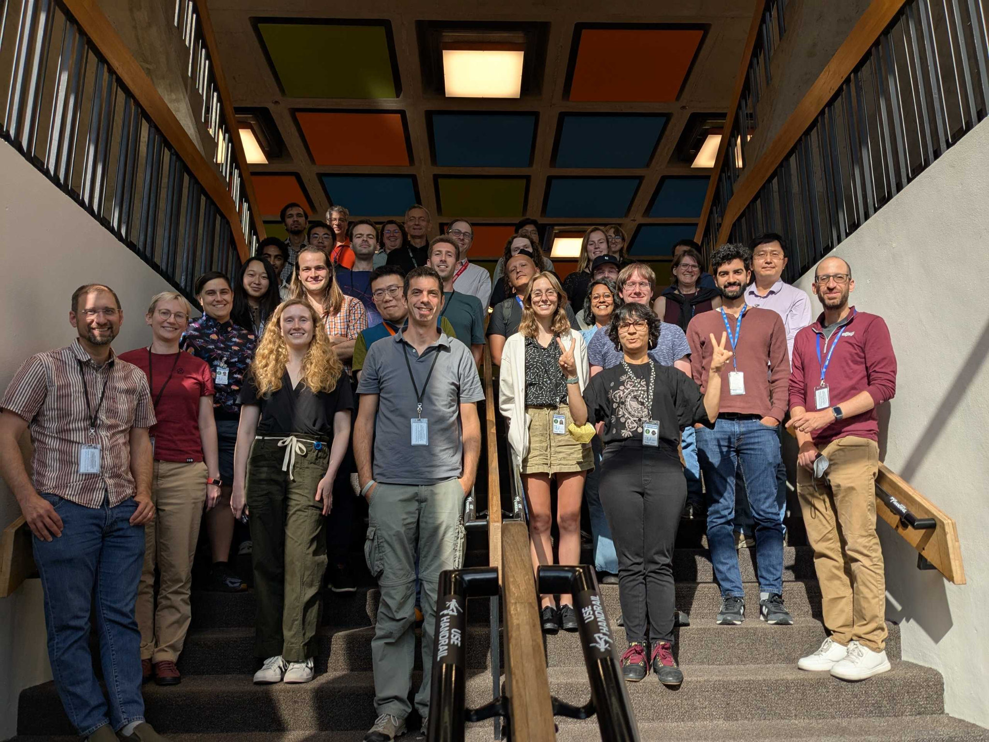
Thank you
DUNE Near Detector Workshop September 2025

Slide 41
Backup

Slide 42
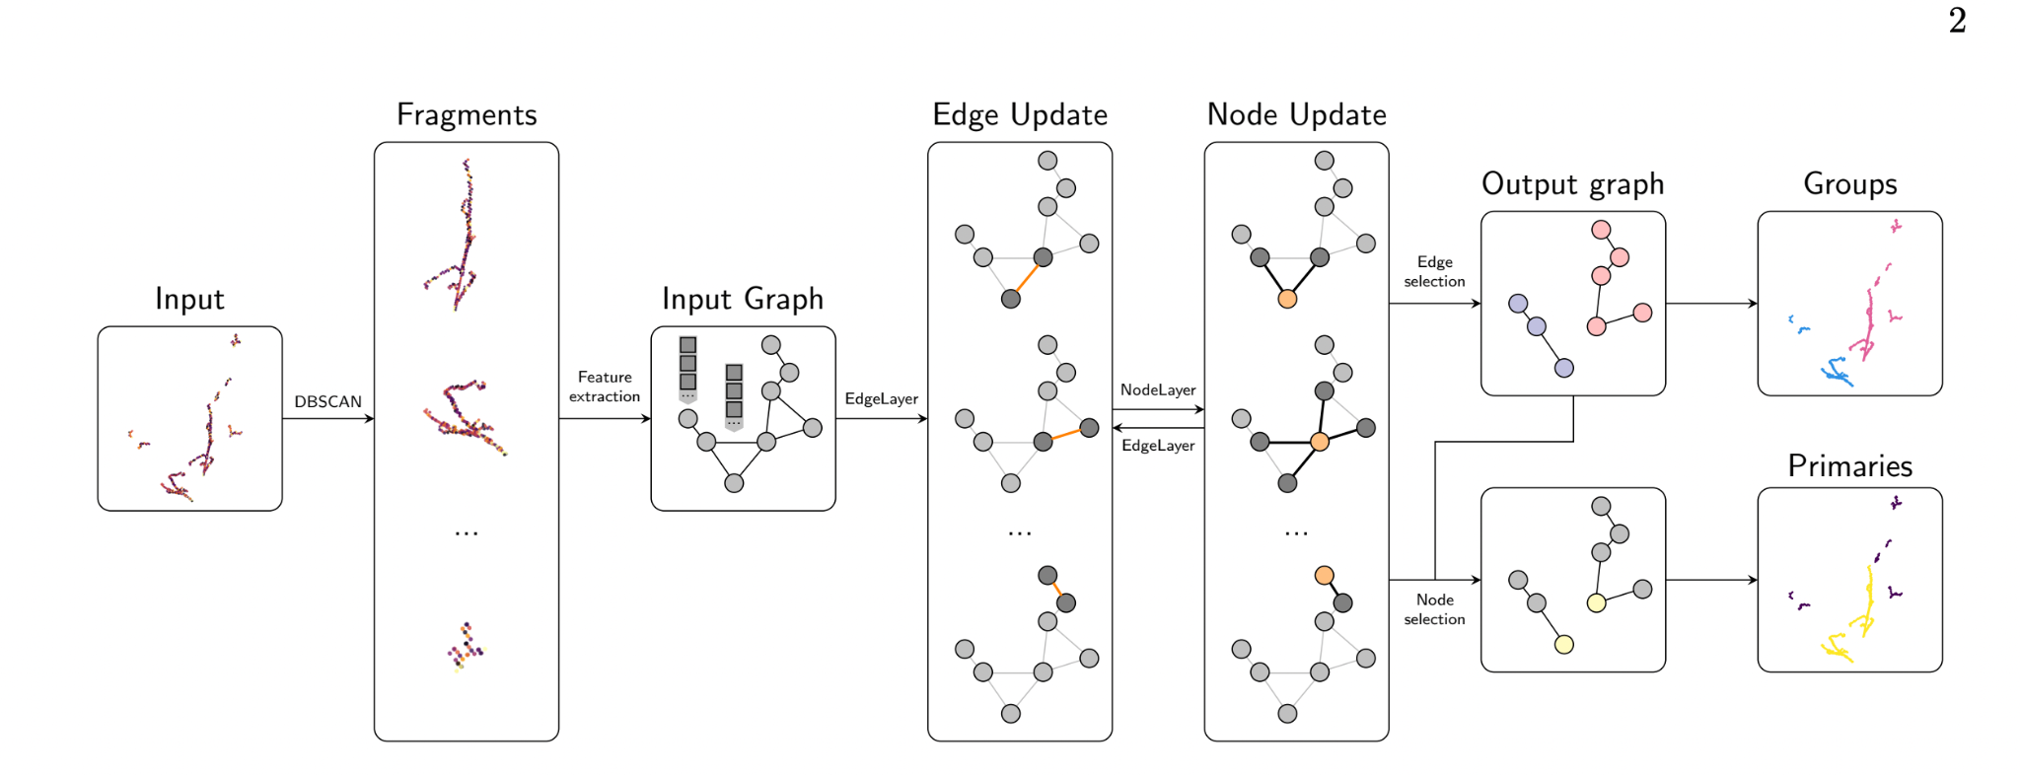
GrapPA: Graph Particle Aggregator
Correctly connected edge = True Positive
Use Graph Neural Network
Ignoring 2x2 for simple test
PhysRevD. 104. 072004
Upstream
Muon Tagger
2x2 LArTPC
Downstream
Muon Tagger
Notes:
Cut GrapPA/Mx2

Slide 43
GrapPA: Graph Particle Aggregator
Correctly connected edge = True Positive
Use Graph Neural Network
Correctly not connected edge = True
Negative
Ignoring 2x2 for simple test
PhysRevD. 104. 072004
Upstream
Muon Tagger
2x2 LArTPC
Downstream
Muon Tagger

Slide 44
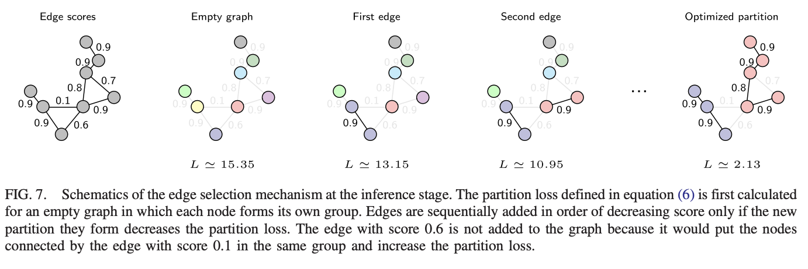
GrapPA: Graph Particle Aggregator
Correctly connected edge = True Positive
Finds best edge configuration for whole entry
Correctly not connected edge = True
Negative
Ignoring 2x2 for simple test
Upstream
Muon Tagger
2x2 LArTPC
Downstream
Muon Tagger
PhysRevD. 104. 072004

Slide 45
2x2 + Mx2 Testing
Notes:
True pos & true negative, zoom y axis in!, DUNE WIP

Slide 46
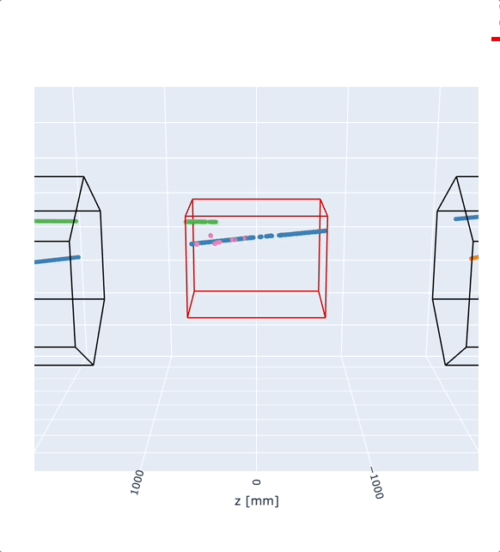
Setting up 2x2 + Muon Tagger with True Tracks
More “match” cases:
Upstream to Downstream (not shown here)
Upstream to 2x2 to Downstream (blue here)
Upstream to 2x2 (not shown here)
2x2 to Downstream (green here)
DUNE Work-In-Progress
SIMULATION
Vertical axis (mm)
SIMULATION
DUNE Work-In-Progress
Beam axis (mm)

Slide 47
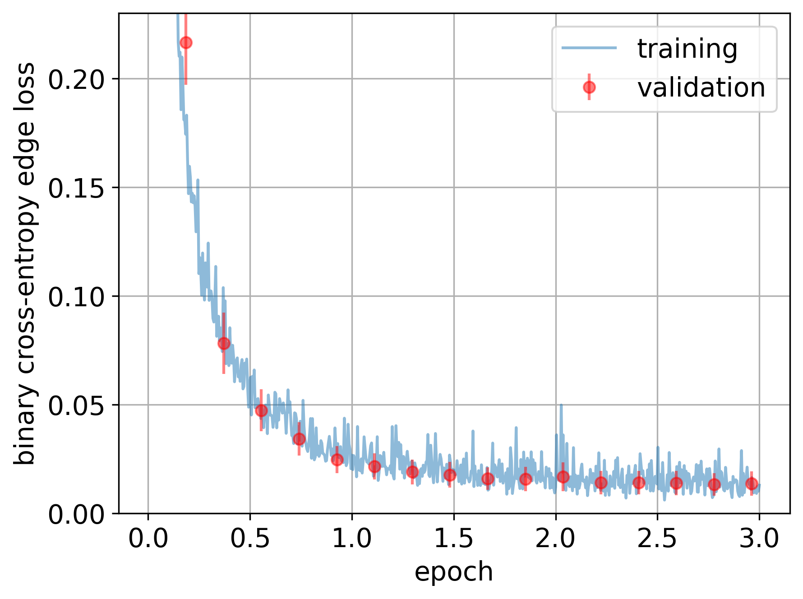
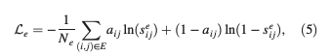
GrapPA: Edge Loss
PhysRevD. 104. 072004
SIMULATION
DUNE Work-In-Progress
Notes:
Nova uses solid scintillator

Slide 48
Mx2 Only
Notes:
True pos & true negative, zoom y axis in!, DUNE WIP

Slide 49
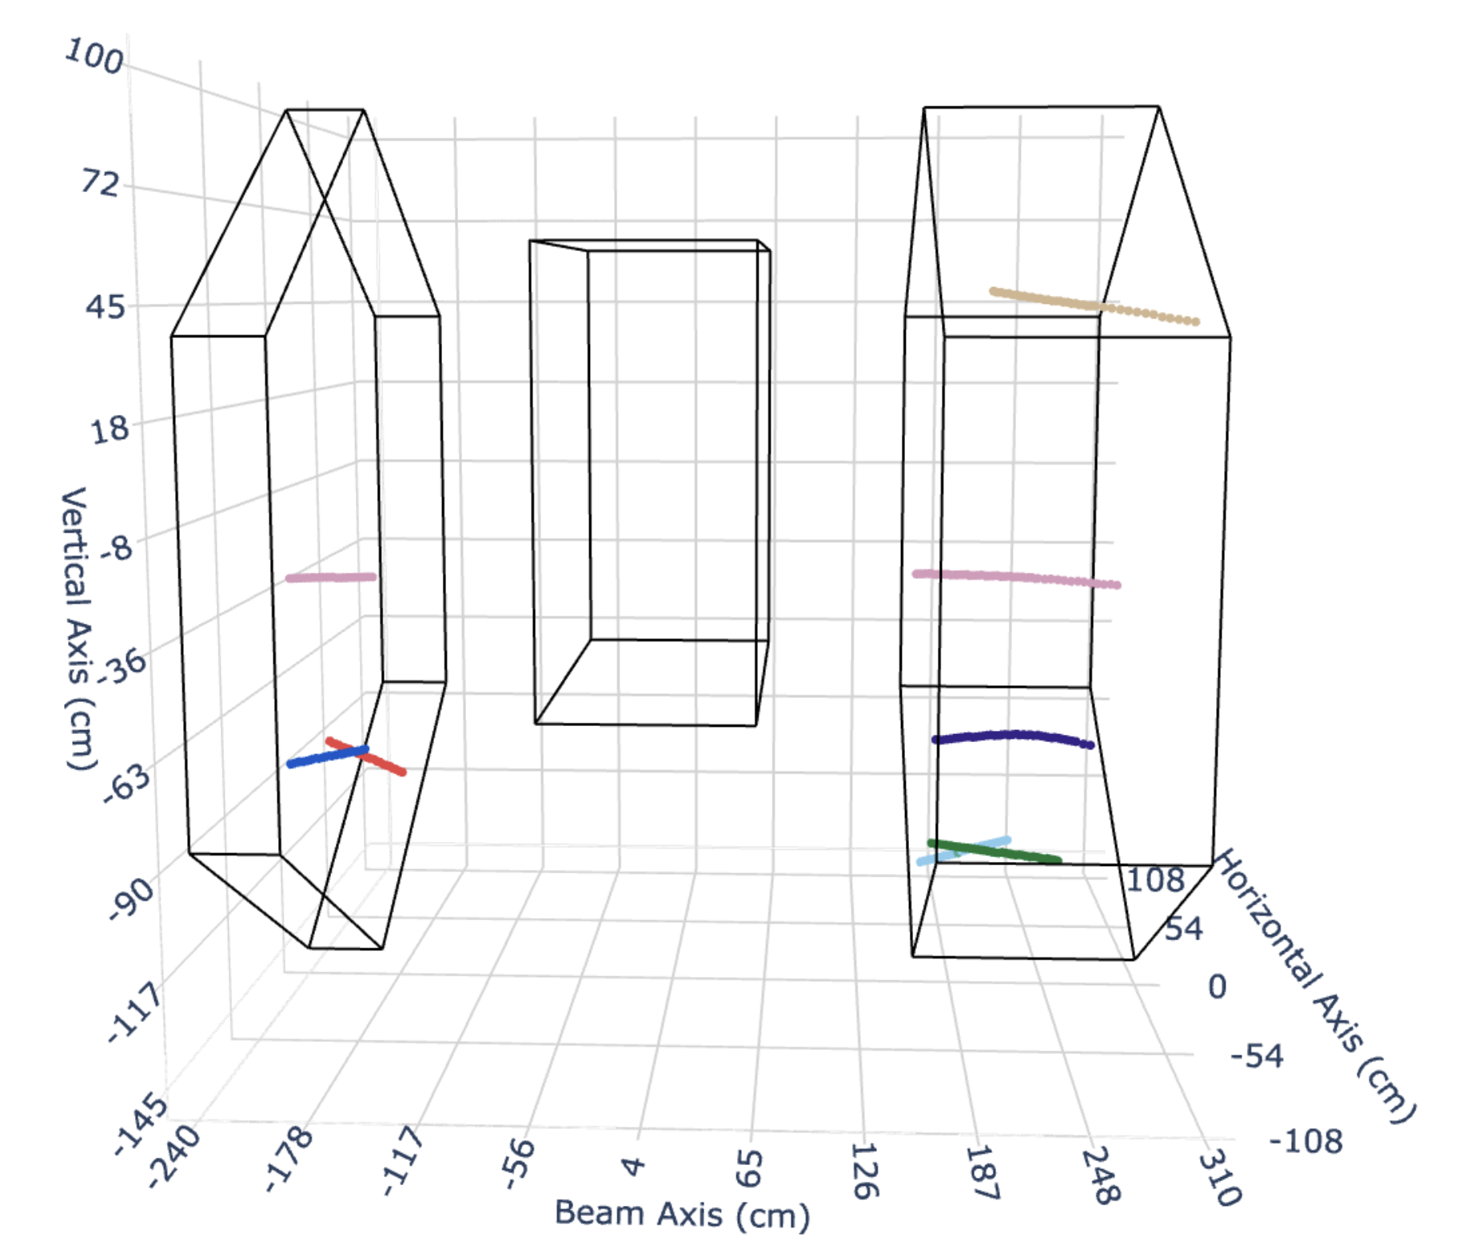
Results: Track Matching Muon Tagger
Colors show true match,
GNN prediction in red line
✅
Colors indicate track segments
Ignoring 2x2 for simple test
Ignoring 2x2 for simple test
GNN Track Reconstruction
SIMULATION
SIMULATION
DUNE Work-In-Progress
DUNE Work-In-Progress
Upstream
Muon Tagger
Downstream
Muon Tagger
Upstream
Muon Tagger
2x2 LArTPC
Downstream
Muon Tagger
2x2 LArTPC

Slide 50
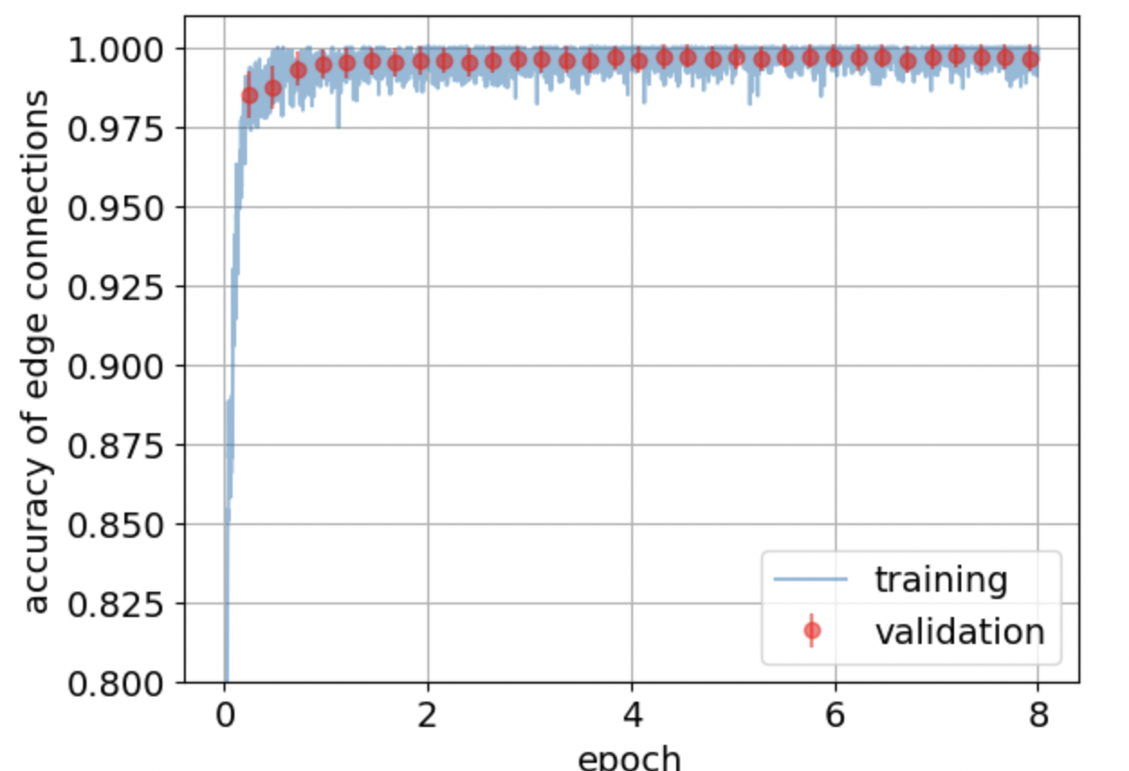
Success: Muon Tagger Track Matching
Colors show true match,
GNN prediction in red line
Validation Sample: 6700 entries reach accuracy of 99.7% at 7.2 epochs (full pass through training sample)!
✅
4 tracks matched!
Ignoring 2x2 for simple test
DUNE Work-In-Progress
Upstream
Muon Tagger
Downstream
Muon Tagger
2x2 LArTPC
Notes:
True pos & true negative, zoom y axis in!, DUNE WIP

Slide 51
Muon Tagger: Track Matching Confusion
2 True Positive
8 True Negative
Even with MUCH MORE negative cases in sample, the network isn’t over-predicting based on statistics
True Negative
True Positive
99 (0.8%) | 81,920 (99.8%)
12,275 (99.2%) | 152 (0.2%)
Ignoring 2x2 for simple test
Negative
DUNE Work-In-Progress
GNN Predicted Label
DUNE Work-In-Progress
Positive
Positive Negative
True Label
Upstream
Muon Tagger
2x2 LArTPC
Downstream
Muon Tagger

Slide 52
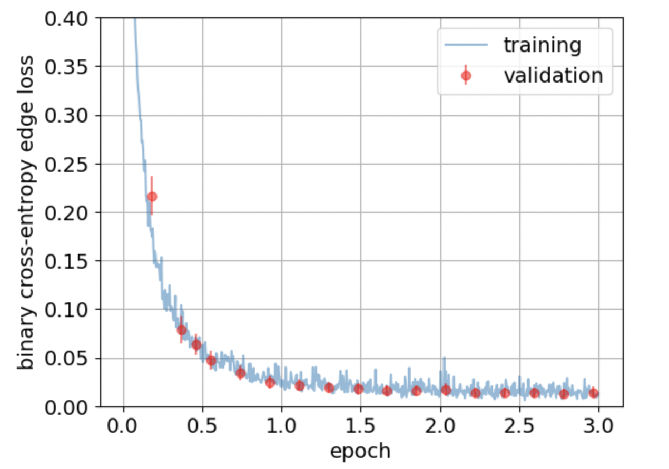
Track Matching on True Particles with 2x2
Loss: Track Matching Muon Tagger Tracks with True Particles in 2x2
Training sample: ~14,000 events
With ~2,700 testing events
Further tuning can be done
Weight positive cases (matching)
Create a threshold for track size to be considered for matching
Add semantics information from previous steps!
→ Very promising result so far!
DUNE Work-In-Progress

Slide 53
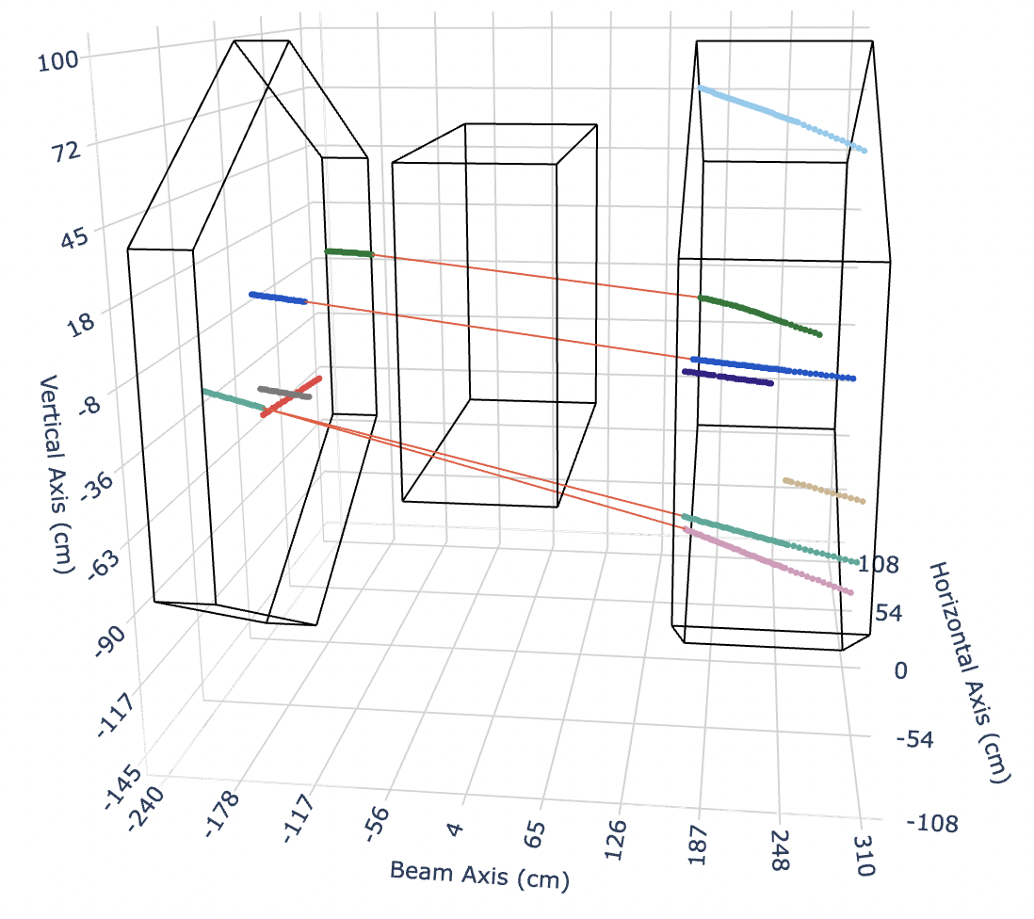
Failure: Track Matching Examples
Not enforced for single match, GNN occasionally tries
GNN connects upstream green to two downstream segments, pink and green
Ignoring 2x2 for simple test
Color = True Match
Orange line = Predicted Match
DUNE Work-In-Progress
Upstream
Muon Tagger
Downstream
Muon Tagger
2x2 LArTPC

Slide 54
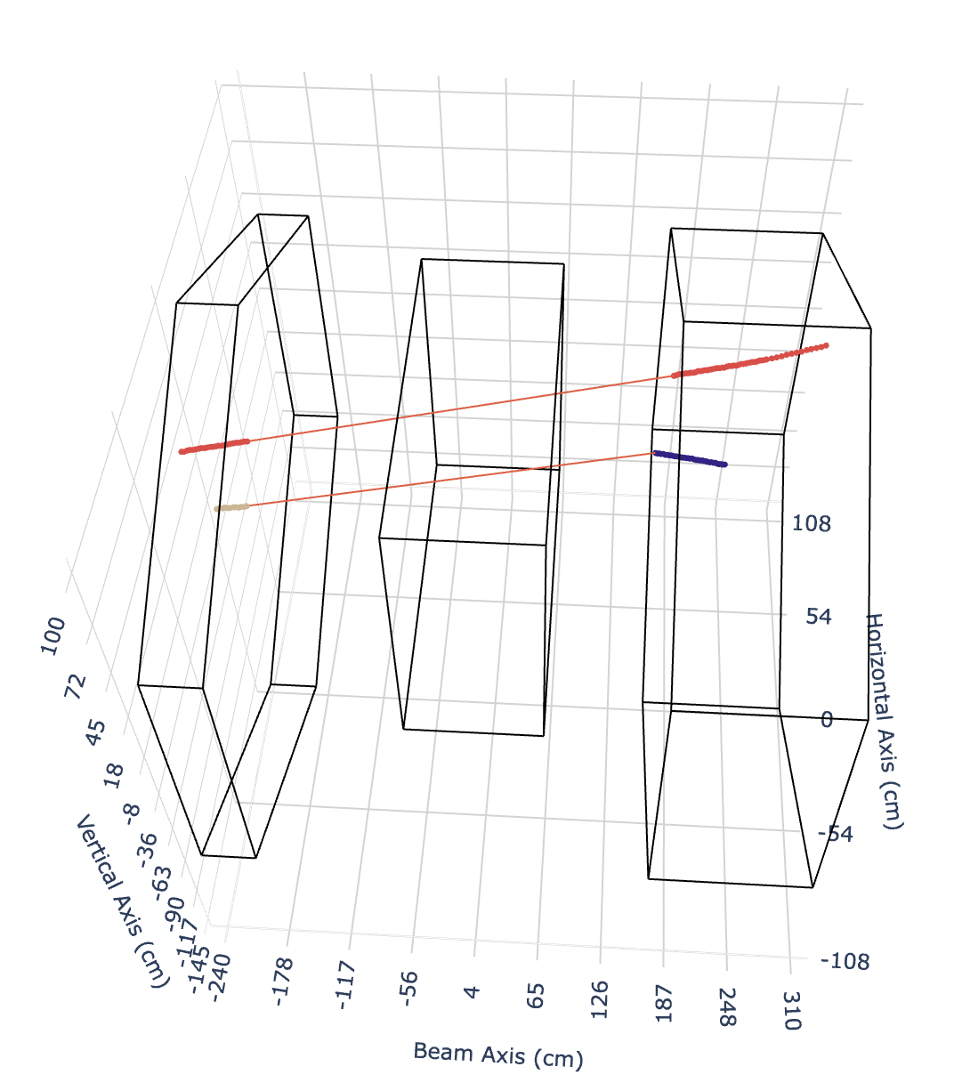
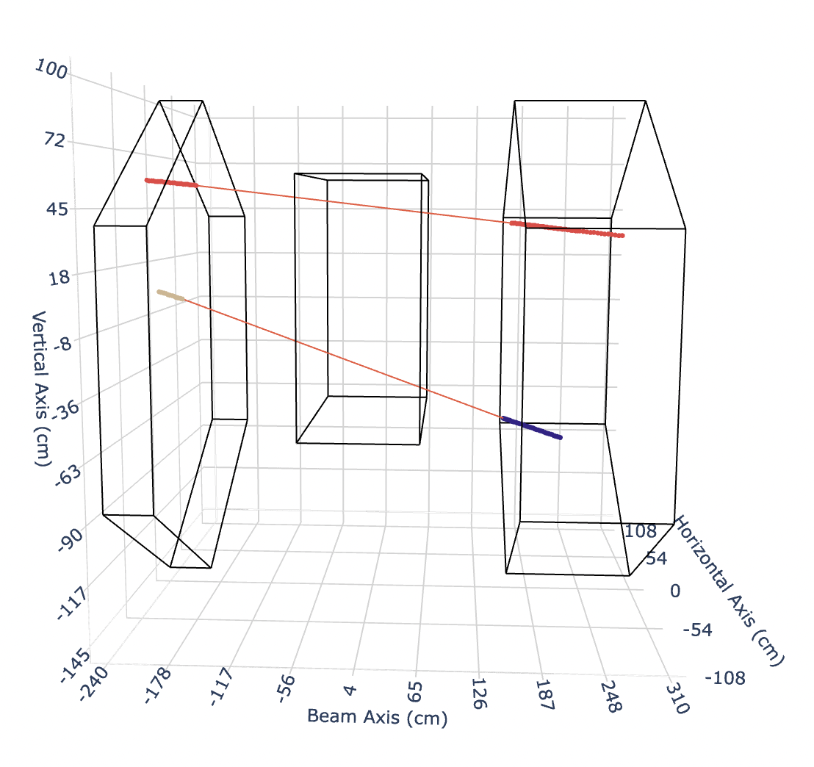
Failure: Track Matching Examples
Side view looks reasonable, but see in top view that should not connect
SIDE VIEW
TOP VIEW
Ignoring 2x2 for simple test
Ignoring 2x2 for simple test
Color = True Match
Orange line = Predicted Match
DUNE Work-In-Progress
DUNE Work-In-Progress
Upstream
Muon Tagger
Downstream
Muon Tagger
2x2 LArTPC

Slide 55
Testing Sample
2 True Matches
8 True Not Matches
Correctly not connected edge
Correctly connected edge
Samples: | Training | Testing
Entries | 28,700 | 6900 (~20%)
# Track Segments | 0-24 | 0-17
Average True Track Match | 1 | 1
Range True Track Match | 0-7 | 0-6
Ignoring 2x2 for simple test
True Match: Same particle that goes through the upstream + downstream taggers
Upstream
Muon Tagger
2x2 LAr with
4 TPCs
Downstream
Muon Tagger

Slide 56
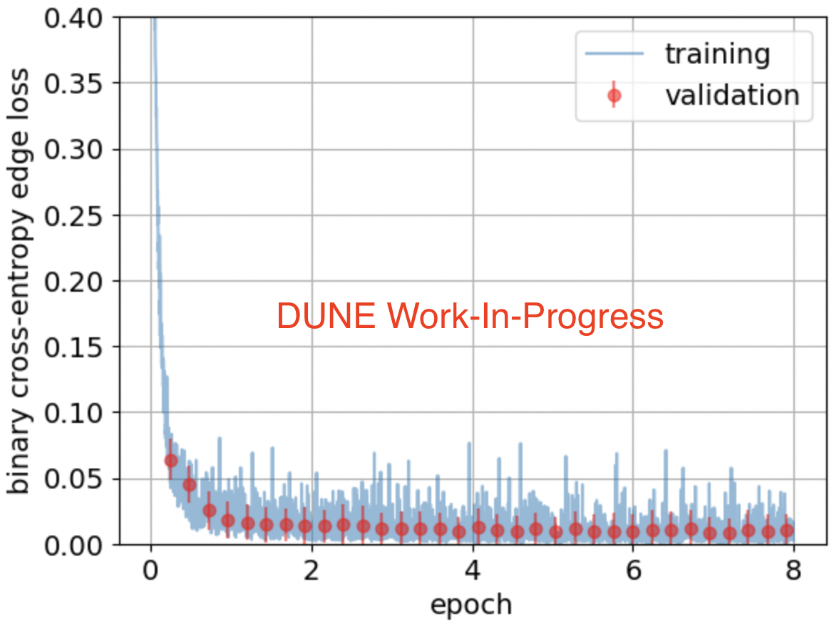
GrapPA: Edge Loss
PhysRevD. 104. 072004
Notes:
Nova uses solid scintillator

Slide 57
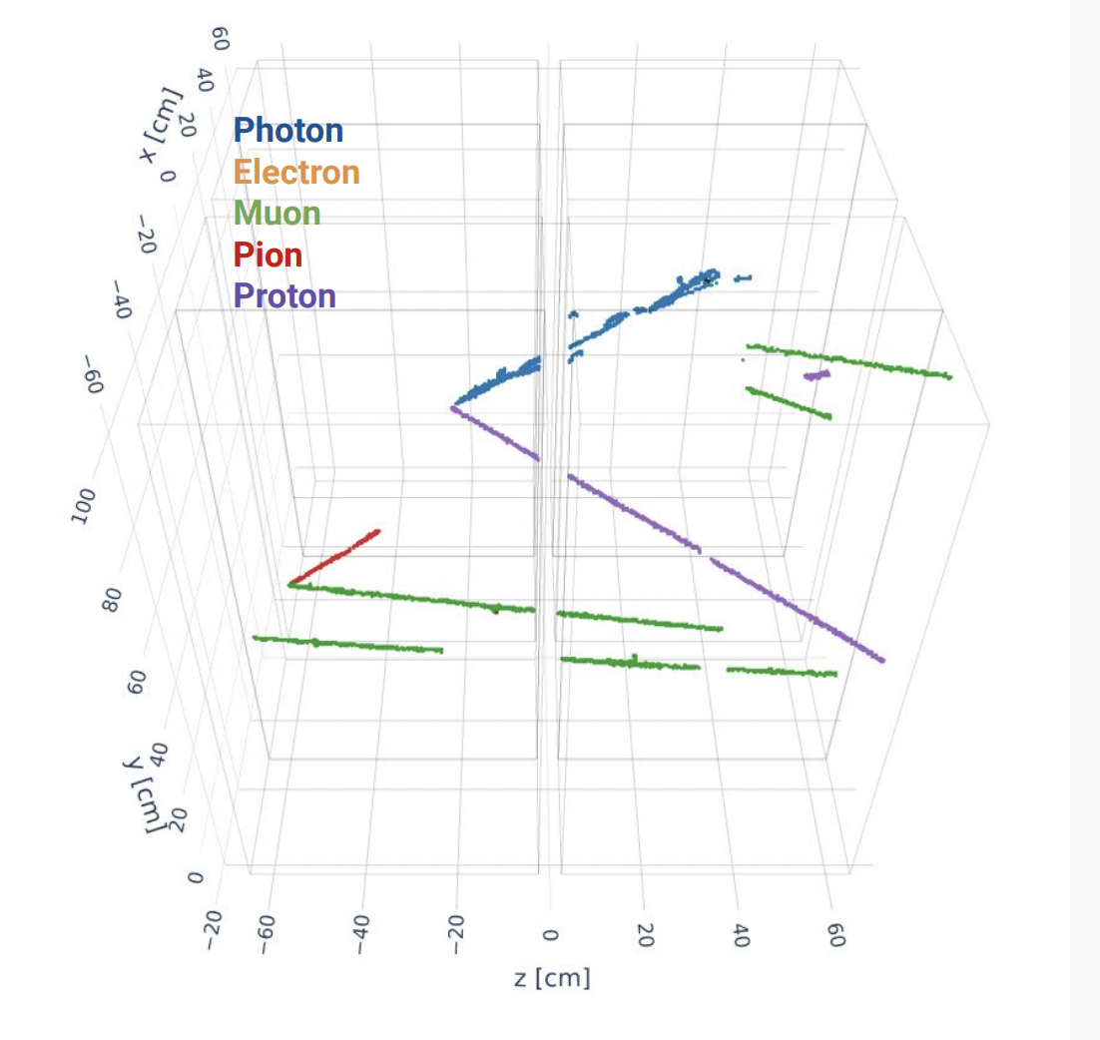

Performance: Example for 2x2 Prototype
Truth
Reco
SIMULATION
SIMULATION
DUNE Work-In-Progress
DUNE Work-In-Progress

Slide 58
Just 2x2
Notes:
True pos & true negative, zoom y axis in!, DUNE WIP

Slide 59

Performance: Metrics
Performance
Reco
SIMULATION
DUNE Work-In-Progress
DUNE Work-In-Progress

Slide 60


2x2 Prototype Beam vs DUNE Beam
NuMI
DUNE (dark green)
https://indico.cern.ch/event/881216/contributions/5048756/attachments/2534229/4361050/Klustova_MINERvAFlux_NuINT22.pdf
https://arxiv.org/pdf/1803.08848.pdf

