Slide 1
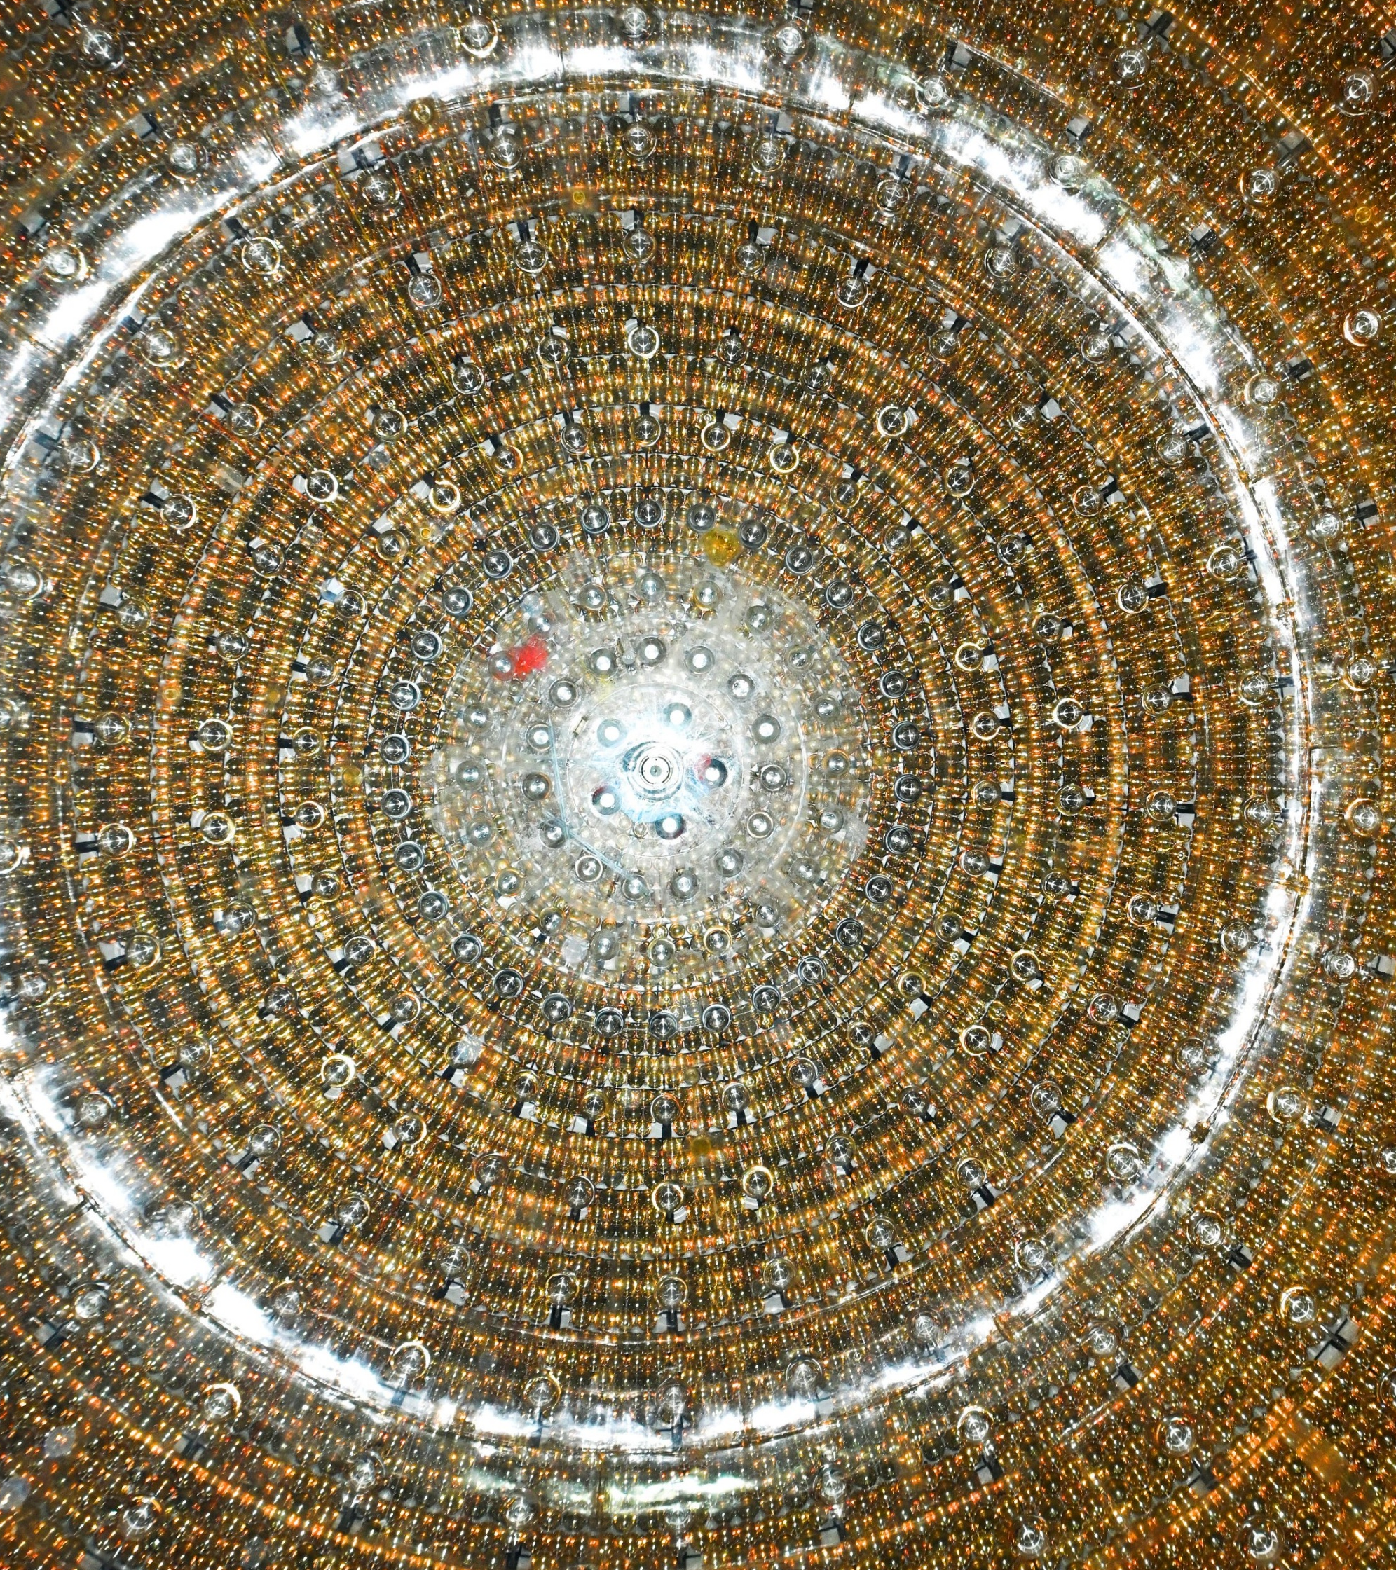





Simulation-based Inference for Precision Neutrino Physics through Neural Monte Carlo Tuning
Arsenii Gavrikov, Andrea Serafini, Dmitry Dolzhikov
on behalf of the JUNO Collaboration
University of Padova & INFN Padova, Italy andrea.serafini@pd.infn.it
Repo
Pre-print

Slide 2
Simulation-based Inference for Precision Neutrino Physics through Neural Monte Carlo Tuning
Our ML guru
JUNO analysis fit/statistics enthusiasts
Arsenii Gavrikov, Andrea Serafini, Dmitry Dolzhikov
on behalf of the JUNO Collaboration
University of Padova & INFN Padova, Italy andrea.serafini@pd.infn.it
Repo
Pre-print

Slide 3
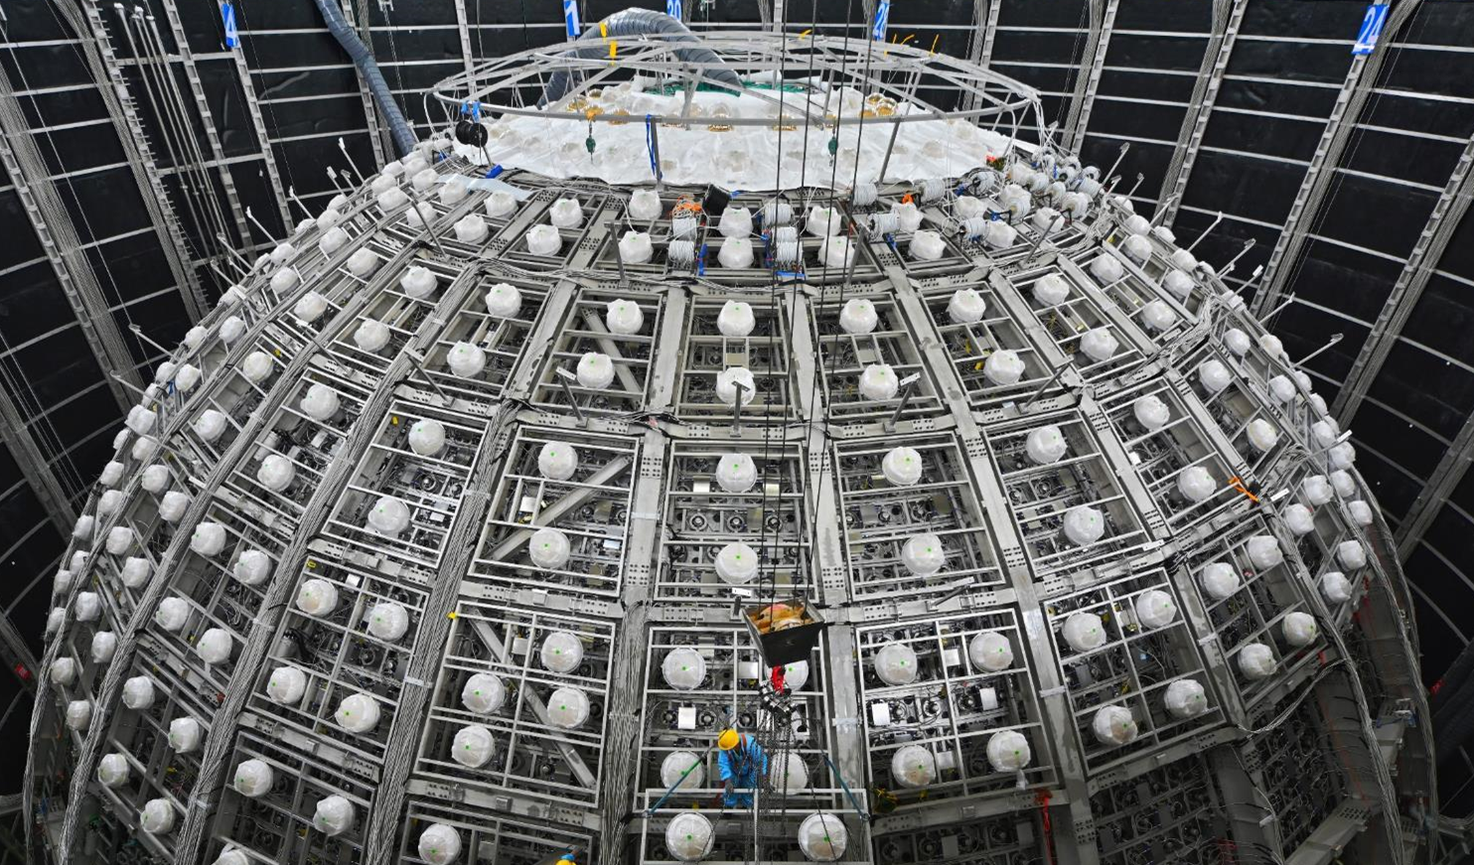
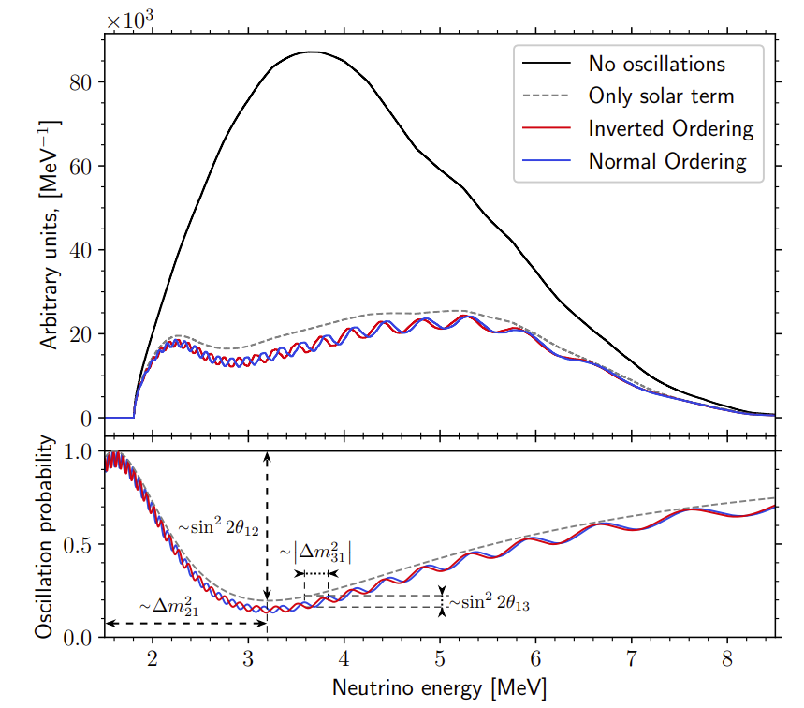
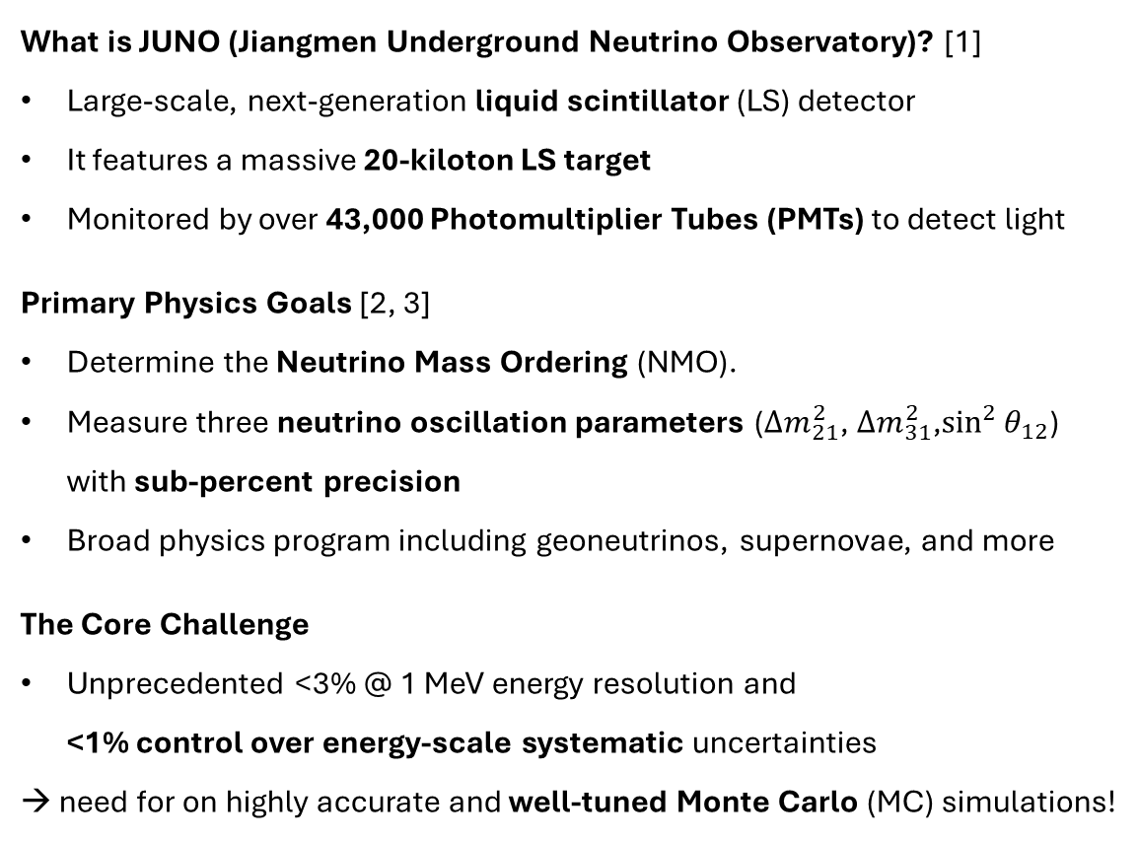
The JUNO experiment
What is JUNO (Jiangmen Underground Neutrino Observatory)? [1]
Large-scale, next-generation liquid scintillator (LS) detector
It features a massive 20-kiloton LS target
Monitored by over 43,000 Photomultiplier Tubes (PMTs) to detect light
Primary Physics Goals [2, 3]
Determine the Neutrino Mass Ordering (NMO).
Measure three neutrino oscillation parameters ($Δm_{21}^{2}$, $Δm_{31}^{2}$,$\sin^{2}{θ_{12}}$) with sub-percent precision
Broad physics program including geoneutrinos, supernovae, and more
The Core Challenge
Unprecedented <3% @ 1 MeV energy resolution and <1% control over energy-scale systematic uncertainties
→ need for on highly accurate and well-tuned Monte Carlo (MC) simulations!
Running since August 2025!!!
[1] JUNO Collaboration 2016 J. Phys. G: Nucl. Part. Phys. 43 030401 [2] JUNO Collaboration 2022 Chinese Phys. C 46 123001 [3] JUNO Collaboration 2025 Chinese Phys. C 49 3, 033104

Slide 4
The Energy Response Challenge
How JUNO Detects Events
JUNO is a calorimeter: a particle deposits energy in the scintillator.
The scintillator emits light collected by PMTs and measured as a total number of photo-electrons (NPE) → our proxy for the visible energy

Slide 5
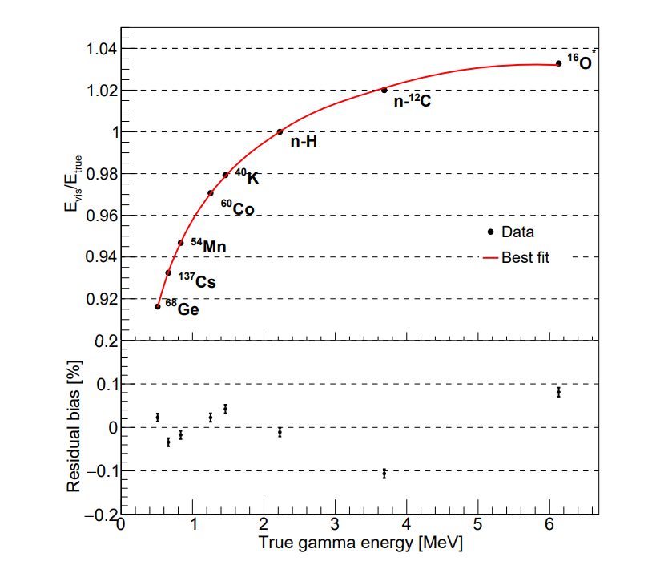
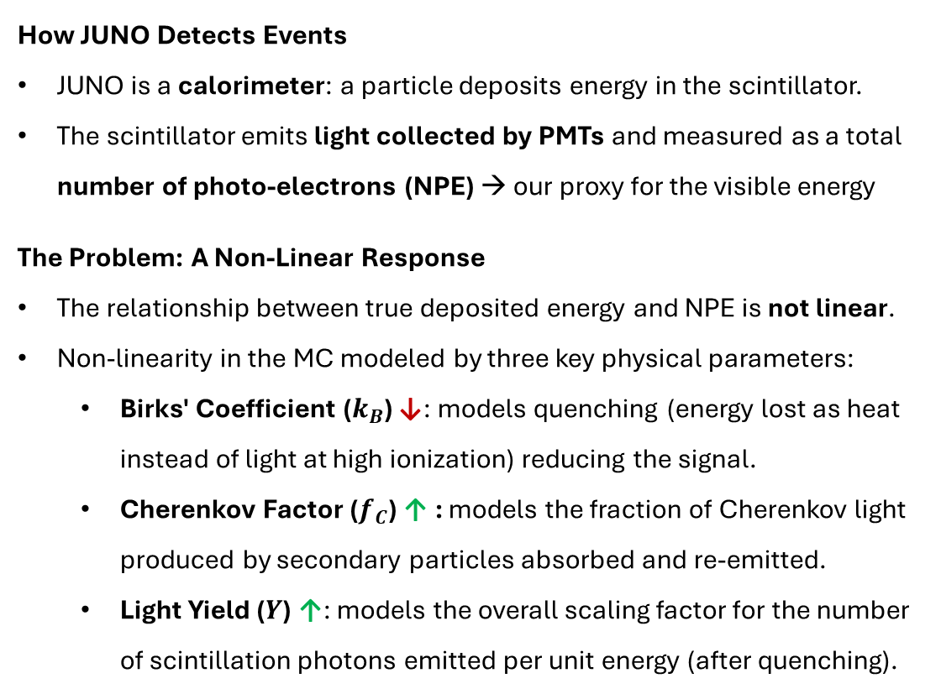
The Energy Response Challenge
How JUNO Detects Events
JUNO is a calorimeter: a particle deposits energy in the scintillator.
The scintillator emits light collected by PMTs and measured as a total number of photo-electrons (NPE) → our proxy for the visible energy
The Problem: A Non-Linear Response
The relationship between true deposited energy and NPE is not linear.
Non-linearity in the MC modeled by three key physical parameters:
Birks' Coefficient ($k_{B}$) ↓: models quenching (energy lost as heat instead of light at high ionization) reducing the signal.
Cherenkov Factor ($f_{C}$) ↑ : models the fraction of Cherenkov light produced by secondary particles absorbed and re-emitted.
Light Yield ($Y$) ↑: models the overall scaling factor for the number of scintillation photons emitted per unit energy (after quenching).

Slide 6
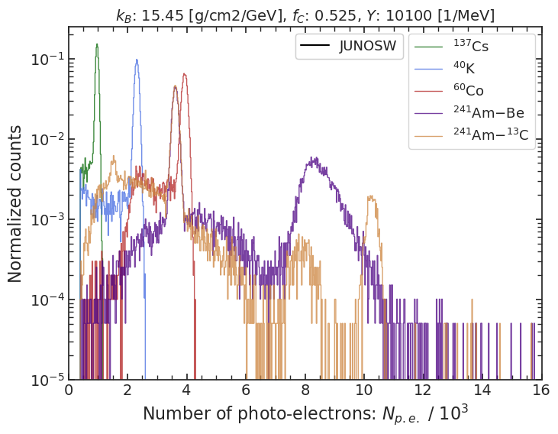

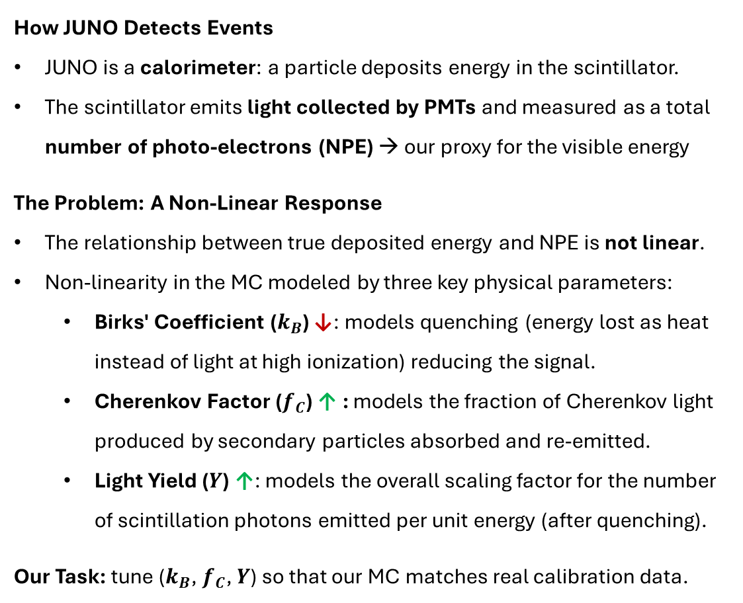


The Energy Response Challenge
$$k_{B}$$
How JUNO Detects Events
JUNO is a calorimeter: a particle deposits energy in the scintillator.
The scintillator emits light collected by PMTs and measured as a total number of photo-electrons (NPE) → our proxy for the visible energy
The Problem: A Non-Linear Response
The relationship between true deposited energy and NPE is not linear.
Non-linearity in the MC modeled by three key physical parameters:
Birks' Coefficient ($k_{B}$) ↓: models quenching (energy lost as heat instead of light at high ionization) reducing the signal.
Cherenkov Factor ($f_{C}$) ↑ : models the fraction of Cherenkov light produced by secondary particles absorbed and re-emitted.
Light Yield ($Y$) ↑: models the overall scaling factor for the number of scintillation photons emitted per unit energy (after quenching).
Our Task: tune ($k_{B}$, $f_{C}$, $Y$) so that our MC matches real calibration data.
↓
$$f_{C}$$
↓
$$Y$$
↓

Slide 7
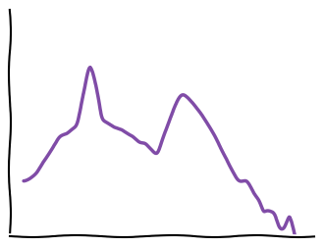




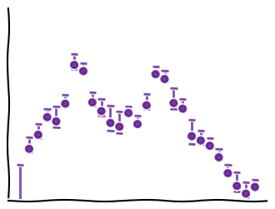

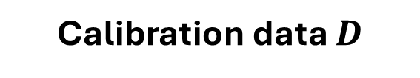
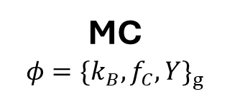

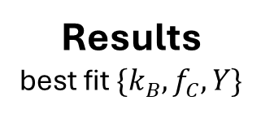
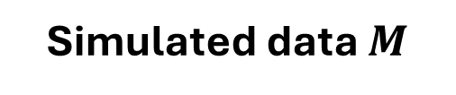
Monte Carlo tuning strategy
The most straightforward approach would be...
MC
$$φ={\{k_{B}, f_{C},Y\}}_{g}$$
Simulated data $M$
$$ℒ(M(φ)|D)$$
Likelihood
Fitter
Results best fit $\{k_{B}, f_{C},Y\}$
Minuit
MCMC
Nested sampling
JUNO
Calibration data $D$

Slide 8
Monte Carlo tuning strategy
The most straightforward approach would be...
too impractical and slow! Can we replace it with a surrogate model?
At each step of the fit, we generate a lot of events with full MC to build spectra of the sources with the corresponding kB_{g} fC_{g} LY_{g}
MC
$$φ={\{k_{B}, f_{C},Y\}}_{g}$$
Simulated data $M$
$$ℒ(M(φ)|D)$$
Likelihood
Fitter
Results best fit $\{k_{B}, f_{C},Y\}$
Analytically intractable
Minuit
MCMC
Nested sampling
JUNO
Calibration data $D$

Slide 9
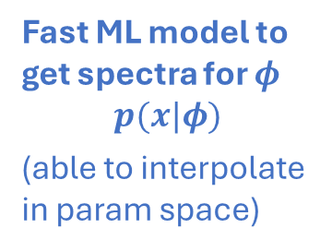
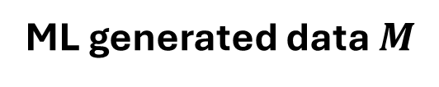
Monte Carlo tuning strategy
The most straightforward approach would be...
too impractical and slow! Can we replace it with a surrogate model?
Neural Likelihood Estimation (NLE)
Fast ML model to get spectra for $φ$
$$p(x|φ)$$
(able to interpolate in param space)
Training
ML generated data $M$
MC
$$φ={\{k_{B}, f_{C},Y\}}_{g}$$
$$ℒ(M(φ)|D)$$
Likelihood
Fitter
Results best fit $\{k_{B}, f_{C},Y\}$
Approximated with SBI
Minuit
MCMC
Nested sampling
JUNO
Calibration data $D$

Slide 10

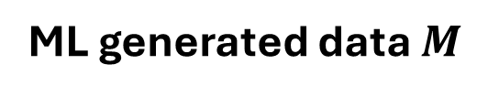
Monte Carlo tuning strategy
The most straightforward approach would be...
too impractical and slow! Can we replace it with a surrogate model?
We wanted to:
keep model under control
use std. inference techniques
eventually use NLE as spectra generator (MC surrogate)
Fast ML model to get spectra for $φ$
$$p(x|φ)$$
(able to interpolate in param space)
WHY NOT?
Training
ML generated data $M$
Neural Posterior Estimation (NPE)
directly outputting the posterior for $φ$,
$$q(φ|D)$$
MC
$$φ={\{k_{B}, f_{C},Y\}}_{g}$$
$$ℒ(M(φ)|D)$$
Likelihood
Fitter
Results best fit $\{k_{B}, f_{C},Y\}$
Approximated with SBI
Minuit
MCMC
Nested sampling
JUNO
Calibration data $D$

Slide 11
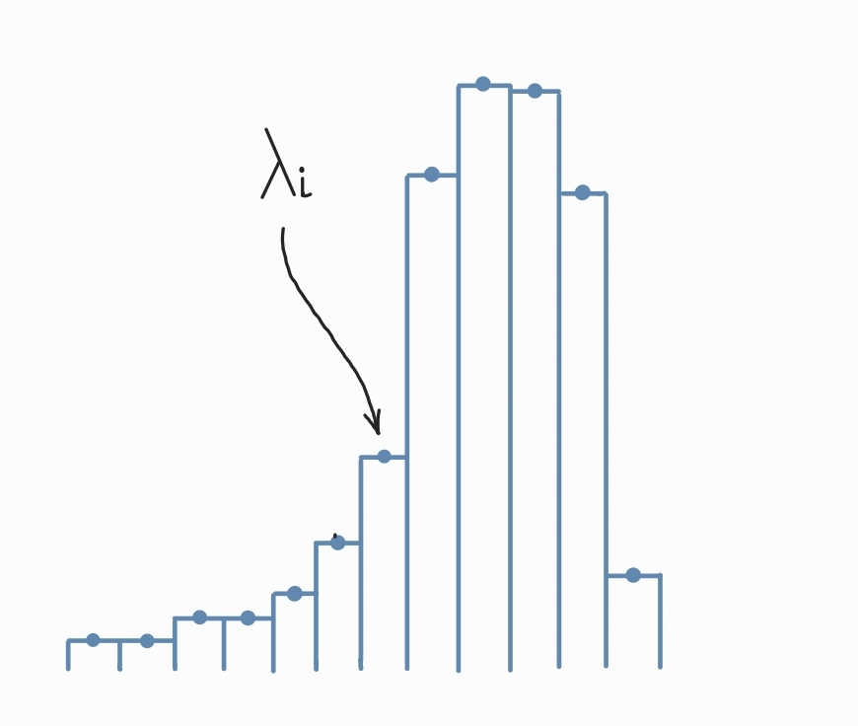
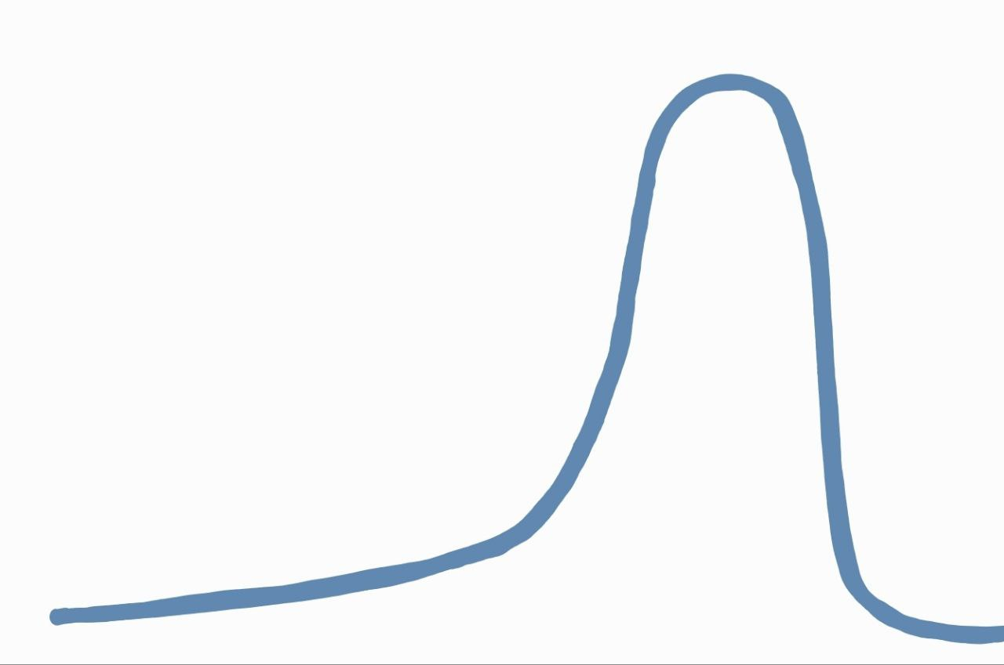
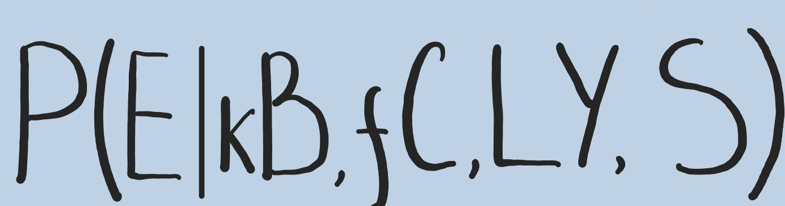
Two Neural Likelihood Estimators
Provides PDF estimation by outputting a histogram
TEDE
+ straight and reliable model - requires pre-defined binning
Multi-output regressor
Aims to directly learn a mapping from the parameters and a source type to the histogram representing the spectra PDF
We use a Transformer encoder-based model [1] as the density estimator (TEDE)
Conditions: kB, fC, LY + source type S
Provides the exact conditional PDF for any energy value:
NFDE
Normalizing Flow-based model
Aims to learn the exact conditional probability of the energies* for a given set of parameters and a source type:
+ exact probability density function
+ no pre-defined binning
+ opens a possibility of an unbinned fit
We use Normalizing Flows-based model [2] to evaluate the exact conditional probability for the events and build the PDF
*represented by amount of light collected
[1] Vaswani A et al, arxiv: 1706.03762
[2] R. J. Rezende et al, arxiv: 1505.05770

Slide 12
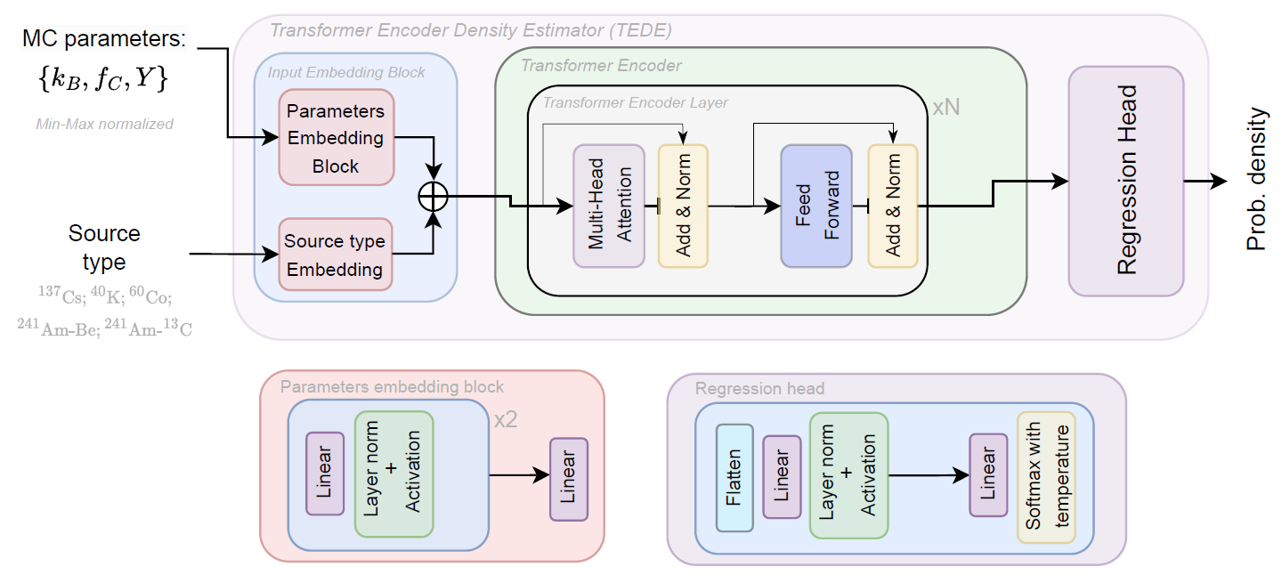
Transformer Encoder-based Density Estimator (TEDE)
Multi-output regressor is based on the Transformer's [1] encoder :
A powerful architecture, well known for NLP and CV applications
Each condition (MC parameter or source type) is treated as a token
Regressor Head block to convert outputs to the spectra PDF with pre-defined binning (bin size of 20 PEs)
[1] Vaswani A et al, arxiv: 1706.03762

Slide 13
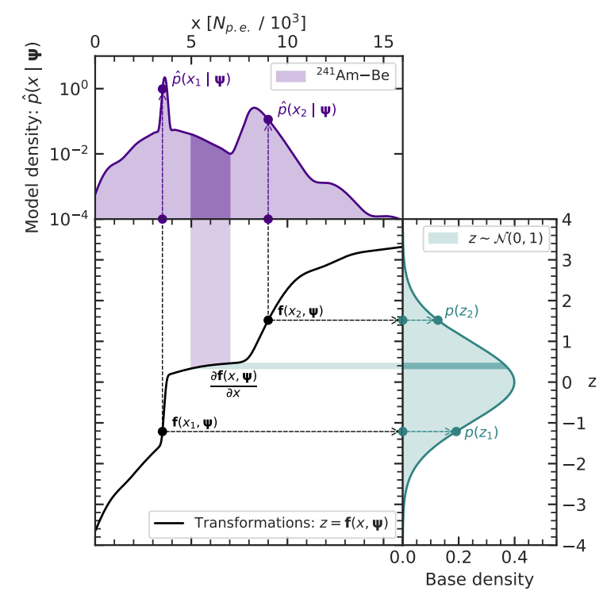
Normalizing Flows-based Density Estimator (NFDE)
Normalizing flows [1]:
generative ML model aimed to explicitly model a density estimation
generalizable for modeling a conditional density estimation as well
based on an idea of transforming a simple known distribution (e.g. standard Gaussian) to the complex, desired distribution by applying multiple learnable (using data) and invertible transformations called flows.
[1] R. J. Rezende et al, arxiv: 1505.05770

Slide 14
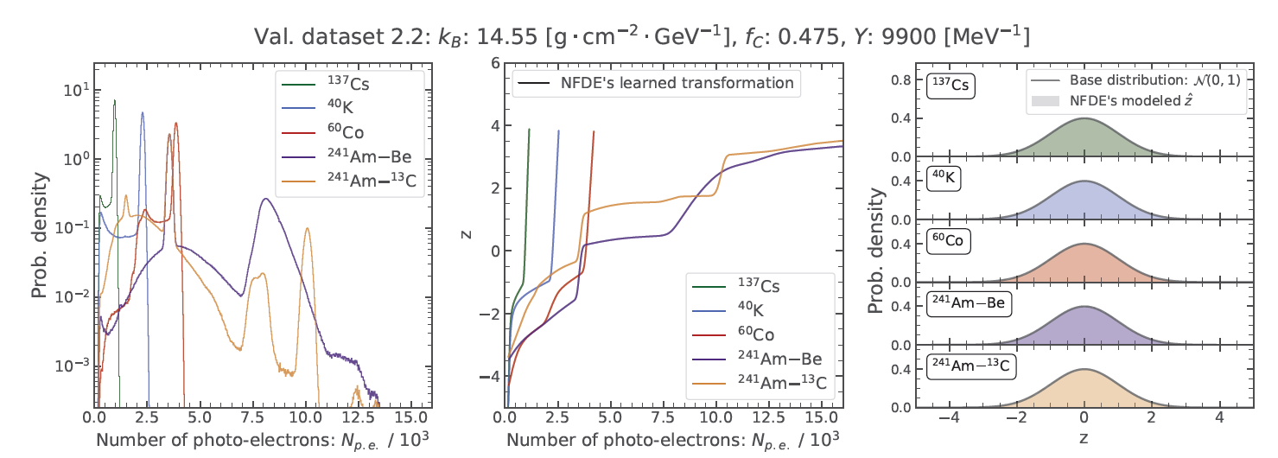
Normalizing Flows-based Density Estimator (NFDE)
Normalizing flows [1]:
generative ML model aimed to explicitly model a density estimation
generalizable for modeling a conditional density estimation as well
based on an idea of transforming a simple known distribution (e.g. standard Gaussian) to the complex, desired distribution by applying multiple learnable (using data) and invertible transformations called flows.
[1] R. J. Rezende et al, arxiv: 1505.05770

Slide 15
Normalizing Flows-based Density Estimator (NFDE)
Normalizing flows [1]:
generative ML model aimed to explicitly model a density estimation
generalizable for modeling a conditional density estimation as well
based on an idea of transforming a simple known distribution (e.g. standard Gaussian) to the complex, desired distribution by applying multiple learnable (using data) and invertible transformations called flows.
“Normalizing” direction
“Generative” direction
[1] R. J. Rezende et al, arxiv: 1505.05770

Slide 16
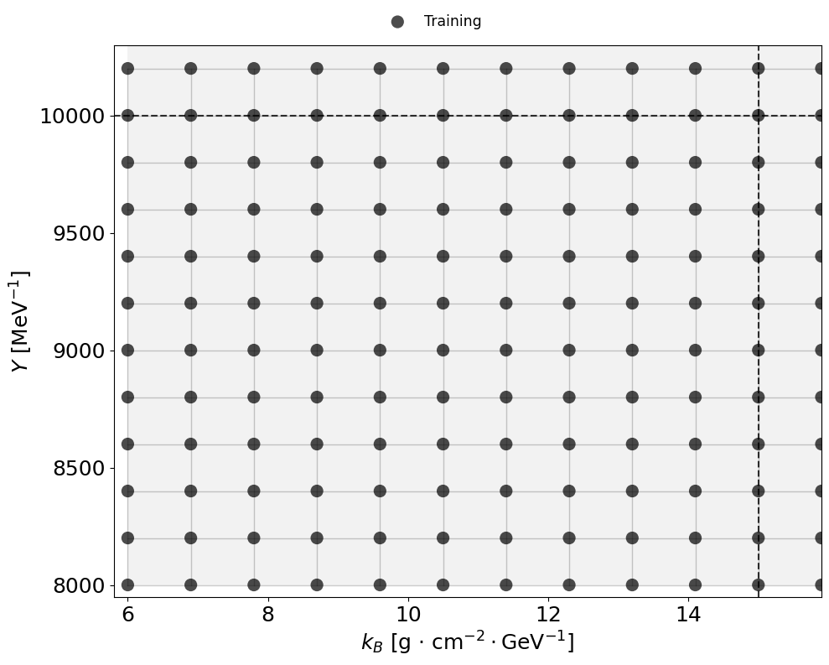
Datasets: training/validation strategy
Y and k_{B} example
Training data
21 points per param (21³ combs)
10k events x 5 sources per point (~500M events)

Slide 17
Datasets: training/validation strategy
Y and k_{B} example
Training data
21 points per param (21³ combs)
10k events x 5 sources per point (~500M events)

Slide 18
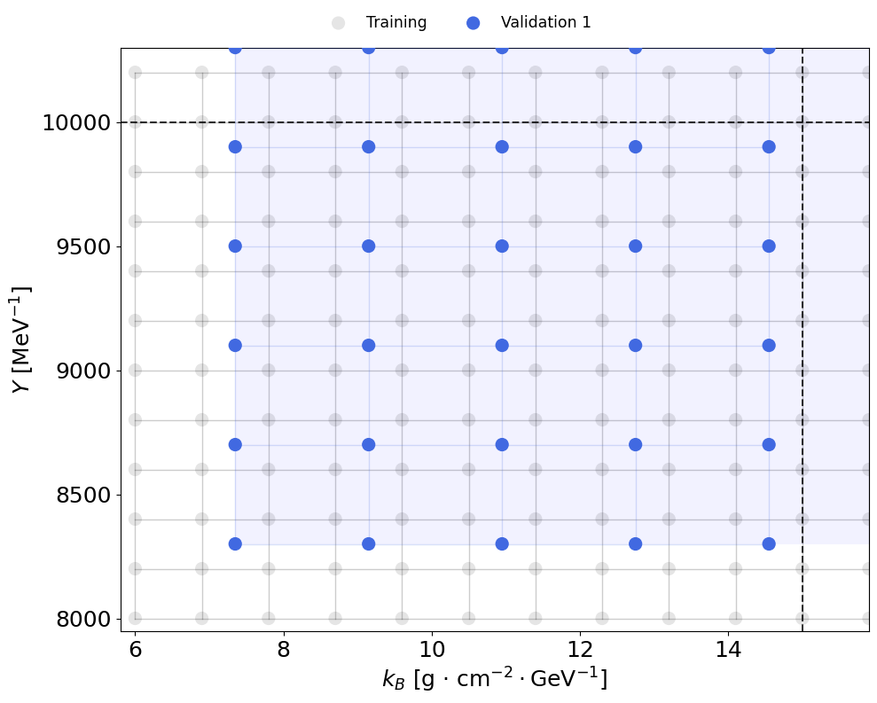
Datasets: training/validation strategy
Y and k_{B} example
Training data
21 points per param (21³ combs)
10k events x 5 sources per point (~500M events)
Validation data #1
10 points per param (10³ combs)
10k x 5 events per point (50M events)
→ cover most of parameter space

Slide 19
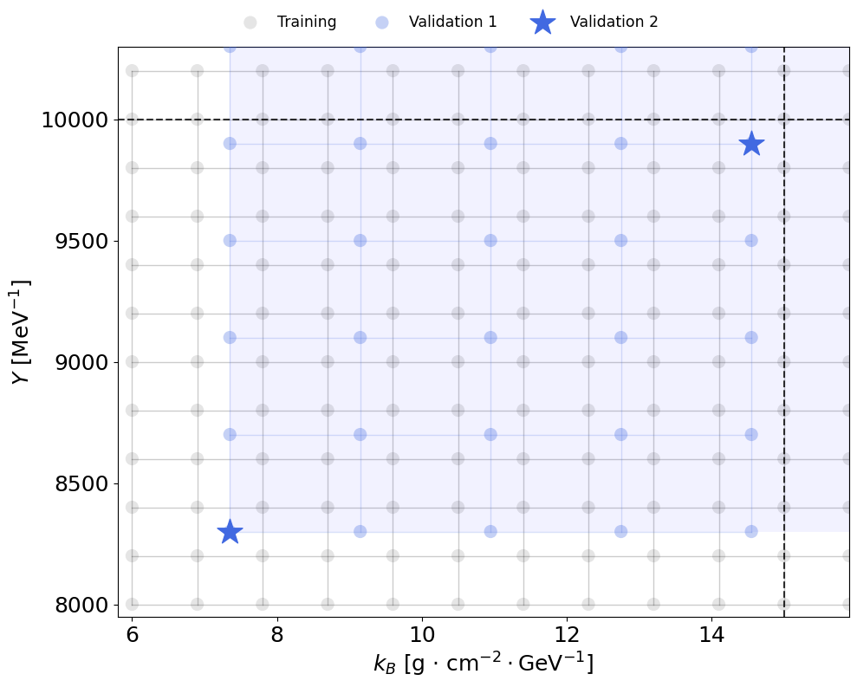
Datasets: training/validation strategy
Y and k_{B} example
Training data
21 points per param (21³ combs)
10k events x 5 sources per point (~500M events)
Validation data #1
10 points per param (10³ combs)
10k x 5 events per point (50M events)
→ cover most of parameter space
Validation data #2
3 points in total
10M x 5 events per point (150M events)
anchor PDF to high-stat spectra

Slide 20
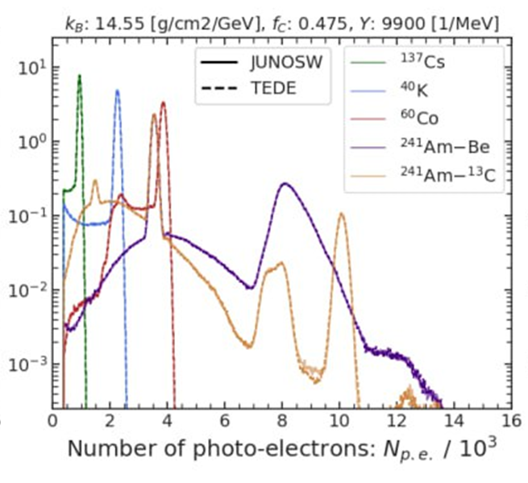
Datasets: training/validation strategy
Y and k_{B} example
Training data
21 points per param (21³ combs)
10k events x 5 sources per point (~500M events)
Validation data #1
10 points per param (10³ combs)
10k x 5 events per point (50M events)
→ cover most of parameter space
Validation data #2
3 points in total
10M x 5 events per point (150M events)
anchor PDF to high-stat spectra

Slide 21
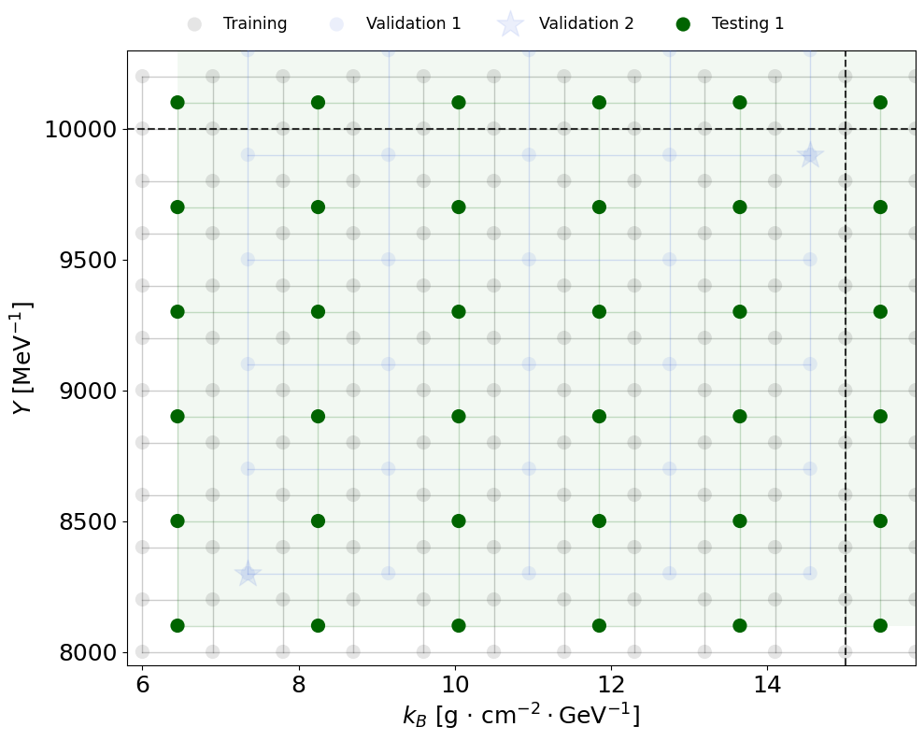
Datasets: training/validation strategy
Y and k_{B} example
Training data
21 points per param (21³ combs)
10k events x 5 sources per point (~500M events)
Validation data #1
10 points per param (10³ combs)
10k x 5 events per point (50M events)
→ cover most of parameter space
Validation data #2
3 points in total
10M x 5 events per point (150M events)
anchor PDF to high-stat spectra
Testing data #1
10 points per param (10³ combs)
10k x 5 events per point (50M events)
→ check possible biases over parameter space

Slide 22
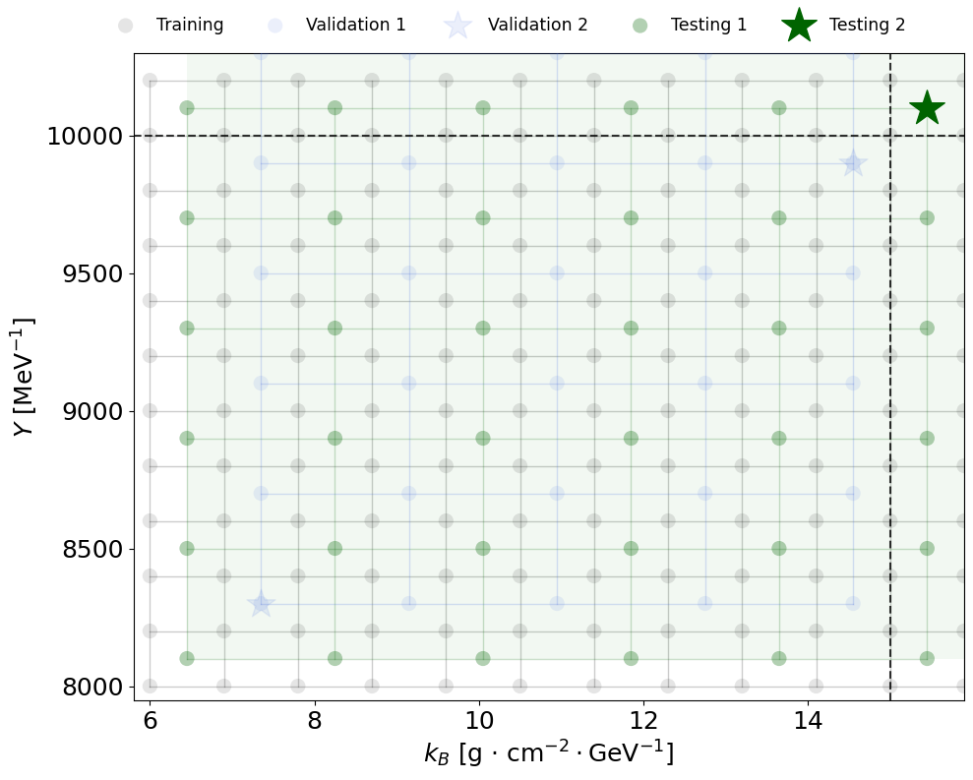
Datasets: training/validation strategy
Y and k_{B} example
Training data
21 points per param (21³ combs)
10k events x 5 sources per point (~500M events)
Validation data #1
10 points per param (10³ combs)
10k x 5 events per point (50M events)
→ cover most of parameter space
Validation data #2
3 points in total
10M x 5 events per point (150M events)
anchor PDF to high-stat spectra
Testing data #1
10 points per param (10³ combs)
10k x 5 events per point (50M events)
→ check possible biases over parameter space
Testing data #2
1 point
1000 x [1k; 2k; 5k; 10k; 25k] events x 5 with diff. seeds
→ Analysis of systematic uncertainty of the model

Slide 23
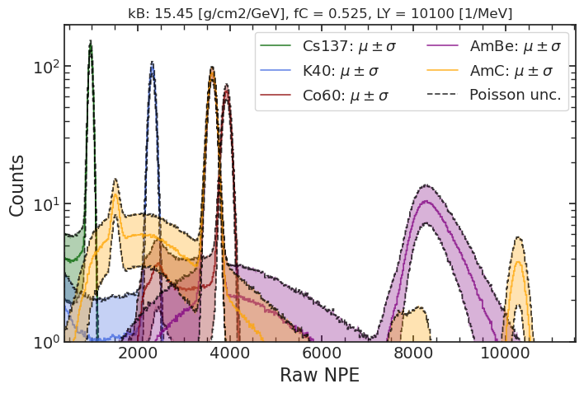
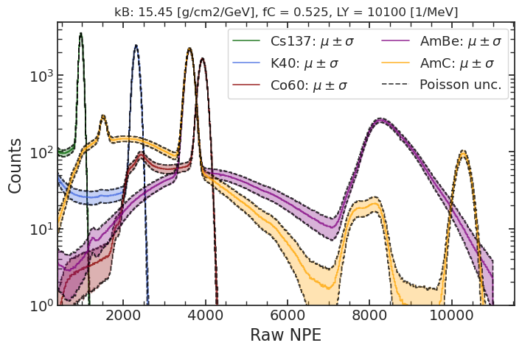
Datasets: training/validation strategy
Y and k_{B} example
Training data
21 points per param (21³ combs)
10k events x 5 sources per point (~500M events)
Validation data #1
10 points per param (10³ combs)
10k x 5 events per point (50M events)
→ cover most of parameter space
Validation data #2
3 points in total
10M x 5 events per point (150M events)
anchor PDF to high-stat spectra
Testing data #1
10 points per param (10³ combs)
10k x 5 events per point (50M events)
→ check possible biases over parameter space
Testing data #2
1 point
1000 x [1k; 2k; 5k; 10k; 25k] events x 5 with diff. seeds
→ Analysis of systematic uncertainty of the model
1k events
25k events

Slide 24
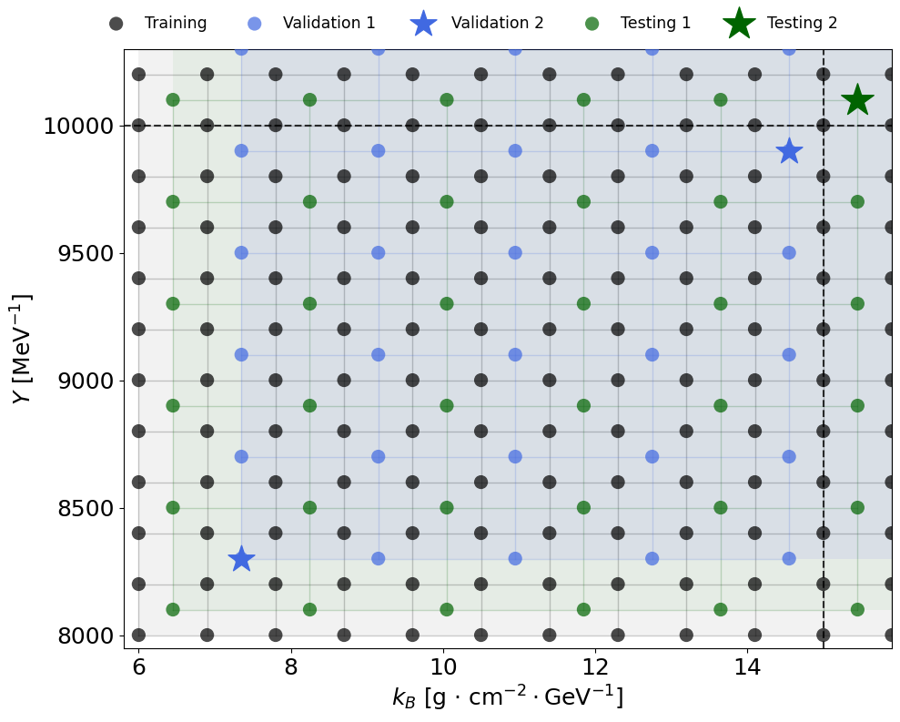
Datasets: training/validation strategy
Y and k_{B} example
Training data
21 points per param (21³ combs)
10k events x 5 sources per point (~500M events)
Validation data #1
10 points per param (10³ combs)
10k x 5 events per point (50M events)
→ cover most of parameter space
Validation data #2
3 points in total
10M x 5 events per point (150M events)
anchor PDF to high-stat spectra
Testing data #1
10 points per param (10³ combs)
10k x 5 events per point (50M events)
→ check possible biases over parameter space
Testing data #2
1 point
1000 x [1k; 2k; 5k; 10k; 25k] events x 5 with diff. seeds
→ Analysis of systematic uncertainty of the model

Slide 25

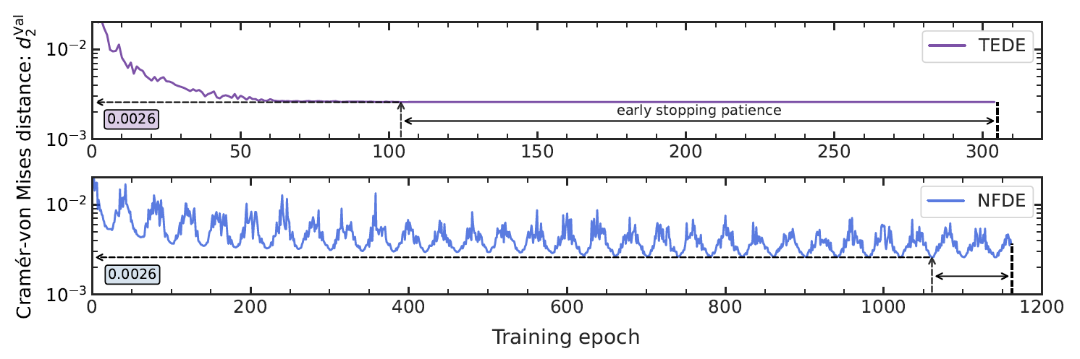
Training and validation of the models
For both models we use Kullback–Leibler divergence as the loss function for training:
As validation metrics we use p-norm distances between distributions' CDFs:
as it is applicable for both TEDE and NFDE cases
p = 1: Wasserstein distance
p = 2: Cramer-von Mises distance
p = ∞: Kolmogorov-Smirnov distance

Slide 26
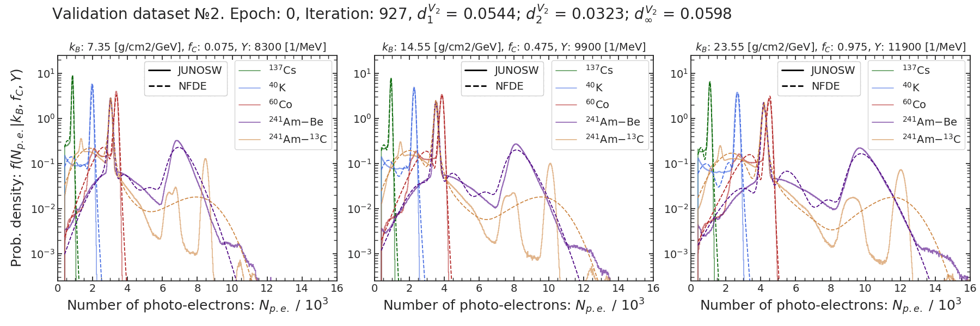
Training and validation of the models
For both models we use Kullback–Leibler divergence as the loss function for training:
As validation metrics we use p-norm distances* between distributions' CDFs:
as it is applicable for both TEDE and NFDE cases
p = 1: Wasserstein distance
p = 2: Cramer von Mises distance
p = ∞: Kolmogorov-Smirnov distance

Slide 27
Parameter estimation
training points
9.6
10.05
10.5
kB
Example with NFDE:
Combined fit on all sources together
Cost function: Extended unbinned likelihood
Optimizer: Nested Sampling (ultranest)*
→ Estimate the kB, fC, LY best parameters
→ Explores full phase space, provides full posterior
→ Shows correlations between the parameters
0.200
0.225
0.250
fC
11600
11700
11800
LY
the testing dataset №1 point is between the points from the training dataset: interpolation
*all fits performed with Minuit, MCMC (emcee), Nested Sampling (ultranest) → consistent results

Slide 28
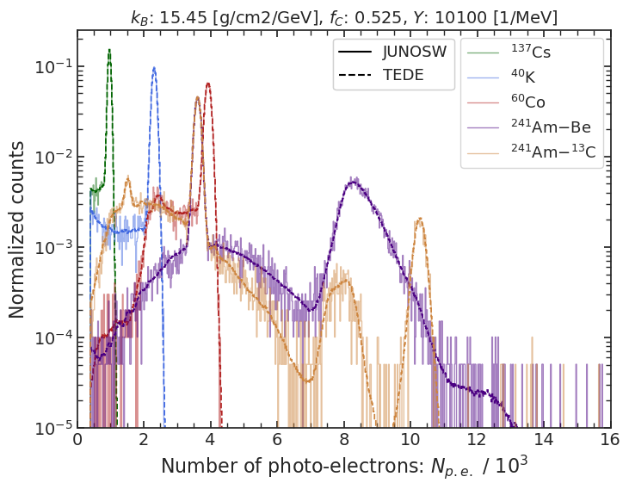

Parameter estimation
9.6
10.05
10.5
kB
Example with NFDE:
Combined fit on all sources together
Cost function: Extended unbinned likelihood
Optimizer: Nested Sampling (ultranest)*
→ Estimate the kB, fC, LY best parameters
→ Explores full phase space, provides full posterior
→ Shows correlations between the parameters
0.200
0.225
0.250
fC
11600
11700
11800
LY
Model provides spctra estimates for any continuous values of the parameters​
Model interpolation smooth and denoised
*all fits performed with Minuit, MCMC (emcee), Nested Sampling (ultranest) → consistent results

Slide 29
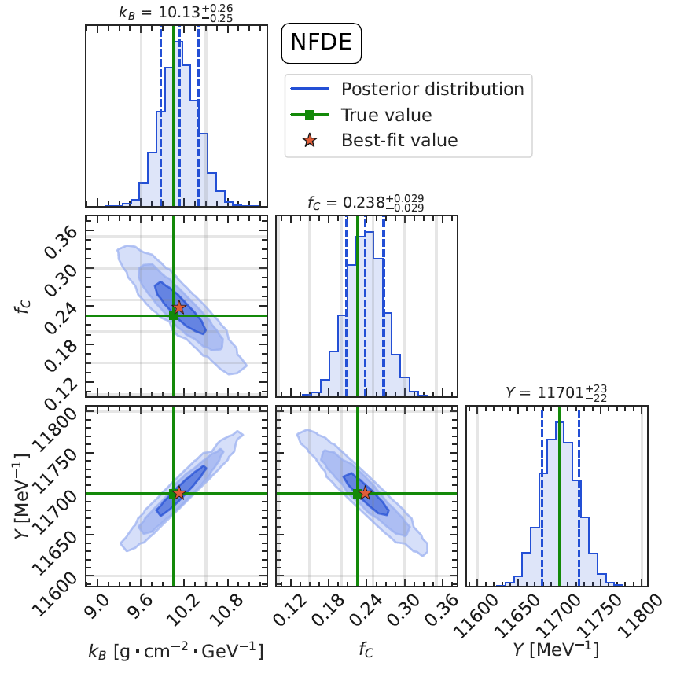
Parameter estimation
Example with NFDE:
Combined fit on all sources together
Cost function: Extended unbinned likelihood
Optimizer: Nested Sampling (ultranest)*
→ Estimate the kB, fC, LY best parameters
→ Explores full phase space, provides full posterior
→ Shows correlations between the parameters
Parameters estimation combined:
kB: 10.13 +- 0.26 10.05 [g/cm²/GeV]
fC: 0.238 +- 0.029 0.225
LY: 11701 +- 23 11700 [1/MeV]
→ well within 1σ (fluctuations expected for 1 fit)
*all fits performed with Minuit, MCMC (emcee), Nested Sampling (ultranest) → consistent results

Slide 30
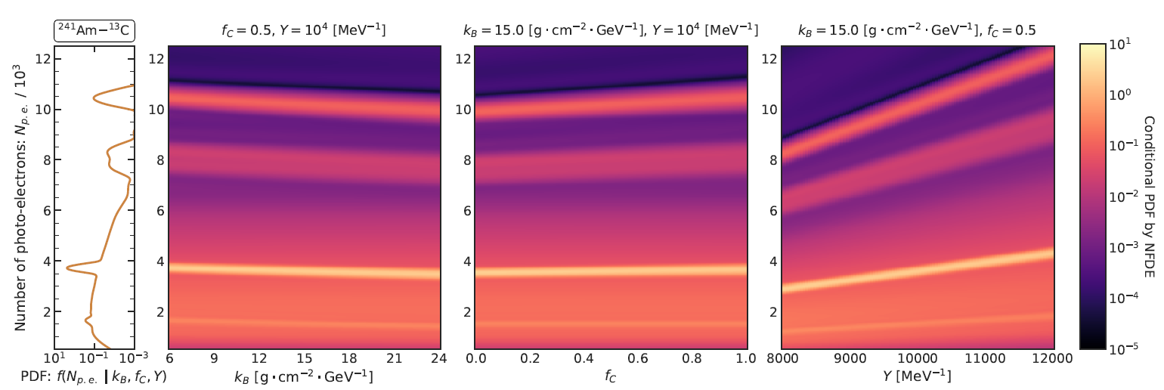
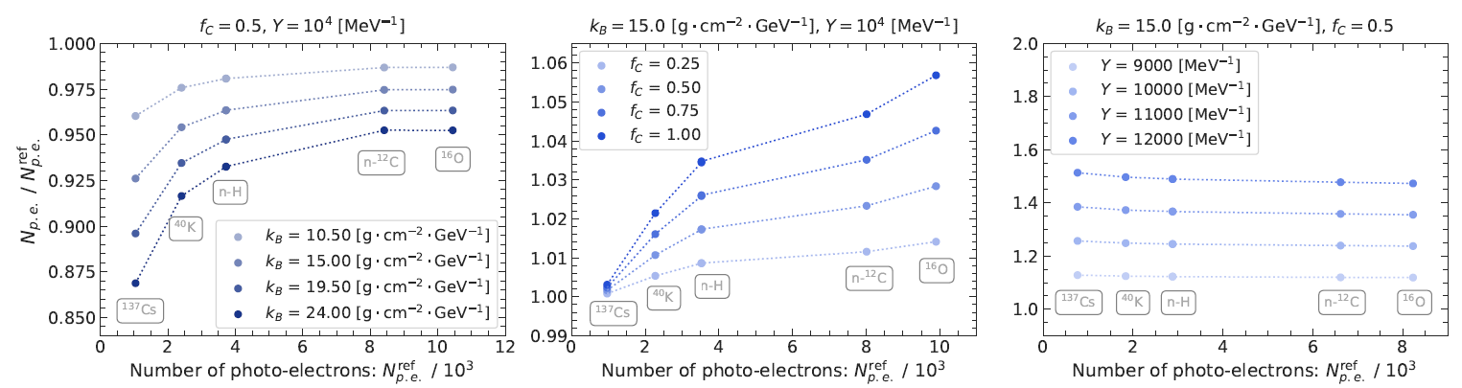
Learned dependences
PDF vs. parameter (almost linear)
PDFs vs. energy (NPE) (energy non-linearity)

Slide 31
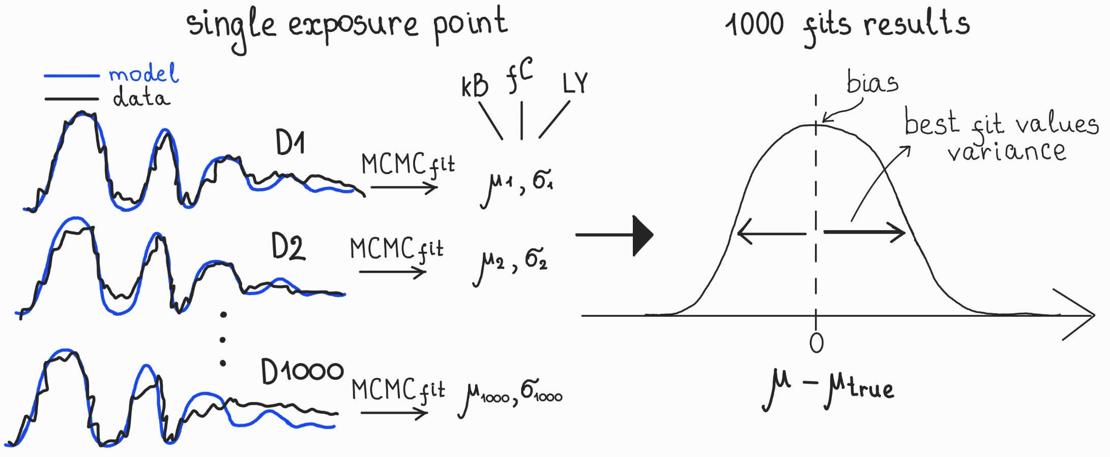


Evaluate ML-driven systematic uncertainty
To perform systematic uncertainty estimation analysis, we use the testing dataset 2:
Unseen during training point in the parameter space: kB, fC, LY = (15.45, 0.525, 10100)
5 different exposures: 1k, 2k, 5k, 10k, 25k events
1000 datasets with different MC generator seed per each exposure
uncertainties estimated by the fit can be compared with the actual variability of the best fit values

Slide 32
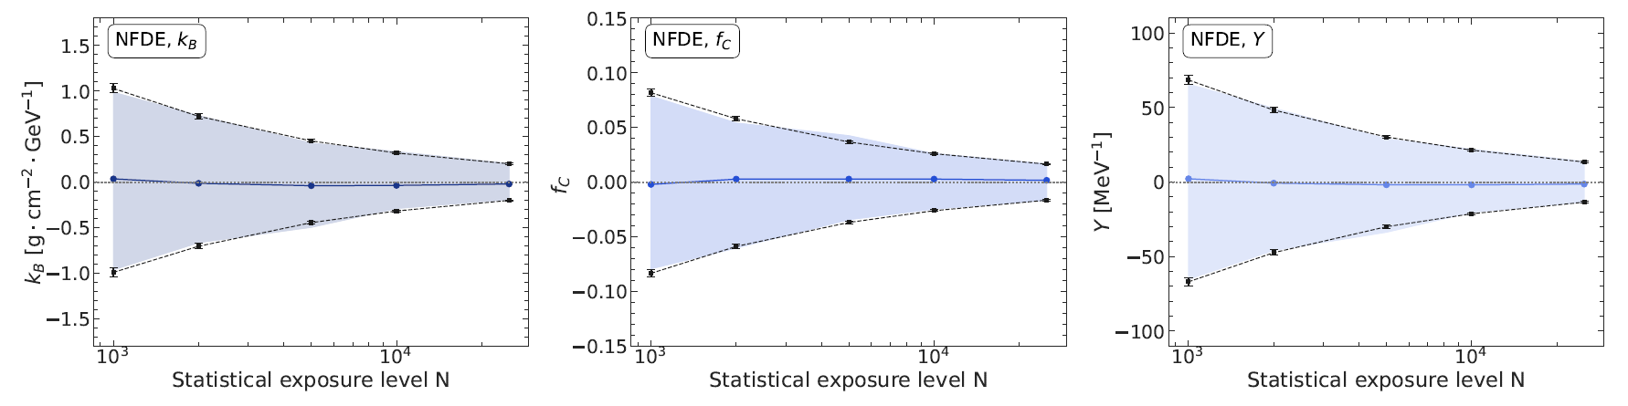
Estimation of ML-driven systematic uncertainty
To perform systematic uncertainty estimation analysis, we use the testing dataset 2:
Unseen during training point in the parameter space: kB, fC, LY = (15.45, 0.525, 10100)
5 different exposures: 1k, 2k, 5k, 10k, 25k events
1000 datasets with different MC generator seed per each exposure
→ Estimated uncertainty matches observed variability
Estimated Stat. Unc.
Observed Std. Dev.

Slide 33
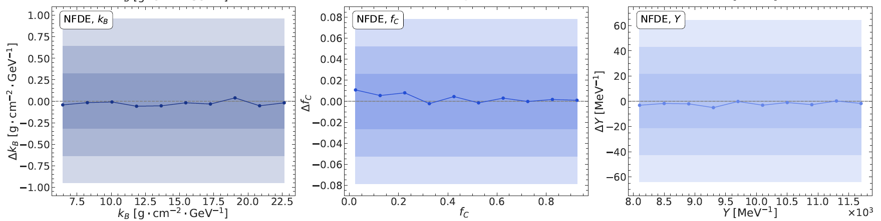
Estimation of ML-driven systematic bias
Using the testing dataset 1, one can check the bias across different points:
Run MCMC fits per each testing point of the dataset
Compare bias with the uncertainty obtained by the previous analysis for the 10k exposure point
→ Observed biases are well within the uncertainty
Observed bias
Stat unc.

Slide 34
Summary
Challenge: systematics investigation for precision neutrino physics with JUNO and accurate energy calibration → requires an extremely well tuned MC, but the traditional MC tuning process is computationally prohibitive.

Slide 35
Summary
Challenge: systematics investigation for precision neutrino physics with JUNO and accurate energy calibration → requires an extremely well tuned MC, but the traditional MC tuning process is computationally prohibitive.
Solution: we developed a Simulation-Based Inference framework using two neural likelihood estimators (TEDE and NFDE) that replace the slow MC simulation with a fast, accurate surrogate models.

Slide 36
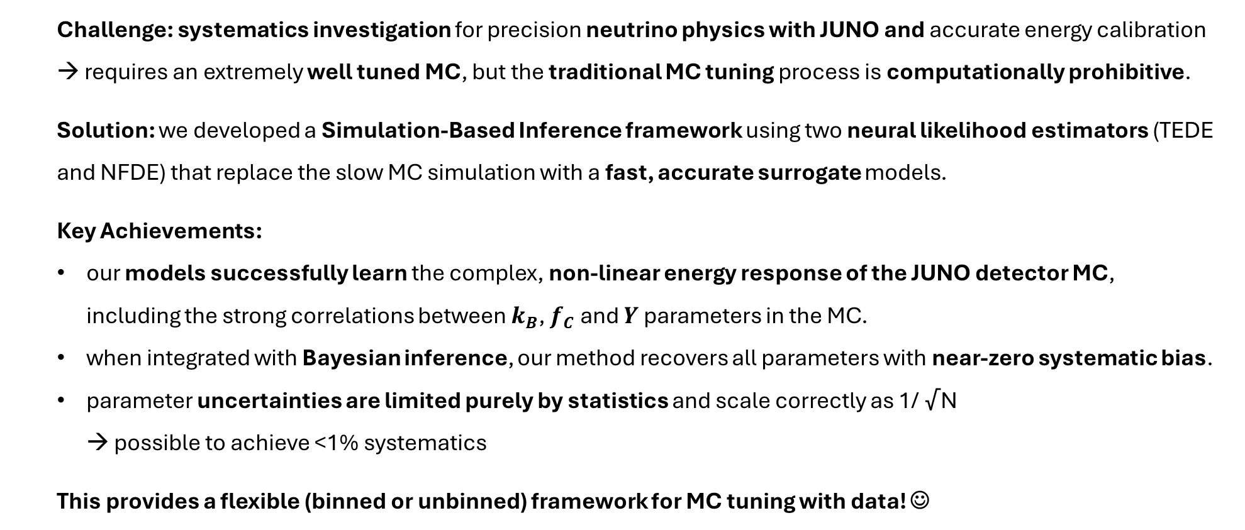
Summary
Challenge: systematics investigation for precision neutrino physics with JUNO and accurate energy calibration → requires an extremely well tuned MC, but the traditional MC tuning process is computationally prohibitive.
Solution: we developed a Simulation-Based Inference framework using two neural likelihood estimators (TEDE and NFDE) that replace the slow MC simulation with a fast, accurate surrogate models.
Key Achievements:
our models successfully learn the complex, non-linear energy response of the JUNO detector MC, including the strong correlations between $k_{B}$, $f_{C}$ and $Y$ parameters in the MC.
when integrated with Bayesian inference, our method recovers all parameters with near-zero systematic bias.
parameter uncertainties are limited purely by statistics and scale correctly as 1/ √N → possible to achieve <1% systematics
This provides a flexible (binned or unbinned) framework for MC tuning with data! ☺

Slide 37
Thanks!
Repo
Pre-print

Slide 38
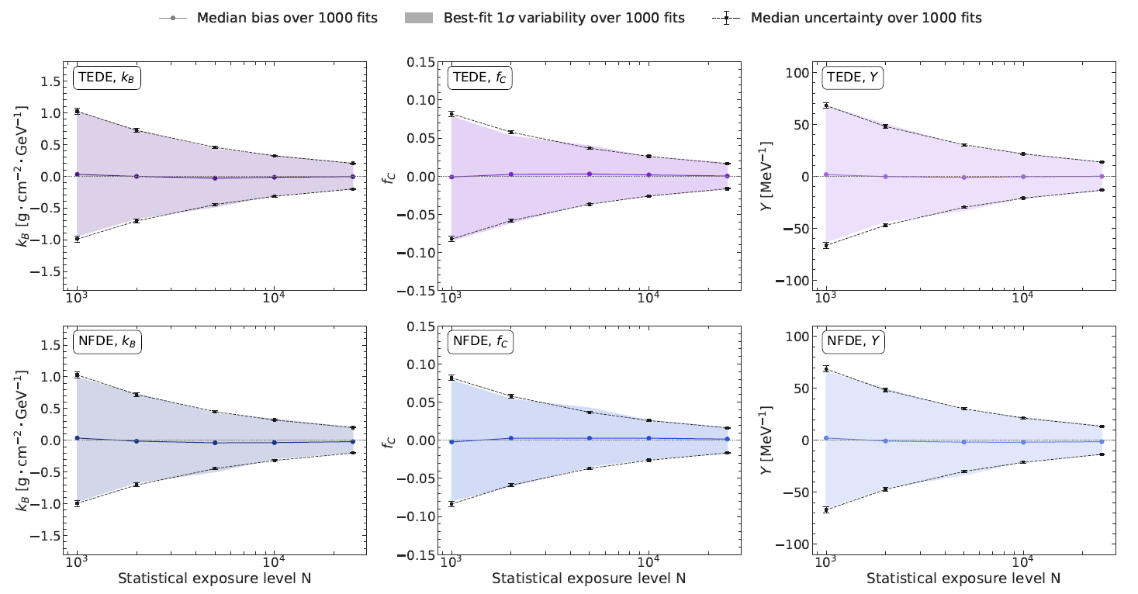
TEDE vs. NFDE (uncertainty)

Slide 39
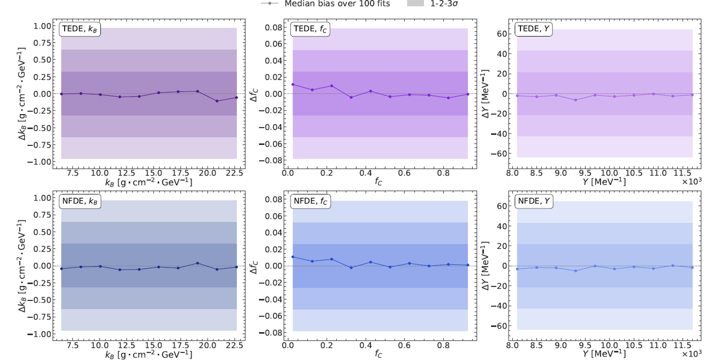
TEDE vs. NFDE (bias)

Slide 40
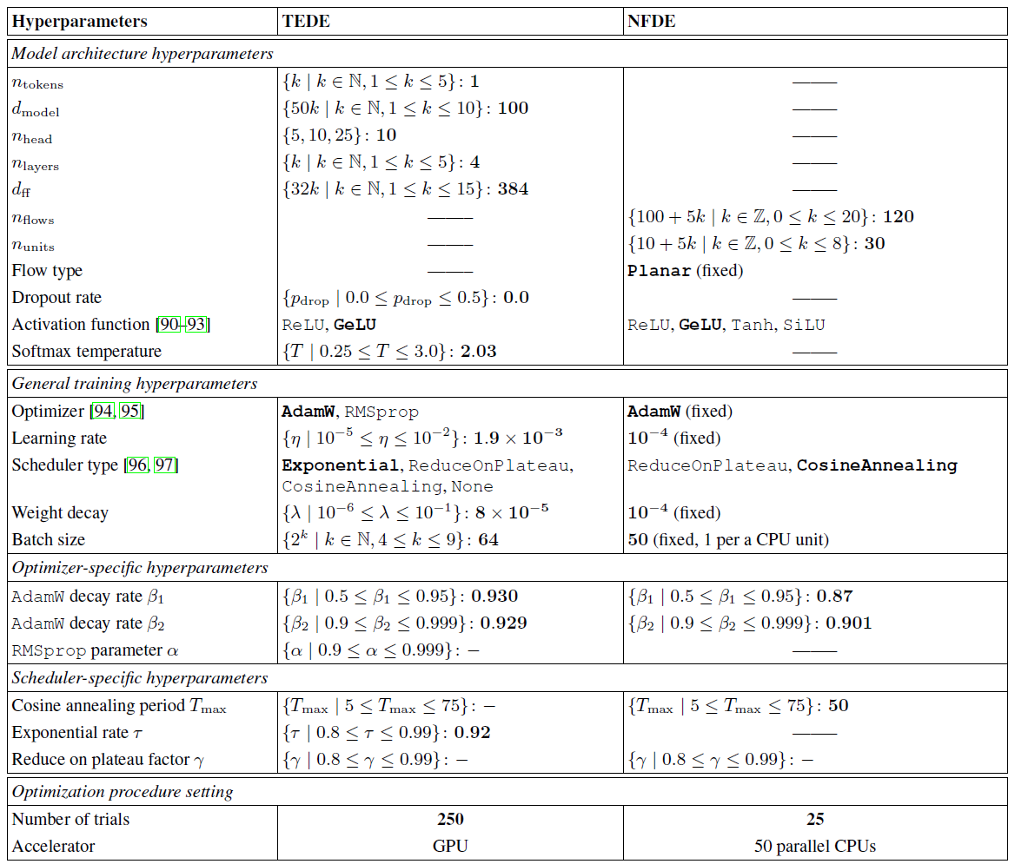
Hyperparameters optimization

Slide 41
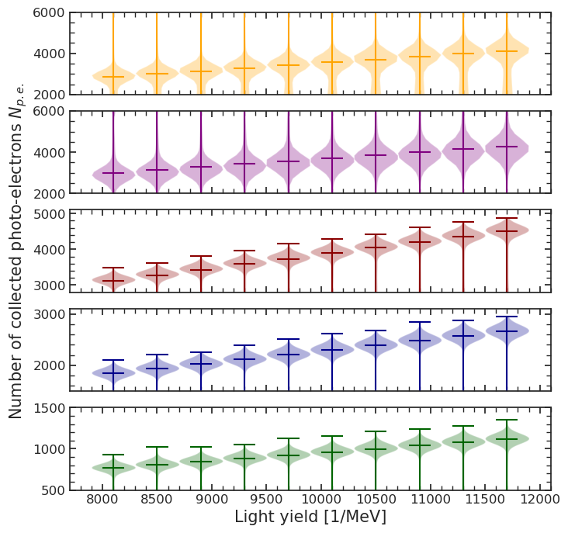
How LS parameters impact the calibration data
LY effect
Am-C
kB and fC are fixed:
kB = 15.45 [g/cm²/GeV]
fC = 0.525
LY is varying
Am-Be
Light yield is the most influential parameter​
All sources are highly affected
Co60
K40
Cs137
Only main peaks are shown
Arsenii Gavrikov, Andrea Serafini, et al – NeuroMCT

Slide 42
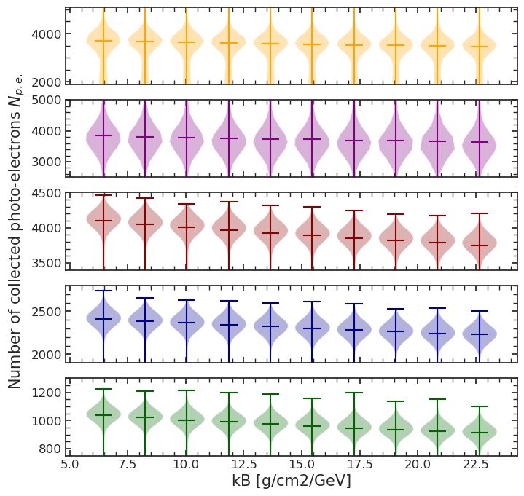
How LS parameters impact the calibration data
kB effect
Am-C
LY and fC are fixed:
LY = 10100 [1/MeV]
fC = 0.525
kB is varying
Am-Be
kB effect is smaller than LY and anticorrelated with the photo peak
All sources are affected
Co60
K40
Cs137
Only main peaks are shown
Arsenii Gavrikov, Andrea Serafini, et al – NeuroMCT

Slide 43
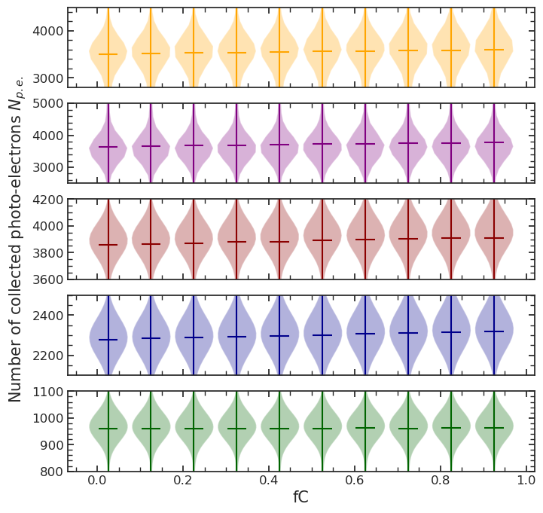
How LS parameters impact the calibration data
fC effect
Am-C
kB and LY are fixed:
kB = 15.45 [g/cm²/GeV]
LY = 10100 [1/MeV]
fC is varying
Am-Be
fC has a minor effect to the spectra
Cs137 is not affected at all
Slight effect for Co60 and K40
Co60
K40
Cs137
Only main peaks are shown
Arsenii Gavrikov, Andrea Serafini, et al – NeuroMCT

Slide 44
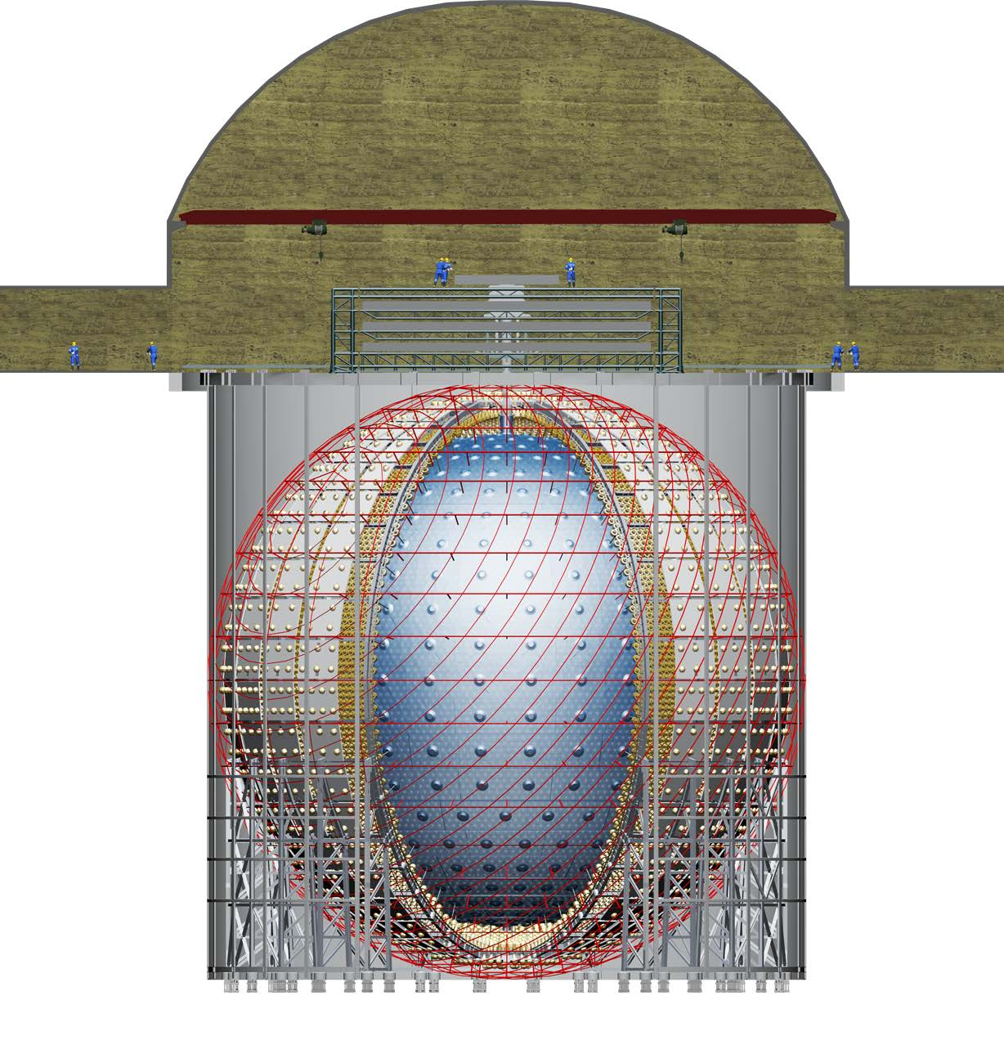






















The JUNO detection process
JUNO will measure the antineutrinos (${\overline{ν}}_{e}$) generated in the fissions occurring in 8 nuclear cores at 52.5 km
$${\overline{ν}}_{e}+p→e^{+}+n$$
$$∼1 m$$
The detection is based on a charged current interaction named Inverse Beta Decay (IBD) on protons (p)
→ sensitive only to electron ${\overline{ν}}_{e}$
$$n$$
$$n$$
$$γ$$
$${\overline{ν}}_{e}$$
$$p$$
$$(2.2 MeV)$$
$$e^{+}$$
$$p$$
$$γ$$
$$E_{e^{+}}∼E_{\overline{ν}}−0.78 MeV$$
$$∼0.1 m$$
$$(0.5 MeV)$$
Detection relies on a double coincidence:
prompt signal: positron (e⁺) annihilation
delayed signal: neutron (n) capture
→ strong handle against most backgrounds
$$e^{−}$$
$$e^{+}$$
$$γ$$
$$(0.5 MeV)$$

Slide 45

The JUNO detector
[Prog. Part. Nucl. Phys. 2021.103927]
43.5 m
Main requirements:
high statistics → 20 kton of liquid scintillator acrylic sphere
<3% energy resolution @ 1 MeV → photocoverage ~78%
energy-scale systematics below 1% → 17612 20" Large-PMT → 25600 3" Small-PMT
35.4 m
 | Target mass [kton] | Energy resolution | Light yield [PE/MeV]
Daya Bay | 0.02 | 8%/√E | 160
Borexino | 0.3 | 5%/√E | 500
KamLAND | 1 | 6%/√E | 250
JUNO | 20 | 3%/√E | ~1600

Slide 46







Detector response: what JUNO actually sees
interaction
light emission
light detection
Calibration campaigns
automated multiple-position and multi-source calibration (link)
periodic calibration campaigns
dual-calorimetry system (link)
$$E_{ν}$$
$$E_{dep}$$
$$E_{vis}$$
$$E_{rec}$$
Antineutrino energy
Deposited energy
Visible energy
Reconstructed energy
6 years
Visible/deposited
Non-linearity
Energy resolution
Deposited energy [MeV]
$$\frac{σ}{E}=\sqrt{{\left(\frac{a}{\sqrt{E}}\right)}^{2}+b^{2}+{\left(\frac{c}{E}\right)}^{2}}$$
Events/bin [#/20 keV]
Events/bin [#/20 keV]
Events/bin [#/20 keV]
Energy resol. [%]
$$a$$
$$b$$
$$c$$
Stochastic term: light yield (from source calibration)
Dominated by non-uniformity
(from multi-source calibration)
PMT dark noise
Deposited spectrum
Visible spectrum
Visible energy [MeV]
Reconstructed spectrum
Energy [MeV]

Slide 47




Detector response: what JUNO actually sees
interaction
light emission
light detection
Calibration campaigns
automated multiple-position and multi-source calibration (link)
periodic calibration campaigns
dual-calorimetry system (link)
$$E_{ν}$$
$$E_{dep}$$
$$E_{vis}$$
$$E_{rec}$$
Antineutrino energy
Deposited energy
Visible energy
Reconstructed energy
Energy resolution
$$\frac{σ}{E}=\sqrt{{\left(\frac{a}{\sqrt{E}}\right)}^{2}+b^{2}+{\left(\frac{c}{E}\right)}^{2}}$$
$$a$$
$$b$$
$$c$$
Stochastic term: light yield (from source calibration)
Dominated by non-uniformity
(from multi-source calibration)
PMT dark noise

Slide 48






JUNO detector response: state of the art
Realistic MC simulation
Measured data
Updated values based on commissioning data and realistic MC simulation
$$\frac{σ}{E}=\sqrt{{\left(\frac{a}{\sqrt{E}}\right)}^{2}+b^{2}+{\left(\frac{c}{E}\right)}^{2}}$$

Slide 49

IBD backgrounds in JUNO
IBD selection cuts | Efficiency [%] | IBD rate [day⁻¹]
All IBDs | 100.0 | 57.4
Fiducial volume | 91.5 | 52.5
IBD selection | 98.1 | 51.1
Energy range | 99.8 | -
Time correlation (∆T_{p-d}) | 99.0 | -
Spatial correlation (∆R_{p-d}) | 99.2 | -
Muon veto (Time+spatial) | 91.6 | 47.1
Combined selection | 82.2 | 47.1
JUNO employs various selection cuts to retain high efficiency and assure high purity in the IBD signal:
Cosmogenic backgrounds → muon veto
Accidental coincidences → fiducial volume + IBD cuts
Irreducible backgrounds → negligible (~1/20 of signal)
Residual backgrounds | Rate [day⁻¹] | Rate unc. [%] | Shape unc. [%]
Geoneutrinos | 1.2 | 30 | 5
World reactors | 1.0 | 2 | 5
Accidentals | 0.8 | 1 | negligible
⁹Li/⁸He | 0.8 | 20 | 10
Atmospheric neutrinos | 0.16 | 50 | 50
Fast neutrons | 0.1 | 100 | 20
¹³C(α,n)¹⁶O | 0.05 | 50 | 50
Total background | 4.11 | - | -

Slide 50







Detection channels in JUNO
NC recoil threshold: 200 keV
Liquid scintillator:
Linear alkylbenzenes
C – 88%
H – 12%
CC on proton
NC on proton
CC on Carbon
NC on electron
$${\overline{ν}}_{e}+p→e^{+}+n$$
$$ν+p→ν+p$$
$$ν+e→ν+e$$
$$ν_{e}+{}_{}^{12}C→e^{−}+{}_{}^{12}N$$
$${\overline{ν}}_{e}+{}_{}^{12}C→e^{+}+{}_{}^{12}B$$

Slide 51

Photomultiplier Tubes

Slide 52



Dual calorimetry system
JUNO employs the dual calorimetry system to correct for electronics non-linearity
Sources of non-linear response:
Non-uniformity (NU)
Liquid scintillator non-linearity (LSNL)
Charge non-linearity (QNL) of L-PMTs
Simulations with extreme channel-level non-linearity of 50% over 100 PE show that L-PMT response ($R$) non-linearity can be corrected using S-PMT as calibration reference:
1.01
1.00
Instrumental non-linearity
0.99
0.98
0
2
4
6
8
True electron energy [MeV]
$$R^{L−PMT}=R_{LSNL}∙R_{NU}^{L−PMT}∙R_{QNL}^{L−PMT}$$
$$\frac{R^{L−PMT}}{R^{S−PMT}}=\frac{R_{QNL}^{L−PMT}}{R_{QNL}^{S−PMT}}$$
$$R^{S−PMT}=R_{LSNL}∙R_{NU}^{S−PMT}∙R_{QNL}^{S−PMT}$$

Slide 53


Other non-linearities
Detector non-uniformity
The detector response to the same charge deposition depends on the position at which the event occurs and needs to be properly characterized.
Liquid scintillator non-linearity
Light emission has an intrinsic non-linearity because of:
Birks’ quenching effect in scintillation photon yield;
Velocity-dependent Cherenkov emission.
1600
1.04
1.02
1500
1.00
0.98
Light Yield [PE/MeV]
Non-linearity (visible/true)
1400
0.96
1300
0.94
Light yield @ center 1345 MeV → 1665 MeV (new resolution model)
0.92
1200
0.90
0
2
4
6
8
10
12
14
16
18
0
1
2
3
4
5
6
Radius [m]
True gamma energy [MeV]

Slide 54

Calibration of the JUNO detector
Slide credits D. Basilico
Radioactive sources (100-200 Hz) + Laser sources
1D: Automatic Calibration Unit (ACU)
2D: Cable Loop System (CLS)
3D: Remotely Operated under-LS Vehicles (ROV)
Boundary: Guide Tube Calibration System (GTCS)
250 calibration points
JHEP 03 (2021) 004

Slide 55



Calibration strategy
Slide credits D. Basilico
JHEP 03 (2021) 004
Comprehensive calibration (250 points, ~48h)
basic understanding of the CD performance
Monthly calibrations (~100 points, ~11h)
monitor non-uniformity
Weekly calibrations (~15 points, ~2.4h)
track variations in LY of LS, PMT gains, and electronics

Slide 56


Normalizing flows-based density estimation
Normalizing flows [1]:
Generative machine learning model
Aims to explicitly model a density estimation
Can be generalized for modeling a conditional density estimation as well
To obtain a value from the target distribution:
sample a value from the base distribution and passing it through all the flows
x: input data
"Normalizing" direction
"Generative" direction
[1] R. J. Rezende et al, arxiv: 1505.05770
8.1
Arsenii Gavrikov, Andrea Serafini, et al – NeuroMCT

Slide 57
Normalizing flows-based density estimation
Normalizing flows [1]:
Generative machine learning model
Aims to explicitly model a density estimation
Can be generalized for modeling a conditional density estimation as well
To obtain a value from the target distribution:
sample a value from the base distribution and passing it through all the flows
x: input data
"Normalizing" direction
"Generative" direction
Normalizing flows are based on an idea of transforming a simple known distribution (e.g. standard Gaussian) to the complex, desired distribution by applying multiple learnable (using data) transformations
Each transformation is called Flow and must be invertible
[1] R. J. Rezende et al, arxiv: 1505.05770
8.2
Arsenii Gavrikov, Andrea Serafini, et al – NeuroMCT

Slide 58
Normalizing flows-based density estimation
Normalizing flows [1]:
Transformations can be very diverse as long as they follow the invertibility condition
We use Planar flow:
x: input data
"Normalizing" direction
"Generative" direction
[1] R. J. Rezende et al, arxiv: 1505.05770
8.3
Arsenii Gavrikov, Andrea Serafini, et al – NeuroMCT

Slide 59
Normalizing flows-based density estimation
Normalizing flows [1]:
Transformations can be very diverse as long as they follow the invertibility condition
We use Planar flow:
where parameters are parametrized by neural networks to include the conditions (MC parameters + source type): conditional probability
x: input data
"Normalizing" direction
"Generative" direction
[1] R. J. Rezende et al, arxiv: 1505.05770
8.4
Arsenii Gavrikov, Andrea Serafini, et al – NeuroMCT

Slide 60
Normalizing flows-based density estimation
Normalizing flows [1]:
Transformations can be very diverse as long as they follow the invertibility condition
We use Planar flow:
where parameters are parametrized by neural networks to include the conditions (MC parameters + source type): conditional probability
How to perform the inference with the model?
x: input data
"Normalizing" direction
"Generative" direction
[1] R. J. Rezende et al, arxiv: 1505.05770
8.5
Arsenii Gavrikov, Andrea Serafini, et al – NeuroMCT

Slide 61



Normalizing flows-based density estimation
Normalizing flows [1]:
Transformations can be very diverse as long as they follow the invertibility condition
We use Planar flow:
where parameters are parametrized by neural networks to include the conditions (MC parameters + source type): conditional probability
How to perform the inference with the model?
x: input data
"Normalizing" direction
"Generative" direction
Data
MC parameters + source type
well-known (e.g. standard Gaussian)
Computed based on the learned transformations
[1] R. J. Rezende et al, arxiv: 1505.05770
8.6
Arsenii Gavrikov, Andrea Serafini, et al – NeuroMCT

