Slide 1

Statistical modeling and sample generation for neutrino physics analyses with Normalizing Flows Mathias El Baz, University of Geneva NPML 2025 27/10/2025
DEPARTEMENT DE PHYSIQUE NUCLEAIRE ET CORPUSCULAIRE

Slide 2
Statistical modeling and sample generation for neutrino physics analyses with NF
Context
Neutrino-nucleus cross section
T2K Near detector fit
Normalizing Flows
Applications
Conclusion
DEPARTEMENT DE PHYSIQUE NUCLEAIRE ET CORPUSCULAIRE
Page 2

Slide 3
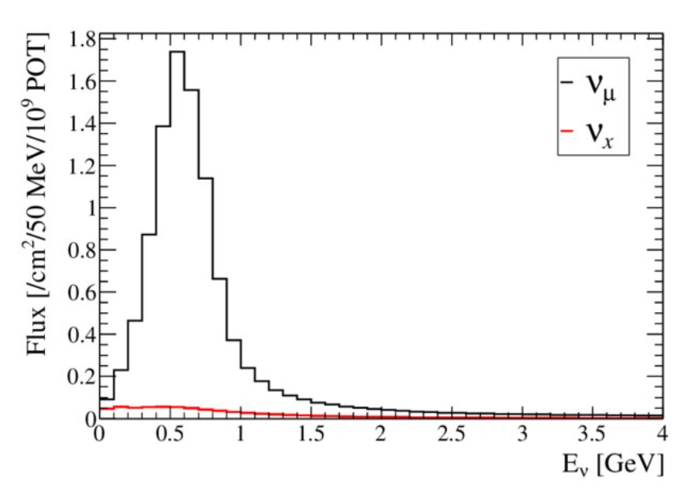
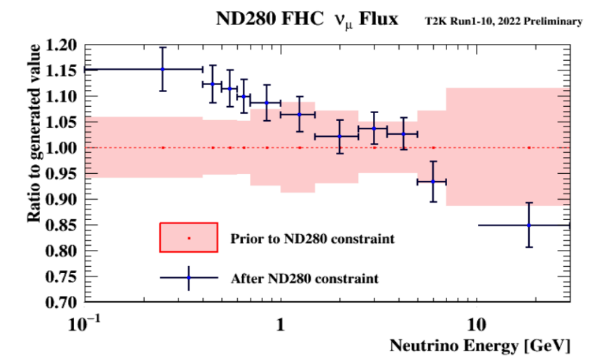
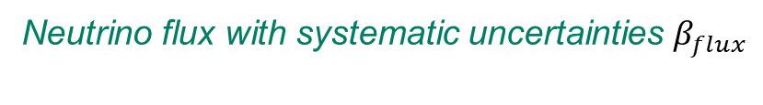
Context
Statistical modeling and sample generation for neutrino physics analyses with NF
Neutrino oscillation/cross-section analyses are chains of probability transports.
$φ\left(E_{ν} | β_{flux}\right)$ $\left(φ\left(E_{ν} | β_{flux},θ_{osc}\right) if oscillated\right)$
Neutrino flux with systematic uncertainties $β_{flux}$
T2K flux prediction
And its systematical uncertainties (before and after fit)
DEPARTEMENT DE PHYSIQUE NUCLEAIRE ET CORPUSCULAIRE
Page 3

Slide 4



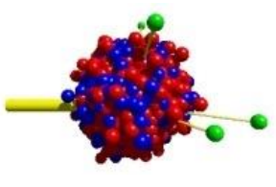

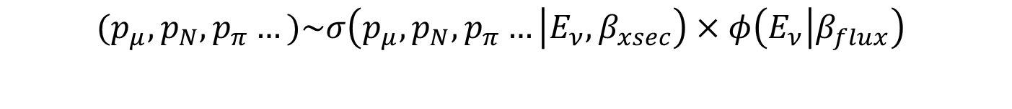
Context
Statistical modeling and sample generation for neutrino physics analyses with NF
Neutrino oscillation/cross-section analyses are chains of probability transports.
$φ\left(E_{ν} | β_{flux}\right)$ $\left(φ\left(E_{ν} | β_{flux},θ_{osc}\right) if oscillated\right)$
$$(p_{μ},p_{N},p_{π}…)\sim σ\left(p_{μ},p_{N},p_{π}… | E_{ν},β_{xsec}\right)×φ\left(E_{ν} | β_{flux}\right)$$
Final state particle kinematics from an MC generator with its set of systematics $β_{xsec}$
NuWro
Genie
NEUT
GiBUU
Achilles
DEPARTEMENT DE PHYSIQUE NUCLEAIRE ET CORPUSCULAIRE
Page 4

Slide 5
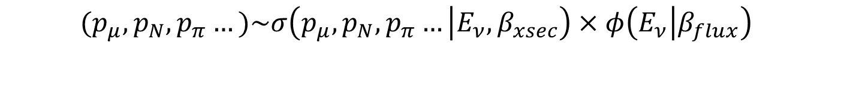

Context
Statistical modeling and sample generation for neutrino physics analyses with NF
Neutrino oscillation/cross-section analyses are chains of probability transports.
$φ\left(E_{ν} | β_{flux}\right)$ $\left(φ\left(E_{ν} | β_{flux},θ_{osc}\right) if oscillated\right)$
$$(p_{μ},p_{N},p_{π}…)\sim σ\left(p_{μ},p_{N},p_{π}… | E_{ν},β_{xsec}\right)×φ\left(E_{ν} | β_{flux}\right)$$
$$N_{MC}^{bin}(β_{flux},β_{xsec},β_{det})$$
Binning in observable space and addition of detector systematics $β_{det}$
DEPARTEMENT DE PHYSIQUE NUCLEAIRE ET CORPUSCULAIRE
Page 5

Slide 6
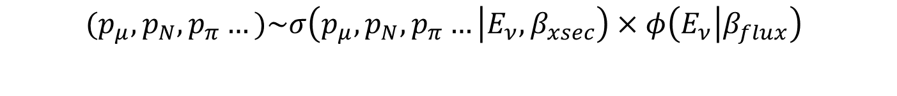
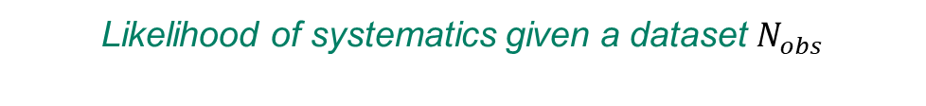

Context
Statistical modeling and sample generation for neutrino physics analyses with NF
Neutrino oscillation/cross-section analyses are chains of probability transports.
$φ\left(E_{ν} | β_{flux}\right)$ $\left(φ\left(E_{ν} | β_{flux},θ_{osc}\right) if oscillated\right)$
$$(p_{μ},p_{N},p_{π}…)\sim σ\left(p_{μ},p_{N},p_{π}… | E_{ν},β_{xsec}\right)×φ\left(E_{ν} | β_{flux}\right)$$
$$N_{MC}^{bin}(β_{flux},β_{xsec},β_{det})$$
$$−\ln\left(𝓛\left(β|N_{obs}\right)\right)=\sum_{bin}{\left[N_{MC}^{bin}\left(β\right)−N_{obs}^{bin}+N_{MC}^{bin}\left(β\right)\ln\left(\frac{N_{obs}^{bin}}{N_{MC}^{bin}\left(β\right)}\right)\right]}+\frac{1}{2}\sum_{i}{{\left(β−\overline{β}\right)}^{T}V_{ }^{−1}\left(β−\overline{β}\right)}$$
Likelihood of systematics given a dataset $N_{obs}$
DEPARTEMENT DE PHYSIQUE NUCLEAIRE ET CORPUSCULAIRE
Page 6

Slide 7
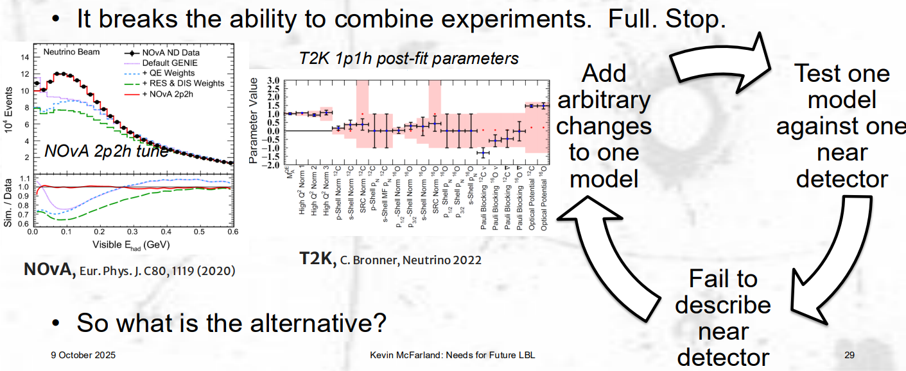
What do we need ?
Statistical modeling and sample generation for neutrino physics analyses with NF
Good parametrization of the models of flux, cross-section and detector response
Flexible, interpretable
Theory-driven (especially for cross-section)
Accurate modelling of the final likelihood
Correlations
Non-gaussian features
Kevin McFarland NuInt 2025
DEPARTEMENT DE PHYSIQUE NUCLEAIRE ET CORPUSCULAIRE
Page 7

Slide 8
Statistical modeling and sample generation for neutrino physics analyses with NF
Context
Neutrino-nucleus cross-sections
T2K Near Detector fit
Normalizing Flows
Conclusion
DEPARTEMENT DE PHYSIQUE NUCLEAIRE ET CORPUSCULAIRE
Page 8

Slide 9
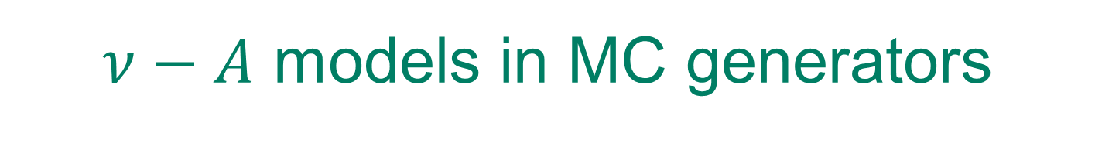
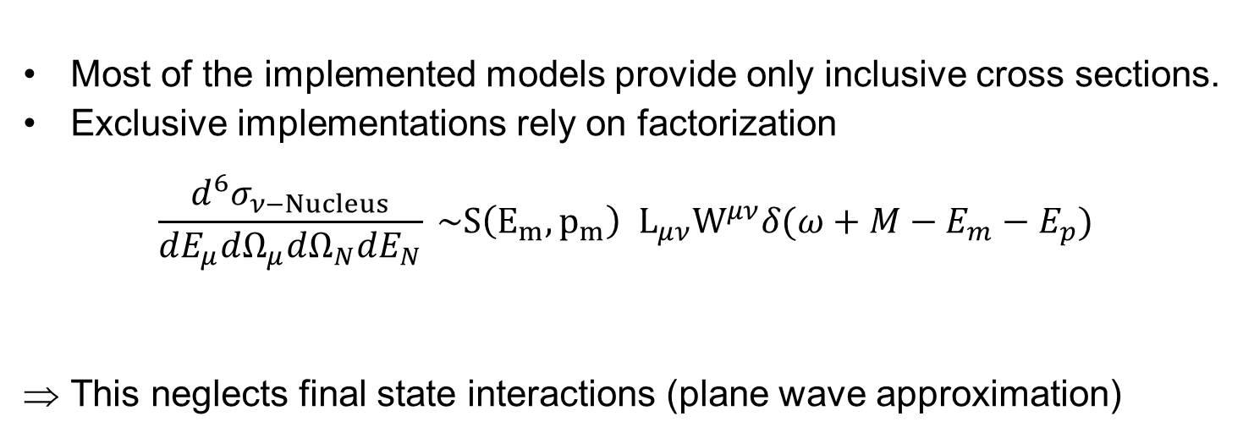
$ν−A$ models in MC generators
Statistical modeling and sample generation for neutrino physics analyses with NF
Most of the implemented models provide only inclusive cross sections.
Exclusive implementations rely on factorization
$$\frac{d^{6}σ_{ν−Nucleus}}{dE_{μ}dΩ_{μ}dΩ_{N}dE_{N}} \sim S\left(E_{m},p_{m}\right){ L}_{μν}W^{μν}δ(ω+M−E_{m}−E_{p})$$
This neglects final state interactions (plane wave approximation)
Spectral function
Neutrino-nucleon
Cross-section
DEPARTEMENT DE PHYSIQUE NUCLEAIRE ET CORPUSCULAIRE
Page 9

Slide 10
Statistical modeling and sample generation for neutrino physics analyses with NF
$ν−A$ models in MC generators
Most of the implemented models provide only inclusive cross sections.
Exclusive implementations rely on factorization
$$\frac{d^{6}σ_{ν−Nucleus}}{dE_{μ}dΩ_{μ}dΩ_{N}dE_{N}} \sim S\left(E_{m},p_{m}\right){ L}_{μν}W^{μν}δ(ω+M−E_{m}−E_{p})$$
This neglects final state interactions (plane wave approximation)
Spectral function
Neutrino-nucleon
Cross-section
How to go beyond factorization ? Outgoing nucleon state = Solution to a nuclear potential
DEPARTEMENT DE PHYSIQUE NUCLEAIRE ET CORPUSCULAIRE
Page 10

Slide 11
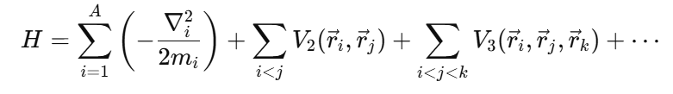
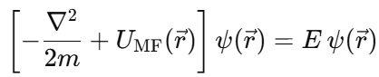
Mean field approximation
Statistical modeling and sample generation for neutrino physics analyses with NF
Many body problem simplified by a central mean nuclear potential
Both bound and scattered nucleon state solutions of the Schrödinger equation with the Mean Field potential
These states are used to compute the cross-section.
Mean field approximation
DEPARTEMENT DE PHYSIQUE NUCLEAIRE ET CORPUSCULAIRE
Page 11

Slide 12
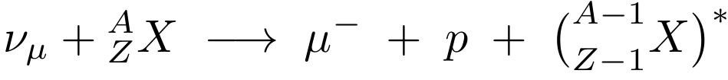
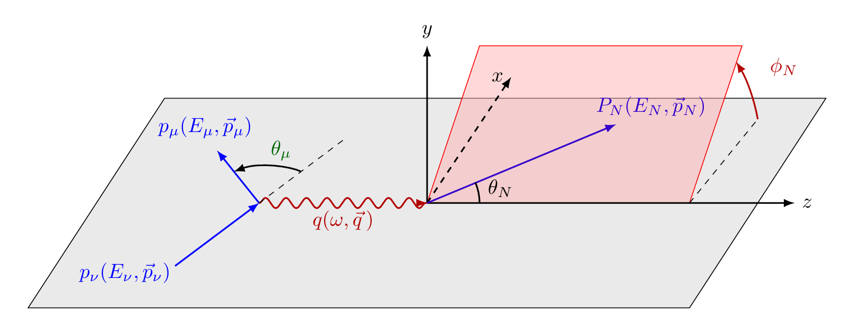
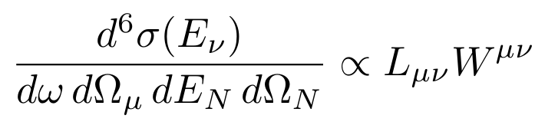
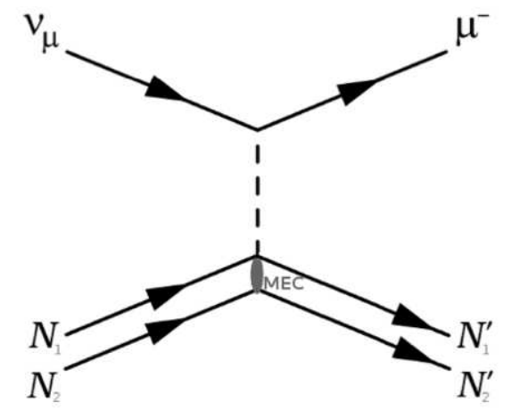
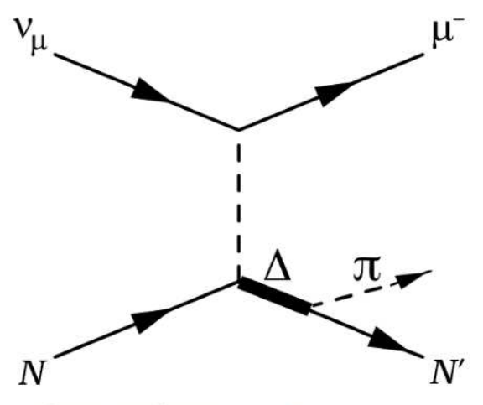
Cross sections predictions
Statistical modeling and sample generation for neutrino physics analyses with NF
1p1h
2p2h
SPP
DEPARTEMENT DE PHYSIQUE NUCLEAIRE ET CORPUSCULAIRE
Page 12

Slide 13
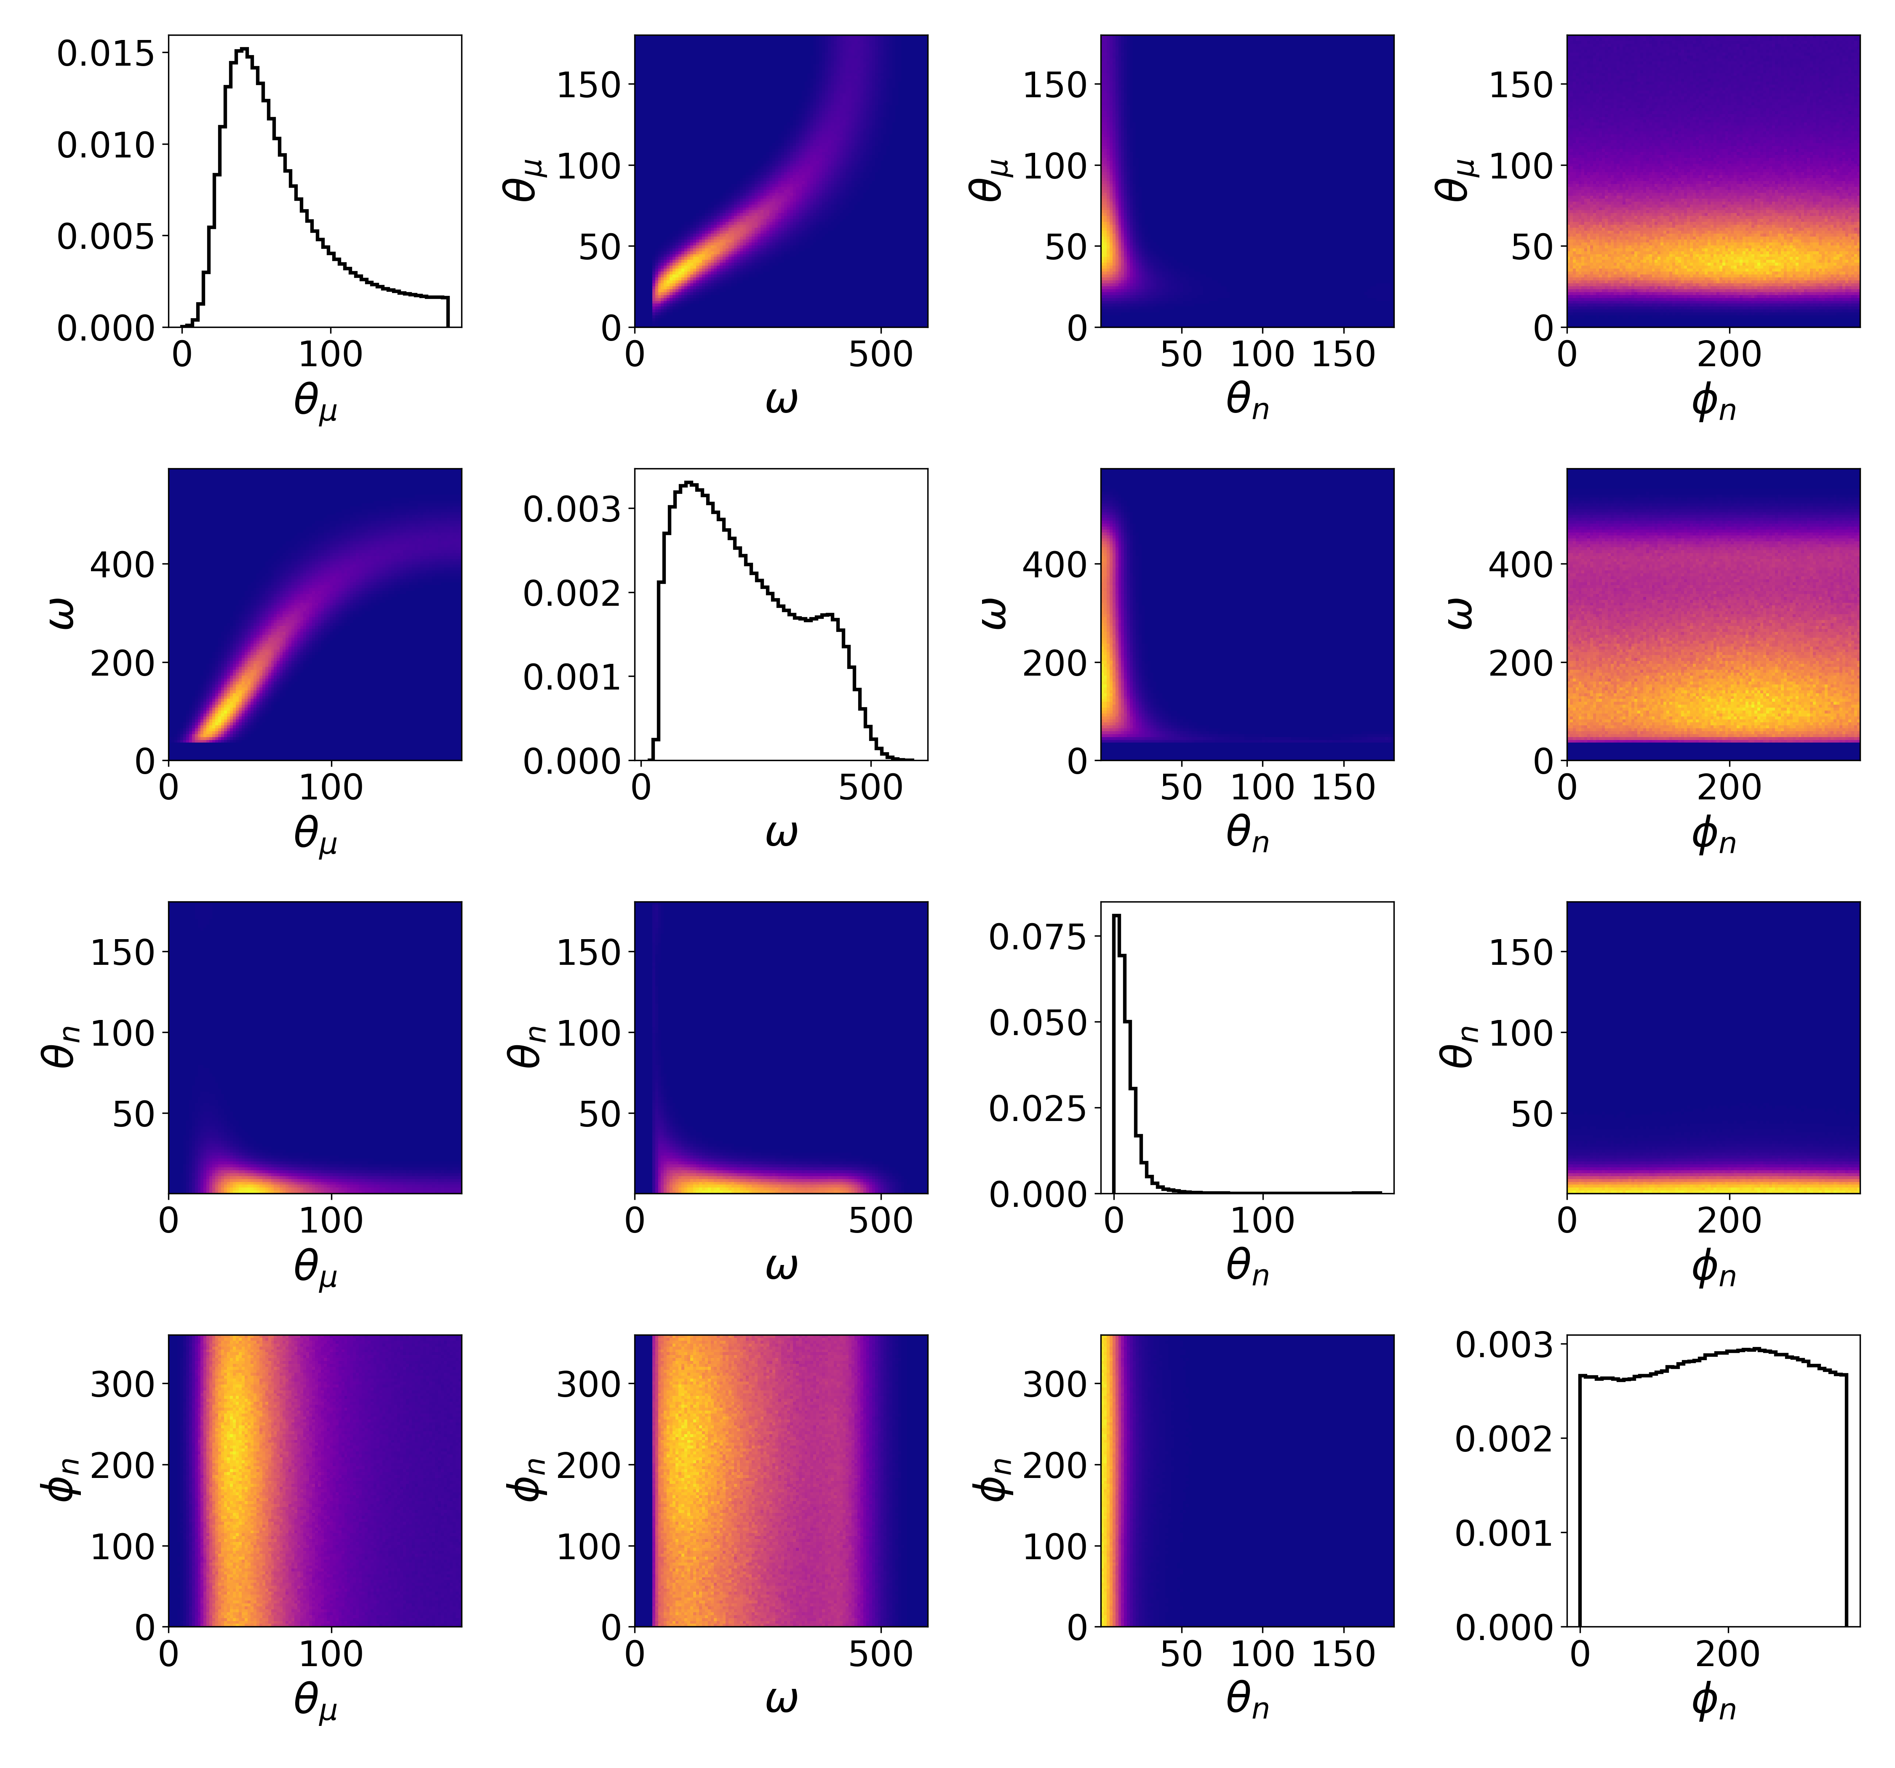
Cross sections predictions
Statistical modeling and sample generation for neutrino physics analyses with NF
1p1h
2p2h
SPP
DEPARTEMENT DE PHYSIQUE NUCLEAIRE ET CORPUSCULAIRE
Page 13

Slide 14
Statistical modeling and sample generation for neutrino physics analyses with NF
Sampling theory-driven exclusive cross sections
Time-consuming cross-section computations
DEPARTEMENT DE PHYSIQUE NUCLEAIRE ET CORPUSCULAIRE
Page 14

Slide 15
Sampling theory-driven exclusive cross sections
Statistical modeling and sample generation for neutrino physics analyses with NF
Naive accept-reject sampling method
Time-consuming cross-section computations
DEPARTEMENT DE PHYSIQUE NUCLEAIRE ET CORPUSCULAIRE
Page 15

Slide 16
Sampling theory-driven exclusive cross sections
Statistical modeling and sample generation for neutrino physics analyses with NF
Naive accept-reject sampling method
Time-consuming cross-section computations
Inefficient sampling in high dimension
DEPARTEMENT DE PHYSIQUE NUCLEAIRE ET CORPUSCULAIRE
Page 16

Slide 17
Sampling theory-driven exclusive cross sections
Statistical modeling and sample generation for neutrino physics analyses with NF
Naive accept-reject sampling method
Time-consuming cross-section computations
Inefficient sampling in high dimension
Very low sampling speed
DEPARTEMENT DE PHYSIQUE NUCLEAIRE ET CORPUSCULAIRE
Page 17

Slide 18
Sampling theory-driven exclusive cross sections
Statistical modeling and sample generation for neutrino physics analyses with NF
Naive accept-reject sampling method
Time-consuming cross-section computations
Inefficient sampling in high dimension
Very low sampling speed
We need a method to evaluate and sample accurately high-dimensional cross-sections
DEPARTEMENT DE PHYSIQUE NUCLEAIRE ET CORPUSCULAIRE
Page 18

Slide 19
Statistical modeling and sample generation for neutrino physics analyses with NF
Context
Neutrino-nucleus cross-section
T2K near detector fit
Normalizing Flows
Applications
Conclusion
DEPARTEMENT DE PHYSIQUE NUCLEAIRE ET CORPUSCULAIRE
Page 19

Slide 20
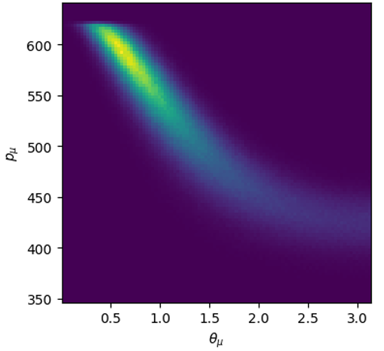
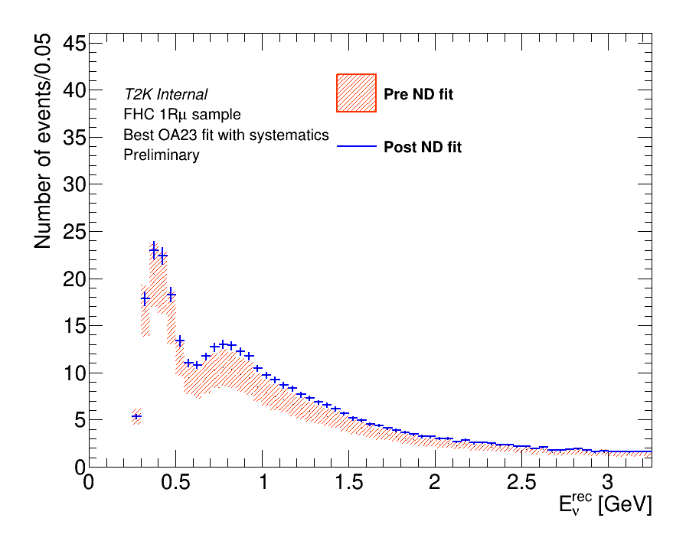
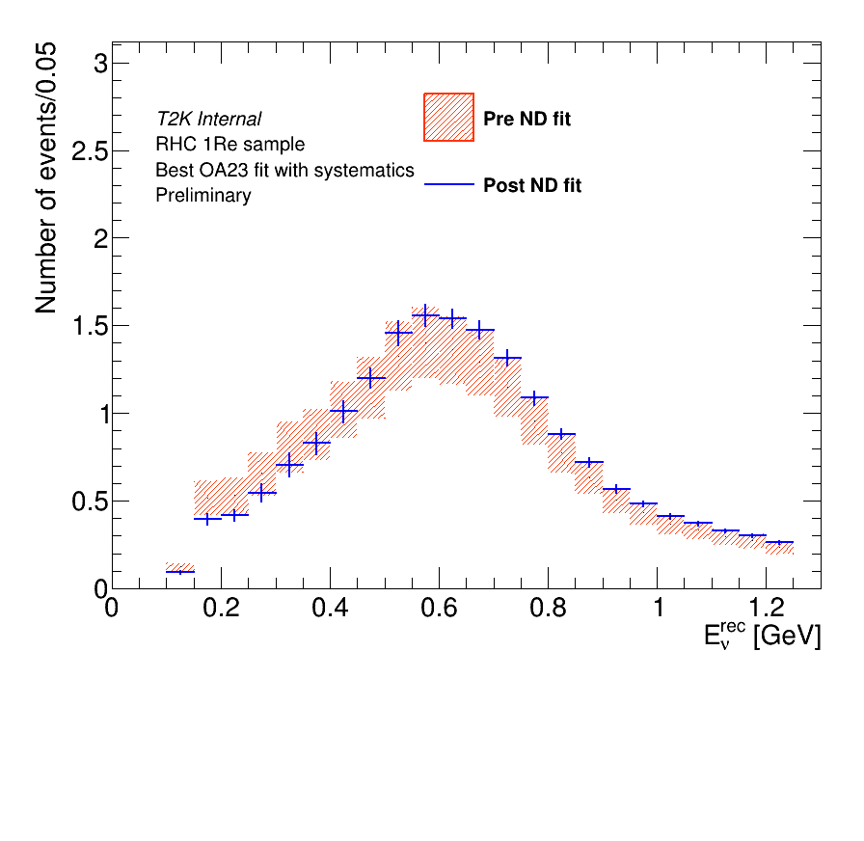
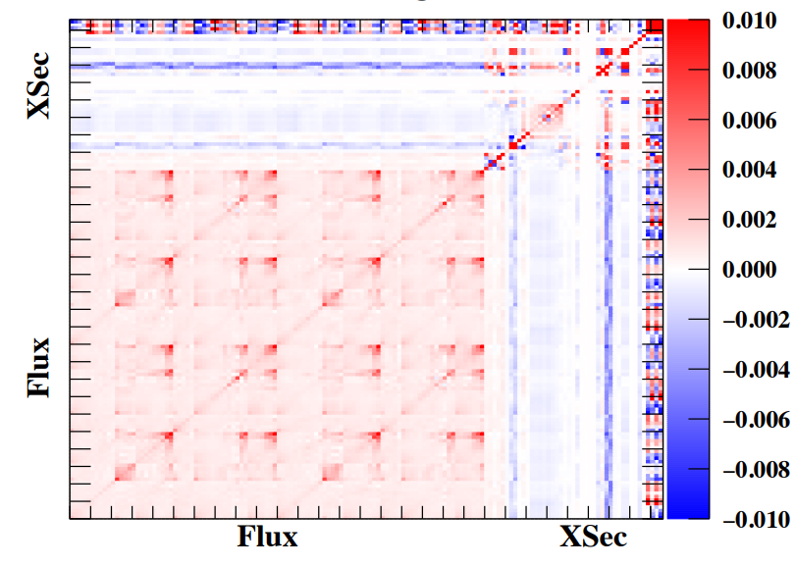


ND/FD fit
Statistical modeling and sample generation for neutrino physics analyses with NF
Observable space
Near detector Systematic space
FD flux prediction + oscillation parameters
$$β\sim p\left(β | Dataset\right)$$
Bayesian
MCMC
Mach3
MLE
Dataset
GUNDAM
$$\hat{β}$$
HESSE
Semi-frequentist = Gaussian assumption on the posterior (locally fitted at the best-fit)
DEPARTEMENT DE PHYSIQUE NUCLEAIRE ET CORPUSCULAIRE
Page 20

Slide 21
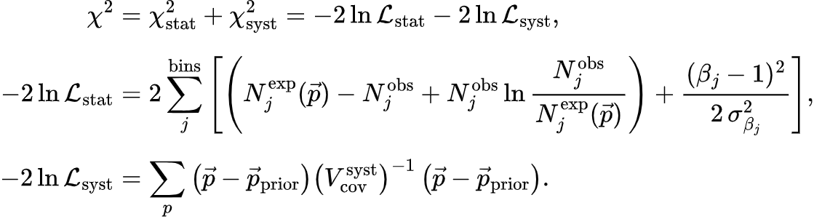
Non-gaussianities
Statistical modeling and sample generation for neutrino physics analyses with NF
DEPARTEMENT DE PHYSIQUE NUCLEAIRE ET CORPUSCULAIRE
Page 21

Slide 22
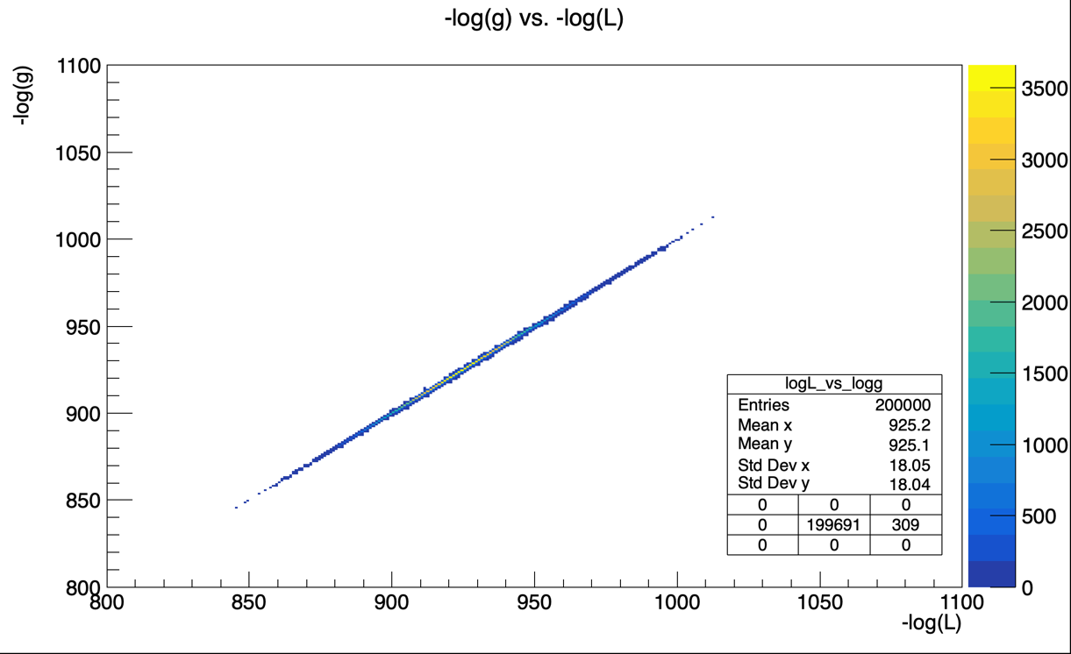
Non-gaussianities
Statistical modeling and sample generation for neutrino physics analyses with NF
Without cross section systematics
Gaussian NLL
True NLL
DEPARTEMENT DE PHYSIQUE NUCLEAIRE ET CORPUSCULAIRE
Page 22

Slide 23
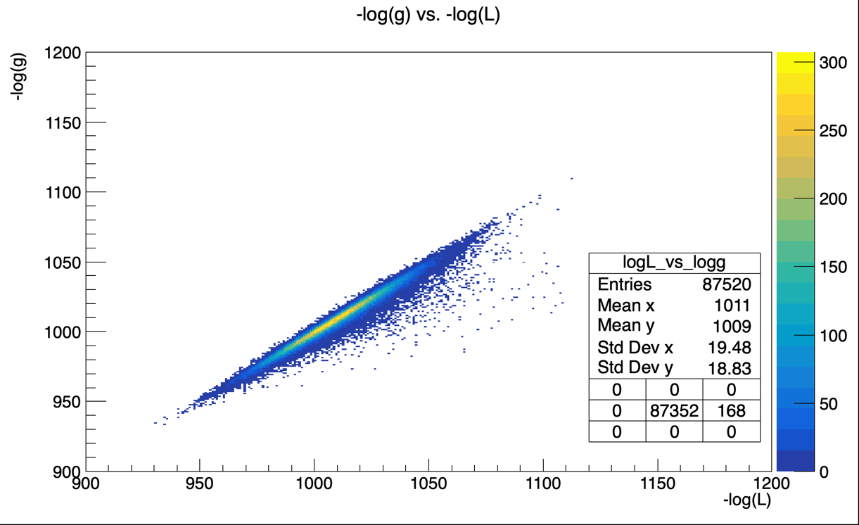
Non-gaussianities
Statistical modeling and sample generation for neutrino physics analyses with NF
Without cross section syst.
With cross section systematics
Gaussian NLL
Gaussian NLL
True NLL
True NLL
DEPARTEMENT DE PHYSIQUE NUCLEAIRE ET CORPUSCULAIRE
Page 23

Slide 24
Semi-frequentist vs MCMC
Statistical modeling and sample generation for neutrino physics analyses with NF
 | Semi-frequentist (Gaussian) | MCMC (Metropolis-Hasting)
+ | Analytical distribution Fast to sample from it Easily marginalizable | Bayesian Complex distribution
- | Might be too simplistic Local fit around the best-fit | Very slow to sample from it Not analytical (Point cloud-like) Complex but might struggle with multimodal distributions
DEPARTEMENT DE PHYSIQUE NUCLEAIRE ET CORPUSCULAIRE
Page 24

Slide 25
Semi-frequentist vs MCMC
ND280 fit with Normalizing Flows
 | Semi-frequentist (Gaussian) | MCMC (Metropolis-Hasting)
+ | Analytical distribution Fast to sample from it Easily marginalizable | Bayesian Complex distribution Unweighted samples
- | Might be too simplistic Local fit around the best-fit | Very slow to sample from it Not analytical (Point cloud-like) Complex but might struggle with multimodal distributions
Can we provide a more complex analytical likelihood that is fast to sample ?
DEPARTEMENT DE PHYSIQUE NUCLEAIRE ET CORPUSCULAIRE
Page 25

Slide 26
Statistical modeling and sample generation for neutrino physics analyses with NF
Context
Neutrino-nucleus cross section
Near detector fit
Normalizing Flows
Conclusion
DEPARTEMENT DE PHYSIQUE NUCLEAIRE ET CORPUSCULAIRE
Page 26

Slide 27







Normalizing flows
Statistical modeling and sample generation for neutrino physics analyses with NF
$$T$$
$${x=T(u)\sim p}_{x }$$
$${u\sim p}_{u }$$
Transformation
Predicted distribution
Base distribution
$$u$$
$$p_{u}$$
$$u$$
$$u$$
DEPARTEMENT DE PHYSIQUE NUCLEAIRE ET CORPUSCULAIRE
Page 27

Slide 28



Normalizing flows
Statistical modeling and sample generation for neutrino physics analyses with NF
$$T$$
$${x=T(u)\sim p}_{x }$$
$${u\sim p}_{u }$$
Transformation
Predicted distribution
Base distribution
$$T(u)$$
$$p_{x}$$
$$u$$
$$x=T(u)$$
$p_{x}\left(x\right)=p_{u}\left(u\right) |\det\left(J_{T}\left(u\right)\right){\left.​\right|}^{−1}$
DEPARTEMENT DE PHYSIQUE NUCLEAIRE ET CORPUSCULAIRE
Page 28

Slide 29
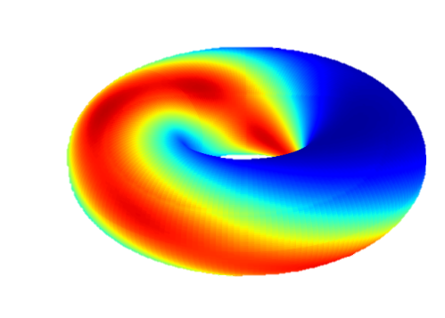
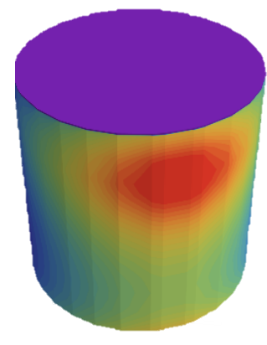
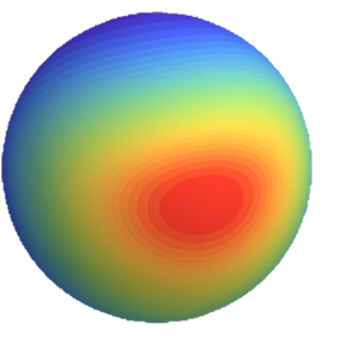
Normalizing flows
Statistical modeling and sample generation for neutrino physics analyses with NF
$$T$$
$${x=T(u)\sim p}_{x }$$
$${u\sim p}_{u }$$
Transformation
Predicted distribution
Can be extended to :
Multidimensional probability space (autoregressive flows)
Some non-euclidian manifolds (product of sphere, tori…)
Base distribution
$$T(u)$$
$$p_{x}$$
$$u$$
$$x=T(u)$$
$p_{x}\left(x\right)=p_{u}\left(u\right) |\det\left(J_{T}\left(u\right)\right){\left.​\right|}^{−1}$
DEPARTEMENT DE PHYSIQUE NUCLEAIRE ET CORPUSCULAIRE
Page 29

Slide 30
Statistical modeling and sample generation for neutrino physics analyses with NF
Context
Neutrino-nucleus cross section
T2K near detector fit
Normalizing Flows
Applications
Conclusion
DEPARTEMENT DE PHYSIQUE NUCLEAIRE ET CORPUSCULAIRE
Page 30

Slide 31
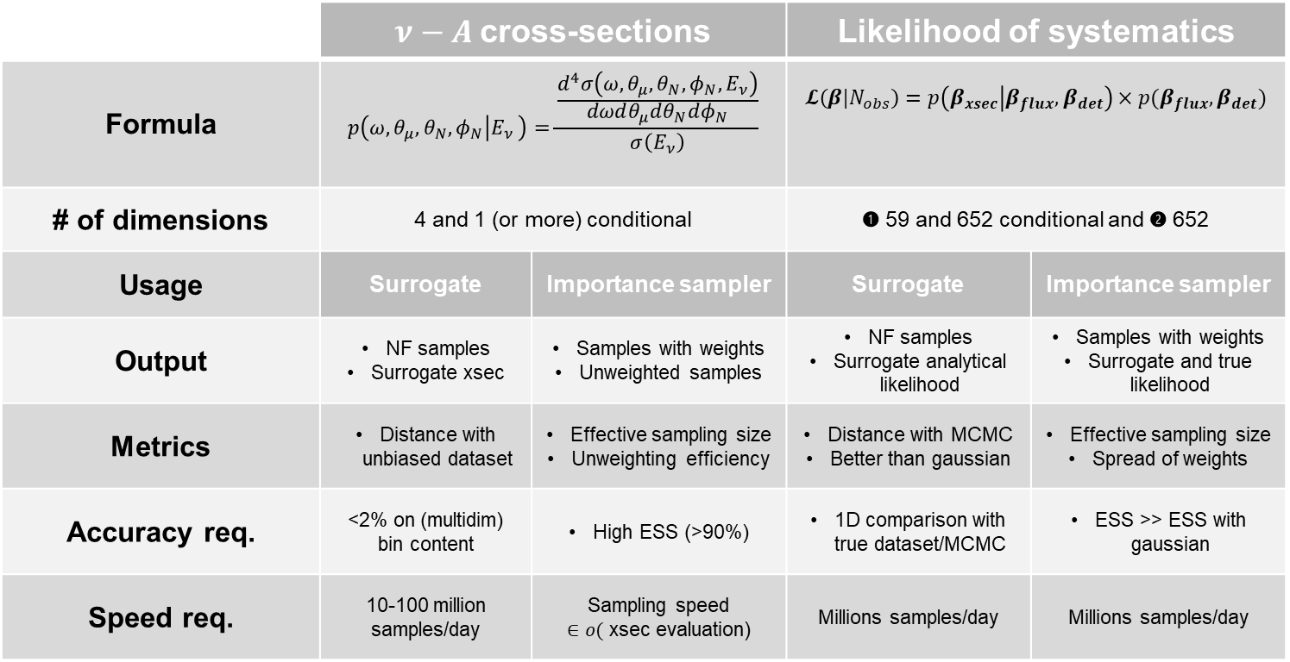
Applying Normalizing Flows : Similarities and differences
Statistical modeling and sample generation for neutrino physics analyses with NF
 | $ν−A$cross-sections |  | Likelihood of systematics
Formula | $$p\left(ω,θ_{μ},θ_{N},φ_{N} | E_{ν} \right)=\frac{\frac{d^{4}σ\left(ω,θ_{μ},θ_{N},φ_{N},E_{ν}\right)}{dωdθ_{μ}dθ_{N}dφ_{N}}}{σ\left(E_{ν}\right)}$$ |  | $$𝓛\left(β|N_{obs}\right)=p\left(β_{xsec} | β_{flux},β_{det}\right)×p(β_{flux},β_{det})$$
# of dimensions | 4 and 1 (or more) conditional |  | ➊ 59 and 652 conditional and ➋ 652
Usage | Surrogate | Importance sampler | Surrogate | Importance sampler
Output | NF samples Surrogate xsec | Samples with weights Unweighted samples | NF samples Surrogate analytical likelihood | Samples with weights Surrogate and true likelihood
Metrics | Distance with unbiased dataset | Effective sampling size Unweighting efficiency | Distance with MCMC Better than gaussian | Effective sampling size Spread of weights
Accuracy req. | <2% on (multidim) bin content | High ESS (>90%) | 1D comparison with true dataset/MCMC | ESS >> ESS with gaussian
Speed req. | 10-100 million samples/day | Sampling speed $∈o($ xsec evaluation) | Millions samples/day | Millions samples/day
➊ Complex conditional NF
Complex conditional NF
➋ Simple scalable NF
DEPARTEMENT DE PHYSIQUE NUCLEAIRE ET CORPUSCULAIRE
Page 31

Slide 32
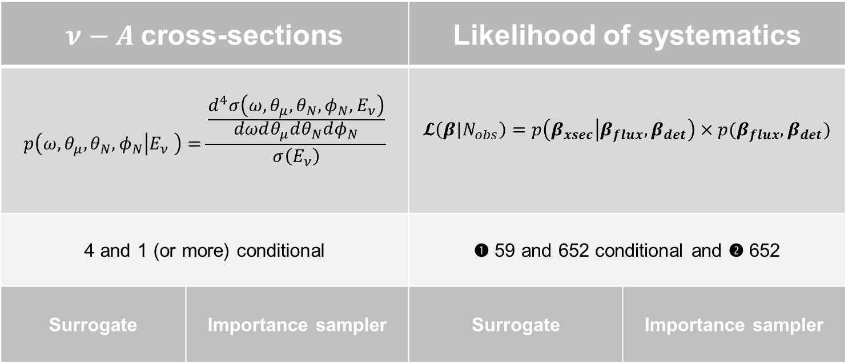
Applying Normalizing Flows : Similarities and differences
Statistical modeling and sample generation for neutrino physics analyses with NF
$ν−A$cross-sections |  | Likelihood of systematics
$$p\left(ω,θ_{μ},θ_{N},φ_{N} | E_{ν} \right)=\frac{\frac{d^{4}σ\left(ω,θ_{μ},θ_{N},φ_{N},E_{ν}\right)}{dωdθ_{μ}dθ_{N}dφ_{N}}}{σ\left(E_{ν}\right)}$$ |  | $$𝓛\left(β|N_{obs}\right)=p\left(β_{xsec} | β_{flux},β_{det}\right)×p(β_{flux},β_{det})$$
4 and 1 (or more) conditional |  | ➊ 59 and 652 conditional and ➋ 652
Surrogate | Importance sampler | Surrogate | Importance sampler
➊ Complex conditional NF
➋ Simple scalable NF
Complex conditional NF
DEPARTEMENT DE PHYSIQUE NUCLEAIRE ET CORPUSCULAIRE
Page 32

Slide 33
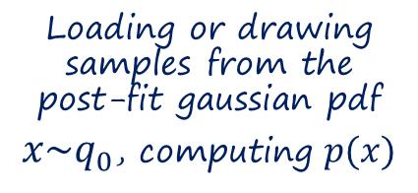
Training process
Statistical modeling and sample generation for neutrino physics analyses with NF
Instantiating the training classes
GPU
CPUs
Loading or drawing samples from the post-fit gaussian pdf
${x\sim q}_{0}$, computing $p(x)$
DEPARTEMENT DE PHYSIQUE NUCLEAIRE ET CORPUSCULAIRE
Page 33

Slide 34
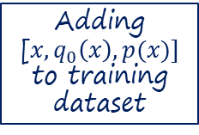

Training process
Statistical modeling and sample generation for neutrino physics analyses with NF
Instantiating the training classes
Training on ${x\sim q}_{0}$
GPU
Adding [${x, q}_{0}\left(x\right),p(x)]$ to training dataset
CPUs
Loading or drawing samples from the post-fit gaussian pdf
${x\sim q}_{0}$, computing $p(x)$
DEPARTEMENT DE PHYSIQUE NUCLEAIRE ET CORPUSCULAIRE
Page 34

Slide 35
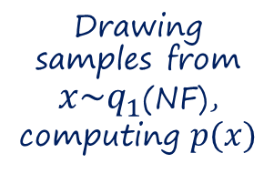
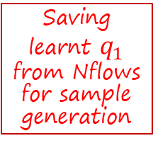
Training process
Statistical modeling and sample generation for neutrino physics analyses with NF
Instantiating the training classes
Training on ${x\sim q}_{0}$
GPU
Saving learnt $q_{1}$ from Nflows for sample generation
Adding [${x, q}_{0}\left(x\right),p(x)]$ to training dataset
CPUs
Loading or drawing samples from the post-fit gaussian pdf
${x\sim q}_{0}$, computing $p(x)$
Drawing samples from ${x\sim q}_{1}$(NF), computing $p(x)$
DEPARTEMENT DE PHYSIQUE NUCLEAIRE ET CORPUSCULAIRE
Page 35

Slide 36
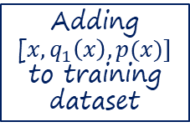

Training process
Statistical modeling and sample generation for neutrino physics analyses with NF
Instantiating the training classes
Training on ${x\sim q}_{0}$
Training on ${x\sim q}_{0}, q_{1}$
GPU
Saving learnt $q_{1}$ from Nflows for sample generation
Adding [${x, q}_{0}\left(x\right),p(x)]$ to training dataset
Adding [${x, q}_{1}\left(x\right),p(x)]$ to training dataset
CPUs
Loading or drawing samples from the post-fit gaussian pdf
${x\sim q}_{0}$, computing $p(x)$
Drawing samples from ${x\sim q}_{1}$(NF), computing $p(x)$
DEPARTEMENT DE PHYSIQUE NUCLEAIRE ET CORPUSCULAIRE
Page 36

Slide 37
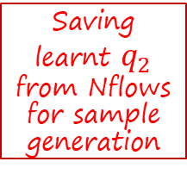
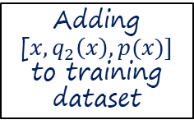
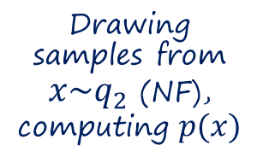
Training process
Statistical modeling and sample generation for neutrino physics analyses with NF
Instantiating the training classes
Training on ${x\sim q}_{0}$
Training on ${x\sim q}_{0}, q_{1}$
…
GPU
Saving learnt $q_{1}$ from Nflows for sample generation
Saving learnt $q_{2}$ from Nflows for sample generation
Adding [${x, q}_{0}\left(x\right),p(x)]$ to training dataset
Adding [${x, q}_{1}\left(x\right),p(x)]$ to training dataset
Adding [${x, q}_{2}\left(x\right),p(x)]$ to training dataset
…
CPUs
Loading or drawing samples from the post-fit gaussian pdf
${x\sim q}_{0}$, computing $p(x)$
Drawing samples from ${x\sim q}_{1}$(NF), computing $p(x)$
Drawing samples from ${x\sim q}_{2}$ (NF), computing $p(x)$
DEPARTEMENT DE PHYSIQUE NUCLEAIRE ET CORPUSCULAIRE
Page 37

Slide 38
Neutrino-nucleus cross sections (Exclusive Mean Field cross sections)
Statistical modeling and sample generation for neutrino physics analyses with NF
DEPARTEMENT DE PHYSIQUE NUCLEAIRE ET CORPUSCULAIRE
Page 38

Slide 39
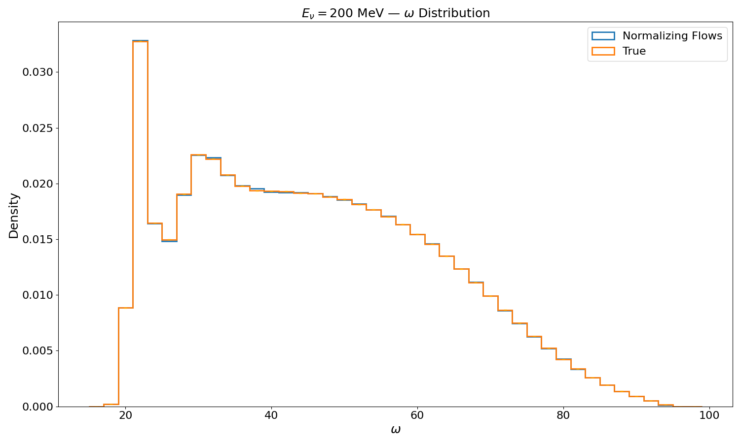
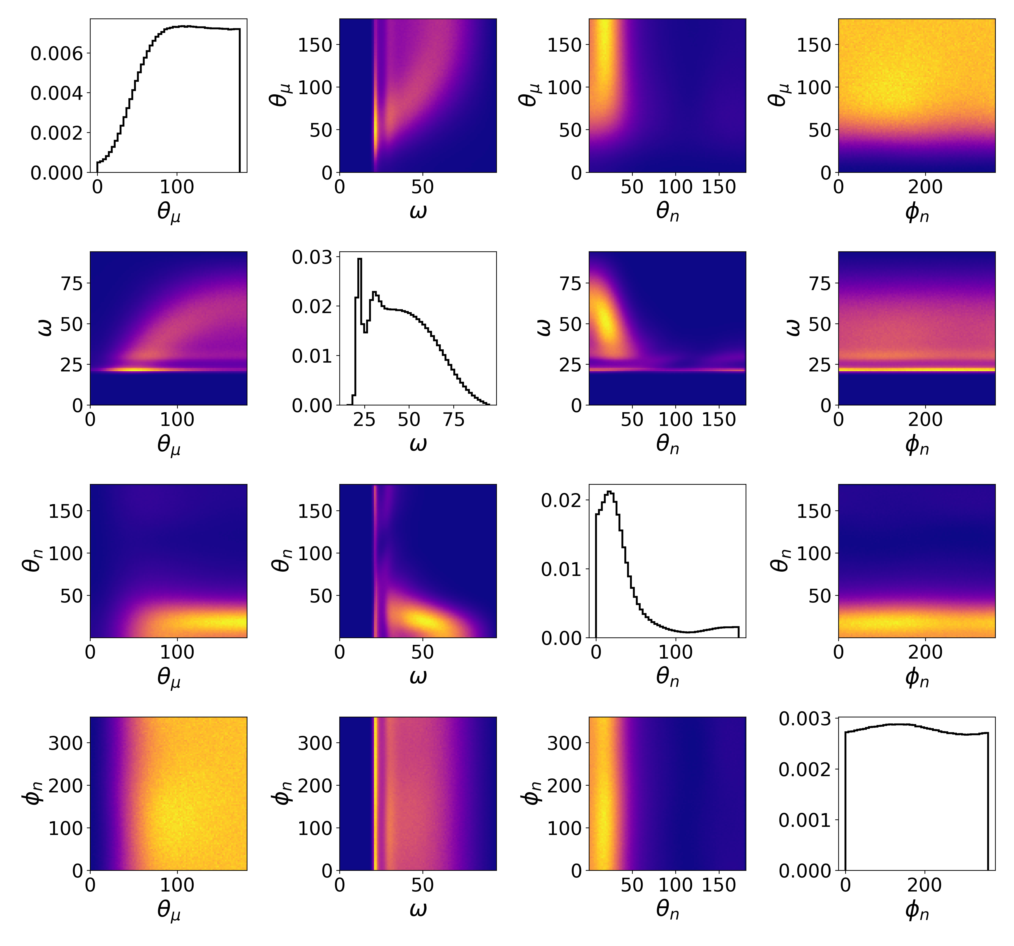
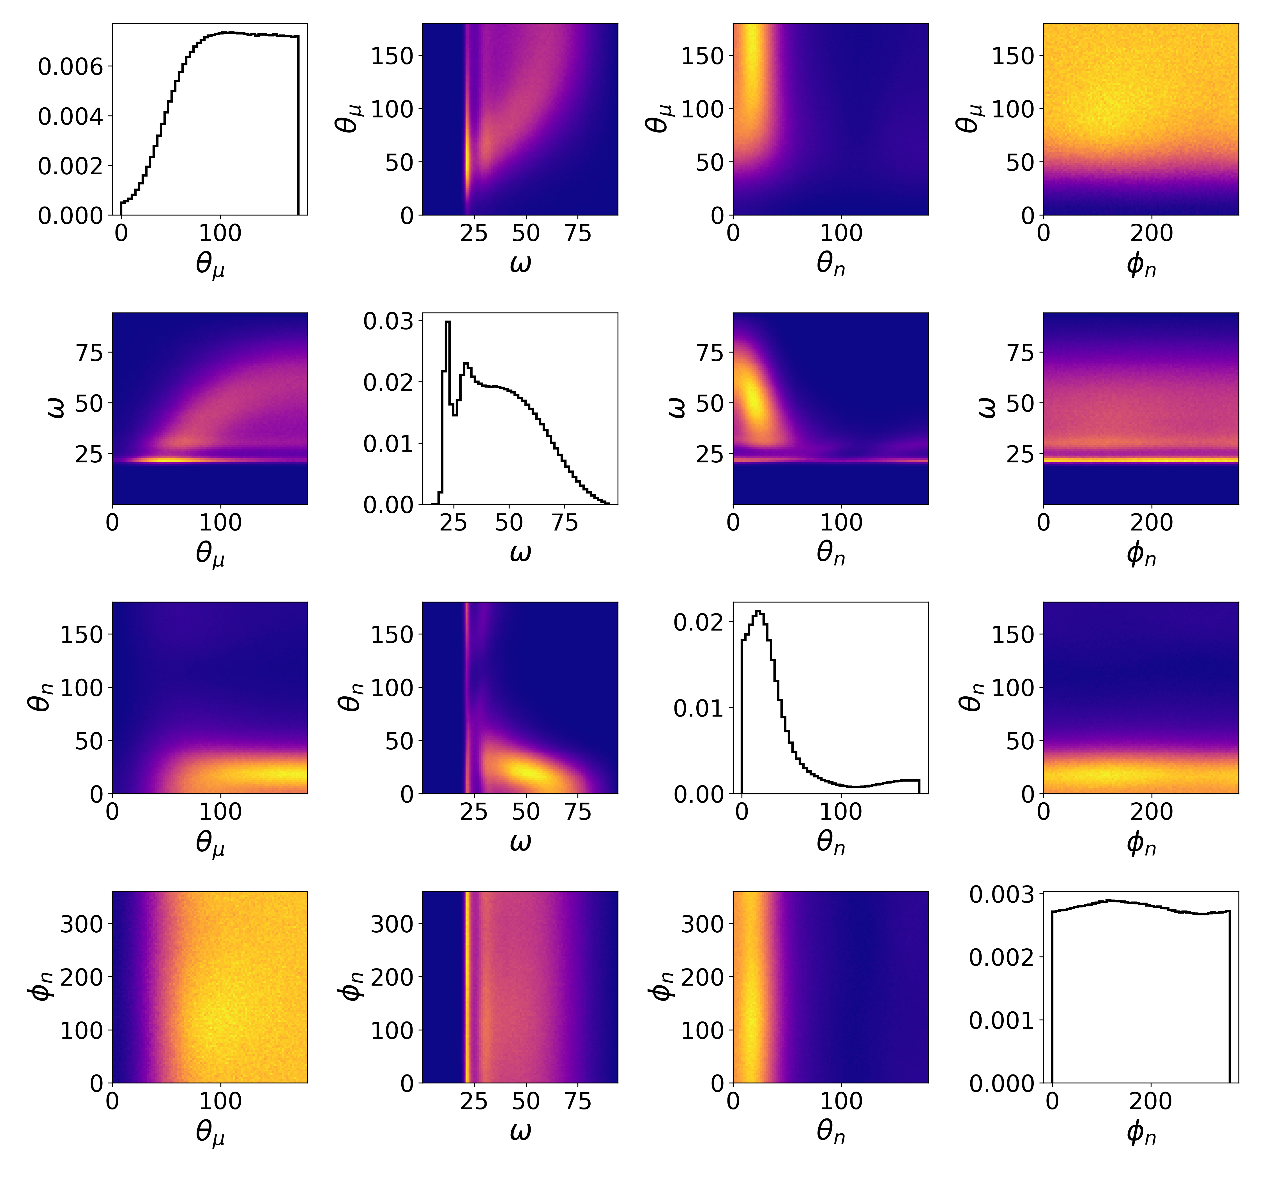
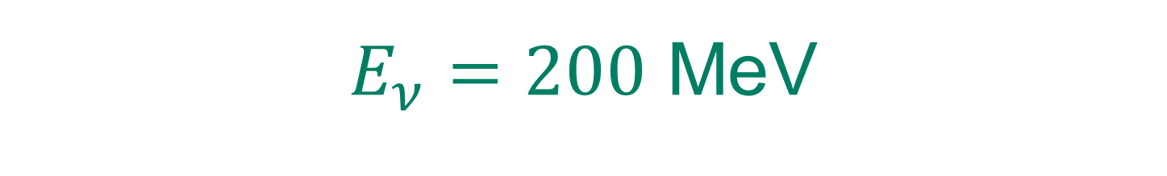
Statistical modeling and sample generation for neutrino physics analyses with NF
$E_{ν}=200$ MeV
True Cross section
NF Surrogate Cross section
DEPARTEMENT DE PHYSIQUE NUCLEAIRE ET CORPUSCULAIRE
Page 39

Slide 40
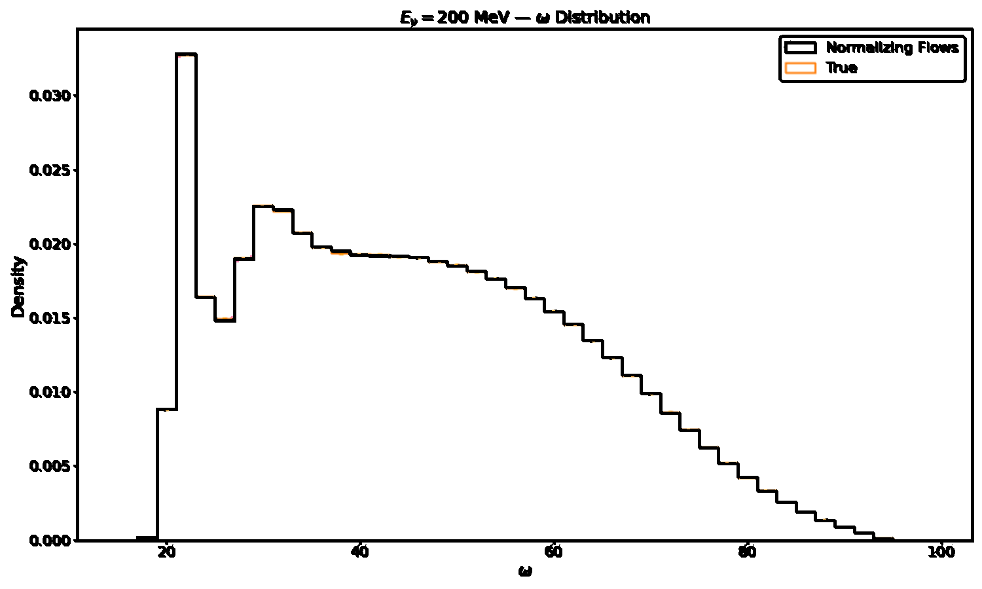
$E_{ν}=200$ MeV
Statistical modeling and sample generation for neutrino physics analyses with NF
True Cross section
NF Surrogate Cross section
DEPARTEMENT DE PHYSIQUE NUCLEAIRE ET CORPUSCULAIRE
Page 40

Slide 41
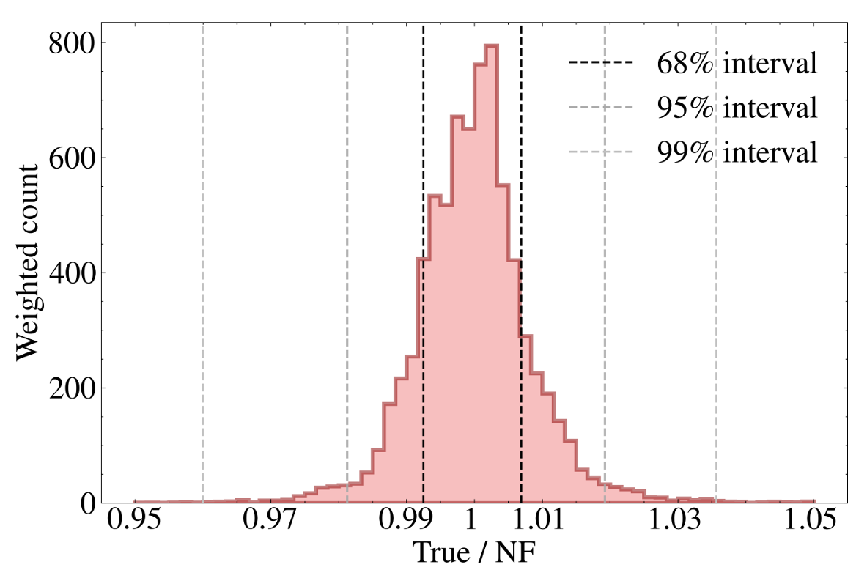
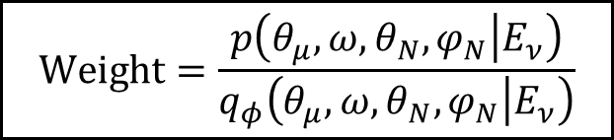
Statistical modeling and sample generation for neutrino physics analyses with NF
Distribution of weights
$$Weight=\frac{p\left(θ_{μ},{ω, θ}_{N},φ_{N} | E_{ν}\right)}{q_{φ}\left(θ_{μ},{ω, θ}_{N},φ_{N} | E_{ν}\right)}$$
Histogram of weights (comparing bin contents of size 1 MeV.deg^3 )
DEPARTEMENT DE PHYSIQUE NUCLEAIRE ET CORPUSCULAIRE
Page 41

Slide 42
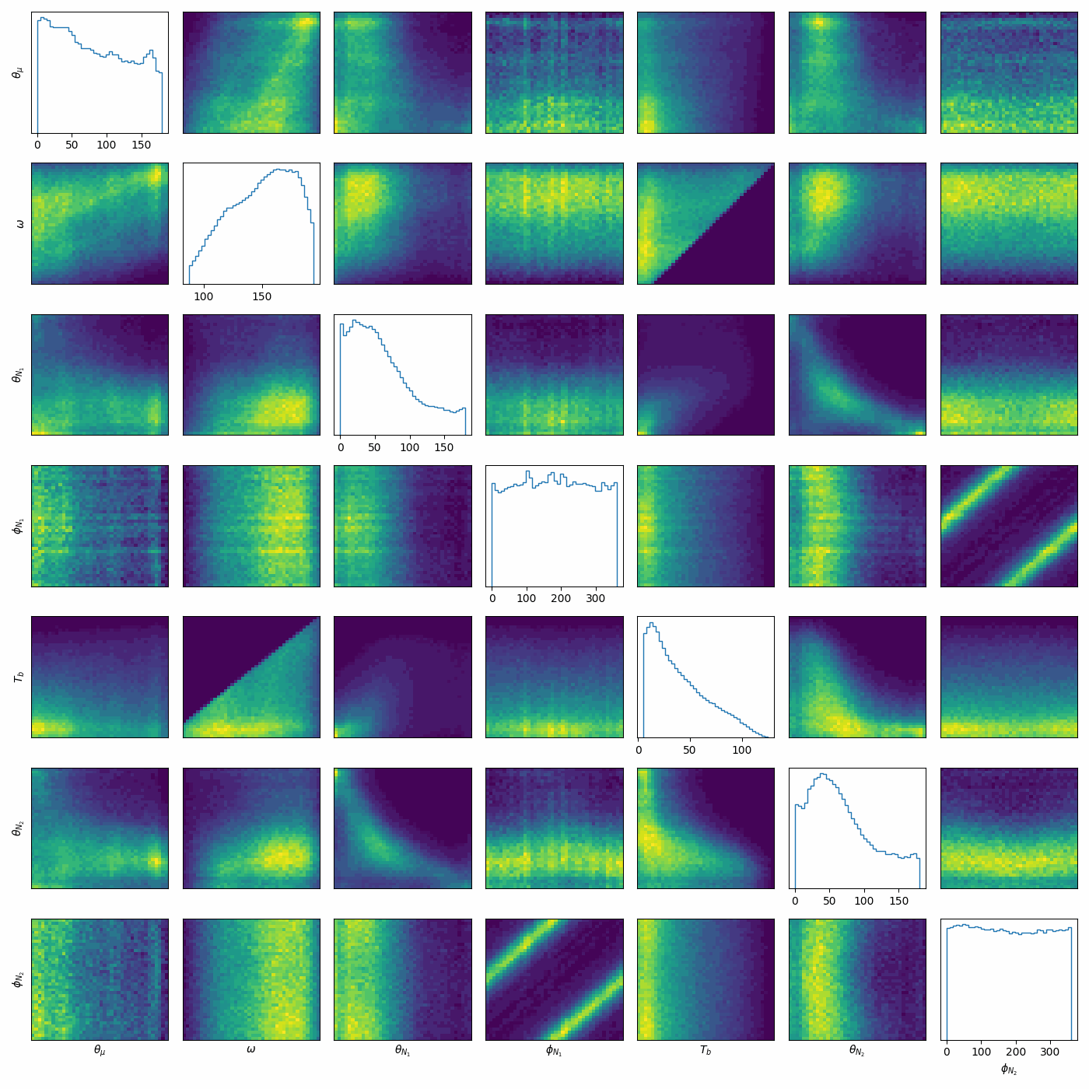
More processes
Statistical modeling and sample generation for neutrino physics analyses with NF
Exclusive 2p2h Mean Field cross section
DEPARTEMENT DE PHYSIQUE NUCLEAIRE ET CORPUSCULAIRE
Page 42

Slide 43
Likelihood of systematics (T2K near detector fit)
Fast MC generator for CCQE 1p1h exclusive cross section
DEPARTEMENT DE PHYSIQUE NUCLEAIRE ET CORPUSCULAIRE
Page 43

Slide 44
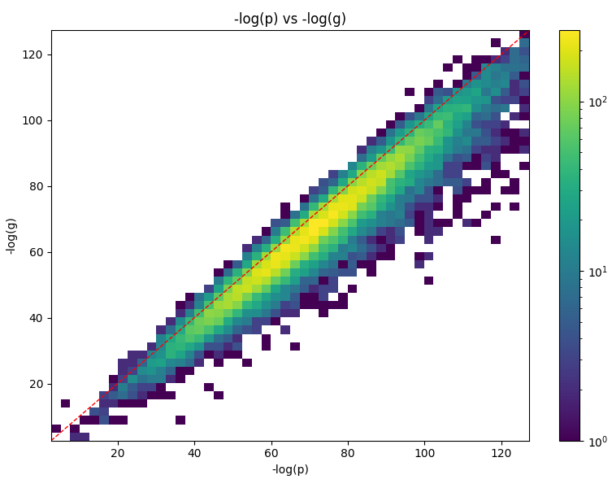
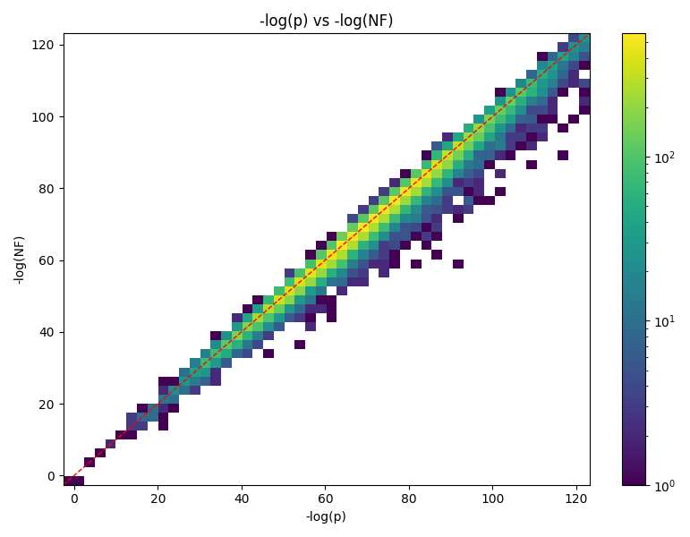
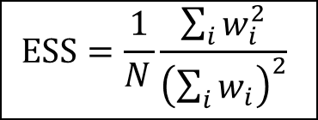
Comparison with true likelihood
Statistical modeling and sample generation for neutrino physics analyses with NF
ESS < 0.2 %
ESS: 22.1%
NLL ( Post-fit Gaussian)
NLL (NF)
NLL (True PyGUNDAM)
NLL (True PyGUNDAM)
$$ESS=\frac{1}{N_{ }}\frac{\sum_{i}{w_{i}^{2}}}{{\left(\sum_{i}{w_{i}}\right)}^{2}}$$
DEPARTEMENT DE PHYSIQUE NUCLEAIRE ET CORPUSCULAIRE
Page 44

Slide 45


Statistical modeling and sample generation for neutrino physics analyses with NF
Comparison with reweighted samples
5 Million samples from NF (5 dim of xsec systematics) reweighted by the true LLH
5 Million samples from NF (5 dim of xsec systematics)
DEPARTEMENT DE PHYSIQUE NUCLEAIRE ET CORPUSCULAIRE
Page 45

Slide 46


Statistical modeling and sample generation for neutrino physics analyses with NF
Comparison with MCMC (Mach3)
Using a common fake data study configuration used by GUNDAM and Mach3.
Marginal histogram sampling from MCMC (blue), NF (gray) and Gaussian (green)
DEPARTEMENT DE PHYSIQUE NUCLEAIRE ET CORPUSCULAIRE
Page 46

Slide 47
Statistical modeling and sample generation for neutrino physics analyses with NF
Context
Neutrino-nucleus cross section
T2K near detector fit
Normalizing Flows
Applications
Conclusion
DEPARTEMENT DE PHYSIQUE NUCLEAIRE ET CORPUSCULAIRE
Page 47

Slide 48


Available softwares
Statistical modeling and sample generation for neutrino physics analyses with NF
NuGenFlow : Software to train and sample NF for Neutrino-nucleus cross-sections
GunFlows : Software to train and sample NF for high dimensional likelihood of systematics
DEPARTEMENT DE PHYSIQUE NUCLEAIRE ET CORPUSCULAIRE
Page 48

Slide 49
Available softwares
Statistical modeling and sample generation for neutrino physics analyses with NF
NuGenFlow : Software to train and sample NF for Neutrino-nucleus cross-sections
GunFlows : Software to train and sample NF for high dimensional likelihood of systematics
Not limited to one collaboration (eg T2K) !
DEPARTEMENT DE PHYSIQUE NUCLEAIRE ET CORPUSCULAIRE
Page 49

Slide 50
Backup
Fast MC generator for CCQE 1p1h exclusive cross section
DEPARTEMENT DE PHYSIQUE NUCLEAIRE ET CORPUSCULAIRE
Page 50

Slide 51

More conditional parameters
Efficient event generation for neutrino-nucleus exclusive cross sections
In systematic studies, we scan physics knobs $θ$
e.g. axial mass, $θ=M_{A}$
DEPARTEMENT DE PHYSIQUE NUCLEAIRE ET CORPUSCULAIRE
Page 51

Slide 52

More conditional parameters
Efficient event generation for neutrino-nucleus exclusive cross sections
In systematic studies, we scan physics knobs $θ$
e.g. axial mass, $θ=M_{A}$
Our normalizing flow already conditions on energy
This can be extended to other conditional parameters
$$q_{φ}\left(kinematics | E_{ν},θ\right)$$
We optimize unweighting efficiency under a chosen prior over $θ$
DEPARTEMENT DE PHYSIQUE NUCLEAIRE ET CORPUSCULAIRE
Page 52

Slide 53
Efficient event generation for neutrino-nucleus exclusive cross sections
For more information : https://journals.aps.org/prd/pdf/10.1103/v7sz-vn3b
DEPARTEMENT DE PHYSIQUE NUCLEAIRE ET CORPUSCULAIRE
Page 53

Slide 54


Plane wave vs Distorted wave
Efficient event generation for neutrino-nucleus exclusive cross sections
This neglects final state interactions (interaction with other nucleons).
Nuclear cascade can be added but no lepton correlation.
Distorted-wave solutions to a nuclear potential (EDRMF, ROP…) include elastic (real potential) and inelastic (imaginary or cascade) interactions.
Cross section in terms of the TKI variables along with T2K data (Alexis Nikolakopoulos)
DEPARTEMENT DE PHYSIQUE NUCLEAIRE ET CORPUSCULAIRE
Page 54

Slide 55


Implementation of EDRMF in NEUT
Efficient event generation for neutrino-nucleus exclusive cross sections
EDRMF and ROP in the next NEUT version by J. McKean et al.
First fully exclusive implementation using the distorted wave approach.
QE interactions for C12 and O16.
Cross section predictions on hydrocarbon with the new NEUT EDRMF implementation (Jake McKean). Other processes are described by an LFG
DEPARTEMENT DE PHYSIQUE NUCLEAIRE ET CORPUSCULAIRE
Page 55

Slide 56




Event generation with NF in HEP
Efficient event generation for neutrino-nucleus exclusive cross sections
$pp → W/Z + nj$ (Gao et al.)
2001.10028, PRD
Top-quark pair production (Bothmann et al.)
https://arxiv.org/pdf/2203.07460
Top pair production events (Stienen et al.)
https://scipost.org/SciPostPhys.10.2.038/pdf
DEPARTEMENT DE PHYSIQUE NUCLEAIRE ET CORPUSCULAIRE
Page 56

Slide 57




Autoregressive flows
Efficient event generation for neutrino-nucleus exclusive cross sections
Computation of $|\det\left(J_{T}\left(u\right)\right){\left.​\right|}^{−1}$ is expensive ($\sim O(D^{3})$)
1D transformation
Conditioner “The NN”
Triangular Jacobian
DEPARTEMENT DE PHYSIQUE NUCLEAIRE ET CORPUSCULAIRE
Page 57

Slide 58







Autoregressive flows implementation
Efficient event generation for neutrino-nucleus exclusive cross sections
The NN implementation is easy !
It is a standard neural network with masked connections
What we want to know is the “distortion at a given point z”
$$h_{3}(z_{2},z_{3})$$
$$h_{1}$$
$$h_{3}(z_{1})$$
$$z_{3}$$
$$z_{1}$$
$$z_{2}$$
Masked Autoregressive Network
DEPARTEMENT DE PHYSIQUE NUCLEAIRE ET CORPUSCULAIRE
Page 58

Slide 59

Rational quadratic Neural Spline Flows
Efficient event generation for neutrino-nucleus exclusive cross sections
Each transformer is parametrized by a monotonous spline made of piecewise rational quadratic functions.
One of the most expressive flows
RQ-NSF and its derivative
DEPARTEMENT DE PHYSIQUE NUCLEAIRE ET CORPUSCULAIRE
Page 59

Slide 60
How to use the NF?
Statistical modeling and sample generation for neutrino physics analyses with NF
As a sample emulator
Million samples per day per CPU (Intel Xeon) | 129
Million samples per day per GPU (RTX 4090) | 1222
Spread of weights *** | 0.72%
Sample quality | Asymptotically biased
As an importance sampler
Unweighting efficiency ** | 53 %
Sample quality | Asymptotically unbiased
* Assuming we want to sample the Ghent CCQE cross section
** Weight cap at the 99.99th quantile
*** Comparing bin content of size 1MeV.deg^3
DEPARTEMENT DE PHYSIQUE NUCLEAIRE ET CORPUSCULAIRE
Page 60

Slide 61
Autoregressive flows implementation
Efficient event generation for neutrino-nucleus exclusive cross sections
The NN implementation is easy !
It is a standard neural network with masked connections
What we want to know is the “distortion at a given point z”
$$h_{3}(z_{2},z_{3})$$
$$h_{1}$$
$$h_{3}(z_{1})$$
$$z_{3}$$
$$z_{1}$$
$$z_{2}$$
Masked Autoregressive Network
DEPARTEMENT DE PHYSIQUE NUCLEAIRE ET CORPUSCULAIRE
Page 61

Slide 62




NF implementation
ND280 fit with Normalizing Flows
Computation of $|\det\left(J_{T}\left(u\right)\right){\left.​\right|}^{−1}$ is expensive ($\sim O(D^{3})$)
Coupling layers
Autoregressive flows
NN
NN
transformer
conditioner
Triangular Jacobian
transformer
conditioner
Easy triangular Jacobian
More “expressive”
Faster
DEPARTEMENT DE PHYSIQUE NUCLEAIRE ET CORPUSCULAIRE
Page 62

Slide 63

Loss function
ND280 fit with Normalizing Flows
Loss = MC estimator of a divergence between two pdfs
Using the gaussian or NF throws
Need to converge using importance sampling
(Forward) Kullback-Leibler divergence (importance sampling version)
$$D_{KL}(p|\left|q_{θ}\right)=E_{p}\left(\log\left(\frac{p}{q_{θ}}\right)\right)=∫dx p\left(x\right)\log\left(\frac{p\left(x\right)}{q_{θ}\left(x\right)}\right)=∫dxg\left(x\right)\frac{p\left(x\right)}{g\left(x\right)}\log\left(\frac{p\left(x\right)}{q_{θ}\left(x\right)}\right)$$
We developed other importance sampling-based loss functions (exponential loss function etc..), but not seriously tested yet
$$Loss\left(θ\right)=\frac{1}{N}\sum_{x_{n}\sim q}{\frac{p\left(x_{n}\right)−q_{θ}(x_{n})}{q\left(x_{n}\right)}\log\left(\frac{p\left(x_{n}\right)}{q_{θ}\left(x_{n}\right)}\right)}≈D_{KL}(p|\left|q_{θ}\right)+D_{KL}(q_{θ}|\left|p\right)$$
DEPARTEMENT DE PHYSIQUE NUCLEAIRE ET CORPUSCULAIRE
Page 63

Slide 64

Application to T2K/SK joint fit
ND280 fit with Normalizing Flows
The T2K/SK joint fit requires an analytical distribution of the likelihood marginalized for importance sampling.
MCMC does not produce an analytical LLH
Gaussian fit has a very low effective sampling size (and might be non-asymptotically biased)
Problem : we can only learn the joint prob. $p(FD,ND)$
We can train 2 Normalizing Flows.
$p(FD,ND)=q_{1}(ND|FD)× q_{2}(FD)$
$q_{1}\left(ND | FD\right)$= $q_{NF_{1}}\left(ND_{ng} | ND_{g},FD\right)×g\left(ND_{g} | FD\right)$
$$q_{2}\left(FD\right)=q_{NF_{2}}(FD_{ng}|FD_{g})×g({FD}_{g})$$
DEPARTEMENT DE PHYSIQUE NUCLEAIRE ET CORPUSCULAIRE
Page 64

Slide 65





Efficient event generation for neutrino-nucleus exclusive cross sections
NF on non-Euclidean manifolds
Differential cross sections depend on angular quantities
Need to be defined on there natural spaces (circle, tori, sphere …)
https://arxiv.org/pdf/2002.02428
The two inclusive kinematics $\left(ω,θ_{μ}\right)$ can be represented on a cylinder $C$and the two nucleon angles $\left(θ_{N},φ_{N}\right)$ on a sphere $S^{2}$
Manifold ${ℳ=C×S}^{2}$
DEPARTEMENT DE PHYSIQUE NUCLEAIRE ET CORPUSCULAIRE
Page 65

Slide 66

Training and sampling process
Efficient event generation for neutrino-nucleus exclusive cross sections
Training
Sampling
Base distribution
Base distribution
$E_{ν}$,
form factor parametrization…
Normalizing Flows
User’s input
User’s input
Normalizing Flows
Surrogate Cross-section
Loss Function
Predicted distribution
First Samples
Cross-section
Resampling
Cross-section
Final Samples
DEPARTEMENT DE PHYSIQUE NUCLEAIRE ET CORPUSCULAIRE
Page 66

Slide 67

700 MeV, 1s shell
Efficient event generation for neutrino-nucleus exclusive cross sections
True Cross section
NF Surrogate Cross section
DEPARTEMENT DE PHYSIQUE NUCLEAIRE ET CORPUSCULAIRE
Page 67

Slide 68

700 MeV, 1s shell
Efficient event generation for neutrino-nucleus exclusive cross sections
DEPARTEMENT DE PHYSIQUE NUCLEAIRE ET CORPUSCULAIRE
Page 68

Slide 69


Improving unweighting efficiency
Efficient event generation for neutrino-nucleus exclusive cross sections
1 million events, both shells, flat flux $E_{ν}=\left[200, 1000\right] MeV$
$$Weight=\frac{p\left(θ_{μ},{ω, θ}_{N},φ_{N} | E_{ν}, α\right)}{q_{φ}\left(θ_{μ},{ω, θ}_{N},φ_{N} | E_{ν}, α\right)}$$
DEPARTEMENT DE PHYSIQUE NUCLEAIRE ET CORPUSCULAIRE
Page 69

Slide 70


Efficient event generation for neutrino-nucleus exclusive cross sections
Improving unweighting efficiency
2 million events, both shells, flat flux $E_{ν}=\left[200, 1000\right] MeV$
Standard deviation = 0.107
$$ESS=\frac{1}{N}\frac{{\left(\sum_{i=1}^{N}{w_{i}}\right)}^{2}}{\sum_{i=1}^{N}{w_{i}^{2}}}$$
0.9999th quantile = 1.90
DEPARTEMENT DE PHYSIQUE NUCLEAIRE ET CORPUSCULAIRE
Page 70

Slide 71

Efficient event generation for neutrino-nucleus exclusive cross sections
The origin of the spread of weights
Slice in TN (fixed other kinematics + monoenergetic beam)
Slice in TN (fixed other kinematics + monoenergetic beam) and local averaging (1 Mev.deg^3)
DEPARTEMENT DE PHYSIQUE NUCLEAIRE ET CORPUSCULAIRE
Page 71

Slide 72
Efficient event generation for neutrino-nucleus exclusive cross sections
The origin of the spread of weights
Training point
Surrogate cross section
Slice in TN (fixed other kinematics + monoenergetic beam)
True cross section
Cross section
Kinematic A
Slice in TN (fixed other kinematics + monoenergetic beam) and local averaging (1 Mev.deg^3)
DEPARTEMENT DE PHYSIQUE NUCLEAIRE ET CORPUSCULAIRE
Page 72

Slide 73


Comparison with unbiased dataset
Efficient event generation for neutrino-nucleus exclusive cross sections
Weight dist. : Point-by-point comparison may be too conservative
Binning smooths out local fluctuations.
Compare 4D histograms for different energy, shell combinations
Histograms $H_{NF}^{MC}$ from NF datasets (100k samples)
Histograms $H_{AR}^{MC}$from Accept-reject datasets (100k samples)
High-stat reference histogram $H_{ }^{ref}$(~500 unweighted samples/bin)
The MNNL for Accept-Reject datasets is the optimal performance benchmark.
Multinomial Negative log-likelihood between $H_{ }^{ref}$ and $H_{ }^{MC}$ (NF or AR)
DEPARTEMENT DE PHYSIQUE NUCLEAIRE ET CORPUSCULAIRE
Page 73

Slide 74




Comparison with unbiased dataset
Efficient event generation for neutrino-nucleus exclusive cross sections
3 different model sizes
RMS = $0.75 σ_{AR}$
RMS = $0.88 σ_{AR}$
Evolution of the MNLL with the neutrino energy for 1s shell (left) and 1p shell (right)
DEPARTEMENT DE PHYSIQUE NUCLEAIRE ET CORPUSCULAIRE
Page 74

Slide 75

Recap of performances
Efficient event generation for neutrino-nucleus exclusive cross sections
DEPARTEMENT DE PHYSIQUE NUCLEAIRE ET CORPUSCULAIRE
Page 75

Slide 76
Recap of performances
Efficient event generation for neutrino-nucleus exclusive cross sections
DEPARTEMENT DE PHYSIQUE NUCLEAIRE ET CORPUSCULAIRE
Page 76

Slide 77


Optimizing the reweighting
Efficient event generation for neutrino-nucleus exclusive cross sections
Spherical nuclei => multipole expansion
No interference between multipoles
Usually truncated at multipole J=10

Slide 78
Multipole convergence
Efficient event generation for neutrino-nucleus exclusive cross sections
What gain in speed do I get if I truncate at the multipole where I reach X% of the cross section ?
Fraction of the cross section | 90% | 95% | 98% | 99% | 99.9%
Factor speed improvement (unweighted) | x4.3 | x2.6 | x1.9 | x1.6 | x1.3
Factor speed improvement (cs weighted) | x12.0 | x7.3 | x4.6 | x3.6 | x2.2
1000 samples drawn uniformly where the diff cs >0
Improvement with respect to constant truncation at J=10

Slide 79
Current architecture
ND280 fit with Normalizing Flows
xsec
Autoregressive RQ Spline
flows
Gaussian samples in eigenspace
CovFlow (optionally trainable)
NF
samples
RealNVP
(optional)
Post-fit Covariance matrix
Flux + detector
DEPARTEMENT DE PHYSIQUE NUCLEAIRE ET CORPUSCULAIRE
Page 79

Slide 80
Application to T2K/SK joint fit
ND280 fit with Normalizing Flows
The T2K/SK joint fit requires an analytical distribution of the likelihood marginalized for importance sampling.
MCMC does not produce an analytical LLH
Gaussian fit has a very low effective sampling size (and might be non-asymptotically biased)
Problem : we can only learn the joint prob. $p(FD,ND)$
We can train 2 Normalizing Flows.
$p(FD,ND)=q_{1}(ND|FD)× q_{2}(FD)$
$q_{1}\left(ND | FD\right)$= $q_{NF_{1}}\left(ND_{ng} | ND_{g},FD\right)×g\left(ND_{g} | FD\right)$
$$q_{2}\left(FD\right)=q_{NF_{2}}(FD_{ng}|FD_{g})×g({FD}_{g})$$
DEPARTEMENT DE PHYSIQUE NUCLEAIRE ET CORPUSCULAIRE
Page 80

Slide 81



LLH profiler
Python implementation using likelihood_sampler class
Useful for consistency check
Highlights non-gaussianities in some params
more profile plots

