Slide 1
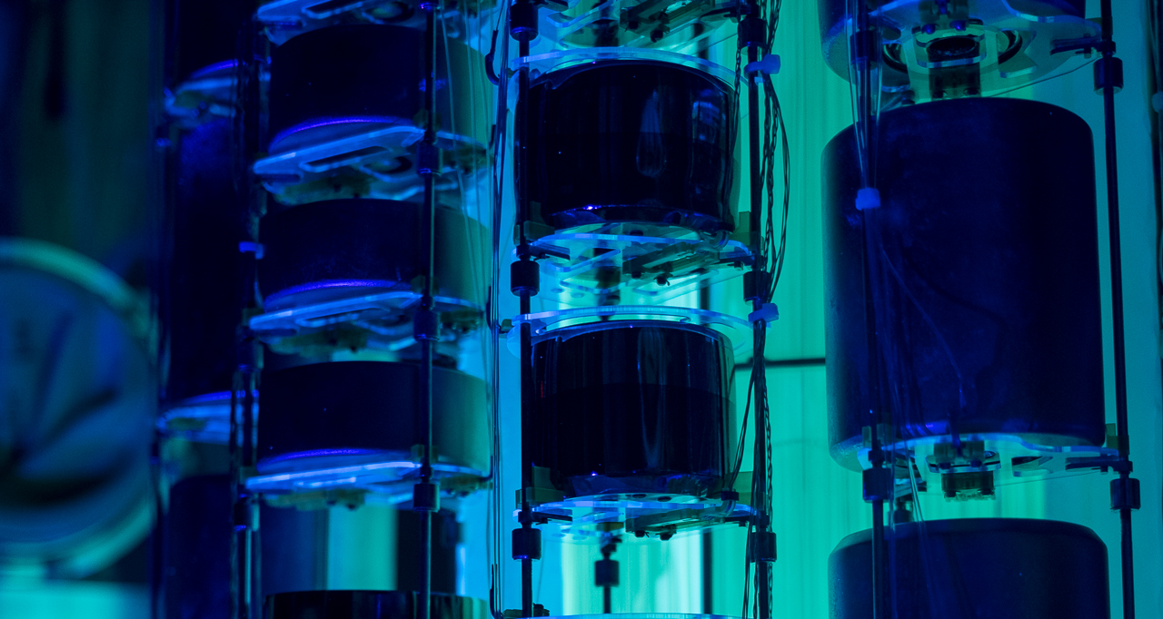


Advancing neutrinoless double beta decay searches with
Marta Babicz
NPML 2025, Tokyo, Japan

Slide 2
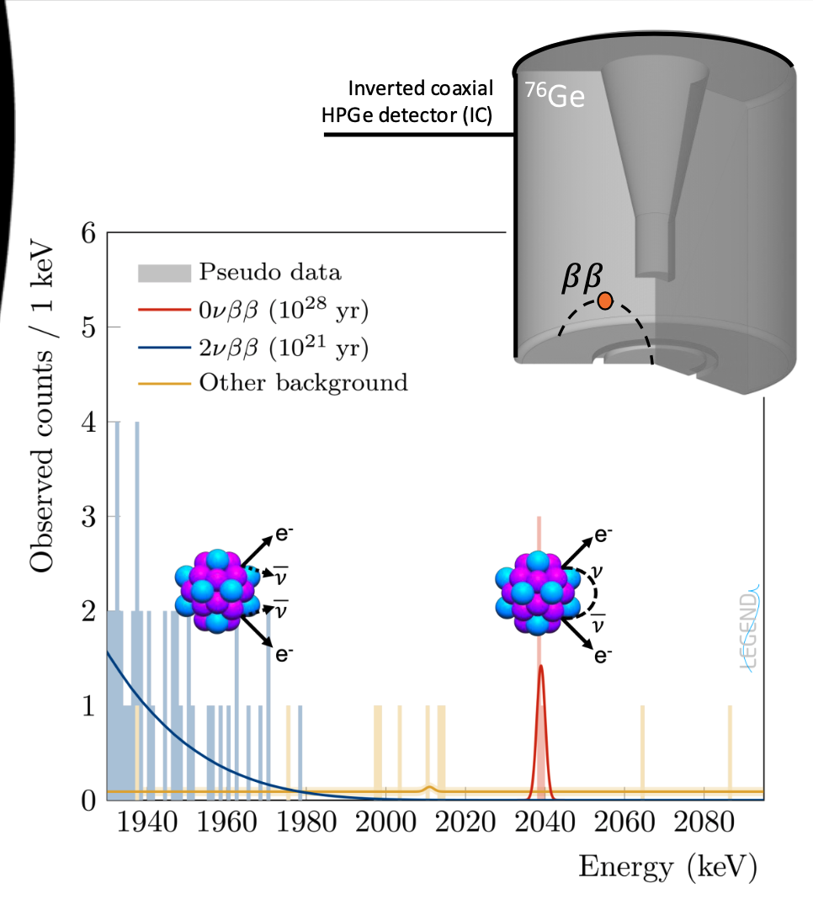
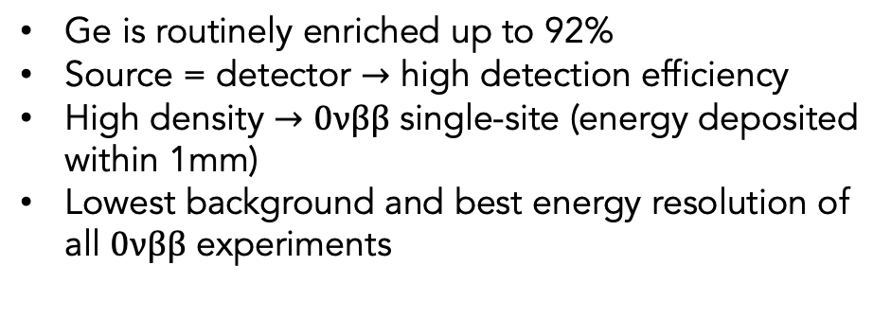
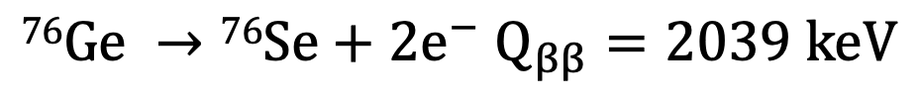
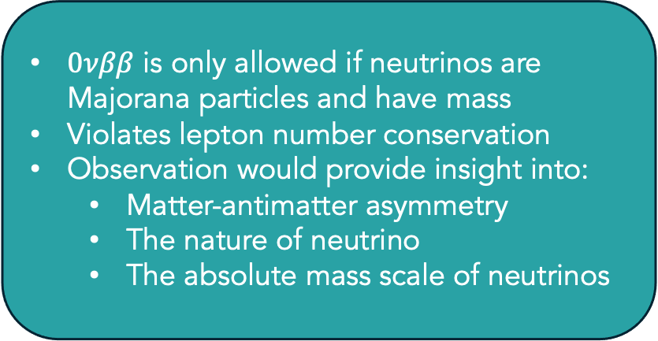
Neutrinoless double beta decay $\left(0νββ\right)$ in ⁷⁶Ge
$0νββ$ is only allowed if neutrinos are Majorana particles and have mass
Violates lepton number conservation
Observation would provide insight into:
Matter-antimatter asymmetry
The nature of neutrino
The absolute mass scale of neutrinos
$$76Ge →76Se+2e^{−} Q_{ββ}=2039 keV$$
Ge is routinely enriched up to 92%
Source = detector $→$ high detection efficiency
High density $→$ $0νββ$ single-site (energy deposited within 1mm)
Lowest background and best energy resolution of all $0νββ$ experiments

Slide 3
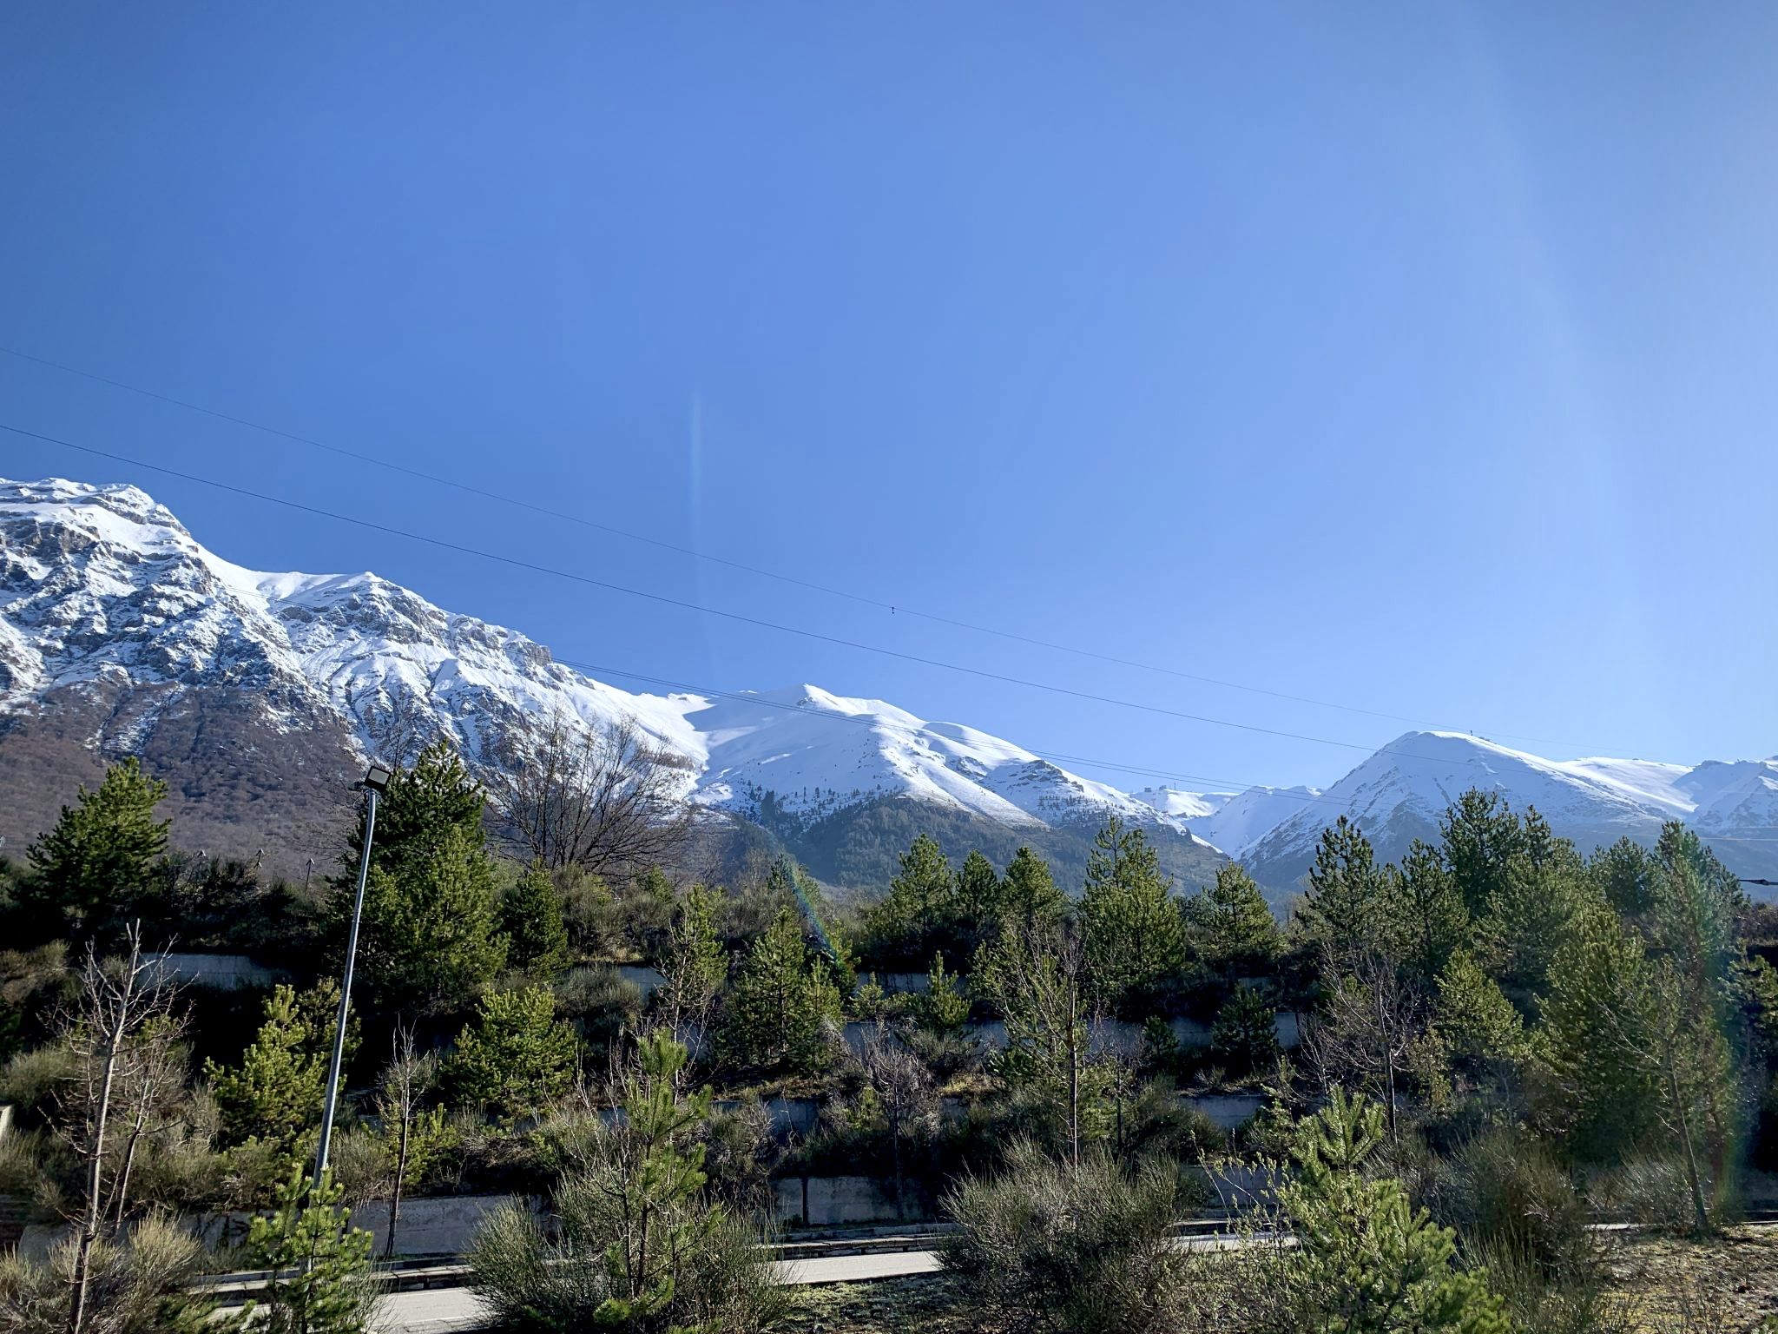
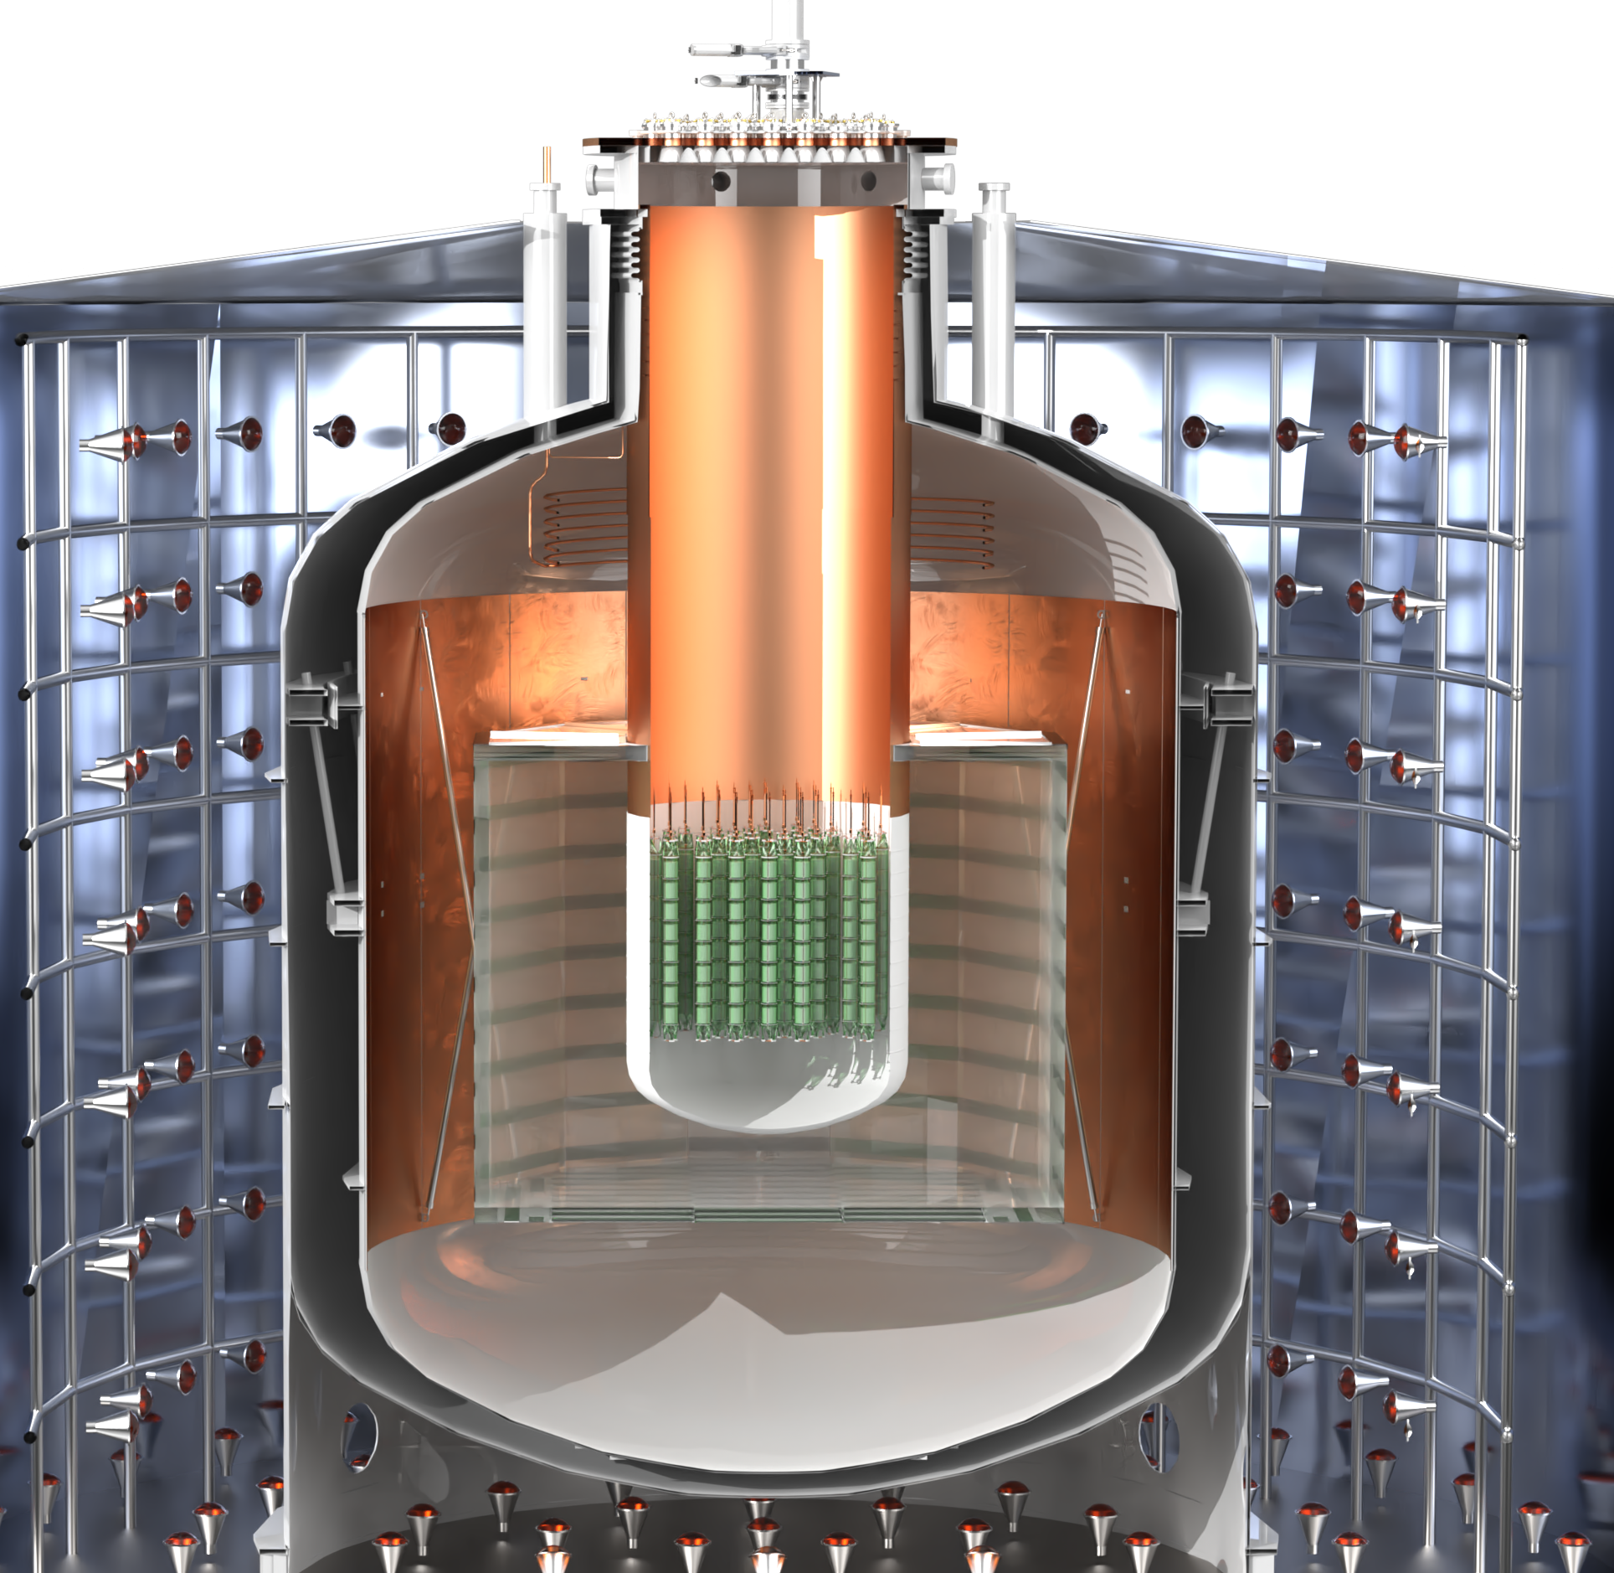
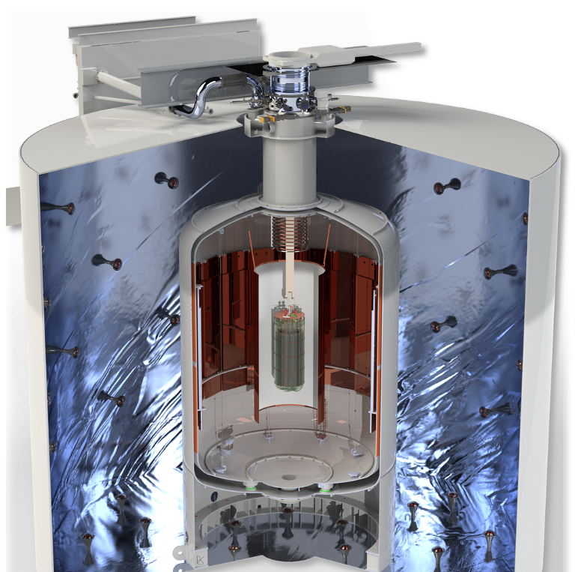
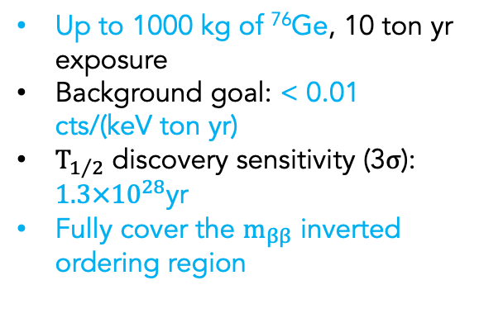
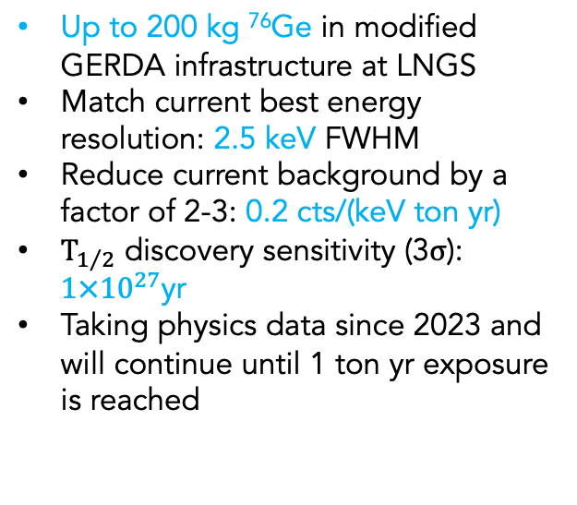
LEGEND: A phased ⁷⁶Ge experimental program
200
Up to 200 kg ⁷⁶Ge in modified GERDA infrastructure at LNGS
Match current best energy resolution: 2.5 keV FWHM
Reduce current background by a factor of 2-3: 0.2 cts/(keV ton yr)
$T_{1/2}$ discovery sensitivity (3$σ$): $1×{10}^{27}$yr
Taking physics data since 2023 and will continue until 1 ton yr exposure is reached
1000
Up to 1000 kg of ⁷⁶Ge, 10 ton yr exposure
Background goal: < 0.01 cts/(keV ton yr)
$T_{1/2}$ discovery sensitivity (3$σ$): $1.3×{10}^{28}$yr
Fully cover the $m_{ββ}$ inverted ordering region
[arXiv 2505.10440]
[arXiv 2107.11462]

Slide 4
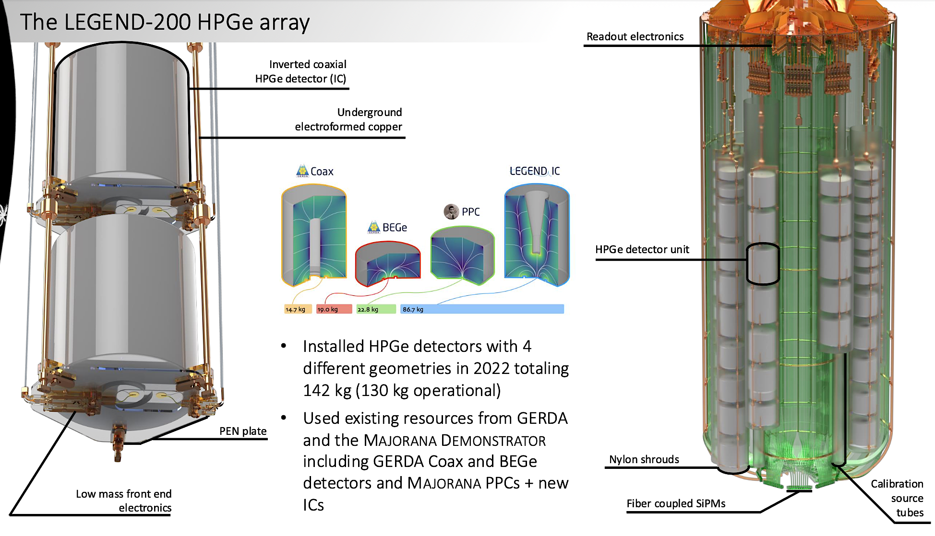
The LEGEND-200 HPGe detector array

Slide 5
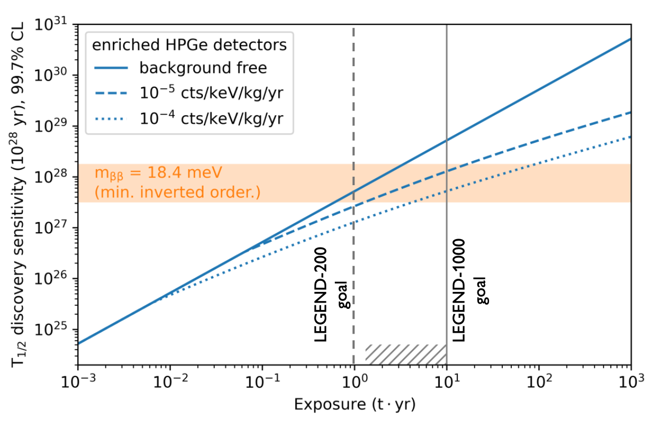
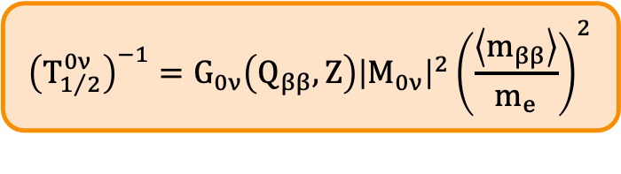

The scientific reach of LEGEND
$${\left(T_{1/2}^{0ν}\right)}^{−1}=G_{0ν}\left(Q_{ββ}, Z\right){\left|M_{0ν}\right|}^{2}{\left(\frac{\left\langle m_{ββ}\right\rangle }{m_{e}}\right)}^{2}$$
$$T_{1/2}^{0ν}∝\left\{\begin{aligned}M∙t \\ \sqrt{\frac{M∙t}{B∙σ}}\end{aligned}\right.$$
background free
with background
LEGEND-200: Background Index Goal 0.2 cts/(keV ton yr)
LEGEND-1000: Background Index Goal < 0.01 cts/(keV ton yr)

Slide 6
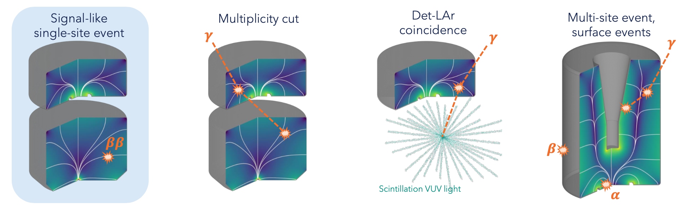
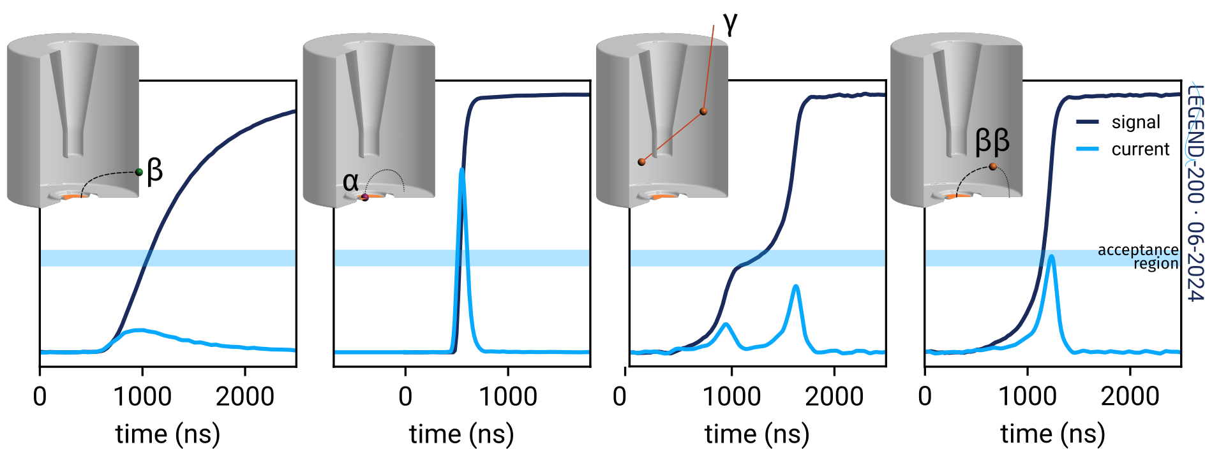
Background Rejection Techniques
Coincidence cuts: • LAr veto: reject events coincident with liquid argon scintillation. • Multiplicity cut: reject events seen in more than one Ge detector.
Pulse shape discrimination (PSD)
A
A/E = max(current)/energy
LQ = normalized late-tail area of the charge pulse
Notes:
n 0νββ, both electrons are emitted from the same nucleus, so:
The two electrons start within femtometers (size of a nucleus).
They each travel only a few millimeters in germanium before stopping (range depends on energy ≲ 2 MeV per electron).
Their energy deposits overlap almost completely, so the detector “sees” them as a single, localized energy cluster.
HPGe detectors have excellent spatial granularity — they can tell apart events that deposit energy in different places (multi-site events, like Compton scatters) versus a compact single-site event.
👉 That’s why 0νββ events are expected to be confined within about 1 mm³ of detector volume: both electrons dump their energy locally.
This feature is actually a powerful background rejection tool, since many backgrounds (gamma rays, cosmic rays) produce multi-site energy deposits spread over larger regions.

Slide 7
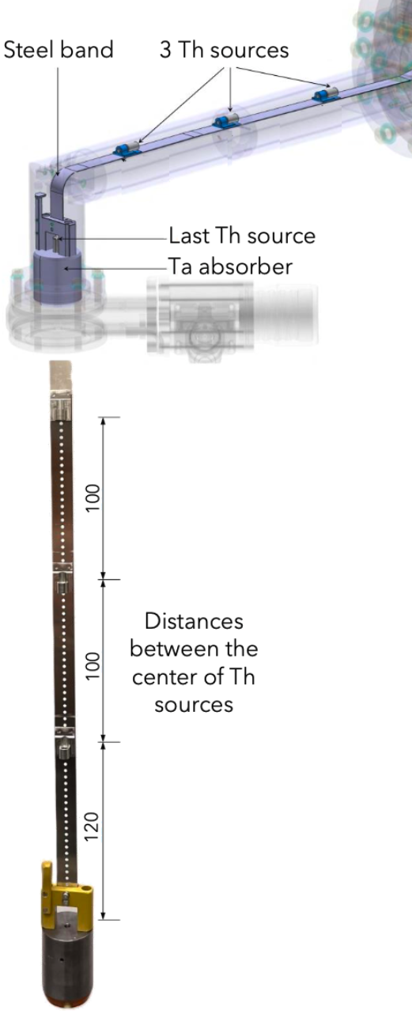
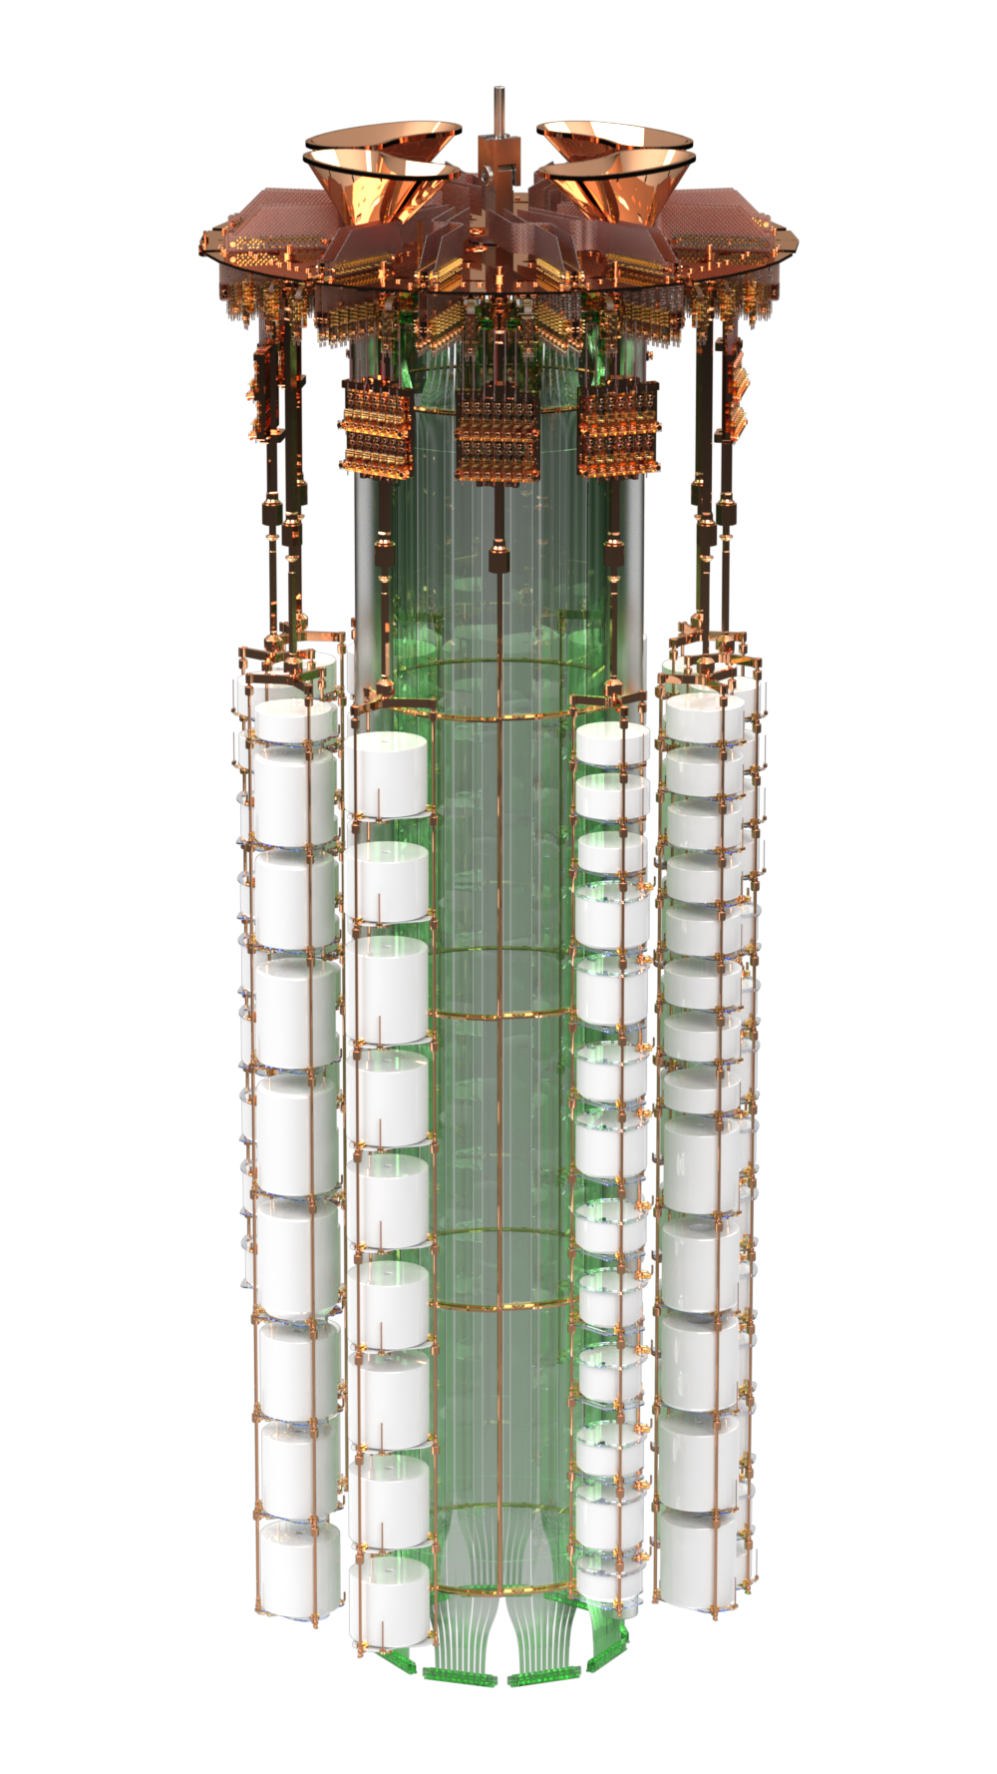
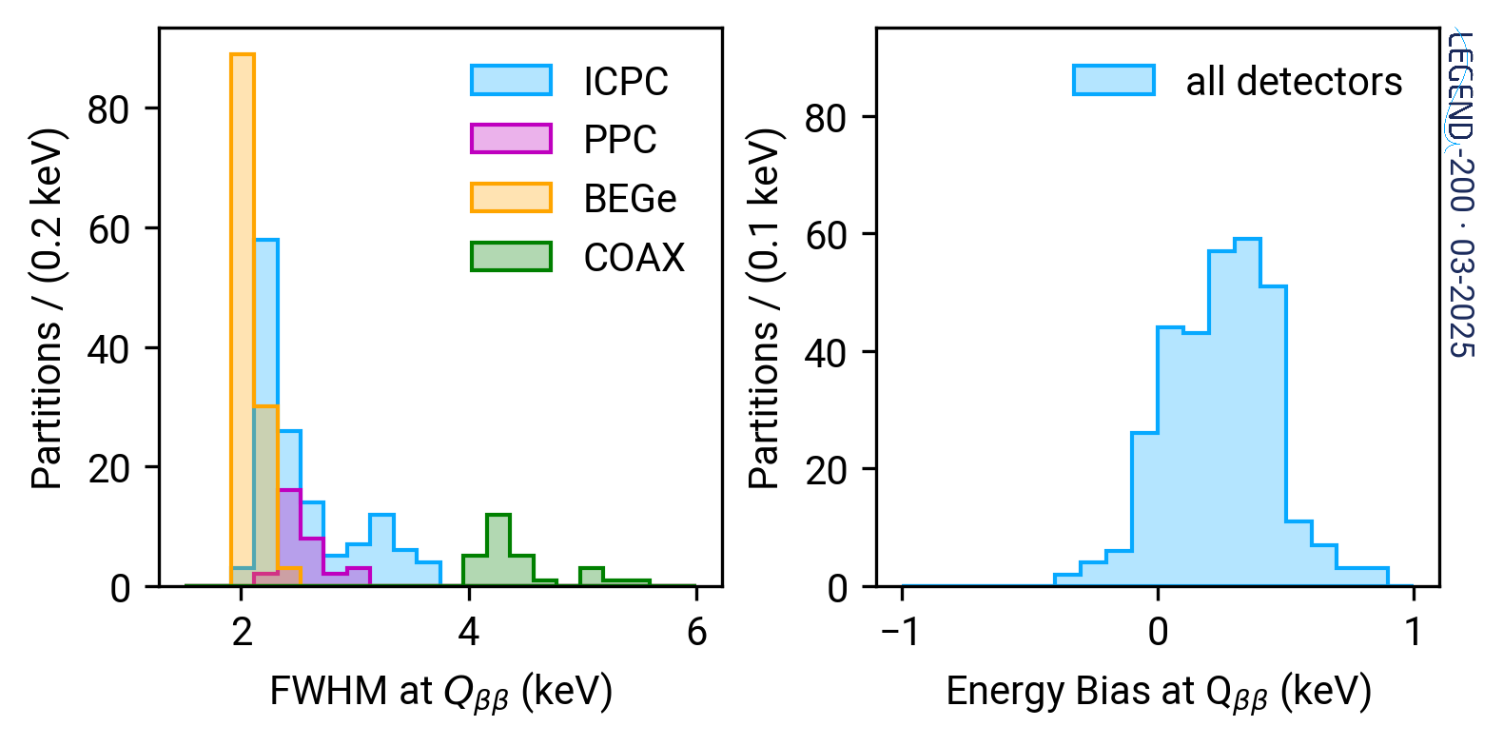
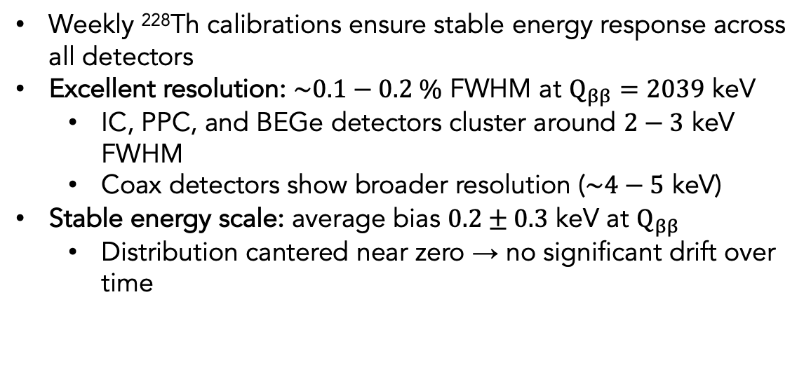
Energy Scale and Resolution
Weekly ²²⁸Th calibrations ensure stable energy response across all detectors
Excellent resolution: $\sim 0.1−0.2 \%$ FWHM at $Q_{ββ}=2039$ keV
IC, PPC, and BEGe detectors cluster around $2−3$ keV FWHM
Coax detectors show broader resolution ($\sim 4−5$ keV)
Stable energy scale: average bias $0.2±0.3$ keV at $Q_{ββ}$
Distribution cantered near zero → no significant drift over time
4 Calibration Systems
Data partitioned based on the stability of both energy and PSD observables to ensure optimal cut performance throughout the dataset

Slide 8
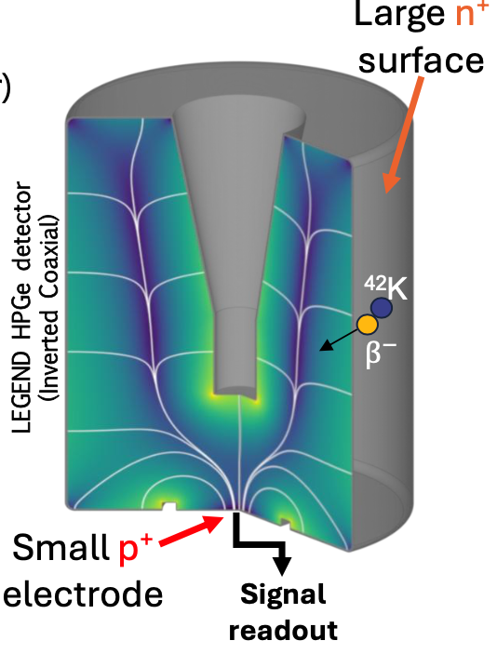


Background Model
⁴²K
$$Q_{ββ}$$
$$Q_{ββ}$$
β-decays from ⁴²K ions accumulating on n⁺ detector surfaces would dominate the background in LEGEND-1000.
Baseline mitigation:
Use underground-sourced liquid argon (UGLAr), which is naturally depleted in ⁴²Ar, to strongly reduce ⁴²K production.
Alternative strategies (if UGLAr unavailable):
Apply machine-learning–based pulse-shape classification to distinguish surface events from bulk single-site events in HPGe detectors.

Slide 9
Machine-learning-based PSD
Classic PSD (A/E, LQ) looks at one instant or one tail metric; it can miss patterns that are spread across the full pulse (early rise, mid shoulder, late tail).
We want a model that can see the whole waveform at once and learn bulk vs surface vs multi-site directly from data, not just from hand-tuned cuts.
Self-attention links distant parts of the pulse in one shot, so the model can compare “rise” vs “late tail” vs “afterpulsing,” which is exactly what separates SSE, MSE, and surface events.
Multi-head attention = parallel views: one head can behave like a learned A/E, another like a learned LQ, others specialize in tiny multi-site shoulders. all simultaneously, without us defining those features.
Fully parallel inference: no recurrent step-by-step scan; the full waveform (tens of µs) is processed in one pass, so this is fast enough to use at scale.
Notes:
Why we need ML-based waveform models
Surface β-decays from ${}^{42}$K on the n⁺ contact mimic $0νββ$-like single-site signals. Classical pulse-shape metrics (A/E, LQ) capture only local waveform features → limited separation power.
To go beyond that, we want a model that can see the whole waveform at once and learn what “bulk-like” vs “surface-like” means from data itself.
Classic PSD (A/E, LQ) looks at one instant or one tail metric; it can miss patterns that are spread across the full pulse(early rise, mid shoulder, late tail).
We want a model that can see the whole waveform at once and learn bulk vs surface vs multi-site directly from data, not just from hand-tuned cuts.
Self-attention links distant parts of the pulse in one shot, so the model can compare “rise” vs “late tail” vs “afterpulsing,” which is exactly what separates SSE, MSE, and surface events.
Multi-head attention = parallel views: one head can behave like a learned A/E, another like a learned LQ, others specialize in tiny multi-site shoulders — all simultaneously, without us defining those features.
Fully parallel inference: no recurrent step-by-step scan; the full waveform (tens of µs) is processed in one pass, so this is fast enough to use at scale.

Slide 10
Transformer Neural Network
It ingests a time series (a whole waveform) and reasons over all timesteps at once.
With encoder-only, its is perfect for classification task using the full waveform context.
One encoder layer =
Multi-head self-attention several parallel attention ‘heads’ form similarity-weighted views of the entire waveform and combine them to capture multiple features simultaneously.
Feed-forward network (MLP) turns “I saw a sharp rise + later shoulder” into a stronger “this looks MSE-ish” signal for that slice.
Residual (“skip”) connections keep learning stable and prevents the network from forgetting the basics of the pulse.
Layer normalisation stabilises activations and gradients across tokens
Positional information attention by itself doesn’t know order, so a time stamp is added to each slice, so the model knows “this is before the peak” vs “this is in the late tail”.
Depth we stack several encoder layers (multi-layer), so deeper blocks learn relations between relations.
A learnable [CLS] token is prepended; it aggregates information from the whole sequence and feeds the final classifier.
Notes:
Here’s a short, talk-track you can read verbatim:
Think of the model as a reader that takes the entire waveform at once—baseline, rise, peak, tail—and reasons over all timesteps together. Using an encoder-only Transformer is ideal here, because the job is classification and it benefits from the full pulse context.
Inside one encoder layer there are two main steps. First, multi-head self-attention: several parallel “heads” each create a similarity-weighted view of the whole waveform. One head might focus on rise sharpness, another on a small delayed shoulder, another on a long tail; then these views are combined so multiple cues are captured at once. Second, a feed-forward network (MLP) refines those features locally—turning patterns like “sharp rise plus a small later bump” into a stronger this looks non-SSE/MSE-ish signal for that slice.
Two stabilizers keep the stack trainable. Residual (skip) connections add each sublayer’s input back to its output, so the network refines the representation instead of overwriting it. Layer normalization keeps activations well-behaved across tokens, which stabilizes learning.
Because attention by itself doesn’t know order, positional information is added: a time stamp for every slice so the model can tell “this is before the peak” from “this is in the late tail,” and learn meaningful time relations.
Depth comes from stacking several encoder layers. Early layers learn simple cues; deeper layers learn relations between relations, building a richer class signal.
Finally, a learnable [CLS] token is prepended to the sequence. During attention, all slices can write information into this summary token; the classifier reads that final summary to produce the PSD decision.

Slide 11
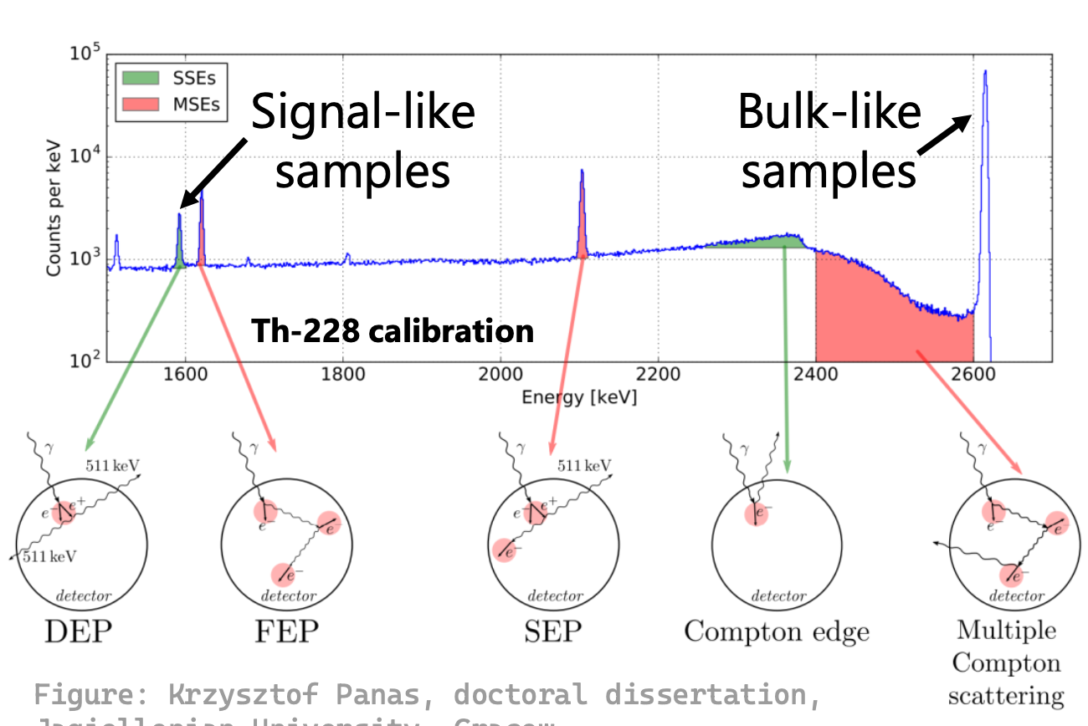
Training Data

Slide 12
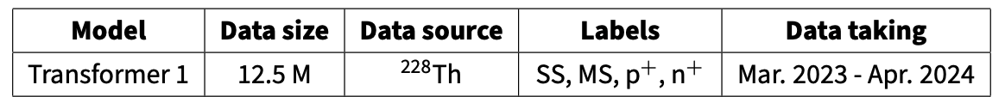
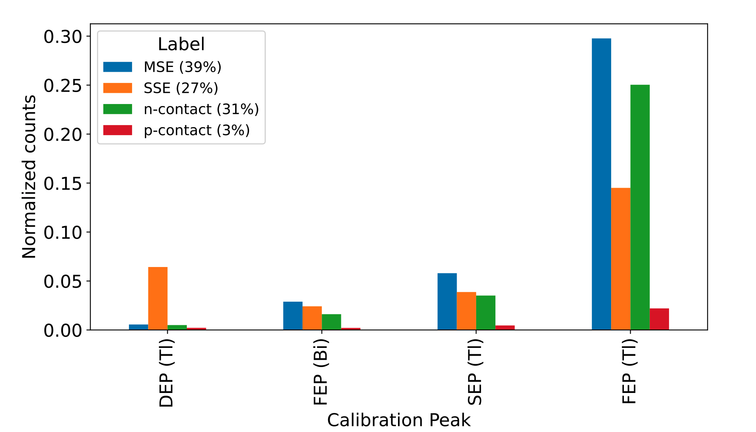
Training Data

Slide 13
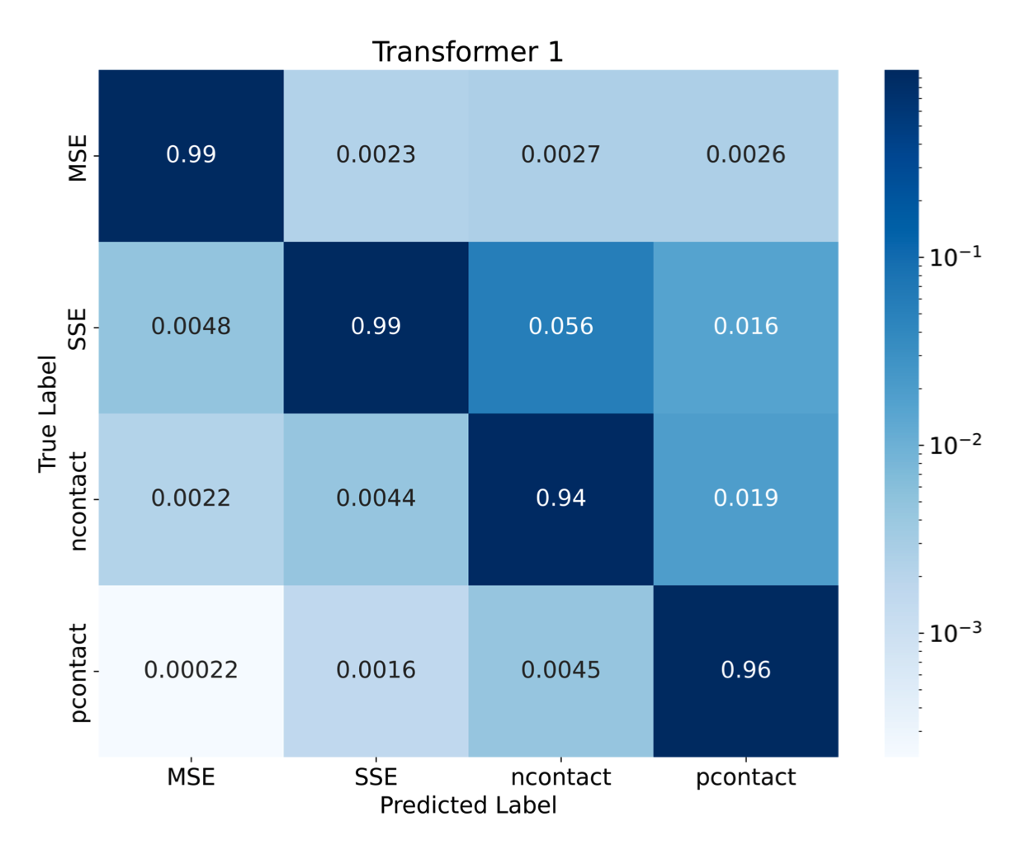
Classification performance
High diagonals: MSE and SSE rows are ~99% correct, p-surface ~96%; n-surface ~94%.
Main confusion: SSE → n-surface (~5–6%) is the largest off-diagonal.
Secondary: n-surface → p-surface (~2%) and SSE → p-surface (~1–2%).
MSE is rock-solid: essentially no leakage into other classes.
For binary PSD (SSE vs non-SSE), the only leak that really matters is SSE mis-tagged as surface (it costs signal efficiency). The biggest hit is SSE being mistaken for n-contact.
Likely causes:
Label/selection noise in surface samples
Notes:
The trainind data imbalance is very likely part of the issue, but The only meaningful leak is SSE → n-contact (~5–6%). That isn’t a classic extreme-imbalance pair (27% vs 31% is fairly close), so imbalance alone can’t fully explain it.
p-contact is tiny (~3%) yet the recall looks high (~96%). That suggests p-contact is separable enough that scarcity didn’t kill it.
The heavy peak/energy imbalance (lots of Tl FEP, much less DEP/SEP/Bi) can still bias the representation toward features prevalent at FEP energies and under-represent non-FEP SSE morphology—this can push borderline SSE toward surface, especially on detectors where surfaces mimic SSE.
abundant FEP (rich in MSE and surfaces) vs fewer clean SSE anchors → the model sees more “non-SSE-like” structure than true SSE variety.
Detector effects: if some detectors’ surface pulses resemble SSE, the model may learn detector-specific shortcuts (priors), shifting SSE toward n-surface.
Boundary data scarcity: not enough borderline SSE vs surface examples (near the A/E cut, small shoulders) to sculpt a sharp boundary.

Slide 14
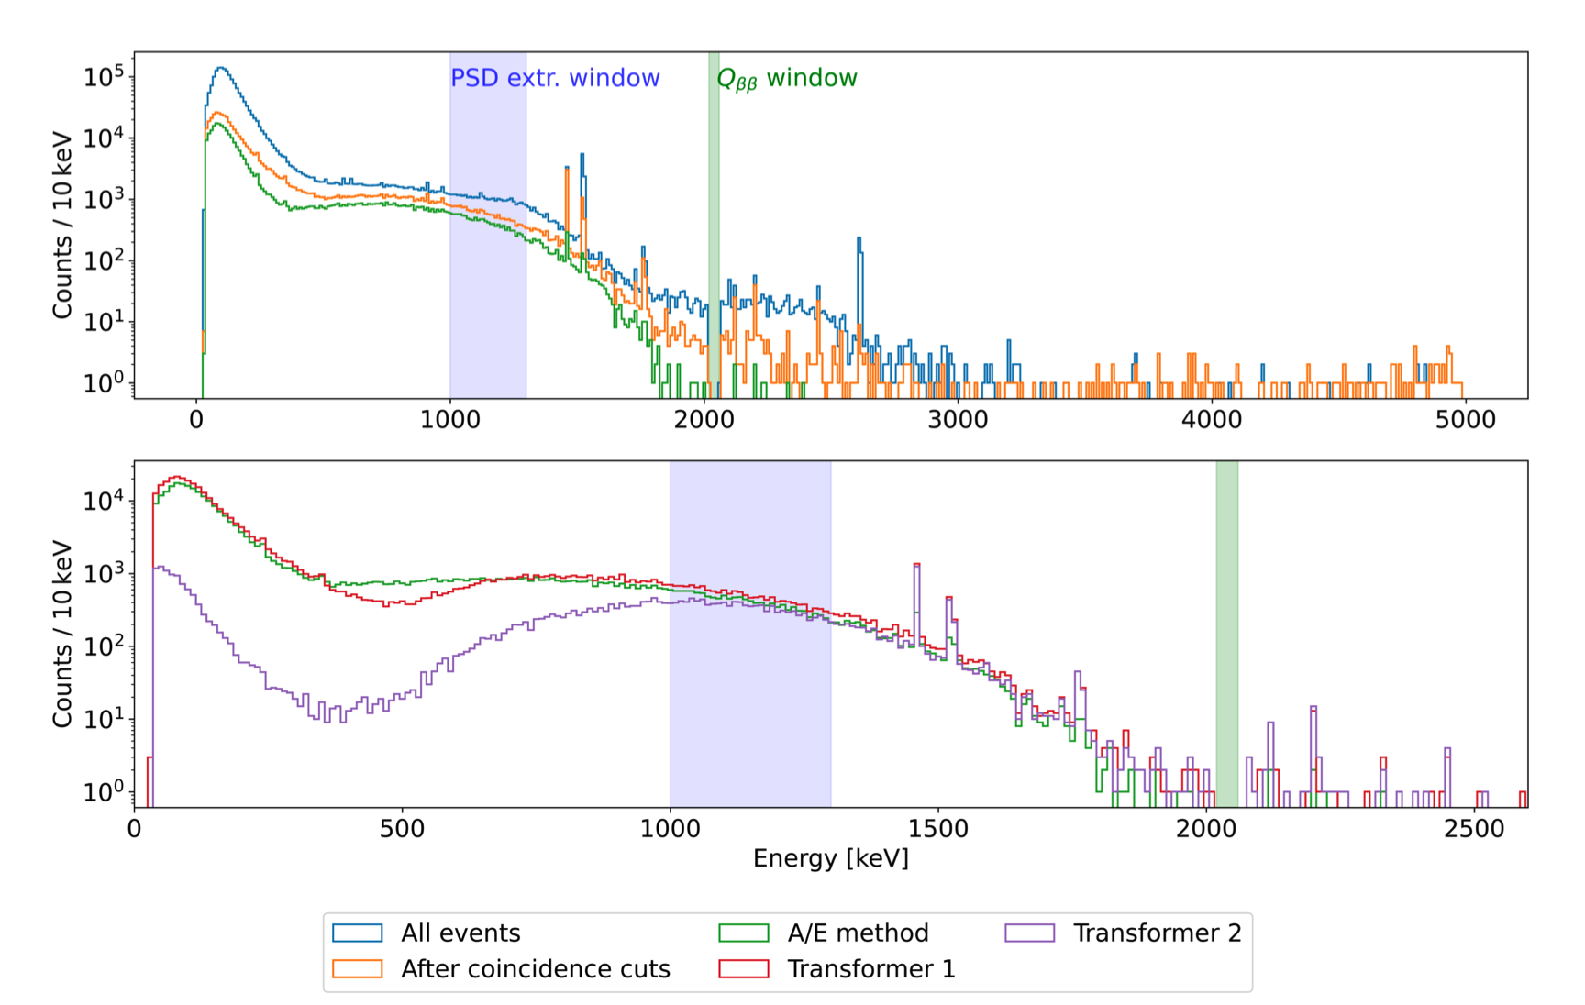
Results
Using all physics runs that passed the LEGEND quality checks (ICPC detectors only)
Traditional PSD

Slide 15
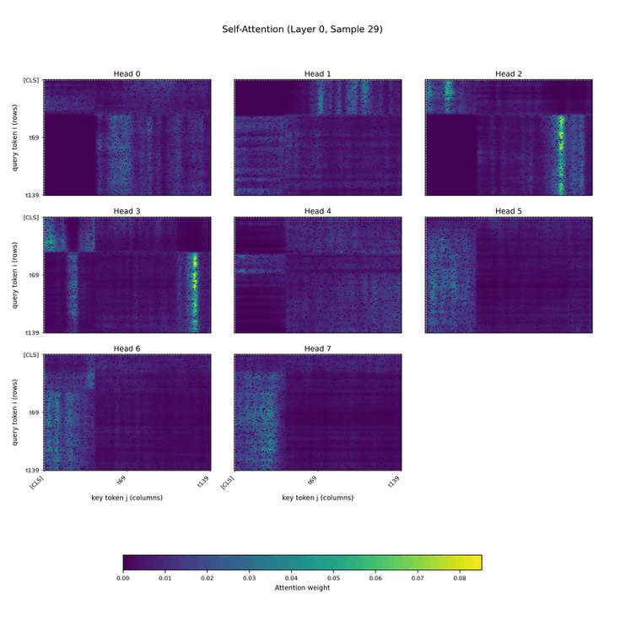
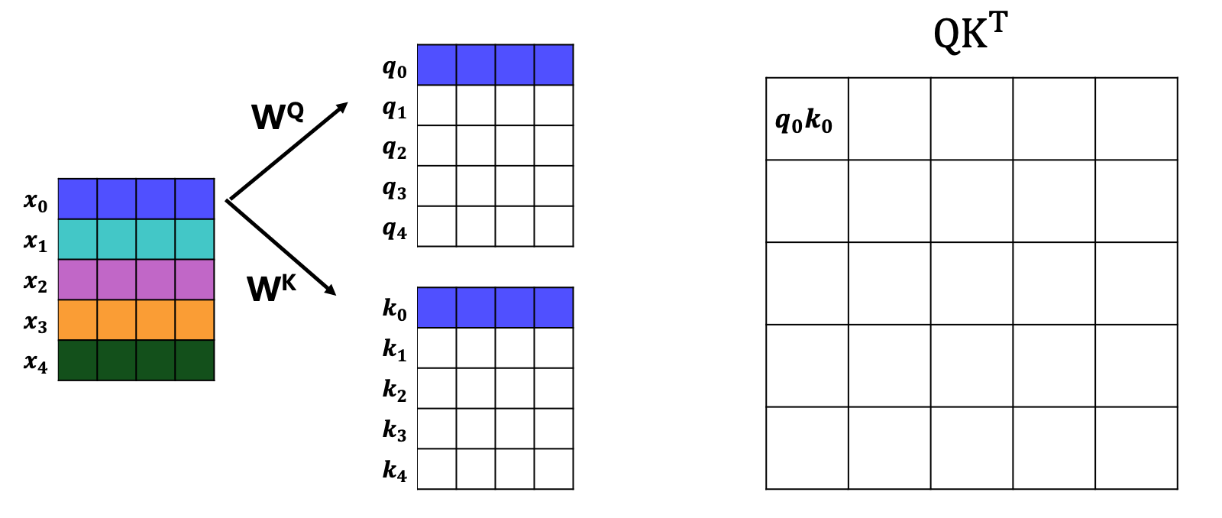
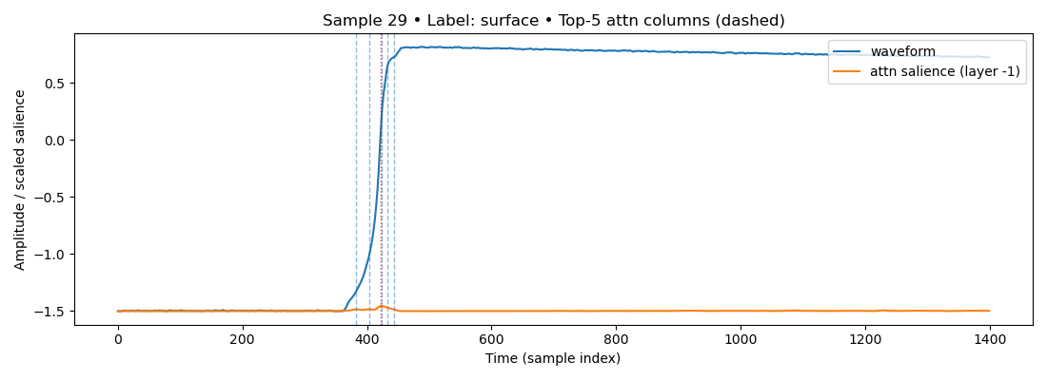
Surface Event

Slide 16

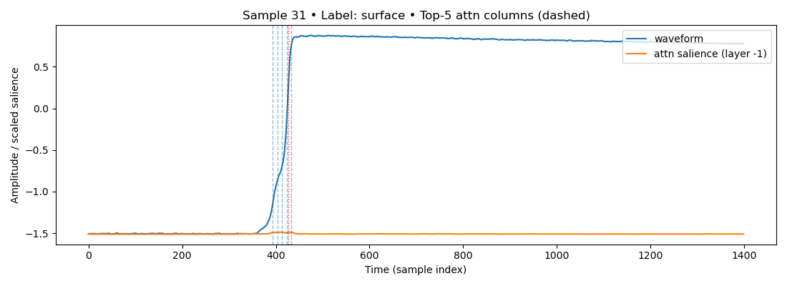
Multi-Site Event

Slide 17
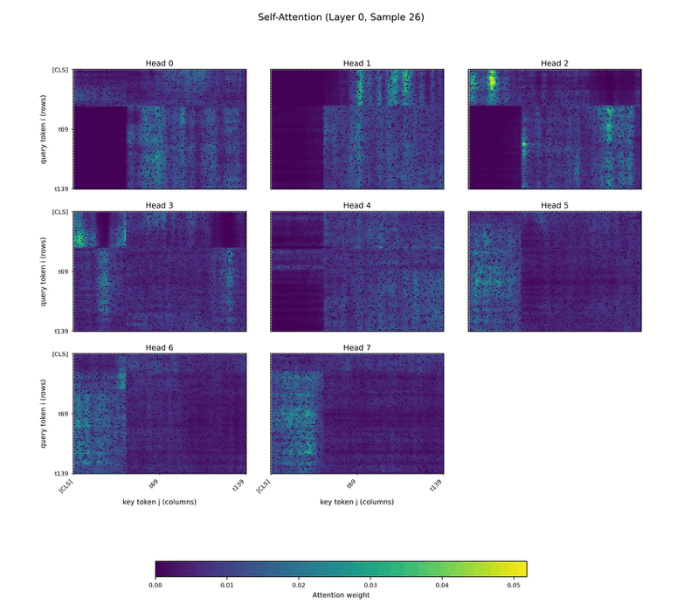
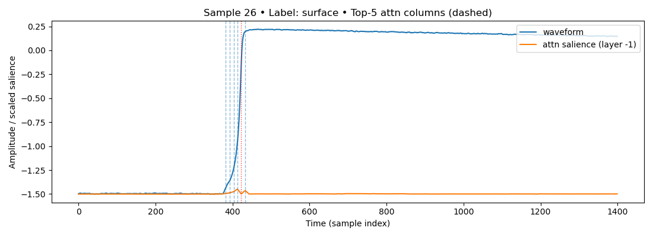
Single-Site Event

Slide 18
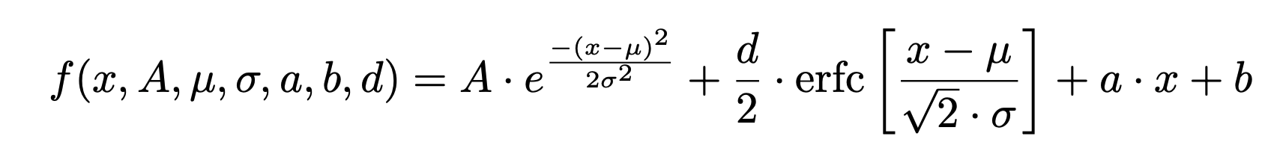
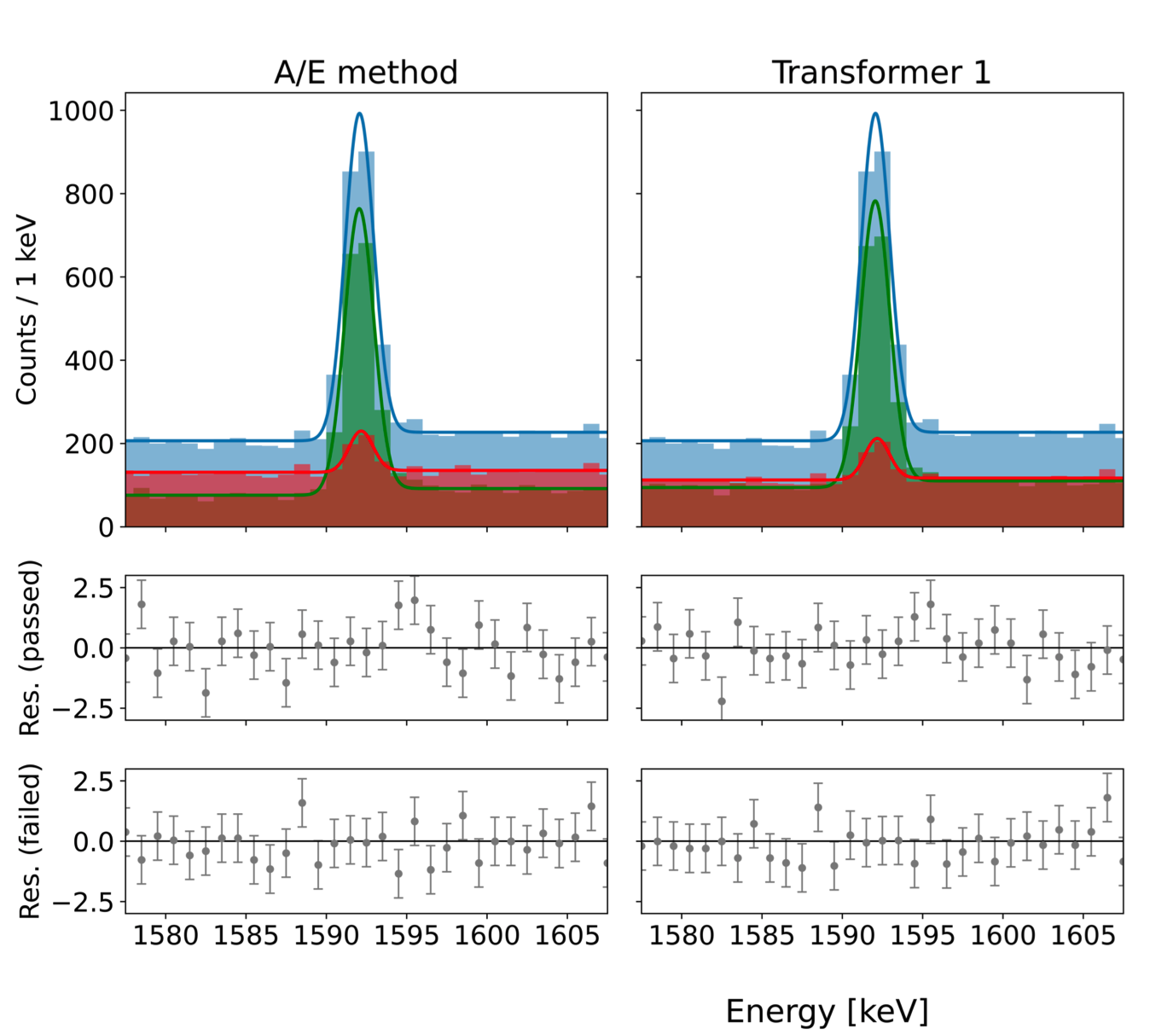
PSD efficiency at ²⁰⁸Tl DEP
Traditional PSD
Transformer
Transformer
Energy [keV]
Notes:
We measure the PSD efficiency at the DEP by fitting the peak twice per detector: once for events that pass the PSD cut and once for those that fail. In each case we fit a Gaussian peak plus a step term to capture low/high-energy tails and a linear background in a narrow ±20 keV window around the DEP. The fit quality is checked with normalized residuals; example pass/fail fits and residuals are shown for (^{208})Tl(and also for a second DEP) in the figures referenced there.
“DEP efficiency = pass-peak ÷ (pass-peak + fail-peak), per detector, then averaged with an explicit detector-spread term so our uncertainty reflects real differences between detectors.”
Peak fitting results in the 208Tl DEP region. Each subfig-
ure shows three histograms: all events (blue), events passing the PSD cut
(green), and events failing the cut (red). The corresponding fits are shown
as line plots. The two lower panels display the normalized residuals for
the fit to the passing (middle) and failing (bottom) event populations. The
residuals confirm the quality and stability of the fits.
The A/E
parameter is calibrated such that approximately 90% of events in the DEP
region are classified as single-site. Consequently, only a small number of
events are expected to fail the cut, which can lead to large uncertainties in
Af due to low statistics.

Slide 19
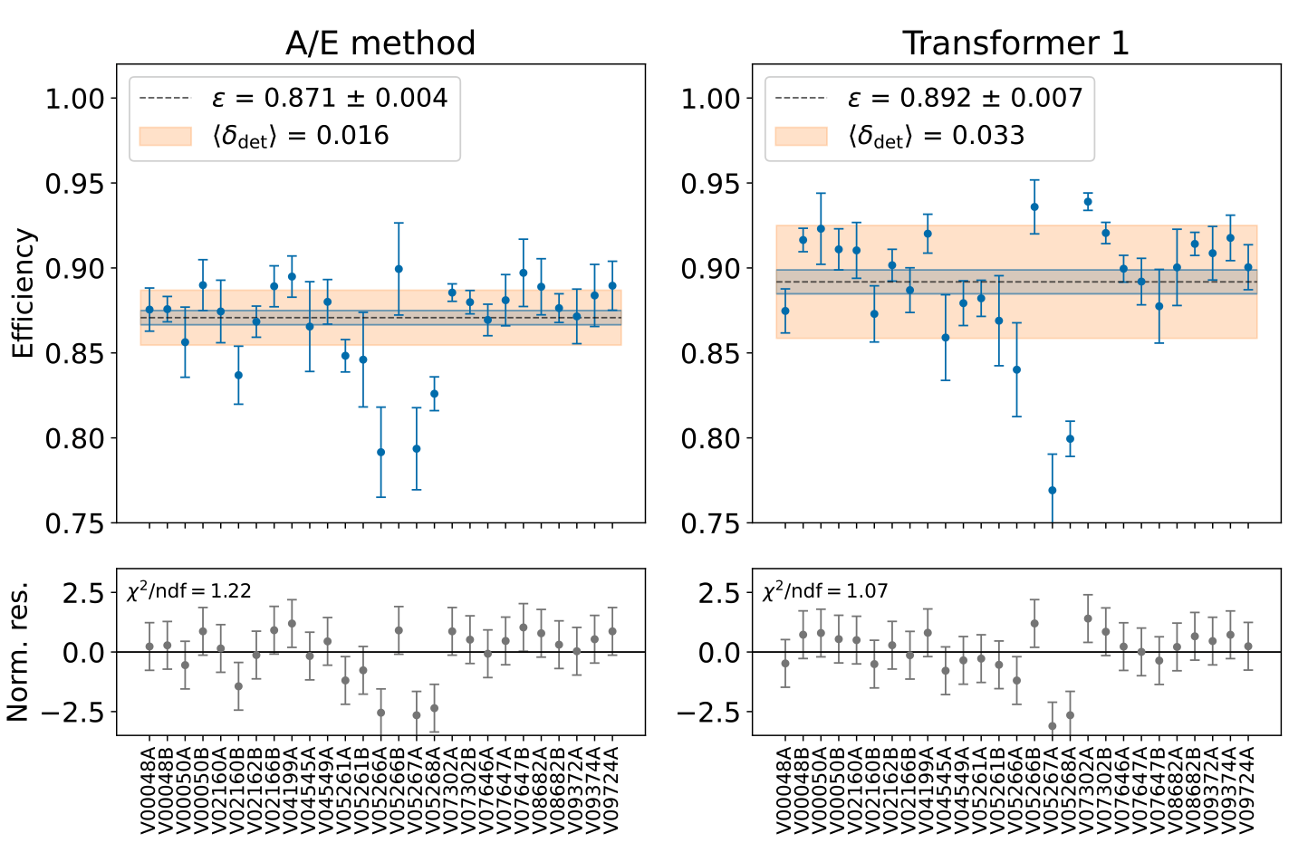
PSD efficiency at ²⁰⁸Tl DEP
Traditional PSD
Transformer
Notes:
From those two fits we take the background-subtracted Gaussian amplitudes—call them “pass” and “fail”—and define the DEP efficiency as pass divided by (pass + fail). The corresponding uncertainty is propagated from the two fitted amplitudes and their errors. That’s the per-detector efficiency point that appears in the plots.
Because detectors are not identical, we combine detectors with a likelihood that includes an extra detector-to-detector variance term. Practically, we fit for a common mean efficiency and an additional spread that soaks up residual hardware differences; this avoids understating the final uncertainty. The figures then show the blue band for the mean efficiency and the orange band for that extra spread, with residual panels underneath.
In words: fit pass/fail peaks → compute a clean per-detector DEP efficiency with an error → combine across detectors while accounting for real detector spread. The method is identical for A/E and for Transformer Model 1; only the definition of “pass/fail” changes.
So we determine the PSD e!ciency individually for each detector. To ob-
PSD e!ciencies in the 208Tl DEP (1592.5 keV) for Mirion detectors used in this analysis. Most detectors exhibit efficiencies (blue band) between 85% and 90%, although a few show noticeably lower performance across all PSD methods. The additional detector-to-detector uncertainty is indicated by the orange band. The standard PSD method shows a small spread
(1.6%), while the Transformer classifications exhibit larger systematic variations (> 3%). The lower panel shows the normalized residuals, demonstrating the quality of the fit.

Slide 20
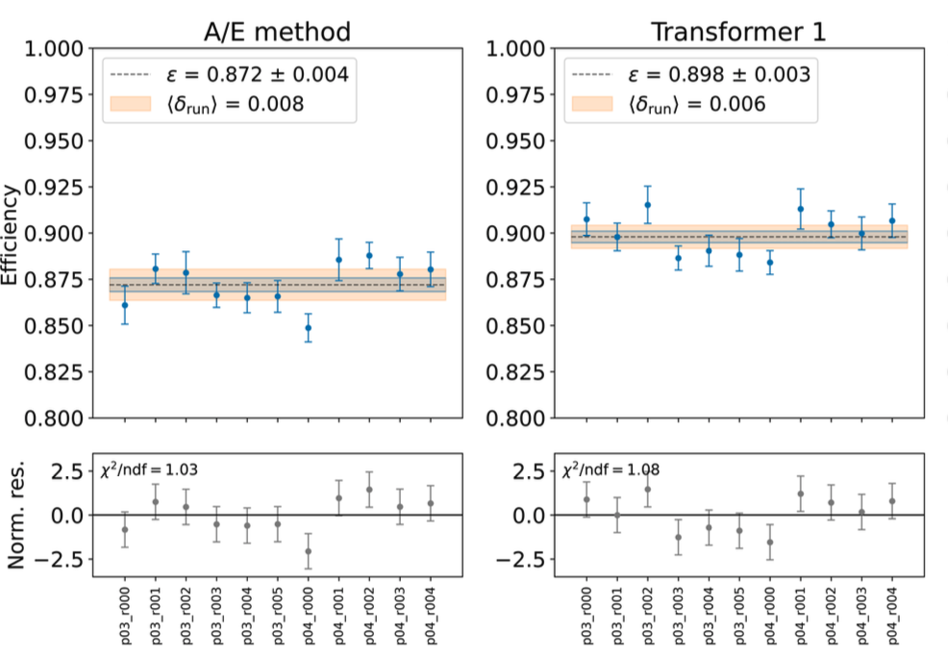
PSD efficiency at ²⁰⁸Tl DEP
Traditional PSD
Transformer
Notes:
What’s being checked
Whether the PSD efficiency drifts with time across data-taking runs, independent of detector-to-detector differences.
Step 1 — Per-run efficiencies
For each run, collect events from all detectors used in the analysis during that run and measure the PSD efficiency at the 208Tl DEP using the same pass/fail peak-fit method you used per detector (Gaussian peak + step + linear background, applied separately to pass and fail). This yields one efficiency (\varepsilon_r) with statistical uncertainty (\sigma_{\varepsilon,r}) per run.
Step 2 — Fit a global mean plus extra run-to-run spread
Treat the set ({\varepsilon_r}) like you did for detector averages, but replace the detector extra spread by a run extra spread term. Concretely, minimize [ \chi^2(\langle\varepsilon\rangle,\langle\phi_{\text{run}}\rangle) =\sum_r\left[\frac{(\varepsilon_r-\langle\varepsilon\rangle)^2}{\sigma_{\varepsilon,r}^2+\langle\phi_{\text{run}}\rangle^2} +\ln(\sigma_{\varepsilon,r}^2+\langle\phi_{\text{run}}\rangle^2)\right], ] which returns the time-averaged efficiency (\langle\varepsilon\rangle) and the extra run-to-run variance(\langle\phi_{\text{run}}\rangle). This is the same likelihood form as the detector-spread fit, just re-indexed by run.
Step 3 — Read the stability
The plot (Fig. 36) shows the per-run points and a blue band for (\langle\varepsilon\rangle); residuals underneath check fit quality. Result: very stable in time.
The table reports the fitted extra spread: (\langle\phi_{\text{run}}\rangle \lesssim 1%) for all methods (A/E ~0.8%, Model 1 ~0.6%), i.e., time variations are sub-percent, much smaller than detector-to-detector spread.
Why this matters downstream
When extrapolating PSD efficiency to (Q_{\beta\beta}), you add this small run-to-run term as a correction/uncertainty component: [ \varepsilon_{\text{PSD}}=\tilde{\varepsilon}{\text{PSD}}+\langle\phi{\text{run}}\rangle+\varepsilon_{2\nu\beta\beta};; \text{(as used later in the summary).} ] Thus, time dependence contributes a tiny uncertainty compared to detector spread; both A/E and Transformer Model 1are time-stable.

Slide 21
Summary
As a proof-of-concept, transformer-based PSD is competitive with traditional PSD, but with current training and systematics it does not clearly outperform the standard cut.
If the training labels come from trad. PSD, a supervised transformer will mostly learn A/E’s decision boundary. It can’t reliably “beat” A/E on that same labelling, at best it replicates or smooths it.
In this work, validation on 2νββ indicates the model generalizes acceptably beyond peaks (a necessary condition), but the central efficiency and its uncertainty still leave it statistically on par with A/E.
Notes:
An encoder-only Transformer (Model 1) that ingests LEGEND waveforms, builds token embeddings (waveform+gradient), adds sinusoidal time stamps, then applies stacked multi-head self-attention + MLP to classify SSE/MSE/surface.
As a proof-of-concept, transformer-based PSD is competitive with traditional PSD, but with current training and systematics it does not clearly outperform the standard cut.
If training targets are derived from trad. PSD selections, the model is effectively learning a teacher’s boundary. In that regime it’s hard to consistently beat the trad. PSD unless the model sees additional supervision (e.g., physics-motivated positives/negatives off the A/E boundary) or exploits features A/E cannot use.
In this work, validation on 2νββ indicates the model generalizes acceptably beyond peaks (a necessary condition), but the central efficiency and its uncertainty still leave it statistically on par with A/E.

Slide 22
What’s next
Improve supervision beyond current PSD.
We could also concentrate training on events near the A/E cut, where extra waveform context could help; so we could use sample re-weighting or focal loss.
Reduce detector-to-detector spread: we can add a tiny detector-ID embedding (or per-detector fine-tuning) so the model learns to factor out hardware quirks that A/E already handles via per-detector calibration. And then quantitatively track the extra variance term in the same likelihood.
Balance better the training data.
We could use A/E to define a narrow acceptance band and apply the Transformer only inside that band (where A/E is least certain). Report background at fixed SSE efficiency from the anchors.
Can save the attention maps for SSE → surface mistakes to verify heads emphasize rise/shoulder/tail regions that match the physics story and not detector quirks
Pulse Shape Simulation + Domain-Adversarial training.
Notes:
Use physics-truth labels (not A/E) — Treat DEP and a clean 2νββ window as SSE; use Compton sidebands and surface-tagged events as non-SSE. Keep A/E only as an auxiliary feature so the model learns waveform physics, not the A/E boundary.
Train on the boundary — Focus training on events near the A/E cut; up-weight them with sample re-weighting or focal loss so the model learns where A/E is least certain.
Reduce detector spread — Add a tiny detector-ID embedding (or light per-detector fine-tuning) so hardware quirks are factored out; track the remaining spread with the same extra-variance fit used in the efficiency plots.
Match training to evaluation — Build stratified batches across energy windows (DEP, SEP, continuum) and class, mirroring the efficiency-ladder mix to avoid train/eval mismatch.
Hybrid deployment — Use A/E to define a narrow acceptance band, and run the Transformer only inside that band; report background at fixed SSE efficiency from the anchors.
Calibrate and propagate — Calibrate the SSE score (e.g., temperature scaling) so the chosen threshold really hits the target efficiency at the anchors, and propagate detector-to-detector spread exactly as in the current combination.
Make it inspectable — Save attention maps for SSE→surface mistakes and check that heads emphasize rise/shoulder/tail rather than detector quirks; use this to guide data cleaning and tweaks.
Leverage PSS + domain adaptation — Pretrain on balanced, truth-labeled simulated pulses; then use domain-adversarial training with labeled sim + unlabeled real to align features and reduce the sim→real and detector variance gaps.

Slide 23

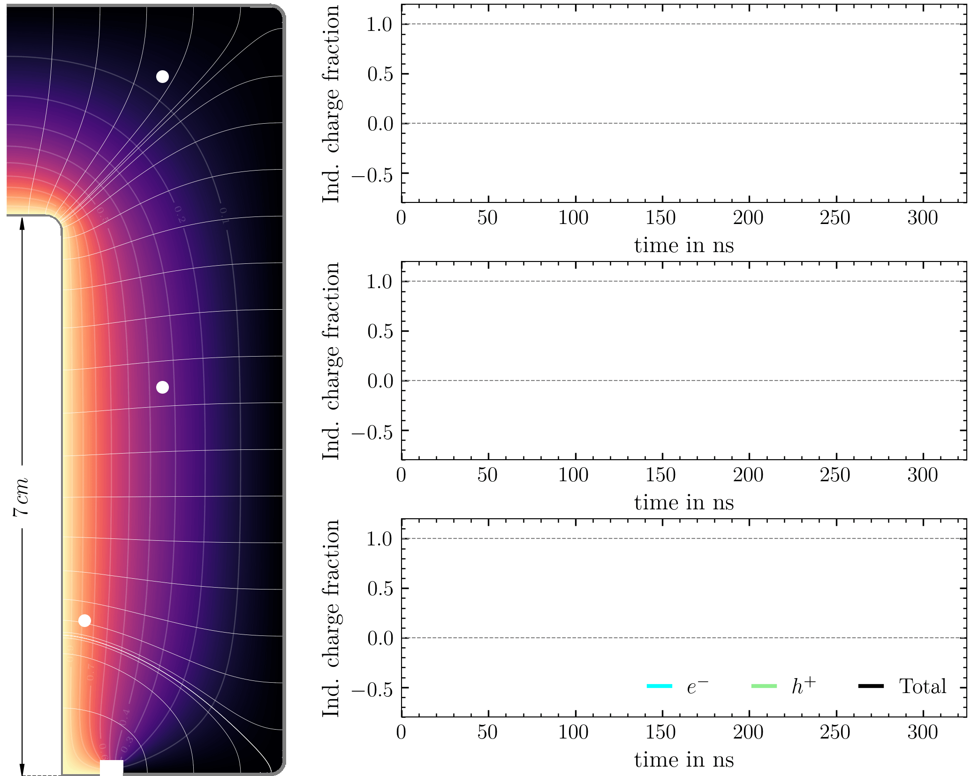
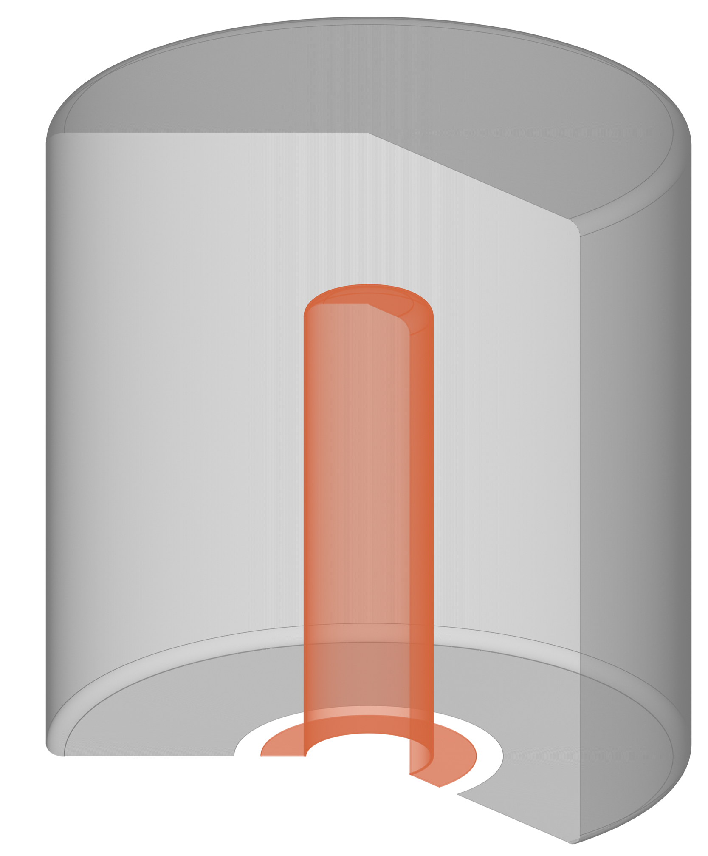
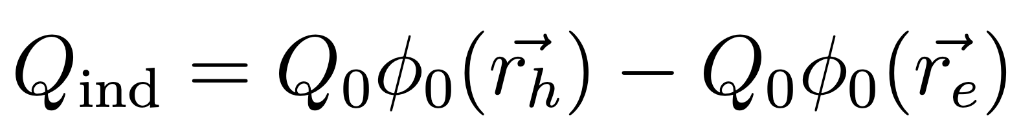
Pulse Shape Simulation: Signal development
Current defaults used by SSD: Bruyneel et al. https://doi.org/https://doi.org/10.1016/j.nima.2006.08.129
Mobility / drift velocity
Temperature model for drift
Shockley-Ramo Theorem

Slide 24
Backup

Slide 25
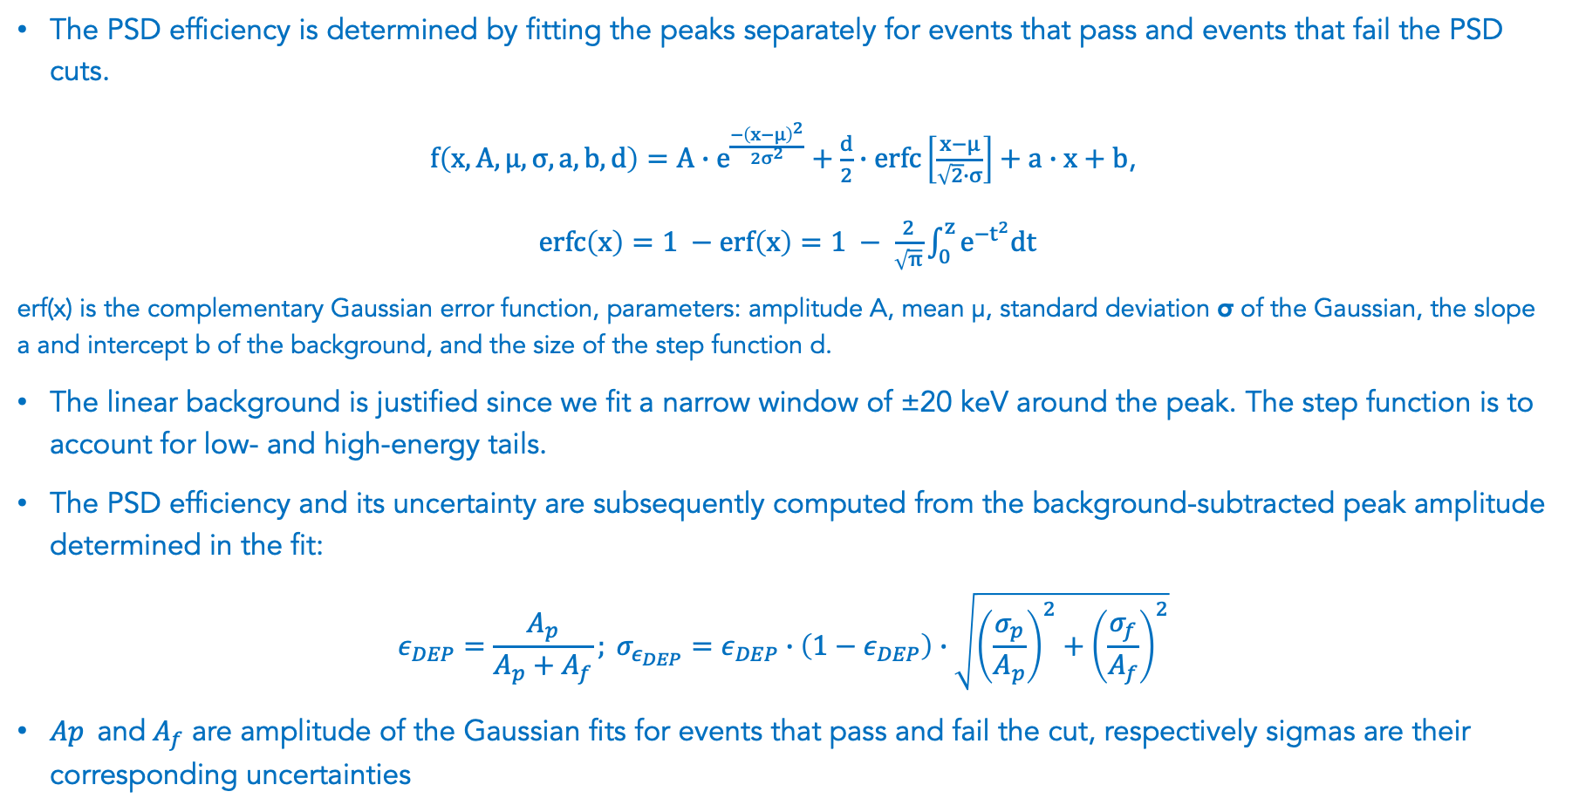
PSD efficiency at ²⁰⁸Tl DEP
The PSD efficiency is determined by fitting the peaks separately for events that pass and events that fail the PSD cuts.
$f\left(x, A, μ, σ, a, b, d\right)=A∙e^{\frac{−{\left(x−μ\right)}^{2}}{2σ^{2}}}+\frac{d}{2}∙erfc\left[\frac{x−μ}{\sqrt{2}∙σ}\right]+a∙x+b$,
$\operatorname{erfc}\left(x\right)=1 −\operatorname{erf}\left(x\right)=1 − \frac{2}{\sqrt{π}}\int_{0}^{z}{e^{−t^{2}}dt}$
erf(x) is the complementary Gaussian error function, parameters: amplitude A, mean µ, standard deviation σ of the Gaussian, the slope a and intercept b of the background, and the size of the step function d.
The linear background is justified since we fit a narrow window of ±20 keV around the peak. The step function is to account for low- and high-energy tails.
The PSD efficiency and its uncertainty are subsequently computed from the background-subtracted peak amplitude determined in the fit:
$$ε_{DEP}=\frac{A_{p}}{A_{p}+A_{f}}; σ_{ε_{DEP}}=ε_{DEP}∙\left(1−ε_{DEP}\right)∙\sqrt{{\left(\frac{σ_{p}}{A_{p}}\right)}^{2}+{\left(\frac{σ_{f}}{A_{f}}\right)}^{2}}$$
${Ap}_{ }$ and$A_{f}$ are amplitude of the Gaussian fits for events that pass and fail the cut, respectively sigmas are their corresponding uncertainties
Notes:
We measure the PSD efficiency at the DEP by fitting the peak twice per detector: once for events that pass the PSD cut and once for those that fail. In each case we fit a Gaussian peak plus a step term to capture low/high-energy tails and a linear background in a narrow ±20 keV window around the DEP. The fit quality is checked with normalized residuals; example pass/fail fits and residuals are shown for (^{208})Tl(and also for a second DEP) in the figures referenced there.
From those two fits we take the background-subtracted Gaussian amplitudes—call them “pass” and “fail”—and define the DEP efficiency as pass divided by (pass + fail). The corresponding uncertainty is propagated from the two fitted amplitudes and their errors. That’s the per-detector efficiency point that appears in the plots.
Because detectors are not identical, we combine detectors with a likelihood that includes an extra detector-to-detector variance term. Practically, we fit for a common mean efficiency and an additional spread that soaks up residual hardware differences; this avoids understating the final uncertainty. The figures then show the blue band for the mean efficiency and the orange band for that extra spread, with residual panels underneath.
In words: fit pass/fail peaks → compute a clean per-detector DEP efficiency with an error → combine across detectors while accounting for real detector spread. The method is identical for A/E and for Transformer Model 1; only the definition of “pass/fail” changes.
If you want one line to close the slide: “DEP efficiency = pass-peak ÷ (pass-peak + fail-peak), per detector, then averaged with an explicit detector-spread term so our uncertainty reflects real differences between detectors.”

Slide 26
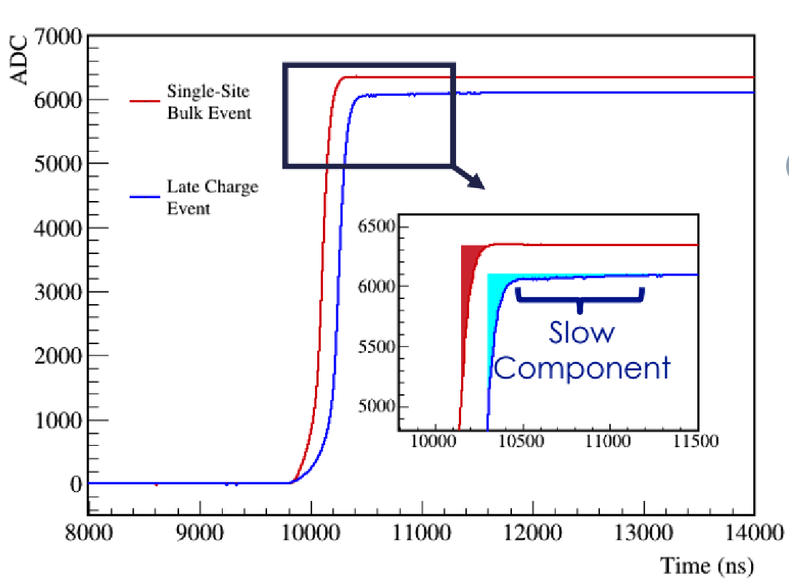
Late Charge (LQ)
Sensitive to slow or “late” charge collection:
Passivated surface and n+ surface events have slow rerelease of charge
Slow charge collection degrades energy → possible background
Look for slow component above rising edge after 80% of charge is collected → area above waveform

Slide 27

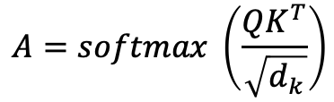








Overview of Attention
W^{Q}, W^{K}, W^{V}: learned matrices
Project the inputs into Queries, Keys and Values
Multiply
$$A=softmax \left(\frac{QK^{T}}{\sqrt{d_{k}}}\right)$$
$$×$$
$$=$$
$$\left(l × d_{k}\right)$$
W^{Q}
Q
X
Q
K
V
$$×$$
$$=$$
$$\left(l × d_{k}\right)$$
W^{Q}
W^{K}
W^{V}
W^{K}
K
X
$$×$$
$$=$$
$$\left(l × d_{v}\right)$$
W^{V}
V
X
X

