Slide 1
Axions and Cosmology
Roberto Peccei
UCLA
KAERU Conference in Honor of K. Hagiwara
Kavli IPMU, Tokyo, Japan
March 25-26, 2015

Slide 2
Axions and Cosmology
The Strong CP Problem and its Resolution
Axions
Invisible Axions and Cosmological Constraints
The Lyth Bound
Escaping the Lyth Bound
Looking for Invisible Axions
Concluding Remarks

Slide 3
The Strong CP Problem and its Resolution
Forty years ago ‘t Hooft resolved the U(1)_{A} problem [why there is no light meson associated with an approximate U(1)_{A} global symmetry of QCD] by pointing out that the QCD vacuum has a more complicated structure than one thought (θ vacuum)
However ‘t Hooft solution engendered another problem: the strong CP problem.
Effectively, the QCD vacuum structure adds and extra term to L_{QCD} which conserves C, but violates P and T:

Slide 4
This term produces an electric dipole moment for the neutron of order:
d_{n} ≈ e m_{q}/M_{n}² θ ≈ 10⁻¹⁶ θ ecm
The strong experimental bound d_{n}< 1.1 x 10⁻²⁶ ecm requires the angle θ to be very small θ < 10⁻⁹ - 10⁻¹⁰ [ Baluni; Crewther Di Vecchia Veneziano Witten].
Why θ should be this small is the strong CP problem
Problem is actually worse if one considers the effect of chiral transformations on the θ-vacuum
Because of the chiral anomaly, these transformations change the θ-vacuum [Jackiw Rebbi ]:
e^{iαQ}5 | θ > = | θ + α >

Slide 5
If besides QCD one includes the weak interactions, in general the quark mass matrix is non-diagonal and complex
L_{Mass} = -‾q_{iR} M_{ij} q_{jL} + h. c.
To diagonalize M one must, among other things, perform a chiral transformation by an angle of Arg det M which, because of the Jackiw Rebbi result, changes θ into
θ_{total} = θ + Arg det M
Thus, in full generality, the strong CP problem can be stated as follows: why is the angle θ_{total} , coming from the strong and weak interactions, so small?

Slide 6
There are only three known classes of solutions to the strong CP problem:
Anthropically θ_{total} is small
CP is broken spontaneously and the induced θ_{total} is small
A chiral symmetry drives θ_{total} → 0
I will make no comments on i
Although ii. is interesting, the models which lead to θ_{total} ≈ 10 ⁻¹⁰ are rather complex and often are at odds with the CKM paradigm and/or cosmology
In my opinion, only iii. is a viable solution, although it necessitates introducing new global, spontaneously broken, chiral symmetries

Slide 7
Thirty eight years ago Helen Quinn and I proposed the first prototype chiral solution suggesting that the SM had an additional U(1) chiral symmetry (now called U(1)_{PQ}) which drives θ_{total} → 0
Very recently two other variant chiral solutions have been proposed:
- Hook uses a Z₂ symmetry which takes SM <-> SM’ and an
anomalous U(1) symmetry to drive θ_{total} → 0
- Ahn uses a flavored version of U(1)_{PQ} [A₄ x U(1)_{PQ} ] to accomplish
the same
These are all very natural solutions to the strong CP problem, since chirality effectively rotates the θ -vacua away:
e^{-i θQ}5 | θ > = | 0 >

Slide 8
Of course, this additional chiral symmetry could be intrinsic to QCD, if the u-quark had no mass, m_{u} = 0 [Kaplan Manohar]. However, calculations on the lattice exclude the m_{u} = 0 solution
Leutwyler
MILC Collaboration
rules out m_{u}=0
at 10σ

Slide 9
Axions
Introducing a global U(1)_{PQ} symmetry, which is necessarily spontaneously broken, replaces:
θ ⇒ a(x) / f_{a}
Static CP Viol. Angle Dynamical CP conserving Axion field
and, effectively, eliminates CP violation in the strong sector
⇒
Here f_{a} is the scale of the breaking of the U(1)_{PQ} symmetry , while a(x) is the Nambu Goldstone axion field associated with the broken symmetry [ Weinberg Wilczek]

Slide 10
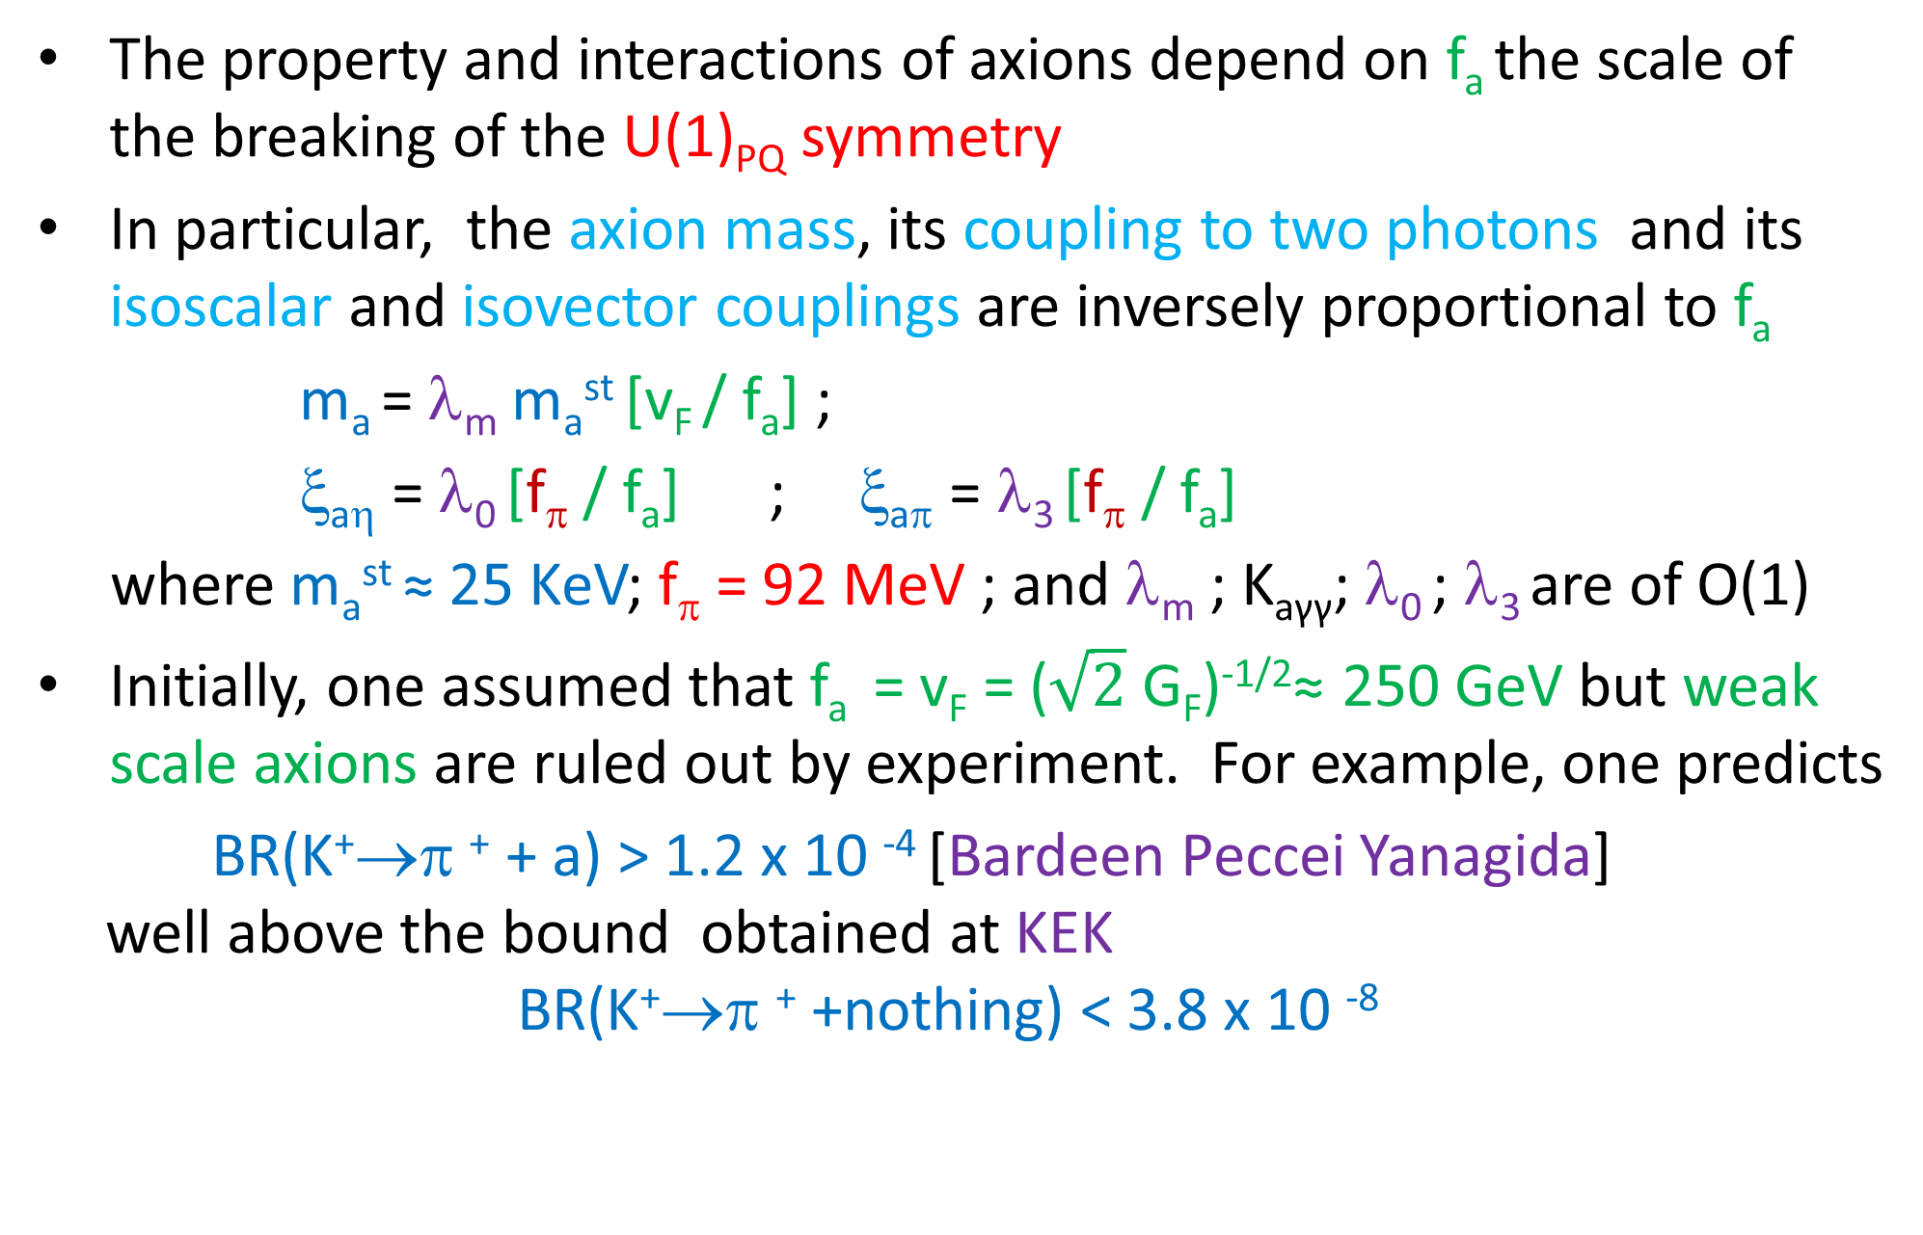
The property and interactions of axions depend on f_{a} the scale of the breaking of the U(1)_{PQ} symmetry
In particular, the axion mass, its coupling to two photons and its isoscalar and isovector couplings are inversely proportional to f_{a}
m_{a} = λ_{m} m_{a}^{st} [v_{F} / f_{a}] ;
ξ_{aη} = λ₀ [f_{π} / f_{a}] ; ξ_{aπ} = λ₃ [f_{π} / f_{a}]
where m_{a}^{st} ≈ 25 KeV; f_{π} = 92 MeV ; and λ_{m} ; K_{aγγ}; λ₀ ; λ₃ are of O(1)
Initially, one assumed that f_{a} = v_{F} = ($\sqrt{2}$ G_{F})^{-1/2}≈ 250 GeV but weak scale axions are ruled out by experiment. For example, one predicts
BR(K⁺→π ⁺ + a) > 1.2 x 10 ⁻⁴ [Bardeen Peccei Yanagida]
well above the bound obtained at KEK
BR(K⁺→π ⁺ +nothing) < 3.8 x 10 ⁻⁸

Slide 11
The choice f_{a} = v_{F} is not necessary to solve the strong CP problem
If f_{a} >> v_{F} then the axion is very light, very weakly coupled and very long lived and such invisible axion models remain viable
These models introduce fields which carry PQ charge but are SU(2)XU(1) singlets . Two different generic models exist:
i) DFSZ Models [Dine Fischler Srednicki; Zhitnisky]
These models add to the PQ model a scalar field σ which carries PQ
charge and f_{a}= <σ> >> v_{F}
ii) KSVZ Models [Kim; Shifman Vainshtein Zakharov]
Only a superheavy quark Q and a scalar field σ carry PQ charge.
The dynamics is such that f_{a}= <σ> >> v_{F} and M_{Q} ≈ f_{a}

Slide 12
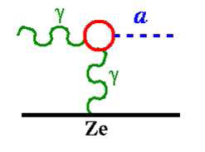
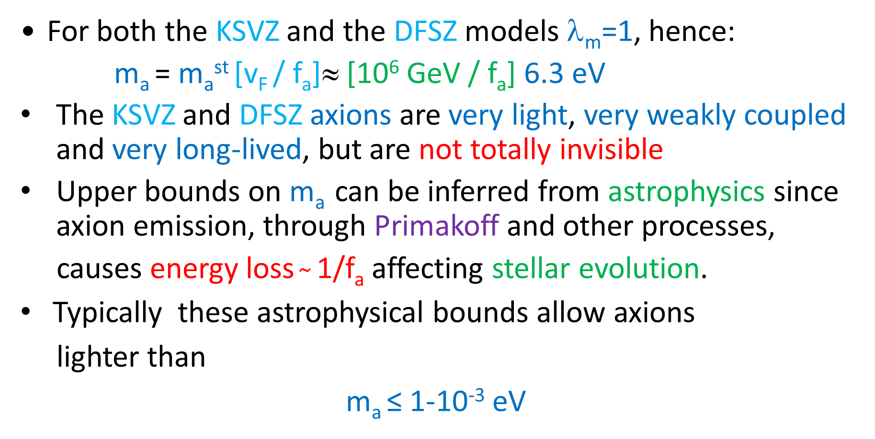
Invisible Axions and Cosmological Constraints
For both the KSVZ and the DFSZ models λ_{m}=1, hence:
m_{a} = m_{a}^{st} [v_{F} / f_{a}]≈ [10⁶ GeV / f_{a}] 6.3 eV
The KSVZ and DFSZ axions are very light, very weakly coupled and very long-lived, but are not totally invisible
Upper bounds on m_{a} can be inferred from astrophysics since axion emission, through Primakoff and other processes,
causes energy loss $̴$ 1/f_{a} affecting stellar evolution.
Typically these astrophysical bounds allow axions
lighter than
m_{a} ≤ 1-10⁻³ eV

Slide 13
Rather remarkably, cosmology gives a lower bound for the axion mass (upper bound on f_{a} ) [Preskill Wise Wilczek; Abbott Sikivie; Dine Fischler]
Physics is simple to understand. When Universe goes through the U(1)_{PQ} phase transition at T ̴ f_{a} >>Λ_{QCD} the QCD anomaly is ineffective and θ is arbitrary. Eventually, when Universe cools to T ̴Λ_{QCD} the axion gets a mass and θ → 0.
The coherent p_{a}=0 axion oscillations towards this minimum contribute to the Universe’s energy density and act as cold dark matter
The detailed results depend on whether the PQ phase transition occurs before or after inflation

Slide 14
If the PQ phase transition happens before (or during) inflation, the axion field is homogenized over enormous distances, and one needs to follow only the evolution of the p_{a}=0 mode
A typical calculation of the axion contribution to Universe’s energy density [Hannestad et al] gives
Ω_{a}h² = 0.195 [f_{a}/10¹² GeV]^{1.184} [θ_{i}²]
where θ_{i} is the initial misalignment angle
Using for θ_{i} an average angle θ_{i}²= <θ²>= π²/3 and assuming that axions are the dark matter in the Universe
Ω_{a}h² = Ω_{CDM}h² = 0.120 ± 0.003
gives the following value for the PQ scale and the axion mass:
f_{a}= 0.24 x 10¹² GeV and m_{a} = 26 x 10⁻⁶ eV

Slide 15
The Lyth Bound
In general, however, the initial misalignment angle θ_{i} is arbitrary. Then the assumption that axions are the dark matter in the Universe gives a relation between θ_{i} and f_{a} :
θ_{i} = 0.748 [10¹² GeV/ f_{a}]^{0.592}
f_{a} (GeV) | 10 ¹² | 10 ¹⁵ | 10 ¹⁸
θ_{i} | 0.75 | 1.3 x 10 ⁻² | 2.1 x 10 ⁻⁴
f_{a} θ_{i} (GeV) | 7.5 x 10 ¹¹ | 1.3 x 10 ¹³ | 2.1 x 10 ¹⁴
These results for f_{a} θ_{i} give an interesting bound, suggested long ago
If inflation occurs after the PQ phase transition isocurvature axion perturbations can arise. Their absence give the Lyth bound

Slide 16
Isocurvature perturbations arise from fluctuations in the initial misalignment angle θ_{i} and have a power spectrum given by:
Δ²_{a}(k) = [2 |δθ_{i}| / θ_{i} ]² = [H_{I} /π θ_{i} f_{a} ]²
where H_{I} is the expansion rate during inflation
Both WMAP and Planck have put bounds on the ratio:
β_{iso} = Δ²_{a}(k) /(Δ²_{R}(k) + Δ²_{a}(k) )
where Δ²_{R}(k) measures the curvature perturbation spectrum.
At k= 0.002 Mpc⁻¹ these collaborations find:
β_{iso}< 0.036 (95% CL) Planck β_{iso}< 0.047 (95% CL) WMAP

Slide 17
Using the best fit result of Planck for Δ²_{R}(k) :
Δ²_{R}(k) =2.2 x 10 ⁻⁹ (k/ 0.05 Mpc ⁻¹) ^{-0.04}
the bound on β_{iso} implies a bound on the isocurvature axion
perturbations at k= 0.002 Mpc⁻¹ :
Δ²_{a}(k ) < 9.25 x 10 ⁻¹¹
Hence the fluctuation in the initial misalignment angle is very small:
|δθ_{i} |/ θ_{i} < 4.8 x 10 ⁻⁶
and there is a strong bound on the expansion rate during inflation:
H_{I} < 3 x 10 ⁻⁵ θ_{i} f_{a}
For a sensible range of PQ scales [10 ¹² GeV < f_{a} < 10 ¹⁸ GeV] this Lyth bound on H_{I} ranges from 2.25 x 10 ⁷ GeV to 6.3 x 10 ⁹ GeV .

Slide 18
The Lyth bound makes only low energy scale inflation models tenable, predicting a very small contribution of the tensor perturbation spectrum Δ²_{h}(k) to the CMB anisotropy.
This tensor spectrum is given by the ratio of H_{I} to the Planck mass
Δ²_{h}(k) = 2 (H_{I}/ πM_{P})²
and, for example, for f_{a} = 10 ¹⁸ GeV, Δ²_{h}(k) < 5.4 x 10⁻¹⁸
This implies a negligibly small tensor to scalar ratio:
r(k) = Δ²_{h}(k) /Δ²_{R}(k) < 2.5 x 10 ⁻⁹
orders of magnitude below the recent joint bound of Planck
and BICEP 2 [ r < 0.11 at k= 0.002 Mpc⁻¹ ]

Slide 19
Escaping the Lyth Bound
One way to avoid the Lyth bound is if the PQ phase transition occurred after inflation, so no isocurvature fluctuations ensue
However, as emphasized originally by Sikivie, in this case other dynamical issues arise due to the formation of axionic strings and domain walls not erased by inflation
At T ≈ f_{a} U(1)_{PQ} gets spontaneously broken, and one-dimensional defects: axionic strings, around which θ= a/f_{a} winds by 2π, are formed
These axionic strings have an energy per unit length μ ≈ f_{a}² ln L f_{a}, where L is the inter-string separation. They decay very efficiently into axions up to temperatures T ≈ Λ_{QCD}

Slide 20
When T ≈ Λ_{QCD} U(1)_{PQ} is explicitly broken by the gluon anomaly. However, since under a PQ transformation θ→ θ + 2αN_{fl} (where N_{fl} is the number of quarks carrying U(1)_{PQ} ) a Z(N_{fl}) discrete symmetry is preserved
Because of this Z(N_{fl}) symmetry there are N_{fl} degenerate vacuum states for the axion field. As a result, neighboring regions in the Universe which are in different axion vacua are separated by domain walls.
At T ≈ Λ_{QCD} , since θ winds by 2π as one goes around an axionic string, the axion field passes through each minimum. As a result each axionic string becomes the edge to N_{fl} domain walls, and the process of axion radiation stops

Slide 21
If N_{fl.} > 1 (like in the DFSZ model) this string-wall network is stable and has a sizable surface energy density
σ ≈ m_{a} f_{a} ² ≈ 6.3 x 10⁹ GeV³ [f_{a} /10¹² GeV]
This is a real problem, since the energy density in these walls dissipates slowly as the Universe expands [Zeldovich Kobzarev Okun]
ρ_{wall} = σ T
and ρ_{wall} now would vastly exceed the closure density of the Universe
This disaster is avoided if N_{fl} =1. Even though there is a unique vacuum, domain walls still form and attach to an axionic string –one wall per string.
However, as Everett and Vilenkin showed, these walls very rapidly get chopped up into pieces, each enclosed by strings. These structures are unstable and disappear by radiating axions

Slide 22
There has been an ongoing controversy on how much the axions radiated by these N_{fl} =1 walls, as well as by axionic strings, contribute to the Universe’s energy density
A recent compilation of Gondolo and Visinelli gives the following range for the ratio α of the contributions to the energy density of string/wall decay compared to that for p_{a}=0 oscillations :
0.16 [Sikivie et al] < α = Ω_{str/wall} /Ω _{p=0} < 186 [Battye Shellard]
In what follows, I will use the recent estimate of Hiramatsu et al:
α = 19 ± 10
and note that it alters the prediction for the axion mass (if θ_{i}²=π²/3 )
for CDM axions to:
m_{a} = 26 x 10⁻⁶ eV (1 + α )^{.884} = 26 x 10⁻⁶ eV (20 ± 10 )^{.884}
pushing it quite close to the astrophysical upper bound
So there may be trouble also in the N_{fl} =1 case!

Slide 23
There is an alternative way to avoid the Lyth bound, which was pointed out originally by Linde
In our discussion of the Lyth bound, we implicitly assumed that f_{a} is fixed during inflation. Linde argues instead that f_{a} = f_{a}(t), starting out very large before inflation f_{a} > M_{P} and very slowly rolling down to its present value
In this case, the isocurvature perturbations have a power spectrum given by:
Δ²_{a}(k) = [H_{I} /π θ_{i} f_{a}(t) ]² ≈ [H_{I} / π θ_{i} M_{P}]²
and the Lyth bound on H_{I} is much weakened:
H_{I} < 10 ⁻⁴ θ_{i} M_{P}
I like to make 2 comments on this Linde/Lyth bound:

Slide 24
This bound is weakest when θ_{i} is large. For example, if θ_{i} = < θ> = π /√3, then
H_{I} < 2 x 10 ¹⁵ GeV [θ_{i} /(π /√3)]
which is similar in magnitude to the bound one has for H_{I} coming from the
tensor to scalar ratio r(k) :
H_{I} < 0.4 x 10 ¹⁵ GeV [r(k) /0.11] ^{½}
The dynamics after inflation, may render irrelevant the solution proposed by Linde to allow for high scale inflation. If in the “preheating” stage after inflation large fluctuations in the axion field occur, they can lead to a non-thermal restoration of U(1)_{PQ} [Kofman Linde Starobinsky Tkachev], reopening the defect scenario problems discussed earlier. To avoid this problem one needs to have:
f_{a} > δa
Problem studied by Kawasaki Yanagida Yoshino who found that, in general
inflation models, U(1)_{PQ} restoration could be avoided if:
f_{a} > (10 ¹² – 10 ¹⁶) GeV

Slide 25
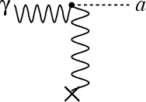
Looking for Invisible Axions
In the last decade there have been active searches for invisible axions using the idea of Sikivie of converting axions into γ by using a B-field in a resonant cavity
This possibility arises from the coupling:
= g_{aγγ} a E . B
In particular, the ADMX experiment is probing the parameter space that would allow invisible axions to be the dark matter in the Universe

Slide 26
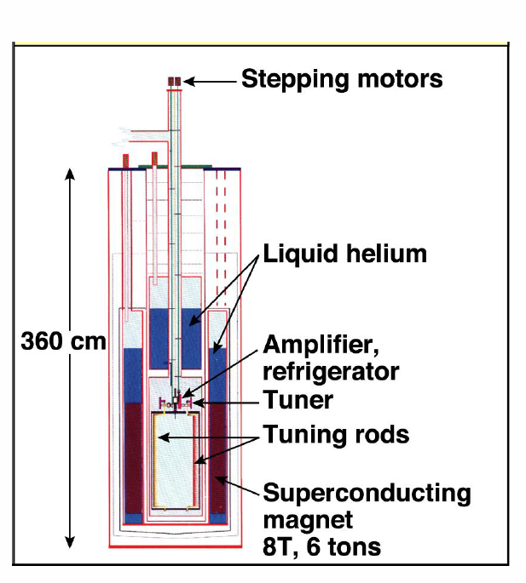
The ADMX experiment started at LLNL but now has moved to the Univ. Washington and is presently undergoing an upgrade to be able to cover more of the parameter space expected for dark matter axions
Schematically
ADMX looks For m_{a} ≈ 10 μeV the
like the Figure photon frequency
which ADMX must
detect is in the GHz
range

Slide 27
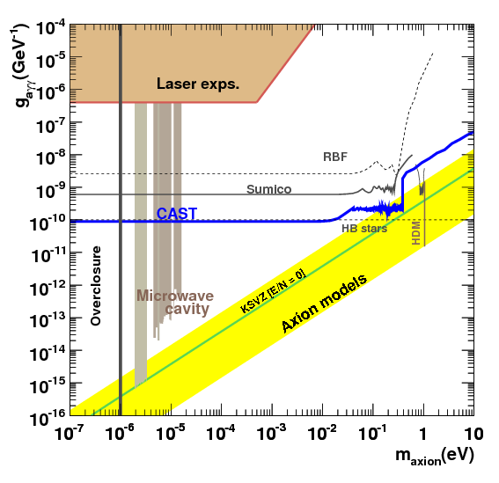
Results of first 10 –years of operations
The ADMX experiment so far has explored the axion mass range
1.9 μeV < m_{a} < 3.3 μeV
at an appropriate strength g_{aγγ} for axions to be the dark matter

Slide 28
Future reach of ADMX is in interesting region if PQ phase transition is before inflation
i) Expected axion
mass if θ_{i}²= π²/3
m_{a} = 26 μeV
ii) If PQ after inflation
and N_{fl} =1 case expect
200 μeV < m_{a}< 526 μeV
axion mass is near
astrophysical bounds
and maybe unreachable?

Slide 29
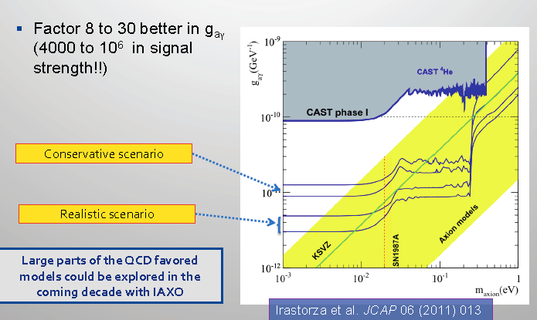
A next generation experiment after CAST (IAXO) is being planned which is more than an order of magnitude more sensitive to g_{aγγ}
Still not quite there [need to reach m_{a}≈ 10 ⁻³ eV g_{aγγ} ≈ 10 ⁻¹³GeV⁻¹]

Slide 30
It is possible that the misalignment angle θ_{I} is not of 0(1) but much smaller θ_{i}<< 1. In this case, dark matter axions are associated with larger scales of U(1)_{PQ} breaking [e.g. if θ_{i} = 1.3 x 10 ⁻² then f_{a} = 10¹⁵ GeV] and the axions are superlight [m_{a} = 6.3 x 10 ⁻⁹ eV for this example]
In many ways PQ breaking scales f_{a} ≈ (10¹⁵- 10¹⁸) GeV are very natural, since axions are ubiquitous in string theories [Svrcek Witten]
Remarkably, one might be able to detect such high PQ breaking scales and superlight dark matter axions [Graham and Rajendran ]

Slide 31
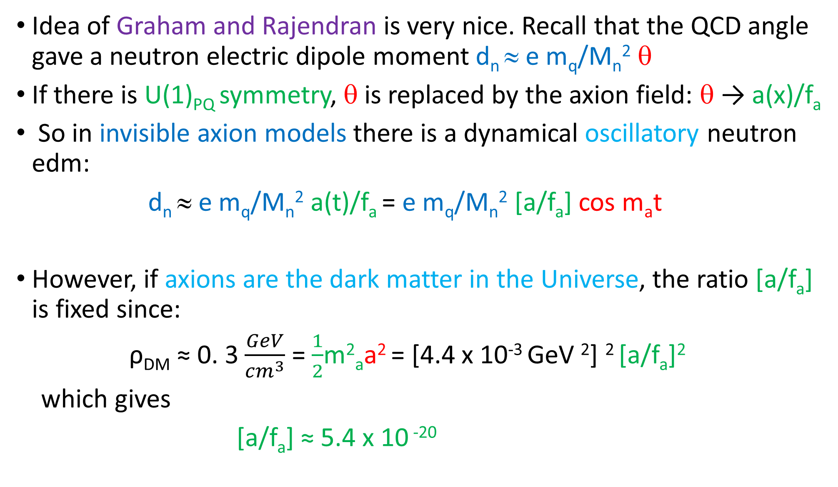
Idea of Graham and Rajendran is very nice. Recall that the QCD angle gave a neutron electric dipole moment d_{n} ≈ e m_{q}/M_{n}² θ
If there is U(1)_{PQ} symmetry, θ is replaced by the axion field: θ → a(x)/f_{a}
So in invisible axion models there is a dynamical oscillatory neutron edm:
d_{n} ≈ e m_{q}/M_{n}² a(t)/f_{a} = e m_{q}/M_{n}² [a/f_{a}] cos m_{a}t
However, if axions are the dark matter in the Universe, the ratio [a/f_{a}] is fixed since:
ρ_{DM} ≈ 0. 3 $\frac{GeV}{{cm}^{3}}$ = $\frac{1}{2}$m²_{a}a² = [4.4 x 10⁻³ GeV ²] ² [a/f_{a}]²
which gives
[a/f_{a}] ≈ 5.4 x 10 ⁻²⁰

Slide 32
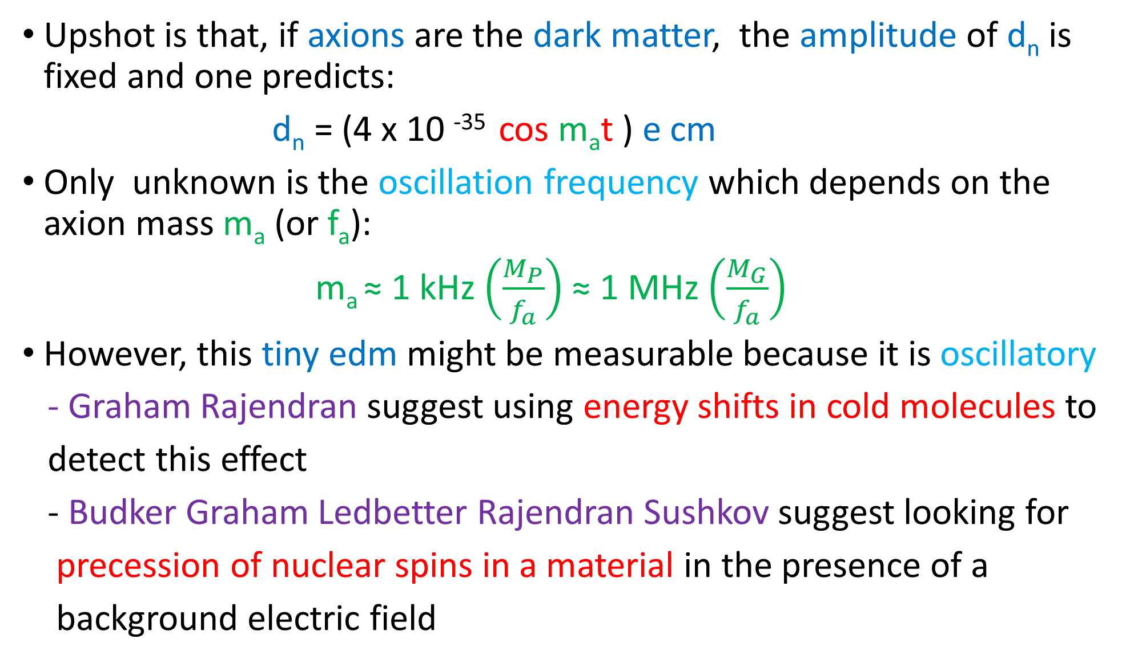
Upshot is that, if axions are the dark matter, the amplitude of d_{n} is fixed and one predicts:
d_{n} = (4 x 10 ⁻³⁵ cos m_{a}t ) e cm
Only unknown is the oscillation frequency which depends on the axion mass m_{a} (or f_{a}):
m_{a} ≈ 1 kHz $\left(\frac{M_{P}}{f_{a}}\right)$ ≈ 1 MHz $\left(\frac{M_{G}}{f_{a}}\right)$
However, this tiny edm might be measurable because it is oscillatory
- Graham Rajendran suggest using energy shifts in cold molecules to
detect this effect
- Budker Graham Ledbetter Rajendran Sushkov suggest looking for
precession of nuclear spins in a material in the presence of a
background electric field

Slide 33
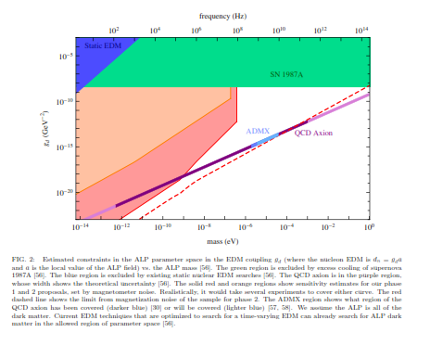
Estimated reach of the proposed Budker et al experiment
m_{a} < 10⁻⁹ eV
^{f}_{a} > 6 x 10¹⁵ GeV

Slide 34
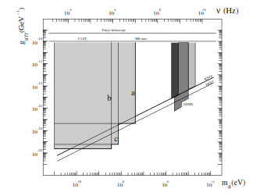
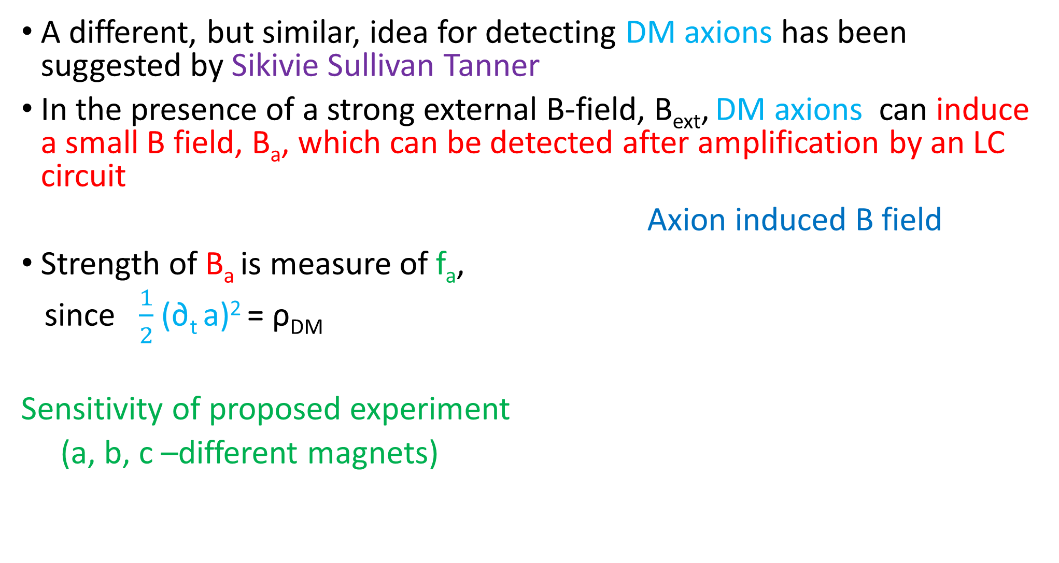
A different, but similar, idea for detecting DM axions has been suggested by Sikivie Sullivan Tanner
In the presence of a strong external B-field, B_{ext}, DM axions can induce a small B field, B_{a}, which can be detected after amplification by an LC circuit
Axion induced B field
Strength of B_{a} is measure of f_{a},
since $\frac{1}{2}$ (∂_{t} a)² = ρ_{DM}
Sensitivity of proposed experiment
(a, b, c –different magnets)

Slide 35
Concluding Remarks
The existence of an additional chiral symmetry- like U(1) _{PQ} -remains the most compelling solution to the strong CP problem
The concomitant axions play an interesting cosmological role and arise naturally in theories beyond the Standard Model
There are both ongoing and proposed experiments which in the next decade or so should tell us if axions exist

