Slide 1


A fresh look at hydrodynamics from fluctuation formulas
Shin-ichi Sasa and Masato Itami
2015/05/28@IPMU

Slide 2
Purpose of my talk
Basic concepts in non-equilibrium statistical mechanics
(20-th century )
- from a viewpoint of large deviation theory
Recent developments in non-equilibrium statistical mechanics
(for last two decades)
- symmetry and variational principle in large deviation theory
3) Presentation of our recent work (2015)
- a Surface-Bulk correspondence
in non-equilibrium statistical mechanics

Slide 3
PART I
Thermodynamics and
Large deviation

Slide 4
Thermodynamics
Thermology
dynamics
heat
work
temperature
pressure
Unified theory of heat and work

Slide 5

How is it unified?
Entropy

Slide 6

Simple Example
material-1
material-2
Thermally insulating
Remove the constraints
Thermally conducting
What is
the equilibrium value?

Slide 7
Answer (Thermodynamics)
material-1
material-2
Thermally conducting
Variational principle
(which comes from
the second law of thermodynamics)

Slide 8
Question
Can you obtain
the equilibrium value
without
thermodynamics (entropy) ?

Slide 9
Quick answer
Yes, the equilibrium value is given as
the most probable (typical) value
almost all microscopic states show

Slide 10

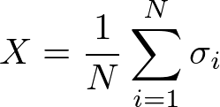
Example : the most probable value
(throwing many coins)
coins:
“head” of i-th coin
“tail” of i-th coin
score:

Slide 11
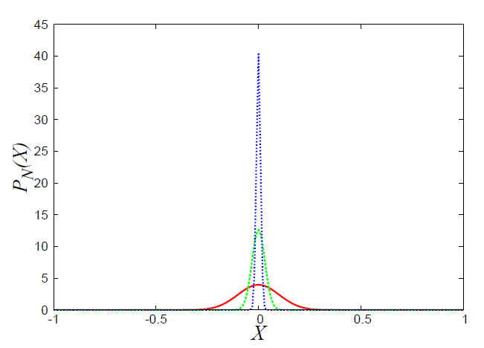
Probability “density” of X
Law of large numbers

Slide 12


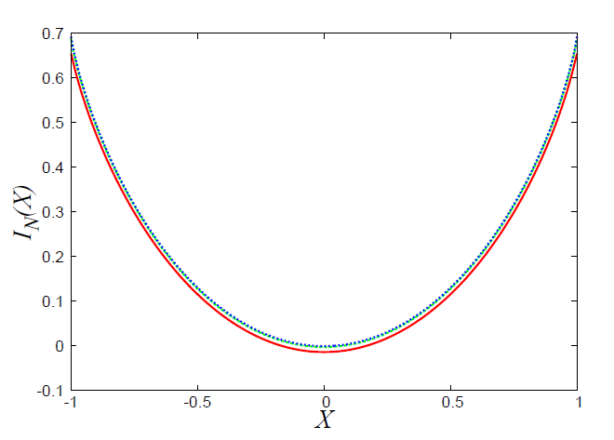

Asymptotic form of

Slide 13




Large deviation theory
The probability of rare (atypical) values
large deviation property
large deviation function
(coin problem)
In general, non-negative and convex function
(with a more precise definition)
most probable value

Slide 14



Remark: central limiting theorem
Gaussian distribution:
If the dispersion is
proportional to 1/N,
and
If the tail can be ignored
quadratic function

Slide 15

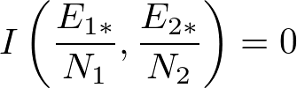
Energy distribution
The most probable value
The principle of equal-weight determines the
large deviation function for a given microscopic model

Slide 16
Large deviation and entropy
Frequency of rare fluctuation
Thermodynamics
(Einstein formula, 1908)
“fluctuation”
(e.g. energy fluctuation)
“response”
(e.g. heat capacity)

Slide 17
PART II
Dynamics and
Large deviation

Slide 18


A simple example
viscous fluid
Impulse force
at equilibrium
with no external forces
slow motion
friction force
velocity
friction coefficient

Slide 19
What corresponds to thermodynamics ?

Slide 20



Hydrodynamics :Stokes (1851)
Solve
with the BC
at the surface of the ball
:viscosity
Calculate the force
from
:radius of the ball
Stokes’ law

Slide 21
Question
Can you derive Stokes’ law
without
the hydrodynamic equations ?

Slide 22
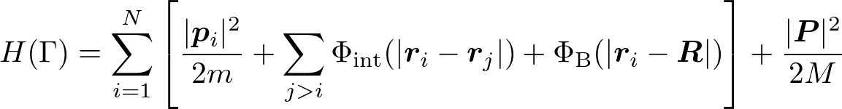
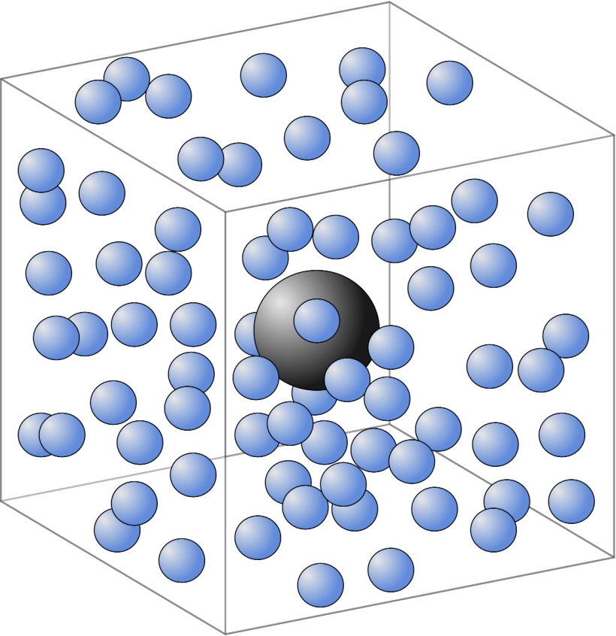



Microscopic setup
microscopic mechanical state
fluid particles
CM of the ball
short-range
interaction
as
radius
of the ball
radius of
the fluid particles
(spherical symmetric )
Force acting on the ball

Slide 23





Basic assumptions
solution of the Hamiltonian equation
for any
Separation of length and time scales
and other scale separation conditions
that will be explained in later arguments

Slide 24

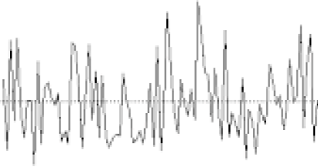




Large deviation
correlation time
of the force
relaxation time
of the ball momentum

Slide 25

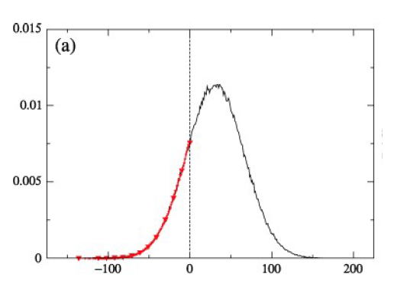


Symmetry
Fluctuation Theorem

Slide 26
Brief history
(pioneers)
Evans, Cohen, Morriss, FT in a determinisitic “toy” model (1993)
Gallavotti-Cohen, a mathematical proof for the FT (1995)
Jarzynski, essentially same identity (work relation) (1997)
Kurchan, FT for Langevin systems (1998)
Lebowitz-Spohn, Maes, Crooks, FT for Markov stochastic systems (1999)
(developments)
Kurchan, Tasaki, quantum FT (2000)
Hatano-Sasa, steady state thermodynamics (2001)
Sagawa-Ueda, information thermodynamics (2010)
(experiment)
Nakamura et al, quantum coherent conductor (2010)

Slide 27
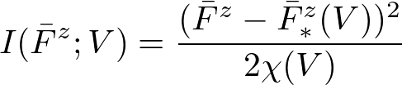
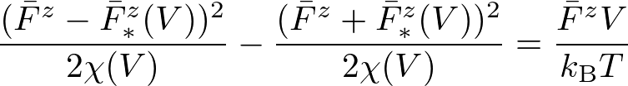



Response formula
Central limiting theorem
Fluctuation theorem
(non-linear response theory)
(linear response theory)

Slide 28

Kirkwood(1946)

Slide 29
PART III
Proof of
the fluctuation theorem

Slide 30





Time dependent probability density
Probability density just after the impulse
time evolution
time-reversal
reversibility
(Liouvile’s theorem)

Slide 31




Identity
(Liouvile’s theorem)
(energy conservation)
(reversibility)
(Equation of motion)

Slide 32




Probability density of time-averaged force
Reflection symmetry

Slide 33
PART IV
Problem

Slide 34
Where are you ?
hydrodynamic equations
Stokes (1851)
Kirkwood’s
formula
(1946)
Fluctuation of the time averaged force to the ball
How do you calculate the fluctuation intensity ?

Slide 35
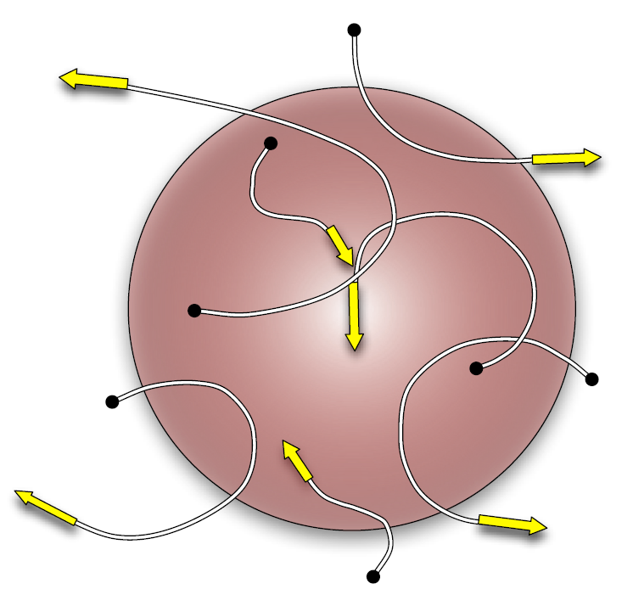
Trajectories of particles interacting with the ball

Slide 36


Decomposition of the force
z-component of the force per unit area on the surface
(= average stress)

Slide 37


Random collisions
The average stress obeys the central limiting theorem :
the dimensional analysis (with some physics)
valid for dilute gases
Area law

Slide 38
Nontrivial nature of Stokes’ law
linear law
NO Central Limiting Theorem
It indicates the existence of
the long-range correlation
of the time-averaged stress
at the surface !

Slide 39
Trajectories of particles interacting with the ball

Slide 40
A key to solve the problem
How is the viscosity related to fluctuations at the surface?

Slide 41


Green-Kubo formula (1954)
correlation time
of the stress fluctuation
relaxation time
of the momentum
density field

Slide 42
Landscape
hydrodynamic equations
Green-Kubo
formula
(1954)
Stress fluctuation
in the bulk
Stokes (1851)
Kirkwood’s
formula
(1946)
Stress fluctuation
at the surface

Slide 43

The heart of the problem
hydrodynamic equations
Green-Kubo
formula
(1954)
Stress fluctuation
in the bulk
Formulate the connection
between bulk and surface
Stokes (1851)
Kirkwood’s
formula
(1946)
Stress fluctuation
at the surface

Slide 44
PART V
effective theory
in the bulk

Slide 45
Two fluctuation formulas
correlation time
of the stress fluctuation
relaxation time
of the momentum
density field
correlation time
of the force
relaxation time
of the ball momentum
The basic assumption:
The same can be found in the two formulas

Slide 46


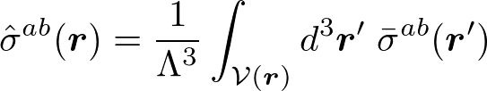

Coarse-grained description
correlation length
of the stress
Coarse-grained and time-averaged stress field
The Green-Kubo formula

Slide 47






Macroscopic fluctuation theory
for
for
is a ultraviolet cut-off in a macroscopic description
(space mesh)

Slide 48


Statistical properties
Scalar part
traceless part

Slide 49


Statistical property of
Fundamental assumption:
The fluctuating stress fields are balanced in each region
The scalar part is determined
from the traceless part !

Slide 50
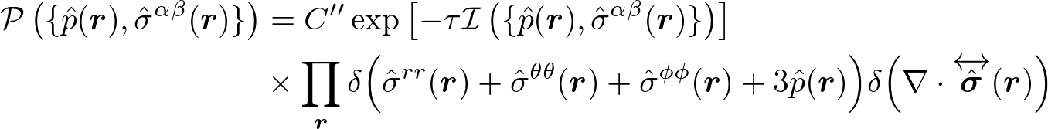
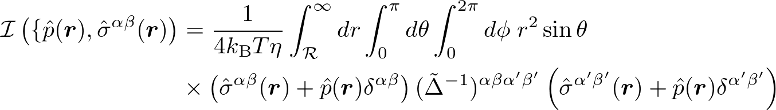


Probability density of stresses
(large deviation principle)
large deviation functional
:spherical coordinates
Boundary conditions:
(spherical symmetric potential
between the ball and particles)

Slide 51
PART VI
Highlight

Slide 52



Stress at the surface
z-component of the force per unit area on the surface
(= average stress)
(continuity of the total stress)
macroscopic fluctuation
probability density of the average stress

Slide 53
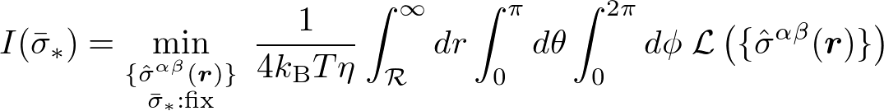


Saddle point estimation
(large deviation property)
(contraction principle)
variational function (Lagragian)
Lagrange multiplier

Slide 54

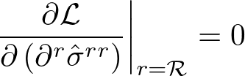

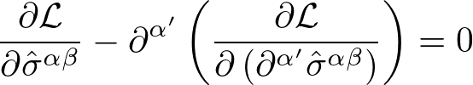
Variational problem
boundary conditions
We impose
(natural boundary condition)
Euler-Lagrange equation

Slide 55
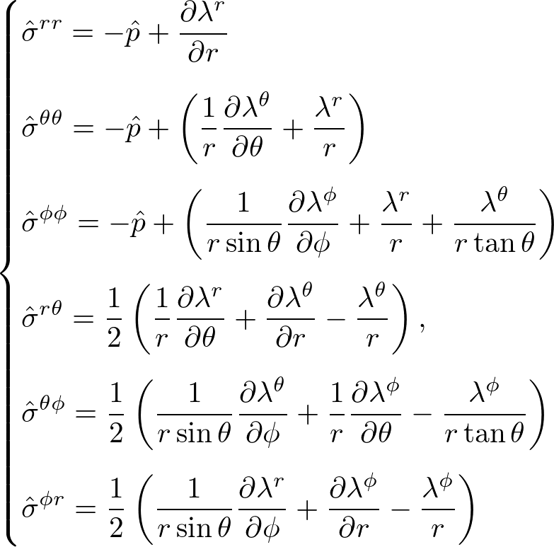

Euler-Lagrange equations
(equivalent to the Stokes equations !)

Slide 56
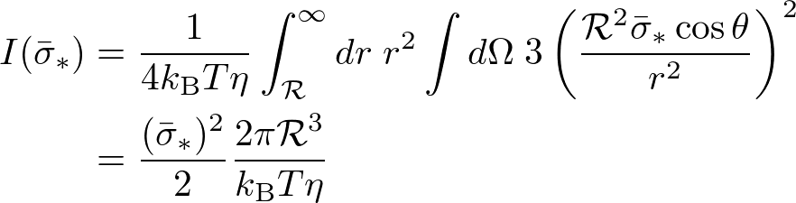


Result
Stokes’ law for the slip BC in hydrodynamics !

Slide 57


Rough surface of the ball
boundary conditions
natural boundary conditions
so that the E-L is obtained
at the surface
Stokes’ law for the stick BC in hydrodynamics !

Slide 58
Summary of the result
hydrodynamic equations
Green-Kubo
formula
(1954)
Stress fluctuation
in the bulk
Formulate the connection
between bulk and surface
Stokes (1851)
Itami-Sasa (2015)
Arxiv:1505.01691
Kirkwood’s
formula
(1946)
Stress fluctuation
at the surface
We have re-derived Stokes’ law from Kirkwood’s formula and
Green-Kubo formula with the aid of large deviation theory.

Slide 59
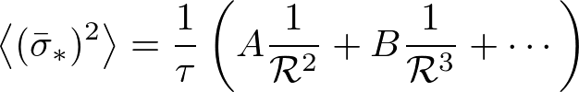

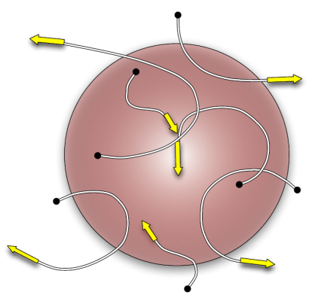

New prediction
Violation of CLT
(NO divergence)
Stokes’ law
Short-range disorder is exactly cancelled by the long range correlation
at the surface

Slide 60
Remark
(large deviation property)
(contraction principle)
Additivity principle:
A variational principle determining the large deviation of
the time averaged current for non-equilibrium lattice gases
(Bodinue and Derrida, 2004;Beritini,Sole, Gabrielli, Jona-Lasino,Landim, 2005)

Slide 61
PART VII
Epilog

Slide 62
Summary of my talk
Basic concepts in non-equilibrium statistical mechanics
(20-th century )
large deviation theory
Recent developments in non-equilibrium statistical mechanics
(for last two decades)
symmetry and variational principle in large deviation theory
3) Presentation of our recent work (2015)
a Surface-Bulk correspondence
in non-equilibrium statistical mechanics

Slide 63
Last message
Non-trivial correlation at the surface
can be calculated by
the variational principle in the bulk
Are there any relations with holography ?

