Slide 1

Entanglement Entropy In Gauge Theories
Sandip Trivedi
Tata Institute of Fundamental Research, Mumbai, India.
Notes:
With Nori Iizuka
Based on earlier work with kachru Kallosh, Linde, Maldacena and
MacAllsiter

Slide 2
On The Entanglement Entropy For Gauge Theories, arXiv: 1501.2593
Sudip Ghosh, Ronak Soni and Sandip Trivedi

Slide 3
References :
Casini, Huerta, Rosabal: Phys. Rev. D. 89, 085012 (2014)
(CHR)
2. D. Radicevic, arXiv:1404.1391
3. S. Aoki, T. Iritani, M. Nozaki, T. Numasawa, N. Shiba, H. Tasaki, arXiv: 1502.04267

Slide 4
References:
W. Donnelly, Phys. Rev. D 77, 104006 (2008)
W. Donnelly, Phys. Rev. D 85, 085004 (2012)
W. Donnelly and A. C. Wall, Phys. Rev. D 86, 064042 (2012)
W. Donnelly, Class. Quant. Grav. 31, no. 21, 214003 (2014)

Slide 5
Outline
Introduction
The Definition In Gauge Theory
Properties
Generalisation to Abelian and Non-Abelian Theories

Slide 6
Outline (Continued)
Replica Trick
Measuring The Entanglement
Conclusions

Slide 7
Introduction
Entanglement has emerged as an important way to quantify the quantum correlations.
Gauge Theories are central to our understanding of the physics and mathematics of the universe!

Slide 8
Introduction
It is therefore worth trying to give a precise definition of entanglement entropy in a gauge theory.

Slide 9
Introduction
In a system with local degrees of freedom the entanglement entropy is straightforward to define.

Slide 10
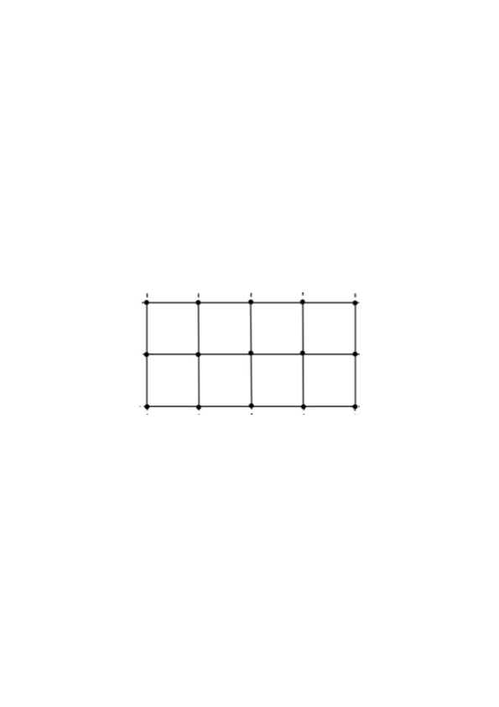
Introduction
E.g. in a spin system
Spin System: single qubit at each site
2- dim Hilbert space at site i:

Slide 11
Full Hilbert space:
Interested in the entanglement between a subset of spins, called the ``inside’’ with the rest, the ``outside’’

Slide 12
Von Neumann entropy

Slide 13
Entanglement In A Gauge Theory
Not as simple to define.
Because there are non-local degrees of freedom, e.g., Wilson loops, or loops of electric flux.
Hilbert space of states does not admit a tensor product decomposition between

Slide 14
Entanglement Entropy In Gauge Theory
Lattice Gauge Theory
Hamiltonian Framework: time continuous, Spatial lattice
For concreteness 2+1 dimensions
Conclusions extend to other dimensions as well.

Slide 15
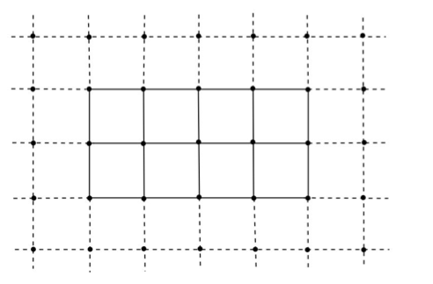
Entanglement Entropy In A Gauge Theory :

Slide 16

Degrees of freedom live on links.
case:
1 qubit :
Hilbert space on the link :

Slide 17
Gauge Transformations defined on vertices
Physical states must be Gauge Invariant :
(Gauss’ Law)

Slide 19
Physical Operators Must be Gauge Invariant:
Examples:
Wilson Loops
Also (analogue of electric flux)

Slide 20
We are interested in the entanglement of the solid links, the ``inside’’ links, with the rest the ``outside’’ links.

Slide 21
Definition will apply to a general set of ``Inside’’ links. They need not fill out a rectangle, or even be a connected set.
Consider a boundary vertex, on which some inside and some outside links terminate.
4
3
1
2

Slide 22
Gauss’ Law:
This means the state of the links on the inside and outside are not independent. Thus the Hilbert space of gauge invariant states does not admit a tensor product decomposition.

Slide 23
Our Definition
Work in an extended Hilbert Space
Obtained by taking the tensor product of the Hilbert spaces on each link.

Slide 24
Moreover a gauge invariant state has a unique embedding in
Orthogonal complement

Slide 25
admits a tensor product decomposition.

Slide 26
Definition:
Regard as a state in
Construct
(Renyi Entropies can be defined similarly.)

Slide 27
Properties:
Definition unambiguous.
Gives rise to a unique state in
And after tracing out over to a unique

Slide 28
Properties:
gives rise to the correct expectation values for any gauge invariant operator
which acts on the inside links alone
Only gauge invariant states contribute in the sum.

Slide 29
Properties:
Endowed with a natural inner product from that on . Meets positivity condition.

Slide 30
Properties
Thus meets strong subadditivity condition
A, B, C three sets of links that do not share any links in common

Slide 31
Properties
is gauge invariant.
is gauge invariant
Embedding of in gauge invariant.

Slide 32
Properties
But let us understand the gauge invariance some more.
How can the resulting answer be expressed in terms of gauge invariant data?

Slide 33
The essential obstacle to having a tensor product decomposition of the Hilbert space of gauge invariant states is Gauss’ law which ties the inside and outside together.
It then follows that can be written as a sum of tensor
products:

Slide 34
Decomposition gauge invariant
Definition of
Gauge invariant

Slide 35
Different values of label different superselection sector.
No gauge invariant operator acting on the inside or outside links alone can change

Slide 36
Follows that:

Slide 37
More details:
Define:
Inside vertices to be those on which only inside links end
Outside vertices: only outside vertices end
Boundary vertices: some inside and some outside links end

Slide 38
The superselection sectors are defined as follow.
At boundary vertex Let the total electric flux going outside be

Slide 39
Define the electric flux vector
where is the total electric flux going out at the boundary vertex.

Slide 40
Then
Gauge invariant with respect to gauge tranformations at the outside vertices
With specifying the electric flux at the boundary vertices.
Similarly

Slide 41
The essentially reason why
, appear
Is that is orthogonal to any state in

Slide 42
Additional Details
Subspace invariant with respect to gauge transformations on the inside vertices.
Similarly

Slide 43
Additional Details
A state where the flux
Going outside from a boundary vertex is not equal to the flux going inside is lies in
So

Slide 44
Additional Details
Now
Giving the final result:

Slide 45
The definition can be shown to be equivalent to the electric center prescription of CHR, in the
and more generally abelian case.
But our definition can be easily generalised also to the Non-Abelian case and to theories with matter.

Slide 46
Theory
Link variable : angle
(oriented links)
On each link Hilbert space
Conjugate momentum:

Slide 47
Gauge Transformation at vertex
Electric flux operator
Gauge invariant

Slide 48
Entanglement Entropy: U(1) Case
Embed in

Slide 49
Can be expressed as a sum over different flux sectors.

Slide 50
Non-Abelian Theories :
Link variable
Hilbert space on each link is that of a rigid rotor.
Two operators

Slide 51
i
j

Slide 52
Rigid Body Quantum Mechanics
: generates rotations with respect to body fixed axis.
: generates rotations with respect to space fixed axis.
State specified by
(Kogut, Susskind, PRD, Jan 1975)

Slide 53
Gauge transformations are generated by
Gauge invariant state:

Slide 54
Again embed in the extended Hilbert space, , which admits a tensor product decomposition

Slide 55
One subtleity:
Electric flux on link given by
However different sectors are specified by giving the value of
At each vertex.

Slide 56
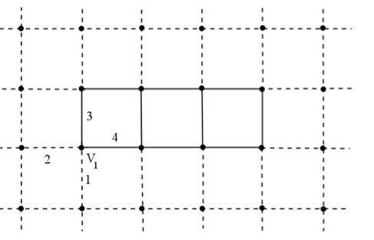

Slide 57
Can be expressed as a sum over different flux sectors.

Slide 58
Further generalisations with matter also straightforward.
Why take this definition seriously?
We will give three reasons below.

Slide 59
1) Physical Motivation
(Related to Toric Code, Kitaev)
Take case:
On Lattice we can impose gauge invariance weakly
gauge theory.

Slide 60
For general to compute the entanglement we would work in the extended Hilbert space
The gauge theory is the
This is exactly our definition.

Slide 61
In Non-Abelian Theory replace

Slide 62
2) Topological Entanglement
In case, for certain topological states (no long range correlations) the topological entanglement can be calculated using this definition.
A
B
Kitaev, Preskill
Levin, Wen
C

Slide 63
Resulting answer for is
This is the ``correct answer’’
In general expect it to be
D: Quantum Dimension

Slide 64
In this case .
Corresponding to 2 particles (electric charge and magnetic charge) which are mutually anionic.
And 4 sectors on the torus.

Slide 65
Similarly for we get
Which is the correct answer, since the quantum dimension is N.

Slide 66
3) Connection To Replica Trick
Euclidean Path Integral method to calculate entanglement.
Agrees with our definition
First calculate

Slide 67
To calculate in 2+1 dim. We work on an n-fold cover of
Obtained by introducing a branch cut at a particular instant of ``time’’ along the spatial region of interest
And identifying values of fields at bottom of branch cut in one copy with their values above the cut in the next.

Slide 69
is obtained by carrying out the path integral on this n-fold cover.
(Minor point: Normalisation).

Slide 70
This can be done also for a lattice gauge theory.
In the Hamiltonian formulation time is continuous, and for each instance of time we have a spatial lattice.
Each link an independent variable.

Slide 72
The path integral automatically gives embedded in the extended Hilbert space
Since each link variable is an independent degree of freedom.

Slide 73
Starting with a gauge invariant state in the far past (or in effect the vacuum) we get a gauge invariant state at

Slide 74
The further identification at t=0 of link variables outside the branch cut (black line) gives the density matrix
And the Path Integral over the N-fold cover then gives
So that

Slide 75
So in the end what the path integral calculates from the replica trick is
Which is exactly our definition.
Of course the manipulations are formal. Strictly speaking, agreement is in the continuum limit, when suitable counter-terms dependent on the boundary of the region of interest are added.

Slide 76
Connection With Quantum Information Theory
Entanglement quantified by comparison with a reference system of N Bell pairs.
Comparison done by entanglement distillation or entanglement dilution.

Slide 77
Connection with Quantum Information Theory
Entanglement Distillation
A
B
2N unentangled qubits

Slide 78
Entanglement Distillation
Carry Out Transformations involving Local Operations and Classical Communication
Local operations act on A and one set of N qubits. Or B and the other set.

Slide 79
To finally arrive at the situation:
A
B
N entangled Bell pairs

Slide 80
Let N be the maximum number of Bell pairs we can produce.
Then
(Actually in an asymptotic sense with copies in the
Limit.)

Slide 81
In our case we have superselection sectors labelled by
The flux
We cannot do local operations, involving gauge invariant operators, and change the superselection sector

Slide 82
Cannot obtain this full entanglement through distillation or dilution.
This is a general difference between gauge theories and say spin systems.

Slide 83
So how well can we do?
(Still in progress).

Slide 84
Conclusions
We have proposed a definition for entanglement entropy in gauge theories.
The definition is applicable to Abelian and Non-Abelian Theories, and also to theories with matter.

Slide 85
Conclusions
It has many nice properties.
i) It is gauge invariant.
ii) Agrees with the Replica trick.
But it does not agree with an operational definition based on entanglement distillation and/or dilution.

Slide 86

Thank you!

Slide 87
So how well can we do?

