Slide 1
Design Considerations for a Magnetized MRD for TITUS
Mark Rayner (Université de Genève)
6th Open Meeting for the Hyper-Kamiokande Project
Near Detector / Flux Pre-meeting
28-31 January 2015, Kavli IPMU, University of Tokyo, Kashiwa
N.B. Lots of work here by Etam Noah and Alain Blondel

Slide 2
There is a significant wrong-sign component in anti-neutrino mode
Constraining this component by measuring the charge of the muons would be a great advantage

Slide 3
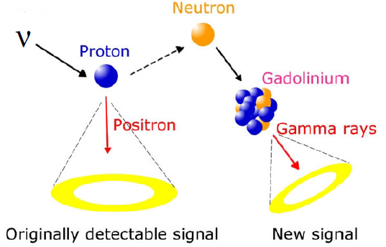
Gadolinium is exciting, but somewhat untested, and not 100% efficient
υ n → ℓ p
υ p → ℓ n
detect with Gd
ε_{Q} ≈ 88% ???
A magnetized MRD can achieve very high charge reconstruction efficiencies

Slide 4
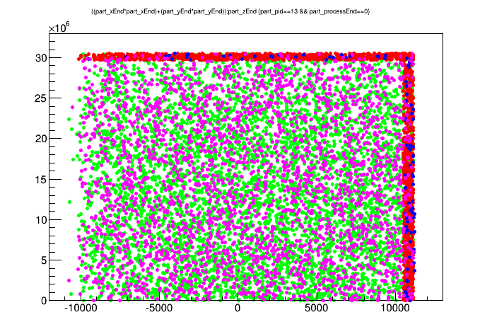
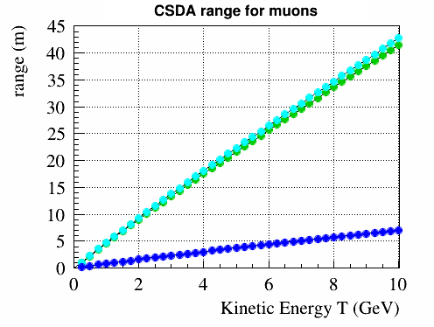
red: mu- leave tank
blue: mu+ leave tank
green: mu- stop in tank
purple: mu+ stop in tank
18% of muons escape the tank
R² (mm²)
courtesy of Matthew Malek
water
scintillator
iron
z (mm)
NB Many interesting muons don’t escape
(The nature of a large detector, and indeed by design…)

Slide 5
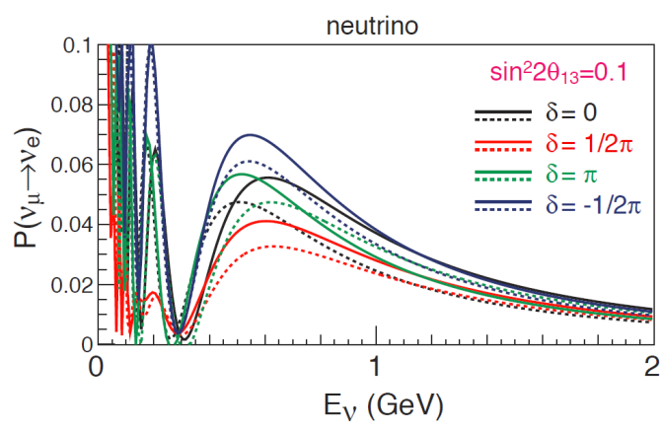
Reconstructing the charge of long, high energy, tracks is easy
Compare χ² in the + and – hypotheses
(well known from past experiments)
Let’s optimize reconstruction in the
interesting E_{ν} < 2 GeV region

Slide 6
Reconstructing the charge of long, high energy, tracks is easy
Compare χ² in the + and – hypotheses
(well known from past experiments)
Let’s optimize reconstruction in the
interesting E_{ν} < 2 GeV region

Slide 7
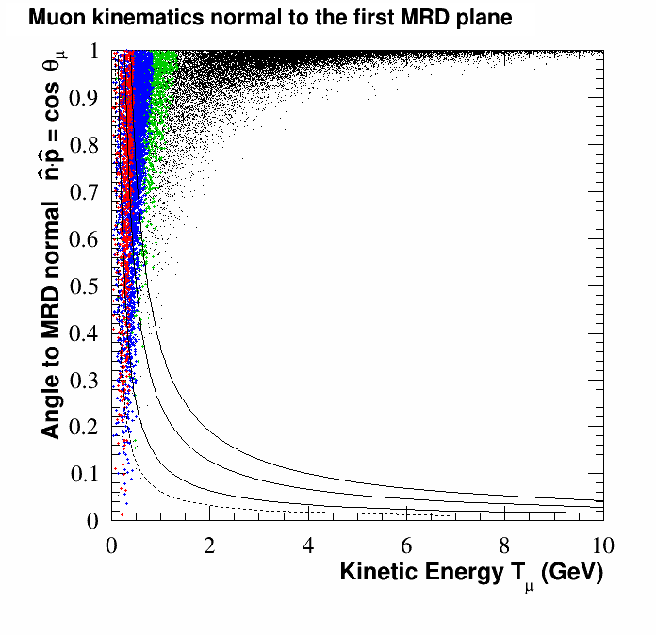
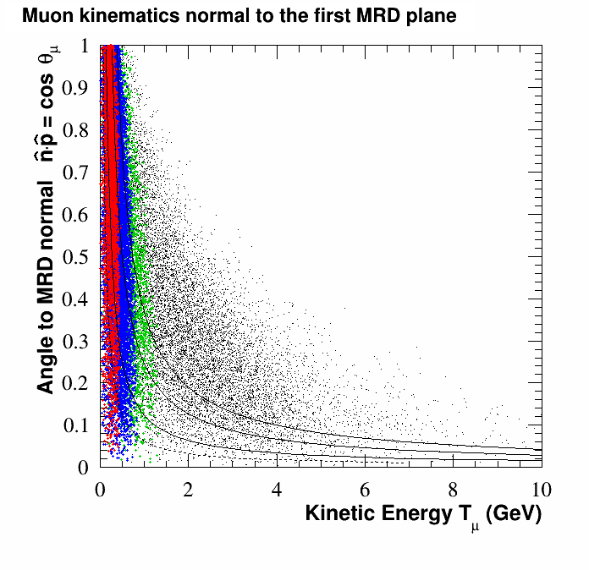
n
θ_{μ}
p
0 GeV < E_{υ} < 0.6 GeV
p
Muon kinematics of υ_{μ} CC
events entering the MRD
0.6 GeV < E_{υ} < 1.0 GeV
θ_{μ}
1.0 GeV < E_{υ} < 1.5 GeV
n
E_{υ} > 1.5 GeV
END MRD
SIDE MRD
Stopped by 30cm of iron
20cm
10cm
5cm

Slide 8
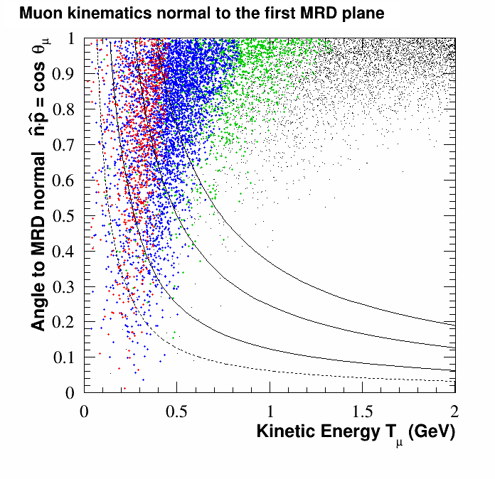
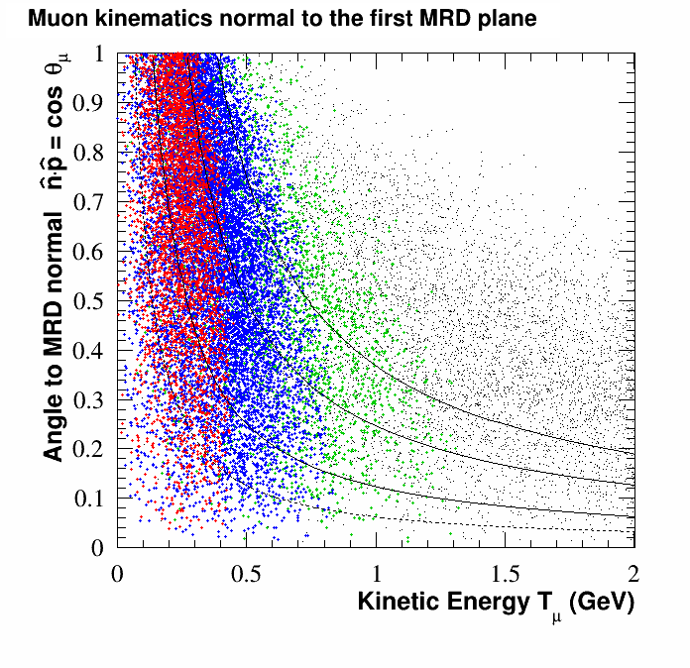
n
θ_{μ}
p
0 GeV < E_{υ} < 0.6 GeV
p
Muon kinematics of υ_{μ} CC
events entering the MRD
ZOOM to oscillation region
0.6 GeV < E_{υ} < 1.0 GeV
θ_{μ}
1.0 GeV < E_{υ} < 1.5 GeV
n
E_{υ} > 1.5 GeV
SIDE MRD
END MRD
Stopped by
30cm of iron
20cm
10cm
5cm

Slide 9
Multiple Scattering is the one unavoidable obstacle to charge reconstruction
In practice, however, track sampling resolution is just as big an effect
x₁
x₂
x₃
x₄
Δ
θ
L
t
(or RPCs…?)
We can greatly improve the charge reconstruction of short tracks by including and optimizing a gap L between the initial few measurement planes
X₀ = 1.757 cm in Fe
X₀ = 50.31 cm in polyethylene
(X₀ / X₀)^{½} = 1.9%

Slide 10
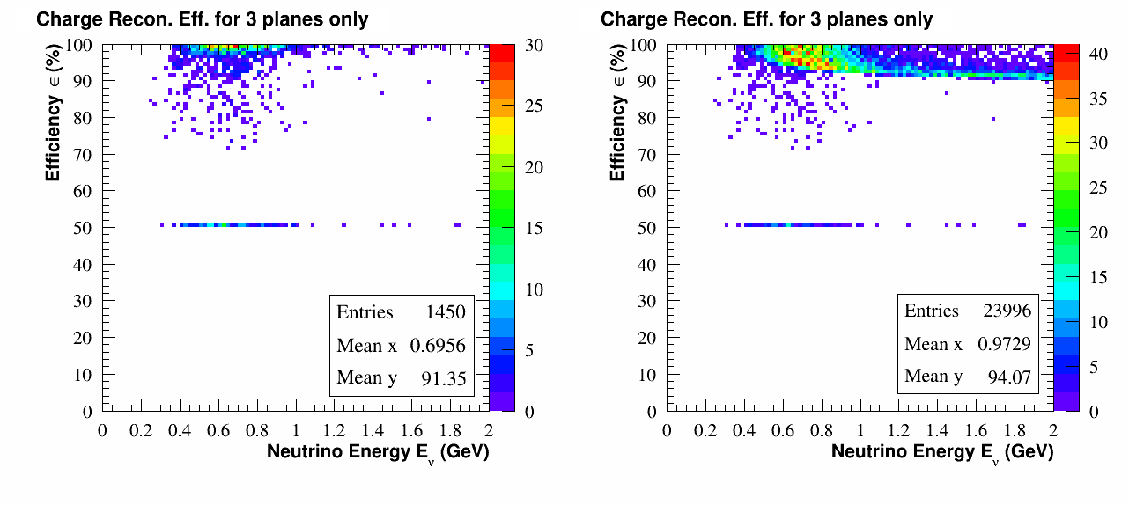
Reconstruction with just three 5cm magnetized planes (L=10cm)
END MRD
~100%
with >3 planes
stops in first
iron plan
muons which stop in or
before the fourth iron plane
all muons with E_{υ} < 2 GeV
Estimated 94% charge reconstruction efficiency in the oscillation region
Need to demonstrate this with a detailed Monte Carlo

Slide 11
Option 1
A fully enclosed tank is very difficult to justify because of cost
7 m
2 m
Sensitivity
Study
Needed
1 m
11 m
22 m
We can take advantage of the symmetry along the z-axis

Slide 12
Option 2
There is also approximate azimuthal symmetry
7 m
2 m
Sensitivity
Study
Needed
1 m
11 m
22 m
Saving, and still reduced systematics on high-angle cross sections?

Slide 13
Option 3
7 m
2 m
Sensitivity
Study
Needed
1 m
11 m
22 m
We can also tune the size of the end-MRD

Slide 14
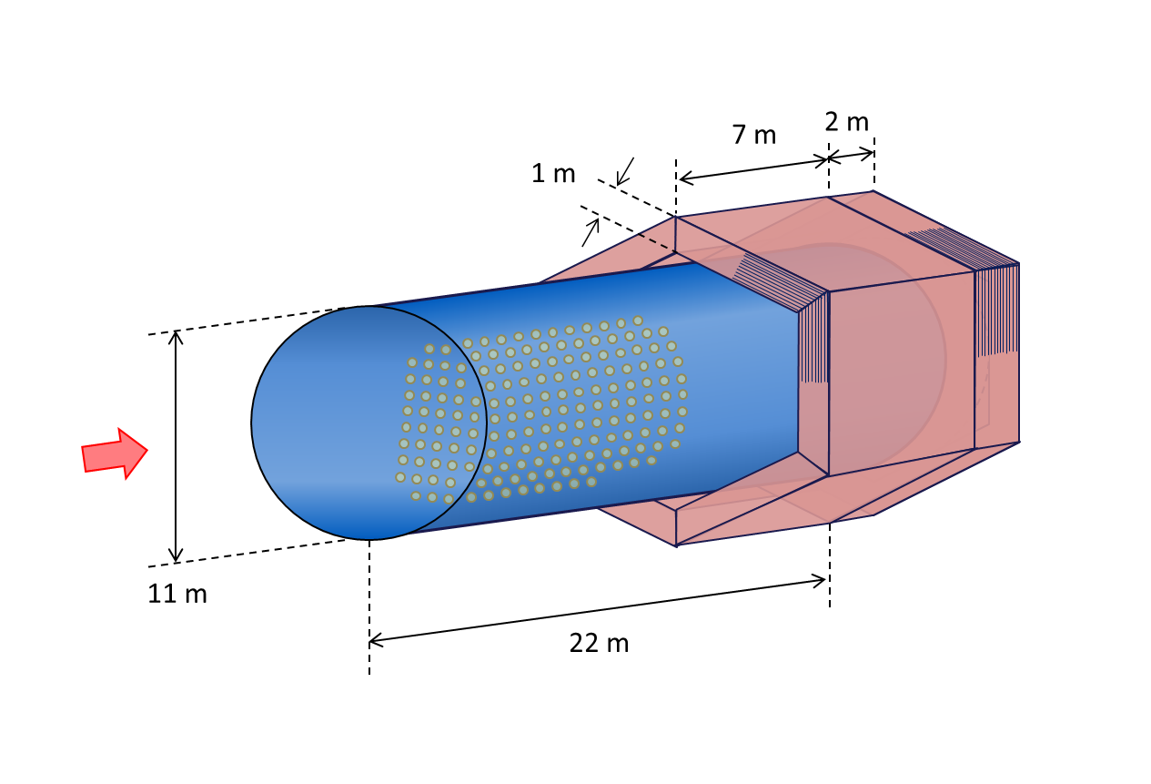
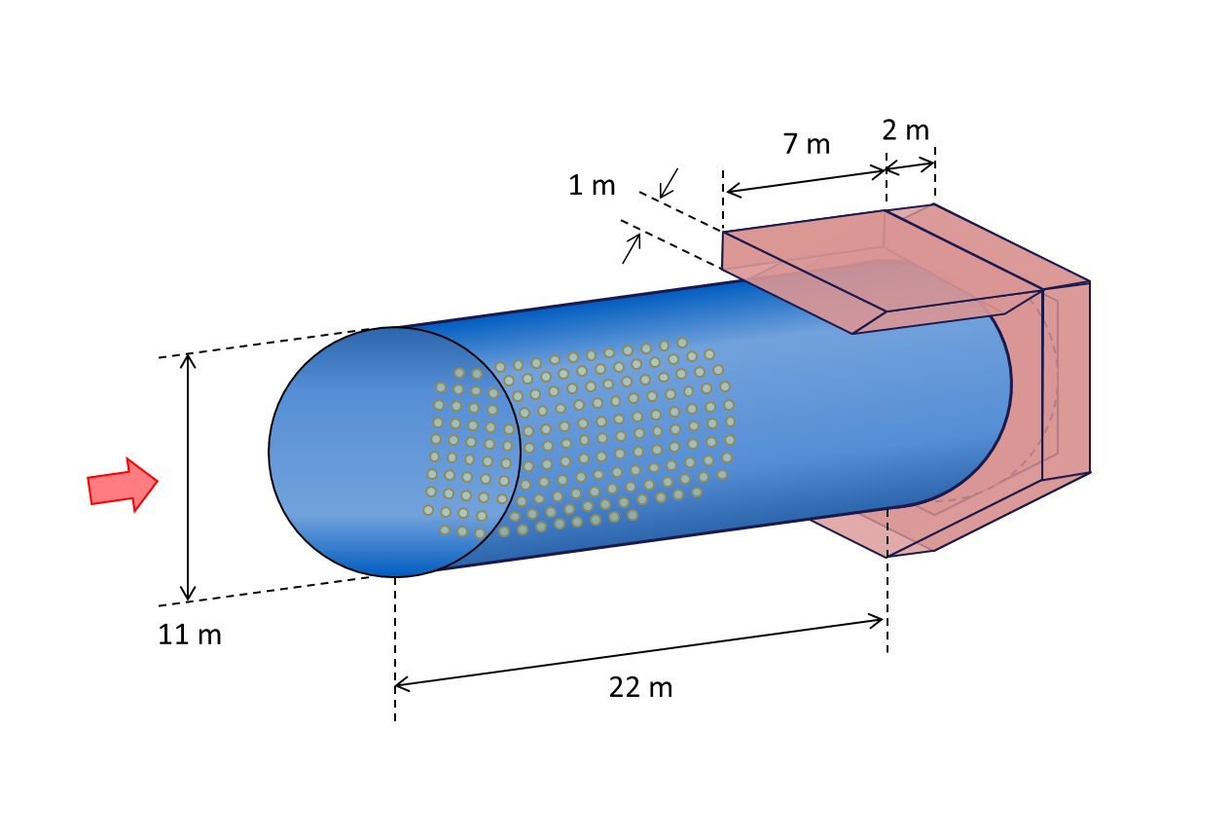
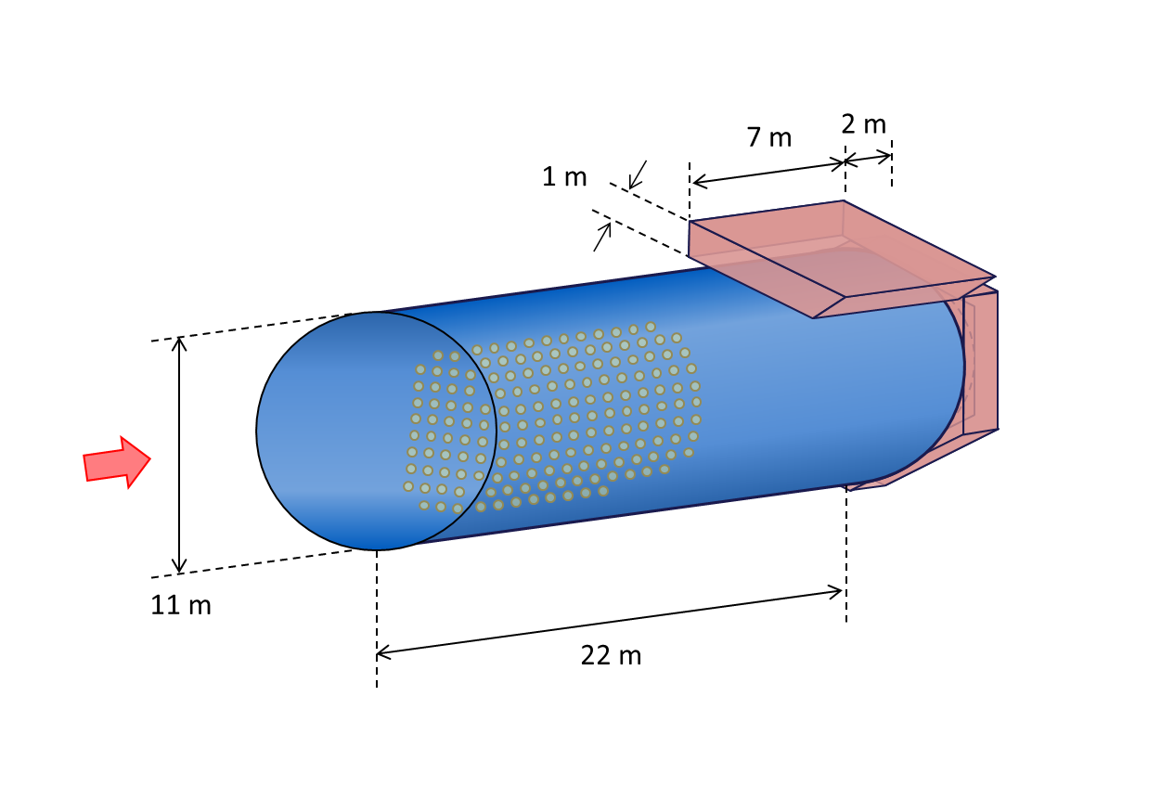
Cost Estimates
Rough, ballpark
2.2 M€ for iron
8.4 M€ for readout
10.6 M€
1.5 M€ for iron
2.5 M€ for readout
4.0 M€
1.3 M€ for iron
2.2 M€ for readout
3.0 M€
We will decide based on sensitivity studies

Slide 15
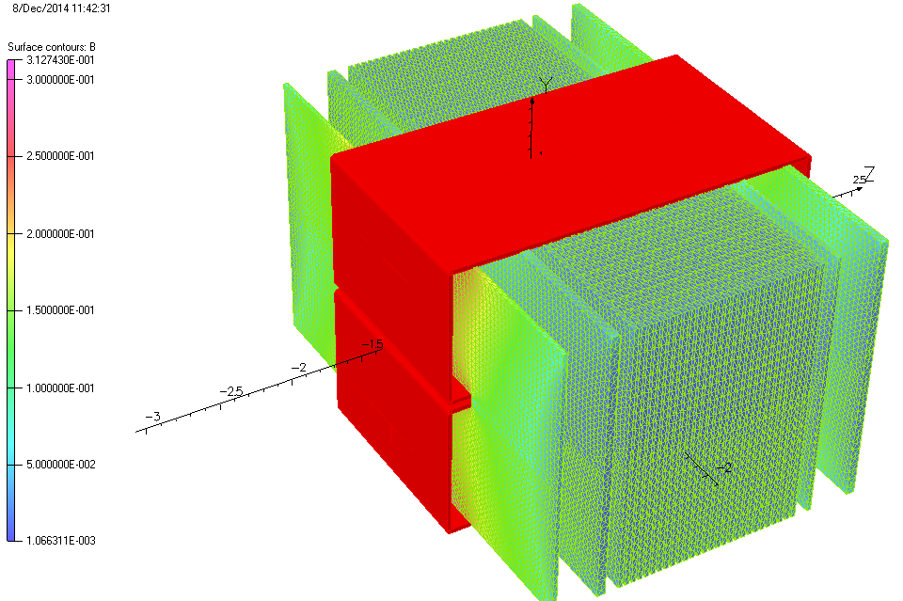
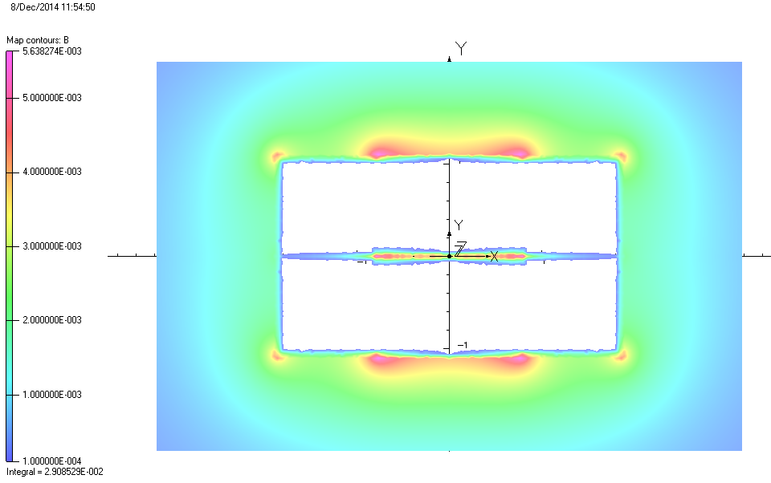
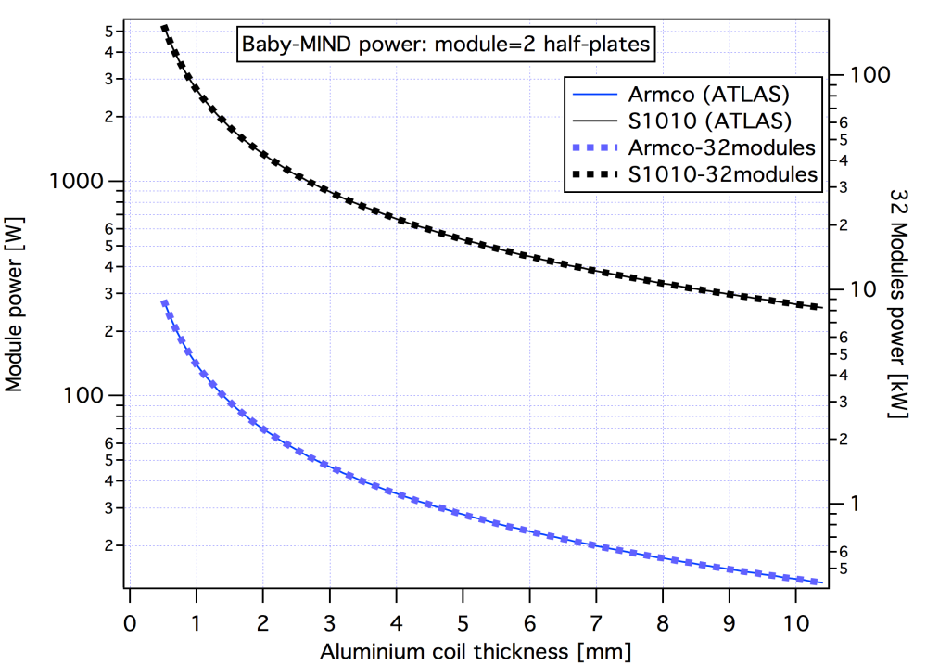
1.5 Tesla Magnetization of the MRD
3 mT
~10 kW standard iron

Slide 16
Summary
A magnetized MRD would be a great complement to Gd
A great deal of synergy with the design for Wagasci
The sensitivity of several options needs to be investigated

