Slide 1
A Magnetized Muon Range Detector for TITUS
Mark Rayner (Université de Genève) for TITUS
6th Open Meeting for the Hyper-Kamiokande Project
31 January 2015, Kavli IPMU, University of Tokyo, Kashiwa
AMDG
Our Lady, untier of knots
N.B. Lots of work here by Etam Noah and Alain Blondel

Slide 2
There is a significant wrong-sign component in anti-neutrino mode
A near detector with the right nucleus and the capacity to directly constrain the wrong-sign component is quite a rational proposition for a superbeam experiment focussed on CP violation

Slide 3
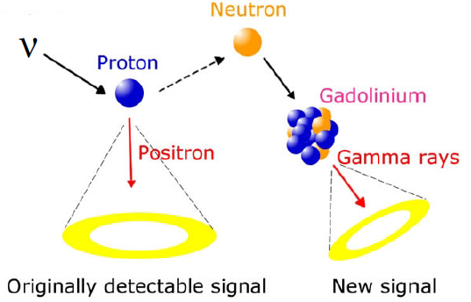
Gadolinium is exciting, but somewhat untested, and not 100% efficient
υ n → ℓ p
υ p → ℓ n
detect with Gd
ε_{Q} ≈ 90%
A magnetized MRD can achieve very high charge reconstruction efficiencies

Slide 4
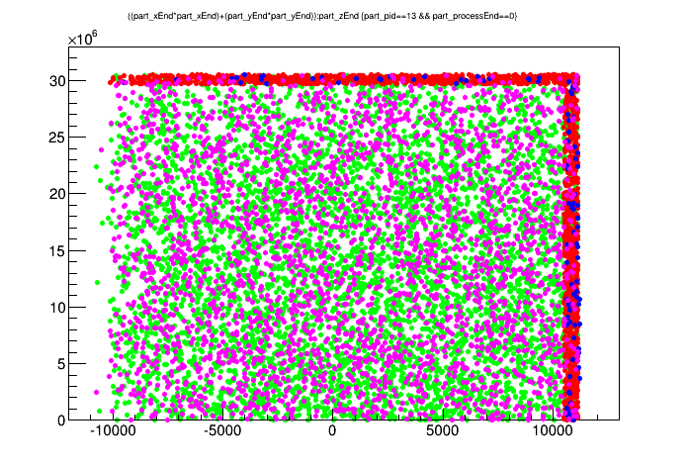
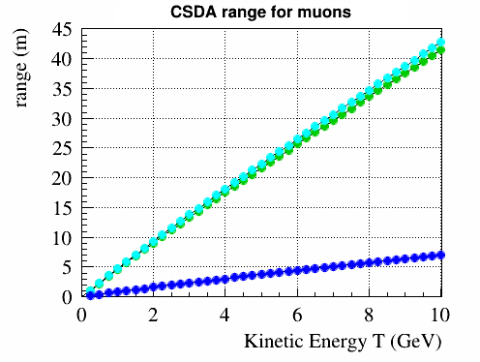
red: mu- leave tank
blue: mu+ leave tank
green: mu- stop in tank
purple: mu+ stop in tank
18% of muons escape the tank
R² (mm²)
courtesy of Matthew Malek
water
scintillator
iron
z (mm)
NB Many interesting muons don’t escape
(The nature of a large detector, and indeed by design…)

Slide 5
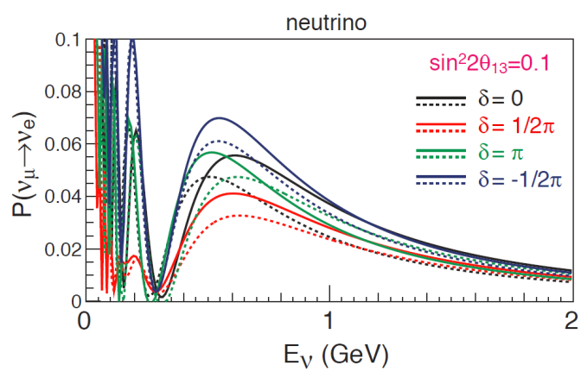
Reconstructing the charge of long, high energy, tracks is easy
Compare χ² in the + and – hypotheses
(well known from past experiments)
Let’s optimize reconstruction in the
interesting E_{ν} < 2 GeV region

Slide 6
Reconstructing the charge of long, high energy, tracks is easy
Compare χ² in the + and – hypotheses
(well known from past experiments)
Let’s optimize reconstruction in the
interesting E_{ν} < 2 GeV region

Slide 7
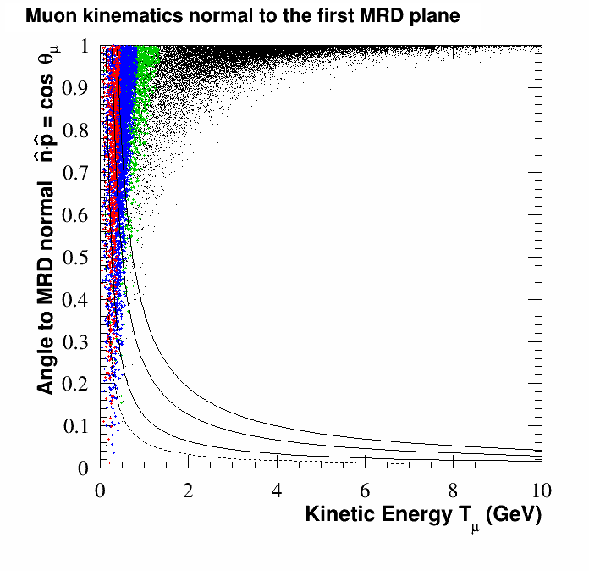
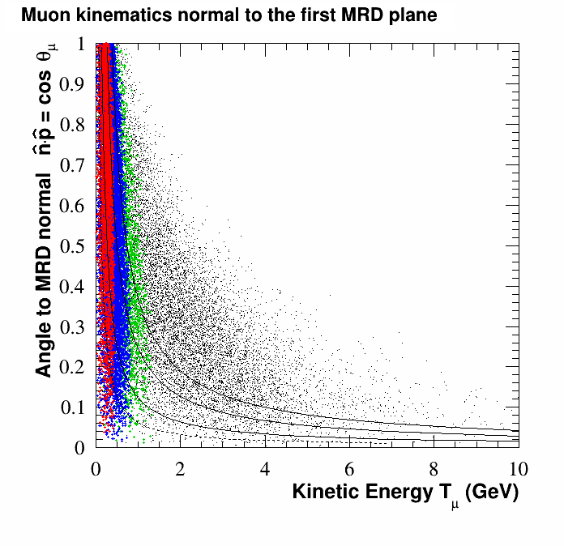
n
θ_{μ}
p_{μ}
0 GeV < E_{υ} < 0.6 GeV
T_{μ}
p_{μ}
Muon kinematics of υ_{μ} CC
events entering the MRD
0.6 GeV < E_{υ} < 1.0 GeV
θ_{μ}
1.0 GeV < E_{υ} < 1.5 GeV
E_{υ}
n
E_{υ} > 1.5 GeV
END MRD
SIDE MRD
Stopped by 30cm of iron
20cm
10cm
5cm

Slide 8
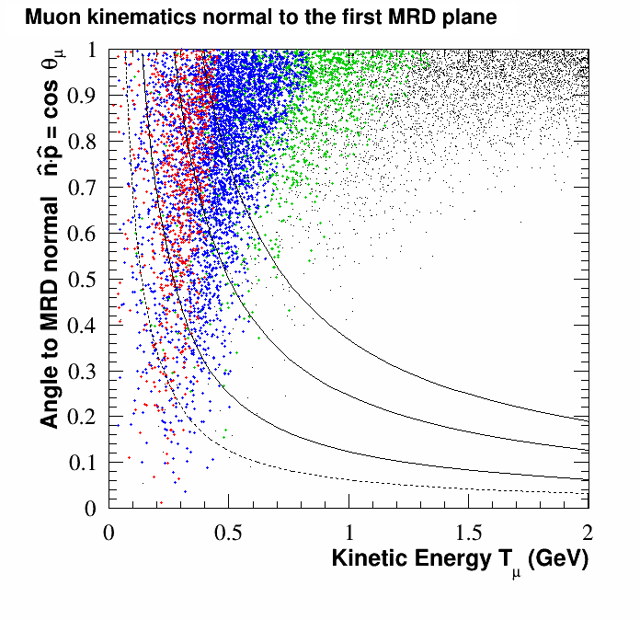
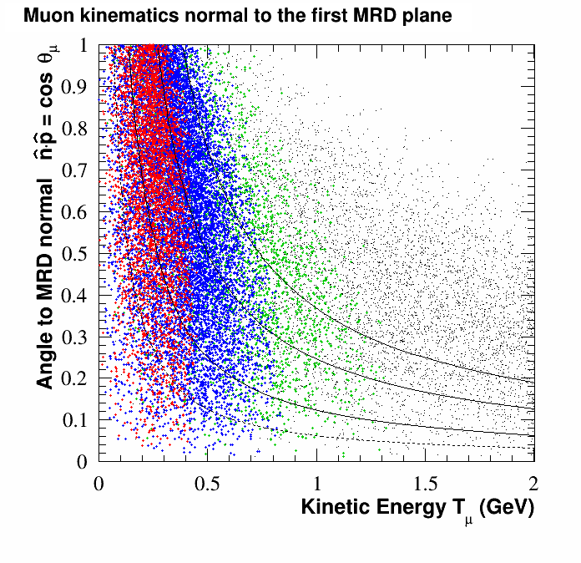
n
θ_{μ}
p_{μ}
0 GeV < E_{υ} < 0.6 GeV
T_{μ}
p_{μ}
Muon kinematics of υ_{μ} CC
events entering the MRD
ZOOM to oscillation region
0.6 GeV < E_{υ} < 1.0 GeV
θ_{μ}
1.0 GeV < E_{υ} < 1.5 GeV
E_{υ}
n
E_{υ} > 1.5 GeV
SIDE MRD
END MRD
Stopped by
30cm of iron
20cm
10cm
5cm

Slide 9
Multiple Scattering is the one unavoidable obstacle to charge reconstruction
In practice, however, track sampling resolution is just as big an effect
x₁
x₂
x₃
x₄
Δ
θ
L
t
magnetized iron
scintillator measurement planes
(or RPCs…?)
We can greatly improve the charge reconstruction of short tracks by including and optimizing a gap L between the initial few measurement planes
X₀ = 1.757 cm in Fe
X₀ = 50.31 cm in polyethylene
(X₀ / X₀)^{½} = 1.9%

Slide 10
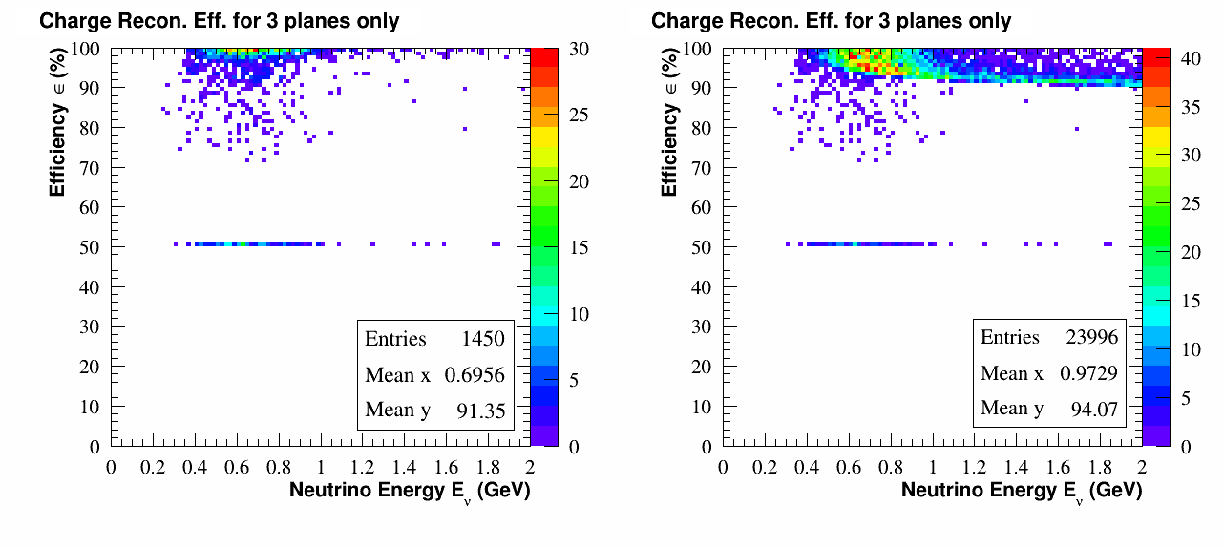
Reconstruction with just three 5cm magnetized planes (L=10cm)
END MRD
~100%
with >3 planes
stops in first
iron plan
muons which stop in or
before the fourth iron plane
all muons with E_{υ} < 2 GeV
Estimated 94% charge reconstruction efficiency in the oscillation region
Need to demonstrate this with a detailed Monte Carlo

Slide 11
Option 1
A fully enclosed tank is very difficult to justify because of cost
7 m
2 m
Sensitivity
Study
Needed
1 m
11 m
22 m
We can take advantage of the symmetry along the z-axis

Slide 12
Option 1
A fully enclosed tank is very difficult to justify because of cost
7 m
2 m
Sensitivity
Study
Needed
1 m
Wagasci
BabyMIND
11 m
22 m
We can take advantage of the symmetry along the z-axis

Slide 13
Option 1
A fully enclosed tank is very difficult to justify because of cost
7 m
2 m
Sensitivity
Study
Needed
1 m
Wagasci
BabyMIND
11 m
22 m
CHORUS air
core magnet
We can take advantage of the symmetry along the z-axis

Slide 14
Option 1
A fully enclosed tank is very difficult to justify because of cost
7 m
2 m
Sensitivity
Study
Needed
1 m
11 m
22 m
We can take advantage of the symmetry along the z-axis

Slide 15
Option 2
There is also approximate azimuthal symmetry
7 m
2 m
Sensitivity
Study
Needed
1 m
11 m
22 m
Savings, and still reduced systematics on high-angle cross sections?

Slide 16
Option 3
We can also tune the size of the end-MRD
7 m
2 m
Sensitivity
Study
Needed
1 m
11 m
22 m
The cost of the end and one sixth of a side are now equal

Slide 17
Option 4
Entirely removing the side-MRD is also an option, though we lose
the capability to constrain the wrong-sign BG for high-angle muons in cross-section measurements
Sensitivity
Study
Needed
2 m
11 m
22 m

Slide 18
Option 4
Entirely removing the side-MRD is also an option, though we lose
the capability to constrain the wrong-sign BG for high-angle muons in cross-section measurements
Sensitivity
Study
Needed
2 m
5 GeV
1 GeV
11 m
22 m
We can still benefit from a larger sample, by using calorimetry by muon range to include muons which exit the tank downstream

Slide 19
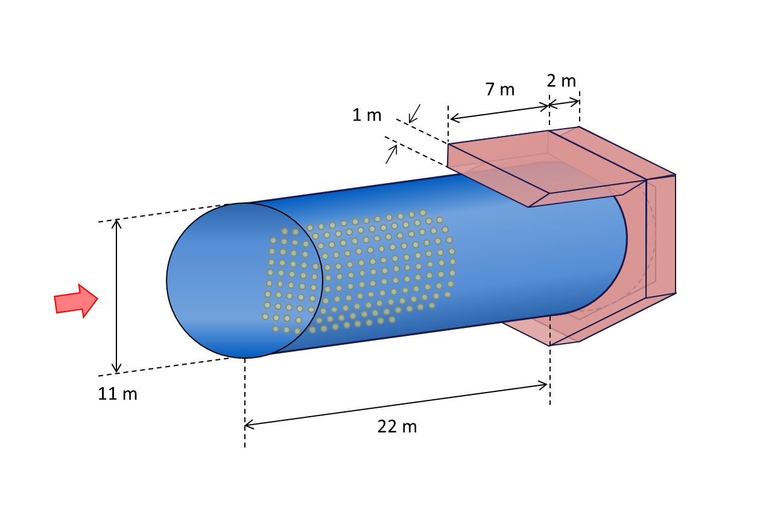
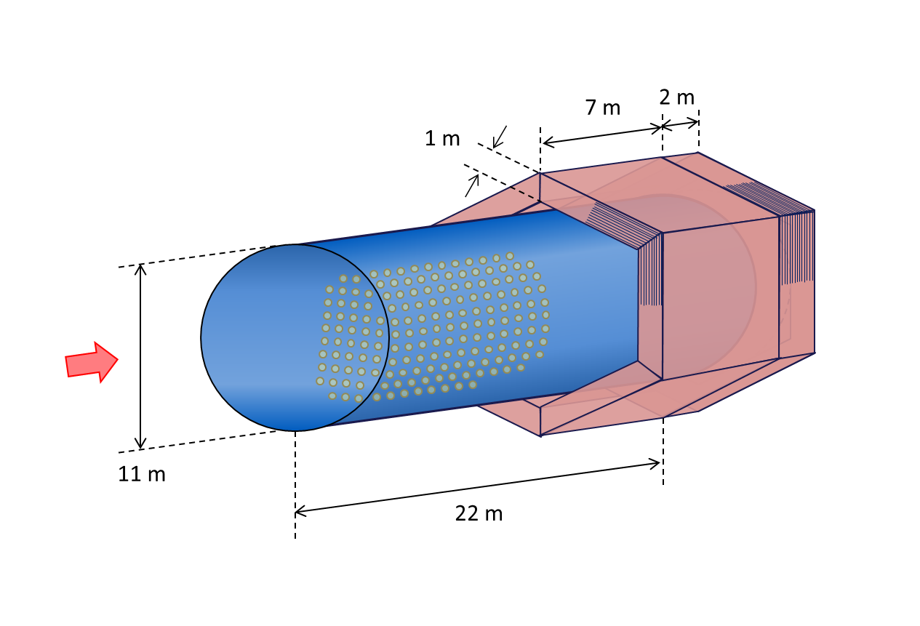
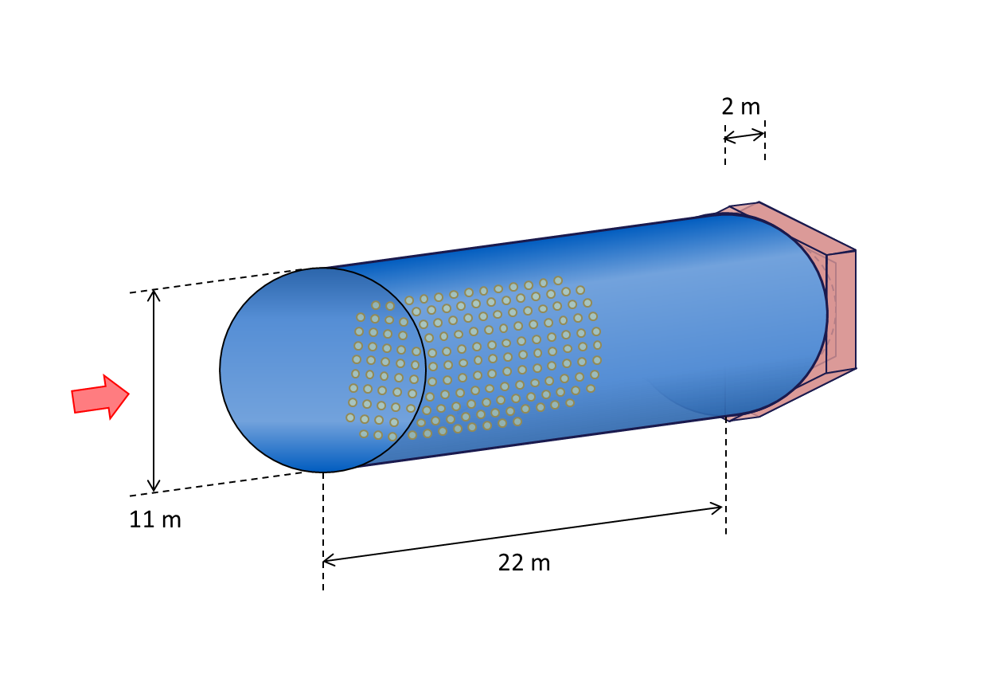
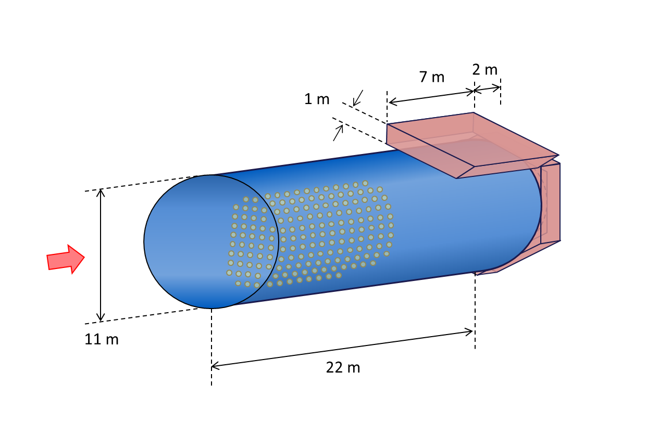
Cost Estimates
Rough, ‘Ballpark’
2.2 M€ for iron
8.4 M€ for readout
10.6 M€
1.5 M€ for iron
2.5 M€ for readout
4.0 M€
We will decide based on sensitivity studies
1.3 M€ for iron
2.2 M€ for readout
3.0 M€
1.1 M€ for iron
1.1 M€ for readout
2.2 M€

Slide 20
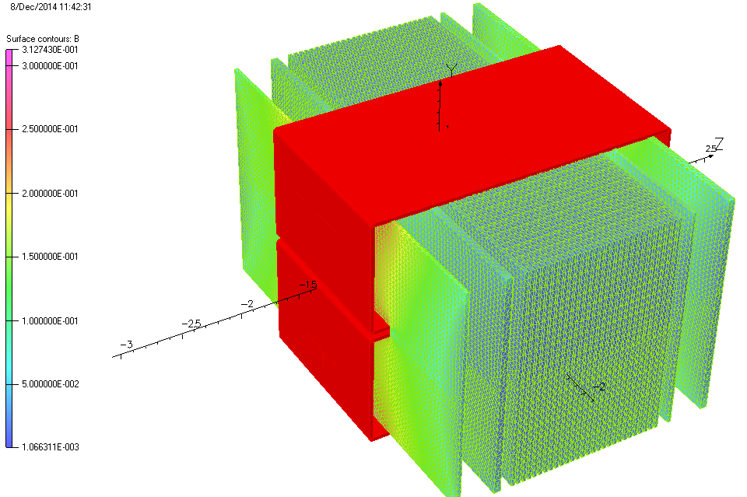
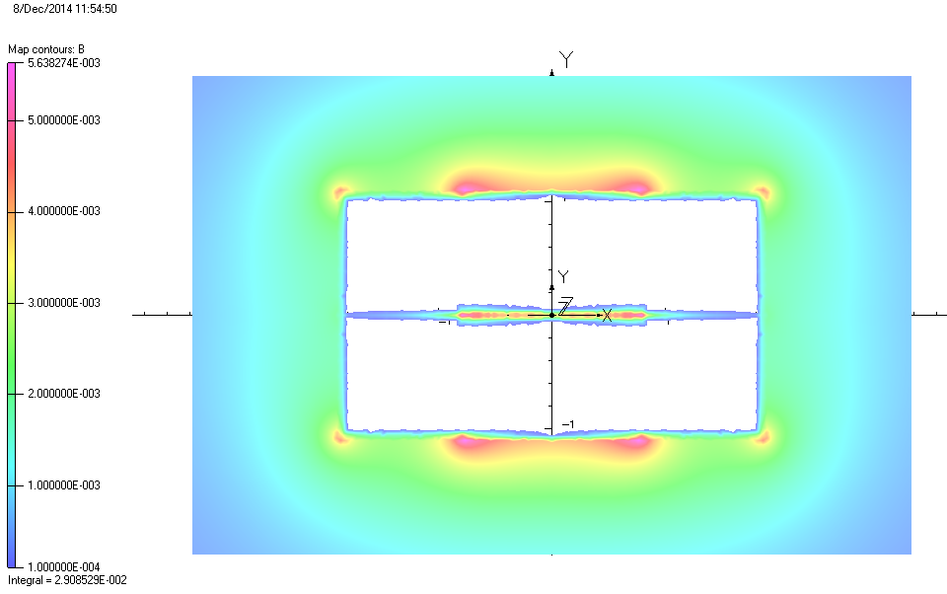
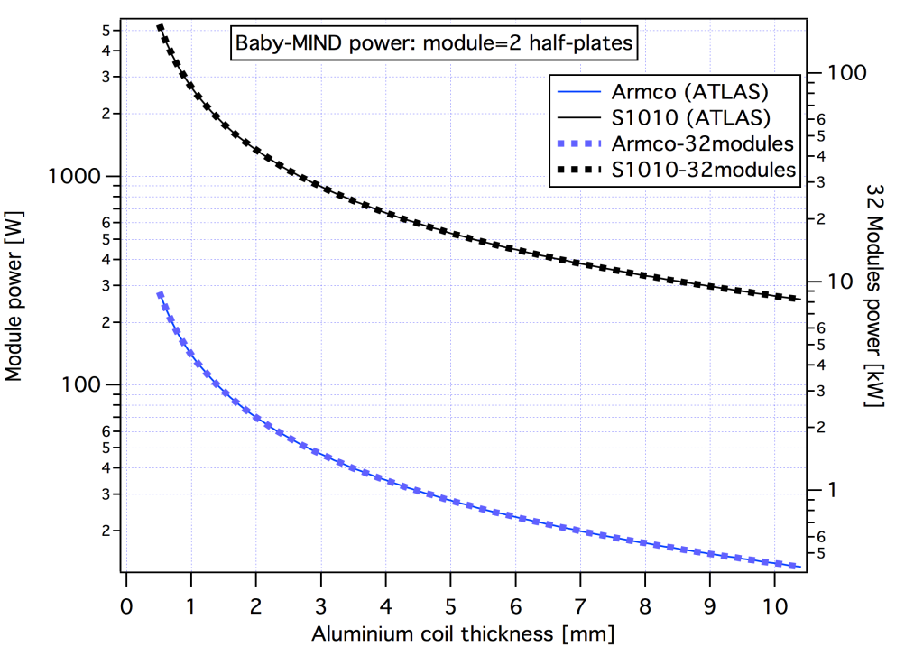
Magnetization of the MRD
3 mT
1.5 T
~10 kW standard iron

Slide 21
Summary
There are three main benefits to adding an MRD to TITUS
The sensitivity of several options needs to be investigated
We will learn from the Wagasci experience with a low-E magnetized MRD
1
Increased sample size via calorimetry by muon range
Direct constraint on wrong-sign contamination
Validation of gadolinium performance
– Include muons which exit the tank but range out in MRD
– Possibility to save money by shrinking the tank, with same statistics?
2
Pro: Well understood physics, high reconstruction efficiency
Con: Sample limited to muons which exit the tank
3
– Gd is a relatively new analysis technique
– Cross-checking with will give us the confidence to really exploit it
2

Slide 22
Backup slides

Slide 23
The B2 experiment / ‘WAGASCI’
Another possible Baby-MIND synergy…
Taichiro Koga

Slide 24
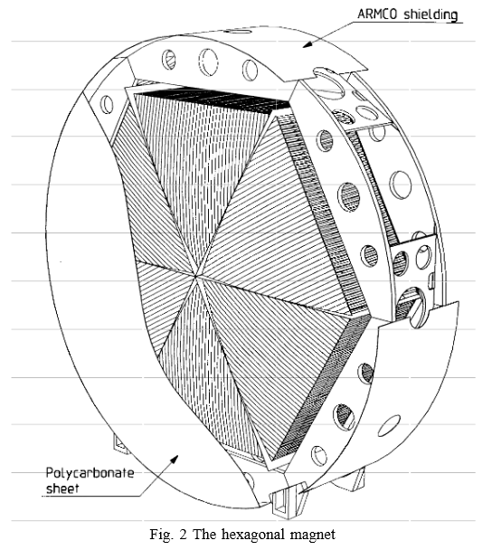
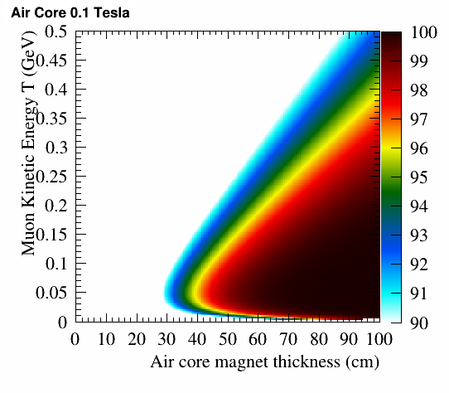
And finally, a fascinating suggestion from Gabriella and Emilio:
➔CHORUS style toroidal air core magnets
Can neglect multiple scattering in air as X₀ = 300 m, compared to 1.8 cm in Fe
The front and back coils are 2.5 mm thick and present 5.6% z/X₀ each
Axial assumption!
3 m
0.75 m
CERN–PPE/94–176, 10 November 1994, F. Bergsma et al.
➔ High efficiency and no energy threshold problem

Slide 25
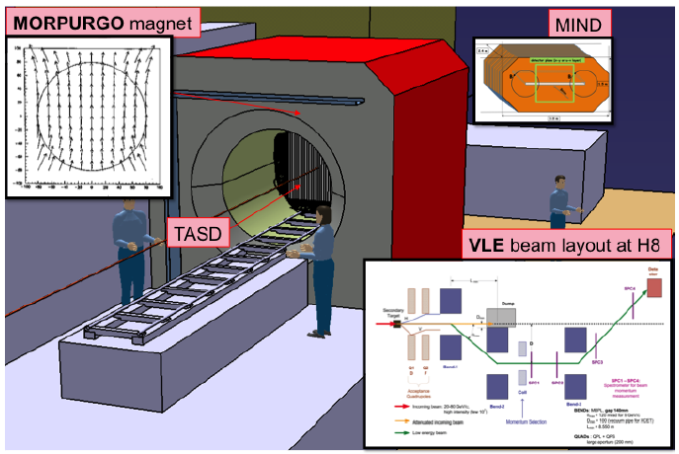
Baby-MIND and TASD: H8 beamline in North Area
(or possibly behind the LBNO-Demo)
3 m
2.5 m
1.5 Tesla
1.5 m
Could also be a practical demonstration of the TITUS MRD charge reconstruction
Contact: Etam Noah, University of Geneva

Slide 26
v
1-400 turns
1-400 turns
1-400 turns
1-400 turns
1-400 turns
1-400 turns
1-400 turns
1-400 turns
1-400 turns
1-400 turns
1-400 turns
1-400 turns
1-400 turns
1-400 turns
1-400 turns
1-400 turns
1-400 turns
1-400 turns
1-400 turns
1-400 turns
1-400 turns
1-400 turns
1-400 turns
1-400 turns
1-400 turns
1-400 turns
1-400 turns
1-400 turns
1-400 turns
1-400 turns
1-400 turns
1-400 turns
1-400 turns
1-400 turns
Option 1)
2 large coils – one upper, one lower coil
each coil wound around half the height of the iron plate assembly,
Pros: field lines are “in principle” very uniform over a wide surface area,
Cons: coil assembly is large and difficult to manipulate. Integration of detector modules is challenging.
Option 2)
Each “half-plate” has its own coil
Pros: Straightforward assembly of detector planes,
Cons: Need technical solution to wind coils.

Slide 27
Some numbers
18% of muons escape the tank
Of these ¾ leave through through the sides
But the sides have eight times the area of the end, and the event rate is much lower
However a partial side MRD could be thinner as there are few high energy muons
Calculations predict good charge reconstruction for a TITUS end-MRD
~100% in the high energy tail (could test the ~80% efficient Gd method)
~95% efficiency in the oscillation region – to be demonstrated with full Monte Carlo!
Optimum low-energy charge reconstruction at t = 5 cm iron plate thickness, but this is not a very sensitive parameter – both θ_{MS} and θ_{B} increase with iron thickness
Charge reconstruction in a magnetized side-MRD is trickier
The angle to the MRD normal vector is higher ➔ reconstruction efficiency is lower
Magnetizing the MRD is not trivial
I suggest it would be ambitious to magnetize more than a portion of a side-MRD
Gaps between plates may significantly increase power requirements
Still in the process of being understood – we can learn from the Wagasci experience
Wagasci has CERN’s support for design and construction and a timescale of ~ 1 year

